Slide 1
Jury’s recommendations on the award of
the N. N. Bogoliubov Prize
for 2019

Slide 2
The Nikolai Bogoliubov Prize is awarded by the Joint Institute for Nuclear Research in recognition of significant contribution to the development of theoretical and mathematical physics, as well as achievements in training young scientists and in international scientific cooperation.
The Prize was established in 1995 by the Committee of Plenipotentiaries of JINR.
The prize is awarded to two scientists whose activities are related to JINR:
one scientist working at an organization of a JINR Member State or an employee of JINR,
one scientist working at an organization of the state which is not a JINR Member State.
The prize is awarded not more than once every two years.

Slide 3
Jury of the N. N. Bogoliubov Prize
V. Matveev (JINR) – Chair
I. Arefieva (MI RAS)
V. Belokurov (MSU)
D. Gorbunov (INR RAS)
R. Jolos (BLTP JINR)
A. Zagorodny (BITP NAS, Kiev)
A. Isaev (BLTP JINR)
V. Rubakov (INR RAS)
S. Troitsky (INR RAS)
A. Filippov (BLTP JINR)

Slide 4
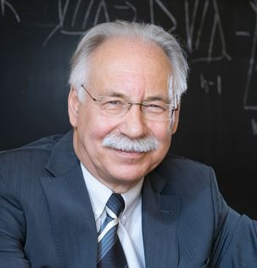
Nominee
Prof. Dmitry Kazakov
Corresponding member of RAS
Director of the Bogoliubov Laboratory of Theoretical Physics, JINR
Head of the Department of Fundamental and Applied Problems of Microworld, Moscow Institute of Physics and Technology
For the outstanding contributions to the development of quantum field theory, renormalization theory and renormalization group revealing the renormalization properties of supersymmetric field theories, for the pioneering papers on multiloop calculations in quantum field theory

Slide 5
Nominee
Prof. Dam Thanh Son
Professor of the Kadanoff Center for Theoretical Physics, University of Chicago
Member of American Academy of Arts and Sciences
Member of National Academy of Sciences, USA
For the achievements in the fields of quantum chromodynamics, applications of string theory and gauge/gravity duality addressing basic questions in strongly interacting many-body systems, and for the pioneering papers on transport coefficients, such as viscosity and conductivity, on strongly coupled three-dimensional gauge theories.

Slide 6
The Jury asks the Scientific Council
to approve these recommendations

