Slide 1
Study of No isotopes with the GABRIELA array
127th session of the Scientific Council

Slide 2
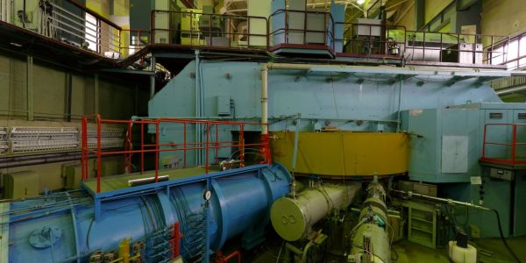
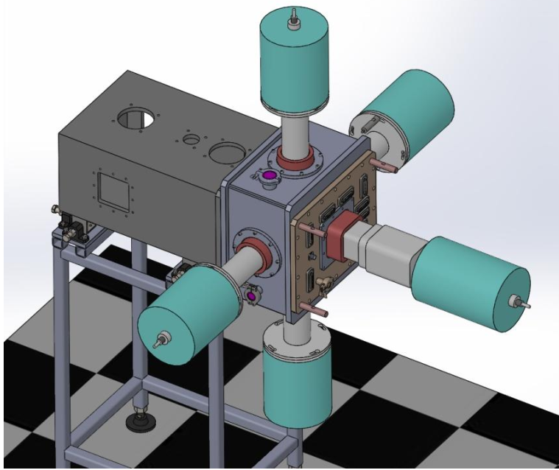
Separator for Heavy Elements Spectroscopy (SHELS)
U-400
GABRIELA
Notes:
We worked on SHELS, it’s velocity filter. Intensity beam provides by U-400 cyclotron and pass thought the separator and implanted into detector system Gabriela.

Slide 3
Total working SET-UP in the world
Dubna Gas Filled Separator (Russia)
SHIP (Darmstadt, Germany)
Berkeley Gas Filled Separator (USA)
GARIS (Saitama, Japan)
SHELS/VASSILISSA (Dubna, Russia)
LIZE3 (GANIL, France)
RITU (JYFL, Finland)
FMA (Argonne, USA)
JAERI-RMS (Tokai, Japan)
TASCA (Darmstadt, Germany)
Gas-filled
Vac. V filter
FPS
Gas-filled
Gas-filled
Vac. V filter
FPS
Vac. E filter
Vac. V filter
FPS
Gas-filled
RDT
FPS
Vac. RMS
RDT
Vac. RMS
Gas-filled
FPS
RDT
— Recoil Decay Tagging
— Heavy element research
FPS
— Focal Plane Spectroscopy
— Spectroscopy studies
Notes:
SHELS is one of ten fasilities around the world that study the properties and structure of heavy nuclei by different methods.

Slide 4
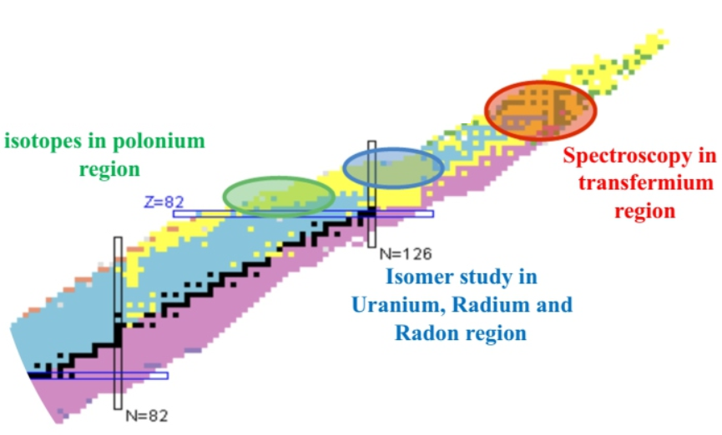
Region of interest
Z > 100
₁₀₆Sg
258
259
260
261
262
263
265
266
₁₀₅Db
256
257
258
259
260
261
262
263
₁₀₄Rf
253
254
255
256
257
258
259
260
261
262
263
₁₀₃Lr
252
253
254
255
256
257
258
259
260
261
262
₁₀₂No
248
250
251
252
253
254
255
256
257
258
259
260
262
₁₀₁Md
245
246
247
248
249
250
251
252
253
254
255
256
257
258
259
260
₁₀₀Fm
242
243
244
245
246
247
248
249
250
251
252
253
254
255
256
257
258
259
Notes:
Region of our interest it is isotopes with Z > 100. From Fm, Md, Rf and so on. But step by step we are moving to region of super heavy nuclei.

Slide 5
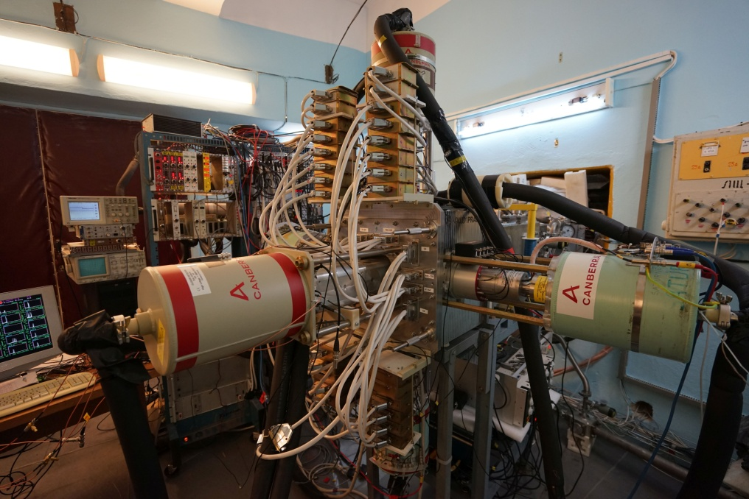
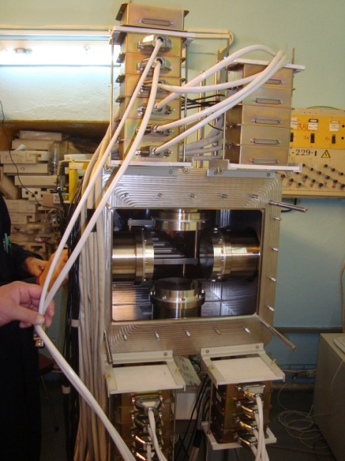
GABRIELA
Vacuum chamber.
Detectors cooling before -30C.
Gamma Alpha Beta Recoil Investigation with the Electromagnetic Analyser
It is used to registration the interest residues with subsequent α decays and fissions, as well as X-rays, γ-rays or conversion electrons. Set-up was upgrade at 2015 years and continues to improve.
Notes:
All researches make on GABRIELA. It necessary for registration the interest recoil nuclei with subsequent α decays and fissions as well as X-rays, γ-rays or conversion electrons. This is vac. chamber, where is installed box of Si- detectors.

Slide 6
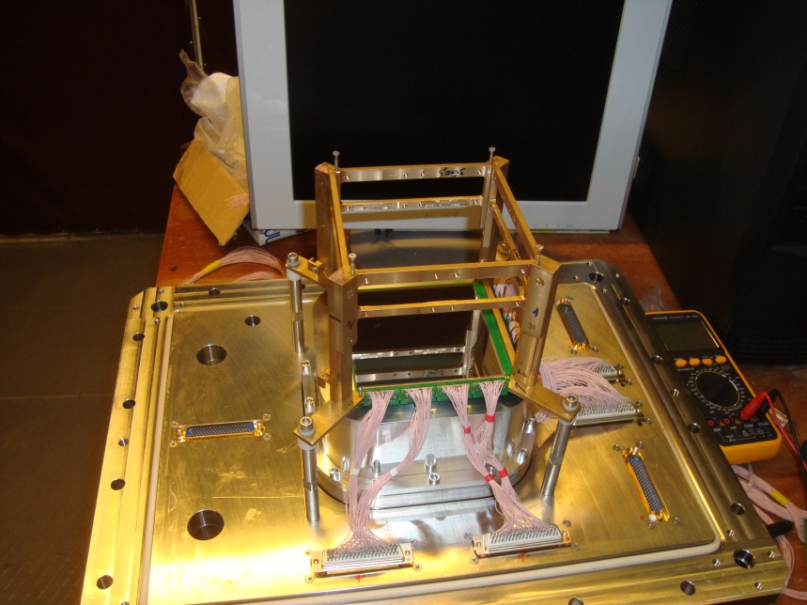
Detectors
Focal plane detector
The active area of the strip detector is 100x100mm²: 128x128 strips - 16384 pixels.
Alpha particles registration efficiency is 70%.
The energy resolution is 15-20 keV for α-particles in the range of 5–7 MeV.
Tunnel detector
It’s consisted of 8 Si-plats.
The active area of the one strip detector is 50x60mm²: 32x32 strips – 1024 pixels, but all plats – 400x480mm²: 8192 pixels.
Alpha particles registration efficiency is 70%.
The energy resolution is 20 keV for α-particles in the range of 5–7 MeV.
Notes:
Complex of Si-detectors consists of focal plane detector and 4 plats as walls. System needs for registration of a-particles in the range of 5-7 MeV, b-particles and products of SF.

Slide 7
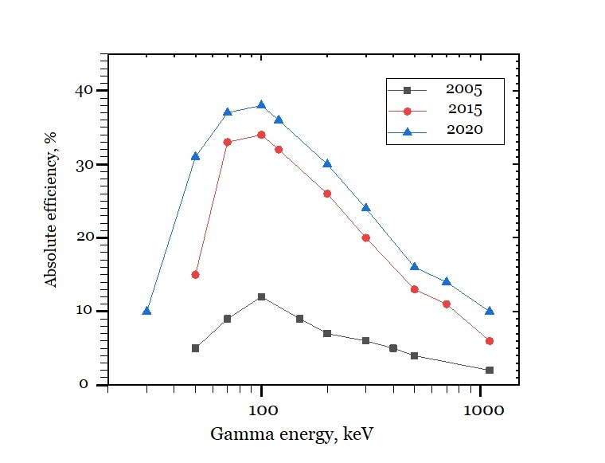
Detectors
Clover detector located behind a frontal DSSD.
4 Single crystal Ge-detectors surrounds tunnel DSSD.
Efficiency of γ-rays registration was increased to 34% for γ-rays of 100 keV and 6% for 1000 keV. In future its value will be higher due to replace all single crystals detectors on clovers. Resolution energy is 2 keV.
Notes:
Ge array is consist of a large clover detector which is installed just behind the focal plane DSSD and 4 coaxial detectors, that surrounded the tunel. All Ge detectors are equipped with BGO shields. This configuration by the detector is more efficient! The calibration of the Ge detectors was performed using standard sources such as ¹⁵²Eu and ¹³³Ba.

Slide 8
Experiments 2019
№ | Experiment | Recoils | Goals
1 | ⁴⁸Ca+²⁰⁸Pb | ²⁵⁴No,²⁵²No, ²⁵³No | Study of ²⁵⁴No isomers.
2 | ⁴⁸Ca+²⁰⁶Pb | ²⁵²No | Collecting statistic.
3 | ⁴⁸Ca+²⁰⁴Pb | ²⁵⁰No | Study of isomers in ²⁵⁰No.
4 | ²²Ne+²³⁸U | ²⁵⁶No | Study of isomers of ²⁵⁶No.
6 | ⁴⁸Ca+²⁰⁸Pb | ²⁵⁴No | Study of ²⁵⁴No isomers.
Notes:
For last years was carried out experiments with accelerated beams of Ca-48 and Ne-22. Study of No isotopes. I will talk about 3 reactions with Ca in more details. Other data still in analysis .

Slide 9
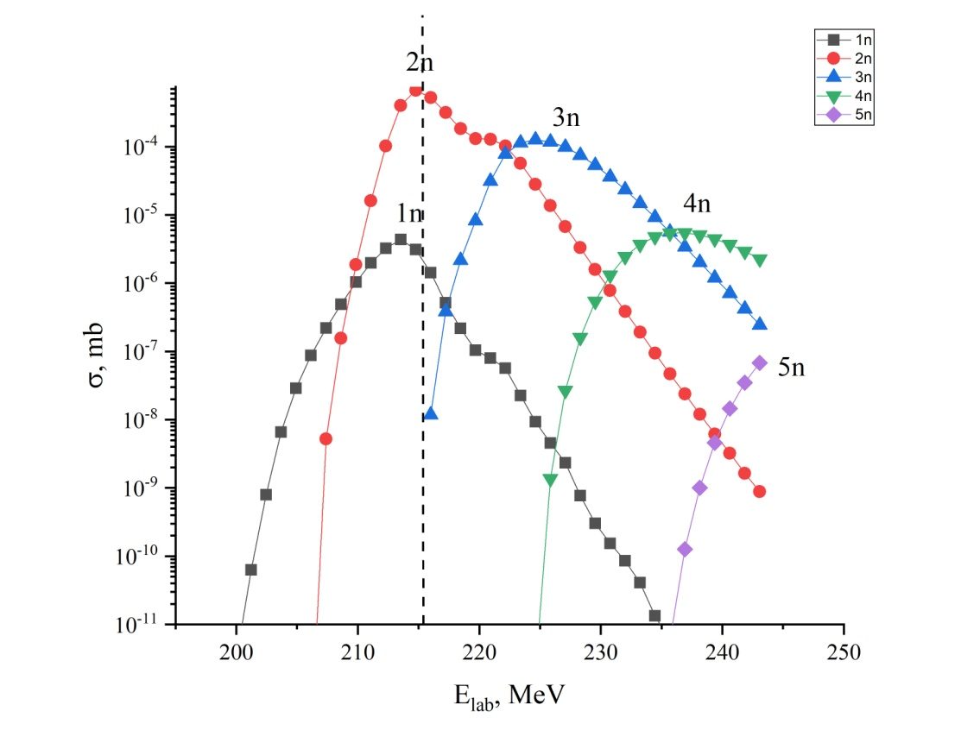
²⁵⁴No
⁴⁸Ca+²⁰⁸Pb →²⁵⁴No + 2n
Cross section: 2μb
Flux ~ 8•10¹⁷
6 days
Beam energy: 226 MeV
²⁵⁴No
51.2 s
Isomers
^{254m1}No
265ms
Goal
Study isomeric states and collecting more statistic of ²⁵⁴No.
^{254m2}No
184μs
IT 100
IT 100
α 90%
SF 0.17%
α
0.01
SF 0.02
SF 0.012
EC 10%
Notes:
Isotope of No-254 has 2 isomeric states with half-time 265 ms and 184 mks. The main goal of experiment was look at second isomeric state.
For 6 days was collected good statistic by energy beam 225-226 MeV.

Slide 10
Recoil-fission(γ) correlation of ²⁵⁴No
²⁵⁴No T_{½} ~ 51.2 s
^{254m1}No T_{½} ~ 265 ms
^{254m2}No T_{½} ~ 184 μs
²⁵²No T_{½} ~ 2.44 s
Recoil-fission(γ) correlation
245 chains
²⁵⁴No has 152 events
²⁵²No has 79 events
Isomers of 14 events
Isomers
1 event from ^{254m2}No has
T_{½} ~ 2 ms that fits into the time range T½x11.
13 events from ^{254m1}No has
T_{½} ~ 309.8 ms that fits into the time range T½x2.
In target ²⁰⁸PbS (360μg) was impurity of ²⁰⁶Pb. ²⁵⁴No has branch on SF is 0.17% and ²⁵²No is 30%, that’s why these correlations good separated by lifetime.
Notes:
We found more short lived events from Recoil-fission correlation in coincidence with gamma-rays.
1 event from ^{254m2}No has T_{½} ~ 2 ms that fits into the time range T½x11.
13 events from ^{254m1}No has T_{½} ~ 309.8 ms that fits into the time range T½x2.
On pic you can see peak of No-254 and its isomers and also No-252 which is formed due to impurity 206 Pb in target.

Slide 11
Levels of ²⁵⁴No
265ms
8⁻
7⁺
778
6⁺
940
5⁺
856
4⁺
887
3⁺
10⁺
267
8⁺
Correlated γ-rays spectrum of ²⁵⁴No
6⁺
Good see gamma transition from isomeric level (265 ms) to excitation levels.
Unfortunately, short lived event (2 ms) can not be attributed to the real events.
4⁺
159
2⁺
0⁺
51.2 s
Notes:
From correlation analysis was received gamma spectrum from which seen gamma transitions from isomeric level with half-time 265 ms to excitation levels. Unfortunately, short lived event (2 ms) can not be attributed to the real events.

Slide 12
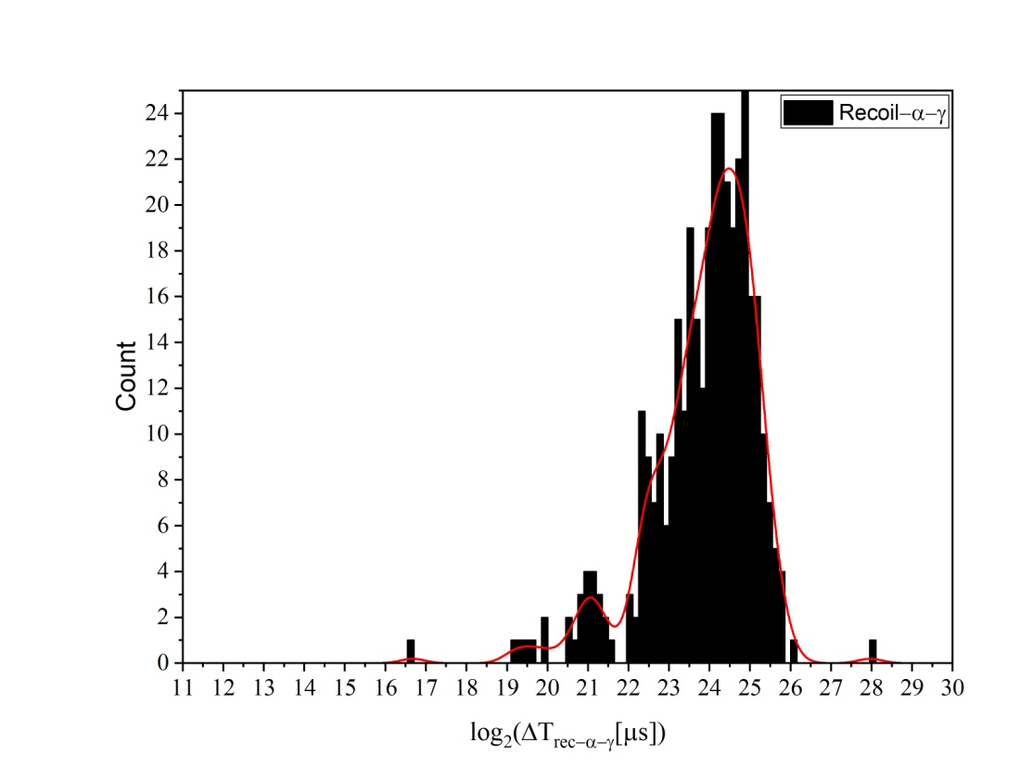
Recoil-α(γ) correlation of ²⁵⁴No and isomers.
Time distribution for correlation Recoil-α in coincidence with γ-ray.
Pic. 1
Pic. 2
Two calculates for different ranges of time and energy was made.
Pic. 1 In calculate were used ranges of lifetime 1300s and energy for ²⁵²⁻²⁵⁴No.
Pic. 2 For isomers were used ranges of lifetime 28 s and energy of 9300-9400 keV.
Recoil-α(γ) correlation 119 events
²⁵⁴No has 32 ev., ²⁵³No has 75 ev., ²⁵²No 12 ev., isomers of 11 ev.
Notes:
For recoil-a correlations was made 2 calculates in big and small range of time and energy. So, Rec-a-g chains of 119, 254 – 32, 253 – 75, 252 – 12, isomers – 11.

Slide 13
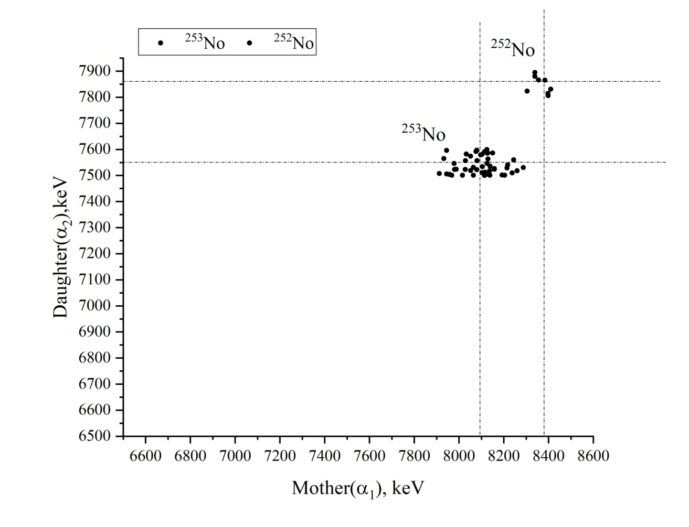
Alpha decay of No isotopes
8003, 8038, 8070, 7144, 8220, 8280
²⁵²No
8372,8415
2.3s
²⁵³No
more α
1.7m
²⁵⁴No
8050,8093
51.2s
α
α
α
²⁴⁸Fm
7800,7830
36s
²⁴⁹Fm
7520
2.6m
²⁵⁰Fm
7430
30m
Pic. 3
Pic. 4
Pic. 3 In reactions ⁴⁸Ca+²⁰⁸Pb were received correlations ²⁵³No-²⁴⁹Fm and ²⁵²No-²⁴⁸Fm.
Pic. 4 The same reactions was received Recoil-α correlation from ^{252,253,254}No. 252 and 253 nobelium is formed due to additive of ^{206,207}Pb in target (²⁰⁸PbS).
Notes:
And also were received Recoil-a-a correlations.
Chains of 254No were not detected, because half-time of 250Fm is very long. But in graphic rec-a correlation 254No was good seen.

Slide 14
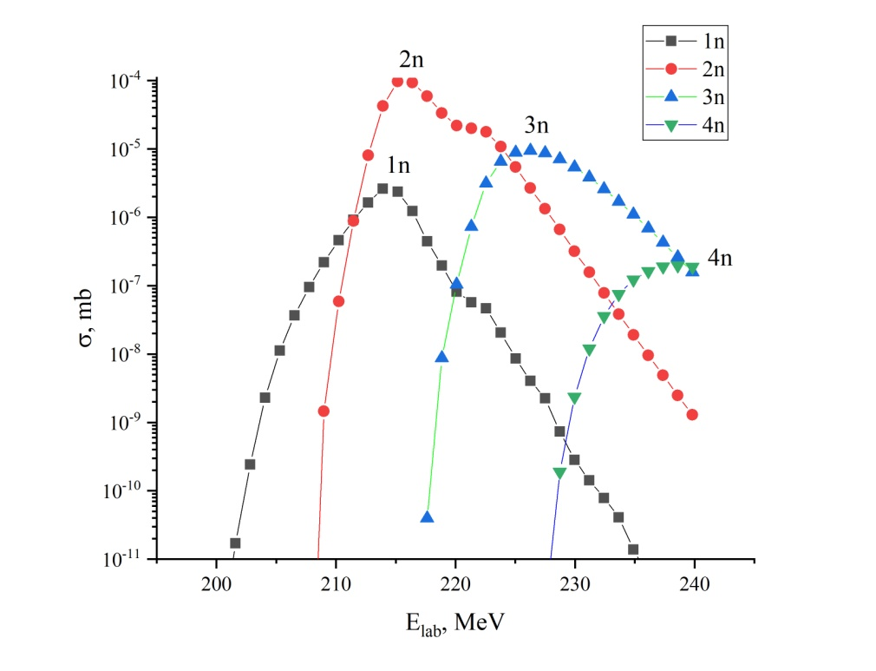
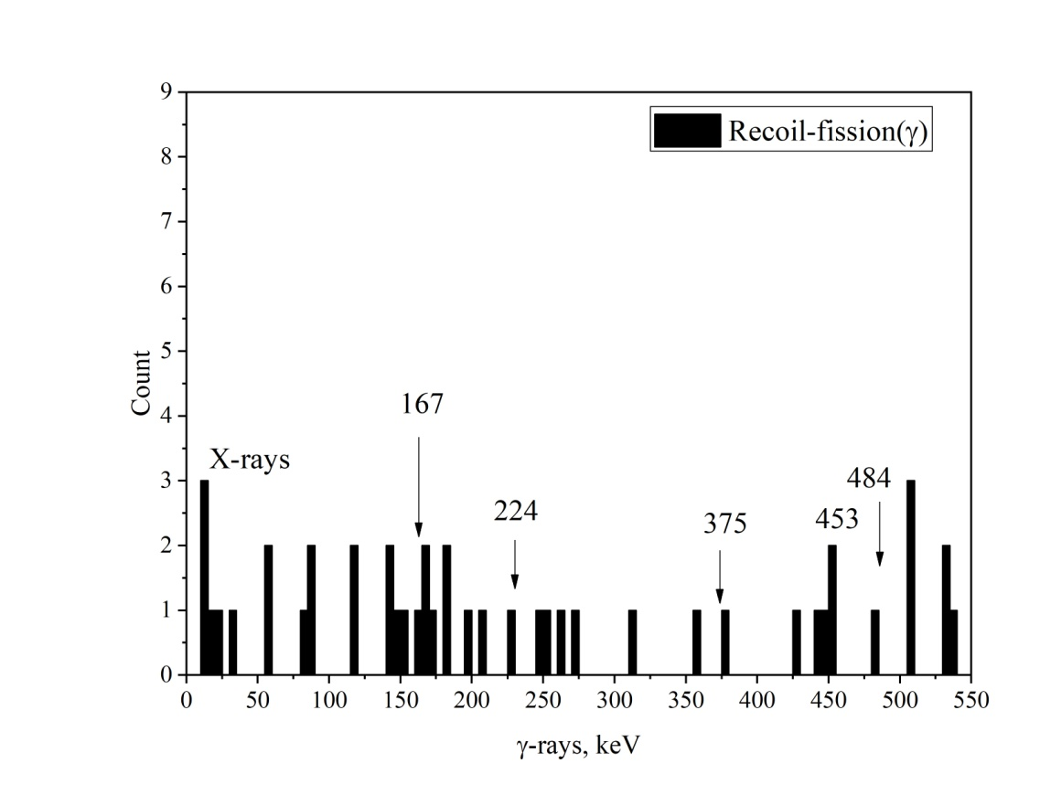
²⁵²No
⁴⁸Ca+²⁰⁶Pb →²⁵²No +2n
Flux ~ 4.6•10¹⁷
Cross-section: 500 nb
SF = 22 000 and 4 days.
20⁺
18⁺
484
This reactions good known and is used for calibration by spontaneous fission.
16⁺
453
14⁺
375
12⁺
10⁺
8⁺
224
6⁺
4⁺
167
2⁺
0⁺
Notes:
This reactions good known and is used for calibration by spontaneous fission. For 4 days was collected good statistic and obtained 22.000 ev of SF.

Slide 15
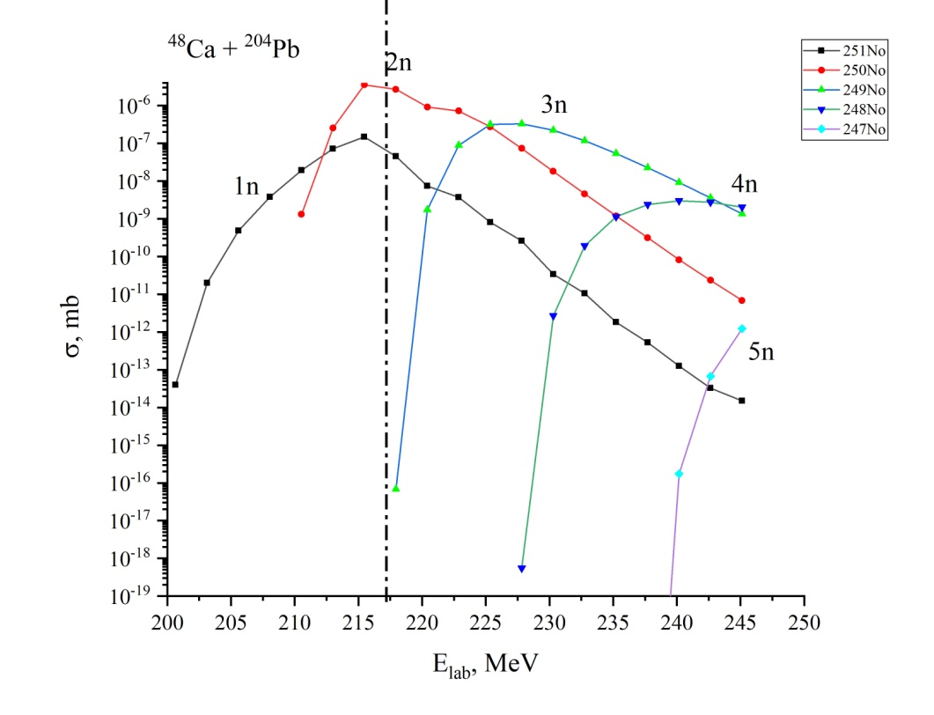
²⁵⁰No
⁴⁸Ca+²⁰⁴Pb →²⁵⁰No + 2n
Cross section: 13nb
Flux: 2.6•10¹⁸
13 days
18000 events of SF
²⁵⁰No
4.6 μs
Isomer
^{250m}No
46μs
Goal
Find isomeric state and increase statistic of alpha decay of ²⁵⁰No. The alpha decay estimate is small.
α ?
SF 100%
IT 100%
Notes:
Isotope of No-252 has 1 isomeric state with half-time 46 mks. The main goal of experiment was look at isomeric state and find alpha branch.

Slide 16
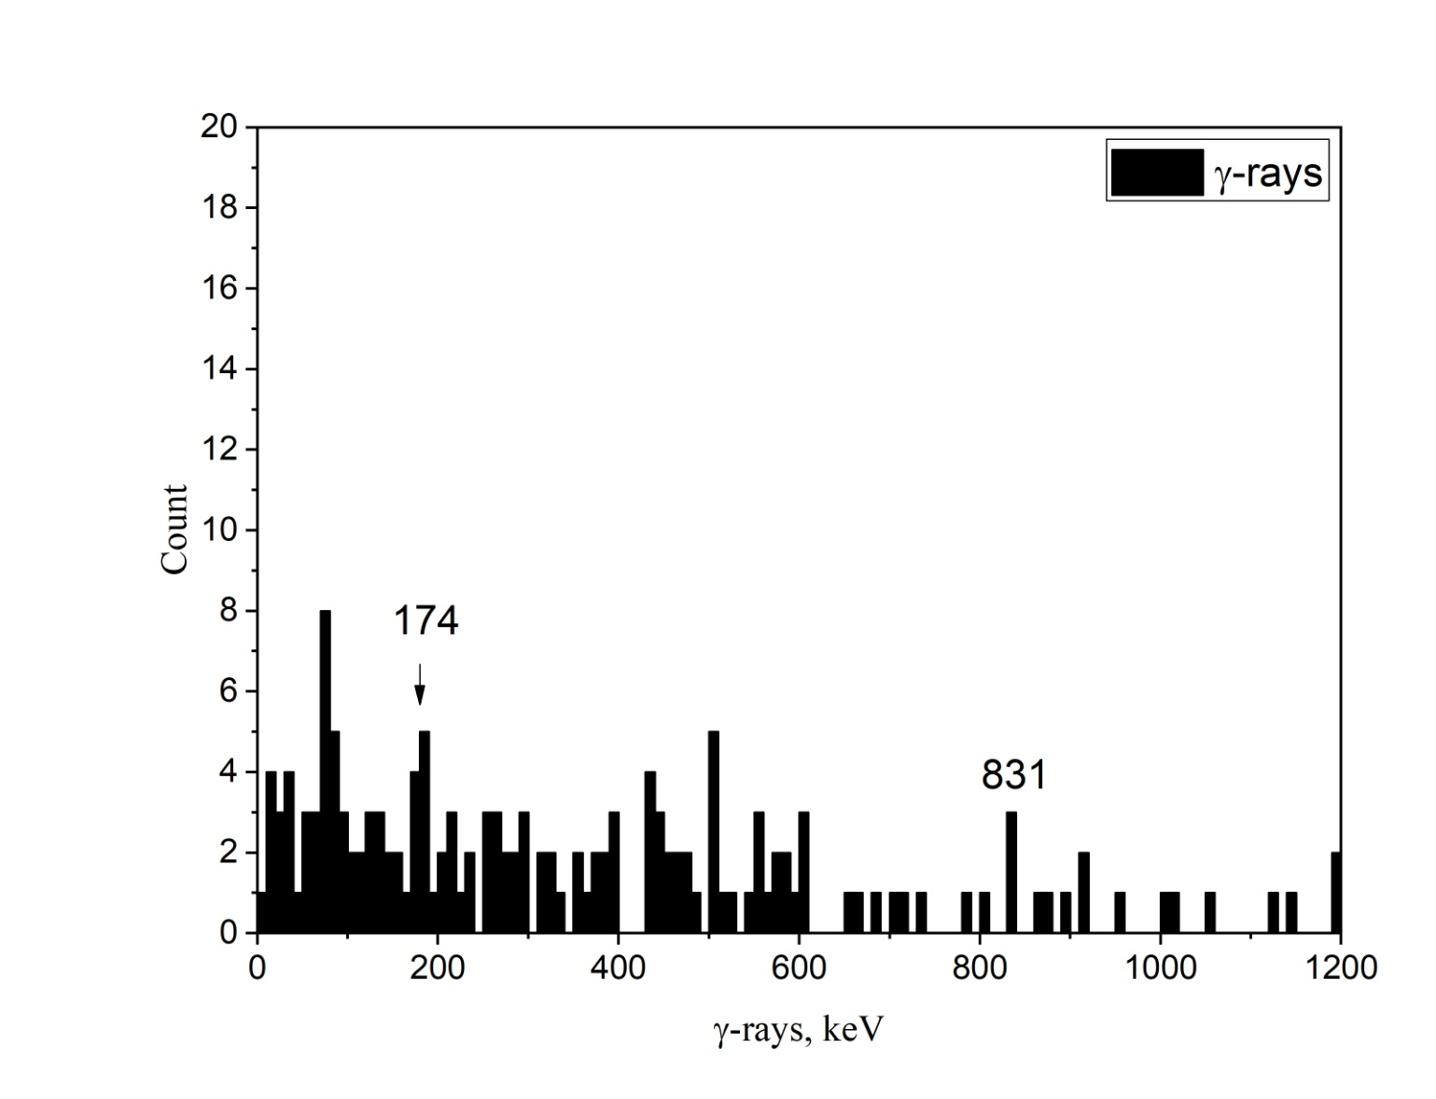
²⁵⁰No
²⁵⁰No T_{½} ~ 4,6 μs
^{250m}No T_{½} ~ 46 μs
In reaction ⁴⁸Ca+²⁰⁴Pb were observed short lived events of ²⁵⁰No with lifetime 26 μs and ^{250m}No with 178μs. Lines 174 and 831 keV is correspond to them.
Alpha decay wasn’t seen. Probability of α decay is 0.000055%.
Notes:
In result was received short lived events of ²⁵⁰No with lifetime 26 μs and ^{250m}No with 178μs. Lines 174 and 831 keV is correspond to them. Alpha decay wasn’t seen.

Slide 17
²⁵⁰No
6⁺
1050
174
4⁺
876?
2⁺
0⁺
²⁵⁰No have 0⁺(g.s), ^{250m}No has 6⁺ level with energy 1050 keV. In experiment was observed gamma line 174, that can be transition 6⁺→4⁺.

Slide 18
Results
For ⁴⁸Ca(²⁰⁸Pb,2n)²⁵⁴No was collected good statistic.
Found:
14 isomers in Recoil-fission correlations and
11 isomers in Recoil-α correlations,
52 chains of alpha decay from ²⁵³No
9 chains of alpha decay from ²⁵²No.
For ⁴⁸Ca(²⁰⁶Pb,2n)²⁵²No was collected good statistic for calibration by SF.
For ⁴⁸Ca(²⁰⁴Pb,2n)²⁵⁰No was collected good statistic. Found:
short lived isomers in Recoil-fission correlations
new gamma transitions.
Alpha branch ~ 0.000055%

Slide 19
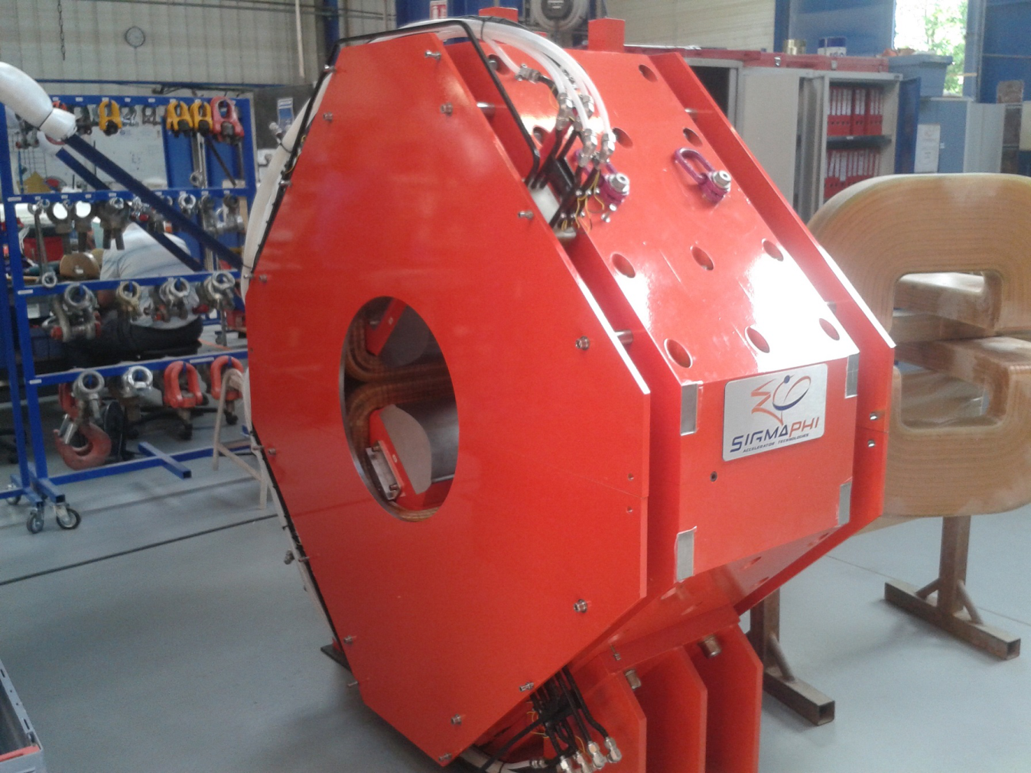
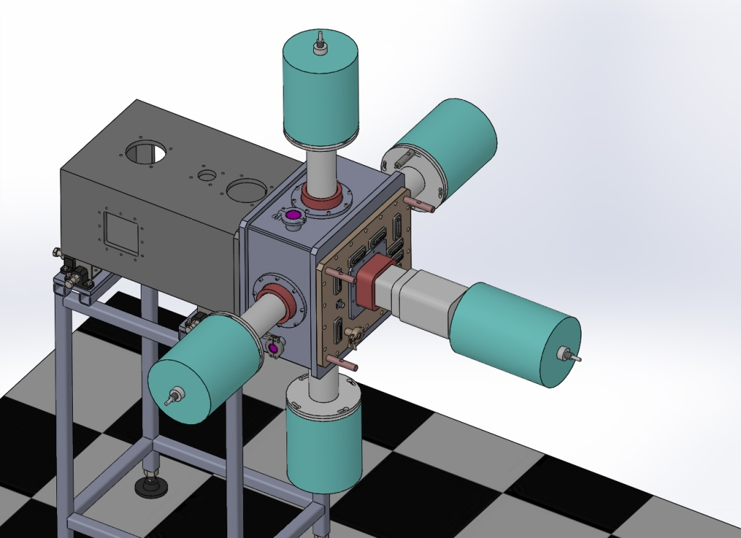
Future
New triplet of lenses: aperture length of 300mm.
5 Ge-detectors, like Clover for GABRIELA.
4 Si-detectors 100x100mm² for tunnel system.
New target, diameter is 24sm.

Slide 20
Peoples
A.V. Yeremin, M.L. Chelnokov, V.I. Chepigin, A.V. Isaev, I.V. Izosimov,
D.E. Katrasev,A.N. Kuznetsov, A.A. Kuznetsova, O.N. Malyshev, Yu.A. Popov,
A.G. Popeko, E.A. Sokol, A.I. Svirikhin, FLNR, JINR, Dubna, Russia
K. Hauschild, A. Lopez-Martens
CSNSM, IN2P3-CNRS, F-91405 Orsay Campus, France
O. Dorvaux, B. Gall, F. Dechery, H. Faure, Z. Asfari
IPHC, IN2P3-CNRS, F-67037 Strasbourg, France
J. Piot , Ch. Stodel
GANIL, France
D. Tonev, E. Stefanova, P. Detistov
Institute for nuclear research and nuclear energy , Sofia, Bulgaria
B. Andel, P. Mosat
Comenius University of Bratislava, Slovakia
S. Hofmann, J. Maurer, S. Heinz
GSI. Darmstadt, Germany
D. Pantelica, C. Nita, C. Borcea
IFIN-HH, Bucharest, Romania
J. Gehlot
IUAC, New Dehli, India

Slide 21
