Slide 1
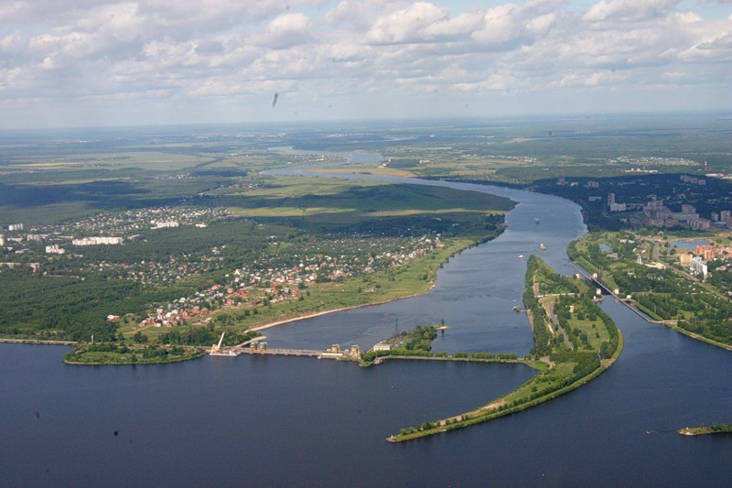
Progress of implementation of the 7-year Plan (2017−2023)
in the NICA project & proposal to update the Plan
V. Kekelidze,
NICA
Volga
river
127-th session of the Scientific Council,
20 – 21 February, 2020, Dubna
Notes:
Good afternoon! First of all I would like to express my gratitude to Prof. Livai and organizers for the invitation and opportunity to give a talk at the Wigner Colloquium

Slide 2

Main goals: to obtain comprehensive information on
hot and dense baryonic matter:
- phase transition peculiarity;
- whether there is a critical end-point?
nucleon spin structure:
- how the spin of proton / neutron is composed?
essential upgrade of existing accelerator complex;
construction of Collider to provide collisions of
ions from p to Au and polarized p и d;
construction of 3 detectors: Baryonic Matter @ Nuclotron (BM@N), Multi Purpose Detector (MPD) and Spin Physics Detector (SPD).
Notes:
NICA is a Nuclotron … The main targets of the project are: ..
That has required a development of accelerator facility and construction of

Slide 3
NICA Complex:
Accelerators, Detectors, Infrastructure
Notes:
Few words on the NICA …

Slide 4


Objects
Accelerator block:
Nuclotron & channels
Injector complex
Booster
Collider
Collider
Injection complex
Nuclotron
Booster
Notes:
This is a view of major NICA facilities. The Nuclotron – supercoducting synchrotron with circumference of 250 meters was put in operation 24 years ago. The beams from Nuclotron are extracted to the experimental hall, where the first experiment of NICA program BM@N is located. The plan is to put in operation a booster in 2019, and collider - in 2020 simultaneously with the MPD.

Slide 5
Nuclotron
The Collider
Type сю | SC synchrotron
particles | p, d, nuclei
max. kinetic energy, GeV/u | 10.71 ( p); 5.35 ( d) 3.8 (Au)
max. mag. rigidity, Tm | 38.5
circumference, m | 251.52
vacuum, Torr | 10⁻⁹
intensity, Au /pulse | 1 10⁹
Design parameters, Stage II
45 T*m, 11 GeV/u for Au⁷⁹⁺
Ring circumference, m | 503,04
Number of bunches | 22
r.m.s. bunch length, m | 0,6
β, m | 0,35
Energy in c.m., Gev/u | 4-11
r.m.s. Δp/p, 10⁻³ | 1,6
IBS growth time, s | 1800
Luminosity, cm⁻² s⁻¹ | 1x10²⁷
Booster
 | value
ion species | A/Z < 3
max. energy, MeV/u | 600
magnetic rigidity, T m | 1.6 – 25.0
circumference, m | 210.96
vacuum, Tor | 10⁻¹¹
intensity, Au /p | 1.5 10⁹
Stage I:
without ECS
reduced number of RF
reduced luminosity
Notes:
The Nuclotron, synchrotron based on the SC magnets developed at JINR, was put in operation in 1993. In was essentially modernized in 2010-2015. It will provide acceleration of gold ions up to kinetic energy 4,4 GeV/u, and protons up to 12 GeV.

Slide 6
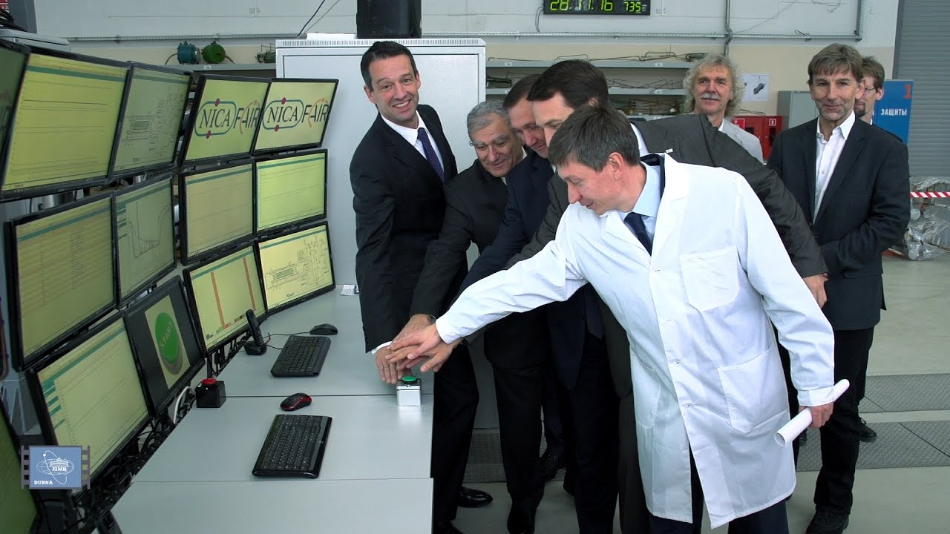
The technological line for production, tests and
certification of SC magnets for NICA and FAIR
was put in operation on November 28, 2016

Slide 7
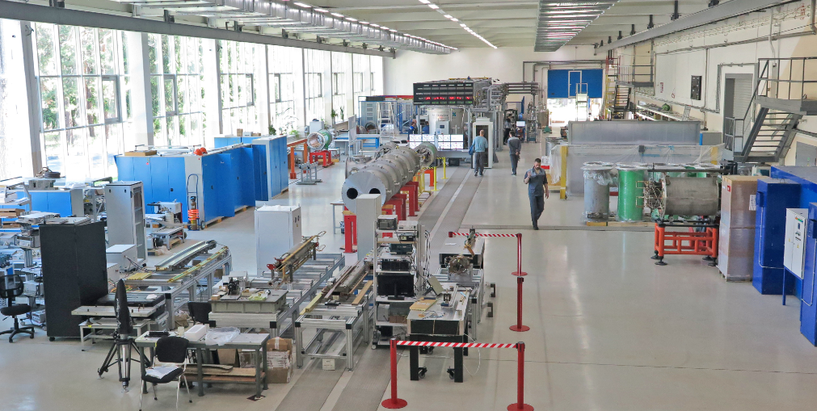
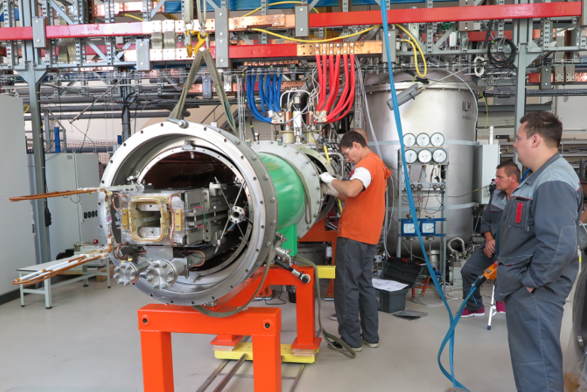
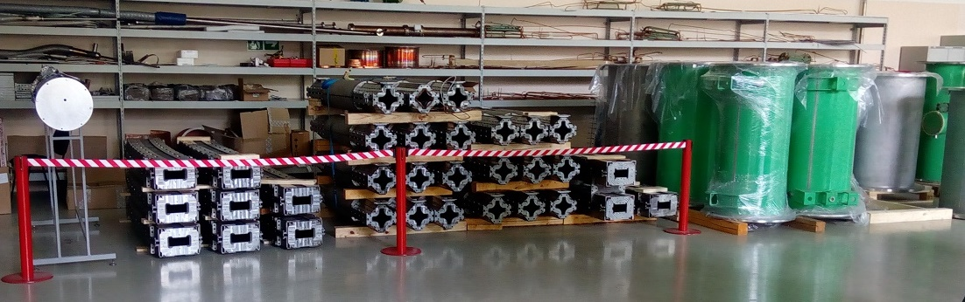
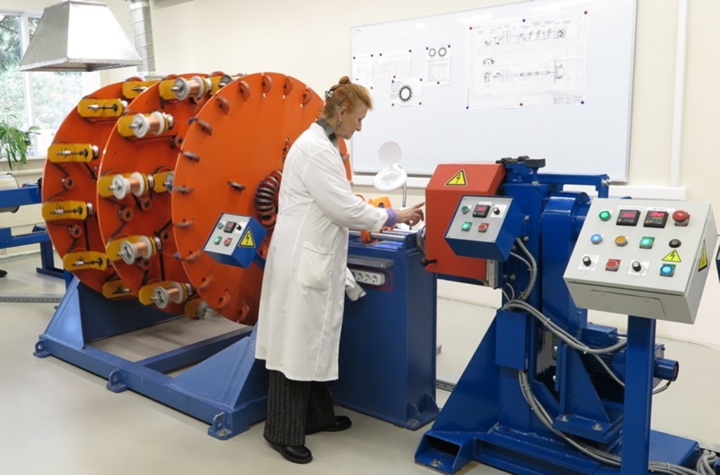
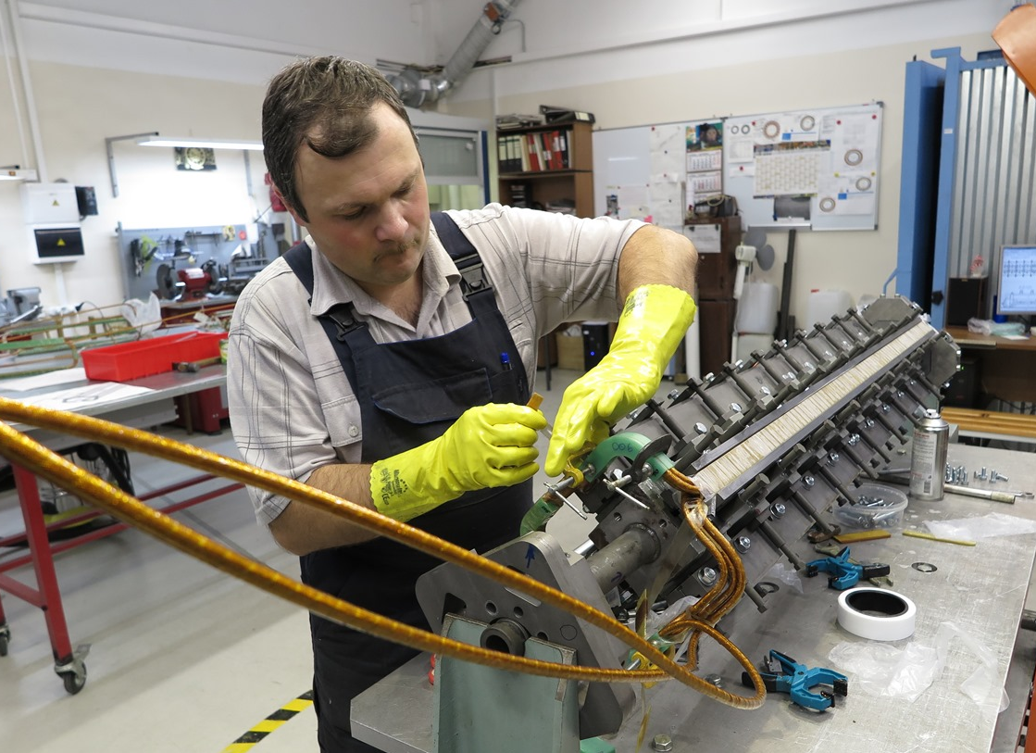
Magnet production (к. 217)
all Booster magnets are produced and tested
production of
Collider magnets
is in progress
Notes:
The technological line for magnet assembly and test has been put in operation. In total almost 450 magnets will be fabricated for NICA and FAIR /SIS100 accelerators. The booster magnet fabrication is going well.
All yokes are already produced and delivered.

Slide 8
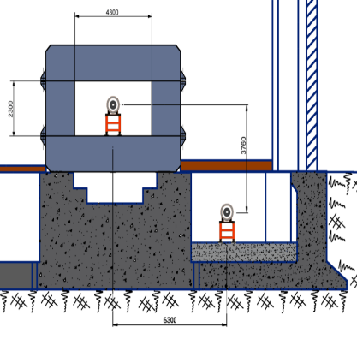
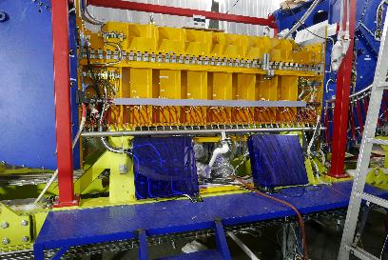
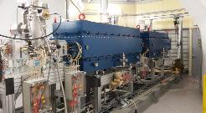
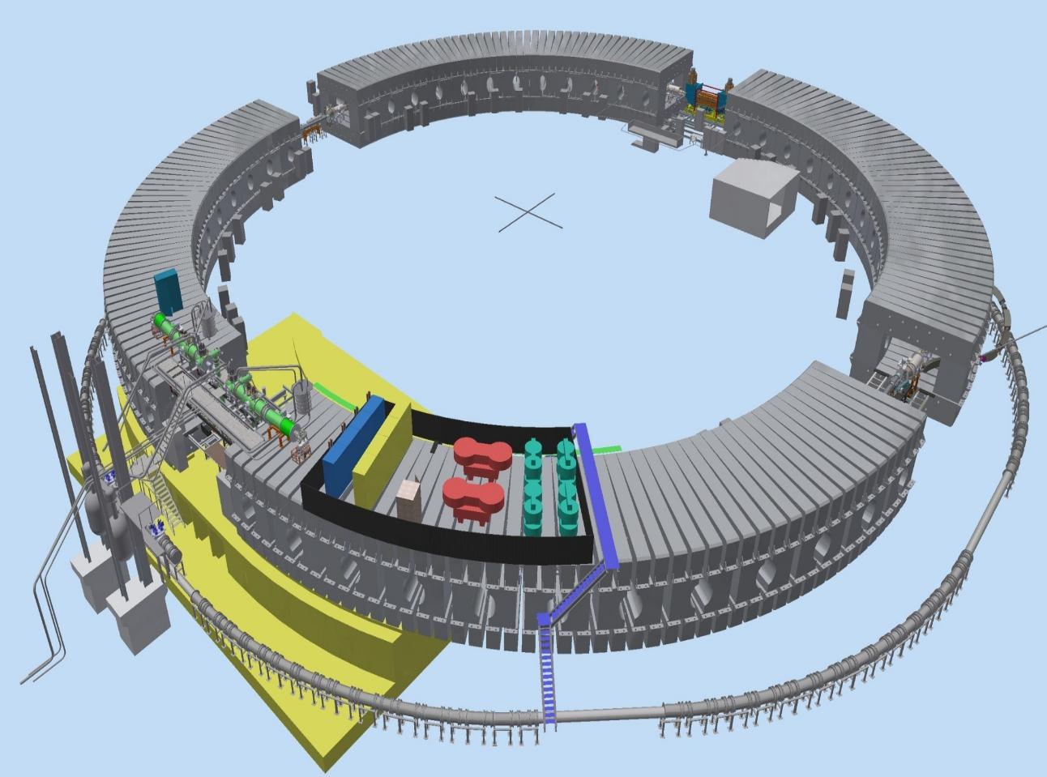
Booster
Booster: assembly since 2018
E-cooling system
injection
Nuclotron
Reference period
Power supplies
extraction
RF station
Nuclotron

Slide 9
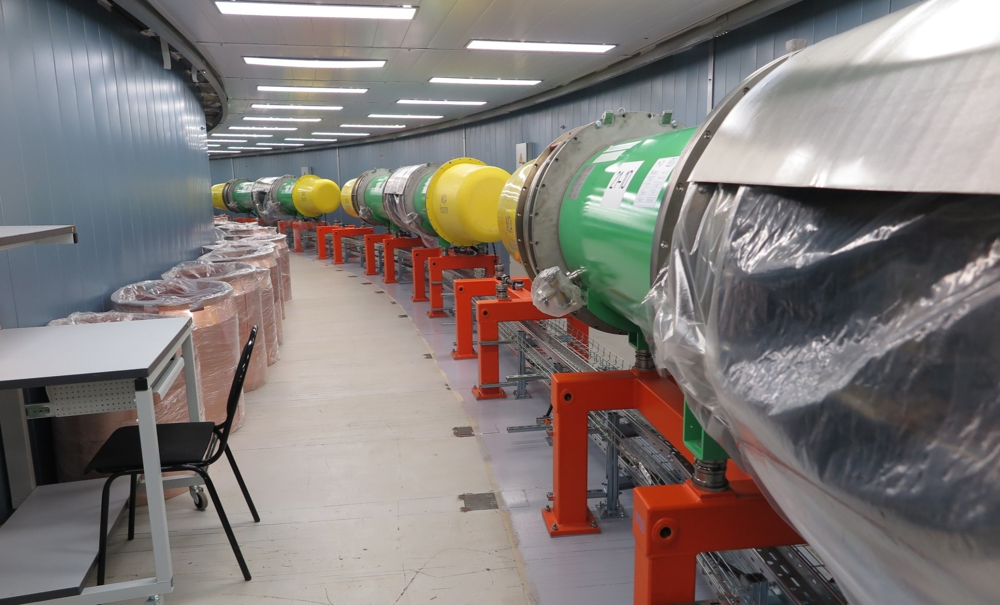
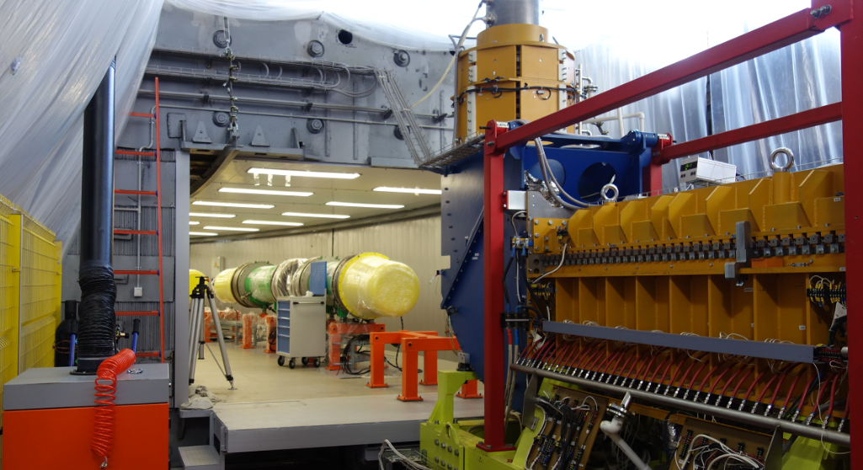
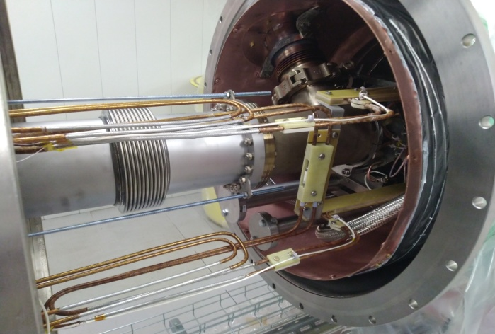
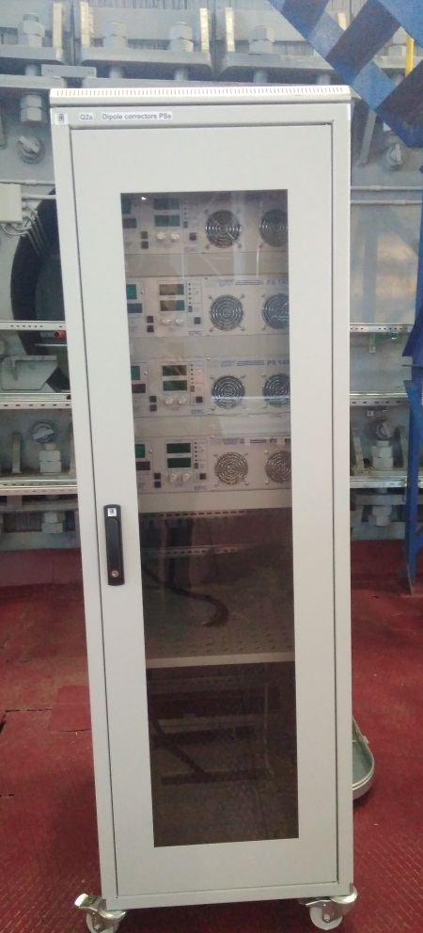
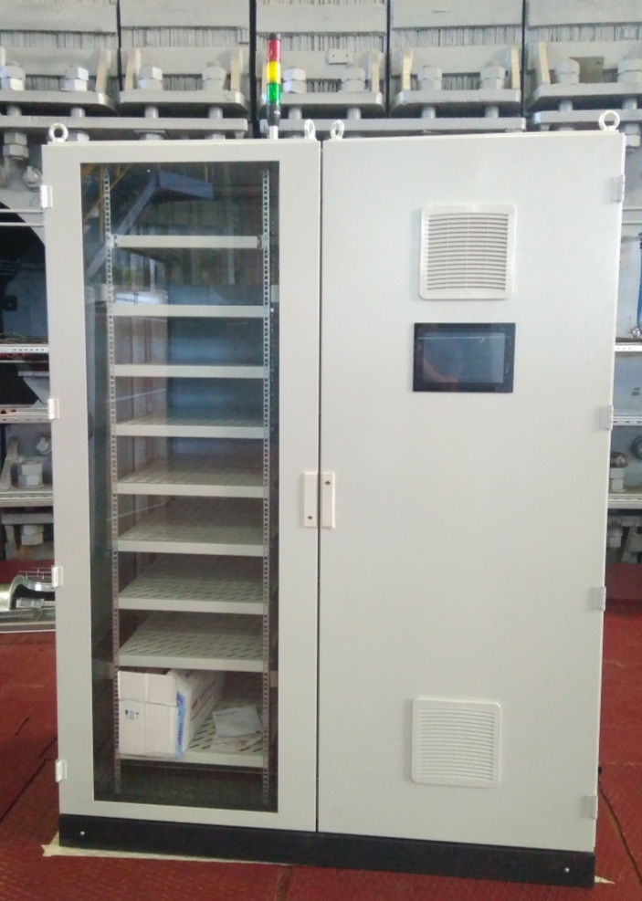
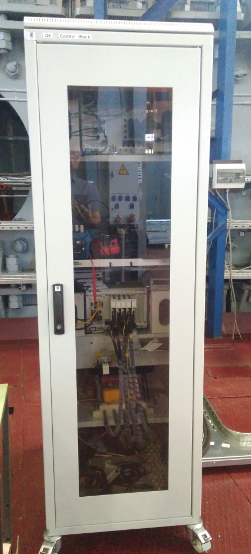
Booster systems
ECS - mounted & tested (Budker institute)
Control and monitoring systems:
beam diagnostics - 90%
control systems - 95%
ACS of beam pipe vacuum pumping - 40%
all 40 dipoles
and
24 quadrupole doublets
mounted in the tunnel;

Slide 10
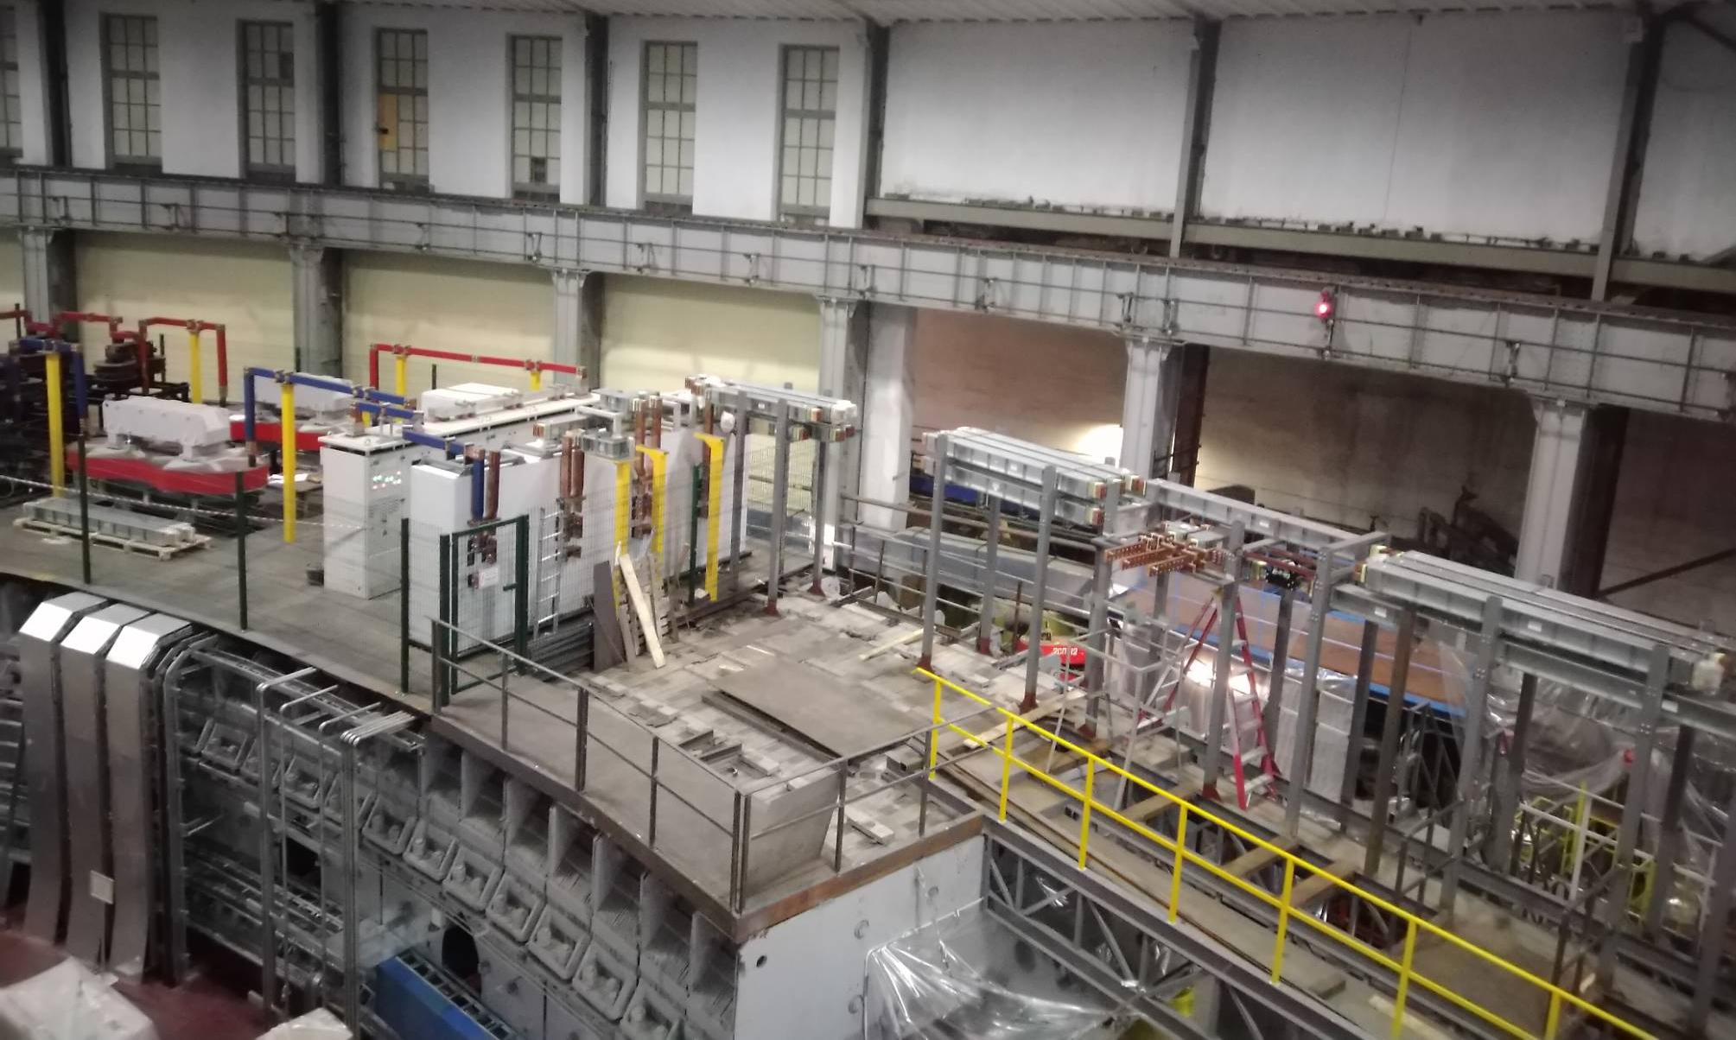
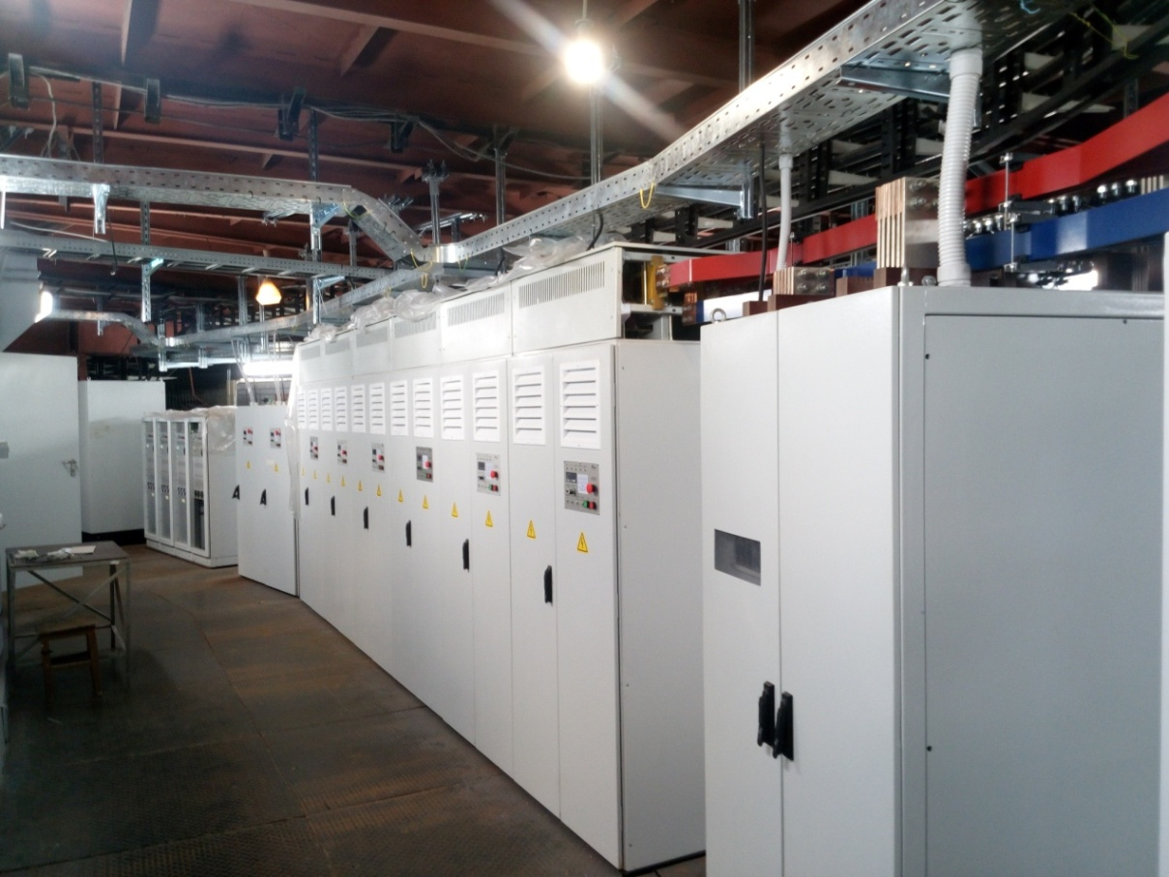
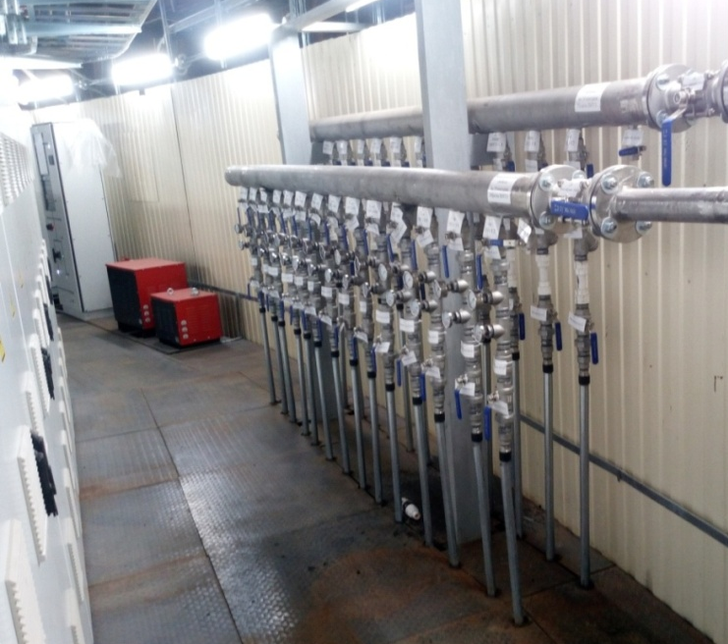
Power supply and energy evacuation systems
readiness:
basic IPS -98%
busbar trunking system - 80%
control system - 95%
Energy evacuation keys
switches
busbar trunking
equivalent load
Power Supply
commissioning
10-12.2019

Slide 11

Booster commissioning schedule
Booster assembly |  | 2018 |  |  |  |  |  |  |  | 2019 |  |  |  |  |  |  |  |  |  |  |  |  | 2020
 |  | V | VI | VII | VIII | IX | X | XI | XII | I | II |  | III | IV | V | VI | VII | VIII | IX | X | XI | XII | I | II | III | IV | VI | VI
“Cold” sections
 | Quadrant 1
 | Quadrant 2
 | Quadrant 3
 | Quadrant 4
 | bypasses and ends
 | reference magnets
 | “Warm” sections
 | E-cooling |  |  |  | commissioned
 | injection section
 | beam extraction section
 | RF system |  |  |  |  |  | Tested
Systems
 | vacuum system
 | power supply
 | cryogenic system
 | thermometry system |  |  |  |  |  |  | Tested
Commissioning with beam
technological commissioning

Slide 12
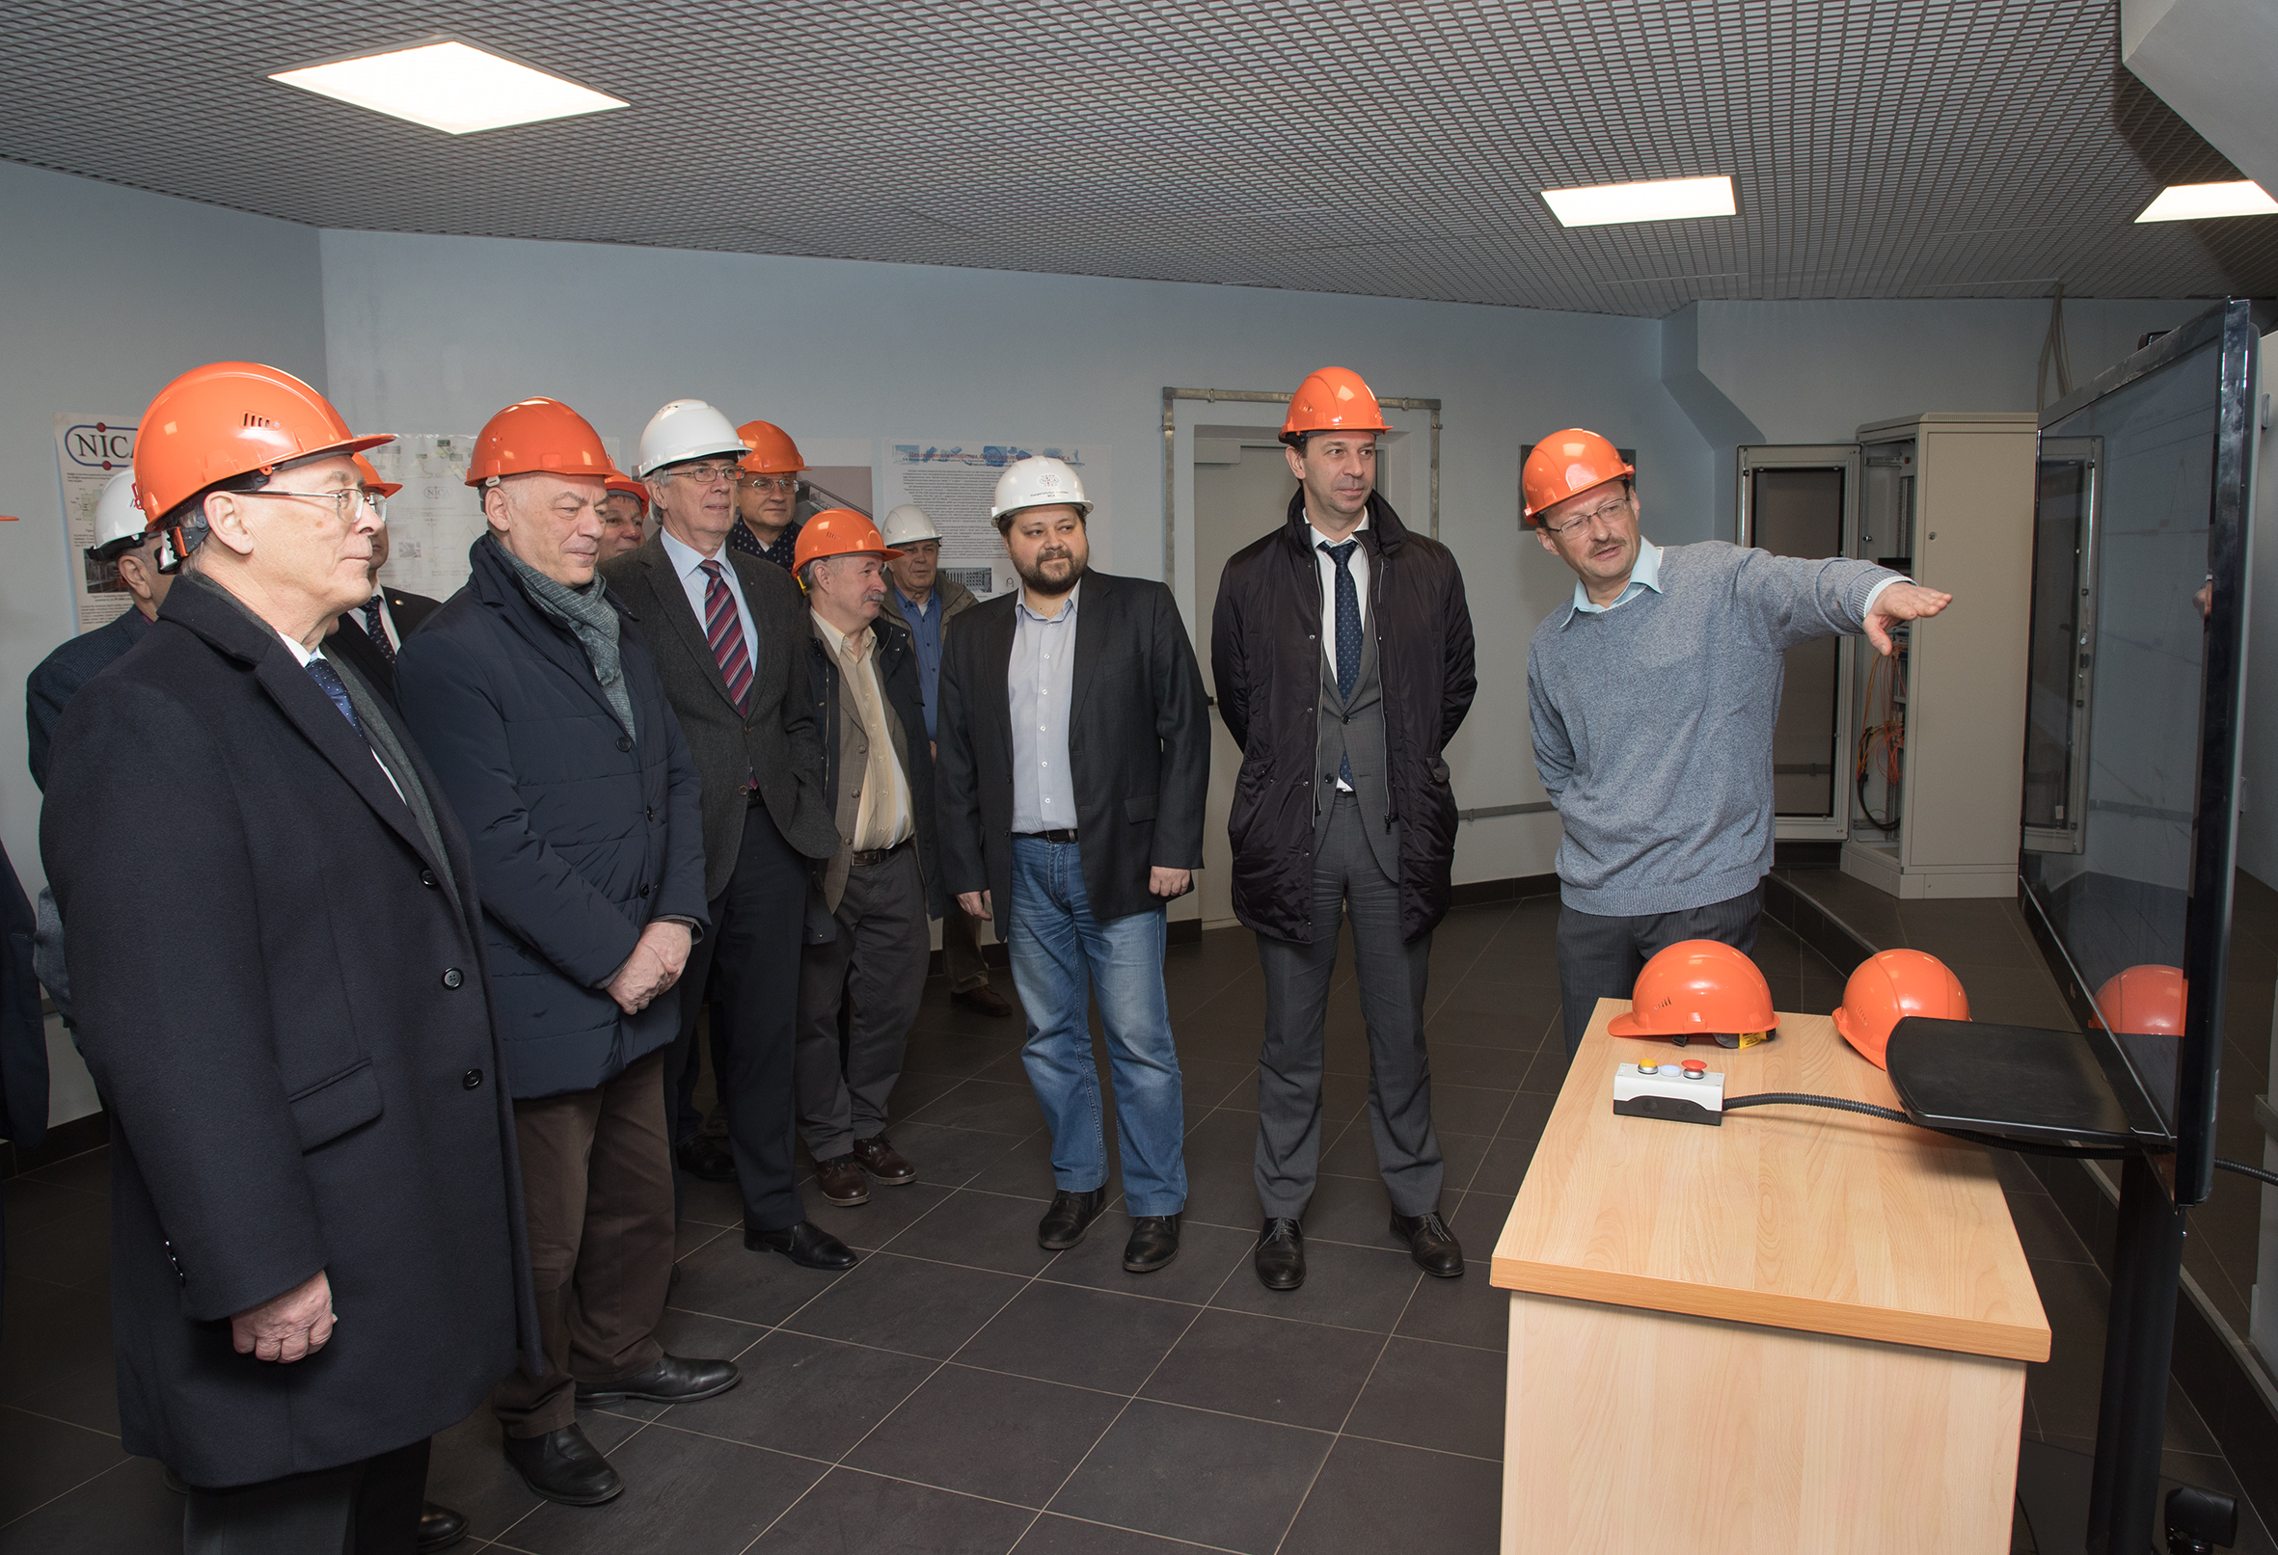
Official start of the Booster commissioning
23 December 2019

Slide 13

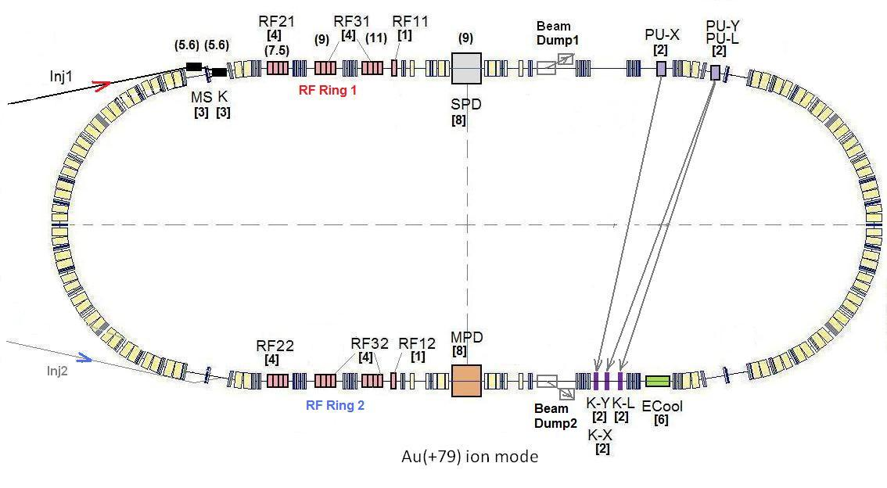
Collider systems installation
SPD
Start of installation:
magnets August 2020
channel equipment - July 2020
RF systems - summer 2020
ECS - summer 2021
MPD
Notes:
The lattice design and prototyping of most collider elements are completed. The ring circumference is twice as one of the Nuclotron. For the gold beam a Luminosity at the energy above 10 GeV per nucleon will be 10 to the 27

Slide 14
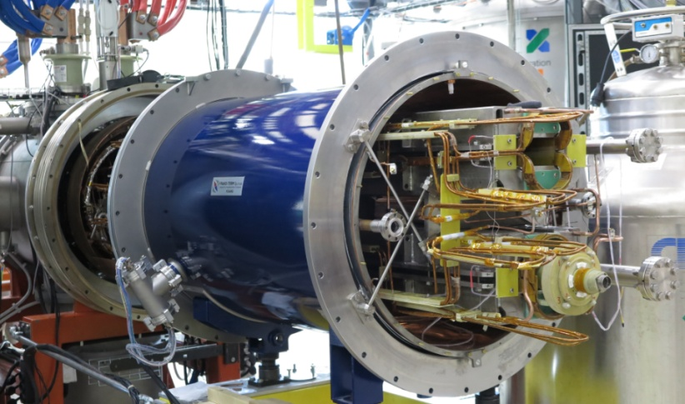
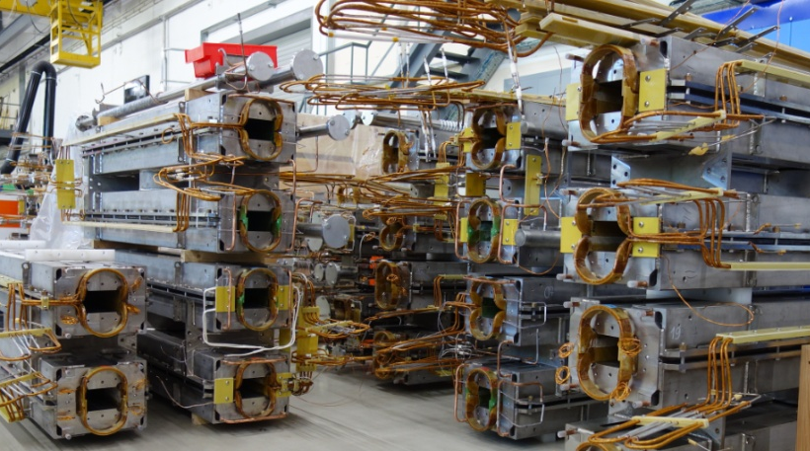
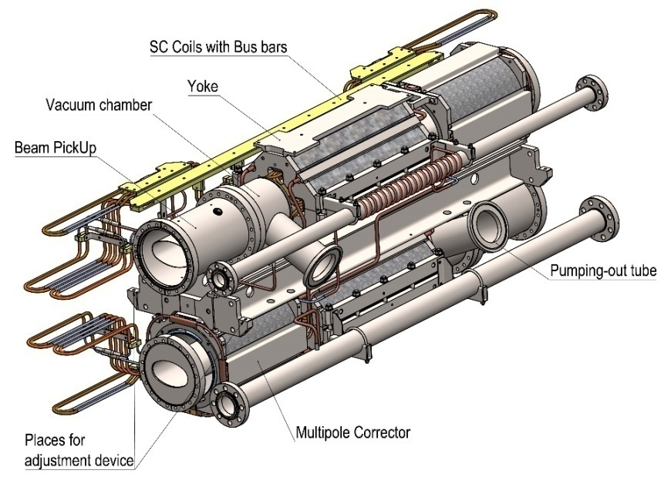
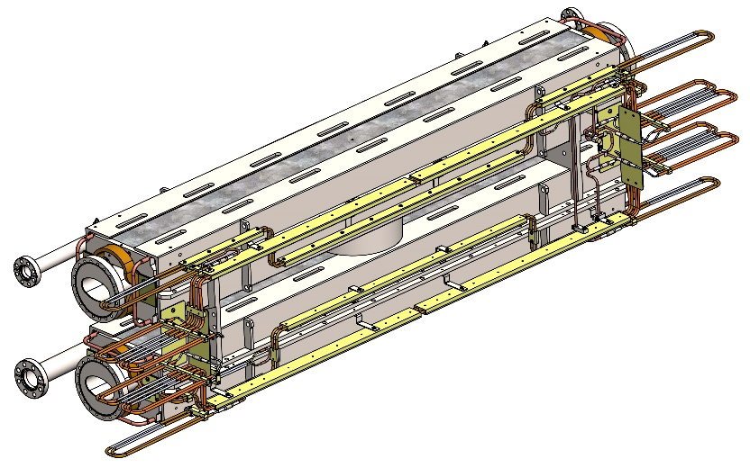
Collider magnets
Dipoles assembly and tests 35%
Quadrupoles 10%
Final focus systems 5%
mounting & commissioning
07.2020 - 07.2021
 | dipoles | lenses
number | 80+8* | 70+12**
Мах. field / gradient | 1.8 T | 23.1 T/m
weignt | 1670 kg | 240 kg

Slide 15
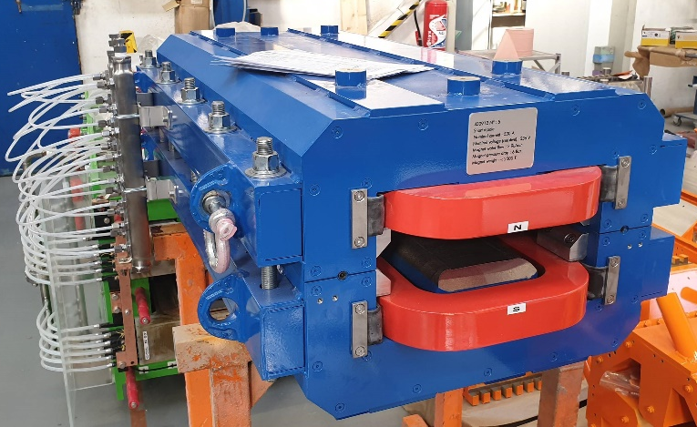
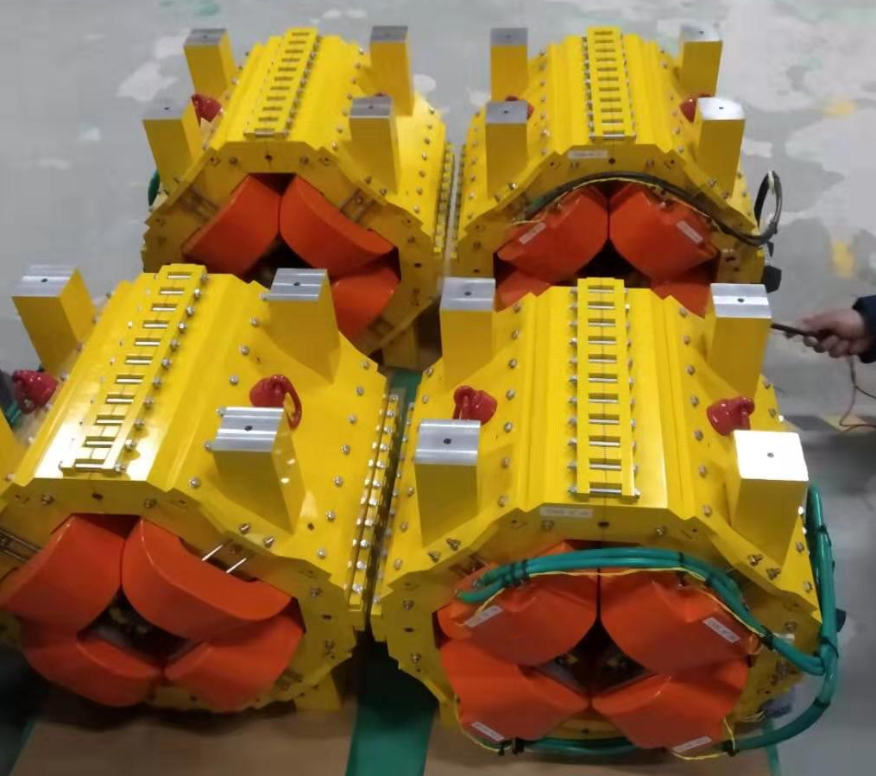
Nuclotron- Collider transport channels
(Sigma-Phi)
magnets – readiness 95%
delivery 02.2020
Vaccum chamber and diagnostics
- readiness 70%
delivery 06.2020
Power supplies- readiness 10%
delivery 08.2020
mounting & commissioning
- 08.2020 > 02.2021
Magnetic element | Number | Effective length, m | Max. magnetic field (gradient), T (T/m)
Long dipole | 21 | 2 | 1.5
Short dipole | 6 | 1.2 | 1.5
Quadrupole Q10 | 22 | 0.353 | 31
Quadrupole Q15 | 6 | 0.519 | 31
Steerer | 33 | 0.466 | 0.114
15

Slide 16
Accelerator commissioning schedule
Completion of mounting December2021
works /contracts in progress
magnet assembly & tests
technological run
commissioning with the beam

Slide 17
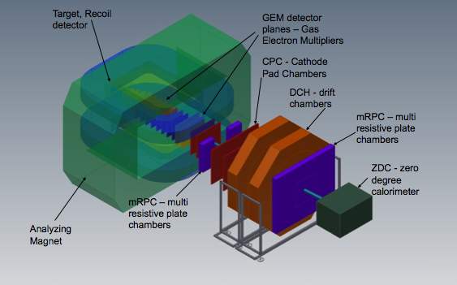

Objects
Detectors:
Baryonic Matter @ Nuclotron
Multi Purpose Detector
Spin Physics Detector
BM@N
SPD TDR
MPD
Notes:
This is a view of major NICA facilities. The Nuclotron – supercoducting synchrotron with circumference of 250 meters was put in operation 24 years ago. The beams from Nuclotron are extracted to the experimental hall, where the first experiment of NICA program BM@N is located. The plan is to put in operation a booster in 2019, and collider - in 2020 simultaneously with the MPD.

Slide 18
Baryonic Matter at Nuclotron
(BM@N) Collaboration:
11 Countries, 21 Institutions, 245 participants
University of Plovdiv, Bulgaria;
Institute of High Energy Physics, China;
Shanghai Institute of Nuclear and Applied Physics, CFS, China;
Tsinghua University, Beijing, China;
Nuclear Physics Institute CAS, Czech Republic;
Tubingen University, Germany;
Tel Aviv University, Israel;
Joint Institute for Nuclear Research;
Almaty Institute of Physics & Technology, Kazakhstan;
Institute of Applied Physics, Chisinev, Moldova;
Warsaw University of Technology, Poland;
University of Wroclaw, Poland;
Institute of Nuclear Research RAS, Moscow, Russia;
NRC Kurchatov Institute, Moscow, Russia;
Institute of Theoretical & Experimental Physics, NRC KI, Moscow, Russia;
Moscow Engineer and Physics Institute, Russia;
Skobeltsin Institute of Nuclear Physics, MSU, Russia;
Moscow Institute of Physics and Technics, Moscow, Russia;
Massachusetts Institute of Technology, Cambridge, USA.

Slide 19
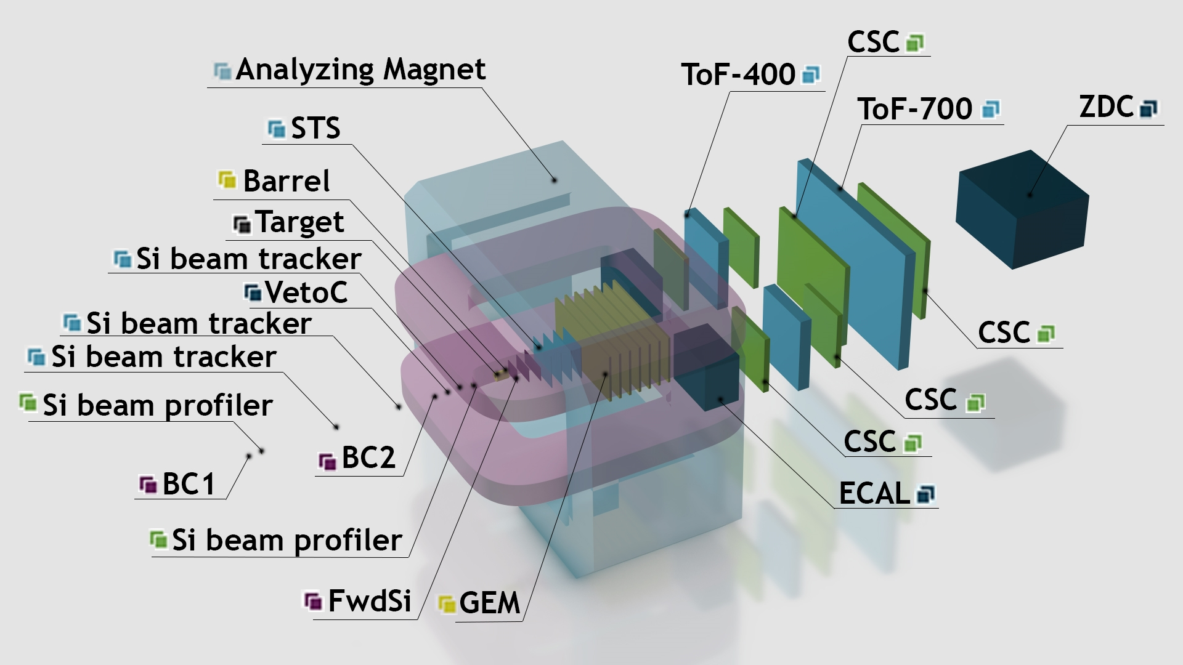
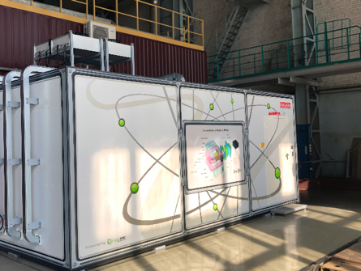
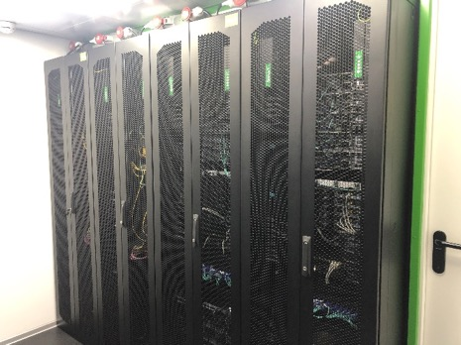
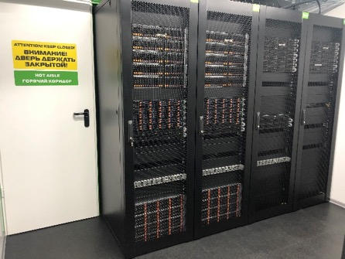
Baryonic Matter at Nuclotron (BM@N)
Mobily computing farm for BM@N

Slide 20

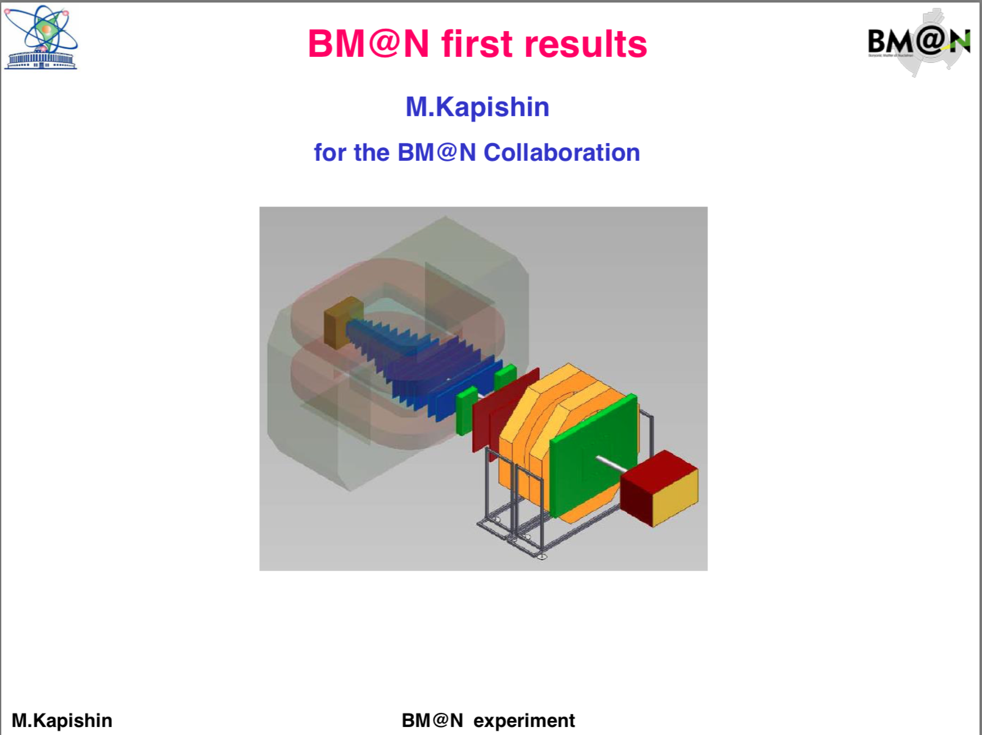

Slide 21

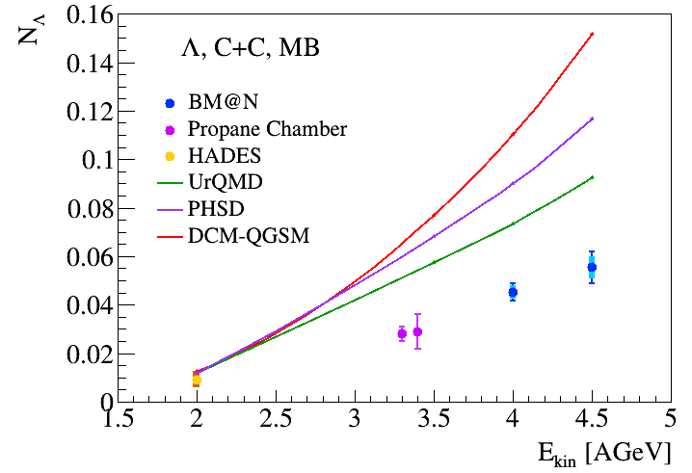
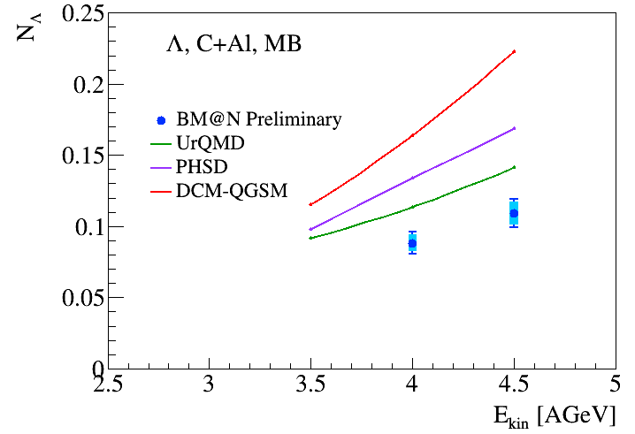
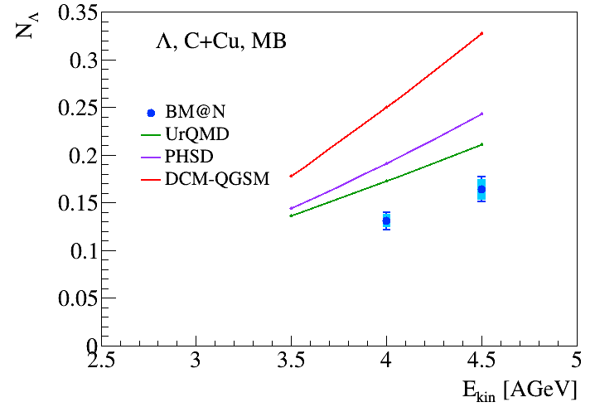
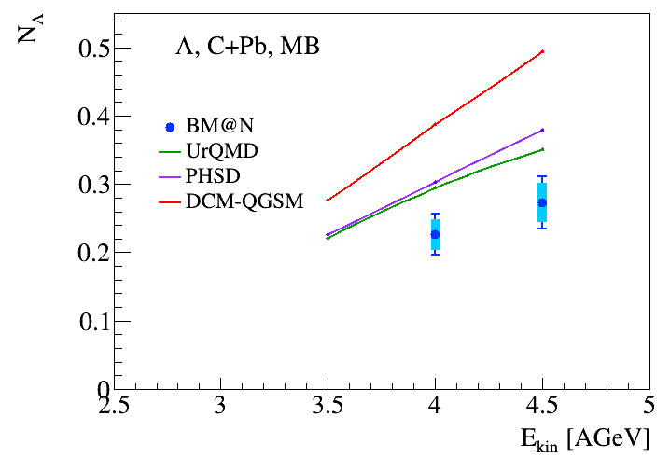
First result of BM@N experiment: Λ hyperon yield in C+C, Al, Cu, Pb interactions
Results presented at SQM 2019 and QM 2019 conferences

Slide 22
Baryonic Matter at Nuclotron (BM@N)
year | 2017 | 2018 | 2021 | 2022 +
beam | C | Ar,Kr, C(SRC) | Kr,Xe | Up to Au
beam, Hz | 0.5M | 0.5M | 0.5M | 2-5M
trigger, Hz | 5k | 10k | 10k | 20k→50k
central tracker | 6 ½ pl.GEM | 6 ½ pl.GEM +3 pl. FwdSi | 7 pl. GEM + 3 pl. FwdSi | 7 pl. GEM + 3 pl. FwdSi + 4 stations STS
status | Tech run | Tech & physics runs | Phys run, Stage I | Phys run, Stage II

Slide 23


MPD Collaboration:
spokesperson – A. Kisiel WUT, Poland
11 Countries, 38 Institutes, 505 participants
IHEP, Beijing, China;
University of South China, China;
Palacky University, Olomouc, Czech Republic;
NPI CAS, Rez, Czech Republic;
Tbilisi State University, Tbilisi, Georgia;
Tubingen University, Tubingen, Germany;
Tel Aviv University, Tel Aviv, Israel;
Joint Institute for Nuclear Research;
IPT, Almaty, Kazakhstan;
FHCal
Consortium MEXNICA, Mexico;
Institute of Applied Physics, Chisinev, Moldova;
WUT, Warsaw, Poland;
NCN, Otwock – Swierk, Poland;
UW, Wroclaw, Poland;
Jan Kochanowski University, Kielce, Poland;
INR RAS, Moscow, Russia;
MEPhI, Moscow, Russia;
PNPI, Gatchina, Russia;
INP MSU, Moscow, Russia;
KI NRS, Moscow, Russia;
SPSU - Dept. of NP, Russia;
St. Petersburg, Russia;
SPSU – Dept. of HEP, St. Petersburg, Russia;
North Ossetia State University, Vladikavkaz, Russia;
Baku State University, NNRC, Azerbaijan;
University of Plovdiv, Bulgaria;
University Tecnica Federico Santa Maria, Valparaiso, Chili;
Tsinghua University, Beijing, China;
USTC, Hefei, China;
Huizhou University, Huizhou, China;
Institute of Nuclear and Applied Physics, CAS, Shanghai, China;
Central China Normal University, China;
Shandong University, Shandong, China;

Slide 24
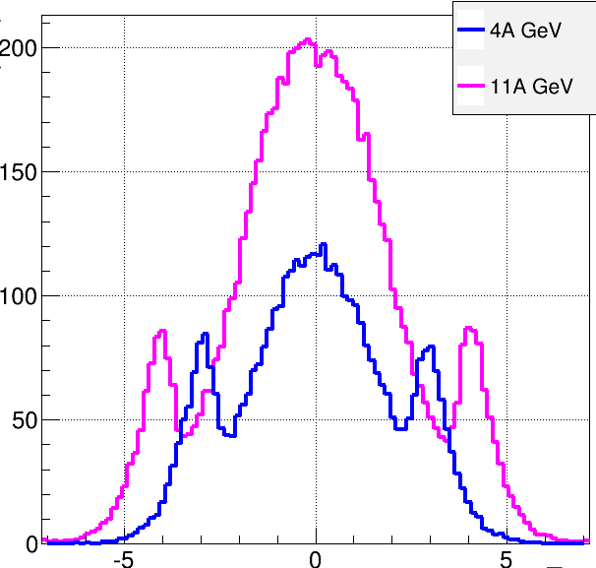
Multi-Purpose Detector (MPD)
Stage I: TPC, TOF, ECAL, FHCal, FFD
acceptance
URQMD
charged
b<11 fm
11 A GeV
4 A GeV
dN/dη
TPC
TOF
ECal
FFD
FHCal
η
Stage I: put in operation in 2021
Notes:
The MPD will be put in operation at two stages. At the first one the barrel part will be equipped with major tracking detector TPC, TOF end ECAL. FHC and FD will be operational as well.
At the second stage the detector will be supplemented with IT and end cap subdetectors.

Slide 25
Multi-Purpose Detector (MPD)
Stage I: TPC, TOF, ECAL, FHCal, FFD
Stage II ( 2023): + ITS + EndCap (CPC / Straw, TOF, ECAL)
Stage II
acceptance
URQMD
charged
b<11 fm
11 A GeV
4 A GeV
dN/dη
TPC
CPC
TOF
ECal
FFD
FHCal
η
Stage I: put in operation in 2021
Notes:
The MPD will be put in operation at two stages. At the first one the barrel part will be equipped with major tracking detector TPC, TOF end ECAL. FHC and FD will be operational as well.
At the second stage the detector will be supplemented with IT and end cap subdetectors.

Slide 26
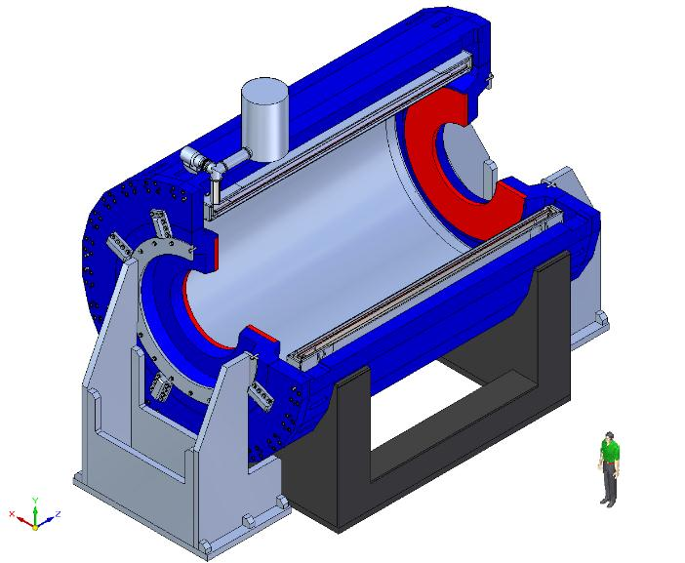
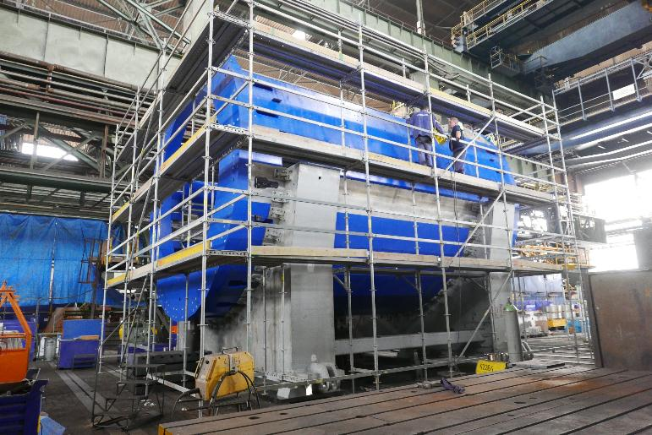
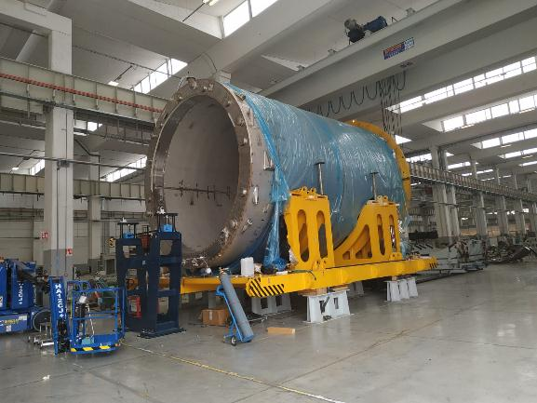
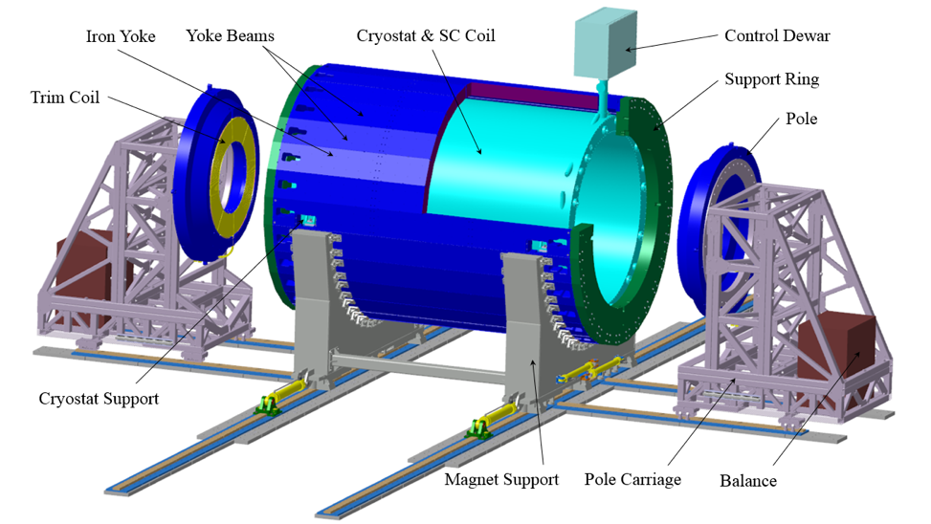
SC solenoid:
Produced inASG (Genova) и Vitkovice HM
B₀=0.5 T
weight ~ 900 t
Nominal current: 1790 A
Stored energy: 14.6 MJ
yoke
Control
Duar
SC coil
cryostat
Trim
Coils
Yoke: all parts in Dubna,
control assembly tolerance~ 0,5 mm
The cryostat with SC coil:
- Ready for cold tests
mounting - Mar.‘20
Notes:
The major part of MPD is SC solenoiodal magnet. It is a challenging project due to very high requirement for the magnetic field homogeneity – better that a permill.
After long negotiations a contract is signed with the ASG sc company – the one which produced a big solenoid for CMS. The ASG is responsible for production of coils, cryostat control system etc. In addition the company takes responsibility for the overall supervision and final characteristics.

Slide 27
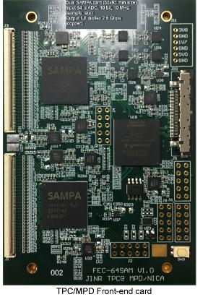
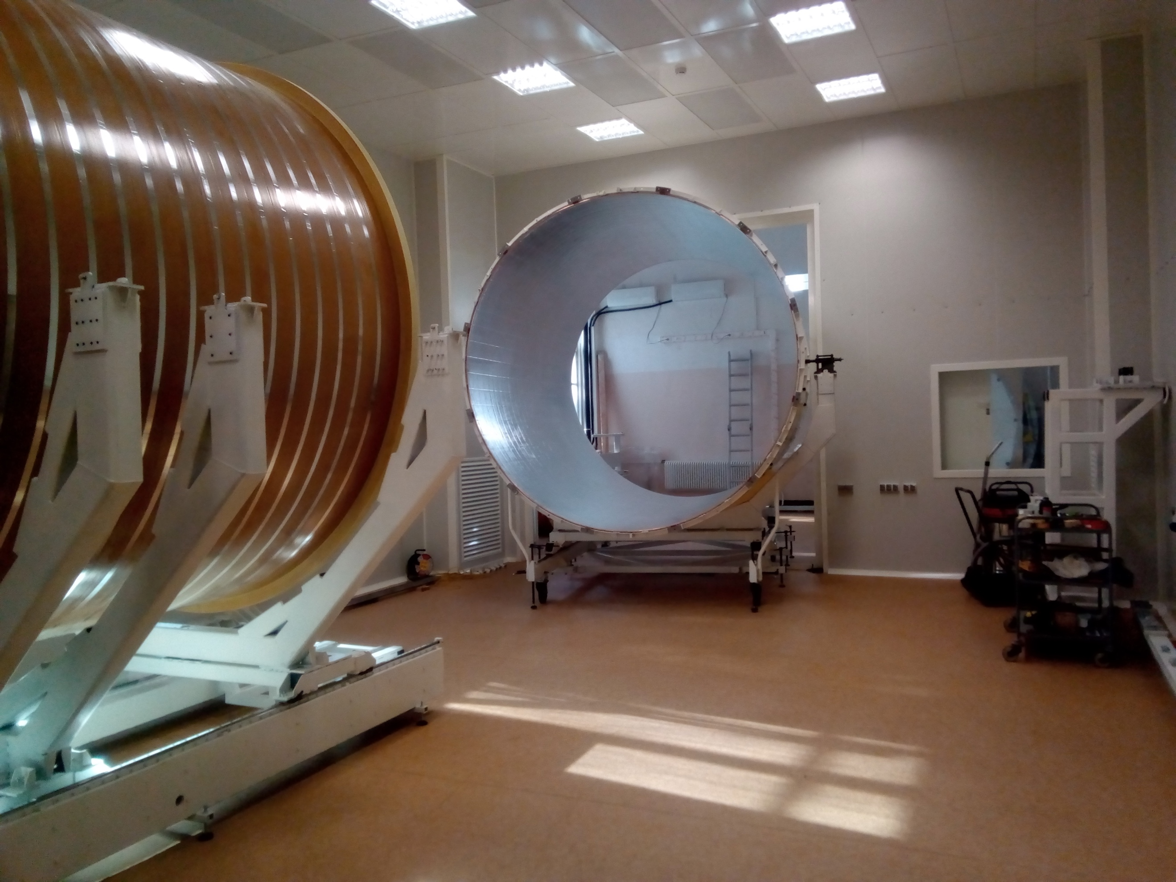
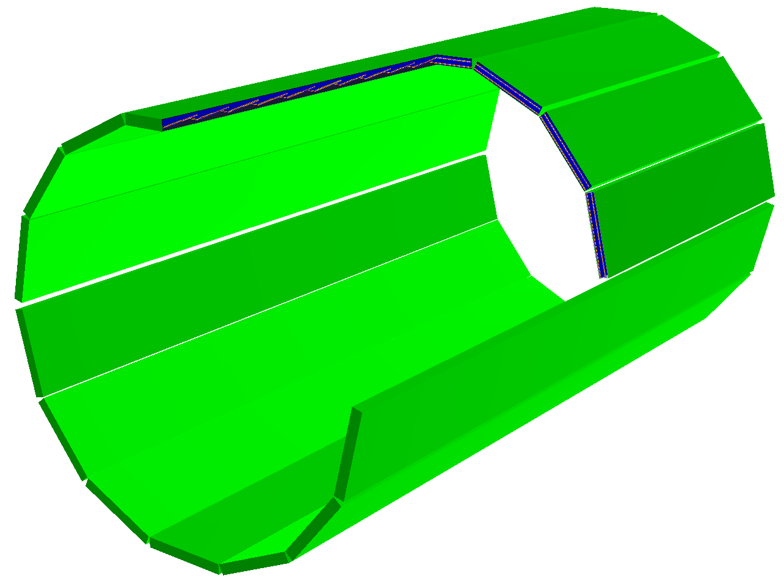
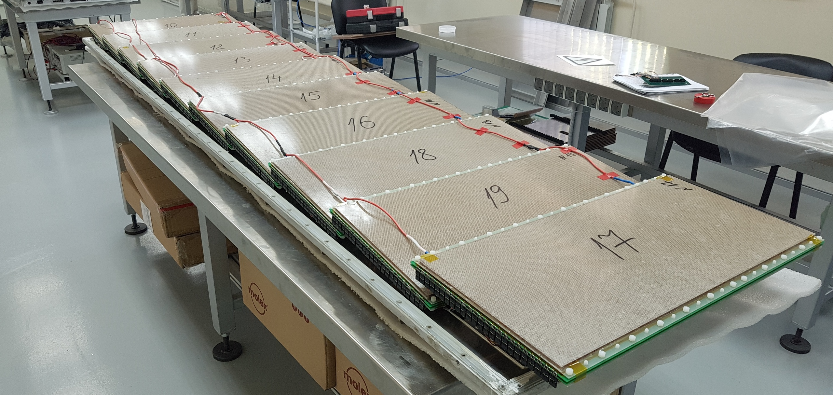
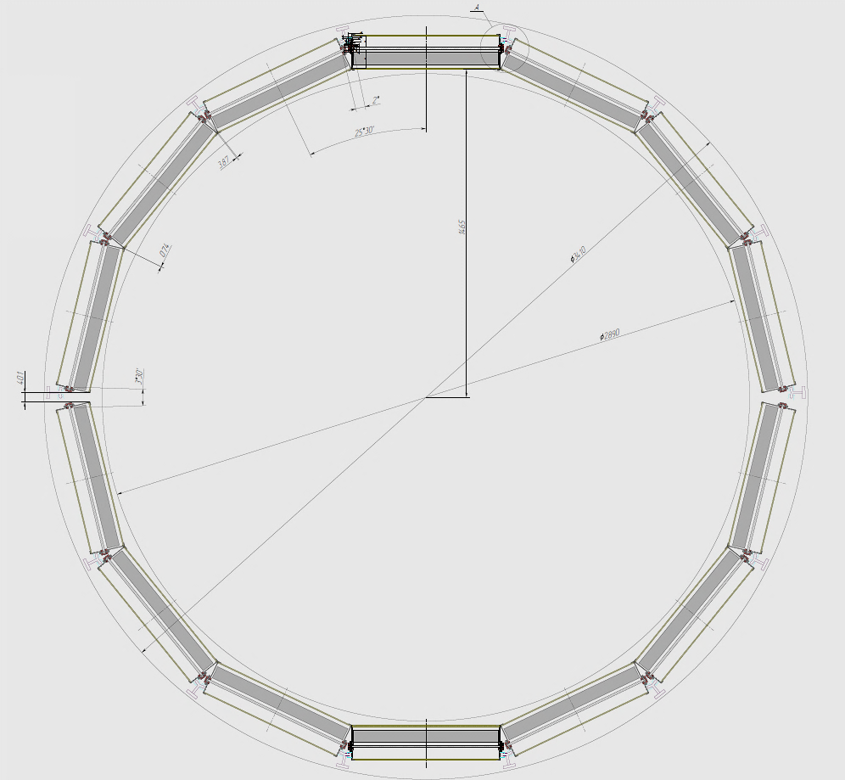
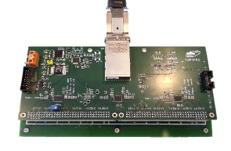
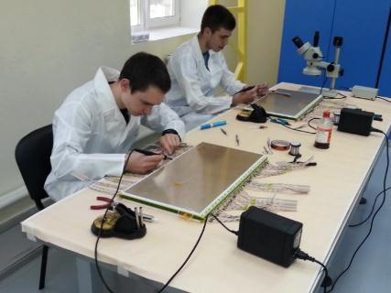


TPC – the basic tracker
length | 340 сm
radius 4 | 140 сm
Radius 1 | 27 сm
gas | 0,9Ar+0,1CH₄
drift velocity | 5.45 см/mks;
drift time | < 30 mks;
N of R/O cham. | 12 + 12
channels | 95 232
Max rate | ~ 7 kHz
FEC64SAM:
4500 SAMPA V4
– delivered from CERN
Assembly in the clean room
Time of flight sytem(TOF)
28 modules
280 prop. cham-s
13 440 channels
R= 170 cm
20% modules assembled & tested
R/O cards with NINO & HPTC
- are produced

Slide 28





Electromagnetic calorimetry (ECal) system
43000 modules «shashlyk» type(Pb+Sc)
L ~35 cм (~ 14 X₀);
Segmentation (4x4 cm²).
~ 100 t
r/o: WLS fibers +MAPD;
π⁰ γγ
Projective
geometry
σ(E) ~ 5% @ 1 GeV;
σ(t) ~ 500 ps
Production plans:
Supporting structure
JINR, IHEP, Tensor + .. - 25%
China - 75%
Blocks f modules
Carbon fiber
ECal ~ 100 t
MOST
allocated
6 М $
- sagitta ~ 5 мм
- material budg. (R)0,13 X₀
Contract signed АО «ЦНИИСМ»
IHEP
Beijing

Slide 29

First Physics with MPD
Preparation of the report on expected physics results on the first run of MPD
Initial running plan for the NICA Complex (beam types, collision energies)
Status of the readiness of the MPD detector subsystems
Calibration and computing readiness
Selection of physics observables with largest discovery potential for the initial data sample
Schedule for preparation of first scientific publications from MPD data

Slide 30

Agreement was signed with 5 Mexico Universities
COLLABORATION AGREEMENT with:
National Autonomous University of Mexico,
  Institute fir Nuclear Science;
Benemerita Autonomous University Puebla;
Research & Advanced Studies Center;
University of Colima;
Autonomous University of Sinaloa.
11 October 2019

Slide 31


NICA days in Warsaw, 21-21 October, 2019
21 October 2019 г. Memorandum was signed by 5 Polish insoftitutions participation in the MPD:
Jan Kochanowski University;
National Centre for Nuclear Research (NCBJ), Otwock;
University of Wroclaw, Wroclaw;
Warsaw University of Technology, Warsaw;
University of Warsaw.

Slide 32



Helmholtz-Wintergespräche, Moscow, 7 February 2020
GSI-JINR Agreement
Got Green Light
and parties exchanged
signed documents
GSI coordinates German institutions participation
in the NICA Project
contribution ~ 20 М Евро

Slide 33

Objects
Infrastructure:
Collider building (#17)
NICA center
Area for applied research
Computing
Engineering
applied research area
NICA Center
Notes:
This is a view of major NICA facilities. The Nuclotron – supercoducting synchrotron with circumference of 250 meters was put in operation 24 years ago. The beams from Nuclotron are extracted to the experimental hall, where the first experiment of NICA program BM@N is located. The plan is to put in operation a booster in 2019, and collider - in 2020 simultaneously with the MPD.

Slide 34



Collider building (№ 17) civil construction
Construction completion– December 2020
August 2019
BM@N
Supplement to the Agreement
with the General Contractor №5:
Draft is prepared; negotiation stage
Plan to sign in March 2020
SPD
MPD
tunnel – preparation for equipment installation
MPD
MPD
Staging in object commissioning:
MPD - March ’20
Collider – July ‘20;
Notes:
The civil construction of the collider complex is going on in accordance with the plans. the MPD hall will be ready by the summer of 2018, and the entire complex will be completed in 2019.

Slide 35
Power substations 6 kV
August 2019
BM@N
1 for bld. 205: 8 МW
1 for CCS: 11 МW
№15
SPD
MPD
5 for collider: 11 МW
Notes:
The civil construction of the collider complex is going on in accordance with the plans. the MPD hall will be ready by the summer of 2018, and the entire complex will be completed in 2019.

Slide 36





Cryogenics
Two recondensers RA05
- are produced
500 kg/h nitrogen recondenser RA-0.5
Completion in 2020
3 satellite
refrigerators
- to be mounted
Compressor
station 4,4 MW
1000 l/h He liquifier
Power in cold will be
more that doubled
from 4 kW to 10 kW at 4.5K
40 м³ резервуар д/жидкого гелия
Cryogenic-compressor station

Slide 37

NICA Center: general designer ООО ПИ «Арена»
Plan:
State Expertise in 2020

Slide 38



NICA Computing and networks
LIT
Data storage:
2017: 1 PB RAW /year
- plan: 10 PB RAW /year
Fast disk memory
of the super computer
«Говорун»

Slide 39


LHEP off-line cluster
- запput in operation on 19 September 2019
3000 cores,
upgraded up to 5000;
3,5+3,5 PB disk memorty

Slide 40
Project schedule
and funding issues
Notes:
Few words on the NICA …

Slide 41



The NICA Project is being implemented in accordance with
the JINR 7-year plans in 2010-2016 and
in 2017- 2023: 237,9 M$
The RF Government Decree
Agreement between
the RF Government
and JINR
signed on June 2-nd 2016
allocation of
initial funding (8,8 B Rub)
updated in
the National Project “Science”
with the allocation of the necessary funding (+ 5,6 BRub)
the beginning of international scientific research
at a scientific facility of the "mega-science" class:
NICA Complex
2022

Slide 42
Updated JINR – RF Agreement
(completion dates and report forms)
17.1.1 | Mounting of the accelerator complex including SC Booster synchrotron and collider | 20.12.21 | Act of completion sent to the MES
17.1.2 | Construction of the experimental set-ups (MPD, BM@N, SPD ) | 01.06.24 | Act of completion sent to the MES
17.1.3 | Construction of the engineering infrastructure | 01.10.22 | Act of completion sent to the MES
17.1.4 | Construction of computer complex | 01.10.21 | Act of completion sent to the MES
17.1.5 | Construction of infrastructure for applied research | 01.12.21 | Act of completion sent to the MES
17.1 | Start of the scientific researches | 25.12.22 | Report sent to the MES

Slide 43
Project management and expertise structure
JINR CP
Supervisory Board
JINR and RF
stockholders
expertise
Cost & Schedule Review Committee
management
JINR SC
Coordination Committee
Project Directorate
Project Leader
Project office
services
Procure-t
Legal off.
SB
DACs
PAC
MAC
Chief Engineer
PFO
Accoun-ting off.
EC
Computing
& network integration
User
Committee
PROJECTS
Detectors
Machines
Civil construction
Engineering
infrastructure
Applied research
infrastructure
COLLABORATIONS
BM@N
MPD
SPD
RRB
IB Boards

Slide 44
The TDR’s of the Accelerator complex
and both detectors BM@N and MPD have been completed in 2012
Three international committees were created to expertise the project:
Machine Advisory Committee
Detector Advisory Committee for MPD
Detector Advisory Committee for BM@N
The committee recommendations initiated a significant modernization of the project to achieve the required competitiveness.
It was decided to implement the project in two stages:
Stage I (Basic Configuration) - allowing to start BM@N and MPD experiments at reasonable conditions (beam species and luminosity);
Stage II – to reach the design parameters of collider in luminosity,
and detectors in acceptances and resolutions.
The Project Stage I cost was estimated
as 17 500 M Rub in 2013 prices (~ 550 M$)
= 28 158,9 M Rub (~ 456,1 M$) in current prices
approved by the JINR PC & SB in March 2019

Slide 45
Key financial table with some redistribution between 5 blocks
for the implementation of the project Complex NICA Stage I
approved by the SB (Dec. 2019)
M $
№ | objects | completion | CB | Spent + commitments
1 | Accelerator complex including Booster and Collider | 20/12/22 | 144,9 | 80,0
2 | Detectors (BM@N, MPD, SPD) | 01/06/24 | 91,1 | 70,1
3 | Engineering infrastructure | 01/10/22 | 187,8 | 184,2
4 | Computing | 01/10/21 | 18,4 | 11,2
5 | Infrastructure for applied researches | 01/12/21 | 13,9 | 2,0
 | total |  | 456,1 | 347,5

Slide 46
The project cost (Stage 1) has been updated twice,
each time approved by the SB:
M $
2013 initial version (in 2013 prices) ~ 550
2019 (Feb) update due to change of currency rate
within the same project value 456,1
2019 (Dec) reallocation of object costs to free up
too tight limits on the infrastructure 456,1
Project
of bld. 17
State
Expertise
Gen. Contractor
~ 3 800 M Rub
Contract
Signed
New Project
of bld. 17
State
Expertise
Gen. Contractor
~ 7 000 M Rub
Updated Contract
to be Signed
JINR - RF
Agreement
Signed
2013
2015
2016
2019
2020
project development under the supervision of MAC and DAC
has led to the essential expansion of the civil construction

Slide 47

Progress in 2014 – 2019 and plans (EVM diagram)
plan
procurement
work done
initial plan
deadline
256 332,1 k$
current plan

Slide 48
Conclusions
The NICA project has been widely recognized
by the international scientific community
and has attracted participants from all over the world
To achieve the required competitiveness, the NICA project
has been substantially modernized since its approval
Construction plans for key blocks of the NICA project,
indicated in the JINR 7-year plan and in the JINR-RF Agreement,
have been updated in the National project "Science"
Work on the project is carried out in accordance with the updated plans; one of the key milestone - the Booster commissioning,
will be implemented in 2020
It is proposed to adopt and approve NICA project implementation
plans specified in the national project “Science”

Slide 49

“When it seems to you that the goal is unattainable, do not change the goal - change your plan of action.”
Confucius.
Thank you

