Slide 1
Progress of implementation of the Seven-year plan for the development of JINR for 2017-2023 in Nuclear physics
127th Session of the JINR Scientific Council
M.Itkis

Slide 2

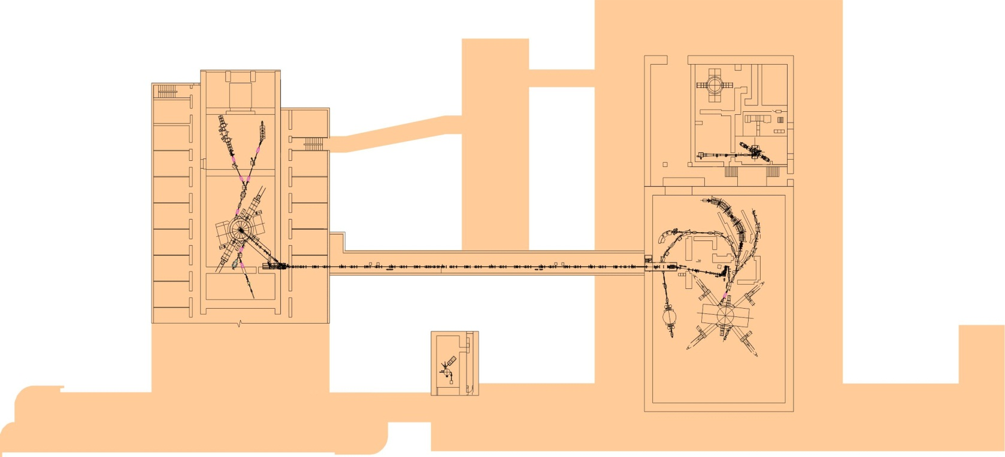

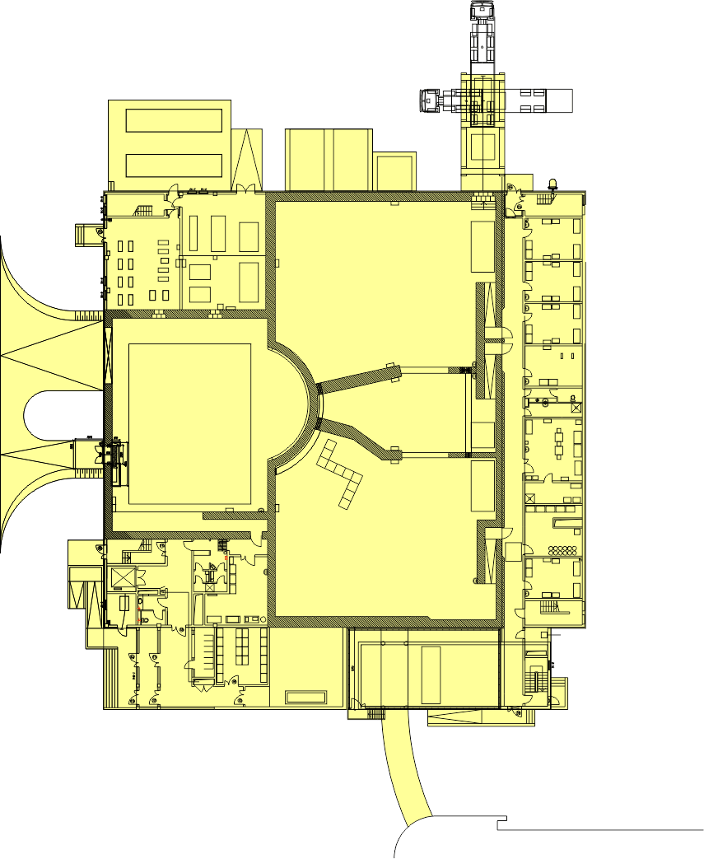
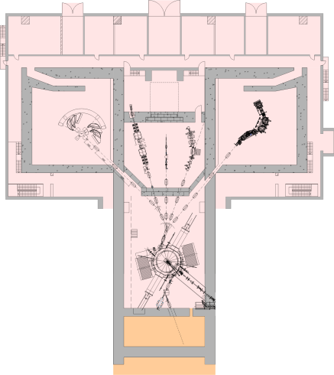
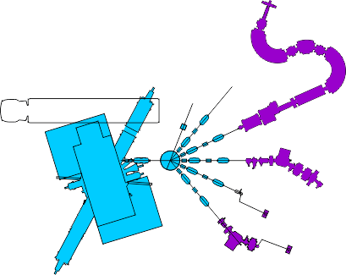

SHE factory
Study of reactions with stable
and radioactive beams
U200
Applied researches
IC100
^{1000м2}
^{1500м2}
Nano-laboratory
DRIBs
^{1500m2}
New accelerator DC-280
Upgraded U400R
U400M
&SC ECR
Synthesis of exotic nuclei and study of their properties
FLNR’s basic directions of research:
1. Heavy and superheavy nuclei:
synthesis and study of properties of superheavy elements;
chemistry of new elements;
fusion-fission and multi-nucleon transfer reactions;
nuclear- , mass-, & laser-spectrometry of SH nuclei.
2. Light exotic nuclei:
properties and structure of light exotic nuclei;
reactions with exotic nuclei.
3. Radiation effects and physical groundwork of nanotechnology.

Slide 3
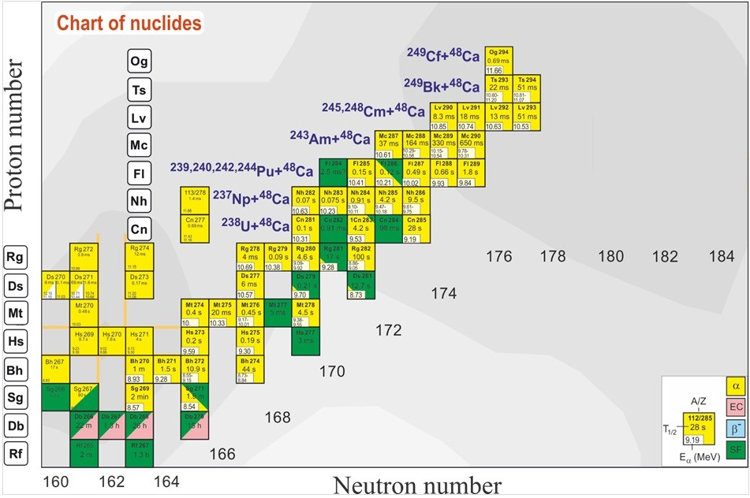
Search for superheavies
What is the next step?
Ti, Cr, Fe, Ni ?
120
Still far from the “island of stability” !!!
What is the next double magic superheavy nucleus?
Z = 114
184
“Inverse” quasifission
can be used to produce
new neutron-rich
SHE
Notes:
50 years ago The existence of island of stability in the region of nuclei with Z = 114 and N = 184 was predicted theoretically [A. Sobiczewski, F. A. Gareev, and B. N. Kalinkin, Phys. Lett. 22, 500 (1966)]
That caused the experimental investigations in the field of the superheavy element (SHE) synthesis.
Nowadays more than 30 isotopes of superheavy elements with Z = 108-118 have been synthesized both in cold an hot fusion reactions
In the Flerov Laboratory of Nuclear Reactions a great success was achieved in the synthesis of superheavy elements in hot fusion reactions of ⁴⁸Ca ions with actinide target nuclei.
Unfortunately, nuclei with Z > 118 cannot be synthesized in ⁴⁸Ca-induced reactions since ²⁴⁹Cf is the heaviest target material available for these purposes.
One of the possible pathways to synthesize new isotopes of superheavy elements with Z = 118 -126 is the reactions of actinide targets with Ti, Cr, Fe and Ni ions.
The interest in damped collisions of heavy nuclei is conditioned by the necessity to find new ways to produce neutron-rich superheavy elements (SHE). Few years ago the inverse (antisymmetrizing) quasifission (QF) process, was proposed to produce SHE in the collisions of transactinides [1]. The low-energy damped collisions of intermediate mass nuclei are less difficult for experimental study than the reactions with transactinides. One may expect that the antisymmetrizing shell effect will be similar in both cases [2].
To study the role of shell effects in inverse QF, the binary reaction channels in the reactions ^{156,160}Gd + ¹⁸⁶W at the Coulomb barrier energy have been investigated. In these reactions the projectile and target nuclei are located between the closed shells with Z = 50, N = 82 (double magic tin) and Z = 82, N = 126 (double magic lead) which should play a significant role in the nucleon transfer process. To form lead-like fragment the projectile nucleus has to transfer about 22 nucleons to the target.

Slide 4
Cross sections of symmetric fragment formations
For 4n channel (E*=40÷50MeV):
⁴⁸Ca+²³⁸U→⁴⁸Ca+²⁴⁴Pu
σ(A_{CN}/2±20) drops ∼2 times
⁴⁸Ca+²³⁸U→⁴⁸Ti+²³⁸U
σ(A_{CN}/2±20) drops ∼10 times
For 3n channel (E*=30÷40MeV):
⁴⁸Ca+²³⁸U→⁴⁸Ca+²⁴⁴Pu
σ(A_{CN}/2±20) drops ∼10 times
⁴⁸Ca+²³⁸U→⁴⁸Ti+²³⁸U
σ(A_{CN}/2±20) drops ∼100 times
3n
4n
For the studied reactions the excitation energies at the barrier energy vary strongly ( 36MeV for the Ca+Pu, 44MeV for the Ti+U and 41MeV for the Cr+Th). It leads to decrease of CS in the case of Ti+U and Cr+Th for 3n ER channel.

Slide 5
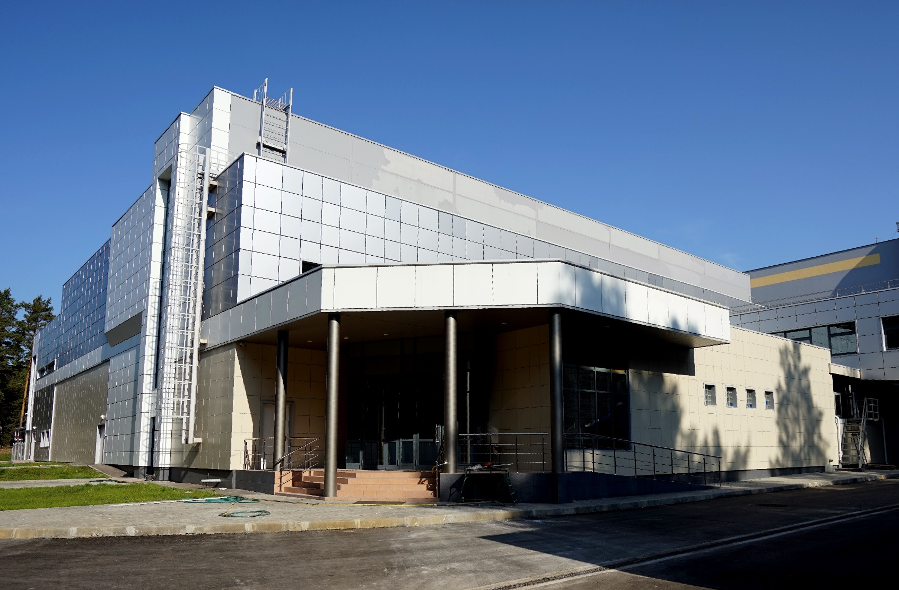
Superheavy Element Factory

Slide 6
FLNR main tasks for 2017–2023
Commissioning and development of "SHE Factory" based on DC280 cyclotron:
smoothly variable energy;
beam intensity ~10 pµA for nuclei with А~50;
new set-ups;
infrastructure for accommodation of user setups.
Modernization of the U400M cyclotron (2020-2021):
new main magnet coils, vacuum, diagnostics and radiation safety control systems;
increasing beam intensities and energies.
Reconstruction of the U400 to U400R cyclotron complex (2020-2023):
new experimental hall;
accelerated ions from helium to uranium;
smoothly variable energy within a wide range 0.8–25 MeV·A;
decrease the cyclotron power consumption.
Development of long-running experimental set-ups

Slide 7
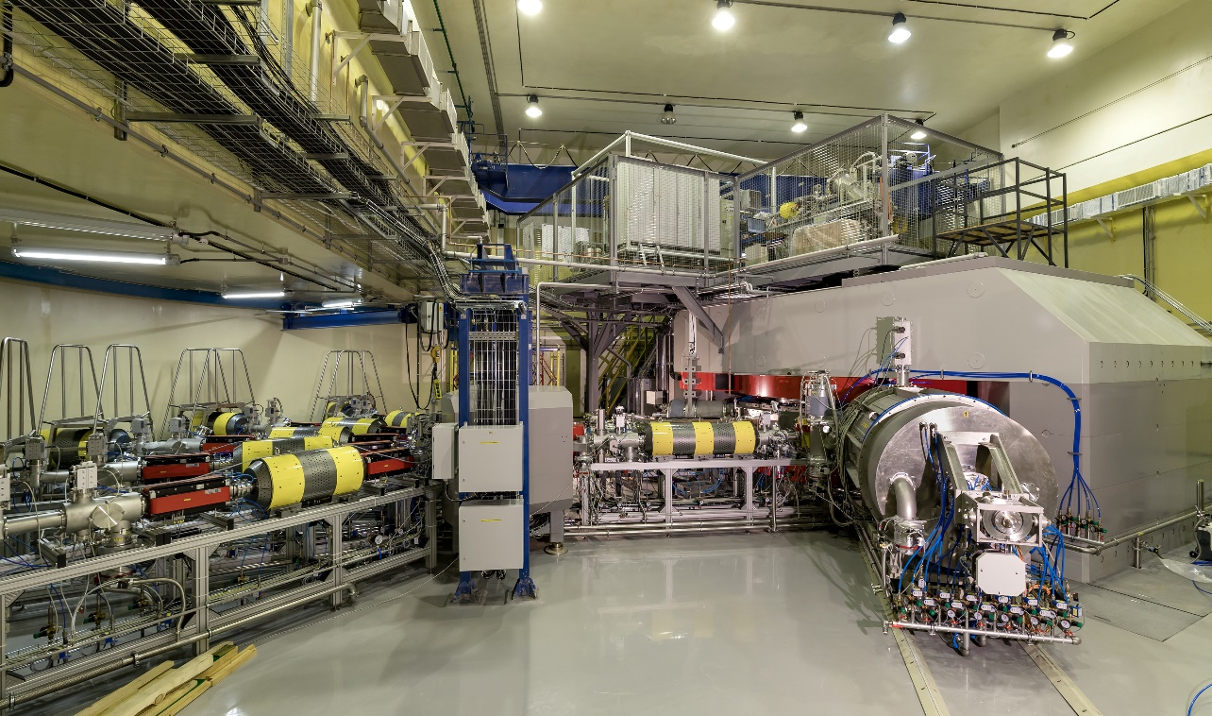
DC-280 ACCELERATOR COMPLEX
SUPERHEAVY ELEMENTS FACTORY
Beams (examples)
Ion | Ion energy [MeV/A] | Estimated output intensity [pps]
⁷Li | 4 | 1×10¹⁴
¹⁸O | 8 | 1×10¹⁴
⁴⁰Ar | 6 | 6×10¹³
⁴⁸Ca | 6 | (6-12)×10¹³
⁵⁴Cr | 6 | 2×10¹³
⁵⁸Fe | 6 | 1×10¹³
¹²⁴Sn | 6 | 2×10¹²
¹³⁶Xe | 6 | 1×10¹⁴
²³⁸U | 7 | 5×10¹⁰
Main parameters
Range of energies | 4÷8 MeV/A
K factor max. | 280
Pole diameter | 4 m
Magnet weight | 1000 t
Magnet power | 300 kW
Vacuum | 10⁻⁷ Torr
Tasks:
Experiments at the extremely low (σ<100 fb) cross sections:
Synthesis of new SHE in reactions with ⁵⁰Ti, ⁵⁴Cr ...;
Synthesis of new isotopes of SHE;
Search for rare decay modes of SHE;
Study of excitation functions.
Experiments requiring high statistics:
Nuclear spectroscopy of SHE;
Precise mass measurements;
Study of chemical properties of SHE.
Main setups:
Gas-filled recoil separator (DGFRS-II);
Gas-filled recoil separator (DGFRS-III) for spectroscopy and chemical studies;
Mass Analyzer of SuperHeavy Atoms (MASHA) – from U-400M
Channels reserved for external users
Notes:
7
Beam intensity of Ca-48 up to 2.5 mkA
Ion energy variation on the target with factor 5
Cyclotron average magnetic field from 1.8 up to 0.8 T

Slide 8
Main parameters of the DC-280
parameters | design | Reached for today
Ion source | DECRIS-PM - 14 GHz on the HV platform (U_{max}=60kV )
Injecting beam potential | Up to 80 keV/Z | 38,04 – 72,89 kV
A/Z | 4÷7.5 | 4,44 (⁴⁰Ar⁺⁷) – 6,86 (⁴⁸Ca⁺⁷)
Energy | 4÷8 MeV/n | 4,01 – 7 MeV/n
Ion (from DECRIS-PM) | 4-136 | 12 (¹²C⁺²) – 84 (⁸⁴Kr⁺¹⁴)
Intensity (A~50) | >10 pµA | 10,43 pµA (⁴⁰Ar⁺⁷), 5,2 pµA (⁴⁸Ca⁺⁷)
Magnetic field level | 0.6÷1.3 T | 0.8÷1.23 T
K factor | 280
Dee voltage | 2x130 kV | 2x130 kV
Power of RF generator | 2x30 kW
Flat-top dee voltage | 2x13 kV | ---
Power of Flat-top generator | 2x2 kW
Emittance | less than 30 π mm·mrad
Accelerator effectivity | >50% | 51,9 % (⁴⁸Ca⁺¹⁰ 5 MeV/n 5 pmkA)

Slide 9
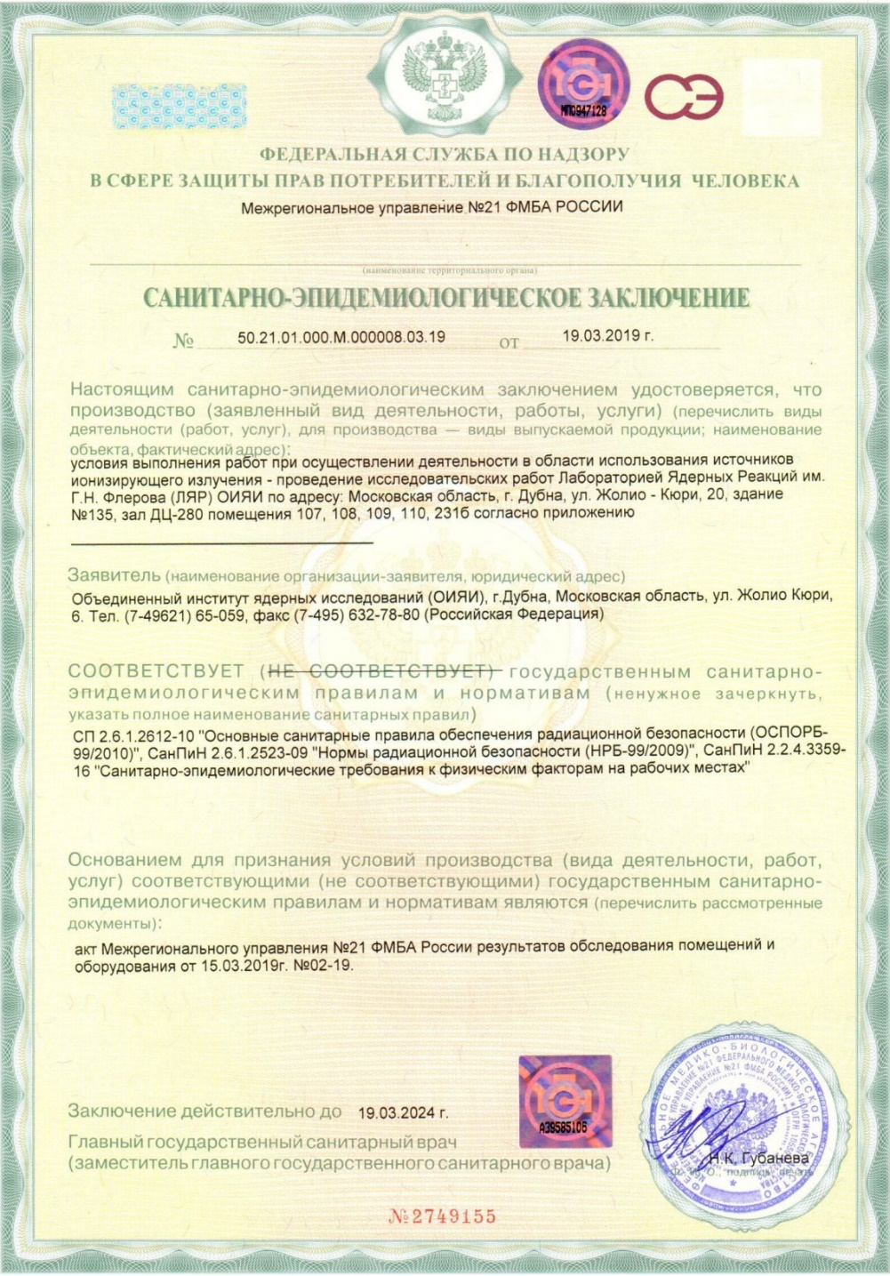
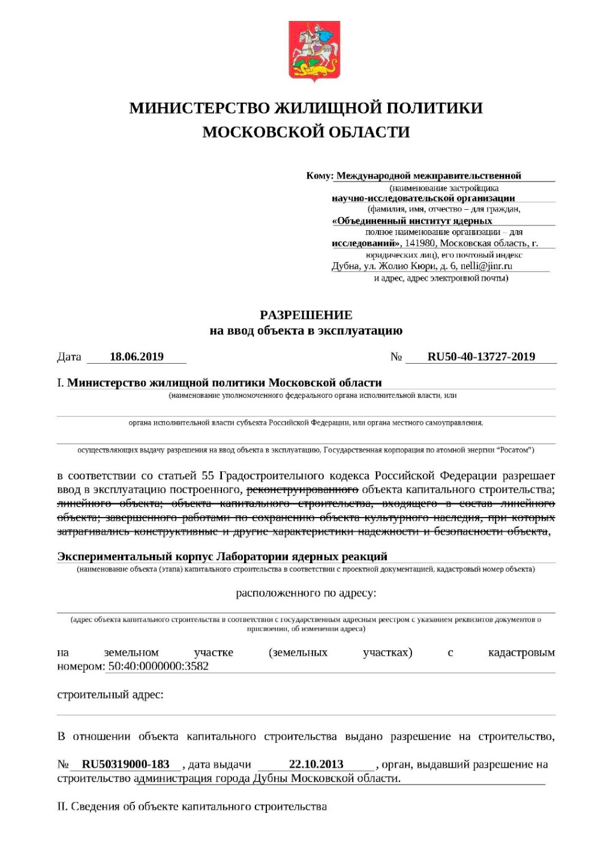
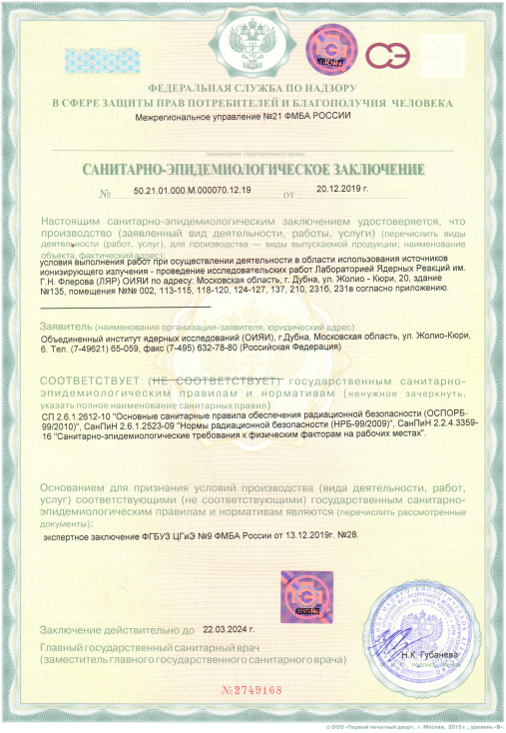
During 2019,
all necessary licenses
to operate the SHE Factory
were obtained
March 19, 2019
June 18, 2019
December 20, 2019

Slide 10
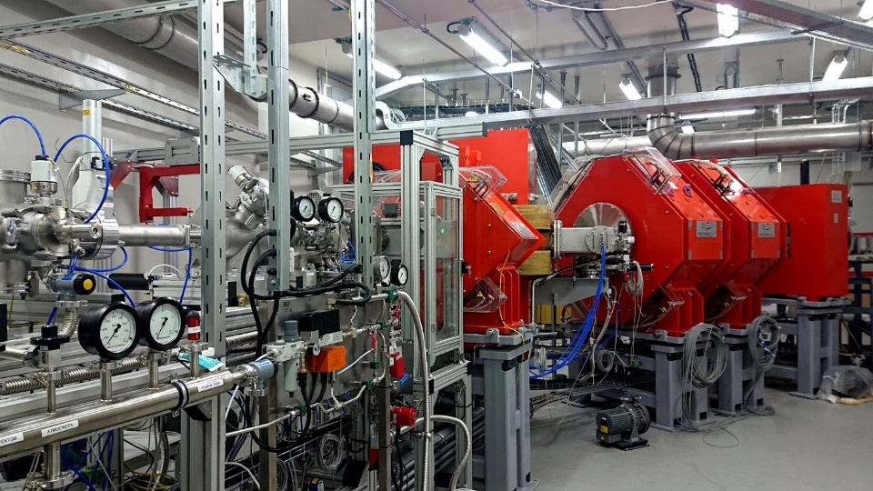
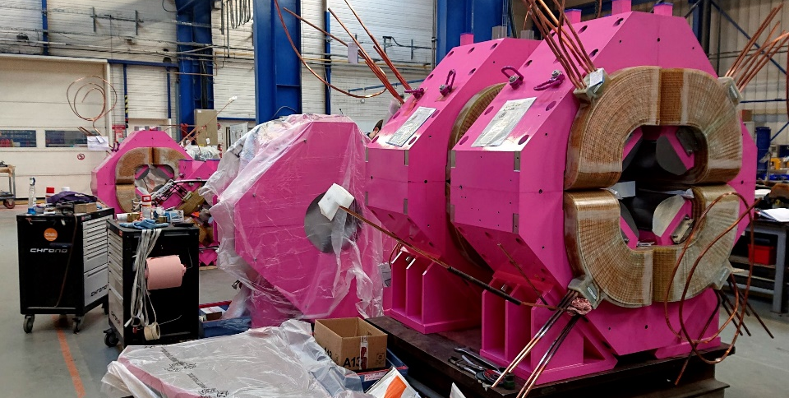
SuperHeavy Element Factory
GFRS-2
status: commissioned;
tests and tuning are in progress
purpose: synthesis of new SHE,
new isotopes of SHE, decay modes, excitation functions, etc.
GFRS-3
status: manufactured,
delivery to Dubna is expected by the end of 2019;
assembling - 2020
purpose: decay spectroscopy; chemistry of SHE
Long-term plans:
Specialized radiochemical complex of the 1st class
ECR ion source on 28 GHz
Development of experimental set-ups

Slide 11
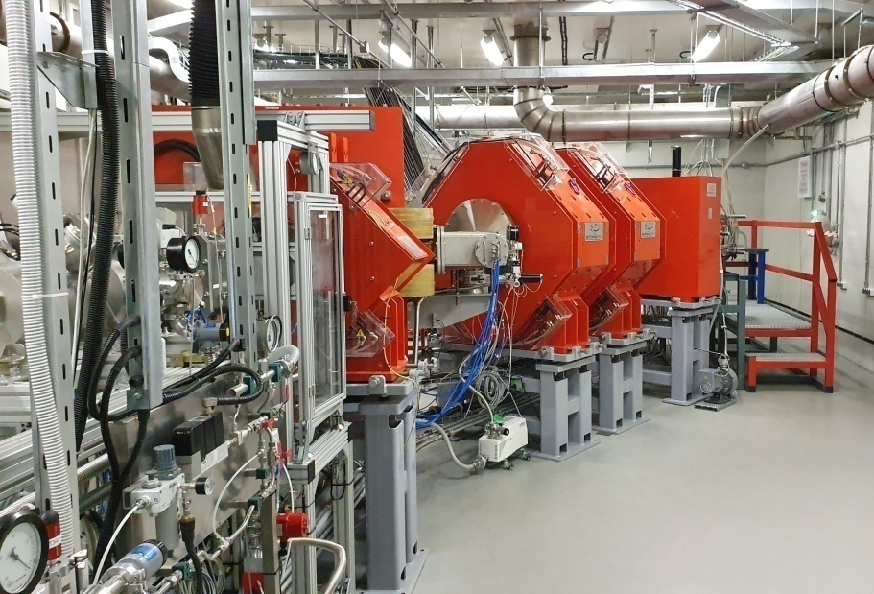
Test reactions:
^{nat}Yb+⁴⁰Ar→²⁰⁷⁻²¹²Ra, ¹⁷⁰Er+⁴⁸Ca →^{214,215}Ra, ^{nat}Yb,¹⁷⁴Yb+⁴⁸Ca →^{216,217}Th (done)
²⁰⁶Pb+⁴⁸Ca →²⁵²No (at present)
Purposes:
Adjustment of optical elements
Transmission
Image size on detector
Dispersion
Background
Optimal gas pressure
Systematics of charge states
Target stability vs. beam intensity
Yield vs. target thickness
Test of digital and analog
Data acquisition systems
Separator GFRS-2

Slide 12
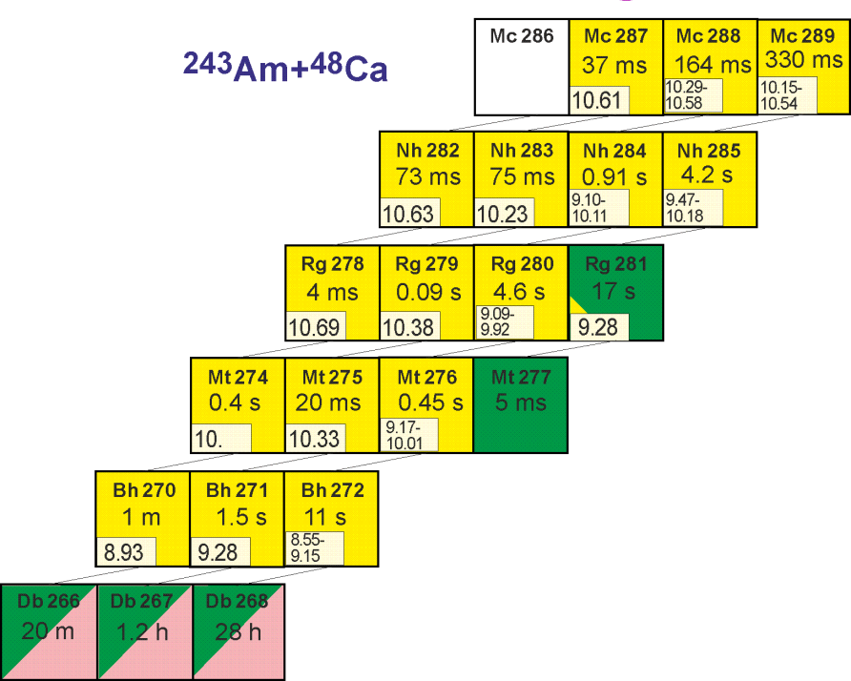
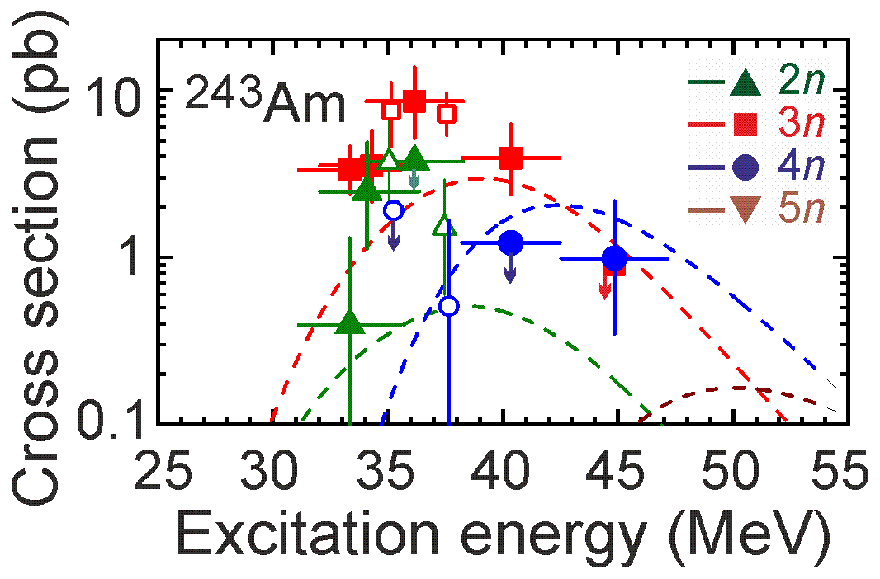
First experiment at SHE Factory: ²⁴³Am+⁴⁸Ca reaction
Americium target is ready
will be started in March
Cross section ≈10 pb
σ=8.5 pb, h_{t}=0.5 mg/cm², ε_{coll}=0.6, I_{beam}=5 pmA → ≈17/day
Scientific purposes:
Excitation function for the 2n-evaporation channel
- Observation of a decay of ²⁸¹Rg
Excitation function for the 3n-evaporation channel
- Two decay times of ²⁷⁶Mt
- Level of cross section for the pxn channel
- Level of EC branch for ²⁸⁸Mc and ²⁸⁴Nh
5n-evaporation channel: new isotope ²⁸⁶Mc, cross section
Technical purposes:
Transmission
Image size on detector
Background
Systematics of charge states
Test of digital and analog data acquisition systems

Slide 13
Running time of the FLNR accelerators in 2017-2019
Accelerator | DC-280 | U-400 | U-400M | IC-100 | МТ-25 | Σ
Operation time (2017) | - | 6546 | 5967 | 3317 | 827 | 16657 hours
Operation time (2018) | - | 6474 | 5863 | 3180 | 1387 | 16904 hours
Operation time (2019) | 3377 | 5867 | 6755 | 3092 | 1019 | 20110 hours

Slide 14
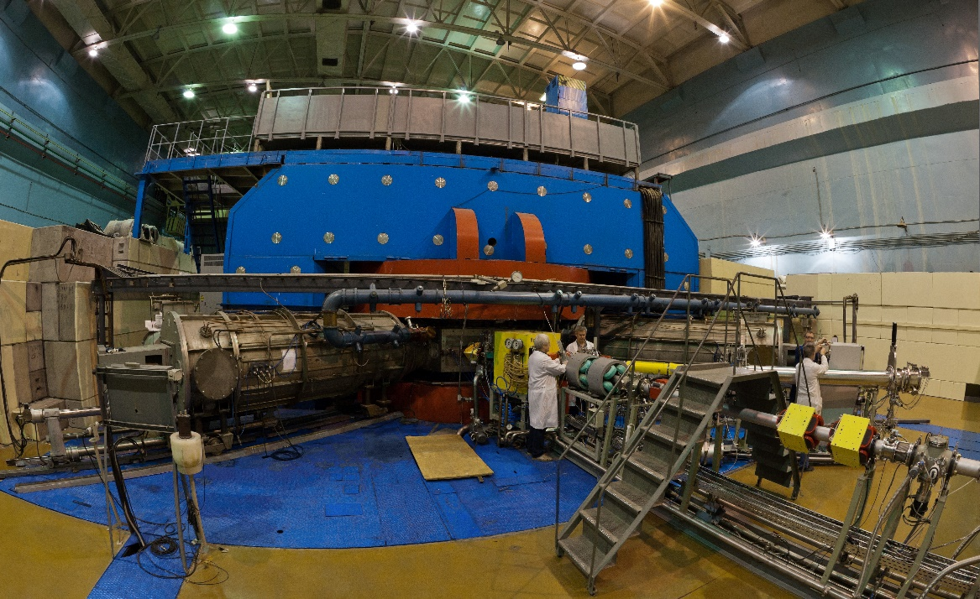
U-400M ACCELERATOR COMPLEX
EXPERIMENTS WITH RADIOACTIVE ION BEAMS
Beams (examples)
Ion | Ion energies [MeV/A] | Output intensity [pps]
⁶Li | 46 | 5×10¹³
⁷Li | 35 | 6×10¹³
¹¹В | 32 | 3×10¹³
¹²С | 47 | 2×10¹³
¹⁵N | 50 | 1×10¹³
¹⁸O | 33 | 1×10¹³
²⁰Ne | 53 | 2×10¹²
³²S | 53 | 1×10¹²
⁴⁰Ar | 40 | 1×10¹²
⁸⁴Kr | 27 | 2×10¹⁰
¹³²Xe | 25 | 1×10⁹
Main parameters
Energy range | 5÷10 & 25÷55 MeV/A
K factor max. | 550
Pole diameter | 4 m
Magnet weight | 2300 t
Magnet power | 1000 kW
Vacuum | 10⁻⁷ Torr
Commissioned: 1991
Modernized: 1996
Reconstruction: 2020-2021 (plan)
Tasks:
Stand-alone mode:
Properties and structure of light exotic nuclei
Reactions with exotic nuclei
Decay properties of nuclei at drip lines
Mass & laser spectroscopy of heavy nuclei
Applied research
Driving accelerator mode:
Production of beams of radioactive nuclei (U-400M → U-400)
Notes:
14
Beam intensity of Ca-48 up to 2.5 mkA
Ion energy variation on the target with factor 5
Cyclotron average magnetic field from 1.8 up to 0.8 T

Slide 15
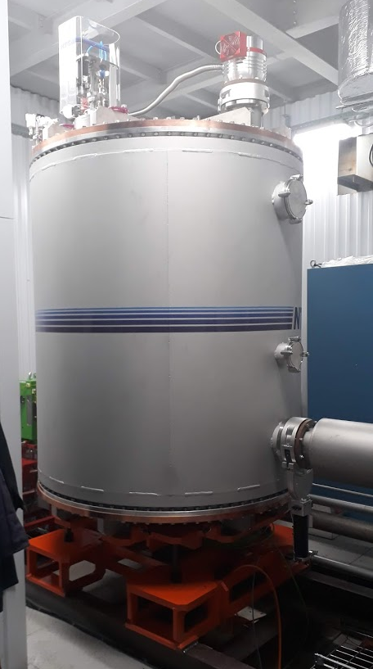
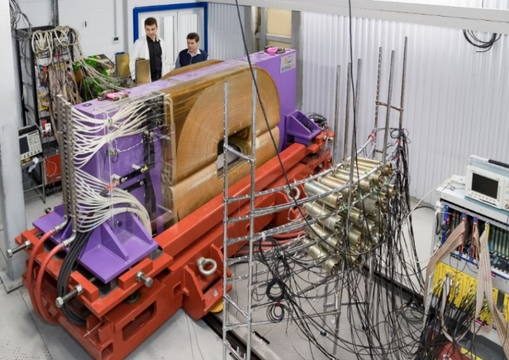
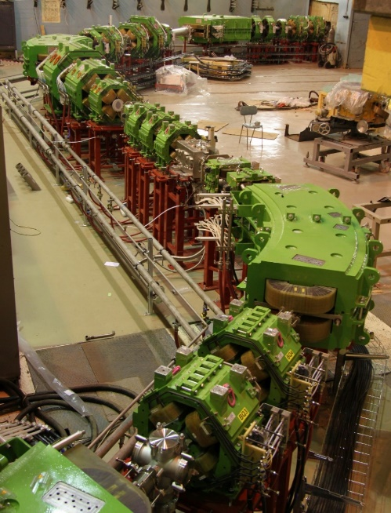
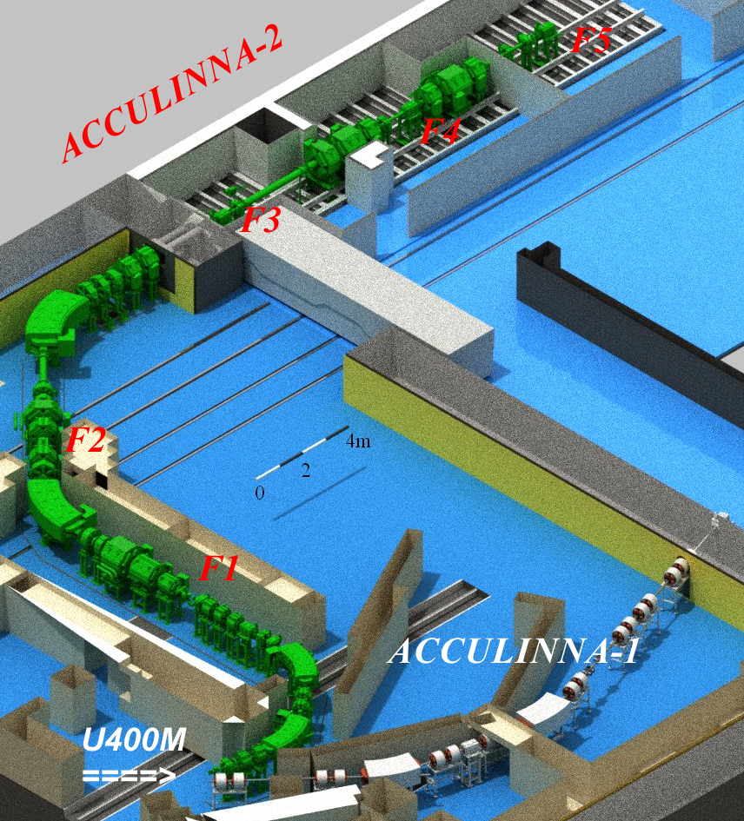
FRAGMENT SEPARATOR ACCULINNA-II
Experiments with radioactive beams
RIB* | Intensity, pps (at 1 pμA) | Energy, MeV/A
⁶He | 4x10⁷ | 22
⁶He | 1x10⁷ | 13
⁸He | 8x10⁴ | 23
¹¹Li | 7x10³ | 33
¹⁴Be | 2x10³ | 35
¹⁵B | 4x10⁵ | 32
¹⁶C | 2x10⁷ | 29
¹⁸C | 1x10⁴ | 25
²⁴O | 2x10³ | 23
⁸B | 2x10⁶ | 16
¹³O | 1x10⁶ | 24
¹⁷Ne | 2x10⁶ | 30
²⁴Si | 7x10³ | 12
²⁸S | 1x10³ | 38
2019: RF kicker
2021: Cryogenic target system (hydrogen, tritium, deuterium): under development (Sarov)
2021: Completion of modernization of the U-400M cyclotron
Continuously: Development of detectors for charged and neutral particles (optical TPC, neutron wall, scintillator arrays, Si-telescopes, active target, HPGe array)
http://aculina.jinr.ru/acc-2.php

Slide 16

December 2017: first experiment @ ACCULINNA-2 fragment separator
⁶He+d (elastic and inelastic scattering in a wide angular range)
⁹Li
⁸Li
2x10⁵ ⁶He/s @ 0.1 pμA
Δp/p = 3%
P ~ 75 %
E ~ 38 AMeV
⁶He
³H

Slide 17
⁸He(d,³He)⁷H – flagship experiment at ACCULINNA-2 fragment separator
Bezbakh A.A. et al., Evidence for the first excited state of ⁷H, PRL 124 (2020) 022502.

Slide 18
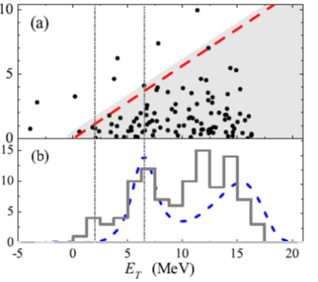
⁸He(d,³He)⁷H – Summary
Missing mass spectrum of ⁷H for the ⁸He(d,³He)⁷H reaction at 26 AMeV obtained in coincidence with tritons (E_{t} > 65 MeV).
Blue dashed curve corresponds the t+4n five body phase volume. It peaks at 6.5 MeV.
Events/1.25 MeV E_3H (MeV
3/2+;5/2+
⁷H_{g.s.}
ΔE ~ 1.1 MeV
Systematics of the lowest excited states for the isotones with closed p_{3/2} neutron subshell.
Conclusions:
i) Indications for the ⁷H g.s. at 1.8(5) MeV
ii) For the first time the ⁷H excited state is observed at E_{T} ~ 6.5(5) MeV, Г ~ 2.0(5) MeV
iii) Quite a low population cross section of ~10 µb/sr was obtained for ⁷H g.s.

Slide 19
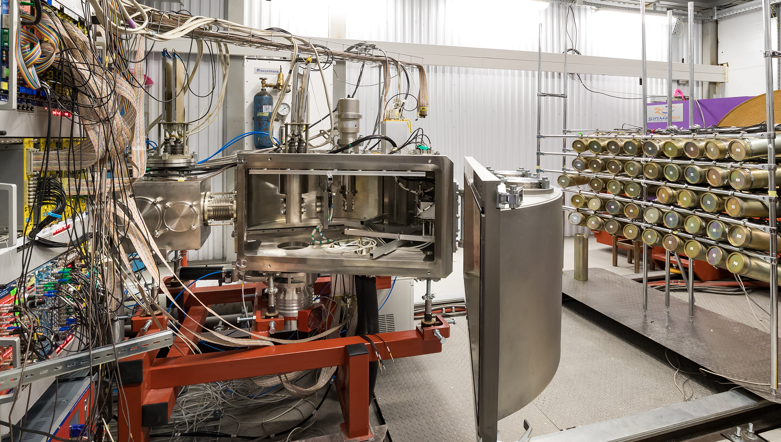
⁹Li(d,p)¹⁰Li → n+⁹Li
Low-lying states of ¹⁰Li populated in the reaction d(⁹Li,p)¹⁰Li → n + ⁹Li were studied.
Proton is registered in coincidence with ⁹Li and neutrons.
Experimental energy resolution was ~ 250 keV (FWHM).
The method is very promising for the study ^{7,9}He, ¹⁰⁻¹²Li and others systems.
Neutron array (44 modules)
stilbene 80 mm x 50 mm +
PMT ETE-9822B
ToF detector
Exit window (steel 180 μ)
D₂ target
DSSD
MWPC
Bezbakh A.A. et al., submitted to Bulletin of the Russian Academy of Sciences: Physics (2020).

Slide 20
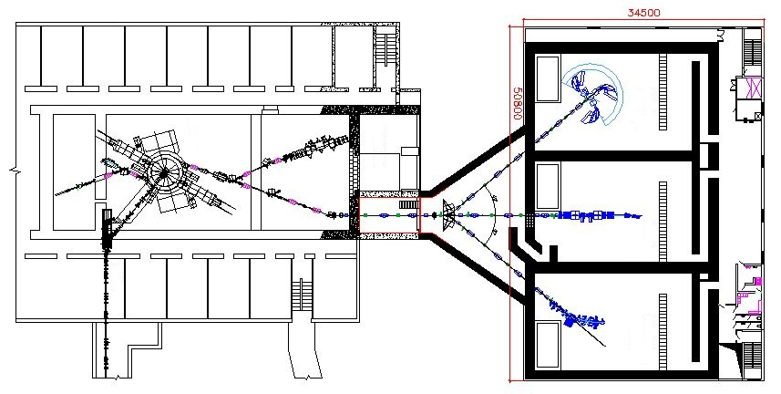
U400R: facility for nuclear reaction studies
new experimental hall
CORSET
U400R
MAVR
SHELS
STAR
GFS
GALS

Slide 21
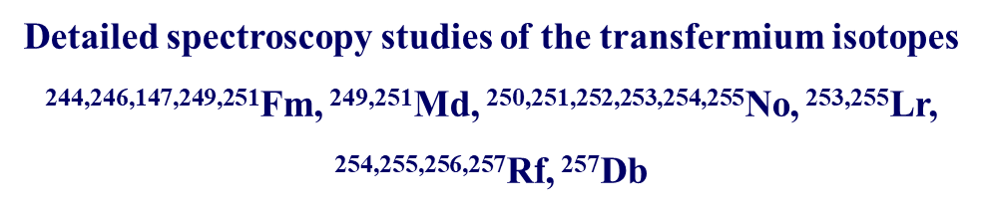
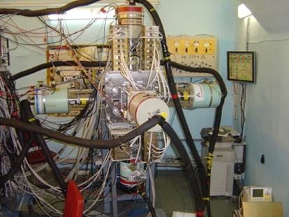
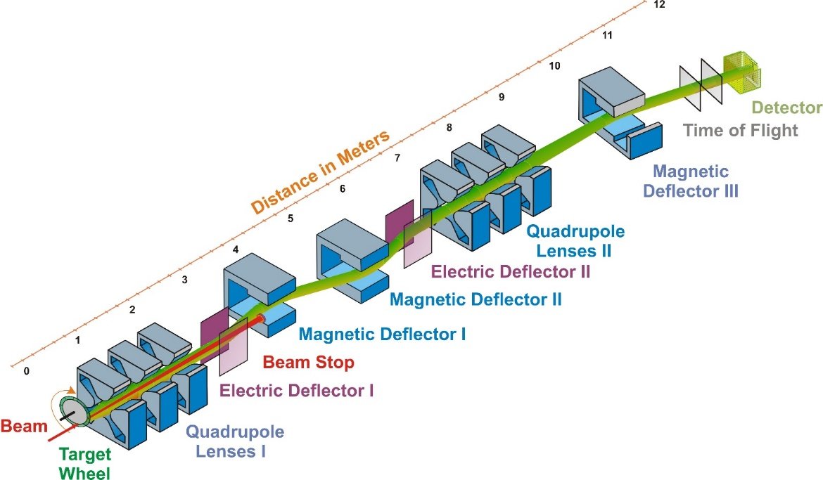
SEPARATOR FOR HEAVY ELEMENTS SPECTROSCOPY (SHELS)
E_{gamma} (keV) | Detection eff.
100 | 34 %
200 | 26 %
300 | 22 %
400 | 17 %
500 | 14 %
Reaction | Transmission efficiency
²²Ne(¹⁹⁷Au,5n)²¹⁴Ac | 0.1
⁴⁰Ar(²⁰⁸Pb,3n)²⁴⁵Fm | 0.3
⁴⁸Ca(²⁰⁸Pb,2n)²⁵⁴No | 0.35
⁵⁰Ti(²⁰⁸Pb,2n)²⁵⁶Rf | 0.4
Notes:
21
Beam intensity of Ca-48 up to 2.5 mkA
Ion energy variation on the target with factor 5
Cyclotron average magnetic field from 1.8 up to 0.8 T

Slide 22
Decay (focal plane) studies
        α-γ (CE) - decay measurements
→ transitions gs(mother) → gs (daughter) → Q-value
→ transitions gs(mother) → excs (daughter) followed by γ, CE
→ E* excited levels
→ Multipolarity of transition(s) to gs or excs
→ spin and parity assignments
→ Q-value (if gs not or weakly populated)
(→ excs (daughter) might be isomeric )
→ transitions isoms (mother) → isoms, excs, gs (daughter)
→ E* isomeric levels
→ spin and parity assignments (correlation between
life-times and spin/parity differences)
ER-γ(CE) – decay measurements
→ transitions isoms(mother) → excs, gs (mother)
→ E* isomeric levels
→ spin and parity assignments

Slide 23
Some experimental results obtained @ SHELS

Slide 24
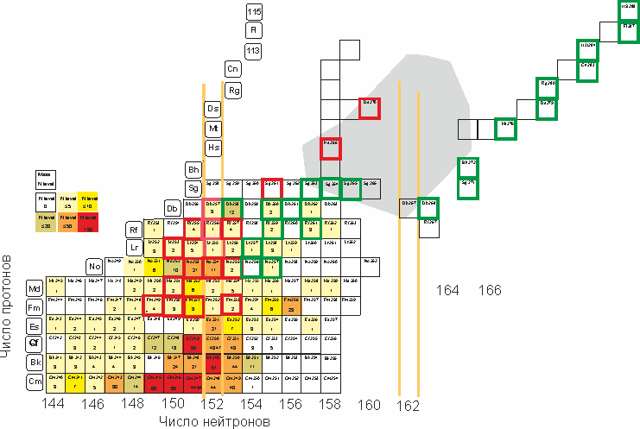
Spectroscopy of transfermium elements at Dubna: Plans

Slide 25
Fusion-quasifission competition in SH mass region
E.M.Kozulin et al., PHYSICAL REVIEW C 99, 014616 (2019)

Slide 26
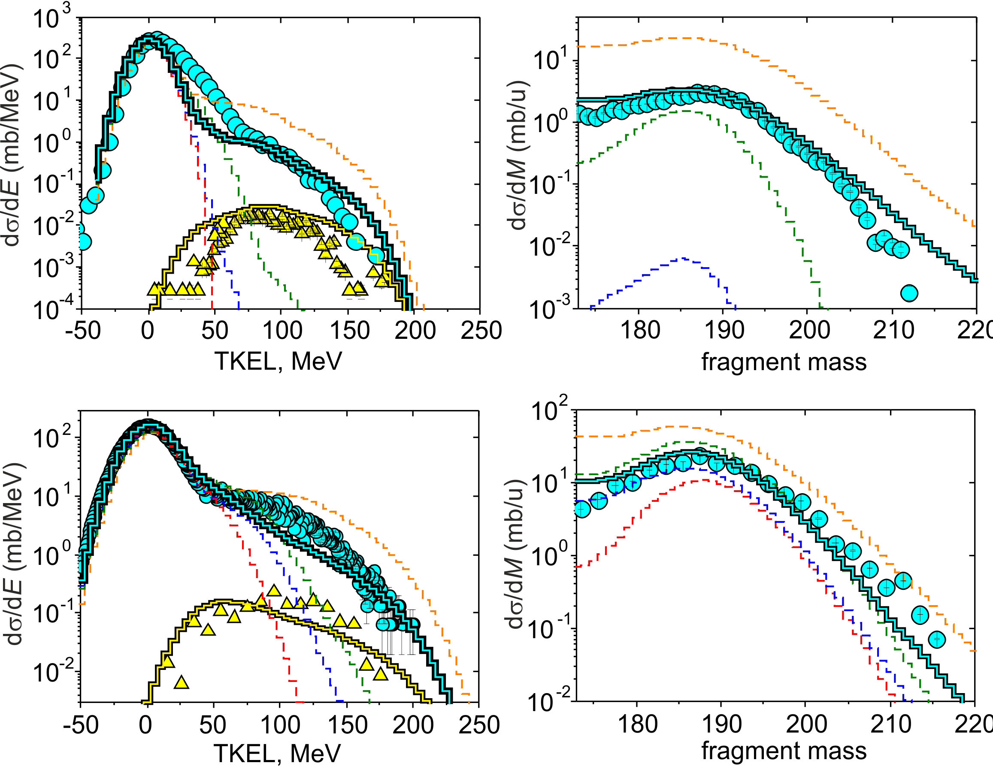
Inverse quasifission
^{156,160}Gd + ¹⁸⁶W
Orientation effects in
multinucleon transfer reactions
E.M. Kozulin et al., Phys. Rev. C96, 064621 (2017)
V.V. Saiko and A.V. Karpov, Phys. Rev. C99, 014613 (2019)

Slide 27
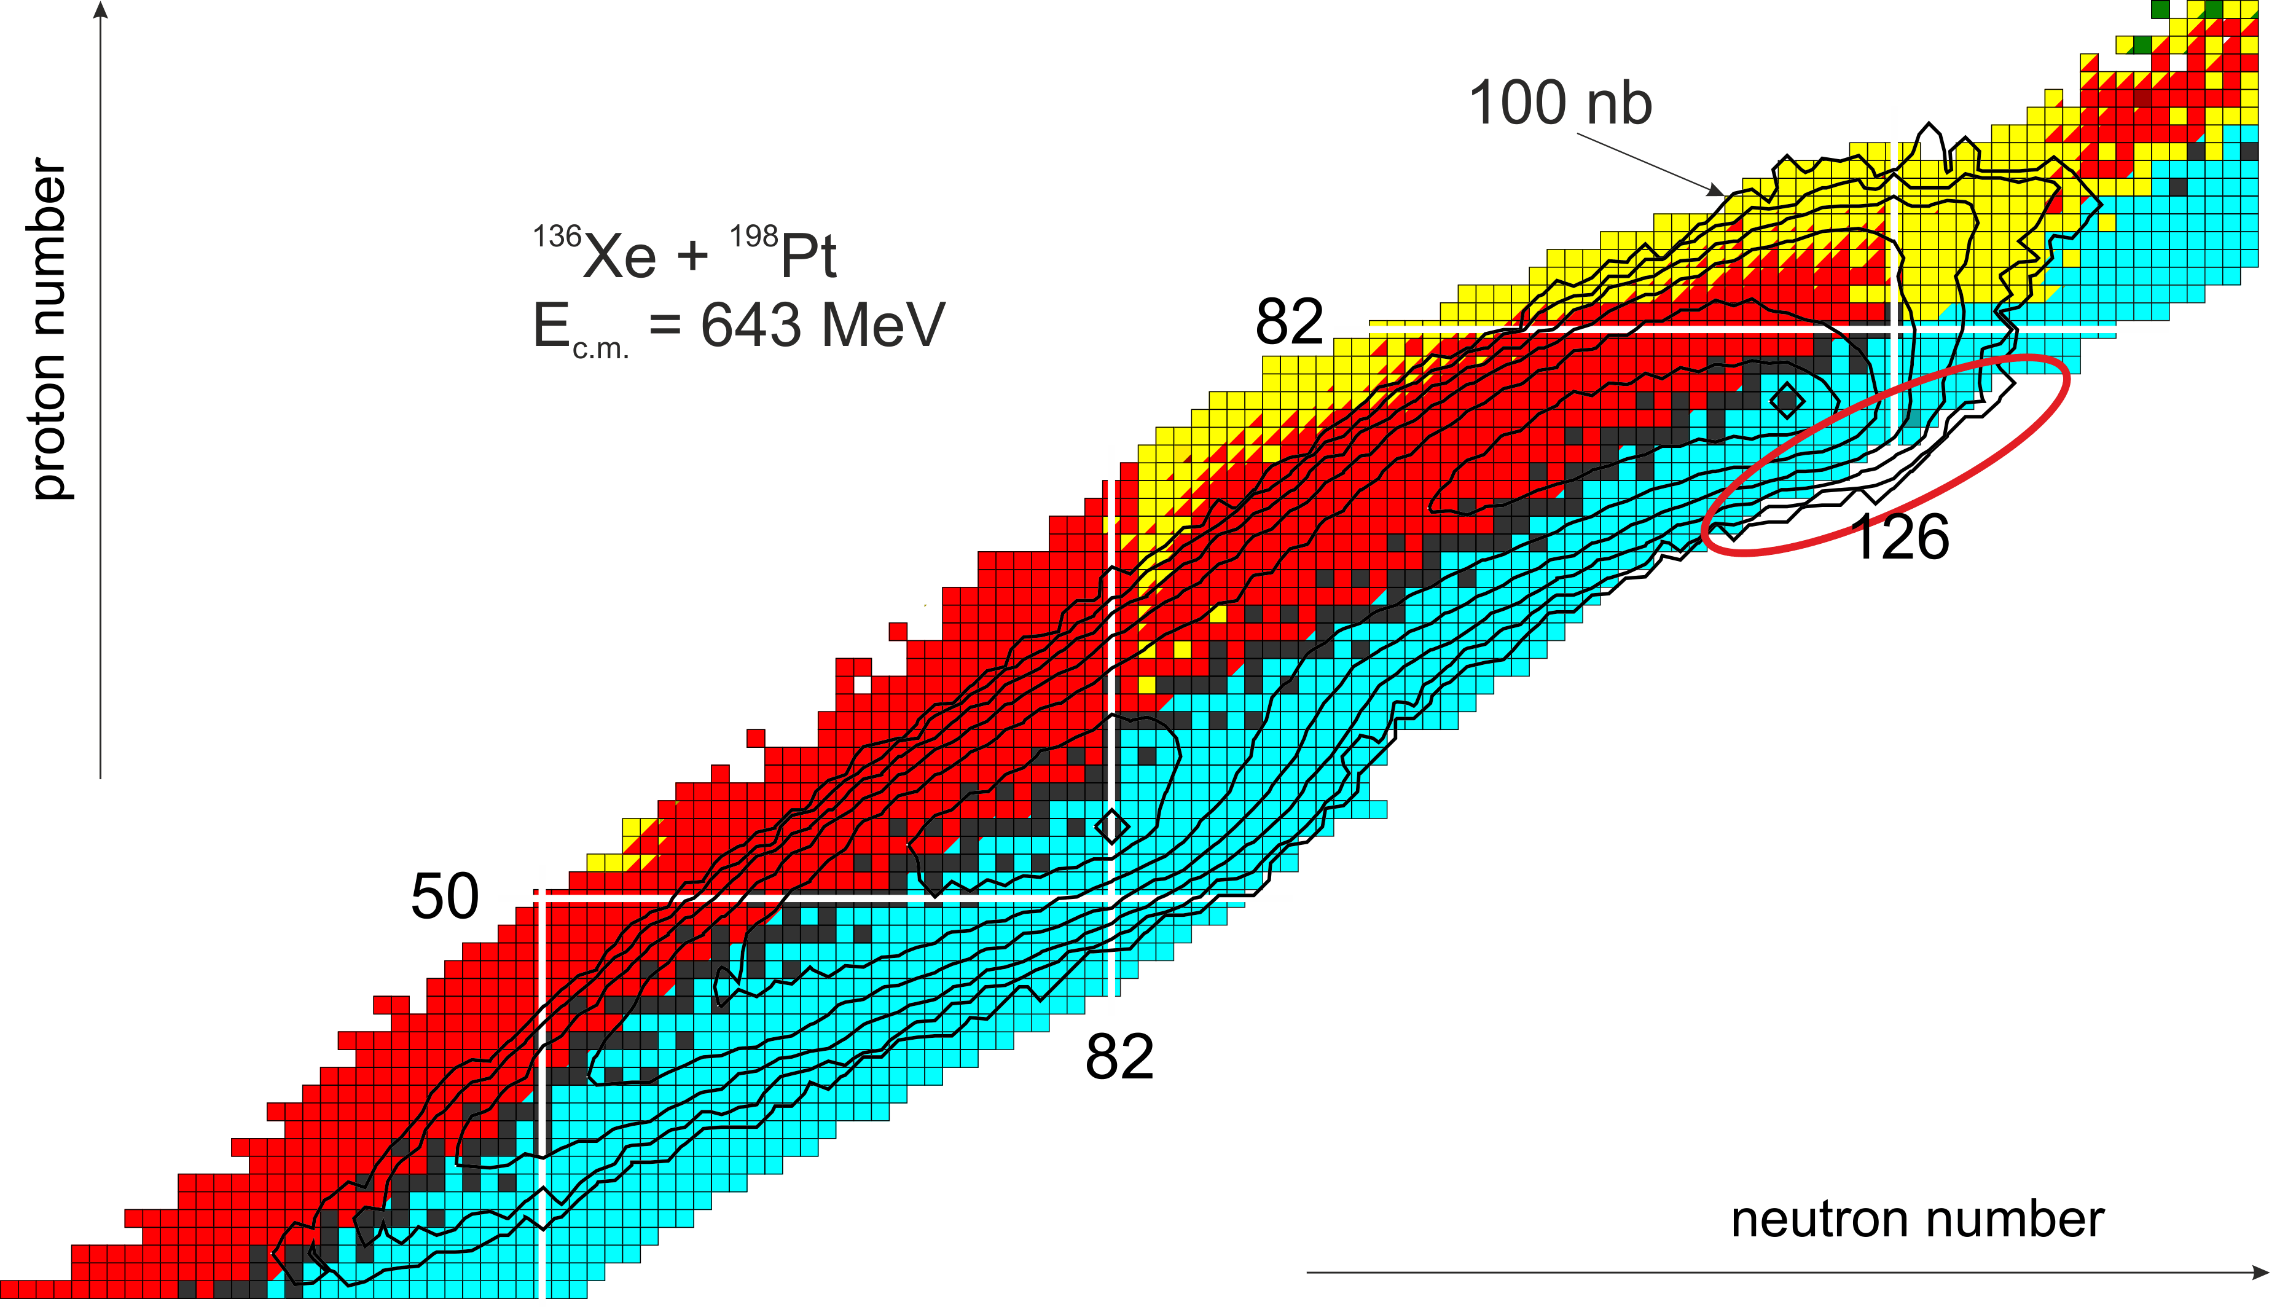
Neutron-rich nuclei in multinucleon transfer reactions
A.V. Karpov and V.V. Saiko, Phys. Rev. C 96, 024618 (2017)

Slide 28
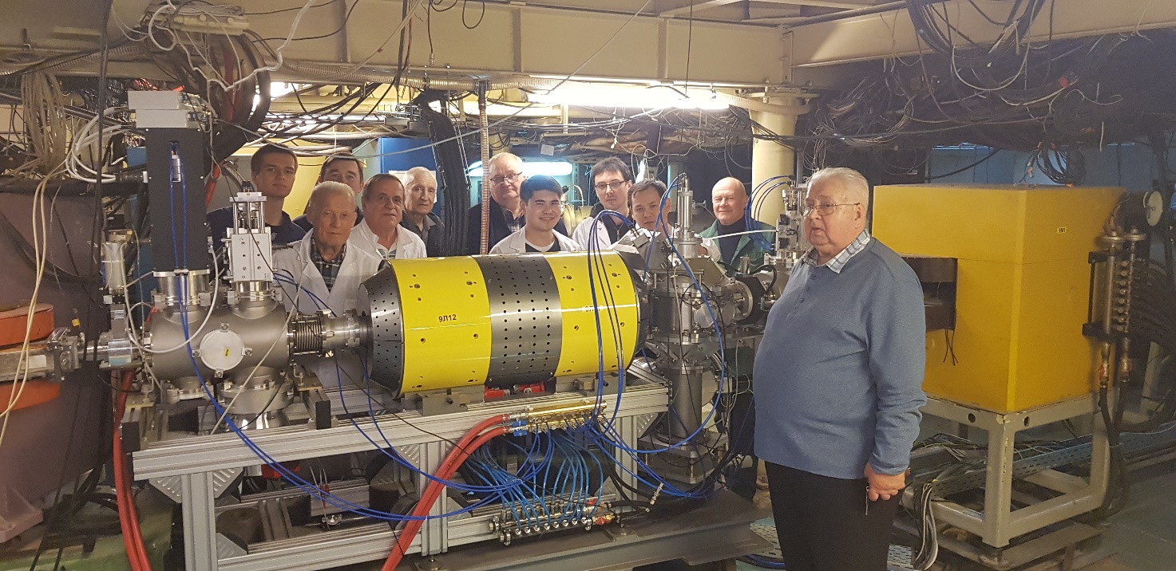
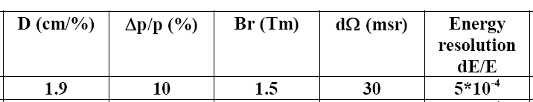
New separator Magnetic Analyzer of High Resolution MAVR: commissioning and first test experiments
Purpose of construction: separation, detection and identification of nuclear reaction products in a wide range of masses (5÷150) and charges (1÷60)
First test: December 2018:
¹⁸О+^{nat}Ta @ 179 MeV
Energy spectrum of ¹⁶C was measured
All the designed parameters were
experimentally verified
Designed parameters of MAVR
Constructed in cooperation with:
Armenia, Bulgaria, Czech Republic, Finland, Poland, and Vietnam

Slide 29
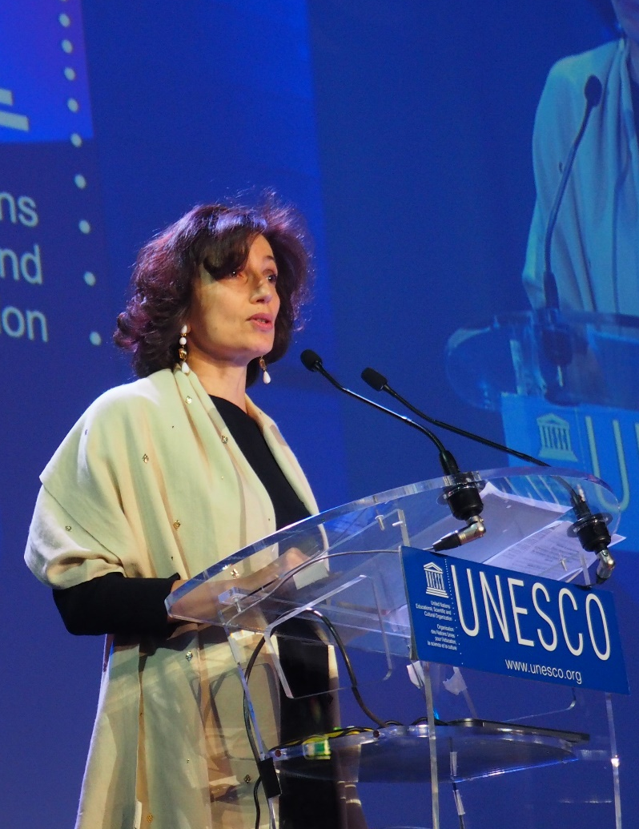
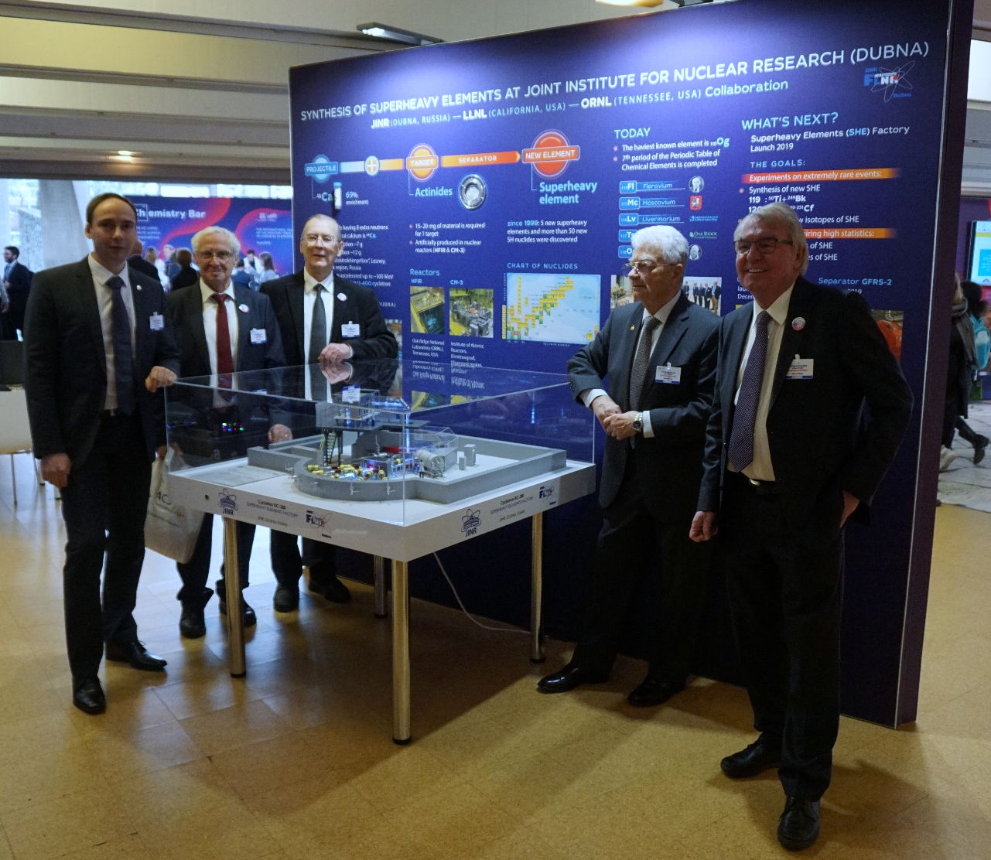
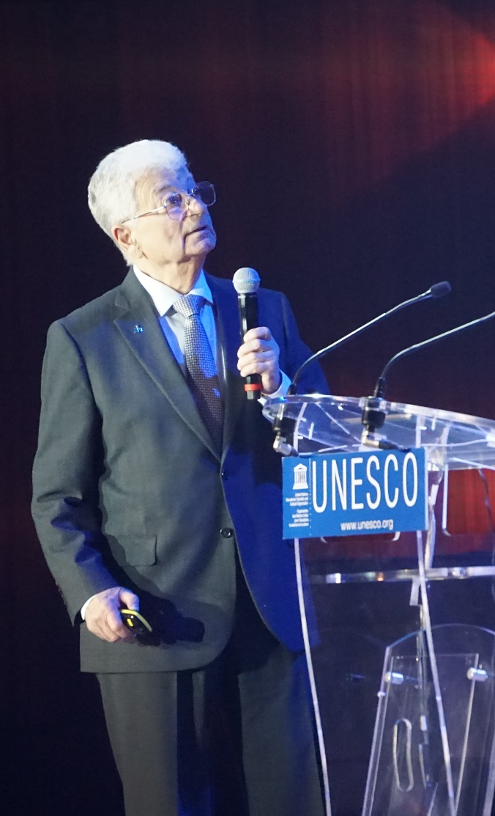

2019 – International Year of the Periodic Table of Chemical Elements (IYPT)
Opening ceremony, UNESCO, Paris
January 29, 2019

Slide 30

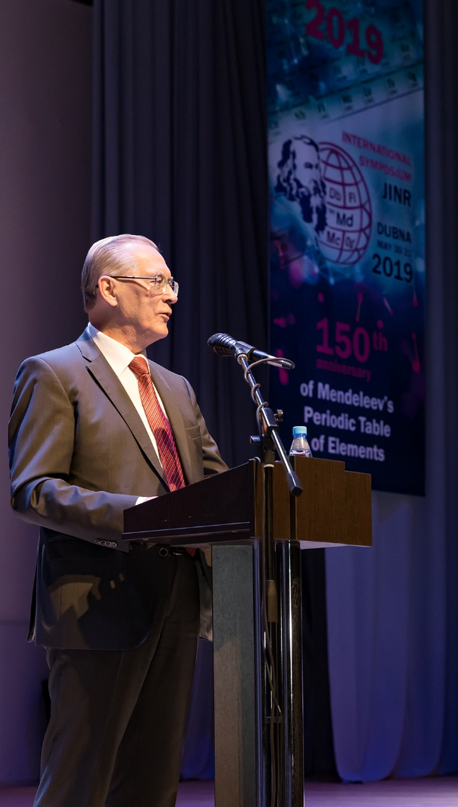
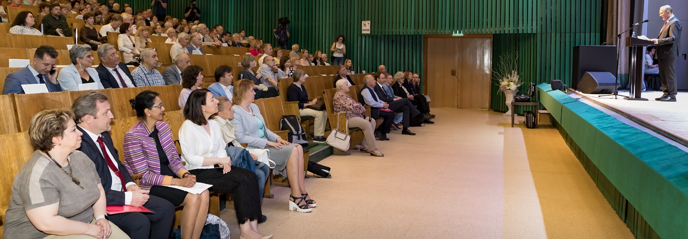

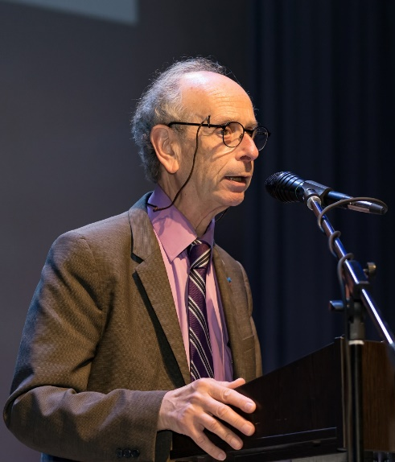
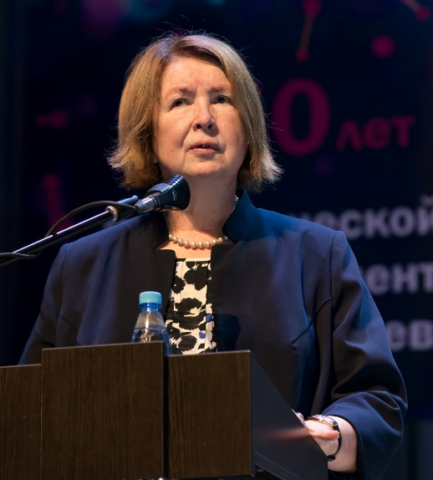
THE PRESENT AND THE FUTURE
of the Periodic Table of Chemical elements
30-31 May, JINR, Dubna

Slide 31
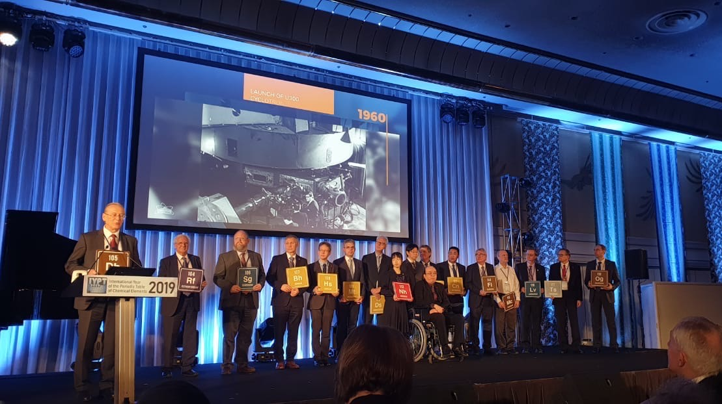
Closing Ceremony of IYPT, Tokyo, December 5, 2019

Slide 32
Neutron Nuclear Physcis
2017-2019 highlights

Slide 33
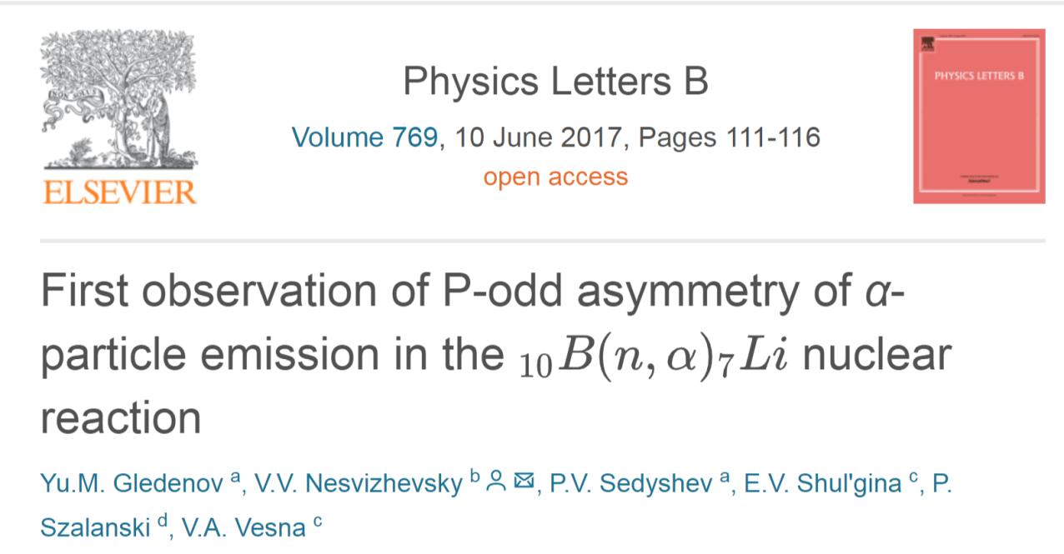
Notes:
First observation of P-odd asymmetry of α-particle emission in the 10B(n, α)7Linuclear reaction. Experimental investigation of spatial parity in reactions of polarized neutrons with light nuclei is an important topic in the framework of exploring the fundamental problem of manifestations of weak interaction in nuclear processes as well as evaluating constants of weak nucleon–nucleon (NN) potential. The precision of measurement of P-odd asymmetry in the emission of α-particles in the reaction 10B(n, α)7Li =−(11.2 ±3.4) ·10−8) is comparable with the precision of measurement of P-odd effect in the reaction 6Li(n, α)3H. The non-zero result in the reaction 10B(n, α)7Li. is obtained for the first time. 10Bis the second light nucleus, after 6Li, where P-odd effect has been observed. P-odd effect in the reaction 10B(n, α)7Lican be theoretically calculated within the cluster model; it would be of high importance to describe the considered reaction also from “first principles”.

Slide 34
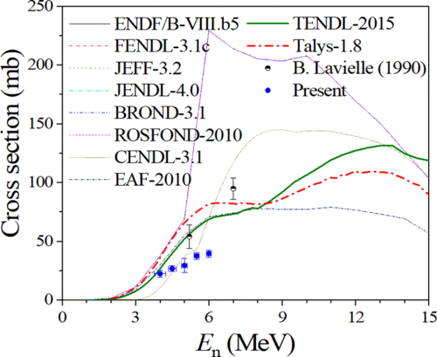
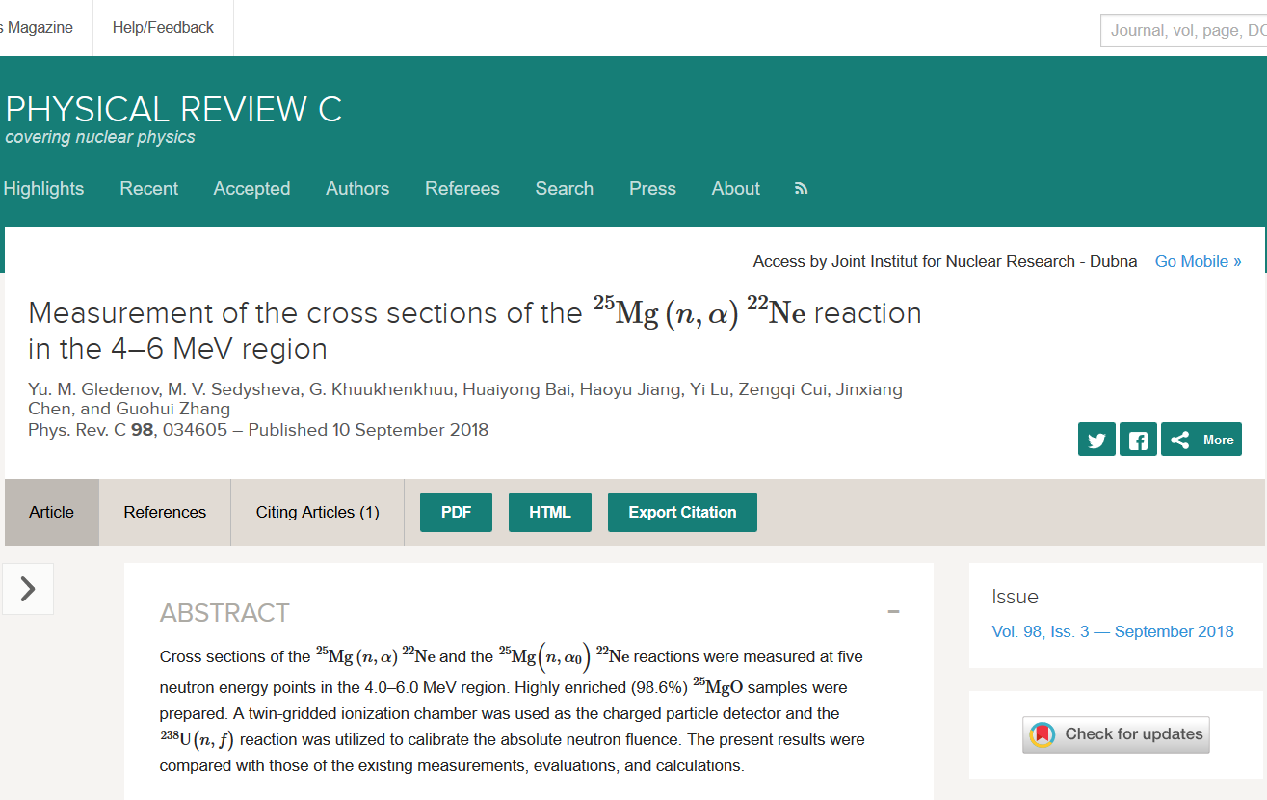
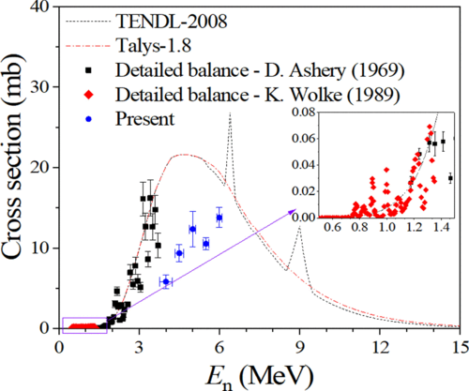
Present cross sections of the ²⁵Mg(n,α)²²Ne reaction compared with existing measurements, evaluations and talys-1.8 code calculations.
During three years t is was measured cross sections of (n,α) with fast neutrons at listed below nuclei:
¹⁴⁴Sm, ⁶⁶Zn, ¹⁰B, ²⁵Mg, ¹⁴N, ^{58, 60, 61}Ni, ^{54,56} Fe
Present cross sections of the ²⁵Mg(n,α₀)²²Ne reaction compared with existing measurements, evaluations and talys-1.8 code calculations.
Notes:
Data on the reactions with the emission of charged particles induced by fast neutrons are of much interest for studying the mechanisms of nuclear reactions and atomic nuclear structure, in choosing engineering materials for nuclear power engineering as well as for studying some astrophysical aspects. A representative example is the ²⁵Mg(n,α)²²Ne reaction. As one can see (upper graphs), up to date, only two data points in the MeV region are included in the EXFOR library, and the discrepancies among different evaluations are apparent. Present measurement were performed at the 4.5 MeV Van de Graff accelerator of Peking University. A twin-gridded ionization chamber created in FLNP JINR was used as the charged particle detector. Cross sections of the 25Mg(n,α)22Ne and the 25Mg(n,α0)22Ne reactions were measured at five neutron energy points in the 4.0–6.0 MeV region. The present results are helpful to constrain the excitation functions of the 25Mg(n,α)22Ne and the 25Mg(n,α0)22Ne reactions, and so that they are useful in the content evaluation of the 22Ne in meteoroids. According to the detailed balance principle, the present results can also provide some information about the 22Ne(α,n)25Mg reaction, which is one of the main neutron sources for the astrophysical s-process nucleosinesis. However, the present results are different from all existing evaluations both in magnitude and in tendency, which indicates that further measurements and improved evaluations are demanded.

Slide 35

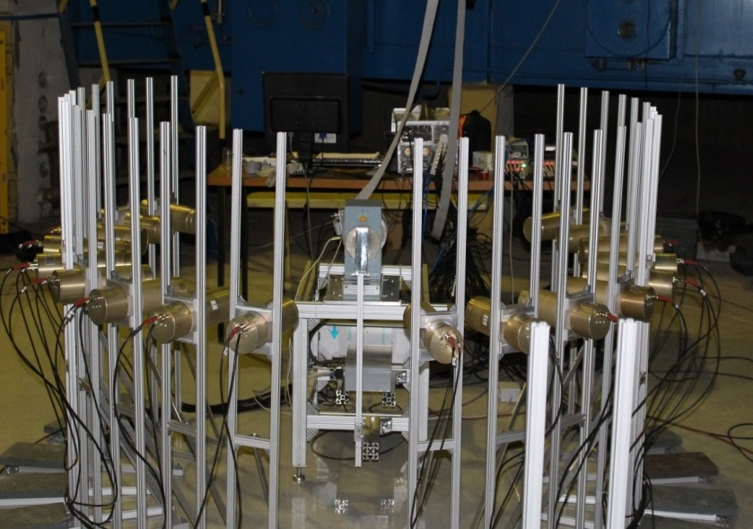
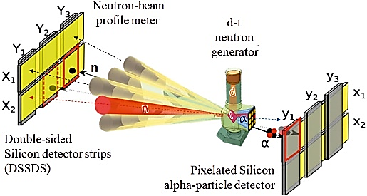
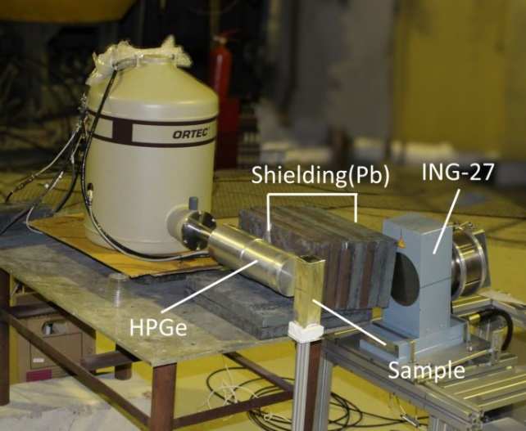
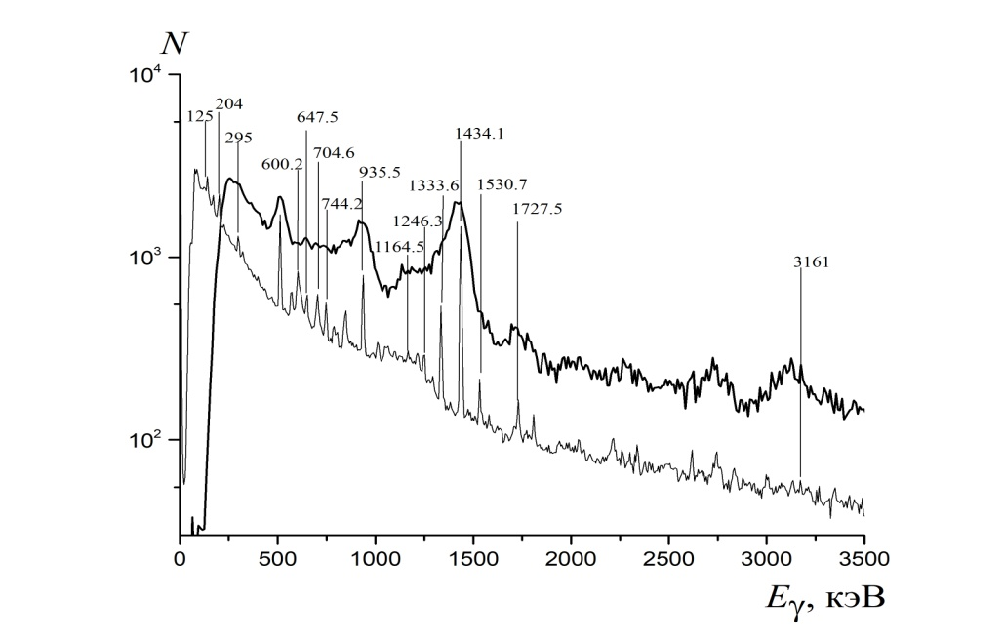
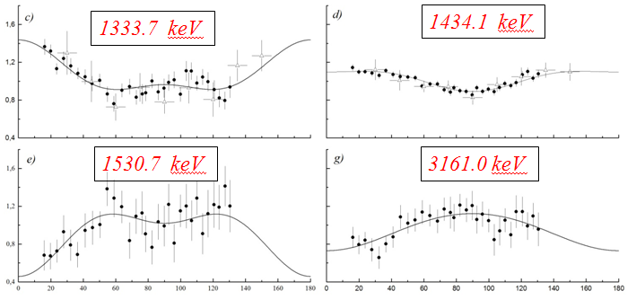
Measurements of yields and gamma rays' angular correlations in reactions with 14.1 MeV neutrons (the TANGRA project).
The tagged neutron method
Romasha Setup (18 BGO detectors)
HPGe detector Setup
d +³Н → ⁴He (3.5МeV) + n (14.1МeV)
E_{γ} (keV)
Examples of measured angular distributions for gamma transitions in chromium
Comparison of energy spectra from BGO and HPGe detectors for the chromium target
Notes:
In the framework of the TANGRA project, measurements of angular correlations and gamma-ray yields in the (n, n’γ) reaction on various nuclei using the tagged neutron method are continued.
The first figure demonstrates the principle of the tagged neutron method: 14.1 MeV neutrons are emitted in the reaction D + T → α + n and are “tagged” by the detection of accompanied α-particles. Gamma-rays from nuclear reactions of neutrons with a target are measured. Two gamma-ray detector configurations were used: 18 BGO detectors for measuring angular distributions of gamma-rays; and one high purity germanium (HPGe) detector for measuring their yields. Some examples of angular distributions and energy spectra for the chromium target are shown in the figures below.

Slide 36
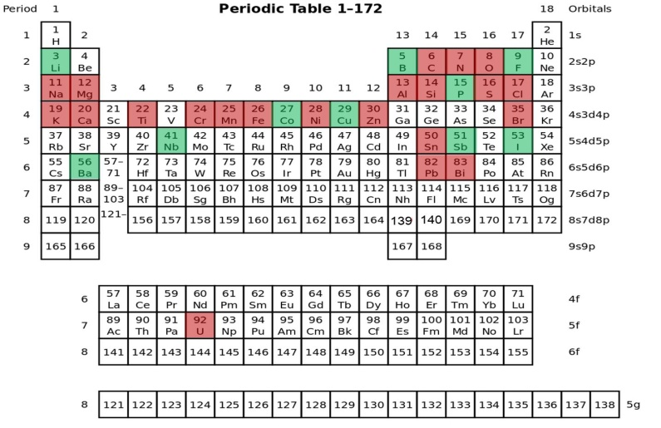

Measurements of yields and gamma rays' angular correlations in reactions with 14.1 MeV neutrons (the TANGRA project).
The partial cross sections for the formation of gamma rays and their angular distributions in inelastic neutron scattering reactions for 22 nuclei were measured in 2017-2019
Some results are already included in the EXFOR library:
41615002 # 2016, V.M. Bystritsky+ ##DAP 6-c-12(n,inl)6-c-12,par,da,g,cos/rsd
41615003 # 2016, V.M. Bystritsky+ ##DAP 6-c-12(n,inl)6-c-12,par,da,g,rsd
41615004 # 2016, V.M. Bystritsky+ ##DAP 6-c-12(n,inl)6-c-12,par,da,g,leg/rsd
41660002 # 2018, D.N. Grozdanov+ ##DAP 6-c-12(n,inl)6-c-12,par,da,g,leg/rsd
41660003 # 2018, D.N. Grozdanov+ ##DAP 6-c-12(n,inl)6-c-12,par,da,g,rsd
41660004 # 2018, D.N. Grozdanov+ ##DAP 8-o-16(n,inl)8-o-16,par,da,g,leg/rsd
41660005 # 2018, D.N. Grozdanov+ ##DAP 8-o-16(n,inl)8-o-16,par,da,g,rsd
Measured nuclei
Closest plans
Notes:
During 2017-2019 the partial cross sections for the formation of gamma rays and their angular distributions in inelastic neutron scattering reactions were measured for 22 nuclei. They are marked by the red color in the table. Green color indicated the targets which are available and are planned to be measured in the nearest future. Some results are already included in the EXFOR nuclear data library.

Slide 37
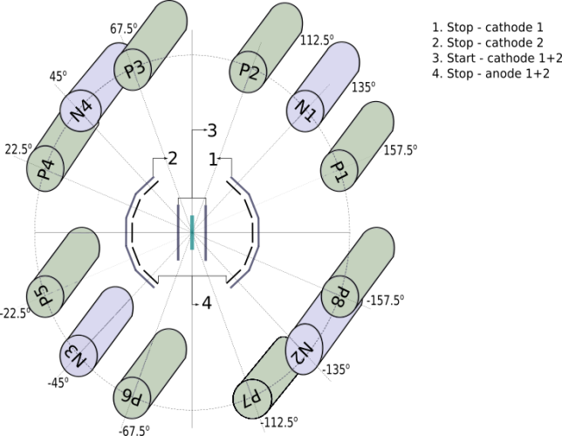





Measurements of the ROT-effect for gamma-rays and neutrons emitted from fission of ²³⁵U induced by polarized neutrons of different energies
The series of experiments is performed at the FRM-II reactor in Garching (Germany)
ROT-effect: angular anisotropy of a fission product emission, which appears due to rotation of a polarized fissioning nucleus.
neutrons, γ-rays
neutrons, γ-rays
Angle of rotation
²³⁵U
Fission
fragments
γ-rays and neutron detectors
Fission fragment detectors
neutrons, γ-rays
neutrons, γ-rays
ROT-effect values for the γ-ray and neutron emission
Neutron energies | γ-rays (x10⁻⁵) | Neutrons (x10⁻⁵) | Year of measurement
Cold neutrons (0.004 eV) | -16.5±1.6 | -21.2±2.5 | 2012
Resonance (0.3 eV) | -3.8±2.8 | +2.6±3.1 | 2017
“Warm” neutrons (0.06 ev) | -16.6±5.6 | -9.8±4.5 | 2018
Strong dependence of the ROT-effect on the incident neutron energy
Notes:
ROT-effect in fission is a formally T-odd effect, which is not currently associated with the violation of time reversal invariance, but is explained by the mechanism of the fission process. Due to rotation of the fissioning nucleus neutrons and γ-rays are emitted, on average, not along the direction of the fission fragments, but at some angle. The direction of rotation depends on the polarization of the target. T-odd effects were discovered in fission in the early 2000s and were measured for a number of nuclei only for cold neutrons. In a series of experiments performed at high flux neutron sources, the ROT-effect was measured for ²³⁵U for different energies of the incident neutrons. Angular anisotropy of the emission of gamma-rays and neutrons was measured as a function of the direction of the spin of incident polarized neutrons. The effect obtained in the lowest resonance of ²³⁵U at 0.3 eV is at least several times smaller than the analogous effect for cold and warm neutrons. This result is in good agreement with the predictions of the theory.

Slide 38


Study of PFN in fission induced by resonance neutrons
A double ionization chamber was designed to measure the kinetic energies, masses, and orientation of fission axe in the 3D space for the correlated fission fragments. The accuracy of direction cosines definition is better than 0.05. 32 PFN detectors were placed close to the axis of the ionization chamber to guarantee the maximum PFN detection efficiency ~0.8π.
PFN distributions measured at FLNP for ²³⁵U(n,f) reaction in comparison with the old data from KI measured in 1964.
[1] Sh. Zeynalov, P. Sedyshev, O. Sidorova, V. Shvetsov. International Journal of Modern Physics: Conference Series, Vol. 48 (2018) 1860123.
Segmented Anode Position Sensitive Detector. UCANS-VII, March 11-15,2017, Bariloche, Argentina
[2] Sh. Zeynalov, P. Sedyshev, O. Sidorova, V. Shvetsov. Prompt fission neutron investigation in 235U(nth,f) reaction. EPJ Web of Conferences 146, 04022 (2017), ND2016
[3] Sh. Zeynalov, P. Sedyshev, O. Sidorova, V. Shvetsov. WONDER 2018 (to be published in EPJ Web of Conferences)
[4] Zeynalov Sh.C., Sedyshev P. P., Sidorova O.V., Shvetsov V.N. ISINN-26, International Seminar on Interaction of Neutrons with Nuclei, Xi‘an, China, 28 May-2 June, 2018
The average PFN emission distribution mass dependence, measured in ²⁵²Cf(sf) reaction in comparison with literature.
The average PFN emission distribution dependence on FF TKE, measured in ²⁵²Cf(sf)
Notes:
Data on prompt fission neutron emission (PFN) in the reactions ²³⁵U(n_{th},f) and ²⁵²Cf(sf) was measured using twin back-to-back ionization chamber (TIC) with Frisch grids along with data acquisition system based on fast waveform digitizers (WFD). Using the digital signal processing (DSP) algorithms along with fission fragments (FF) and PFN analysis software we managed to correct PFN multiplicity dependences for measured reaction that widely used in the scientific literature. Position sensitive TIC for FF and PFN emission study was developed and investigated in capability to be used in combination with 32 liquid scintillators for PFN characteristic measurement. Developed setup opens new perspectives for investigations of resonance neutron induced fission and the sub-barrier fission, induced by thermal neutrons for nuclei as ²³²Th,²³⁷Np, ²³⁸U.

Slide 39

Notes:
The quasispecular reflection of cold neutrons from powders of raw and fluorinated detonation nanodiamonds have been studied. As expected, fluorination, which had removed hydrogen and amorphous carbon from the surface of the nanoparticles, increased the probability of quasispecular reflection. This method can be used for focusing and delivery of neutrons, and is thus complementary to supermirrors [25], at certain conditions. It might serve for designing and building more efficient neutron facilities and sources.

Slide 40






Measurement of the palladium content in the engine elements (nozzles) of the “Proton” launch vehicle using neutron resonance analysis at the IREN facility
Spectrum from parts containing palladium
Spectrum from a sample of pure palladium
Spectrum from palladium-free parts
The mass of detected palladium is 99 ± 7 mg in a sample with a mass of 60 g. The sensitivity of the method is about 2 mg / g.
Notes:
A feasibility study has been performed at the resonance neutron source IREN of FLNP for determining the content of palladium in the engine elements of the "Proton" rocket. There was a need for nondestructive analysis of the engines in order to determine if they contain palladium, which could cause the rocket crash. The neutron resonance analysis is especially sensitive for the elements like palladium, for which the resonance neutron capture cross section is very large. Two samples (engine components) were used of approximately the same weight (about 60 g), provided by the "ROSCOSMOS" corporation, one of them containing palladium, the other without palladium, and a standard sample of pure palladium (5 g). The results of the measurement demonstrated the presence of characteristic resonances in the sample containing palladium (see. Fig.). The weight of detected palladium is 99 ± 7 mg for the 60 g sample. Thus, the sensitivity of the method is about 2 mg / g.

Slide 41




Notes:
Unique samples of the remains from the Moscow Kremlin necropolises are being investigated in the Frank Laboratory of Neutron Physics using neutron activation analysis at the IREN facility and the IBR-2 reactor. There are the following among the samples:
- a fragment of the brain and organic matter from the skull of Elena Glinskaya – mother of Tsar Ivan the Terrible,
- fragments of hair of Anastasia Romanovna - the first Russian Tsarina, the first wife of Ivan the Terrible,
- rib bone of Tsarevich Ivan Ivanovich - son of Tsar Ivan the Terrible, etc.
The obtained results allowed archaeologists to confirm the hypothesis of mercury poisoning of Anastasia Romanovna, to clarify some circumstances of the life and the death of some representatives of the medieval Russian nobility.
В Лаборатории нейтронной физики с помощью нейтронного активационного анализа на установке ИРЕН и реакторе ИБР-2 исследуют уникальные образцы останков из некрополей Московского Кремля. Среди образцов:
- фрагмент мозга и органика из черепа Елены Глинской – матери Ивана Грозного,
- фрагменты волос Анастасии Романовны - первой русской царицы, первой жены Ивана Грозного,
- реберная кость царевича Ивана Ивановича – сына царя Ивана Грозного и др.
Полученные данные позволили археологам подтвердить гипотезу об отравлении ртутью Анастасии Романовны, а также прояснить некоторые обстоятельства жизни смерти представителей средневековой русской знати.

Slide 42






Nanotoxicology. The effects of silver nanoparticles received from the mother’s body
during the prenatal and lactation periods
Examples of the movement pattern of an animal with different types of behavior in the Morris test: 1 – directional search, 2 – random searching, 3 – thigmotaxis (strategy of incapable individuals)
These studies will be carried out in future with another type of nanoparticles, since they are very important to assess the toxic effect of nanomaterials on the human reproductive system
Silver content in the brain
Silver content in the blood
Notes:
Sector of Neutron Activation Analysis and Applied Research together with the Moscow Regional Clinical Research Institute named after Vladimirsky carried out for the first time the research to assess the effect on the mice offspring of silver nanoparticles received from the mother's body in the prenatal and lactation periods. Cognitive function levels were compared in young animals exposed to silver nanoparticles and control animals. The results of behavioral tests showed that in the prenatal period, the brain regions responsible for the formation of spatial memory are more vulnerable to silver nanoparticles than after birth, which leads to impaired cognitive function in the offspring. The silver content in various organs (blood, liver, lungs, kidneys and brain) of females and their offspring was determined by the method of neutron activation analysis. The data obtained are important for assessing the toxic effect of nanomaterials on the human reproductive system.
Сектор НАА и прикладнвх исследований ЛНФ совместно с Московским областным научно-исследовательским клиническим институтом им. М. Ф. Владимирского впервые выполнил работу по оценке влияния на потомство наночастиц серебра, поступивших из организма матери в пренатальный период и период лактации. Были сравнены уровни когнитивных функций у молодых животных, подвергавшихся влиянию наночастиц серебра и контрольных животных. Результаты поведенческих тестов показали, что в пренатальный период области мозга, отвечающие за формирование пространственной памяти, более уязвимы перед наночастицами серебра, чем после рождения, что приводит к нарушению когнитивных функций у потомства. Содержание серебра в различных органах (кровь, печень, легкие, почки и мозг) самок и их потомства было определено методом нейтронного активационного анализа. Полученные данные важны для оценки токсического эффекта наноматериалов на репродуктивную систему человека.

Slide 43

Neutrino programme: DANSS, new results
Ratio of e⁺ spectra in the DANSS Bottom/Top positions (constant for no-signal): 2016-2019
Full 2016-2019 statistics (2M events, twice as much as published data) has been processed with an improved analysis method and taking into account systematic errors
No statistically significant sign of the sterile neutrino oscillations effect was observed.
Notes:
The DANSS project is a segmented spectrometer (one cubic meter) from plastic scintillators that measures antineutrino spectra at different distances from the reactor (by inverse beta decay). Deviations of the ratio of these spectra, measured at different distances, from the constant (3ν hypothesis) are a possible signal of the mixture with a sterile neutrino (4ν hypothesis).
Full 2016-2019 statistics (2M events, twice as much as published data) has been processed with an improved analysis method and taking into account systematic errors
No statistically significant sign of the sterile neutrino oscillations effect was observed.
Проект DANSS - сегментированный спектрометр (объем кубический метр) из пластических сцинтилляторов, измеряющий спектры антинейтрино на разных расстояниях от реактора (методом инверсного бета-распада). Отклонения отношения этих спектров, измеренных на разных расстояниях, от константы (3ν гипотеза) – возможный сигнал о примеси стерильного нейтрино (4ν гипотеза).
Полная статистика за 2016–2019 гг. (2 млн. Событий, в два раза больше опубликованных данных) была обработана с использованием улучшенного метода анализа и с учетом систематических ошибок
Статистически значимых признаков эффекта осцилляций в стерильное нейтрино не наблюдалось.

Slide 44

The DANSS: new exclusion plot
New data allowed to extend essentially excluded area of sterile neutrino phase space in comparison with old results published in 2018. This is the best experimental result in the world.
Reactor anomaly best fit point was excluded at > 5 σ.
Systematics influence is small, results of our method are independent from shape of ν-spectrum and detector efficiency.
DANSS continues to take data, we continue to improve data analysis and study systematics.
Best fit for expected 4ν signal
DANSS
DANSS:
- sensitivity
- exclusion areas
95%CL and 90%CL
Preliminary
Notes:
New data allowed to extend excluded area of phase space for 4n hypothesis in comparison with old results published in 2018. This is the best experimental result in the world.
Reactor anomaly best fit point was excluded at >5 sigma.
Systematics influence is small, results of our method are independent from shape of antinu-spectrum, detector efficiency.
DANSS continues to take data and progress in detector calibration and systematics studies is going on.
Новые данные позволили расширить исключенную область фазового пространства 4nu модели по сравнению со старыми результатами, опубликованными в 2018 году. Это лучший экспериментальный результат в мире.
Точка лучшего фита реакторной аномалии исключена на уровне более 5 сигма.
Влияние систематики невелико, результаты данного метода не зависят от формы спектра реакторных антинейтрино и эффективности детектора.
DANSS продолжает собирать данные, и продолжается процесс совершенствования обработки и исследования систематических эффектов.

Slide 45






GEMMA/vGEN experiment
The GEMMA-3/νGeN projects investigate fundamental properties of neutrino at Kalinin Nuclear Power Plant (KNPP) with a low background innovative semiconductor HPGe detectors. Such investigations allow to perform:
The search for the coherent elastic neutrino-nucleus scattering (CEvNS) using high flux of reactor neutrino.
Search for the New Physics using non-standard neutrino interactions.
Investigation of the nuclear structure: form factors, Weinberg angle at low energies,…
Search for the neutrino magnetic moment
Investigation of background for dark matter, reactor monitoring,…
Spectrometer is been constructing at ∼ 10 m from powerful 3.1 GW reactor’s core under an enormous antineutrino flux of more than >5⋅10¹³ ν/(s⋅cm²). Location also allows to have good shielding against cosmic radiation ∼ 50 m w.e. Movable platform allows to suppress systematic uncertainties connected with unknow information about neutrino flux and backgrounds.
Notes:
vGEN/GEMMA-3 projects is aimed to investigates fundamental properties of neutrino at close vicinity to the reactor core of Kalinin Nuclear Power Plant. In particular, the searches for coherent elastic neutrino nucleus scattering and magnetic moment of neutrino are performed. It also has many other future applications like search for sterile neutrino, non-standard neutrino interactions and reactor monitoring.
vGEN/GEMMA-3 projects are aimed to investigation of fundamental properties of neutrino. The searches for CEvNS and MMN are performed. The experimental setup is been constructed under the reactor core of KNPP (285 km from Dubna). The distance to the reactor core is just 10 m, so the detector is under an enormous antineutrino flux of more than 5*10^13 neutrinos/(s*cm2). This is the highest value in the field.
Проекты vGEN/GEMMA-3 нацелены на исследование фундаментальных свойств нейтрино. В частности, производится поиск когерентного упругого рассеяния нейтрино на ядре и магнитного момента нейтрино. Экспериментальная установка строится под реактором Калининской АЭС находящейся на расстоянии 285 км от Дубны. Расстояние до ядра реактора составляет всего 10 м, таким образом детектор находится под огромным потоком нейтрино более чем 5*10^13 нейтрино/(см сек). Это наивысшее значение потока для данной области исследований. Конструктивные материалы реактора, расположенные вокруг установки, служат хорошей защитой от космического излучения.

Slide 46




GEMMA/vGEN experiment
Innovative low background low threshold HPGe detectors are used to detect signal from neutrinos. It was demonstrated a possibility to acquire signal below 200 eV (with trigger efficiency of about 70%). Energy resolution of the first detector measured with pulse generator is 78.0(3) eV (FWHM).
Background spectrum of vGEN/GEMMA-3 at LSM (1 kg detector, 44 kgd)
^{68,71}Ge (L)
1.3 keV
⁶⁸Ga (K)
(9.659 keV)
⁶⁵Zn (K)
(8.979 keV)
^{68,71}Ge (K)
10.367 keV
Backgrounds from surrounding and cosmic radiation are suppressed by passive and active shielding. Measurements at LSM underground laboratory (Modane, France) proved very good radiopurity of all components. Very good background level comparable with dark matter experiments has been observed.
^{56,57,58}Co (K)
(7.112 keV)
^{73,74}As (K)
(11.103 keV)
Notes:
The setup is surrounded by constructive materials of the reactor, which serve as good shielding against cosmic radiation. Innovative low background low threshold HPGe detectors are used to detect signal from neutrinos. A demonstrated possibility to acquire signal below 200 eV is important for detection of the low energy recoils from neutrino scattering.
Инновационные низкопороговые низкофоновые детекторы из сверхчистого германия используются для детектирования сигналов от нейтрино. Была продемонстрирована возможность регистрации сигналов с энергией ниже 200 эВ, что очень важно для регистрации низкоэнергетичных сигналов от ядер отдач.

Slide 47



GEMMA/vGEN experiment
November 2019 start installations at KNPP.
First background spectra has already been taken!
At low energy only cosmogenic lines are observed, background index is still improving
Data taking is stable and ongoing
Analysis is been optimized
Preliminary!! Background index will be improved!
^{68,71}Ge (L)
1.3 keV
⁶⁵Zn (K)
(8.979 keV)
Improvement in comparison with GEMMA-I:
Energy threshold: 2 keV → 200 eV (achieved)
Neutrino flux: 2.6⋅10¹³ ν/(s⋅cm²) → 5⋅10¹³ ν/(s⋅cm²) (achieved)
Mass: 1.5 kg → 5.5 kg (first detector is at place, waiting for others to be ready)
μ_{v} < 2.9⋅10^{–11}μ_{B} (world best limit) → μ_{v} < (5-9)⋅10^{–12}μ_{B} (after few years of data taking)
^{68,71}Ge (K)
10.367 keV
Future: detectors with an ultimate energy threshold in the range of 10 eV. New cryostat has been ordered!
Notes:
The data taking at KNPP are ongoing at the moment. Key parameters of the experimental setup are improved significantly in a comparion with GEMMA-I experiment which holds the best current limit for MMN.
В настоящее время начат набор данных на Калининской АЭС. Ключевые параметры экспериментальной установки были значительно улучшены по сравнению с предыдущей фазой эксперимента GEMMA-I, получившей лучший современный лабораторный предел на значение магнитного момента нейтрино.

Slide 48



EDELWEISS experiment
4800 mwe
Direct search for Dark Matter (DM) is the fundamental scientific problem addressed by the EDELWEISS experiment. It is located at LSM (Modane, France) underground laboratory at the depth of 4800 m w.e. Experiment searches DM with specially developed HPGe detector-bolometers having the ability of efficient discrimination for background events. With an excellent energy resolution and low energy threshold EDELWEISS detectors optimized for the search of low-mass WIMPs and other DM candidates at low-energy region inaccessible by other techniques.
The breakthrough made by the EDELWEISS due to creation of detectors sensitive to the nuclear recoil energy range below 100 eV opens up completely new possibilities not only for DM search, but also for studying neutrinos with coherent elastic neutrino-nucleus scattering (CEνNS).
Search for light WIMPs in EDELWEISS-2019 experimental spectrum
Notes:
Прямой поиск частиц темной материи является фундаментальной научной задачей эксперимента EDELWEISS. В эксперименте используются HPGe детекторы-болометры (Рис. 1), позволяющие проводить высокоэффективный отбор фоновых событий. Благодаря высокому энергетическому разрешению и низкому порогу регистрации, детекторы EDELWEISS позволяют проводить поиски легких WIMP и аксионо-подобных частиц в области энергий, недоступной для других экспериментов. В 2019 г. новые результаты эксперимента связаны с разработкой уникальных низкопороговых детекторов-болометров, позволяющих детектировать ядра отдачи с рекордными энергиями от ~20 эВ. Измерения с новыми детекторами ведутся в подземной лаборатории LSM (Модан, Франция) и в IP2I (Лион). Из измерений с новыми детекторами получены и опубликованы результаты по поиску WIMP в районе масс ниже 1 ГэВ/с² (Рис. 2). Кроме того, в рамках совместного использования криостата EDELWEISS с экспериментом CUPID получены результаты по полной идентификации α/γ(β) фоновых событий. В результате синергии между экспериментами в 2019 году осуществлен набор данных с целью достижения наилучшей чувствительности к 0ν2β распаду ¹⁰⁰Mo (arXiv:1909.02994).

Slide 49


Ricochet experiment
Ricochet is a new experiment aimed to investigate of CEvNS at a precision of ∼ 1%. Due to significant uncertainties in low-energy quenching (energy loss distribution between ionization and direct excitations of lattice vibrations), only next-generation cryogenic bolometers, with an unprecedented low-energy threshold and the ability to suppress background events, can provide ~1% precision for measurement of CEνNS up to O(10) eV. Such accuracy, which is supposed to be achieved in the new Ricochet experiment, R&D of which is carried out on the basis of EDELWEISS with the active participation of JINR, will allow verification of various extensions of the Standard Model and will significantly extend our understanding of the electroweak sector. To conduct the experiment, a study was begun of the potential location of the setup near the ILL research reactor (France) and near the WWER-1200 reactor of the Novovoronezh NPP.
Ge-NTD prototype detector for Ricochet
Schematic view of the Ricochet experimental setup
Notes:
Прорыв, осуществленный EDELWEISS, в создание детекторов, регистрирующих сигнал в диапазоне энергий ядер отдачи ниже 100 эВ, открывает совершенно новые возможности не только поиска частиц темной материи, но и исследования нейтрино, используя когерентное рассеяние на ядрах (CEνNS). Поиск физики за пределами Стандартной модели с CEνNS требует измерений с высочайшим уровнем точности в самом низу энергетического диапазона индуцированных ядерных отдач, так как ожидается, что влияние Новой физики будет приводить к спектральным искажениям для энергий ядер отдачи ниже 100 эВ. Из-за существенных неопределенностей в квенчинге в области низких энергий (распределение энергии потерь между ионизацией и прямыми возбуждениями колебаний решетки), только криогенные болометры следующего поколения, как уже разработанные EDELWEISS, с беспрецедентным низкоэнергетическим порогом и возможностью подавления фоновых событий, смогут обеспечить ~1% прецизионность измерения CEνNS вплоть до O(10) эВ. Такая точность, которую предполагается достичь в новом эксперименте Ricochet, R&D которого ведется на базе EDELWEISS с активным участием ОИЯИ, позволит проверить различные расширения Стандартной модели и значительно повлияет на наше понимание электрослабого сектора. Для проведения эксперимента начато изучение мест потенциального расположения установки вблизи исследовательского реактора ILL (Франция) и вблизи реактора ВВР-1200 Нововоронежской АЭС.

Slide 50


Using the Precision Laser Inclinometer in the VIRGO Gravity Antenna
Precision Laser Inclinometer in TT1 (CERN)
VIRGO inclinometer Indoor Gravity Antenna (Pisa)
In 2019, work began on the use of a Precision Laser Inclinometer for angular seismic isolation of the active elements of the VIRGO Gravity Antenna (Pisa, Italy)
An agreement has been reached between CERN, JINR, and INFN on the use of a PLI in the VIRGO system.
In August and October 2019, two PLIs were installed in the VIRGO zone to monitor the angular microseismic activity of the Earth's surface.
Notes:
A fundamentally new detector, the Precision Laser Inclinometer (PLI), has been developed and put into operation at JINR, which makes it possible to detect angular oscillations of the earth surface in the frequency range of 10⁻⁶ to 4 Hz with the maximum sensitivity of 2.4 ⋅ 10⁻¹¹ rad/Hz^{−1/2}. Five complete inclinometer sets are manufactured and supplied to CERN for monitoring LHC deformations. Up to date, three of them have been successfully put into operation. A trilateral Addendum was signed by JINR, EGO–VIRGO, and CERN to start using the PLI for stabilization of active elements of IGA VIRGO against angular microseismic oscillations. In August and October 2019, two PLIs were installed in the experimental hall of the Northern Mirror of IGA VIRGO. They showed stable performance for several months.
В ОИЯИ создан и введён в действие прецизионный лазерный инклинометр (PLI) – принципиально новый детектор, сделавший возможным регистрацию угловых колебаний земной поверхности в диапазоне частот 10⁻⁶–4 Гц с максимальной чувствительностью 2.4∙10⁻¹¹ рад/Гц^{1/2}. Для регистрации деформаций коллайдера LHC изготовлены и поставлены в ЦЕРН пять комплектов инклинометров . На данный момент успешно запущены три. Подписан трёхсторонний договор между ОИЯИ, Европейской гравитационной обсерваторией Virgo и CERN о начале работ по стабилизации активных элементов Интерференционной Гравитационной Антенны (ИГА) от угловых микросейсмических колебаний на базе PLI. В августе и октябре 2019 г. установлены два инклинометра в экспериментальном зале северного зеркала ИГА. Получена устойчивая работа инклинометров в течение нескольких месяцев.

Slide 51



THEORETICAL PHYSICS
E.T.Gregor, N.N.Arsenyev, M.Scheck, T.M.Shneidman, M.Thürauf, C.Bernards, A.Blanc, R.Chapman, F.Drouet, A.A.Dzhioev (BLTP)
J. Phys. G: Nucl. Part. Phys. 46 (2019) 075101
The quasiparticle random phase approximation (QRPA) and cluster model (CM) were applied to explain the observed 2 orders of magnitude reduction of B(E1;3⁻₁→2⁺₁) strength along Mo isotopes. The models suggest that this sharp drop is due to the interference between the neutron and proton contributions to the E1 transition.
Notes:
The quasiparticle random phase approximation (QRPA) and cluster model (CM) were applied to explain the observed 2 orders of magnitude reduction of B(E1;3⁻₁→2⁺₁) strength along Mo isotopes. The models suggest that this sharp drop is due to the interference between the neutron and proton contributions to the E1 transition.
Квазичастичное приближение случайной фазы (QRPA) и кластерная модель (CM) были применены для объяснения наблюдаемого уменьшения на 2 порядка величины силы перехода B(E1;3⁻₁→2⁺₁) для изотопов Мо. Модели предполагают, что такое резкое уменьшение связано с интерференцией нейтронного и протонного вкладов в E1 переход.

Slide 52

THEORETICAL PHYSICS
Unified description of cluster radioactivity and spontaneous fission
I.S. Rogov, G.G. Adamian, N.V. Antonenko, Phys. Rev. C 100, 024606 (2019)
For the first time, alpha-decay, cluster radioactivity, and spontaneous fission were simultaneously described with the unified approach exploiting a dynamics in charge asymmetry coordinate η_{Z}.
Notes:
For the first time, alpha-decay, cluster radioactivity, and spontaneous fission were simultaneously described with the unified approach exploiting a dynamics in charge asymmetry coordinate η_{Z}.
Впервые альфа-распад, кластерная радиоактивность и спонтанное деление были одновременно описаны с помощью единого подхода, использующего динамику по координате зарядовой асимметрии.

Slide 53


Thank You!

