Slide 1







Progress in implementation of the 7-years Plan of JINR
INTERNATIONAL INTERGOVERNMENTAL ORGANIZATION
МЕЖДУНАРОДНАЯ МЕЖПРАВИТЕЛЬСТВЕННАЯ ОРГАНИЗАЦИЯ
JOINT INSTITUTE FOR NUCLEAR RESEARCH
ОБЪЕДИНЕННЫЙ ИНСТИТУТ ЯДЕРНЫХ ИССЛЕДОВАНИЙ
Joint Institute for Nuclear Research
SCIENCE BRINGING NATIONS TOGETHER
Boris Sharkov
Condensed Matter Physics
and
Radiobiology
Scientific Council Meeting September 20-21, 2018.

Slide 2

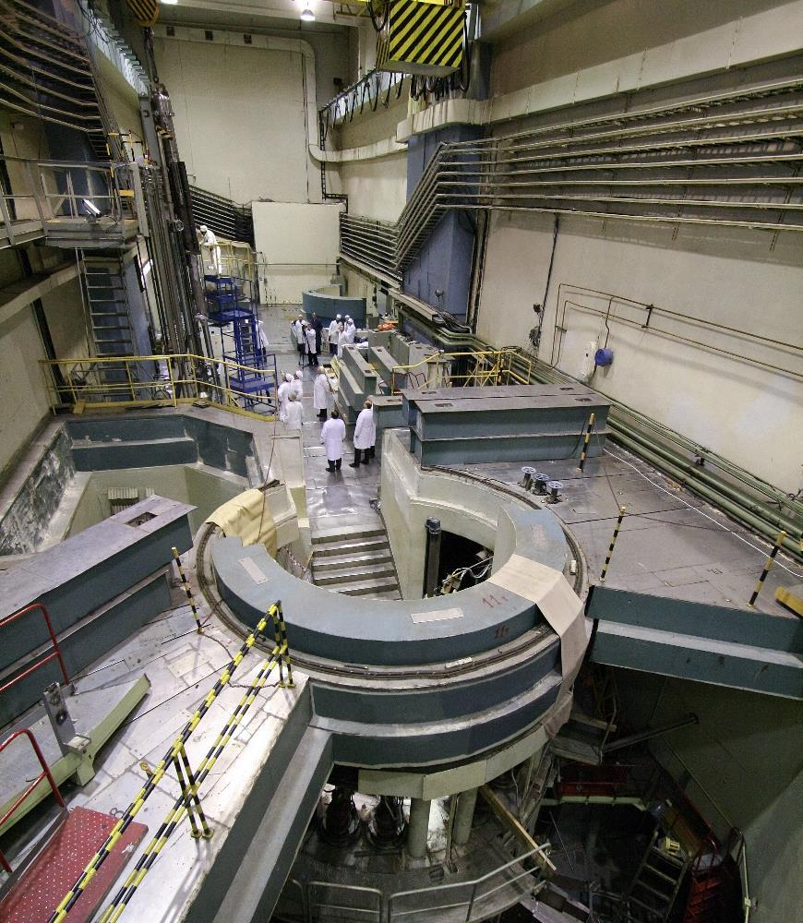
FLNP Proposal for the “Seven-year Plan…”
Corrections in neutron scattering and optical research methods

Slide 3
Basic FLNP Tasks within Current 7-years Plan
Safe and reliable operation of the IBR-2 reactor;
Completion of the Cryogenic Moderators complex project;
Constant upgrade and development of the spectrometers at the IBR-2;
Realization of the User Program at 15 instruments of the IBR-2 reactor and it’s expansion to other instruments at IBR-2 and other FLNP facilities;
Completion of the first stage of IREN accelerator based neutron source, regular operation for experiment;
Development of the conceptual design of the DNS-IV neutron source – JINR basic facility aims to replace IBR-2 after exhausting it’s lifetime;
Successful realization of the development program on reactor infrastructure and cryogenics moderators.
Upgrade of the existing and construction of the new instruments at IBR-2.
About 200 papers published annually.

Slide 4
Additional tasks compared to the primary version of the 7-yeard plan
Construction of the SOLCRYS laboratory with 2 beamlines for X-ray diffraction and SAXS studies at the SOLARIS synchrotron source (Krakow, Poland);
Investigations of the dynamics of the power feedback effects at the IBR-2 resulting in necessity of preparation for new fuel load manufacturing for IBR-2;

Slide 5
PRIMARY GOAL 1
Safe and reliable operation of the IBR-2 reactor

Slide 6
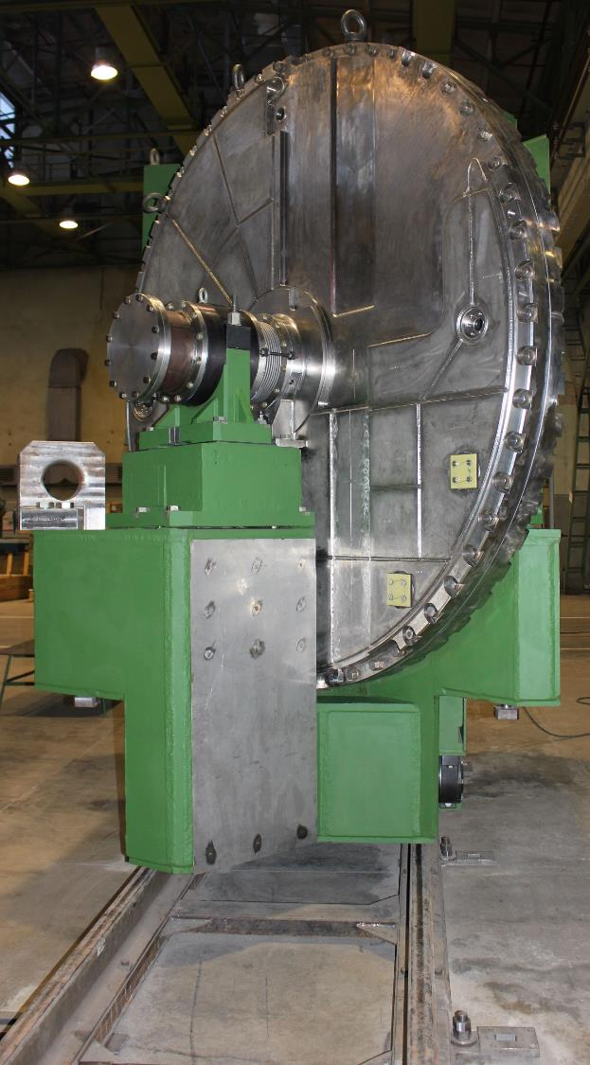
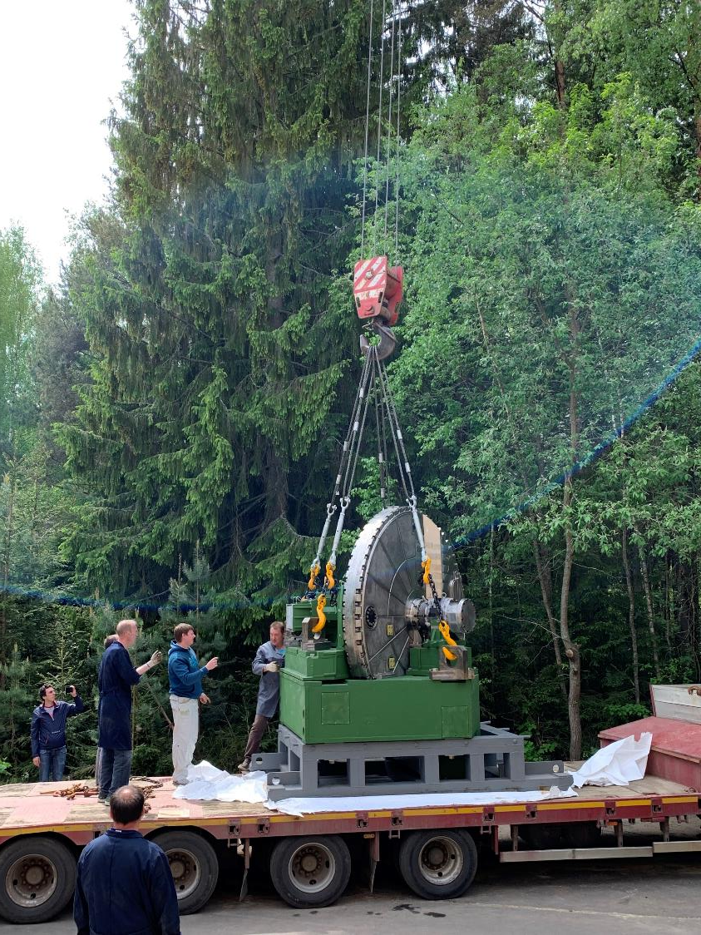
Spare Movable Reflector for IBR-2
MR-3 at Votkinsk Machinery
In December 2018 the spare movable reflector MR-3 manufacturing was finished.
It is delivered to JINR and prepared for the tests at FLNP stand.
MR-3 arrived at FLNP JINR
Notes:
The lifetime of the working movable reflector (MR-2) is scheduled to year 2032, nevertheless already now we prepared the spare version because production time is about 5 years and in case of failure of the present MR we’ll stop completely research at the IBR-2;

Slide 7
Major IBR-2 equipment upgrade and replacement in 2019
Replacement of the sections III and IV of the SB-117 0.4 kV switchboard of the external power supply system;
Technical specifications preparations and design works on replacement of the different switchboards and ventilation controls at the IBR-2 building;
Replacement of the filters in the special ventilation system (scheduled until 2022);
Realization of the backup power supply system project;

Slide 8
Corrections to the plan of major IBR-2 equipment upgrade and replacement in 2020-2022
Research contract on IBR-2 dynamics with NIKIET;
Design, manufacturing and assembling of the 2 air/lNa heat exchangers;
Design of the Fuel Assembly for the new IBR-2 fuel load;
Corrections for the years beyond 2022 will be done later, based on results achieved;

Slide 9
PRIMARY GOAL 2
Constant upgrade and development of the spectrometers at the IBR-2

Slide 10
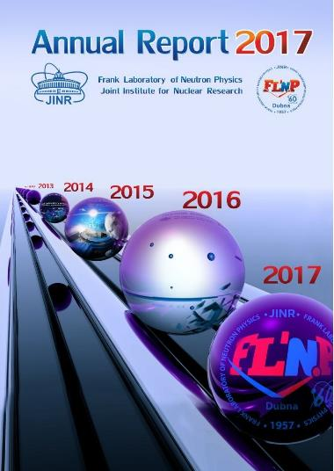
Comparison of the effectiveness of the IBR-2 instruments with the instruments at European sources
We have about 160 neutron instruments at 13 European neutron sources, generating almost 30000 instrument ⋅ days, resulting 1900 scientific papers each year;
The numbers given are for an average beamline/instrument/source. Goal is to have instruments efficiency on the world record level.
IBR-2 neutron source brightness enables that.
We’re following recommendations of the PAC on CMP
by improving moderators, neutron guides, detectors and fighting with backgrounds.
16 instrument ⋅ days/paper in Europe
17 instrument ⋅ days/paper at IBR-2
At IBR-2 we have 15 instruments, operating about 2500 hours per year, that generates about 1563 instrument ⋅ days, resulting about 90 scientific papers each year;

Slide 11
An example of the “success story”
DN-6 high pressure diffractometer upgrade

Slide 12
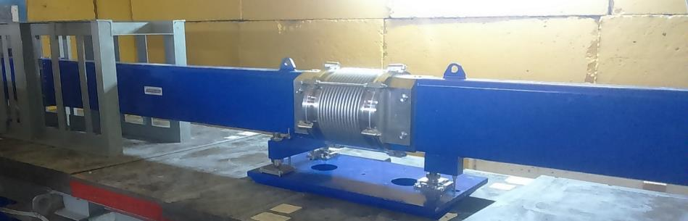
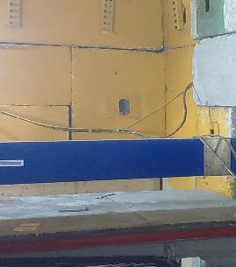
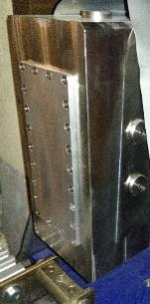
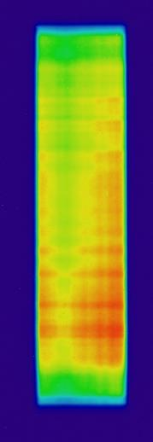
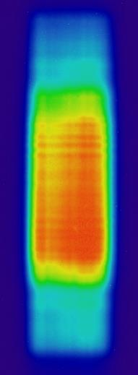
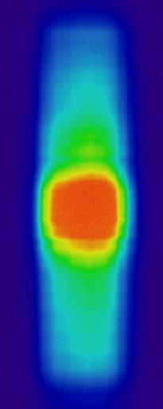
DN-6 diffractometer: new focusing neutron guide
0 cm
45 cm
87 cm
Notes:
The length of the new focusing device is 7 meters. The intensity distributions on the various distances to the flange of the focusing device were obtained during the first September cycle of IBR-2 with the help of a neutron tomograph . The most optimal focusing distance was found and the diffractometer was aligned with respect to this point. On the right there are the neutron patterns of vanadium before and after modernization, as well as their ratio-gain factor. Average gain is 6-7. The diffractometer slightly lost its resolution because of the angular divergence, but still remains quite comparable with the resolution of diffractometer dn-12.

Slide 13
DN-6 parameters
Parameters | DN-6 | DN-12
Neutron flux at sample position Before upgrade After upgrade | ~0.5×10⁷ n/cm²/s ~2.7×10⁷ n/cm²/s | ~1.5×10⁶ n/cm²/s
Distance: Moderator-sample Sample-detector | 30.0 m 0.5 m | 26.0 m 0.4 m
Resolution Δd/d (d=2 Å) Before upgrade After upgrade | 2θ=90°: 0.011 0.013 | 2θ=90°: 0.012
Exposition time per pressure point | 2-48 h | 12-36 h
Sample volume | 0.01-2 mm³ | 2 mm³
Pressure range | 40 GPa (DAC) 10 GPa (WC) 8 GPa (sapphire anvils) | 10 GPa (WC anvils) 8 GPa (sapphire anvils)
Due to neutron flux, sample environment and detectors improvements
the total DN-6 gain factor became ~ 60
Notes:
Due to the high neutron flux on the sample after modernization and wide solid angle of the detector system the gain factor of DN-6 compared with the DN-12 is about 60. It is enabled to reduce both the time of the experiment with the high-pressure cells and to expend the pressure region up to 40 GPa, because the opportunity to use not only sapphire anvils but also WC and diamond anvils is become.

Slide 14
5-years plan on upgrade and development of the IBR-2 instruments and proposals on construction new ones.
By the end of 2020 new version of the document will be published, expanded to other FLNP facilities

Slide 15
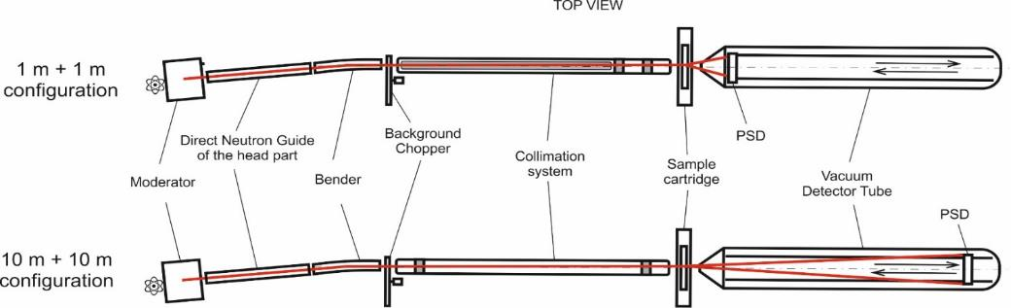
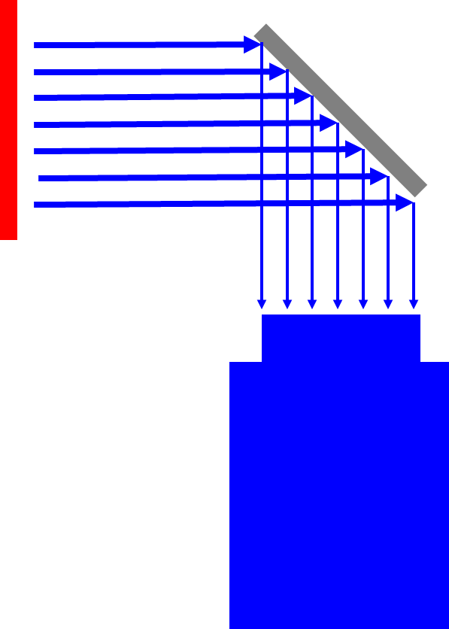
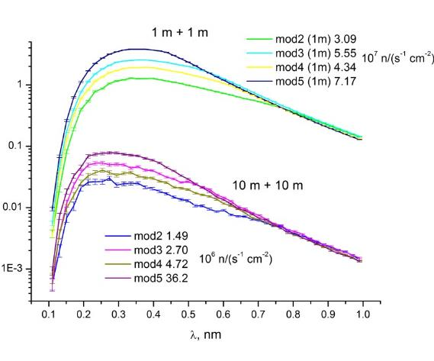
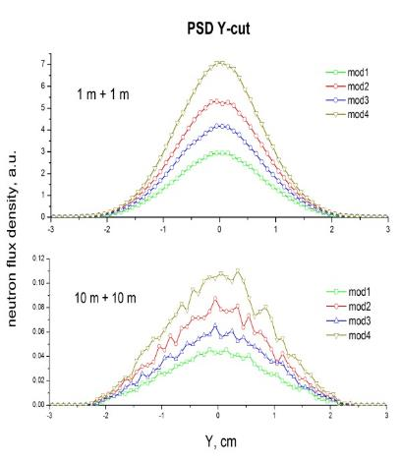
A concept of new small angle scattering and imaging spectrometer at 10-A channel of IBR-2 (present in 7-ys plan)
Expected parameters
Beam size | 50×50 мм²
Neutron wavelength range: | 0.5 – 10 Å
q-range: | 0.003 – 0.5 Å⁻¹
Angular resolution | 5 - 20 %
Maximum sample size | 20×50×50 мм²
Incident neutron flux at the sample | 2.0×10⁶ см⁻² c⁻¹
Detector system | PSD, ³He, 64×64 см², resolution 5×5 мм²
ССD camera based detector
Beamline 10A
32 m
T = 100 K
Flux distribution
Spectrum calculations
Bender modifications (m = 2)
 | Number of mirror channels | Length | Radius of curvature
mod1 | 20 | 1 m | 7.16 m
mod2 | 20 | 2 m | 14.32 m
mod3 | 30 | 1 m | 7.16 m
mod4 | 30 | 2 m | 14.32 m
M.V.Avdeev, R.A.Eremin, V.I.Bodnarchuk, I.V.Gapon, V.I.Petrenko, R. Erhan, A.V. Churakov, D.P.Kozlenko,
J. Surf. Investigation. (2018)

Slide 16
Optical methods and X-rays

Slide 17
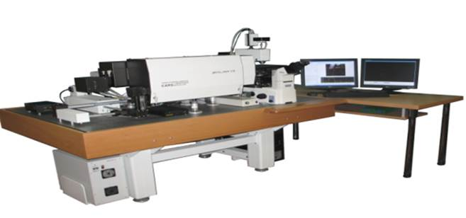
Raman Spectroscopy at FLNP
Sector of Raman Spectroscopy
Upgrade of the optical platform based on the “CARS” microspectrometer for ultra-sensitive spectroscopy of the combined (SERS+CARS) Raman signal amplification – SECARS.
Search and selection of the most sensitive and reproducible in the spectrum of SERS-active plasmon substrates for surface-enhanced Raman spectroscopy (SERS).
Basic facility:
“CARS” microspectrometer
+
Supporting instrumentation:
AFM
Spectrophotometer
Laser particle size analyzer
…
Highly-contrast visualization of analyte molecules/samples by nonlinear Raman microspectroscopy.
Registration of extremely low concentrations of organic molecules comparable to the level of units of molecules.
Study of the spectral and structural characteristics of upconversion phosphors with various rare earth elements based on nanoglassceramics.
Synthesis of core-shell nanostructures and laboratory tests for their biomedical practical applications.
Notes:
The slide shows the main tasks and problems of the 7-year development plan in the field of Raman spectroscopy at the JINR FLNP.
For the first three years of the current 7-year plan, a certain success has been achieved on all of these issues, and so far the program has been completed by more than 50%. Of particular note are the significant results in contrast imaging and ultra-sensitive recording of Raman spectra at a molecular concentration of 10⁻¹⁸ mol.
Also, during these years, several auxiliary devices (AFM, IR spectrometer, laser particle analyzer, etc.) were purchased, which contributed to the implementation of the scientific program on the “CARS” base microspectrometer.
На слайде приведены основные задачи и проблемы 7-летнего плана развития в области рамановской спектроскопии в ЛНФ ОИЯИ.
За первые три года текущей 7-летки по всем перечисленным вопросам достигнут определенный успех и к настоящему времени программа выполнена более чем на 50 %. Особо следует отметить значимые результаты по контрастной визуализации и ультрачувствительнй регистрации рамановских спектров на уровне концентрации молекул 10⁻¹⁸ Моль.
Также, в эти годы были приобретены несколько вспомогательных приборов (АСМ, ИК-спектрометр, лазерный анализатор частиц и др.), которые способствовали реализации научной программы на базовом микроспектрометре «КАРС».

Slide 18
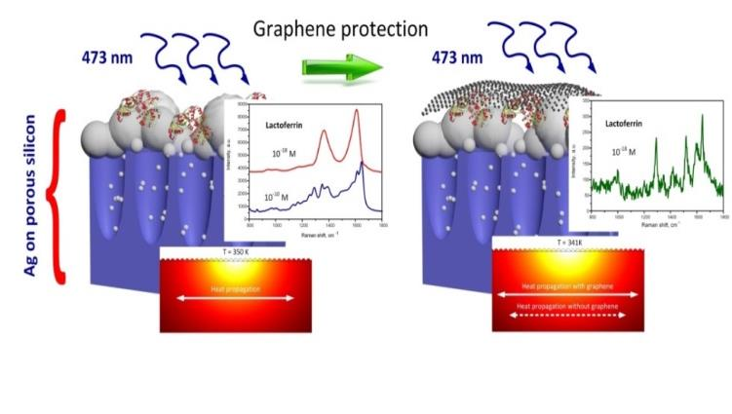
Amendment to the 7-year plan:
Sector of Raman Spectroscopy
based on the results and achievements obtained during the first 3 years of the 7-year development plan, especially with regard to the highly sensitive detection of Raman spectra of analyte molecules, it is proposed to supplement the research program on Raman spectroscopy with a scientific and applied task, namely RAMAN BIOSENSING.
Proposal on instrumentation:
a new specialized ultra-low frequency Raman spectrometer equipped with unique notch Bragg filters which gives access to frequencies down to 5-10 cm⁻¹
Cost ~ 90 k$ (2021-2022)

Slide 19
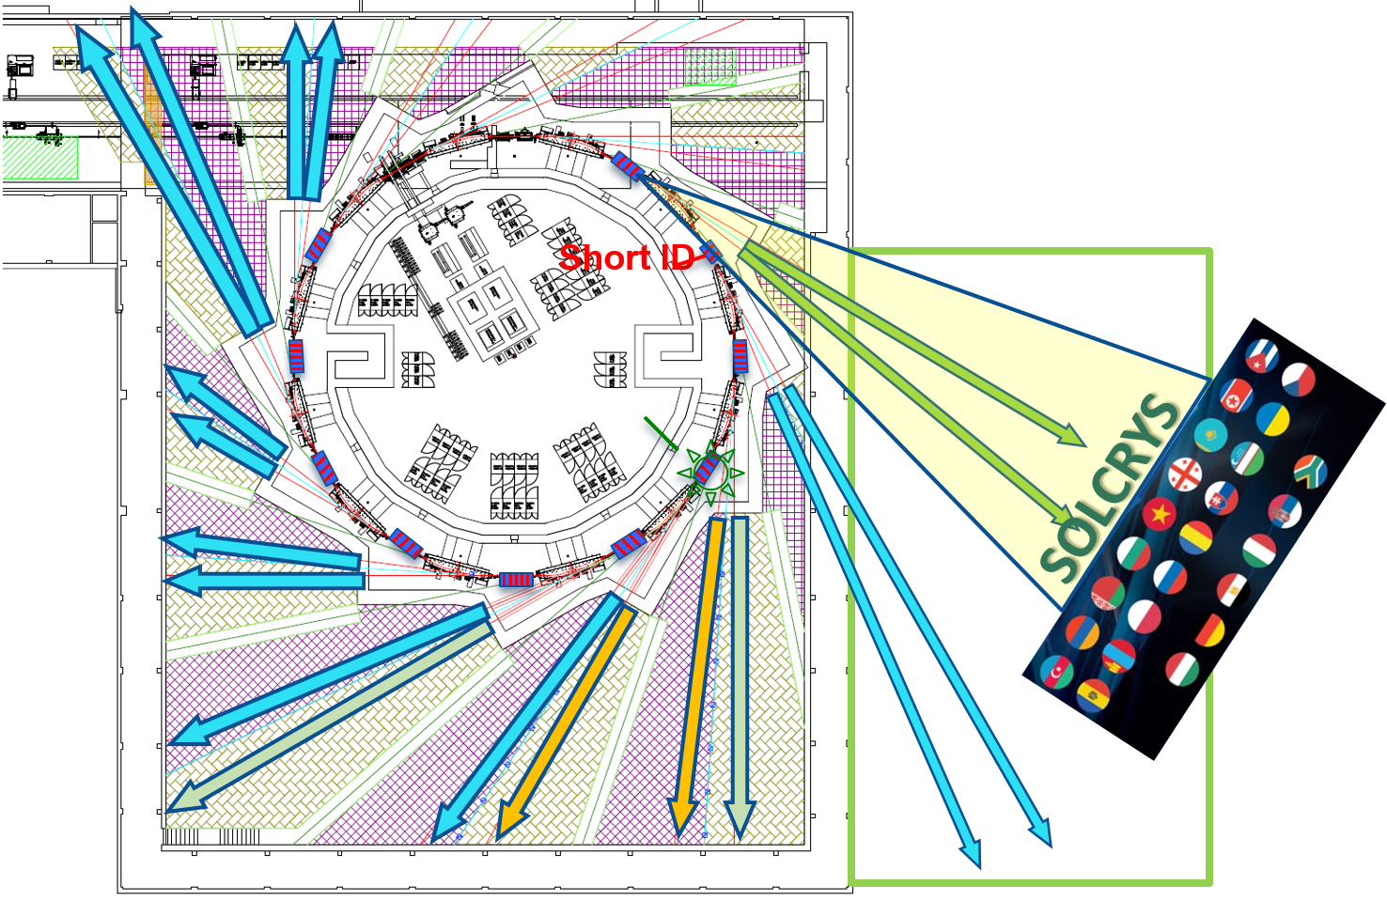
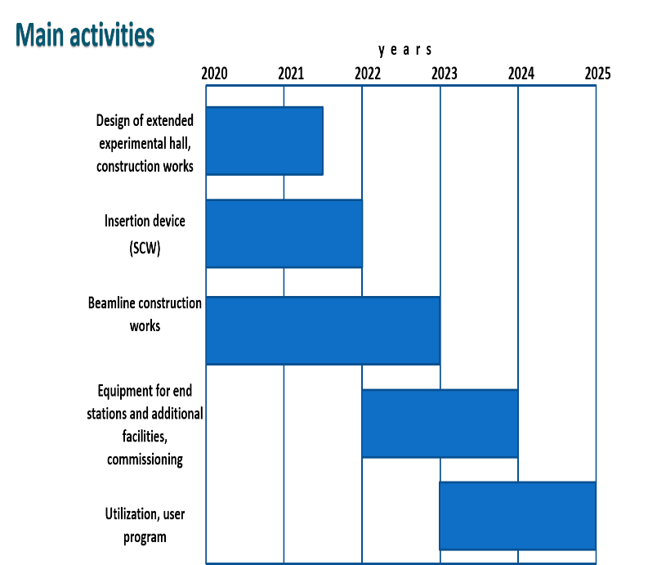
SOLCRYS laboratory for structural research
Spectrometer | Techinques
MX-BioSAXS-PD | Macromolecular Crystallography diffraction Small Angle X-ray Scattering Powder Diffraction at extreme temperatures and pressures
Notes:
The condensed matter research at JINR is performed in the area of new materials (catalysts, polymers, etc.), nanomaterials (nanoparticles, nanocomposites, etc.), materials at extreme conditions (superconductors, perovskites, etc.), and biomaterials (proteins, DNA, etc.). The methods based on the synchrotron radiation will be available at Polish National Synchrotron Radiation Centre SOLARIS, where JINR proposed to build a new laboratory for structural research SOLCRYS. The three measuring stations that will allow accomplishing this goal have been identified and selected for the construction as:
Macromolecular X-ray Crystallography
Small-Angle X-ray Scattering
Powder Diffraction
Plan of the SOLCRYS construction for years 2020-2023:
The extension of the existing experimental hall that will contain the endstations of the crystallographic beamline as well as the laboratory of samples preparation.
Elaboration and development of the Technical Infrastructure within a scope necessary to install and properly operate the research equipment of the SOLCRYS laboratory.
Design, purchase and installation of the Research Infrastructure, including the sample preparation facilities.
Исследования конденсированных сред в ОИЯИ ведутся в области материаловедения новых материалов (катализаторов, полимеров и т. д.), наноматериалов (наночастицы, нанокомпозиты и т. д.), материалов в экстремальных условиях (сверхпроводники, перовскиты и т. д.) и биоматериалов (белки, ДНК и т. д.). Методы исследования, основанные на рассеянии синхротронного излучения, будут проводиться в Польском национальном центре синхротронного излучения SOLARIS, где ОИЯИ предлагает создать новую лабораторию для структурных исследований SOLCRYS. Три измерительные станции, которые позволят достичь этой цели представляют:
макромолекулярная рентгеновская кристаллография;
малоугловое рентгеновское рассеяние;
порошковая дифракция.
Программа строительства лаборатории SOLCRYS на 2020-2023:
Расширение существующего экспериментального зала для размещения конечных станций кристаллографической линии, а также лаборатории для подготовки образцов.
Разработка и развитие технической инфраструктуры в объеме, необходимом для установки и правильной эксплуатации исследовательского оборудования лаборатории SOLCRYS.
Проектирование, приобретение и установка исследовательской инфраструктуры, в том числе объектов для подготовки образцов.

Slide 20
Conceptual design of the DNS-IV

Slide 21
Basic parameters of the reactor
Parameter | Value
1 Average thermal power, MW | 15
2 Operational mode | pulsed
3 Repetition rate, Hz | 10
4 Fuel | NpN
5 Coolant | Na
6 Inlet temperature of the coolant, ⁰С | 290
7 Outlet temperature of the coolant, ⁰С | 391
8 Coolant flow through ½ of the core, kg/s | 58
9 Pressure drop across the core, Pa | 0,33·10⁵
10 Fast neutrons flux density on the reactor vessel surface, 10¹⁴ n/cm²·s¹ | 5,7
11 Fluence on the reactor vessel for 20 000 hours, n/cm² | 4,1·10²²

Slide 22
General view of the reactor in the bulk concrete
IC
Shutter
Stationary reflector
Ø 2m
Reactivity modulator
Ø 6m

Slide 23
Control
CR-2 (Ni)
EP-2 (Ni)
CR-1 (Ni)
AR-2 (Ni)
EP-1 (Ni)
CR-3 (TiH2)
CR-4 (TiH2)
AR-1 (Ni)

Slide 24
Spectrometers – Moderators: Optimization task
The basic set of spectrometers can include 15 the most called-for instruments, with ~10 additional ones as the second stage
Spectrometers at moderators for the first stage: 2 (80-90K+300 K) – small/bi-spectral, 4 (80-90 K)– large/cold, 9 (<30K) – small/very cold
Moderator size: 8 – small (~10 x 10 cm or d=10 cm), 7 – large (~20 x 20 cm)
The optimal “Moderator – NG” distance is around L = (2 ÷ 3) m
Instruments can be grouped to take a full advantage of moderators
*) from report of A. Balagurov

Slide 25
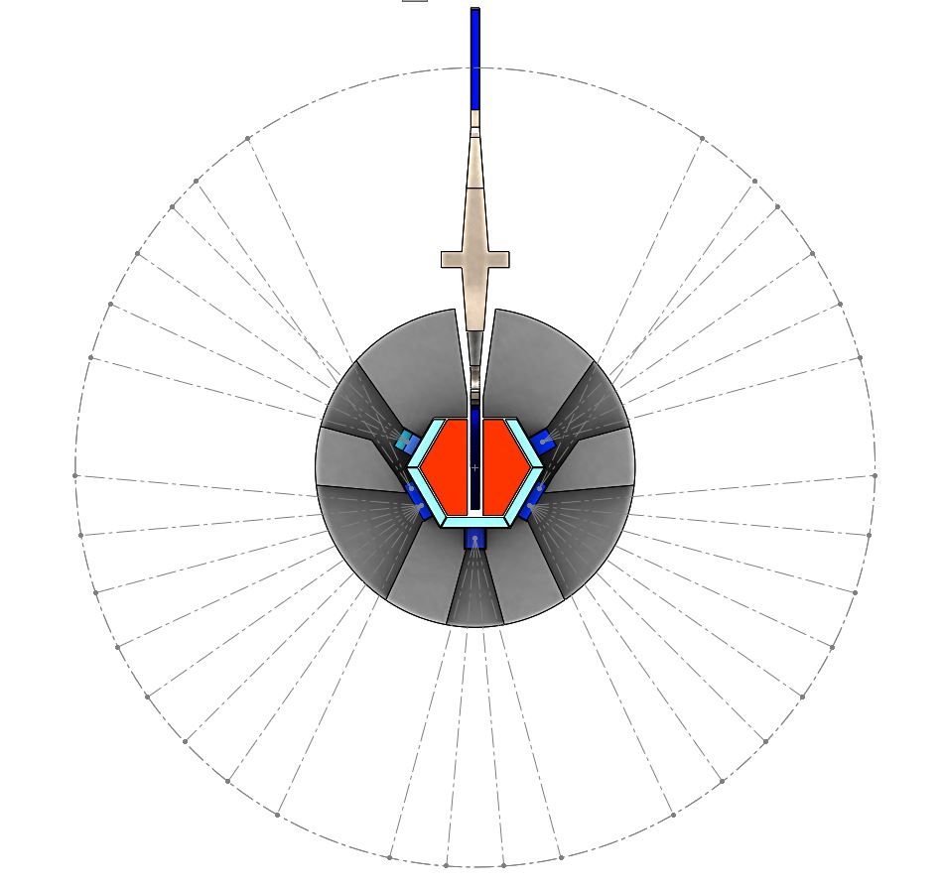
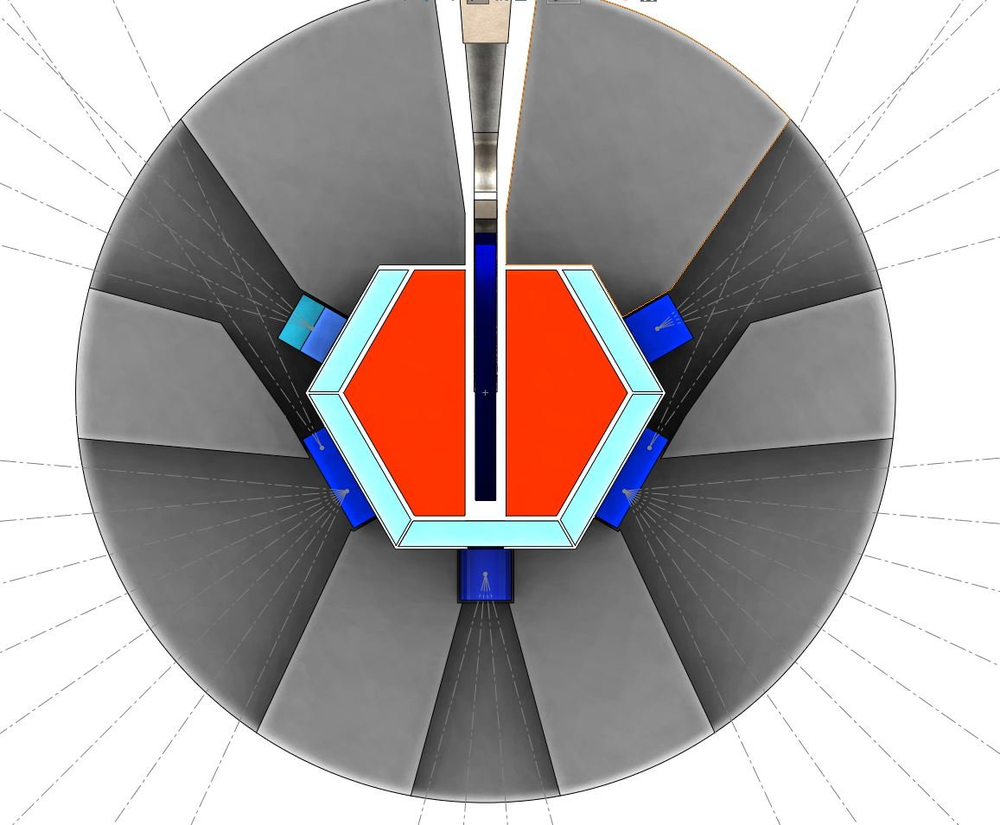
4 – small/ cold (80K)
Moderators design
for DNS-IV
8 – large cold (80K)
8 – large/ very cold (<30K)
Core
2- small/tangential/cold (80K)
2- small/ tangential/ very cold (<30K)
32 beamports with
10° separation:
For instruments:
4 – bi spectral
8 – large cold
8 – large very cold
8 – small cold
4- small tangential cold
Water pre-moderators
4– small /cold
(80K)
4 – bi spectral
(300+80K)
Be reflector

Slide 26
Current status
According to the recommendations of the PAC extensive work on studying the experimental background at IBR-2 instruments is in progress;
Negotiation with RosAtom enterprises are in progress;
The program on simulation of the instruments at DNS-IV is launched at FLNP;

Slide 27
Joint meeting of the Presidium of the Science and Technology Council of the State Corporation “Rosatom” and leaders of the Joint Institute for Nuclear Research

Slide 28
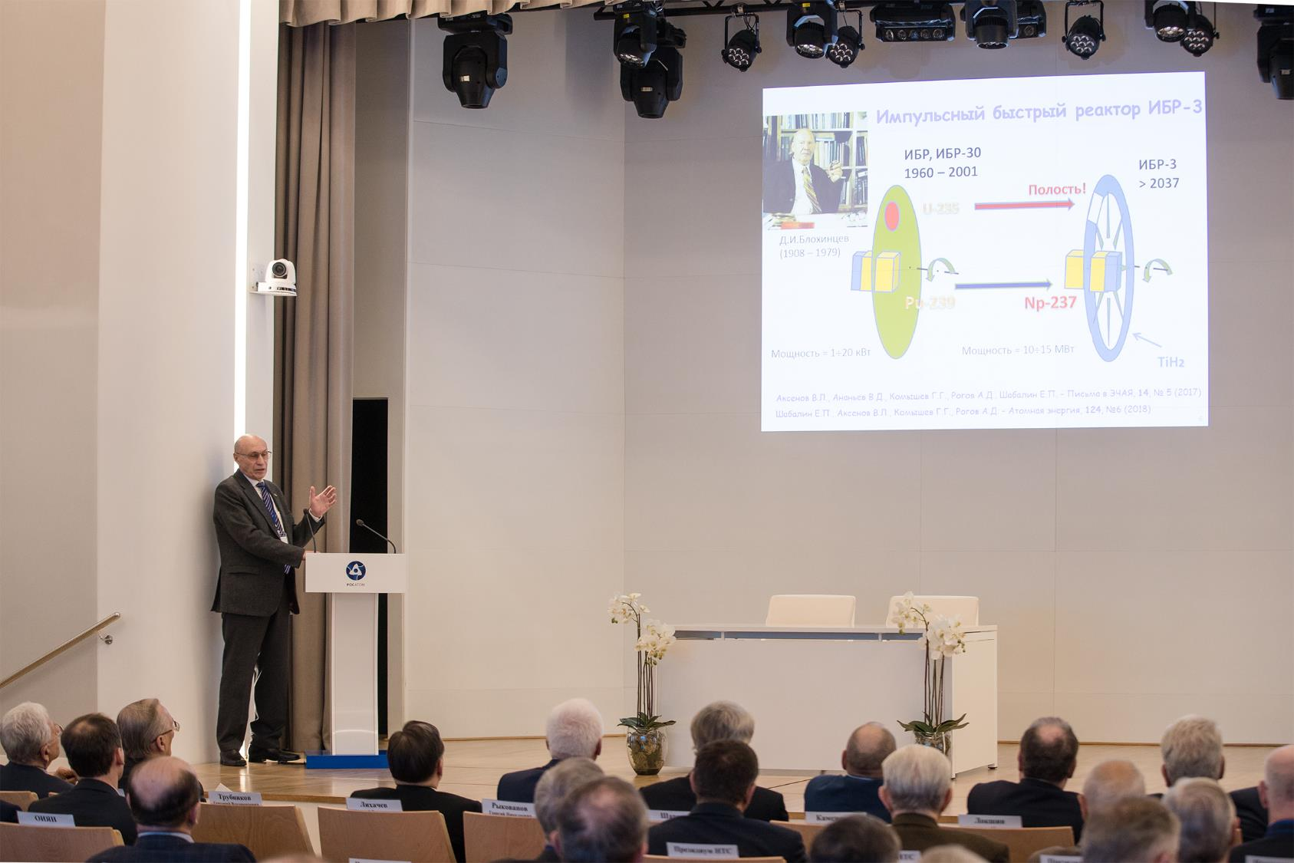
The IBR-3 fast pulse reactor was a topic of the report by FLNP Scientific Leader, RAS Corresponding Member V. L. Aksenov; the co-author of the report was A. V. Lopatkin (NIKIET).

Slide 29
PROJECT ROADMAP (preliminary)
Stage | 18 | 19 | 20 | 21 | 22 | 23 | 24 | 25 | 26 | 27 | 28 | 29 | 30 | 31 | 32 | 33 | 34 | 35 | 36 | 37
Concept development
Conceptual design
Investment justification
R&D
Technical design
Construction
Commissioning

Slide 30
The State Corporation “Rosatom” and the Joint Institute for Nuclear Researcher signed a cooperation agreement on partnership interaction in some issues of leading scientific projects, including the development of the NICA collider complex, the Superheavy Element Factory, the use of the IBR-2 pulse reactor and the development of a new pulse reactor facility in Dubna.
The IBR-3 fast pulse reactor was a topic of the report by FLNP Scientific Leader, RAS Corresponding Member V. L. Aksenov; the co-author of the report was A. V. Lopatkin (NIKIET).
http://www.jinr.ru/posts/rosatom-and-jinr-signed-an-agreement-on-cooperation/

Slide 31
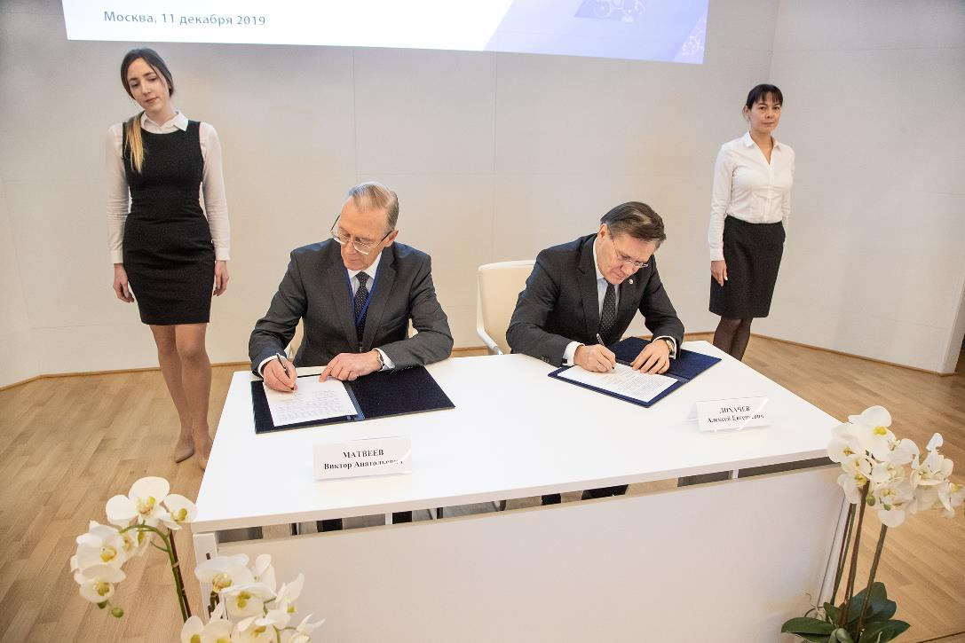
RosAtom and JINR signed an agreement on cooperation in several JINR projects on December 11 2019
http://www.jinr.ru/posts/rosatom-and-jinr-signed-an-agreement-on-cooperation/

Slide 32
Corrections to the 7-years plan

Slide 33
Rationale
IBR-2 neutron flux density makes it one of the best sources in the world;
In order to keep this position the first priority is to set to the safe and reliable operation of the reactor;
Plans to perform outpacing upgrade and replacement of the main components of the IBR-2 infrastructure in shorter period compared to scheduled for 2020-2027 before;
For the same reason it is necessary to start preparation for the production of the fresh fuel load for IBR-2 in order to guarantee it’s operation after 2028;

Slide 34
Rationale cont.
Concentration of the resources within the existing 7-years plan on the IBR-2 is leading to limited possibilities for upgrade of the instruments as well as successfully design and develop new ones;
Development of the DNS-IV source also goes faster and requires more funds than estimated before;

Slide 35
FLNP application to the JINR directorate for correction of the 7-years plan for years 2017-2023
The detailed request assumes the funding increase for the topics “Neutron scattering and optical research” at the amount of about 3 M$ annually for the years 2021-2023.
and “Neutron Nuclear Physics” remains unchanged

Slide 36
The FLNR experimental facilities (IC-100, MT-25, U-200, U-400, U-400M, DC-280) provide possibility to conduct a wide range of radiation-physics and radioisotope research.
- detailed study of effects induced by heavy ions in matter aimed at applications of beams of accelerated ions in nanotechnology;
- investigation of radiation resistance of materials under the impact of multi-charged ions, including testing of microelectronic circuits for space technology;
- development of next-generation of functional track membranes;
- synthesis of nano-objects with unique properties for new applications;
- development of hybrid nanotechnologies, combining methods of ion track technology and coating, thin-layer, and surface modification technologies;
- production of radioisotopes for nuclear medicine and radioecological studies with γ-quanta, α-particle-, and heavy-ion beams;
Special attention will be given to the development of specialized channels at the new DC-280 and modernized U-400R accelerators as well as to the development of the new FLNR Laboratory Building in cooperation with the International Innovation Center of Nanotechnologies (a joint project between JINR and Rosnano).
Applied research with heavy ions
Radiation-physics, radioisotope, radioecology, applications of heavy-ion beams in nanotechnology in 2017-2023

Slide 37
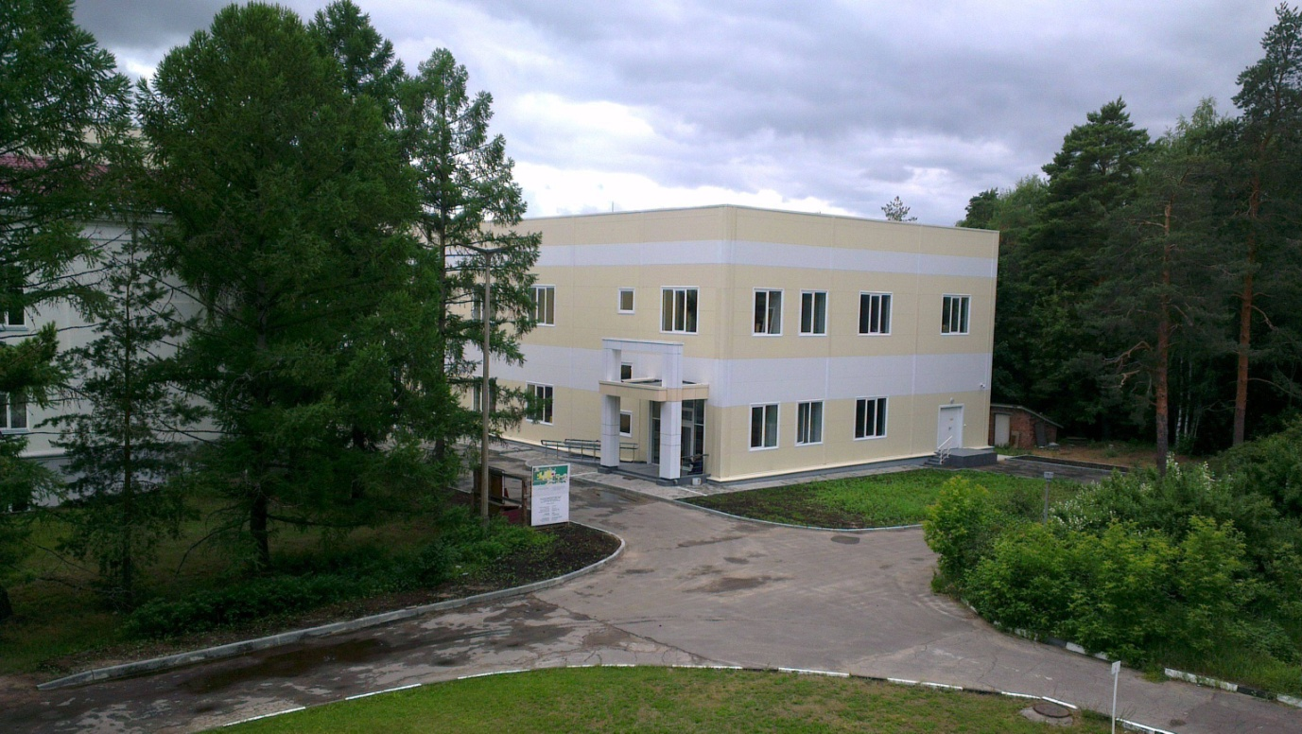
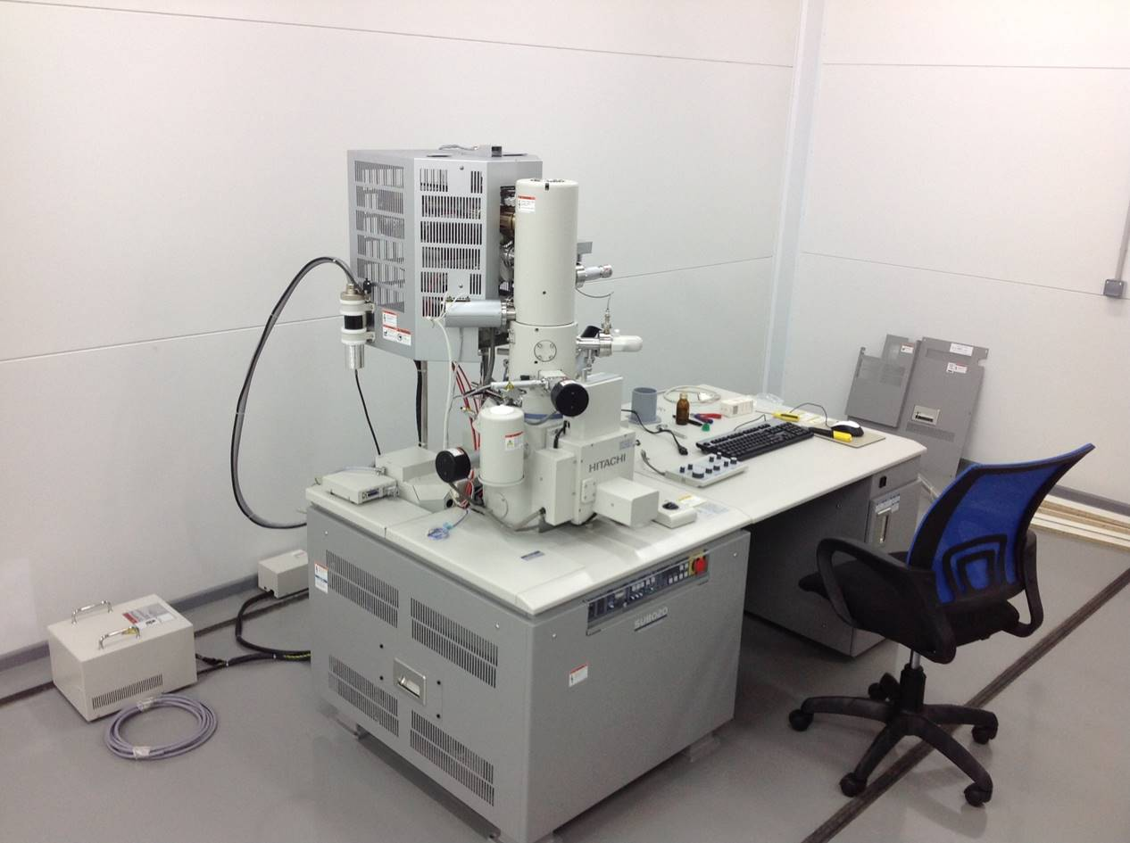
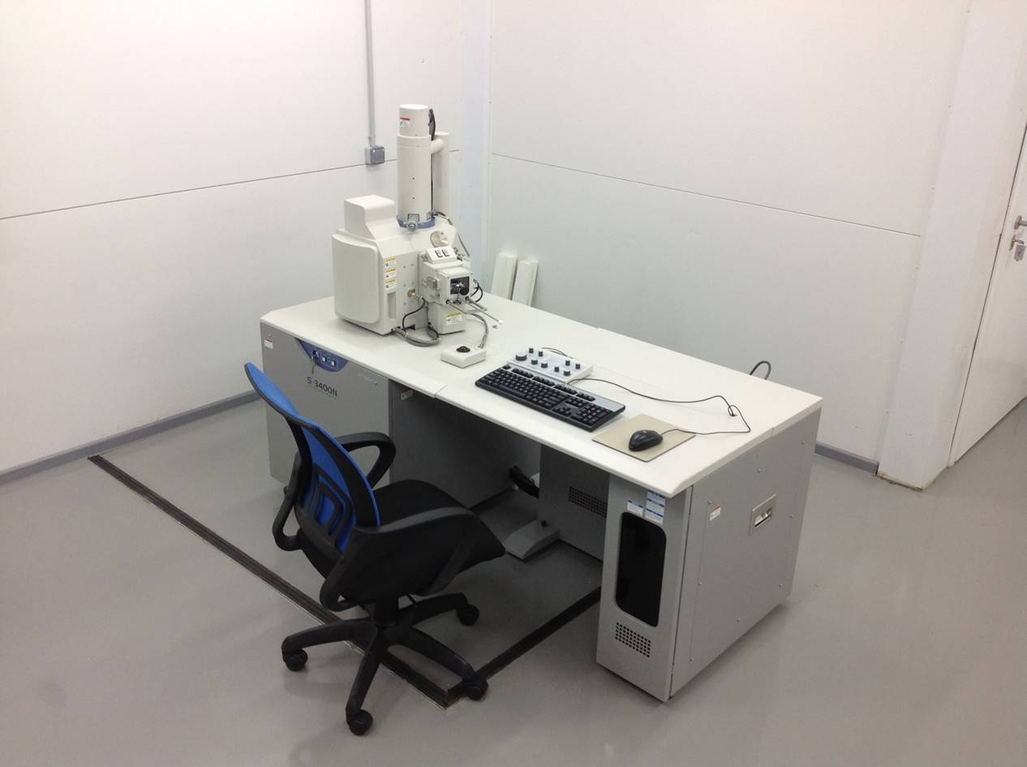
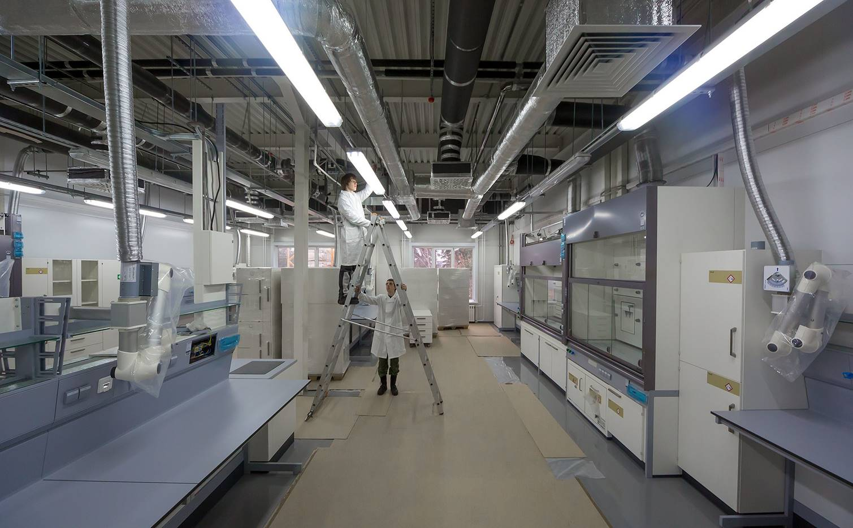
Nano Laboratory

Slide 38
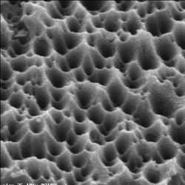
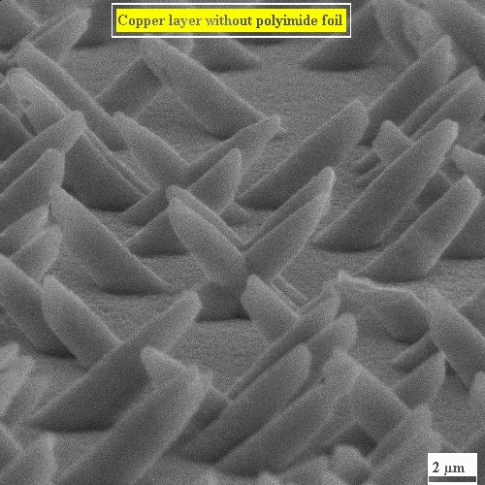
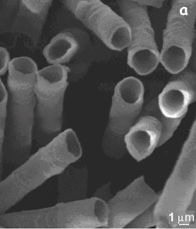
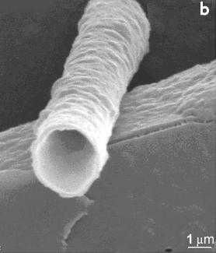
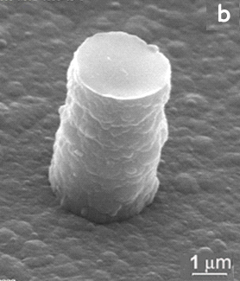
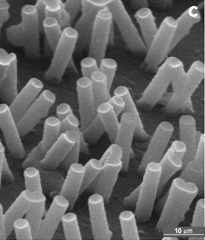
Accelerators-born nanostructures
new composite materials:
extended layers adhesion strength
increased thermal resistance
flexible printed circuit boards
Polymer composites produced with the use of track membranes
nanotubes nanowires

Slide 39
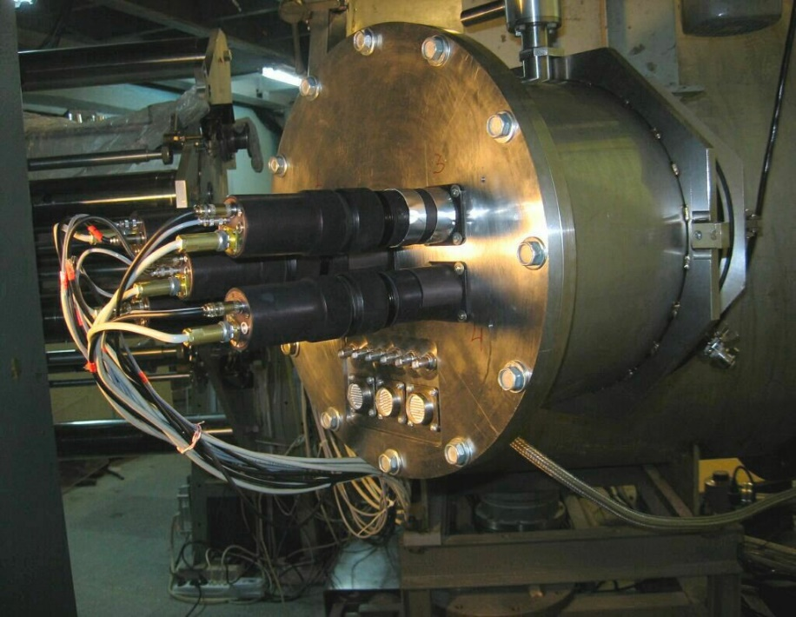
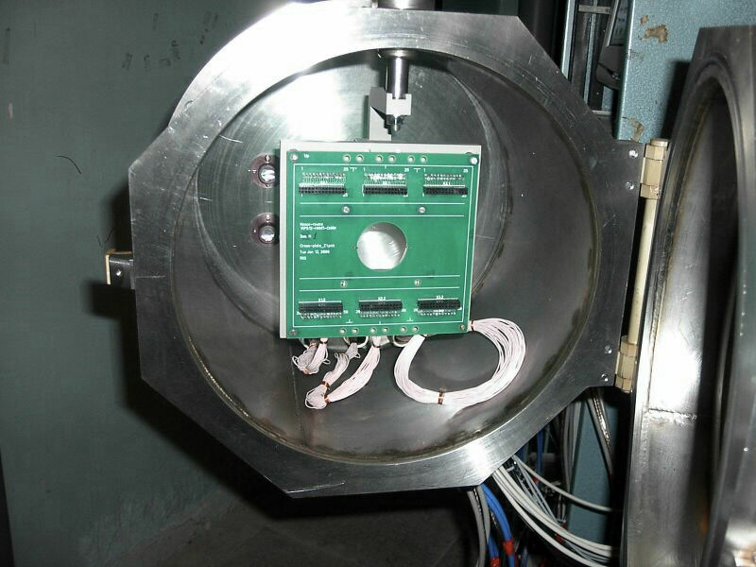
Radiation Hardness Tests For Electronic Components
Development of radiation-proofed electronic components is the first priority task of the modern high-class electronic industry.
Long-distance space flights, long-living satellites, etc. are extremely critical to the quality of electronic chips.

Slide 40
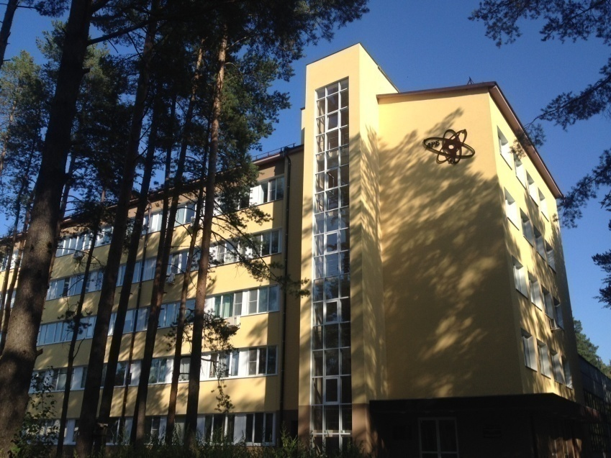

Laboratory of Radiation Biology
biological action of heavy charged particles of different energies
Notes:
40

Slide 41
LRB Structure and Staff
Department of Radiation Biology and Physiology:
Molecular Radiobiology Sector;
Radiation Cytology Sector;
Radiation Physiology Sector;
Radiation Neurochemistry Sector;
Mathematical Modeling Sector;
Radiation Genetics Group.
Department of Radiation Research:
Group for Modeling of Ionizing Radiation Interaction with Matter;
Group for Studying Radiation Fields of JINR’s Basic Facilities and Environment.
Astrobiology Sector
Total staff is about 100 people
2 Academicians, 1 Corresponding
Member of RAS
9 Doctors of Sciences,
12 Candidates of Sciences
Notes:
The LRB has the following structure. Its total staff is about 100 people, with domination of youth. Due to the efficient educational policy our Lab becomes an attractive center for talented young people from JINR Member States and worldwide.

Slide 42
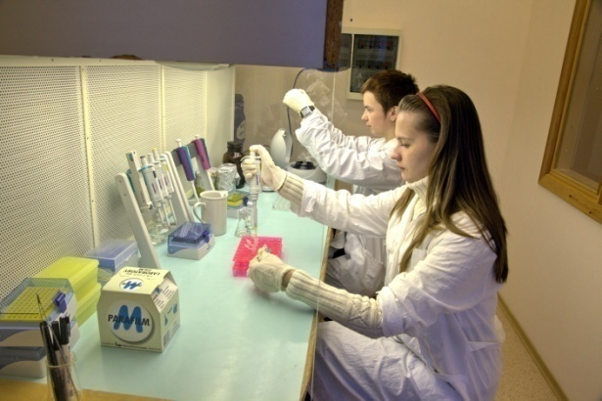

LRB personnel age distribution
half of LRB scientific staff are young researchers

Slide 43
LRB 7 years plan
Theme:
04-9-1077-2009/2020 "Research on the Biological Effect of Heavy Charged Particles of Different Energies"
Research on the mechanisms of the formation of molecular damage to the DNA structure by accelerated heavy charged particles of different energies and its repair
Research on the patterns and formation mechanisms of gene and structure mutations in mammalian cells under exposure to heavy charged particles. Clarifying the genetic instability mechanism of mammalian and human cells.
Research on the mechanisms of the induction of morphological and functional damage to the retina and different parts of the central nervous system (CNS) by accelerated heavy charged particles and its repair.
Mathematical modeling of the effects of ionizing radiations of different LET at the molecular and cellular levels. Development and analysis of mathematical models of the molecular mechanisms of high-energy charged particle-induced damage to the CNS structure and functions.
Radiation research
Astrobiological research
Theme:
04-9-1112-2013/2022 "Research on Cosmic Matter on the Earth and in Nearby Space; Research on the Biological and Geochemical Specifics of the Early Earth."

Slide 44
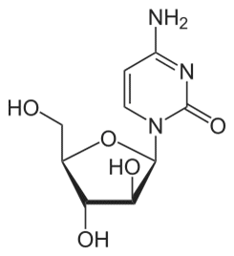
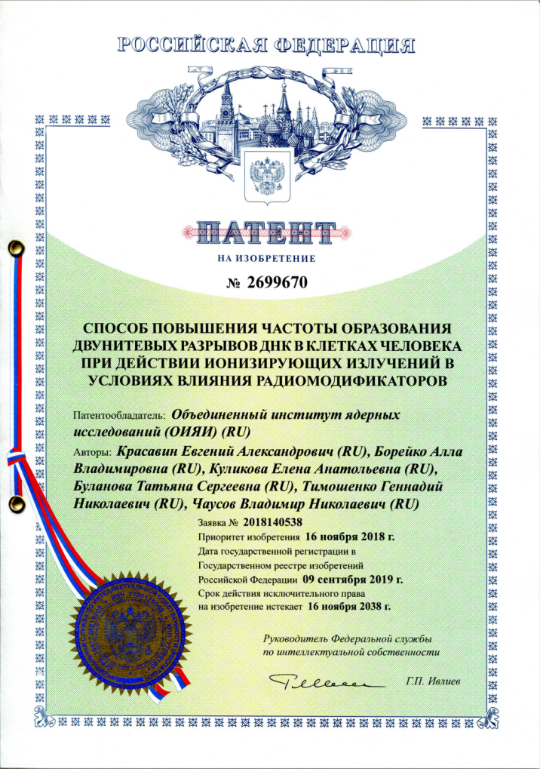
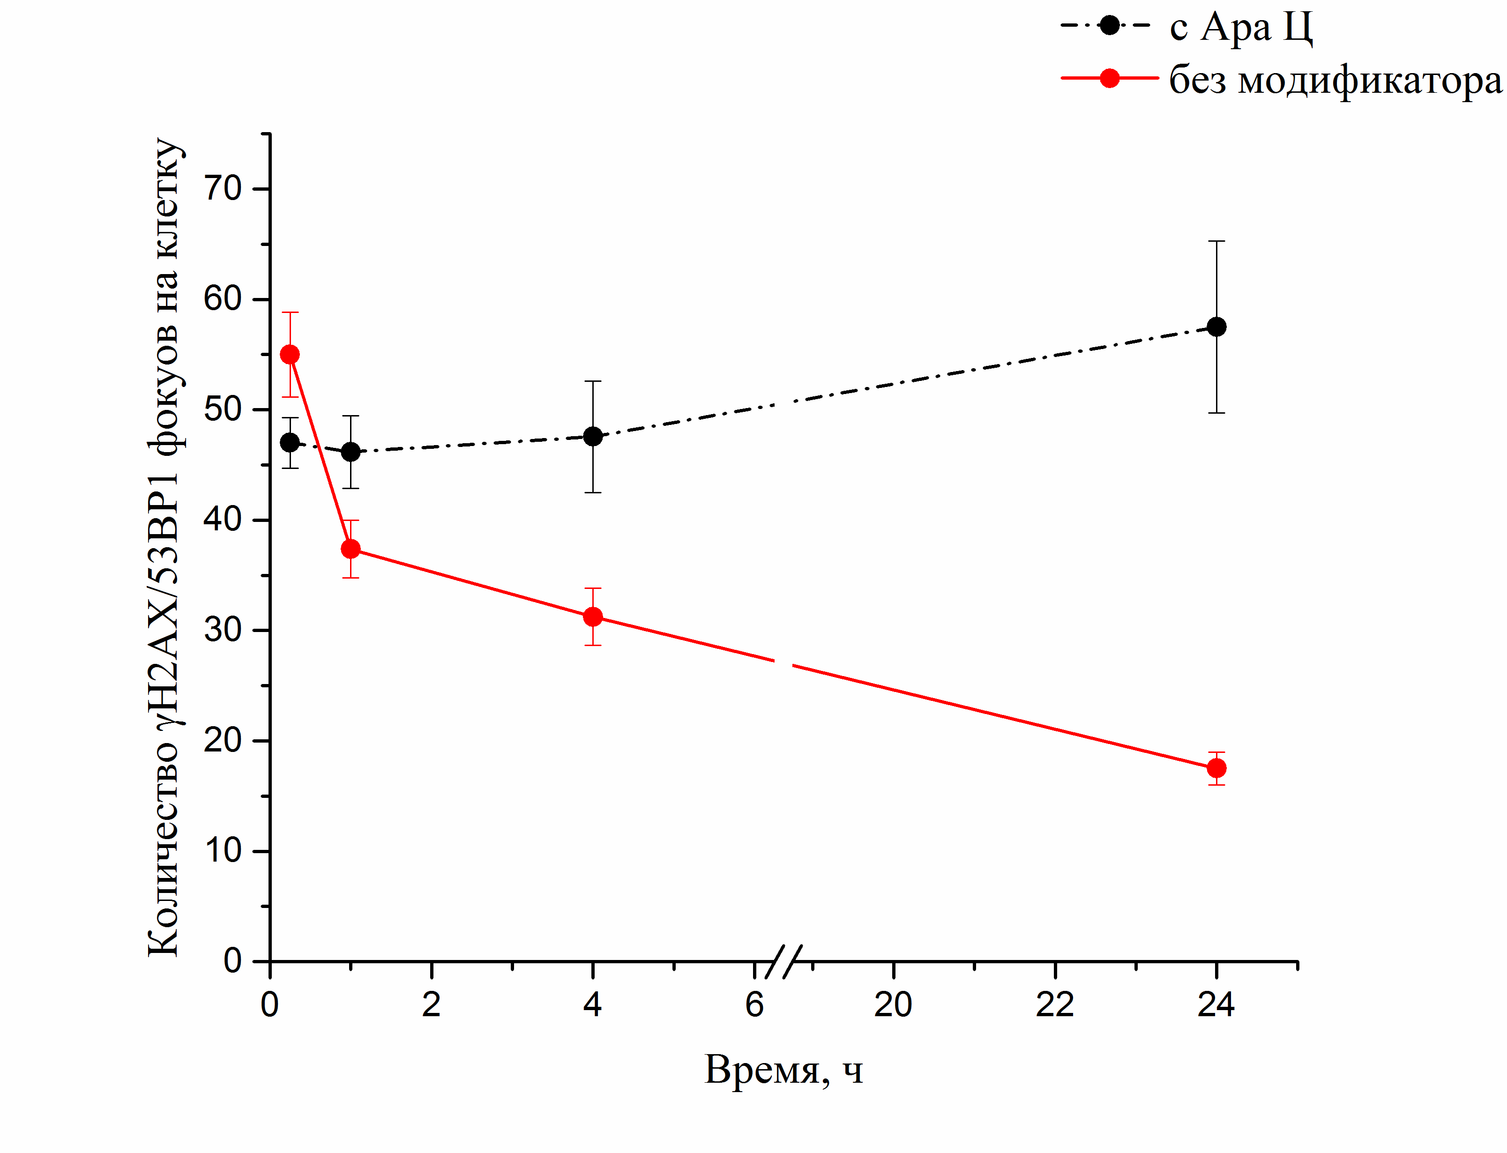
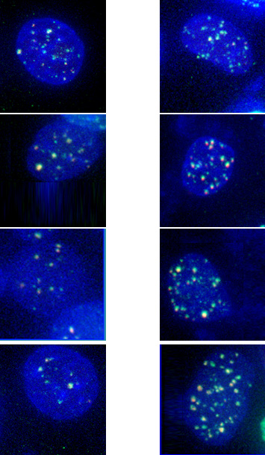
The mechanism for enhancing the damaging effect of ionizing radiation on tumors
Patent for invention
Increase of the biological effectiveness of proton radiation by DNA synthesis inhibitors
arabinoside cytosine (AraC)
officinal drug
with Ara C
without AraC
Amount of γН2АХ/53BP1 foci per cell
Time, hours
DNA damage in the Glioblastoma U87 cells
irradiated by medical proton beam (1.25 Gy)
Notes:
A new promising method for cancer therapy was invented in the Laboratory of Radiation Biology of the Joint Institute for Nuclear Research (LRB JINR). It is based on the increase of the biological effectiveness of gamma and proton radiations by the special drugs. Experiments on human tumor cells revealed the sharp increase of lethal DNA damage in the presence of these drugs (see figure). A patent for the invention has been obtained.

Slide 45

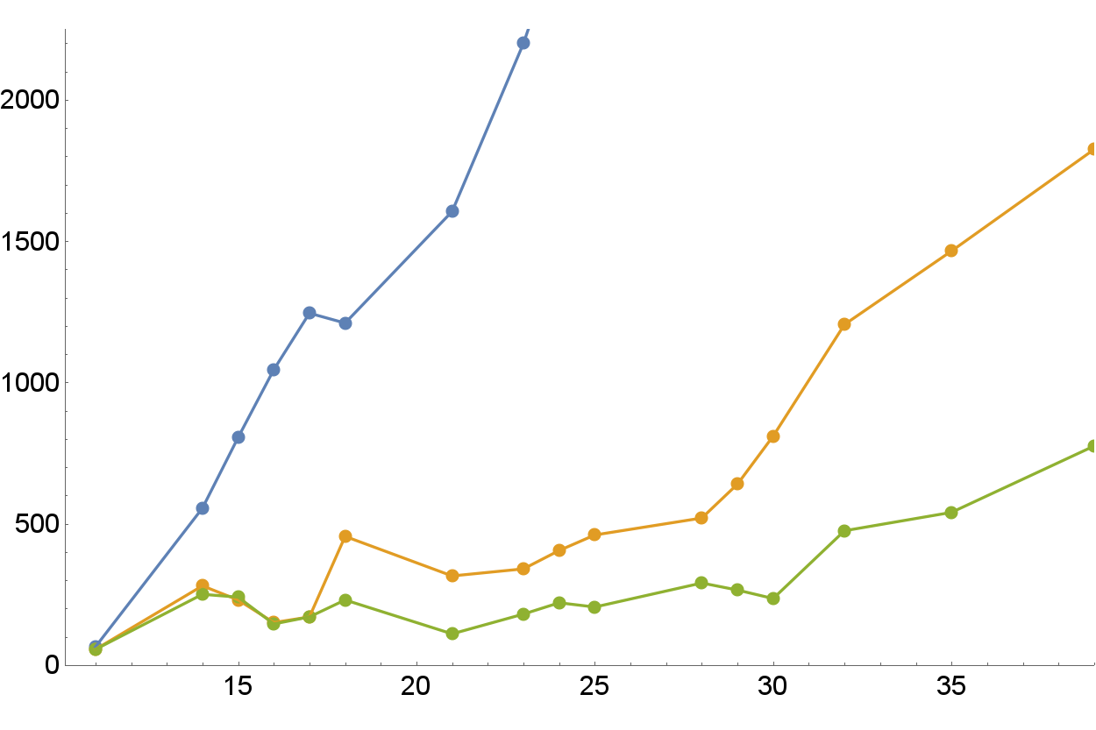

Preclinical animal study with transplanted
melanoma tumor in mice treated by medical proton beam
Without treatment:
death at day 30
Protons 10 Gy
Irradiation
Tumor size, mm³
Survivors
AraC +
Protons 10 Gy
Time after transplantation of tumor cells, day
Melanoma tumor volume growth rate is ~3 times lower with modifying agent
Notes:
The approach is based on the use of a drug licensed for cancer treatment. Recent preclinical experiments carried out by the LRB and the Center of Medical Radiology (Obninsk) on animals with inoculated melanoma tumor demonstrated higher effectiveness of medical proton beam in the presence of this drug. On day 30, control animals died without irradiation. Irradiated animals survived. Melanoma tumor volume growth rate was 3 times lower with modifying agent. New method could strongly enhance the efficiency of existing gamma and proton treatment facilities.

Slide 46
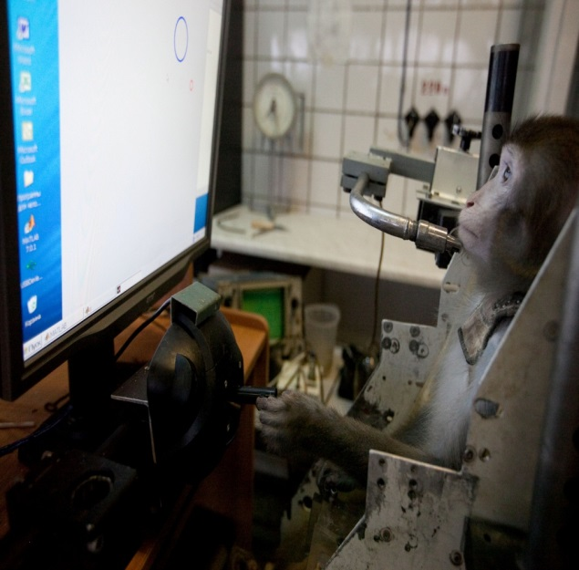
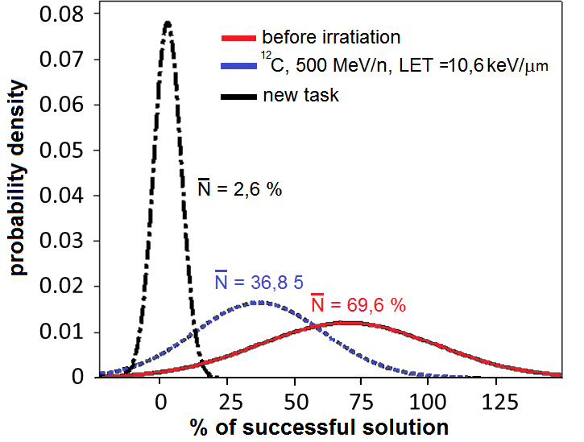
Radiation Physiology on primates
First worldwide unique experiments on primates to simulate the action of radiation on cognitive functions were performed with protons, carbon and krypton ions
The monkeys were preliminary trained to solve logical tasks with computer. The effect of exposure by 500 MeV/n Carbon ions at 1 Gy dose consisted in significant inhibiting cognitive activity of the monkeys.
In experiments with gamma-rays and protons with energy 170 MeV (LET = 0.53 keV/μm) at the same dose 1 Gy similar effect was not observed.
The probabilities of right solution for untrained monkey
( ), trained monkey ( ) and trained monkey after carbon Ions irradiation ( ).
¹²C ions:
bad performance
1 Gy ¹²C ions:
bad performance
protons:
no effect
1Gy protons:
no effect
%
Notes:
First exposure was done on med beam LNP, than in 40 days the head was exposured to 1 Gy of carbon beam at Nuclotron.
40 days after monkey’s head irradiation with 170 MeV protons, no disorders were observed in cognitive functions
All monkeys were preliminary trained to solve computer gaming tasks of increasing difficulty to simulate the basic elements of the operator's activity.
The number of attempts and right decisions were registered for each animal. As a result 1Gy carbon ions in contrast to protons lead to a prominent decrease of % successful decisions.
2 years ago pilot Kr78 exposure was done

Slide 47
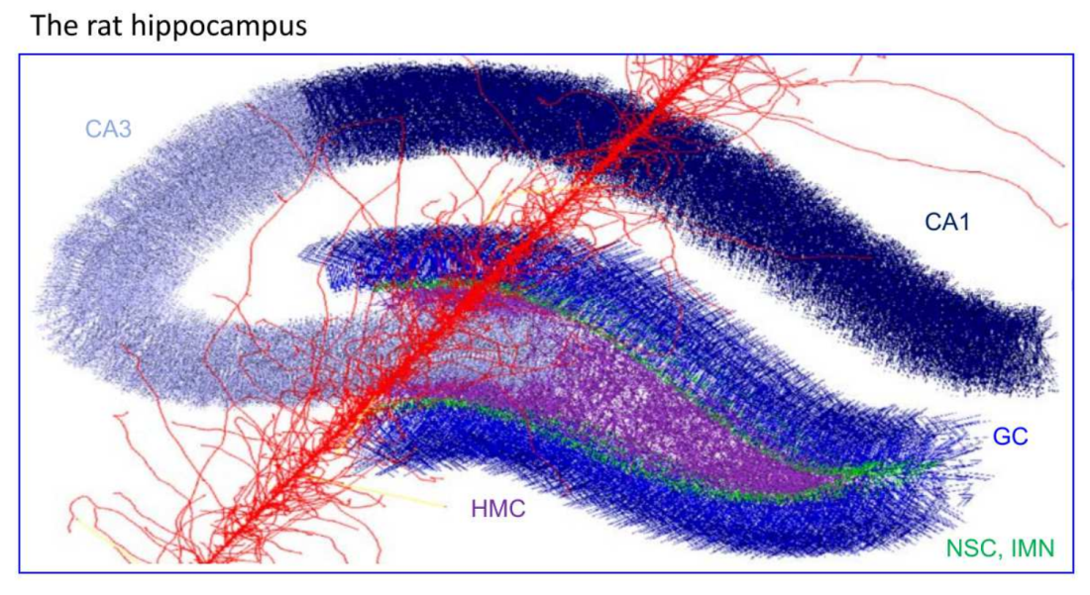
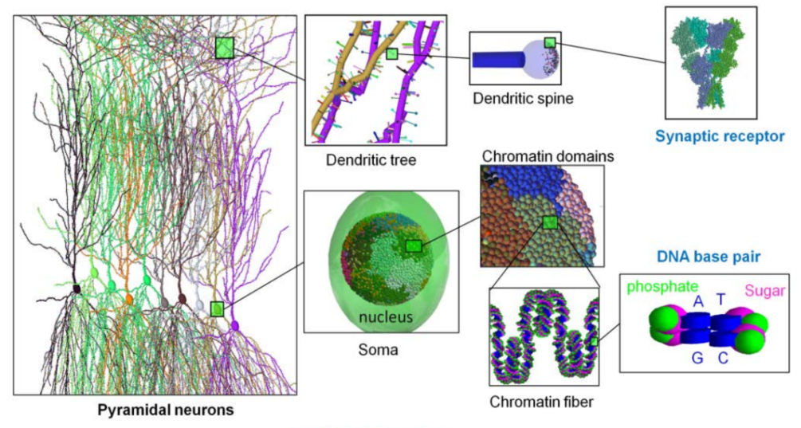
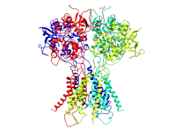
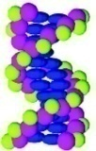
Mathematical Modeling
The hierarchy of new mathematical models to simulate radiation-induced damage to the Central Nervous System at different organization levels and time scales has been developed
Organization Levels:
Proteins
Brain regions ( 3D model of hippocampus traversed by 600 Mev/u Fe ion)
Neurons
Elements of cell
DNA
Methods:
Neural network modeling
Biochemical kinetics
Timescales: From femtoseconds to days
Molecular dynamics
Monte Carlo simulation
Notes:
The modeling studies aim to develop the hierarchy of mathematical models to simulate the radiation-induced pathologies at different organization levels and time scales: from molecular damage to brain neural networks.
In addition to the traditional Monte Carlo technique, the LRB's approach involves computational methods from different areas (molecular dynamics, biochemical kinetics, neural network modeling).

Slide 48

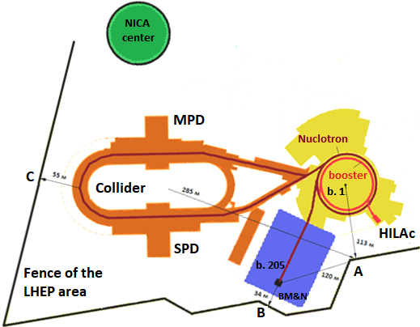
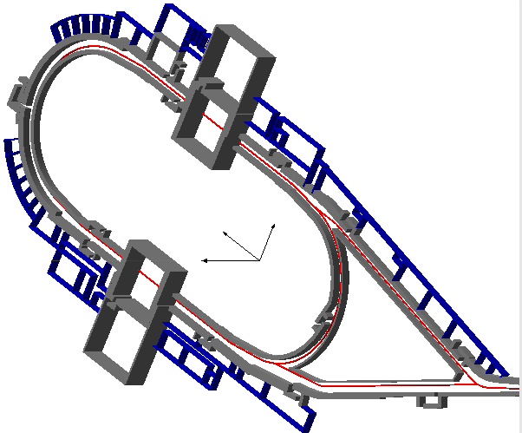
Radiation Research
Calculations of Radiation Shielding and Prediction of Radiation Environmaent around NICA Complex are Completed
Critical points for calculation of the
radiation
environment around
the NICA
complex
Collider model
Notes:
The main task is radiation protection management.
Calculation has been completed of the radiation environment around the NICA complex resulting from all radiation sources. The calculation and prediction of the radiation conditions at the NICA facilities are highly detailed and take into account all the physical processes; they have been performed with Monte Carlo codes of radiation transport in the matter. A number of design solutions have been proposed to protect NICA personnel from radiation exposure and decrease the radiation level in the environment. It has been shown that the fulfillment of the project measures of radiation protection at the NICA complex will ensure that the effective dose values at the LHEP site border will not exceed the established norms.

Slide 49
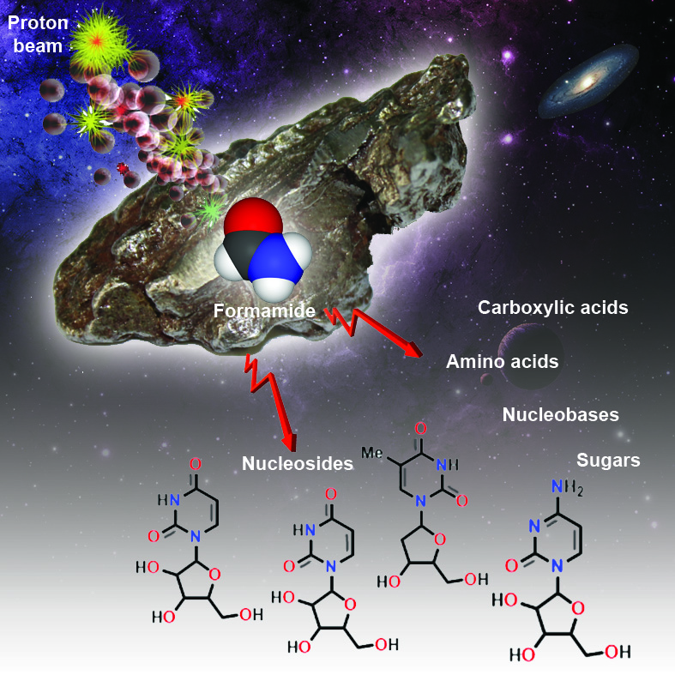

Astrobiology
Synthesis of prebiotic compounds from “formamide + meteorite matter” under particle exposure was observed for the first time
(supports panspermia hypothesis)
Key elements of life were detected:
nucleobases, nucleosides
heterocycles and sugars
amino acids
carboxylic acids
High-energy particle irradiation of widespread formamide molecule can provoke spontaneous generation of biomolecules in space

Slide 50


Infrastructure
Renovation of two buildings was performed
Building No 113
Building No 113 after renovation

Slide 51


Infrastructure
Renovation of two buildings was performed
Building No 71 after renovation
Building No 71

Slide 52




Education:
Biophysics Department
at Dubna University
More than 20 years ago, the Biophysics Department was established with JINR Directorate’s support at Dubna University
about 130 students graduated
38 work at LRB
(about 85% of scientific staff under 35 year)
Education program
Bachelors
“Human and Environmental Radiation Protection”
Masters
“Radiation Biophysics and Astrobiology”
Postgraduates
“Radiation Biology”

Slide 53




International Biophysics Collaboration
20-22 May 2019
First meeting
JINR joined the
International Biophysics Collaboration
International Biophysics Collaboration will coordinate the radiobiological and medical research at world leading accelerator centers and new facilities
(NICA in Russia, RAON in Korea, FRIB in USA, FAIR, SPIRAL2 and SPES in Europe, etc.)
Notes:
JINR joined the International Biophysics Collaboration (IBC). The Collaboration will coordinate the radiobiological and medical research at world leading accelerator centers and new facilities (including NICA!). A member of the IBC Executive Committe from JINR side is dr. Alexander Bugay - the newly elected director of the LRB.

Slide 54
Conclusion on Progress in Implementation
of the 7-years Plan of JINR
Main achievements:
New method of the enhancement of low-LET ionizing radiation’s biological effectiveness for radiation medicine (protected by JINR patent)
Start of worldwide unique experiments on primates irradiated with heavy ions
Development of hierarchy of new mathematical models to simulate radiation-induced damage to the CNS at different organization levels and time scales
Results of shielding calculations and prediction of radiation environment at NICA Complex
Synthesis of prebiotic compounds in the “formamide + catalysts” system under exposure to particle beams (panspermia hypothesis)
Progress achieved during the period of 2017-2019 can be recognized as successful , NO corrections in 7-years plan are required.

