Slide 1

PAC on Particle Physics
52nd Meeting:
Report to Scientific Council
JINR, February 20, 2020
Itzhak Tserruya

Slide 2
52nd PAC-PP Agenda – February 3-4, 2020
Highlights of the 52nd PAC-PP meeting:
Update reports on NICA, MPD and BM@N
Projects seeking continuation / revised / new theme:
ATLAS upgrade
NA64, FASA
Mu2e Meg-II, COMET
Reports from ALICE, ATLAS and CMS

Slide 3
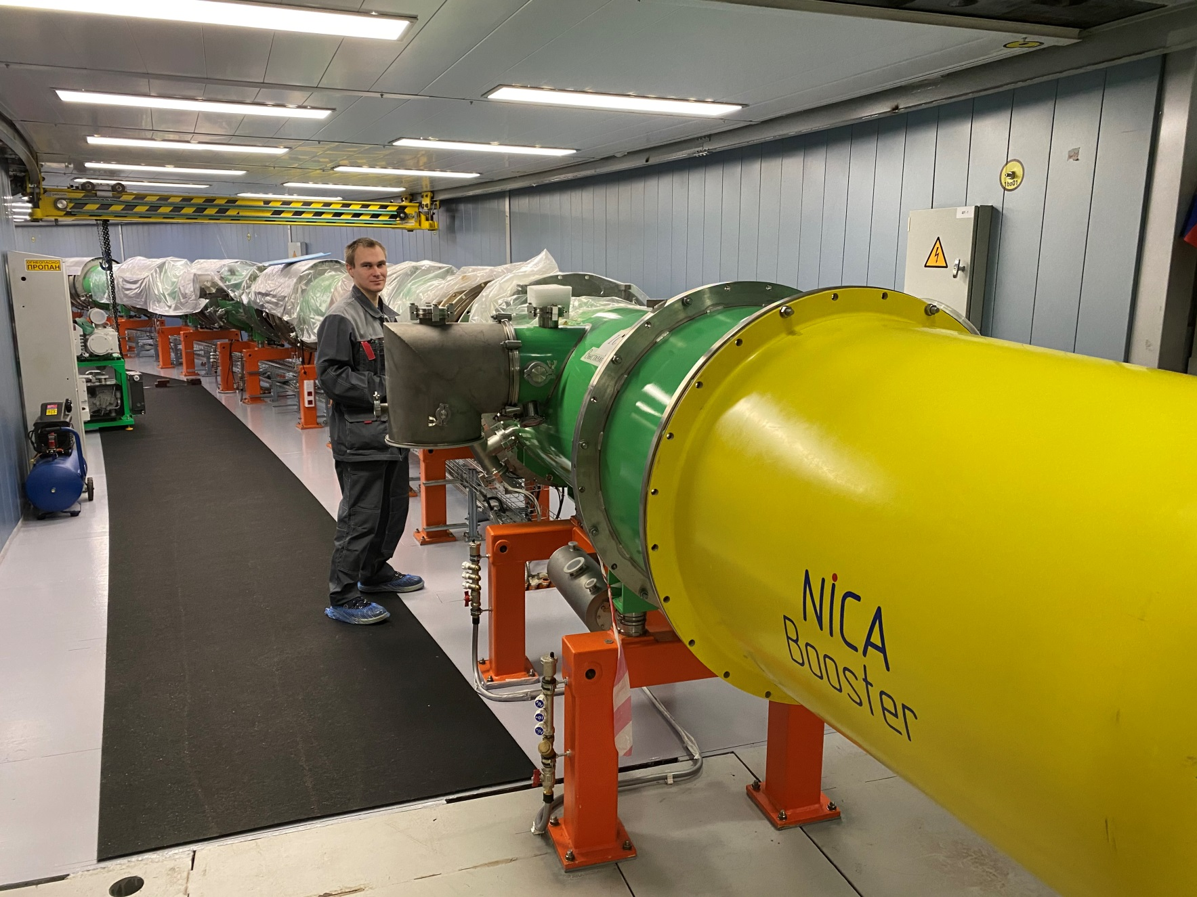
Report on the Nuclotron-NICA project
A. Sidorin
The PAC is pleased to note that all the magnets of the Booster synchrotron have been installed in the ring and that commissioning work has started.
The PAC supports the active preparatory work for starting the collider assembly: test of the RF1 system and progress in the serial production of the collider magnets.
May-June 2020: Booster commissioning with beam
September 2020: Delivery of Booster-Nuclotron transport line
End 2020: First operation Booster+ Nuclotron
Summer 2020: start collider assembly

Slide 4
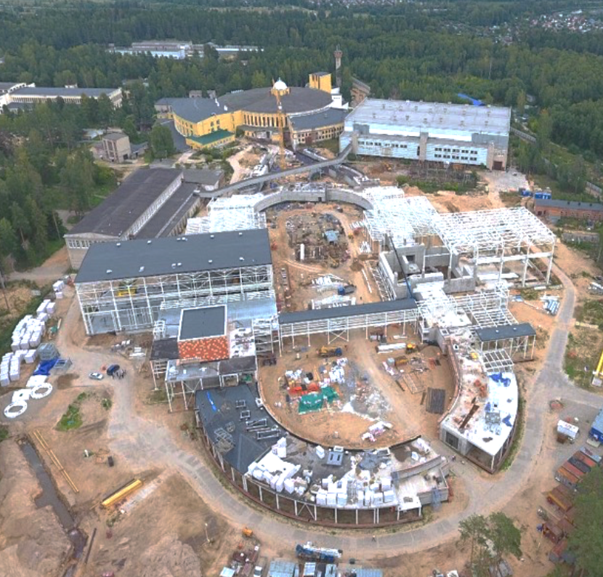
Infrastructure Developments
N. Agapov
The PAC appreciates the openness of the report pointing out at sources of delay in civil construction and suggesting the need to revise procurement procedures.
Construction of new buildings
Upgrading plants for liquid He and N₂ production
Upgrade of power supply systems (24 → 52 MW)
Development of thermal grids and pipelines
A

Slide 5
MPD
Adam Kisiel
The PAC welcomes the collaboration efforts to develop the detector elements with a view to completing the first stage of the detector construction and commissioning by 2021.
Transportation of MPD magnet yoke parts into the MPD hall
ECAL:
Production of modules started in Russia.
Production in China to start soon (first funding was recently approved by MOST).

Slide 6
BM@N
Mikhail Kapishin
The Committee is pleased to see the efforts toward the completion of the experimental set-up for the heavy-ion run in 2021.
Hybrid central tracker for heavy ions: STS + GEM
Beam intensity of a few 10⁶ Hz
7 GEM stations
4 STS stations
Target
& trigger detectors

Slide 7
Recommendations on projects approved for completion in 2019 and proposed for continuation
ATLAS upgrade – A. Cheplakov.
The PAC appreciates the progress made by the JINR group in fulfilling its obligations in the ATLAS uprade project, in particular the continuation of mass-production of the MicroMegas chambers for the New Small Wheel of the Muon spectrometer
The PAC reiterates its concern that the JINR ATLAS team is split into two groups, a hardware group and an analysis team.
Recommendation.
  The PAC reiterates the recommendation made at its previous meeting to consider unifying the two JINR ATLAS projects, one devoted to physics analysis and operations and the other focused on detector upgrade and R&D, into a single one.
  The PAC recommends continuation of JINR’s participation in the ATLAS upgrade project for the period 2021–2023 with first priority.

Slide 8
Recommendations on projects approved for completion in 2019 and proposed for continuation
NA64 revised proposal - D. Peshekhonov
The PAC is pleased to note that the action plan previously requested from the authors to improve the ratio of FTE to participants, to attract students and to get involved in data analysis, is satisfactorily addressed. The ratio of FTE to participants has increased by 60% and 4 new students were attracted to participate in MC simulation, data analysis, electronics and detector development.
Recommendation.
The PAC recommends continuation of JINR’s participation in the NA64 project for the period 2021–2023 with first priority.

Slide 9
Proposal of a new project
FASA revised proposal – S. Avdeev
  Background:
  FASA was presented for the first time at the PAC meeting of June 2019.
  The PAC noted that similar work on Multi-Fragmentation of Nuclei was carried out some 40 years ago at Fermilab, at CERN-PS and at the BEVATRON and BEVALAC.
  The PAC requested the authors to sharpen their scientific case taking into account these earlier data and to present a convincing case on how they can solve the still open question of break-up or thermalization in the multifragmentation of nuclei.
The PAC considers that the authors have not overcome the criticism raised at the previous PAC session. The authors have not convinced the PAC that FASA is a detector capable of resolving the open question of the multifragmentation process.
The FASA detector lacks isotope identification of light nuclei like ³He-⁴He, ⁶Li-⁷Li, ⁷Be-⁹Be. Data have shown, almost forty years ago, that spectra of these isotopes are very different from each other indicating different times in the reaction mechanism.
Furthermore the FASA detector has limited capability in measuring the full event in 4π geometry.
Recommendation.
The PAC recommends rejection of the FASA project.

Slide 10
Proposal of a new project
Search for new physics in the charged lepton sector, including 3 experiments:
    - Mu2e and MEG-II – V. Glagolev
    - COMET – Z. Tsamalaidze
The PAC recognizes the scientific merit of the charged-lepton flavor violation processes as probes for new physics.
The PAC considers the authors’ experience adequate to carry out these experiments and appreciates the involvement of young scientists.
The PAC also notes the hardware contributions of JINR in the three experiments, the production of the Mu2e cosmic veto system, the visualization of the MEG-II event display, and the successful R&D for ultrasonic welding of 12μm thin-walled straw tubes for the COMET experiment.
However, the PAC considers that participation in three different experiments with very similar scientific goals and competing with each other is not fully justified and not in line with the spirit of the recommendations made at the joint session of the PAC for Particle Physis and the PAC for Nuclear Physics in January 2019.
Recommendation.
The PAC proposes that effort and resources be focused on one single experiment, thus providing better conditions for the JINR team to achieve stronger impact, visibility and leadership in that experiment.
The PAC also realizes the complexity associated with such a decision and thus recommends approval of the project with the three experiments for only one year. This should allow enough time for the proponents, in coordination with the DLNP Director and JINR management, to consider the PAC’s proposal and to decide on their long-term involvement in this interesting physics project.

Slide 11
Reports on scientific results obtained by the JINR groups in the LHC experiments
ALICE - E. Rogochaya.
The group has published several results concerning the photoproduction of light vector mesons in ultraperipheral Pb-Pb collisions at 5.02 TeV and, for the first time, the identical charged kaon femtoscopic correlations in p-Pb collisions at the energy of √sNN=5.02 TeV that showed consistency with the predictions of hydrodynamic models.
The JINR-ALICE group is also interested in a femtoscopic correlation analysis for pairs of opposite sign kaons produced in Pb-Pb collisions at 2.76 TeV.
The PAC appreciates the effort of the JINR team in physics analyses and encourages further increase of this effort.
In response to the recommendations made by the PAC concerning rejuvenation, three PhD and one undergraduate students were invited to work on the data analysis.
The PAC requests the group to submit at the next PAC meeting a detailed plan of its future activities with milestones.

Slide 12
Reports on scientific results obtained by the JINR groups in the LHC experiments
ATLAS - E. Khramov
The group’s members have continued their analyses in defining the structure of the proton at ultrahigh energies, in searches for Zγ, Wγ and Hγ resonances in boosted jet plus photon final states and Supersymmetry processes, and in the search for a valence-like nonperturbative component of heavy quarks in the proton.
Results on the search for Pentaquark, for B_{c} excited states and associated production of the ttbar quark pair and Higgs boson were reported at various international conferences.
The JINR group received an ATLAS Software Development Grant to participate in the development of the event triggers indexing infrastructure and implementation of the new configurations mechanism for the AthenaMT framework. This allowed it to increase the Institutional Commitments coverage from 50% in 2018 to 90% in 2019.
The PAC appreciates the group’s plans to continue the above mentioned analyses and expand its participation in the ATLAS software development.

Slide 13
Reports on scientific results obtained by the JINR groups in the LHC experiments
CMS – V. Aleksakhin
The PAC appreciates the contribution of the JINR group in the search for extra gauge bosons and extra dimensions in the dimuon channel, the recent results on searches for extra Higgs bosons decaying into a pair of b-quarks and muons, and the cross-section measurements of Drell–Yan lepton pair production.
The PAC also commends the operation and service work carried out by the group in the Phase 1 upgrage project, in the operation of the Tier1 and Tier2 computer centres, as well as the CMS Regional Operation Centre.
The PAC appreciates the JINR group’s activity in the R&D work for the Phase 2 upgrade of the CMS detector.

Slide 14
Strategic long-range plans
B. Sharkov and D. Naumov
The PAC takes note of the reports concerning the current preparation of the draft of the Strategic plan for the long-term development of JINR in its major sections, and in particular those related to particle physics, heavy-ion physics and spin physics.
The PAC looks forward to being informed about the final version of the Strategic plan.

Slide 15
Scientific Report
The PAC heard with interest the report “Pion at various stages of heavy-ion collisions” presented by E. Kolomeitsev and thanks the speaker for his presentation.

Slide 16
Presentations by young scientists
The PAC reviewed 18 poster presentations in particle physics by young scientists from DLNP, BLTP and VBLHEP.
The Committee selected the poster “Real-time detection of supernova neutrino signal ” presented by A. Sheshukov to be reported at this session of the Scientific Council.

Slide 17
Next PAC-PP Meeting – February 3-4, 2020
The next meeting of the PAC-PP will be held on June 29-30, 2020
The following items are proposed to be included in the agenda of the next meeting:
  Follow-up on the to-do-list from this PAC meeting
  Status report on the Nuclotron-NICA project
  Status report from the Coordinator of the Nuclotron experimental programme
  Status report on infrastructure issues including Nuclotron
  Status report on the MPD project
  Status report on the BM@N project
  Consideration of new projects
  Reports and recommendations on the projects to be completed in 2020
  Posters from young physicists

Slide 18

Thank you!

