Slide 1
Programme Advisory Committee
for Condensed Matter Physics
51st meeting (20 – 21 January 2020)
Dénes Lajos Nagy
127th session of the JINR Scientific Council, 20–21 February 2020, Dubna

Slide 2
Agenda of the 51st PAC meeting

Slide 3
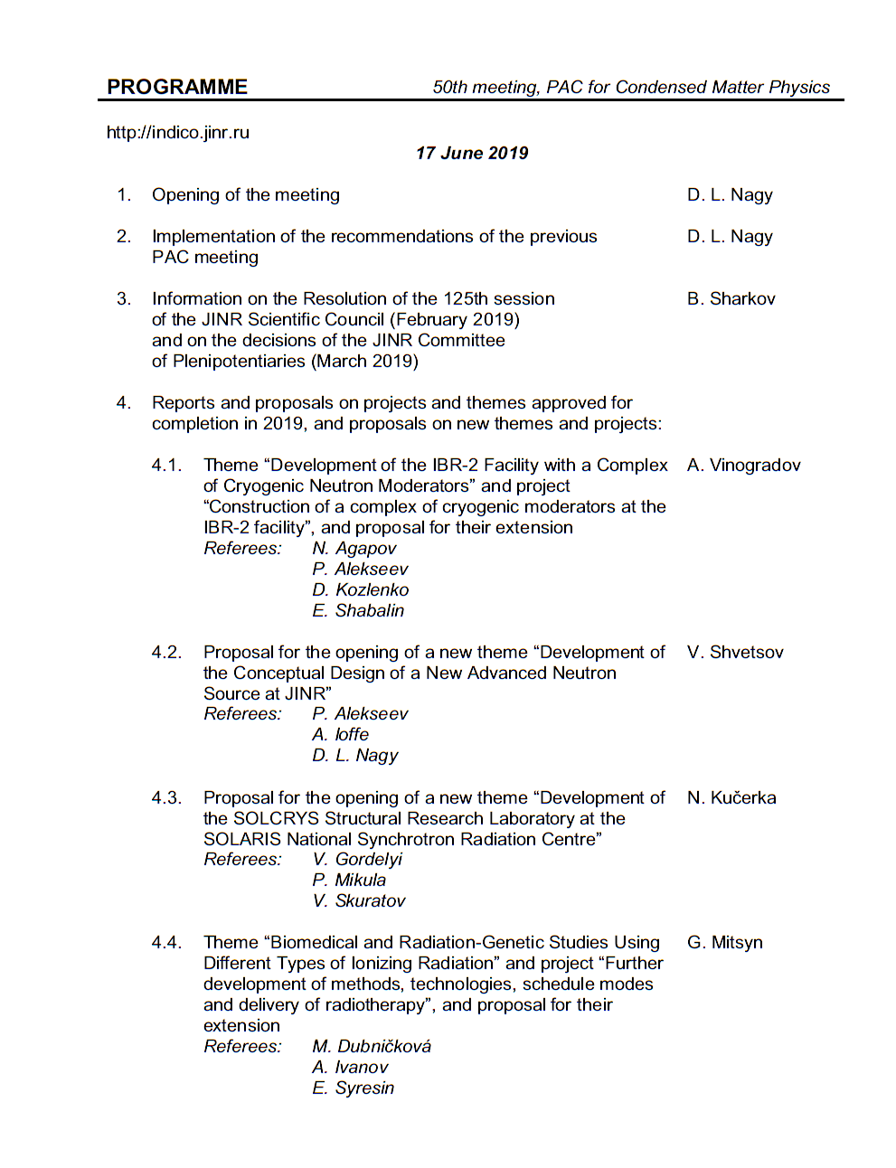
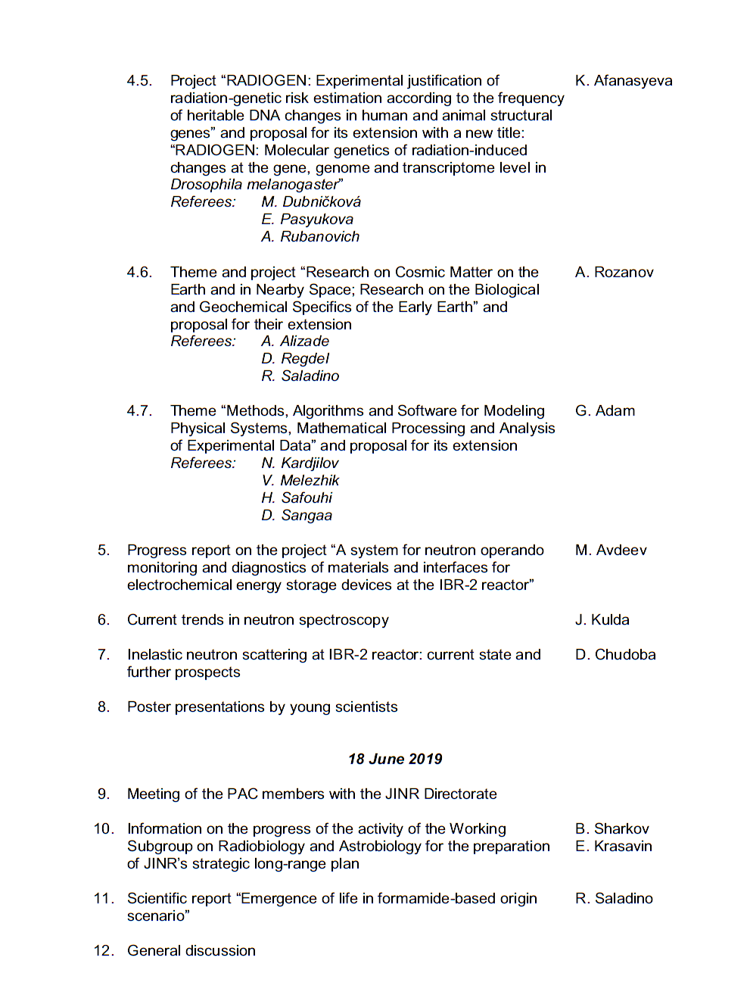
Agenda of the 51st PAC meeting
Highlights of the PAC-CMP meeting:
Progress in development of a concept for a new neutron source of JINR
Main results of the instrumentation development and scientific research
in condensed matter physics at the IBR-2 reactor in 2019
FLNP User Programme at the IBR-2 spectrometers
Report on the project for open information and educational environment

Slide 4
Development of the concept for a new neutron source at JINR
The PAC heard the progress report on developing the concept of the new neutron source at FLNP presented by V. Shvetsov.
The PAC notes the results of consideration of the two alternative concepts of DNS-IV, i.e. the pulsed neutron reactor IBR-3 with ²³⁷Np core and the accelerator-driven spallation neutron source with PuO₂ core providing neutron multiplication factor of about 20-50.
Both options have been under a feasibility study at the N. A. Dollezhal Research and Development Institute of Power Engineering (Moscow).
The final recommendation made within this study is based on such criteria as achievable neutron characteristics, nuclear safety, engineering complexity, timeline and estimated costs. It was found that the engineering complexity of the second option made its implementation rather uncertain, both in terms of time and costs.
Therefore, the pulsed neutron reactor IBR-3 with NpN fuel will become the working concept for further development of DNS-IV.

Slide 5
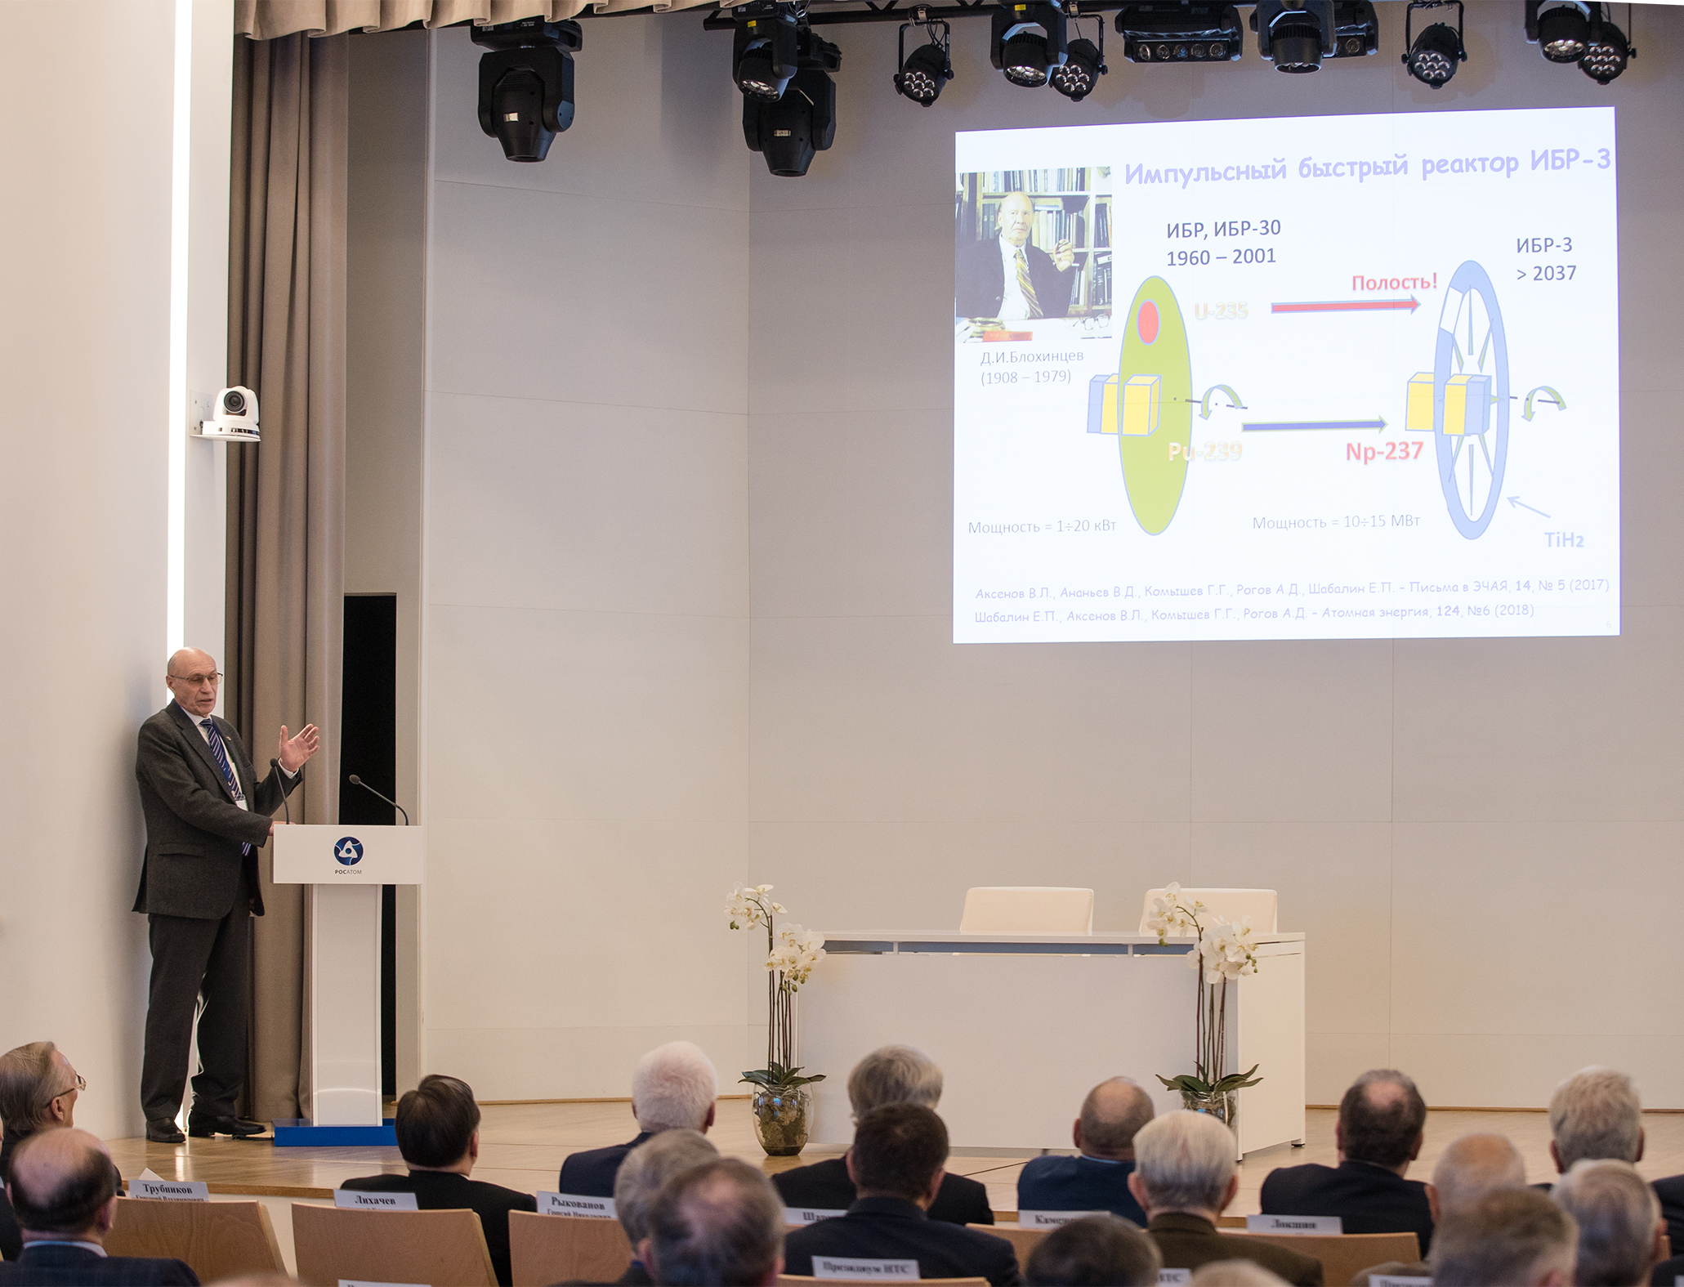
Development of the concept for a new neutron source at JINR
Joint meeting of the Presidium of the Science and Technology Council of the “Rosatom” State Atomic Energy Corporation and leaders of the Joint Institute for Nuclear Research
The State Corporation “Rosatom” and the Joint Institute for Nuclear Researcher signed a cooperation agreement on partnership interaction in some issues of leading scientific projects, including the development of the NICA collider complex, the Superheavy Element Factory, the use of the IBR-2 pulse reactor and the development of a new pulse reactor facility in Dubna.
The IBR-3 fast pulse reactor was a topic of the report by FLNP Scientific Leader, RAS Corresponding Member V. L. Aksenov; the co-author of the report was A. V. Lopatkin (NIKIET).

Slide 6
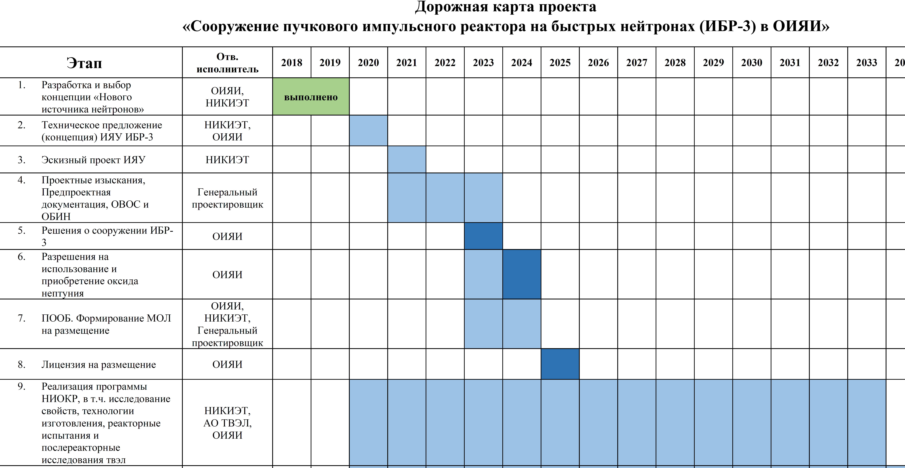
Development of the concept for a new neutron source at JINR
The PAC notes the starting of JINR cooperation with the A.A. Bochvar High-technology Research Institute of Inorganic Materials (Moscow) aimed at developing a roadmap for NpN reactor fuel fabrication. The PAC also welcomes presenting the detailed roadmap for the DNS-IV implementation.
Roadmap for the construction of the IBR-3 pulsed fast neutron reactor at JINR

Slide 7
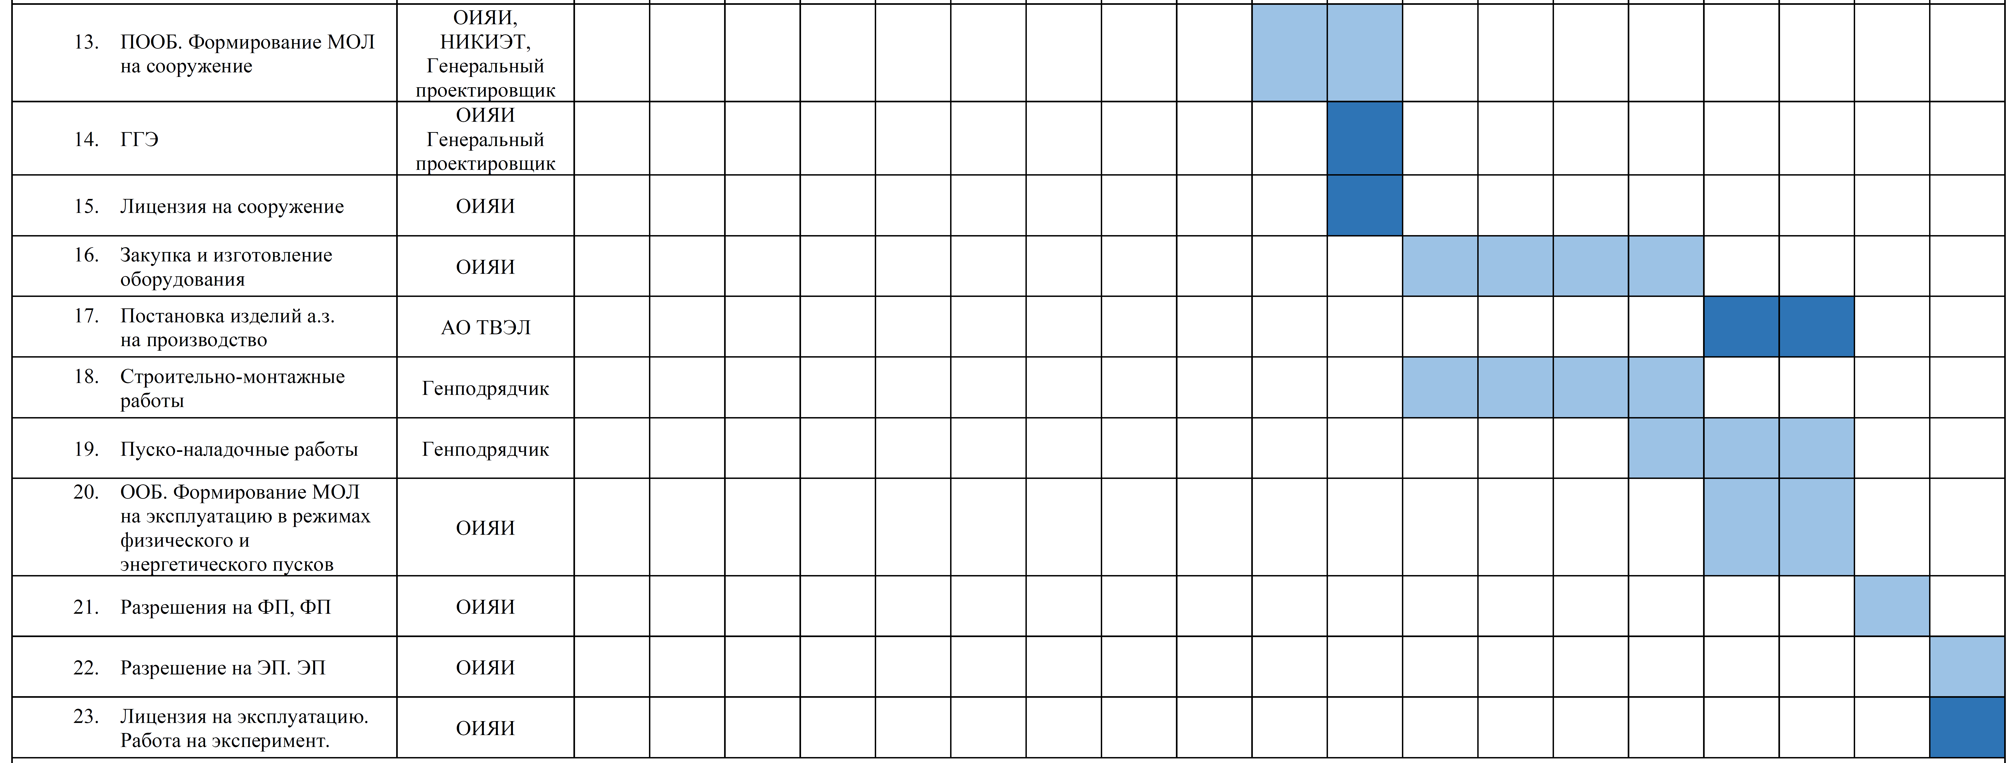
Development of the concept for a new neutron source at JINR

Slide 8
Development of the concept for a new neutron source at JINR
Recommendation 1. The PAC congratulates the FLNP Directorate on determining the working concept of the new neutron source and recommends its deeper elaboration.
Recommendation 2. The PAC has significant concerns about the background of the new facility and draws attention to the crucial importance of achieving background levels on IBR-3 and its instruments corresponding to the world-best practice.

Slide 9
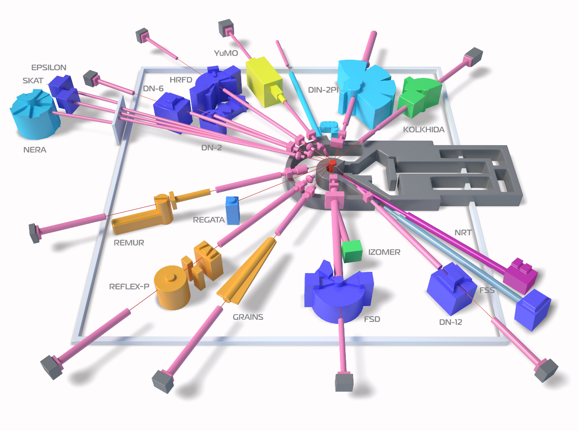
Main results of the instrumentation development and scientific research in condensed matter physics at the IBR-2 reactor in 2019
Diffractometers:
HRFD, DN-6, RTD, DN-12, FSD, SKAT/Epsilon, FSS
The PAC was informed by D. Kozlenko about the main results of the instrumentation development and the scientific research in the field of condensed matter physics at the IBR-2 reactor in 2019.
Reflectometers:
REMUR, REFLEX, GRAINS
2011:
11 instruments
in operation
Now:
15 instruments
in operation
Small Angle Scattering Spectrometer: YuMO
Inelastic Neutron Scattering Spectrometers:
NERA, DIN-2PI
Radiography and Tomography: NRT
New Instruments:
DN-6, GRAINS, NRT, FSS
Reconstruction:
REFLEX – SESANS

Slide 10
Main results of the instrumentation development and scientific research in condensed matter physics at the IBR-2 reactor in 2019
The PAC considers the activities focused on the upgrade of the IBR-2 instruments to be important for providing competitive research opportunities for the realization of the FLNP scientific programme to the external users and for expanding the research areas.

Slide 11
Main results of the instrumentation development and scientific research in condensed matter physics at the IBR-2 reactor in 2019
Recommendation.
The PAC appreciates the demonstrated examples of the new scientific results and instrumentation developments at IBR-2 achieved in 2019.
At its future meetings, the PAC requests that the instrumentation development and the highlights of obtained scientific results be reported separately.

Slide 12
FLNP User Programme
Work schedule of the IBR-2 reactor in 2019
The PAC heard information presented by D. Chudoba on the statistics of the FLNP User Programme at the IBR-2 spectrometers

Slide 13
FLNP User Programme

Slide 14
FLNP User Programme

Slide 15
FLNP User Programme
The ratio of numbers of experimental reports to number of accepted proposals

Slide 16
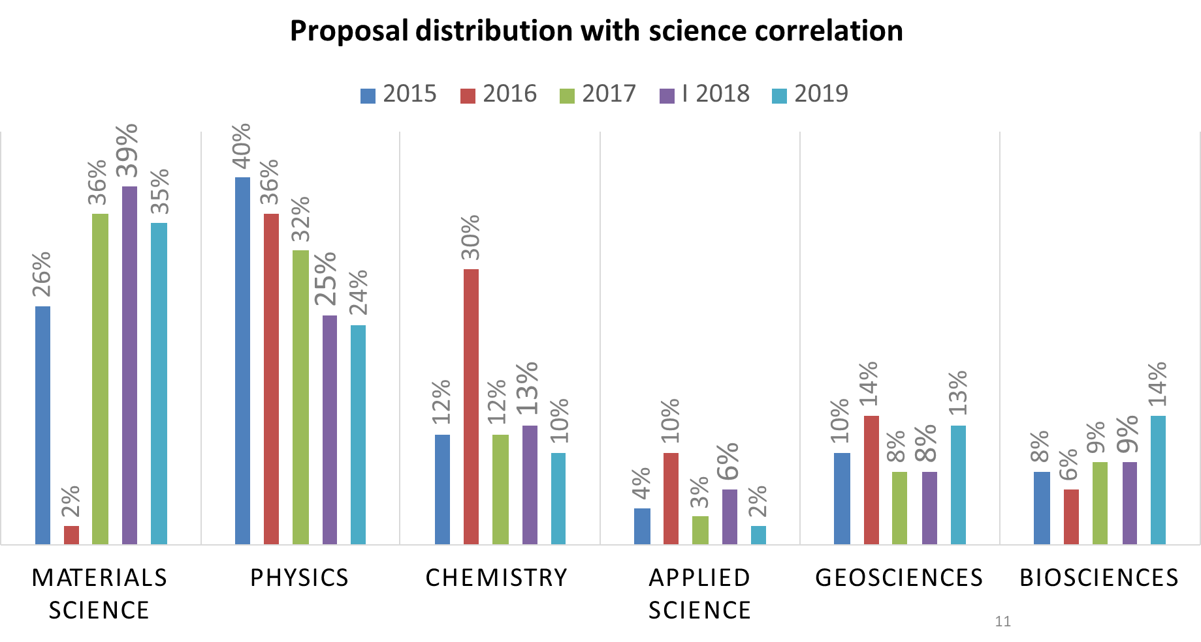
FLNP User Programme

Slide 17
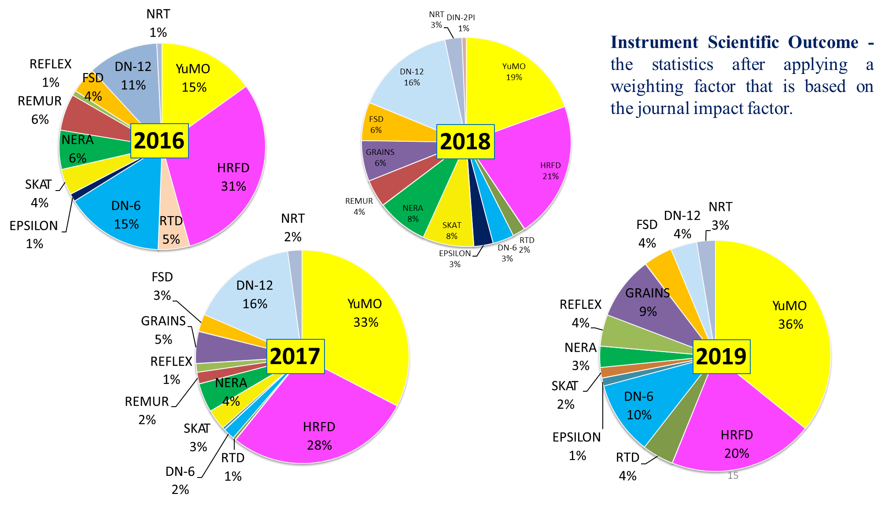
FLNP User Programme

Slide 18
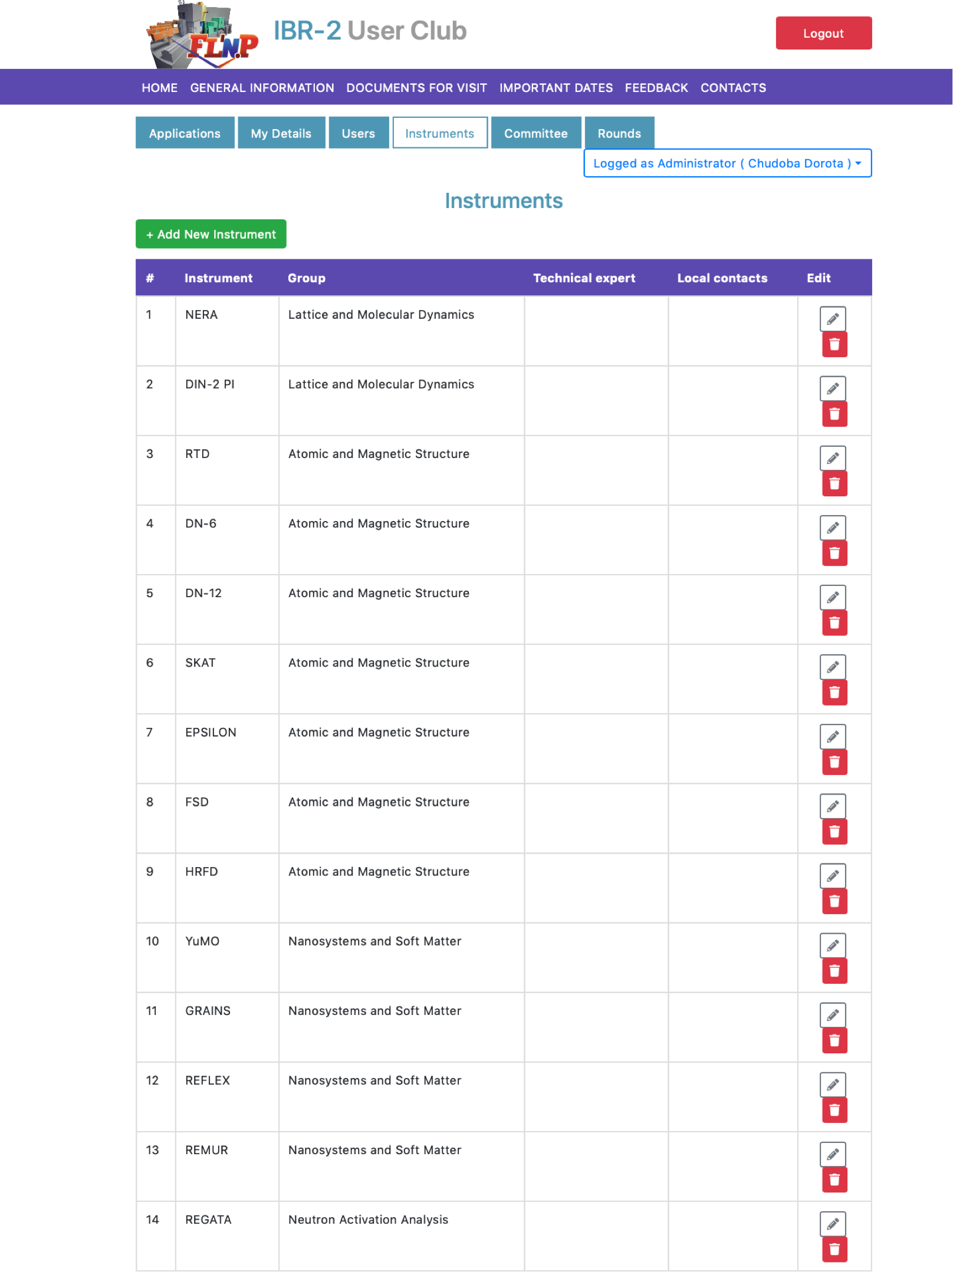
FLNP User Programme
IBR-2 User Club
Neutron activation analysis:
REGATA (installation will be included in the User Programme starting from March 2020)
New Expert Committee: Neutron Activation Analysis
The PAC supports further developing the FLNP User Programme with the included neutron activation analysis facility.
Recommendation. The PAC recommends considering a possibility of changing the application submitting period for the second round.

Slide 19
Inelastic neutron scattering at IBR-2
The PAC heard reports presented by W. Zajac and D. Chudoba on the current trends in neutron spectroscopy and on the status of inelastic neutron scattering spectroscopy at FLNP.
The PAC notes the fact that the two spectrometers mentioned in the reports no longer satisfy the requirements of users from Eastern Europe.
The PAC takes note of the progress of work for opening the new project of developing a new inelastic neutron scattering spectrometer within the theme “Investigations of Condensed Matter by Modern Neutron Scattering Methods” for 2021–2023.
Recommendation. The PAC supports the development of new inelastic neutron scattering instruments and the preparation for opening the new project for the period 2021–2023.
The PAC expects a detailed proposal for this new project to be presented at the next PAC meeting.

Slide 20

Development of a neutron radiography and tomography instrument at the WWR-K reactor (Almaty, Kazakhstan)
The PAC heard a report presented by K. Nazarov on developing a neutron radiography and tomography facility at the WWR-K reactor of the Institute of Nuclear Physics (Almaty, Kazakhstan) in collaboration with FLNP.
Institute of Nuclear Physics,
Almaty, Kazakhstan
Joint Institute for Nuclear Research,
Dubna, Russia
Protocol on joint cooperation between the Joint Institute for Nuclear Research (Dubna) and the RSE Institute for Nuclear Physics (Almaty) № 4785-4-17/19 from 11.12.2017 y.
Project period: 2017-2019

Slide 21
Development of a neutron radiography and tomography instrument at the WWR-K reactor (Almaty, Kazakhstan)
The PAC takes note of the description of the main components of the experimental set-up and the results of the first test experiments.
Neutron source: Steady-state reactor WWR-K
A reactor operating
200 days/year
7
8
6
9
10 cycles with 20 days
Thermal power: 6 MW
Fuel: UO₂ +Al
5
1
4
Heat carrier and moderator:
light water
2
3
Flux: 2,2×10¹⁴ thermal neutrons/cm²·s
Recommendation. The PAC compliments the results of this activity and recommends following up with the implementation of the suggested research programme.

Slide 22

Report on the project
The PAC reviewed the report presented by Yu. Panebrattsev on the completed project
“Development of an open information and educational environment to support research priorities in material science and structure of matter”
and the proposal for opening a new project
“Open information and educational environment for supporting fundamental and applied multidisciplinary research at JINR”.

Slide 23
Report on the project
Project goals
Use of modern educational technologies for various training methods and courses for students and specialists to work at JINR. Attracting talented youth from the participating countries to work at JINR.
Integration of the results of fundamental and applied research obtained at JINR into the education process in the JINR Member States and Associate Members.
Collaboration with leading world scientific centers (CERN, BNL) to create educational resources for physics teachers and high school students.
Promotion of fundamental and applied multidisciplinary research conducted at JINR and the JINR brand to a wide audience. Development of courses prepared by the leading JINR specialists for international open education platforms.
Creation of educational and exhibition content on JINR topics at the level of leading research centers.

Slide 24
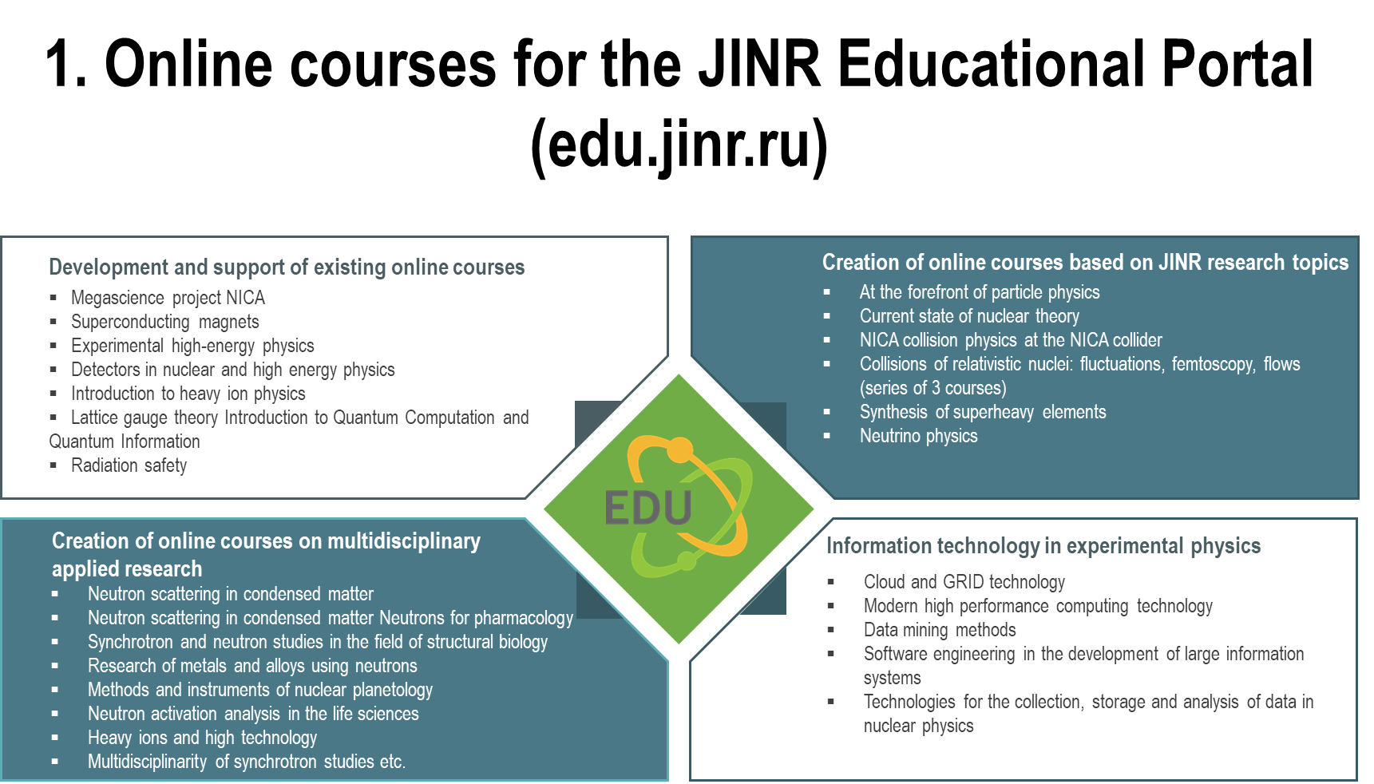
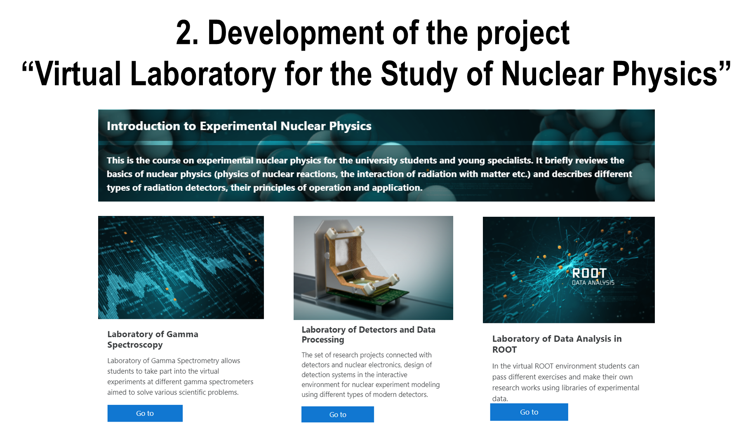

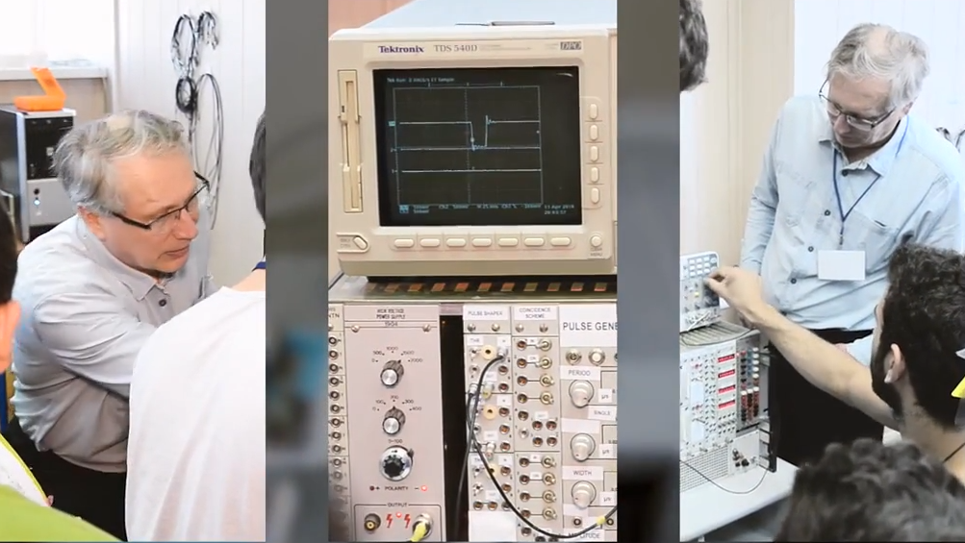
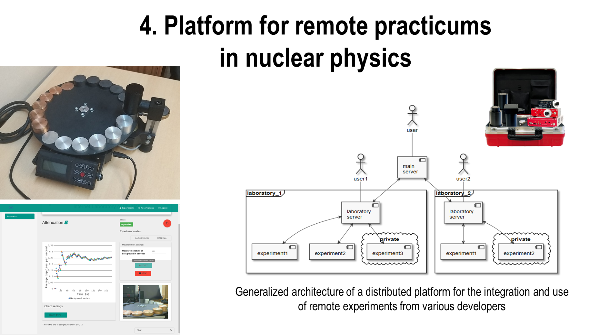
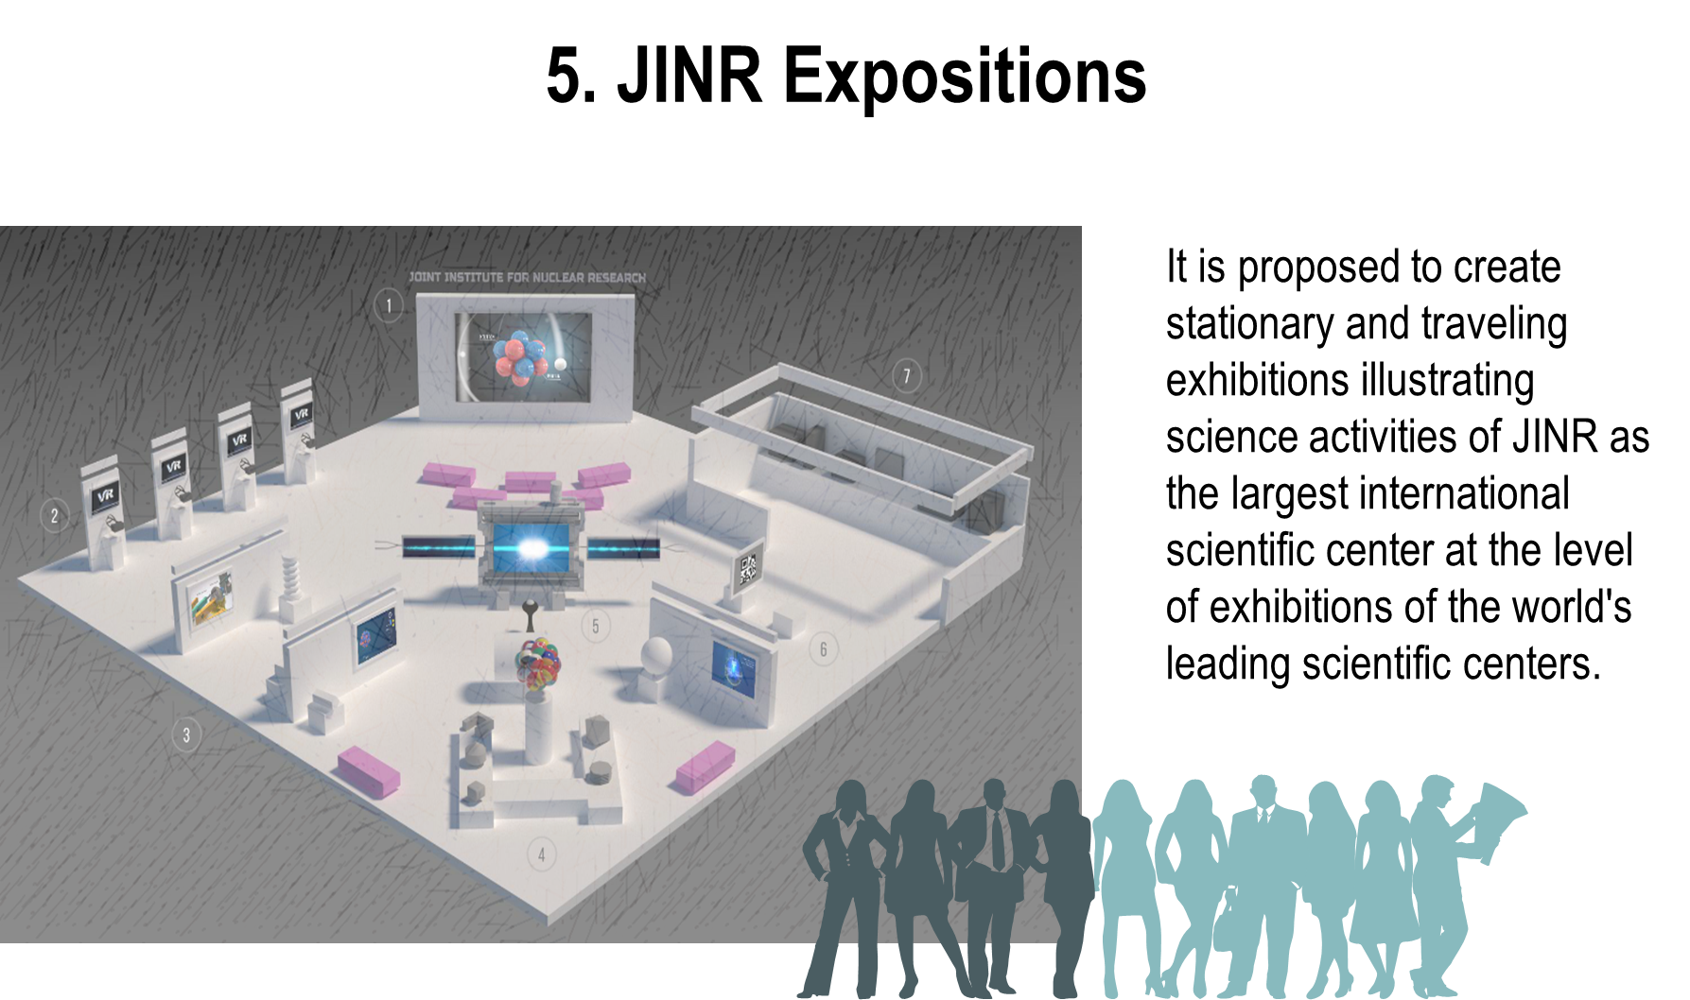
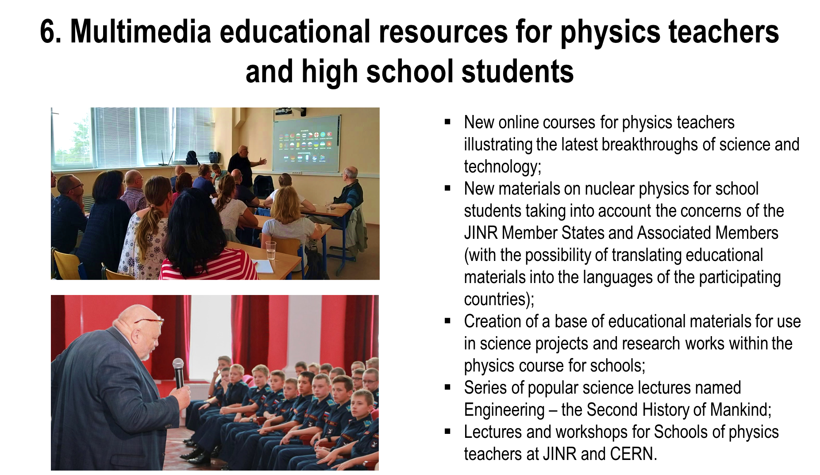
Report on the project

Slide 25
Report on the project
Recommendation
As to the successful implementation of the project “Development of an open information and educational environment to support research priorities in material science and structure of matter”, the PAC supports its completion and recommends opening the new project “Open information and educational environment for supporting fundamental and applied multidisciplinary research at JINR” for implementation in 2021–2023 within the theme “Organization, Support and Development of the JINR Human Resources Programme”.
In future reports on this new project, the PAC would like to be informed on the integration of the JINR educational environment into education schedules and plans of the JINR Member States’ universities and scientific organizations.

Slide 26
Scientific reports & conferences
“Microscopic mechanism of the spontaneous polarization in strontium hexaferrites” (V. Turchenko)
“Ultrasensitive detection of analyte molecules at attomolar concentration by Raman spectroscopy” (G. Arzumanyan)
“Superconductor spintronics based on Josephson nanostructures” (Yu. Shukrinov)
“TEM examination of the ceramics irradiated with heavy ions of fission fragment energies” (V. Skuratov)
“Structural modification of carbon materials by swift heavy ions” (A. Olejniczak).
The PAC thanked the speakers for their excellent presentations.
The PAC took note of the information about the International Conference “Radiobiological Basis of Radiation Therapy” (17–18 October 2019, Dubna).

Slide 27
Poster presentations
The PAC reviewed 15 poster presentations by young scientists
in condensed matter physics and related fields.
The poster
“Neutron activation analysis as a tool for tracing the accumulation of silver nanoparticles in tissues of female mice and their offspring”
by I. Zinicovscaia
was selected as the best poster at the session.
The PAC noted two other high-quality posters:
“Synthesis and research of magnetic nanoparticles of the “core-shell” type for bioapplications” by A. Nazarova
&
“Investigation of internal structure and atomic dynamics of pharmaceutical compounds under the influence of high pressure” by N. Belozerova
Recommendation. The PAC recommends the poster “Neutron activation analysis as a tool for tracing the accumulation of silver nanoparticles in tissues of female mice and their offspring” to be reported at the session of the Scientific Council in February 2020.

Slide 28
Next meeting of the PAC
The next meeting of the PAC for Condensed Matter Physics will be held on 2–3 July 2020.
Its preliminary agenda includes:
information by the PAC Chair on the implementation of the recommendations of the current PAC meeting;
information by the JINR Directorate on the sessions of the Scientific Council (February 2020) and of the Committee of Plenipotentiaries (March 2020);
reports and recommendations on themes and projects to be completed in 2020 and on new themes and projects;
progress of the development of the concept for JINR’s new neutron source (reports by the FLNP Directorate and the WSG-5 Chair);
report by the FLNP Directorate on its vision of the IBR-2 instrumentation development for the next five years;
overview of all the themes and projects related to the PAC for Condensed Matter Physics;
status reports on the upgrade of FLNP instruments;
information about scientific meetings;
scientific reports (not more than three);
poster session.

Slide 29
Thank you for your attention

