Slide 1
Programme Advisory Committee for Nuclear Physics
51st meeting
30–31 January 2020
Marek Lewitowicz

Slide 2
Programme Advisory Committee for Nuclear Physics,
51st meeting, 30–31 January 2020
4. Research activities under the theme “Investigations of Neutron Nuclear Interactions and Properties E. Lychagin
of the Neutron”: status and prospects
5. Letter of intent to open a new project: “Modernization of the EG-5 accelerator and development A. Doroshkevich
of its experimental infrastructure”
6. Proposal for opening a new project: “BECQUEREL” P. Zarubin
7. Status of the Factory of superheavy elements V. Semin, V. Utyonkov
8. Prospects for the study of multinucleon transfer reactions A. Yeremin
9. Poster presentations by young scientists
10. Scientific reports:
10.1. “Fusion reactions in nuclear astrophysics” V. Sargsyan
10.2. “Prompt neutron investigation in nuclear fission induced by resonance neutrons” S. Zeynalov

Slide 3
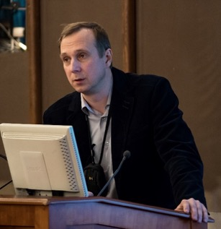
Research activities under the theme “Investigations of Neutron Nuclear Interactions and Properties of the Neutron”: status and prospects
50th PAC for NP recommendations for this theme
Egor Lychagin
In the future the PAC expects more details on the programme of nuclear data measurements, in particular the objectives, the priorities and the complementarity with the worldwide programmes.
The FLNP Directorate is advised to focus on the modernization of experimental halls and pavilions.
The PAC recommends that special attention be given to the beam delivery systems to increase neutron fluxes at the experiment places. The PAC expects a detailed report on this topic to be presented at the next meeting.

Slide 4
Research activities under the theme “Investigations of Neutron Nuclear Interactions and Properties of the Neutron”: status and prospects
The leader of the theme was appointed Egor Lychagin instead of Valery Shvetsov
The very broad research program in the framework of the theme includes:
research of quantum-mechanical phenomena with ultracold and cold neutrons;
  Including Development of the advanced Very Cold Neutron Source
study of properties of the neutron;
  Including Investigation of possibility of the neutron lifetime measurement at IBR-2 beam
study of nuclear reactions induced by neutrons;
  Including program at TANGRA facility
  Including investigations of various fission parameters and characteristics of Prompt Fission Neutron (PFN) emission
applied research using nuclear physics methods.
  Including development of the Neutron Activation Analysis (NAA) and Neutron Resonance Capture Analysis (NRCA)
Egor Lychagin

Slide 5
Research activities under the theme “Investigations of Neutron Nuclear Interactions and Properties of the Neutron”: status and prospects
Development of the advanced Very Cold Neutron Source
Collaboration in the framework of
CREMLINplus WP3 T3.1 between:
ILL (Grenoble, France),
NRC KI-PNPI (Gatchina Russia),
JINR (Dubna, Russia),
PTI (St-Petersburg, Russia),
UCA (Clermont-Ferrand, France),
UNIMIB (Milano, Italy),
ESS (Lund, Sweden)
NCSU (Raleigh, NC, USA)
During the last year, a lot of simulation and experimental work (NAA, SANS, XRD, PGA etc.) was done to define optimal parameters of the powder and its production.
In 48 months (starting from February 2020) the prototype of the VCN source should be developed and tested experimentally.
5

Slide 6
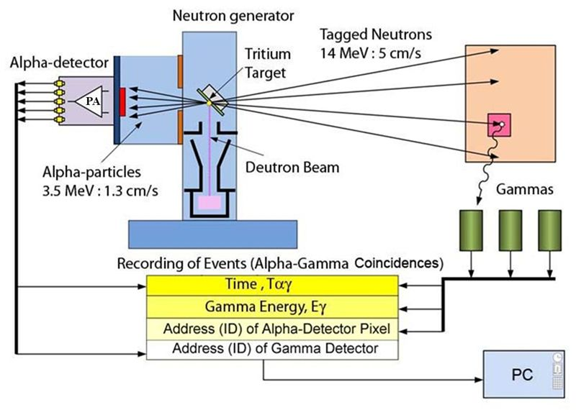
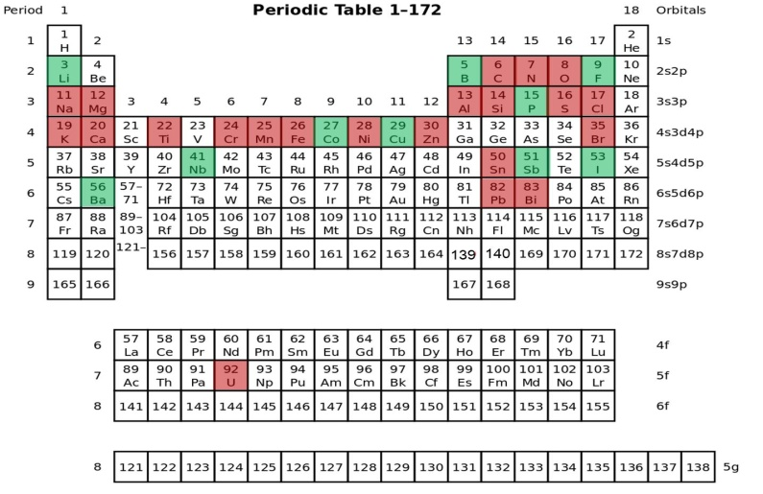

Measurements of yields and gamma rays' angular correlations in reactions with 14.1 MeV neutrons (TAgged Neutrons & Gamma-Rays -TANGRA project).
Modernization of the TANGRA facility using an HPG detector are planned in 2020-2022 :
further measurements of yields and angular correlations of gamma rays
measurement of the reactions (n, 2n) and (n, f)
theoretical analysis of experimental data
Measured nuclei
Closest plans

Slide 7
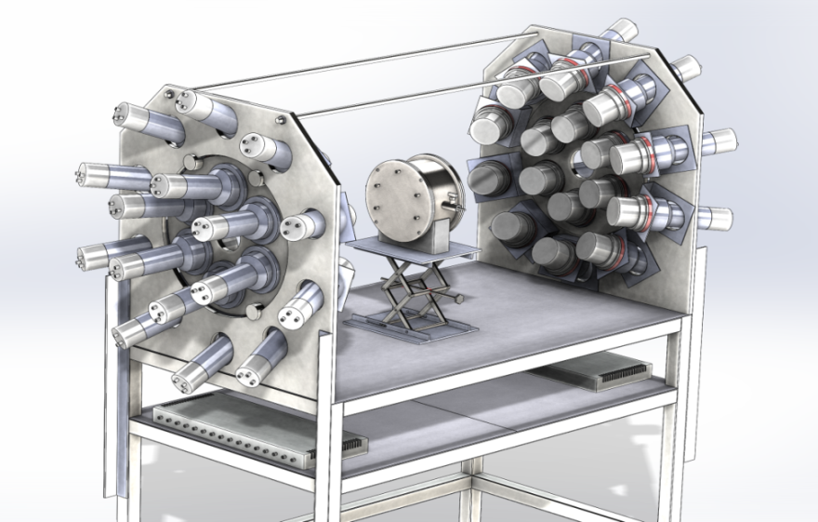
Research activities under the theme “Investigations of Neutron Nuclear Interactions and Properties of the Neutron”: status and prospects
Investigations of various fission parameters and characteristics of Prompt Fission Neutron (PFN) emission.
A double ionization chamber was designed to measure the kinetic energies, masses, and the orientation of fission axis in the 3D space for the correlated fission fragments.
The accuracy of direction cosines definition is better than 0.05
32 PFN detectors were placed close to the axis of the ionization chamber to guarantee the maximum PFN detection efficiency ~0.8π.
The set-up was totally assembled, the work place at the beam line №2 of IREN was prepared.

Slide 8
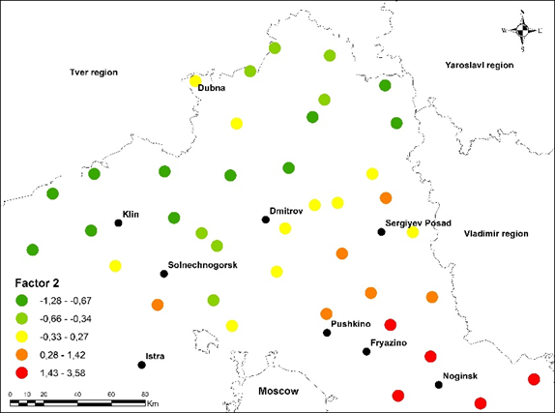
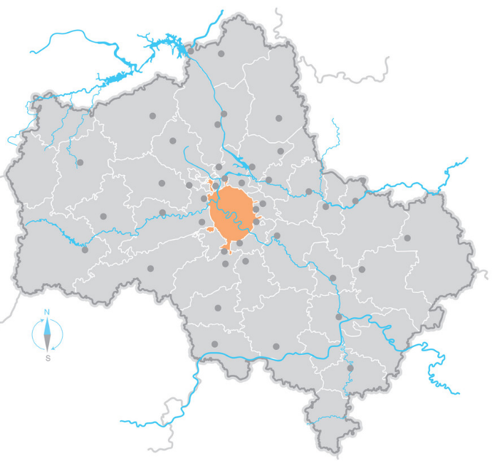
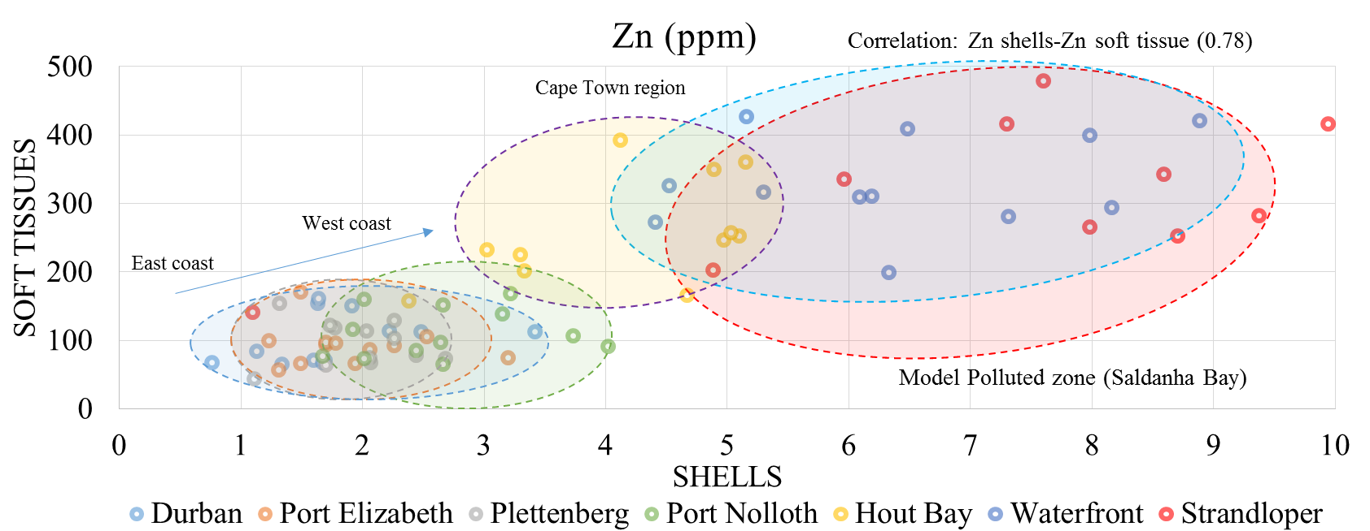
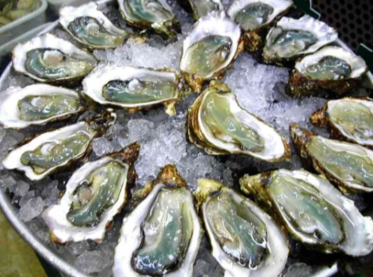
Research activities under the theme “Investigations of Neutron Nuclear Interactions and Properties of the Neutron”: status and prospects
Applied Research
Experimental methods and setups
NAA, XRF (REGATA, REGATA-2)
Neutron resonance spectroscopy (at IREN)
Experiments at Van-der-Graaf EG-5 (modernization of the accelerator)
Further plans for Neutron Activation Analysis (NAA)
Including the REGATA facility in the FLNP User Programme;
Improvement of the NAA at the REGATA facility at IBR-2;
Development and construction of the low-background γ-ray spectrometer and the α spectrometer;
Participation in the 2020/2021 European moss survey;
Research in the field of environmental studies, geology, material science, medicine, nanotoxicology, etc.
International program "Heavy metal atmospheric deposition in Europe”
Mo, W and Sb
In 2019 in the framework of the “Mussel watch” project of JINR-SA mussels were collected at the six stations along the South African coast, The obtained data showed that the most polluted place is the area near Capetown.
Moscow

Slide 9
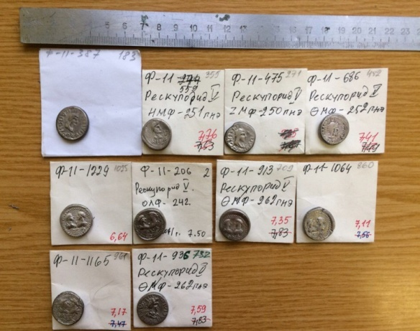
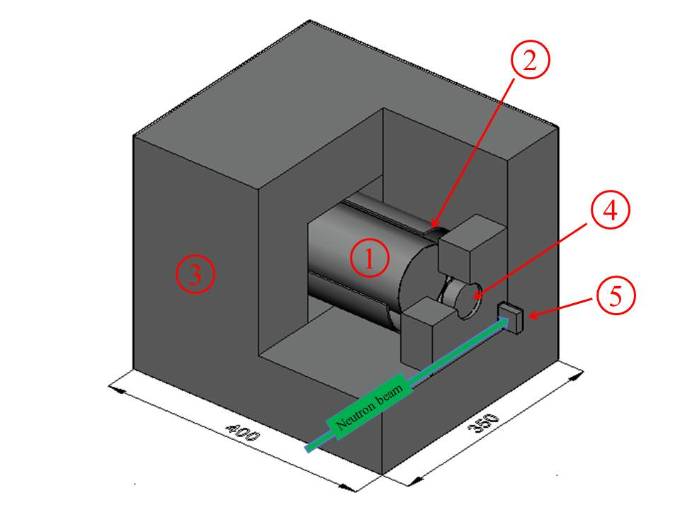
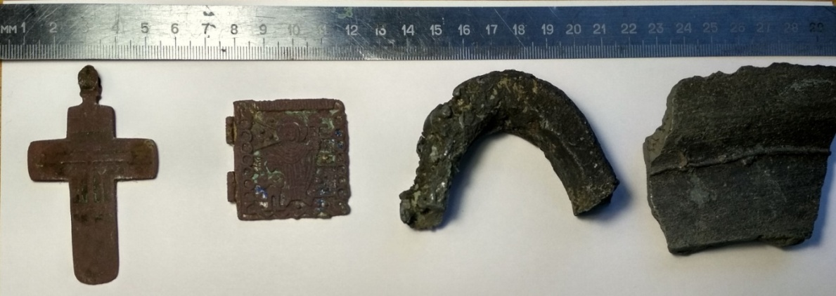
Research activities under the theme “Investigations of Neutron Nuclear Interactions and Properties of the Neutron”: status and prospects
Neutron Resonance Capture Analysis (NRCA)
10 coins from the largest treasure of the Bosporus straits of the 3rd-4th centuries. A.D.
The main advantages of the Neutron Resonance Analysis:
Nondestructive,
Sensitivity to isotopic element content,
Fundamental opportunity to study samples of any shape and size,
Very limited induced activity.
№ | Element | Mass, g
1 | Cu | 63.4± 3.2
2 | Ag | 8.42± 0.27
Measured weight 73.033 g |  | 71.8 ± 3.2 g
In 2020, it is planned to conduct research at the IREN facility on archaeological samples obtained from the Institute of Archeology of the Russian Academy of Sciences.
1. HPGe gamma detector
2. B₄C cover
3. Lead shield covered with Cd
4. LiF window
5. Sample
cross
icon
horseshoe-shaped metal object
fragment
of the bell

Slide 10
PAC for NP recommendations for the theme
“Investigations of Neutron Nuclear Interactions and Properties of the Neutron”
The PAC recommends that priorities of this theme be better focused.
Special attention should be paid to the development of key technologies for the new neutron source.
The PAC appreciates the development of activities related to Intense REsonance Neutron Source (IREN).
The PAC encourages an active use of the extracted beams for both basic and applied research in order to make more efficient use of the facilities operating time.

Slide 11
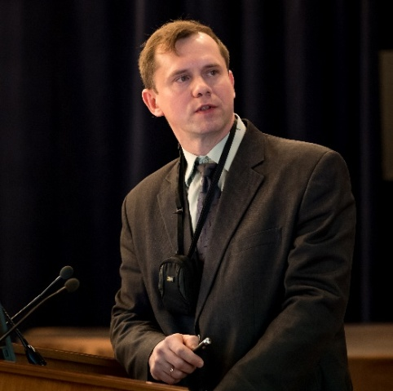
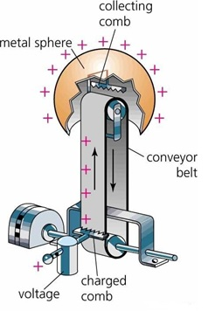
Letter of intent to open a new project: “Modernization of the EG-5 accelerator
and development of its experimental infrastructure”
New project
Technical task:
Restoring the technical parameters of the EG-5 accelerator:
energy up to 4.1 MeV (2,9 MeV today)
current above 50μA (100nA today)
Ways to solve:
Tube replacement;
Modernization of infrastructure;
Young staff training.
Alexander Doroshkevich
Plans
Development of the experimental infrastructure
1. New spectrometers.
2. Microbeam Project.
3. Use of multibeam configuration
The estimated 3-years project cost is 1,5M$

Slide 12
PAC for NP recommendations for the letter of intent to open a new project:
“Modernization of the EG-5 accelerator and development of its experimental infrastructure”
The PAC supports the presentation of a full proposal within the theme “Investigations of Neutron Nuclear Interactions and Properties of the Neutron”.
The project should define expected accelerator specifications in accordance with the priorities of the scientific programme.
The PAC recommends comparing carefully the two options: modernization of the present EG-5 accelerator or purchase of a new accelerator taking into account the risk associated with the proposed upgrade.
The full project should include detailed information about the schedule, human and financial resources as well as a risk analysis.

Slide 13
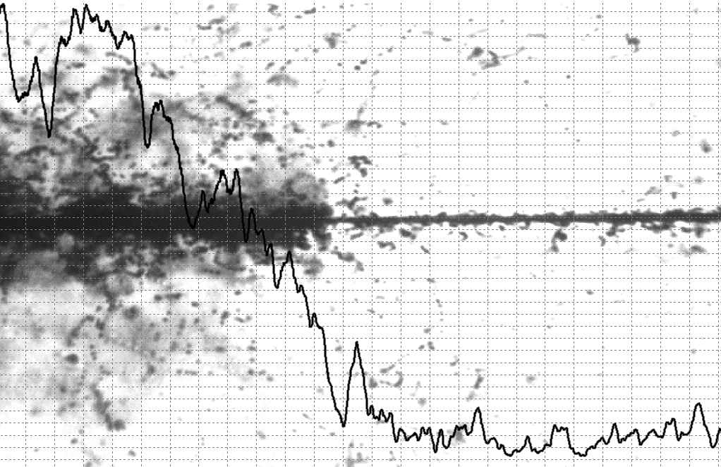
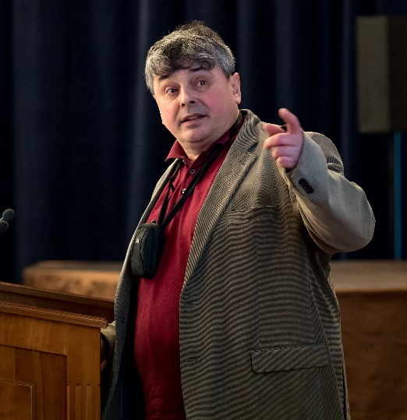
Proposal for opening a new project: “BECQUEREL”
Pavel Zarubin
Studies of nuclear fragmentation using nuclear emulsions have a very long history. Nevertheless this method still keeps promising opportunities, in particular due to the high resolution in determination of emission angles of relativistic fragments. The project is devoted to experiments with various accelerators, apart from studies of multifragmentation processes, authors plan to search for unstable states in nuclei.
The PAC recommends that the VBLHEP Directorate provide financial support for renovation of the equipment used in the BECQUEREL experiment in 2021. The proposal should be presented at the PAC meeting in January 2021.

Slide 14
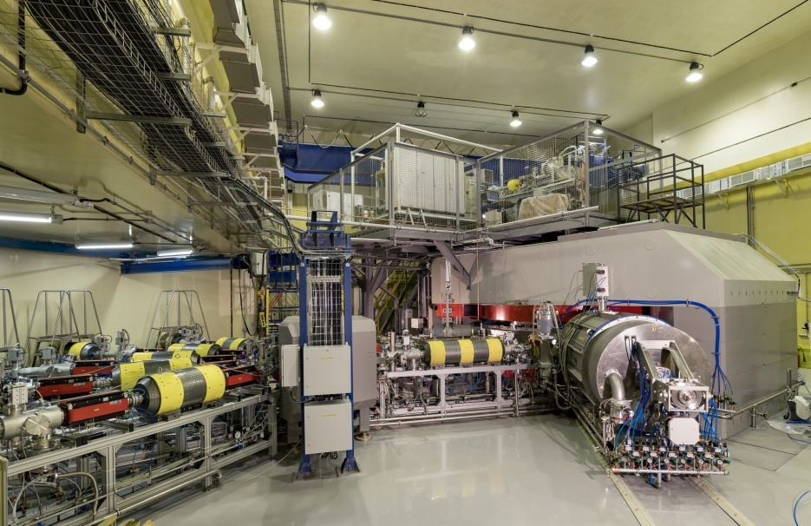

Status of the Factory of superheavy elements: DC-280 cyclotron
Vasiliy Semin
Accomplished tasks:
Test of accelerator systems with high intensity
Testing of cyclotron systems during longtime operation
Investigation of stability of accelerated beams
Debugging of high voltage elements
Staffing of the DC-280 work group

Slide 15
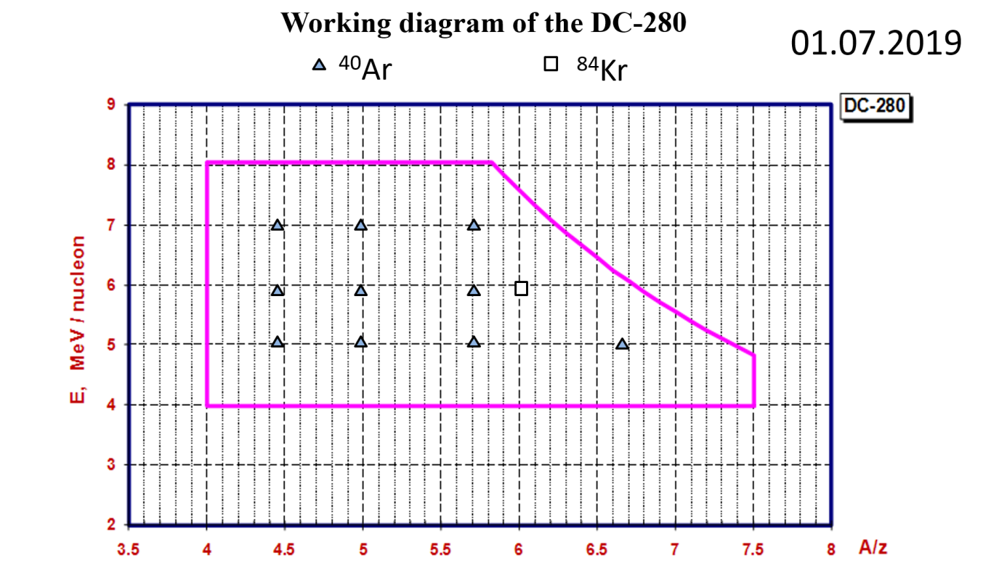
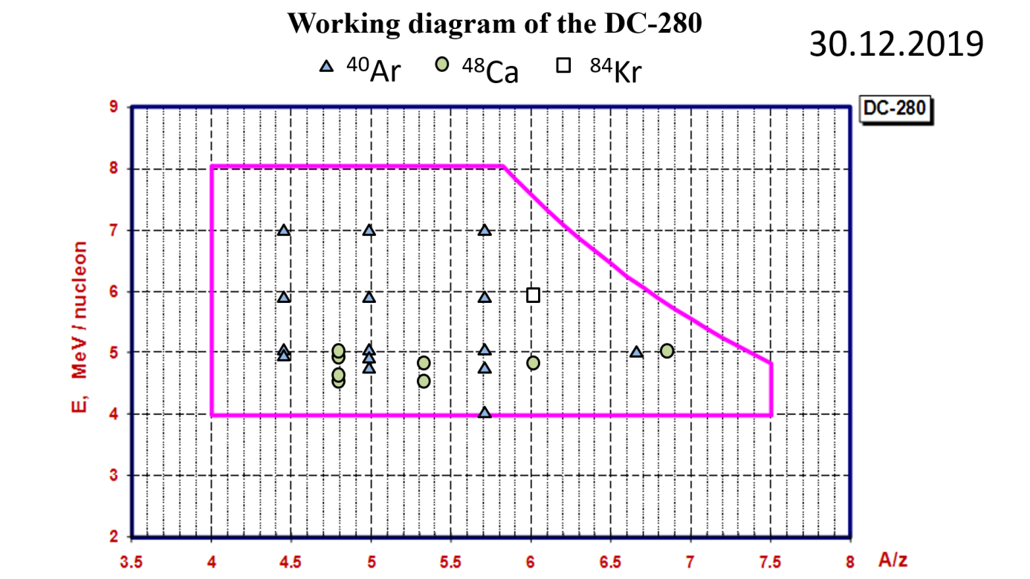
Status of the Factory of superheavy elements: DC-280 cyclotron
Reached today:
⁴⁰Ar beam intensity 10 pμA;
⁴⁸Ca beam Intensity 5 pμA;
50% efficiency from axial injection to transport channel;
90% efficiency through transport channel to the separator;
5% beam current stability;
Ongoing tasks:
HF amplifier power supply stability;
Commissioning of Flat-Top System;
Curing electrical breakdowns of some HV elements;
Improvement of the overall efficiency

Slide 16
Main parameters of the DC-280
parameters | design | Reached for today
Ion source | DECRIS-PM - 14 GHz on the HV platform (U_{max}=60kV )
Injecting beam potential | Up to 80 keV/q | 38,04 – 72,89 kV
A/Z | 4÷7.5 | 4,44 (⁴⁰Ar⁺⁷) – 6,86 (⁴⁸Ca⁺⁷)
Energy | 4÷8 MeV/n | 4,01 – 7 MeV/n
Ion (from DECRIS-PM) | 4-136 | 12 (¹²C⁺²) – 84 (⁸⁴Kr⁺¹⁴)
Intensity (A~50) | >10 pµA | 10,43 pµA (⁴⁰Ar⁺⁷), 5,2 pµA (⁴⁸Ca⁺⁷)
Magnetic field level | 0.6÷1.3 T | 0.8÷1.23 T
K factor | 280
Dee voltage | 2x130 kV | 2x130 kV
Power of RF generator | 2x30 kW
Flat-top dee voltage | 2x13 kV | ---
Power of Flat-top generator | 2x2 kW
Emittance | less than 30 π mm·mrad
Accelerator effectivity | >50% | 51,9 % (⁴⁸Ca⁺¹⁰ 5 MeV/n 5 pμA)

Slide 17
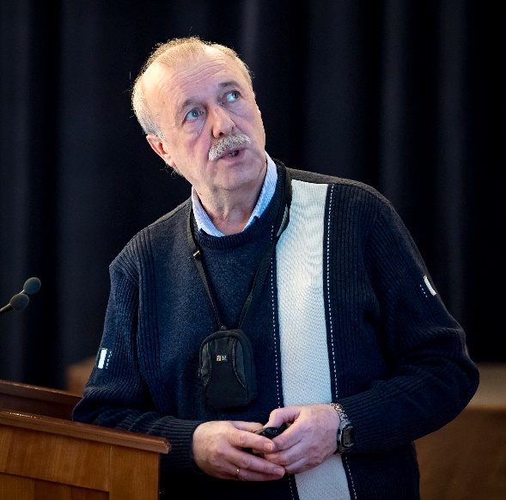
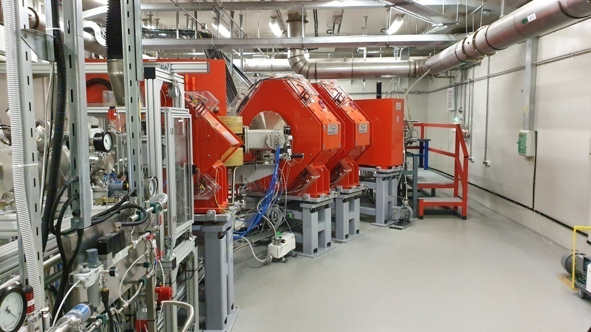
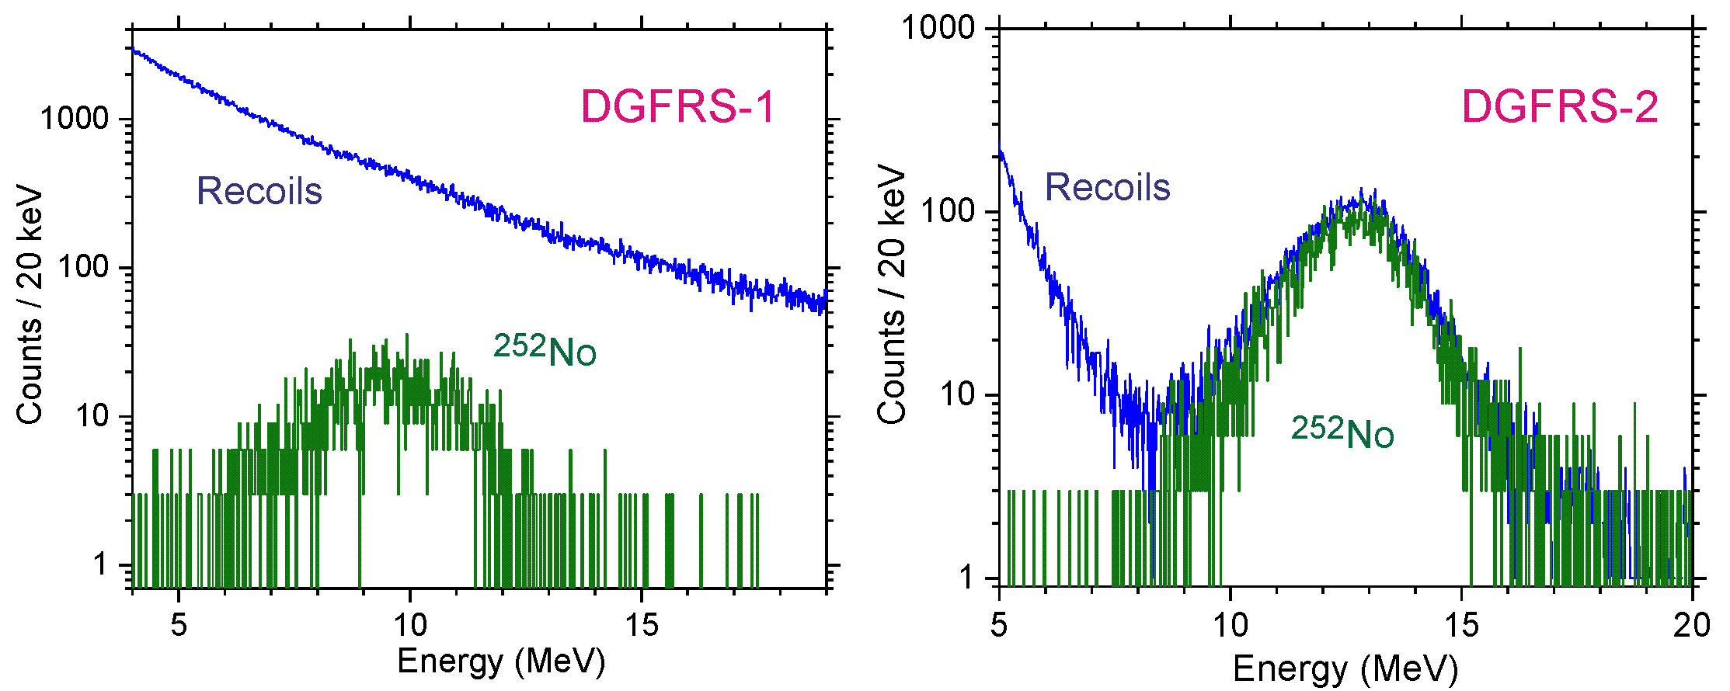
Status of the separator DGFRS-2: results of test experiments
The installation and commissioning of the new gas-filled separator (GFS-2) was completed.
Test reactions:
^{nat}Yb+⁴⁰Ar→²⁰⁷⁻²¹²Ra,
¹⁷⁰Er+⁴⁸Ca →^{214,215}Ra, ^{nat}Yb,¹⁷⁴Yb+⁴⁸Ca →^{216,217}Th,
²⁰⁶Pb+⁴⁸Ca →²⁵²No
Vladimir Utyonkov
The experiments showed excellent background event suppression in the focal plane of the separator
Adjustment of optical elements Q_{v}, D_{h}, Q_{h}, Q_{v}, D
Transmission
Image size on detector
Dispersion
Background
Optimal gas pressure
Systematics of charge states
Target stability vs. beam intensity
Yield vs. target thickness
Test of digital and analog
data acquisition systems

Slide 18
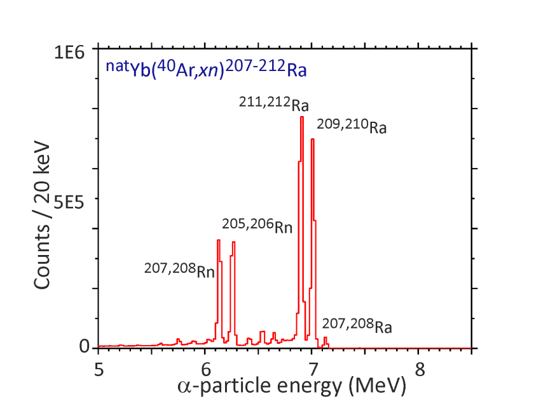
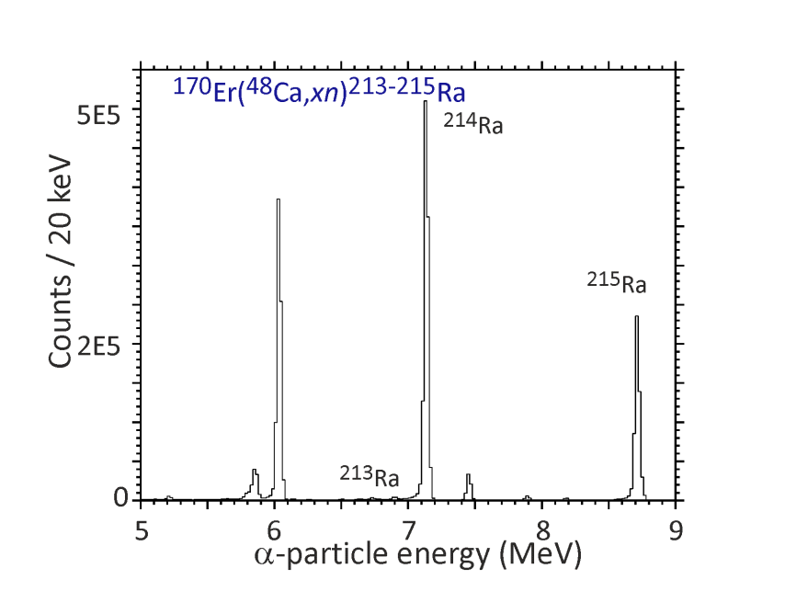
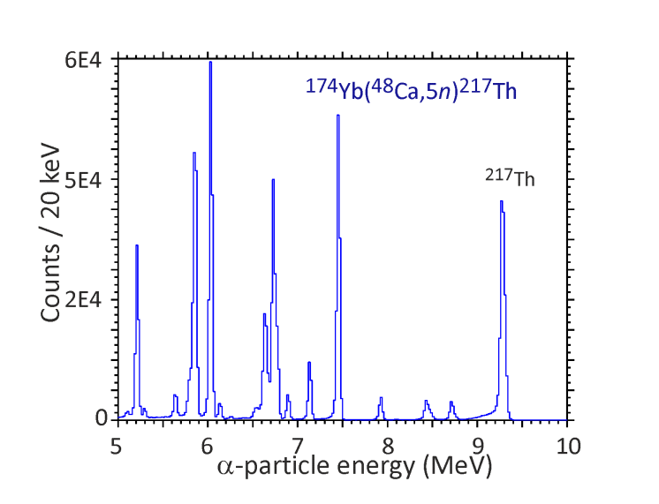
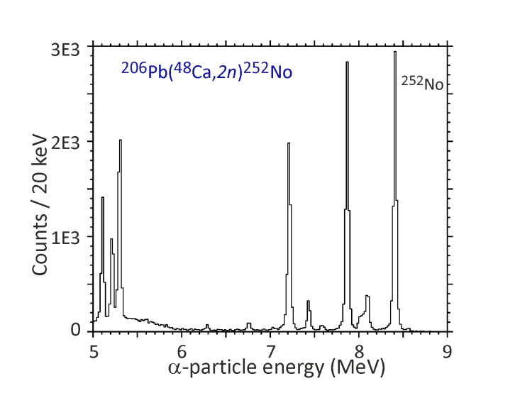
Status of the separator DGFRS-2: results of test experiments
Cross sections ~10⁸⁻⁹ pb
Test reactions:
^{nat}Yb (0.21, 0.43, 0.54, 0.64 mg/cm²)+⁴⁰Ar→²⁰⁷⁻²¹²Ra
¹⁷⁰Er (0.54 mg/cm²)+⁴⁸Ca →^{214,215}Ra
^{nat}Yb (0.21, 0.43, 0.54, 0.64 mg/cm²)+⁴⁸Ca →^{216,217}Th
¹⁷⁴Yb (0.35 mg/cm²) +⁴⁸Ca →^{216,217}Th
²⁰⁶Pb (0.43 mg/cm²) +⁴⁸Ca →²⁵²No

Slide 19
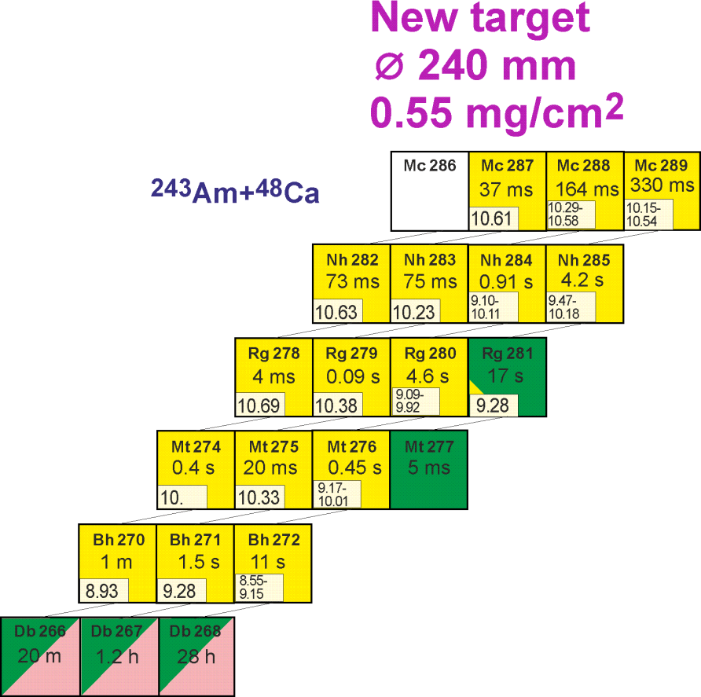
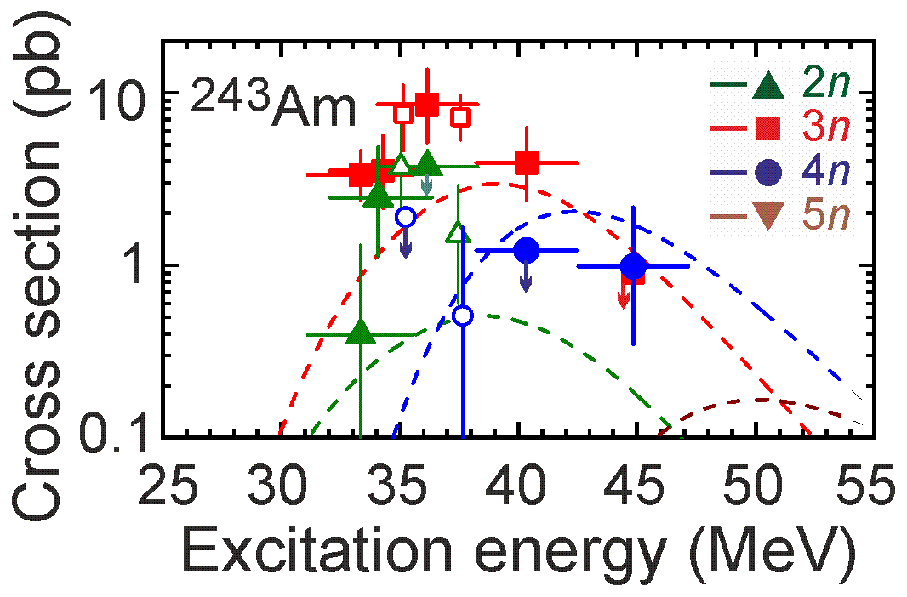
Future experiment at SHE Factory ²⁴³Am+⁴⁸Ca → ²⁹¹Mc* reaction
Cross section ≈10 pb
σ=8.5 pb, h_{t}=0.5 mg/cm², ε_{coll}=0.6, I_{beam}=5 pμA → N ≈ 17/day
Excitation function for the 2n-evaporation channel (²⁸⁹Mc)
- Observation of α decay of ²⁸¹Rg
Excitation function for the 3n-evaporation channel (²⁸⁸Mc)
5n-evaporation channel: new isotope ²⁸⁶Mc

Slide 20
PAC for NP recommendations related to “Status of the Factory of superheavy elements: DC-280 cyclotron”
The PAC congratulates the Flerov Laboratory of Nuclear Reactions for the excellent work in this highly demanding field of SHE research.
The intensities achieved at DC-280 are already among the highest in the world, and the results are extremely encouraging for the continuation of this research programme.
The PAC recommends that FLNR continue the efforts of completing the test experiments and starting the implementation of the experimental programme at the SHE Factory.

Slide 21
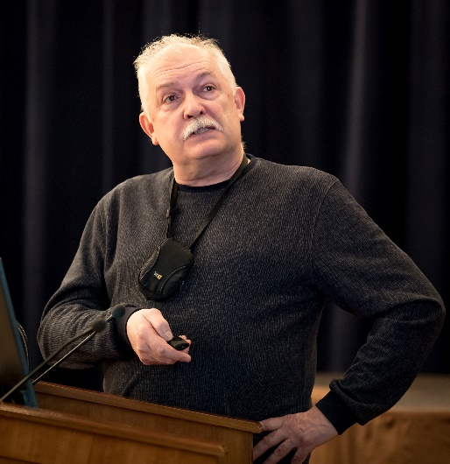
Prospects for the study of multinucleon transfer reactions (MNT)
Regions of interests in MNT reactions
3
1
Study of neutron deficient isotopes in the region 82 < Z < 100
1
Alexander Yeremin
2
Study of isotopes in the region N = 126, r – process in astrophysical nucleosynthesis
3
Study of neutron rich isotopes in the region Z > 100
2

Slide 22
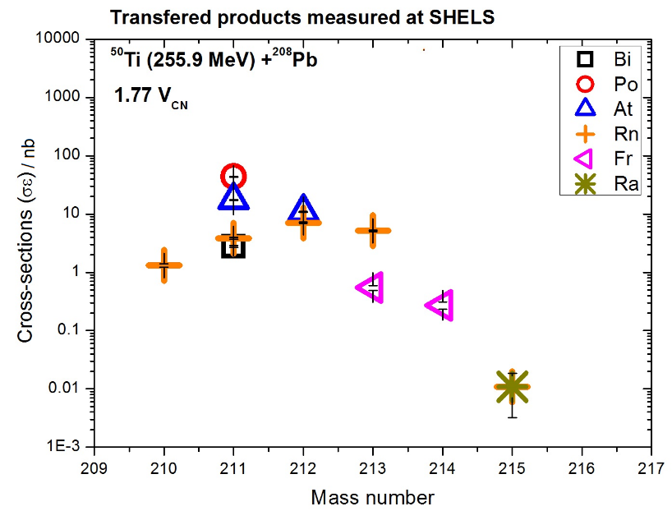
Prospects for the study of multinucleon transfer reactions (MNT)
Feasibility studies at SHELS
Isotopic distributions of MNT products measured in collisions of Ti + Pb at SHELS
→ sensitivity: 10 pb/sr in 5 hours of irradiation
Next experiment : April 2020, ⁴⁸Ca + ²⁴³Am, study of MNT products, 1 week

Slide 23
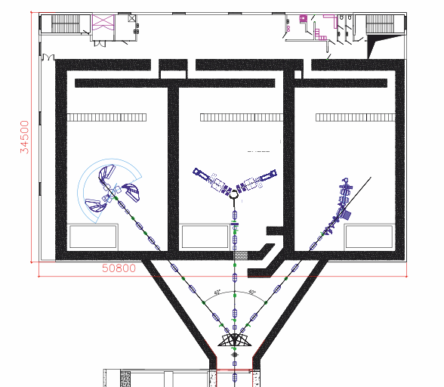
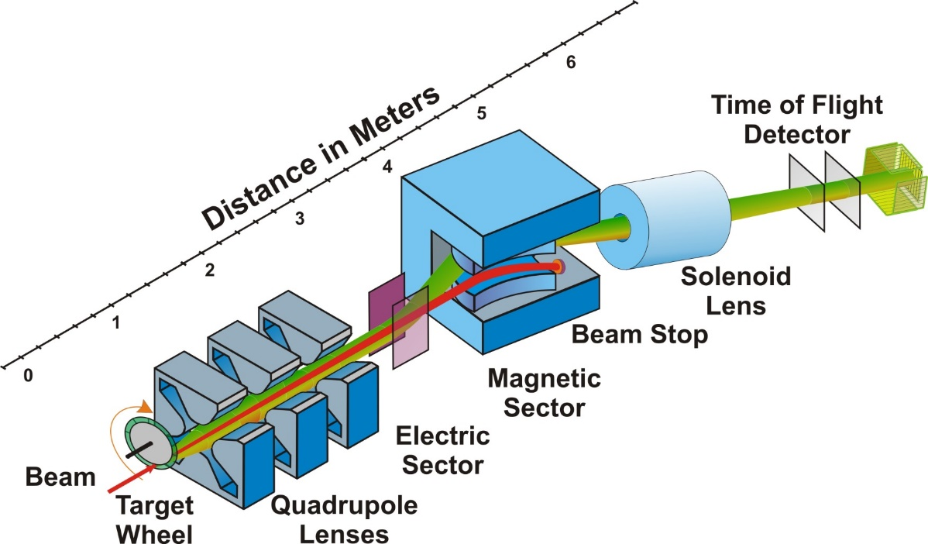
Prospects for the study of multinucleon transfer reactions (MNT)
Future Plans at FLNR
Are MNT reactions suitable for the production of (super)heavy nuclei?
  Z > 92, N ≈ 126 → MNT might be favourable for n-deficient transuranium isotopes
  n-rich SHE → study of new isotopes up to Z ~ 108 seems to be feasible
Future development of dedicated experimental set up analysis of MNT products under different angles.
New project of set-up Separator for TransActinide Research (STAR).
STAR

Slide 24
PAC for NP recommendations for “Prospects for the study of multinucleon transfer reactions (MNT)”
The PAC remarks that, along with the study of new isotopes, the exploration of MNT-reaction mechanism is of great importance, and strongly supports the development of a specialized set-up dedicated to a comprehensive study of such mechanism. Investigations of MNT reactions will highly benefit from the upgrade of the U-400 cyclotron complex, where it is planned to produce also an uranium beam of sufficient intensity.
The PAC recommends presenting as soon as possible a detailed project of a new dedicated set-up aimed at measuring features of the MNT reactions and their products (for instance, mass, energy, angular distributions, and possibly charge).
The PAC also recommends substantiating this project with an in-depth theoretical study aimed at clarifying the correlation of the entrance channel of the reaction with the above mentioned features of the MNT reactions and products.

Slide 25
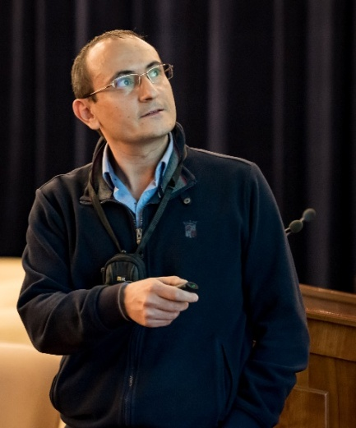
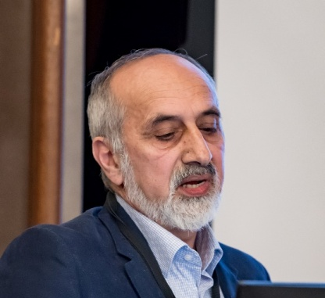
Scientific reports
The PAC heard the report
“Fusion reactions in nuclear astrophysics”
Using quantum diffusion approach, the S-factors for fusion reactions like ¹²C+¹²С –– important for stellar evolution –– are calculated, extrapolated to low energy and compared with experimental data.
Vazgen Sargsyan
Shakir Zeynalov
The PAC heard with interest the report
“Investigation of prompt neutrons from fission induced by resonance neutrons”
The PAC supports the programme of near-future investigations using the set-up on the beams of the IREN facility and looks forward to hearing a report soon on new scientific results obtained with its help.

Slide 26
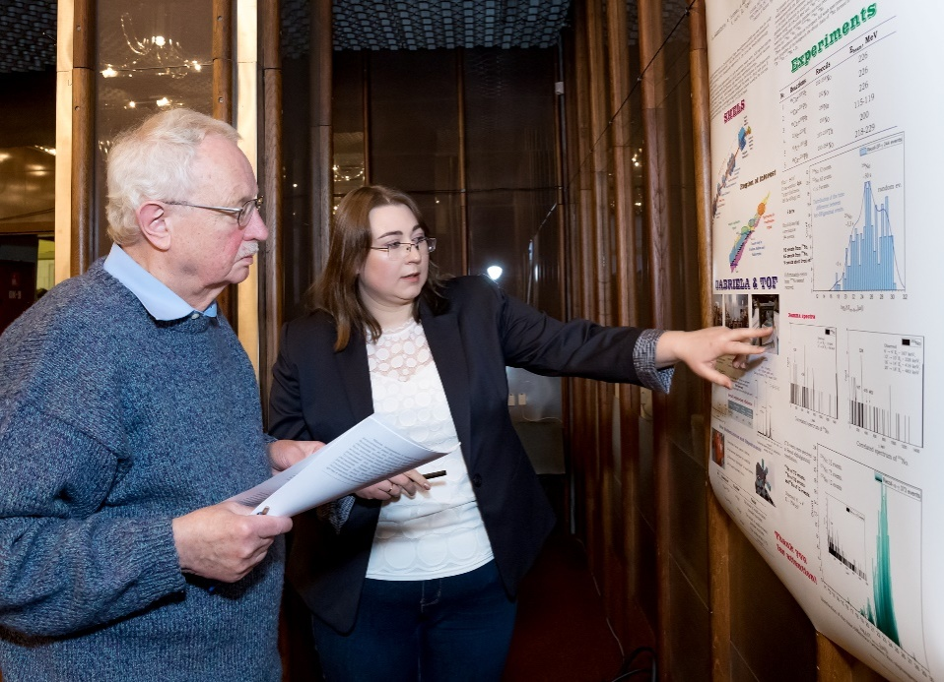
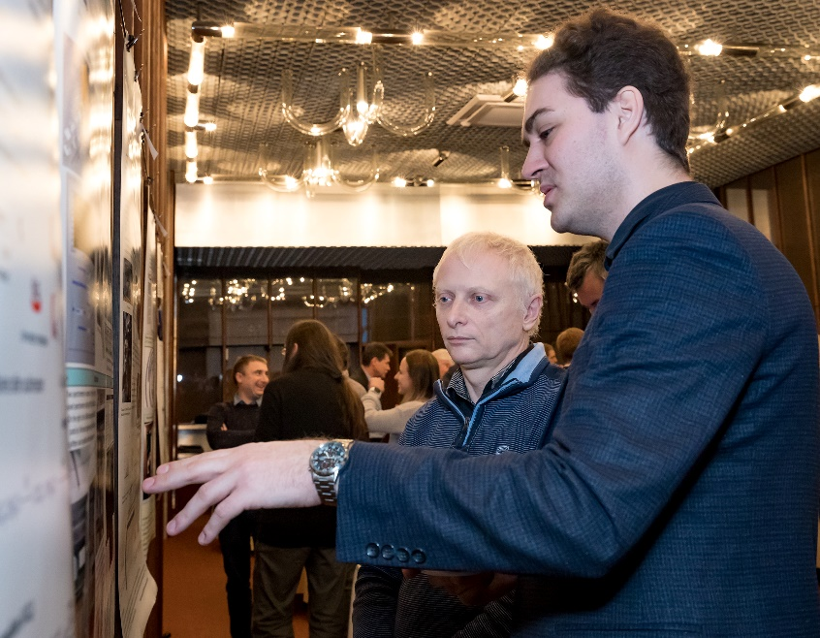
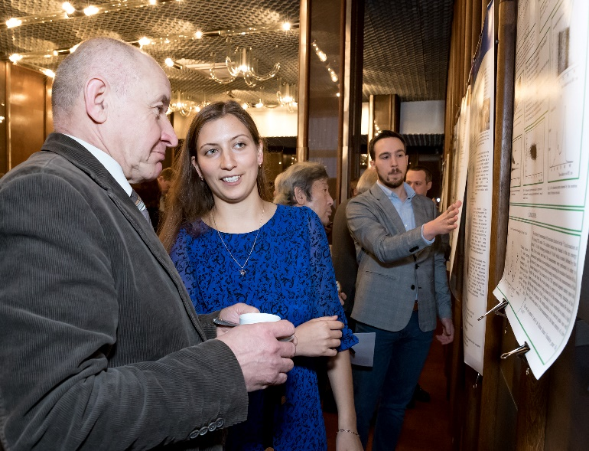
Poster session
The PAC reviewed 13 poster presentations in the field of nuclear physics research by young scientists from FLNR.
The best posters selected are:
“Study of No isotopes with the GABRIELA array” presented by Alena Kuznetsova
“Effective method of excitation function measurement for (α, n) reactions at low energies” presented by El’vira. Gazeeva
“Data acquisition and control systems developed for the synthesis of superheavy elements at the experiment DGFRS-II FLNR JINR” presented by Leo Schlattauer
The PAC recommends the poster “Study of No isotopes with the GABRIELA array” to be reported at the session of the Scientific Council in February 2020.
Leo Schlattauer
Alena Kuznetsova
El’vira Gazeeva

Slide 27
THANK YOU FOR YOUR ATTENTION!

Slide 28
Research activities under the theme “Investigations of Neutron Nuclear Interactions and Properties of the Neutron”: status and prospects
Investigation of possibility of the neutron lifetime measurement at IBR-2 beam
V. Kuznetsov approach:
L₁
L₂
The issue on the appropriateness of allocation of these studies in the form of a project will be decided based on the results of the ongoing test measurements.
28

Slide 29
Research activities under the theme “Investigations of Neutron Nuclear Interactions and Properties of the Neutron”: status and prospects
The 126 SC recommendations:
The Scientific Council appreciates FLNP’s outstanding achievements in the research of fundamental symmetries with polarized neutrons, the wide range of excellent results in the field of applied research within international programmes, and the importance of the work for the development of the accelerator facility carried out at IREN.
The Scientific Council supports the recommendation of the PAC for Nuclear Physics to extend the theme “Investigations of Neutron Nuclear Interactions and Properties of the Neutron” for 2020–2022 with first priority for further research activities in nuclear physics using FLNP’s neutron facilities: the highly intense pulsed neutron source IREN and the IBR-2 pulsed reactor.
The FLNP Directorate is advised to focus on the modernization of experimental halls and pavilions with beams of the IREN facility, on the construction of a polarized nuclear target for the work with polarized neutrons at IREN, and on the upgrade of the EG-5 electrostatic generator.

Slide 30
Efficiency of acceleration in cyclotron DC-280
Ion | Energy | Intensity (puA) |  |  |  |  | Efficiency (%)
 |  | axial injection |  | cyclotron |  | Transport Channel
 |  | After separation | vertical part | r=400 | r=1770 |  | Axial injection | capture | Cyclotron | Extraction | Total
⁴⁰Ar⁺⁷ | 236 | 14,3 | 12,9 | 9 | 7,7 | 6,3 | 90,2% | 69,8% | 85,6% | 81,8% | 44,0%
⁴⁰Ar⁺⁷ | 195 | 28,7 | 24,7 | 17,1 | 14,2 | 10,4 | 86,0% | 69,1% | 83,5% | 73,2% | 36,4%
⁴⁸Ca⁺⁷ | 240 | 12,6 | 11,3 | 7,6 | 6,5 | 4,8 | 90,0% | 67,4% | 85,3% | 73,5% | 38,0%
⁴⁸Ca⁺⁷ | 240 | 10,9 | 9,8 | 6,9 | 6,1 | 5,2 | 90,0% | 70,9% | 88,2% | 84,8% | 47,7%
⁴⁸Ca⁺⁸ | 230 | 4,4 | 4 | 2,8 | 2,4 | 1,9 | 90,1% | 68,8% | 86,9% | 80,8% | 43,4%
⁴⁸Ca⁺⁹ | 230 | 6,1 | 5,5 | 4,6 | 3,3 | 2,3 | 90,0% | 84,1% | 70,4% | 70,6% | 37,6%
⁴⁸Ca⁺¹⁰ B | 240 | 9 | 8,07 | 5,58 | 5,1 | 4,7 | 90,0% | 69,2% | 91,4% | 91,4% | 51,9%
⁴⁸Ca⁺¹⁰ B | 240 | 8,3 | 7,5 | 5,5 | 5 | 4,3 | 90,0% | 73,6% | 90,2% | 86,3% | 51,6%
⁸⁴Kr⁺¹⁴ | 496 | 3,1 | 2,8 | 1,7 | 1,6 | 1,4 | 90,6% | 60,0% | 92,9% | 92,3% | 46,6%

Slide 31
Experimental methods of MNT reactions studies
● Radiochemical methods
Radiochemical methods (offline) 100% collection efficiency, nearly background-free High-yield chemical separation of individual elements (40-90 %).
Most sensitive for isotopes with half-lives between about one hour and a few months that undergo alpha decay or spontaneous fission (SF).
Target thickness: ²³⁸U, ²⁴⁸Cm (1 to 3 mg/cm² ), No kinematics.
cross section limit: down to nanobarn. region 3 – region Z > 100
● Gas cell system + ISOL + detectors (KEK, Japan), IGISOL (JYFL, Finland)
0.01 to 1 % detection efficiency for transfer products. Most sensitive for isotopes with half-lives from about milliseconds.
Target thickness: ~ 10 mg/cm², No kinematics. 2 – region N ~ 126
Beam intensity (²³⁸U) – 50 pnA, yield > 100 counts / day, mass measurements (200 keV).
● Separation of MNT products with existing kinematic separators
0.1 to 1 % detection efficiency for transfer products (Zero angle). Most sensitive for isotopes with half-lives from about microseconds to few hours.
Target thickness: 300 to 500 μg/cm^{2,} MNT products velocity determination.
Cross section limit: down to nanobarn within 5 hours of irradiation with beam intensity
of 5×10¹² p/sec. 1 – region 82 < Z < 100; 3 – region Z > 100
● Future development of dedicated experimental set ups. MNT products velocity
and angular distribution determination. 3 – region Z > 100

