Slide 1






Strategic Long Range Plan for JINR
Victor Matveev
Boris Sharkov
INTERNATIONAL INTERGOVERNMENTAL ORGANIZATION
МЕЖДУНАРОДНАЯ МЕЖПРАВИТЕЛЬСТВЕННАЯ ОРГАНИЗАЦИЯ
JOINT INSTITUTE FOR NUCLEAR RESEARCH
ОБЪЕДИНЕННЫЙ ИНСТИТУТ ЯДЕРНЫХ ИССЛЕДОВАНИЙ
Joint Institute for Nuclear Research
SCIENCE BRINGING NATIONS TOGETHER
The International Working Group
has been established
in order to organize
the elaboration of the Strategic Long Range Plan
(SLRP) of JINR

Slide 2
The Long-Range Strategy of JINR
SLRP International Working Group
SLRP for Basic Science,
Innovative development and
advanced Education
Development of JINR as the International Intergovernmental Scientific Research Organization
Thematically
oriented
sub-groups
Thematically
oriented
sub-groups

Slide 3
The Long-Range Strategy of JINR development up to 2030 and
The SLRP WG membership:
V. Matveev (chair), B. Sharkov and N. Russakovich (vice-chairs),
V. Aksenov, V. Bednyakov, L. Cifarelli, A. Dubnickova, S. Gales, H. Gutbrod,
M. Itkis, M. Jezabek, R. Jolos, D. Kazakov, V. Kekelidze, V. Korenkov,
E. Krasavin, R. Lednicky, M. Lewitowicz, D.L. Nagy, Yu. Oganessian,
E. Rabinovici, V. Rubakov, A. Sorin, M. Spiro, H. Stoecker, G. Trubnikov,
I. Tserruya, G. Zinovjev
The International Working Sub-Groups where established in 2017
for elaboration of the JINR Strategic Long Range Plan (SLRP) for the JINR development up to 2030. SLRP will form the basis of the next JINR 7-year plan for the period 2024-2030.

Slide 4
Thematical sub-groups cover core research areas of the JINR scientific program
Nuclear Physics at low and intermediate energies.
Particle, High-Energy and Neutrino Physics.
Relativistic Heavy-Ion and SPIN Physics.
Condensed Matter and Neutron Nuclear Physics.
Theoretical Physics.
Radio- and Astrobiology.
Information Technologies and High Performance Computing.
Members of the sub-groups – outstanding experts from JINR, member states and world science community

Slide 5
Development of JINR as International
Intergovernmental Organisation
social HR policy, education and development
of intellectual potential; A. Ruzaev
social and engineering infrastructure; S. Kulikov
advancement of legal and administrative functions of the institute; M. Vasiliev
international relations and involvement of the new member states. D. Kamanin

Slide 6
Scientific Council 19 -20 September 2019
<resolution>
The SC recommends that the international WG ensures preparation of an integrated document based on materials presented by thematic subgroups describing the overall strategy with flagship projects and partnership priorities.
Editorial Board has been set up.
The SC recommends to inform the CPP at its session in November 2019 about the progress in preparing the Strategic plan for long-term development of JINR.
CPP November 2019
<resolution>
VI. Recommendations :
To take note….
To commission the JINR Directorate to send the Draft SLRP to the PP until 1 March 2010.

Slide 7
Here I give the floor to Boris Sharkov who coordinated the work of the sub-groups on preparation of consolidated , integral document and chaired the Editorial Board

Slide 8
The JINR Long Range Strategy Plan up to 2030
Proposals from JINR Laboratories for the SLRP
were considered at two sessions of the PAC`s,
at the meeting of JINR Technical – Scientific Council.
The reports of the representatives from the SLRP Working Sub-Groups were discussed in the session of JINR Scientific Council in September in 2019.
The whole project of the SLRP is to be completed at the end of 2019 and shall be considered at the February session of the JINR Scientific Council and then presented for approval by the
JINR Committee of the Plenipotentiaries
in the March session in 2020.
❒ Working documents of IWG for JINR strategic long-range planning
are available at https://indico.jinr.ru/
❒ Direct link: https://indico.jinr.ru/category/257/

Slide 9

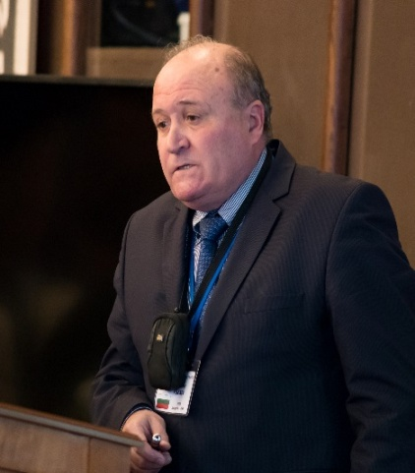
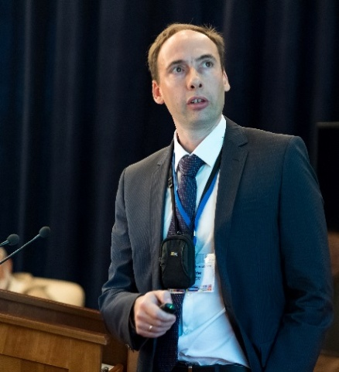

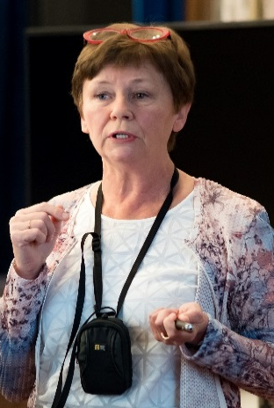
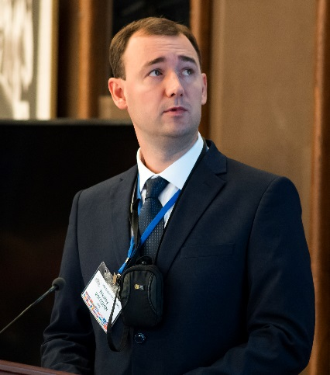
126th session of the Scientific Council
The Working Sub-Groups reports at the 126th session ( 19-20 Sept.,2019) of the JINR Scientific Council on the preparation of the draft Strategic plan for the long-term development of JINR up to 2030.
The Scientific Council took note of the reports concerning the current preparation of the draft Strategic plan for the long-term development of JINR in its major sections, presented by DLNP Deputy Director D. Naumov (particle physics), VBLHEP Deputy Director R. Tsenov (relativistic heavy-ion physics and spin physics), FLNR Scientific Secretary A. Karpov (nuclear physics at low and intermediate energies), by FLNP Directorate Adviser A. Ioffe (condensed matter physics and neutron nuclear physics), by LRB Senior Researcher E. Nasonova (radiobiology), and by LIT Researcher N. Voytishin (information technology).

Slide 10
Possible Structure of a Laboratory‘s SLRP
A) Executive Summary
B) Introduction: What is and has been done in the Laboratory a) Past and present Research Projects
b) National and International networking and context
c) Staff and Equipment today
C) Medium Range Projects
a) Project M1 – Motivation, proposed research, international context,
needed resources (equipment, infrastructure, manpower)
b) Project M2 – .....................
c) Project Mn – ......................
D) Long Range Projects
a) Project L1 – Motivation, international context, proposed research,
needed resources (equipment, infrastructure, manpower)
b) Project L2 – .........................
E) Summary with time line and international context

Slide 11


Nuclear Physics at Low energies
Physics of Supper Heavy Elements
Neutron reach - Exotic nuclei
Nuclear Astrophysics
Nuclear chemistry and atomic physics of extreme strong Coulomb fields
Yu. Oganessian, S. Dmitriev, A. Karpov

Slide 12
Sub-group
Nuclear physics of low and intermediate energies including atomic physics, nuclear chemistry, and astrophysics
Synthesis and properties of superheavy elements
Study of exotic nuclei
Nuclear reactions induced by heavy ions
Local working group
Group of experts
 | Name | Institution
1. | Alexander Karpov | JINR
2. | Sergey Sidorchuk | JINR
3. | Sergey Dmitriev | JINR
4. | Vladimir Utyonkov | JINR
5. | Alexander Eremin | JINR
6. | Nikolay Aksenov | JINR
7. | Alexander Rodin | JINR
8. | Yuri Penionzhkevich | JINR
9. | Andrey Fomichev | JINR
10. | Leonid Grigirenko | JINR
11. | Vladimir Rachkov | JINR
 | Name | Institution
1. | Robert Eichler | PSI
2. | Emanuele Vardaci | INFN
3. | Gottfried Münzenberg | GSI
4. | Ephraim Eliav | School of Chem., Tel Aviv Uni.
5. | Mikhail Onegin | NRC KI, Petersburg
6. | James Roberto | ORNL
7. | Joseph Hamilton | Vanderbilt University
8. | Marek Pfützner | Warsaw University

Slide 13

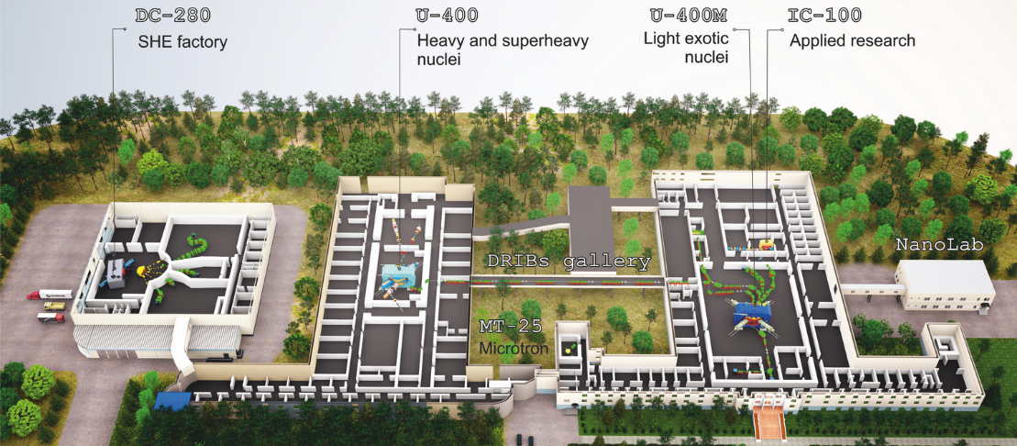
FLNR’s basic directions of research
FLEROV LABORATORY OF NUCLEAR REACTIONS
DRIBS-III ACCELERATOR COMPLEX
Heavy and superheavy nuclei
Light exotic nuclei
Nuclear reaction studies
Radiation effects and physics basics
of nanotechnology
Accelerator technologies
Notes:
13
Beam intensity of Ca-48 up to 2.5 mkA
Ion energy variation on the target with factor 5
Cyclotron average magnetic field from 1.8 up to 0.8 T

Slide 14
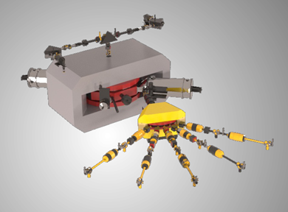
Summary for NP
Realization of the experimental program in the area of SHE research
Development of experimental set-ups @ the SHE Factory.
Construction a specialized radiochemical complex of the 1st class.
Continuation of experimental program on light exotic nuclei at the modernized U-400M cyclotron with the use of the ACCULINNA-2 fragment separator.
Research Infrastructure :
Development of ECR ion source on 28 GHz for acceleration of ions up to Uranium.
Upgrade the U-400 (U-400R) accelerator, construction of the new experimental hall
and equipping it with existing and new set-ups intended mainly for the study of nuclear reactions.
The total available beam time of three FLNR’s cyclotrons (DC-280, U-400R, and U-400M) is expected to be of about 15 000 hours annually. This will allow us to formulate a user policy and open the FLNR facilities for external users.

Slide 15
Relativistic Heavy Ion and Spin Physics
V. Kekelidze, R. Tsenov, D. Peshekhonov

Slide 16
Sub-group
Relativistic Heavy-Ion and Spin Physics
Local working group and Group of experts
 | Name | Institution
1. | Alessandro Bachetta | Uni Padova
2. | Alexander Kovalenko | LHEP JINR
3. | Alexander Sorin | JINR
4. | Gennady Zinovjev | LTP JINR
5. | Horst Stoecker | GSI
6. | Itzhak Tserruya | Weizmann Inst.
7. | Luisa Cifarelli | INFN Bologna
8. | Oleg Teryaev | LHEP JINR
9. | Richard Lednicky | JINR
10. | Roumen Tsenov | LHEP JINR
11. | Sergey Shmatov | LHEP JINR
12. | Vladimir Kekelidze | LHEP JINR

Slide 17

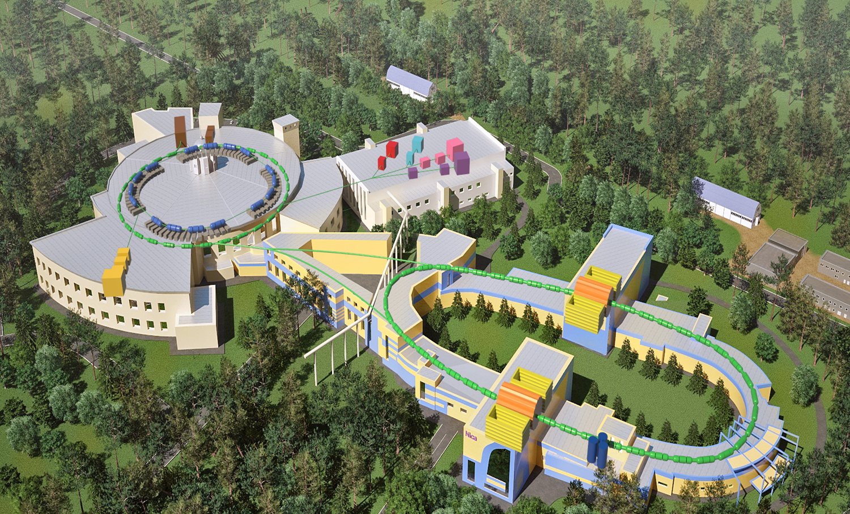

Mega-science flagship project at JINR: Nuclotron Based Ion Collider Facility (NICA)
DRIBS-III ACCELERATOR COMPLEX
Notes:
17
Beam intensity of Ca-48 up to 2.5 mkA
Ion energy variation on the target with factor 5
Cyclotron average magnetic field from 1.8 up to 0.8 T

Slide 18
Summary for Relativistic Heavy-Ion and Spin Physics
Realization of the NICA scientific program based on:
Heavy ion (up to Au⁺⁷⁹) collisions at center-of-mass energy in the range 4 – 11 AGeV;
Collisions of transversely and longitudinally polarized protons and deuterons at center-of-mass energy up to 27 GeV
Available at: https://indico.jinr.ru/conferenceDisplay.py?confId=296,
Involvement in external experiments:
Traditionally, the HEP scientific program of JINR includes participation in experiments at accelerator centers around the world (CERN, BNL, DESY, FAIR/GSI) that provide unique conditions to perform studies in the fields of high-energy heavy-ion physics and spin physics. The key factor here is a mutual benefit from the exchange of new scientific information and know-how. JINR participation will depend on the discovery potential of the experiments and leading role in them of the JINR researchers
The continuing participation in the experiments NA61 and COMPASS at SPS, ALICE at LHC and STAR at RHIC is of invaluable importance for preparation and realization of the physics program at the NICA complex.
Strategically important is the JINR participation in experiments at future electron-ion collider (EIC) facility to be built in US and in fixed-target experiments at FAIR-GSI.
The JINR strategy for cooperative research at other accelerator centers should be linked closely to the updated European Strategy for Particle Physics, expected to be available in 2020.

Slide 19
Particle Physics and Astrophysics
V. Bednyakov, N. Rusakovich, D. Naumov

Slide 20


JINR PP & AP five pillars
Multi Messenger Astronomy
Accelerator Physics & Technologies
Education & Outreach
Neutrino Physics
Detector Technologies

Slide 21

JINR PP & AP five pillars
Accelerator Physics & Technologies
NICA – BM@N, MPD & SPD
ATLAS
CMS
ALICE
Future Colliders
JINR – CERN strategic partnerships
JINR actively participates in the LHC programmes :
ATLAS, CMS , ALICE and the Collider itself and planning to contribute to the LHC detectors upgrade.
JINR participate in the four SPS projects:
Compass-II (NA58) – nucleon spin structure, hadron spectroscopy (with interests to future SPD at NICA);
NA61 – (intersects with BM@Nuclotrone and MPD);
NA62 – CP-violation and rare decays;
NA64 – search for the dark sector;
Accelerator development: HL-LHC CLIC,ILC LHeC, FCC,
Precise laser metrology (super sensitive inclinometr) , Neutrino platform, DUNE; other - nTOF, DIRAC,
Computing and Information Technologies, WLCG, Tier-1,2

Slide 22

JINR PP & AP five pillars
}
Baikal-GVD
TAIGA
Gravitational Wave Detector
Multi Messenger Astronomy
MM Astronomy
}
}
JUNO
NOvA
DUNE, HK
Dark-Side-20k
ARGO
Edelweiss
DANSS
NuGEN, RICOCHET
GEMMA-III
Dark
Matter
MH, CP
Neutrino Physics
}
Mag. Moment,
Coherent,
Sterile
GERDA
SuperNEMO
LEGEND-1000
Mass Meas.
}
$$0νββ$$
}
KATRIN

Slide 23
JINR PP & AP five pillars
Education & Outreach
Education and Teachers programs
Detector Technologies
Development of novel particle detectors, in particular compact forward calorimeter developed in the FCAL collaboration, pixel detectors based on GaAs sensors and MPGD detectors (Micromegas, RPC, etc) which are currently developed in JINR.

Slide 24
Baikal GVD – Flagship Experiment of JINR

Slide 25
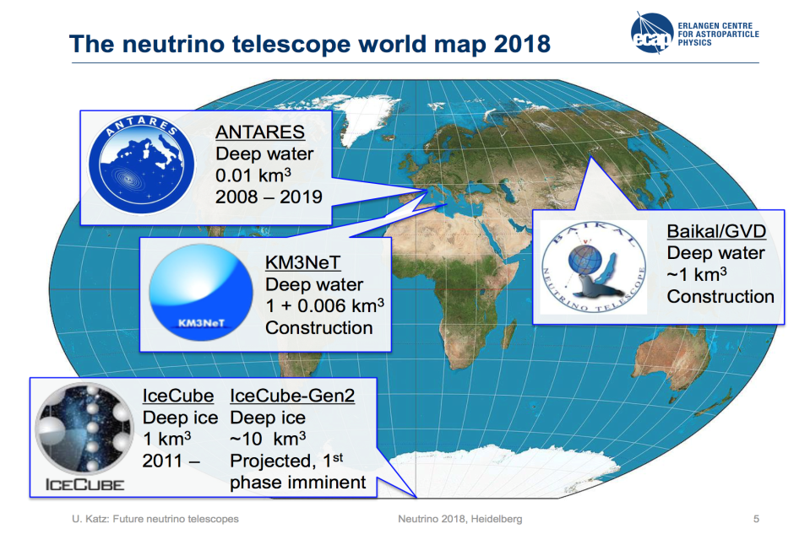

Slide 26
Accelerator Physics & Technologies. MT
 | 24 |  | 25 |  | 26 |  | 27 |  | 28 |  | 29 |  | 30 |  | Main physics goal Budget, USD
ATLAS & CMS | LS3 upgrade |  |  |  |  | RUN4 |  |  |  |  |  |  | LS4 |  | Beyond the SM, precision EW and QCD 3.4M & 2.8M
 |  |  |  |  |  | LS4, LS5 R&D
Future Colliders |  |  |  |  |  |  |  |  |  |  |  |  |  |  | Beyond the SM, precision EW and QCD 3.4M & 2.8M
NICA-SPD |  |  |  |  |  |  |  |  |  |  |  |  |  |  | TMD PDF, 21M
R&D | Construction& Commissioning | Data taking | STOP | Decision Point

Slide 27
Accelerator Physics & Technologies. LT
 | 31 |  | 32 |  | 33 |  | 34 |  | 35 |  | 36 |  | 37 |  | Main physics goal Budget, USD
ATLAS & CMS | RUN5 |  |  |  |  |  |  |  | LS5 |  | RUN6 |  |  |  | Beyond the SM, precision EW and QCD 3.4M & 2.8M
 | LS5 R&D
Future Colliders |  |  |  |  |  |  |  |  |  |  |  |  |  |  | Beyond the SM, precision EW and QCD 3.4M & 2.8M
NICA-SPD |  |  |  |  |  |  |  |  |  |  |  |  |  |  | TMD PDF, 21M
R&D | Construction& Commissioning | Data taking | STOP | Decision Point

Slide 28
Neutrino Physics & AstroPhysics. MT
 | 24 |  | 25 |  | 26 |  | 27 |  | 28 |  | 29 |  | 30 |  | Main physics goal Budget, USD
Baikal-GVD |  |  |  |  |  |  |  |  |  |  |  |  |  |  | UHE Neutrino sources, 45M
 | Phase II up to 1.2 km3 |  |  |  |  |  |  |  | Phase III
 | R&D for Phase III
JUNO |  |  |  |  |  |  |  |  |  |  |  |  |  |  | Neutrino mass ordering, precision lepton mixing, SN, proton decay 7.5M
NOvA DUNE HK |  |  |  |  | STOP data taking. Analyses continue |  |  |  |  |  |  |  |  |  | Neutrino mass ordering, CP-violation in the lepton sector 10M
R&D | Construction& Commissioning | Data taking | STOP | Decision Point

Slide 29


 | 24 |  | 25 |  | 26 |  | 27 |  | 28 |  | 29 |  | 30 |  | Main physics goal Budget, USD
DarkSide-20k ARGO | DarkSide-20k data taking |  |  |  |  |  |  |  |  |  |  |  |  |  | Dark Matter, 0.7M
TAIGA | TAIGA IACT+HiScore data taking |  |  |  |  |  |  |  |  |  |  |  |  |  | High energy cosmic ray and gamma spectrum above 10¹⁵ eV 1.8M
 | One IACT gamma-telescope/year
Edelweiss | R&D for new detector and cryogenic system |  |  |  |  |  |  |  | Next phase of bolometric search in LSM |  |  |  |  |  | Dark Matter,
GERDA | R&D Legend-1000 |  |  |  | LEGEND-1000
SuperNEMO
VIRGO |  |  |  |  |  |  |  |  |  |  |  |  |  |  | GW, 1.4M
$$0νββ$$
$$0νββ$$
R&D | Construction& Commissioning | Data taking | STOP | Decision Point

Slide 30
Summary for Particle Physics and Astrophysics
Mid-term plans:
ATLAS - Phase 1, Phase 2
CMS
JUNO - JINR is the major collaboratior
Dark Matter – Edelweis, DarkSide
CP-violation – NOvA, MO
Kalinin PP – magnetic moment, coherent, sterile
Taiga – 100 TeV gamma rays
Gerda, SuperNEMO – 0νββ
Long-term plans:
BAIKAL GVD
NOvA - DUNE or HyperK
JUNO
ATLAS, CMS – HL LHC
Gravitational waves interferometers :
LIGO, VIRGO, Einstein

Slide 31
Radiobiology — Astrobiology
E. Krasavin, A. Bugay, E. Nasonova

Slide 32
Sub-group
Radiobiology — Astrobiology
Local working group
Group of experts
 | Name | Institution
1. | Evgeny Krasavin | JINR
2. | Mikhail Ostrovsky | JINR
3. | Alexey Rosanov | JINR
4. | Alexander Bugay | JINR
5. | Igor Koshlan | JINR
6. | Gennady Timoshenko | JINR
7. | Elena Nasonova | JINR
 | Name | Institution
1. | Rouben Arutyunyan | Yerevan University (Armenia)
2. | Michael Waligórski | Inst.Nucl.Phys. Krakow (Poland)
3. | Azhub Gaziev | Inst. Cell Biophysics RAS (Russia)
4. | Anatoly Grigoryev | Inst. Biomedical Problems RAS (Russia)
5. | Richard Hoover | Athens State University (the U.S.)
6. | Ernesto Di Mauro | La Sapienza Univ. of Rome (Italy)

Slide 33


Modern trends in radiobiology
Fundamental radiobiological research: studying mechanisms of radiation action at the molecular, cellular, tissue, and organismal levels of biological organization
Radiation and nuclear medicine: refinement of tumor radiation therapy techniques (proton and carbon therapy); designing new radio sensitizers and radio protectors; extension of the list of the radionuclide pharmaceuticals for diagnostics and treatment
Radiation safety of deep space flights: refinement of the approaches to human protection from heavy charged particles
Origin of Life
on the Earth,
Astrobiology
JINR’s Laboratory of Radiation Biology
Fundamental aspects of radioecology: research at the level of ecosystems and populations, participation in EU programs
Applied radiation technologies: development of methods of raising crop capacity and improvement of agricultural product quality; elimination of pathogenic micro- and macroflora; disinfection of agricultural waste, etc.
V. Matveev
Notes:
Reflecting modern trends in radiobiology, the following fields are of top priority of the JINR radiobiological research activities:
fundamental radiobiological research,
radiation safety of deep space flights,
nuclear medicine.
In the current Seven-Year Plan, studies will be mainly focused on the response of different structures of the central nervous system to radiation exposure determining the specifics of the cognitive and behavioral functions of laboratory animals.

Slide 34
Summary for Radiobiology — Astrobiology
Molecular radiobiology
Radiation cytogenetics
Radiation Physiological studies on primates
top priority research!
Radiation Medicine
15-fold increase of proton beam efficiency by DNA synthesis inhibitors
Mathematical modeling of radiation-induced effects
Astrobiology
Radiation protection research:
Radiation Protection management and shielding at new nuclear facilities (incl. NICA)
Main future topics and required infrastructure identified

Slide 35
Condensed matter and neutron physics
V. Aksenov, V. Shvetsov, A. Ioffe

Slide 36
Sub-group
Condensed matter and neutron physics
Local working group and Group of experts
 | Name | Institution
1. | A. Ioffe | JINR / Heinz Maier-Leibnitz Zentrum, München, Germany
2. | V.L. Aksenov | JINR / NRC “Kurchatov Institute”, Moscow, Russia
3. | J. Carpenter | Argonne National Laboratory, Chicago, USA
4. | A. Harrison | Diamond Light Source, Didcot, UK
5. | N. Kucerka | JINR / Slovakia
6. | T.V. Kulevoy | NRC “Kurchatov Institute” – ITEP, Moscow, Russia
7. | A.V. Lopatkin | NIKIET, Moscow, Russia
8. | F. Mezei | European Spallation Source, Lund, Sweden
9. | P. Mikula | Nuclear Physics Institute – Řež, Czech Rep.
10. | D. Nagy | Wigner Research Centre for Physics, Budapest, Hungary
11. | V. Nesvizhevsky | Institute Laue-Langevin, Grenoble, France
12. | L. Rosta | Budapest Neutron Center, Budapest, Hungary
13. | S.F. Sidorkin | Institute for Nuclear Research of RAS, Troitsk, Russia
14. | I.T. Tretyakov | NIKIET, Moscow, Russia
15. | D. Chudoba | JINR / Poland

Slide 37
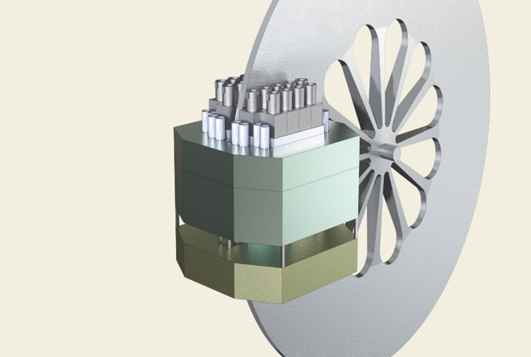
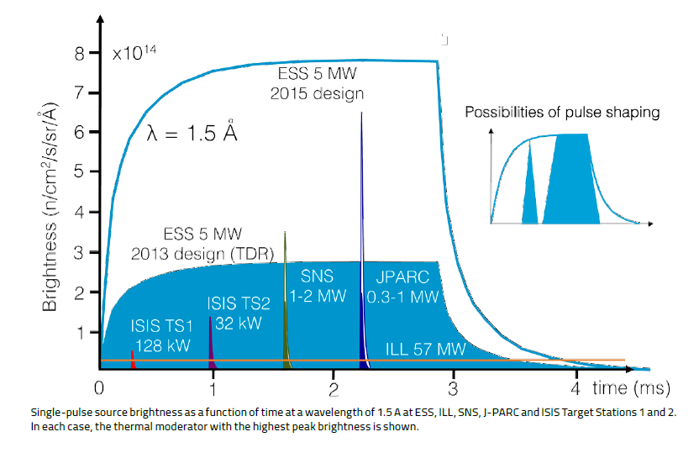
New Dubna Neutron Source: DNS-IV
New Dubna source will provide shorter neutron pulses, however containing the same number of neutrons as at ESS.
=> it will be as good as ESS for low resolution experiments and better for high resolution experiments.
Pulsed reactor IBR-3
Reactivity modulator
Core +reflector
DNS-IV: Φ_{peak}~10¹⁶
IBR-2M
x10
λ=1.5Å
DNS-IV - not just another neutron source,
but one of the best in the world!
Mean flux of ILL

Slide 38
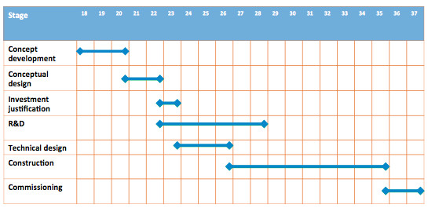
Time-line for DNS-IV
Both options are under the feasibility study in N.A. Dollezhal Research and Development Institute of Power Engineering (NIKIET), Moscow
©NIKIET

Slide 39
Summary for Condensed matter and neutron physics
Short-term perspectives:
Development and upgrade of the IBR-2 instruments. Already now there are examples at JINR of more than 10-fold increase in efficiency;
Startup of the IREN source at designed parameters;
Long-term perspectives :
new neutron source in order to replace IBR-2 after the end of its lifetime → superbooster NEPTUN

Slide 40
Theoretical Physics
R. Jolos, D. Kazakov, S. Nedelko

Slide 41
THEORETICAL PHYSICS
As one of the largest centers, the BLTP will act as a “generator” of interdisciplinary studies and international cooperation, thus determining the global scientific agenda of both theoretical and experimental researches.
BLTP has an expertise in a wide range of areas related to the theory of fundamental interactions, nuclear theory, condensed matter physics and modern mathematical physics.
Scientific and organizational policy of the Laboratory relies on multidisciplinary theoretical physics on the basis of advanced mathematics, support of the JINR experimental program, strengthening of the scientific brainpower through the interplay of research and education.
The strategy of development of theoretical physics at JINR will be based on studies of the coherent set of fundamental problems at the frontiers of modern physics defined by the current and future experimental program of JINR as well as its own, purely theoretical, priorities.
Respectively, the main objective of theoretical research will be not only a high-grade support of in-home and world-wide experimental program of JINR but also securing the predictive power of JINR scientific potential in whole, and high level of receptivity of JINR to new worldwide trends in fundamental physics.

Slide 42
Summary for Theoretical Physics
Theory of fundamental interactions:
Standard Model and its extensions
Neutrino physics
Hadron structure and spin physics
Heavy flavour physics and hadron spectroscopy
Hot and dense Hadronic Matter
Dark Matter problem
Astrophysical aspects of particle physics
Support of physics programs of major international collaborations and those at the JINR basic facilities
Nuclear physics:
Structure of exotic nuclei
Mechanism of nuclear reactions
Nuclear dynamics
Nuclear astrophysics
Few- and many-body systems
Ab-initio approaches
Analysis of experimental data and in guiding the experimental programs.
Interdisciplinary connections with particle, atomic, and statistical physics.
Modern mathematical physics:
Classical and quantum integrable models and their exact solutions
Supersymmetric theories
Cosmological models
Theory of condensed matter:
Complex many-body systems
Equilibrium and non-equilibrium statistical systems
Two-dimensional materials
Statistical models
Support of material investigations at FLNP
Dubna International Advanced School of Theoretical Physics (DIAS-TH)

Slide 43
Information Technology and Scientific Computing
V. Korenkov, N. Voytishin

Slide 44
Sub-group
Information Technology and Scientific Computing
Local working group
 | Name | Institution
1. | Vladimir Korenkov | JINR
2. | Andrey Dolbilov | JINR
3. | Valery Mitsyn | JINR
4. | Tatyana Strizh | JINR
5. | Dmitry Podgainy | JINR
6. | Petr Zrelov | JINR
7. | Irina Filozova | JINR
8. | Vladimir Gerdt
9. | Oxana Streltsova
10. | Nikolay Voytishin
Group of experts
 | Name | Institution
1. | Ian Bird | CERN
2. | Peter Hristov | Bulgarian Academy of Sciences / CERN
3. | Weidong Li | HEP Institute of Chinese Academy of Sciences
4. | Oxana Smirnova | Lund University/NeIC
5. | Alexei Klimentov | CERN / BNL
6. | Patrick Fuhrmann | DESY
7. | Gaetano Maron | INFN

Slide 45
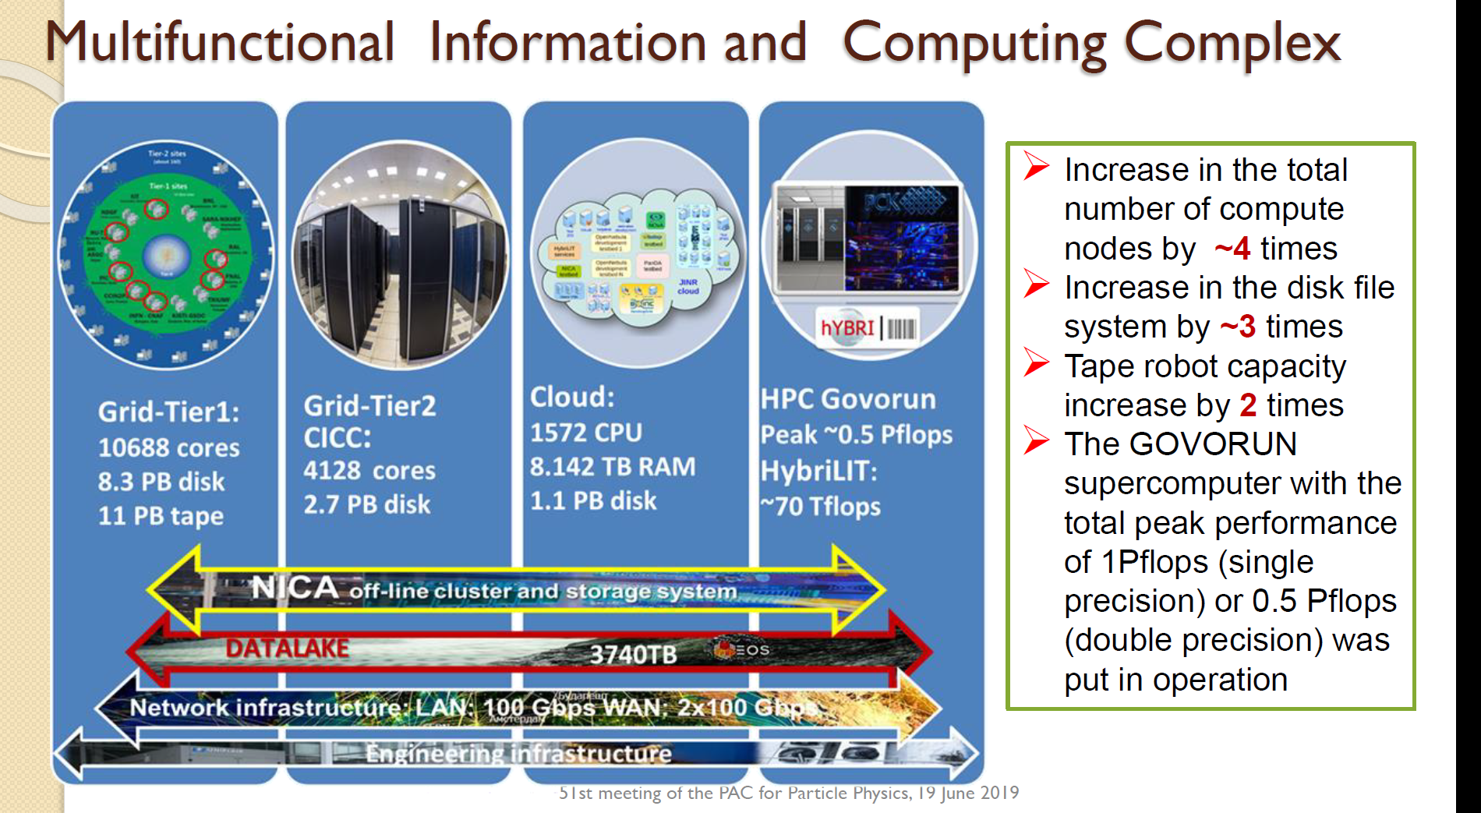

Slide 46
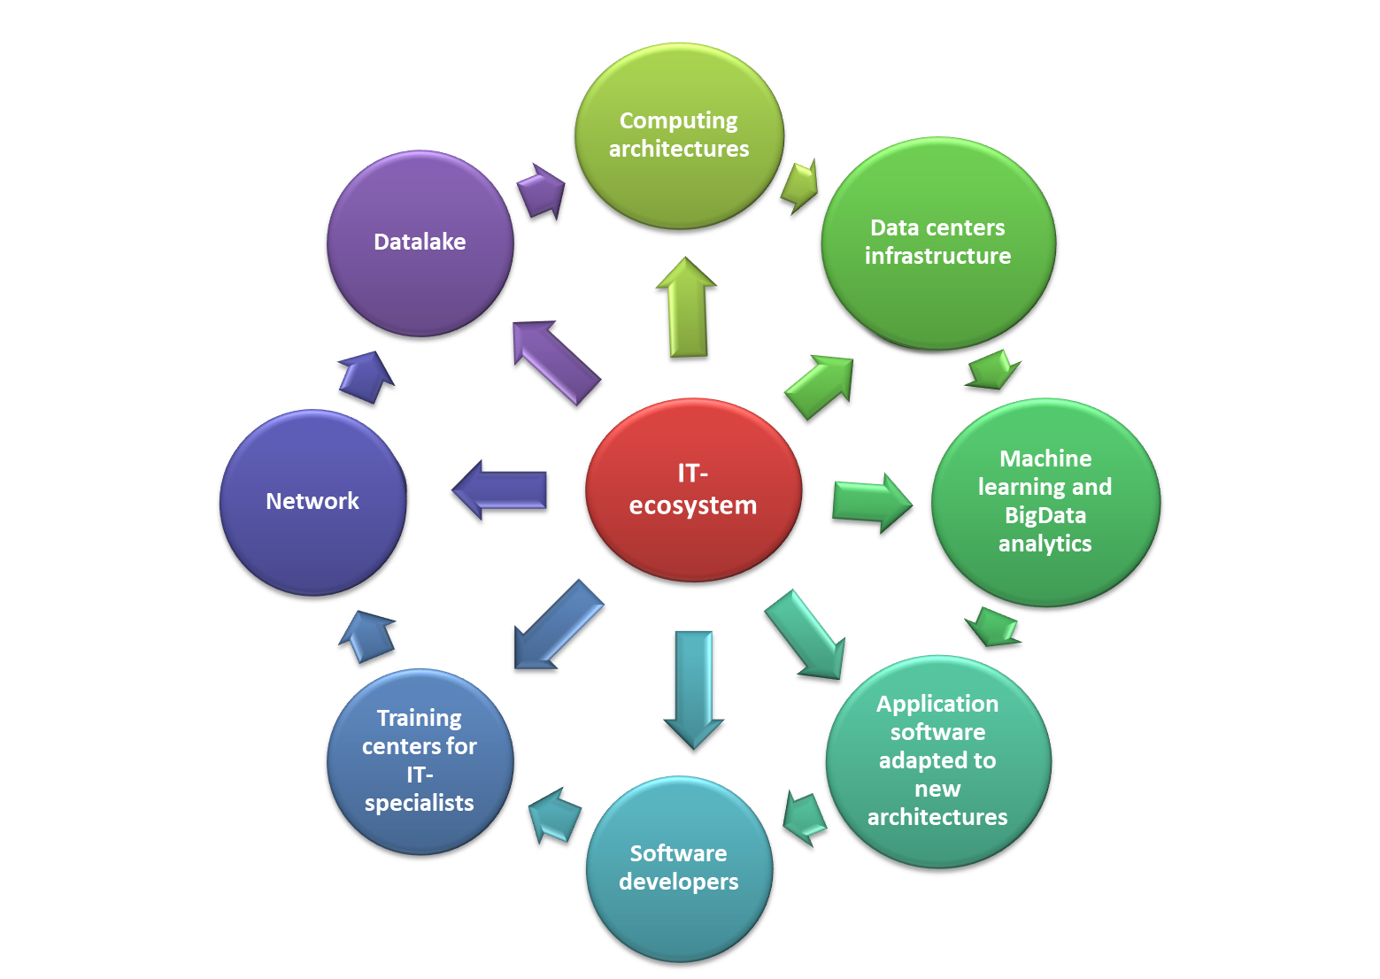
Summary for IT and Scientific Computing
AIM
Expandable worldwide dynamically evolving IT-ecosystem that combines a variety of technological solutions, state-of-art computing concepts and methodologies.
PURPOSES
Significantly reduce the time spent on the implementation of projects that require computing resources and IT expertise
BENEFICIARIES
JINR, its Member States and international collaborators

Slide 47
EB : Structure of a Strategic Long Range Plan
Executive Summary
Nuclear Physics at low and intermediate energies
Particle Physics (HEP on large scale international facilities).
Neutrino and astrophysics
Relativistic Heavy Ion and Spin Physics.
Condensed Matter and Neutron Nuclear Physics.
Theoretical Physics
Radiobiology (including astrobiology)
IT, Big Data and High Performance Computing.
Conclusions
https://indico.jinr.ru/event/1121/

Slide 48

JINR’s Long Range Strategy plan for up to 2030
NICA – II ( SpinPD, MPD-Upgr., NICA-HL, Innov.Centre )
DRIBS-III (Dubna Radioactive Beam Complex for Super-Heavy Elements and Exotic Nuclei studies)
SC HI LINAC-100 and DERICA Project (Dubna Electron Rare Isotope Collider fAcility)
Physics with the ultra cold neutrons at IBR-2M
Dubna NS-IV: Super booster “NEPTUN” - Pulsed Np-237 Neutron Reactor
Baikal–GVD Neutrino Telescope Upgrade above 1 km³
BIG DATA and DATA LAKES IT Technologies Center, Supercomputer “Govorun” Upgrade
Hadron Therapy research complex, Radiobiology Center
Participation in the World Global Projects ( ILC, FCC,etc)
Notes:
Наряду с оценкой текущих показателей работы Института, в ОИЯИ проводится работа по долговременному планированию и определению приоритетов развития Института на отдаленные периоды (до 2030 года). На слайде представлено текущее видение приоритетных проектов будущего.

Slide 49
Proposals for the JINR Long-Range Strategy Plan
  NICA-II ( SPD, MPD-Upgrade, NICA-HL, Innovation Centre )
DRIBS-III (Dubna Radioactive Beam Complex for Super-Heavy Elements and Exotic Nuclei studies)
and SHE Factory upgrade
SC HI LINAC-100 and DERICA Project (Dubna Electron Rare Isotope Collider fAcility)
• Physics with the ultra cold neutrons at IBR-2M
Dubna PNS-IV: Super booster “NEPTUN” (Pulsed Np-237 Neutron Reactor)
Baikal–GVD Deep Underwater Neutrino Telescope Upgrade (above 1 km³)
BIG DATA @ IT Technologies Center, Supercomputer “GOVORUN” Upgrade
Hadron Therapy research complex, Radiobiology Center,
Participation in the World Global Projects ( HL-LHC, ILC, ClIC, FCC, etc )
Deep Underground Law background Neutrino and Astroparticle Physics (JUNO, Neutrino Platform, T2K, BNO, etc )
Other

Slide 50
Timelines for major projects of JINR
Timeline | 2020 | 2023 |  |  | 2026 |  | 2029 |  |  | ~ 2032 |  | ~ 2035 |  |  | ~2038
Project
SHE-Factory | Operation and Development
DERICA | R&D |  | Design & Prototyping |  |  | Decision | Phased Construction | Phased Construction |  |  |  |  |  | Operation
NICA MPD | Construction |  |  | Operation |  |  |  | Upgrade |  |  |  |  | Operation
NICA SPD | R&D & Design | Construction & Commissioning |  | Construction & Commissioning |  |  | Physics Experiment |  |  |  | Operation |  |  |  | Up-grade | Up-grade
IBR-3 | Technical Design & Prototyping |  |  | Decision |  | Construction |  | Construction |  |  |  |  |  |  | Operation | Operation
Baikal- GVD | Construction + Data Taking |  |  |  | Upgrade + Data Taking | Upgrade + Data Taking | Upgrade + Data Taking | Upgrade + Data Taking |  |  |  |  |  |  | Data Taking | Data Taking
FCC or ILC | Participation in Design-Study |  |  |  |  |  | Decision |  | Participation in Construction |  |  |  |  |  | Operation | Operation

Slide 51
Заключение
Редакционная Группа завершает работу над подготовкой интегрального, сбалансированного текста.
Стратегический План Развития ОИЯИ - должен послужить основой разработки следующей 7-летки,
а также стать основой для принятия Руководящими Органами Института мудрых решений, ведущих ОИЯИ к новым научным достижениям,
к научному лидерству ,
к научной славе.

Slide 52
Procedural timeline
Status reports of the topical sub-groups. SC – September 2019
International WG meeting –recommendations for sub-groups and for editorial board (EB) - September 2019
Discussion in S-T-Committee of JINR, recommendations for EB – October 2019
Status report in CPP – November 2019
Integration and final text editing - November 2019 – January 2020
Draft sent to the members of IWG (15.01.2020) - amendments suggested
Presentation in S-T-Committee of JINR February 2020
Presentation in SC - February 2020
Approval by CPP - March 2020
Printing of the SLRP book (scientific part).

Slide 53
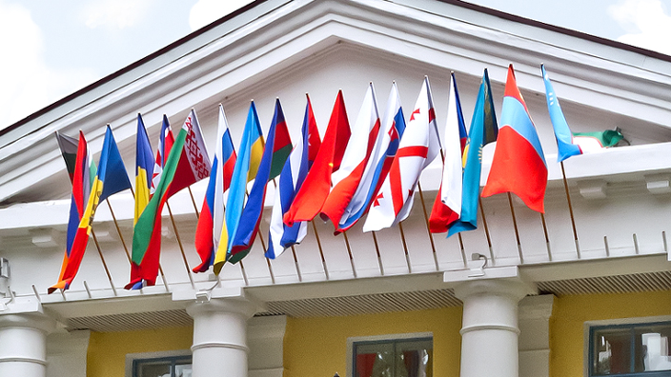
The current versions of working documents from the sub-groups are posted : https://indico.jinr.ru/event/1121/
SLRP will form the basis of the next JINR 7-year plan for the period 2024-2030
SLRP is a forward look enabling JINR scientific community, in interaction with policy makers of JINR member States, to develop long-term views and analyses of future research developments with the aim of defining research agendas of JINR laboratories in national and international context

Slide 54



2030
We have a strategy !
2020

Slide 56
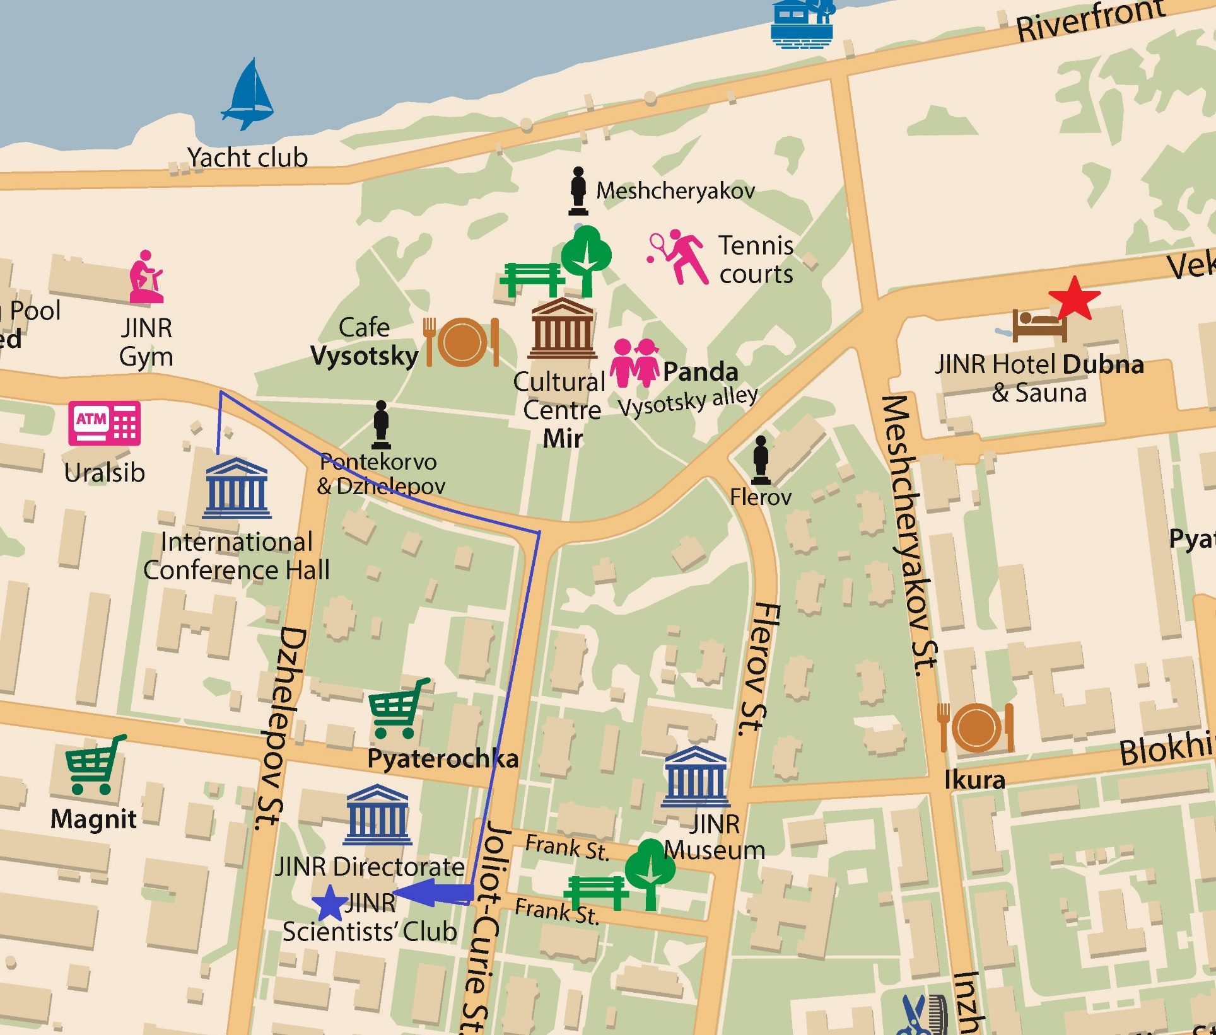

Slide 57
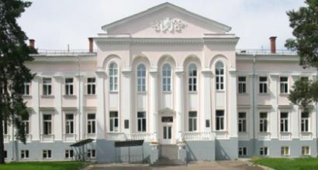
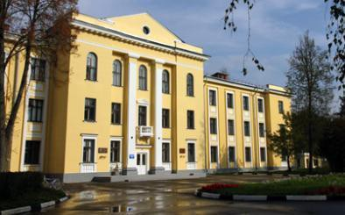
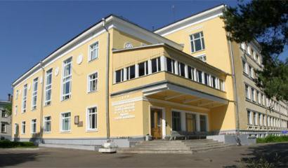
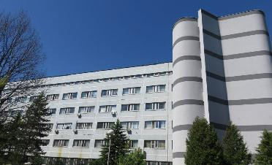

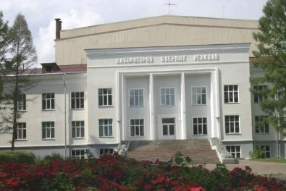
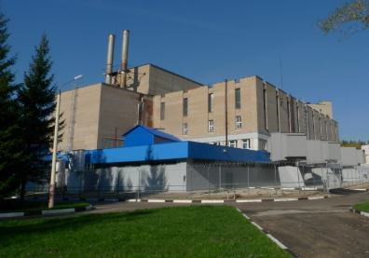
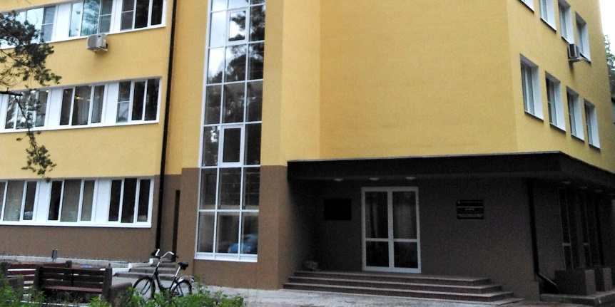
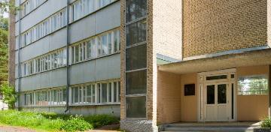
Veksler and Baldin
Laboratory of High Energy Physics
Bogoliubov
Laboratory of Theoretical Physics
Dzhelepov Laboratory of Nuclear Problems
Laboratory of Information Technologies
Flerov
Laboratory of Nuclear Reactions
Laboratory of Radiation Biology
Frank Laboratory of Neutron Physics

Slide 58
New Dubna Neutron Source: DNS-IV
New Dubna source will provide shorter neutron pulses, however containing the same number of neutrons as at ESS.
=> it will be as good as ESS for low resolution experiments and better for high resolution experiments.
Pulsed reactor IBR-3
Reactivity modulator
Core +reflector
DNS-IV: Φ_{peak}~10¹⁶
IBR-2M
x10
λ=1.5Å
DNS-IV - not just another neutron source,
but one of the best in the world!
Mean flux of ILL

Slide 59
SLRP IWG
Development of JINR
as International
Intergovernmental
Organisation
SLRP for Science
Thematically
oriented
sub-groups
Thematically
oriented
sub-groups

Slide 60
Стратегическая цель развития ОИЯИ до 2030 года
Стратегической целью является развитие ОИЯИ как научного центра мирового уровня, занимающего лидирующие позиции в области физики высоких энергий, ядерной физики и физики тяжелых ионов, физики нейтрино и астрофизики, физики конденсированного состояния, радиационной биологии, информационных технологий и высокопроизводительного компьютинга, а также в области междисциплинарных исследований и инновационных технологий.

Slide 61
Развитие ОИЯИ
как международной межправительственной
научно-исследовательской организации
Вместе со стратегическими планами достижения лидирующих позиций на приоритетных для ОИЯИ научных направлениях стоит важная цель совершенствования всех сторон деятельности нашего научного центра, включая современные методы подготовки высококвалифицированных кадров как для самого Института, так и в интересах государств-членов ОИЯИ, опираясь на современные научно-организационные методы управления деятельностью лабораторий и Института в целом, учитывая опыт крупнейших международных центров мира, добиваясь привлекательности работы в ОИЯИ для талантливой молодежи, создавая для этого необходимые условия.

Slide 62
Миссия
Международной Рабочей Группы по разработке долгосрочной стратегии развития ОИЯИ до 2030 года (SLRP)
SLRP - это взгляд в будущее, позволяющий научному сообществу ОИЯИ во взаимодействии с его партнерами в государствах-членах ОИЯИ и других странах, а также учитывая координируемые ведущими международными научными организациями планы развития исследований в области фундаментальной физики на глобальном уровне, разрабатывать долгосрочные планы развития фундаментальных и прикладных, инновационных исследований ОИЯИ, на основе анализа и изучения перспектив развития существующих и создания новых базовых экспериментальных установок и научных комплексов, а также возможного расширения и обновления научной программы ОИЯИ с целью определения приоритетов исследовательских программ лабораторий ОИЯИ в национальном, с учетом интересов государств-членов Института, и в международном контексте.

