Slide 1
Programme Advisory Committee
for Condensed Matter Physics
Follow-up after
50th meeting (17 – 18 June 2019)
Dénes Lajos Nagy
51st meeting of the PAC Condensed Matter Physics, 20–21 January 2020, Dubna

Slide 2
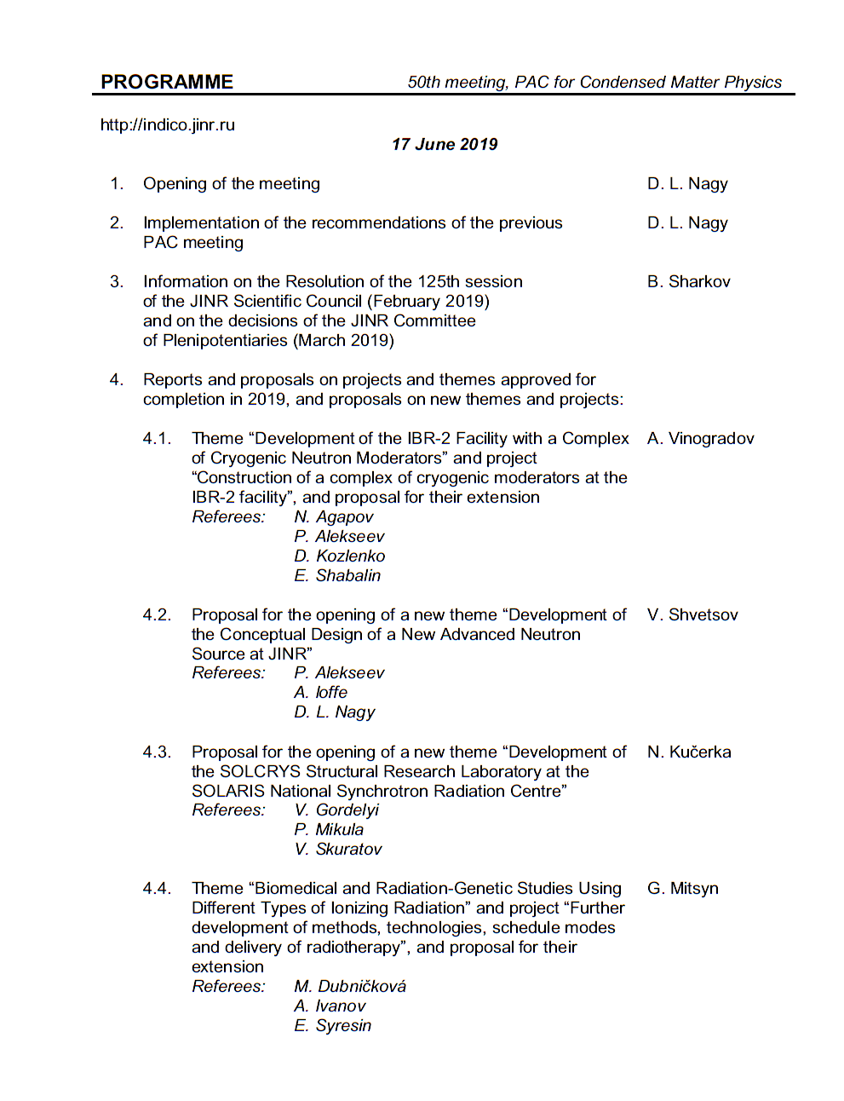
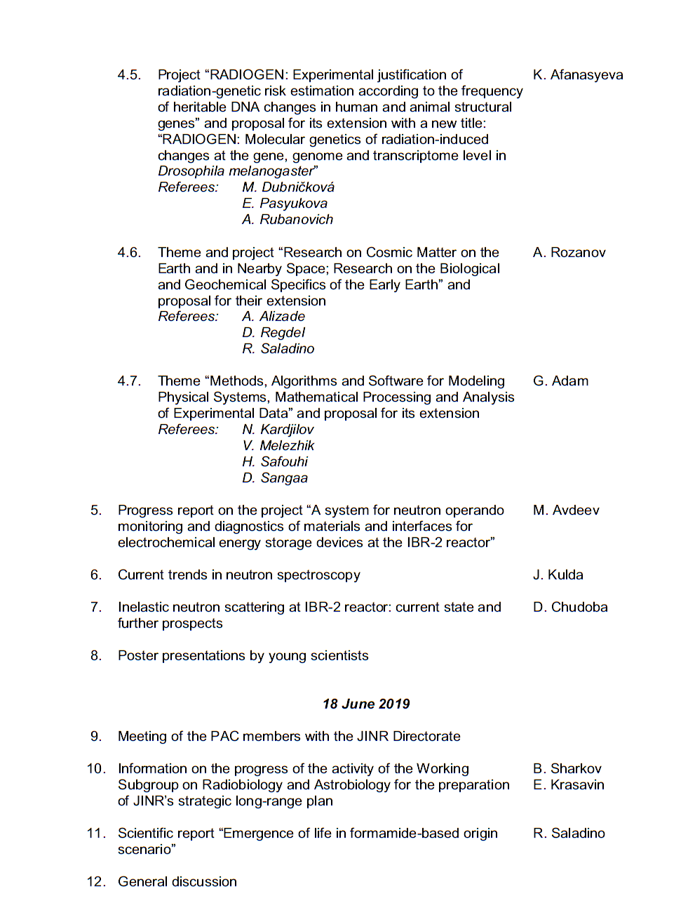
Agenda of the previous PAC meeting
Highlights of the previous PAC meeting:
Reports and proposals on projects and themes approved for completion in 2019, and proposals on new themes and projects
Development of the Conceptual Design of a New Advanced Neutron Source at JINR
Development of the SOLCRYS Structural Research Laboratory at the SOLARIS National Synchrotron Radiation Centre
Inelastic neutron scattering at IBR-2 reactor: Current state and further prospects

Slide 3
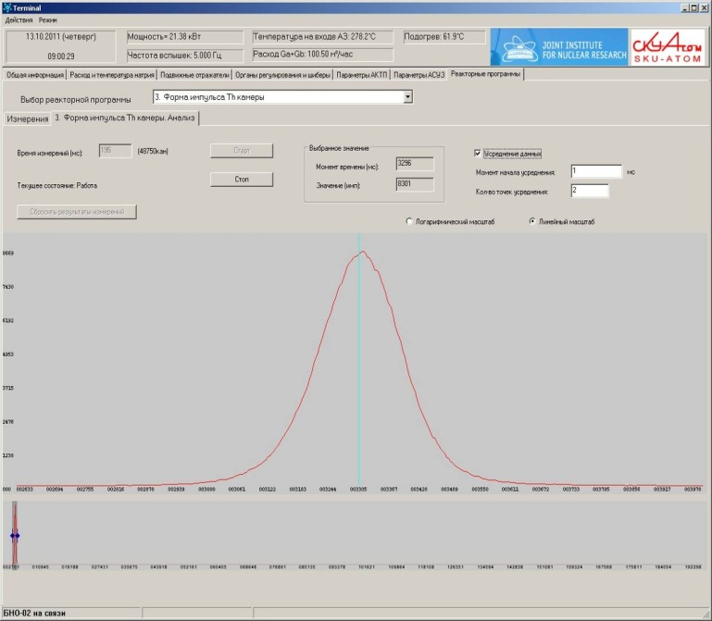
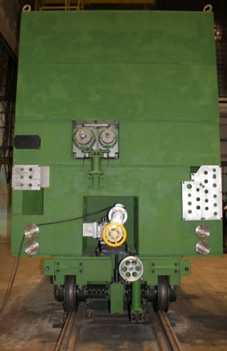
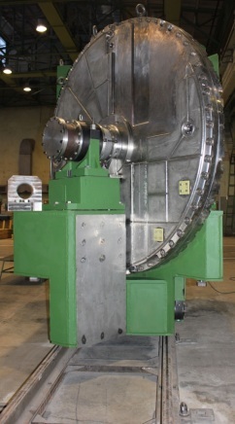
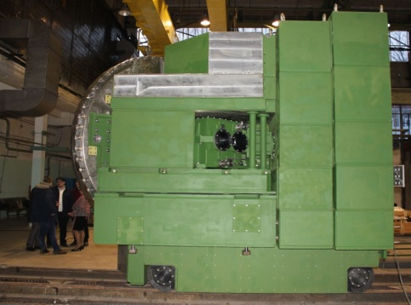
Reports and proposals on themes and projects
Report on the theme “Development of the IBR-2 Facility with a Complex of Cryogenic Neutron Moderators” and justification for its extension for 2020-2022
A. Vinogradov
1. Detailed statistics on reactor power and current status of IBR-2 beams at http://flnp.jinr.ru/ibr2
/current.html
2. Provision of physics research program on extracted neutron beams
 | Operation for physics experiments, hr. (plan - 2500 hr. per year) | Number of shutdowns
2017 | 2471 | 1
2018 | 1587 | 4
2019 | 1406 (as of May 01, 2019) | 1
Average power
2 MW
Peak power
1850 MW
200 μs
3. A new stationary radiation monitoring system has been put into regular operation. Dosimetric control and radiation monitoring meet the modern requirements of the safety rules and regulations
4. Manufacturing of a reserve reactivity modulator MR-3R

Slide 4
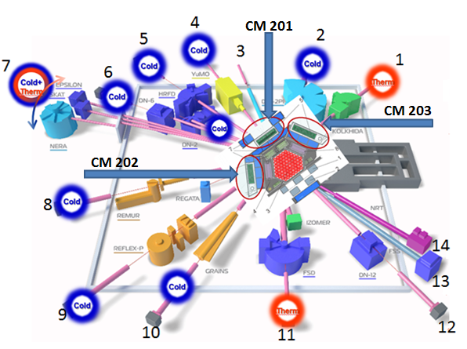
Report on the theme “Development of the IBR-2 Facility with a Complex of Cryogenic Neutron Moderators” and justification for its extension for 2020-2022
Project within the theme: “Construction of a Complex of Cryogenic moderators at the IBR-2 facility”
Complex of combined moderators
at IBR-2 reactor
N | Project | Status
1 | Development of a new mass flow rate meter | Completed
2 | Development of a device for mechanically removing pellets from the moderator chamber | In progress
3 | Project development, manufacturing and preliminary installation of CM-201 (beamlines 1, 4, 5, 6, 9) | Completed
4 | Development and construction of CM-203 (beamlines 2, 3) | Suspended
5 | Studies of additives to reduce viscosity | Completed
6 | Development and commissioning of a new cryogenic system | Completed
The Scientific Council noted the importance of activities within the theme “Development of the IBR-2 Facility with a Complex of Cryogenic Neutron Moderators” and project “Construction of a complex of cryogenic moderators at the IBR-2 facility” and supported their extension for 2020–2022.

Slide 5
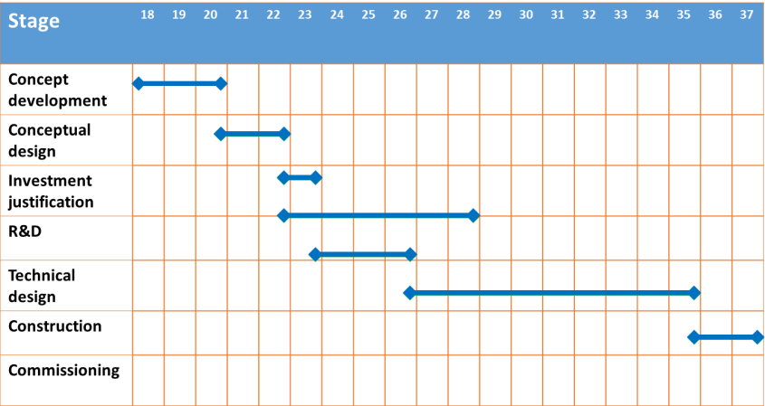
Proposal for the opening of a new theme “Development of the Conceptual Design of a New Advanced Neutron Source at JINR”
V. Shvetsov
The PAC notes the significant progress achieved by the FLNP team in developing a technical justification for the concept of the new source. At the same time, it would like to draw the attention of the project leaders and FLNP Directorate to the necessity of developing a rationale for the scientific programme for the new source.
Basic parameters of the reactor
Project roadmap (preliminary)
Parameter | Value
1 Average thermal power, MW | 15
2 Operational mode | pulsed
3 Repetition rate, Hz | 10
4 Fuel | NpN
5 Coolant | Na
6 Inlet temperature of the coolant, ⁰С | 290
7 Outlet temperature of the coolant, ⁰С | 391
8 Coolant flow through ½ of the core, kg/s | 58
9 Pressure drop across the core, Pa | 0,33·10⁵
10 Fast neutrons flux density on the reactor vessel, 10¹⁴ n/cm²·s¹ | 5,7
11 Fluence on the reactor vessel for 20 000 hours, n/cm² | 4,1·10²²
At present we have contract with NIKIET on feasibility study of the:
Pulsed reactor with mechanical modulation of reactivity, based on Np fuel
ADS with mechanical modulation of reactivity (super booster), based on PuO₂ fuel
The Scientific Council noted the significant progress achieved in developing a technical justification for the concept of a new neutron source at JINR and supported the recommendations made by the PAC on the opening of the proposed theme for 2020–2022. At the same time, special attention should be paid towards developing the scientific programme for the new source in the field of condensed matter physics and nuclear physics as well as to defining a management structure and a time schedule, specifying milestones and expected results of this new theme.

Slide 6
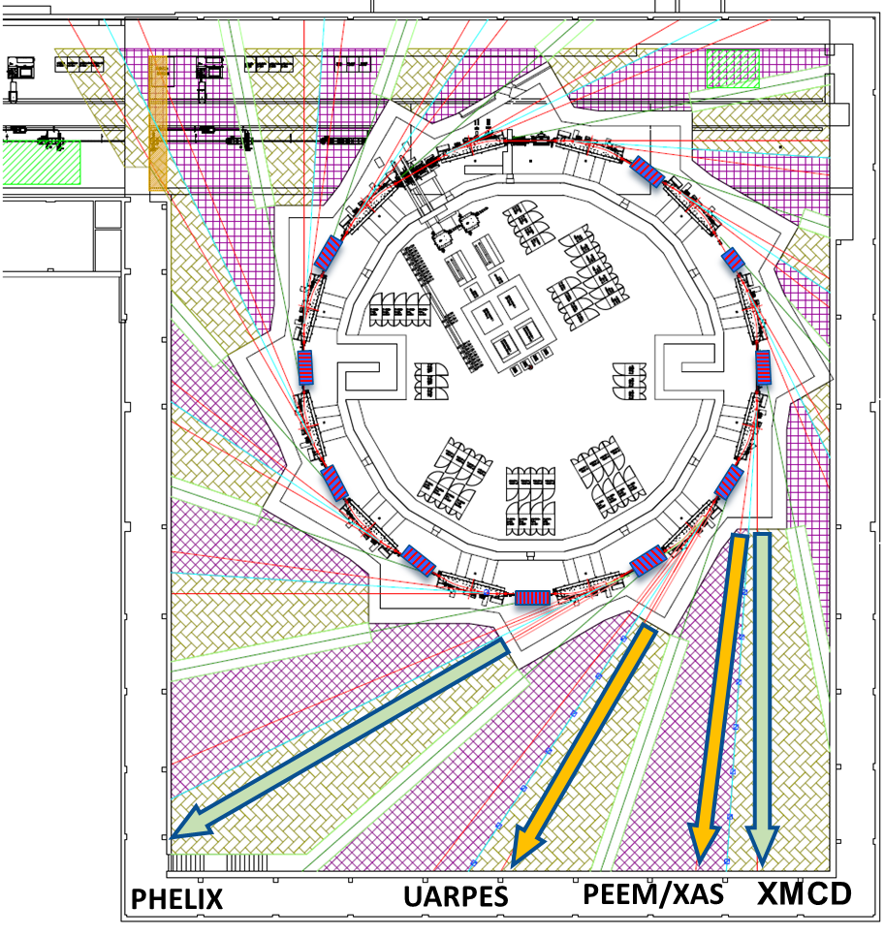
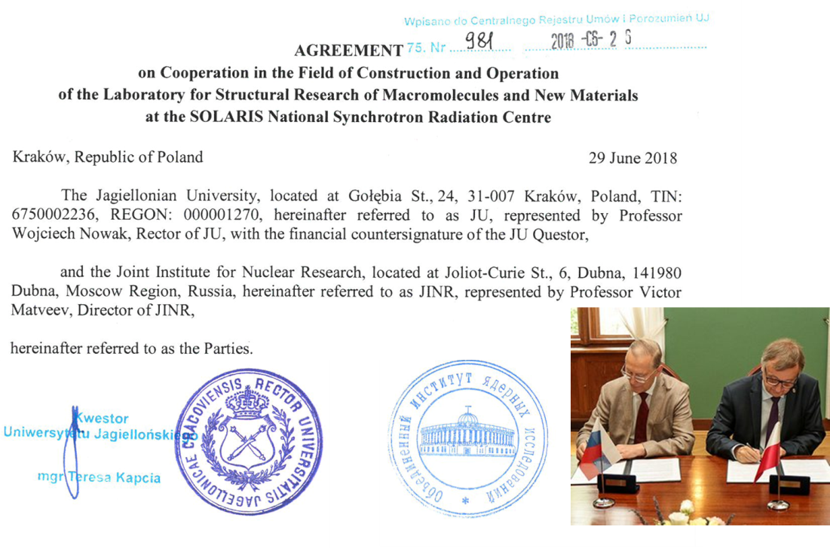
JINR–SOLARIS cooperation
The PAC heard the status and recent developments of the JINR–SOLARIS collaboration to develop the joint facility for structural research using synchrotron X-rays and a proposal for opening a new theme “Development of the SOLCRYS Structural Research Laboratory at the SOLARIS National Synchrotron Radiation Centre” presented by N. Kučerka.
The parameters of the existing facility and those for the new instruments proposed to be built allow one to estimate a potential for their future scientific use. An interest has been expressed by several organizations from JINR Member States.
SOLARIS beamlines
Beamlines at the delivery:
Ultra Angle-Resolved Photoelectron Spectroscopy
Photoemission Electron Microscopy X-ray Absorption Spectroscopy
Beamlines under construction:
angle integrated photoelectron spectroscopy
X-ray Magnetic Circular Dichroism
The Scientific Council took note of the status of the cooperation between JINR and the SOLARIS National Synchrotron Centre (Kraków, Poland) focusing on the development of a joint facility for structural research using synchrotron X-rays.
The Scientific Council supported the recommendation of the PAC on the opening of the proposed theme for 2020–2022 and took note of the interest of several organizations from JINR Member States in taking part in this activity.

Slide 7
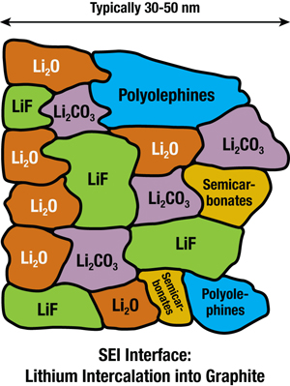
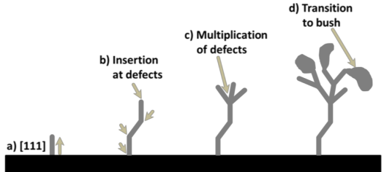
Status report by on the project “A system for neutron operando monitoring and diagnostics of materials and interfaces for electrochemical energy storage devices at the IBR-2 reactor”
M. Avdeev
Structural Research of Electrochemical Accumulators
Interface evolution
Formation of solid electrolyte interphase (SEI)
Project objectives
Development of common approaches to the effective use of neutron scattering methods (diffraction, reflectometry, small-angle scattering) in the analysis of the structural evolution of various types of electrodes and interfaces for electrochemical energy storage devices during operation (operando mode).
Design and development of specialized electrochemical cells and sample environment systems for operando research in neutron scattering experiments.
Electrode structure evolution
Negative
Electrode
Growth of dendrites
The Scientific Council was satisfied with the progress of the project and supported the PAC’s recommendation on its continuation.
Lithium intercalation
Main objective
Study of operating electrodes and interfaces (operando mode)

Slide 8
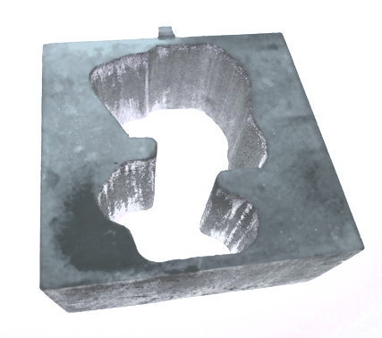
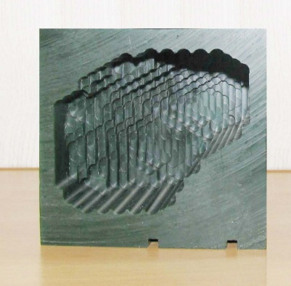
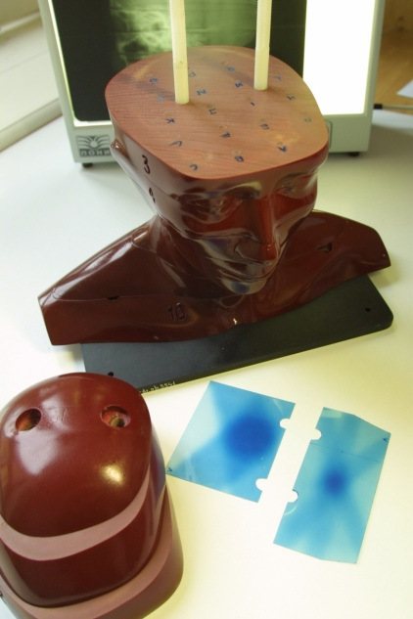
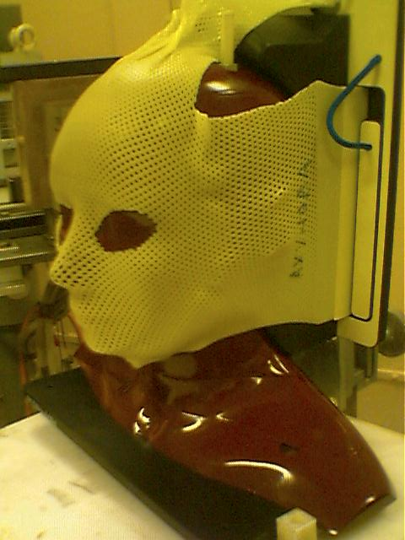
Theme “Biomedical and Radiation-Genetic Studies Using Different Types of Ionizing Radiation”
G. Mitsyn
Project “Further development of methods, technologies, schedule modes and delivery of radiotherapy”
The PAC emphasizes the high importance of the results achieved both in the field of clinical research on proton radiotherapy applications for the treatment of different diseases and in the field of radiobiology. Particularly, it should be stressed that the clinical research has entered a new phase, in which the statistical analysis of the treatment results becomes possible and the effectiveness of the proton radiotherapy techniques realized at JINR is seen.
Technologies to calculate and to produce individual collimators of Wood alloy and boluses (patient specific proton range moderators of irregular shape) of a special machinable wax using a digital computer controlled milling machine have been developed and realized
Using heterogenous “Alderson phantom” and radiochromic films a set of dosimetric experiments on verification of all the technological steps of treatment planning and realization of proton beam irradiation was carried out.
Patient set-up verification
The Scientific Council, together with the PAC, was pleased with the results achieved by DLNP’s Medico-Technical Complex both in the field of clinical research on proton radiotherapy applications for the treatment of different diseases and in the field of radiobiology. The Scientific Council supported extension of the discussed theme and project for 2020–2022.

Slide 9
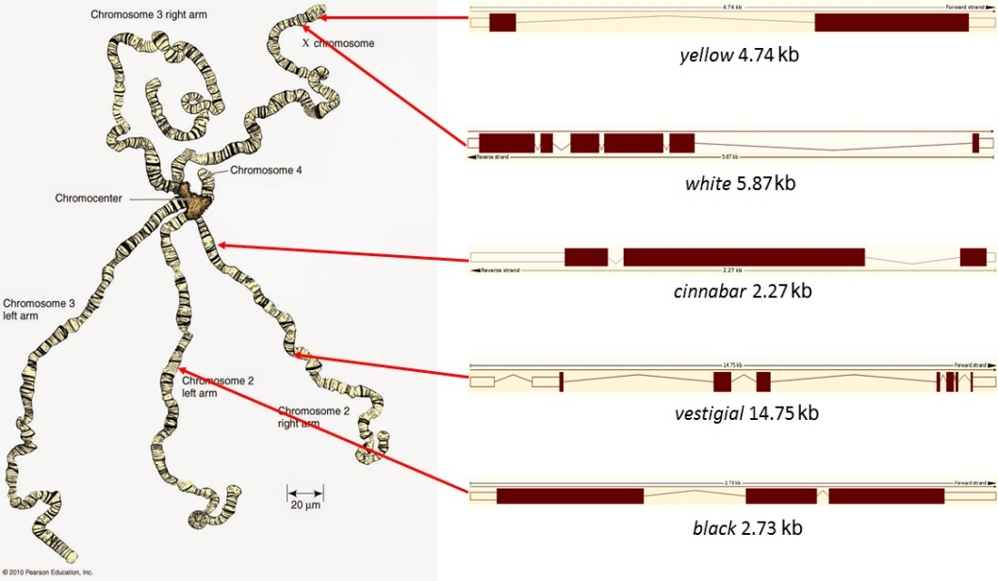
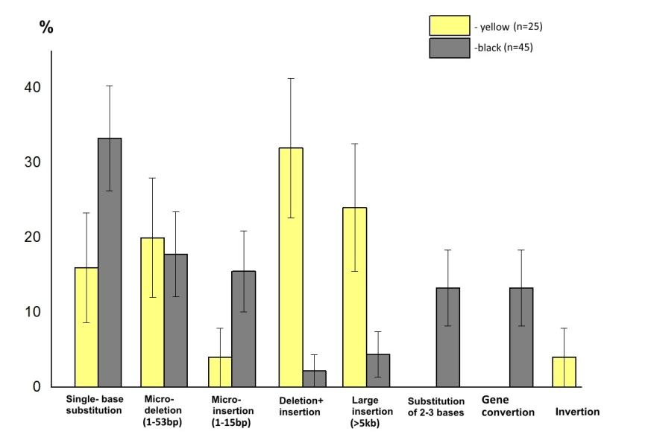
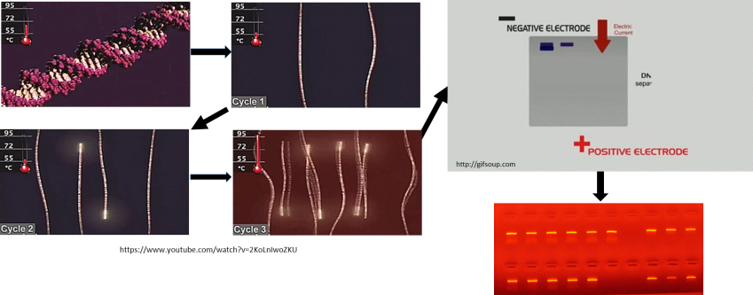
Theme “Biomedical and Radiation-Genetic Studies Using Different Types of Ionizing Radiation”
RADIOGENE project
K. Afanasyeva
The PAC notes the challenge of the situation in research that, although there is a vast amount of evidence for radiation-induced mutations in diverse biological systems, there is no exact evidence for radiation-induced germ cell mutations that could cause genetic disease in human population.
The PAC further notes that the concept of the project is based on results of hereditary diseases from mutations occurring in germ cells of Drosophila, and also on ionizing radiation capable of inducing similar changes in all experimental systems of the project. The PAC recognizes the significant progress in the development of this project and the new fundamental data in the nature of radiation genetics of living organisms and frequency of inherited changes in the DNA of gene mutations induced by γ-rays and fission neutrons in the Drosophila germ cells.
The PAC especially notes the high scientific and methodological level of the research based on advanced DNA technologies.
Spectra of γ-ray-induced DNA changes at the yellow and black genes of Drosophila melanogaster
Molecular methods: polymerase chain reaction (PCR)
The Scientific Council supported extension of this project for 2020–2022.

Slide 10
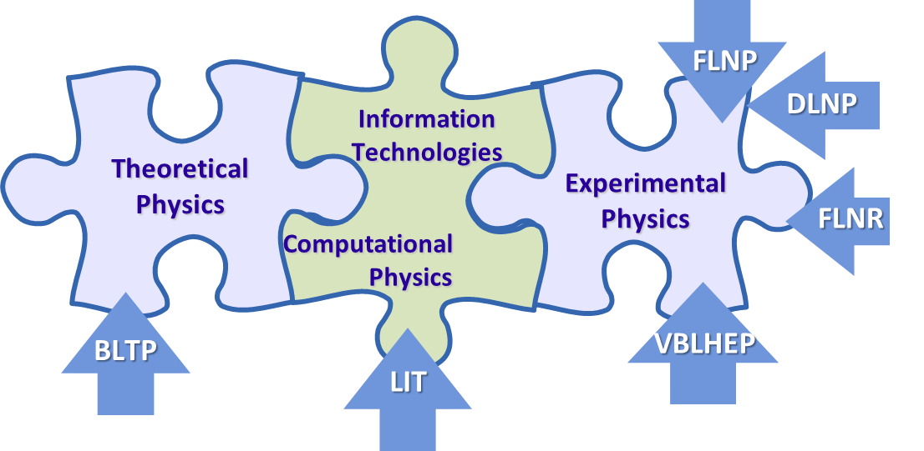
Theme “Methods, Algorithms and Software for Modeling Physical Systems,
Mathematical Processing and Analysis of Experimental Data”
Gh. Adam
The PAC highly appreciates the results obtained in the development of new mathematical methods, algorithms, and software packages intended to address topics of the outmost importance for the experimental and theoretical research conducted at JINR.
LIT involvement in JINR research: 53 projects of 28 topics of the 2019 JINR Topical Plan
Exceptional role of “GOVORUN” supercomputer
Summary
of recent achievements was presented
Big Data analytics and quantum computing
MMCP Conferences, 2011, 2015, 2017, 2019
The Scientific Council appreciated LIT’s efforts to achieve development and upgrade of the JINR telecommunication and network infrastructure; modernization of the MICC engineering infrastructure, increase in performance of computing resources and data storage systems.
The Scientific Council supported the recommendations of the PAC for Nuclear Physics and of the PAC for Condensed Matter Physics to extend the theme “Information and Computing Infrastructure of JINR” and the MICC project for 2020–2023.

Slide 11
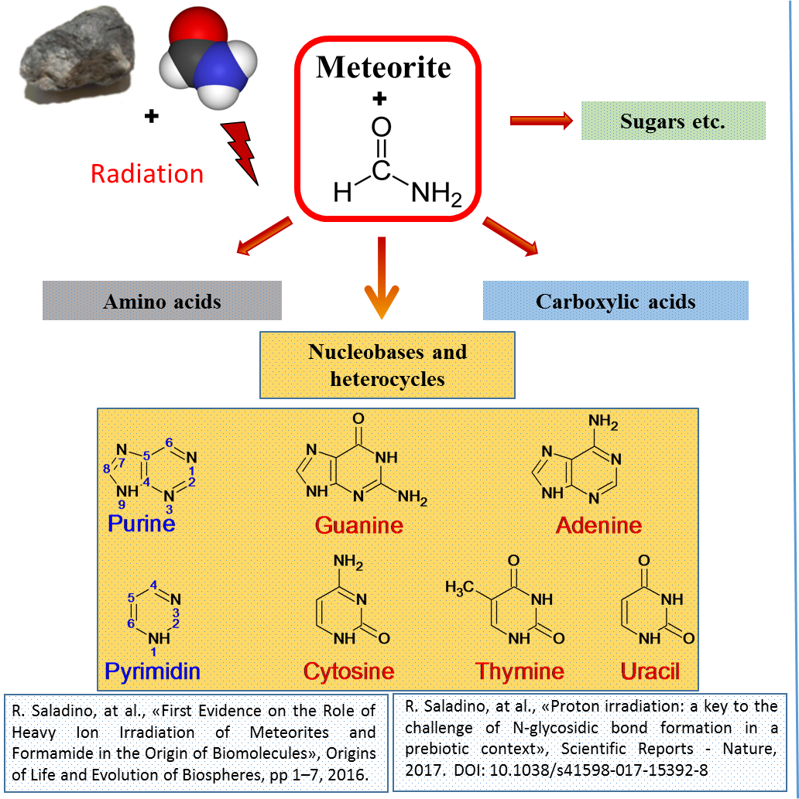
Theme and project “Research on Cosmic Matter on the Earth and in Space; Research on the Biological and Geochemical Specifics of the Early Earth”
The results achieved by the Astrobiology Sector of the Laboratory of Radiation Biology for the past three years indicate the high productivity of its research.
In addition to using JINR's facilities, in particular the Phasotron and the IBR-2 reactor, the Sector has acquired its own equipment. In 2017, a modern Tescan Vega 3 scanning electron microscope was put into operation, by which fossilized microorganisms in meteorites are searched for and studied.
Eukaryotic microorganisms have been found in the Orgueil meteorite; the results of this research have been published in the Paleontological Journal of the Russian Academy of Sciences.
The Scientific Council agrees with the PAC’s recommendation on extension of this concluding theme and project for 2020–2022.

Slide 12
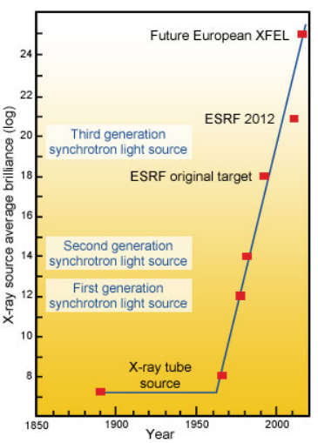
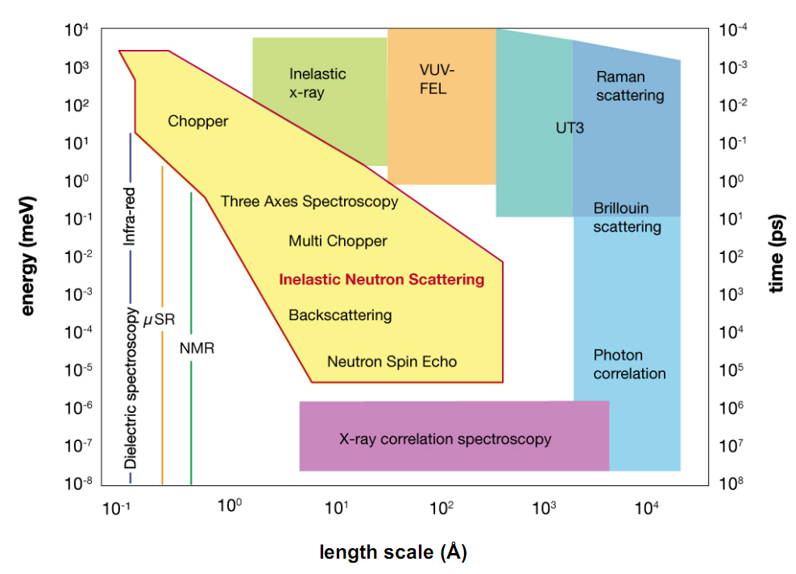
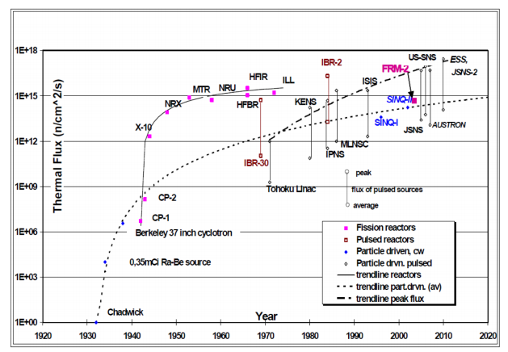
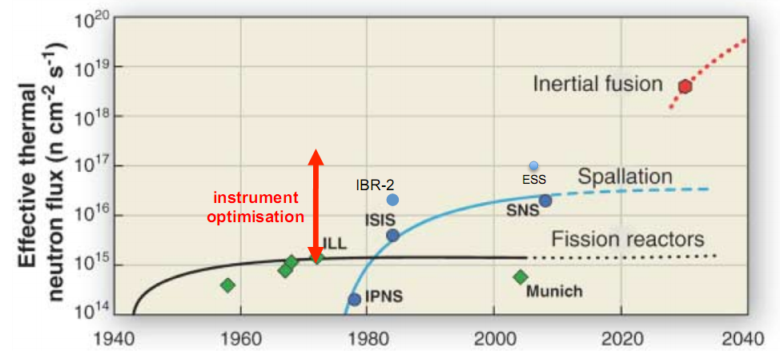
Inelastic neutron scattering at IBR-2
The PAC heard with interest an overview of the current trends in neutron spectroscopy worldwide presented by J. Kulda.
40+ years of instrument development & infrastructure optimisation
result in 2-3 orders of gain in experiment efficiency
• impact:
– typical experiment duration reduced by factor 2-3
– samples volumes reduced proportionately (eg. spectroscopy 10-50 mm3, proteins 0.1 mm3)
– new science (frustrated magnetism, chemical kinetics, protein crystallography, ...)
all known production reactions produce MeV neutrons
moderation to <1ev is a diffusive and incoherent process

Slide 13
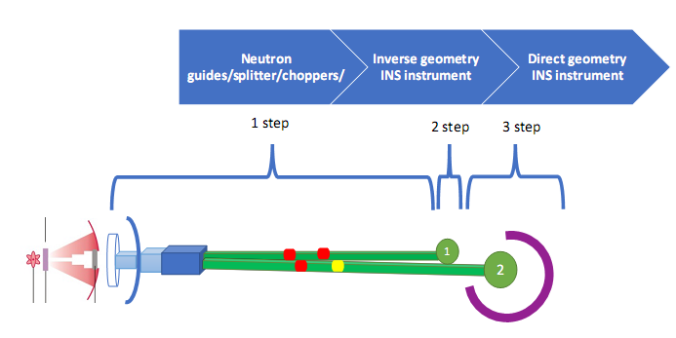
Inelastic neutron scattering at IBR-2
The PAC took note of the presentation by D. Chudoba on the current state of inelastic neutron scattering instruments operating at IBR-2.
The PAC notes that the two spectrometers mentioned in the report are the only inelastic neutron scattering instruments available at JINR.
The PAC was informed about FLNP plans to open a new project to further develop these spectrometers for 2021–2023.
The Scientific Council welcomed the results of discussion of the inelastic neutron scattering instruments at IBR-2 within the context of the current trends in neutron spectroscopy worldwide.
Considering that the two spectrometers reviewed by the PAC are the only inelastic neutron scattering instruments available at JINR, the Scientific Council supported the development of new inelastic neutron scattering instruments and FLNP’s intention to present a proposal for opening a new project to further develop the two existing instruments.
Inverse geometry INS instrument

Slide 14
Announcement
FLNP SEMINAR
dedicated to the 75th anniversary of Professor
A. M. Balagurov
22 January 2020 (Wednesday), 15⁰⁰
FLNP Conference Hall (3rd floor)
Programme of the Seminar:
1. V.N. Shvetsov. Opening speech.
2. V.L. Aksenov. On the history of neutron Fourier diffractometry.
3. G.D. Bokuchava. Neutron Fourier diffractometry: current status and prospects.

Slide 15
Thank you for your attention

