Slide 1

Main Results of Instrumentation Development and Scientific Research in the Field of Condensed Matter at the IBR-2 Reactor in 2019
D.P. Kozlenko
Frank Laboratory of Neutron Physics, Joint Institute for Nuclear Research, 141980 Dubna, Russia

Slide 2
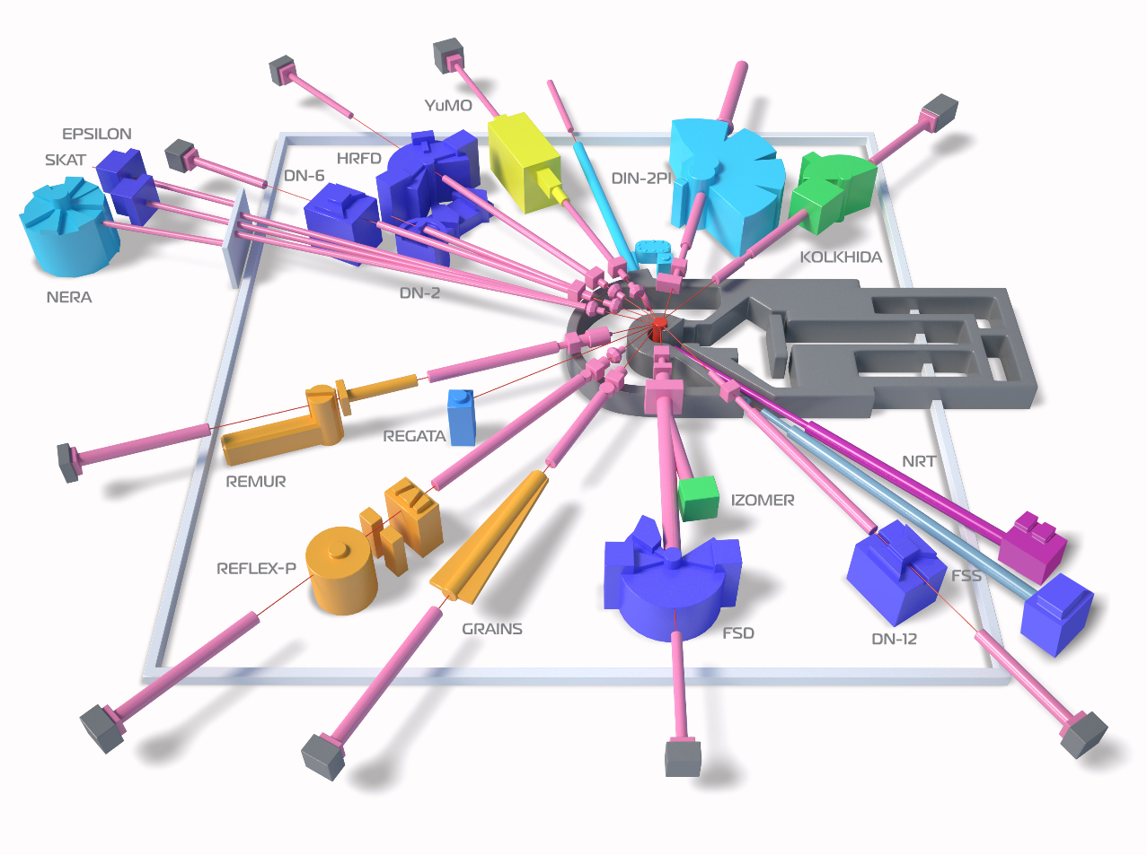
IBR-2M Spectrometers Complex
Diffractometers:
HRFD, DN-6, RTD, DN-12, FSD, SKAT/Epsilon, FSS
Reflectometers:
REMUR, REFLEX, GRAINS
Small Angle Scattering Spectrometer: YuMO
Inelastic Neutron Scattering Spectrometers:
NERA, DIN-2PI
Radiography and Tomography: NRT
New Instruments:
DN-6, GRAINS, NRT, FSS
2011:
11 instruments in operation
Now:
15 instruments in operation
Reconstruction:
REFLEX – SESANS

Slide 3
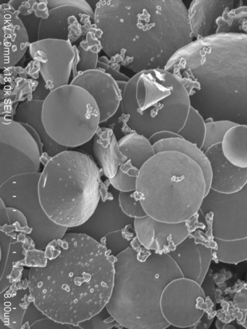
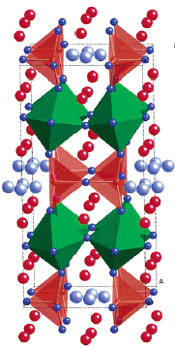
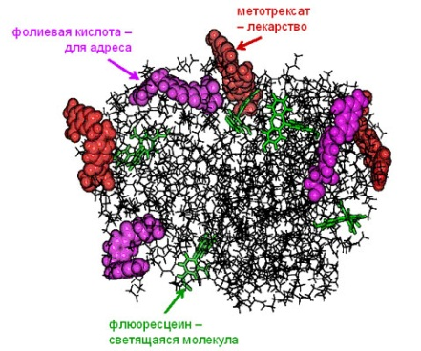
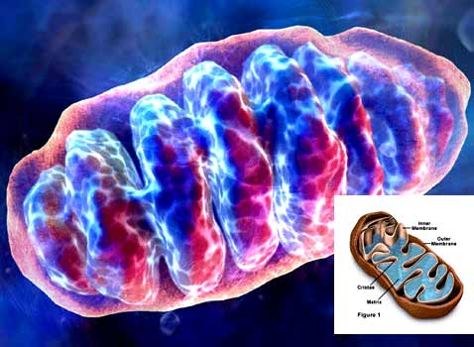
The priority directions of fundamental research :
Nanoscale physics
Physics and Chemistry of Functional Materials
Physics and Chemistry of
Complex Liquids and Polymers
Physics of Soft Condensed Matter

Slide 4
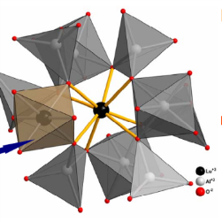
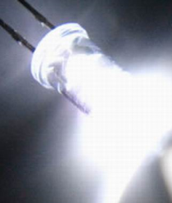
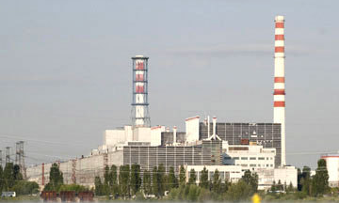
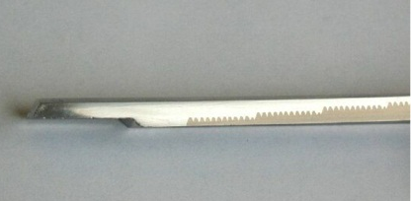
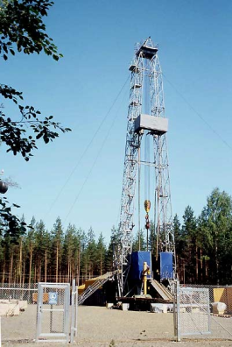
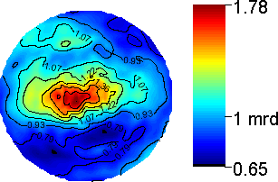
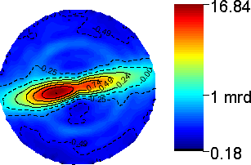
The priority directions of applied research:
Structural characterization of functional
materials used in different (nano)technologies
Non-destructive control of residual
stresses and internal organization of bulk
materials and products
Texture analysis of geomaterials
and constructional materials
Stainless steel
Zr based alloy

Slide 5
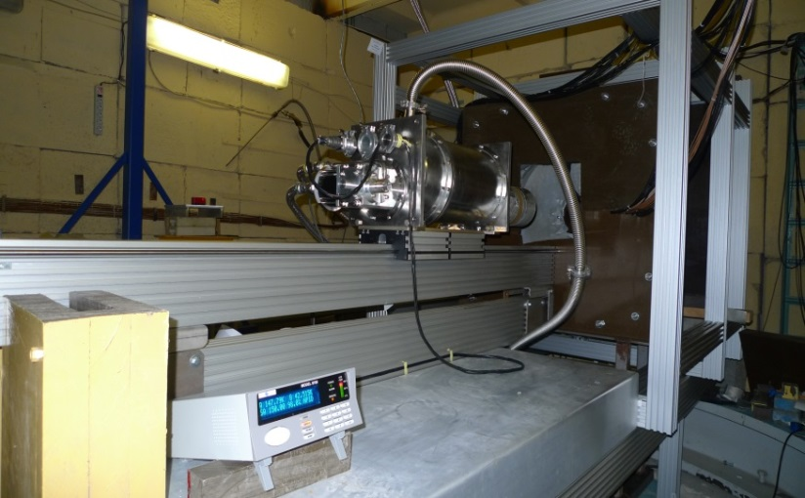
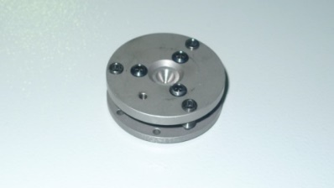
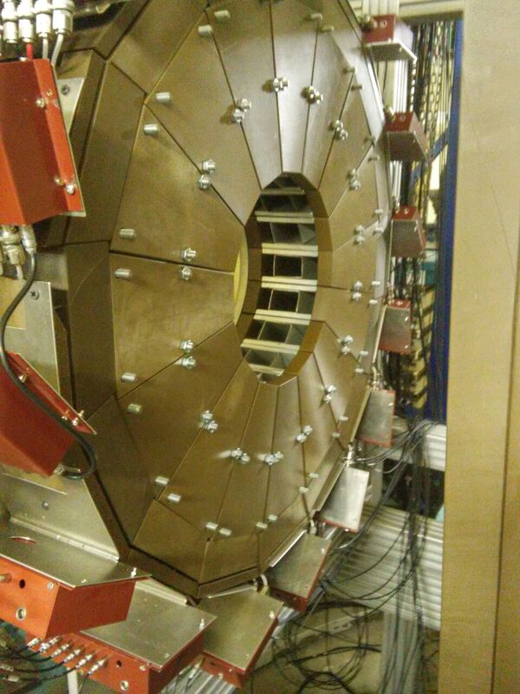
Diffractometer DN-6 for studies of microsamples under extreme conditions
DAC
Intensity gain: 12 times (compared to DN-12)
Pressure range: 30-50 GPa
Temperature range: 4– 300 K
Sample volume: 0.01-0.05 mm³
DN-6 diffractometer
90-deg. circular detector of DN-6, consisting of 96 separate ³Не counters
Neutron diffraction patterns of Cr₂O₃ sample measured in sapphire anvil cell up to 4.6 GPa
Neutron diffraction patterns of Cr₂O₃ sample measured in DAC up to 35 GPa

Slide 6
Further Development of DN-6: Installation of Neutron Parabolic Focusing Device (7 m length)
Neutron flux at sample position: 3⋅10⁷ n/cm²/s (with focusing device)
Resolution at d = 2 Å, 2θ =90⁰: Δd/d = 0.025
D-spacing range: 0.8 - 12 Å
Pressure range: 0 – 50 GPa
Temperature range: 4 – 300 K
Top level among relevant class of instruments, achievable pressure range comparable with SNAP (SNS)
The averaged incident neutron flux gain is ~ 6 times.
Multiplication factor compared to DN-12: 35 times

Slide 7
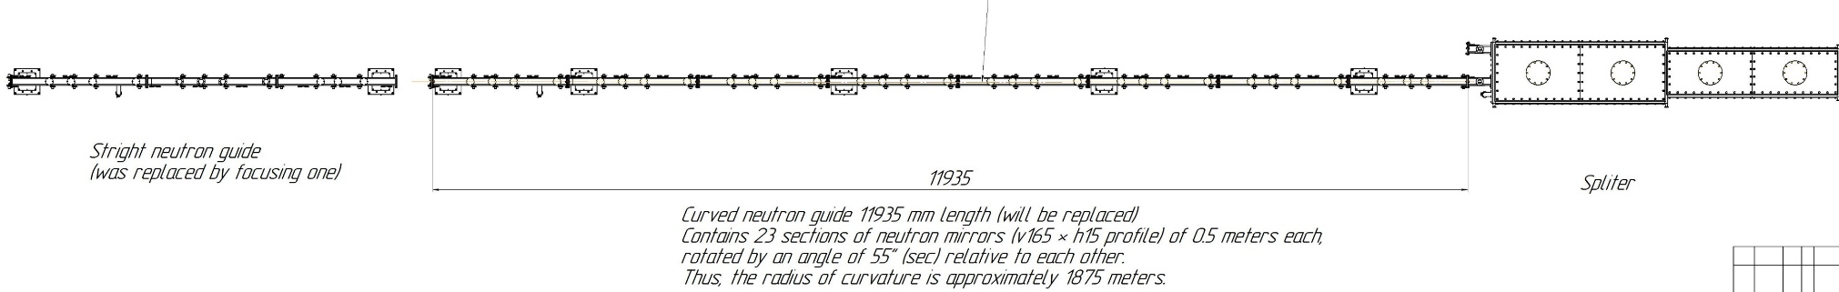
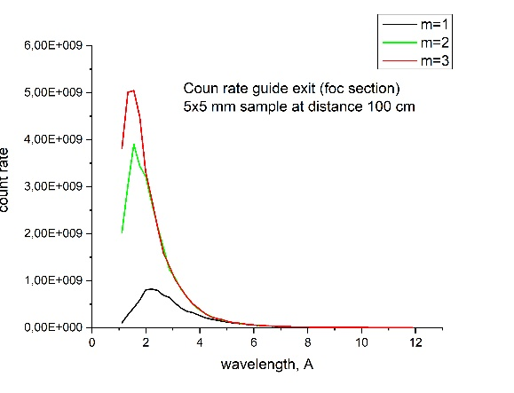
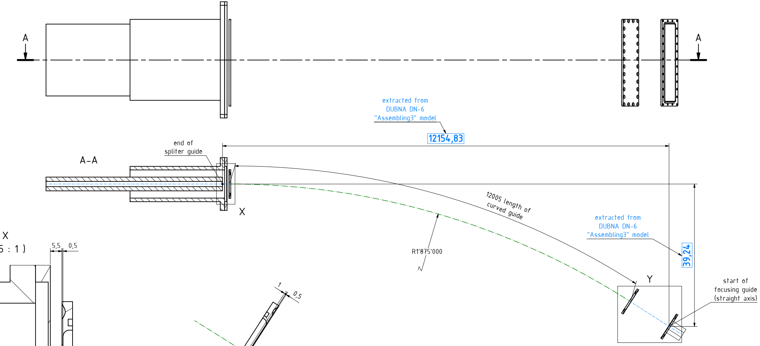
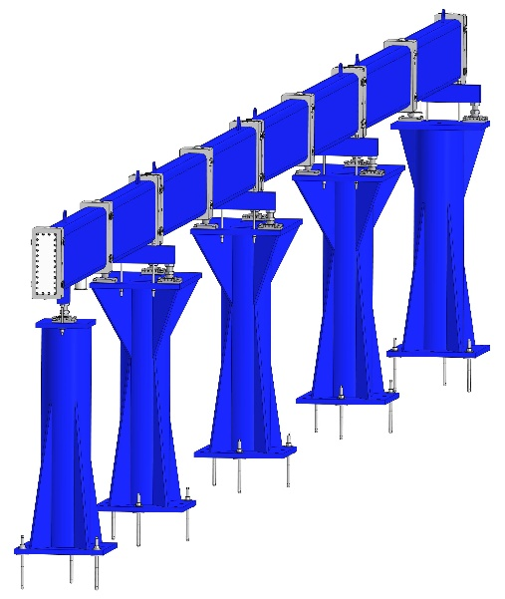
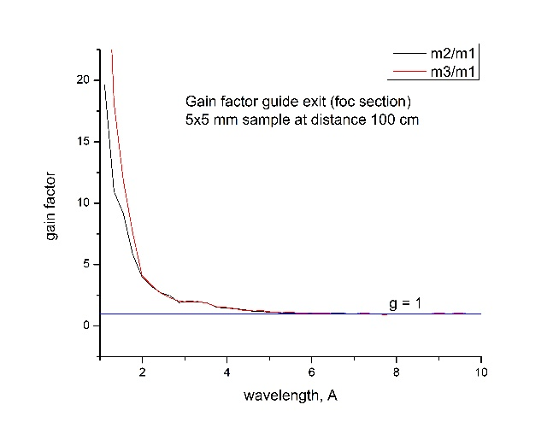
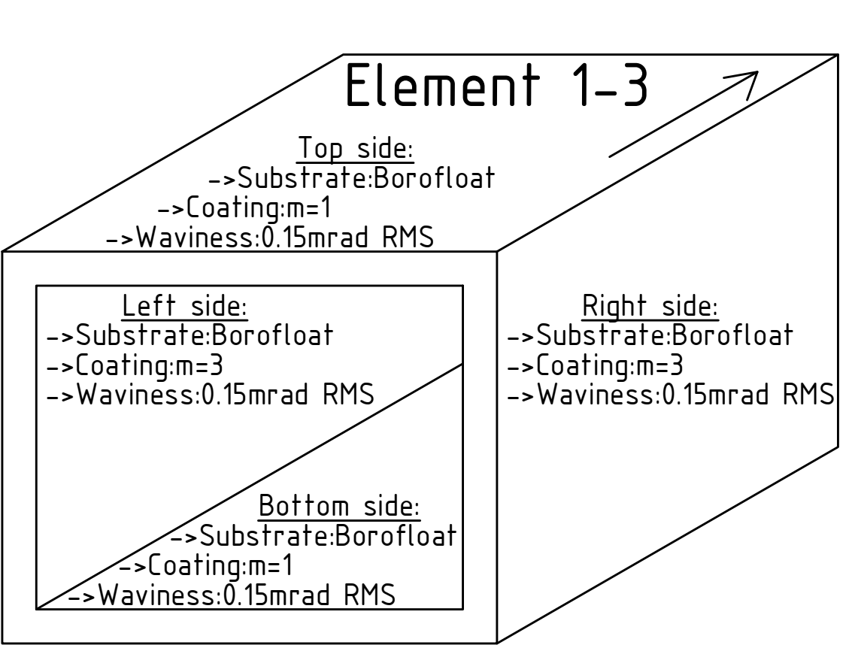
Upgrade of the Curved Part of the Neutron Guide
Replacement part –
curved neutron guide based on natural Ni coating mirrors (coating: m=1)
Calculations
Mechanical layout
Final model
Swissneutronics, completion of fabrication – first half of 2020
The replacement of the curved part of the mirror neutron guide (17 m) from m = 1 to m = 3 will provide gain factor ~ 2 times for 2<λ<5 Å and >5 for λ<2 Å

Slide 8
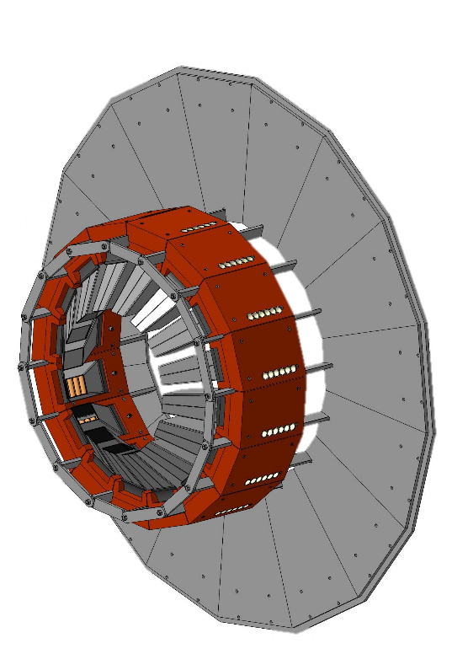
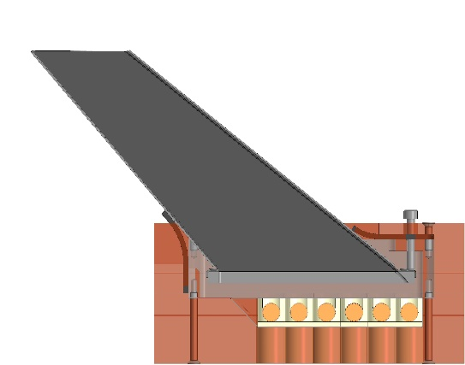
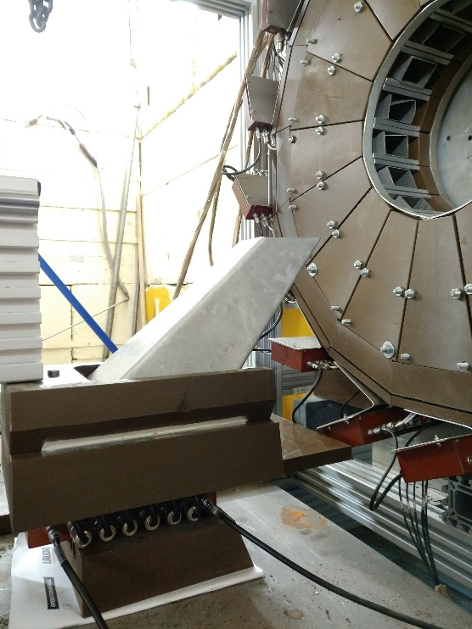
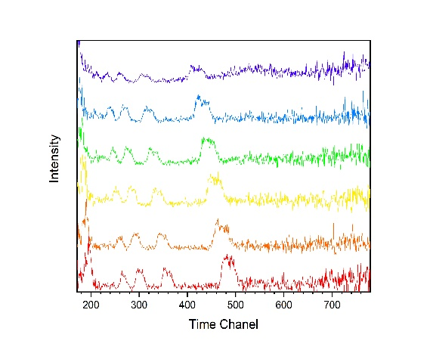
Development of new circular detector for scattering angle 45 deg
Model of 45 degrees 96 He³⁺
neutron counters based ring detector
One of 16 detector modules
Test experiment setup
D_{hkl} range | Up to 14Å
Solid angle | Up to 0,63 sr
2θ angle range | 32°-54°
Δd/d | ≈0.025 for λ=2Å
Neutron diffraction patterns of 1mm³ La(¹¹B)₆ for 2θ region 40-48 deg.

Slide 9
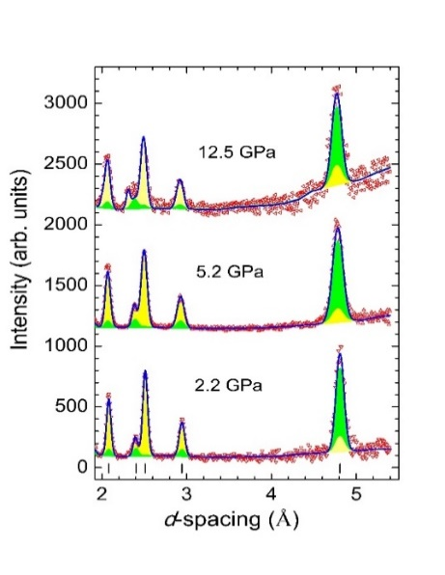
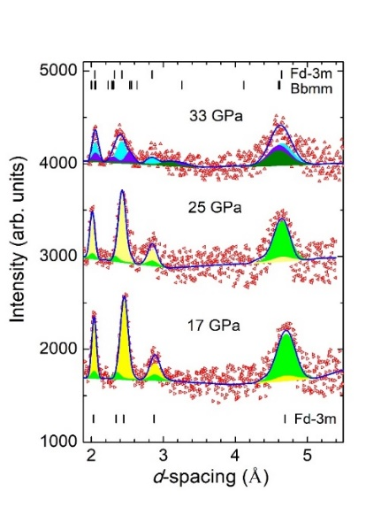
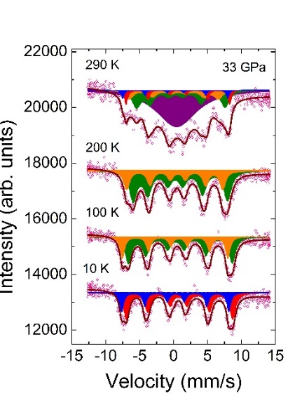
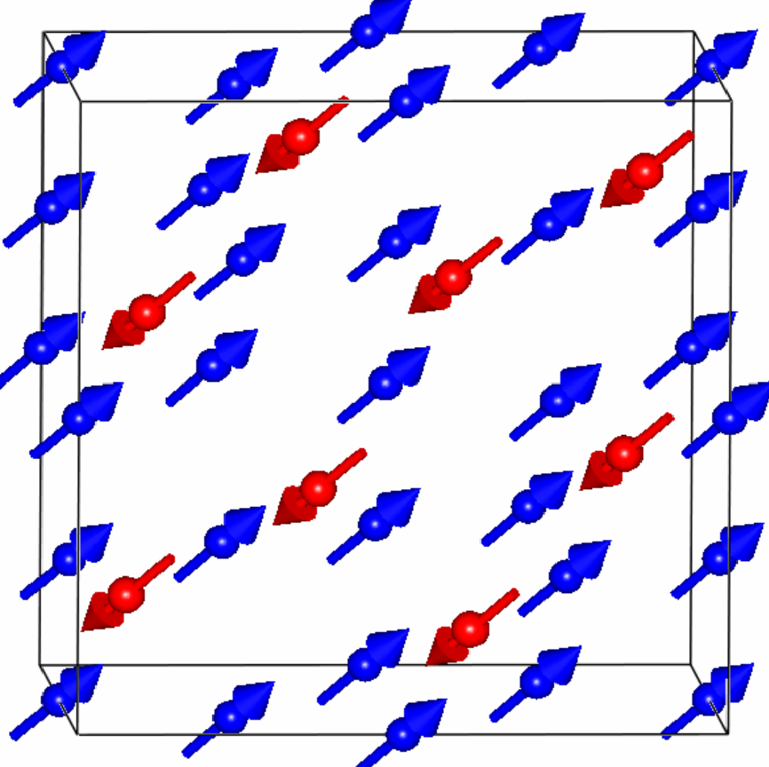
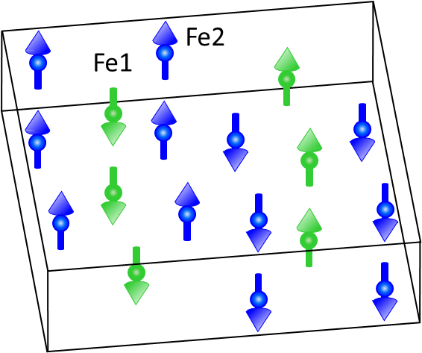
Magnetic and electronic properties of magnetite across the high pressure anomaly
Magnetite Fe3O4 demonstrates pressure-induced anomalous behavior of magnetic and electronic properties in vicinity of the structural phase transition, occurring at P ~ 25-30 GPa
Synchrotron Moessbauer spectra of ⁵⁷Fe-enriched magnetite measured at 33 GPa and different T
Neutron diffraction patterns of magnetite measured at ultrahigh pressures up to 35 GPa at RT
Inverse spinel cubic Fd-3m
Post-spinel orthorhombic Bbmm
P
Ferri-magnetic, T_{N} = 850 K at 0 GPa
Ferri-magnetic, T_{N} = 420 K at 33 GPa
P-T phase diagram of magnetite
D.P.Kozlenko et al., Scientific Reports 9, 4464 (2019)
Notes:
The magnetite Fe₃O₄, being anciently known magnetic material to human kind and remaining in leading positions for development of advanced technologies presently, demonstrates a number of puzzling physical phenomena, remaining at focus of extensive research for more than century. Recently the pressure-induced anomalous behavior of physical properties of magnetite in vicinity of the structural phase transition, occurring at P ~ 25-30 GPa, has attracted particular attention, and its nature remains unclear. Here we study the magnetic and electronic properties of magnetite across high pressure anomaly and in the pressure-induced phase by means of neutron diffraction and ⁵⁷Fe synchrotron Moessbauer spectroscopy over pressure 0-40 GPa and temperature 10-290 K ranges. In the high pressure phase the long range ferrimagnetic order formation below T_{NP} ~ 420 K was observed and spin arrangement symmetry was deduced. The structural, magnetic and electronic phase diagram of magnetite in the discussed pressure range is established.
Минерал магнетит Fe₃O₄ является одним из первых магнитных материалов, использующихся человечеством с древних времен, в настоящее время он также находит широкое применение в развитии современных технологий. Магнетит демонстрирует ряд необычных физических явлений, которые активно исследуются но протяжении более ста лет. Недавно было обнаружено аномальное поведение физических свойств магнетита при высоких давлениях в области структурного фазового перехода, происходящего при Р ~ 20-25 ГПа. Для выяснения природы этого явления проведено исследование магнитных и электронных свойств магнетита с помощью дифракции нейтронов и синхротронной Мессбауэровской спектроскопии на изотопе железа ⁵⁷Fe в диапазоне давлений 0 – 40 ГПа и температур 10 – 300 К. В фазе высокого давления обнаружено ферримагнитное упорядочение, возникающее при температуре T_{NP} ~ 420 K и установлена его симметрия. Определена структурная, магнитная и электронная диаграмма магнетита в исследуемом диапазоне термодинамических параметров.

Slide 10
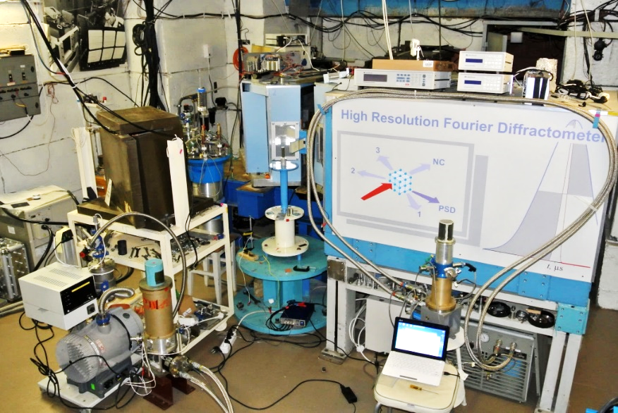
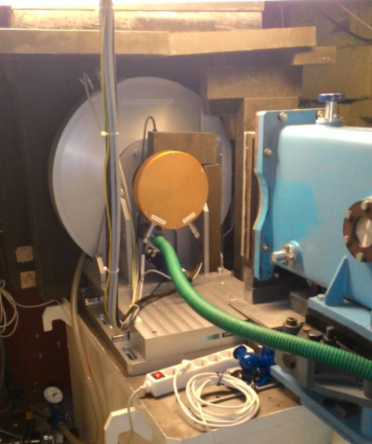
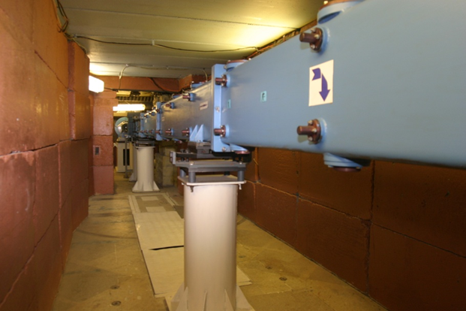
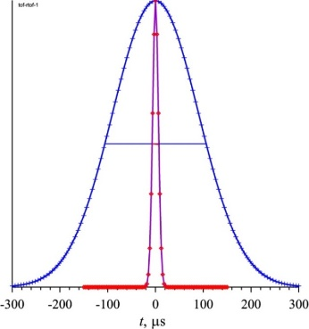
High Resolution Fourier Diffractometer
New Fourier chopper and neutron guide with vertical parabolic focusing. The intensity gain factor ~2.5.
Δt_{0f} = 15 μs
t
I(ω, t) ~ ∫ σ(τ)·R[(τ - t), ω] dτ
0

Slide 11
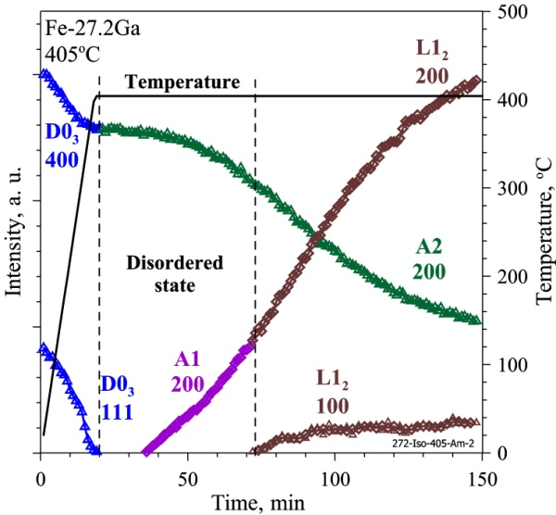
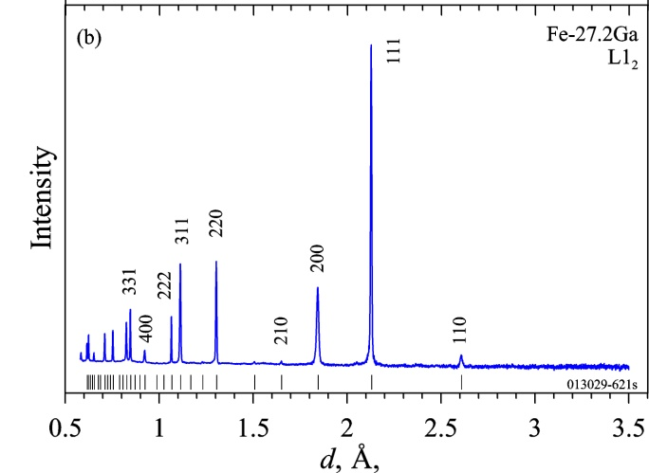
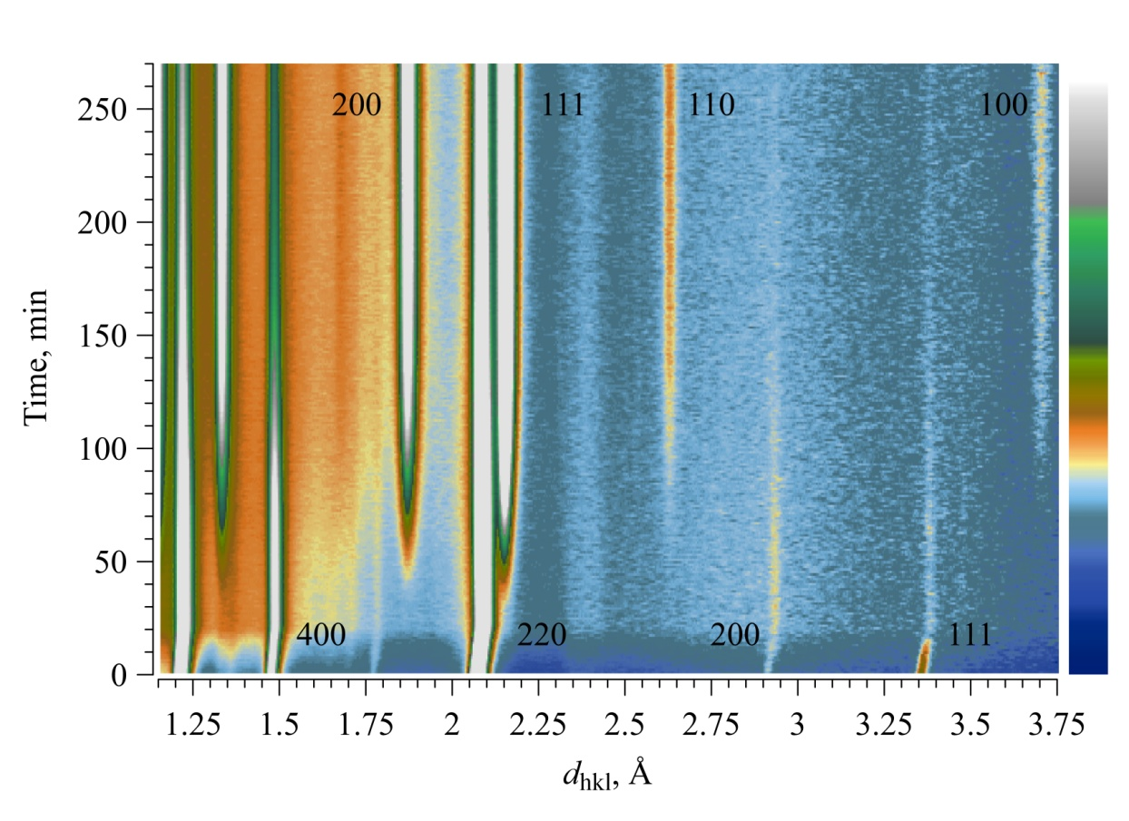
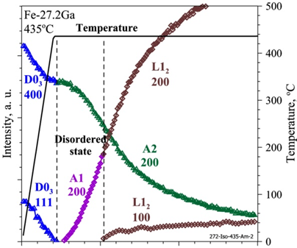
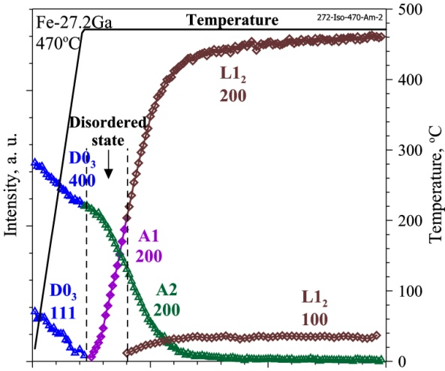
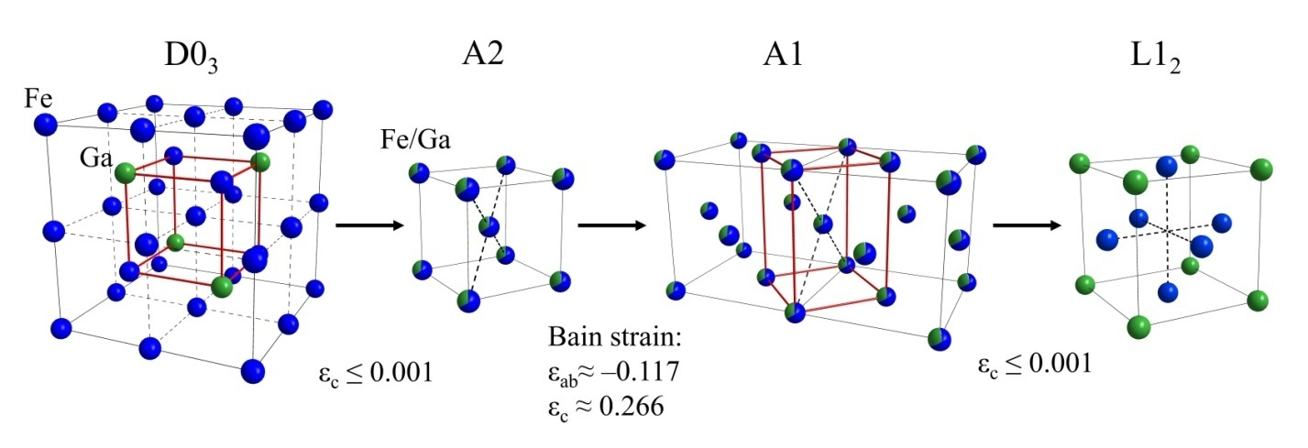
The isothermal phase transitions in Fe3Ga-type compounds
Giant magnetostriction effects
A.M. Balagurov et al., Acta Cryst. B 75, 1024 (2019)
Notes:
Проведены исследования изотермических фазовых переходов в функциональных сплавах F3Ga. Возможности установки ФДВР использовались максимально полно: состояния перед нагревом и после исследовались в режиме высокого разрешения. Переходы исследовались в режиме высокой интенсивности, время экспозиции в таких in situ экспериментов составляло 1 минута. Примеры дифрактограмм показаны.
Слева показаны изменения во времени интенсивностей основных (D0₃, 400 и L1₂, 200) и сверхструктурных (D0₃, 111 и L1₂, 100) дифракционных пиков в ходе быстрого нагрева и последующей изотермической выдержке при температурах 405, 435 и 470 ºС (левая шкала). Исчезновение пика (D0₃, 111) означает переход D0₃ → A2. Появление пика (L1₂, 100) означает переход А1 → L1₂. Вертикальными линиями обозначены интервалы времен, в которых структура находится в неупорядоченном состоянии. Начало шкалы времени соответствует началу подъема температуры.
Определено, что переход между D0₃ → L1₂. проходит через атомно неупорядоченные фазы сплавов.
Иллюстрация перехода показана внизу слайда.
D0₃ → L1₂ есть переход первого рода с большим (~1%) скачком атомного объема, требующим значительной перестройки кристаллической решетки. При переходах типа разупорядочения (D0₃ → A2) и упорядочения (A1 → L1₂) деформация решетки однородна и очень мала (ε ≤ 0.001), тогда как при переходе 1-го рода А2 → A1 линейные деформации различны и составляют ε_{c} ≈ 0.266, ε_{ab} ≈ -0.117.

Slide 12
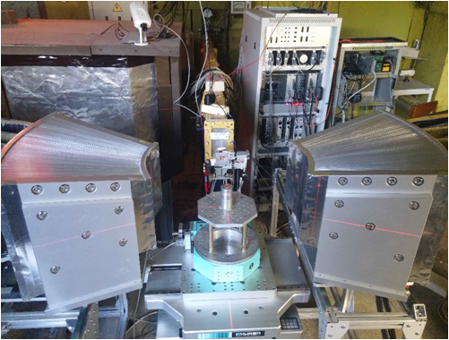
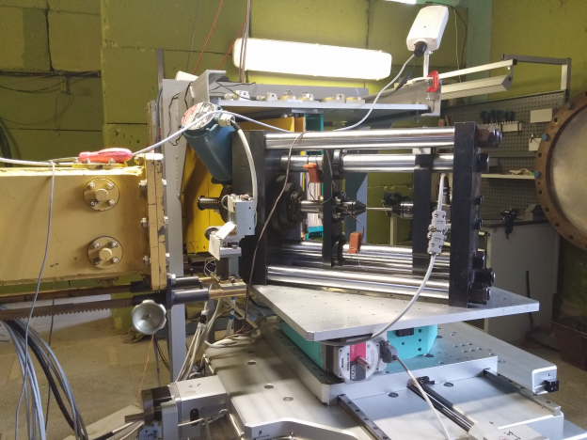
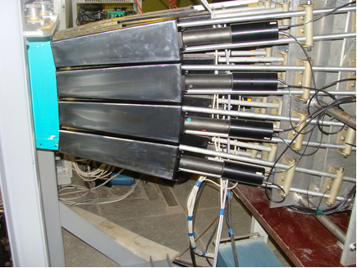
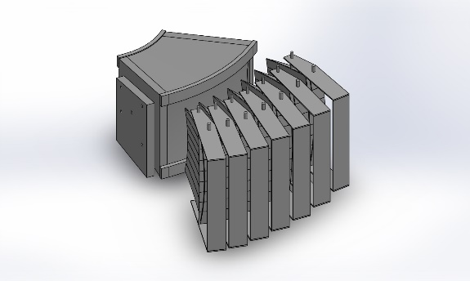
Fourier Stress Diffractometer Upgrade
Beam profiles:
analytical calculations and Monte Carlo simulation
Gauge volume of 1.8 mm
Loading machine LM-20
Development of the 90-deg scintillation detector ASTRA
Development of new Fourier Chopper

Slide 13
FSD: Lattice strain evolution in AZ31 magnesium alloy under applied load
Pawley refinement results (sample TD): lattice parameters a and c
Diffraction patterns evolution vs. applied load
Microstrain vs. applied load

Slide 14
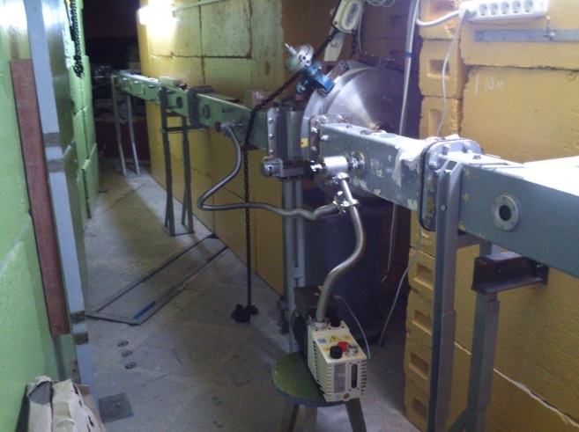
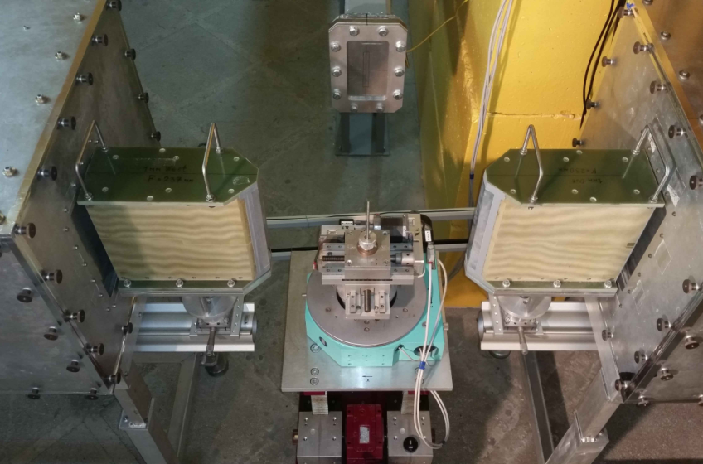
Installation of Fourier Stress Spectrometer (FSS) Components at 13 beamline of IBR-2
The neutron guide, Fourier chopper and detector system of the FSS spectrometer (left). The high resolution spectrum of the iron sample and resolution function (right).
The replacement of the mirror neutron guide with a new one (m = 2, linear convergence), is completed.

Slide 15
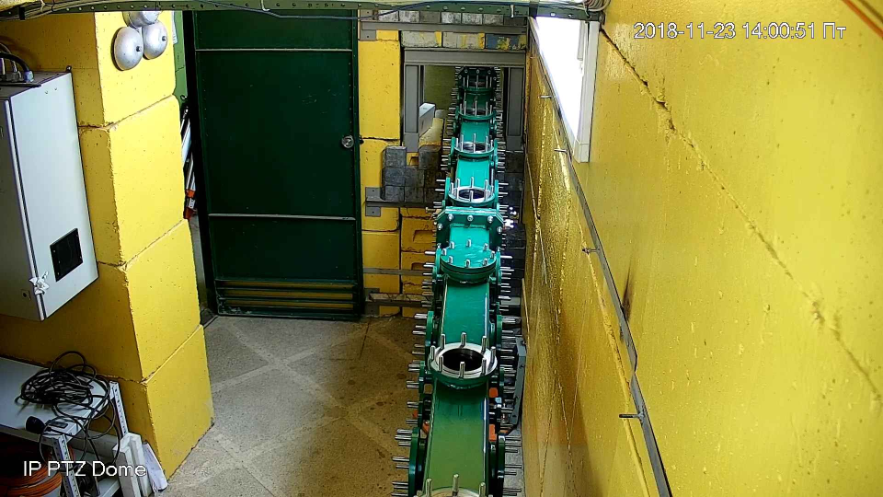
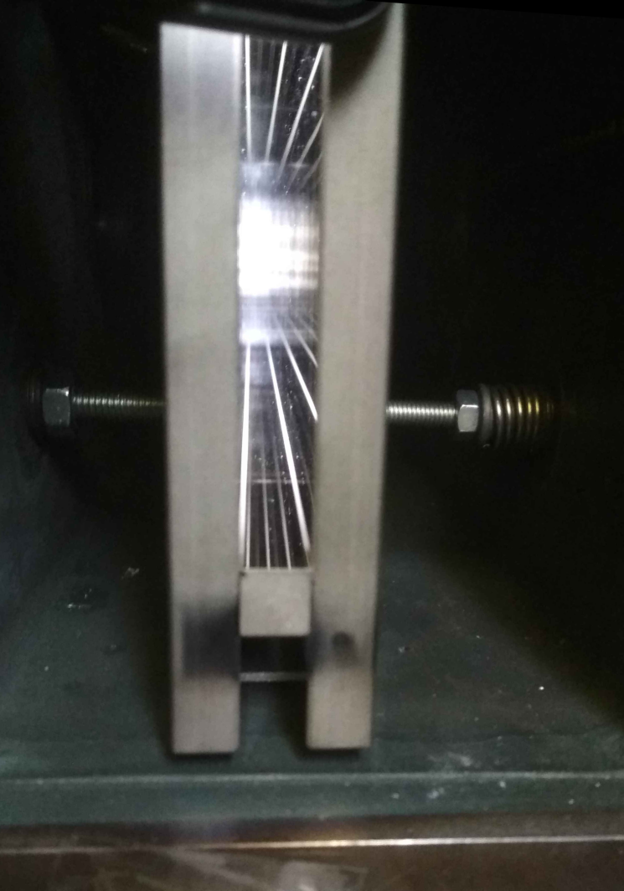
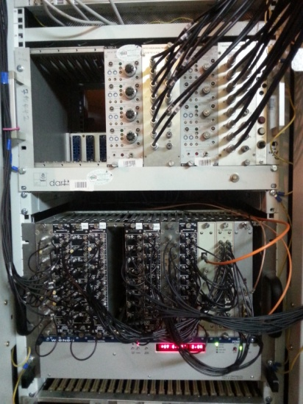
New neutron guide (m=2) at FSS diffractometer (beamline 13)
FSS: spectra measured with old and new neutron guides
FSS: comparison of spectral distributions measured with old and new neutron guides
FSS: new neutron guide
Resolution function of FSS at max.
F-chopper speed Ω_{max} = 2000 rpm
List-mode DAQ unit MPD-32
FSS spectrum fitted by Rietveld method

Slide 16
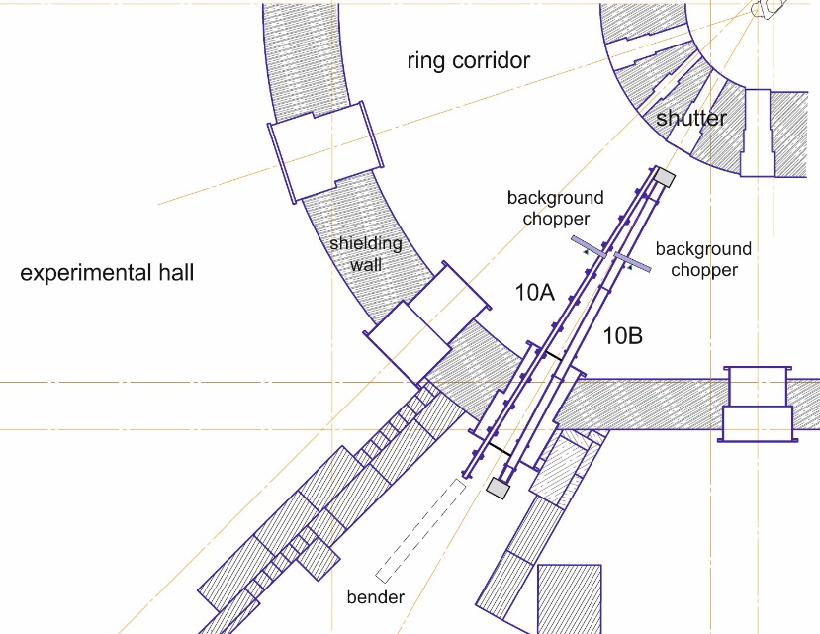




Modernization of channel 10, IBR-2
GRAINS (10b)

Slide 17





Modified neutron reflectometry cell for studies of electrochemical interfaces
‘beam from bottom’
configuration
Electrolyte filling
WE/CE connectors
RE connector
PEEK case
Counter electrode
Seal groove
Single crystal block Si
Pressing plates (Al)

Slide 18






Studies of electrochemical interfaces for lithium ion batteries by neutron reflectometry
Neutron Reflectometry
Electrochemical measurements (deposition mass)
M.V.Avdeev, A.A.Rulev, E.E.Ushakova, Ye.N.Kosiachkin, V.I.Petrenko, I.V.Gapon, E.Yu.Kataev, V.A.Matveev, L.V.Yashina, D.M.Itkis.
Appl. Surf. Sci. 486 (2019) 287
A.A.Rulev, A.V.Sergeev, L.V.Yashina, T.Jacob, D.M.Itkis, ChemElectroChem 6 (2019) 1324

Slide 19


Development of new small angle scattering and imaging spectrometer at 10-A channel of IBR-2
Beamline 10A
Expected parameters
Beam size | 50×50 мм²
Neutron wavelength range: | 0.5 – 10 Å
q-range: | 0.003 – 0.5 Å⁻¹
Angular resolution | 5 - 20 %
Maximum sample size | 20×50×50 мм²
Incident neutron flux at the sample | 1.0×10⁶ см⁻² c⁻¹
Detector system | PSD, ³He, 100×100 см², resolution 5×5 мм²
ССD camera based detector
32 m
T = 300 K
Before bender
(detector overload)
Beam splitter – completed, installed, 2019, (Mirrotron)
Bender – completed, 2017 (Mirrotron)
Neutron transport system - to be completed and installed in 2020 (Mirrotron)
Detector vacuum tube – fabrication in progress, completion in 2021 (Mirrotron)
PSD detector – conclusion of the contract is planned in 2020
After bender
TOF
T = 30 K
Before bender
(strong detector overload)
After bender
M.V.Avdeev, R.A.Eremin, V.I.Bodnarchuk, I.V.Gapon, V.I.Petrenko, R. Erhan, A.V. Churakov, D.P.Kozlenko, J. Surf. Investigation. (2018)
TOF

Slide 20












Isotope Identifying Reflectometry at REMUR spectrometer:
Created the channels of secondary radiation: spin-flipped neutrons, charged particles and gamma-quants

Slide 21






SESANS Instrument Development at 9 channel of IBR-2
Spin rotator coil upgrade
Cooling system development
Testing the experimental concept

Slide 22

YuMO Small Angle Scattering Spectrometer
L₁ =17.8 m, L₂ =13.2 m
Neutron flux at sample position: 4⋅10⁷ n/cm²/s
Q-range: 7⋅10⁻³ - 0.5 Å⁻¹
Q-resolution: 5-20 %
Typical measurement time: 10 m
Unique dynamic Q-range Q_{max}/Q_{min} ~ 90
Fast measurements
1 – two reflectors;
2 – zone of reactor with moderator;
3 – chopper;
4 – first collimator;
5 – vacuum tube;
6 – second collimator;
7 – thermostate;
8 – samples table;
9 – goniometer;
10-11 – Vn-standard;
12 – ring-wire detector;
13 – position-sensitve edetector "Volga";
14 – direct beam detector.
Development of new incident beam collimator, modernization of detector system, sample environment

Slide 23
Structural organization of the iron oxide nanoparticles in SBA-15 nanoporous silica
SANS curve and structural organization modeling
A.Zeleňáková, et al., Scientific Reports 9, 1 (2019)

Slide 24

Development of the neutron guide system of the NERA spectrometer
Spectral distribution of the incident neutron beam at the sample position measured with the vanadium sample
Elements of the supermirror neutron guide with vertical focusing (m = 5)
The end part sections of the mirror neutron guide (m = 1) at the NERA spectrometer of 25 m length have been replaced by the supermirror sections ( m = 5) with vertical focusing, fabricated by SwissNeutronics. The average gain factor of 1.5 times has been achieved.

Slide 25



Spectrometer for Neutron Radiography and Tomography
Upgrade of the Two Mirror CCD-based detector

Slide 26




Neutron imaging and diffraction study of Chelyabinsk meteorite
Photo of the studied meteorite fragment
Neutron diffraction pattern of the fragment, analyzed by the profile matching method
Parts of the 3D model of structural organization of the studied fragment, obtained by neutron tomography. The pink regions correspond to metallic inclusions
S.E.Kichanov, D.P.Kozlenko et al., Springer Nature Applied Sciences (2019)

Slide 27

Thank You for Your Attention!

