Slide 1
Development of the
neutron radiography and tomography instrument at the WWR-K reactor, Almaty, Kazakhstan
K.M. Nazarov^{1,2}, B.Muhametuly^{1,3}, S.E. Kichanov¹, D.P. Kozlenko¹, E.A. Kenzhin³, E.V. Lukin¹, A.A.Shaimerdenov³, A.V. Rutkauskas¹
¹Frank Laboratory of Neutron Physics, Joint Institute for Nuclear Research, Dubna, Russia
²L.N. Gumilev Eurasian National University, Nur-Sultan, Kazakhstan;
³ Institute of Nuclear Physics, Almaty, Kazakhstan
51-st meeting of the PAC for Condensed Matter Physics
20 January 2019 Dubna, Russia
Kuanysh Nazarov
knazarov@jinr.ru

Slide 2
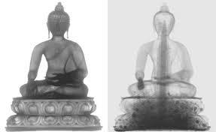
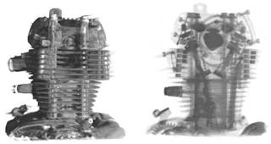
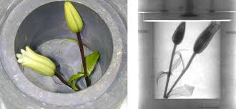
Institute of Nuclear Physics
Introduction: Neutron imaging
Nuclear interaction
Magnetic interaction
High penetration
Sensitive to low-Z materials
X-ray
neutron
51-st meeting of the PAC for Condensed Matter Physics
20 January 2019 Dubna, Russia
Kuanysh Nazarov
knazarov@jinr.ru
2

Slide 3
Institute of Nuclear Physics
Creation of a new neutron imaging facility
Institute of Nuclear Physics,
Almaty, Kazakhstan
Joint Institute for Nuclear Research,
Dubna, Russia
Protocol on joint cooperation between the Joint Institute for Nuclear Research (Dubna) and the RSE Institute for Nuclear Physics (Almaty)
№ 4785-4-17/19 from 11.12.2017 y.
Project period: 2017-2019
51-st meeting of the PAC for Condensed Matter Physics
20 January 2019 Dubna, Russia
Kuanysh Nazarov
knazarov@jinr.ru
3

Slide 4
Institute of Nuclear Physics
Neutron source: Steady-state reactor WWR-K
A reactor operating
200 days/year
7
8
6
9
10 cycles with 20 days
Thermal power: 6 MW
5
Fuel: UO₂ +Al
1
4
2
3
Heat carrier and moderator:
light water
Flux: 2,2×10¹⁴ thermal neutrons/cm²·s
51-st meeting of the PAC for Condensed Matter Physics
20 January 2019 Dubna, Russia
Kuanysh Nazarov
knazarov@jinr.ru
4

Slide 5
Institute of Nuclear Physics
Conversion of active core WWR-K reactor
from HEU fuel to LEU fuel
WWR-C type
36%
WWR-KN type
19,7 %
1972-2015 years
2015 - present
51-st meeting of the PAC for Condensed Matter Physics
20 January 2019 Dubna, Russia
Kuanysh Nazarov
knazarov@jinr.ru
5

Slide 6
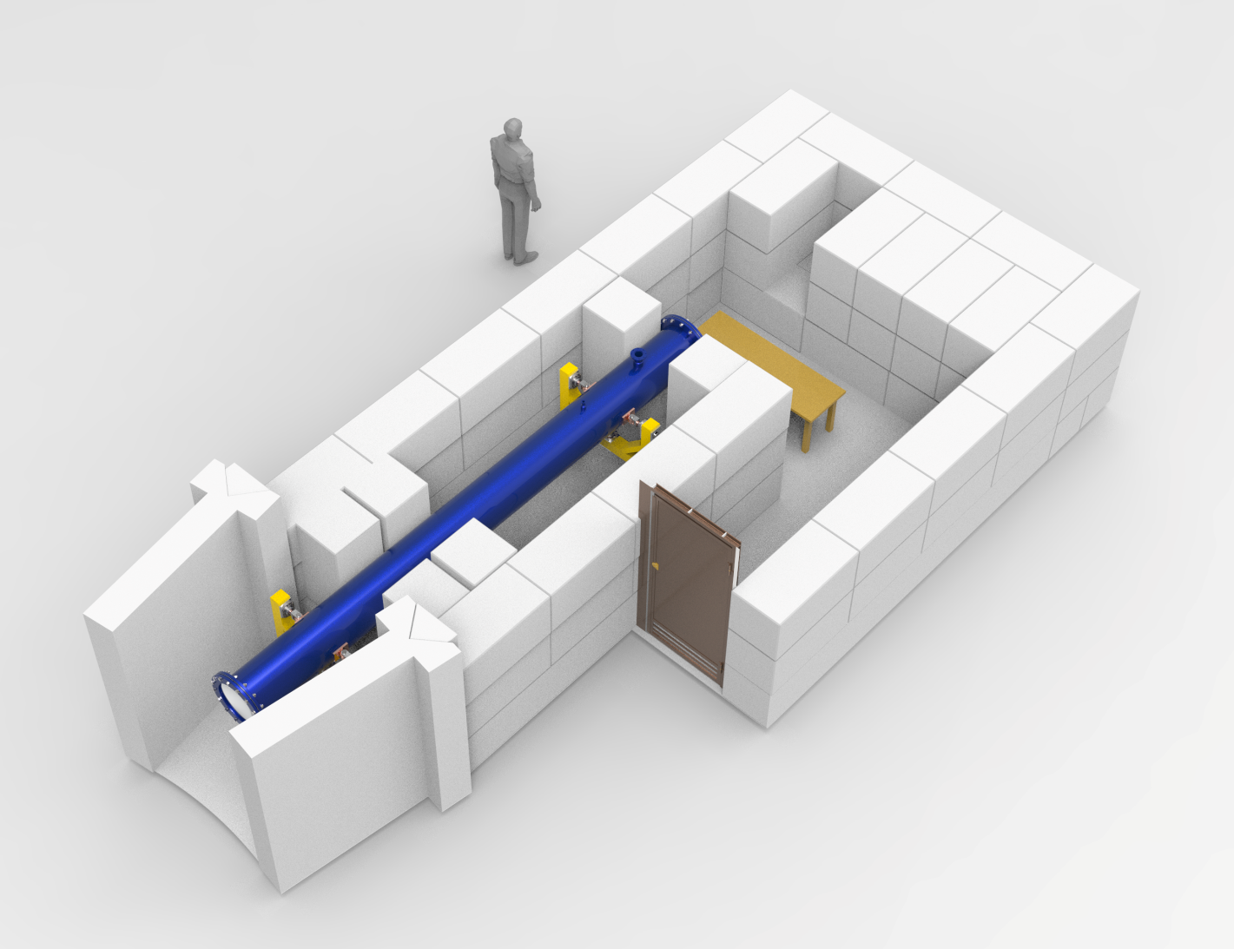
Institute of Nuclear Physics
Concept of neutron imaging facility
51-st meeting of the PAC for Condensed Matter Physics
20 January 2019 Dubna, Russia
Kuanysh Nazarov
knazarov@jinr.ru
6

Slide 7
Institute of Nuclear Physics
Concept of neutron imaging facility
10 m
3,5 m
7 m
Flight tube 5,2m
10 cm diameter
Neutron flux = 1*10^9
Neutron beam size 20*20 cm^2
8 cm
2 cm
1,4*10^8 n/(s*cm^2) at L/D=86
1*10^7 n/(s*cm^2) at L/D=350
Pinhole with diameter D
51-st meeting of the PAC for Condensed Matter Physics
20 January 2019 Dubna, Russia
Kuanysh Nazarov
knazarov@jinr.ru
7

Slide 8
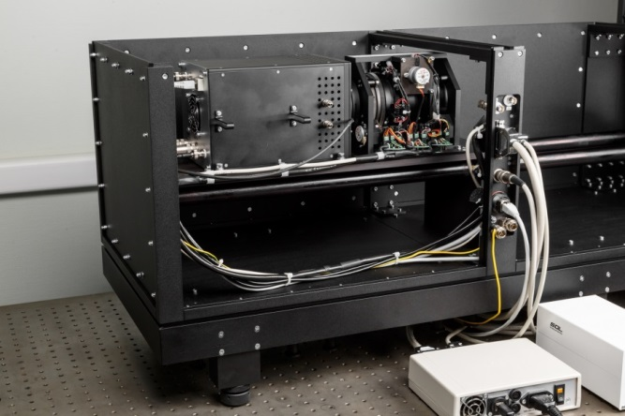
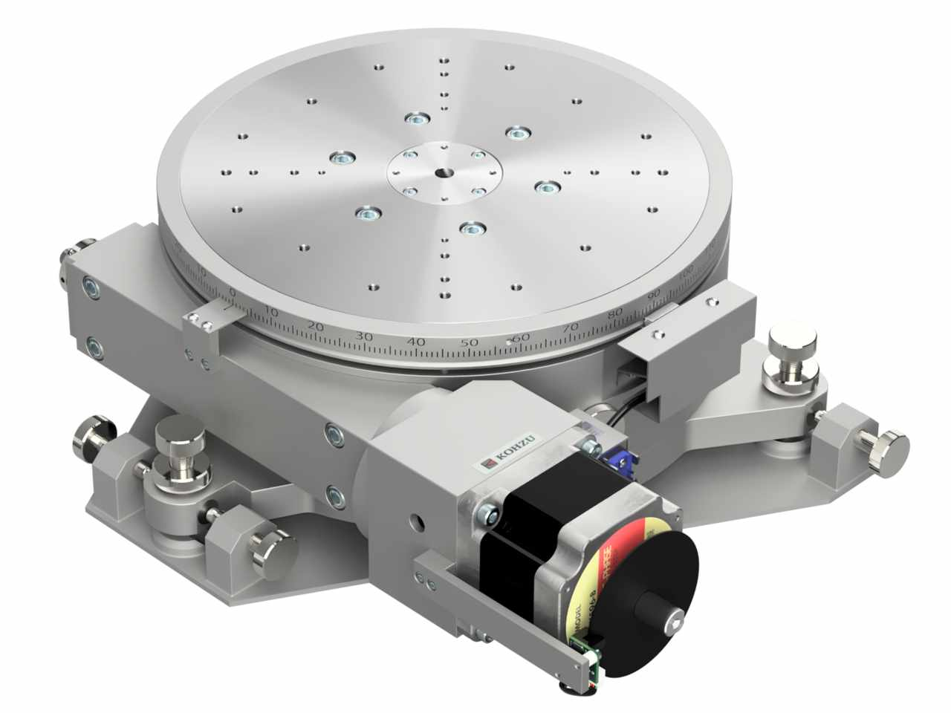
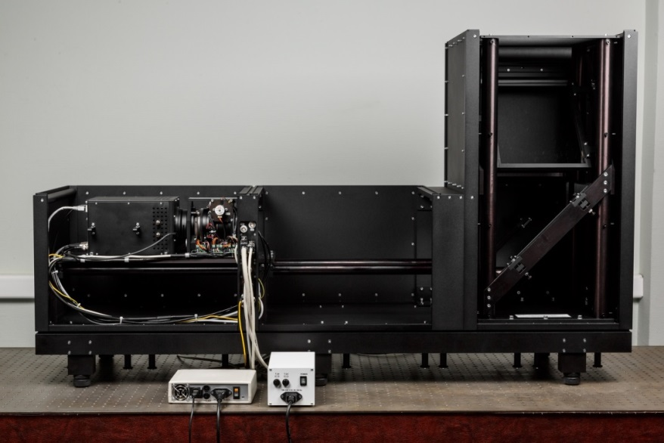
Institute of Nuclear Physics
Detector system of neutron imaging facility
Parameters of neutron imaging station
L/D ratio | 100 -2000
Field-of-view | From 5*5 cm² 20*20 cm²
Converter: Scintillation screen | ⁶LiF/ZnS:( Ag,Cu) –thickness 0.1 mm ⁶LiF/ZnCdS:Ag – thickness 0,05 mm Gadox –thickness 0,02 mm
CCD camera | HAMAMATSU-S12101 2048х2048 pixels 12x12 мкм, 24x24 мм
Lens system | 70-300 mm with variable focal length
Pixel size | 25-100 $μm$
Neutron flux | 1.4*10⁸ n/cm²/s at L/D=100 1*10⁷ n/cm²/s at L/D=350
Company: KOHZU, Japan
Material: Aluminum Alloy
Angular range: ${360}^{o}$
Load capacity: 392 N
Resolution at full step: ${0,002}^{o}$
51-st meeting of the PAC for Condensed Matter Physics
20 January 2019 Dubna, Russia
Kuanysh Nazarov
knazarov@jinr.ru
8

Slide 9
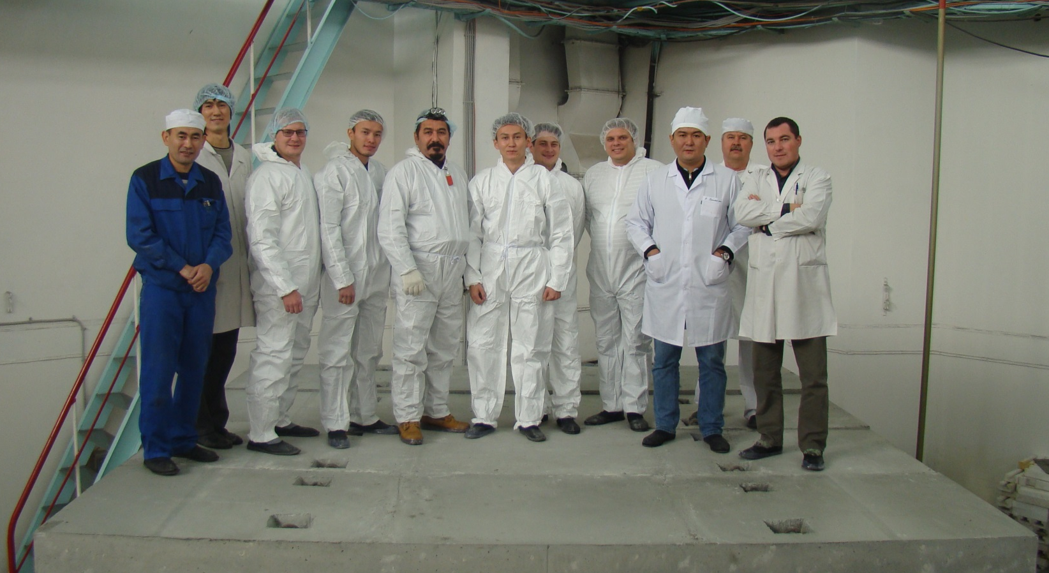
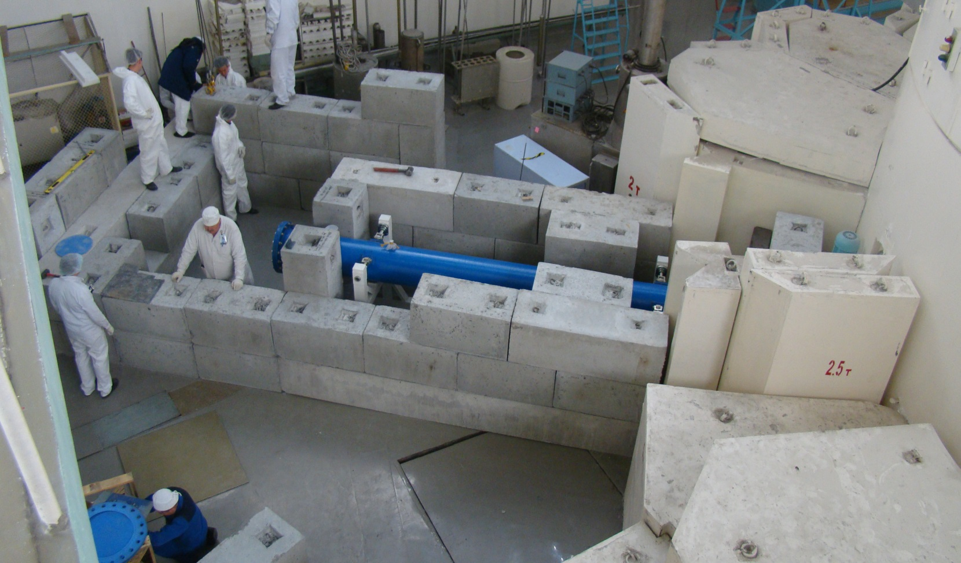
Institute of Nuclear Physics
Joint working group from JINR and INP
….the last shielding element is in place! Happy faces
51-st meeting of the PAC for Condensed Matter Physics
20 January 2019 Dubna, Russia
Kuanysh Nazarov
knazarov@jinr.ru
9

Slide 10
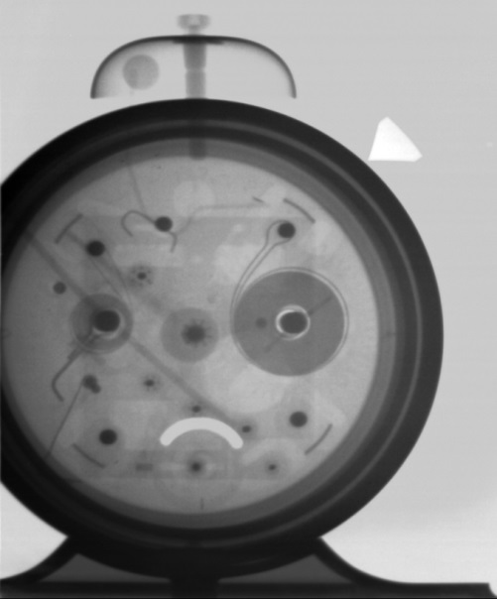
Institute of Nuclear Physics
Test experiments. First images
2 cm
5 cm
20 cm
Rotor of small engine
Padlock
Alarm clock
51-st meeting of the PAC for Condensed Matter Physics
20 January 2019 Dubna, Russia
Kuanysh Nazarov
knazarov@jinr.ru
10

Slide 11
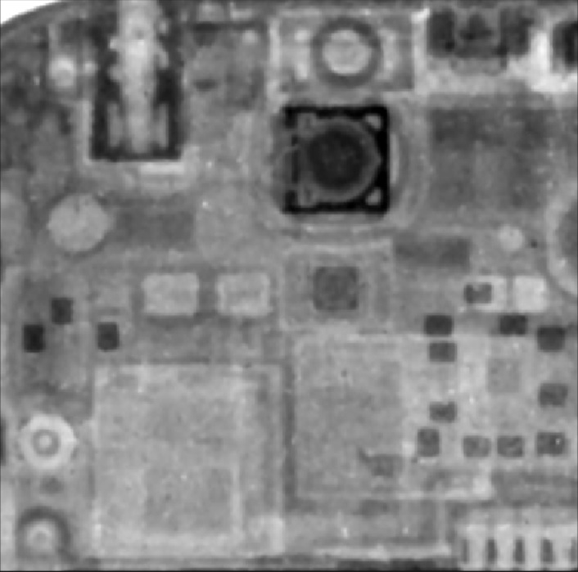
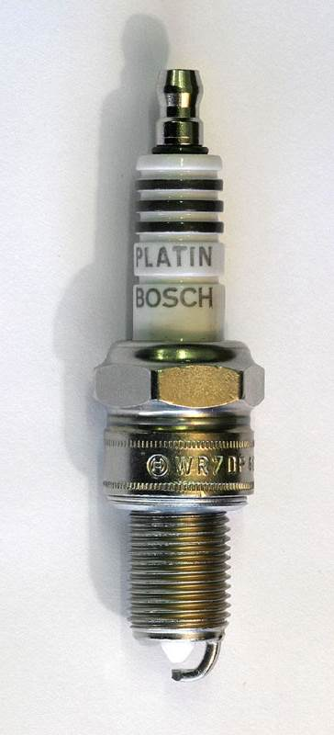
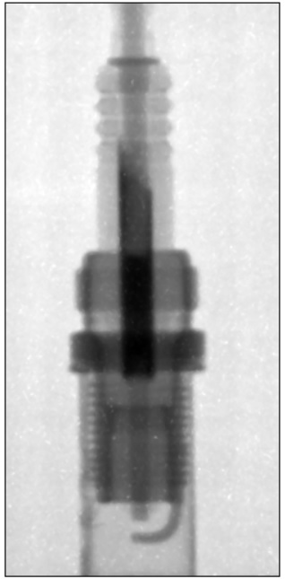
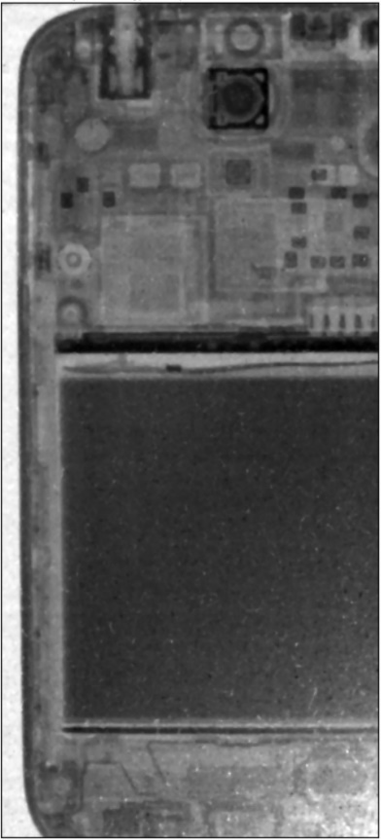
Institute of Nuclear Physics
Test experiments. First images
Car spark plugs
Smart-phone Samsung
51-st meeting of the PAC for Condensed Matter Physics
20 January 2019 Dubna, Russia
Kuanysh Nazarov
knazarov@jinr.ru
11

Slide 12
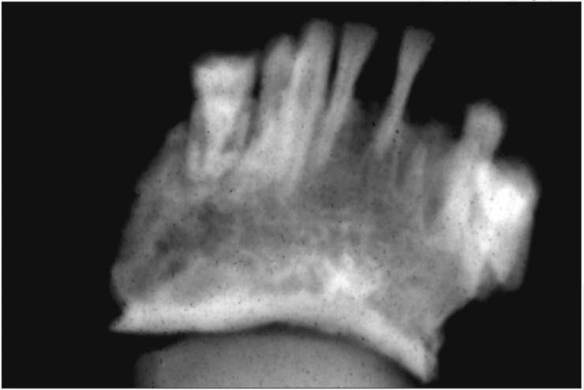
Institute of Nuclear Physics
Test experiments. First tomography images
Faculty of History, Archeology and Ethnology,
Al-Farabi Kazakh National University, Almaty, Kazakhstan
Real photo and neutron radiographic image,
3D model of the lower jaw of a fossil human from Saka tribe.
Excavation site: Rakhat village, Almaty region, Kazakhstan.
51-st meeting of the PAC for Condensed Matter Physics
20 January 2019 Dubna, Russia
Kuanysh Nazarov
knazarov@jinr.ru
12

Slide 13
Institute of Nuclear Physics
Thank you for your attention!!!
Any Questions?
51-st meeting of the PAC for Condensed Matter Physics
20 January 2019 Dubna, Russia
Kuanysh Nazarov
knazarov@jinr.ru
13

