Slide 1
The microscopic mechanism of spontaneous polarization in strontium hexaferrites
Frank
Laboratory of
Neutron Physics
Vitalii Turchenko^{1,2}, Alex Trukhanov³, Sergej Trukhanov³
… science brings people together
¹ Frank Laboratory of Neutron Physics, Joint Institute for Nuclear Research, 141980, Dubna, 6 Joliot-Curie Str., Russia
² Donetsk Institute of Physics and Technology named after O.O. Galkin of the NASU, 46 Nauki Avenue, 03680, Kyiv, Ukraine
³ SSPA "Scientific and practical materials research center of NAS of Belarus", 19 P. Brovki Str., 220072, Minsk, Belarus
Joint Institute for
Nuclear Research
Dubna – 2020

Slide 2
Introduction
Strontium hexaferrites have been discovered by firm Philips in 1950-s.
PROPERTIES
Large magnetocrystalline anisotropy.
High coercive force (H_{c}∼160–55 * 10³ A/m)
High Curie temperature ( ~ 460⁰ C).
High saturation magnetization.
Excellent chemical stability.
Good corrosion resistivity.
High electrical resistivity ( ≥10⁴ Ω*cm).
TECHNICAL APPLICATION
Permanent magnets [1].
Magnetic recording media (recording tapes, flexible hard discs) [2].
Microwave devices [3].
Microwave-absorbing coating
[1] http://www.magnets.com.cn/in2a.htm
[2] R. E. Fayling J. Appl. Phys. 49, 1823 (1978);
[3] Yang Xin-Chun, Liu Rui-Jiang [et. al.] Chin. Phys. B 22, 058101 (2013).
2

Slide 3
Actuality
BaFe_{12-x}D_{x}O₁₉ [3]
BaFe₁₂O₁₉ [1]
BaFe₁₂O₁₉: P_{r}= 11.8 μC/cm²;
BiFeO₃: P_{r}= 6.1 μC/cm²
T= 300 K
SrFe₁₂O₁₉ [2]
BaFe₁₂O₁₉:
M_{r}= 32 emu/g;
H_{c}= 1697 Oe;
BiFeO₃:
M_{r}= 0.1 emu/g;
H_{c}= 200 Oe;
320 times more
8 times more
T= 300 K
[1] Guolong Tann, Xiuna Chen JMMM, V. 327, 87–90 (2013).
[2] G. Tann, X. Chen Journal of Electroceramics, V.42 906 – 911 (2013).
[3] V. Turchenko et al. J. Magn. Magn. Mater. 477 (2019) 9.
3

Slide 4
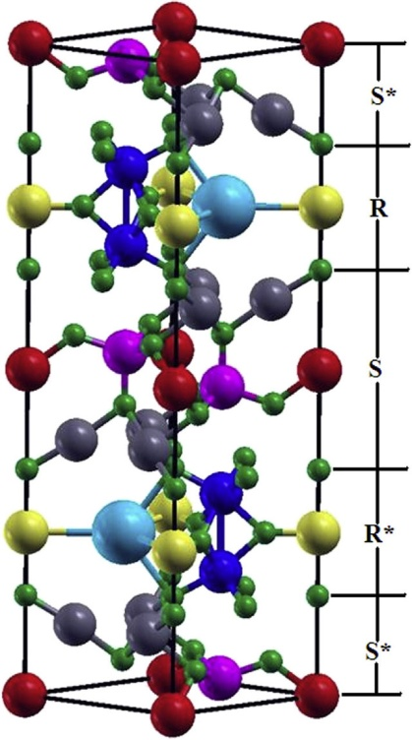
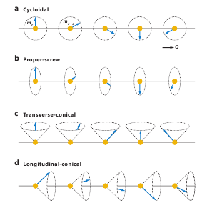
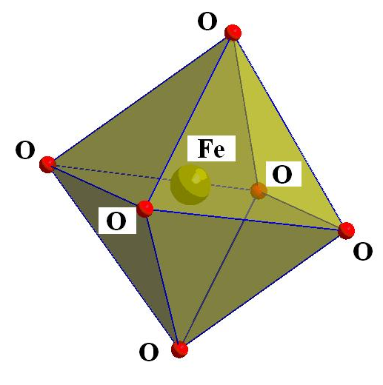
Actuality
BaFe₁₂O₁₉ [1]
BaFe_{12-x-δ}Sc_{x}Mg_{δ}O₁₉ [4]
SrFe₁₂O₁₉ [2]
a) Cycloidal
b) Proper-screw
c) Transverse-conical
d) Longitudinal-conical
[1] Guolong Tann, Xiuna Chen JMMM, V. 327, 87–90 (2013).
[2] G. Tann, X. Chen Journal of Electroceramics, V.42, 906 – 911 (2013).
[3] G.L. Tan, M. Wang, Journal of Electroceramics V.26, 170 (2011).
[4] Y. Tokunaga, Y. Kaneko Phys. Rev. Lett. V.105, 257201 (2010).
[5] A.S. Mikheykin et al. Eur. Phys. J. B V.87, 232(1-9) (2014).
4

Slide 5
The main aim of present work is ascertain reasons and microscopic mechanism of appearance of ferroelectric properties in strontium hexaferrites partially substituted with indium ions.
5

Slide 6
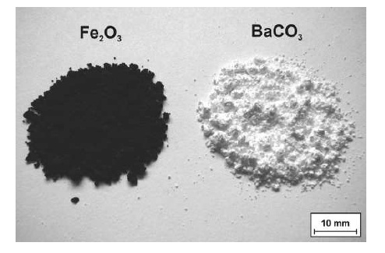
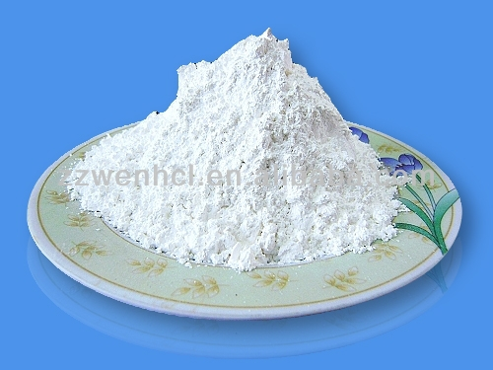
Synthesis technique :
High purity oxides Fe₂O₃, In₂O₃ and carbonate SrCO₃ have been weighed and mixed with design ratio.
Mixture was sintered in air at 1200⁰C for 6 h in an electrical furnace.
Powder samples SrFe_{12-x}In_{x}O₁₉ (x= 0.1 – 1.2) were annealed at 1300⁰C ( 6 h ).
SrFe_{12-x}In_{x}O₁₉
Fe₂O₃
SrCO₃
In₂O₃
t_{ann}= 1300⁰C
6
Notes:
All investigated samples have been prepared from high purity oxides of hematite(Fe₂O₃) , corundum(Al₂O₃) and strontium carbonate(SrCO₃) by the conventional solid state method.
All investigated samples have been obtained from
high purity oxides Fe₂O₃ , Al₂O₃ and carbonate BaCO₃ .
At ﬁrst these chemical compositions have been weighed and mixed with design ratio.
Then the synthesis has been performed. (at 1200ºC and at 1300ºC.)
After synthesis the sample has been slowly cooled (100ºC*h⁻¹).

Slide 7
Experimental procedure :
Ponderomotive method – information about phase-transition temperature ferrimagnetic – paramagnetic (the Curie temperature ) by Liquid Helium Free High Field Measurement System (VSM);
The specific magnetization measurement has been carried out on the MPMSXL superconducting quantum SQUID interferometer at temperature 4 and 300 K;
Ferroelectric loops were measured using TFAnalyser 2000 (Aix-ACCT SystemsGmbH. Co.), it was measured the current depending on the applied voltage. The polarization has been determined as the integral of current over time;
Neutron diffraction studies of sample in the temperature range from 1.5 to 350 K have been carried out on the diffractometers G 4-1 and G 4-4 in the experimental hall of the nuclear centre in Laboratoire Léon Brillouin (LLB) (Saclay, France). The measurement has been performed in a monochromatic neutron beam with a wavelength of 2.426 Å and 1.9593 Å, consequently. Also tof-method has been carried out at High resolution fourier diffractometer (IBR-2M, Dubna).
7

Slide 8
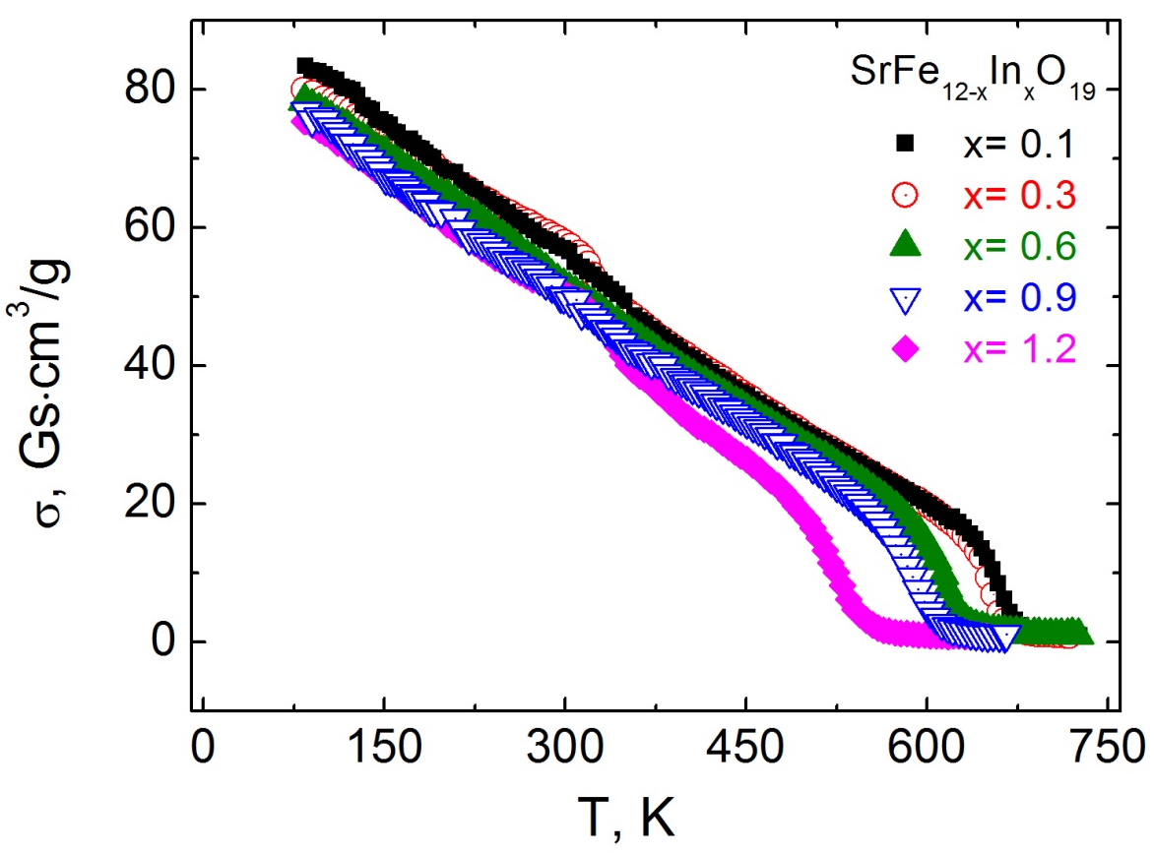
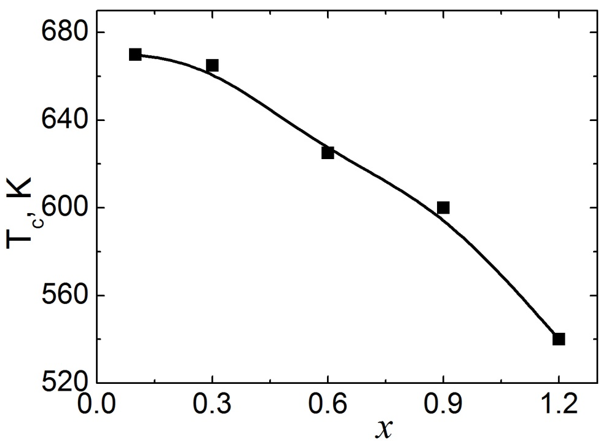
The temperature dependences of the specific magnetization of SrFe_{12-x}In_{x}O₁₉ (x= 0.1 – 1.2) compounds
The less value of the Curie temperature of SrFe_{12-x}In_{x}O₁₉ (x= 0.1 – 1.2) comparing with initial compound SrFe₁₂O₁₉ confirms substitution of magnetoactive Fe ions with diamagnetic In ions.
T_{c} (SrFe₁₂O₁₉) ≈ 720 K [1, 2]
Figure 1. The temperature dependence of the specific magnetization of SrFe_{12-x}In_{x}O₁₉ (x= 0.1 – 1.2) compounds.
[1] T. Tsutaoka, N. Koga J. Magn. Magn. Mater. 325 36 (2013).
[2] B. T. Shirk, W. R. Buessem, J. Appl. Phys. 40 1294 (1969) .
Figure 2. The concentration dependence of the Curie
temperature of SrFe_{12-x}In_{x}O₁₉ (x= 0.1 – 1.2) compounds.
8
Notes:
This behaviour of the Curie temperature confirms the replacement of magnetoactive iron ions with diamagnetic indium ions.

Slide 9
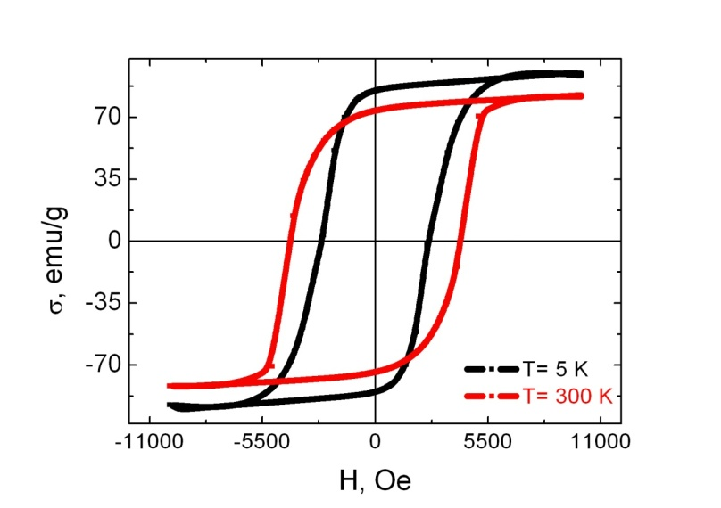
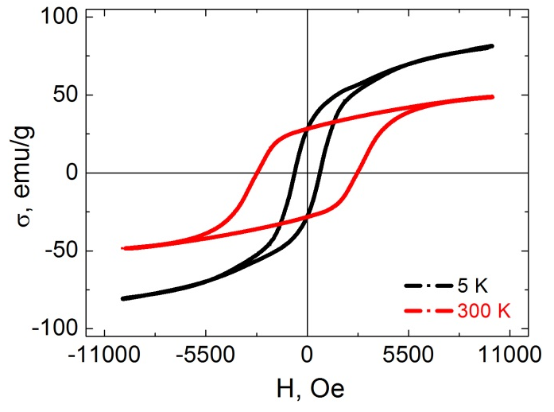
The field dependences of the specific magnetization of SrFe_{12-x}In_{x}O₁₉ (x= 0.1 and 1.2) compounds
x= 0.1
In order to estimate the magneto-crystalline anisotropy constant of In substituted Sr ferrite has been used:
The Law of Approach of Saturation [1, 2]:
In the case, where the sample is considered as ensemble of weakly interacting uniaxial monodomain particles with hexagonal structure:
M_{s}, A, B, C and χ_{d} – refined parameters:
Ms – the saturation magnetization;
A/H – magnetic rigidity;
C – factor proportional to K³;
B – anisotropic parameter
χ_{d}H – represents the ﬁeld-induced increase in the
spontaneous magnetization of domains.
x= 1.2
K_{5K} = 3.64 *10⁶ erg/cm³
K_{300K} = 2.99 *10⁶ erg/cm³
H_{a} – the crystal anisotropy field
x= 0.1
K_{5K} = 2.49 *10⁶ erg/cm³
K_{300K} = 1.58 *10⁶ erg/cm³
x= 1.2
[1] Jun Wang, Fan Zhao et al. J. Appl. Phys. 110, 096107 (2011)
[2] Z. Yang, C.S. Wang et al. Mat. Science Eng. B90, 142-145 (2002)
[3] M. Ghimire et al. JMMM, 454, 110–120 (2018)
K_{SrFe12O19} = 3.02 *10⁶ erg/cm³ [3]
9

Slide 10
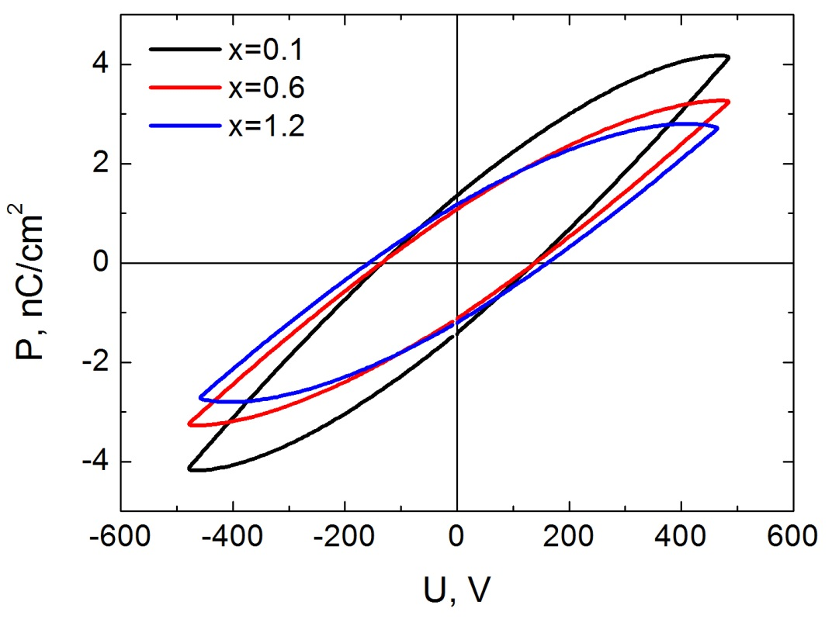
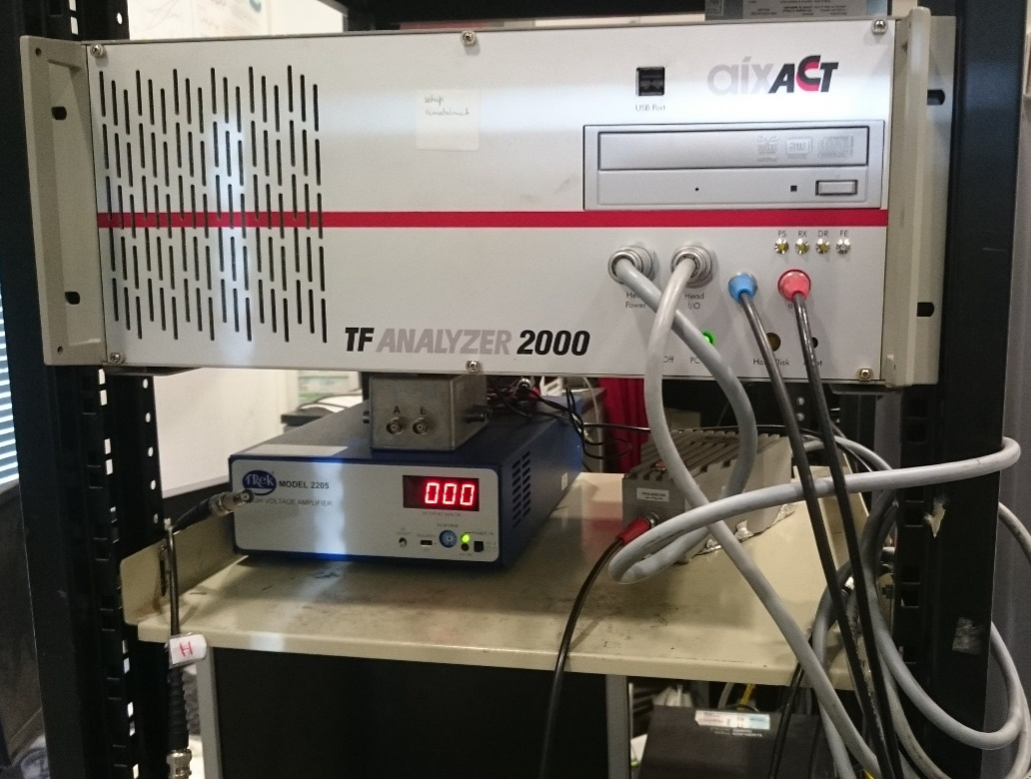
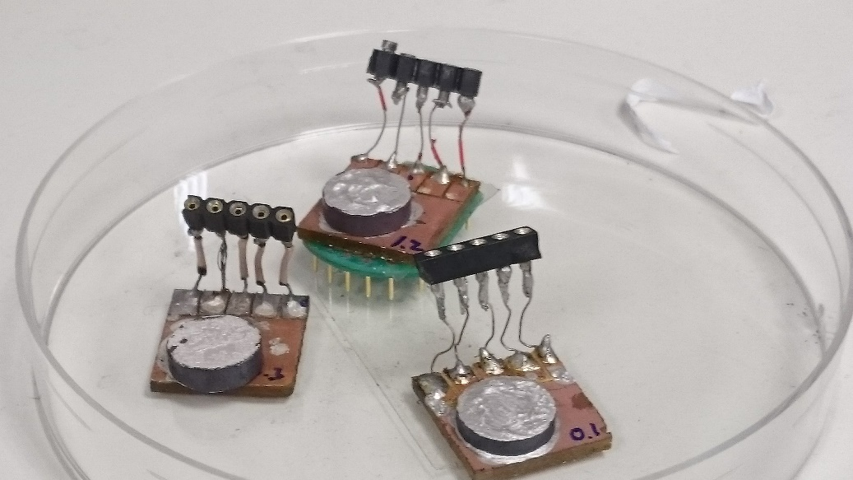
Ferroelectric loops of SrFe_{12-x}In_{x}O₁₉ (x= 0.1; 0.6 and 1.2)
Ferroelectric loops were measured as the current depending on the applied voltage. The polarization has been determined as the integral of current over time.
The coercive force (E_{с}):
x= 0.1 138 V
x= 0.6 140 V
x= 1.2 161 V
Maximal values of polarization (P_{max}):
x= 0.1 4.17 nC/cm²
x= 0.6 3.26 nC/cm²
x= 1.2 2.79 nC/cm²
Spontaneous polarization (P_{r}):
x= 0.1 1.35 nC/cm²
x= 0.6 1.08 nC/cm²
x= 1.2 1.19 nC/cm²
10

Slide 11
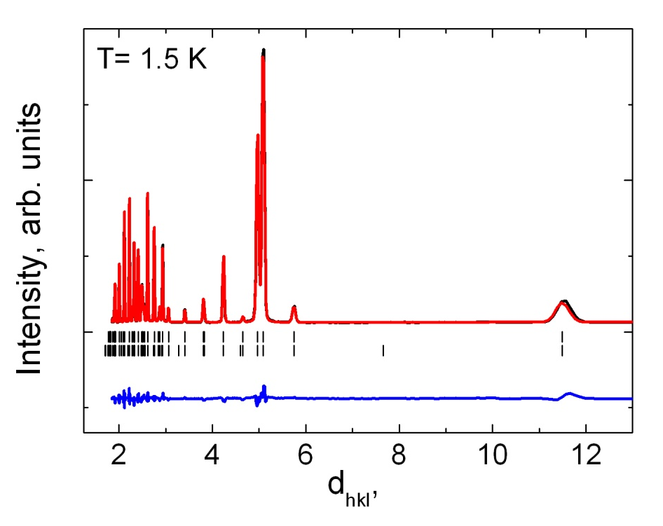
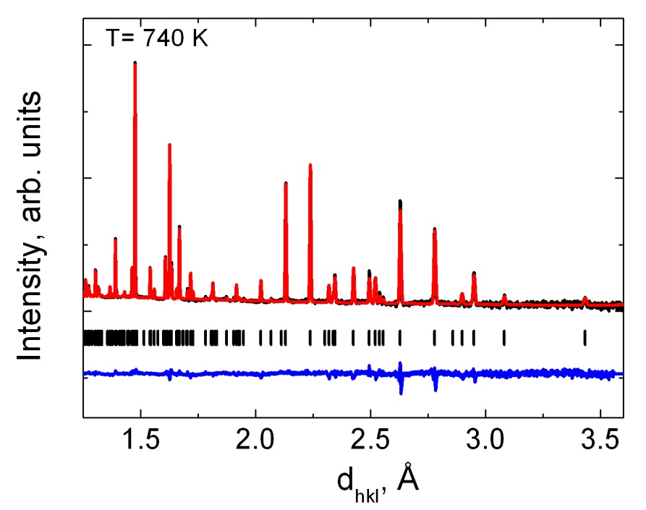
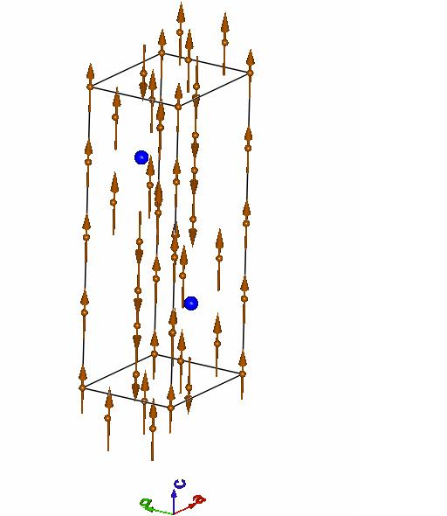
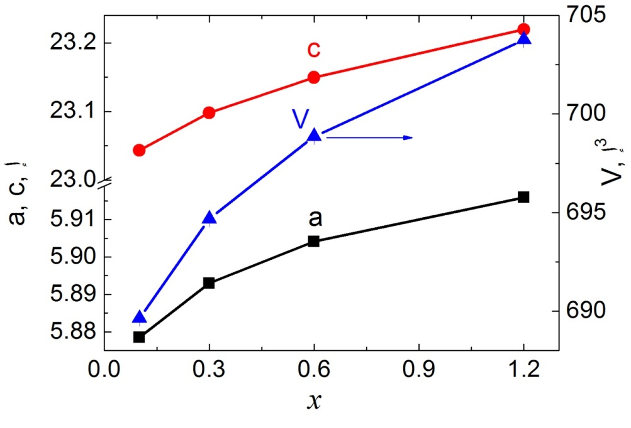
Crystal structure of SrFe_{12-x}In_{x}O₁₉ (x= 0.1 – 1.2) compounds
G 4-1
Crystal structure
HRFD
Magnetic structure
Å
Fig.1. Neutron diffraction pattern of SrFe_{11.9}In_{0.1}O₁₉ in a monochromatic neutron beam
Fig.2. Neutron diffraction pattern of SrFe_{11.9}In_{0.1}O₁₉ measured in tof-method
V, Ǻ³
a, c, Ǻ
r(Fe_{VI}³⁺)= 0.785 Ǻ
r(In_{VI}³⁺)= 0.94 Ǻ
Fig.3. The concentration dependence of structural parameters a and c (left scale) and volume V (right scale) of unit cell for SrFe_{12-x}In_{x}O₁₉ (x= 0.1 – 1.2) compound.
11
Notes:
To obtain information about evolution of crystal and magnetic structures in a broad temperature range we applied neutron High Resolution Fourier Diffractometer (HRFD) at nuclear reactor (IBR-2M, Dubna).
In our investigations we applied such methods: X-ray diffraction, neutron time-of-flight and ponderomotive.

Slide 12
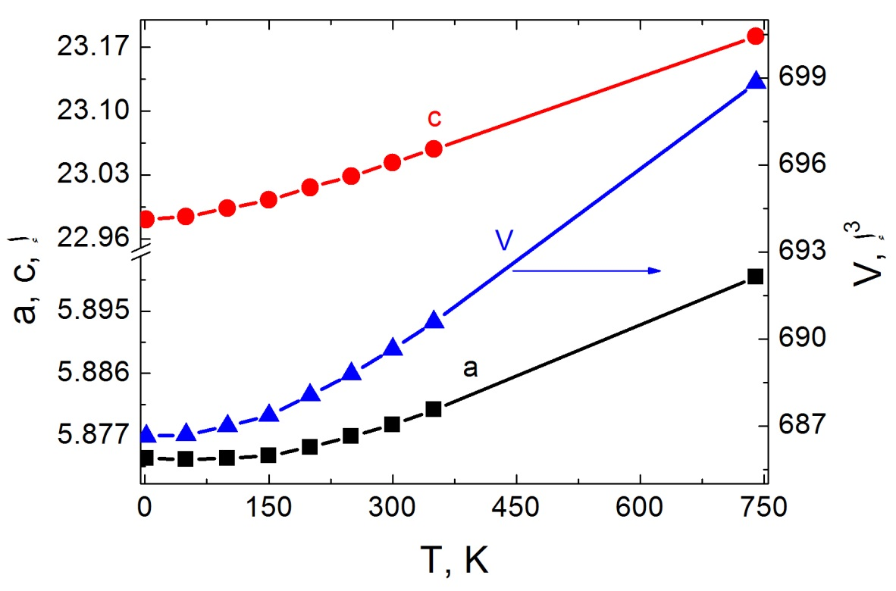
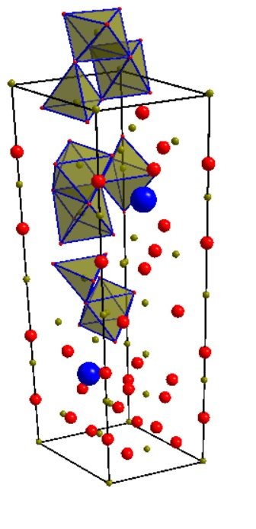
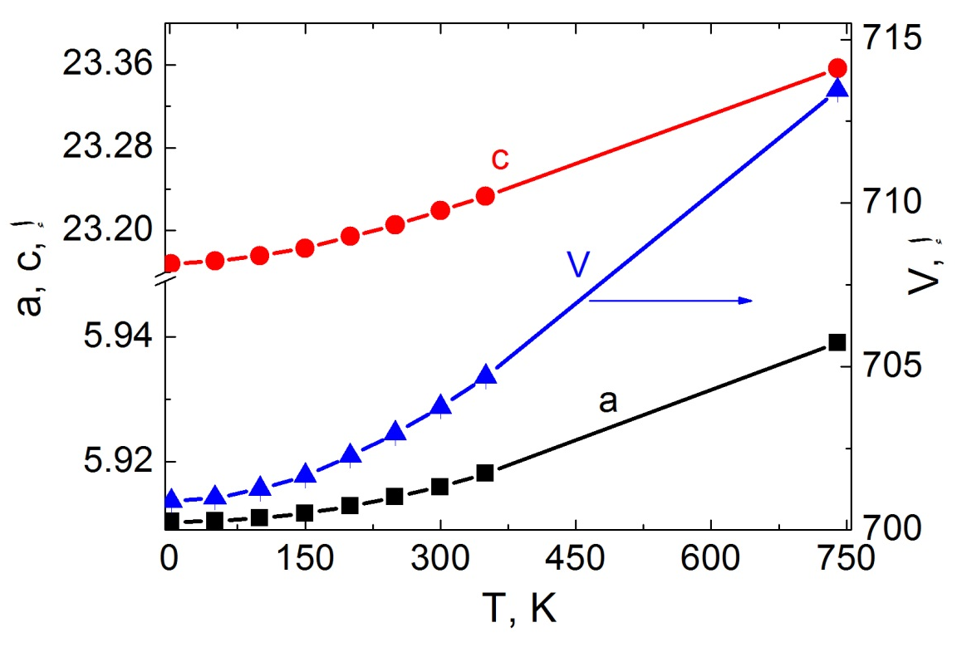
Crystal structure of SrFe_{12-x}In_{x}O₁₉ (x= 0.1 and 1.2) hexaferrite
SG P6₃/mmc (No. 194)
x= 0.1
SG P6₃mc (No. 186)
V, Ǻ³
a, c, Ǻ
● - Sr
● - Fe / In
● - O
x= 1.2
a, c, Ǻ
V, Ǻ³
The similar behavior of lattice parameters in low temperature range in perovskites has been explained by the mutual rotations and tilts of oxygen octahedra, according to [1].
[1] S.N. Bushmeleva, V.Yu. Pomjakushin et al. JMMM, V. 305, P. 491, (2006).
12

Slide 13
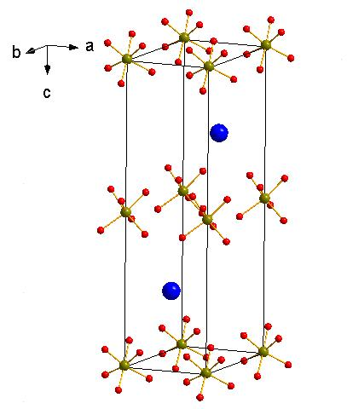
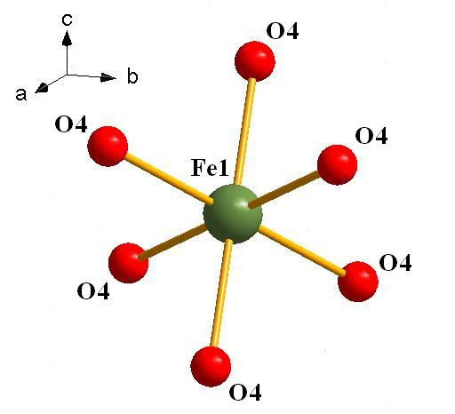
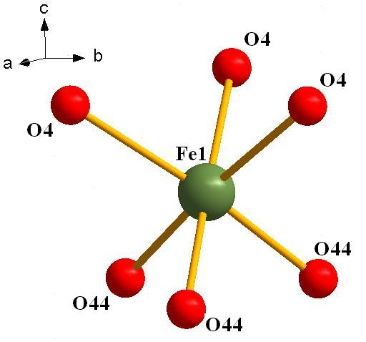
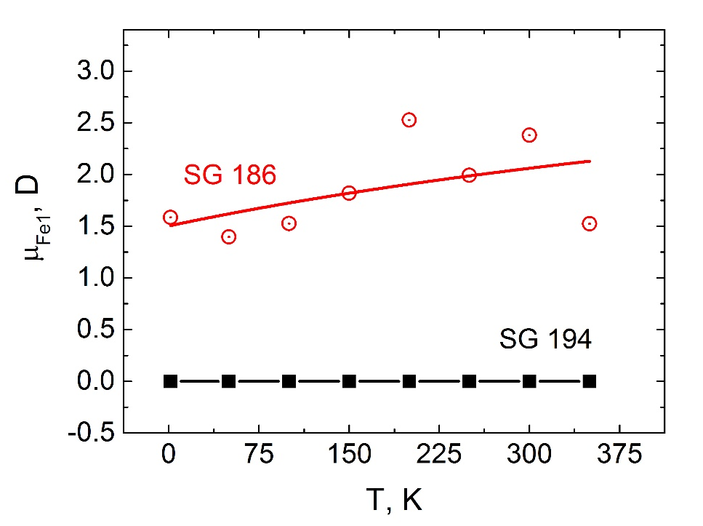
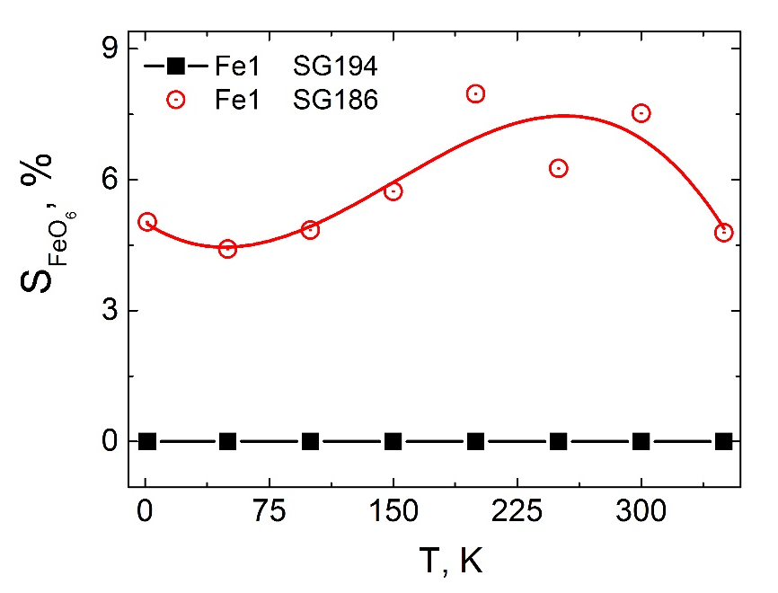
Difference between SG P6₃/mmc (No. 194) and SG P6₃mc (No. 186)
centrosymmetric
non centrosymmetric
Dipole moments
Distortions
where d_{i}(T) is the distance between Fe and O ions;
<d(T)> is the average distance <Fe–O> in the oxygen octahedron.
13

Slide 14
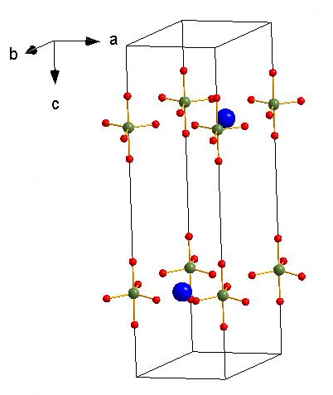
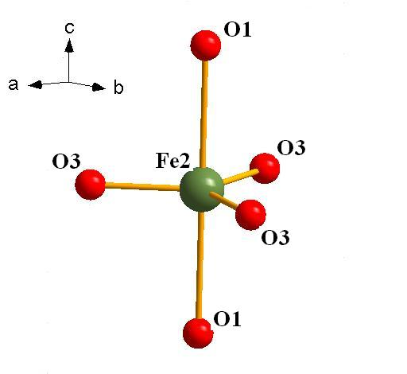
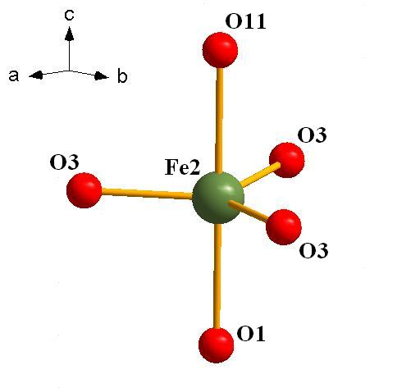
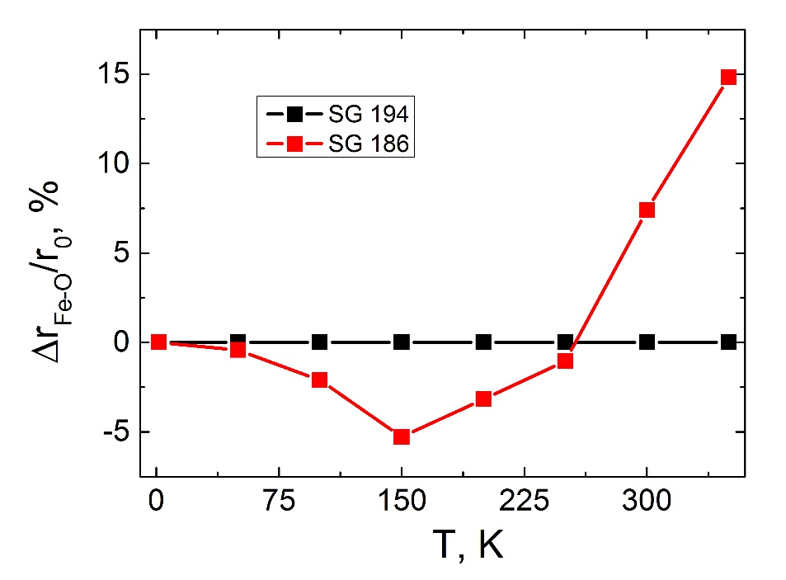
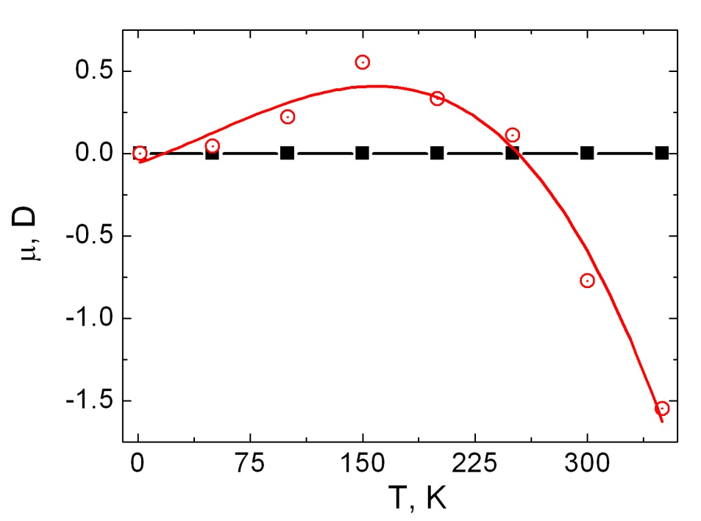
Difference between SG P6₃/mmc (No. 194) and SG P6₃mc (No. 186)
centrosymmetric
non centrosymmetric
The relative change in distances among iron ion Fe2 and apical oxygen anions O1 and O11
Relative change
of distances
SG 194
SG 194
SG 186
SG 186
Dipole moments
14

Slide 15
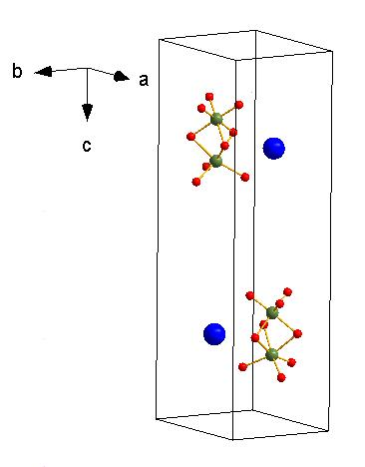
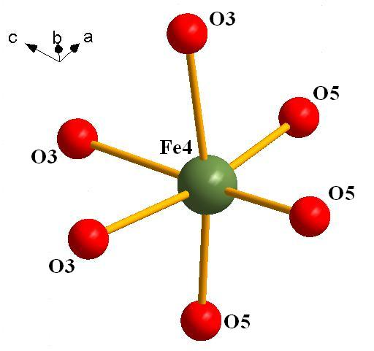
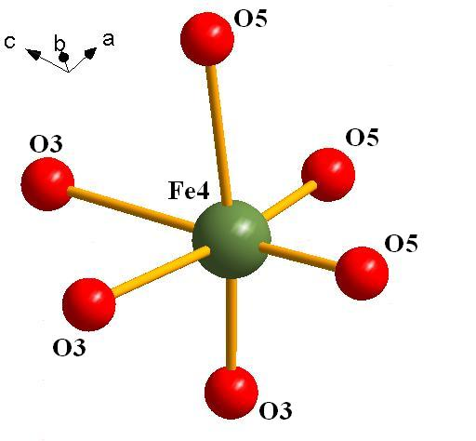
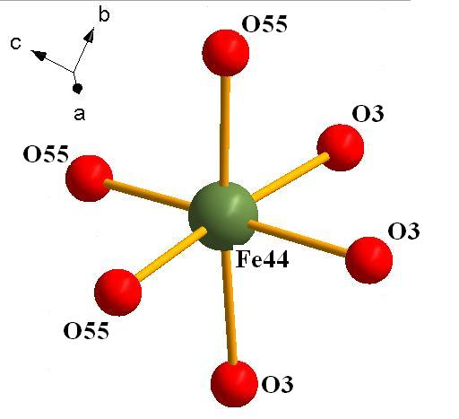
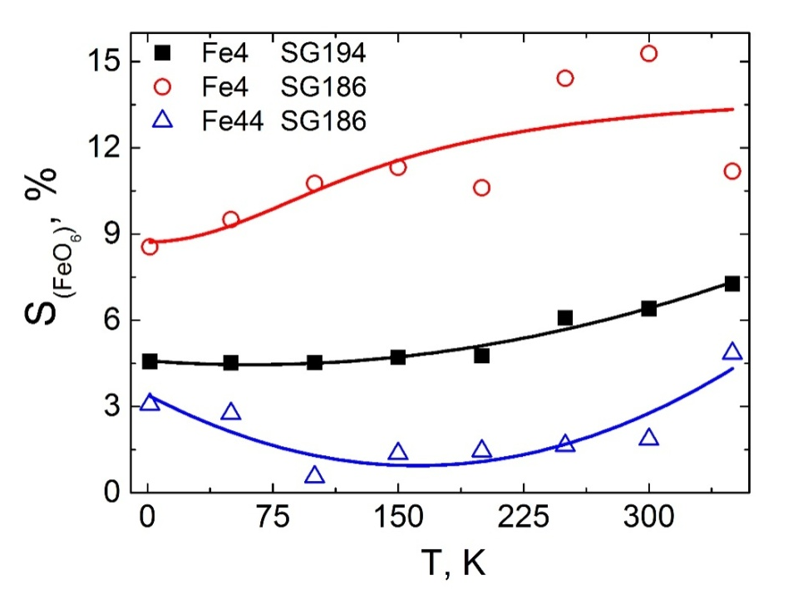
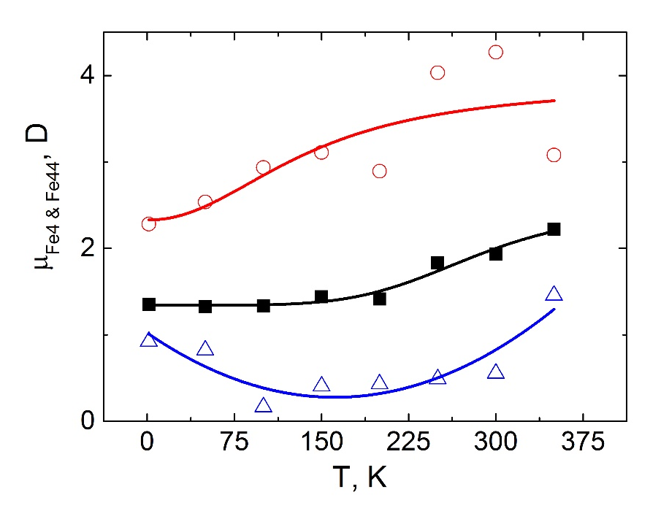
Difference between SG P6₃/mmc (No. 194) and SG P6₃mc (No. 186)
centrosymmetric
non centrosymmetric
Distortions
Dipole moments
Fe4 SG 186
Fe4 SG 194
Fe44 SG 186
15

Slide 16
Conclusions
The investigation of crystal structure of strontium ferrite partially substituted with diamagnetic ions has been carried out by neutron diﬀraction methods with high resolution.
The electric field-induced polarization has been found out in solid solutions strontium hexaferrites partially substituted with In ions.
The refinement of crystal structure of solid solutions of SrFe_{12-x}In_{x}O₁₉ (x = 0.1 – 1.2) has been carried out in the framework both centrosymmetric (P6₃/mmc) and non-centrosymmetric (P6₃mc) space groups.
The appearance of spontaneous polarization in solid solutions of strontium hexaferrites can be explained as result of unequal distortions of neighboring oxygen polyhedra.
Notes:
The total magnetic moment per formula unit and the Curie temperature decrease as the ambient temperature is increased because of rising of thermal fluctuations.

Slide 17
Acknowledgment
Institut de Ciencia de Materials de Barcelona-CSIC, Campus de la UAB, Bellaterra 08193, Barcelona, Spain
Bernar Bozzo
Ignasi Fina
Laboratoire Léon Brillouin, UMR12 CEA-CNRS, Bât. 563 CEA Saclay, 91191 Gif sur Yvette Cedex, France
Francua Demay
Florence Porcher

Slide 18
Thanks for
Your Attention!

Slide 19
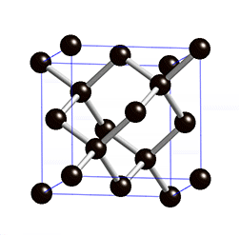
SG P6₃/mmc (No. 194)
In crystallography, a point group which contains an inversion center as one of its symmetry elements is centrosymmetric [1].
Sr (2d)
In such a point group, for every point (x, y, z) in the unit cell there is an indistinguishable point (-x, -y, -z). Such point groups are also said to have inversion symmetry [2].
Sr (2d)
Fe4 – 4f_{VI}
[1] Richard J. D. Tilley “Crystals and Crystal Structures”, John Wiley. pp. 80–83. (2006) ISBN 978-0-470-01821-7.
[2] Liang Fu and C. L. Kane, Phys. Rev. B 76 045302 (2007). doi:10.1103/PhysRevB.76.045302.
19

Slide 20
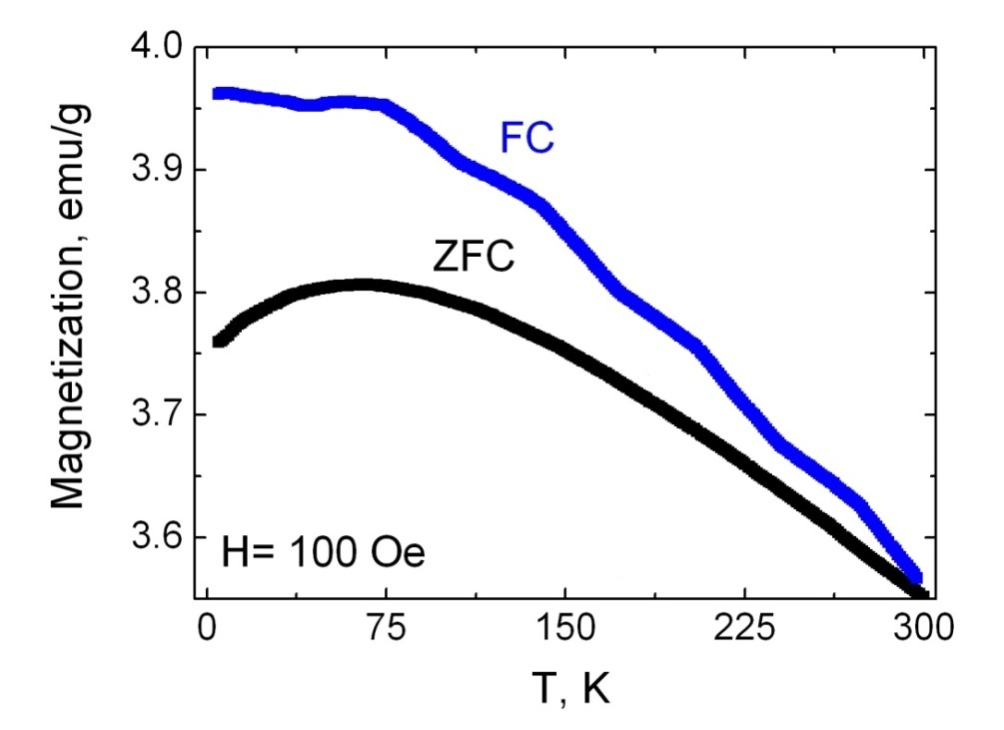
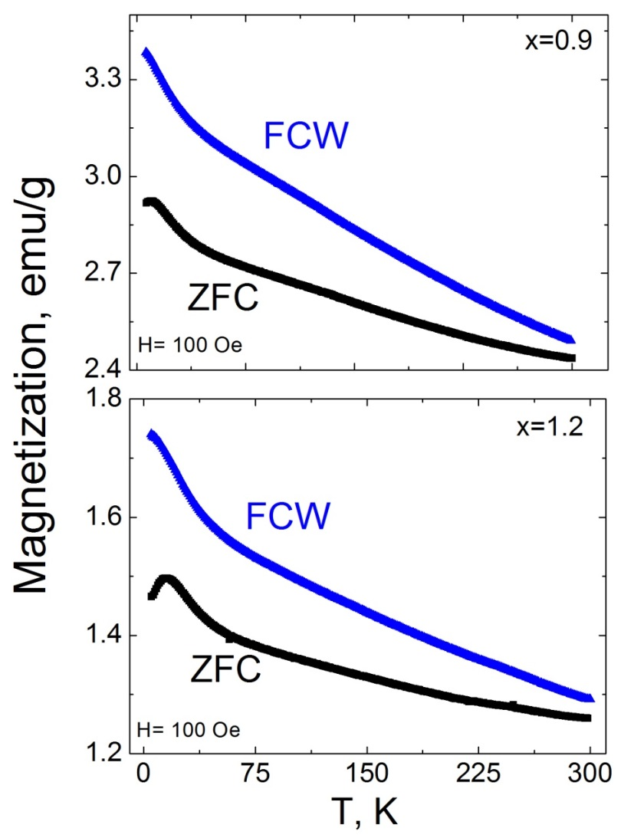
Temperature dependences of magnetization of SrFe_{12-x}In_{x}O₁₉ (x= 0.1; 0.9 and 1.2)
FC
x= 0.1
T_{max}
FC
FCW
The Bean-Livingston equation:
ZFC
T_{irr}
$$T=\frac{K_{V}V}{{25k}_{B}}$$
K_{V} is the volume anisotropy constant;
k_{B} is the Boltzmann constant
V is the volume of magnetic particle, which should be overcome by magnetic field in order to change the orientation of magnetic moment of particles.
x= 0.1
T_{max}≈ 55 K
l_{55K}≈ 2.3 nm
average size
l_{300K}≈ 4.4 nm
maximal size
of magnetic regions
T_{irr}≈ 300 K
20
Notes:
Значение Tb or T_{irr} соответствует температуре ниже которой энергия тепловых флуктуацийв кристаллите существенно меньше энергии магнитной анизотропии и определяется выражением [XX]:
(ввв)
Наличие широкого максимума на кривой ZFC(Рис.Ч) указывает на разброс частиц по размерам и является суммой узких максимумов для частиц различной величины. Таким образом, широкий максимум определяется вкладом объемных долей частиц определенного размера.

