Slide 1
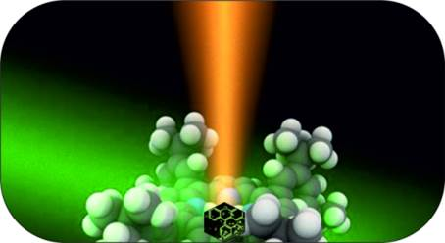
Ultrasensitive detection of analyte molecules at attomolar concentration by Raman spectroscopy
Grigory Arzumanyan
FLNP, Sector of Raman spectroscopy
51st meeting of the PAC for Condensed Matter Physics
20 – 21 January 2020

Slide 2
OUTLINE
Introduction in brief: development of biosensing techniques (proteins, lipids, acids, etc.)
2. Raman as a powerful and sensitive tool for biosensing:
a) Highly sensitive detection of human lactoferrin
by Surface-Enhanced Raman Spectroscopy (SERS)
b) Silver 3D dendrites nanostructures for attomolar
limit of analyte molecules detection by SERS
3. Summary
2
2

Slide 3
Development of biosensing techniques
The main goals of biosensing studies include:
non-invasive and sensitive tests for early diagnostics
accuracy and reliability to reduce risks of false results
medical diagnostics of different types of dangers to human health, including cancer, brain diseases, viruses-induced illnesses and other
Along with the enzyme-linked immunoassay (ELISA) and a high performance liquid chromatography (HPLC), Raman spectroscopy has been considered as a powerful and sensitive tool for biosensing as well.
3

Slide 4
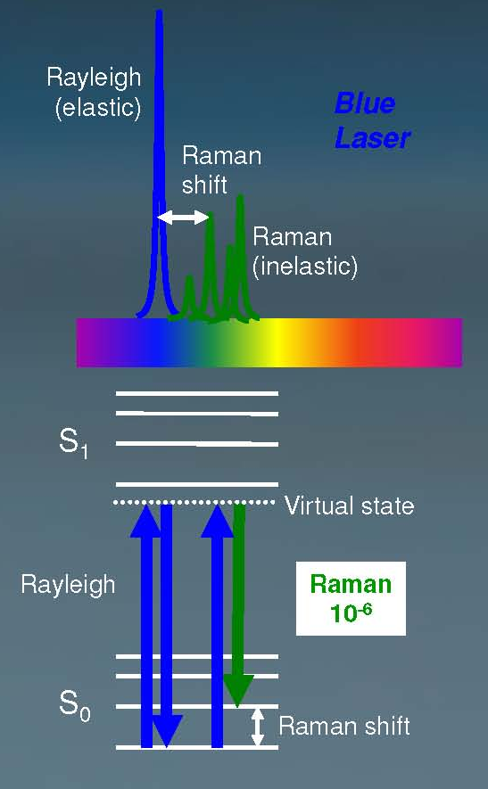
VIBRATIONAL (RAMAN, SERS) SPECTROSCOPY
Raman signal is very informative – vibrational frequencies are characteristic of chemical bonds in a specific molecule
Main advantages
very high sensitivity (enhanced Raman, SERS, CARS)
non-invasive probing (controlled by laser power & λ)
short-term analysis (a few seconds or minutes)
compatibility with water solutions
non-photobleaching signal for live cells studies
chemical imaging without exogenous tags
single excitation wavelength
a small sample volume and simplicity of preparation
Major limitation of spontaneous Raman:
weak signal which limits its practical application
4

Slide 5
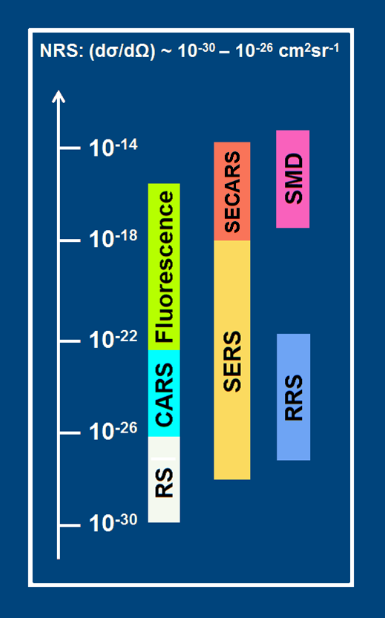
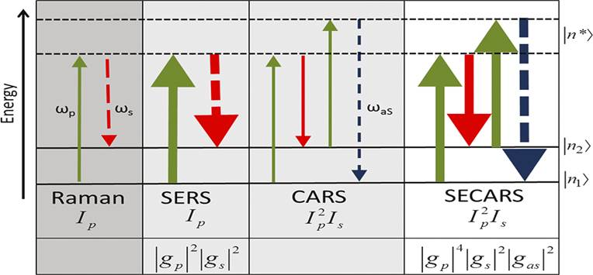
Modalities and trends in enhanced Raman microspectroscopy
RS – Raman Scattering (spontaneous)
RRS – Resonance Raman Scattering
CARS – Coherent Anti-Stokes Raman Scattering
SERS – Surface Enhanced Raman Scattering
SECARS – Surface Enhanced CARS
TERS – Tip-Enhanced Raman Spectroscopy
SHINERS – a new generation of Raman technique Shell-Isolated NP Enhanced Raman Spectroscopy
10⁻¹⁴
10⁻¹⁸
10⁻²²
Single Molecule Detection (SMD) level ~ 10⁻¹⁵
10⁻²⁶
10⁻³⁰
5

Slide 6
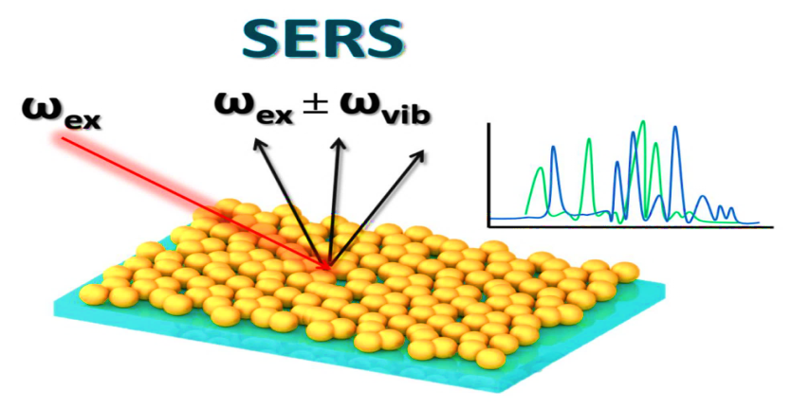
Surface Enhanced Raman Scattering (SERS) –
Enhancement factors under suitable conditions can be as high as 10⁸⁻¹², in some specific cases even higher which allow a few / single molecule detection level.
Two main mechanisms of SERS enhancement:
1. Electromagnetic (dominant):
- collective oscillations of free electrons (plasmons) in the metallic nanostuctures upon a laser excitation. Enhancement by local optical fields close to surface of metallic NPs at resonance conditions – surface plasmon resonance (SPR).
2. Chemical (much weaker than 1):
- charge-transfer (electrons) process in the ground and excited states of the adsorbed molecule-metal system (metal-molecule bonds).
SERS involves inelastic light scattering by molecules adsorbed onto Ag or Au NPs with nanoscale roughness.
6

Slide 7
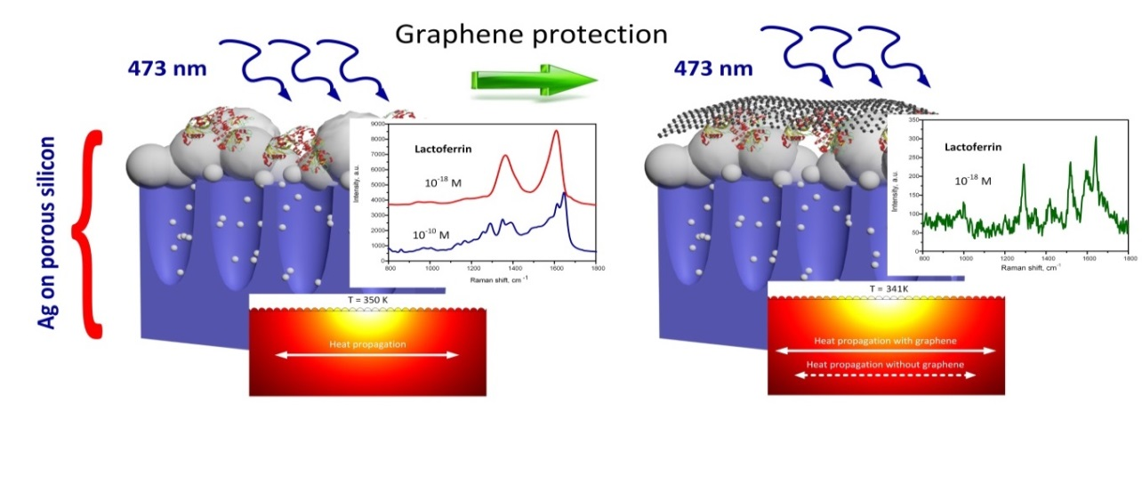
SERS of lactoferrin adsorbed on silvered porous silicon (por-Si) and covered with graphene
Lactoferrin is a multifunctional glycoprotein that is widely represented in various secretory fluids, such as milk, salvia, tears, etc.
Lactoferrin is one of the components of the immune system of the body and is part of the innate defense
7

Slide 8
Materials and Methods:
(substrates were fabricated in BSUIR, Minsk)
Monocrystalline Si wafers (c-Si) were used for the fabrication of the por-Si template.
The por-Si layers of a 5 µm thickness, a 75% porosity and a 70–100 nm pore diameter were fabricated by an electrochemical anodization.
After anodization, a silver immersion deposition on the por-Si was performed from a water-ethanol solution of 3 mM AgNO₃ for 70 min resulting in a dominant deposition of Ag NPs on an external surface of the porous material.
Chemical vapor deposition (CVD) for the synthesis of graphene and a wet-chemical transfer of graphene was used.
The SERS-active layer is composed of quasi-spherical silver particles, which dominating sizes are in the range of 10–150 nm, however, some of them have diameters of 150–700 nm).
SEM images of the silvered por-Si:
(left) top view; (right) cross-section
8
Notes:
It was found that the por-Si causes a negative surface potential of silver particles.

Slide 9
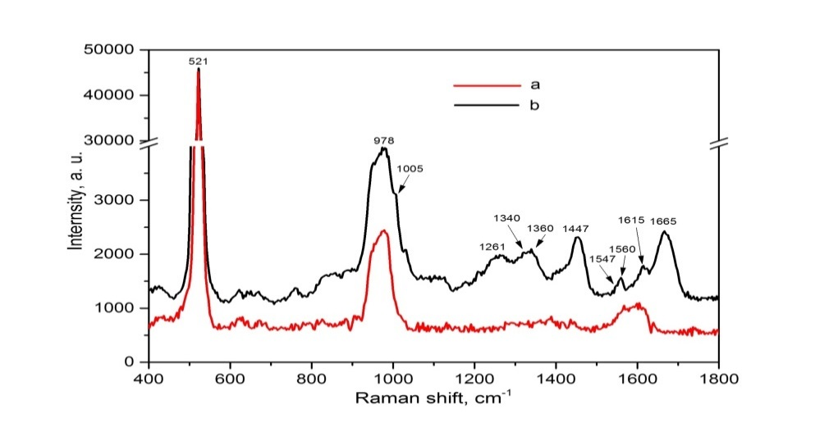
SERS-spectroscopy of lactoferrin molecules at 10⁻⁶M
Recombinant human lactoferrin from milk of transgenic goats (similar to those of natural human lactoferrin from woman’s milk) was used in experiments.
Raman band (cm⁻¹) | Assignment
1005 | Phe (Phenylalanine) - ring breathing mode
1230-1300 | Amide III – (C-N stretch & N-H bend)
1340 & 1360 | Trp (Tryptophan)
1447 | CH₂ – bending mode
1547 & 1560 | Trp (Tryptophan)
1600–1615 | Tyr (Tyrosine)
1665 | Amide I (C = O & C = N stretching)
SERS spectra of the silvered por-Si:
Virgin; (b) after adsorption of the lactoferrin
molecules from the 10^{–6} M solution.
Spectra were registered during 1s at laser power of 1.45 mW
and at the excitation wavelength of 473 nm
Amide I band - a marker for the interpretation of secondary protein structure.
9

Slide 10
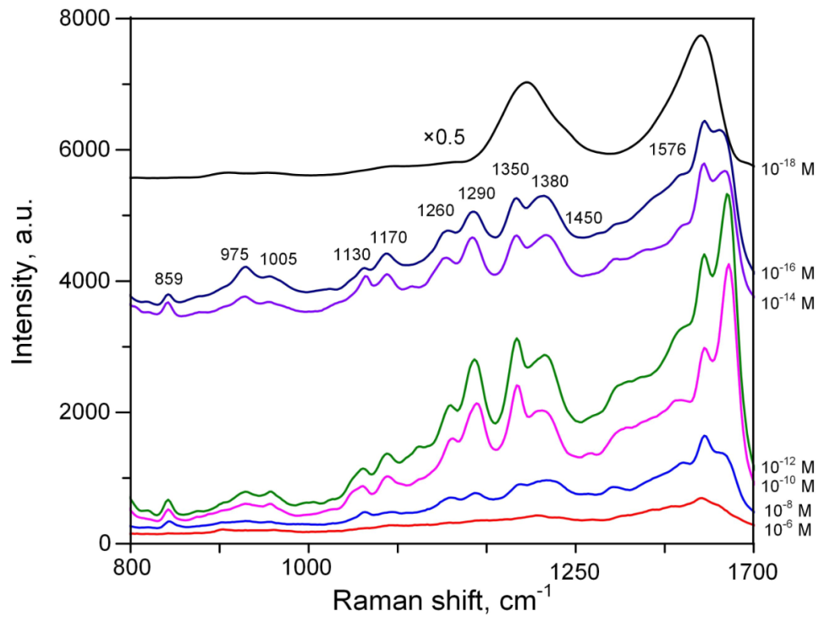
Revealing of the minimal detectable concentration of lactoferrin by SERS
SERS spectra of lactoferrin at 10⁻⁶ to 10⁻¹⁸ M concentrations obtained by the collection and integration of the SERS spectra maps (10 х 10 µm)
The laser power was decreased to 0.14 mW in contrast to the previous measurement (1.45 mW)
to eliminate a harmful photothermal effect.
10

Slide 11
Specific peculiarities of lactoferrin SERS spectra
Lactoferrin mostly exists in tetramer and monomer forms
determined by its concentration.
In particular, monomers were dominant at concentrations below 10⁻¹⁰ M, and converted into tetramers at concentrations above 10⁻⁹−10⁻¹⁰ M.
The SERS spectra at the 10⁻¹⁴ and 10⁻¹⁶ M concentrations have lower intensities and started to change (more prominent amorphous carbon bands) due to heating to the temperature of lactoferrin denaturation at about 350 K.
11

Slide 12
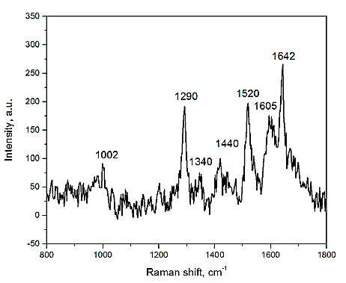
Overcoming the limitation – highly-sensitive SERS spectrum of lactoferrin molecules at 10⁻¹⁸ M concentration and covered with graphene
Most of the lactoferrin Raman bands are presented in the spectrum:
1002 cm⁻¹ (Phe), 1290 cm⁻¹ (Amide III), 1340 cm⁻¹ (Trp), 1440 cm⁻¹ (CH²), 1605 cm⁻1 (Tyr)
and 1642 cm⁻¹ (Amide I).
Biosensors, 2019, 9, 34, pp. 1-19.
12

Slide 13
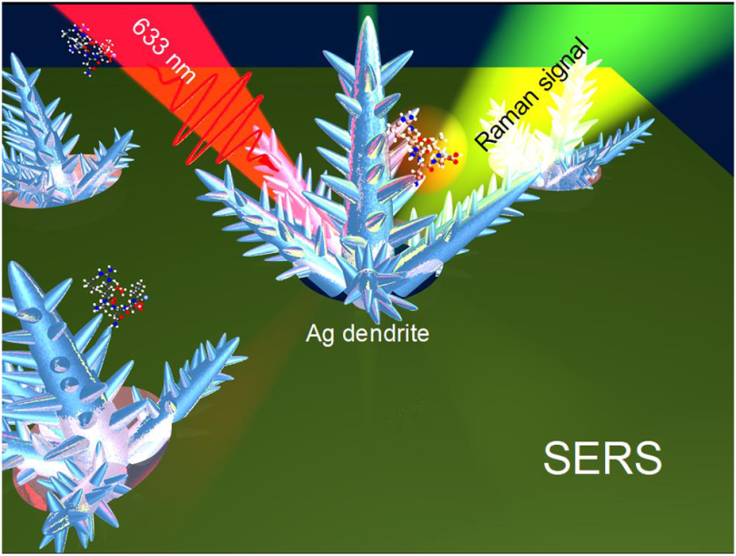
Silver 3D dendrites for attomolar limit of analyte
molecules detection by SERS
The metallic dendrites refer to volumetric nanomaterials of a fractal type and consist of an ensemble of metallic NPs forming 3D branched structures similar to the fern leaves.
13

Slide 14
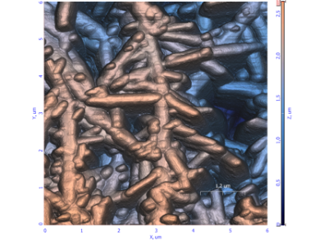
Why dendrites?
Advantages in SERS spectroscopy
Excitation upon a wide range of laser wavelengths (including IR) due to the wider spectral surface plasmon resonance band.
Use of low laser powers and portable instrumentation for biosensing due to richly-developed dendrites’ morphology that possesses much more hot spots compared to the 2D nanostructures.
Our objectives
To extend a range of the excitation wavelengths of the dendritic SERS-active substrates to the near-IR region (785 nm) along with new limits in sensitivity.
to eliminate analyte destruction
to quench its luminescence
to avoid contribution from tissue media that is transparent in an IR light
14

Slide 15
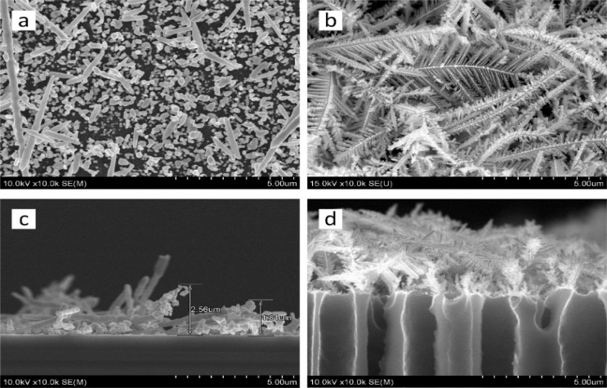
Materials and methods
Template – a macroporous silicon (macro-PS) was used as a template for the formation of the Ag dendrites.
Fabrication method – electrochemical anodization: the macro-PS layers with pore diameters of 1.2-1.5 μm and thickness of 5 μm were formed.
Selective silver deposition – combination of the Si surface layer ion-etching in argon plasma followed by the Ag wet corrosion deposition from the solution containing AgNO₃ salt, alcohol and small amount of hydrofluoric acid (HF).
Morphology of the silver dendrites on silicon and macroporous silicon
Ag dendrites on mono-Si have a much less developed structure compared to Ag dendrites on macro-PS.
Advantageously, the dendrites layer on macro-PS with a thickness of ~3 µm are formed at the periphery of the pore entrances (non-precipitation of Ag on the pores’ walls).
A length of central trunks of the lateral dendrites reaches 20-25 μm, and the lateral branches ~ 3-7µ, also a large number of additional outgrowths of 100-300 nm length.
SEM images of (a, b) top and (c, d) cross-section views of (a, c) mono-Si and (b, d) macro-PS with a deposited Ag layer.
15

Slide 16
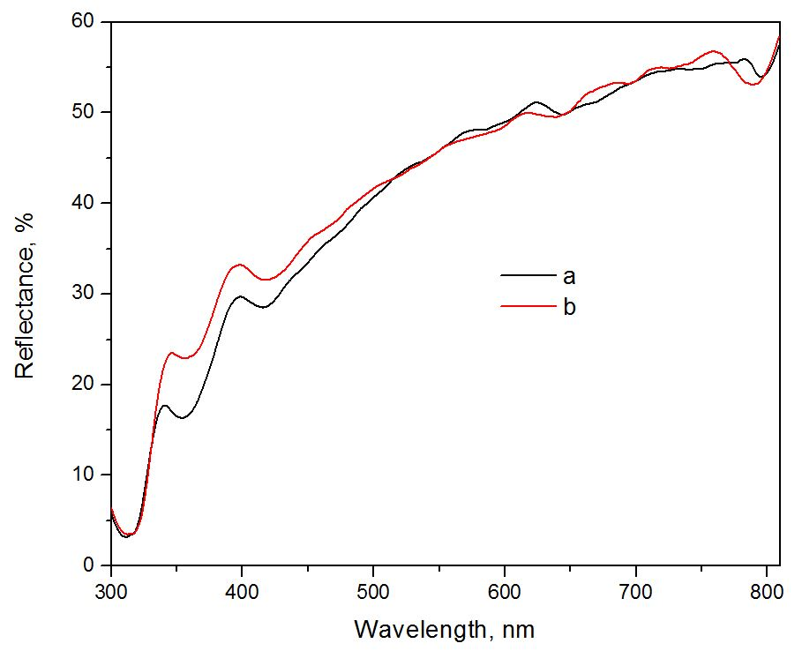
Optical properties – reflectance spectra
635
780
For both samples several absorption bands associated with SPR modes were observed: centered around 430, 635 and 780 nm.
430
Reflectance spectra of the Ag layers deposited
on (a) mono-Si and (b) macro-PS
16

Slide 17
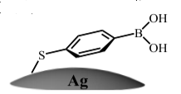
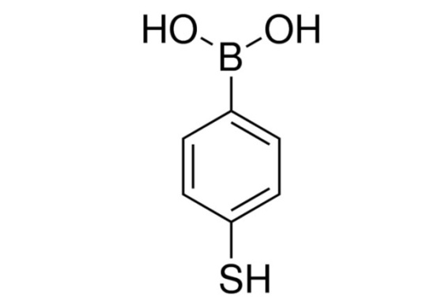
SERS-activity of Ag dendrites on Si and porous silicon
Analyte/reporter molecules
MercaptoPhenylBoronic Acid (4-MPBA)
This analyte:
is characterized smaller Raman cross section comparing with organic dyes that are more often used to estimate a SERS-activity.
is considered as an important agent to provide highly sensitive detection of a glucose and other macromolecules – so it is of a large interest of medical analysis and diagnostics.
17

Slide 18
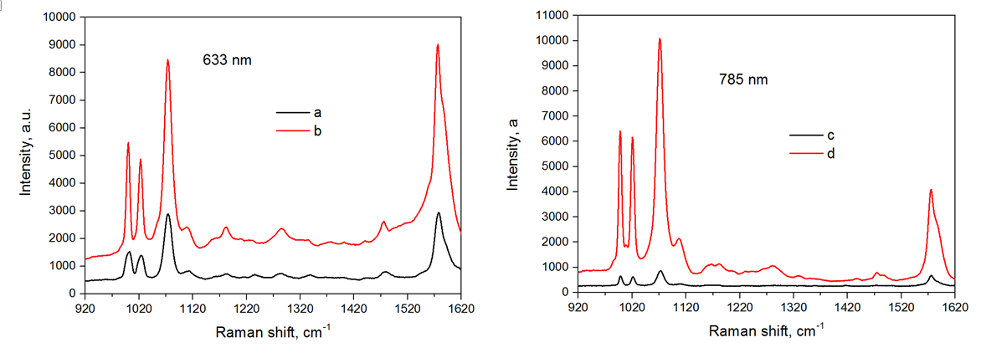
SERS-activity of Ag dendrites on flat and porous Si
SERS spectra are dominated by the raman bands of 4-MPBA at 998, 1021, 1074, and 1576 cm⁻¹
Assignments:
998 – β_{CCC}
1021 – β_{CH}
1074 – β_{CCC}+νcs
1576 – νcc (aromatic ring vibration)
SERS spectra of the 4-MPBA molecules with a concentration of 10⁻⁶ M, on (a, c) mono-Si and (b, d) macro-PS,
excited by 633 and 785 nm laser.
The substrate of Ag dendrites on macro-PS provides a higher intensity of the peaks compared to Ag dendrites on mono-Si.
The amplification effect is manifested more strongly for excitation of laser radiation at a longer wavelength: for 633 nm, the gain in the intensity of the peaks is 3.5 to 5 times, while for the 785 nm wavelength this gain is 12-15 times.
ν, stretching mode
β, in plane bending mode
18

Slide 19
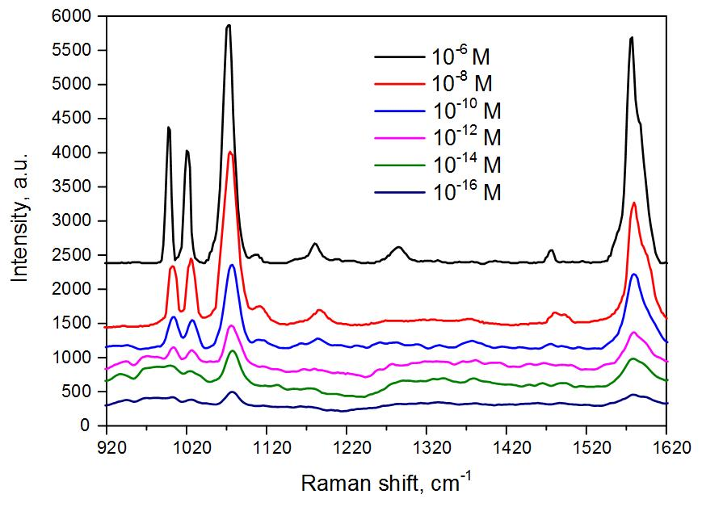
Detection limit (4-MPBA) of SERS-active substrates
based on the silver dendrites on macro-PS
Average SERS spectra of 3 maps (100 × 100 μm) of the Ag dendrites/macro-PS kept in the 4-MPBA solutions with different concentrations.
The excitation wavelength is 785 nm.
19

Slide 20
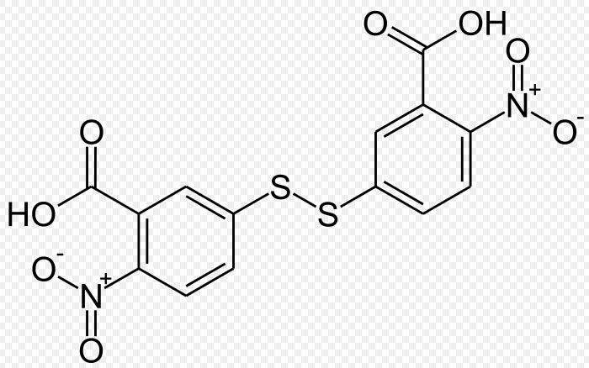
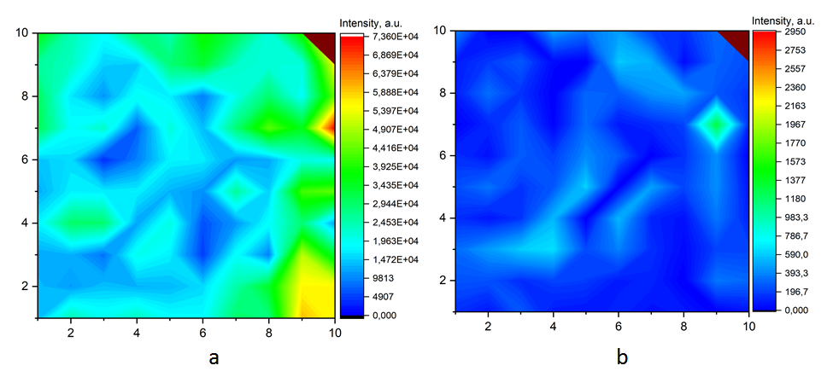
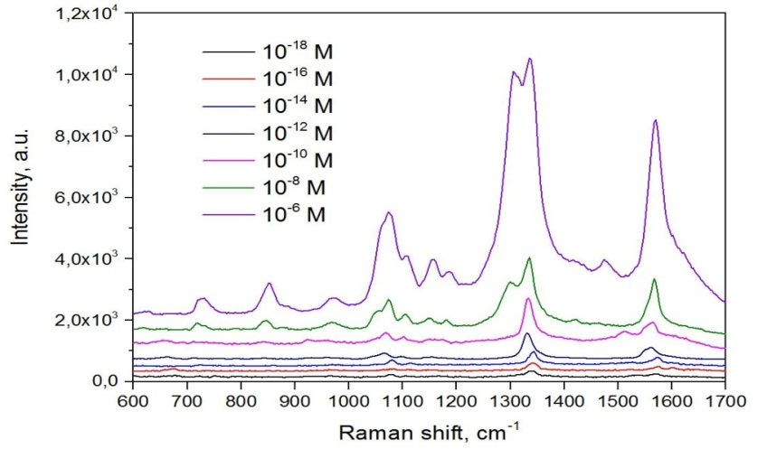
Detection limit of DTNB analyte/reporter molecules
adsorbed at the silver dendrites on macro-PS
Raman reporter: DTNB
Dithionitrobenzoic acid
1338 сm⁻¹
1558 сm⁻¹
Distribution maps of 1338 cm⁻¹ band intensity in the SERS spectra of DTNB molecules from solutions at concentrations: (a) 10⁻⁶ M ; (b) 10⁻¹⁸ M
-------------------------------------------------------------------------
1338 cm⁻¹ – symmetric nitro stretch. mode ν_{s}(NO₂)
1558 cm⁻¹ – aromatic ring stretching mode
Average SERS spectra for three maps of the
Ag dendrites/macro-PS kept in the DTNB
solutions with different concentrations. The excitation wavelength 785 nm.
J. Appl. Phys, 2019, 126
Ready for submission to Biosensors, 2020
20

Slide 21
SUMMARY on Lactoferrin
We employed SERS-spectroscopy to study the biomolecules with high molecular weight using the lactoferrin as test analyte and SERS-active substrates based on the silvered por-Si and graphene protection of the analyte molecules.
SERS spectra of lactoferrin adsorbed from 10⁻⁶ M solution were rather weak but the decrease of the concentration down to the 10⁻¹⁰ M level (monomer sizes) led to the enormous growth of the SERS signal.
To decrease the temperature in the laser spot below the the temperature of lactoferrin denaturation, the analyte molecules were protected with graphene, which allowed detecting lactoferrin adsorbed from the 10-¹⁸ M solution.
To our knowledge a reliable SERS study of the lactoferrin molecules adsorbed on the solid SERS-active substrates has not been reported before.
21

Slide 22
SUMMARY on Ag dendrites nanostructures
3D silver nanostructures, which consist of Ag NPs and network of Ag dendrites deposited on the surface of macro-PS, are fabricated and investigated.
Vertically located Ag dendrites have a small length of 0.5 - 1.5 μm, while the length of lateral Ag dendrites can reach 15-20 μm.
With the use of such Ag dendrites nanostructures on marco-PS, it was possible for the first time to detect 4-MPBA and DTNB molecules with very low concentrations of 10⁻¹⁶ M and 10⁻¹⁸ M, respectively.
The discovered increase in the intensity of the peaks for Ag nanostructures on macro-PS is associated with a wide band of plasmon resonance characteristic of Ag dendrites and with the presence of a large number of “hot spots”.
22

Slide 23
Thank You!

Slide 24
Spare

Slide 25
ELISA & HPLC in brief:
advantages and limits
25

Slide 26
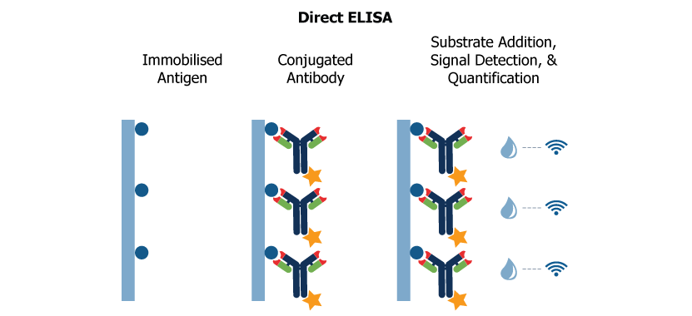
Enzyme-linked immunosorbent assay (ELISA) – a commonly used analytical assay to detect the presence of a ligand (commonly a protein) using antibodies directed against the protein to be measured.
Benefits:
a high specificity
provide enough reproducibility of data
allow the quantitative investigation of analytes.
General shortages:
a tedious/laborious procedure (24 h or even several days analysis) and operates with relatively large sample volumes
the detection limit of the conventional ELISA is near a nanomolar concentration, which is inadequate to reach the clinical threshold of many proteins’ biomarkers, especially in the early stage of diseases
26

Slide 27
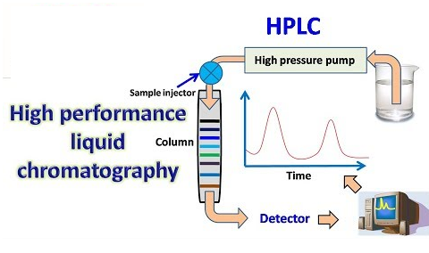
High-performance liquid chromatography (HPLC) – is one of the effective techniques in analytical chemistry used to separate, identify, and quantify each component in a mixture.
Advantages:
capable of the multicomponent analysis of real-life samples and complex mixtures with good resolution
- employed for determining all major whey proteins
Main shortages:
there is no universal detector, hence the detection is more problematic if the analyte does not absorb ultraviolet (UV)
has many operating parameters and is more inconvenient for routine measurements
similar to the ELISA technique, the HPLC hardly provides a suitable detection limit of protein biomarkers for clinical application
high cost
27

Slide 28
Materials and Methods:
Recombinant human lactoferrin from milk of transgenic goats (similar to those of natural human lactoferrin from woman’s milk) was used in experiments.
The analyte’ powder was dissolved in a deionized water to obtain the solutions of 10⁻⁶–10⁻¹⁸ M concentrations.
The c-Si and silvered por-Si samples of a 0.25 cm² surface area were immersed in 1 mL of the analyte’ solution for 1 h before the measurements.
Laser source with a 473 nm wavelength and a spot diameter about 600 nm was used to excite the samples.
28

Slide 29
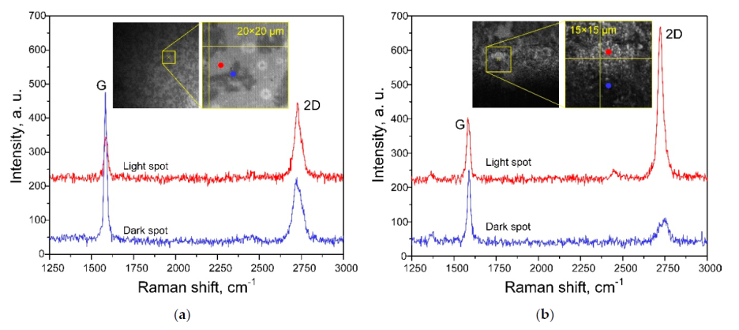
Characterization of Graphene-Containing Films
It is well-known that graphite’s Raman spectra can contain three intensive bands – G, 2D, and D:
- the G band (1582 cm⁻¹) is associated with a doubly degenerated phonon mode of E_{2g} symmetry.
- the 2D band (around 2710 cm⁻¹) gives information about the ordering of graphite (graphene) layers.
- the band D (1352 cm⁻¹) characterizes defects in the graphite (graphene) structure.
The graphene monolayer can be found on both substrates. This follows from:
the position of the G band (1587 cm⁻¹),
the FWHM of the 2D band (29 cm⁻¹) and the I_{G}/I_{2D} ratio.
The band associated with deformation, disorder, and defects in crystalline structure of
graphene (~1350 cm⁻¹) cannot be found in the spectra evidencing its good quality.
a) Raman and (b) SERS spectra of graphene-containing film on the (a) c-Si and (b) silvered por-Si substrates

Slide 30
Chemical vapor deposition (CVD) was used for the synthesis of graphene. Electrochemically polished copper foil was annealed for 1 h at 1050 C in Ar and H₂ gases’ flow with a rate of 160 and 150 cm³/min, respectively. Then a 4 cm³/min methane flow was introduced into the CVD reactor for 10 min.
A wet-chemical transfer of graphene without a polymer support was used.
A preparation of the graphene films for the transfer was carried out as follows:
the underside of the copper foil was processed for 3 min in a solution of HNO₃:H₂O, mixed in a volume ratio of 1:3 and
the copper foil was completely dissolved in an aqueous solution of FeCl₃ . As a result, the graphene film remained floating on the surface of the solution. Before the graphene transfer, this solution was carefully replaced several times with distilled water, which facilitated its purification from the products of chemical reactions. When working on the transfer process, the substrate containing silvered por-Si areas was immersed in the solution, placed under the graphene film and lifted up from the solution. In this case, the graphene film remained on the surface of the substrate.

Slide 31
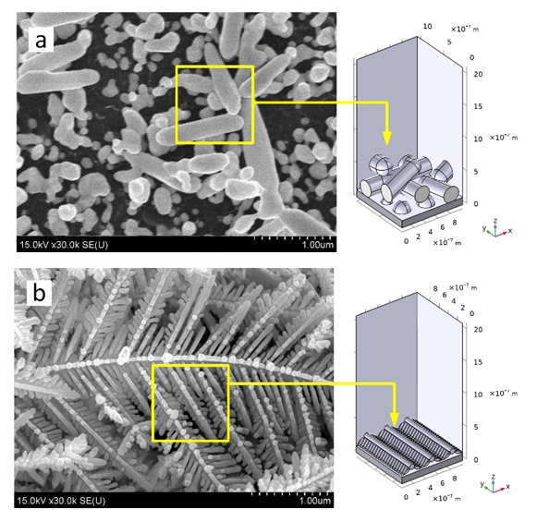
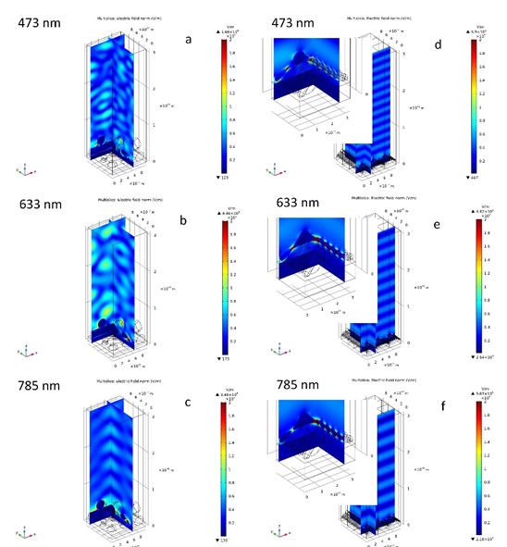
Computer simulation using COMSOL AC/AD Module
Areas selected for the simulation of the electric field strength in the Ag dendrites on (a) mono-Si and (b) macro-PSi
Electric field strength distribution simulated for the silver dendrites on (a, b, c) mono-Si and (d, e, f) macro-PS upon different excitation wavelengths.
31

Slide 32
Estimation of an active area of the dendrites and count the number of molecules under the laser spot.
SEM top views of the Ag dendrites (a) before and (b, c) after adsorption of DTNB molecules from the solutions at the (b) 10⁻⁸ M and (c) 10⁻¹² M concentrations.
Inset shows SEM top view of a single nanocluster at a higher magnification.
Important notes:
some nanoclusters were observed on the Ag dendrites after keeping in the DTNB solutions
nanoclusters were observed on the samples with the concentration down to 10⁻¹² M
they have a shape of a semisphere with an average diameter of 7 nm (~ 90 nm³)
they are not observed on the fresh SERS-active substrate and therefore they can be composed of only analyte molecules
we suppose that the nanoclusters were formed while drying an adsorbed layer of the analyte molecules to reduce its surface energy

Slide 33
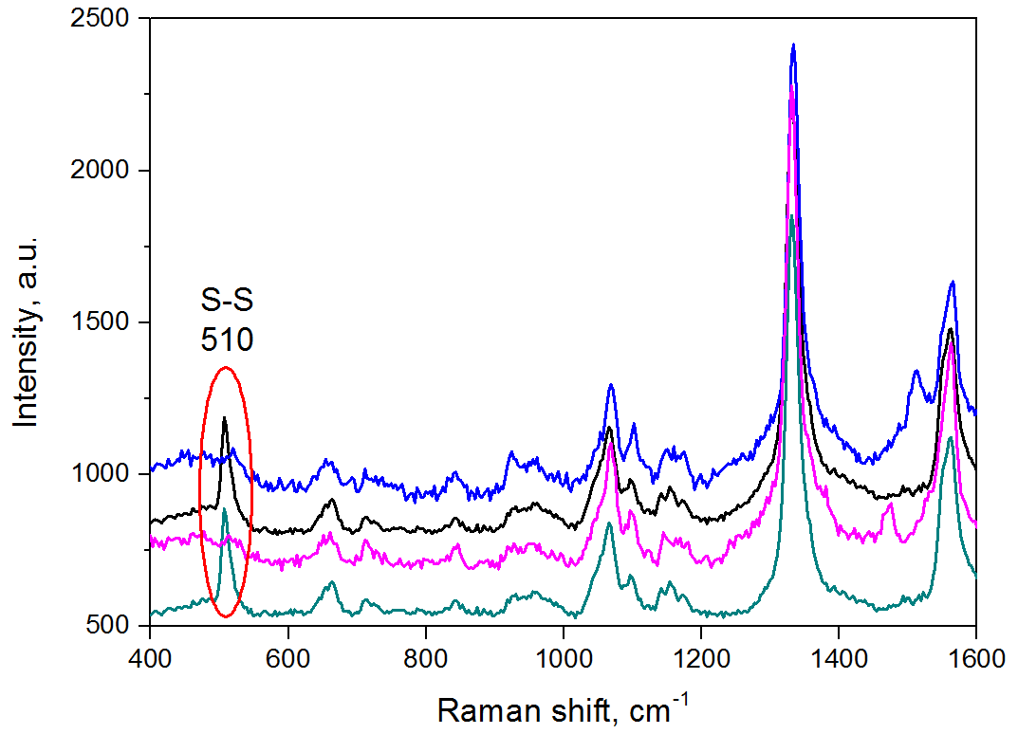
Estimation of an active area of the dendrites and count the number of molecules under the laser spot.
Important notes:
the disulfide bond breaking in the DTNB molecules results in a chemisorption of the TNB products in active spots on the substrate that have the largest density of the surface states.
the chemisorbed molecules should be strongly anchored on the surface.
Point SERS spectra of the Ag dendrites/macro-PS kept in the 10⁻¹² M DTNB solutions.
at attomolar concentr. the 1 ml of analyte solution will be a source of maximally 1204 TNB products
the area of the SERS-active substrate is 10 mm² and it contains 100 maps (each map area have a chance to adsorb about 12 TNB products)
the SERS-spectra did not contain the S-S band – thus it is logical to suppose that some spots with monomolecular layer of TNB were detected.
assuming the diameter of the single spot is equal to that of the nanocluster we can speak about detection of several tens of molecules.

Slide 34
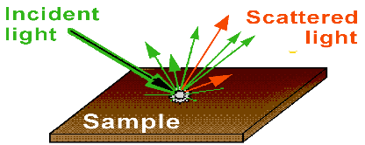
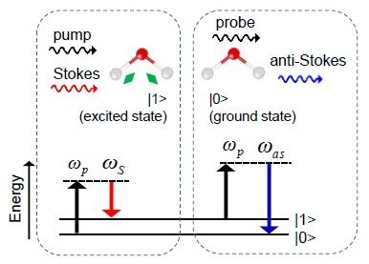
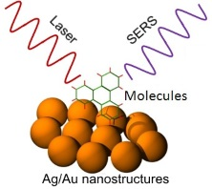
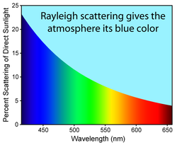
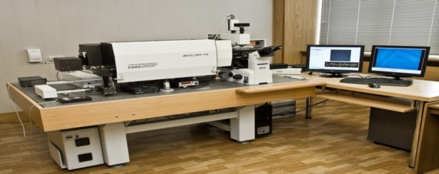
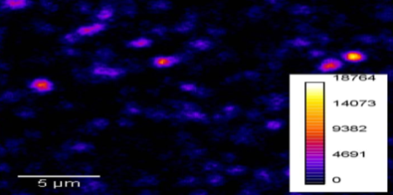
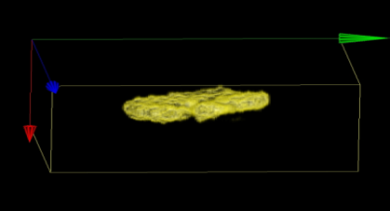
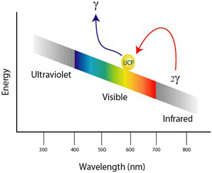
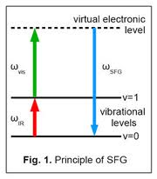
Multimodal optical platform at FLNP, JINR
Raman
F-CARS, E-CARS, P-CARS
SERS
Transmitted and reflected channels
SECARS
“CARS” microscope
Up-conversion luminescence
SHG, SONICC
Second harmonic & sum frequency generation
34

