Slide 1

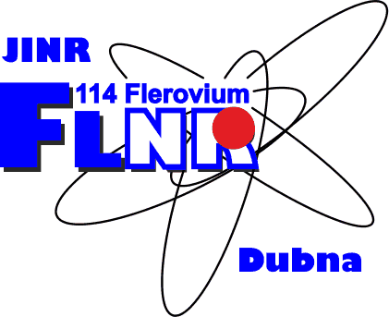
Structural modification of carbon materials
by swift heavy ions
A.Olejniczak^{1,2}, N. A. Nebogatikova³, Z. Jovanović⁴, A.V. Frolov⁵,
and V. A. Skuratov¹
¹Joint Institute for Nuclear Research (RU)
²Nicolaus Copernicus University in Toruń (PL)
³Rzhanov Institute of Semiconductor Physics (RU)
⁴Vinča Institute of Nuclear Sciences (RS)
⁵Kotelnikov Institute of Radio Engineering and Electronics (RU)
aolejnic@chem.umk.pl
51st PAC for Condensed Matter Physics
20 January, 2020
A. Olejniczak
Structural modification of carbon materials by swift heavy ions

Slide 2
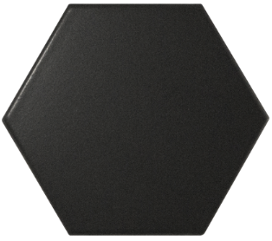
Outline
Carbon nanomaterials
Graphene
Fluorographene
(FG)
Graphene oxide
(GO)
Bulk carbon
materials
Pyrolytic craphite
(PG)
Glassy carbon
(GC)
C
tailoring the properties of 2D materials
investigation of the damage response of carbon nuclear materials
A. Olejniczak
Structural modification of carbon materials by swift heavy ions

Slide 3
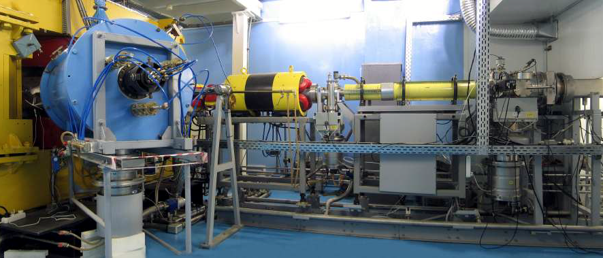
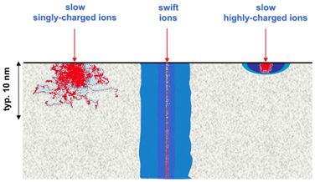
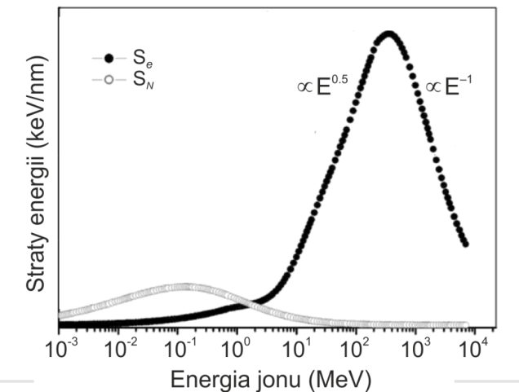
Irradiation details
Stopping power values calculated per single layer of
graphene sheet (SRIM-2013 code):
Aumayr et al. J. Phys.: Condens. Matter 23 (2011) 393001
Ion | E | S_{e} | S_{N}
 | (MeV) | (keV/layer) | (eV/layer)
Bi | 710 | 8.97 | 32.3
Xe | 167 | 5.76 | 26.6
Kr | 107 | 3.80 | 12.0
V | 61 | 2.53 | 2.7
Ar | 46 | 1.88 | 4.7
Xe | 0.2 | 0.25 | ~ 95
Energy loss (keV/nm)
Ion energy (MeV)
S_{e} threshold for damage creation : graphite 2.41 keV/layer (J. Liu Phys Rev B 64:2001;184115)
For suspended graphene S_{e} 1.22-1.48 keV/layer (H. Vazquez, Carbon 114:2017;511-518)
A. Olejniczak
Structural modification of carbon materials by swift heavy ions

Slide 4
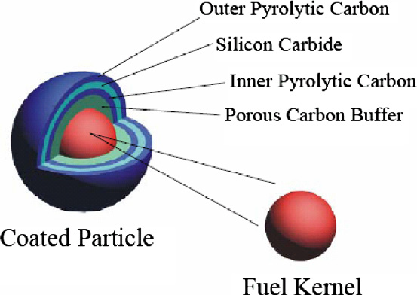
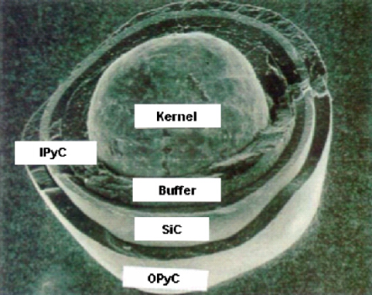
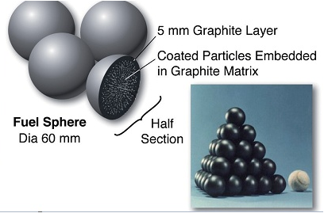
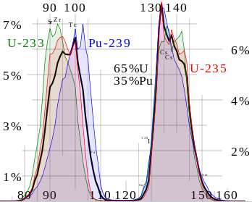
Practical aspects: TRISO fuel for next generation nuclear reactors
TRIstructural ISOtropic (TRISO) coated particle fuel:
Fig. source: Allen, T., Busby, J., Meyer, M., & Petti, D. Materials today, (2010) 13, 14.
Designed to nuclear reactor projects that involve goals of high coolant temperatures or high burnup performance of nuclear fuel.
Porous C buffer – attenuates recoiling fission products (FPs) and accommodates internal gas buildup and particle dimensional changes
SiC – acts as main pressure vessel and provides a diffusion barrier to prevent the release of FPs
PyC layers- protect SiC from chemical attack during particle operation. Additional diffusion barriers for FPs. IPyC protects the fuel kernel during SiC deposition.
Fission product yields by mass for thermal neutron
fission (Image source: wikipedia)
IC100 cyclotron - we can accelerate heavy ions with masses
and energies similar to those of FPs.
A. Olejniczak
Structural modification of carbon materials by swift heavy ions

Slide 5
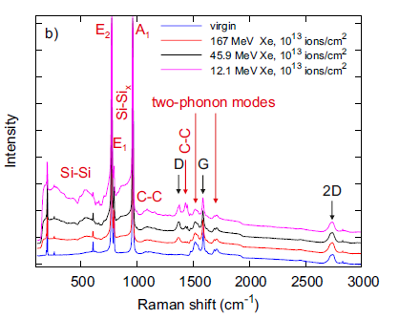
Practical aspects: TRISO fuel for next generation nuclear reactors
TRIstructural ISOtropic (TRISO) coated particle fuel:
Fig. source: Allen, T., Busby, J., Meyer, M., & Petti, D. Materials today, (2010) 13, 14.
Fission product yields by mass for thermal neutron
fission (Image source: wikipedia)
SiC – insensitive to irradiation in electronic stopping regime
Very sensitive to irradiation in nuclear stoping regime.
A. Olejniczak et al.
Structural changes in SHI irradiated HOPG and GC

Slide 6
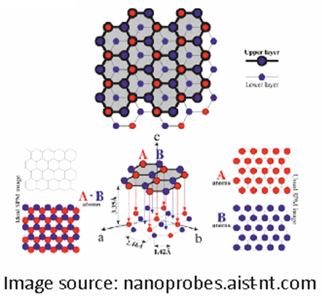
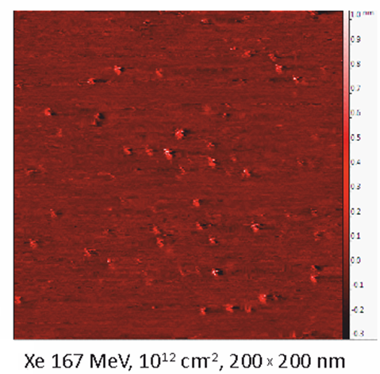
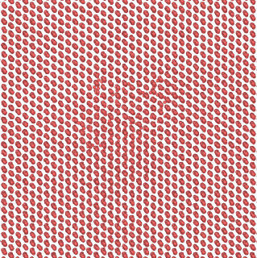
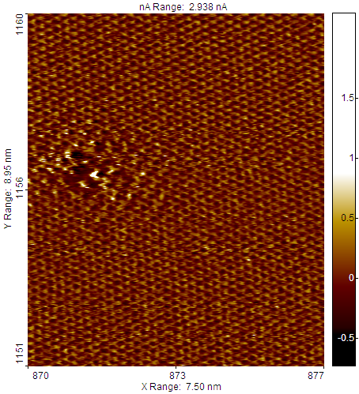
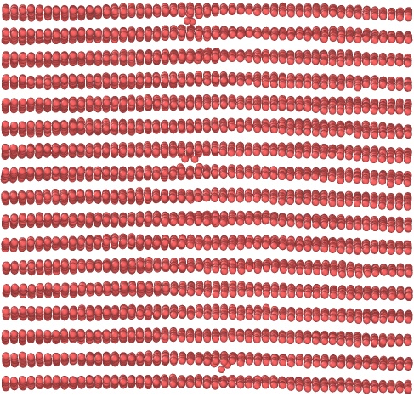
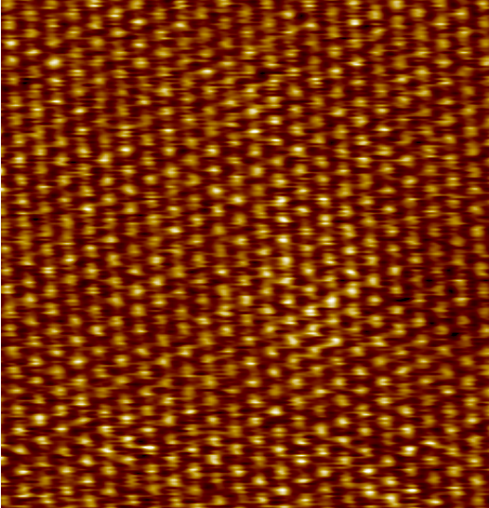
HOPG STM images and preliminary modeling results
MC (TREKIS code) + MD, Xe 167 MeV,
R. Rymzhanov
Xe 167 MeV, 10¹² cm⁻²,
x range: 7.5 nm
Presence of two types of nanohillocks: the first type refers to regions with damaged C lattice (point-like defects, 2-3 nm in size); the second type represents distorted protrusions with undamaged lattice.

Slide 7
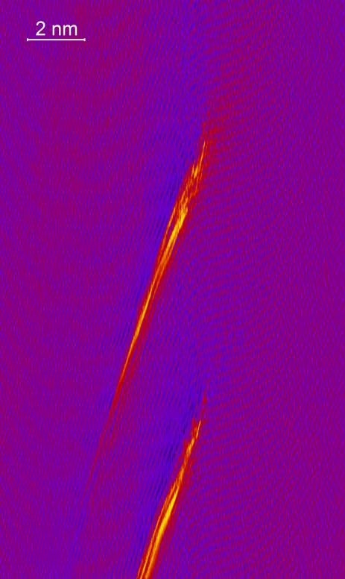
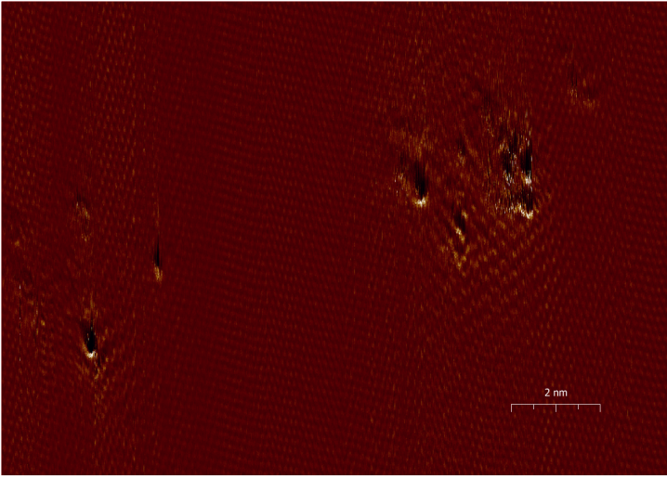
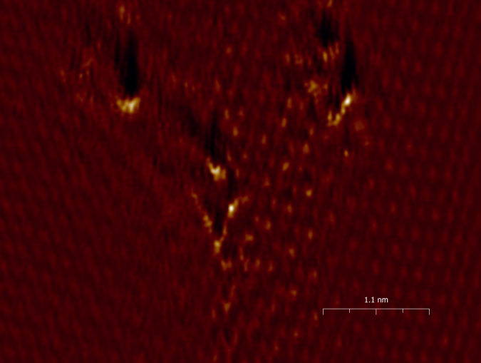
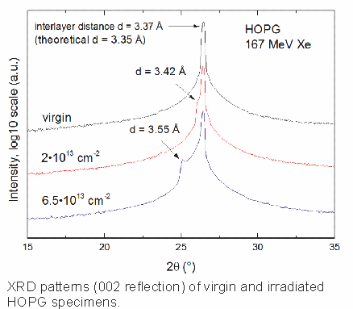
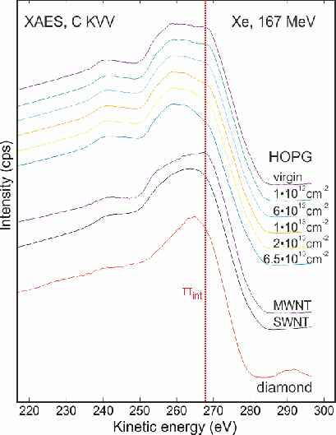
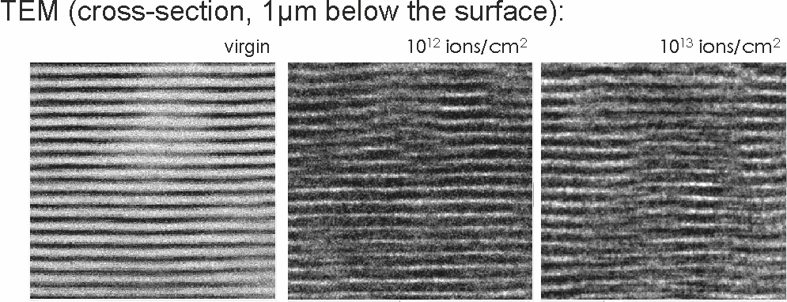
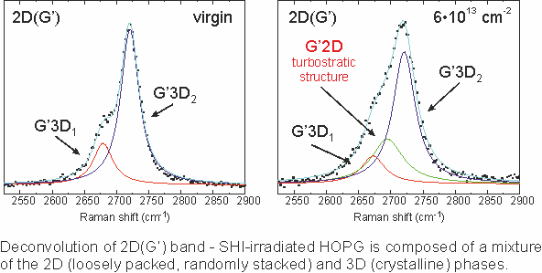
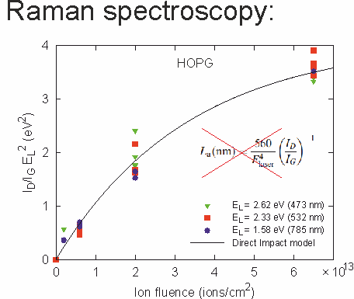
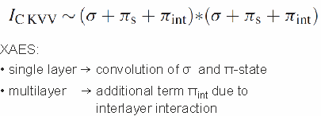
Practical aspects: TRISO fuel for next generation nuclear reactors
STM:
Bi ~700 MeV, 10¹¹ cm⁻², Se = 25 keV/nm
XRD
XAES
Raman spectroscopy

Slide 8


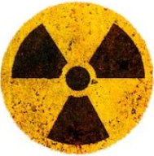
Glassy carbon: properties and possible applications in nuclear technology
resistance to high temperatures
chemical and corrosion resistance
high hardness and strength
low density
extreme resistance to thermal shock
Properties
high thermal and electrical conductivity
construction materials for modern molted salt reactors (coatings)
matrix for disposal/solidification
of radioactive waste
Potential applications
A. Olejniczak
Structural modification of carbon materials by swift heavy ions

Slide 9
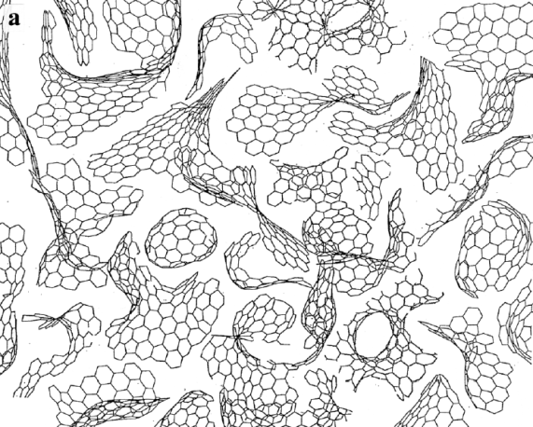
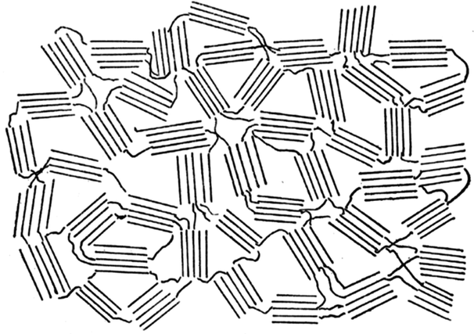
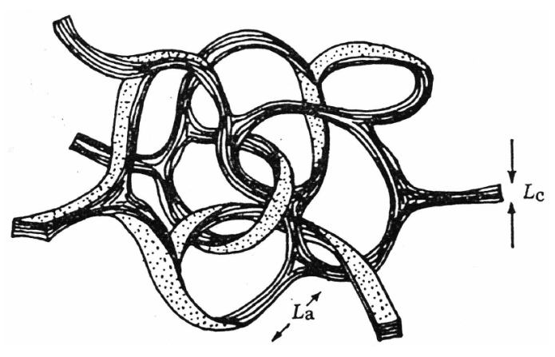
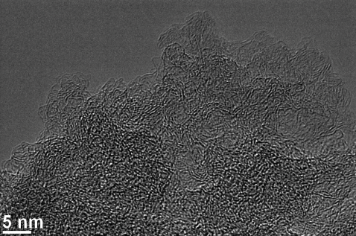
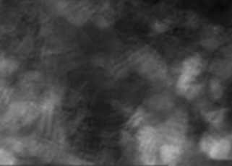
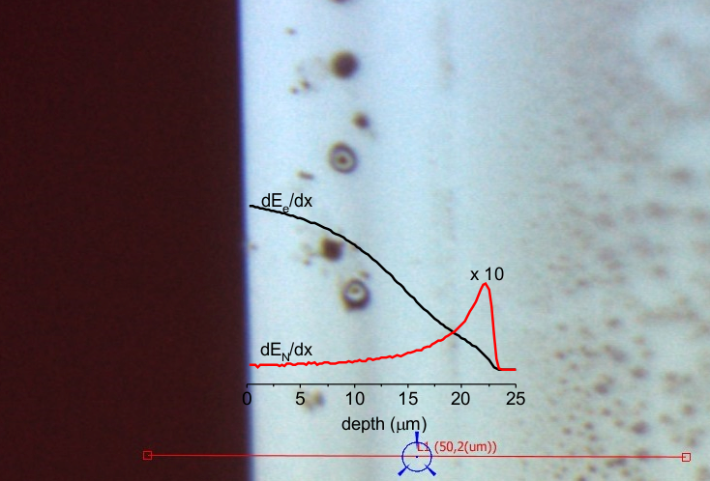
Glassy carbon (GC) models, properties and potential aplications
P. J. F. Harris,
Philos. Mag. (2004):, 84, 3159
R. E. Franklin,
Proc. R. Soc. A (1951) 209, 196
G. M. Jenkins and K. Kawamura,
Nature (1971), 231, 175
TEM images of turbostratic carbon samples prepared in different conditions
Optical image (cross-section, GC1000 specimen irradiated with 167 MeV Xe
ions, fluence 6∙10¹³ ions/cm²)
overlapped with Se and SN profiles calculated in SRIM.
A. Olejniczak
Structural modification of carbon materials by swift heavy ions

Slide 10
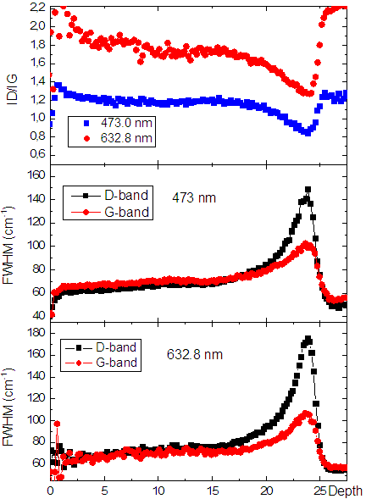
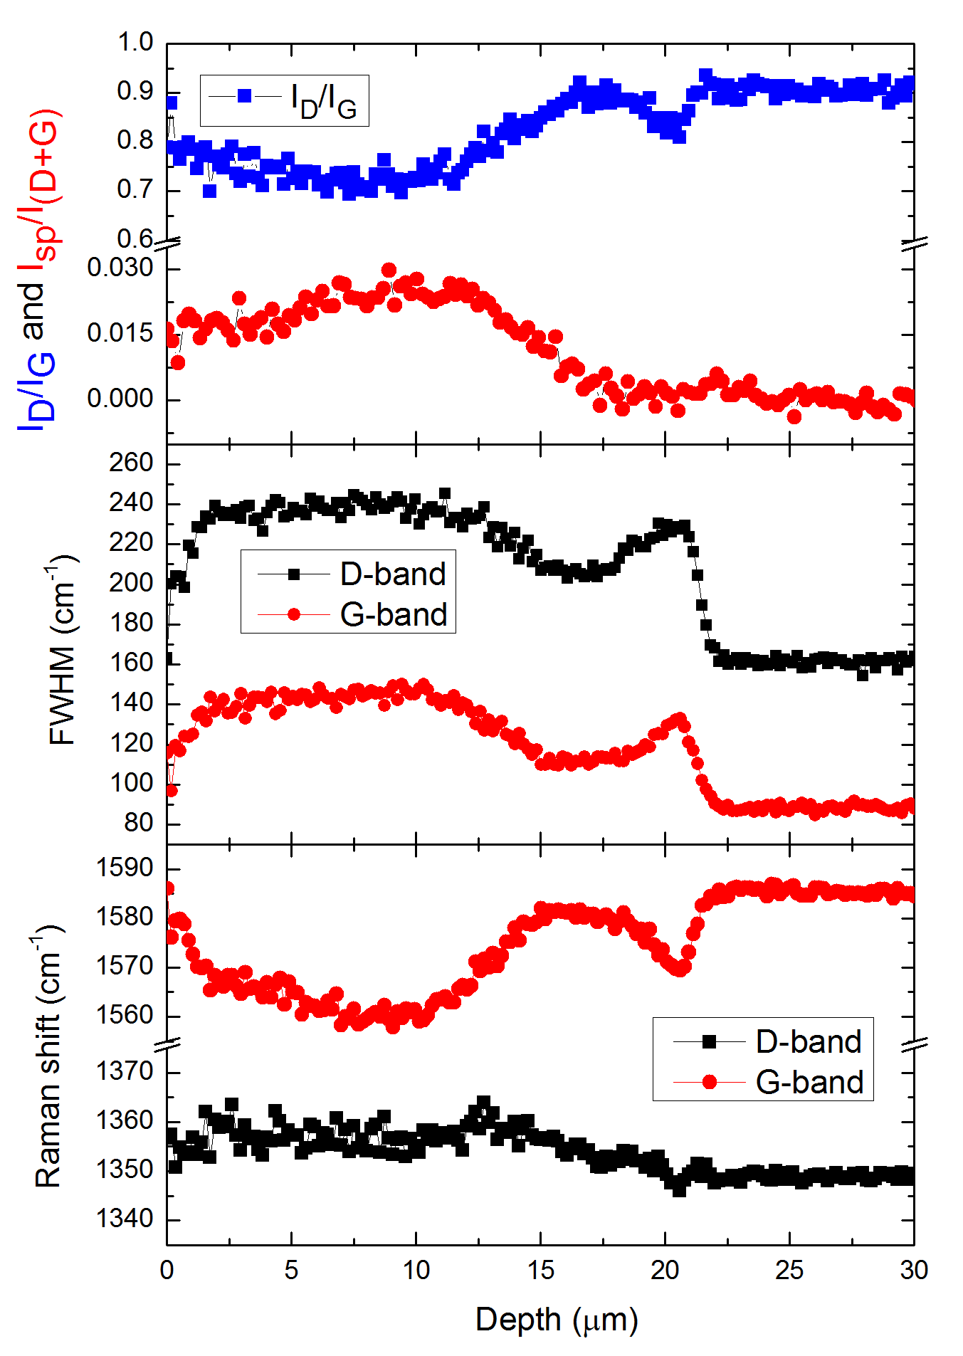
Glassy carbon (GC 2200°C vs. GC 1000°C) Raman depth profiling
GC 2200°C
GC 1000°C
Samples carbonized at high temperature are highly resistant to irradiation in electronic stopping regime.
Ion ranges and damage profile consistent with SRIM calculations. Formation of sp-hybridized carbon chains.

Slide 11
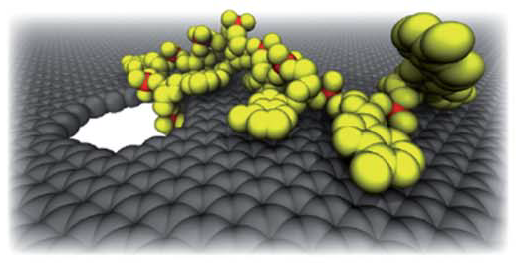
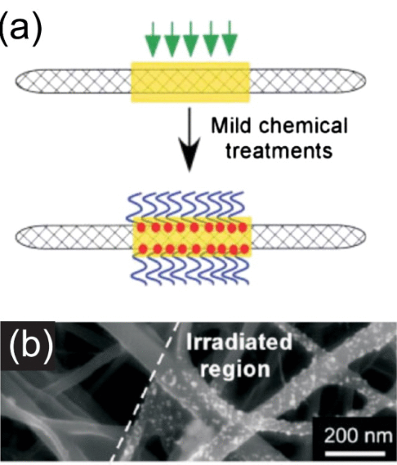
Tailoring the properites of Graphene by ion beams
Defect engineering
Creation of (re)active sites
Nano-sized pores
Doping
Nanopatterning and nanofabrication
Modification of transport properties
Band gap opening
Sensing
Chemical functionalization
Molecular separation
Energy storage
DNA sequencing
Low energy ions
Electronic & transport properties
Focused ion beams
Nanodevices, nanolitography
D. B. Wells et al.,
Nano Lett., 2012, 12, 4117–4123.
M. S. Raghuveer et al. Adv. Mater. 18, 547 (2006)

Slide 12
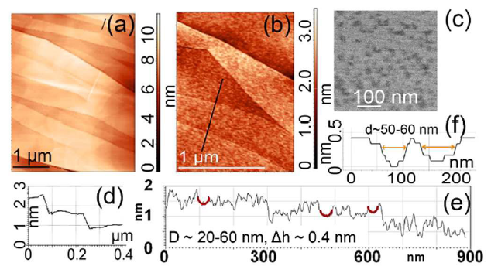
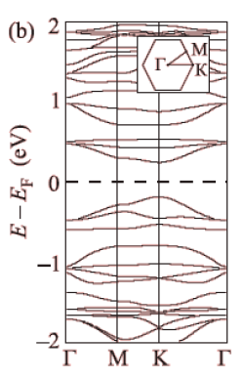
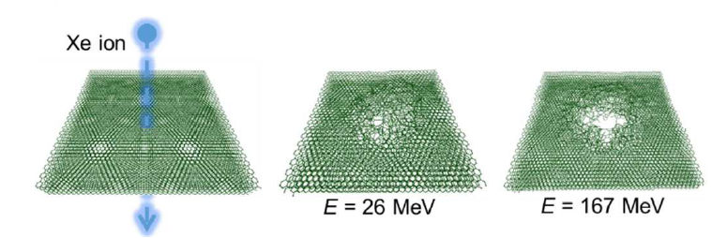

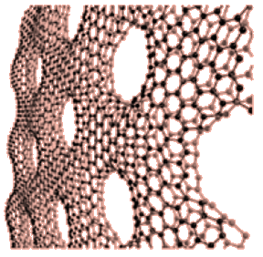
Multilayer graphene (surface topography, TS-MD simulations)
AFM and SEM images of prisine and Xe-ion irradiated multigraphene
TS (TTM)-MD simulations. Heat transfer between the electronic and atomic subsystems is carried out via an inhomogeneous Langevin thermostat
Chernozatonskii, JETP Letters, 2014
The possibility of opening a band gap in the nanostructured samples due to the introduction of an array
of antidots with partially reconstructed edges. (N.A Nebogatikova et al., Nanoscale, 2018, 10, 14499)

Slide 13
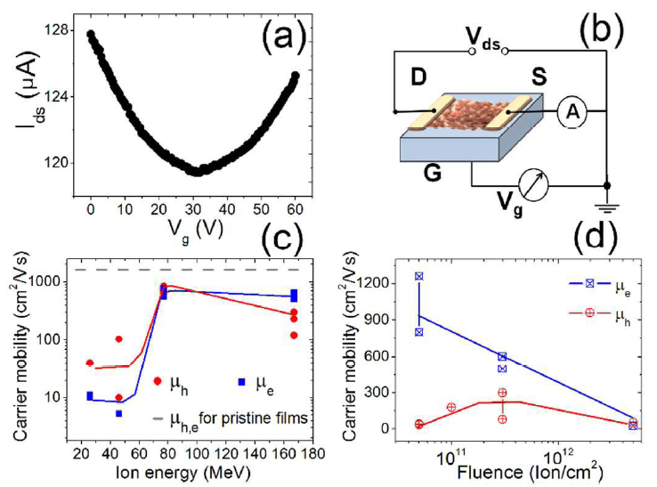
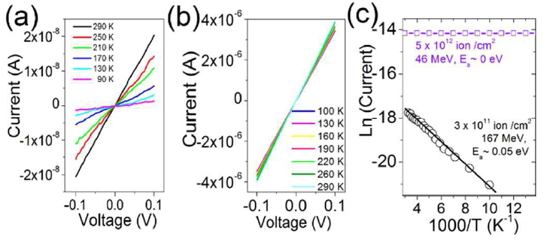
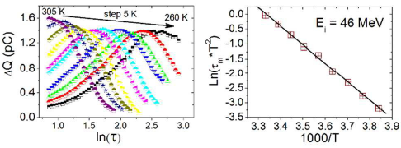
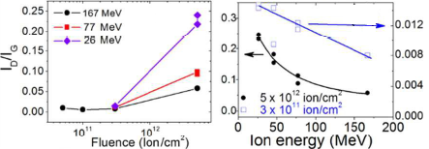
Multilayer graphene (mobility, band gap opening)
I-V characteristics of graphene films irradiated with 167 and 46 MeV Xe ions and temperature dependence of electric current in irradiated films shown in an Arrhenius plot
The mobility of charge carriers calculated from C-V characteristics of the films in transistor configuration
Damage evolution studied with/by the Raman spectroscopy
(disorder parameter)
Presence of charge carrier trapping centers evidenced by
Q-DLTS spectroscopy (activation energy ~ 0.5 eV)
The possibility of opening a band gap in the nanostructured samples due to the introduction of an array
of antidots with reconstructed edges. (N.A Nebogatikova et al., Nanoscale, 2018, 10, 14499)

Slide 14
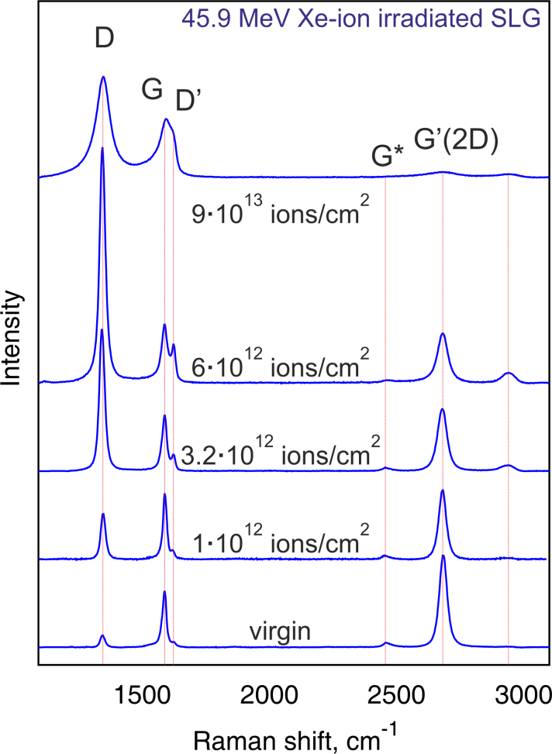
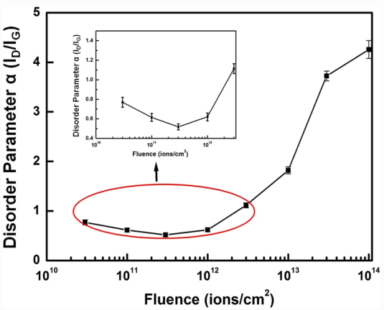
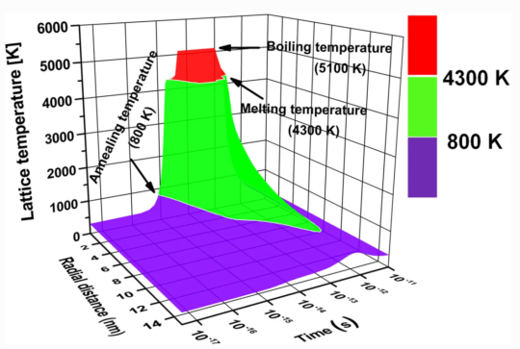
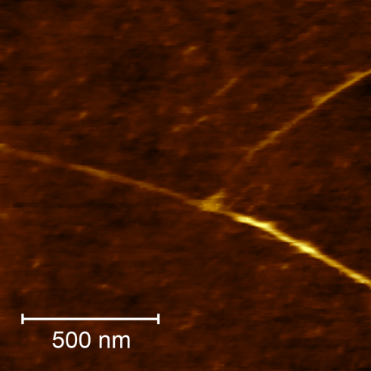
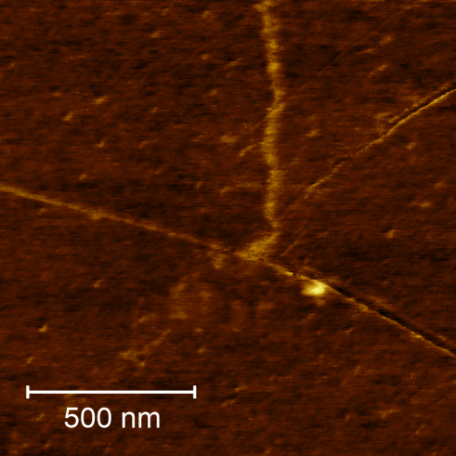
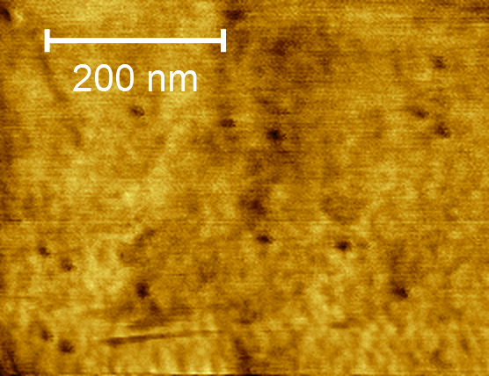
Healing of CVD graphene
800
virgin
61 MeV V, 10¹¹ cm⁻²
600
700 MeV Bi, 10¹⁰ cm⁻²
700 MeV Bi, 10¹¹ cm⁻²
400
200
Sheet resistance (ohm/sq)
0
SLG
BLG
TLG
Sheet resistance (4-contact, Van der Pauw)
of virgin and SHI-irradiated high-quality
CVD graphene.
(↑) Raman spectra of virgin and 46 MeV Xe ion-irradiated CVD graphene.
Purification/annealing of graphene with 100-MeV Ag ion irradiation
S. Kumar et al. Nanoscale Res Lett. 2014; 9(1): 126
(←) AFM images of 700 MeV Bi-ion
Irradiated SLG samples – from left to right: height and phase (tapping mode), lateral force (contact mode)
Purification/annealing of high-quality CVD graphene confirmed for irradiation with energetic light ions (low Se) by sheet resistance and Hall mobility. Degradation of transport properties for heavy high-Se ions.

Slide 15



Localized defunctionalization - recovery of graphene structure
Localized defunctionalization of FG/GO is of particular interest from a nanoelectronics point of view - the potential to precisely engineer conductive and insulating regions
To date, FG/GO nanopatterning has been archived by:
laser beams ,
focused ion beams
electron beams
scanning probe microscopy techniques (e.g. based on
heated-tip, electrochemical, and catalytic lithography).
Swift heavy ions -> highly localized structural modification
We intended to employ this unique feature of SHI to create
nanometer-sized deoxygenated regions in FG/GO films:
recovered G spots as QDs
recovered G spots with damaged cores
as coupled QD-antidots
Fluorographene (F/C = 1)
Graphene oxide (fig. source: S. Kim et al.
Nature materials (2012) , 11, 544

Slide 16






FG (irradiation results, mobility, ….)
AFM and SEM images of virgin and 26 MeV Xe-ion irradiated FG films.
TEM image of ion track created in FG.
Effects observed upon SHI irradiation:
- nanostructuring of films (fracturing)
significant increase in conductivity
(for lateral and vertical configuration)
appearance of electrically active small QDs (~1.4-4 nm)
N. Nebogatikova at al., under review
XPS C1s and F1s core level spectra – F/C ratio decreases
with ion fluence => defunctionalization of FG film

Slide 17




GO ion irradiation-induced defunctionalization (XPS study)
Changes in the surface atomic fraction of C atoms for GO films irradiated with different ions as functions of the ion fluence (a) and deposited electronic energy density (b).
Ordering/damage evolution by Raman spectroscopy
virgin GO
C-O
sp²/sp³
C/O ~ 2.5
Evolution of C1s core level XPS spectra for GO specimens irradiated with different doses of 46 MeV Ar ions
The degree of graphene oxide defunctionalization by SHIs with different energies scales well with
the deposited electronic energy density.

Slide 18








Electrical transport mechanism
Transport properties of GO and its derivatives are often described
by variable range hopping (VRH):
R(T) = R₀ + exp(T₀/T)^{p}
T₀ - characteristic temperature
p - characteristic exponent - distinguishes the conduction mechanism
Different p values reported for GO and its derivatives, including
p=1/2 (ES-VRH) p=1/3 (2D Mott-VRH) and p =1/4 (3D Mott-VRH)
Resistance curve derivative analysis (RCDA) employed to elucidate
the mechanism (plot lnW vs lnT):
W = - ∂lnρ(T)/ ∂lnT
W – reduced activation energy
At low temperatures R(T) is well-fitted by EF-VRH (p=1/2) model
At higher temperatures - contribution of a thermally activated
process (p = 1), expressed by:
R(T) = R₀ + exp(T₀/T)^{p}
Fitting parameters used to estimate the localization length
and band gap
Upon irradiation material changes from an
insulator to a semiconductor
Efros-Shklovskii-VRH model highlights the
localization of wavefunctions inside
graphene domains -> suits the expected QD
nature of the fabricated structures

Slide 19





Graphene oxide (XPS and Raman)
Graphene oxide: AFM,SEM, iTS model – possible interpretation
Kr 107 MeV S_{e} = 3.8 keV/layer
Xe 167 MeV S_{e} = 5.76 keV/layer
Au 120 MeV S_{e} = 6.03 keV/layer
Chetna Tyagi at al.
J. Phys. Chem. C 122: 2018; 9632
iTS code by M. Toulemonde
Bi 710 MeV S_{e} ~ 9 keV/layer
Kr 107 MeV:
Protrusions d 22-30 nm measured at the base
FWHMs of 12-17 nm, height 1-2.5 nm
Low LF areas d ~ 15 nm (at the base), FWHMs of 6-9 nm
Xe 167 MeV:
high SE signal indensity d ~ 27-35 nm
darker spots 7.5-10 nm
Bi 710 MeV - CRATERS!
Height
LF

Slide 20




Graphene oxide (XPS and Raman)
The 2160 cm⁻¹ band is attributed to polyynes of relatively short length:
average C atom number in the sp-chains:
9.7 – according to Kastner formula
8 - based on experimental frequencies
Spectral range of 1930-2066 cm⁻¹ is characteristic of both polycumulenes and long-chain polyynic species (> C12) -however, its assignment to polycumulenes seems to be more plausible.
Similar carbon chain length can be found in the simulation images for graphene irradiated with 84 MeV Ta ions (S_{e} ~ 14.7 keV/nm).
C-O
C-OH
C=C, C=O, HOH
C=O
O-H
virgin
C=C
E_{1u}
sp²-sp³
C-H
C≡C, C≡N?
10¹³ cm⁻²
Fig.source: H. Vazquez
Carbon 114 (2017)
511-518
Proposed idealized structure of nanosized rGO spots embeded in GO matrix
Raman (top) and FT-IR (bottom) spectra of GO specimens.

Slide 21







Development of new experimental setups
The need for in-situ characterization:
K. Kupka, GSI ,PhD Thesis 2016.
C. Hubert, GSI ,PhD Thesis 2016.
Development/upgrading of the experimental setups:
Integrated SPM(AFM/STM) – RAMAN –PL
– SNOM – TERS system
Cryogenic probe station for electrical measurements
Figure source: S. Lumetti PhD Thesis

Slide 22
Conclusions and acknowledgments
The results were discussed on the example of various carbon-based materials irradiated with swift heavy ions (MeV energy range), showing the occurrence of the following phenomena:
engineering conductive and insulating regions in GO and FG by localized
defunctionalization
modification of transport properties of graphene by controlled introduction of
structural defects (opening a band gap for multilayer graphene, «healing» of CVD
graphene)
formation of the misaligned (turbostratic) phase for HOPG,
formation of sp-hybridized carbon chains in GO and GC
Thanks to our collaborators:
Irina V. Antonova - Rzhanov Institute of Semiconductor Physics
Ruslan A. Rymzhanov – FLNR, JINR
Miroslaw Kulik – UMCS, Lublin
Željko Mravik – Vinča Institute of Nuclear Sciences
Jacques H. O’Connell – Nelson Mandela Metropolitan University
Thank you for your attention!!!

