Slide 1

TEM examination of ceramics irradiated with heavy ions of fission fragment energies
V.A. Skuratov
Flerov Laboratory of Nuclear Reactions, Joint Institute for Nuclear Research, Dubna, Russia

Slide 2




Collaborators:
Centre for HRTEM, Nelson Mandela University
Port Elizabeth, South Africa
Eurasian National University
Institute of Nuclear Physics
Nur-Sultan, Kazakhstan
Belarusian State University, Minsk, Belarus

Slide 3
The overall intention of this work is to yield sufficient basic data to determine and compare the radiation tolerance of ceramics against against swift heavy ion (SHI) irradiation simulating fission fragment impact.
Examination of the dense ionization effect in ceramics and oxides irradiated with heavy ions of fission fragments energy:
Evaluation of latent track parameters in Al₂O₃, Si₃N₄, YAP, YAG as function of electron stopping power and irradiation temperature;
Structural consequences of latent track interference in Al₂O₃ and Si₃N₄;
Surface effects of dense ionization in dielectrics and surface nanoscale radiation damage formation.
Transmission electron microscopy (TEM) is the only direct experimental technique for observation of SHI-induced latent tracks in solids

Slide 4
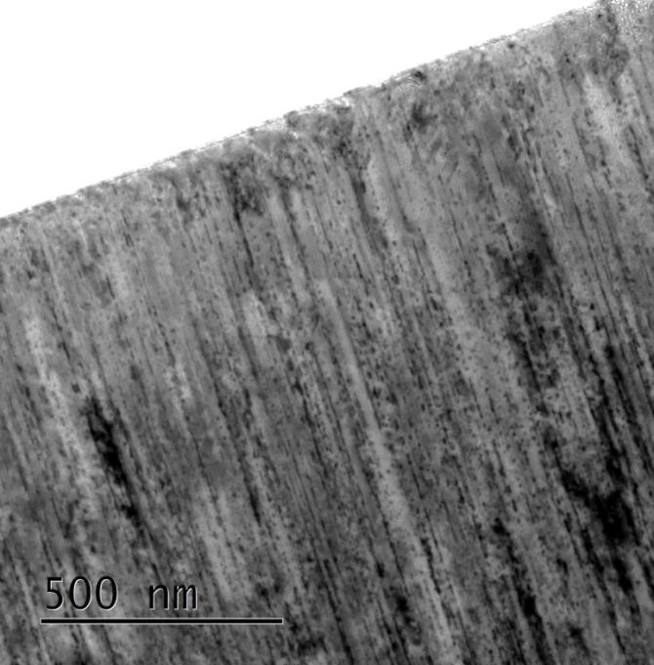
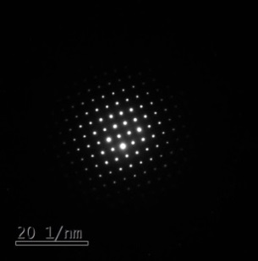
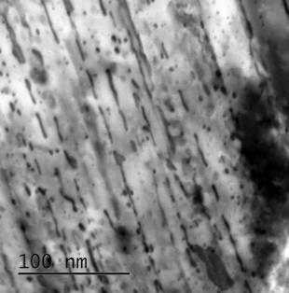
Al₂O₃
167 MeV xenon ion induced tracks in Al₂O₃
V.A.Skuratov et al., Nucl. Instr. Meth.B 327 (2014) 89

Slide 5
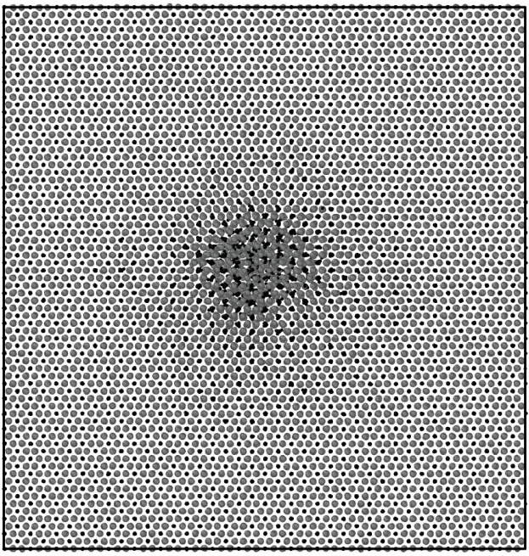
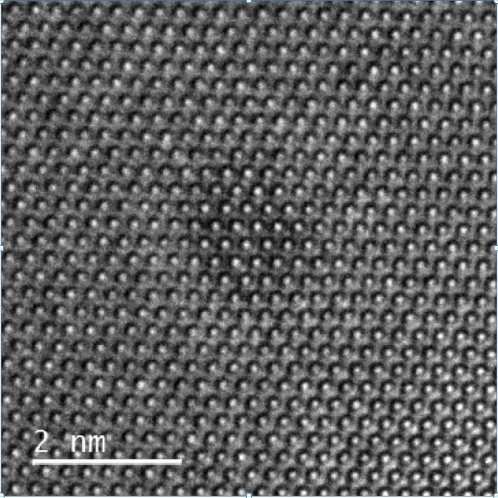
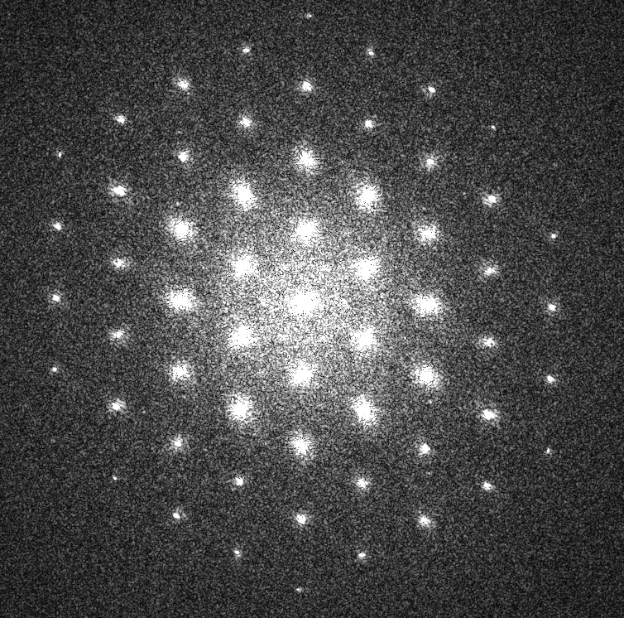
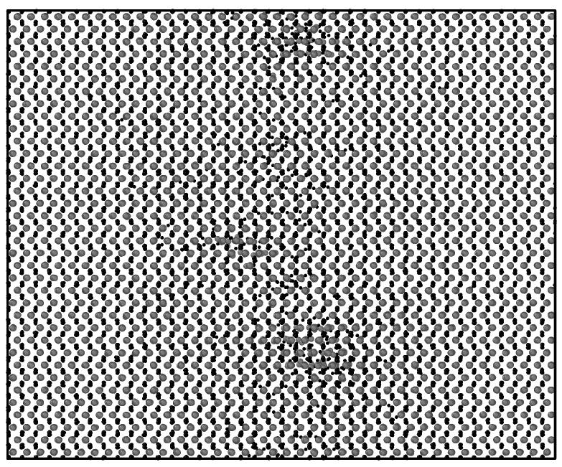
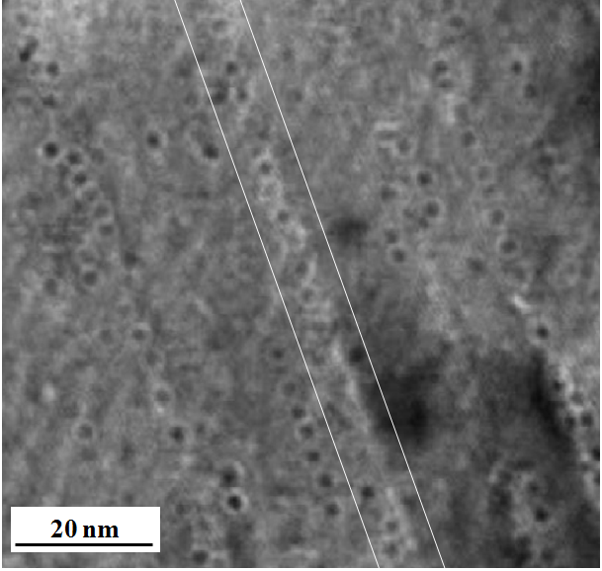
TEM and MD simulated 167 MeV Xenon ion induced tracks in Al₂O₃
9.8 nm
~1.8 nm
Y
Z
X
Z
Y
- Al
- O
X
R. A. Rymzhanov et al. J. Phys. D. 50 (2017) 475301

Slide 6
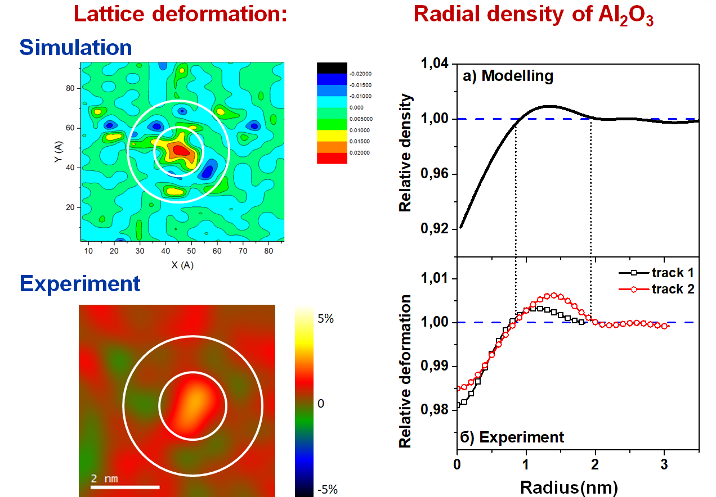
167 MeV Xenon ion induced tracks in Al₂O₃
J. H. O’Connell et al., Nucl. Instr. Meth.B 374 (2016) 97

Slide 7
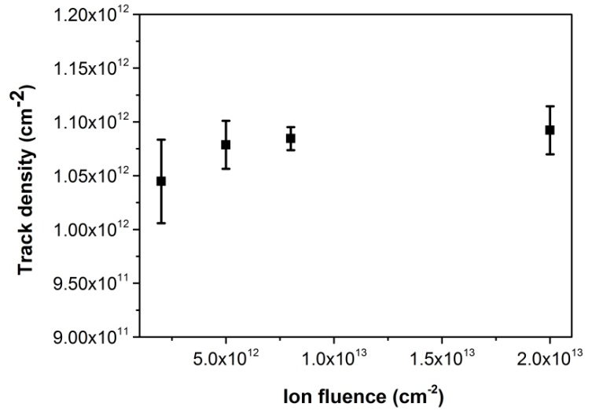
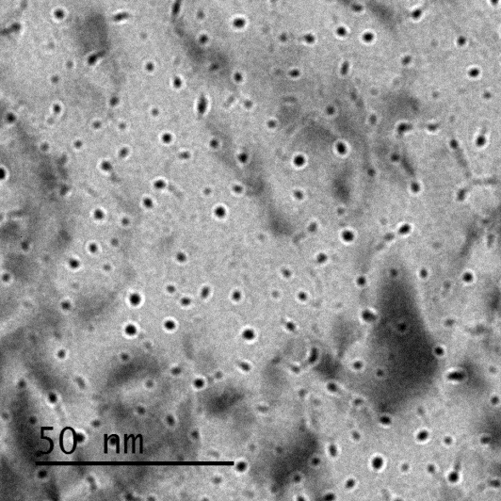
167 MeV Xenon ion induced tracks in Al₂O₃
  The number of ion tracks saturates at fluence of ~ 1.1 x 10¹² cm⁻²
J. H. O’Connell et al., Nucl. Instr. Meth.B 374 (2016) 97

Slide 8
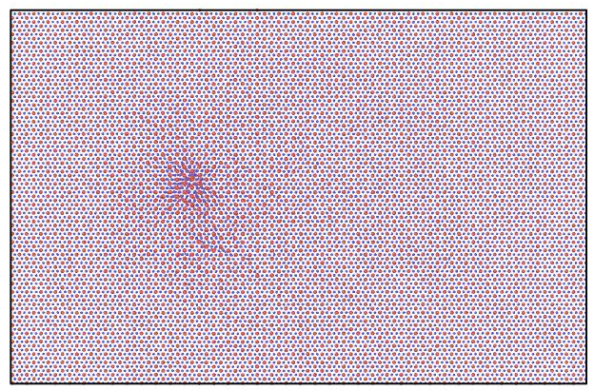
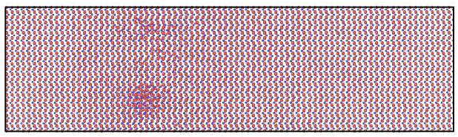
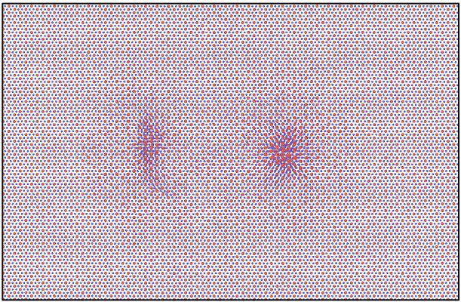
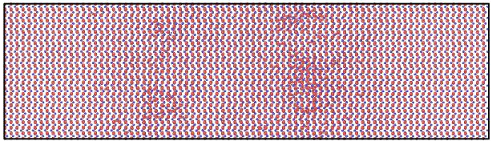
Overlapping SHI tracks
Xe 167 MeV
6.5 nm
Passage of a second ion causes annealing of defects created by the first one
Passage of the ion at longer distances from older tracks causes partial annealing of the defects
Effective radius of recovery is ~6.5 nm (experimental ~5.4 nm) and corresponds to track density of ~2.7×10¹² см⁻²
R.A. Rymzhanov et al.,
Nucl.Instr.Meth. B 435 (2018) 121

Slide 9
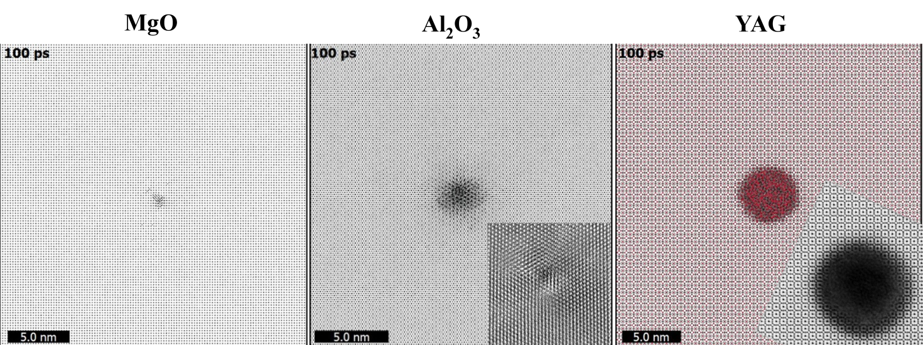
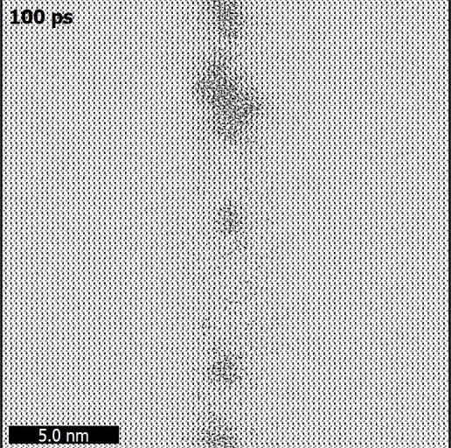
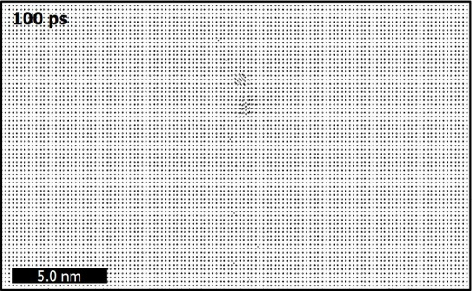
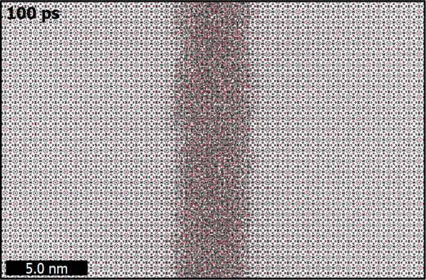
Recrystallization during track formation propcess
  TEM insets
MgO - only point defects were created around the ion trajectory
Al₂O₃ - crystalline discontinuous track with the diameter about 2 nm
YAG - continuous amorphous track of ~6.5 nm in diameter

Slide 10
Y₃Al₅O₁₂
39.7 keV/nm
23.0 keV/nm
17.0 keV/nm
11.5 keV/nm
Track size in YAG vs electronic stopping power

Slide 11
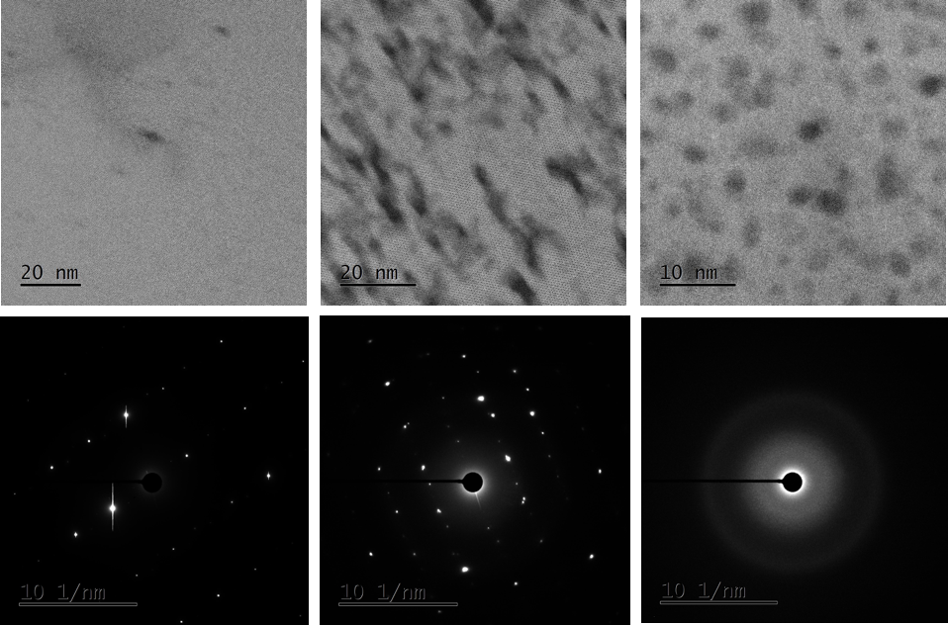
p-Si₃N₄ + Xe 220 МэВ
5x10¹¹ см⁻²
1x10¹³ см⁻²
2x10¹⁴ см⁻²

Slide 12
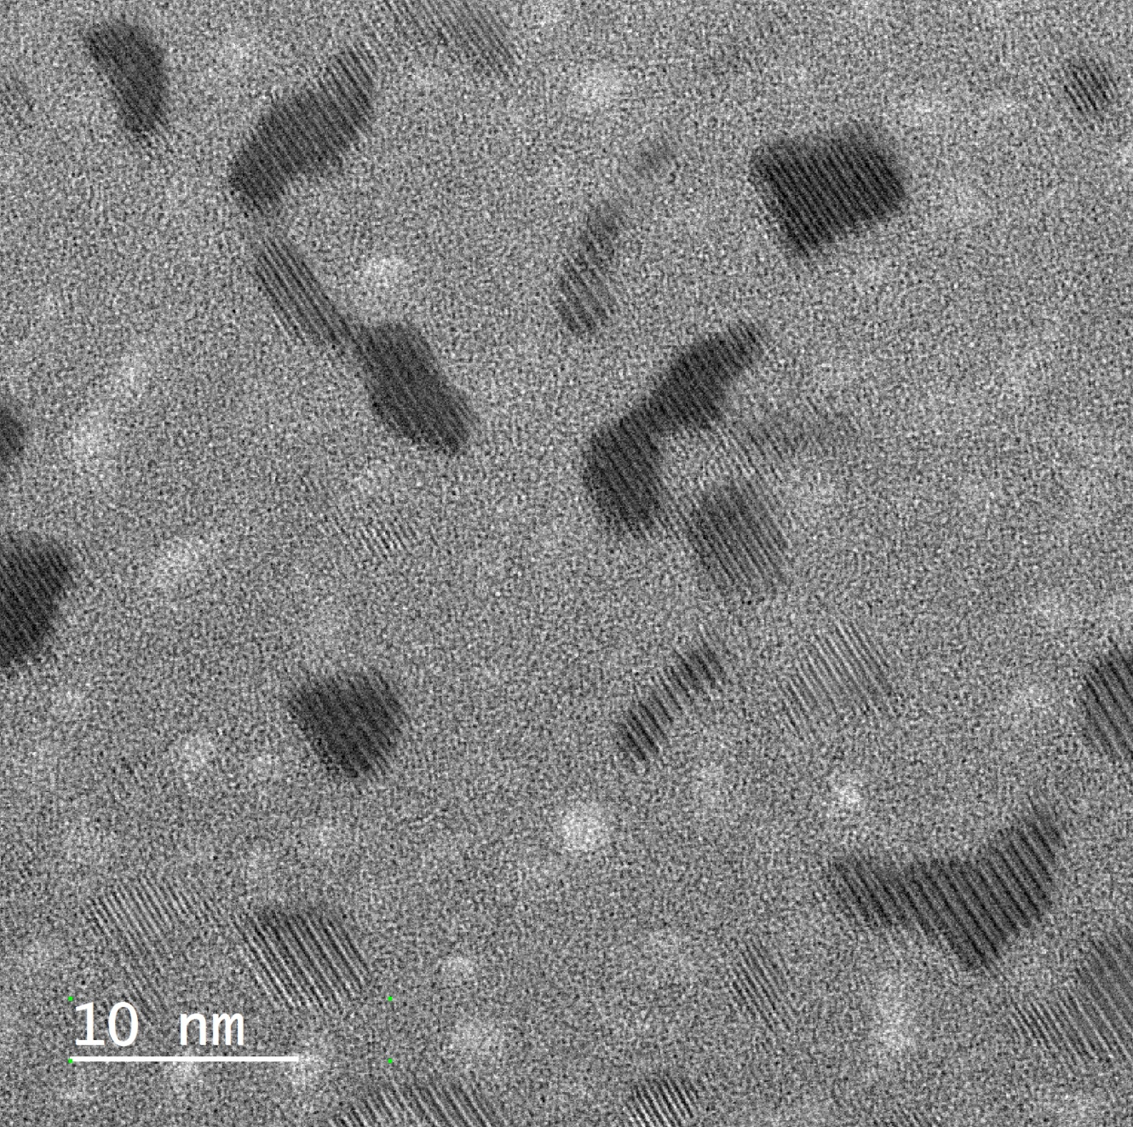
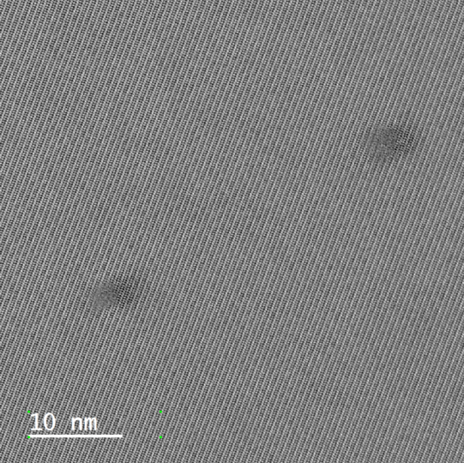
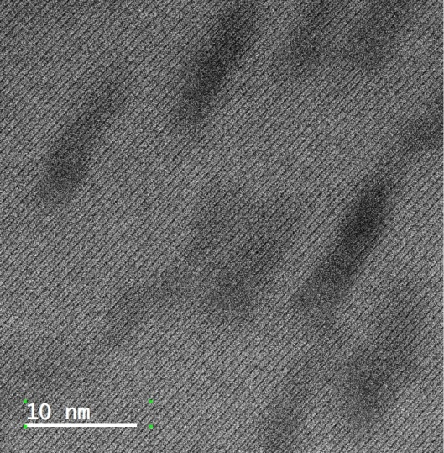
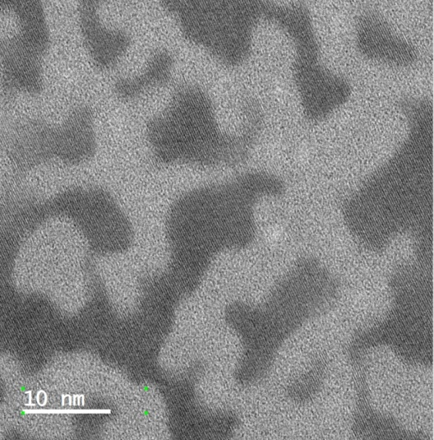
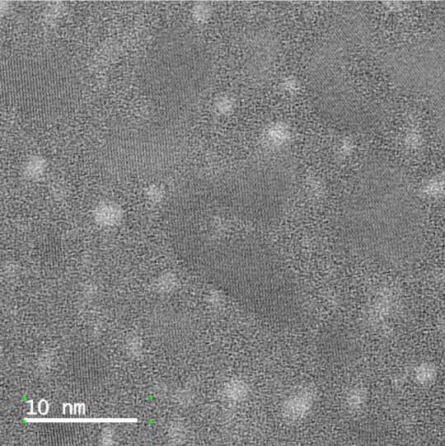
Si3N4 +Bi, 700 MeV
Amorphous tracks in crystalline matrix
Amorphous tracks in amorphous matrix
Ion fluence for latent track overlapping Ф_{overlap.} ×πR² = 1cm²
R=1.65 nm Ф_{overlap.} = 1.2×10¹³ cm²

Slide 13
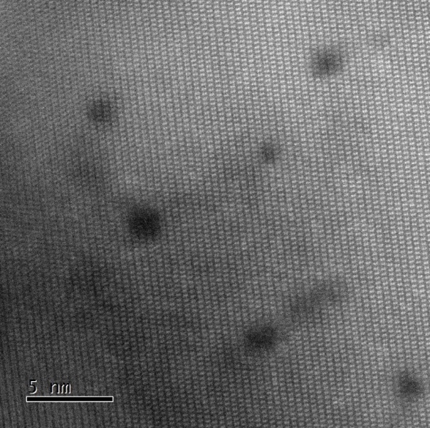
a-Si₃N₄ и n-Si₃N₄ + Bi 710 МэВ
a-Si₃N₄
n-Si₃N₄

Slide 14
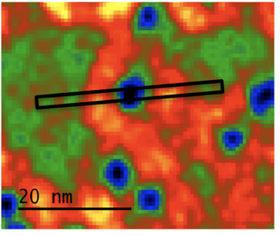
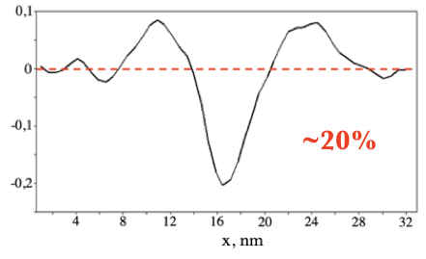
a-Si₃N₄ + Bi 710 МэВ, 5x10¹⁰ см⁻²
х, нм
Radial density of Si₃N₄

Slide 15
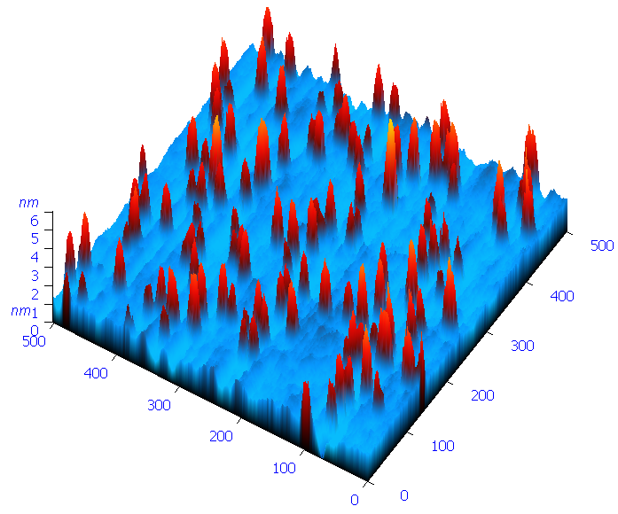
Surface effects of dense ionization in ceramics and oxides
3D AFM image of of MgAl₂O₄ surface irradiated with 710 MeV Bi ions.
Ion fluence 5x10¹⁰ cm⁻².

Slide 16
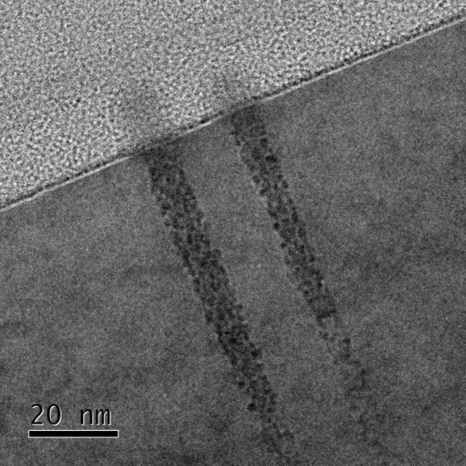
Surface effects of dense ionization in ceramics and oxides
167 MeV Xenon ion induced hillocks and latent tracks in TiO₂

Slide 17
Xe (167 MeV)+TiO₂

Slide 18
Surface effects of dense ionization in ceramics and oxides
Xe (220 MeV) + TiO₂: Hillock size vs irradiation temperature

Slide 19
Surface effects of dense ionization in ceramics and oxides
Al₂O₃
Y₃Al₅O₁₂
ZrO₂:Y

Slide 20
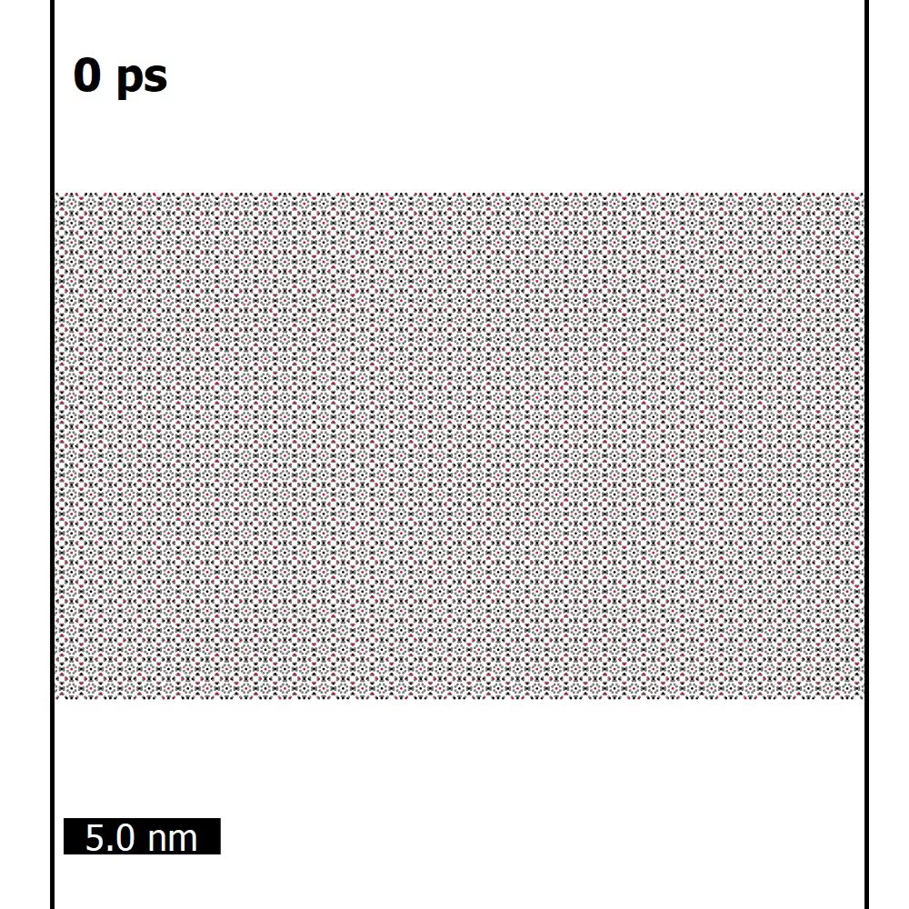
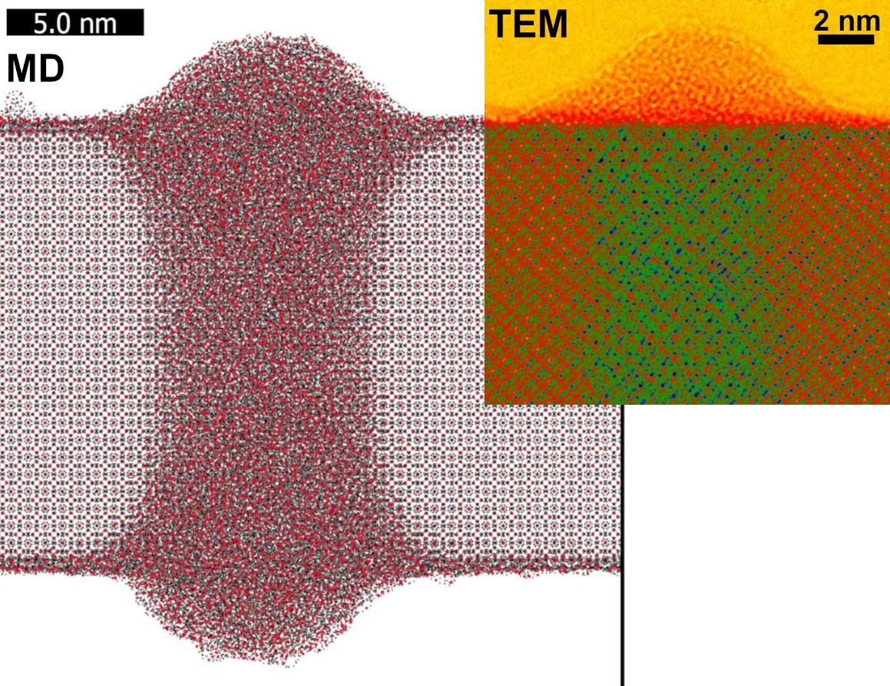
Amorphous hillocks in YAG
Bi 700 MeV ion
YAG demonstrates almost no damage recovery:
amorphous cylindrical track and amorphous hillock
R.A. Rymzhanov et al., J.App.Phys. 2020, 127(1) 015901

Slide 21
Summary
Latent track formation processes are governed by recrystallization of ion track region
Final defect structure of swift heavy ion irradiated ceramics is defined by interference of isolated latent track regions

Slide 22
Thank you for your attention!

