Slide 1
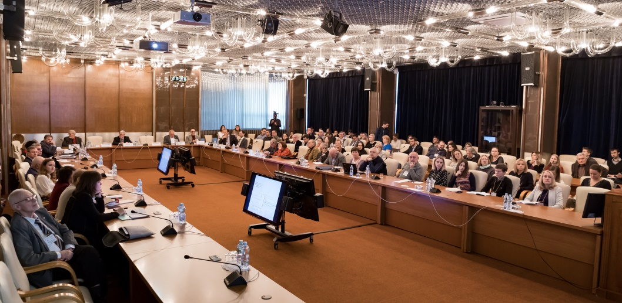
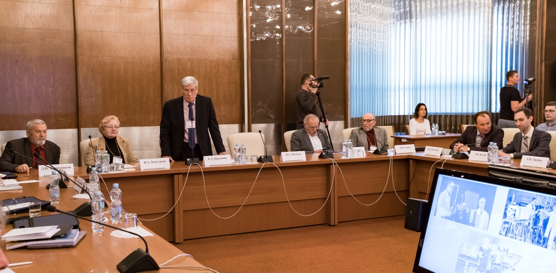
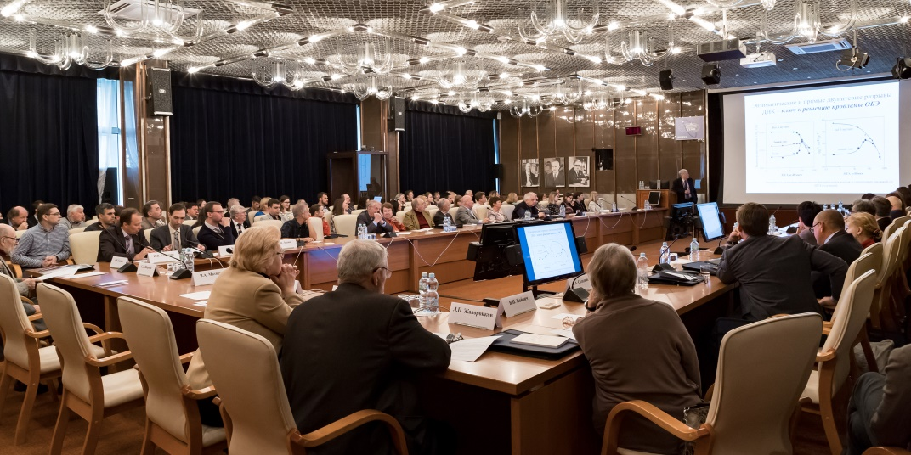

Slide 2
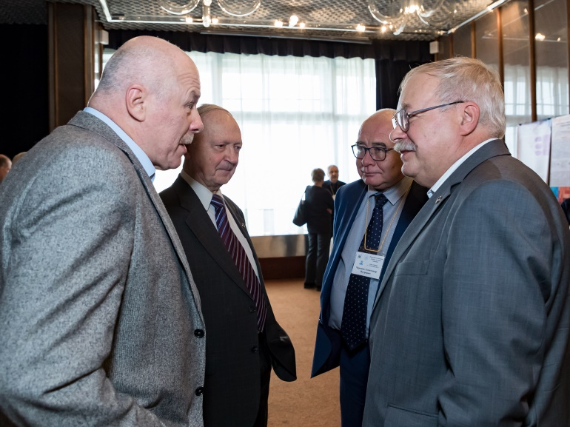
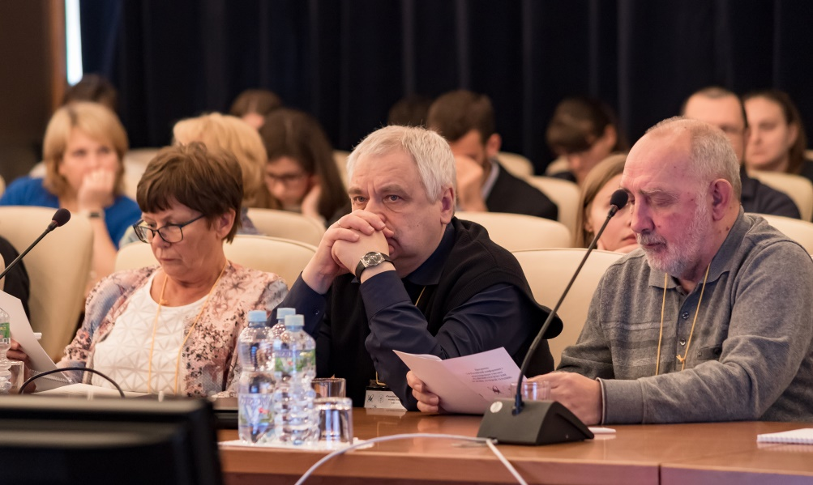
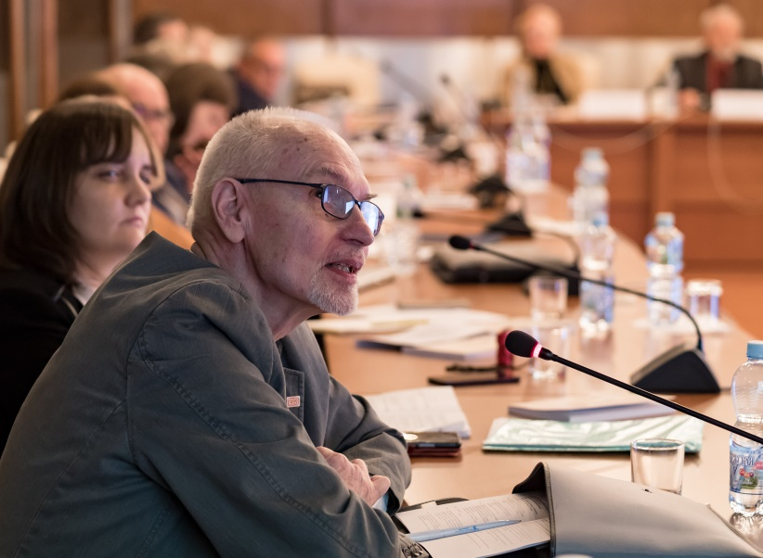
The main topics of the conference
Patterns of, and molecular and cellular mechanisms behind, the radiosensitivity of normal and tumor cells and tissues. Modern approaches to radiosensitivity control based on new fundamental knowledge.
Biological basis and clinical effects of new radiation therapy methods. Prediction and evaluation of radiation therapy efficiency.
Development and application of radiomodifiers in the radiation therapy of tumors. Radiopharmaceuticals in diagnosing and therapy.
Evaluation of the long-term consequences of radiation exposure.

Slide 3
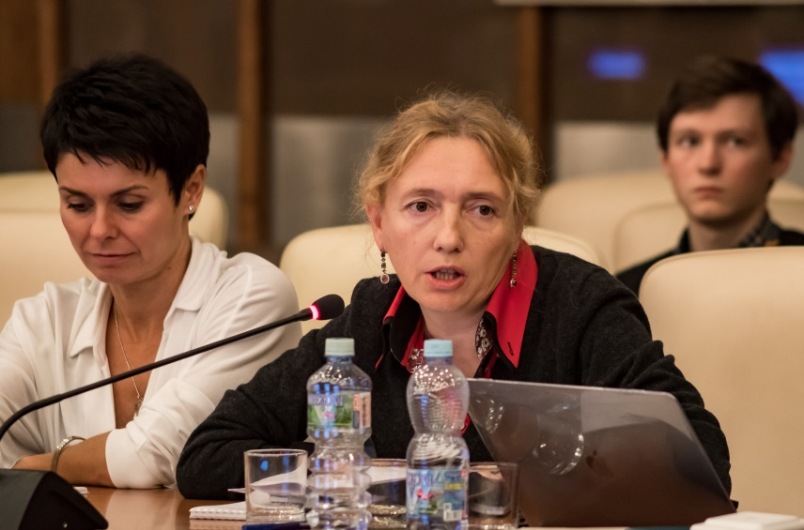
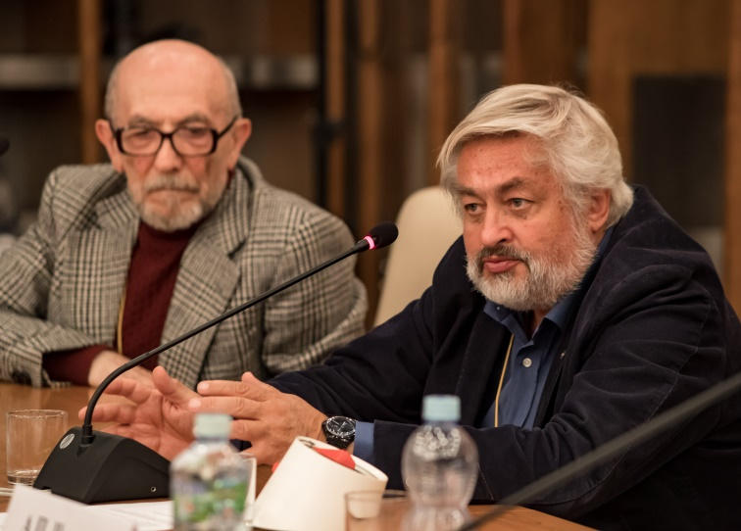
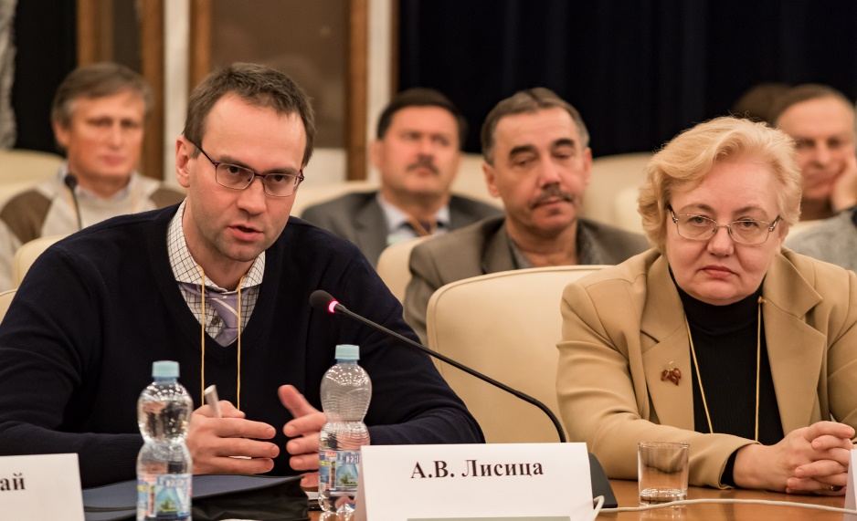
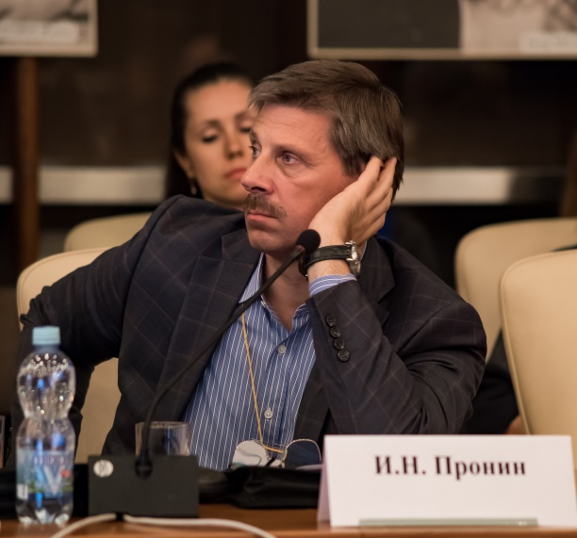
32 oral reports and 12 posters were presented at the conference sessions.
Of great interest to the conference participants was a round-table discussion of the psychoneurological disorders during the radiation therapy of cancer, which was attended by more than 50 scientists and medical practitioners and Acads. RAS I.N. Pronin and A.V. Lisitsa.
The main conclusion of the meeting:
it is necessary to establish logistics between all interested institutions.

Slide 4
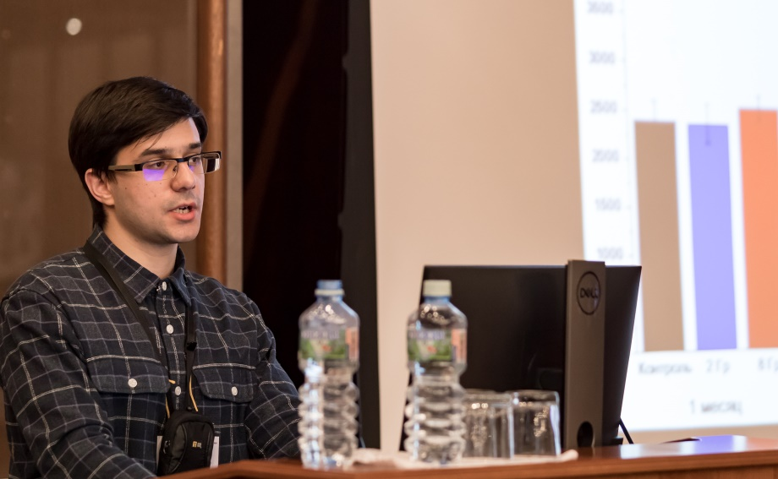
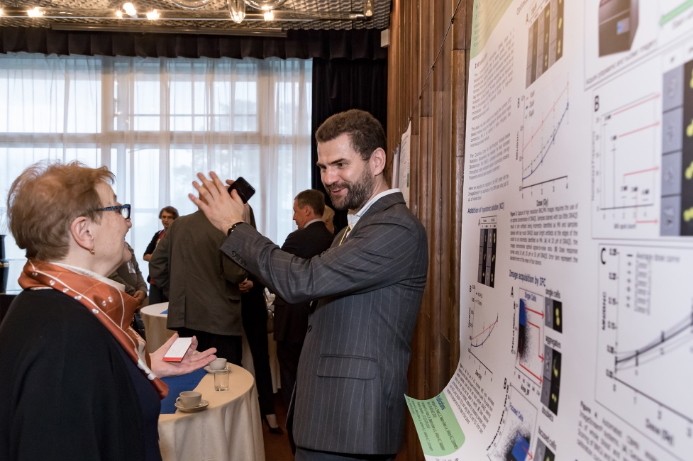
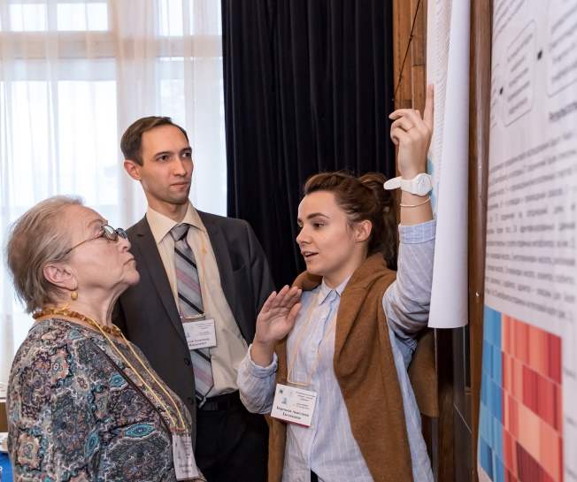
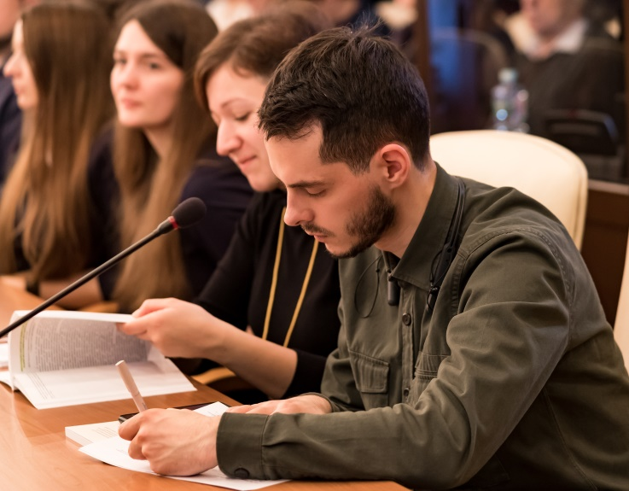
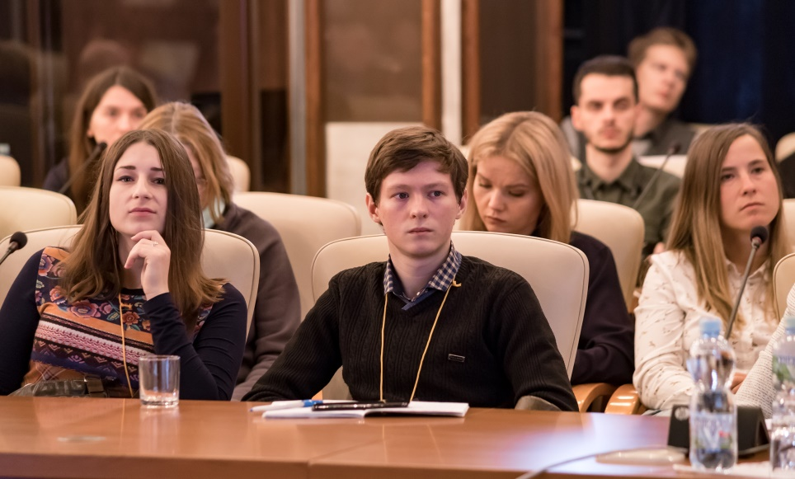
As part of the conference, a contest was held between young scientists where 17 oral and poster reports were considered.
All the contest participants got certificates and gifts; the winners were awarded laureate diplomas and prizes.

Slide 5
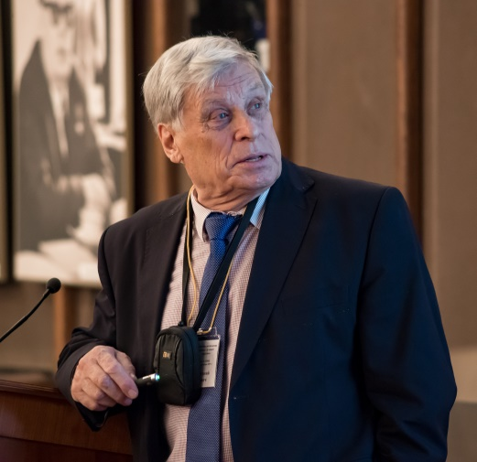
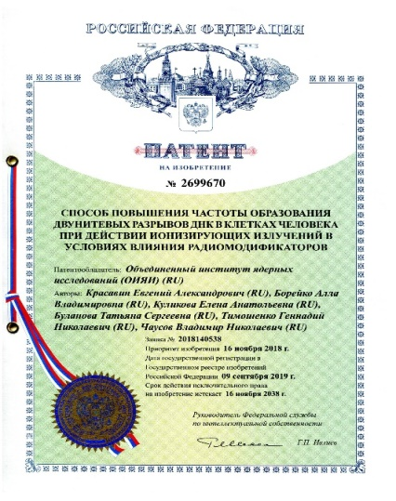
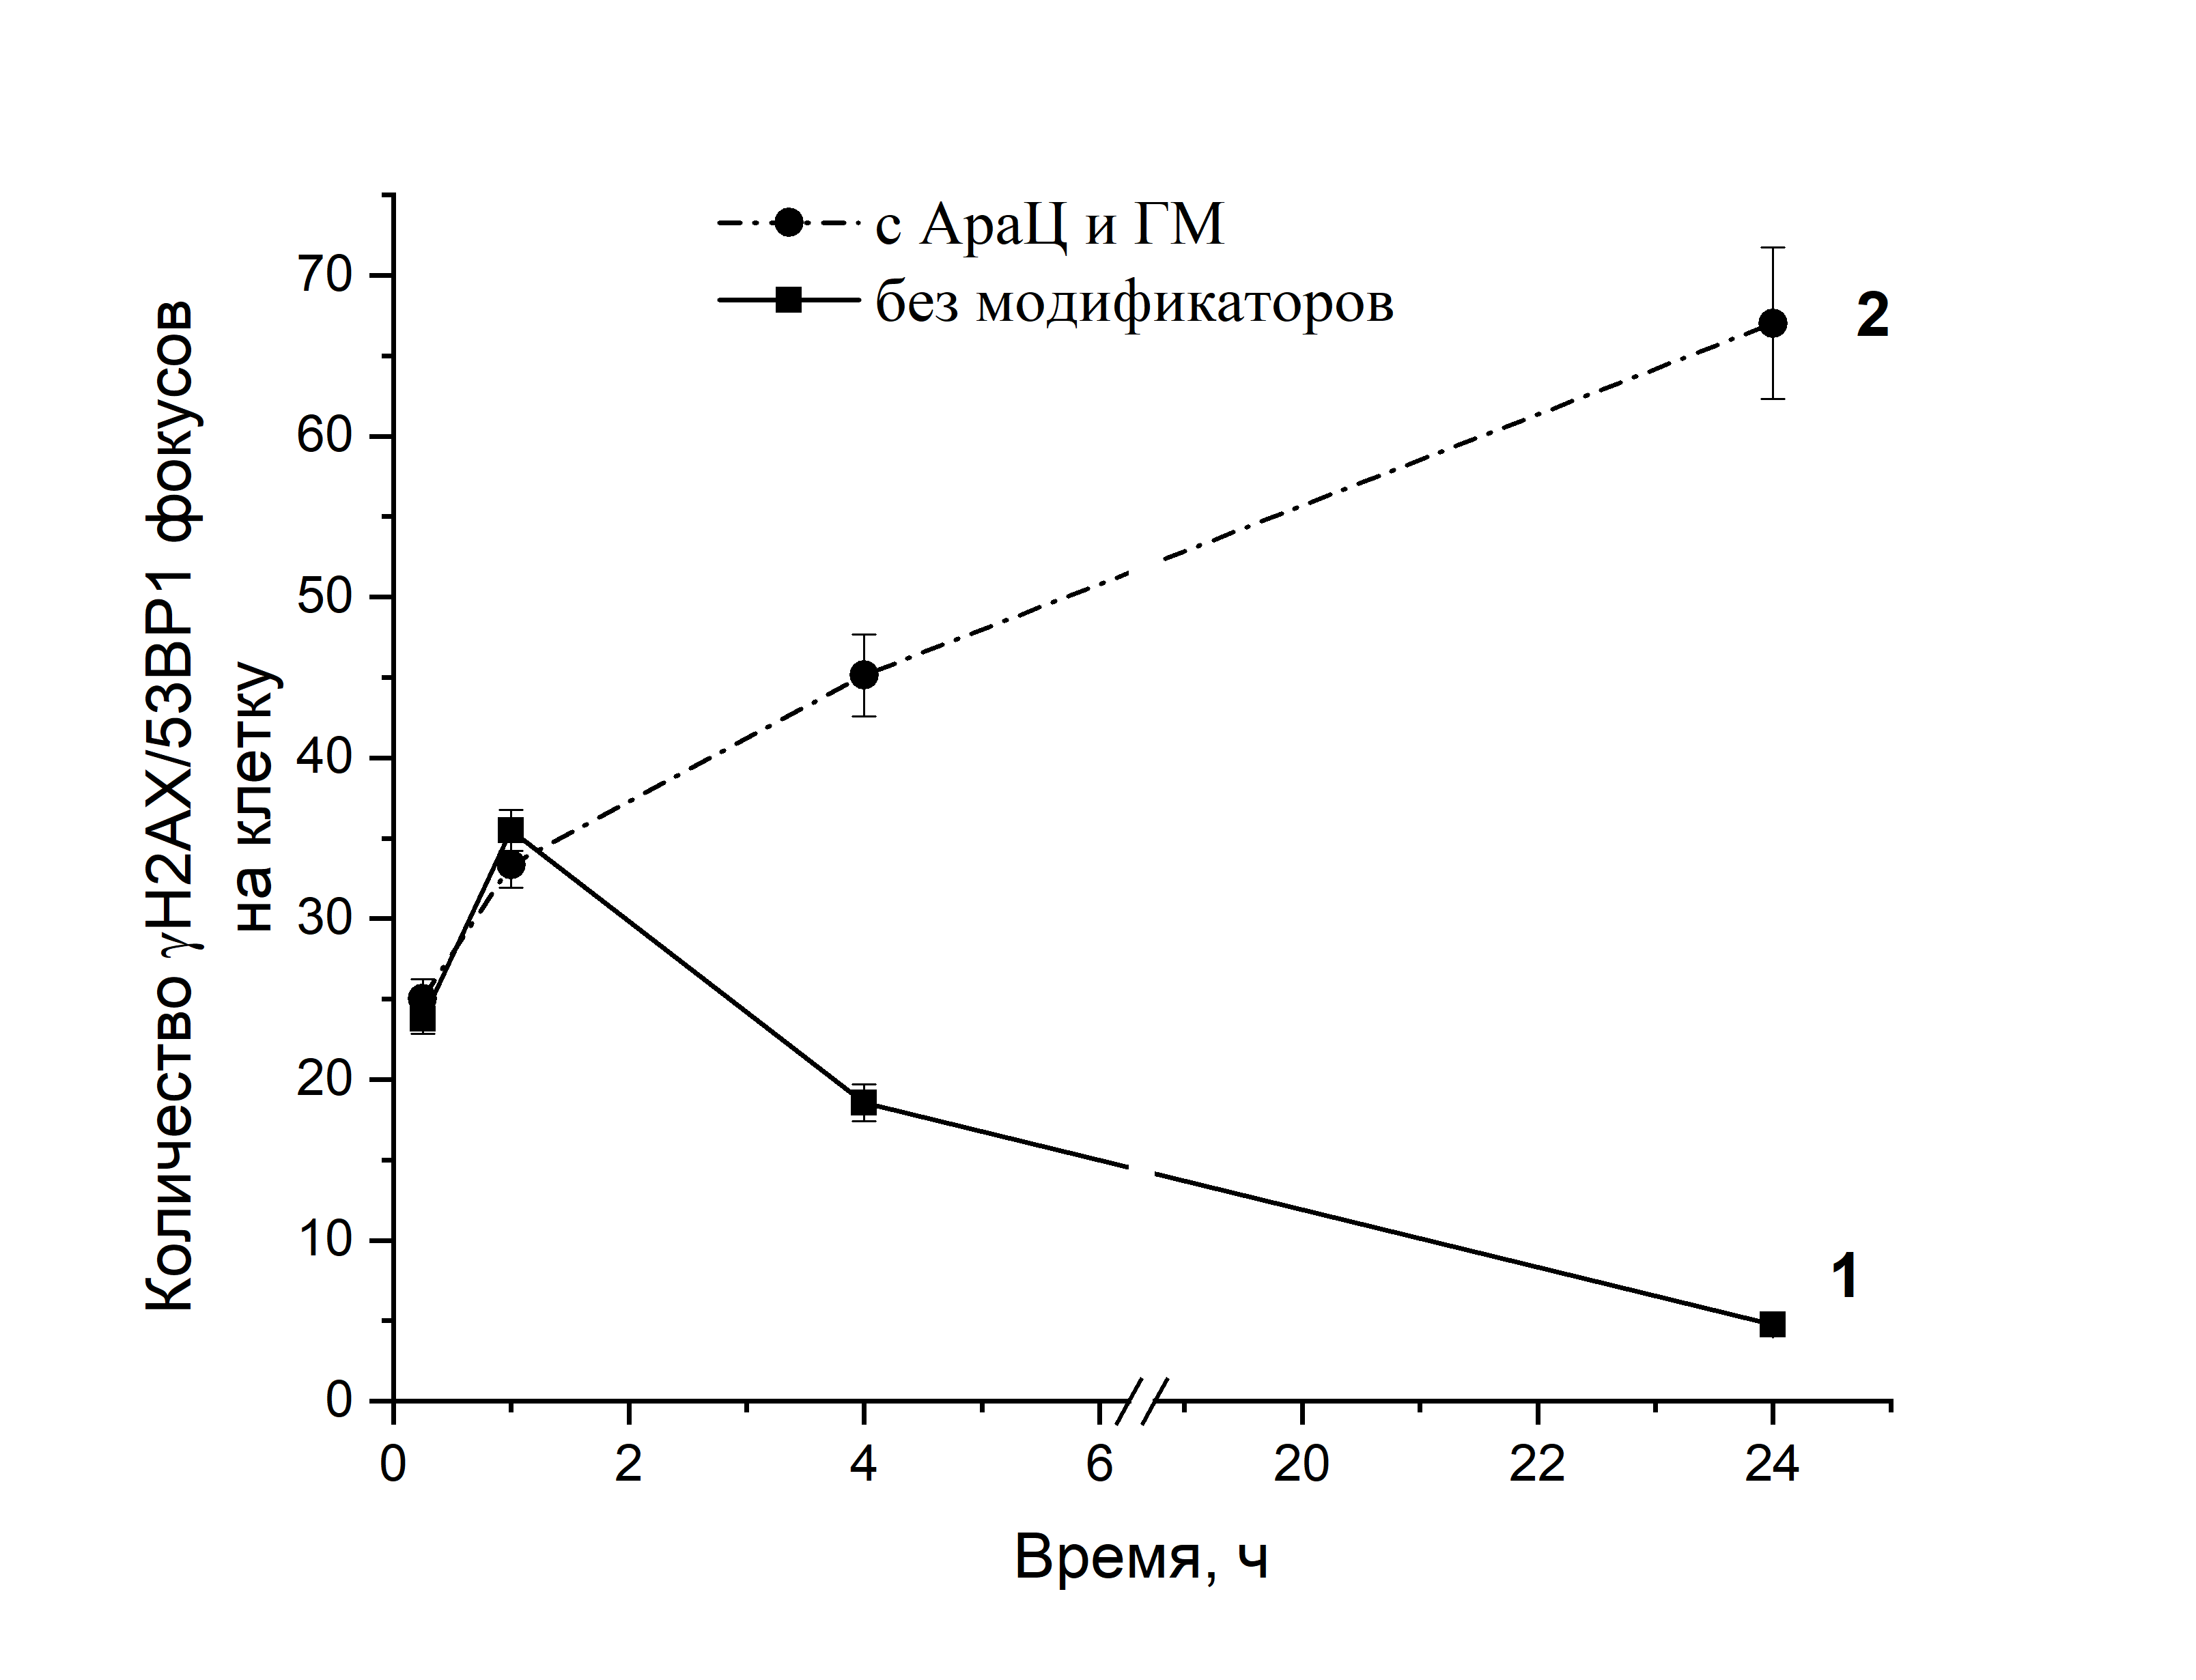
A NEW METHOD FOR INCREASING THE EFFECTIVENESS OF IONIZING RADIATION ON TUMOR TISSUE CELLS (E.A. Krasavin)
In vitro experiments have established that under the action of ionizing radiation on human cells in the presence of 1-β-D-arabinofuranosylcytosine (Ara-C) and hydroxyurea (HU) — officinal medications used in oncology practice — transformation of DNA single-strand breaks into lethal double-strand breaks occurs, which leads to a sharp increase in cell death.
The method largely increases the biological effectiveness of therapeutic proton beams and gamma-ray facilities and brings the areas of the therapeutic use of proton and carbon ion accelerators significantly closer to each other.
Patent №2699670 has been obtained for a new method of enhancing the radiation effect on living cells.

Slide 6
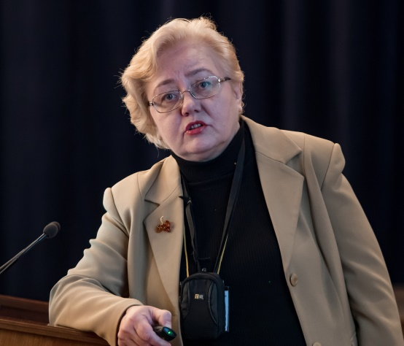
TUMOR STEM CELLS' RESPONSE TO A SINGLE AND FRACTIONATED IONIZING RADIATION EXPOSURE (I.A. Zamulaeva)
Cancer stem cell (CSC) response to fractionated low-LET ionizing radiation exposure has been studied in experimental and clinical conditions.
The results indicate the radioresistance of CSCs not only to single, but also fractionated irradiation, and point to the need to take into account the radiobiological properties of CSCs when searching for new antitumor agents and developing personalized medicine methods.
“a cancer stem cell … is a cell within a tumor that possess the capacity to self-renew and to cause the heterogeneous lineages of cancer cells that comprise the tumor”

Slide 7
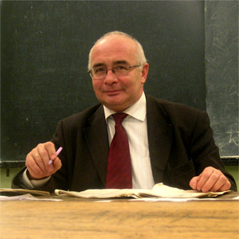
DEVELOPMENT OF MOSCOW UNIVERSITY'S MEDICAL PHYSICIST TRAINING AND RETRAINING CURRICULA (A.P. Chernyaev)
It is necessary to bring up to date the radiobiology courses and to prepare a modern radiobiology textbook. Due to the shortage of specialists in medical physics and engineers in the respective fields, such programs at higher education institutions of Russia must be expanded.

Slide 8
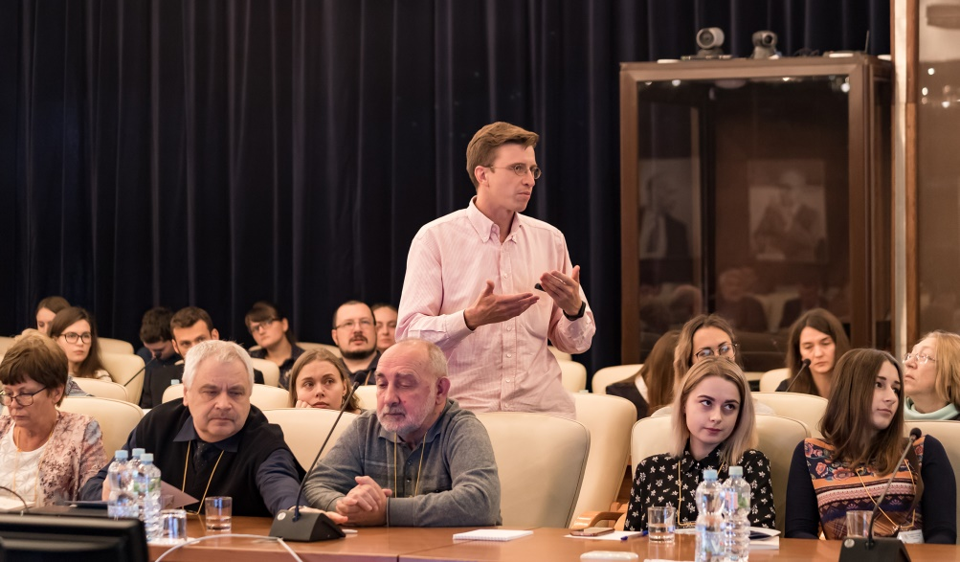
The following decisions have been taken based on the conference results:
Experimental radiobiological research must be developed in the following fields:
Studying the role of tumor stem cells and designing radiation therapy methods taking into account their resistance;
Enhancement of the cumulative effect of joint exposure to ionizing radiation and other physical and chemical factors;
Evaluation of the prospects offered by combining immunotherapy and radiation exposure of the tumor;
Application of radiomodifiers and stimulators of post-irradiation tissue regeneration. Special attention should be paid to the protection of the healthy tissues without decreasing the efficiency of radiation therapy.

Slide 9
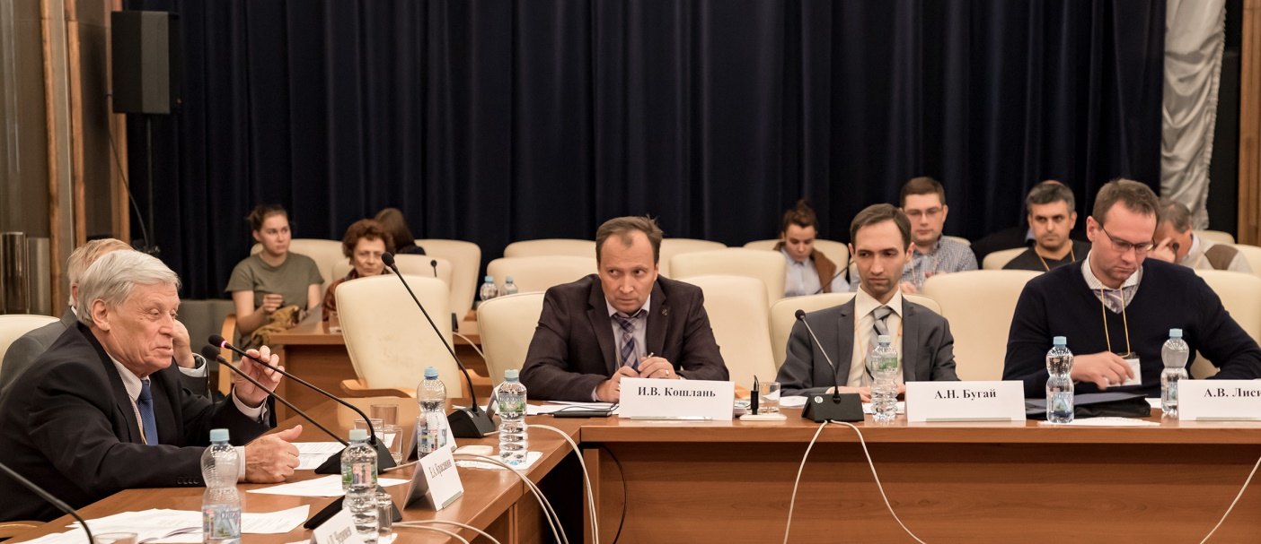
The following decisions have been taken based on the conference results:
It is necessary to develop hygienic regulations and methods of establishing the safe levels for the "new" types of patients' and personnel's radiation exposure — especially, for the repeating diagnostic procedures like computer tomography.
Due to the shortage of specialists in medical physics and engineers in the respective fields, such programs at higher education institutions of Russia must be expanded. It is necessary to bring up to date the radiobiology courses and to prepare a modern radiobiology textbook.
In connection with the need for training radiobiological and radiological staff, the annual conduction of A.S. Saenko International School for Young Scientists "Current Problems in Radiobiology" must be supported.
Based on the clear benefit of the joint events with the participation of radiobiological experimentalists and clinicians, the conferences "Radiobiological Basis of Radiation Therapy" should be regularly conducted every two years.

Slide 10
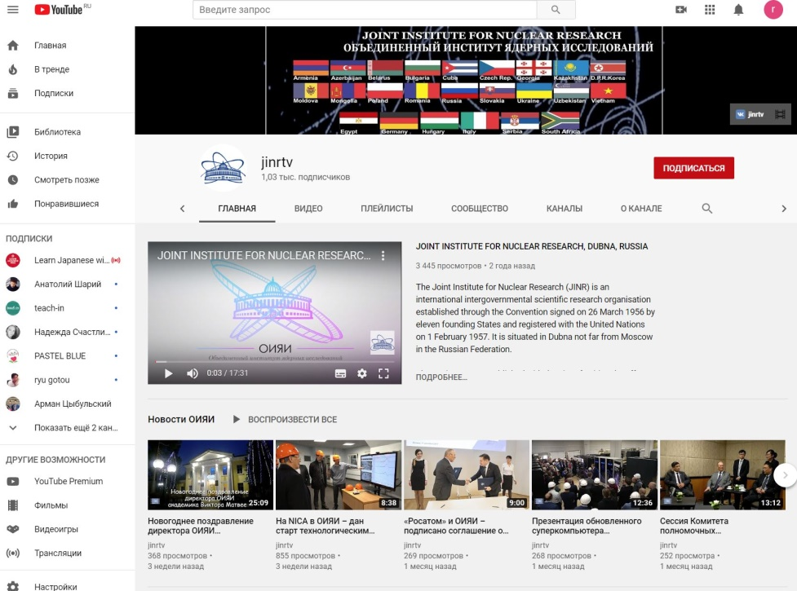
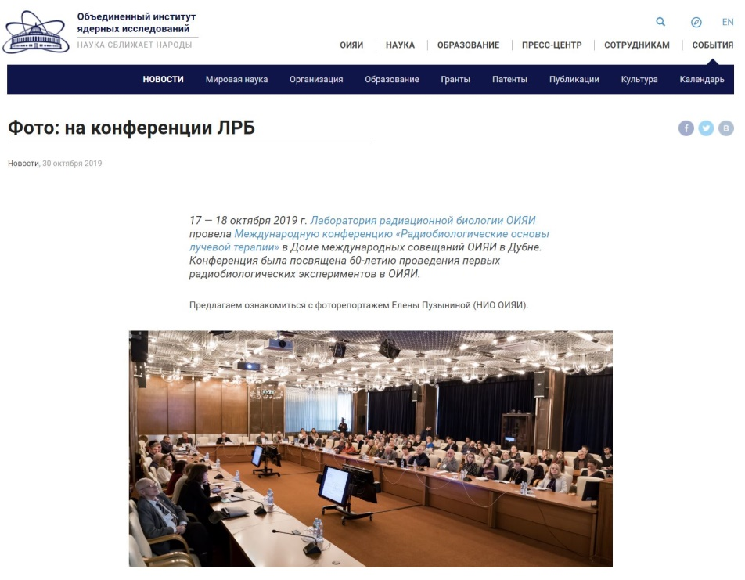
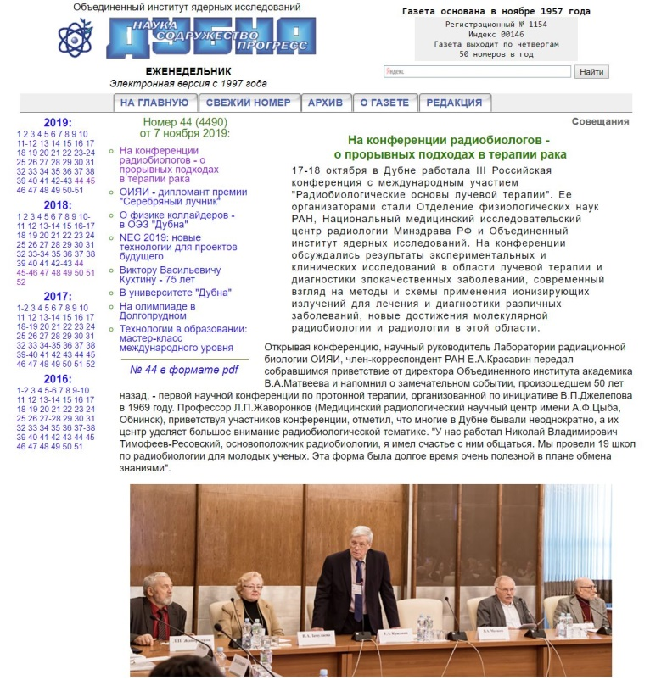
Conference Links
https://www.youtube.com/watch?v=QtBr282QAFU
http://www.jinr.ru/posts/na-konferentsii-radiobiologov-o-proryvnyh-podhodah-v-terapii-raka/
http://jinrmag.jinr.ru/2019/44/ra44.htm
http://jinrmag.jinr.ru/2019/45/ra45.htm

Slide 11
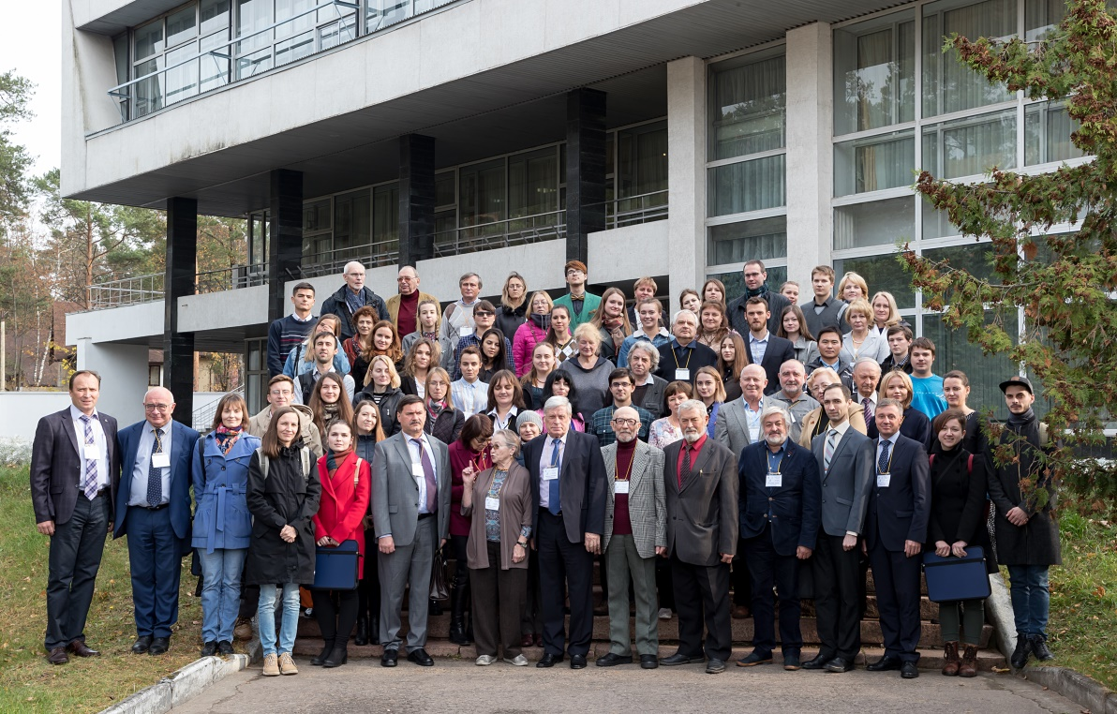
Thank you for attention!

