Slide 1
Fusion reactions in nuclear astrophysics
V. V. Sargsyan
(BLTP, JINR)
G. G. Adamian (BLTP, JINR)
N. V. Antonenko (BLTP, JINR)
H. Lenske (JLU, Giessen)

Slide 2
Key fusion reactions
In a hydrogen-rich environment the light elements such as Li, Be, and B have all positive (p, α) Q values. These nuclei are easily destroyed, before fusion reactions start to play a role.
The stable carbon isotopes ^{12,13}C are the first nuclei with sufficiently negative (p, α) Q values. This makes ¹²C + ¹²C the first fusion reaction that needs to be considered in nuclear astrophysics.
In non-explosive scenarios carbon fusion takes place in the center of massive stars toward the end of their lifetime during the carbon-burning phase at temperatures of about 0.6–1 GK.
In stellar explosions carbon fusion plays a role during the ignition phase of supernovae (1–10 GK).
Fusion reactions involving ¹⁶O, plays a role only at higher temperatures.
In explosive environments.

Slide 3
Key fusion reactions
The study of fusion of light heavy nuclei (C, O, Si…) at extreme sub- barrier energies (e.g. Gamow energies for C+C reaction is 1-3 MeV) is a key to understand and predict different scenarios of evolution of the stars.
Main problem:
Gamow energies are in a range where no reliable cross-section measurements can be made with present technologies.
Possible solution:
Extrapolation of the existing experimental data to lower energies starting with data at higher energies.
Theoretical calculations.

Slide 4
S-factor
More convenient representation of the fusion cross section at low energies
Gamow factor
--- Sommerfeld parameter
--- beam velocity
Some models predict, that the Gamow factor accounts for the main part of the strong energy dependence of the fusion cross section, such that the S-factor exhibits only a weak energy dependence far below the Coulomb barrier.
This feature is often used to extrapolate the cross section into the region of the Gamow window, in order to predict the astrophysical reaction rates.

Slide 5
S-factor for ¹⁶O+¹⁶O reaction
Existence of a maximum in S- factor ?
The maximum was observed in ⁶⁴Ni+⁶⁴Ni and ⁵⁸Ni+⁵⁸Ni reaction Jiang, PRC 93 2004
The structure of S - factor is critical for the extrapolation of data!

Slide 6
S-factor for ¹²C+¹²C reaction
More dramatic situation in ¹²C+¹²C reaction !
Resonant behavior at low energies does not allow to make a clear conclusion about the maximum.

Slide 7
The capture cross section
For the light and medium-heavy nuclei the fusion is governed by the penetrability of the nuclei through the Coulomb and orbital angular momentum barriers (the so called capture).
The capture cross-section is a sum of partial capture cross-sections
Тhe partial capture probability at fixed energy and angular momentum
Different approaches and models offer different methods of calculation of capture probability

Slide 8
The assumptions of the QD approach
The quantum diffusion approach based on the following assumptions:
The capture (fusion) can be treated on the one collective variable: the relative distance between the colliding nuclei: R.
Collective coordinate is coupled to the internal excitations.
The internal excitations (for example, low-lying collective modes such as dynamical quadropole and octupole excitations of the target and projectile, single particle excitations etc. ) can be presented as an environment.

Slide 9
The formalism of QD approach
The full Hamiltonian of the system:
The collective subsystem
(inverted harmonic oscillator)
The internal subsystem
Coupling between the subsystems
(linear coupling)

Slide 10
Approximation: realistic nucleus-nucleus potential → inverted oscillator
The real interaction between nuclei can be approximated by the inverted oscillator.
The frequency of oscillator is found from the condition of equality of classical action

Slide 11
The analytical expressions for the first and second moments
Functions determine the dynamic of the first and second moments
--- are the roots of the following
equation

Slide 12
The capture probability in quantum diffusion approach
Capture probability depends on the ratio of mean value and the variance of the collective coordinate:
The coupling to internal excitations leads to fluctuation of collective coordinate.
Equations for the mean value and variance contain friction and diffusion.
The friction and diffusion are obtained in a self-consistent way.
Our approach takes into account the fluctuation and dissipation effects in the collisions of heavy ions which model the coupling with various channels.

Slide 13
The capture probability
Constant friction coefficient was used.
The frequency of the approximated oscillator.
The internal excitation width ---  is responsible for non-Markovian effects.
The QD approach was successfully applied to describe the heavy ion fusion reactions at near- and below the Coulomb barrier energies.

Slide 14
Nucleus-nucleus interaction potential:
The calculated potentials respect to their barriers for the indicated reactions
The large Coulomb repulsion in case of the ¹⁶O+²⁰⁸Pb reaction leads to steep fall off of the potential, compared to those in case of ¹⁶O+¹⁶O reaction.
The same energy below the Coulomb barrier, two colliding nuclei approach to closer distance in case of the heavier system.

Slide 15
External turning point
The dependence of the external turning point on energy is completely different for reactions with light and heavy nuclei!
The R_{ext} indicates the extent of the overlap of nuclear density profiles, which responsible for the nuclear friction.
At the same energy below the barrier, the external turning point is located much closer to the position of the corresponding Coulomb barrier in case of heavy system.
One need to include in model the dependence of friction on coordinate!

Slide 16
To consider reactions with light heavy nuclei one need to extend the model!!
Include the energy dependence of friction, (dependence of the friction on the external turning point).
At each energy, to find an effective “frequency”, which replace the real potential with an inverted oscillator in a proper way.

Slide 17
The friction is proportional to the square of the nuclear force:
Gross, Phys. Rep. (1978)
Weidenmuller, Prog. Part. Nucl. Phys. (1978)
This form of friction takes into account the comparatively larger overlap of the nuclear surfaces is case of two heavier nuclei.
Determination of the “frequency” of the replaced oscillator:
The same height and the position of the barrier of the real potential with the height and the position of inverted oscillator.
The condition of equality of the energy under the barrier:
Determination of the excitation width:
Markovian limit

Slide 18
Probability at extreme sub-barrier energies
At low energies (weak friction limit) one obtains simple expression for the capture probability !
--- Coulomb energy at R=R_{b}
For very light nuclei the formulas are applicable already at energies 1-2 MeV below the barrier.
The formulas could be used to obtain analytical expression for the S- factor position and reaction rates.

Slide 19
Results of calculations
The main trend of new experimental data is reproduced.
We clearly identify a maximum in S- factor.

Slide 20
Results of calculations
The calculation is in good agreement with the experimental data
The lowest data are very close to the position of the maximum of S factor

Slide 21
Results of calculations

Slide 22
Results of calculations

Slide 23
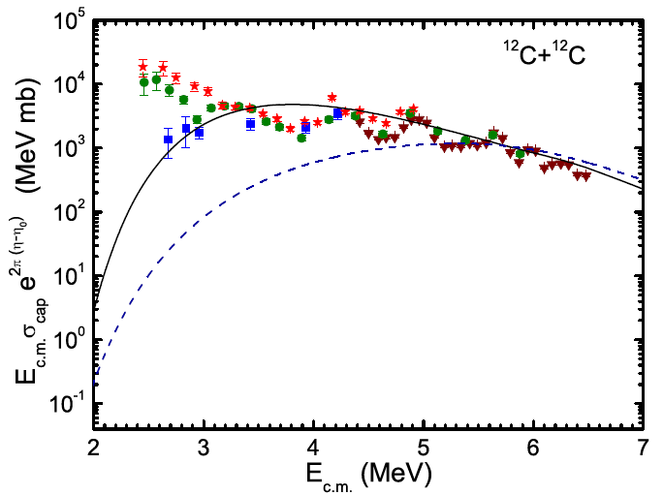
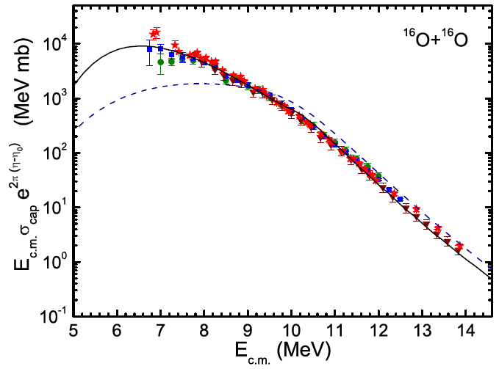
Comparison with the WKB model
The fluctuation and dissipation effects taken into account in our model (solid line) increase fusion probability at sub-barrier energies and decrease at above barrier energies compared to WKB model (dashed line).

Slide 24
Reactions with heavier (medium mass) nuclei

Slide 27
Summary
In collisions of light nuclei at low sub-barrier energies, the external turning point is located far from the Coulomb barrier position. This means weak overlap of nuclear surfaces and, correspondingly, small friction.
We extended our QD approach and considered the friction depending on the bombarding energy. Using the extended approach, we compared the calculated capture cross-sections with the available experimental data. In all cases we obtained a good description of the experiments.
Comparing the fusion excitation functions calculated within the quantum diffusion and WKB approaches, we found that the fluctuation and dissipation increase fusion cross section at sub-barrier energies.
The maximum in S-factor is predicted. However, more experimental data at low energies is needed to confirm our predictions.
In the limit of weak friction, which corresponds to extreme sub-barrier energies, the analytic expression for the capture probability is obtained. This simple expression can be applied to the reactions of astrophysical interest.
The strong decline of fusion cross sections at sub-barrier energies considerably reduces the stellar burning rates and, moreover, leads to severe experimental problems, inhibiting the measurements in many cases.

Slide 28
Thank you!

Slide 29
Nucleus-nucleus interaction potential:
Double-folding formalism used for nuclear part:
Nucleus-nucleus potential:
density - dependent effective nucleon-nucleon interaction
Woods-Saxon parameterization for nucleus density
Adamian et al., Int. J. Mod. Phys E 5, 191 (1996).

Slide 30
Coordinate dependent friction
The friction is proportional to the square of the nuclear force:
Gross, Phys. Rep. (1978)
Weidenmuller, Prog. Part. Nucl. Phys. (1978)
the variation of ₀ 2 times leads to the change of the results of the calculations less then 5% !
This form of friction takes into account the comparatively larger overlap of the nuclear surfaces is case of two heavier nuclei.
The friction decreases more rapidly than the corresponding nuclear potential.

Slide 31
Propagator for the inverted oscillator
For the inverted oscillator the propagator has the form:
--- the mean value of the collective coordinate and momentum
--- the variances and
Dadonov, Man’ko, Tr. Fiz. Inst. Akad. Nauk SSSR 167, 7 (1986).
The expression for the capture probability

