Slide 1
Implementation of the recommendations of the 50-th meeting of the
Programme Advisory Committee for Nuclear Physics
Marek Lewitowicz

Slide 2
Programme Advisory Committee for Nuclear Physics
50th meeting, 24–25 June 2019
1. Opening of the meeting M. Lewitowicz
2. Implementation of the recommendations of the previous PAC meeting M. Lewitowicz
3. Information on the Resolution of the 125th session of the JINR Scientific Council (February 2019) and on the decisions M. Itkis
of the JINR Committee of Plenipotentiaries (March 2019)
4. Report on the theme “Information and Computing Infrastructure of JINR” and proposal for its extension Т. Strizh
5. First results of the experiments with the ACCULINNA-2 fragment separator A. Fomichev
6. Proposal for the opening of a new project "Construction of a prototype of the initial section of a high-current L. Grigorenko
heavy-ion linear accelerator aimed at producing intense radioactive ion beams for basic research"
7. Report on the theme “Investigations of Neutron Nuclear Interactions and Properties of the Neutron” and its project.
7.1 Project TANGRA Yu. Kopatch
7.2 Report on the theme "Investigations of Neutron Nuclear Interactions and Properties of the Neutron" E. Lychagin
7.3 Letter of intent to open a new project: "Construction of a prototype of the set-up for measurement of the V. Kuznetsov
neutron lifetime using the time-of-flight method“
7.4 Letter of intent to open a new project: "Construction of a prototype of the polarized nuclear target“ V. Novitsky
8. Poster presentations by young scientists
9. Closed discussion of the poster presentations
10. Information about the proposal for the opening of a new theme "Development of the Conceptual Design V. Shvetsov
of a New Advanced Neutron Source at JINR"
11. Progress report on the E&T&RM project and proposal for its extension A. Baldin
12. General discussion

Slide 3
Programme Advisory Committee for Nuclear Physics
50th meeting, 24–25 June 2019
14. Meeting of the PAC members with the JINR Directorate (closed discussion)
15. Report on the project "GDH & SPASCHARM & NN: Study of the nucleon spin structure in strong and Yu. Uzikov
electromagnetic interactions" and proposal for its extension
16. Scientific report "Transverse momentum distributions of hadrons in the Tsallis nonextensive statistics“ A. Parvan
17. Proposals for the agenda of the next PAC meeting
18. Preparation of the PAC recommendations
19. PAC recommendations
20. Closing of the meeting
21. Visit to the Laboratory of Information Technologies T. Strizh

Slide 4
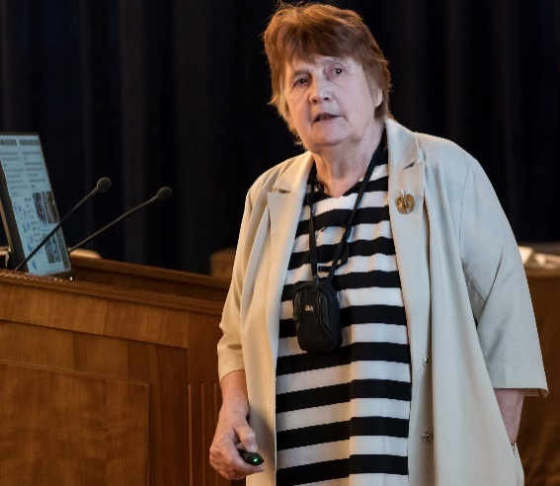
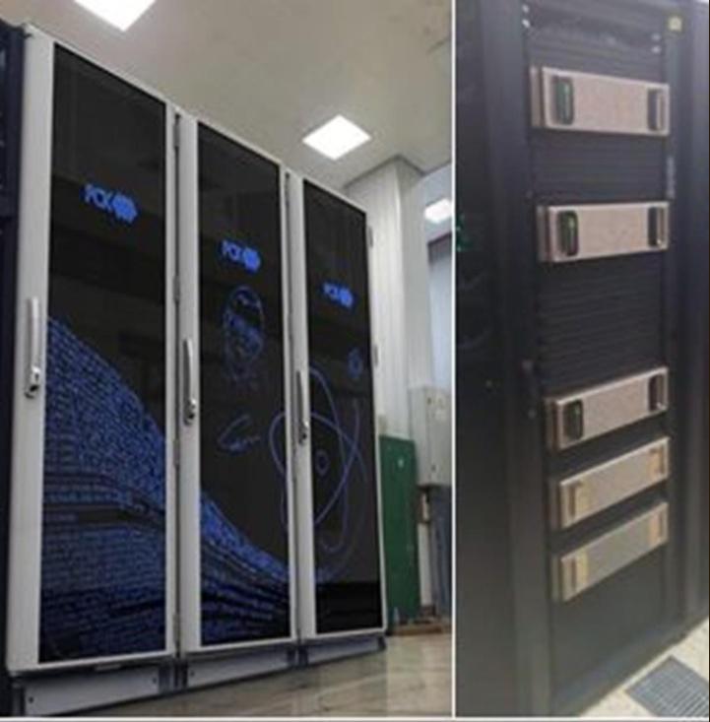


Report on the theme “Information and Computing Infrastructure of JINR”
and proposal for its extension
Main goals:
to ensure the further development of the network, information and computing infrastructure of JINR for the research and production activities of the Institute and its Member States on the basis of state-of-the-art information technologies.
Main activities:
Multifunctional Information and Computing Complex (MICC);
Information and software support of scientific and production activities at JINR;
Development of the system of training and advanced training of IT professionals based on the educational and research infrastructure.
Tatyana Strizh
The PAC appreciates LIT’s efforts to achieve the following objectives: development and upgrade of the JINR telecommunication and network infrastructure; modernization of the MICC engineering infrastructure, increase in performance of computing resources and data storage systems.
The PAC recommends extension of the theme “Information and Computing Infrastructure of JINR” and the MICC project for the period 2020–2023 with first priority.

Slide 5
The Scientific Council supports the development of JINR information systems aimed at providing information and software support for the JINR research and management activities within the theme “Information and Computing Infrastructure of JINR”.
The Scientific Council appreciates LIT’s efforts to achieve development and upgrade of the JINR telecommunication and network infrastructure; modernization of the MICC engineering infrastructure, increase in performance of computing resources and data storage systems.
The Scientific Council supports the recommendations of the PAC for Nuclear Physics and of the PAC for Condensed Matter Physics to extend the theme “Information and Computing Infrastructure of JINR” and the MICC project for 2020–2023, with first priority.

Slide 6
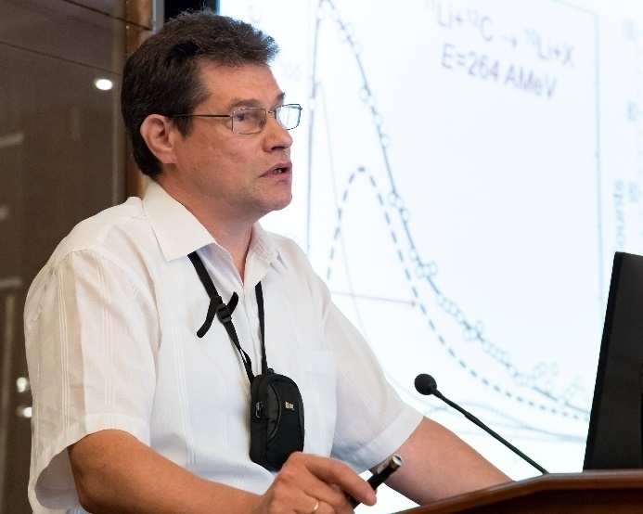
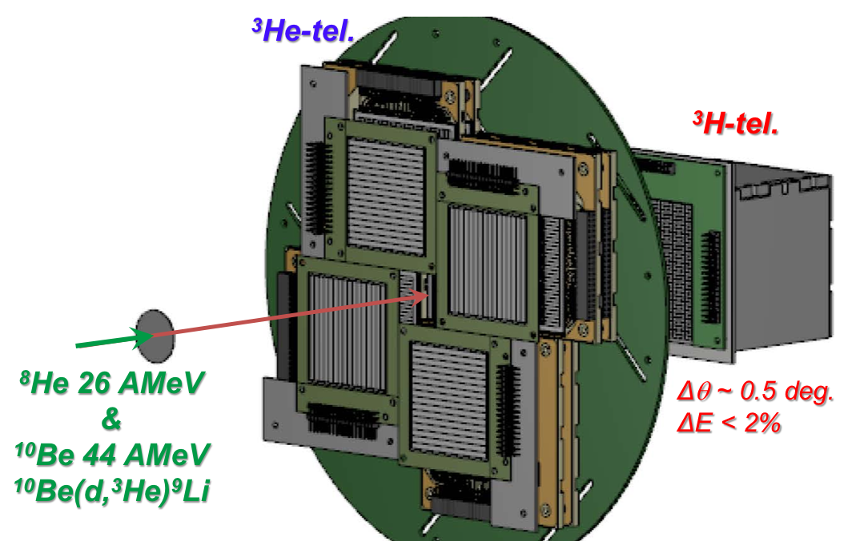
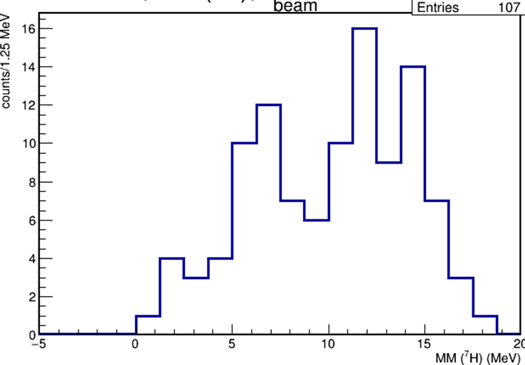
First results of experiments with the ACCULINNA-2 fragment-separator
⁸He(d,³He)⁷H - scheme of the 1-st flagship experiments
November 2018: 10 days, two ³He-telescopes installed at 17 deg.
April 2019: 12 days, four ³He-telescopes installed at 15 deg.
Andrey Fomichev
⁸He(d,³He)⁷H – preliminary results, energy distributions (Nov. 2018)
⁷H
Indications for the ⁷H g.s. at 2.0(5) MeV and for the excited state at E_{T} ~ 6.5(5) MeV with Г ~ 2.0(5) MeV were obtained. The data with more statistics (April 2019) are currently under analysis.

Slide 7
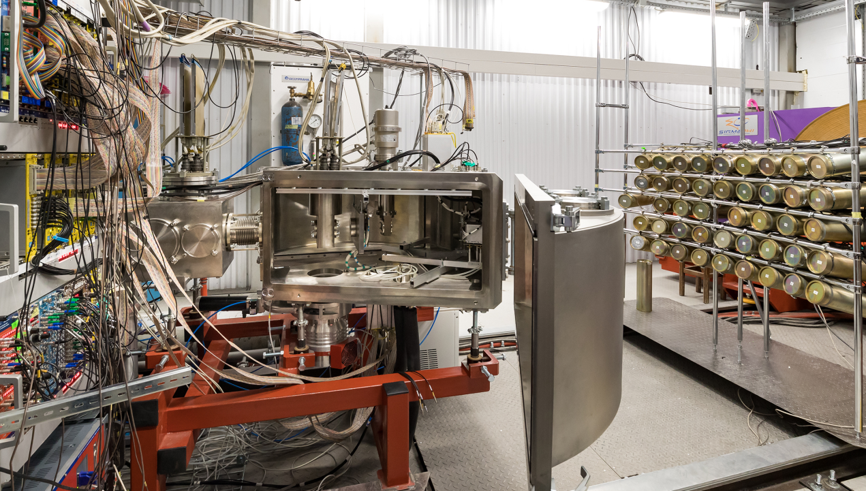
First results of experiments with the ACCULINNA-2 fragment-separator
⁹Li(d,p)¹⁰Li → n+⁹Li /the 2-d flagship experiment, March 2019
The combined mass method (p-⁹Li-n coincidences) is very promising for ¹⁰Li study and could be applied for other isotopes (^{7,9}He, ^{10,11,12}Li etc.).
Higher statistics and better quality for neutron detection will help to study the ¹⁰Li low energy spectrum in more detail. These measurements are scheduled in fall 2020.
The PAC congratulates the ACCULLINA-2 group on the successful start with two convincing ⁷H and ¹⁰Li dedicated runs.
Since the time schedules and the requested resources remain reasonable, the PAC recommends that the Directorate fully support the ACCULLINA-2 project to continue the scientific programme that appears to be promising.
The PAC requests a more detailed presentation on the next experimental investigations (increased efficiency, longer runs, etc.) to be submitted at future meetings.

Slide 8
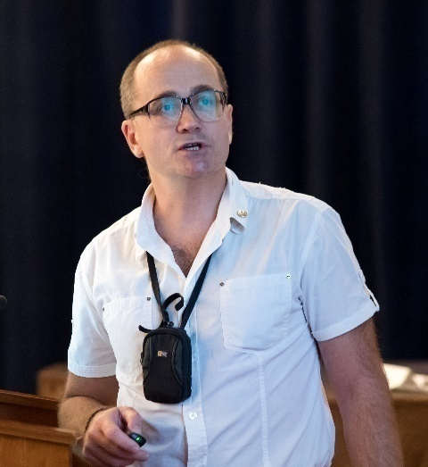
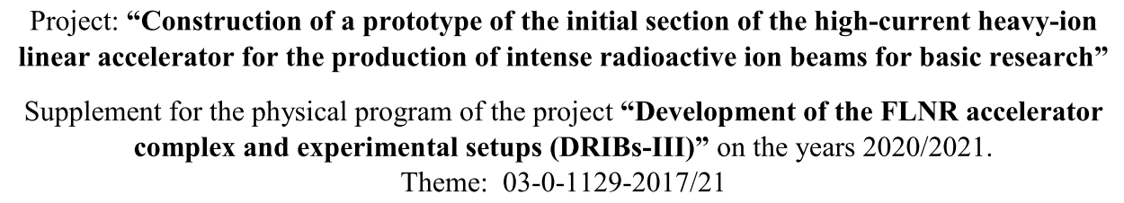
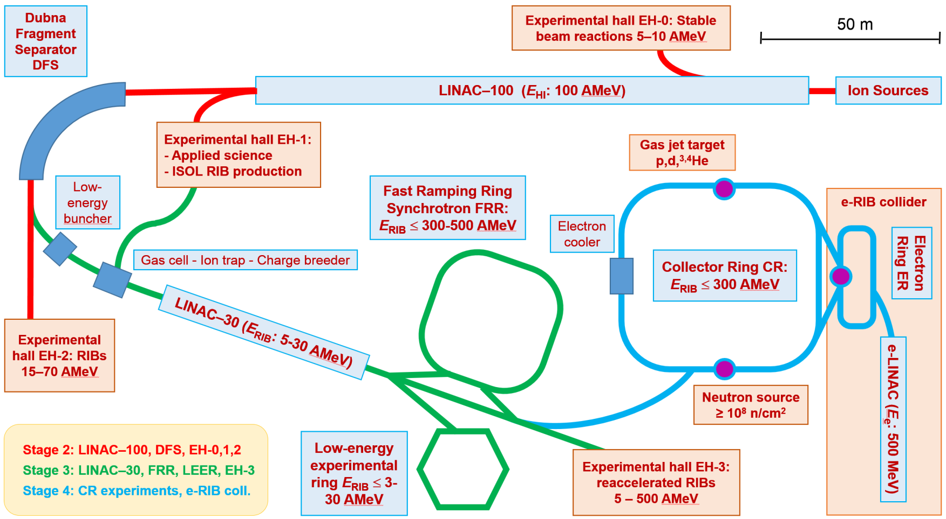
Proposal for construction of a prototype of the initial section of a high-current heavy-ion linear accelerator
Leonid Grigorenko
Project emphasis
Reaccelarated RIBs, storage ring physics including e-RIB collider
Basic facility
High-current superconducting HI cw-LINAC-100

Slide 9
Proposal for construction of a prototype of the initial section of a high-current heavy-ion linear accelerator
The PAC recommends the opening of the project ”Construction of a prototype of the initial section of a high-current heavy-ion linear accelerator aimed at producing intense radioactive ion beams for basic research” under the theme “Development of the FLNR Accelerator Complex and Experimental Setups (DRIBS-III)” for the two-year period 2020–2021.
The PAC is convinced that the full accomplishment of the project would require its extension beyond this period. This work should be supported both in terms of manpower and financial resources, but so that the just starting programmes on research of SHE at the new SHE Factory are not perturbed.
At the same time, the PAC recommends elaborating a more detailed work schedule for the development of the facility by determining the stages, their goals and the required resources. Special attention should be paid to the front-end development of the initial part of the accelerator, to the design of high-power production target and of high-intensity gas cell for radioactive ion beams.
The great interest of a number of Russian and foreign institutes in the technical developments for realization of the presented project is certainly advantageous for a timely completion of the work. This offer should be used to the full extent exploring all possible collaborations with leading international laboratories in which superconducting LINACs are designed and/or operated.
The PAC recommends exploring synergies in the SC LINAC design with the high power LINAC considered in the “Pluton” version of the new JINR neutron facility.

Slide 10
The Scientific Council supports the PAC’s recommendation on the opening of a new project “Construction of a prototype of the initial section of a high-current heavy-ion linear accelerator aimed at producing intense radioactive ion beams for basic research” for the period 2020–2021.
The proposed work plan aims at constructing a prototype of the initial section of the linear accelerator and at designing the LINAC-100 accelerator.
This work should be supported both in terms of manpower and financial resources, but so that the just starting research programme at the Factory of superheavy elements is not perturbed.

Slide 11
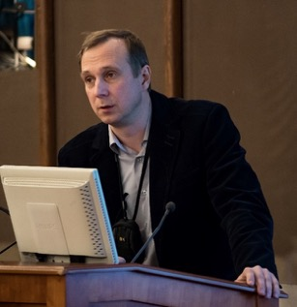
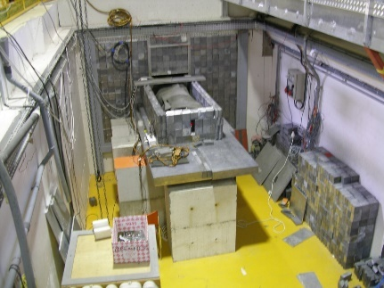
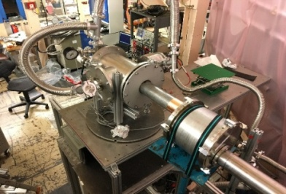
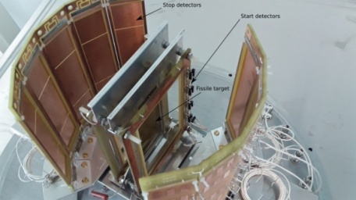
Report on the theme
"Investigations of Neutron Nuclear Interactions and Properties of the Neutron"
Main scopes of research:
Investigations of violations of fundamental symmetries in neutron-nuclear interactions and related data
Investigation of fundamental properties of the neutron, UCN physics
Applied and methodological research
Egor Lychagin
Main directions of research:
Investigation of P-T-symmetry breaking in reactions with neutrons;
Nuclear data measurements for neutron energy up to 1GeV;
Research with very cold and ultracold neutrons;
Nuclear analytical methods and research for different fields of science;
Methodical research;
Development of the Intense REsonance Neutron Source (IREN).
Project TANGRA (TAgged Neutrons & Gamma RAys)
Today, Egor Lychagin will comment and answer the questions.
The PAC recommends extension of the theme “Investigations of Neutron Nuclear Interactions and Properties of the Neutron” for 2020–2022 with first priority for further research activities in nuclear physics using FLNP neutron facilities: the highly intense pulsed neutron source IREN, the IBR-2 pulsed reactor and the EG-5 electrostatic generator.
In the future the PAC expects more details on the programme of nuclear data measurements, in particular the objectives, the priorities and the complementarity with the worldwide programmes.
The FLNP Directorate is advised to focus on the modernization of experimental halls and pavilions.
The PAC recommends that special attention be given to the beam delivery systems to increase neutron fluxes at the experiment places. The PAC expects a detailed report on this topic to be presented at the next meeting.

Slide 12
The Scientific Council appreciates FLNP’s outstanding achievements in the research of fundamental symmetries with polarized neutrons, the wide range of excellent results in the field of applied research within international programmes, and the importance of the work for the development of the accelerator facility carried out at IREN.
The Scientific Council supports the recommendation of the PAC for Nuclear Physics to extend the theme “Investigations of Neutron Nuclear Interactions and Properties of the Neutron” for 2020–2022 with first priority for further research activities in nuclear physics using FLNP’s neutron facilities: the highly intense pulsed neutron source IREN and the IBR-2 pulsed reactor.
The FLNP Directorate is advised to focus on the modernization of experimental halls and pavilions with beams of the IREN facility, on the construction of a polarized nuclear target for the work with polarized neutrons at IREN, and on the upgrade of the EG-5 electrostatic generator.
Special attention should be given to the beam delivery systems in order to increase neutron fluxes.

Slide 13

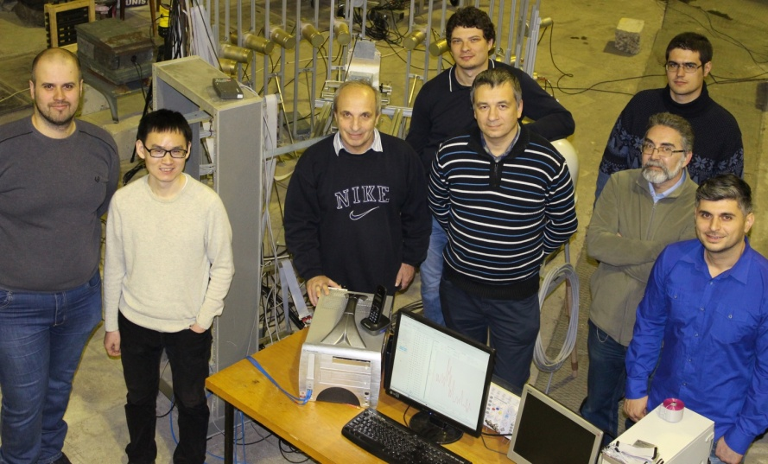



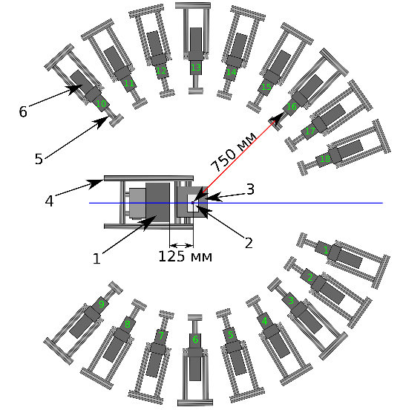
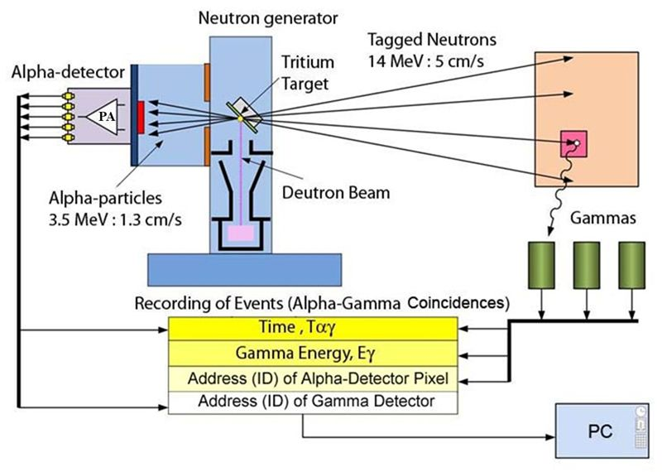





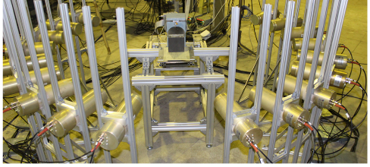



Report and Proposal for Extension of the
Project TANGRA (TAgged Neutrons & Gamma-Rays)
The project "TANGRA“ is devoted to study of neutron-nuclear interactions, using the tagged neutron method
TANGRA Setups
Yuri Kopatch
The use of BGO crystals and HP-Ge detectors
resulted in significant improvements of γ-ray energy resolution.

Slide 14
Report and Proposal for Extension of the Project TANGRA (TAgged Neutrons & Gamma-Rays)
Plans for 2020-2022:
Construction of a prototype of a setup for elemental analysis using TNM and high-resolution detectors;
Experiments on the measurement of cross-sections of (n,2n), (n, n’) reactions;
Experiments to measure angular correlations of gamma-ray and neutron emission in reactions of inelastic neutron scattering on light nuclei.
Development of a theoretical model to describe angular correlations in inelastic scattering of fast neutrons;
Development of a technique of searching for diamonds in kimberlite ores using the tagged neutron method. Design and development of 1024-pixel neutron generator (VNIIA);
Studies of the Martian soil model.
The PAC recognizes the importance of the TANGRA project and recommends its extension for the period 2020–2022 with first priority. The international collaboration with the institutes that have expressed their interest should be intensified. The ultimate goal of analyzing Martian soil should be vigorously pursued.

Slide 15
The Scientific Council recognizes the importance of the project “Research and development of the tagged neutron method for identification of the elemental structure of matter and studies of nuclear reactions (TANGRA)”
The Scientific Council supports the PAC’s recommendation to extend this project for 2020–2022, with first priority.

Slide 16
Letters of intent to open new projects under the theme “Investigations of Neutron Nuclear Interactions and Properties of the Neutron”
"Construction of a prototype of the set-up for measurement of the neutron lifetime using the time-of-flight method“.
"Construction of a prototype of the polarized nuclear target“.
The PAC suggests before considering full proposals that the authors:
prove the stability and the calibration accuracy for single pixel detector for the project “Construction of a prototype of the set-up for measurement of the neutron lifetime using the time-of-flight method”;
propose a realistic design of the cryostat for the project “Construction of a facility for polarization of neutrons and nuclei”.
General Recommendation: The PAC recommends that the authors develop a more detailed work plan by determining the stages, their goals, and the required resources, formalize this activity into a project within the above theme, and submit it to the next PAC meeting.

Slide 17
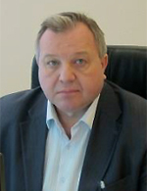
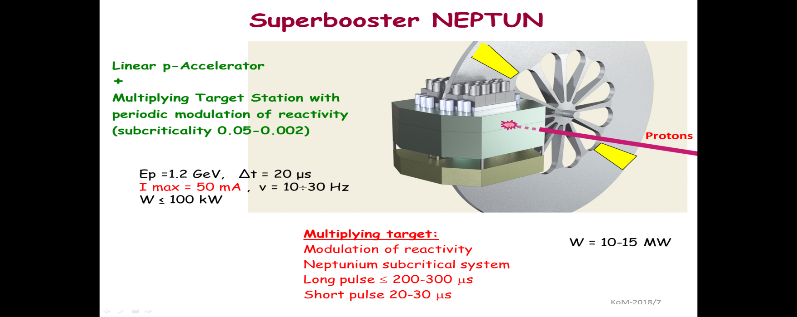
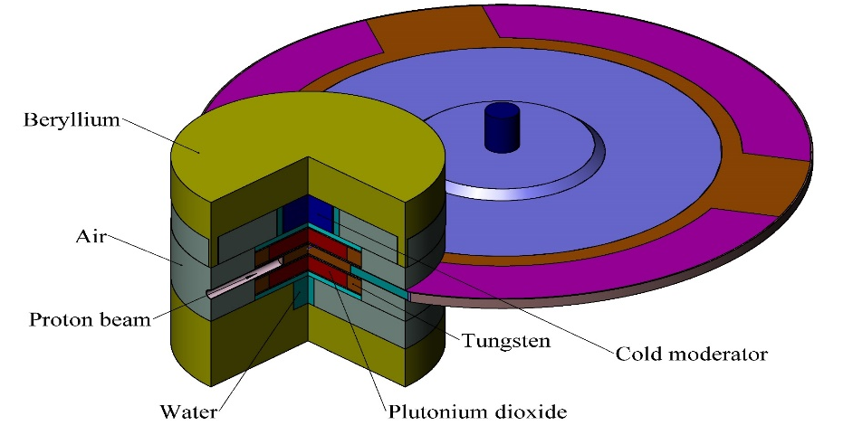
Information about the proposal for the opening of a new theme
"Development of the Conceptual Design of a New Advanced Neutron Source at JINR"
Dubna Neutron Source of the Fourth Generation two options:
PuO₂ based superbooster
Valery Shvetsov
Progress outline:
A superbooster (multiplying target of proton linear accelerator with periodic reactivity modulation) is being considered for the new neutron source
Feasibility study of 2 concepts (neptunium and plutonium based) has been started
Time schedule road map has been developed that establishes 6 major stages and proposes the finalization in 2035 – replacing the present source IBR-2M smoothly

Slide 18
Information about the proposal for the opening of a new theme
"Development of the Conceptual Design of a New Advanced Neutron Source at JINR"
PROJECT ROADMAP (preliminary):
Stage | 18 | 19 | 20 | 21 | 22 | 23 | 24 | 25 | 26 | 27 | 28 | 29 | 30 | 31 | 32 | 33 | 34 | 35 | 36 | 37
Concept development
Conceptual design
Investment justification
R&D
Technical design
Construction
Commissioning
The PAC supports the proposal for the opening of the new theme “Development of the Conceptual Design of a New Advanced Neutron Source at JINR” for the period 2020–2022.
The PAC requests the FLNP Directorate and the new theme leaders to keep it regularly informed of the progress of work to develop a new neutron source, taking into account the implementation of the ongoing research programme on nuclear physics.

Slide 19
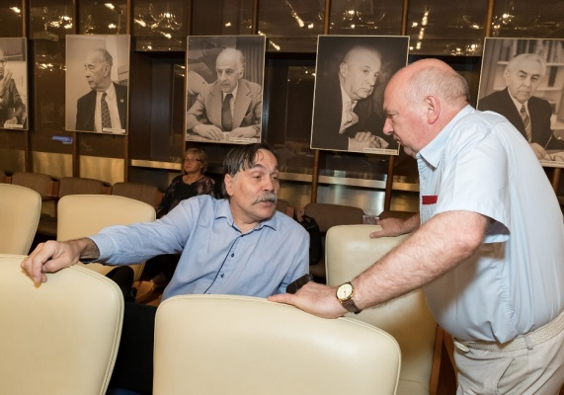
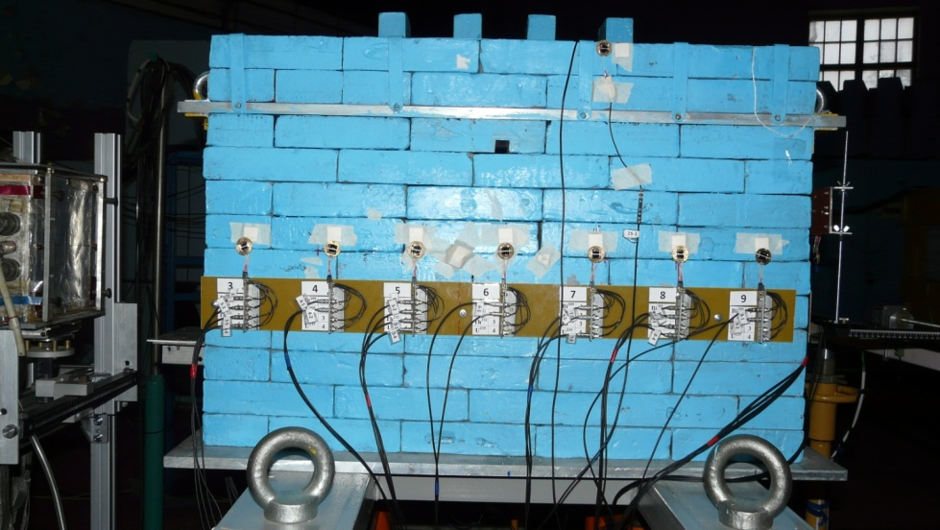
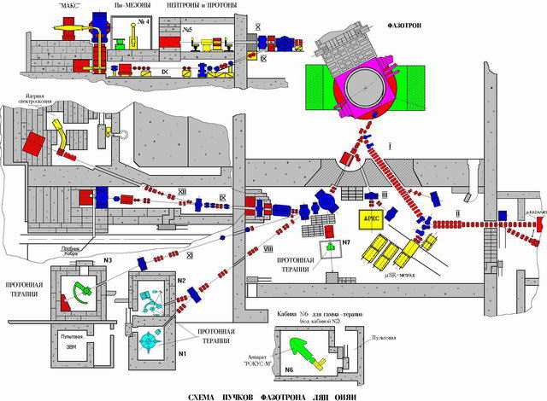
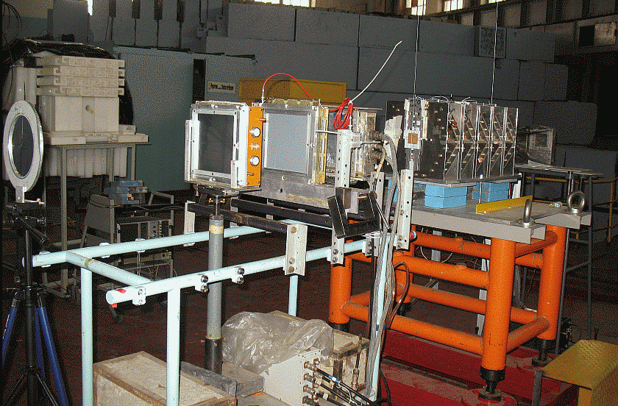
Project E&T&RM
Main results:
Calculations of radiation fields were carried out when quasi-infinite target was irradiated with a proton beam with energy of E_{p} = 660 MeV and safe irradiation regimes were chosen.
Experiments with different neutron-forming targets were carried out.
These targets were installed in the centre of the blanket of the “Big uranium target”. The equipment was prepared to obtain experimental data on the fission numbers of the transmutation and the neutron spectra of the leakage.
The PAC emphasizes the positive aspects of the project, e.g. possibility to study recycling of the spent nuclear fuel, development of new neutron detectors, comparison of Monte Carlo simulations with experimental results, and participation of PhD students.
Anton Baldin
The PAC notes considerable efforts in the transfer and installation of the “Big uranium target” at the DLNP Phasotron and recommends extension of the E&T&RM project for 2020 with first priority

Slide 20
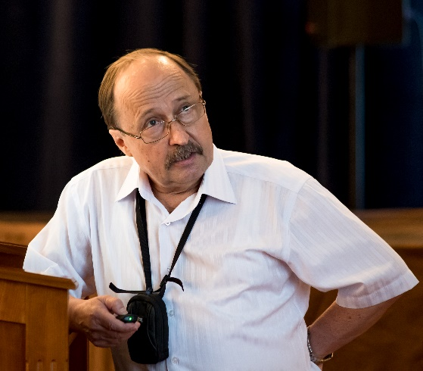
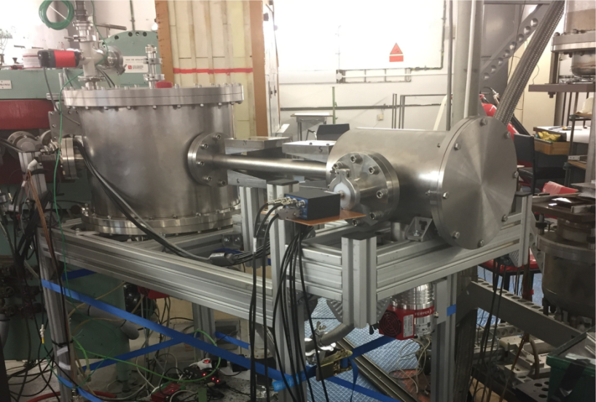
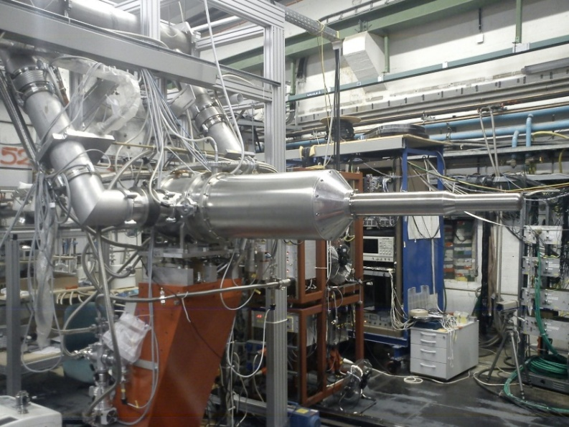
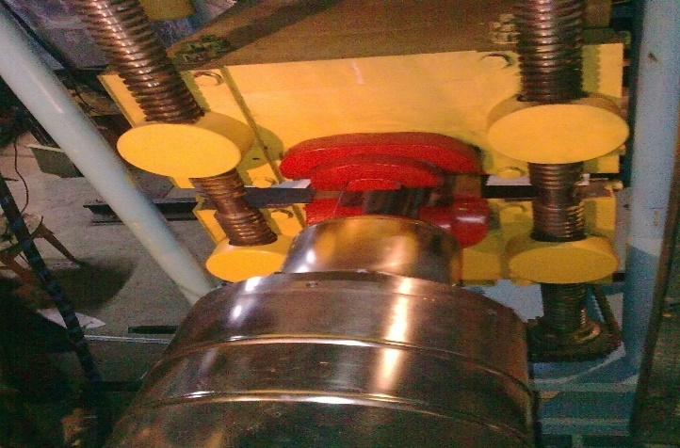
Report on the project "GDH&SPASCHARM&NN:
Study of the nucleon spin structure in strong and electromagnetic interactions" and proposal for its extension
The project consists of three independent experimental activities:
Yuri Uzikov
The GDH experiment
(MAMI-C Mainz):
The SPASCHARM experiment
(IHEP Protvino):
The NN experiment
(Prague):
The experiment has produced new results of excellent novelty and quality.
It is progressing well with a new polarized target using a horizontal 3He/4He dilution refrigerator to be used with the Crystal Ball and TAPS spectrometer.
The experiment is well under way using the high energy proton and antiproton beams and will soon produce new significant results in the study of nucleon structure by spin observables.
In 2022–23 new polarized beams are in preparation which will significantly enlarge the scope of the experiments.
The NN experiment is preparing a 14 MeV polarized neutron beam to be directed on a polarized deuterium target to study the 3N forces in strong (nd) interactions.

Slide 21
Report on the project "GDH&SPASCHARM&NN:
Study of the nucleon spin structure in strong and electromagnetic interactions" and proposal for its extension
The PAC acknowledges the important role of the Dubna group in all three experiments and recommends extension of the GDH&SPASCHARM&NN project with first priority for 2020–2022.
In order to maintain Dubna’s international visibility, the researchers should actively continue to take part in all measurements.
The Scientific Council takes note of the work under the GDH&SPASCHARM&NN project, which consists in fact of three independent experimental activities connected by the study of the nucleon spin structure in strong and electromagnetic interactions, and technically strongly supported by the frozen spin polarized proton and deuteron targets built and maintained by JINR’s group.
The Scientific Council acknowledges the important role of the Dubna group in all three experiments and supports the PAC’s recommendation to extend this project for 2020–2022, with first priority.

Slide 22
General recommendation
The PAC in agreement with the JINR Directorate strongly recommends that all proposals for new projects and requests for extension of themes or projects contain full information on required financial and human resources and a SWOT analysis.
Common issues by the joint session of the PAC for Particle Physics
and of the PAC for Nuclear Physics
The Scientific Council looks forward to being informed of the decision concerning the Neutrino programme evaluated by the joint session of the PAC for Particle Physics and of the PAC for Nuclear Physics in January 2019 and to knowing when and how this programme will be re-evaluated.
In general, the Scientific Council recommends that better allotment of scientific themes to respective PACs be made.

Slide 23
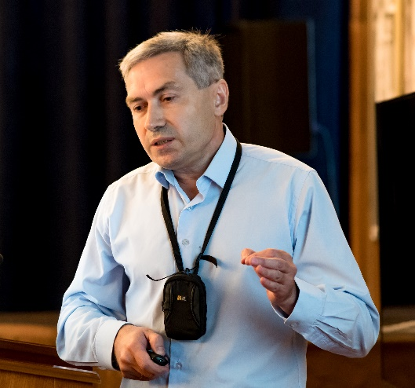
Scientific reports
The PAC heard with interest the excellent report on
“Transverse momentum distributions of hadrons in the Tsallis nonextensive statistics”
This investigation is of particular interest for JINR since standard Boltzmann–Gibbs statistics also fails at NICA energies; therefore, the PAC supports its continuation with detailed calculations of Tsallis nonextensive statistics in the NICA energy region.
The PAC supports continuation of these research activities.
Alexander Parvan
Poster session
The PAC reviewed 13 poster presentations in the field of nuclear physics research by young scientists from LIT and FLNP.
The best posters selected are:
“T-odd angular correlations in the emission of prompt gamma rays and neutrons in the fission of uranium by polarized neutrons” presented by D. Berikov.
“Measurements of gamma ray yields from (n,xγ) reactions at the TANGRA set-up” presented by N. Fedorov.
“Monte Carlo study of systematic errors in the measurement of the scattering of ¹⁵N ions by ^{10,11}B”
presented by I. Satyshev.
The PAC recommends the poster “T-odd angular correlations in the emission of prompt gamma rays and neutrons in the fission of uranium by polarized neutrons” to be reported at the session of the Scientific Council inSeptember 2019.
This poster was not reported at the 126th session of the Scientific Council.

Slide 24
THANK YOU FOR YOUR ATTENTION!

Slide 25
The Scientific Council takes note of the work under the GDH&SPASCHARM&NN project, which consists in fact of three independent experimental activities connected by the study of the nucleon spin structure in strong and electromagnetic interactions, and technically strongly supported by the frozen spin polarized proton and deuteron targets built and maintained by JINR’s group.
The Scientific Council acknowledges the important role of the Dubna group in all three experiments and supports the PAC’s recommendation to extend this project for 2020–2022, with first priority.

Slide 26
Common issues by the joint session of the PAC for Particle Physics
and of the PAC for Nuclear Physics
The Scientific Council looks forward to being informed of the decision concerning the Neutrino programme evaluated by the joint session of the PAC for Particle Physics and of the PAC for Nuclear Physics in January 2019 and to knowing when and how this programme will be re-evaluated.
In general, the Scientific Council recommends that better allotment of scientific themes to respective PACs be made.

