Slide 1
Research activities under the theme
"Investigations of Neutron Nuclear Interactions and Properties of the Neutron":
status and prospects
E. Lychagin

Slide 2
At the 50th meeting of the PAC for Nuclear Physics, a rather detailed report on the theme was presented and the main results obtained during 2017-2019 were shown. The theme was extended for the next three years. The leader of the theme was appointed Lychagin E.V. instead of Shvetsov V.N.
Issues addressed and the main goals of research:
Experimental and theoretical investigation of symmetry breaking effects in reactions with neutrons and fundamental properties of the neutron to test the parameters of the Standard Model and search for "new physics".
Investigation of the properties of excited nuclei, reactions with emission of charged particles, fission physics.
Obtaining of relevant data for astrophysics, nuclear power engineering and nuclear waste transmutation problem using neutron- and gamma-induced reactions.
Application of neutron physics methods in other fields of science and technology.
Development and construction of detectors of neutrons and other ionizing radiation, as well as applied methods in nuclear physics with neutrons. Development of the Intense REsonance Neutron Source (IREN) and the experimental base at the IREN and IBR-2 facilities.
Main directions of research in the framework of the theme:
Research of quantum-mechanical phenomena with ultracold and cold neutrons, study of the properties of a neutron;
Study of nuclear reactions caused by neutrons;
Applied research using nuclear physics methods.

Slide 3
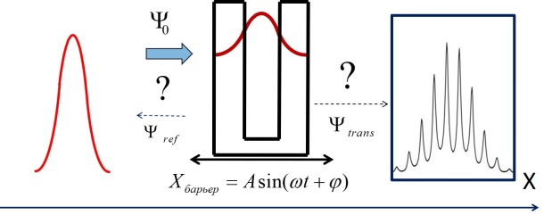
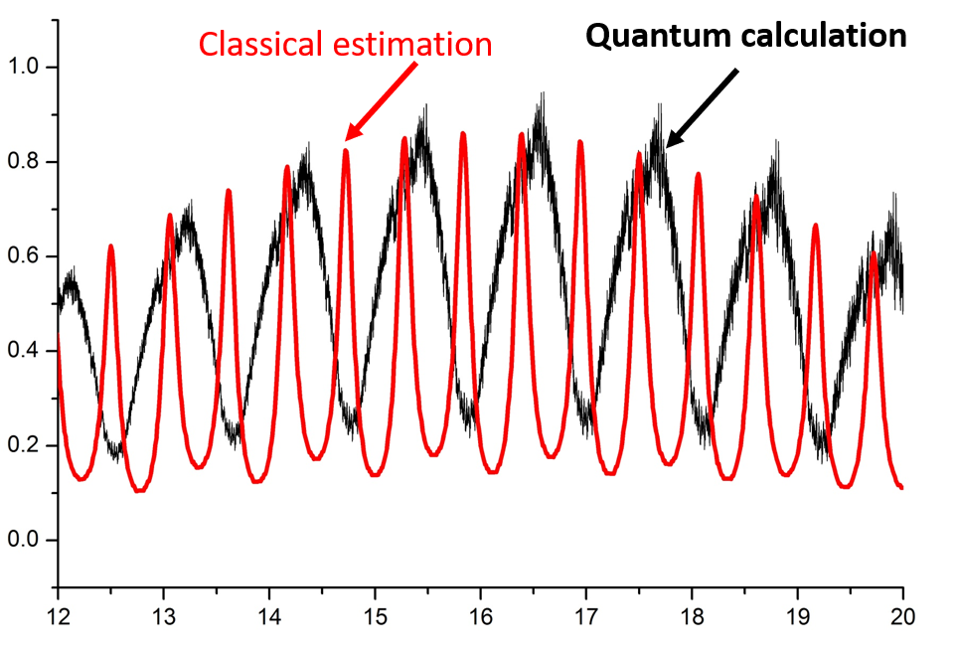
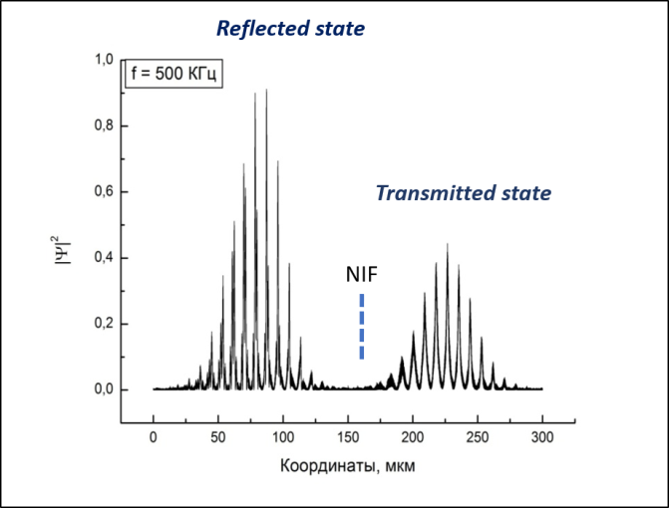
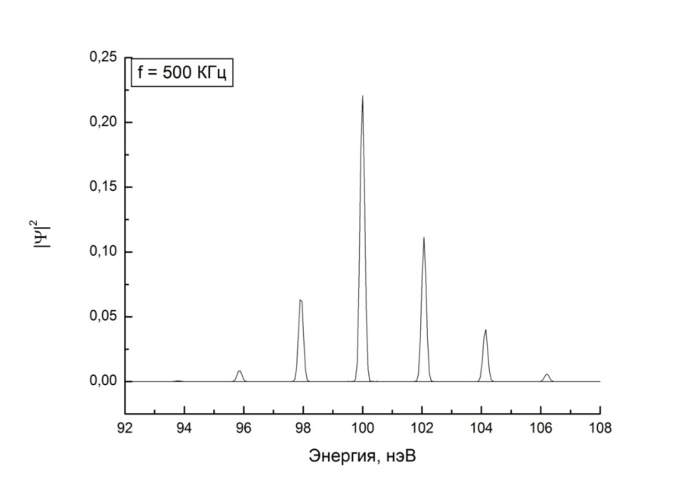
Interaction of Ultracold Neutrons with a Neutron Interference Filter Oscillating in Space
Comparison of different types of calculations
Wave packet transformation
Energy spectrum of the transmitted state
Time modulation of the transmitted wave at high oscillation frequency
M. А. Zakharov, A. I. Frank, G. V. Kulin, S. V. Goryunov. Journal of Surface Investigation.
X-Ray, Synchrotron and Neutron Techniques. 2020 (In print)

Slide 4
Nonstationary Diffraction of Ultracold Neutrons from a Moving Grating and Efficiency of Energy Transfer to a Neutron
G. V. Kulin, A. I. Frank, M. A. Zakharov, S. V. Goryunov, et al. JETP, 129, 806 (2019)
The result of calculation: it is possible to choose grate parameters to get high intensity in high orders with large energy transfer
The possibility of increasing the intensity of high diffraction orders allows us to think about a time lens on a moving grating using diffraction in the 2nd and 3rd orders.

Slide 5
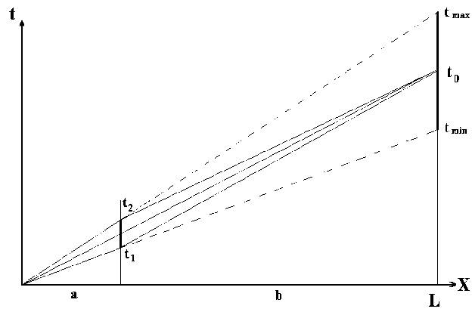

Time focusing problem
F.L.Shapiro PEPAN 2, (1971) 975-979
A.I.Frank and R.Gähler. Phys. of Atomic Nuclei, 63, (2000) 545
$$τ −time then the valve is open$$
τ_{p}
T
t
The gain factor for IBR-2 or DNS is 500
but construction of fast chopper near reactor active core is unreal.
(For ESS the gain factor is 30)

Slide 6
Development of the advanced Very Cold Neutron Source
Collaboration in the framework of
CREMLINplus WP3 T3.1 between:
ILL (Grenoble, France),
NRC KI-PNPI (Gatchina Russia),
JINR (Dubna, Russia),
PTI (St-Petersburg, Russia),
UCA (Clermont-Ferrand, France),
UNIMIB (Milano, Italy),
ESS (Lund, Sweden)
NCSU (Raleigh, NC, USA)
During the last year, a lot of simulation and experimental work (NAA, SANS, XRD, PGA etc.) was done to define optimal parameters of the powder and its production.
For 48 months (starting from February 2020) we should develop, produce and test experimentally the prototype of the VCN source.

Slide 7
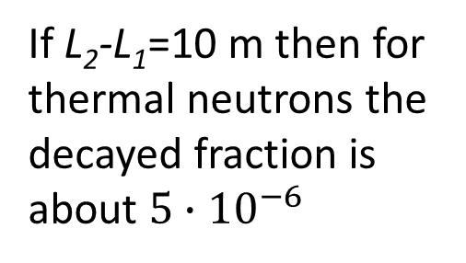
Investigation of possibility of the neutron lifetime measurement at IBR-2 beam
V. Kuznetsov approach:
L₁
L₂
If L₂-L₁=10 m then for thermal neutrons the decayed fraction is about $5∙{10}^{−6}$

Slide 8







$$t$$
$$⋯$$
$$f_{1}$$
$$f_{2}$$
$$f_{3}$$
$$f_{n}$$
$$\left\langle f\right\rangle$$
The flux intensity was suppressed by 10³ times to use the count mode.

Slide 9
A plan for the second half of the year:
Realizing similar measurements in the current mode.
Building a collimator system and evacuating flight from the moderator to the 10m base.
Modeling the decay by proper absorber and demonstration of its observation at fix flight pass 10 m.
The issue on the appropriateness of allocation of these studies in the form of a project will be decided based on the results of these test measurements.

Slide 10
Study of nuclear reactions caused by neutrons.
Search for the contribution of weak interaction in reactions with low-nucleon systems
Investigation of violation P- and T- symmetries in neutron resonances
Study of the P-even and T-odd correlations in fission
Developing of a prototype of the polarized nuclear target based onthe dynamic pumping of polarization (DPP)
Investigations of various fission parameters and characteristics of PFN emission
Measurements of yields and gamma rays' angular correlations in reactions with 14.1 MeV neutrons (the TANGRA project)
Research of the reactions (n, p) and (n, α) on resonant and fast neutrons (nuclear data)

Slide 11
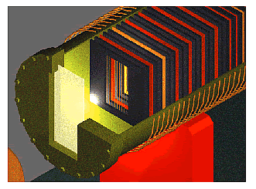
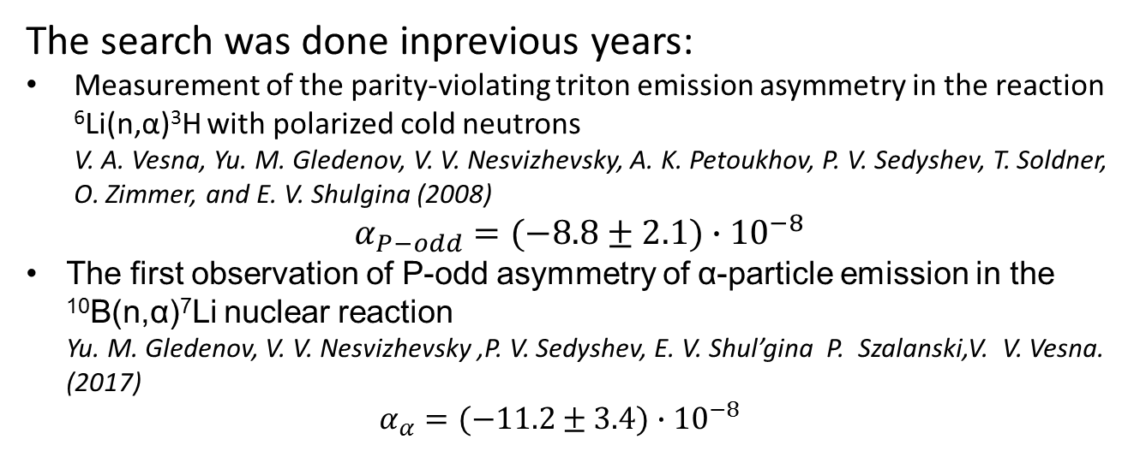
Search for the contribution of weak interaction in reactions with low-nucleon systems.
The search was done inprevious years:
Measurement of the parity-violating triton emission asymmetry in the reaction ⁶Li(n,α)³H with polarized cold neutrons
V. A. Vesna, Yu. M. Gledenov, V. V. Nesvizhevsky, A. K. Petoukhov, P. V. Sedyshev, T. Soldner, O. Zimmer, and E. V. Shulgina (2008)
$$α_{P−odd}=(−8.8±2.1)∙{10}^{−8}$$
The first observation of P-odd asymmetry of α-particle emission in the ¹⁰B(n,α)⁷Li nuclear reaction
Yu. M. Gledenov, V. V. Nesvizhevsky ,P. V. Sedyshev, E. V. Shul’gina P. Szalanski,V. V. Vesna. (2017)
$α_{α}=(−11.2±3.4)∙{10}^{−8}$
Multisection ionization chamber
The matter of discussion:
measuring the asymmetry of particle ejection in the output channel relative to the direction of the neutron spin in the ³He(n,p)³H reaction. Deep modernization of the experimental set-up It is need. The required calculations and estimations will be performed during 2020.
Theoretical estimation was carried out at:
M. Viviani et al, PHYSICAL REVIEW C82, 044001 (2010)
V. Gudkov PHYSICAL REVIEW C82, 065502 (2010)

Slide 12
Investigation of violation of P- and T- symmetries in neutron resonances.
Neutron resonances are manifestation of the complex structure of compound nuclei. Dynamically, the amplified P-odd effects in these resonances have been actively studied, but the complexity of the theoretical interpretation led to a decrease of interest. Yet, until now, information on the parameters of p-resonances (positions, neutron widths) is scarce and does not allow their statistical analysis.
Recently, there has been growing interest in searching for violation of T-invariance by searching for the so-called 3-vector and 5-vector correlations in the total cross section of the interaction of polarized neutrons with oriented (polarized or aligned) nuclei or by the manifestation of the characteristically sign in reactions. It could be “forward-backward” asymmetry searches in the emission of gamma quanta after neutron capture in the p-wave resonance, for example.
It is necessary to draw up a research program in this area. The first candidates for measuring “forward-backward” correlations are the ¹¹³Cd(n,γ), ¹¹⁷Sn(n,γ), and ³⁵Cl(n,p)³⁵S, reactions, the study of which has been started earlier.

Slide 13
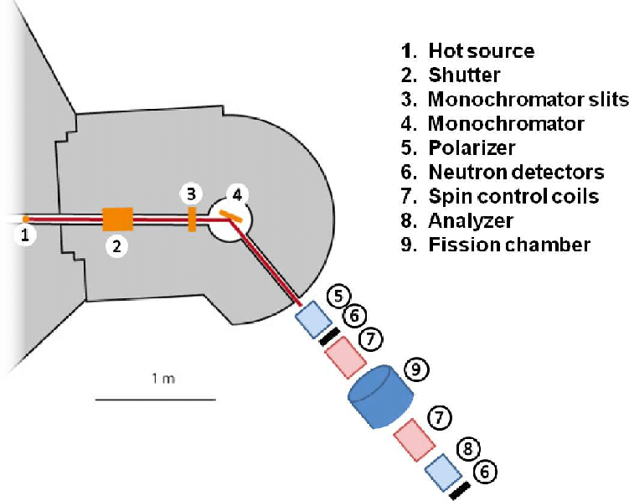
Study of the P-even and T-odd correlations in fission (TRI and ROT effects).
In cooperation with ITEP, PNPI
During 2019 methodological work was performed to prepare measurements at a resonance of 1.14 eV of ²³⁵U. The design of a new collimator for the POLI facility has been developed. It allows to perform measurements at neutron energies up to 1.5 eV. Modernization of the experimental facility is realized which allows to increase the effect of accumulation rate nearly by an order of magnitude.
In 2020-2022 comparative measurement of the T-odd ROT effect for the nuclei ²³⁵U and ²³³U, preparation and realization of the experiment at the second resonance ²³⁵U (1.14 eV) will be carried out.
Comparison of the facility at FRM-II with IBR-2 should be done during 2020. Implementation of test measurements at the IBR-2 reactor with the purpose of studying the possibility of research of the similar T-odd effects using the time-of-flight technique are planned.

Slide 14
Developing of a polarized nuclear target based on the dynamic pumping of polarization (DPP).
It will allow:
to carry out qualitatively new measurements of P-odd effects, while simultaneously reversing the spins of the nucleus and the neutron;
to carry out qualitatively new measurements of TRI and ROT effects;
to measure the separated cros sections, especially for the neutron induced fission;
finally, to bring the possibility of measuring the T-odd correlation at a resonance of 0.74 eV La
There is no doubt that as the experimental base develops, new tasks will arise.
A letter of intent to open a new project: "Construction of a prototype of the polarized nuclear target“ was presented by Dr. V.Novitsky
PAC recommendations were:
To propose a realistic design of the cryostat for the project “Construction of a facility for polarization of neutrons and nuclei”.
To develop more detailed workplans by determining the stages, their goals, and the required resources.

Slide 15
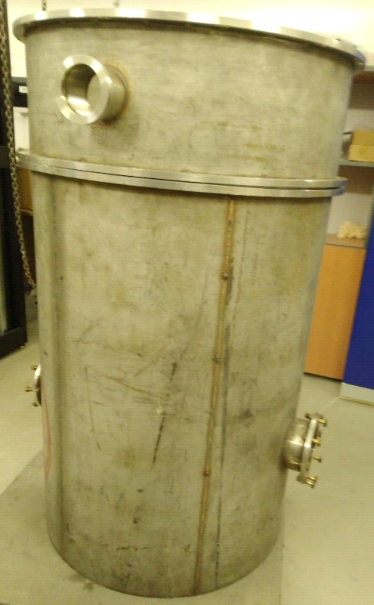
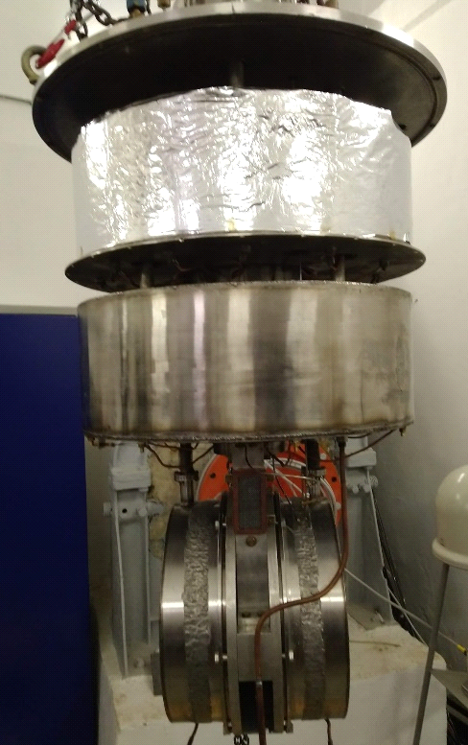
Developing of a polarized nuclear target prototype based on the dynamic pumping of polarization (DPP).
During the second half of the year:
Old refrigerator with superconducting magnet was transported to the lab
Estimation of the required equipment for different stages of the development are in progress
Stages are:
Developing of a mobile infrastructure for the working with cryogenic equipment.
Setting up of a system with condensation of cryogenic liquids.
Test work with ITEP cryostat, development of technology for obtaining ultra-low temperatures on the target.
Testing a superconducting magnet, operating in the "frozen" mode.
Establishment of a microwave polarization pump system and work with an NMR system.
The detailed project will be presented at one of the nearest PAC meetings.

Slide 16
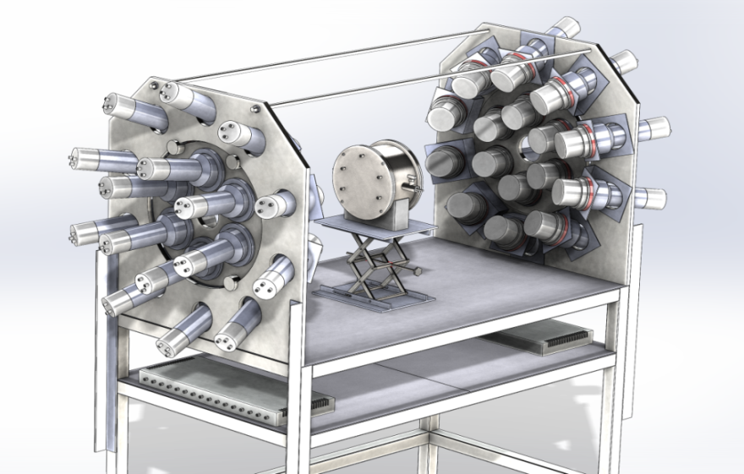
Investigations of various fission parameters and characteristics of PFN emission.
A double ionization chamber was designed to measure the kinetic energies, masses, and the orientation of fission axe in the 3D space for the correlated fission fragments. The accuracy of direction cosines definition is better than 0.05.
32 PFN detectors were placed close to the axis of the ionization chamber to guarantee the maximum PFN detection efficiency ~0.8π.
The set up was totally assembled, the workplace at the beam №2 of IREN was prepared.
Detailed information will be presented by Dr. Zeynalov after lunch

Slide 17
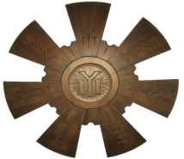
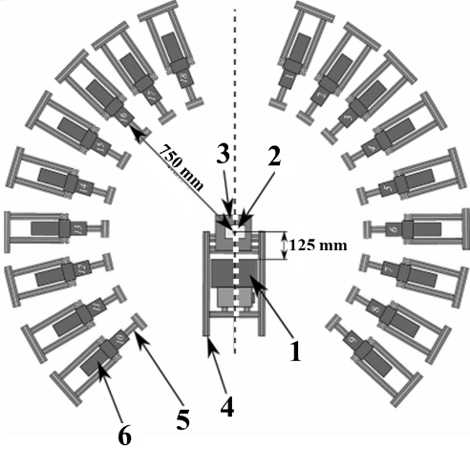
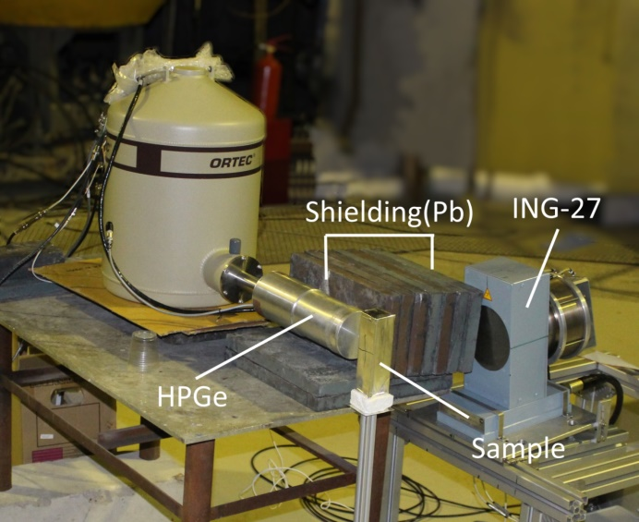
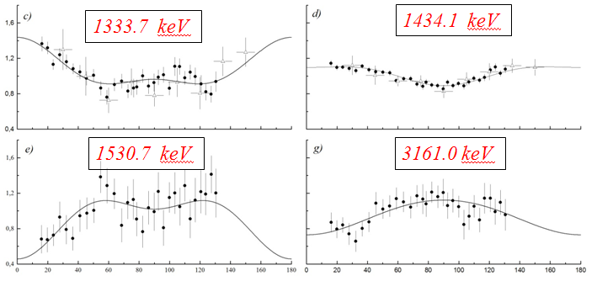
Measurements of yields and gamma rays' angular correlations in reactions with 14.1 MeV neutrons (the TANGRA project).
The partial cross sections for the formation of gamma rays and their angular distributions in inelastic neutron scattering reactions for 22 nuclei were measured in 2017-2019
Configuration with 18 BGO
Test of the configuration with HPG
Some results was included in EXFOR already:
41615002 # 2016, V.M. Bystritsky+ ##DAP 6-c-12(n,inl)6-c-12,par,da,g,cos/rsd
41615003 # 2016, V.M. Bystritsky+ ##DAP 6-c-12(n,inl)6-c-12,par,da,g,rsd
41615004 # 2016, V.M. Bystritsky+ ##DAP 6-c-12(n,inl)6-c-12,par,da,g,leg/rsd
41660002 # 2018, D.N. Grozdanov+ ##DAP 6-c-12(n,inl)6-c-12,par,da,g,leg/rsd
41660003 # 2018, D.N. Grozdanov+ ##DAP 6-c-12(n,inl)6-c-12,par,da,g,rsd
41660004 # 2018, D.N. Grozdanov+ ##DAP 8-o-16(n,inl)8-o-16,par,da,g,leg/rsd
41660005 # 2018, D.N. Grozdanov+ ##DAP 8-o-16(n,inl)8-o-16,par,da,g,rsd
Examples of measured angular distributions for gamma transitions in chrome

Slide 18
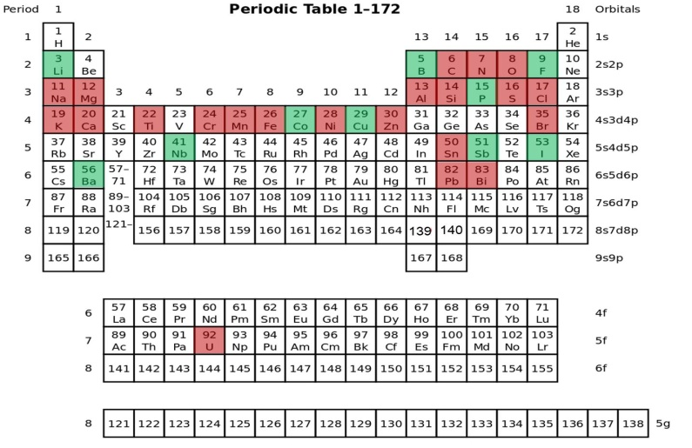

Measurements of yields and gamma rays' angular correlations in reactions with 14.1 MeV neutrons (theTANGRA project).
Modernization of the TANGRA facility using a HPG detector, further measurements of yields and angular correlations of gamma rays, measurement of the reactions (n, 2n) and (n, f), theoretical analysis of experimental data, development of methods for the analysis of kimberlite ores in order to detect large diamonds are planned in 2020-2022 .
Measured nuclei
Closest plans

Slide 19
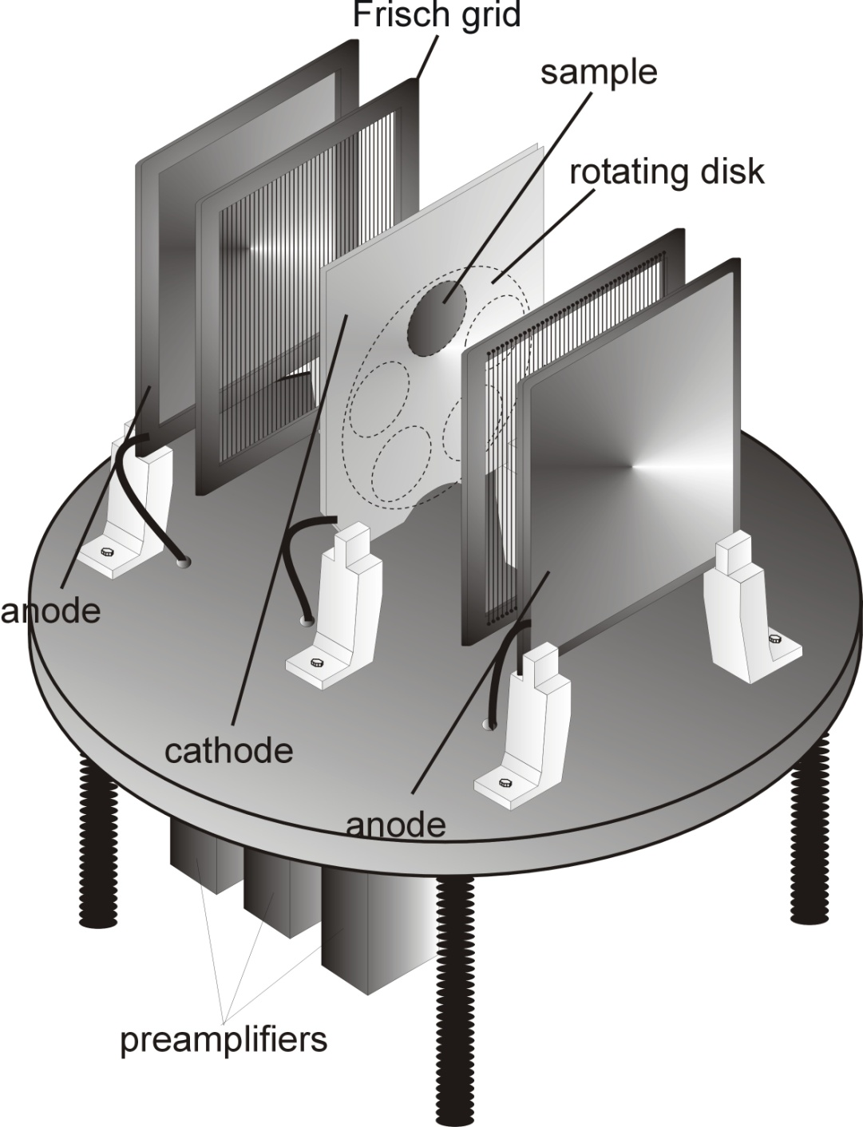
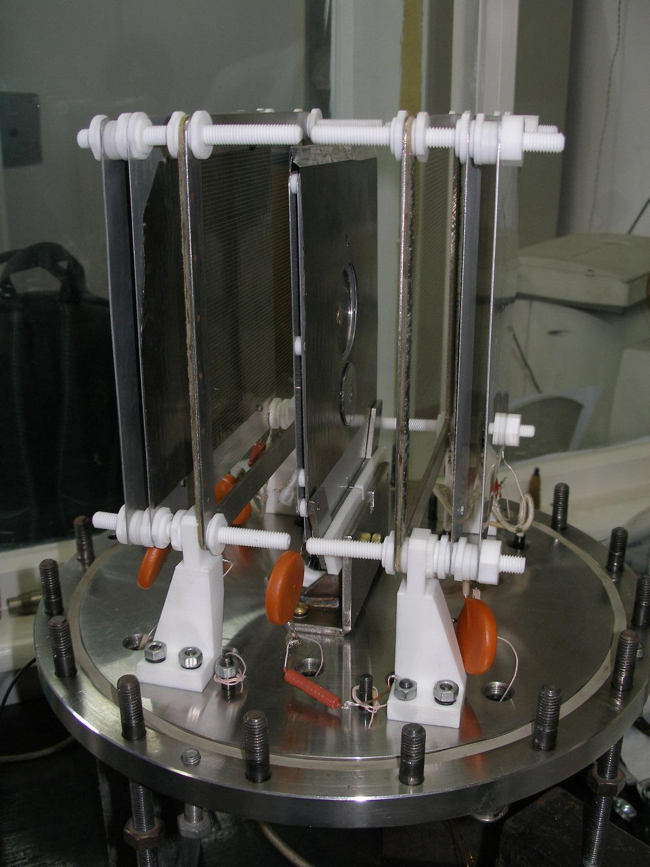
Research of the reactions (n, p) and (n, α) on resonant and fast neutrons (nuclear data)
Research of the reactions (n, p) and (n, α) on resonant and fast neutrons is underway. In October-November, measurements were carried out on the reaction ¹⁴N(n,α)¹¹B at E_{n}=4,25-6,0 MeV, ⁵⁸Ni(n, α) at 4.75, 5.0, 5.25, 5.5 MeV and ^{60,61}Ni(n, α) at 5.0, 5.5 MeV. The data is currently processed.
Two main reasons:
astrophysical research,
request for nuclear data from nuclear power.
NEA Nuclear Data Request Submission Form
Request from the national data base BROND
The subject of research and development on the part of FLNP is to obtain new experimental information on the (n, α) reaction cross sections for the following nuclei: ¹⁴N, ³⁵Cl, ⁵⁶Fe, ⁹¹Zr, ⁶Li.
At the IREN beam Dr. Yu. Gledenov and his team plan to measure the cross sections of the reactions ⁶Li(n,α)³H, ³He(n,p)³H, ¹⁴N(n,p)¹⁴C, ³⁵Cl(n,p)³⁵S in the neutron energy range of 1 eV-10 keV.

Slide 20
The applied research
Experiments at Van-der-Graaf EG-5 (modernization of the accelerator)
NAA, XRF (REGATA, REGATA-2)
Neutron resonance spectroscopy (at IREN)
Developing of set-up for PGA

Slide 21
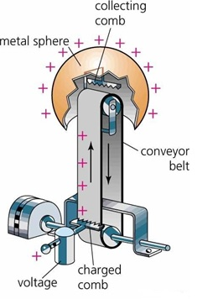
Modernization of the EG-5 accelerator and development of its experimental infrastructure.
Now we can’t get current more than 1mkA at a target. It is too small to make experiments with fast neutrons. The accelerator needs deep modernization.
New project
Technical task:
Restoring the technical parameters of the EG-5 accelerator:
energy up to 4.1 MeV
current above 50mkA.
Ways to solve:
Tube replacement;
Modernization of infrastructure;
Young staff training.
Plans
Development of the experimental infrastructure
1. New spectrometers.
2. Microbeam Project.
3. Use of multibeam configuration
The estimated project cost is about 1500k$ per 3 years.
Details will be presented
in the report of Dr. A.Doroshkevich

Slide 22


NAA at REGATA facility
FLNP directorate adviser
The new head of NAA sector
Inga Zinicovscaia
Marina Frontasyeva

Slide 23
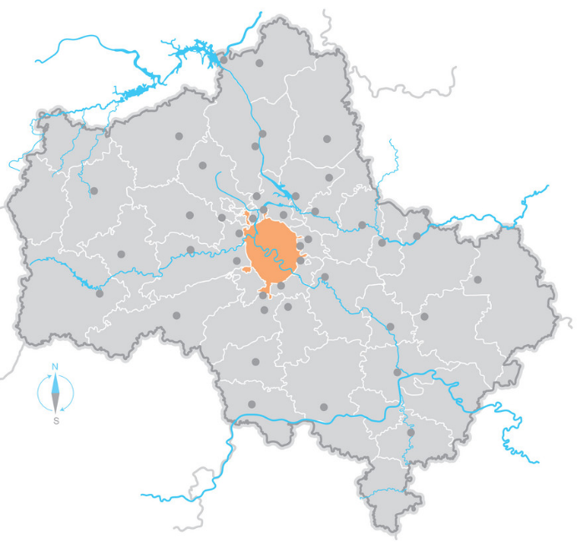
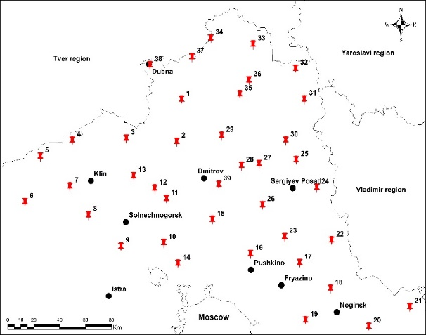
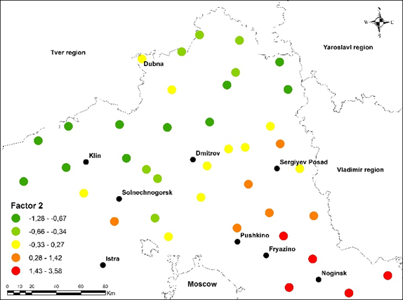
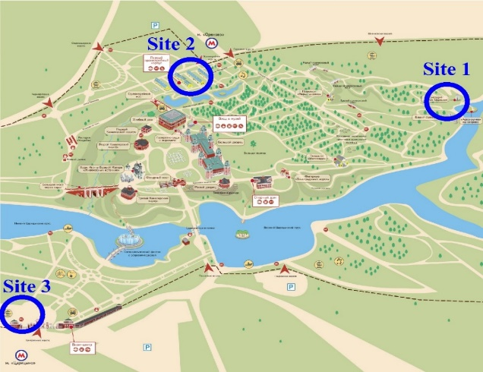
Active and passive biomonitoring studies in the Moscow region.
International program "Heavy metal atmospheric deposition in Europe”
Mo, W and Sb
Moscow
In 2020-2021 15 European countries in collaboration with SNAAPI will participate in a new moss survey.
Sampling map
Map of the exposure sites
The State Historical Architectural Art and Landscape Museum-Reserve "Tsaritsyno"

Slide 24
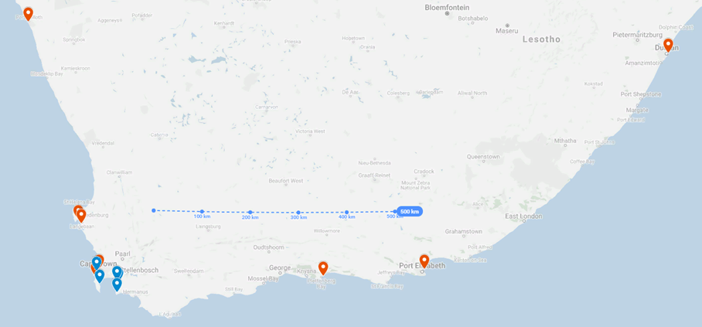
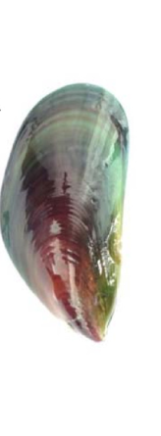
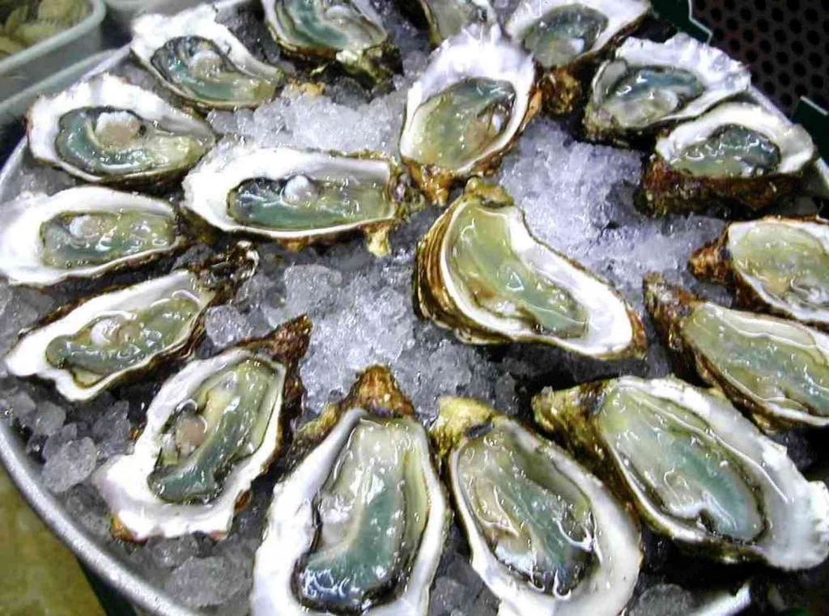
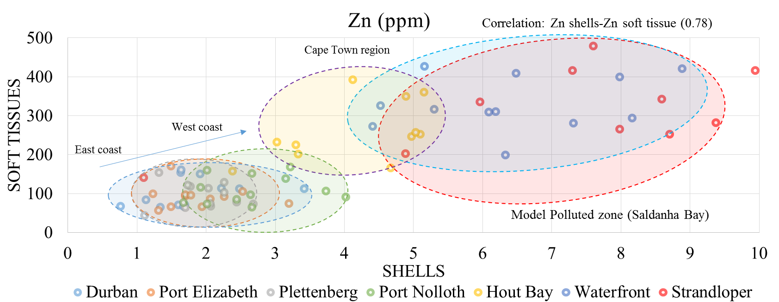
Environmental Assessment of Coastal Ecosystems. Water biomonitoring.
Sampling map
In 2019 in the framework of the “Mussel watch” project of JINR-SA mussels were collected at the six stations along the South African coast. The obtained data showed that the most polluted place is the area near Capetown. In 2020 this study will be continued, including other regional areas of the South Africa.
Zn in mussels among coastal zones

Slide 25
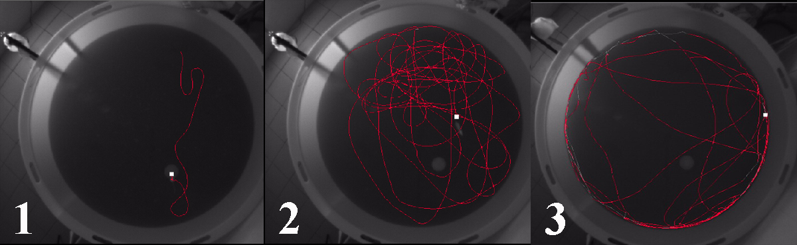
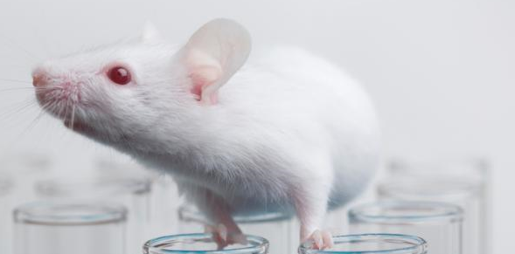
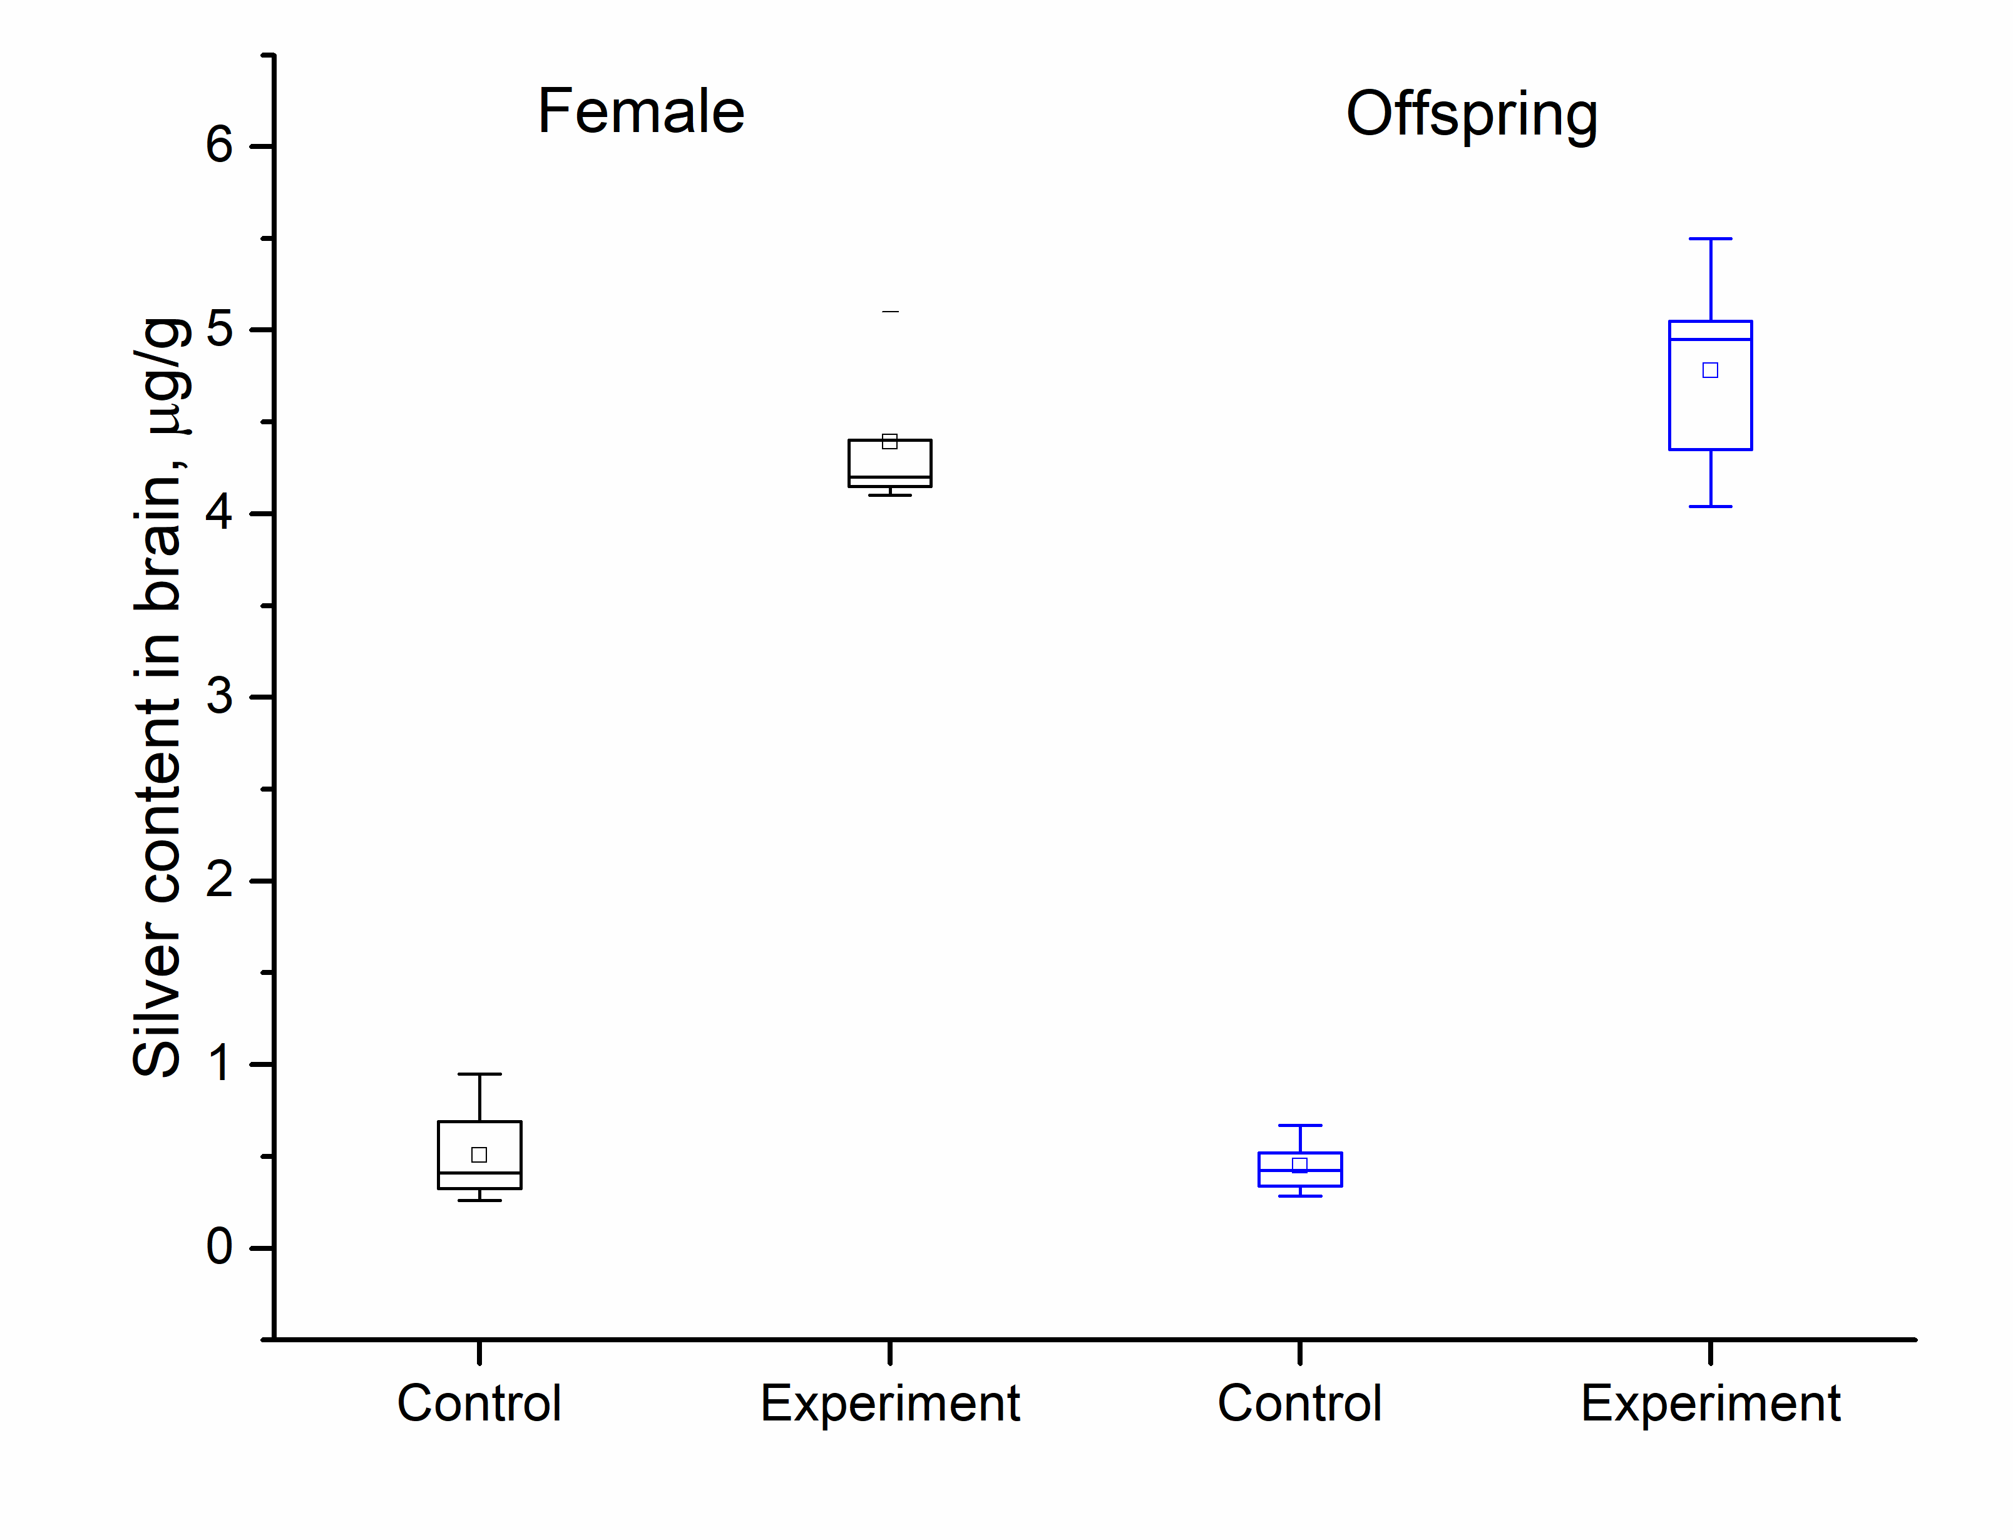
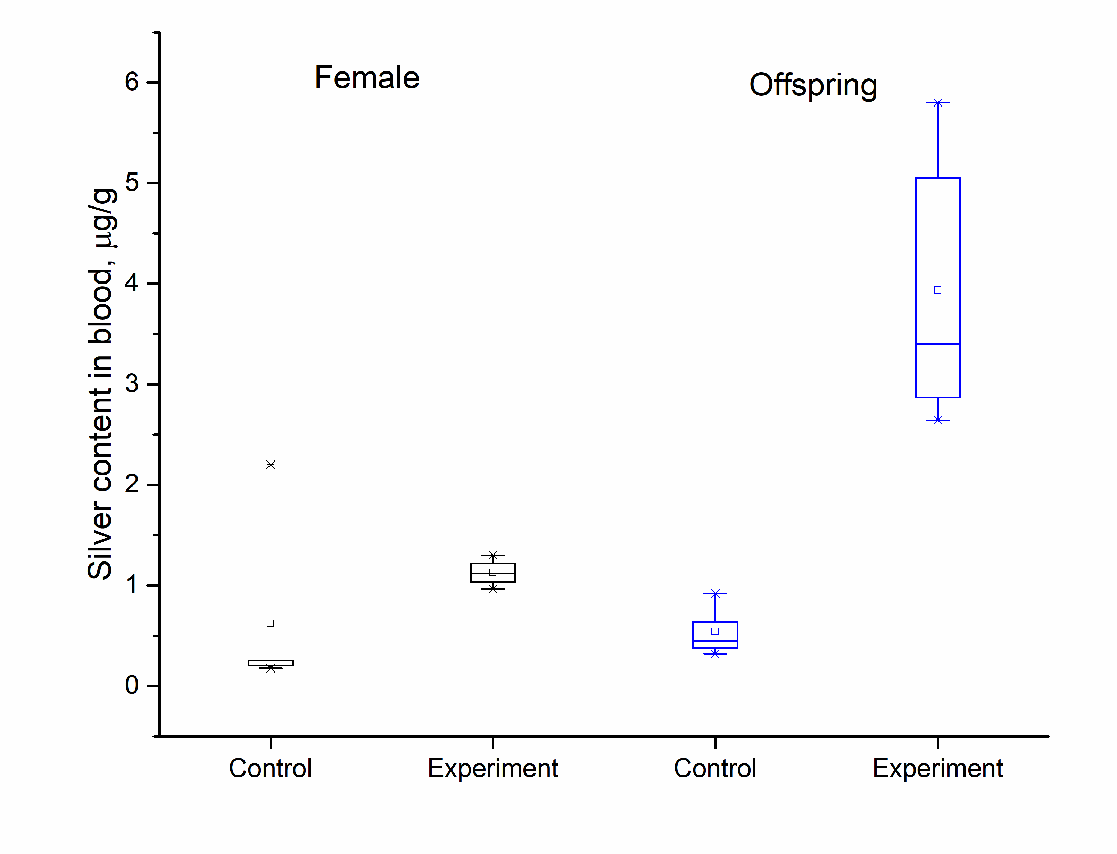

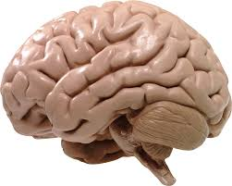
Nanotoxicology. The effects of silver nanoparticles received from the mother’s body during the prenatal and lactation periods.
Examples of the movement pattern of an animal with different types of behavior in the Morris test: 1 – directional search, 2 – random searching, 3 – thigmotaxis (strategy of incapable individuals)
These studies will be carried out in future with another type of nanoparticles, since they are very important to assess the toxic effect of nanomaterials on the human reproductive system.
Silver content in the brain
Silver content in the blood

Slide 26
Further plans for NAA
1) Including the REGATA facility in the FLNP User Programme;
2) Improvement of the methodology of The Neutron activation analysis at the REGATA facility;
3) Development of the new REGATA control panel;
4) Development and construction of the low-background γ-ray spectrometer and the α spectrometer;
5) Participation in the 2020/2021 European moss survey;
6) Further scientific research performed in the Sector of Neutron Activation Analysis and Applied Research in the field of environmental studies, geology, material science, medicine, nanotoxicology, etc.

Slide 27
Neutron Resonance Capture Analysis (NRCA)
The main advantages of the Neutron Resonance Analysis:
Nondestructive,
Sensitivity to isotopic element content,
Fundamental opportunity to study samples of any shape and size,
The practical lack of induced activity.
This makes it a promising method for researching cultural heritage items and archaeological artifacts.

Slide 28
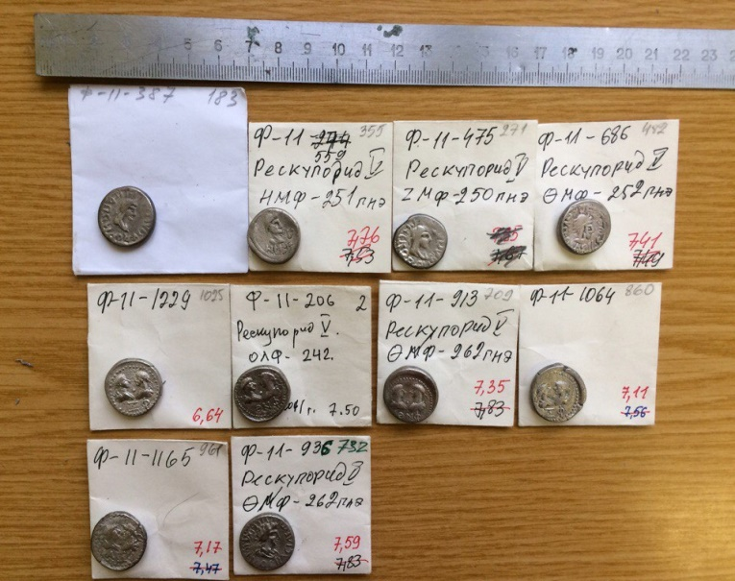
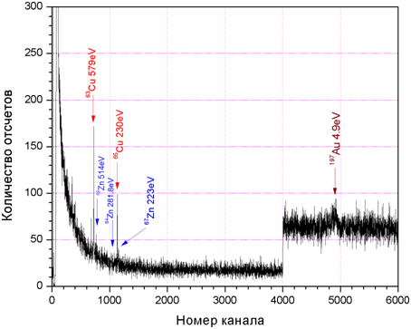
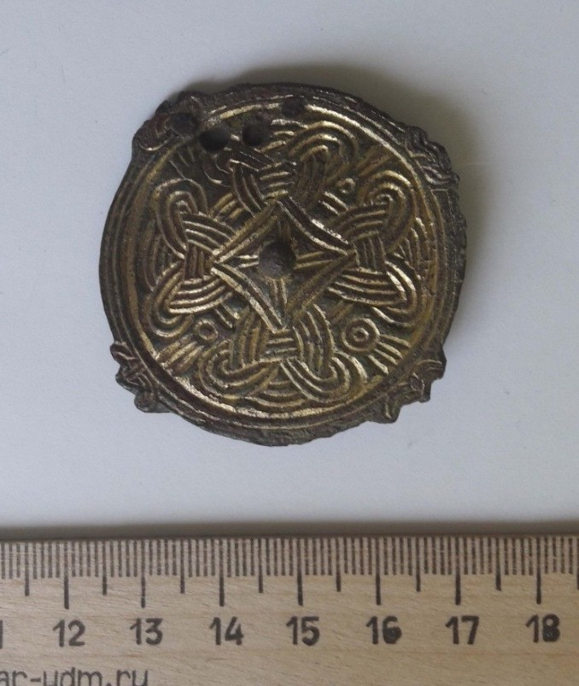
Neutron Resonance Capture Analysis (NRCA) .
Artifacts obtained from the Institute of Archeology of the Russian Academy of Sciences
№ | Element | Mass, g
1 | Cu | 63.4± 3.2
2 | Ag | 8.42± 0.27
Measured weight 73.033 g |  | 71.8 ± 3.2 g
10 coins from the largest treasure of the Bosporus straits of the 3rd-4th centuries. A.D.
Fibula from the Podbolotievsky burial ground, left by the pre-Slavic Finnish-speaking tribe of Murom. The 10th century AD.
№ | Element | Mass, g
1 2 3 | Au Cu Zn | 0.00177± 0.00021 21.7 ± 3.4 1.34± 0.47
 | Measured weight 19.980 г. | 23.0 ±3.4

Slide 29
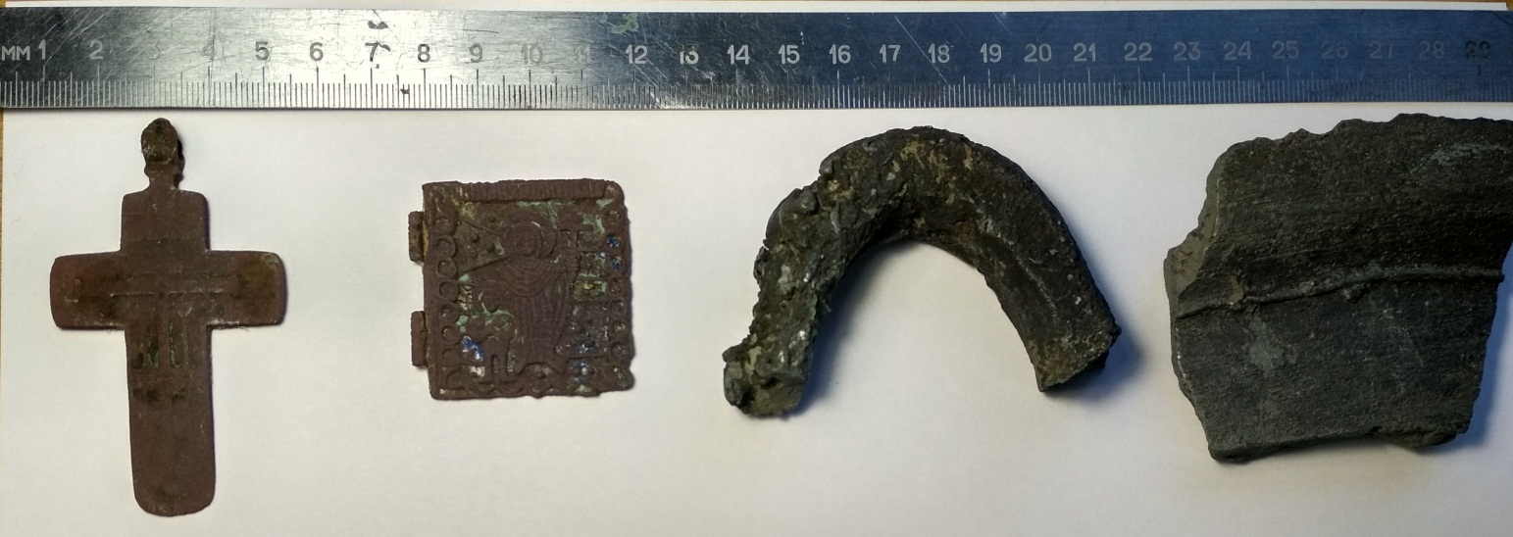
Neutron Resonance Capture Analysis (NRCA).
In 2020, it is planned to conduct research at the IREN facility on archaeological samples obtained from the Institute of Archeology of the Russian Academy of Sciences.
Sample List:
quadrophilic cross (VAE-2015)
icon (VAE-2015)
horseshoe-shaped metal object
fragment of the bell
(d. Zubovo)

Slide 30
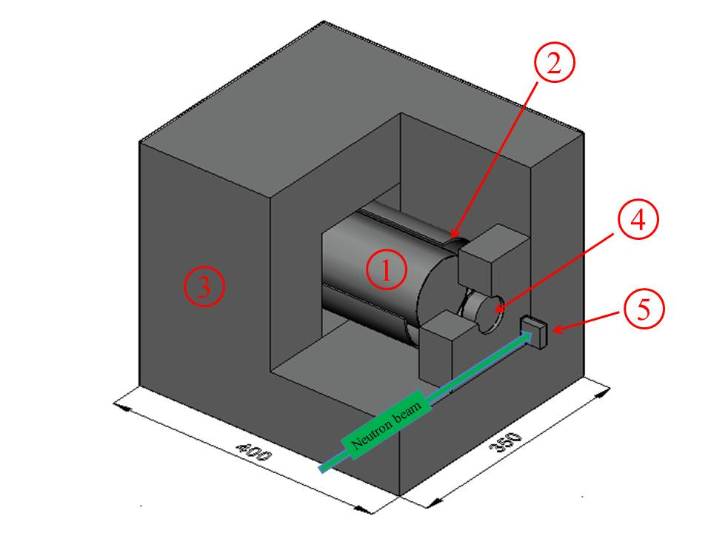
Neutron Prompt Gamma Analysis (NRCA)
1. HPGe gamma detector
2. B₄C cover
3. Lead shielding covered with Cd
4. LiF window
5. Sample
Current sensitivity to hydrogen is 20μg of protons
Ways to improve the sensitivity:
Precise beam collimation
Additional screen against fast neutrons
TOF mode of measurements
Improving of vacuum channel
Improving the detector shielding
Anti-Compton system
16-17 December 2019 International Workshop
The Use of Nuclear Physics Methods for Cultural Heritage Research
The results of young scientists with neutron imaging, neutron diffraction, NAA, NRCA, PGA, XRF were presented at the workshop.

Slide 31
Thank you for attention

Slide 32
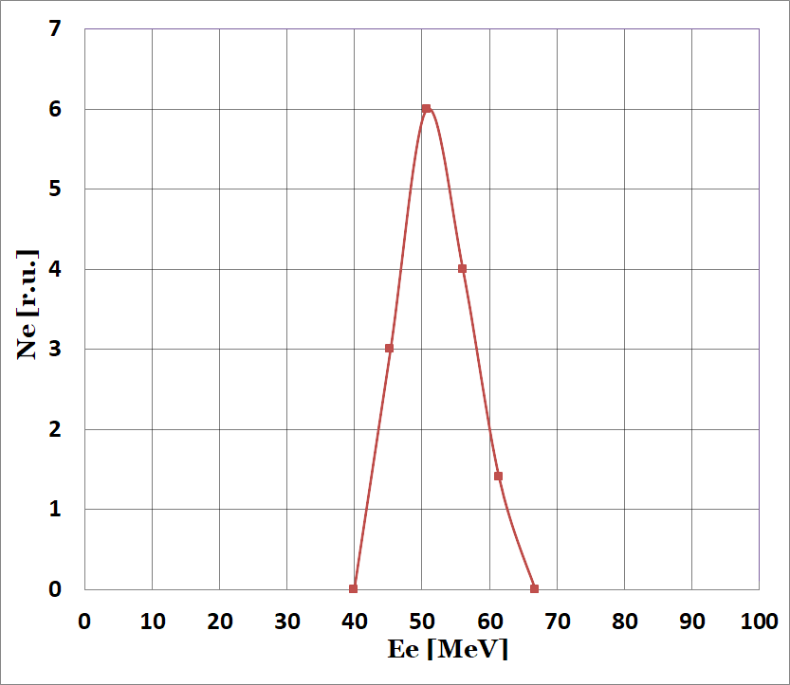
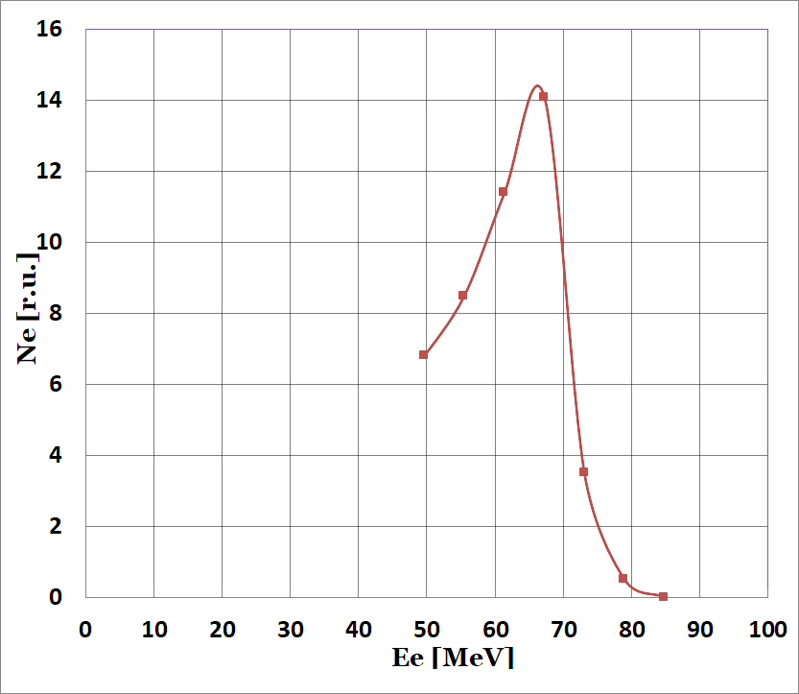
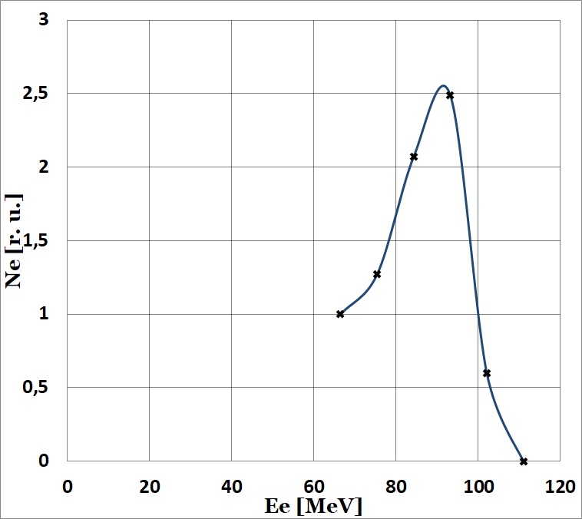
February 2017 г
December 2019 г
December 2019 г
Small current

