Slide 1
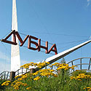
eremin@jinr.ru
Programme Advisory Committee for Nuclear Physics 51st meeting,
30–31 January 2020
Prospects of investigation of multinucleon transfer reactions.
A.V. Yeremin
FLNR JINR

Slide 2
BASIC DIRECTIONS of RESEARCH at FLNR JINR
1. Heavy and superheavy nuclei
Synthesis and study of properties of superheavy elements
Chemistry of new elements
Spectroscopy of heavy nuclei
Fusion-fission and multi-nucleon transfer reactions
2. Light exotic nuclei
Properties and structure of light exotic nuclei
Reactions with exotic nuclei
3. Radiation effects and physical bases of nanotechnology
4. Accelerator technology
Notes:
2

Slide 3
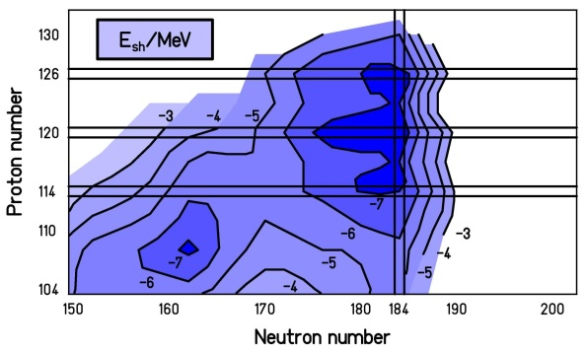

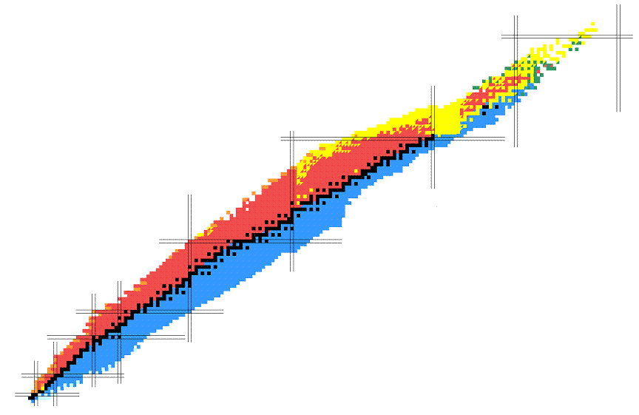
Superheavy nuclei
Present Chart of Nuclides
118 known elements
~ 4000 known isotopes
~ 4000 further isotopes expected
We are still far from the center of the SHE-island
Astrophysical
r-process path

Slide 4
How to reach SHE island?
Superheavy nuclei
Present
▪ Fusion of stable beams with
stable (Pb, Bi) targets
▪ Fusion of stable beams (⁴⁸Ca) with
radioactive transactinide targets
Z = 92
Future
▪ Multinucleon transfer reactions
▪ Fusion with radioactive ion beams
(low RI intensities, not discussed here)

Slide 5
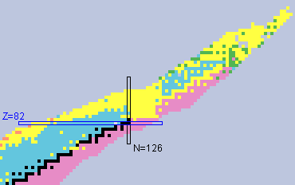
Regions of interests in MNT reactions
3
1
Study of neutron deficient isotopes in the region 82 < Z < 100
1
2
Study of isotopes in the region N = 126, r – process in astrophysical nucleosynthesis
3
Study of neutron rich isotopes in the region Z > 100
2

Slide 6
Experimental methods of MNT reactions studies
● Radiochemical methods
Radiochemical methods (offline) 100% collection efficiency, nearly
background-free High-yield chemical separation of individual elements (40-90 %).
Most sensitive for isotopes with half-lives between about one hour and a few months that
undergo alpha decay or spontaneous fission (SF).
Target thickness: ²³⁸U, ²⁴⁸Cm (1 to 3 mg/cm² ), No kinematics.
cross section limit: down to nanobarn. region 3 – region Z > 100
● Gas cell system + ISOL + detectors (KEK, Japan), IGISOL (JYFL, Finland)
0.01 to 1 % detection efficiency for transfer products. Most sensitive for isotopes with half-lives from
about milliseconds.
Target thickness: ~ 10 mg/cm², No kinematics. 2 – region N ~ 126
Beam intensity (²³⁸U) – 50 pnA, yield > 100 counts / day, mass measurements (200 keV).
● Separation of MNT products with existing kinematic separators
0.1 to 1 % detection efficiency for transfer products (Zero angle). Most sensitive for isotopes with
half-lives from about microseconds to few hours.
Target thickness: 300 to 500 μg/cm^{2,} MNT products velocity determination.
Cross section limit: down to nanobarn within 5 hours of irradiation with beam intensity
of 5×10¹² proj/sec. 1 – region 82 < Z < 100; 3 – region Z > 100
● Future development of dedicated experimental set ups. MNT products velocity
and angular distribution determination. 3 – region Z > 100

Slide 7
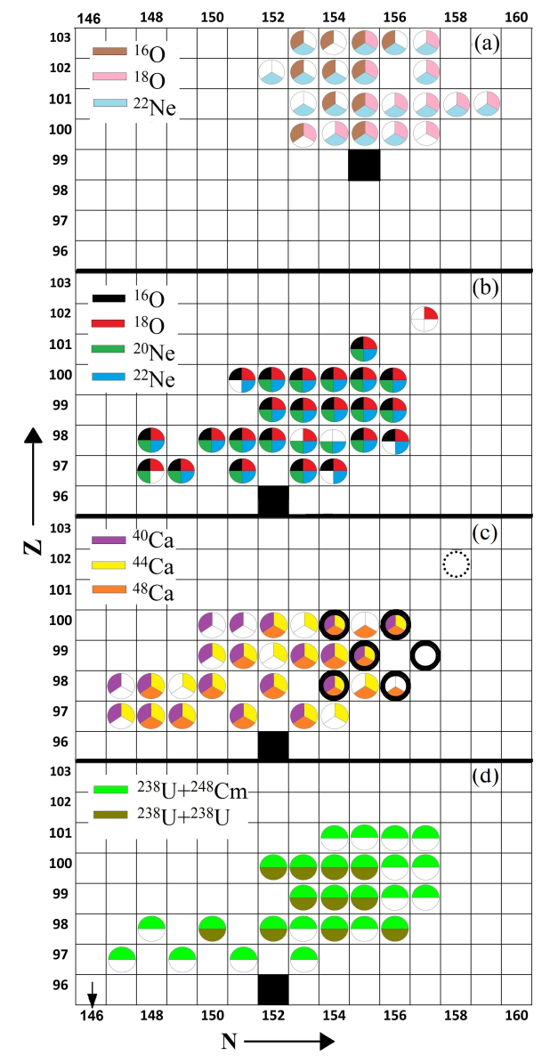
First studies of transuranium nuclei in MNT reactions
O, Ne + Es
▪ years 1975 – 1995, LBL and GSI
▪ radiochemical methods for isotope
separation and identification
▪ sensitivity:
σ ~ 20 nb; T_{1/2} > 1 min.
▪ observation:
- MNT products with Z ≤ 103
- no new nuclides observed
O, Ne + Cm
Ca + Cm
U + Cm

Slide 8
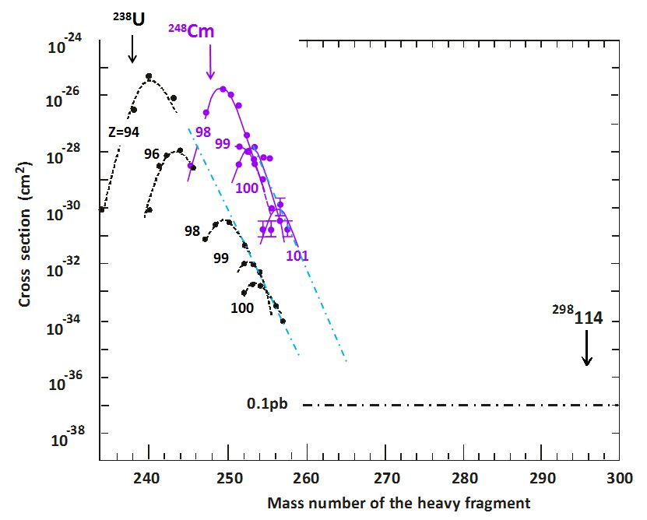
²³⁸U + ²³⁸U, ²³⁸U + ²⁴⁸Cm,
GSI, 1977 - 1981

Slide 9
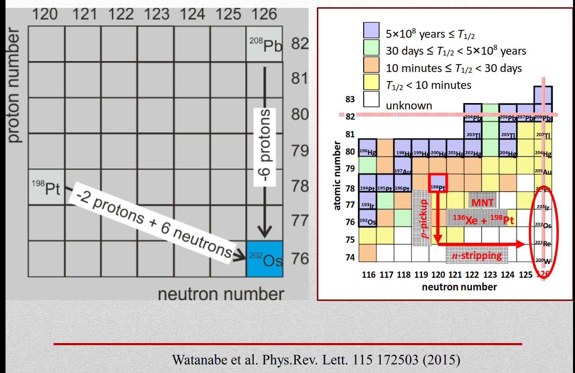
Gas stopping cells
2 – region N ~ 126

Slide 10
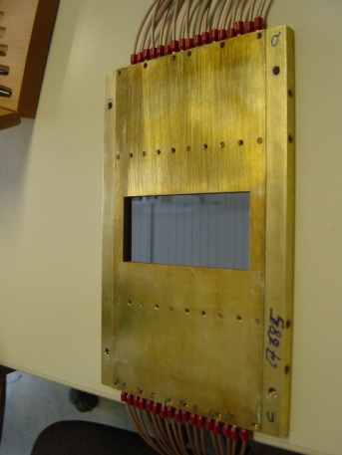
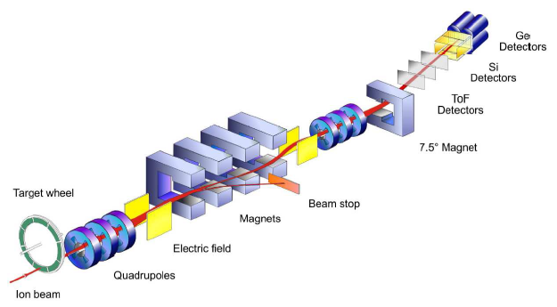
Separation of MNT Products with a Velocity Filter
Velocity filter SHIP at GSI Darmstadt
(→ usually used for superheavy fusion products)
N_{detector} ≈ 100 / s
I_{beam} ≈ 5·10¹² / s
Isotope identification
via radioactive decays
α₁
E, T_{1/2}
α₂
E, T_{1/2}
α₃
Δθ = (0 ± 2)° → ε_{MNT} ≈ 0.01
E, T_{1/2}
sf

Slide 11
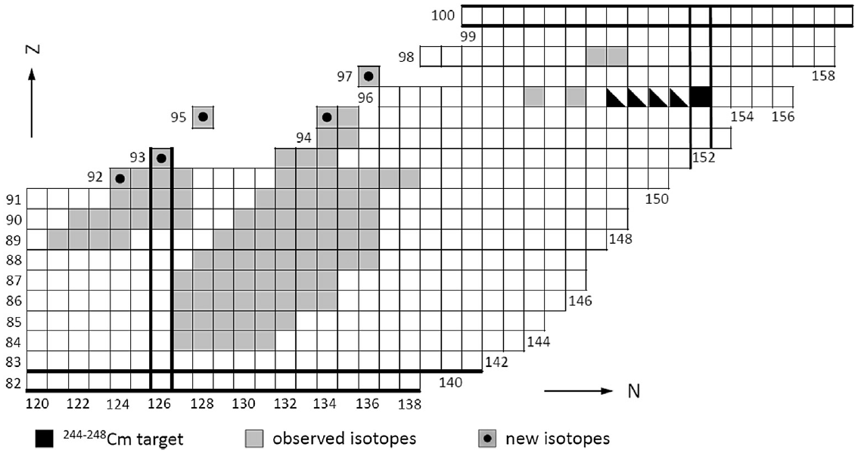
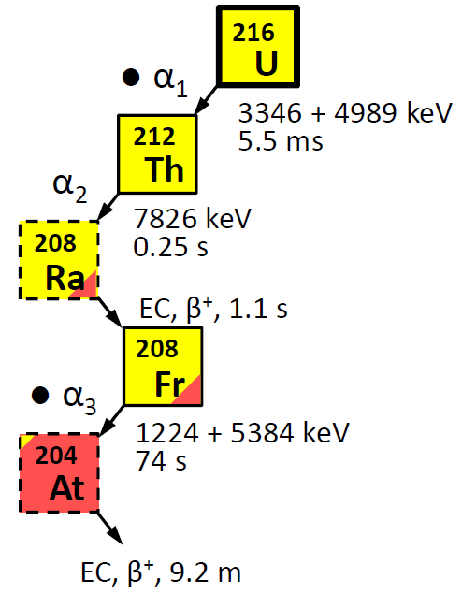
MNT reactions in ⁴⁸Ca + ²⁴⁸Cm @ SHIP
Population of „below-target“ nuclei
1 – region 82 < Z < 100
▪ Identification of ~100 MNT products by α-decay tagging
▪ Observation of 5 new neutron-deficient isotopes with Z ≥ 92
(in 2 hours of irradiation)
H.M. Devaraja et al., Phys. Lett. B 748, 199 (2015).

Slide 12
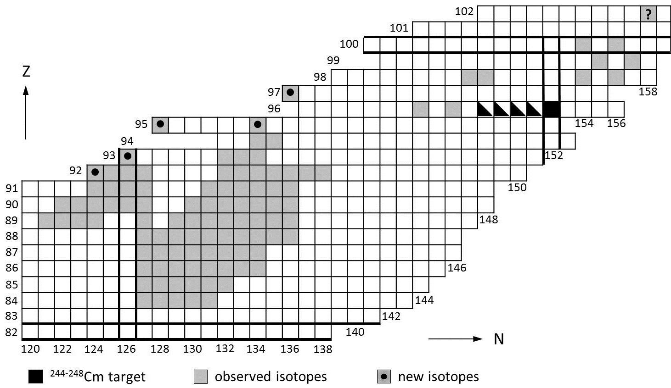
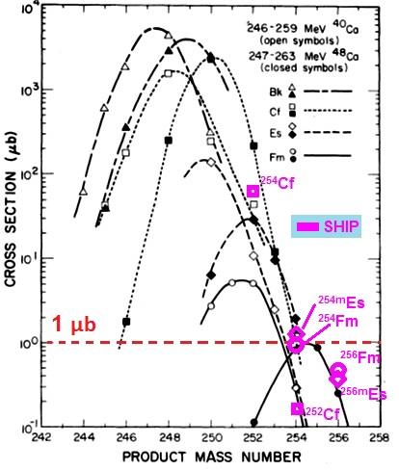
Population of „above-target“ nuclei @ SHIP
3 – region Z > 100
²⁶⁰No
²⁶⁰No would be the so far heaviest transfer product observed with
²⁴⁸Cm targets: Cm (Z=96) + 6p; previously only seen with Es (Z=99)
Future experiments are in consideration at SHELS (FLNR Dubna),
SHIP not available for MNT experiments now.

Slide 13
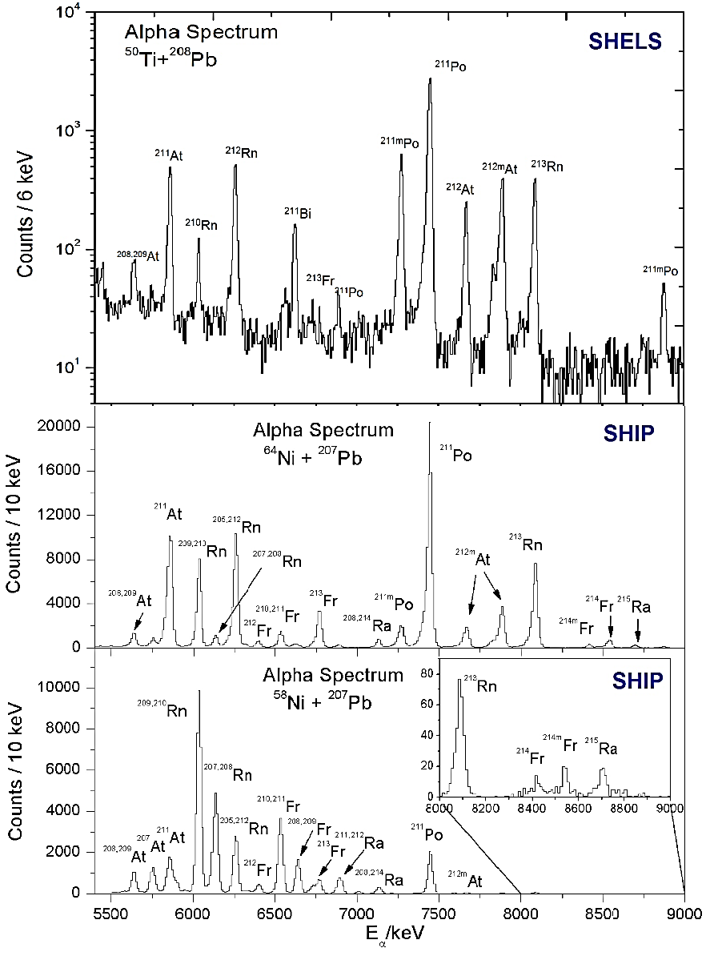
Feasibility studies at SHELS in Nov. 2018
Alpha spectra from MNT products measured at SHELS (November 2018) and SHIP with Pb targets
SHELS:
⁵⁰Ti+²⁰⁸Pb collisions
SHIP:
^{58,64}Ni+²⁰⁷Pb collisions

Slide 14
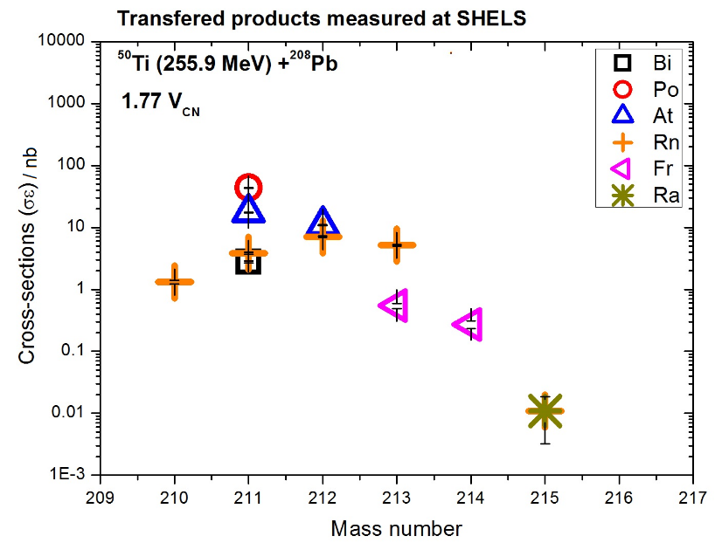
Feasibility studies at SHELS in Nov. 2018
Isotopic distributions of MNT products measured in collisions of
Ti + Pb at SHELS
→ sensitivity: 10 pb/sr in 5 hours of irradiation
Closest plans: April 2020, ⁴⁸Ca + ²⁴³Am, study of MNT products, 1 week

Slide 15
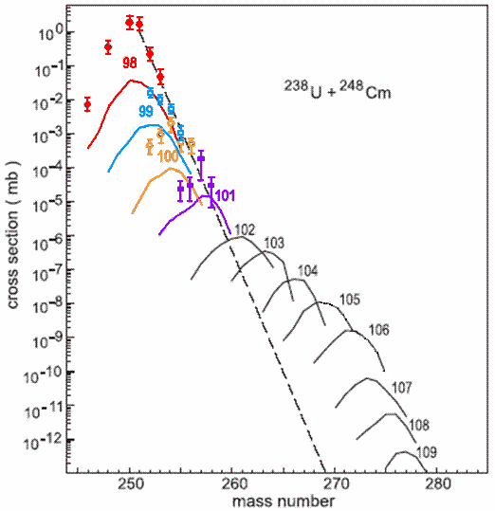
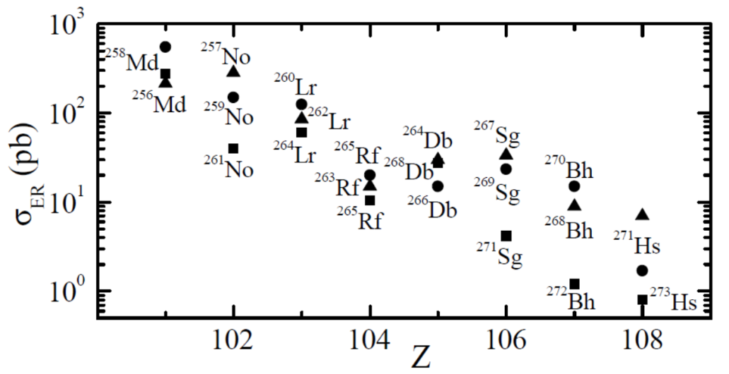
MNT products beyond Z = 102 ?
Theoretical predictions
U + Cm
⁴⁸Ca + ²⁴⁸Cm
²³⁸U + ²⁴⁸Cm
1 nb
1 nb
σ < 1 nb
▪ Dinuclear system model
(G. Adamian, N. Antonenko et al.)
▪ diabatic internuclear potentials
▪ adiabatic internuclear potentials
(V. Zagrebaev, W. Greiner et al.)
→ New n-rich superheavy isotopes up to Z ~ 108 appear feasible

Slide 16
Choice of the collision system
Example: Synthesis of Fm isotopes in MNT reactions with different projectile nuclei on ²⁴⁸Cm targets
▪ Choice of collision system seems not critical if MNT products are not too far from the target nucleus
▪ but: target Z should be as big as possible

Slide 17
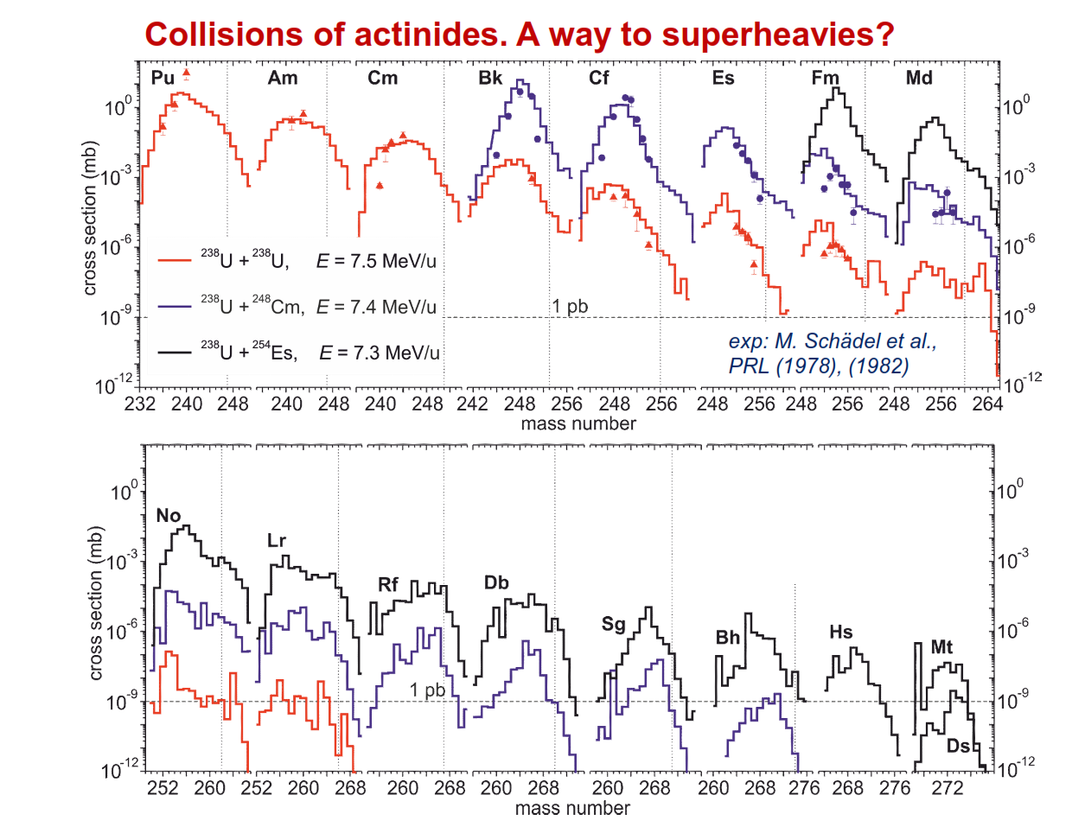

Slide 18
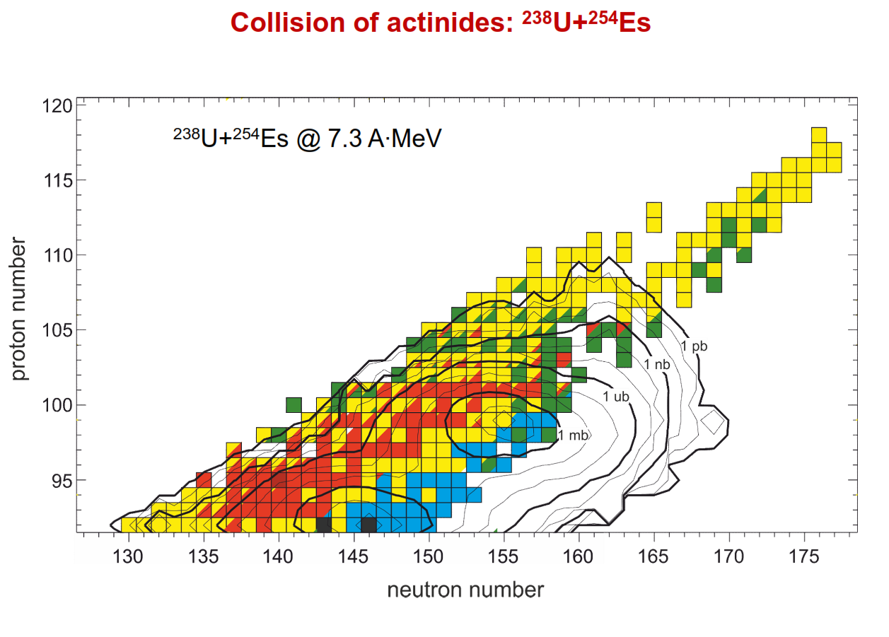

Slide 19
Kinematics of MNT reaction products

Slide 20
²³⁸U + ²⁴⁸Cm → ≈ ²⁹⁸114 + ≈ ¹⁷⁸Yb (MNT reaction)
Nucl. | Е(МeV) | Bρ (vac. Т∙m) | Bρ (He. Т∙m) | Bρ (H₂. Т∙m) | V (cm/ns) | E/q_{vac} (MV)
²³⁸U | 1586 | 1.31 | 1.94 | 1.94 | 3.6 | 23.5
²⁴⁸Cm | 1585 | 1.30 | 1.96 | 1.96 | 3.51 | 22.9
²⁹⁸Fl | 19.6 | 0.83 | 2.04 | 2.52 | 0.36 | 1.49
¹⁷⁸Yb | 1532 | 1.30 | 1.77 | 1.77 | 3.97 | 25.8
²⁹⁸Fl | 1538 | 1.30 | 2.13 | 2.13 | 3.15 | 20.4
¹⁷⁸Yb | ← 20.1 | 0.68 | 1.75 | 1.93 | ← 0.45 | 1.55
⁴He | 103 |  | 1.46 |  | 5.7
¹H₂ | 26 |  |  | 0.74 | 6.0
For ²⁹⁸Fl V (cm/ns) 3.15; E/q_{vac} (MV) 20.4 at 0⁰
V (cm/ns) 0.36; E/q_{vac} (MV) 1.49 at 30⁰ - 40⁰

Slide 21
Summary and Future Plans
● At the velocity filter SHIP in reactions of ⁴⁸Ca + ²⁴⁸Cm more than 100 MNT
products with proton numbers up to Z = 102 were observed
● The „velocity filter method“ allowed for the first time the observation
of new transuranium isotopes in MNT reactions
● The „velocity filter method“ allowed the so far highest sensitivity,
σ_{1 event} ~1 nb, for MNT products
● Are MNT reactions suitable for the production of (super)heavy nuclei?
● Z > 92, N ≈ 126 → MNT might be favourable for n-deficient transuraniums
● n-rich SHE → new isotopes up to Z ~ 108 seem feasible
● Future development of dedicated experimental set ups, analysis of MNT products under different angles.

Slide 22

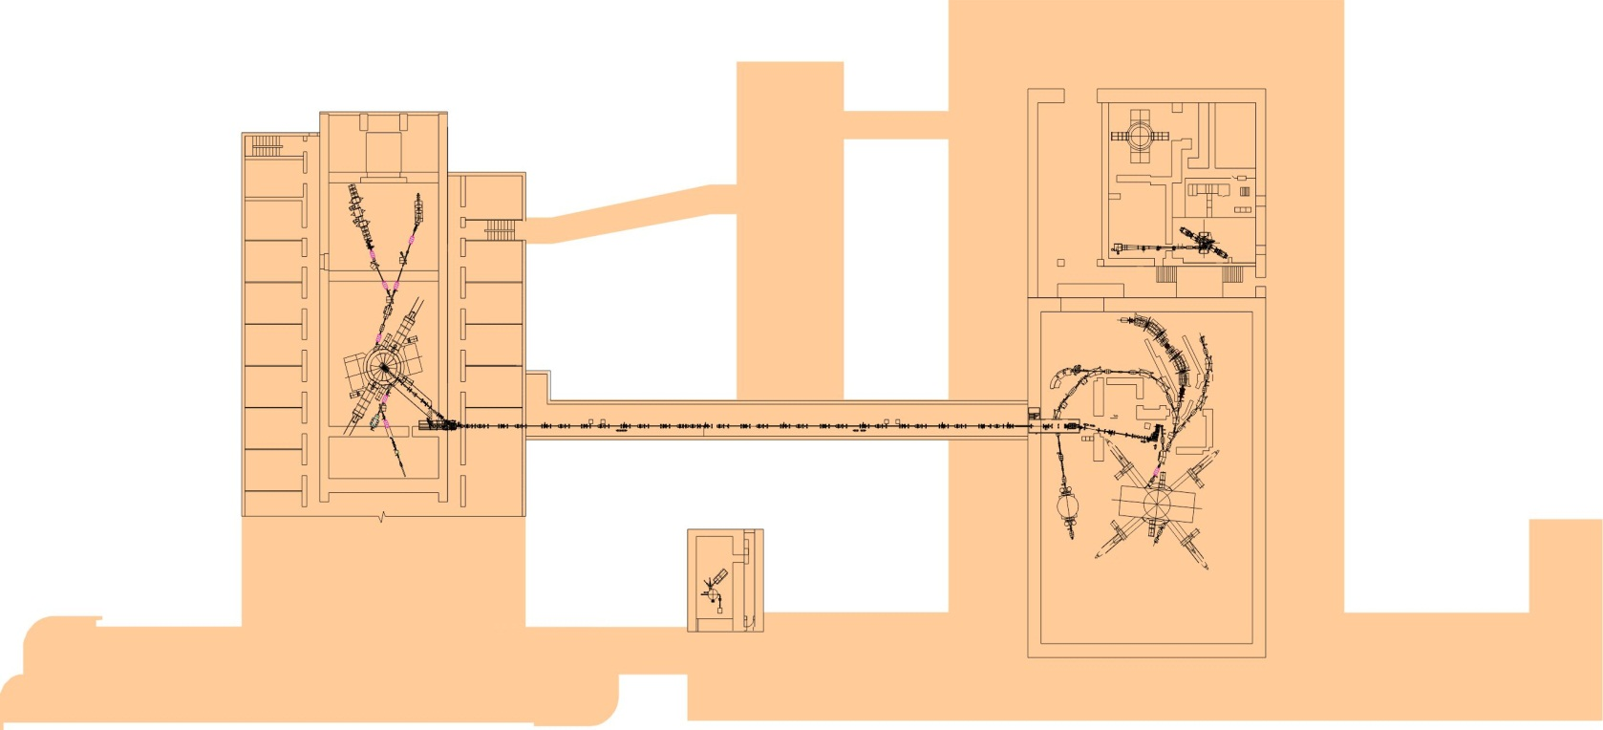
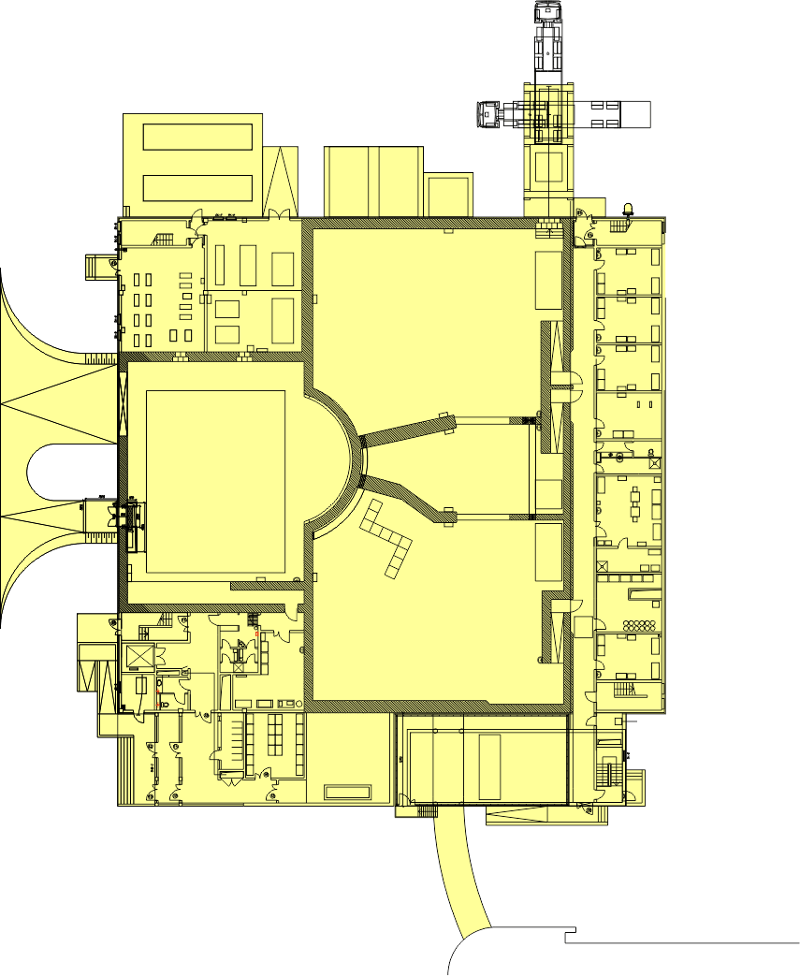
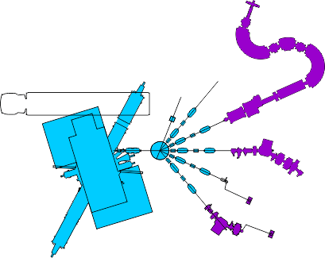
FLNR accelerators (present)
SHELS + GABRIELA
Dubna Gas Filled Separator
DC280
1000m²
IC100
DRIBs
U400
MT25
U400M
U400M
SHE experiments
Nuclear
Physics
Exotic Nuclei
E = 30 ÷ 60 MeV/n
A < 60

Slide 23
FLNR U400 cyclotron with ECR source
(in future – U400R + new experimental hall)
U400
U400R
 | У 400 (A/Z=5÷12) |  | У 400R (A/Z=4÷12)
Accelerated beams | Energy (A∙MeV) | Intensity | Energy (A∙MeV) | Intensity
6<A<40
⁷Li | 17 | 6×10¹³ | 17 | 1×10¹⁴
¹⁸O | 19 | 2×10¹³ | 19 | 1×10¹⁴
⁴⁰Ar | 5 | 9×10¹² | 5 | 3×10¹³
A ~ 60
⁴⁸Ca | 5 | 7.5×10¹² | 5 | 2×10¹³
⁵⁴Cr | 5 | 4×10¹² | 5 | 6×10¹²
⁵⁸Fe | 5 | 4.4×10¹² | 5 | 6×10¹²
A ~ 150
¹²⁴Sn | 5 | 3×10¹¹ | 5 | 2×10¹²
¹³⁶Xe | 5 | 5×10¹¹ | 5 | 3×10¹²
A ~ 240
²³⁸U | 7 | 3×10¹⁰ | 7 | 10¹¹
Complete
fusion
MNT reactions
Smooth energy variation. Increase of beam intensity by factor of 3.

Slide 24
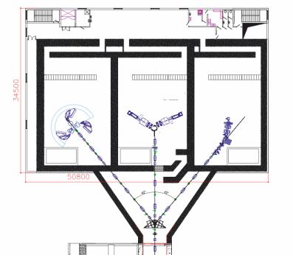
FLNR accelerators (future)
New experimental hall
DC280
SHELS
1000m²
IC100
DRIBs
U400R
MT25
U400M
U400M
SHE experiments
Nuclear
Physics
Exotic Nuclei
E = 30 ÷ 60 MeV/n
A < 60

Slide 25

STAR
STAR – Separator for
TransActinide Research

Slide 26
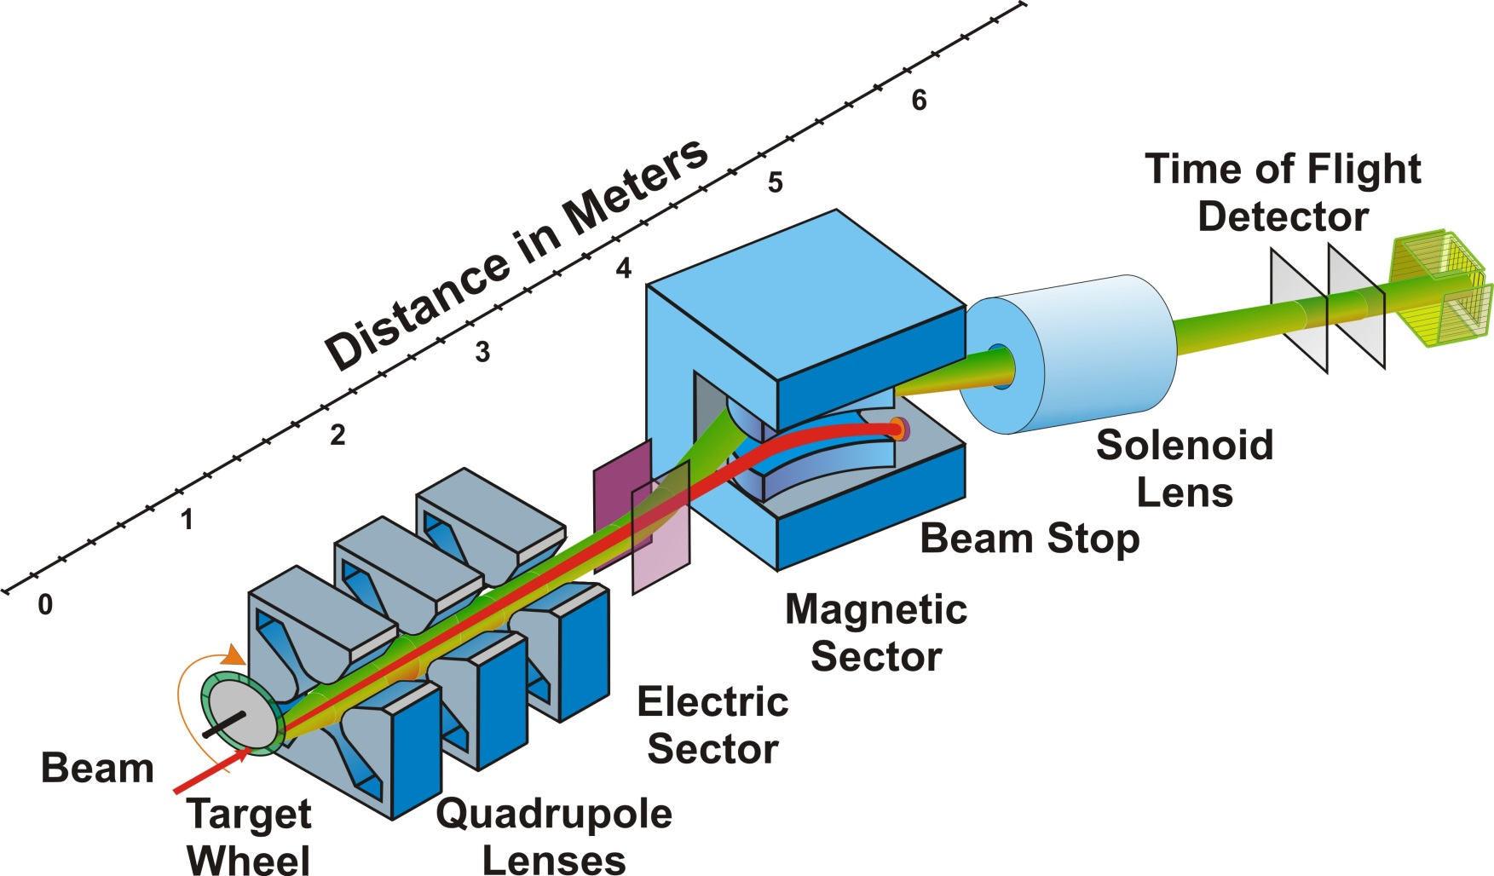
STAR – Separator for TransActinide Research

Slide 27
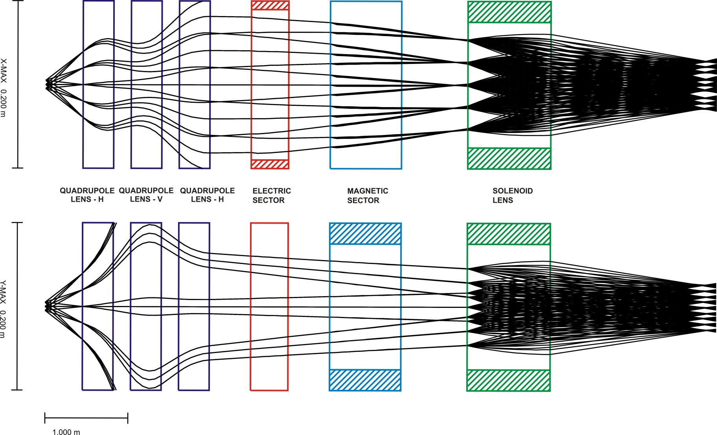
STAR – Separator for TransActinide Research

Slide 28

STAR – Separator for TransActinide Research
Thank you for your attention!

