Slide 1
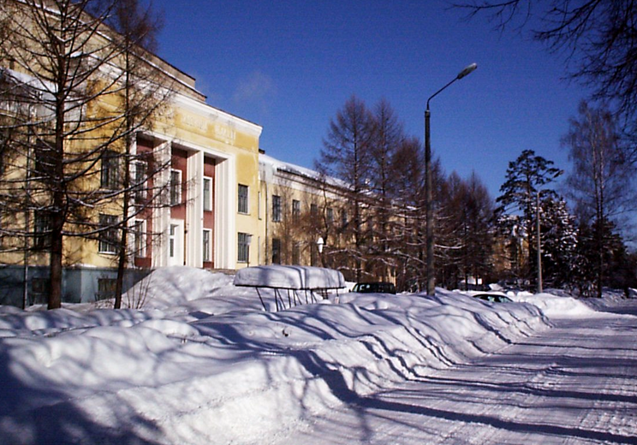
Status of the DC-280 cyclotron
of Factory for Super Heavy Elements
Vasiliy Semin
Scientific and Technological accelerator department
FLEROV LABORATORY of NUCLEAR REACTIONS,
Joint institute for nuclear research, Dubna, Russia

Slide 2
Main parameters of the DC-280
parameters | design | Reached for today
Ion source | DECRIS-PM - 14 GHz on the HV platform (U_{max}=60kV )
Injecting beam potential | Up to 80 keV/Z | 38,04 – 72,89 kV
A/Z | 4÷7.5 | 4,44 (⁴⁰Ar⁺⁷) – 6,86 (⁴⁸Ca⁺⁷)
Energy | 4÷8 MeV/n | 4,01 – 7 MeV/n
Ion (from DECRIS-PM) | 4-136 | 12 (¹²C⁺²) – 84 (⁸⁴Kr⁺¹⁴)
Intensity (A~50) | >10 pµA | 10,43 pµA (⁴⁰Ar⁺⁷), 5,2 pµA (⁴⁸Ca⁺⁷)
Magnetic field level | 0.6÷1.3 T | 0.8÷1.23 T
K factor | 280
Dee voltage | 2x130 kV | 2x130 kV
Power of RF generator | 2x30 kW
Flat-top dee voltage | 2x13 kV | ---
Power of Flat-top generator | 2x2 kW
Emittance | less than 30 π mm·mrad
Accelerator effectivity | >50% | 51,9 % (⁴⁸Ca⁺¹⁰ 5 MeV/n 5 pmkA)

Slide 3
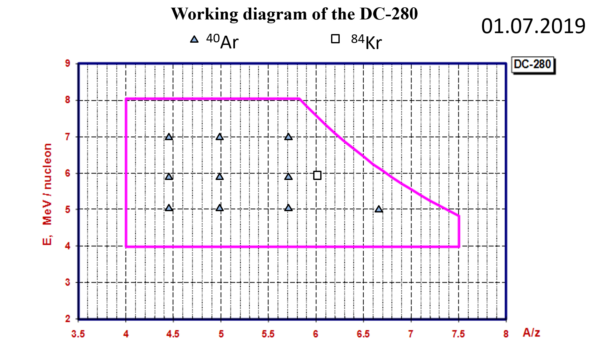

Slide 4
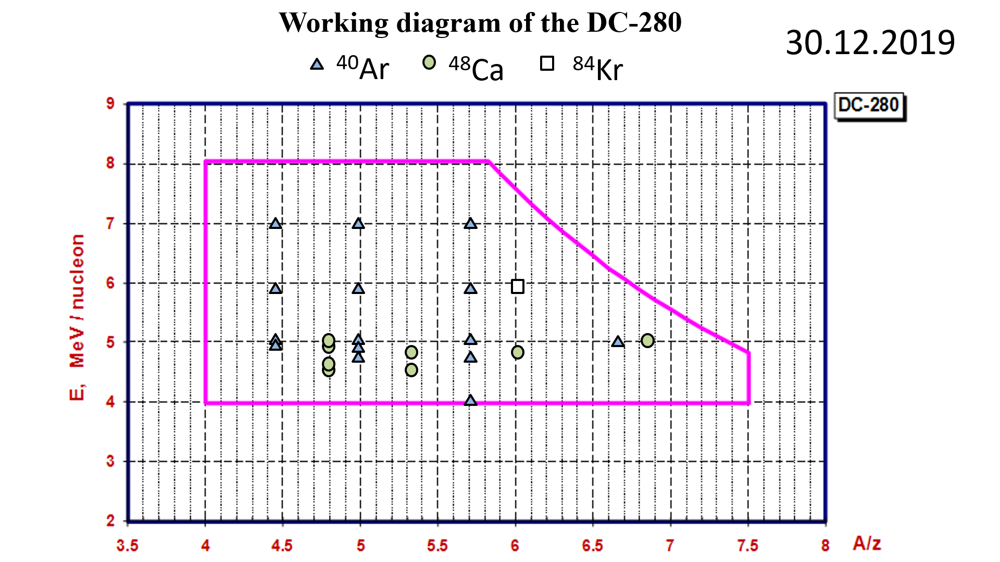

Slide 5
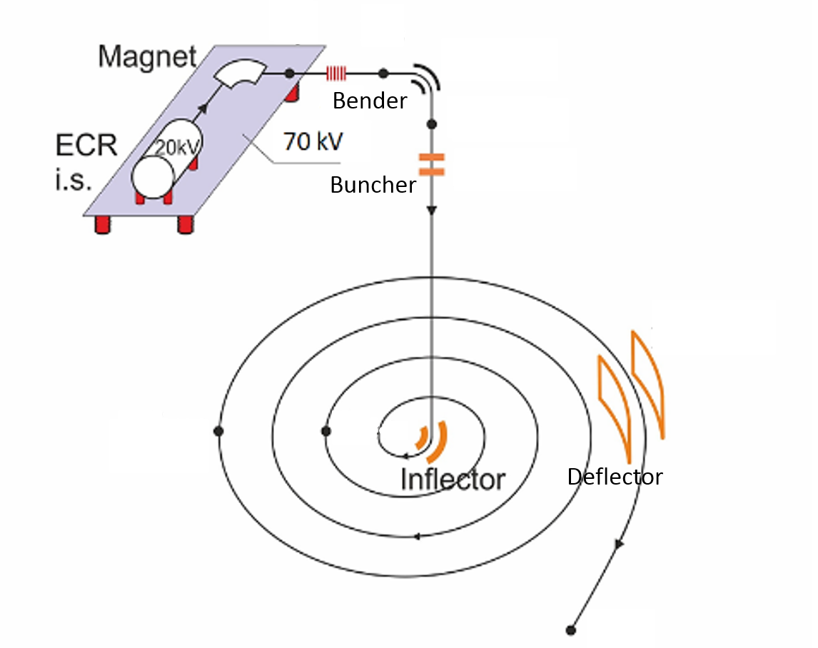
Efficiency of acceleration in cyclotron DC-280
1
2
4
3
Axial injection system
After Separation
Vertical part
Incite cyclotron
R = 40 cm
R = 177 cm
Transport channel
Before DGFS
5

Slide 6
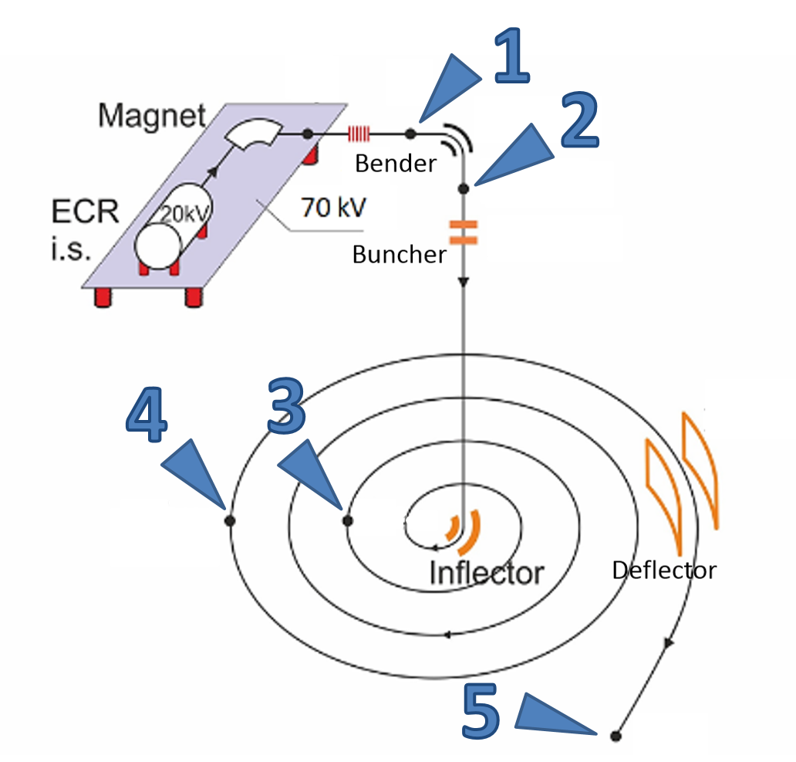
Efficiency of acceleration in cyclotron DC-280
Ion | Energy (MeV) | Intensity (puA) |  |  |  |  | Efficiency (%)
 |  | axial injection |  | cyclotron |  | Transport Channel
 |  | After separation | vertical part | r=400 | r=1770 |  | Axial injection | capture | Cyclotron | Extraction | Total
 |  | 1 | 2 | 3 | 4 | 5 | 2/1 | 3/2 | 4/3 | 5/4 | 5/1
⁴⁰Ar⁺⁷ | 236 | 14,3 | 12,9 | 9 | 7,7 | 6,3 | 90,2% | 69,8% | 85,6% | 81,8% | 44,0%
⁴⁰Ar⁺⁷ | 195 | 28,7 | 24,7 | 17,1 | 14,2 | 10,4 | 86,0% | 69,1% | 83,5% | 73,2% | 36,4%
⁴⁸Ca⁺⁷ | 240 | 12,6 | 11,3 | 7,6 | 6,5 | 4,8 | 90,0% | 67,4% | 85,3% | 73,5% | 38,0%
⁴⁸Ca⁺⁷ | 240 | 10,9 | 9,8 | 6,9 | 6,1 | 5,2 | 90,0% | 70,9% | 88,2% | 84,8% | 47,7%
⁴⁸Ca⁺¹⁰ B | 240 | 9 | 8,07 | 5,58 | 5,1 | 4,7 | 90,0% | 69,2% | 91,4% | 91,4% | 51,9%
⁴⁸Ca⁺¹⁰ B | 240 | 8,3 | 7,5 | 5,5 | 5 | 4,3 | 90,0% | 73,6% | 90,2% | 86,3% | 51,6%
⁸⁴Kr⁺¹⁴ | 496 | 3,1 | 2,8 | 1,7 | 1,6 | 1,4 | 90,6% | 60,0% | 92,9% | 92,3% | 46,6%
Axial injection system
After Separation
Vertical part
B
Incite cyclotron
R = 40 cm
R = 177 cm
Transport channel
Before DGFS

Slide 7
Resolved tasks:
Test of accelerator systems with high intensity
Testing of cyclotron systems during longtime work
Investigation of accelerated beam stability
Staffing of the DC-280 work group
Debugging of services processes for high voltage elements

Slide 8
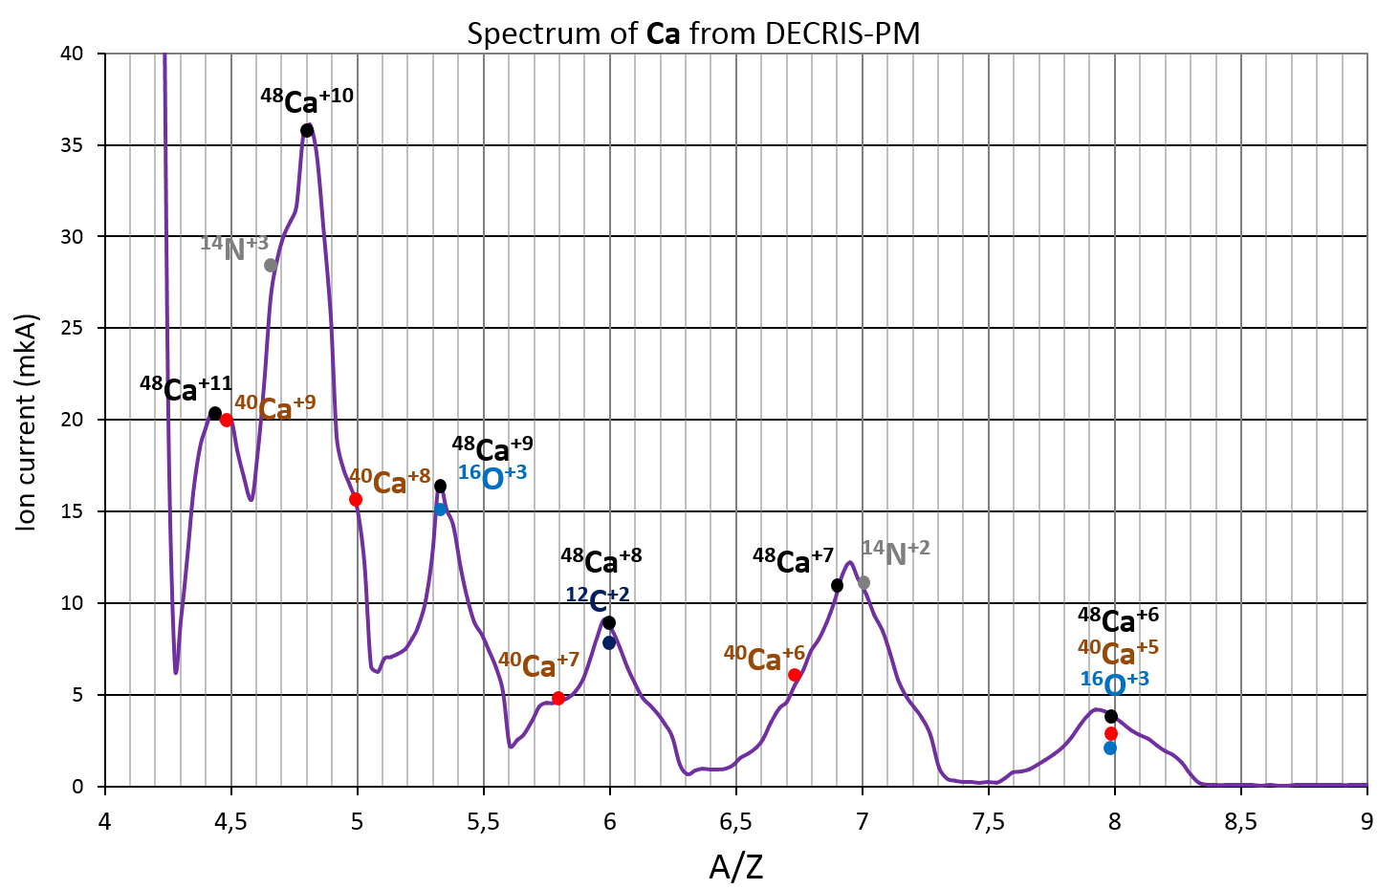
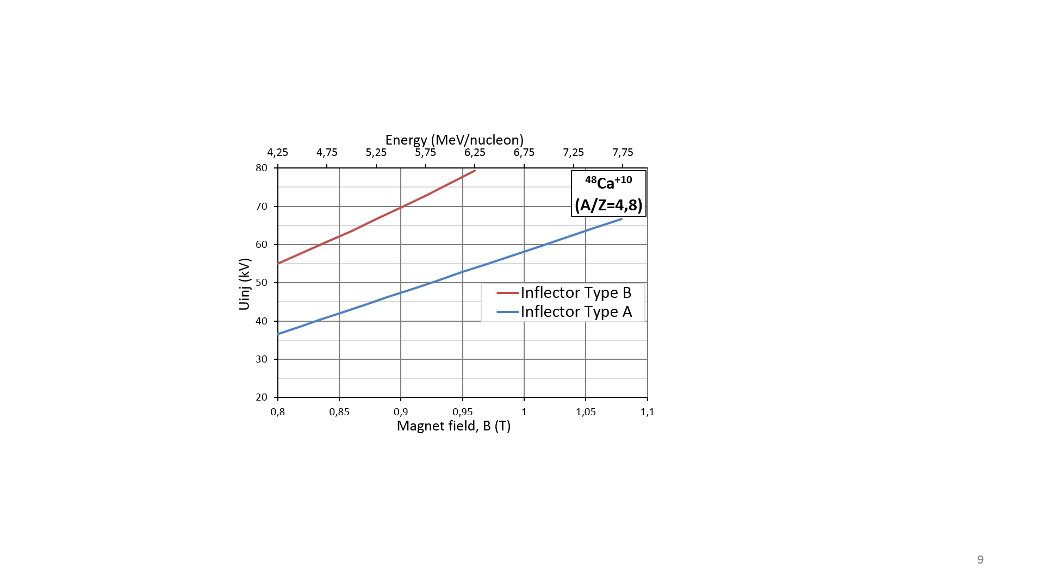
267 MeV (5,56 MeV/n)
Ions trajectory in central of the cyclotron
Inflector magnetic radius
Type A R_{m}=7,5 cm
Type B R_{m}=9,2 cm

Slide 9
⁴⁸Ca
№ | Date | consumption (mg/h) | Time (h) | Current (pmkA) | Z
1 | 11 - 13.11.2019 | 1,49 | 48 | 8,9 | +9
2 | 13 - 18.11.2019 | 1,09 | 52 | 4,4 | +8
3 | 18 - 22.11.2019 | 0,48 | 72 | 2,5 | +10
4 | 22 - 26.11.2019 | 0,54 | 91 | 3 | +10
5 | 26 - 29.11.2019 | 0,31 | 66 | 3 | +10
6 | 29.11 - 03.12.2019 | 0,93 | 81 | 3 | +10
7 | 03 - 06.12.2019 | 0,54 | 72 | 5,7 | +7
8 | 06 - 12.12.2019 | 0,83 | 111 | 10+2 | +10
9 | 12 - 21.12.2019 | 0,33 | 209 | 4 | +10
average
0,56 mg/h
Ion | Energy | Intensity (puA) |  |  |  |  |  | Efficiency (%)
 |  | axial injection |  | cyclotron |  | Transport Channel | Target
 |  | After separation | vertical part | r=400 | r=1770 |  |  | Axial injection | capture | Cyclotron | Extraction | Transport Channel | Total
⁴⁸Ca⁺¹⁰ B | 240 | 9 | 8,07 | 5,58 | 5,1 | 4,7 | 4,2 | 90,0% | 69,2% | 91,4% | 91,4% | 90% | 47 %
⁴⁸Ca⁺¹⁰ B | 240 | 8,3 | 7,5 | 5,5 | 5 | 4,3 | 3,9 | 90,0% | 73,6% | 90,2% | 86,3% | 90% | 46 %

Slide 10
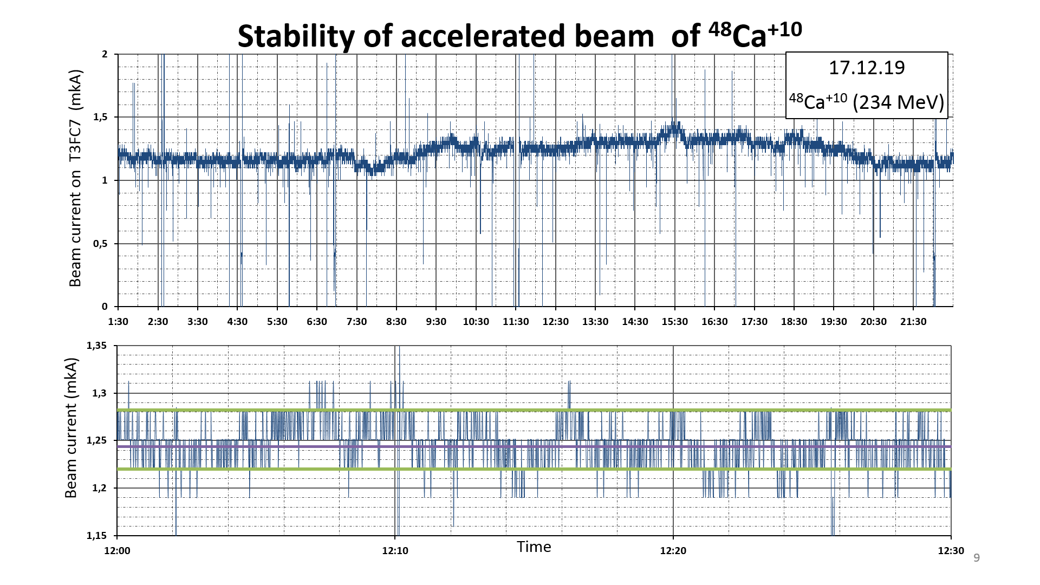
Beam stability at acceleration of 48Ca+10 ions
5 %

Slide 11
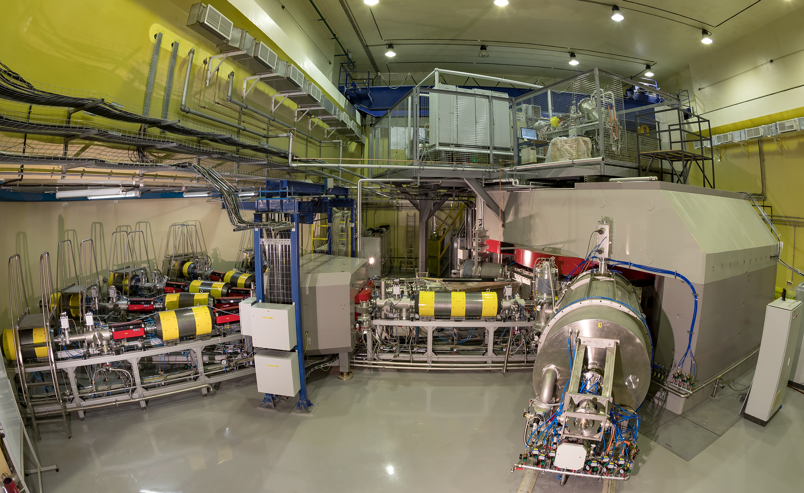
Reached for today:
40 Ar beam intensity 10 pm kA;
48Ca beam Intensity 5 pmkA;
Efficiency 50% from Axial injection to transport channel;
Efficiency 90% through transport channel;
Beam current stability 5%;
Current tasks :
HF amplifier power supply stability;
Commissioning of Flat-Top System;
Problem of electrical breakdowns of HV elements;
Improving of efficiency

Slide 12
Efficiency of acceleration in cyclotron DC-280
Ion | Energy | Intensity (puA) |  |  |  |  | Efficiency (%)
 |  | axial injection |  | cyclotron |  | Transport Channel
 |  | After separation | vertical part | r=400 | r=1770 |  | Axial injection | capture | Cyclotron | Extraction | Total
⁴⁰Ar⁺⁷ | 236 | 14,3 | 12,9 | 9 | 7,7 | 6,3 | 90,2% | 69,8% | 85,6% | 81,8% | 44,0%
⁴⁰Ar⁺⁷ | 195 | 28,7 | 24,7 | 17,1 | 14,2 | 10,4 | 86,0% | 69,1% | 83,5% | 73,2% | 36,4%
⁴⁸Ca⁺⁷ | 240 | 12,6 | 11,3 | 7,6 | 6,5 | 4,8 | 90,0% | 67,4% | 85,3% | 73,5% | 38,0%
⁴⁸Ca⁺⁷ | 240 | 10,9 | 9,8 | 6,9 | 6,1 | 5,2 | 90,0% | 70,9% | 88,2% | 84,8% | 47,7%
⁴⁸Ca⁺⁸ | 230 | 4,4 | 4 | 2,8 | 2,4 | 1,9 | 90,1% | 68,8% | 86,9% | 80,8% | 43,4%
⁴⁸Ca⁺⁹ | 230 | 6,1 | 5,5 | 4,6 | 3,3 | 2,3 | 90,0% | 84,1% | 70,4% | 70,6% | 37,6%
⁴⁸Ca⁺¹⁰ B | 240 | 9 | 8,07 | 5,58 | 5,1 | 4,7 | 90,0% | 69,2% | 91,4% | 91,4% | 51,9%
⁴⁸Ca⁺¹⁰ B | 240 | 8,3 | 7,5 | 5,5 | 5 | 4,3 | 90,0% | 73,6% | 90,2% | 86,3% | 51,6%
⁸⁴Kr⁺¹⁴ | 496 | 3,1 | 2,8 | 1,7 | 1,6 | 1,4 | 90,6% | 60,0% | 92,9% | 92,3% | 46,6%

