Slide 1
Status of the separator DGFRS-2:
Results of test experiments
V.K. Utyonkov
Flerov Laboratory of Nuclear Reactions JINR
51th meeting of the PAC for Nuclear Physics
30 January 2020
International Conference Centre

Slide 2
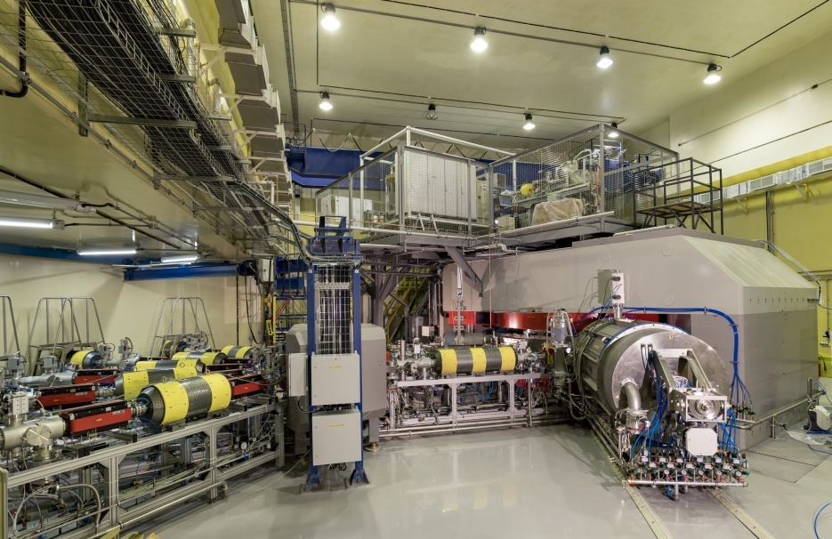
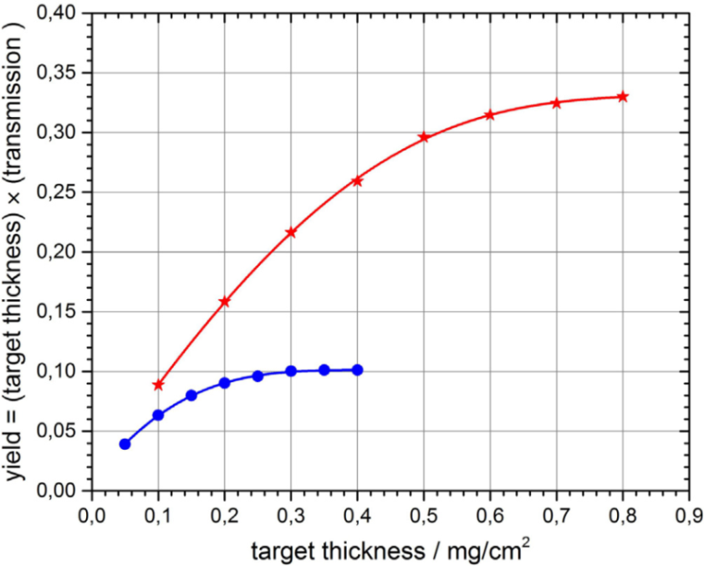
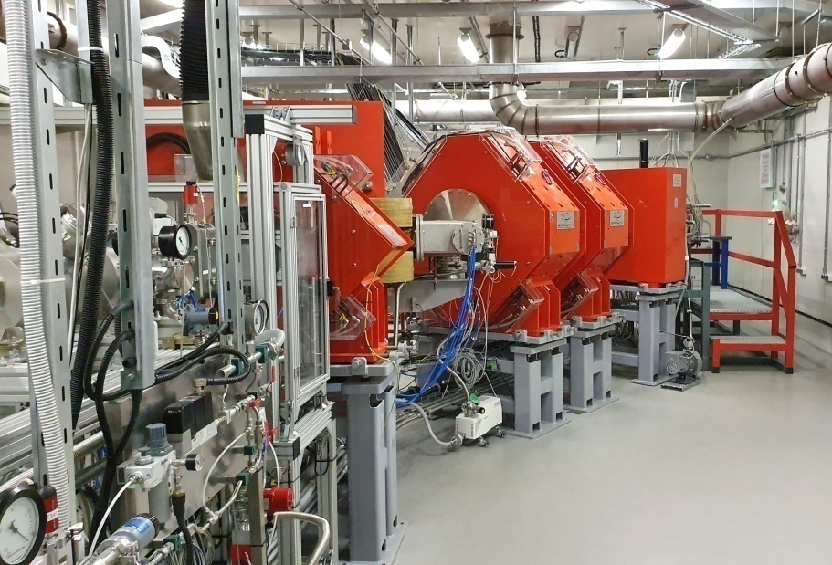
SHE Factory
Cyclotron DC 280
Ion | Expected beam intensity of (4-8) MeV/A ions (pps)
⁴⁸Ca | 0.6-1.2×10¹⁴
⁵⁰Ti | 3×10¹³
factor of 10
Separator DGFRS-2
DGFRS-2
factor of 3
DGFRS-1
Simulated yields of Fl isotopes (A.G. Popeko)
DQ_{h}Q_{v} set-up Q_{v}D_{h}Q_{h}Q_{v}D set-up

Slide 3

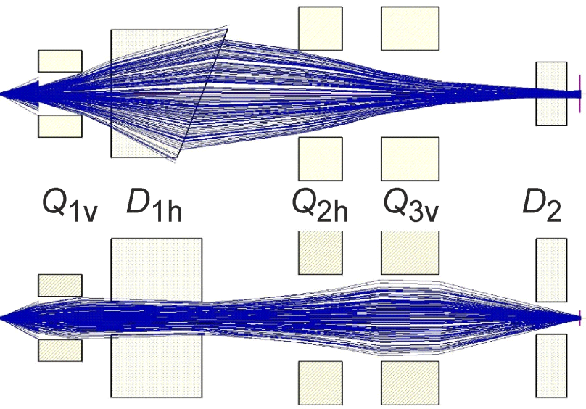
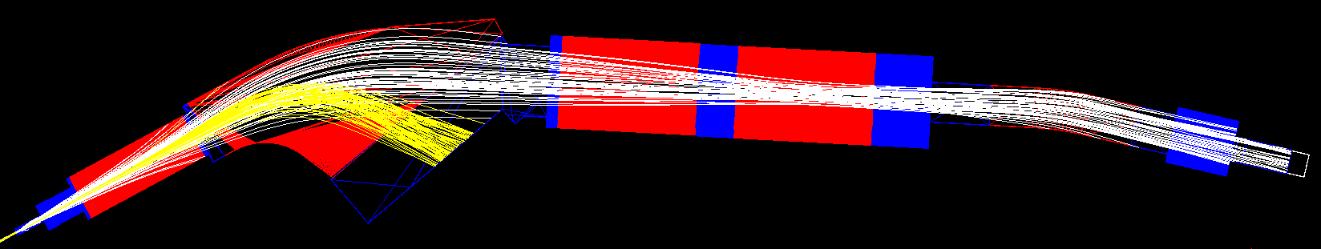
Separator DGFRS-2
Quadrupole 1
A.G. Popeko
D.I. Solovyev
N.D. Kovrizhnykh
Quadrupoles 2 & 3
Effective length | 456 mm
Bore diameter | 150 mm
Maximum field gradient | 13.3 T/m
Effective length | 600 mm
Bore diameter | 300 mm
Maximum field gradient | 5.4 T/m
Dipole 1
Dipole 2
Gap | 120 mm
Bending angle | 31.5⁰
Bending radius | 1.86 m
Maximum field | 1.80 T
Pole face angle (entrance/exit) | -8.4⁰ / -44.5⁰
Effective length | 1025 mm
Gap | 120 mm
Bending angle | 10⁰
Bending radius | 2.58 m
Maximum field | 1.81 T
Pole face angle (entrance/exit) | 0⁰
Effective length | 451 mm

Slide 4
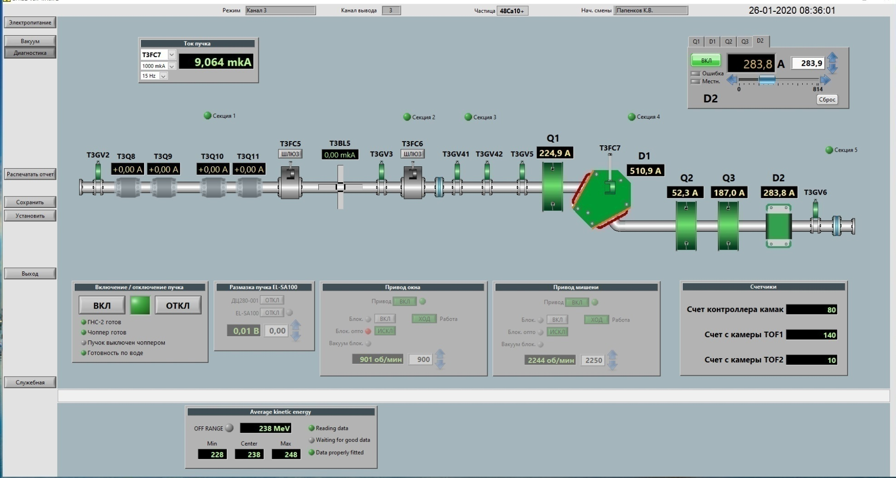
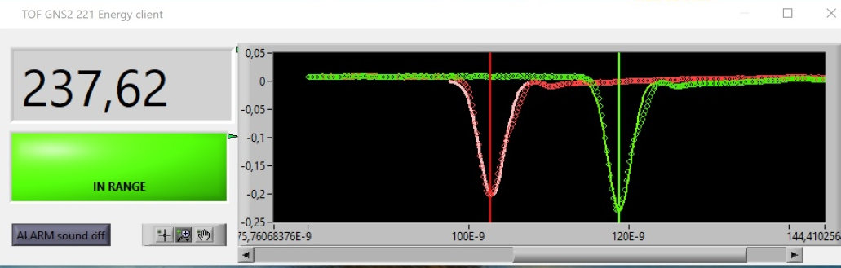
Separator DGFRS-2: control and safety components of the magnetic elements measurement of the beam energy

Slide 5
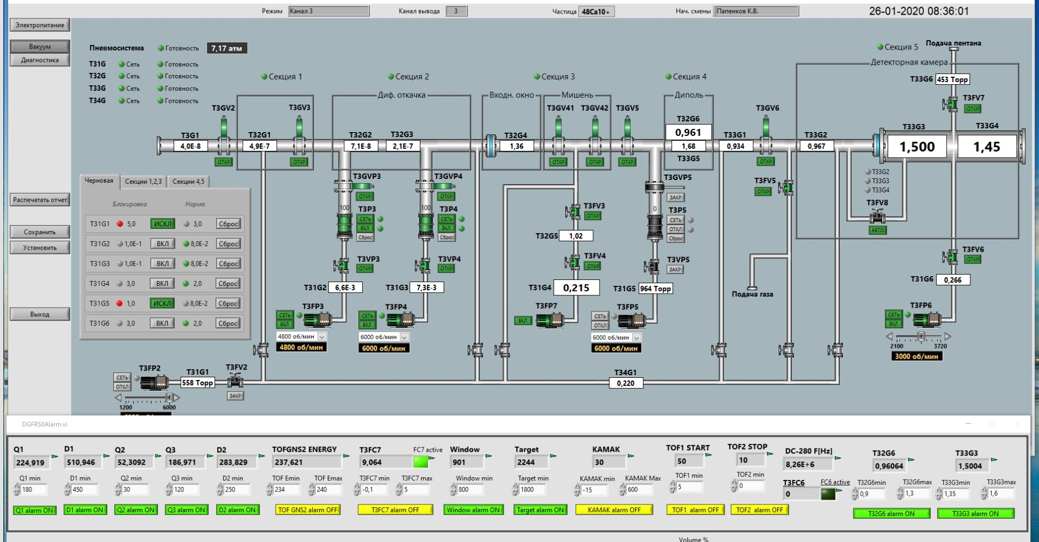
Separator DGFRS-2: control and safety components of the vacuum systems

Slide 6
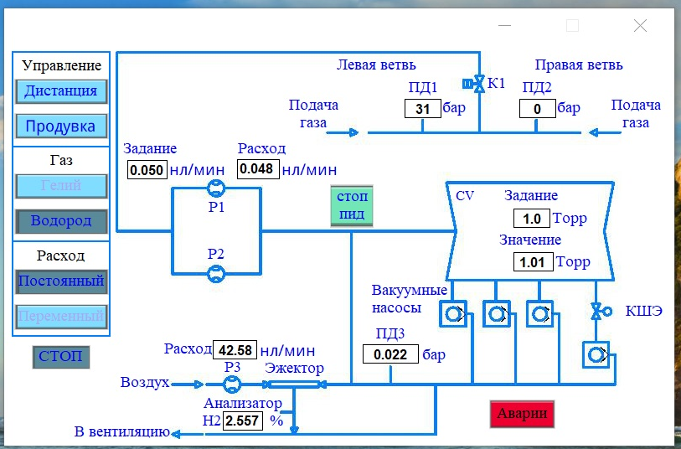
Separator DGFRS-2: control and safety components of the gas system

Slide 7
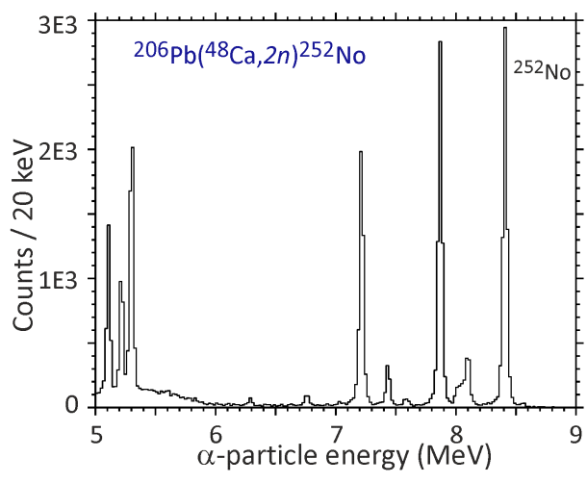
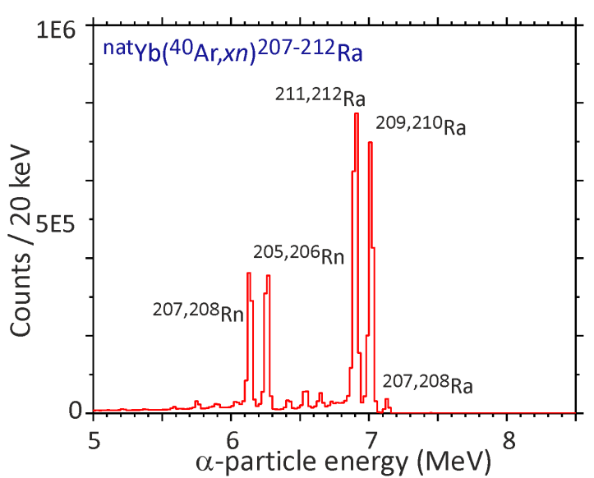
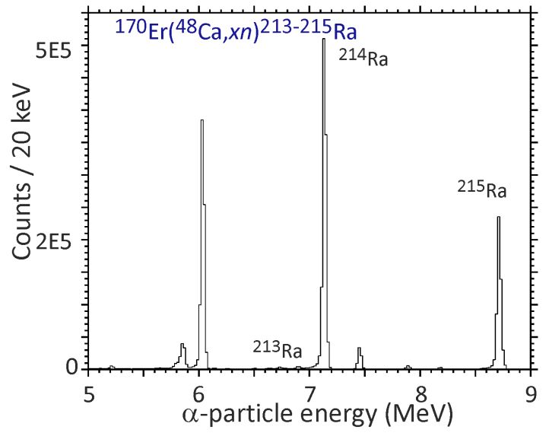
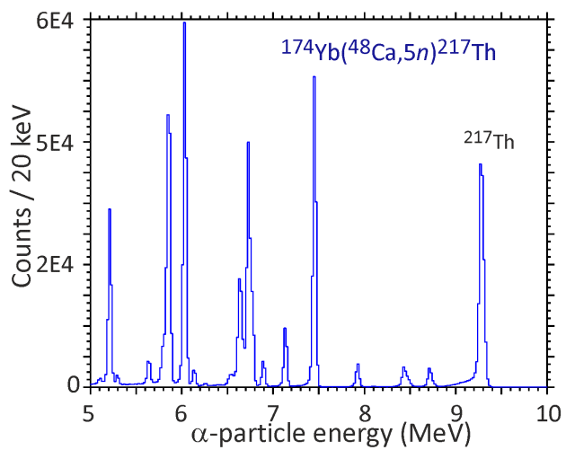
Test reactions:
^{nat}Yb+⁴⁰Ar→²⁰⁷⁻²¹²Ra, ¹⁷⁰Er+⁴⁸Ca →^{214,215}Ra, ^{nat}Yb,¹⁷⁴Yb+⁴⁸Ca →^{216,217}Th,
²⁰⁶Pb+⁴⁸Ca →²⁵²No
Cross section ~10⁸⁻⁹ pb
Adjustment of optical elements Q_{v}, D_{h}, Q_{h}, Q_{v}, D
Reactions:
^{nat}Yb (0.21, 0.43, 0.54, 0.64 mg/cm²)+⁴⁰Ar→²⁰⁷⁻²¹²Ra
¹⁷⁰Er (0.54 mg/cm²)+⁴⁸Ca →^{214,215}Ra
^{nat}Yb (0.21, 0.43, 0.54, 0.64 mg/cm²)+⁴⁸Ca →^{216,217}Th
¹⁷⁴Yb (0.35 mg/cm²) +⁴⁸Ca →^{216,217}Th
²⁰⁶Pb (0.43 mg/cm²) +⁴⁸Ca →²⁵²No

Slide 8
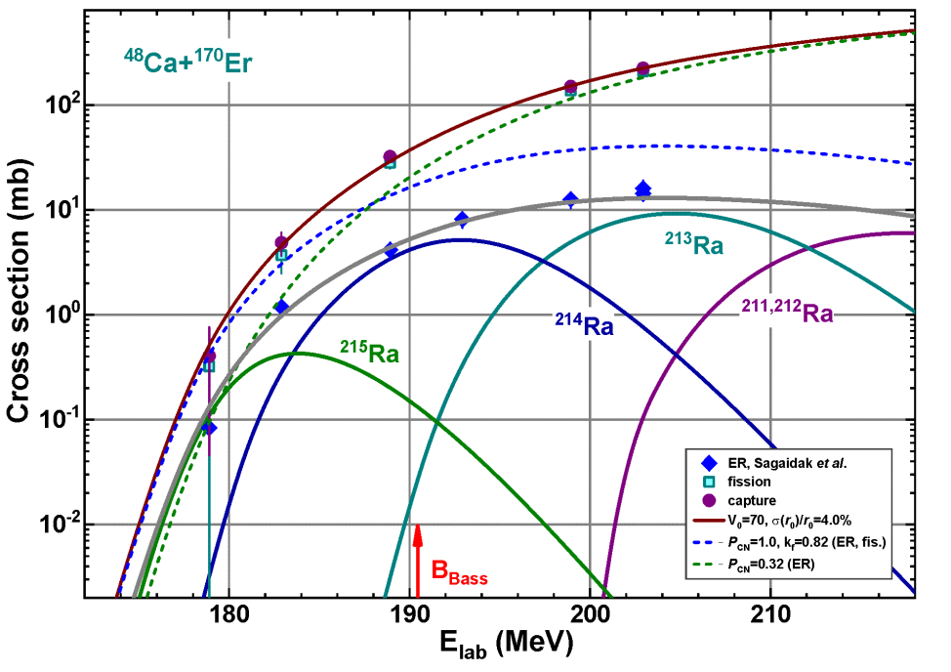
Test reactions:
^{nat}Yb+⁴⁰Ar→²⁰⁷⁻²¹²Ra, ¹⁷⁰Er+⁴⁸Ca →^{214,215}Ra, ^{nat}Yb,¹⁷⁴Yb+⁴⁸Ca →^{216,217}Th,
²⁰⁶Pb+⁴⁸Ca →²⁵²No
Cross section ~10⁸⁻⁹ pb
Adjustment of optical elements Q_{v}, D_{h}, Q_{h}, Q_{v}, D
Transmission
¹⁷⁰Er (0.54 mg/cm²)+⁴⁸Ca →^{214,215}Ra
From calculated cross section:
> 45%
Will be measured in the ²⁰⁶Pb+⁴⁸Ca →²⁵²No reaction

Slide 9
Test reactions:
^{nat}Yb+⁴⁰Ar→²⁰⁷⁻²¹²Ra, ¹⁷⁰Er+⁴⁸Ca →^{214,215}Ra, ^{nat}Yb,¹⁷⁴Yb+⁴⁸Ca →^{216,217}Th,
²⁰⁶Pb+⁴⁸Ca →²⁵²No
Cross section ~10⁸⁻⁹ pb
Adjustment of optical elements Q_{v}, D_{h}, Q_{h}, Q_{v}, D
Transmission
Image size on detector
Dispersion
¹⁷⁰Er + ⁴⁸Ca → ²¹⁴Ra
¹⁷⁴Yb + ⁴⁸Ca → ²¹⁷Th
σ _{X} 64 - 92 mm
σ _{Y} 12 - 15 mm
Depends on reaction and target thickness
D ₁ 32 mm / %Bρ
D ₂ 2.6 mm / %Bρ
Increase of detector size?

Slide 10
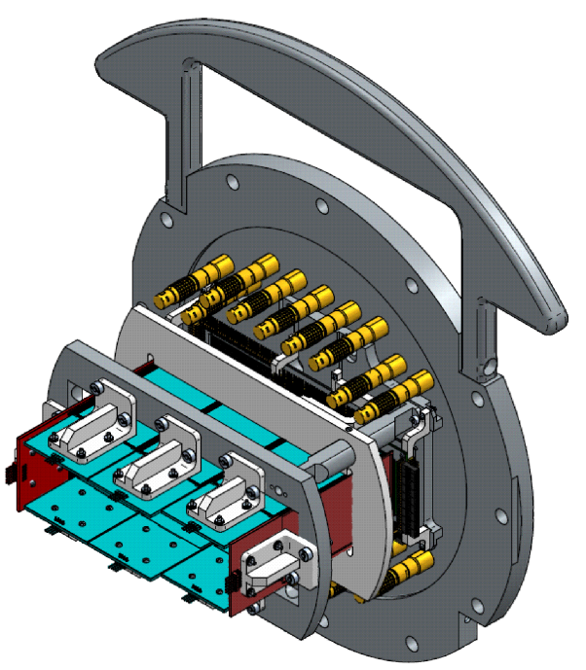
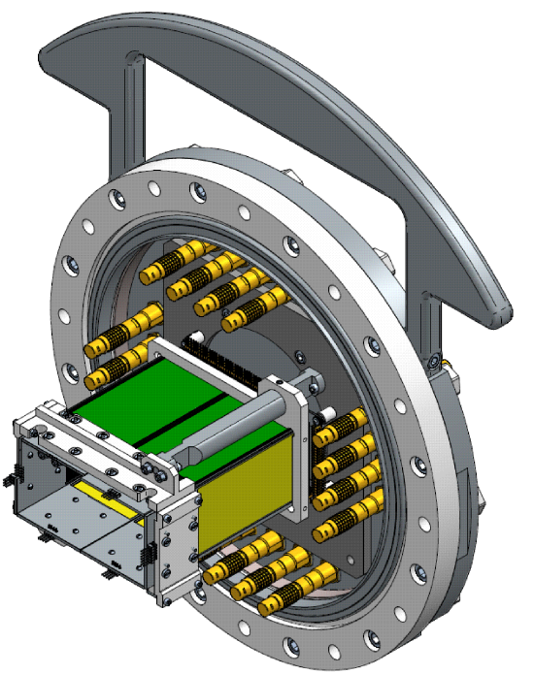
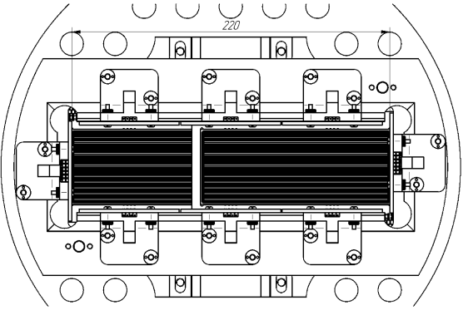
New detectors:
Horizontal size 220 mm
Vertical size 48 mm
Horizontal size 128 mm
Vertical size 48 mm
Increase of detection efficiency by factor of 1.3 - 1.5

Slide 11
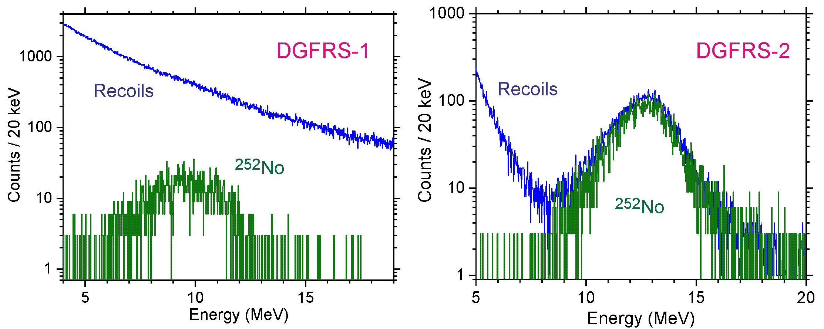
Test reactions:
^{nat}Yb+⁴⁰Ar→²⁰⁷⁻²¹²Ra, ¹⁷⁰Er+⁴⁸Ca →^{214,215}Ra, ^{nat}Yb,¹⁷⁴Yb+⁴⁸Ca →^{216,217}Th,
²⁰⁶Pb+⁴⁸Ca →²⁵²No
Cross section ~10⁸⁻⁹ pb
Adjustment of optical elements Q_{v}, D_{h}, Q_{h}, Q_{v}, D
Transmission
Image size on detector
Dispersion
Background
Increase of suppression of background nuclei
by more than factor of 200

Slide 12
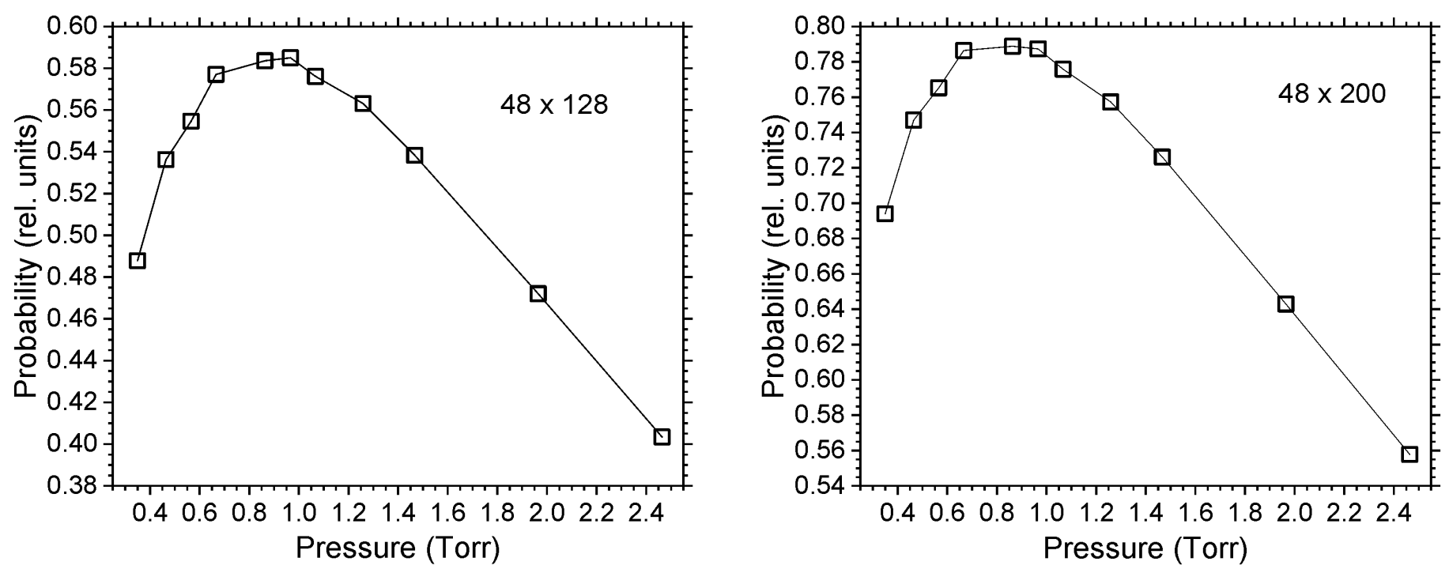
Test reactions:
^{nat}Yb+⁴⁰Ar→²⁰⁷⁻²¹²Ra, ¹⁷⁰Er+⁴⁸Ca →^{214,215}Ra, ^{nat}Yb,¹⁷⁴Yb+⁴⁸Ca →^{216,217}Th,
²⁰⁶Pb+⁴⁸Ca →²⁵²No
Cross section ~10⁸⁻⁹ pb
Adjustment of optical elements Q_{v}, D_{h}, Q_{h}, Q_{v}, D
Transmission
Image size on detector
Dispersion
Background
Optimal gas pressure

Slide 13
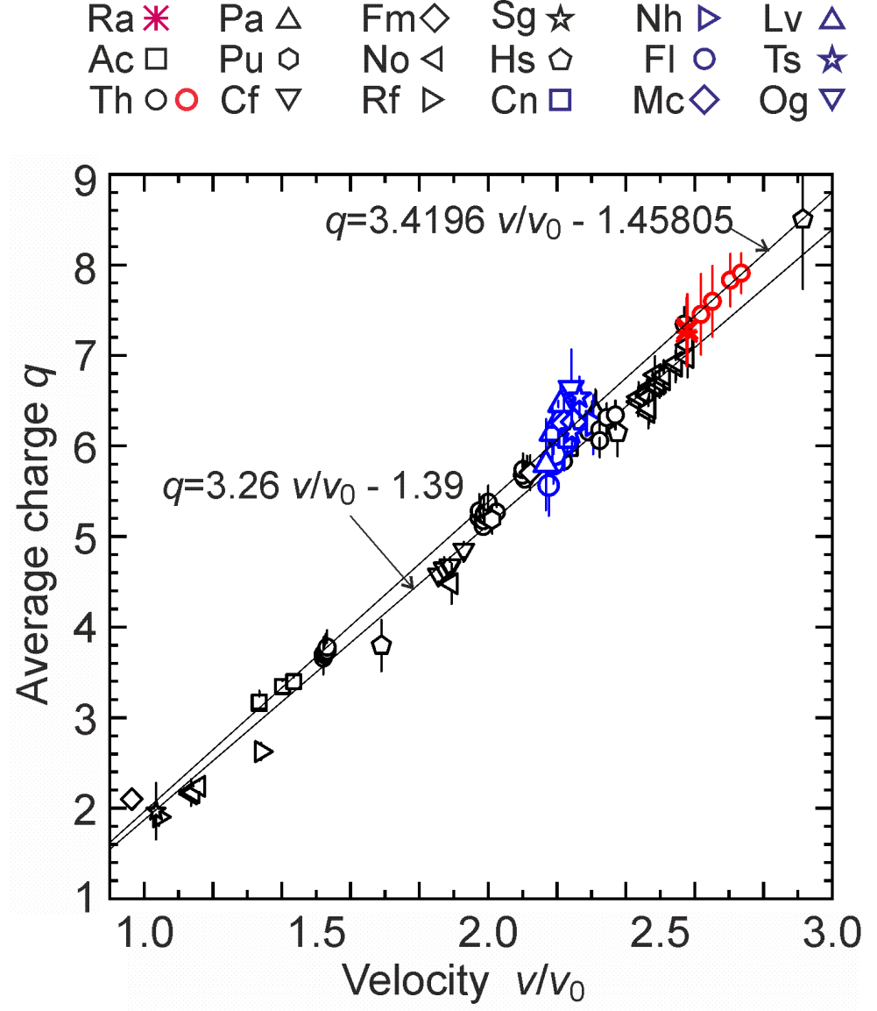
Test reactions:
^{nat}Yb+⁴⁰Ar→²⁰⁷⁻²¹²Ra, ¹⁷⁰Er+⁴⁸Ca →^{214,215}Ra, ^{nat}Yb,¹⁷⁴Yb+⁴⁸Ca →^{216,217}Th,
²⁰⁶Pb+⁴⁸Ca →²⁵²No
Cross section ~10⁸⁻⁹ pb
Adjustment of optical elements Q_{v}, D_{h}, Q_{h}, Q_{v}, D
Transmission
Image size on detector
Dispersion
Background
Optimal gas pressure
Systematics of charge states
Difference in the average charge by 5%
Effective length of dipole in DGFRS?
Should be measured for ²⁵²No in the ²⁰⁶Pb+⁴⁸Ca reaction

Slide 14
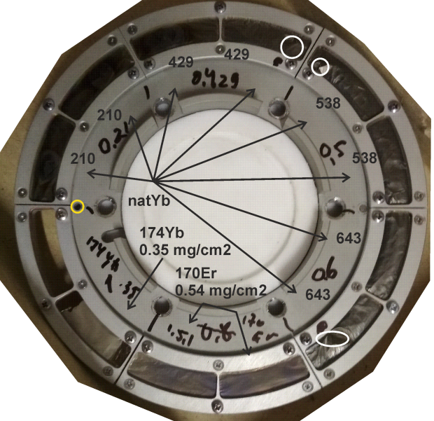
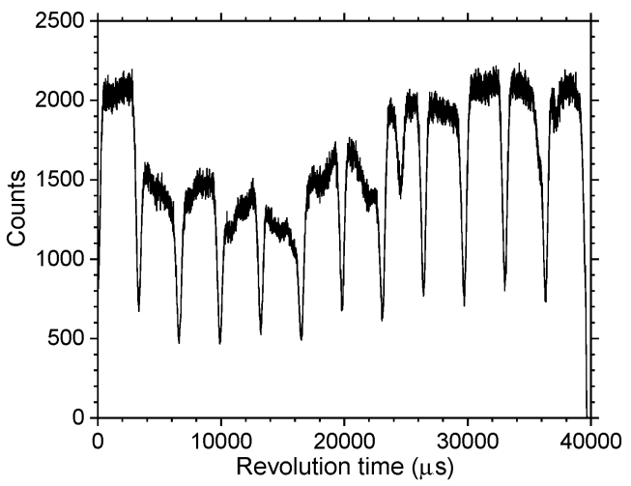
Test reactions:
^{nat}Yb+⁴⁰Ar→²⁰⁷⁻²¹²Ra, ¹⁷⁰Er+⁴⁸Ca →^{214,215}Ra, ^{nat}Yb,¹⁷⁴Yb+⁴⁸Ca →^{216,217}Th,
²⁰⁶Pb+⁴⁸Ca →²⁵²No
Cross section ~10⁸⁻⁹ pb
Adjustment of optical elements Q_{v}, D_{h}, Q_{h}, Q_{v}, D
Transmission
Image size on detector
Dispersion
Background
Optimal gas pressure
Systematics of charge states
Target stability vs. beam intensity
Yield vs. target thickness
6 targets with different thickness on one wheel
Will be measured in the ^{nat}Yb+⁴⁸Ca reaction
in February, 2020

Slide 15
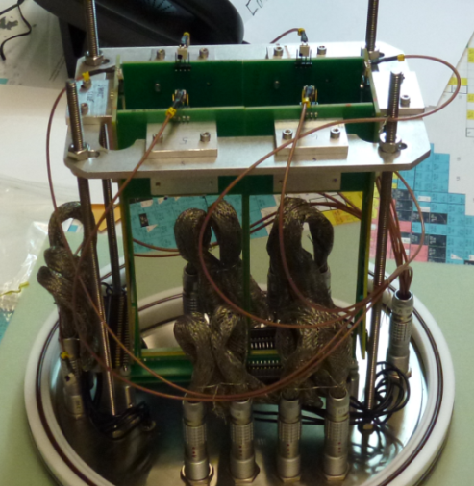
Test reactions:
^{nat}Yb+⁴⁰Ar→²⁰⁷⁻²¹²Ra, ¹⁷⁰Er+⁴⁸Ca →^{214,215}Ra, ^{nat}Yb,¹⁷⁴Yb+⁴⁸Ca →^{216,217}Th,
²⁰⁶Pb+⁴⁸Ca →²⁵²No
Cross section ~10⁸⁻⁹ pb
Adjustment of optical elements Q_{v}, D_{h}, Q_{h}, Q_{v}, D
Transmission
Image size on detector
Dispersion
Background
Optimal gas pressure
Systematics of charge states
Target stability vs. beam intensity
Yield vs. target thickness
Test of digital and analog
data acquisition systems
48×128 DSSD & 6×8 SSSD
Digital and analog electronics,
in parallel
L. Schlattauer

Slide 16
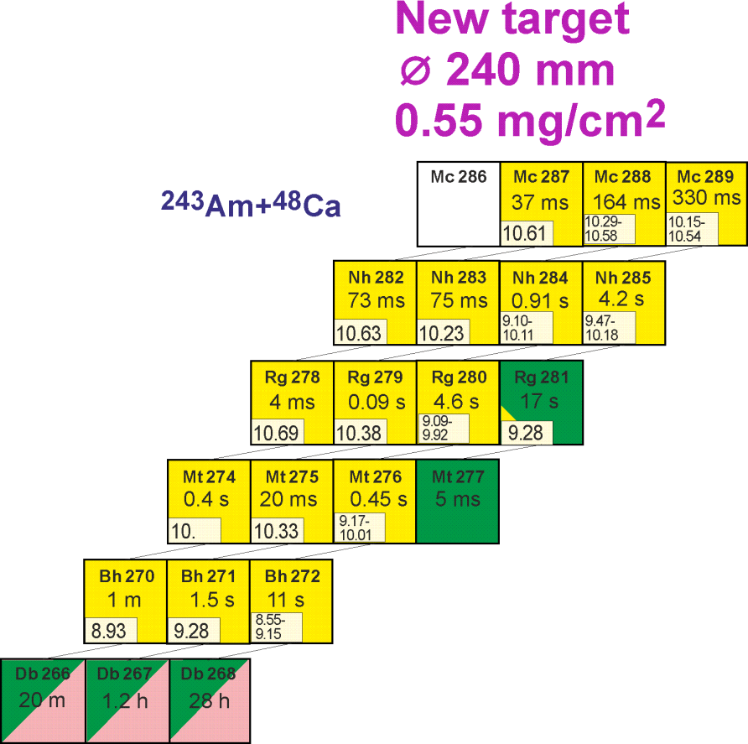
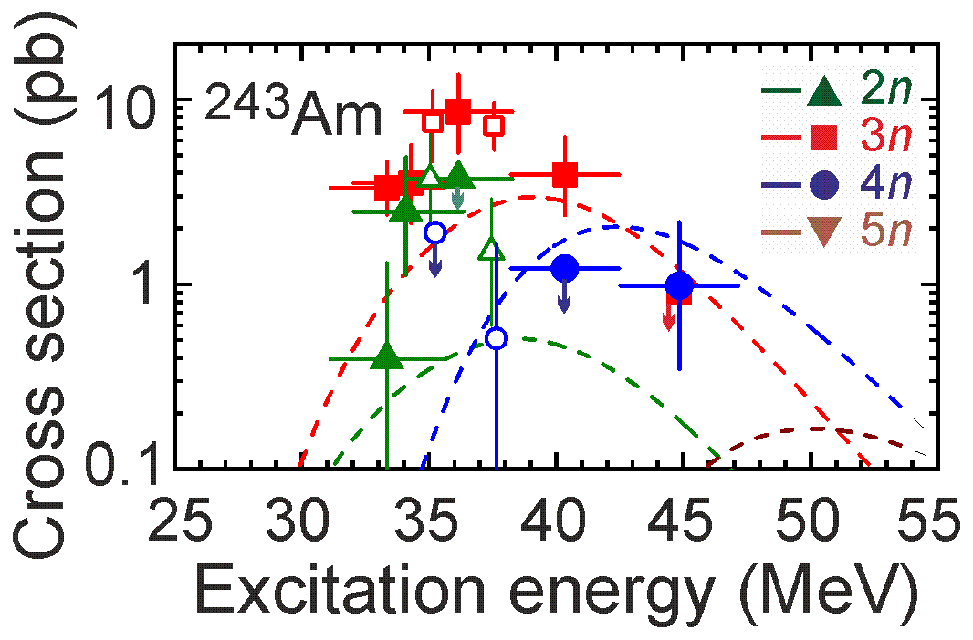
Future experiment at SHE Factory
²⁴³Am+⁴⁸Ca reaction
Cross section ≈10 pb
σ=8.5 pb, h_{t}=0.5 mg/cm², ε_{coll}=0.6, I_{beam}=5 pμA → ≈17/day
Excitation function for the 2n-evaporation channel
- Observation of α decay of ²⁸¹Rg
Excitation function for the 3n-evaporation channel
- Two decay times of ²⁷⁶Mt
- Level of cross section for the pxn channel
- Level of EC branch for ²⁸⁸Mc and ²⁸⁴Nh
5n-evaporation channel: new isotope ²⁸⁶Mc,
cross section
Transmission
Image size on detector
Background
Systematics of charge states
Test of digital and analog data acquisition systems

Slide 18
First experiments at SHE Factory
²⁴³Am+⁴⁸Ca test reaction
Cross section ≈10 pb
σ=8.5 pb, h_{t}=0.5 mg/cm², ε_{coll}=0.6, I_{beam}=5 pμA → ≈17/day
Adjustment of optical elements Q_{v}, D_{h}, Q_{h}, Q_{v}, D
Transmission
Image size on detector
Background
Target stability vs. beam intensity and dose
Systematics of charge states
Test of digital and analog data acquisition systems

Slide 19
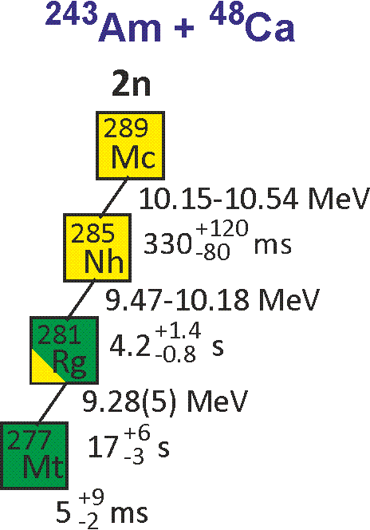
First experiments at SHE Factory
²⁴³Am+⁴⁸Ca test reaction
²⁹¹Ts: 16 (DGFRS)+2 (TASCA)
2+2 α of ²⁸¹Rg
Cross section ≈10 pb
σ=8.5 pb, h_{t}=0.5 mg/cm², ε_{coll}=0.6, I_{beam}=5 pμA → ≈17/day
Excitation function for the 2n-evaporation channel
- Observation of α decay of ²⁸¹Rg
²⁸⁹Mc :14
DGFRS, TASCA, BGS
no α of ²⁸¹Rg
Adjustment of optical elements Q_{v}, D_{h}, Q_{h}, Q_{v}, D
Transmission
Image size on detector
Background
Target stability vs. beam intensity and dose
Systematics of charge states
Test of digital and analog data acquisition systems

Slide 20
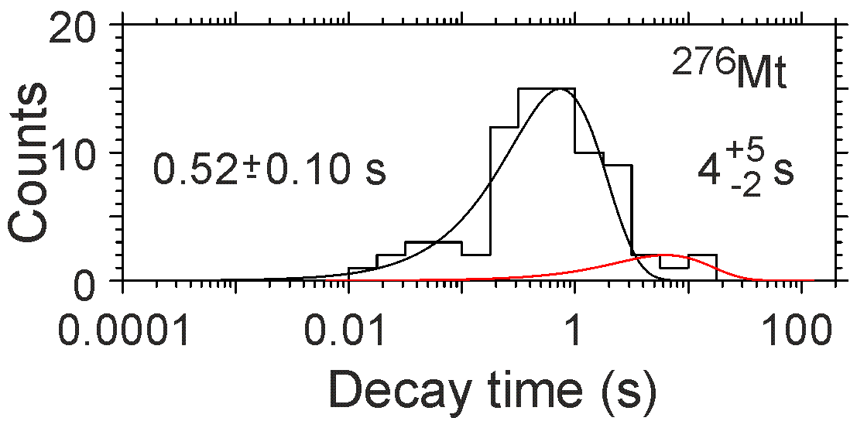
First experiments at SHE Factory
²⁴³Am+⁴⁸Ca test reaction
Cross section ≈10 pb
σ=8.5 pb, h_{t}=0.5 mg/cm², ε_{coll}=0.6, I_{beam}=5 pμA → ≈17/day
Excitation function for the 2n-evaporation channel
- Observation of α decay of ²⁸¹Rg
Excitation function for the 3n-evaporation channel
- Two decay times of ²⁷⁶Mt
Adjustment of optical elements Q_{v}, D_{h}, Q_{h}, Q_{v}, D
Transmission
Image size on detector
Background
Target stability vs. beam intensity and dose
Systematics of charge states
Test of digital and analog data acquisition systems

Slide 21
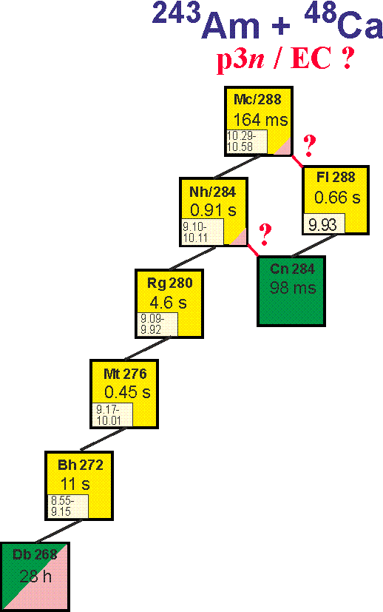
First experiments at SHE Factory
²⁴³Am+⁴⁸Ca test reaction
p2n/EC ?
Cross section ≈10 pb
σ=8.5 pb, h_{t}=0.5 mg/cm², ε_{coll}=0.6, I_{beam}=5 pμA → ≈17/day
Excitation function for the 2n-evaporation channel
- Observation of α decay of ²⁸¹Rg
Excitation function for the 3n-evaporation channel
- Two decay times of ²⁷⁶Mt
- Level of cross section for the pxn channel
- Level of EC branch for ²⁸⁸Mc and ²⁸⁴Nh
Adjustment of optical elements Q_{v}, D_{h}, Q_{h}, Q_{v}, D
Transmission
Image size on detector
Background
Target stability vs. beam intensity and dose
Systematics of charge states
Test of digital and analog data acquisition systems

Slide 22
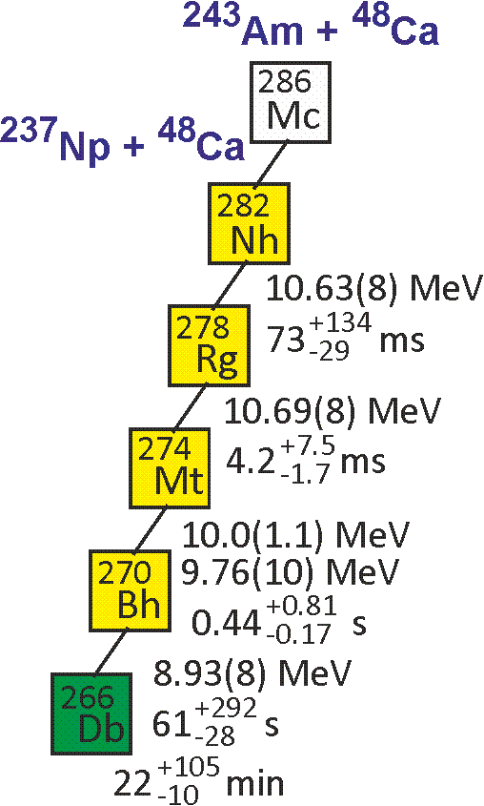
First experiments at SHE Factory
²⁴³Am+⁴⁸Ca test reaction
²⁴⁴Pu - ²⁸⁷Fl: 1 (DGFRS-1)
²⁴²Pu - ²⁸⁵Fl: 1 (BGS)
Cross section ≈10 pb
σ=8.5 pb, h_{t}=0.5 mg/cm², ε_{coll}=0.6, I_{beam}=5 pμA → ≈17/day
Excitation function for the 2n-evaporation channel
- Observation of α decay of ²⁸¹Rg
Excitation function for the 3n-evaporation channel
- Two decay times of ²⁷⁶Mt
- Level of cross section for the pxn channel
- Level of EC branch for ²⁸⁸Mc and ²⁸⁴Nh
5n-evaporation channel: new isotope ²⁸⁶Mc,
cross section
Adjustment of optical elements Q_{v}, D_{h}, Q_{h}, Q_{v}, D
Transmission
Image size on detector
Background
Target stability vs. beam intensity and dose
Systematics of charge states
Test of digital and analog data acquisition systems

Slide 23
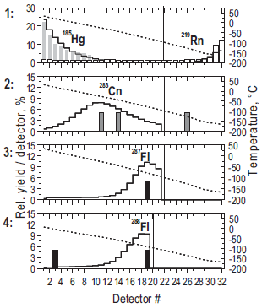
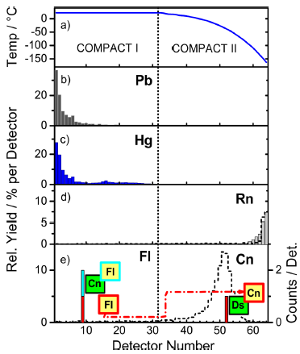
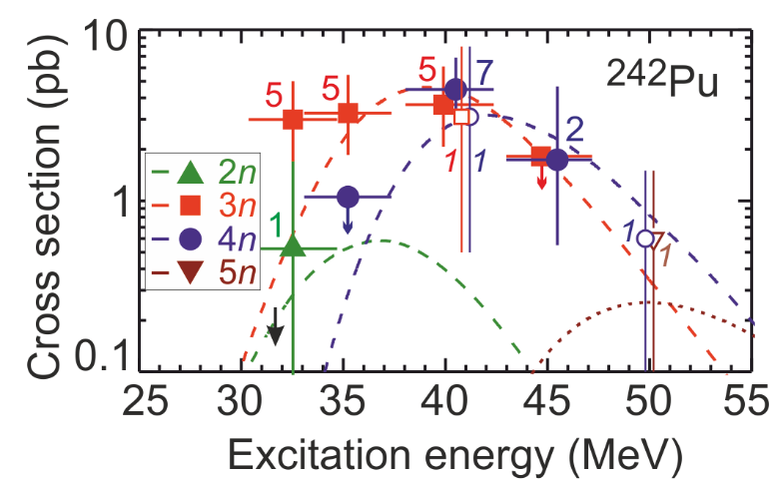
First experiments at SHE Factory
²⁴²Pu+⁴⁸Ca test reaction – chemical properties
A. Yakushev et al., Inorg. Chem. 53, 1624 (2014)
R. Eichler et al., Radiochim. Acta 98, 133 (2010)
Is flerovium a metal or a noble gas?
Cross section ≈8 pb (3n – 3.6 pb, 4n – 4.5 pb)
σ=8 pb, h_{t}=0.5 mg/cm², ε_{coll}=0.6, I_{beam}=5 pμA →
≈16/day ×ε_{chem}

Slide 24
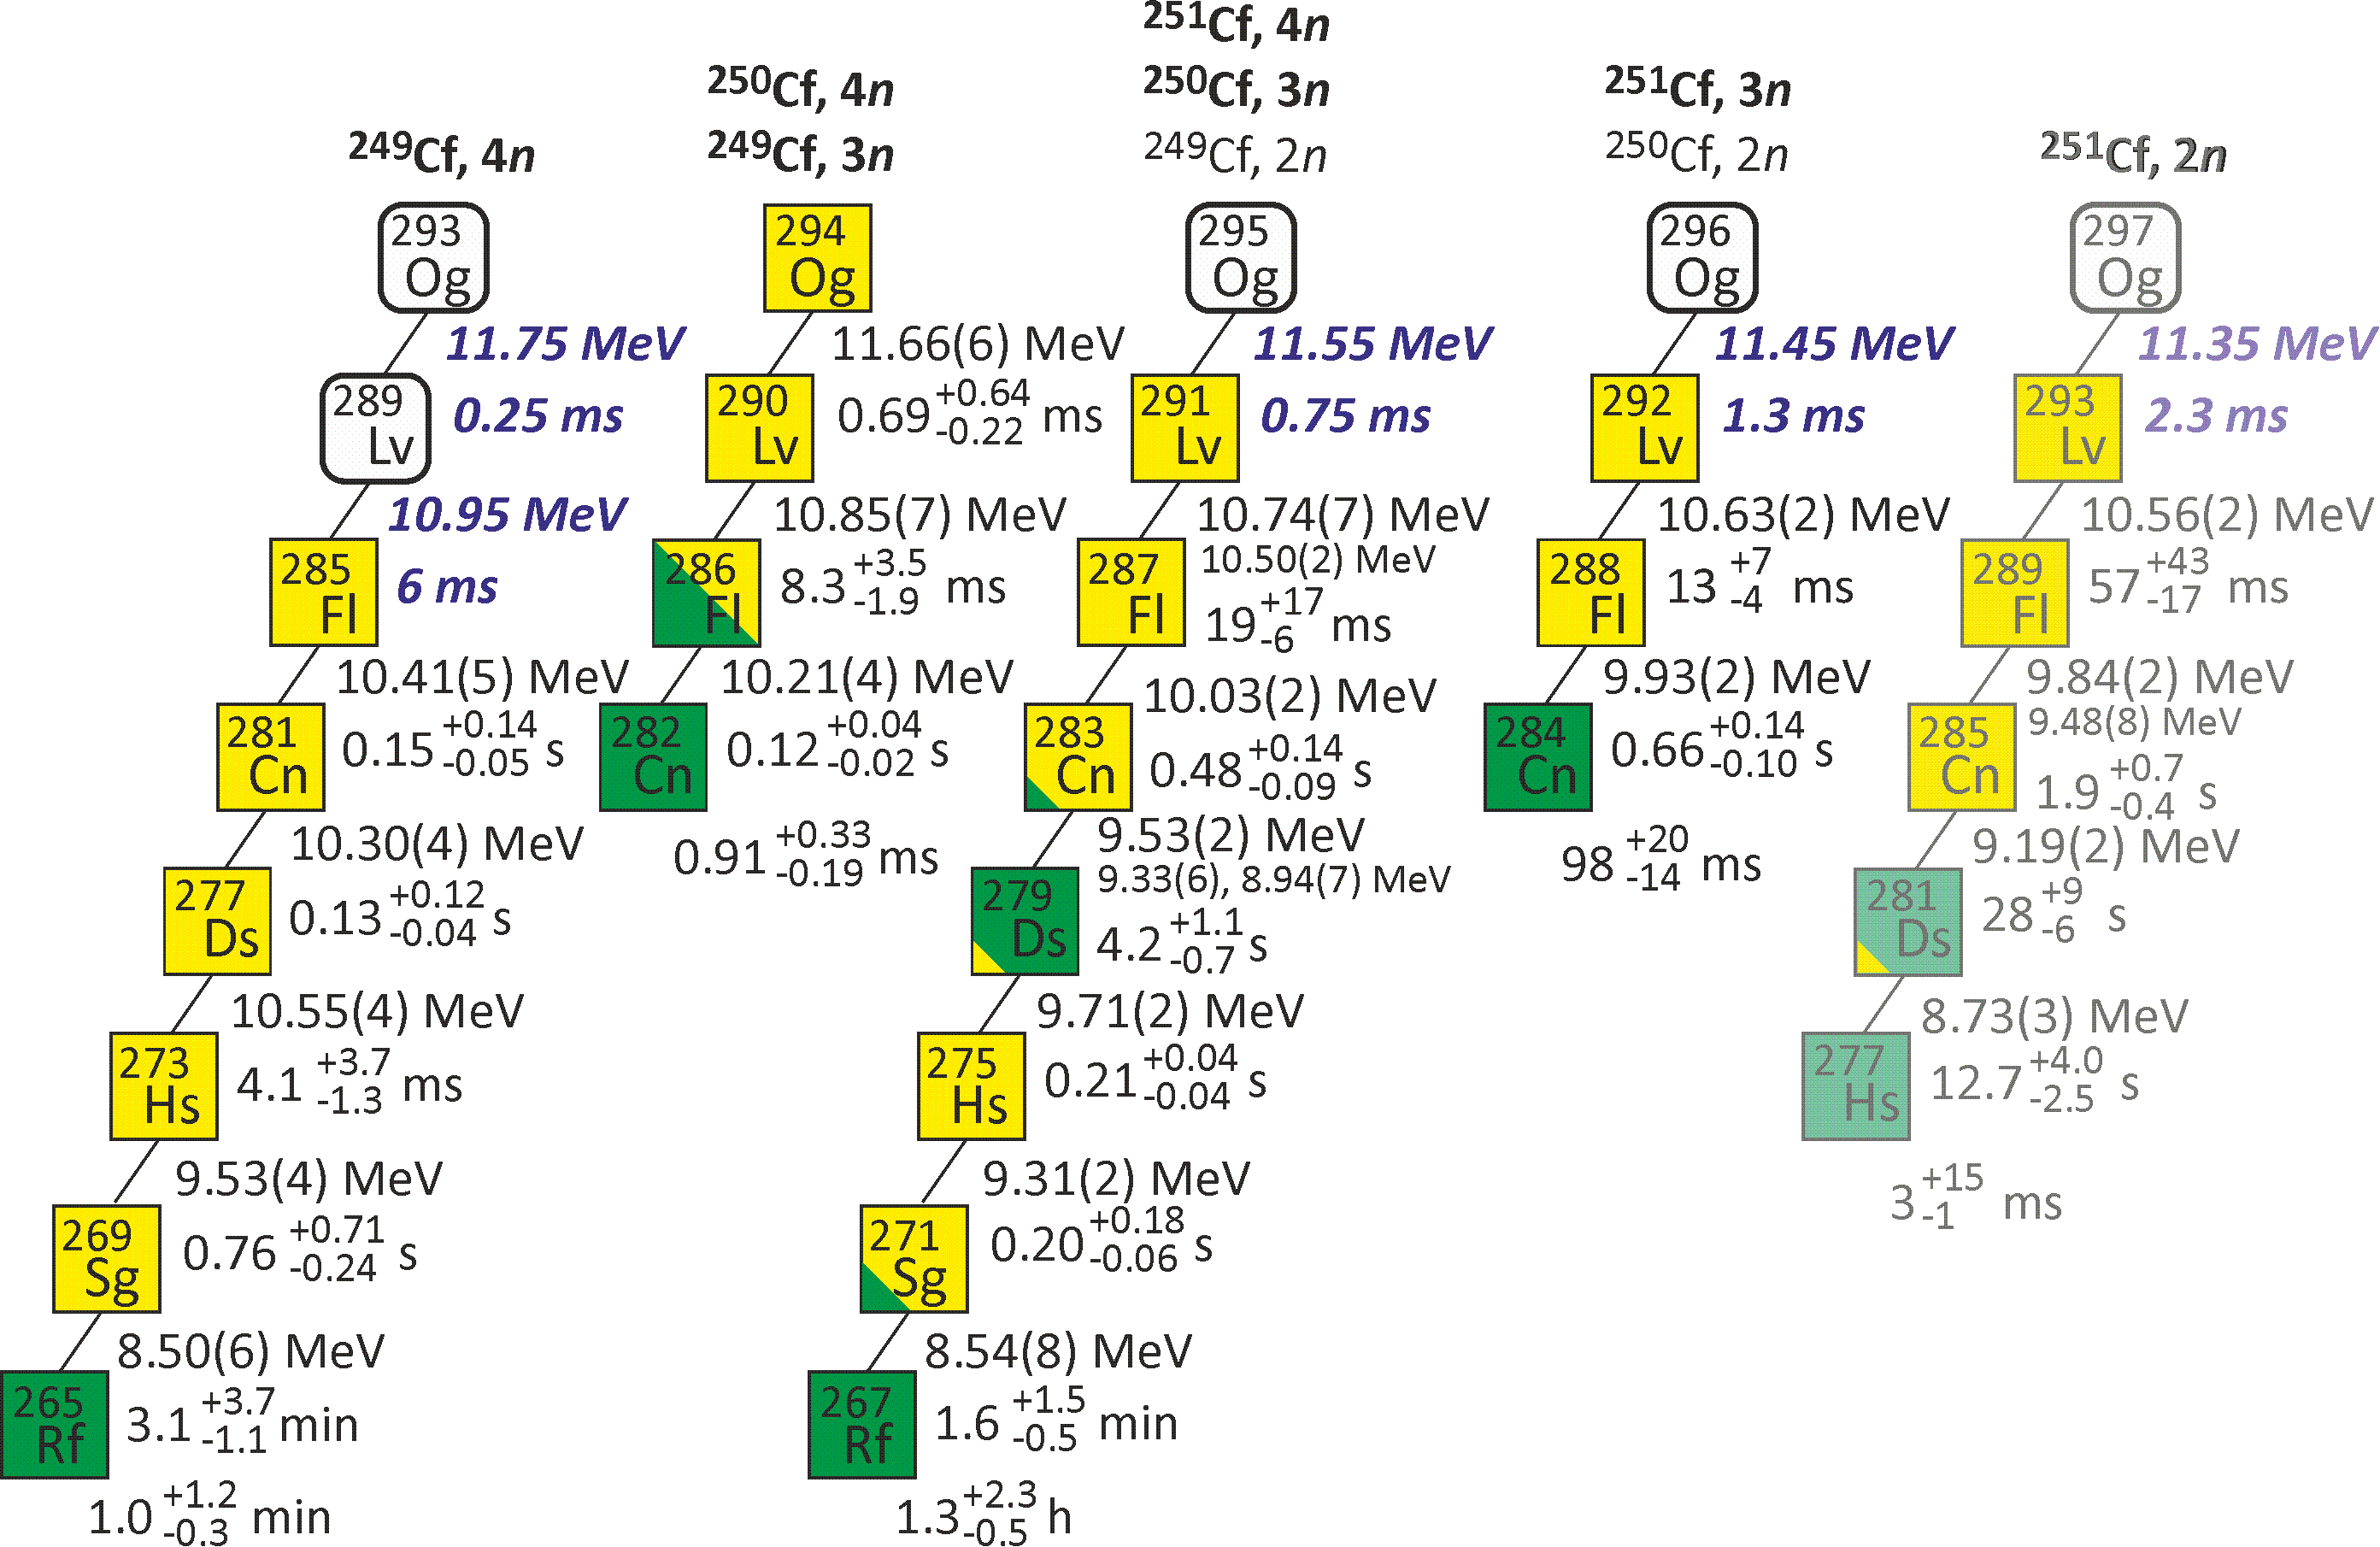
First experiments at SHE Factory
²⁴⁹⁻²⁵¹Cf+⁴⁸Ca – synthesis of the heaviest Og isotopes
Expected decay properties of Og isotopes
New ²⁴⁹⁻²⁵¹Cf target is under preparation at ORNL
σ=0.5 pb, h_{t}=0.3 mg/cm², ε_{coll}=0.6, I_{beam}=5 pμA → ≈4 events per week
Synthesis of element 120 in the reaction with ⁵⁰Ti

Slide 25
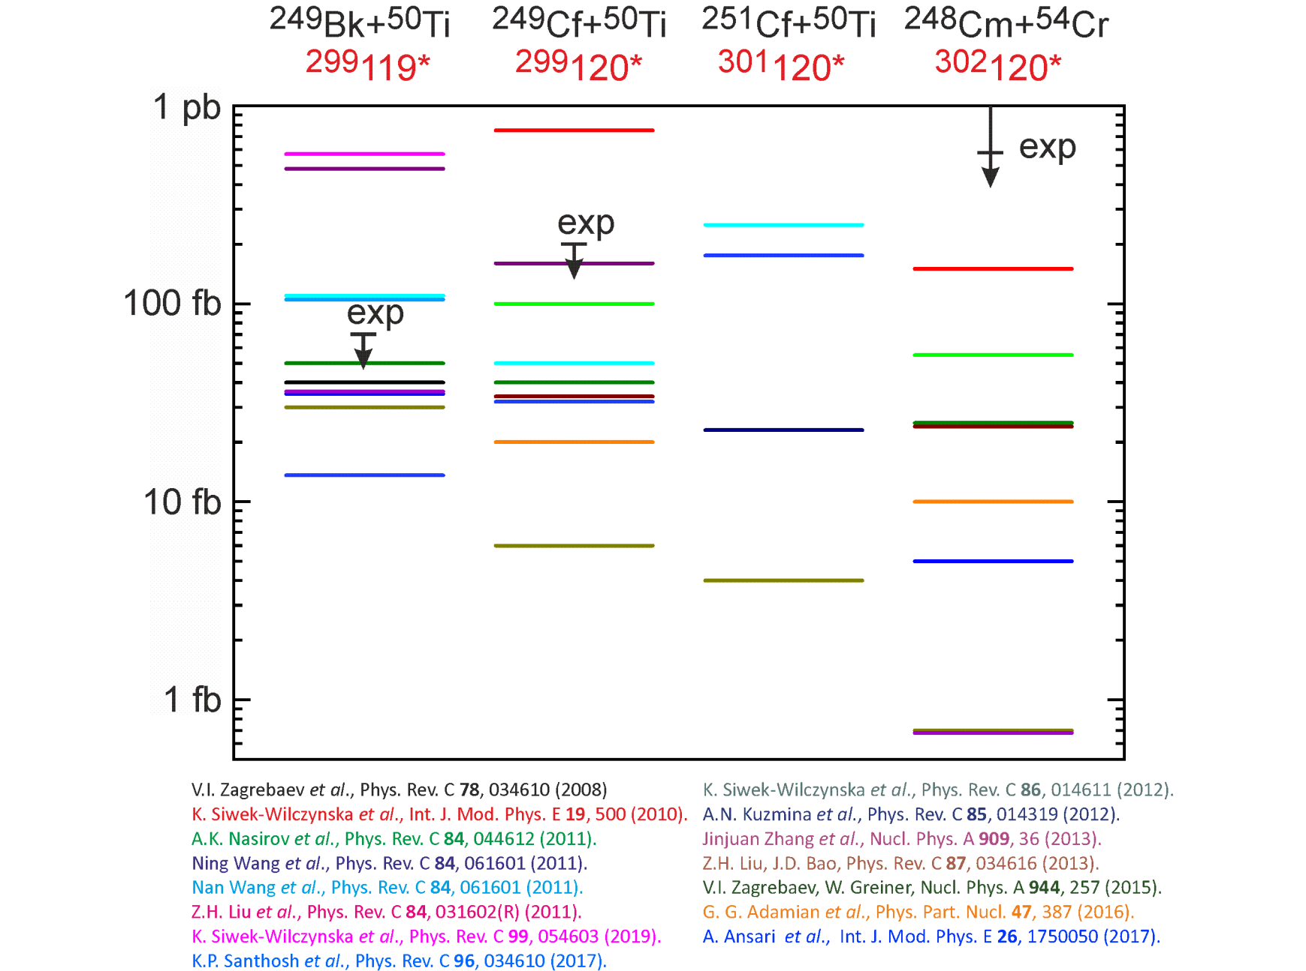
Predicted cross sections for production of isotopes of elements 119 and 120

Slide 26
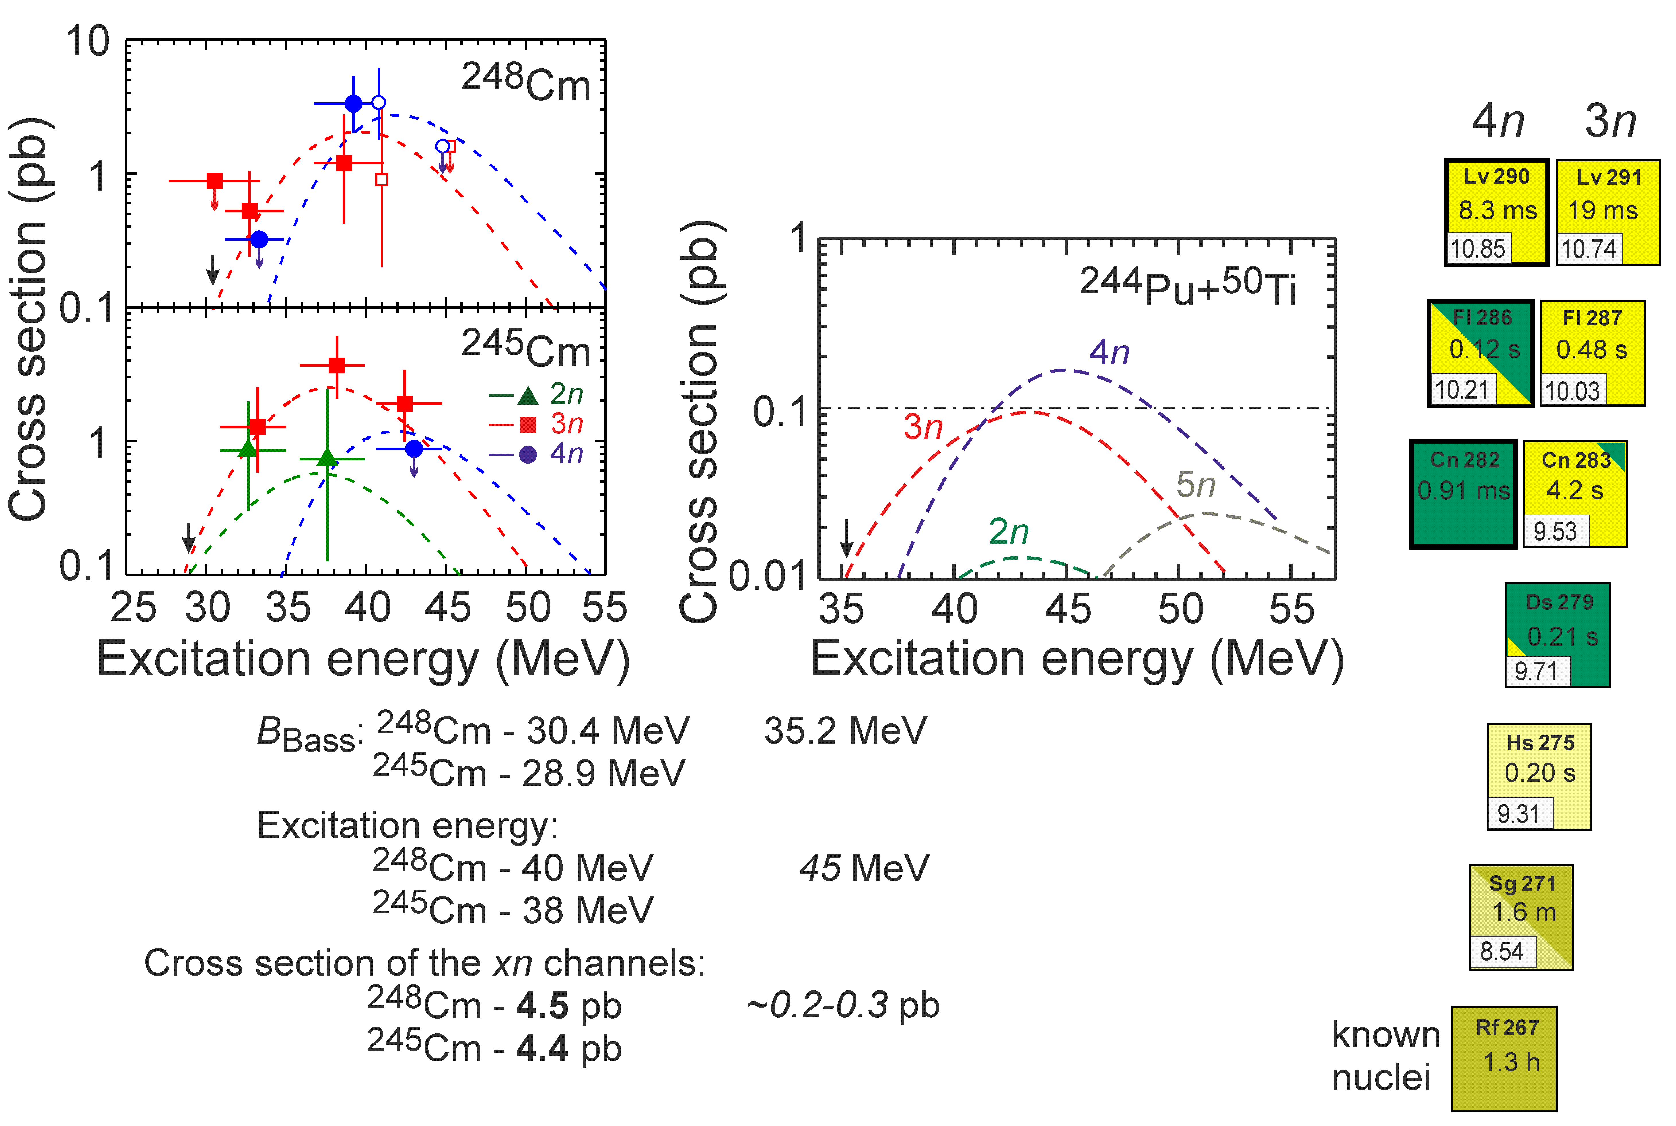
Unknown cross sections for production of elements 119 and 120
From ⁴⁸Ca to ⁵⁰Ti
Test reactions: ²⁴⁶Cm+⁴⁸Ca ²⁹⁴Lv* ²⁴⁴Pu+⁵⁰Ti ²⁹⁴Lv*
V. Zagrebaev and W. Greiner
σ=0.2 pb, h_{t}=0.3 mg/cm², ε_{coll}=0.6, I_{beam}=3 pμA → ≈1 event per week

Slide 27
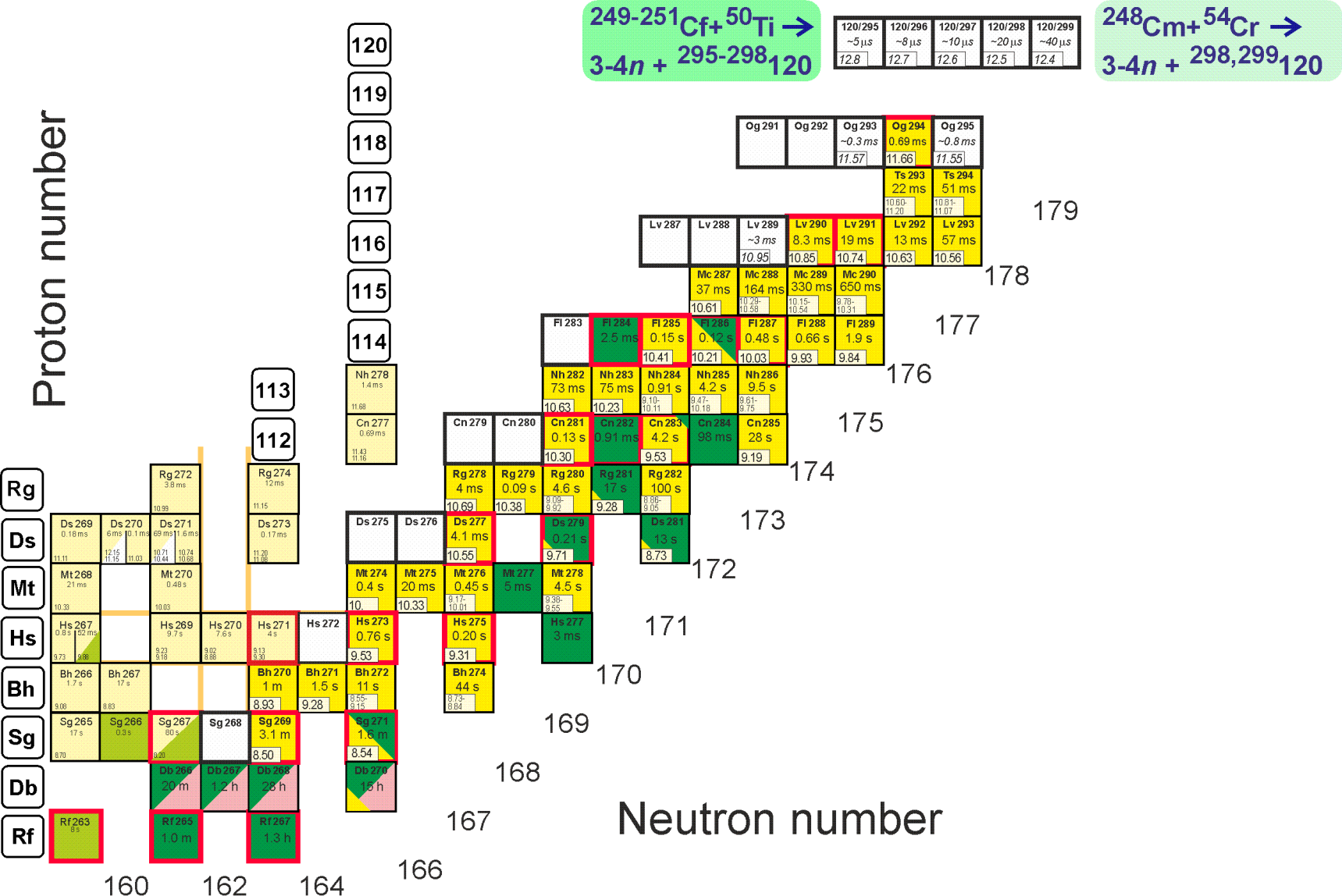
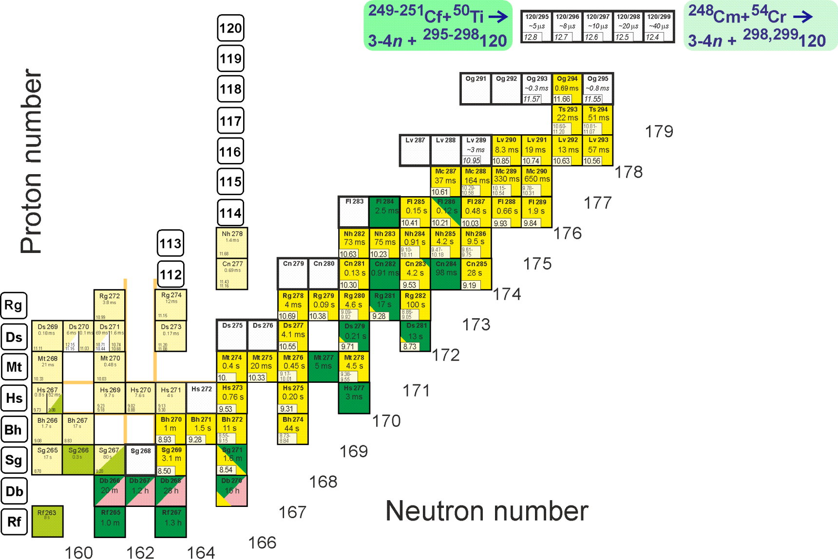
First experiments at SHE Factory
Synthesis of new element 120
²⁴⁹Cf(⁵⁰Ti,3-4n)^{295,296}120
²⁵¹Cf(⁵⁰Ti,3-4n)^{297,298}120
²⁴⁸Cm(⁵⁴Cr,3-4n)^{298,299}120
Descendants ²⁹⁴Og, ^{290,291}Lv, ^{284–286}Fl … are known
σ=10 fb, h_{t}=0.3 mg/cm², ε_{coll}=0.6, I_{beam}=3 pμA → ≈1 event per 5 months

Slide 28
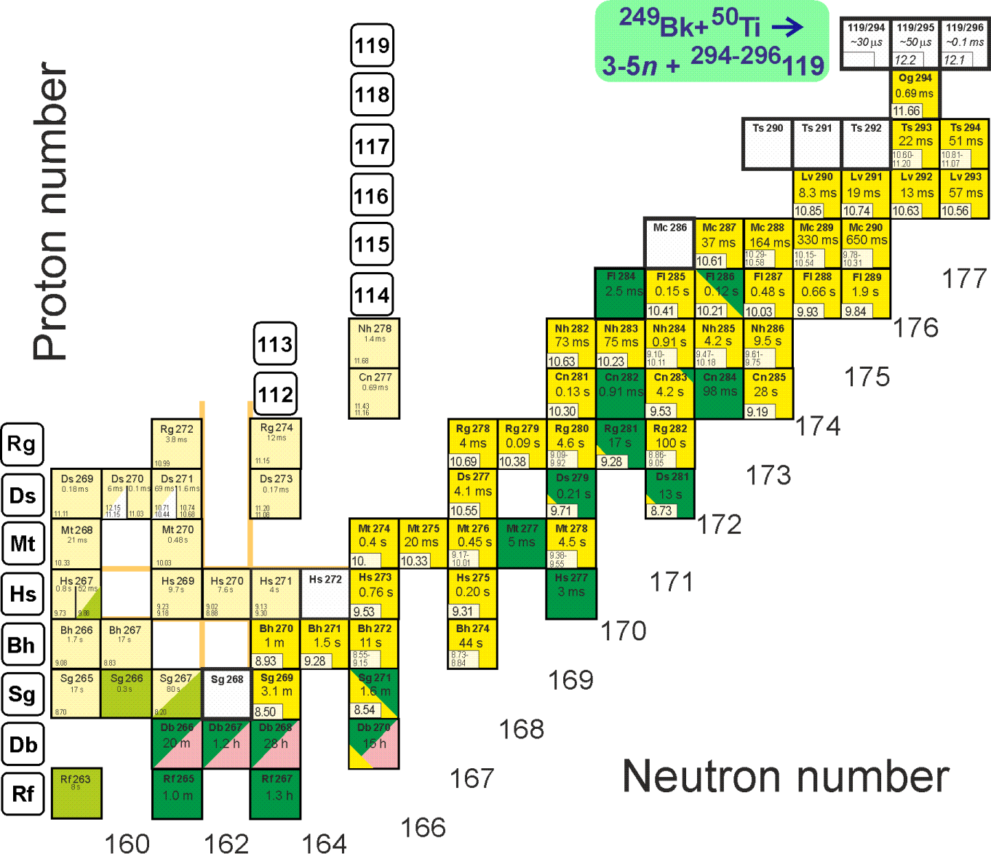
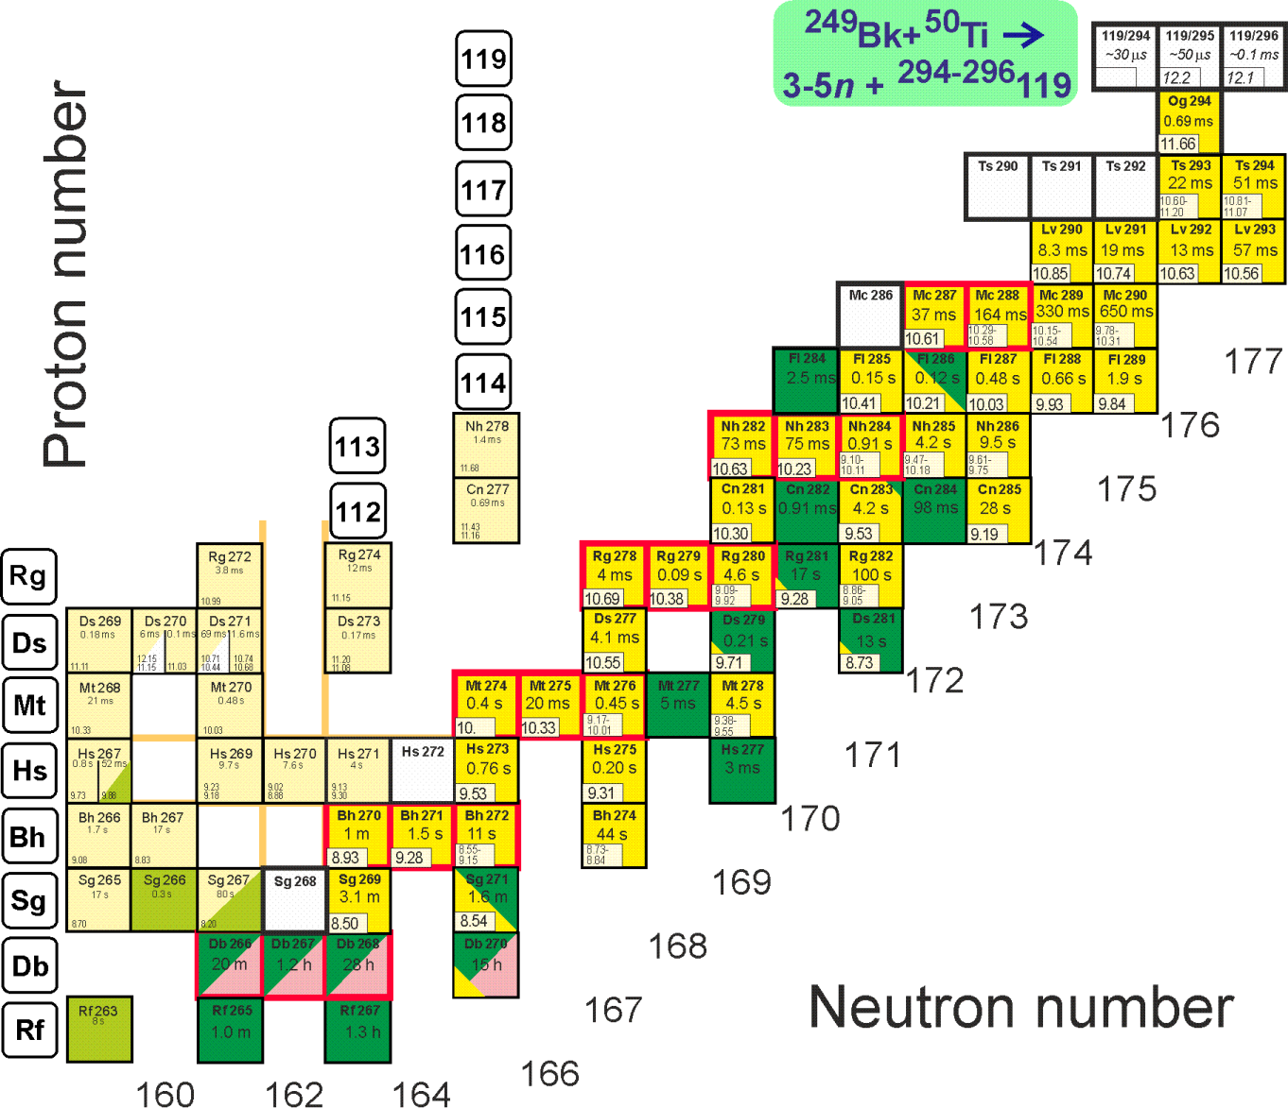
First experiments at SHE Factory
Synthesis of new element 119
²⁴⁹Bk(⁵⁰Ti,3-4n)^{295,296}119
Descendants ^{287,288}Mc, ²⁸²⁻²⁹⁴Nh… are known
σ=50 fb, h_{t}=0.3 mg/cm², ε_{coll}=0.6, I_{beam}=3 pμA → ≈1 event per month

Slide 29
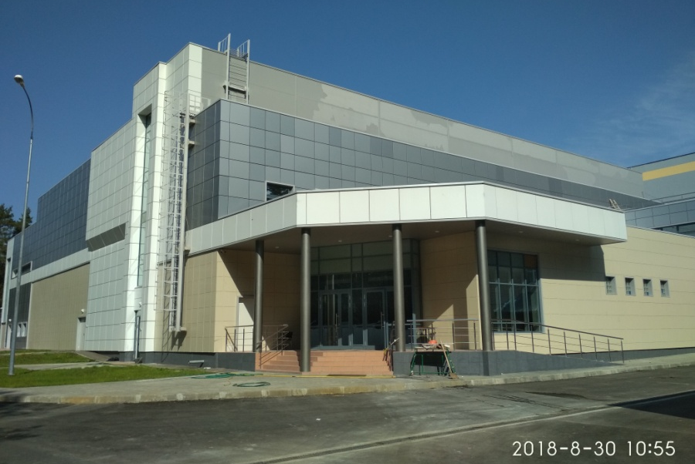


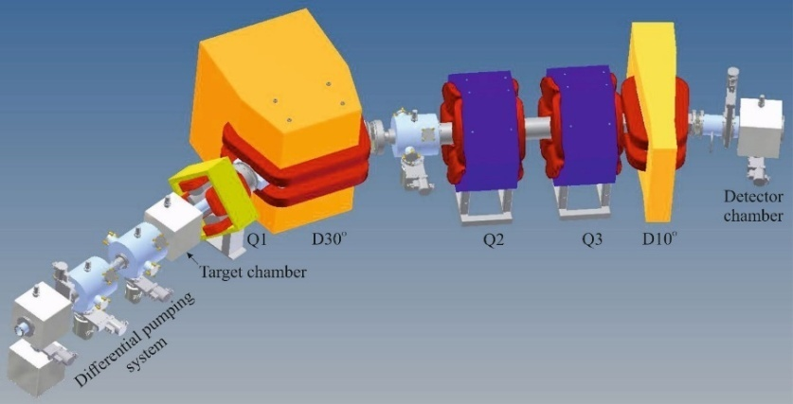
Super-Heavy Element (SHE) Factory
SHE Factory Building
High-current cyclotron DC-280
Gas-filled separator
Preseparator
Notes:
The project of the SHE factory includes three principal components: i) high current accelerator, ii) new experimental hall and iii) a number of the next generation facilities.

Slide 31
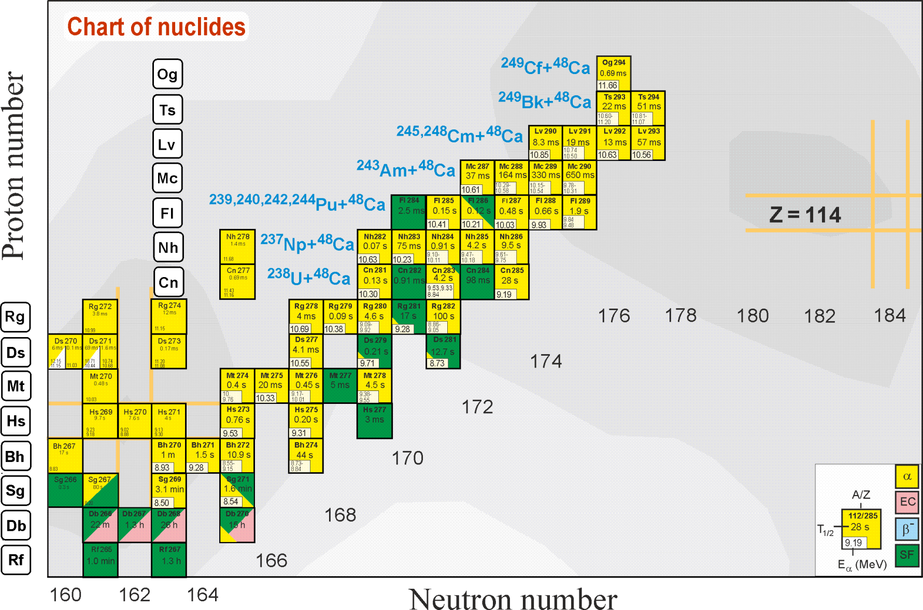
Further investigation of region of superheavy nuclei

Slide 32
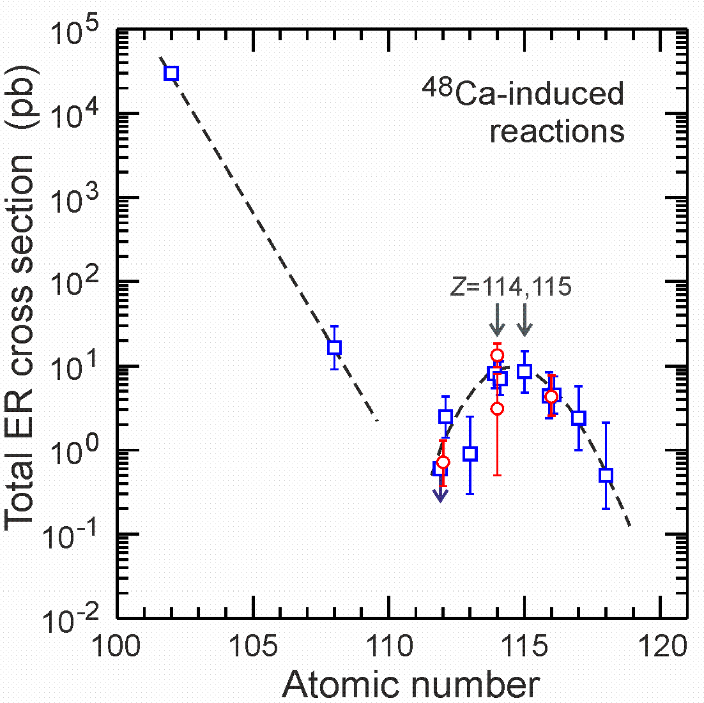
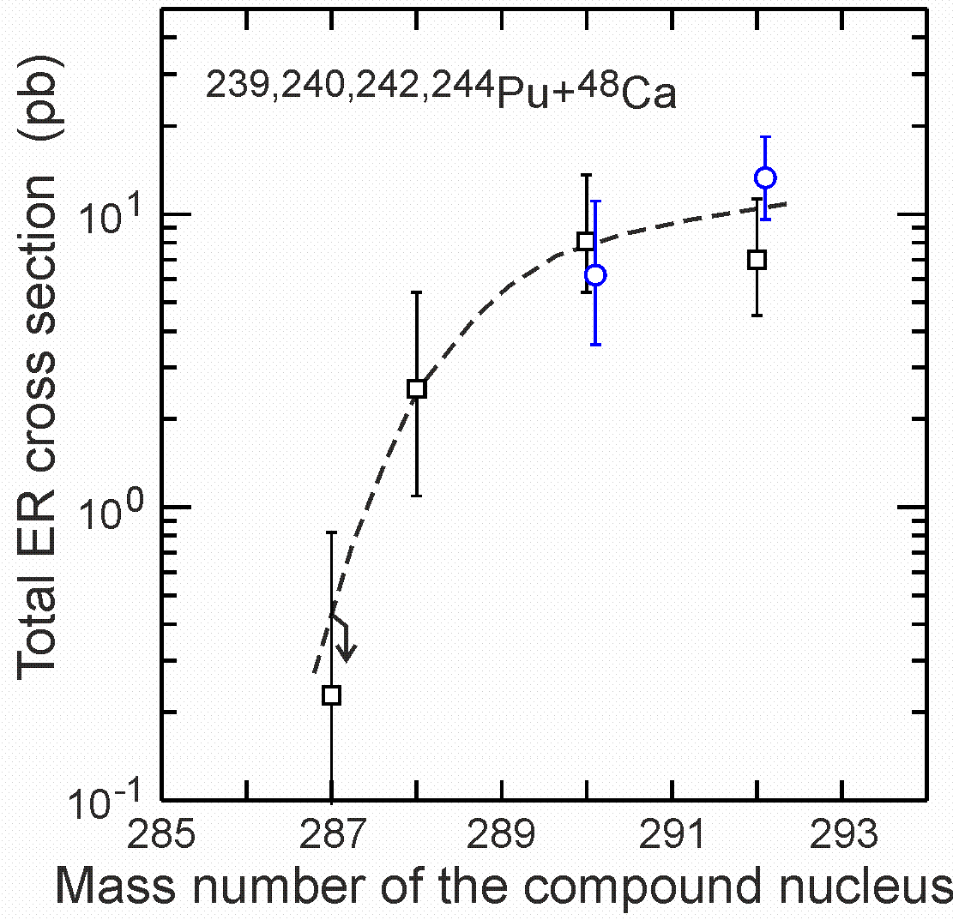
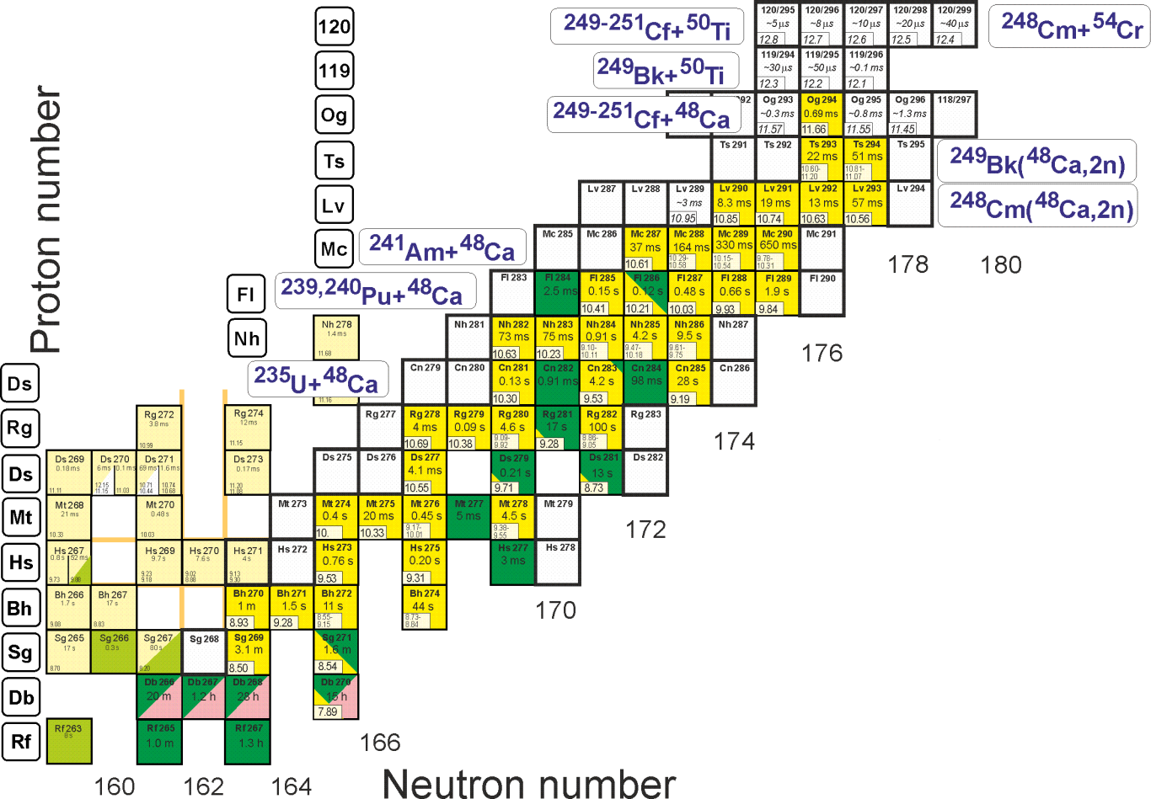
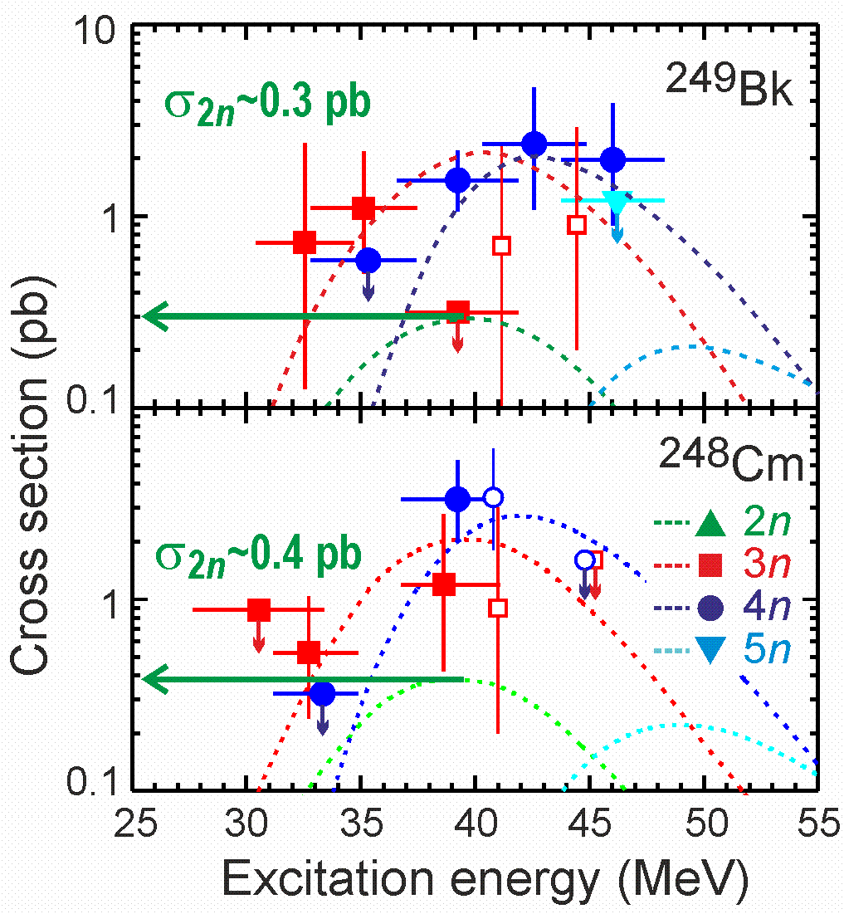
Drop of production cross section →
Increase of sensitivity of experiment
with increase of Z
with decrease of N
Factor of ~50
10 fb?
New facility for
super-heavy element research:
Super Heavy Element (SHE) Factory
2 fb?
V.I Zagrebaev
with increase of N

