Slide 1

52nd PAC on Particle Physics
JINR, February 3-4, 2020
Implementation of recommendations and work towards optimisation
of the research programme
Itzhak Tserruya

Slide 2
Outline
Highlights of the Recommendations from the 51st PAC – PP
126th Scientific Council meeting (September 19-20, 2019)
Recent developments
Agenda

Slide 3
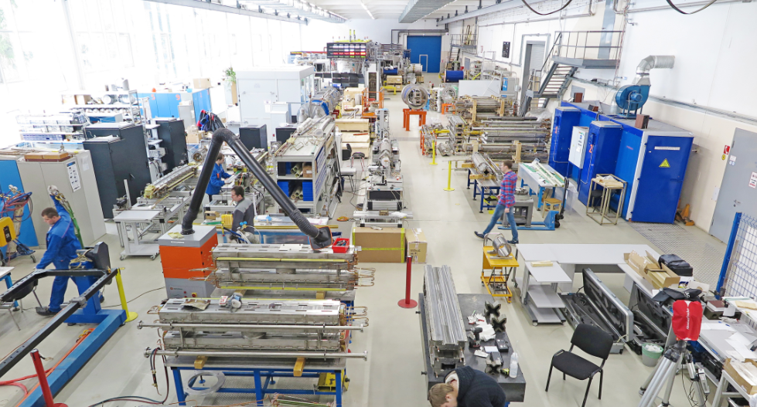
51st PAC-PP highlights: NICA
S. Kostromin
The PAC is pleased to support the active work on the mounting of the Booster superconducting magnets inside the Synchrophasotron yoke and expects the assembly and commissioning with beam to be completed by the end of 2019.
The PAC requests to improve the diagnostics of the accelerator complex in order to be able to deliver to the users well identified beams without contaminations.
Booster
90% sc-magnets passed tests
50% sc-magnets delivered to ring tunnel

Slide 4
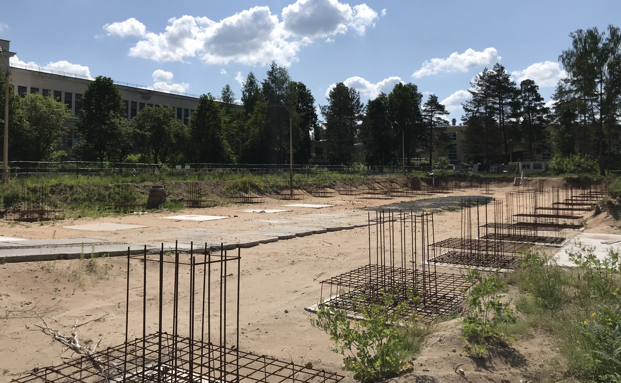
Infrastructure Developments
Yu. Mitrofanova
The Committee acknowledges the progress achieved and welcomes the efforts of the Laboratory to reduce the delay of the construction work schedule for the infrastructure of the collider complex.
Compressor Hall
The original contract with PSJ was terminated last year
New contract signed with LCC Stroytekhinvest, Moscow in May 2019
Expected completion 2020
A

Slide 5
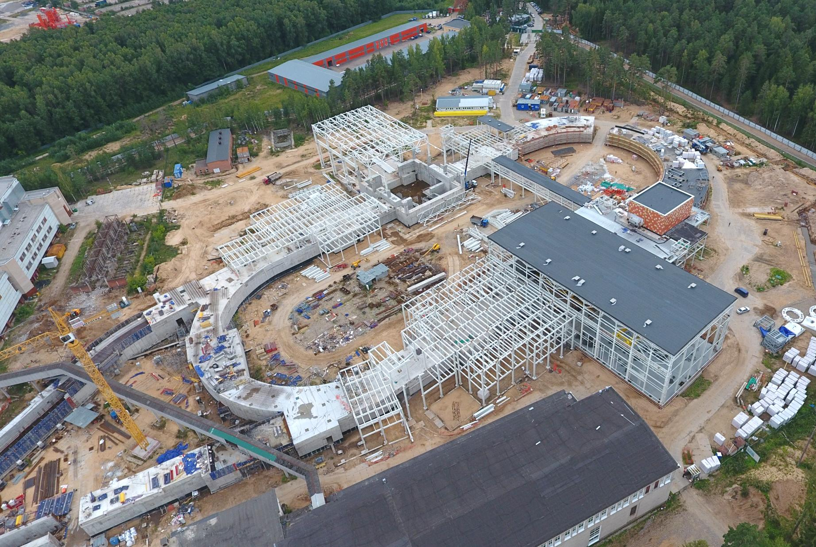
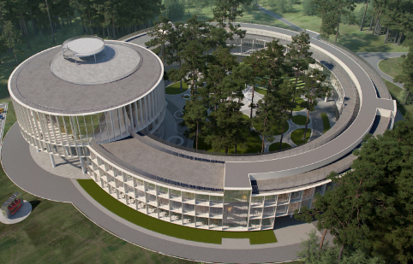
Infrastructure Developments
Yu. Mitrofanova
NICA Collider Site - August 2019
SPD building
MPD building
NICA Innovation Center
A

Slide 6
51st PAC-PP highlights: MPD
Adam Kisiel
The PAC welcomes the admission of two new institutions to the MPD collaboration: the University of Warsaw and the China Institute of Nuclear Energy.
The Committee is pleased to note the establishment of the Detector Council, Executive Council and Physics Working Groups of this collaboration.
The PAC is impressed by the magnitude and quality of the simulations already accomplished or those being performed by the PWG.
The PAC welcomes the collaboration efforts to develop the detector elements, as well as its computing and software infrastructure with a view to completing the first stage of the detector by 2021.
MPD stage 1: status
Magnet – assembly & magnetic field measurement – 2019-20
FHCal – production in progress: 100 modules + FE electronics ready by end of 2019
TOF - production in progress: all mRPC assembled by March 2020
FFD – production in progress
TPC – production in progress: FE cards for 24 ROC ready by august 2020
ECAL – TDR completed. Module production: 75% in China, 25% in Russia
Integration – TDR in preparation

Slide 7
MPD simulations
Adam Kisiel
ECAL
Conversions
π⁰ γγ
η γγ
π⁰ γγ (e⁺e⁻) (e⁺e⁻)
η γγ (e⁺e⁻) (e⁺e⁻)
0<p_{T}<0.5 GeV/c
1.0<p_{T}<1.5 GeV/c
Hyperons
Resonances
𝜙(1020) K⁺K⁻
K*(892)⁰ K± 𝜋∓
𝝨(1385)± 𝜋± 𝛬
⍴ π⁺π⁻
2.5<p_{T}<3.0 GeV/c
1.0<p_{T}<1.2 GeV/c
0<p_{T}<0.2 GeV/c
1.0<p_{T}<1.5 GeV/c

Slide 8
51st PAC-PP highlights: BM@N
Mikhail Kapishin
The PAC congratulates the BM@N team for the presentation of first physics results on the production of lambda hyperons and encourages it to shorten the time between data collection and release of preliminary results.
The PAC appreciates the ongoing efforts for the preparation of the BM@N set-up for heavy-ion beams in 2021.
BM@N Preliminary results
𝛬 hyperon production in 4 AGeV C + C, Al, Cu interactions
C+C, MB

Slide 9
General considerations on JINR participation in the LHC experiments
Currently, each one of the three LHC themes, ALICE, ATLAS and CMS, has two associated projects, one devoted to operations and physics analysis and the other focused on detector upgrade and R&D, with substantial overlap of the JINR personnel involved in the two projects.
The PAC considers that the separation into two projects is not justified and recommends that the JINR Directorate consider unifying the two activities into one single project in order to better monitor and regulate the execution of the so far distinct projects.
The PAC found it very convenient and useful to simultaneously review the three LHC projects at the same PAC meeting and thus decided to approve them for the same period of time so as to keep synchronized their future submission and review cycles.
In general, the PAC proposes to have a thorough yearly review of each LHC experiment, with oral presentation at the January meetings, and a short written report at the June meetings just pointing to the progress in the fulfilment of the milestones of relevance for the JINR groups.
The PAC requested from each LHC experiment to present at the next PAC meeting of a project-plan/timeline over the next 4 years indicating who is going to work on each subproject together with a series of milestones and deliverables to be used by the PAC to monitor and regulate the execution of the whole project.

Slide 10
Recommendations on projects approved for completion in 2019 and proposed for continuation
NA64 – D. Peshekhonov
The PAC notes the relevance of the research programme and its potential in the quest for dark matter.
The PAC recognizes the excellent role played by the JINR team in the design, production, test and installation of the straw tube chambers, together with their data acquisition software, online monitoring and visualization, reconstruction and Monte-Carlo simulation.
The PAC also notes that the recommendations made by the PAC for Particle Physics and the PAC for Nuclear Physics at their joint session in January 2019, to improve the ratio of FTE to participants, to attract students and to get involved in data analysis are not properly addressed in the presented material.
Recommendation.
  The PAC decides to postpone any recommendation on the project till the authors present to the PAC, not later than at the next session in January 2020, a revised proposal including an action plan where the previous recommendations mentioned above are addressed.
  Till then, if needed, the PAC recommends that the JINR management provide sufficient resources to the group to allow continuation of their work and commitments.

Slide 11
Proposal of a new project
FASA – S. Avdeev
The main goal of the project is the study of space-time characteristics of hot nuclei formed in the collisions of light relativistic ions with heavy targets. The experiment is carried out using relativistic beams from the Nuclotron and the 4π–FASA detector. Its thirty telescopes will allow spectroscopic and correlation measurements in terms of relative angles (from 10° to 180°) or relative velocities of intermediate-mass fragments. Radial flow as a function of the fragment charge, thermalization in the hot spectator of the target, and the time of disintegration will be studied.
Recommendation
  The PAC notes that similar work was carried out some 40 years ago on Multi-Fragmentation of Nuclei at Fermilab, at CERN -PS and at the BEVATRON and BEVALAC.
  The PAC requests the authors to sharpen the scientific case taking into account these earlier data and to present a convincing case on how they can solve the still open question of break-up or thermalization in the multifragmentation of nuclei.
  The PAC looks forward to receiving an improved proposal with details on the target thickness, the identification power of their telescopes for He and Be isotopes, and a simulation of the performance of the experiment in comparison with theoretical predictions.

Slide 12
Scientific Council (I)
Excerpts from the Resolutions of the 126th session of the SC held on September 19-20, 2019:
General considerations relevant to the PAC-PP:
The SC supports the efforts of the JINR Directorate towards constructing the basic configuration of the NICA complex, noting the completion of the main systems of the Booster synchrotron and of the fabrication of the yoke of the solenoidal magnet for the MPD detector.
The SC appreciates the first physics results produced in the BM@N experiment and the continued analysis of the data taken earlier in this experiment.
The SC also notes the commissioning of the updated computer cluster at VBLHEP to meet the challenges of the NICA complex.
The SC takes note of the holding at JINR, on 17 April 2019, of the 3rd Meeting of the MPD and BM@N Collaborations, which covered the physics programme of the MPD and BM@N experiments, and progress in detector subsystems work and in analysis of experimental data.

Slide 13
Scientific Council (II)
Common issues
The SC looks forward to being informed of the decision concerning the Neutrino programme evaluated by the joint session of the PAC for Particle Physics and of the PAC for Nuclear Physics in January 2019 and to knowing when and how this programme will be re-evaluated. In general, the Scientific Council recommends that better allotment of scientific themes to respective PACs be made.
The SC recommends that more attention should be given to the participation of female scientists in the Scientific Council and in the PACs and more generally in the life of JINR at all levels.
Recommendations in connection with the PAC-PP:
The SC endorsed and supported all recommendations made by the PAC – PP.
In particular:
The SC supported the PAC’s approach for the evaluation of the JINR’s participation in the LHC experiments.
The SC supports the PAC’s recommendations on the continuation of ongoing projects in particle physics: the LHC experiments, CMS, ATLAS and ALICE and SCAN-3

Slide 14
Scientific Council (III)
Recommendations in connection with the PAC-PP (ongoing projects):
The SC supports the PAC’s decision to postpone any recommendation on the NA64 project till the authors present to the PAC a revised proposal where the recommendations made at the joint session of two PACs –– to improve the ratio of FTE to participants, to attract students and to get involved in data analysis –– are properly addressed. Till then the JINR management shall provide sufficient resources to the group to allow continuation of their work and commitments.
The Scientific Council seconds the PAC’s evaluation of the FASA project and the request that the authors submit an improved proposal, better focusing its scientific content, taking into account data obtained 40 years ago at Fermilab, CERN-PS, Bevatron and Bevalac, and presenting a convincing argument on how they can solve the still open question of break-up or thermalization in the multifragmentation of nuclei.
The Scientific Council draws to the attention of the leaders of the BOREXINO, PANDA and COMET projects to be concluded in 2019 that they should present their reports at the meeting of the PAC in February 2020.

Slide 15
Recent Developments
4th Collaboration meeting of MPD at WUT on October 20-23, 2019
4th Collaboration meeting of BM@N At JINR on October 15-16, 2019
Booster:
Assembly completed. Successful first Technical run at the end of 2019.
JINR’s Strategic Long Range Plan:
The entire document of the SLRP is being finalized and shall be soon submitted to the Scientific Council.

Slide 16
52st PAC-PP agenda February 3-4, 2020
Highlights of today's meeting:
Update reports on NICA, MPD and BM@N
Projects seeking continuation / revised / new theme:
ATLAS upgrade
NA64, FASA
Mu2e Meg-II, COMET
SLRP report

Slide 17
Thank you !

