Slide 1







Strategic Long Range Plan for JINR
Boris Sharkov
INTERNATIONAL INTERGOVERNMENTAL ORGANIZATION
МЕЖДУНАРОДНАЯ МЕЖПРАВИТЕЛЬСТВЕННАЯ ОРГАНИЗАЦИЯ
JOINT INSTITUTE FOR NUCLEAR RESEARCH
ОБЪЕДИНЕННЫЙ ИНСТИТУТ ЯДЕРНЫХ ИССЛЕДОВАНИЙ
Joint Institute for Nuclear Research
SCIENCE BRINGING NATIONS TOGETHER
The International Working Group
has been established
in order to organize
the elaboration of the Strategic Long Range Plan
(SLRP) of JINR

Slide 2
The Long-Range Strategy of JINR development up to 2030 and
The SLRP WG membership:
V. Matveev (chair), B. Sharkov and N. Russakovich (vice-chairs),
V. Aksenov, V. Bednyakov, L. Cifarelli, A. Dubnickova, S. Gales, H. Gutbrod,
M. Itkis, M. Jezabek, R. Jolos, D. Kazakov, V. Kekelidze, V. Korenkov, E. Krasavin, R. Lednicky, M. Lewitowicz, D.L. Nagy, Yu. Oganessian, E. Rabinovici,
V. Rubakov, A. Sorin, M. Spiro, H. Stoecker, G. Trubnikov, I. Tserruya,
G. Zinovjev
The International Working Sub-Groups where established in 2017
for elaboration of the JINR Strategic Long Range Plan (SLRP) for the JINR development up to 2030. SLRP will form the basis of the next JINR 7-year plan for the period 2024-2030.

Slide 3
Стратегическая цель развития ОИЯИ до 2030 года
Стратегической целью является развитие ОИЯИ как научного центра мирового уровня, занимающего лидирующие позиции в области физики высоких энергий, ядерной физики и физики тяжелых ионов, физики нейтрино и астрофизики, физики конденсированного состояния, радиационной биологии, информационных технологий и высокопроизводительного компьютинга, а также в области междисциплинарных исследований и инновационных технологий.

Slide 4
Развитие ОИЯИ как международной межправительственной научно-исследовательской организации
Вместе со стратегическими планами достижения лидирующих позиций на приоритетных для ОИЯИ научных направлениях стоит важная цель совершенствования всех сторон деятельности нашего научного центра, включая современные методы подготовки высококвалифицированных кадров как для самого Института, так и в интересах государств-членов ОИЯИ, опираясь на современные научно-организационные методы управления деятельностью лабораторий и Института в целом, учитывая опыт крупнейших международных центров мира, добиваясь привлекательности работы в ОИЯИ для талантливой молодежи, создавая для этого необходимые условия.

Slide 5
Миссия
Международной Рабочей Группы по разработке долгосрочной стратегии развития ОИЯИ до 2030 года (SLRP)
SLRP-это взгляд в будущее, позволяющий научному сообществу ОИЯИ во взаимодействии с его партнерами в государствах-членах ОИЯИ и других странах, а также учитывая координируемые ведущими международными научными организациями планы развития исследований в области фундаментальной физики на глобальном уровне, разрабатывать долгосрочные планы развития фундаментальных и прикладных, инновационных исследований ОИЯИ, на основе анализа и изучения перспектив развития существующих и создания новых базовых экспериментальных установок и научных комплексов, а также возможного расширения и обновления научной программы ОИЯИ с целью определения приоритетов исследовательских программ лабораторий ОИЯИ в национальном, с учетом интересов государств-членов Института, и в международном контексте.

Slide 6
The Long-Range Strategy of JINR
SLRP International Working Group
SLRP for Basic Science,
Innovative development and
advanced Education
Development of JINR as the International Intergovernmental Scientific Research Organization
Thematically
oriented
sub-groups
Thematically
oriented
sub-groups

Slide 7
SLRP IWG
Development of JINR
as International
Intergovernmental
Organisation
SLRP for Science
Thematically
oriented
sub-groups
Thematically
oriented
sub-groups

Slide 8
Thematical sub-groups cover core research areas of the JINR scientific program
Nuclear Physics at low and intermediate energies.
Particle, High-Energy and Neutrino Physics.
Relativistic Heavy-Ion and SPIN Physics.
Condensed Matter and Neutron Nuclear Physics.
Theoretical Physics.
Radio- and Astrobiology.
Information Technologies and High Performance Computing.
Members of the sub-groups – outstanding experts from JINR, member states and world science community

Slide 9
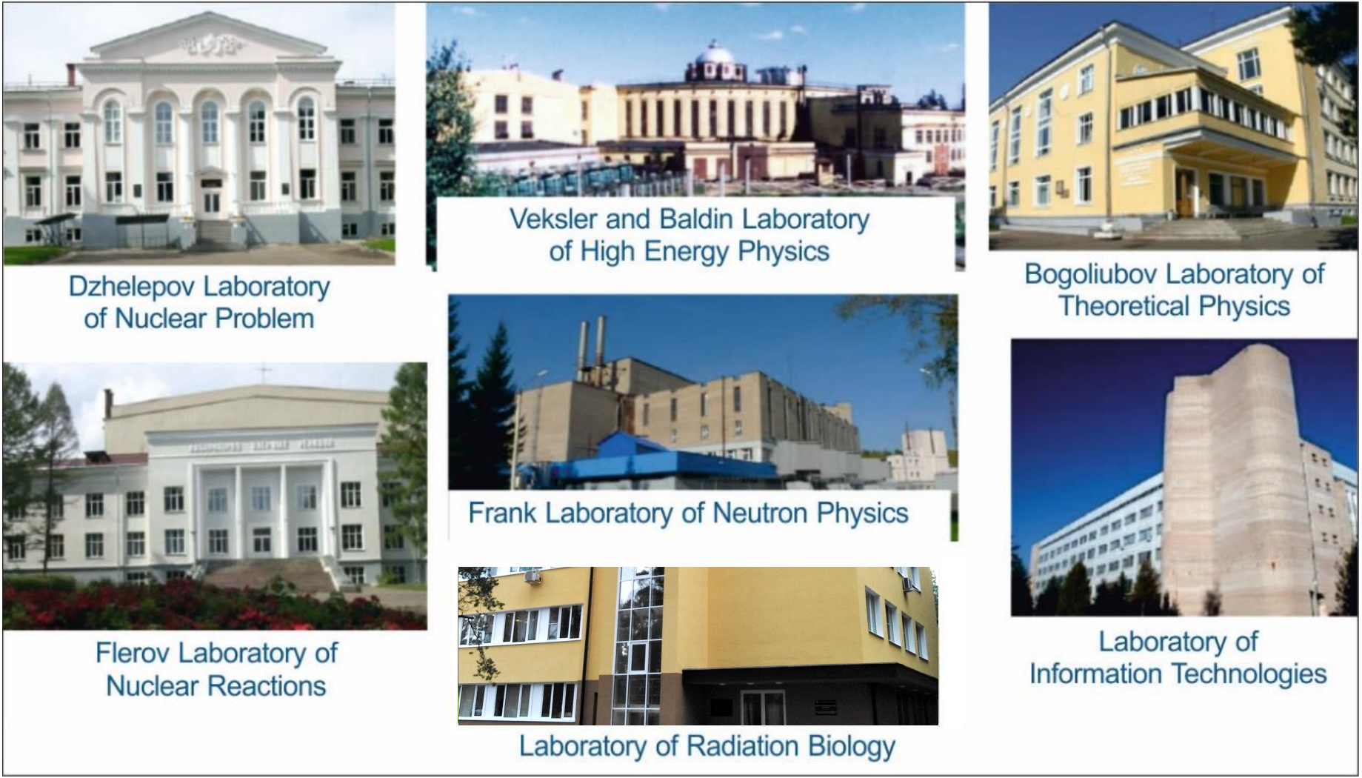

Slide 10
Development of JINR as International
Intergovernmental Organisation
HR policy, education and development of intellectual potential; A.Ruzaev
social and engineering infrastructure; S.Kulikov
advancement of legal and administrati
functions of the institute; M.Vasiliev
international relations and involvement of the
new member states.
. D.Kamanin

Slide 11
The JINR Long Range Strategy Plan up to 2030
Proposals from JINR Laboratories for the SLRP
were considered at two sessions of the PAC`s,
at the meeting of JINR Technical – Scientific Council.
The reports of the representatives from the SLRP Working Sub-Groups were discussed in the session of JINR Scientific Council in September in 2019.
The whole project of the SLRP is to be completed at the end of 2019 and shall be considered at the February session of the JINR Scientific Council and then presented for approval by the
JINR Committee of the Plenipotentiaries
in the March session in 2020.
❒ Working documents of IWG for JINR strategic long-range planning
are available at https://indico.jinr.ru/
❒ Direct link: https://indico.jinr.ru/conferenceDisplay.py?confld=490

Slide 12
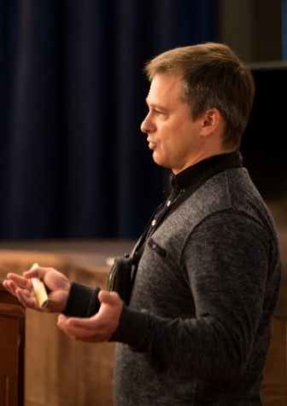
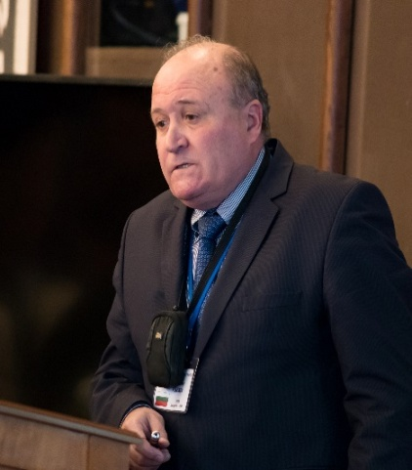
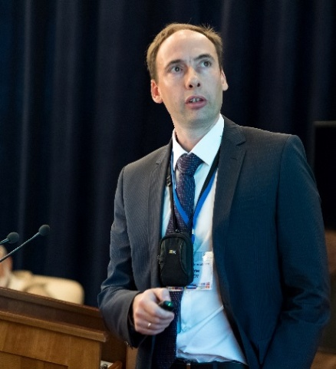

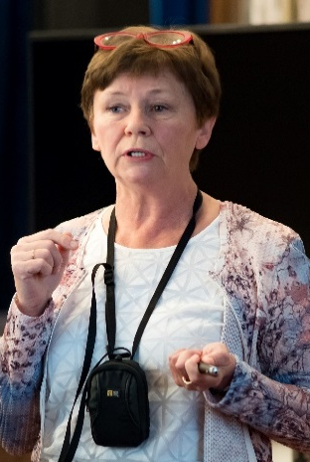
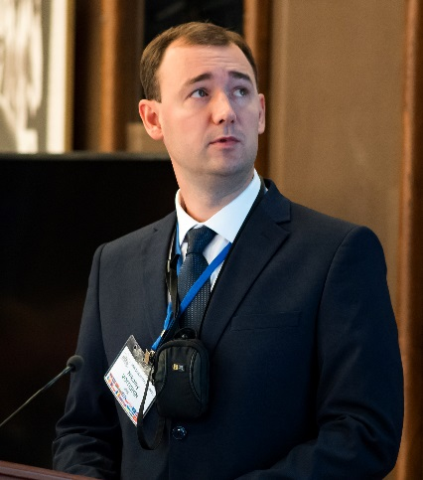
126th session of the Scientific Council
The Working Sub-Groups reports at the 126th session ( 19-20 Sept.,2019) of the JINR Scientific Council on the preparation of the draft Strategic plan for the long-term development of JINR up to 2030.
The Scientific Council took note of the reports concerning the current preparation of the draft Strategic plan for the long-term development of JINR in its major sections, presented by DLNP Deputy Director D. Naumov (particle physics), VBLHEP Deputy Director R. Tsenov (relativistic heavy-ion physics and spin physics), FLNR Scientific Secretary A. Karpov (nuclear physics at low and intermediate energies), by FLNP Directorate Adviser A. Ioffe (condensed matter physics and neutron nuclear physics), by LRB Senior Researcher E. Nasonova (radiobiology), and by LIT Researcher N. Voytishin (information technology).

Slide 13
Scientific Council 19 -20 September 2019
<resolution>
The SC recommends that the international WG ensures preparation of an integrated document based on materials presented by thematic subgroups describing the overall strategy with flagship projects and partnership priorities.
Editorial Board has been set up.
The SC recommends to inform the CPP at its session in November 2019
about the progress in preparing the Strategic plan for long-term
development of JINR.

Slide 14
Possible Structure of a Laboratory‘s SLRP
A) Executive Summary
B) Introduction: What is and has been done in the Laboratory a) Past and present Research Projects
b) National and International networking and context
c) .. Staff and Equipment today
C) Medium Range Projects
a) Project M1 – Motivation, proposed research, international context , needed resources (equipment, infrastructure, manpower)
b) Project M2 – ......................
n) Project Mn - ......................
D) Long Range Projects
a) Project L1 – Motivation, international context, proposed research, needed resources (equipment, infrastructure, manpower)
b) Project L2 - .........................
E) Summary with time line and international context

Slide 15


Nuclear Physics at Low energies
Physics of Supper Heavy Elements
Neutron reach - Exotic nuclei
Nuclear Astrophysics
Nuclear chemistry and atomic physics of extreme strong Coulomb fields
Y.Oganesian, S. Dmitriev, A. Karpov

Slide 16
Sub-group
Nuclear physics of low and intermediate energies including atomic physics, nuclear chemistry, and astrophysics
Synthesis and properties of superheavy elements
Study of exotic nuclei
Nuclear reactions induced by heavy ions
Local working group
Group of experts
 | Name | Institution
1. | Alexander Karpov | JINR
2. | Sergey Sidorchuk | JINR
3. | Sergey Dmitriev | JINR
4. | Vladimir Utyonkov | JINR
4. | Alexander Eremin | JINR
5. | Nikolay Aksenov | JINR
6. | Alexander Rodin | JINR
7. | Yuri Penionzhkevich | JINR
8. | Andrey Fomichev | JINR
9. | Leonid Grigirenko | JINR
10. | Vladimir Rachkov | JINR
 | Name | Institution
1. | Robert Eichler | PSI
2. | Emanuele Vardaci | INFN
3. | Gottfried Münzenberg | GSI
4. | Ephraim Eliav | School of Chem., Tel Aviv Uni.
5. | Mikhail Onegin | NRC KI, Petersburg
6. | James Roberto | ORNL
7. | Joseph Hamilton | Vanderbilt University
8. | Marek Pfützner | Warsaw University

Slide 17

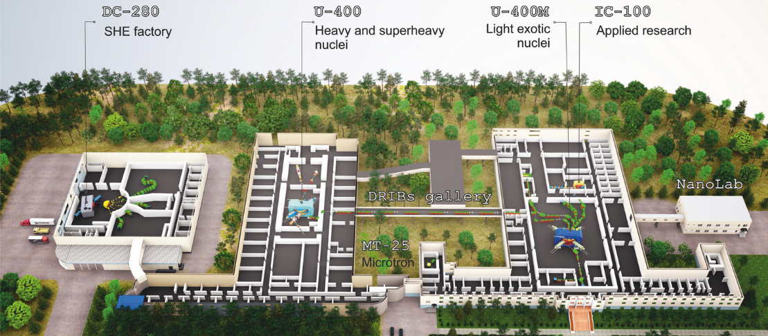
FLNR’s basic directions of research
FLEROV LABORATORY OF NUCLEAR REACTIONS
DRIBS-III ACCELERATOR COMPLEX
Heavy and superheavy nuclei
Light exotic nuclei
Nuclear reaction studies
Radiation effects and physics basics
of nanotechnology
Accelerator technologies
Notes:
17
Beam intensity of Ca-48 up to 2.5 mkA
Ion energy variation on the target with factor 5
Cyclotron average magnetic field from 1.8 up to 0.8 T

Slide 18
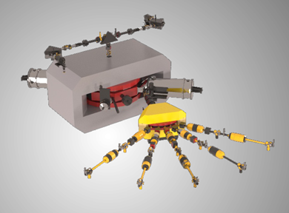
Summary for NP
Realization of the experimental program in the area of SHE research.
Development of experimental set-ups @ the SHE Factory.
Construction a specialized radiochemical complex of the 1st class.
Continuation of experimental program on light exotic nuclei at the modernized U-400M cyclotron with the use of the ACCULINNA-2 fragment separator.
Development of ECR ion source on 28 GHz for acceleration of ions up to Uranium.
Upgrade the U-400 (U-400R) accelerator, construction of the new experimental hall
and equipping it with existing and new set-ups intended mainly for the study of nuclear reactions.
The total available beam time of three FLNR’s cyclotrons (DC-280, U-400R, and U-400M) is expected to be of about 15 000 hours annually. This will allow us to formulate a user policy and open the FLNR facilities for external users.

Slide 19
Relativistic Heavy Ion and Spin Physics
V. Kekelidze, R. Tsenov, D. Peshekhonov

Slide 20
Relativistic Heavy-Ion and Spin Physics
Alessandro Bachetta (Uni Padova)
Alexander Kovalenko (LHEP JINR)
Alexander Sorin (JINR)
Gennady Zinovjev (LTP JINR)
Horst Stoecker (GSI)
Itzhak Tserruya (Weizmann Inst.)
Luisa Cifarelli (INFN Bologna)
Oleg Teryaev (LHEP JINR)
Richard Lednicky (JINR)
Roumen Tsenov (LHEP JINR) – local coordinator
Sergey Shmatov (LHEP JINR)
Vladimir Kekelidze (LHEP JINR) - chairman

Slide 21
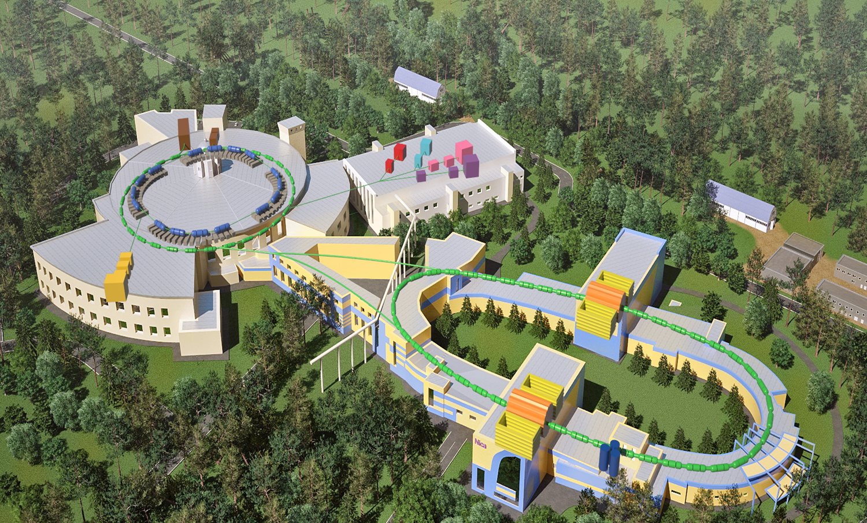

Summary
First priority in the next decade is the realization of the NICA scientific program

Slide 22
Summary
First priority in the next decade is the realization of the NICA scientific program based on:
  Heavy ion (up to Au⁺⁷⁹) collisions at center-of-mass energy in the range 2 – 11 AGeV;
  Collisions of transversely and longitudinally polarized protons and deuterons at center-of-mass energy up to 27 GeV
Available at: https://indico.jinr.ru/conferenceDisplay.py?confId=296,

Slide 23
+ Involvement in external experiments
Traditionally, the HEP scientific program of JINR includes participation in experiments at accelerator centers around the world (CERN, BNL, DESY, FAIR/GSI) that provide unique conditions to perform studies in the fields of high-energy heavy-ion physics and spin physics. The key factor here is a mutual benefit from the exchange of new scientific information and know-how. JINR participation will depend on the discovery potential of the experiments and leading role in them of the JINR researchers
The continuing participation in the experiments NA61 and COMPASS at SPS, ALICE at LHC and STAR at RHIC is of invaluable importance for preparation and realization of the physics program at the NICA complex. Strategically important is the JINR participation in experiments at future electron-ion collider (EIC) facility to be built in US and in fixed-target experiments at FAIR-GSI.
The JINR strategy for cooperative research at other accelerator centers should be linked closely to the updated European Strategy for Particle Physics, expected to be available in 2020.

Slide 24
Particle Physics and Astrophysics
V. Bednyakov, N. Rusakovitch, D. Naumov

Slide 25




Neutrino programme: BAIKAL-GVD
Detection of ultrahigh-energy
cosmic neutrinos
BAIKAL-GVD-1
2304 light sensors
combined in 8 clusters
of vertical strings at
750 – 1300 m depths.
Detection volume 0.4 km³
Objectives:
Neutrino astrophysics above few TeV
Dark matter – indirect search
Exotic particles – monopoles, Q-balls, nuclearites, …
April 2017
Taking data
April 2016
Taking data
300 m
“Dubna”
Demonstration
Cluster (2015)
~600 m
~1 km
120 m
Notes:
The pioneering research towards neutrino astronomy in Lake Baikal, Siberia, was initiated more than 35 years ago. First atmospheric neutrinos under water were identified in 1993. This important proof of principle stimulated the construction of other current neutrino telescopes world-wide (ANTARES, IceCube, KM3NeT).
In 2013, the IceCube Neutrino Project at the South Pole announced the revolutionary discovery of ultrahigh-energy neutrinos of astrophysical origin. The observed flux and energy cannot be explained by terrestrial sources. Therefore the identification of the cosmic sources of these neutrinos is now the top priority in the field of neutrino astronomy. Once the sources are identified, ultrahigh-energy neutrinos will open a new astronomical observation channel and will allow studying phenomena which are not accessible by other means.
From 2014 on, the BAIKAL Neutrino project has gained significant momentum towards the construction of a cubic kilometer array of optical modules (OM) in Lake Baikal. This array will be capable to study cosmic ultrahigh-energy neutrinos in much detail. The main advantage of the Baikal Gigaton Volume Detector (Baikal GVD) is its superior accuracy for the neutrino arrival direction –– a key element for the discovery of point-like neutrino sources. The experiment has a unique perspective in obtaining first-class physics results and identifying the sources of ultrahigh-energy astrophysical neutrinos.
The Baikal–GVD (Gigaton Volume Detector) project at Baikal Lake is a logical continuation and development of the investigations that have been carried out by the Baikal collaboration in the past several years. Its experience gives a reliable basis for creation of a new kilometer-sized detector.
At the beginning of April 2015 the Dubna cluster was put into operation at Baikal, which is larger than the Eiffel Tower in size. In April 2016 an extended cluster will be brought into operation, which will be larger than the Ostankino TV tower height.
Early in April 2016 the Baikal collaboration extended the Dubna cluster by increasing the number of optical modules (OMs) from 192 to 288. This is a final version of the cluster for the projected cubic-kilometer Baikal–GVD neutrino telescope and one of three largest high-energy neutrino detectors in the world.
Further development suggests extension of the detector site infrastructure and increase in the number of participating organizations. In 2015 a test bed for long-term testing of electronic systems for the detector was built and an OM assembly and test line was launched at DLNP.
In summer 2016 a new coast data-acquisition center will be assembled.
The building bought in Baikalsk is prepared for the use as local storage facilities for finished facility elements and laboratory premises. This will simplify delivery of finished detector elements to the assembly site in 2016.
The first two of the 8 clusters of Baikal-GVD are already taking data and will release first scientific results in summer 2017. This research infrastructure is presently funded by JINR and Russia. By 2020, Baikal GVD will be instrumented with about 2300 OMs and reach a volume of 0.4 cubic kilometers. Baikal GVD is a member of the Global Neutrino Network and follows a common worldwide strategy within this network, which also includes the projects IceCube, ANTARES and KM3NeT. By now, the GVD project itself has foreign partners from the Czech Republic, Germany, Poland, Russia, and Slovakia. In addition, researchers from IceCube and from the Mediterranean Sea region have been using the Baikal infrastructure for common measurements and for prototype tests.
The expected top-class results of Baikal-GVD, its active and regular scale expansions and the upgrade of the full local infrastructure make the project a unique opportunity for a collaboration of EU and Russia institutions and JINR.

Slide 26
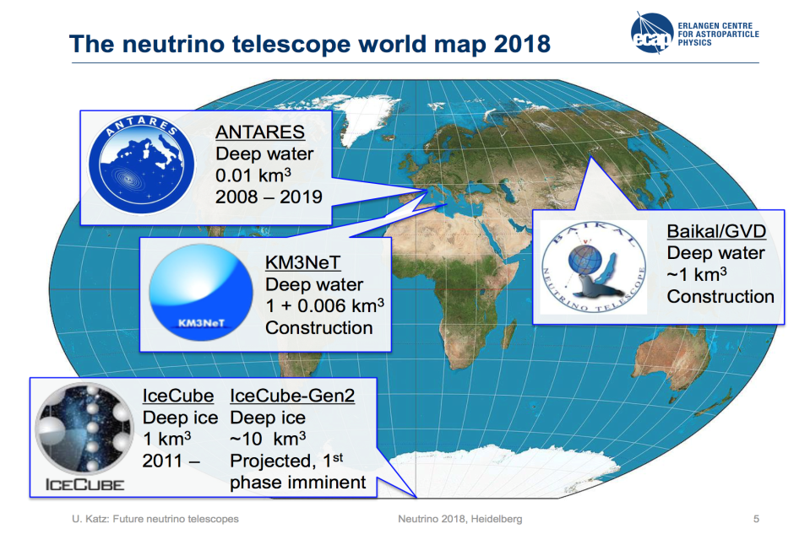

Slide 27
Baikal GVD – Flagship Experiment of JINR

Slide 28
Summary - Particle Physics and Astrophysics
Mid-term plans
ATLAS - Phase 1 , Phase 2
CMS
JUNO - JINR is the major collaboratior
Dark Matter – Edelweis, DarkSide
CP-violation – NOvA, MO
Kalinin PP – magnetic moment, coherent, sterile
Taiga – 100 TeV gamma rays
Gerda, SuperNEMO – 0vbb
Long-term plans
BAIKAL GVD
NOvA - DUNE or HyperK
JUNO
ATLAS, CMS – HL LHC
Gravitational waves interferometers – LIGO, VIRGO, Einstein

Slide 29
JINR – CERN strategic partnerships
JINR actively participates in the LHC programmes including the ATLAS, CMS , ALICE and the Collider itself and planning to contribute to the LHC detectors upgrade.
Besides, JINR participate in the four SPS projects:
Compass-II (NA58) – nucleon spin structure, hadron spectroscopy (with interests to future SPD at NICA);
NA61 – (intersects with BM@Nuclotrone and MPD);
NA62 – CP-violation and rare decays;
NA64 – search for the dark sector;
Accelerator development: HL-LHC CLIC,ILC LHeC, FCC, Precise laser metrology (super sensitive inclinometr) ,
Computing and Information Technologies, WLCG, Tier-1,2
Neutrino platform, DUNE; other - nTOF, DIRAC,
Education and Teachers programs etc.

Slide 30
Radiobiology — Astrobiology
E. Krasavin, A. Bugay, E. Nasonova

Slide 31
Expert Group in the Radiobiology — Astrobiology field
Chairman E. Krasavin (JINR), Corr. Member RAS, Lab. Dir. krasavin@jinr.ru
M. Ostrovsky (JINR), Acad. RAS ostrovsky3535@mail.ru
A. Rozanov (JINR), Acad. RAS aroza@paleo.ru
A. Bugay (JINR), Dr. bugay@jinr.ru
I. Koshlan (JINR), Dr. koshlan@yandex.ru
G. Timoshenko (JINR), Dr. tim@jinr.ru
E. Nasonova (JINR), Dr. nasonova@jinr.ru
Co-chairman R. Arutyunyan, Corresponding Member of the National Academy of Sciences of Armenia, Yerevan University (Armenia) rouben_a@hotmail.com
M. Waligórski, Prof., Institute of Nuclear Physics, Krakow (Poland) z5waligo@cyf-kr.edu.pl
A.I. Gaziev, Prof., Institute of Cell Biophysics, the Russian Academy of Sciences (RAS), Pushchino (Russia) gaziev.iteb@gmail.com
A.I. Grigoryev, Acad. RAS, Institute of Biomedical Problems RAS (Russia) grigoriev@imbp.ru
R. Hoover, Prof., Athens State University (the U.S.) Entogonia@aol.com
E. Di Mauro, Prof., La Sapienza University of Rome (Italy) ernesto.dimauro@uniroma1.it

Slide 32


Modern trends in radiobiology
Fundamental radiobiological research: studying mechanisms of radiation action at the molecular, cellular, tissue, and organismal levels of biological organization
Radiation and nuclear medicine: refinement of tumor radiation therapy techniques (proton and carbon therapy); designing new radio sensitizers and radio protectors; extension of the list of the radionuclide pharmaceuticals for diagnostics and treatment
Radiation safety of deep space flights: refinement of the approaches to human protection from heavy charged particles
Origin of Life
on the Earth,
Astrobiology
JINR’s Laboratory of Radiation Biology
Fundamental aspects of radioecology: research at thelevel of ecosystems and populations, participation in EU programs
Applied radiation technologies: development of methods of raising crop capacity and improvement of agricultural product quality; elimination of pathogenic micro- and macroflora; disinfection of agricultural waste, etc.
V. Matveev
Notes:
Reflecting modern trends in radiobiology, the following fields are of top priority of the JINR radiobiological research activities:
fundamental radiobiological research,
radiation safety of deep space flights,
nuclear medicine.
In the current Seven-Year Plan, studies will be mainly focused on the response of different structures of the central nervous system to radiation exposure determining the specifics of the cognitive and behavioral functions of laboratory animals.

Slide 33
Summary
Molecular radiobiology
Radiation cytogenetics
Radiation Physiological studies on primates
top priority research!
Radiation Medicine
15-fold increase of proton beam efficiency by DNA synthesis inhibitors
Mathematical modeling of radiation-induced effects
Astrobiology
Radiation protection research
Radiation Protection management and shielding at new nuclear facilities (incl. NICA)
Main future topics and required infrastructure identified

Slide 34
Condensed matter and neutron physics
V. Aksenov, V.Shvetsov, A. Ioffe,

Slide 35
Contribution on behalf of WSG-5 on condensed matter and neutron physics:
A. Ioffe (Germany) – Jülich Center for Neutron Science at Heinz Maier-Leibnitz Zentrum, München
Frank Laboratory of Neutron Physics JINR, Dubna (Chairman)
V.L. Aksenov (Russia) – National Research Center “Kurchatov Institute”, Moscow;
Frank Laboratory of Neutron Physics JINR, Dubna
J. Carpenter (USA) – Argonne National Laboratory, Chicago
A. Harrison (UK) – Diamond Light Source, Didcot, Member of JINR Scientific Council
N. Kucerka (Slovakia) – Frank Laboratory of Neutron Physics JINR, Dubna
T.V. Kulevoy (Russia) – National Research Center “Kurchatov Institute” – ITEP, Moscow
A.V. Lopatkin (Russia) – N.A. Dollezhal Research and Development Institute of Power Engineering (NIKIET), Moscow
F. Mezei (Sweden) – European Spallation Source, Lund
P. Mikula (Czech. Rep.) – Nuclear Physics Institute – Řež, Member of the JINR PAC on Condensed Matter Physics
D. Nagy (Hungary) – Wigner Research Centre for Physics, Budapest (Chairman of JINR PAC on Cond. Matter Physics)
V. Nesvizhevsky (France) – Institute Laue-Langevin, Grenoble, Member of JINR PAC on Nuclear Physics
L. Rosta (Hungary) – Budapest Neutron Center, Budapest
S.F. Sidorkin (Russia) – Institute for Nuclear Research of Russian Academy of Sciences, Troitsk Moscow Reg.
I.T. Tretyakov (Russia) – N.A. Dollezhal Research and Development Institute of Power Engineering (NIKIET), Moscow
D. Chudoba (Poland) – Frank Laboratory of Neutron Physics JINR, Dubna (scientific secretary)

Slide 36
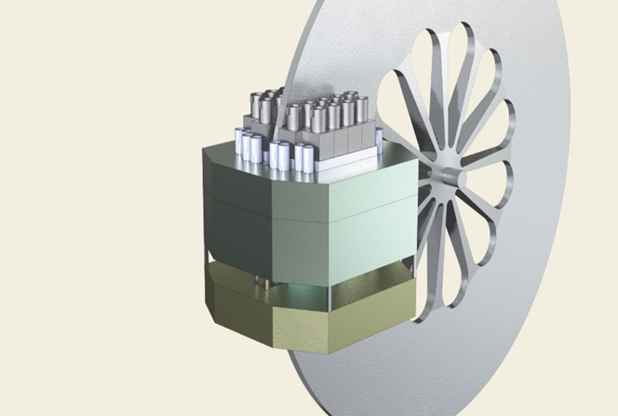
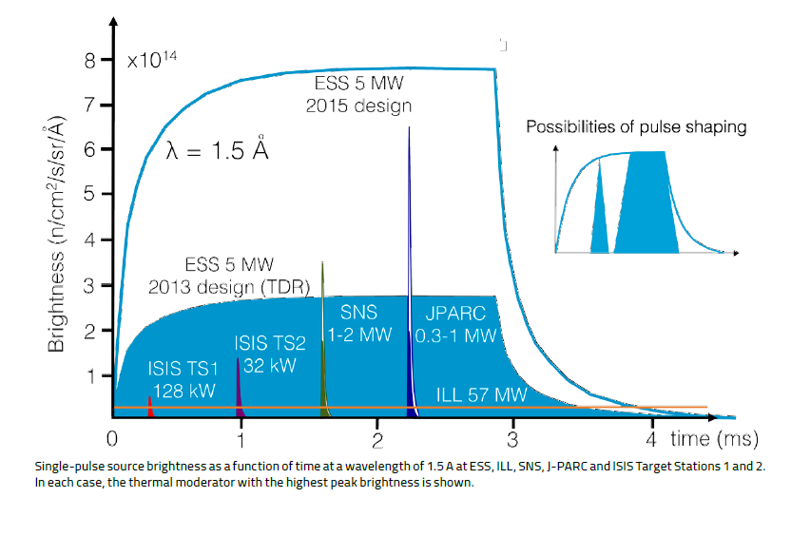
New Dubna Neutron Source: DNS-IV
New Dubna source will provide shorter neutron pulses, however containing the same number of neutrons as at ESS.
=> it will be as good as ESS for low resolution experiments and better for high resolution experiments.
Pulsed reactor IBR-3
Reactivity modulator
Core +reflector
DNS-IV: Φ_{peak}~10¹⁶
IBR-2M
x10
λ=1.5Å
DNS-IV - not just another neutron source,
but one of the best in the world!
Mean flux of ILL

Slide 37
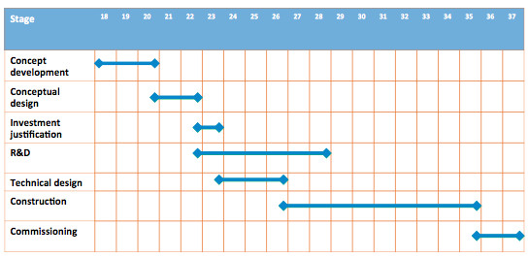
Time-line for DNS-IV
Both options are under the feasibility study in N.A. Dollezhal Research and Development Institute of Power Engineering (NIKIET), Moscow
©NIKIET

Slide 38
Summary for CM and neutron physics
Short term perspectives:
  Development and upgrade of the IBR-2 instruments. Already now there are examples at JINR of more than 10-fold increase in efficiency
  Startup of the IREN source at designed parameters;
Long term perspectives – new neutron source in order to replace IBR-2 after the end of its lifetime > superbooster NEPTUN

Slide 39
Information Technology and Scientific Computing
V. Korenkov, N. Voytishin

Slide 40
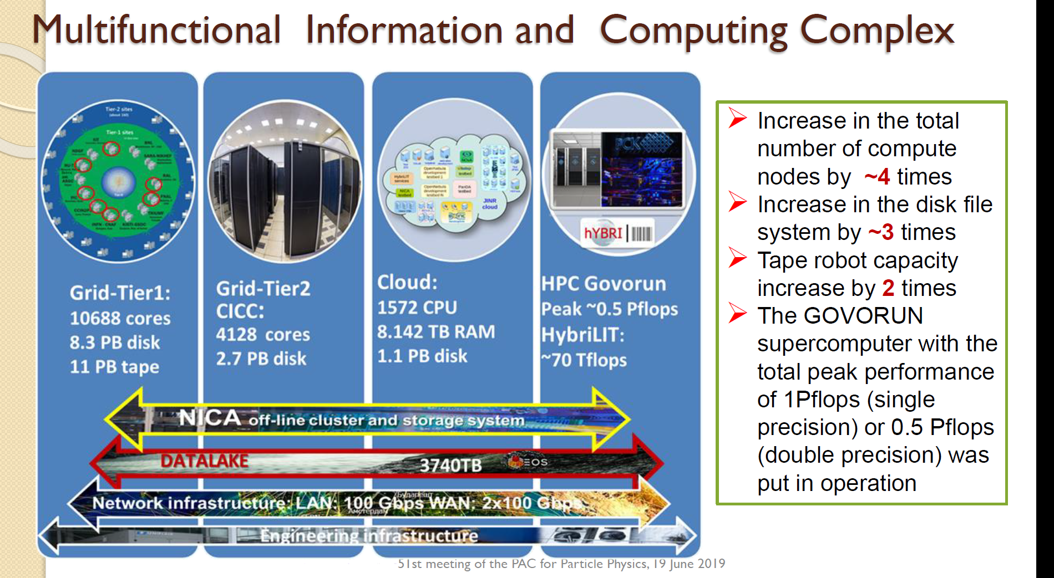

Slide 41

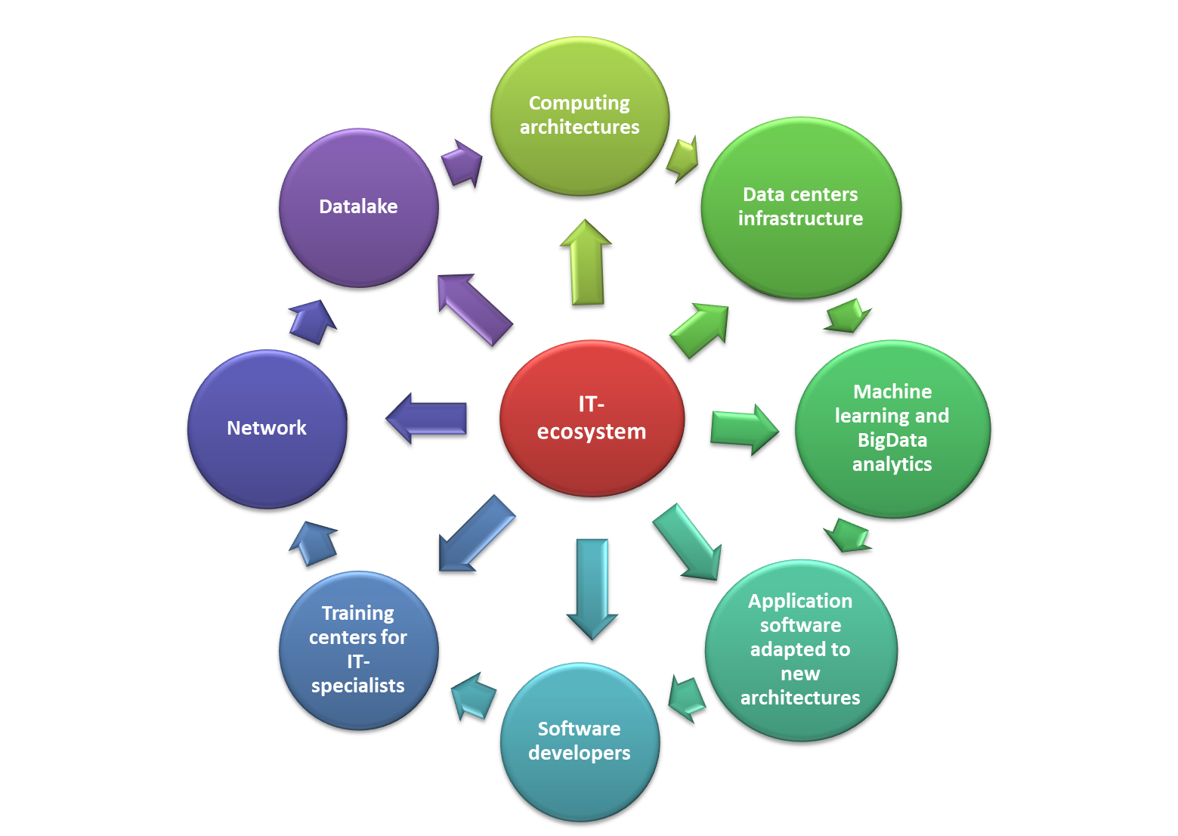
AIM
Expandable worldwide dynamically evolving IT-ecosystem that combines a variety of technological solutions, state-of-art computing concepts and methodologies.
PURPOSES
Significantly reduce the time spent on the implementation of projects that require computing resources and IT expertise
BENEFICIARIES
JINR, its Member States and international collaborators

Slide 42
WG Members Input
Victor Matveev
Itzhak Tserruya
Valery Rubakov
Horst Stoecker
Grigory Trubnikov
Sidney Gales
Michel Spiro
Structure – coherence/homogeneity
Priorities
Motivation, international context
Uniqueness, leadership…
Balance of research at home and outside
Inter-laboratories co-operation
Neutrino physics enhancement
CMS, fixed target experiments enhancement
Time lines !!!

Slide 43
EB : Structure of a Strategic Long Range Plan
Executive Summary
• Nuclear Physics at low and intermediate energies
Particle Physics (HEP on large scale international facilities).
Neutrino and astrophysics
Relativistic Heavy Ion and Spin Physics.
Condensed Matter and Neutron Nuclear Physics.
• Theoretical Physics
Radiobiology (including astrobiology)
IT, Big Data and High Performance Computing.
• Conclusions

Slide 44

JINR’s Long Range Strategy plan for up to 2030
NICA – II ( SpinPD, MPD-Upgr., NICA-HL, Innov.Centre )
DRIBS-III (Dubna Radioactive Beam Complex for Super-Heavy Elements and Exotic Nuclei studies)
SC HI LINAC-100 and DERICA Project (Dubna Electron Radioactive Ion Collider fAcility)
Physics with the ultra cold neutrons at IBR-2M
Dubna NS-IV: Super booster “NEPTUN” - Pulsed Np-237 Neutron Reactor
Baikal–GVD Neutrino Telescope Upgrade above 1 km³
BIG DATA and DATA LAKES IT Technologies Center, Supercomputer “Govorun” Upgrade
Hadron Therapy research complex, Radiobiology Center
Participation in the World Global Projects ( ILC, FCC,etc)
Notes:
Наряду с оценкой текущих показателей работы Института, в ОИЯИ проводится работа по долговременному планированию и определению приоритетов развития Института на отдаленные периоды (до 2030 года). На слайде представлено текущее видение приоритетных проектов будущего.

Slide 45
Proposals for the JINR Long-Range Strategy Plan
NICA-II ( SPD, MPD-Upgrade, NICA-HL, Innovation Centre )
DRIBS-III (Dubna Radioactive Beam Complex for Super-Heavy Elements and Exotic Nuclei studies)
and SHE Factory upgrade
SC HI LINAC-100 and DERICA Project (Dubna Electron Rare Isotope Collider fAcility)
• Physics with the ultra cold neutrons at IBR-2M
Dubna PNS-IV: Super booster “NEPTUN” (Pulsed Np-237 Neutron Reactor)
Baikal–GVD Deep Underwater Neutrino Telescope Upgrade (above 1 km³⁾
BIG DATA @ IT Technologies Center, Supercomputer “GOVORUN” Upgrade
Hadron Therapy research complex, Radiobiology Center,
Participation in the World Global Projects ( HL-LHC, ILC, ClIC, FCC, etc )
Deep Underground Law background Neutrino and Astroparticle Physics (JUNO, Neutrino Platform, T2K, BNO, etc )
Other

Slide 46
Timelines for major projects of JINR
Timeline | 2020 | 2023 |  |  | 2026 |  | 2029 |  |  | ~ 2032 |  | ~ 2035 |  |  |  | ~2038
Project
SHE-Factory | Operation and Development |  |  |  |  |  |  |  |  |  |  |  |  |  | Operation
DERICA | R&D |  | Design & Prototyping |  |  | Decision | Phased Construction |  |  |  |  |  |  | Operation
NICA MPD | Construction |  |  | Operation |  |  |  | Upgrade |  |  |  |  | Operation
NICA SPD | R&D & Design | Construction & Commissioning |  | Construction & Commissioning |  |  | Physics Experiment |  |  |  | Operation |  |  |  |  | Up-grade | Up-grade
IBR-3 | Technical Design & Prototyping |  |  | Decision |  | Construction |  | Construction |  |  |  |  |  |  |  | Operation | Operation
Baikal- GVD | Construction + Data Taking |  |  |  | Upgrade + Data Taking | Upgrade + Data Taking | Upgrade + Data Taking | Upgrade + Data Taking |  |  |  |  |  |  |  | Data Taking | Data Taking
FCC or ILC | Participation in Design-Study |  |  |  |  |  | Decision |  | Participation in Construction |  |  |  |  |  |  | Operation | Operation

Slide 47
Заключение
Редакционная Группа активно работает над подготовкой интегрального, сбалансированного текста.
Стратегический План Развития ОИЯИ - должен послужить основой разработки следующей 7-летки,
а также стать основой для принятия Руководящими Органами Института мудрых решений, ведущих ОИЯИ к новым научным достижениям,
к научному лидерству ,
к научной славе.

Slide 48
Procedural timeline
Status reports of the topical sub-groups. SC – September 2019
International WG meeting –recommendations for sub-groups and for editorial board (EB) - September 2019
Discussion in S-T-Committee of JINR, recommendations for EB – October 2019
Status report in CPP – November 2019
Integration and final text editing - November 2019 – January 2020
Presentation in SC for approval - February 2020
Approval by CPP - March 2020
Printing of the SLRP book (scientific part).

Slide 49
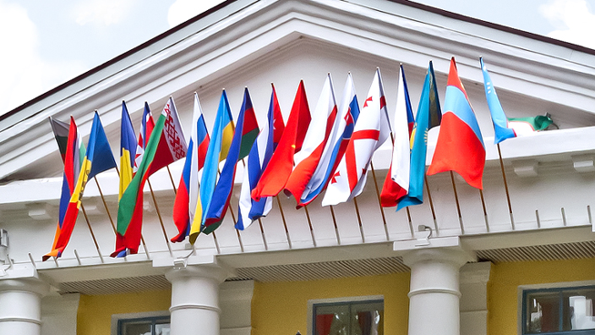
The current versions of working documents from the sub-groups are posted : https://indico.jinr.ru/event/1121/
SLRP will form the basis of the next JINR 7-year plan for the period 2024-2030
SLRP is a forward look enabling JINR scientific community, in interaction with policy makers of JINR member States, to develop long-term views and analyses of future research developments with the aim of defining research agendas of JINR laboratories in national and international context.

Slide 50



2030
We have a strategy !
2020

