Slide 1
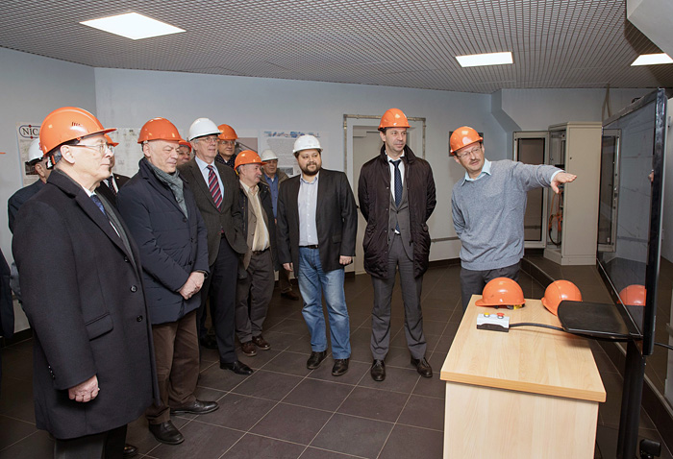
Progress towards realization of the Nuclotron-NICA project
A.Sidorin, on behalf of the team
A.Sidorin for the AD team
PP PAC, JINR, Dubna, 3-4 February 2020

Slide 2
Contents
Status of the Booster assembly and commissioning
- HILAc-Booster transport line
- Cryo-magnetic system
- Plans of the commissioning works
Preparations for the Collider assembly

Slide 3
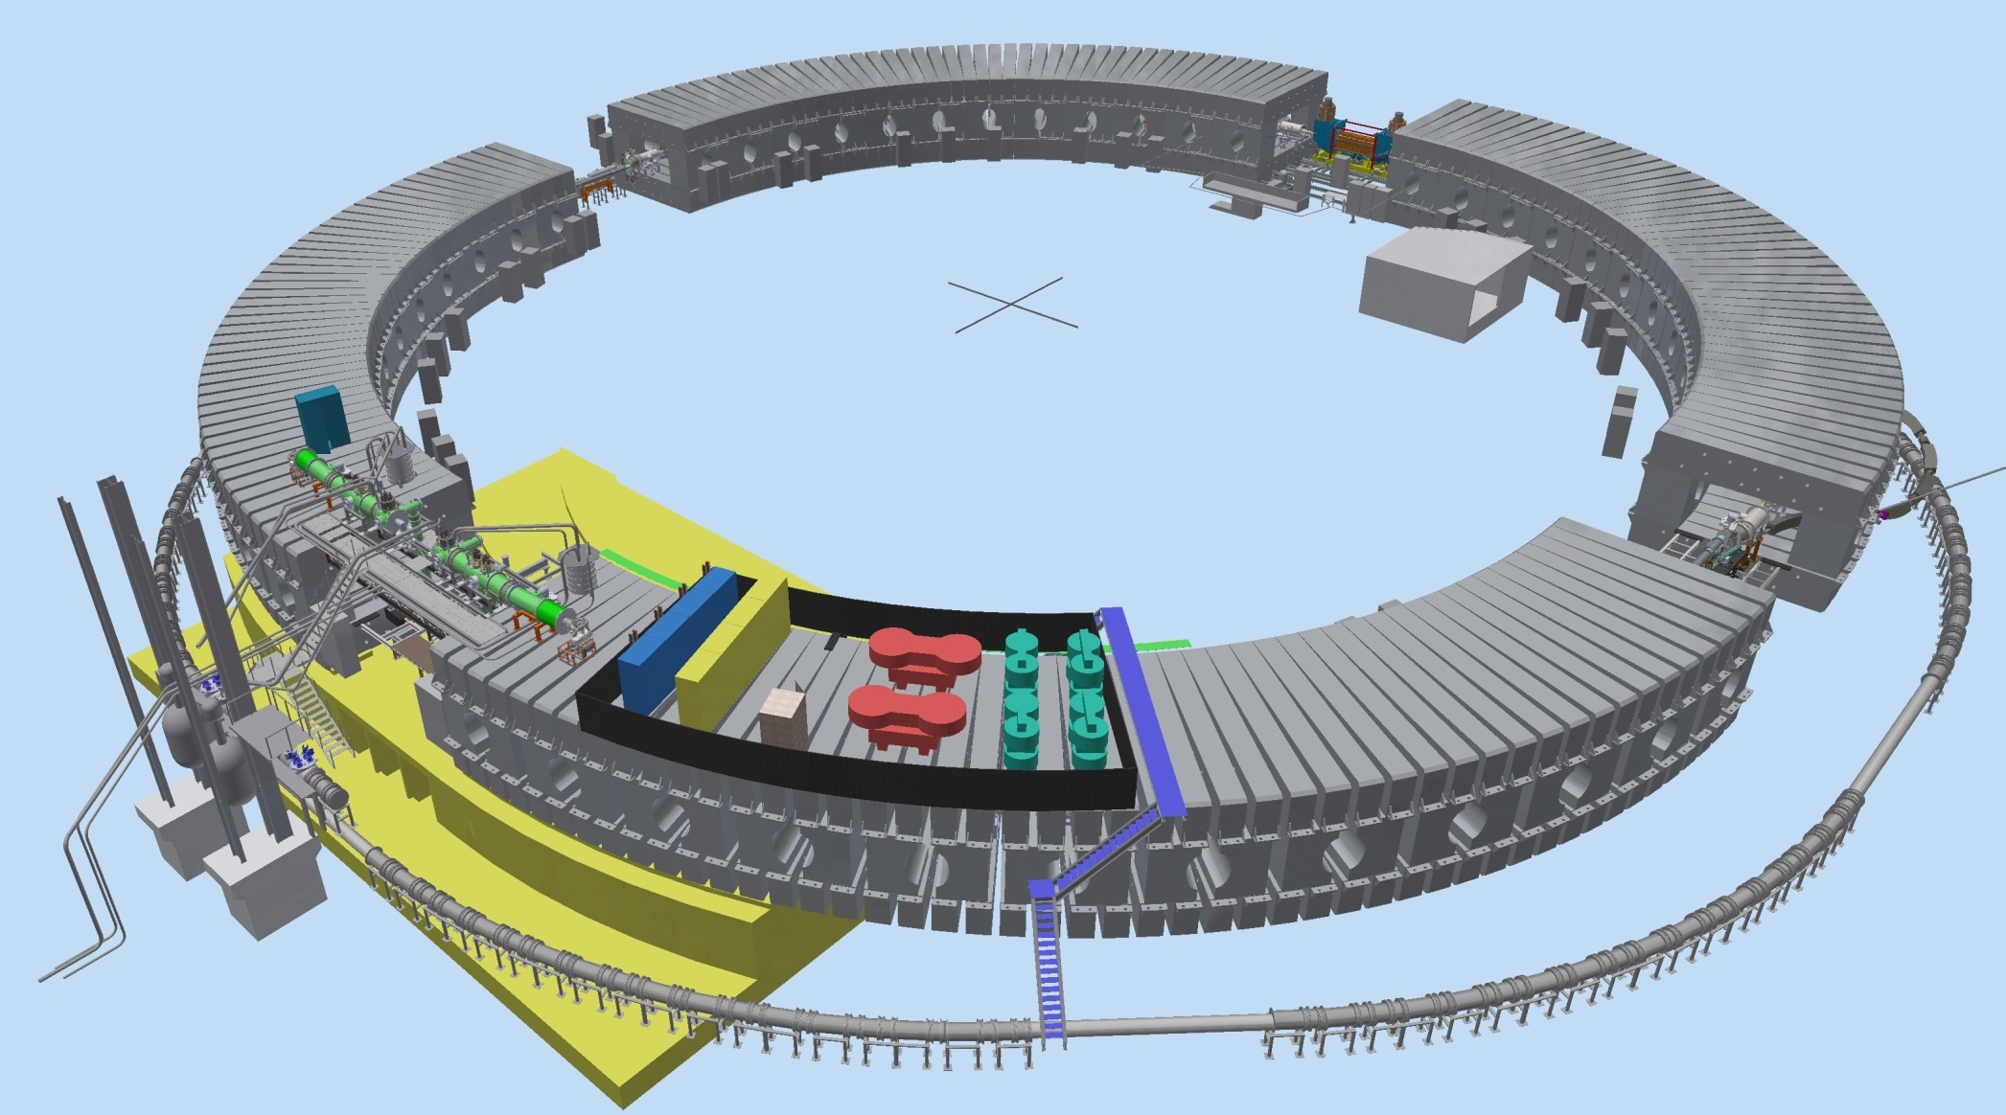
Booster
Booster 3D view
Injection system
E-cooling system
BNBTL
Measurement period
Extraction system
Power supply
Nuclotron
Accelerating station

Slide 4
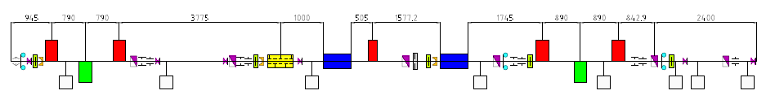
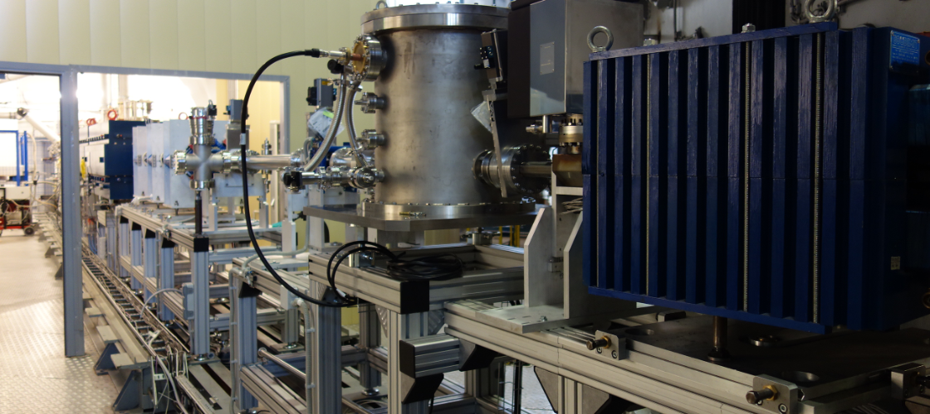
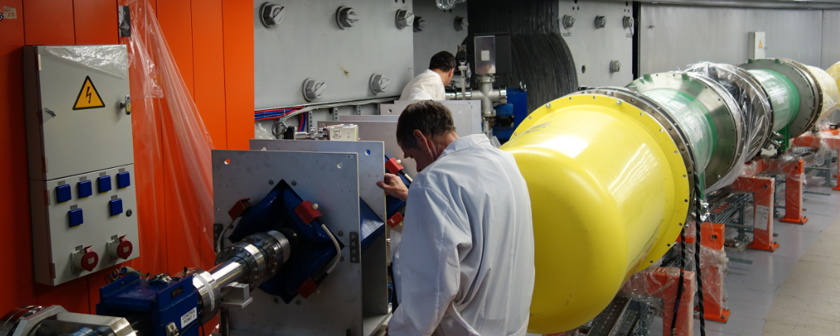
HILAc-Booster Beam Transport Line
transport with minimal ion losses
debunching
matching
Separation and adsorption of neighbor charge states of ions.
Provide different schemes of the beam injection into the Booster.
Mounting was finished in July

Slide 5
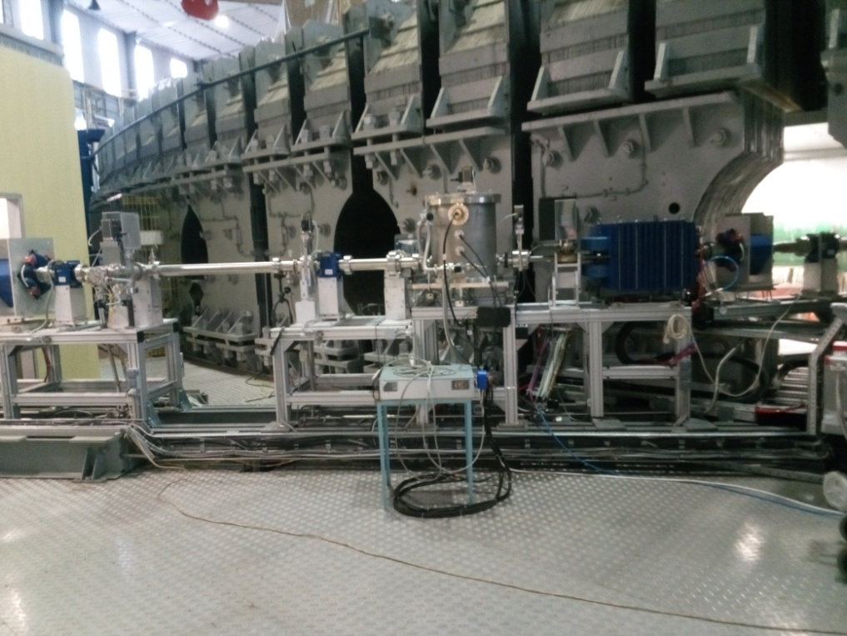
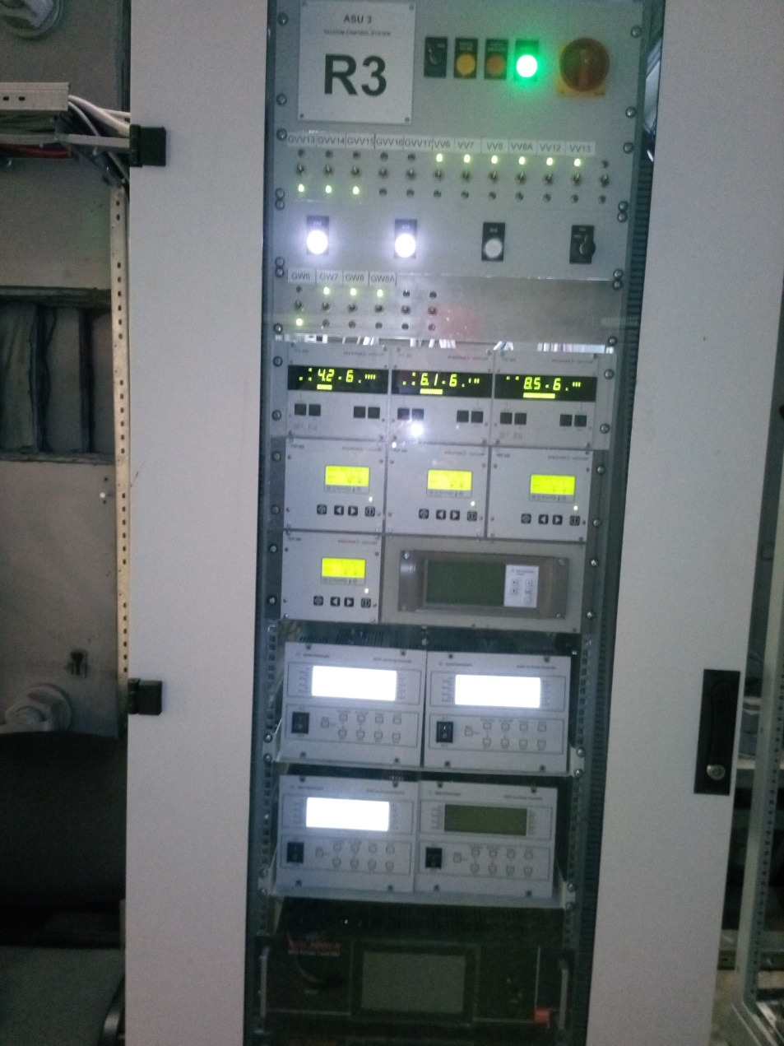
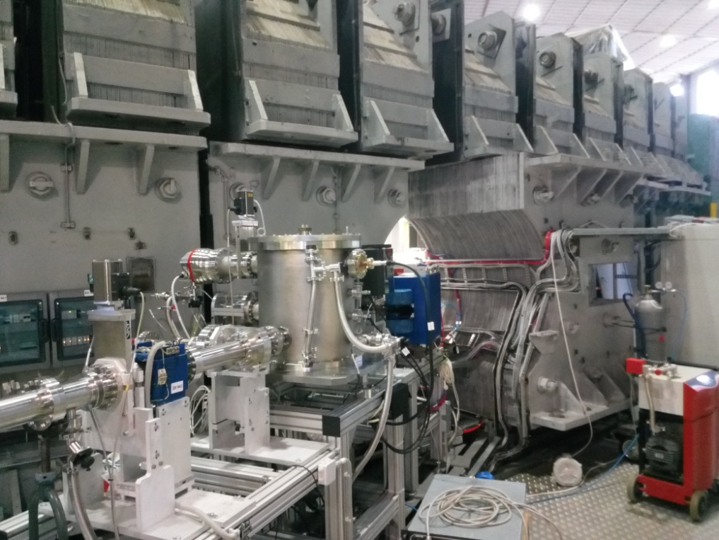
HILAc-Booster transport line
October:
preparation for commissioning
December:
commissioned

Slide 6
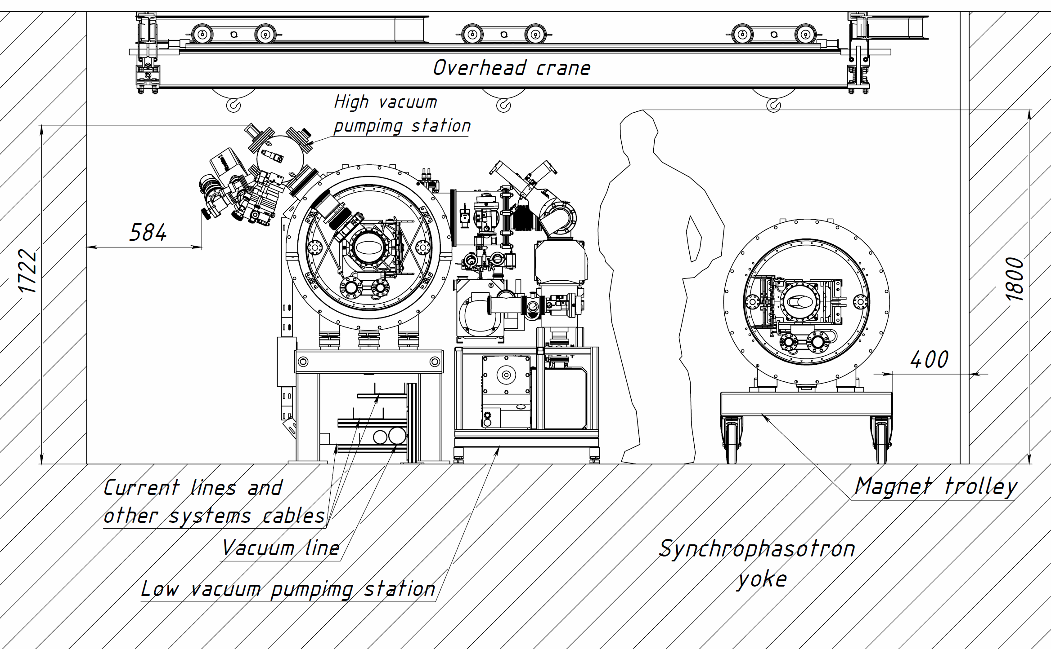
Booster
Booster Cryo-magnetic system
The booster tunnel cross section

Slide 7
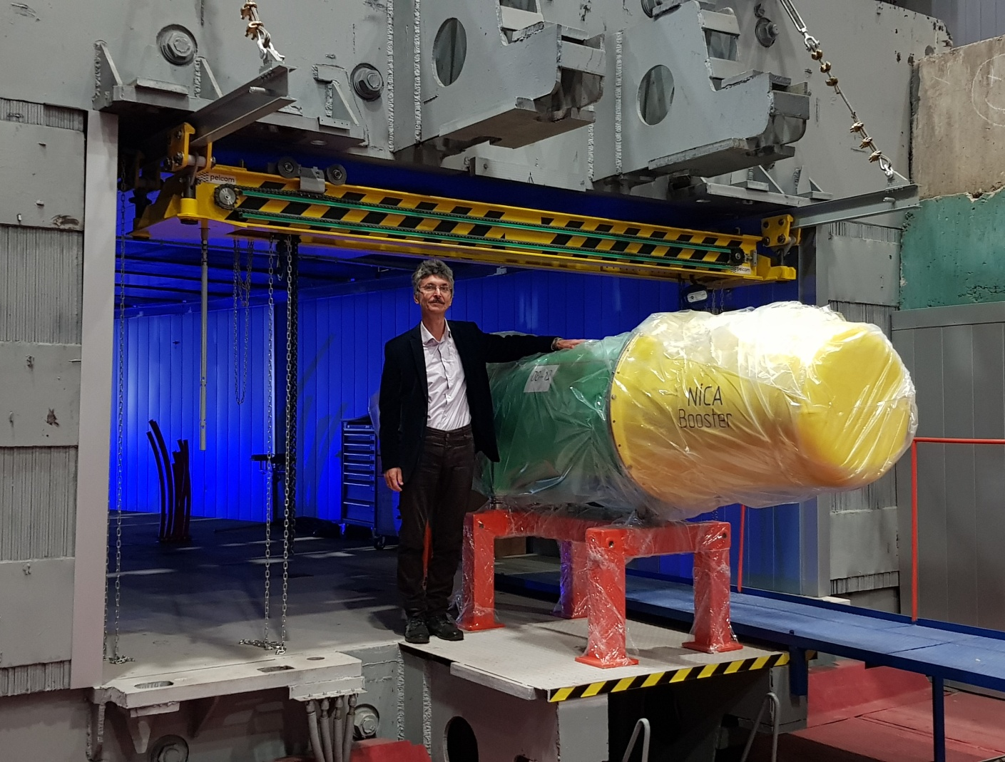
Booster Cryo-magnetic system
First dipole magnet was installed in SFT yoke in September 2018

Slide 8

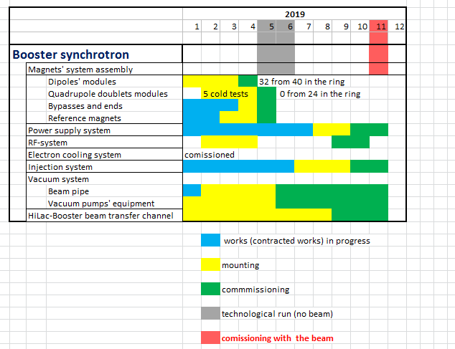
S.Kostromin, PP PAC 20.01.2019
Time-schedule
Booster
Booster (25 Tm)
up to 578 MeV/u
Apr-May 2019 –
technological run
Oct-Nov 2019
- commissioning with the beam

Slide 9
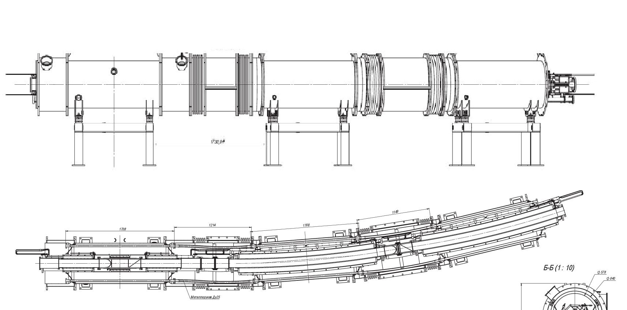
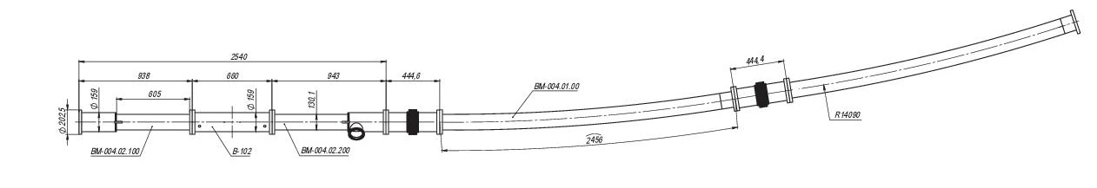
Booster Cryo-magnetic system
Regular period
Quadrupole doublet
Dipole module
Dipole module
Lenses
Corrector
Pick-up
Beam chamber

Slide 10
Booster Cryo-magnetic system
Pick-up stations were purchased in FMB (Berlin):
term of delivery – October 2018,
first serial pick-up was transferred to Dubna in May 2019
During cryogenic tests at a few lenses were measured
displacement of optical axis (up to 0.5 mm) after cycle of cooling and heating
The reason: displacement of the winding inside the yoke
All 24 blocks were reassembled with more strong fixation of the windings
and passed through the cryogenic tests again
Now all the magnets are at the ring

Slide 11
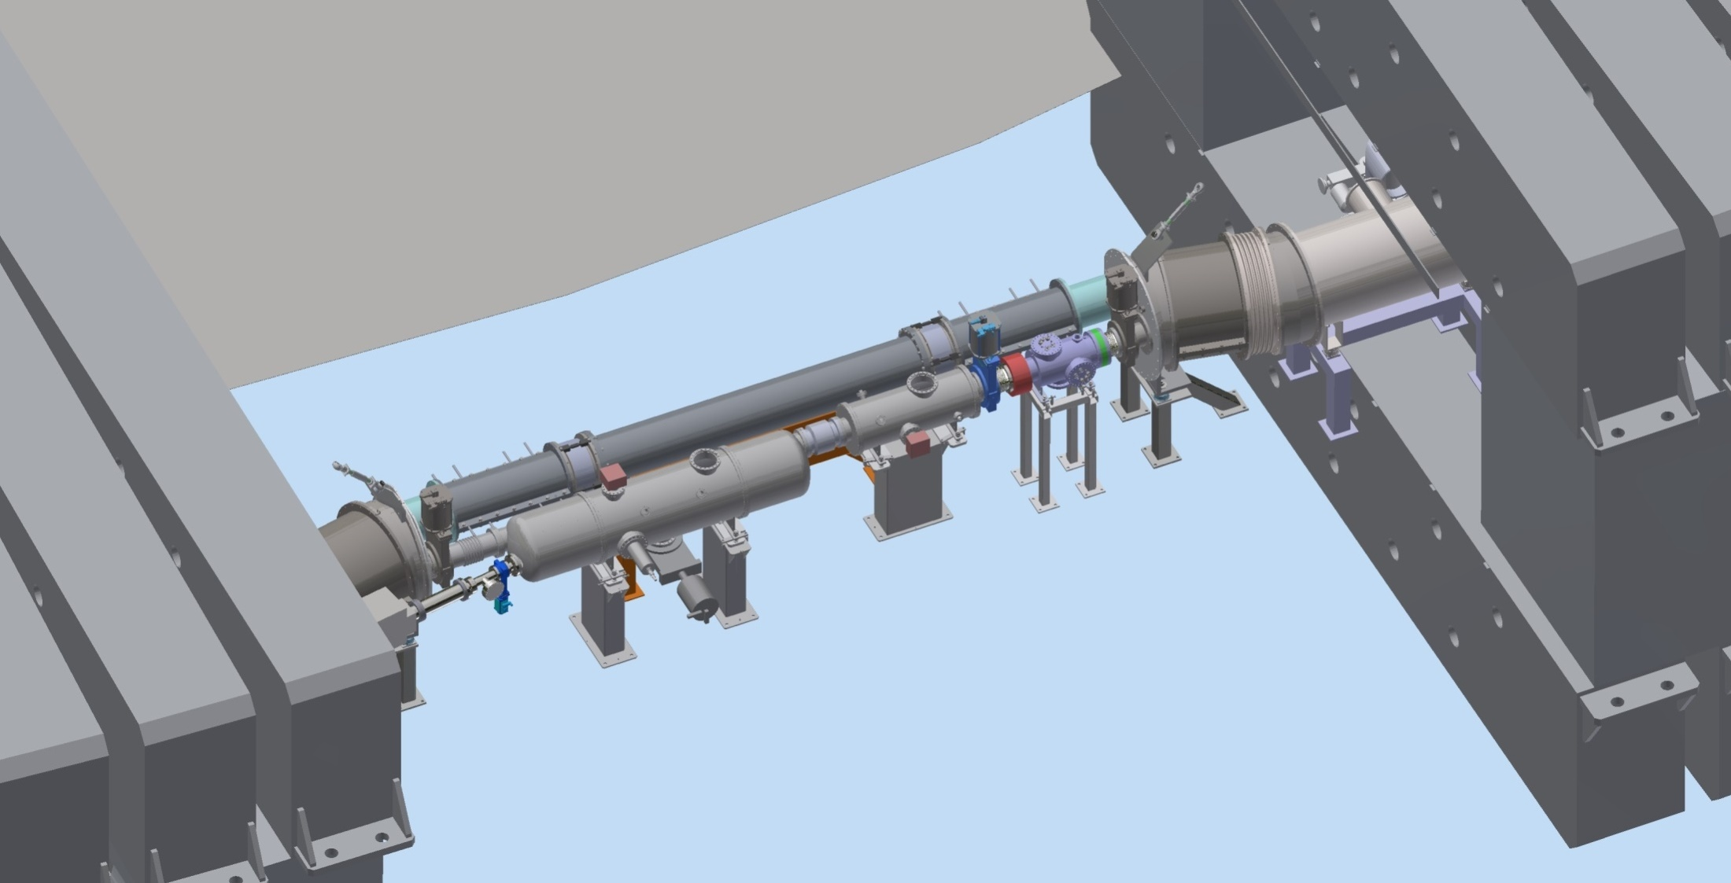
Booster injection system
First warm gap
Bypass
Quadrant I
Quadrant IV
Kicker
Electrostatic septum
Injection channel from HILAC

Slide 12
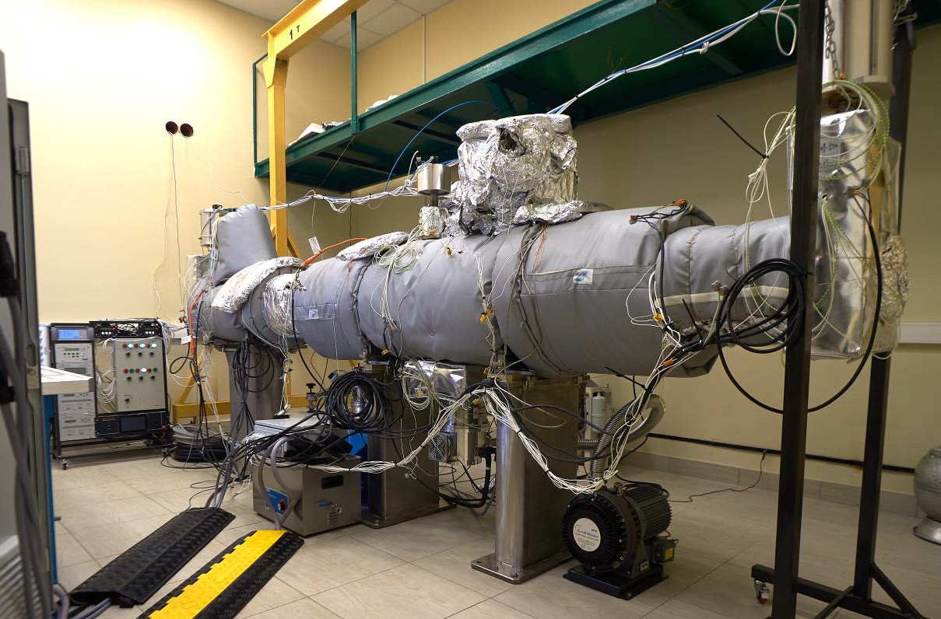
Booster injection septum
Vacuum test of electrostatic septum
• Cryosystems/HiVac companies

Slide 13
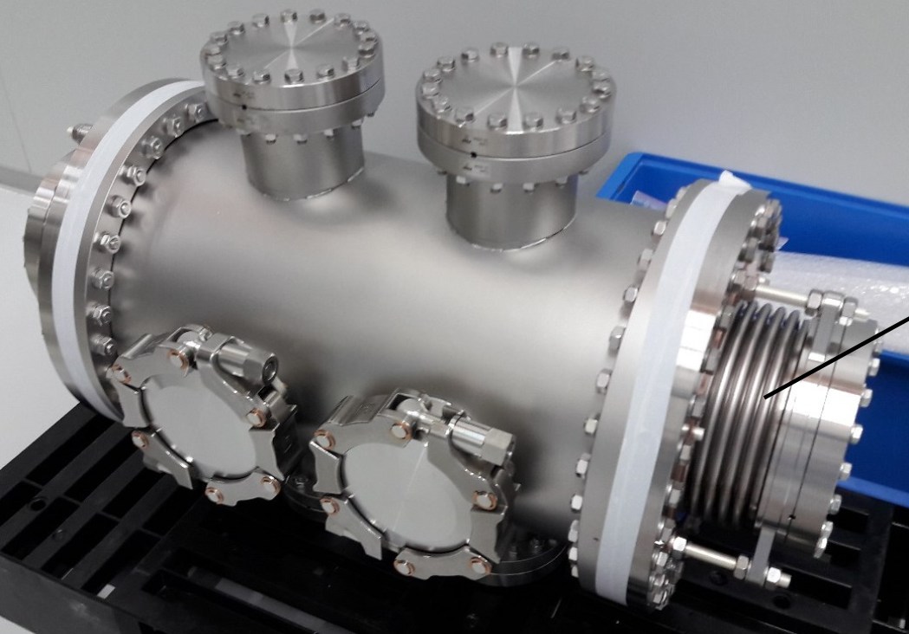
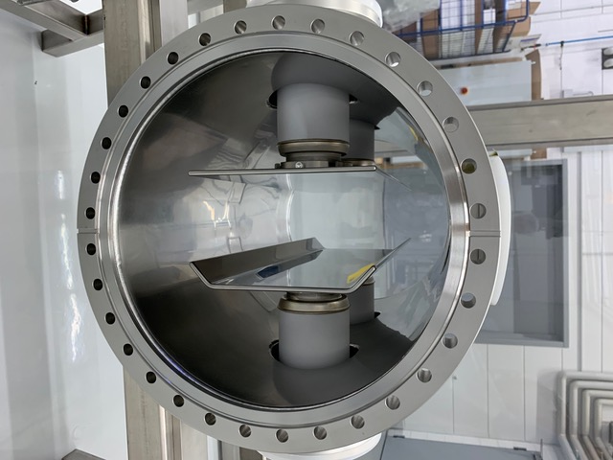
Booster injection kicker
Electrostatic kicker
• BEVATECH/PINK companies

Slide 14
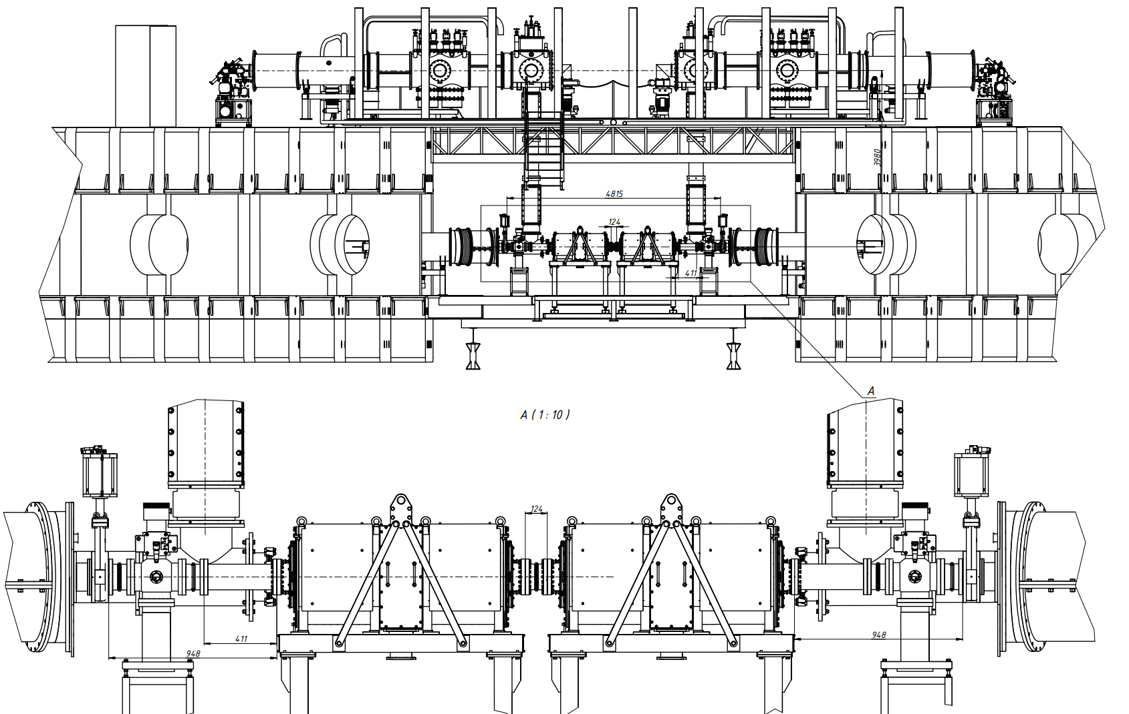
Booster acceleration stations + Measurement period
Second warm gap
Pump stations
RF tanks

Slide 15
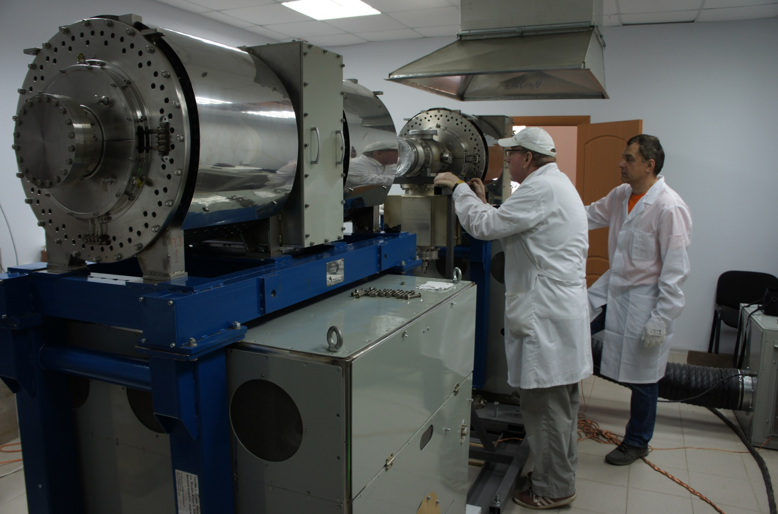
Booster acceleration stations
Testing of accelerating stations
• Budker Institute of Nuclear Physics

Slide 16
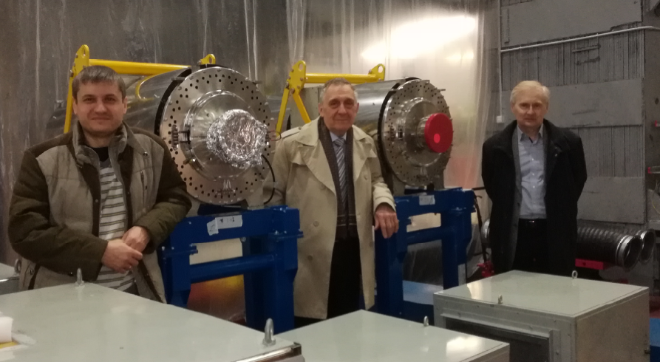
Booster acceleration stations

Slide 17
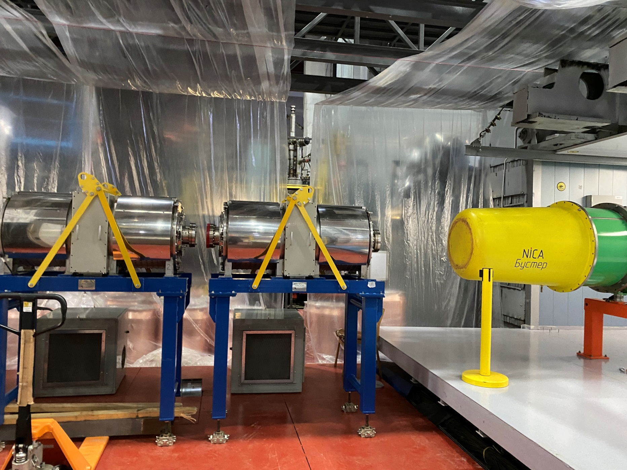
Booster acceleration stations

Slide 18
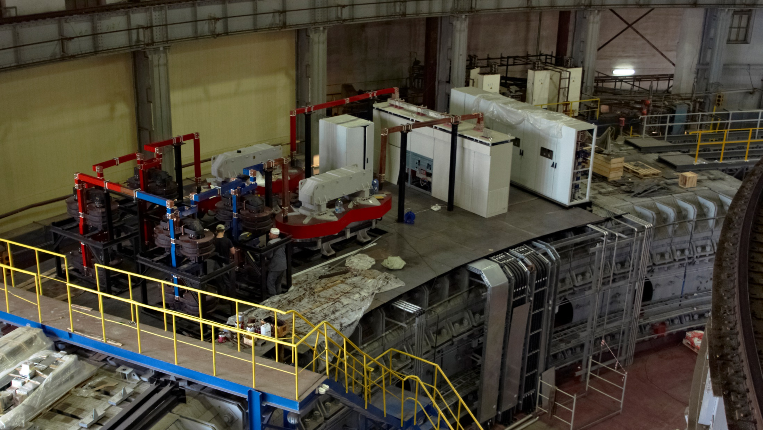
Elements of Power supply system

Slide 19
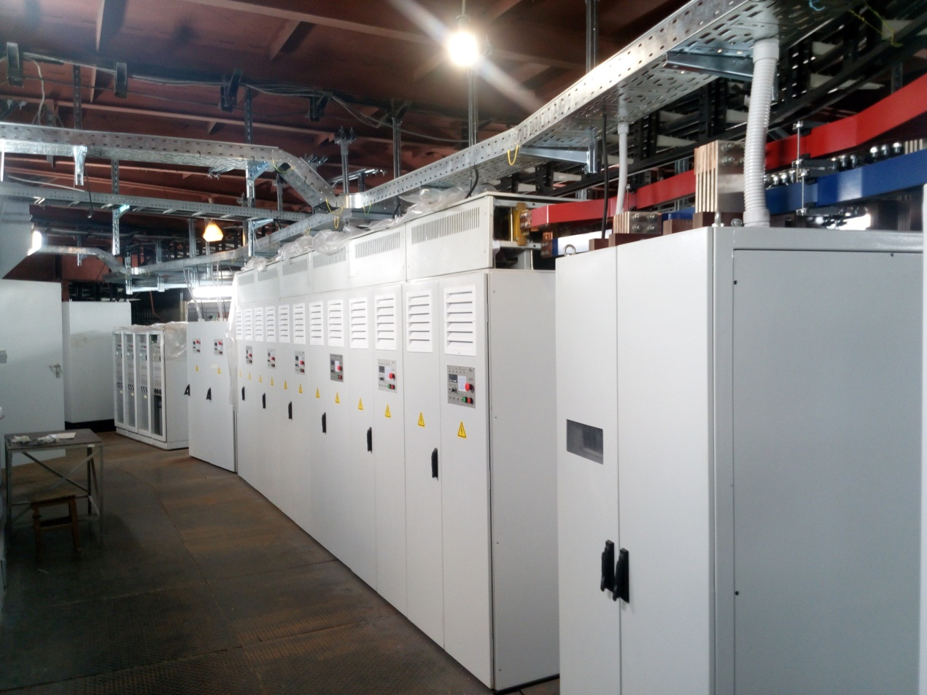
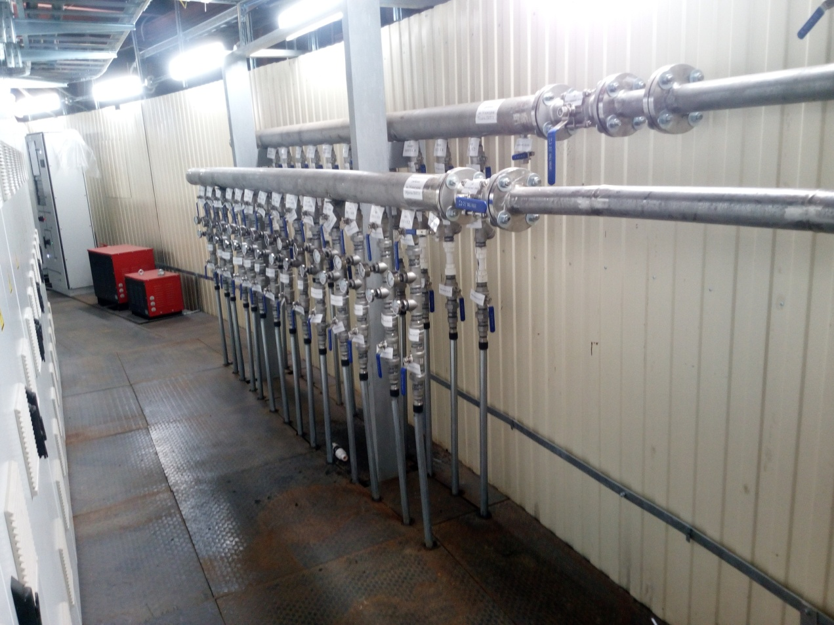
Elements of Power supply system
Room in the basement

Slide 20
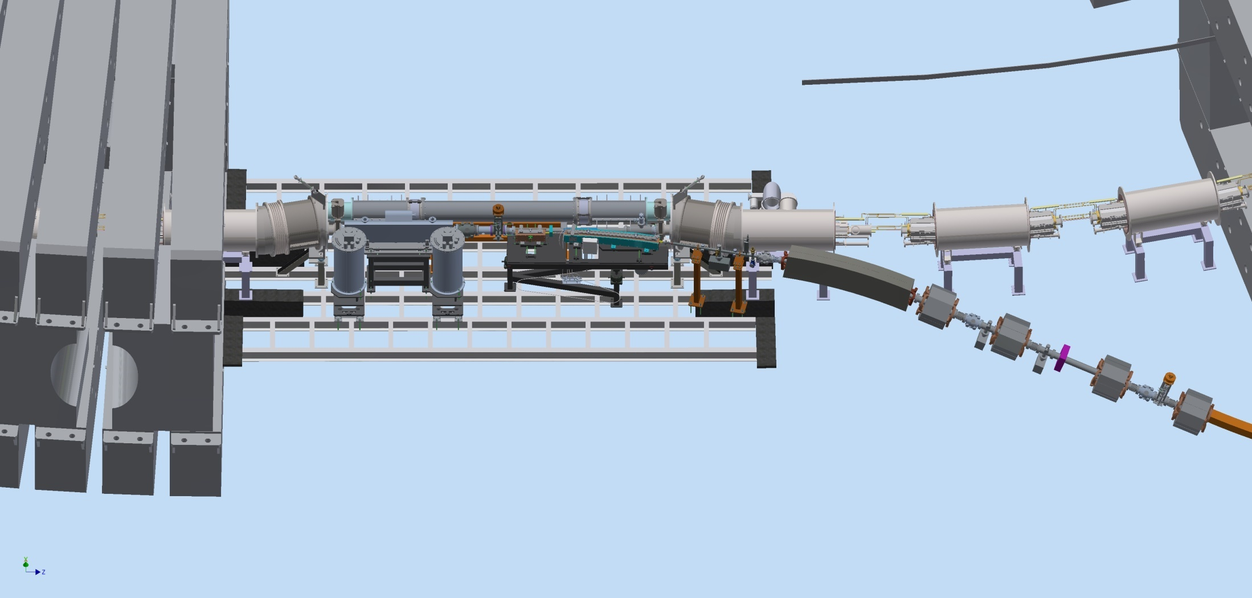
Booster Extraction system
Booster fast extraction system
Third warm gap
Bypass
Quadrant II
Quadrant III
Kicker
Pickup
Septum 1,2
Extraction channel to Nuclotron
The kicker and septum will be delivered from BINP at the end of February

Slide 21
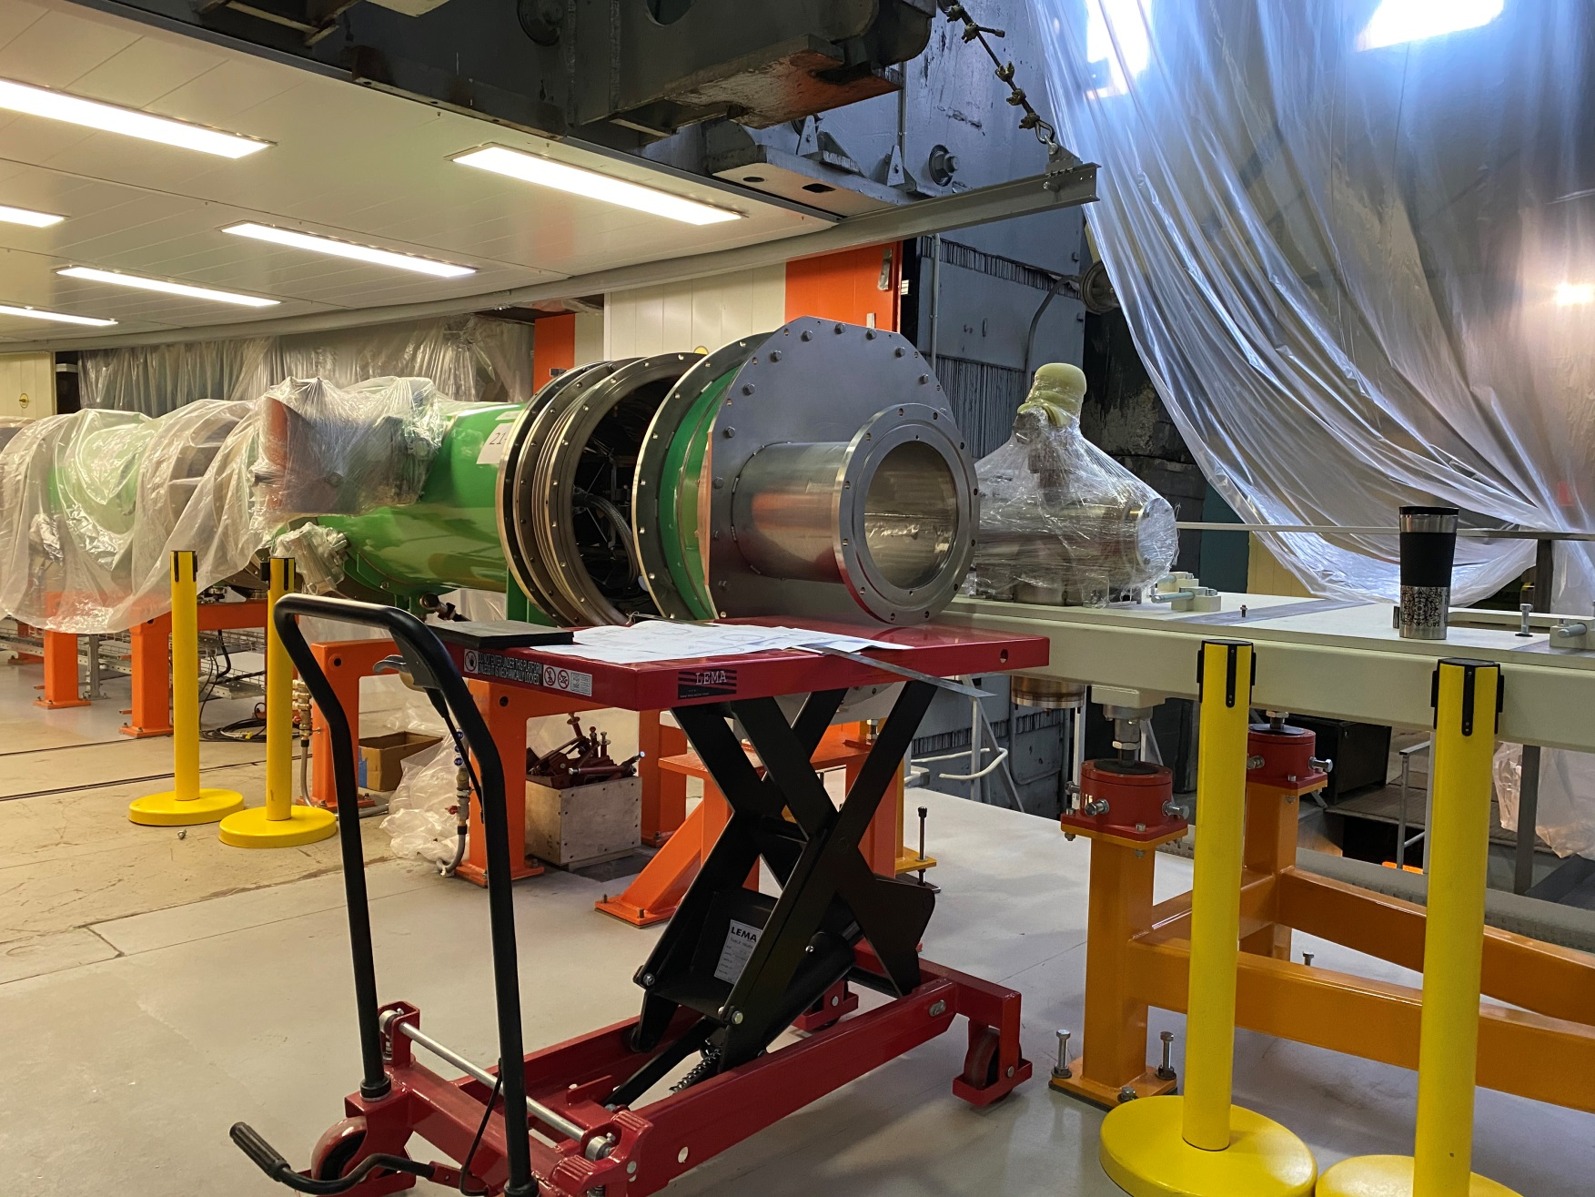
Booster fast extraction system
Assembly of the bypass

Slide 22
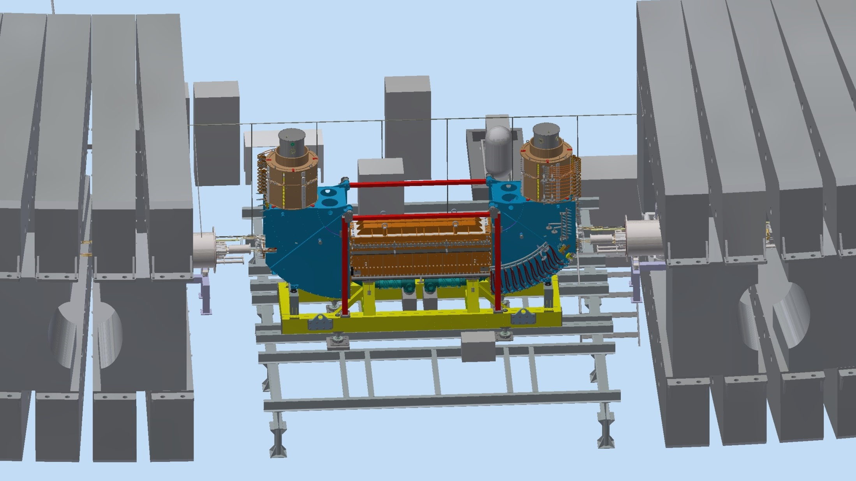
Booster electron cooling system
4-th warm gap
22

Slide 23
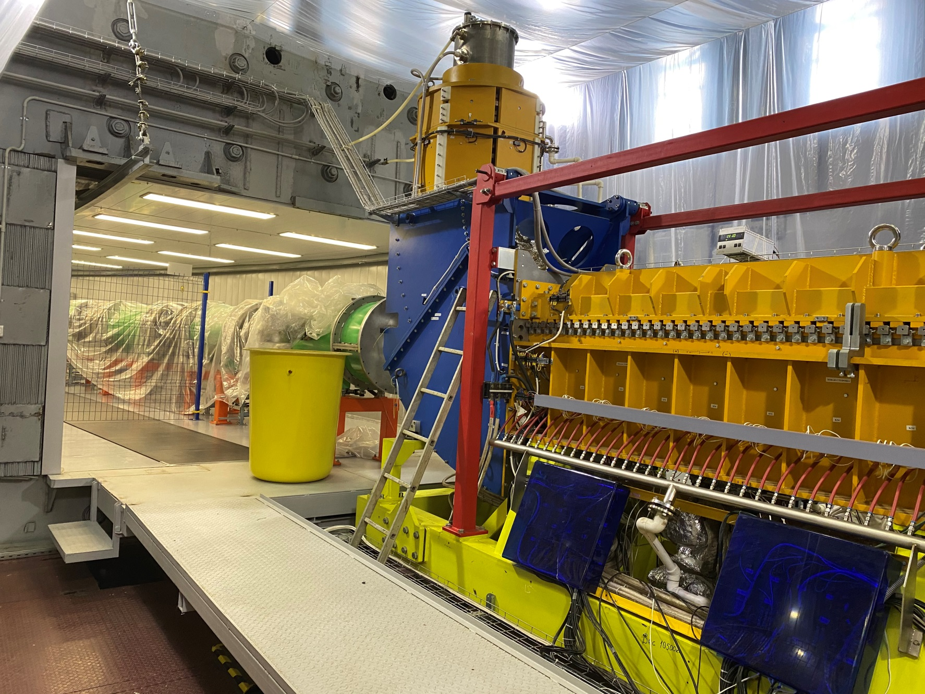
Booster electron cooling system
Budker Institute of Nuclear Physics

Slide 24
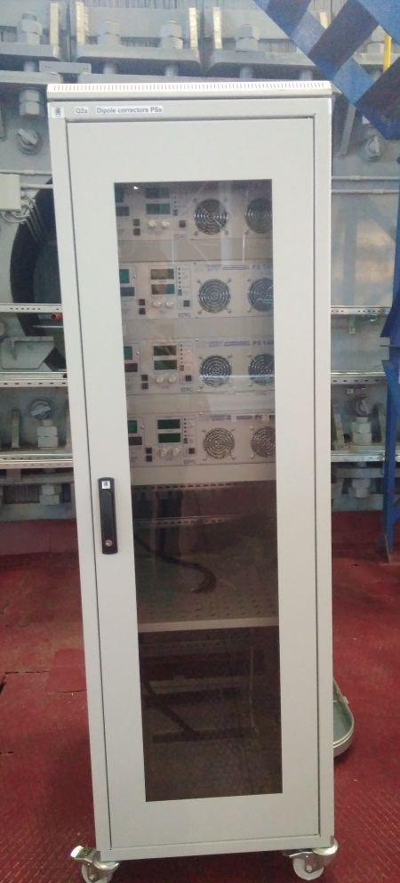
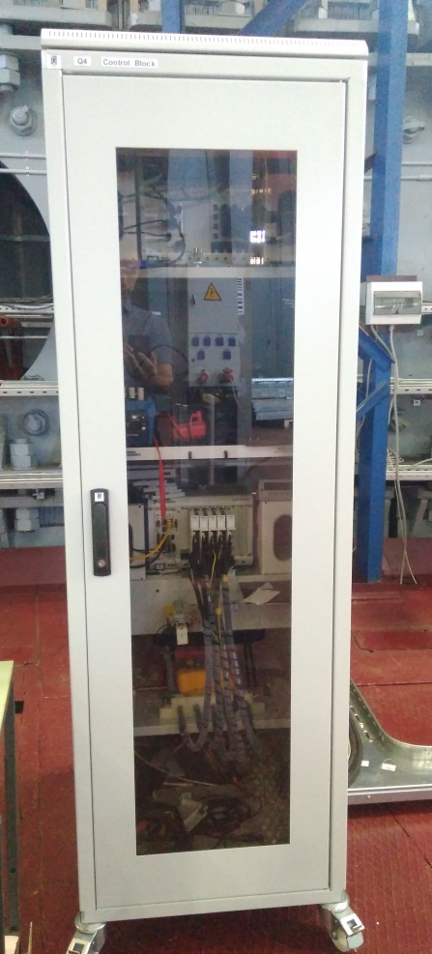
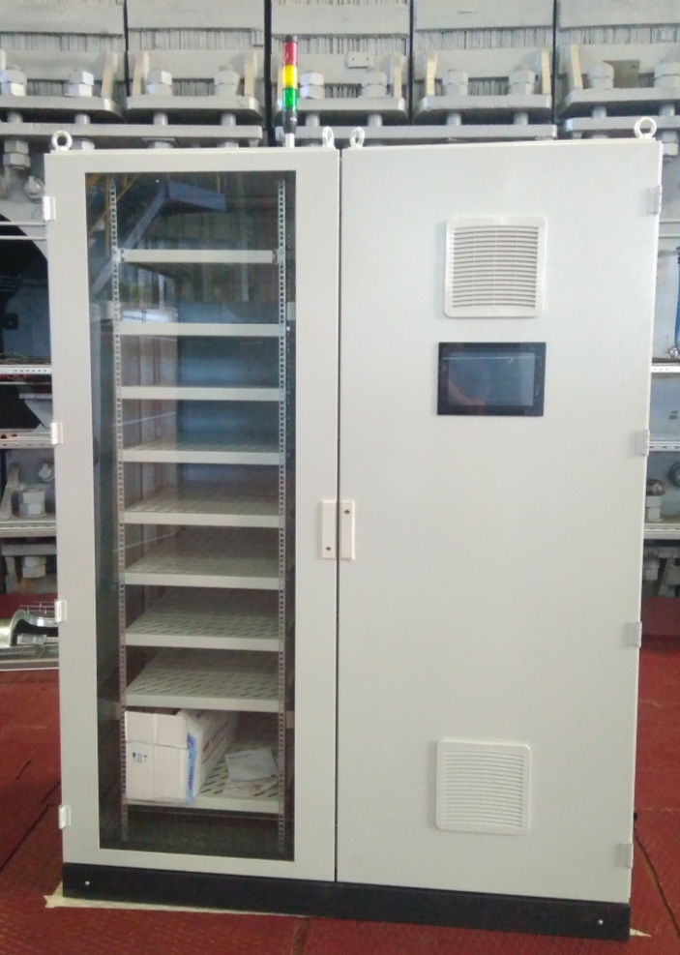
Booster Control and diagnostic systems
Control rack of correctors
Measuring rack of BPM and thermometry
Control rack of vacuum system

Slide 25
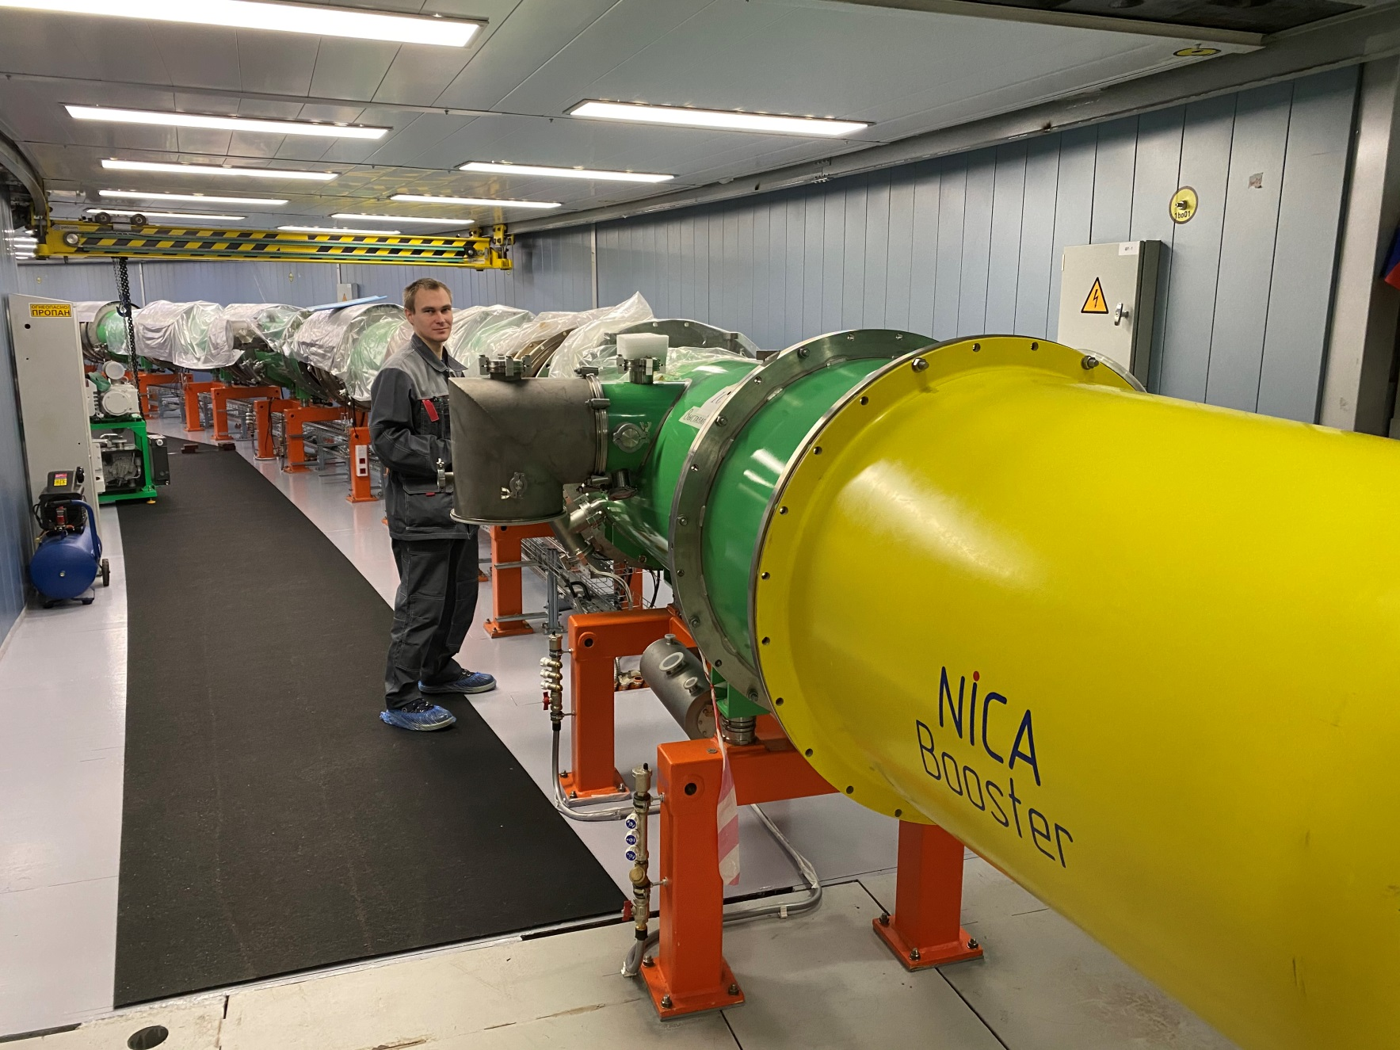
Booster vacuum system

Slide 26
Booster commissioning
23 December official start of the booster commissioning:
Tuning of power supply and test of energy evacuation system
on equivalent load
Quadrant by quadrant test of vacuum system
(In parallel: assembly of measurement period)
Cooling of cryo-magnetic system, test of thermometry
and quench detectors
Test of cryo-magnetic system with current
(In parallel: Completion of the beam pipe assembly)
- Test with ion beam (May - June 2020)

Slide 27
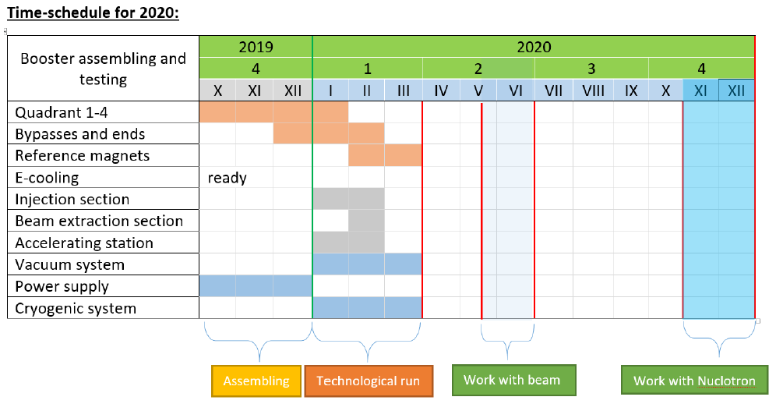
Booster commissioning

Slide 28
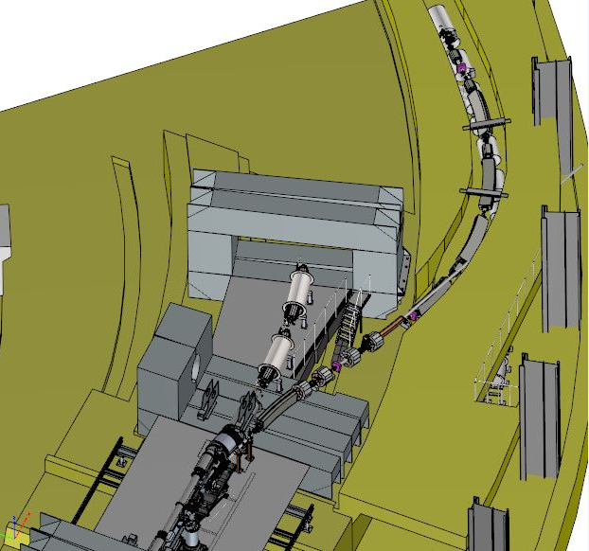
Booster-Nuclotron transport line
beam transport with minimal ion losses
Separation of neighbor charge states.
under contract with BINP
Channel delivery
September 2020
Stable operation of the Booster and Nuclotron together
depends on compressor power

Slide 29
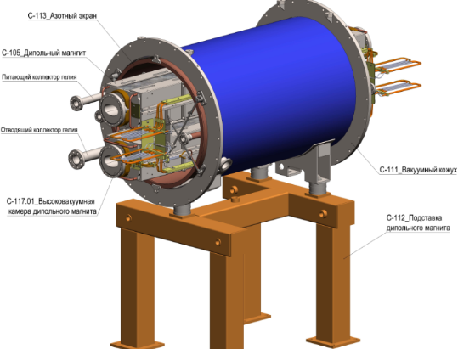
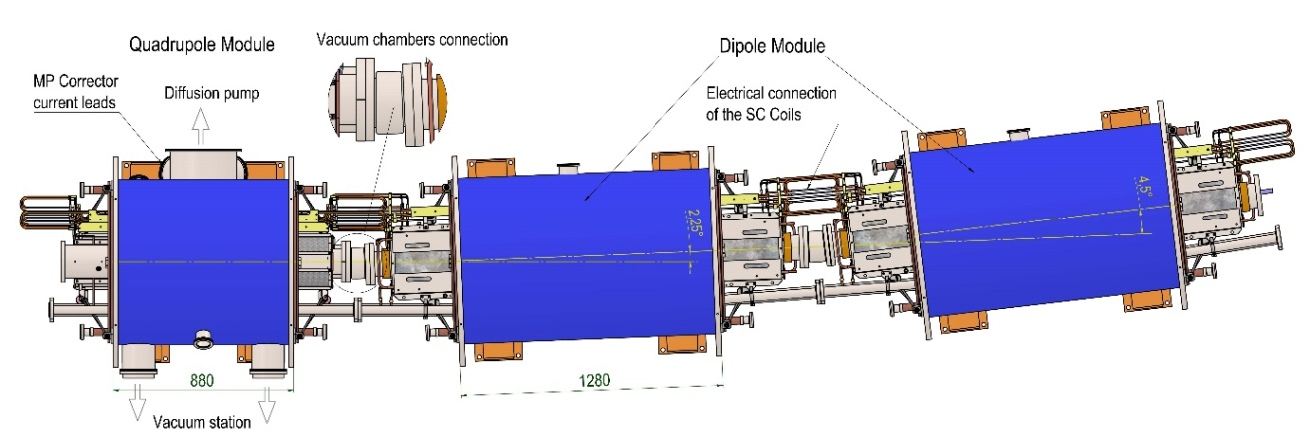
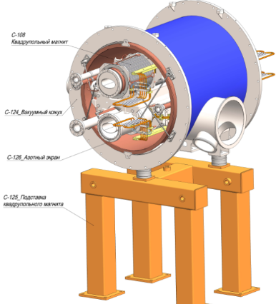
Plans for the collider assembly
This summer (depending on building completion):
Mounting dipole magnets of the Collider first arc section
Assembly of the Nuclotron-Collider beam transport line
Mounting of RF-1 stations

Slide 30
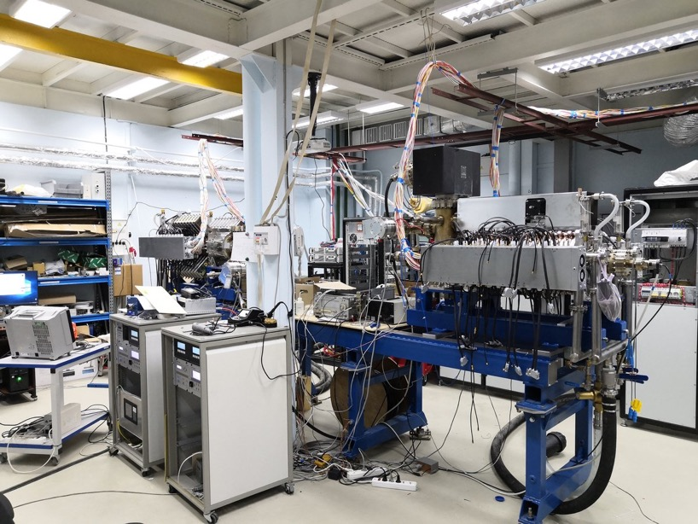
Collider barrier bucket
Tested at BINP, transported to JINR in January 2020

Slide 31
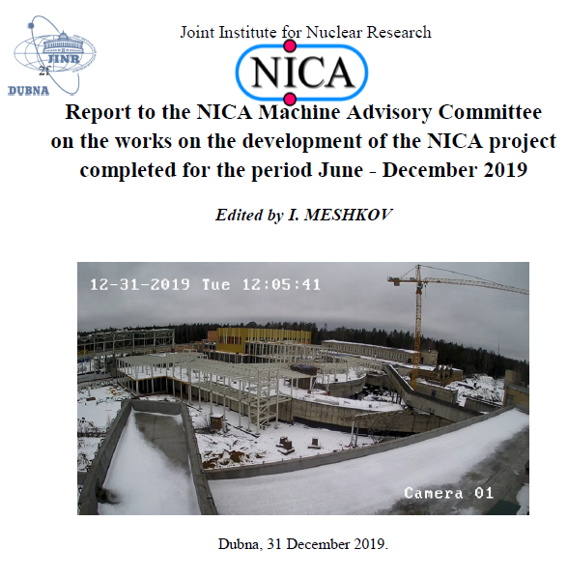

According to request of the Machine Advisory Committee
Interim report on NICA project progress (under edition by I. Meshkov)
prepared in January 2020
http://nucloweb.jinr.ru/nica/MAC/20Jan16_Rpt_to_MAC.pdf

Slide 32

Thank your for attention

