Slide 1
Pulse research reactor IBR-3 - optimization of parameters "Method of reducing the level of power fluctuations in pulsed reactors"
E. P. Shabalin, Hassan А. А., S. A. Kulikov, M. V. Rzyanin
Дубна, 2020

Slide 2
Content
The concept of a pulsed neutron source "NEPTUNE", the main features of the Neptune reactor.
Description of the problem of non-stationary processes of reactor power (fluctuations of the pulse amplitude, the possibility of oscillatory instability).
Proposed solution to the problem of non-stationary processes.
Methodology.
Conclusion.

Slide 3
1- ОСНОВНЫЕ ОСОБЕННОСТИ РЕАКТОРА НЕПТУН:
1 - The proposed source will have a peak neutron flux up to 5 ${10}^{16} n.\sec^{−1}.{cm}^{−2}$ and a time average flux density of up to${10}^{14} n.\sec^{−1}.{cm}^{−2}(in IBR−2M: 0.7{ 10}^{16} and$ ${10}^{13}$).
2 - The generation time of fast neutrons (τ) in the neptunium core is 5-7 times shorter than in the core with plutonium (the task of having a short pulses of neutrons becomes easier).
3 - A low value of the delayed neutrons fraction (β-eff) determines a low background power in the intervals between pulses (3-4 times less).
4 - Possibility of using neutron moderating materials as a Reactivity Modulator (RM) ( like high-temperature resistance, hydride’s metal Ti$H_{2, }YH2).$
5 – There is no reactivity effect from the fuel burnup (it is possible to work without additional fuel loading during the entire reactor cycle):
Np237 (n absorption) Np238 (β-decay, (2.117 days) Pu238 (Fissionable material)

Slide 4
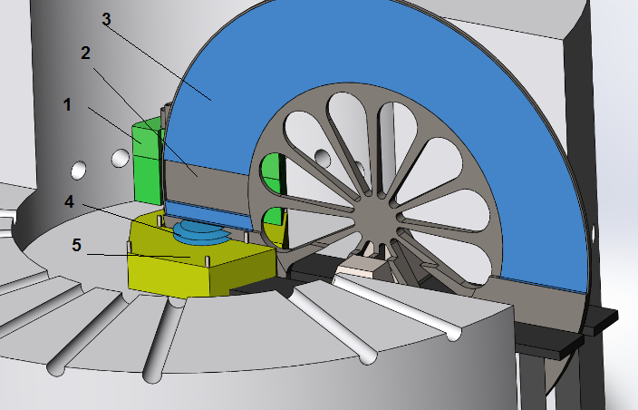
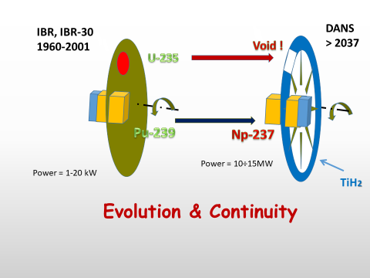
Concept of the IBR-3 reactor (NEPTUNE)
Evolution and Continuity of FLNP Pulsed Reactors
Reactore core,
Vacuum,
Ti$H_{2, }$
Moderator (water),
Be as a reflector.

Slide 5
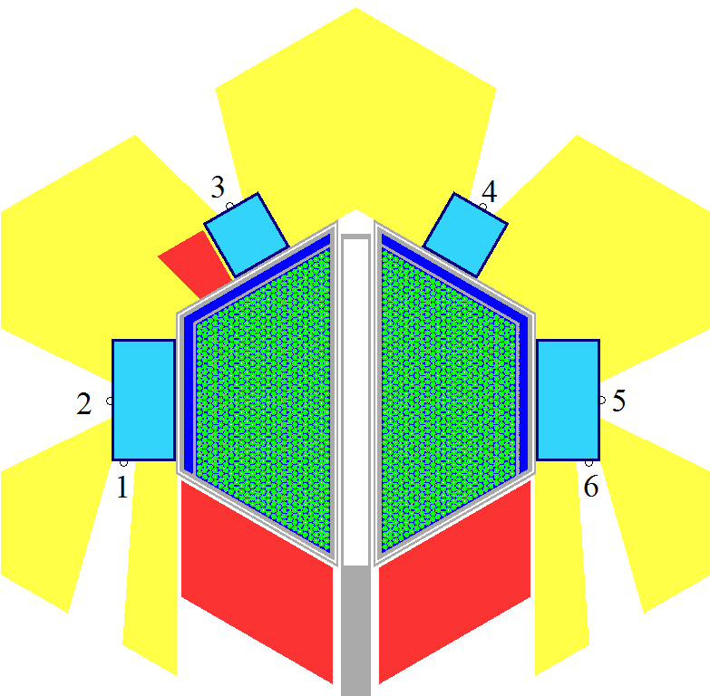
The reactor with the biological protection.
Cross-section of the IBR-3 reactor.

Slide 6
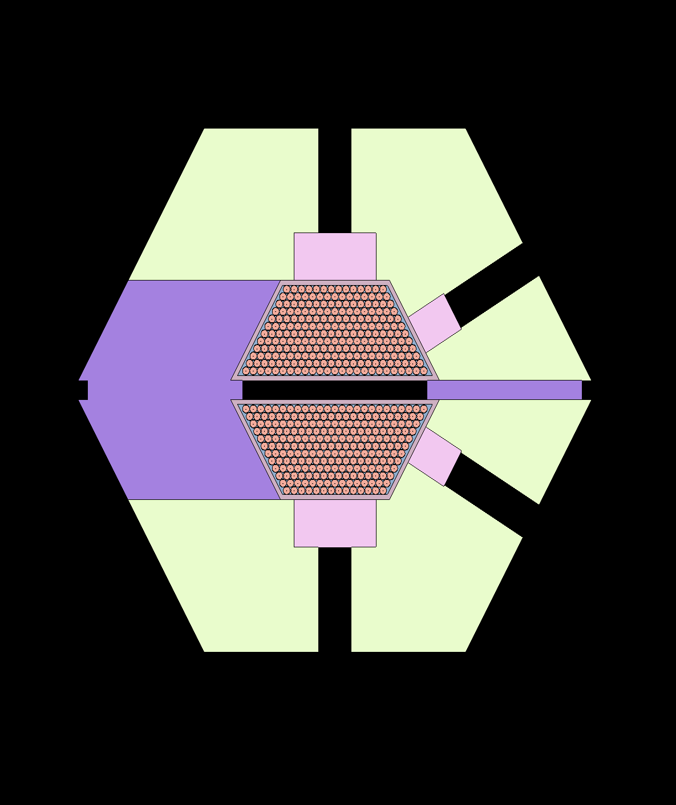
The main parameters of the reactor
Параметр | Значение
AVERAGE THERMAL POWER , MW | 10- 15
OPERATING MODE | pulsed
PULSE FREQUENCY, Hz | 10
FUEL | NpN
CLADDING MATERIAL OF FUEL RODS | s.steel ЧС-68
COOLER | Na
REFLECTOR | NICKEL ALLOY + BERYLLIUM
MODERATOR, PREMODERATOR | Hydrides, water, beryllium
COOLANT TEMPERATURE AT THE INLET TO THE CORE AND AT THE OUTLET, ⁰С | 290-390
PRESSURE DROP THROUGH THE CORE, Pa | 0,33·10⁵
FLUENCE ON THE REACTOR SURROUNDING’S FOR 20,000 h, n / СМ² | 4,1·10²²
AVERAGE NEUTRON THERMAL FLUX AT THE SURFACE OF WATER MODERATOR, 2π- equivalent 10¹³ cm⁻²∙sec⁻¹ | 12
EFFECTIVE FRACTION OF DELAYED NEUTRONS | 0,00131
GENERATION TIME OF THE SPONTANEOUS NEUTRONS , n,sec | 8-10

Slide 7
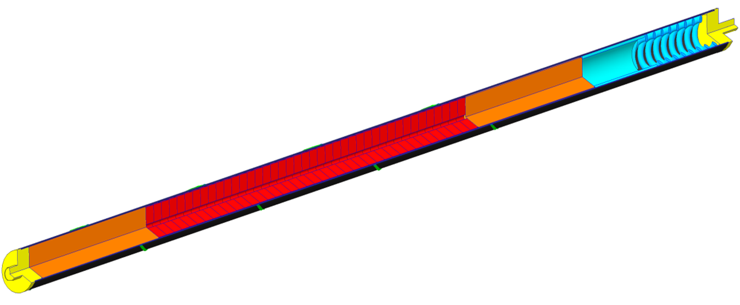
FUEL ROD
Параметр | Значение
Nominal fuel rod length, мм | 750-800 мм
Fuel column height, мм | 410 мм
Outer clad diameter, мм | 17,5
Inner clad diameter, мм | 16,7
Diameter of central hall, мм | 2
Fuel | NpN, tablet
Density of fuel, gm /см³ | 13,4
Total mass of fuel , кг | 500-550 k gm

Slide 8
2- The problem of non-stationary in reactor’s power:
$\frac{Q_{n}}{Q_{0}}$ = $e^{(\frac{∆ρ}{β_{puls}})}$ (1)
${ θ}_{effective}≅{(\frac{\tilde{τ}}{α V^{2}})}^{\frac{1}{3}}$ (2)
$β_{puls}≅0.5 {(∝ V^{2} {\tilde{τ}}^{2})}^{\frac{1}{3}}$ (3)
$T= \frac{\frac{γ_{1}}{α_{1}}+\frac{γ_{2}}{α_{2}}}{∆K} − γ_{1}τ_{2}= \frac{γ_{1}τ_{1}+ γ_{2}τ_{2}}{∆K} − γ_{1}τ_{2}= \frac{\tilde{τ}}{∆K}− γ_{1}τ_{2}$ (4)
where; $θ_{effective}:$pulse duration, Q – pulse energy power
α : The coefficient of reactivity parabola of RM
$V$ : Linear velocity of RM ,
$\tilde{ τ}$ : Average neutron generation time,
β_{pulse} : Impulse delayed neutron fraction,
T : Reactor period.
From the kinetic theory of IBR-type reactors formulas 1.2.3.4 are taken.
For the Np reactor core; α ≈ 10⁻⁴ см⁻² , v =62 м/sec и τ = 10 nano sec., according to eq. (3) β_{pulse} = 3.5 10⁻⁵.
For this value of β_{puls} and at reactivity fluctuations in order of ± 10⁻⁵ к _{eff} the pulse power will rise to ± 33 % , and at reactivity fluctuation in order of + 2.5 10⁻⁵ к _{eff} ,the oscillations of pulse power will already reach 2 Q ₀ - i.e. the limit level.

Slide 9
3- Proposed solution to the problem of non-stationary problem of the reactor power:
One of the main solutions to reduce power fluctuations and increase the instability limit is to increase the (β_{puls}) parameter (see formula (1)) through increasing the generation time of prompt fission neutrons.
An increase in the generation life time of a neutron in the Neptune reactor can be achieved by adding to the periphery of the core isotopes that can fission by epi-thermal neutrons.
Suitable candidates for this are Pu-239 with the first fission resonance of 0.3 eV and U - 235 with its weak resonances in this energy range.

Slide 10
ABOUT THE PROBLEM OF INSTABILITY
In addition to the problem of power fluctuations, there is one more reason to rise the value of pulsed
fraction of delayed neutrons (β_{puls}),we can say that the instability (like that observed in reactor IBR-2M) threshold. It is also related to (β_{puls}) and increasing the value of (β_{puls}) will increase the limits of appearance of this instability.
At the IBR-2M, the (β_{puls}) is 4 times larger, but this does not mean that Neptune will become unstable already at 2 MW like IBR-2M, the instability threshold can be increased and even completely eliminated by an adequate design of the reactor fuel elements. (this is the topic of my next work)
Nevertheless, the increase in (β_{puls}) for at least 2 times will be very enough to IBR-3.

Slide 11
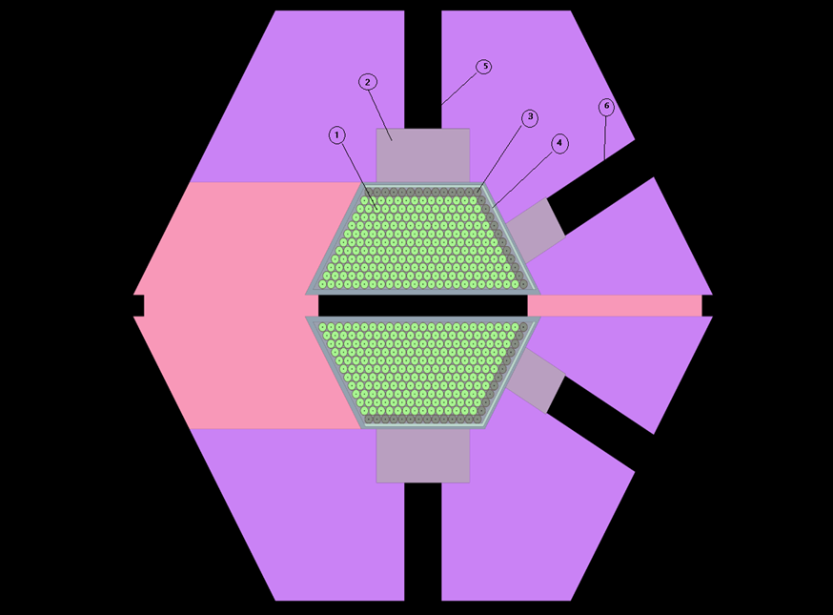
Figure 3. Neptunium core with U-235 or Pu-239 addition at the periphery.
1- NpN fuel rod.
2- water moderator.
3- fuel rod with additions.
4- Gd layer,
5- First channel,
6- Second channel.

Slide 12
2,1- Reactor core with Pu-239:

Slide 13
2,1- Reactor core with Pu -239:
In this case, the first fission resonance, is at 0.3 eV. And the maximum cross section is at 3000 barn, the minimum (in the range 0.2-0.4 eV) is 1000 barn. The absorption length in plutonium nitride (90% Pu-239) will be 0.2-0.3 mm; in neptunium nitride (outside resonances of 0.5 eV and ~ 1.1 eV) - about 1.5 mm. we studied two different models of using Pu, one with Np and another without.
In the model without neptunium, which is easier to implement, there is an disadvantage of reduction in energy released in comparison with neptunium fuel elements, which leads to a decrease in the thermal neutron flux at the surface of the moderators.
In the mixed homogeneous version, the plutonium concentration is limited to about 20% (by volume) (so that the energy release does not exceed the maximum allowable), and this may not be enough for the required increase in the neutron generation time.

Slide 14
2,2- Reactor core with U-235:

Slide 15
2,2- Reactor core with U-235:
A fuel rod was considered with both uranium nitride and a mixture of uranium and neptunium nitrides. In the second case, the fission in these rods will happen between two resonances of neptunium capture (about 0.5 eV and ~ 1.1 eV).
An amount of uranium slightly more than 50% is sufficient for the complete absorption of epi-thermal neutrons.
The advantages of the uranium variant over the plutonium variant are the more optimal filtration of thermal and epi-thermal neutrons with gadolinium and a positive effect on the thermal neutron flux.
The disadvantage is an increase in the fraction of delayed neutrons, i.e. increasing the background power of the reactor by 10–20%.

Slide 16
3- METHODOLOGY
For the calculation, the SERPENT code (2.1.31) and the ENDF / B-VII B nuclear data library were used; to solve computational problems, the supercomputer Govorun, LIT, JINR was used.
In the first row next to water moderator (see figure 2) the fuel compositions (NpN) was replaced by one of the following compositions:
PuN + NpN, at different volumes percent (10 + 90/ 15 + 85 and 20 + 80 vol % for PuN and NpN respectively).
Pu + ZrN, at different volumes percent (10 + 90, 15 + 85, 20 + 80 and 25 + 75 vol % for PuN and ZrN respectively).
UN at different U-235 enrichments (25%, 50% and 60%).
UN + NpN at different volumes percent and U-235 enrichments (40 + 60 vol% and 40% enrichment, 40 + 60 vol% and 90% enrichment and 50 + 50 vol% and 50% enrichment).
And each of the previous options was tested with three different thicknesses of Gd filter (0.1, 0.3 and 0.5 cm).

Slide 17
4,1 Generation time:
The best results for PuN was found to be (15% PuN + 85% NpN) at 0.1 cm Gd and (20% PuN + 80% NpN) at 0.1 cm Gd. and
and for UN, the addition was for (40% UN (40% enrichment) + 60% NpN) on a 0.1 cm Gd filter and (50% UN (50% enrichment) + 50% NpN) also on a 0.1 cm Gd filter.
All of these options provide the proposed generation times and do not greatly increase the neutron background between pulses, and the next section will discuss further analysis for these compositions only.

Slide 18
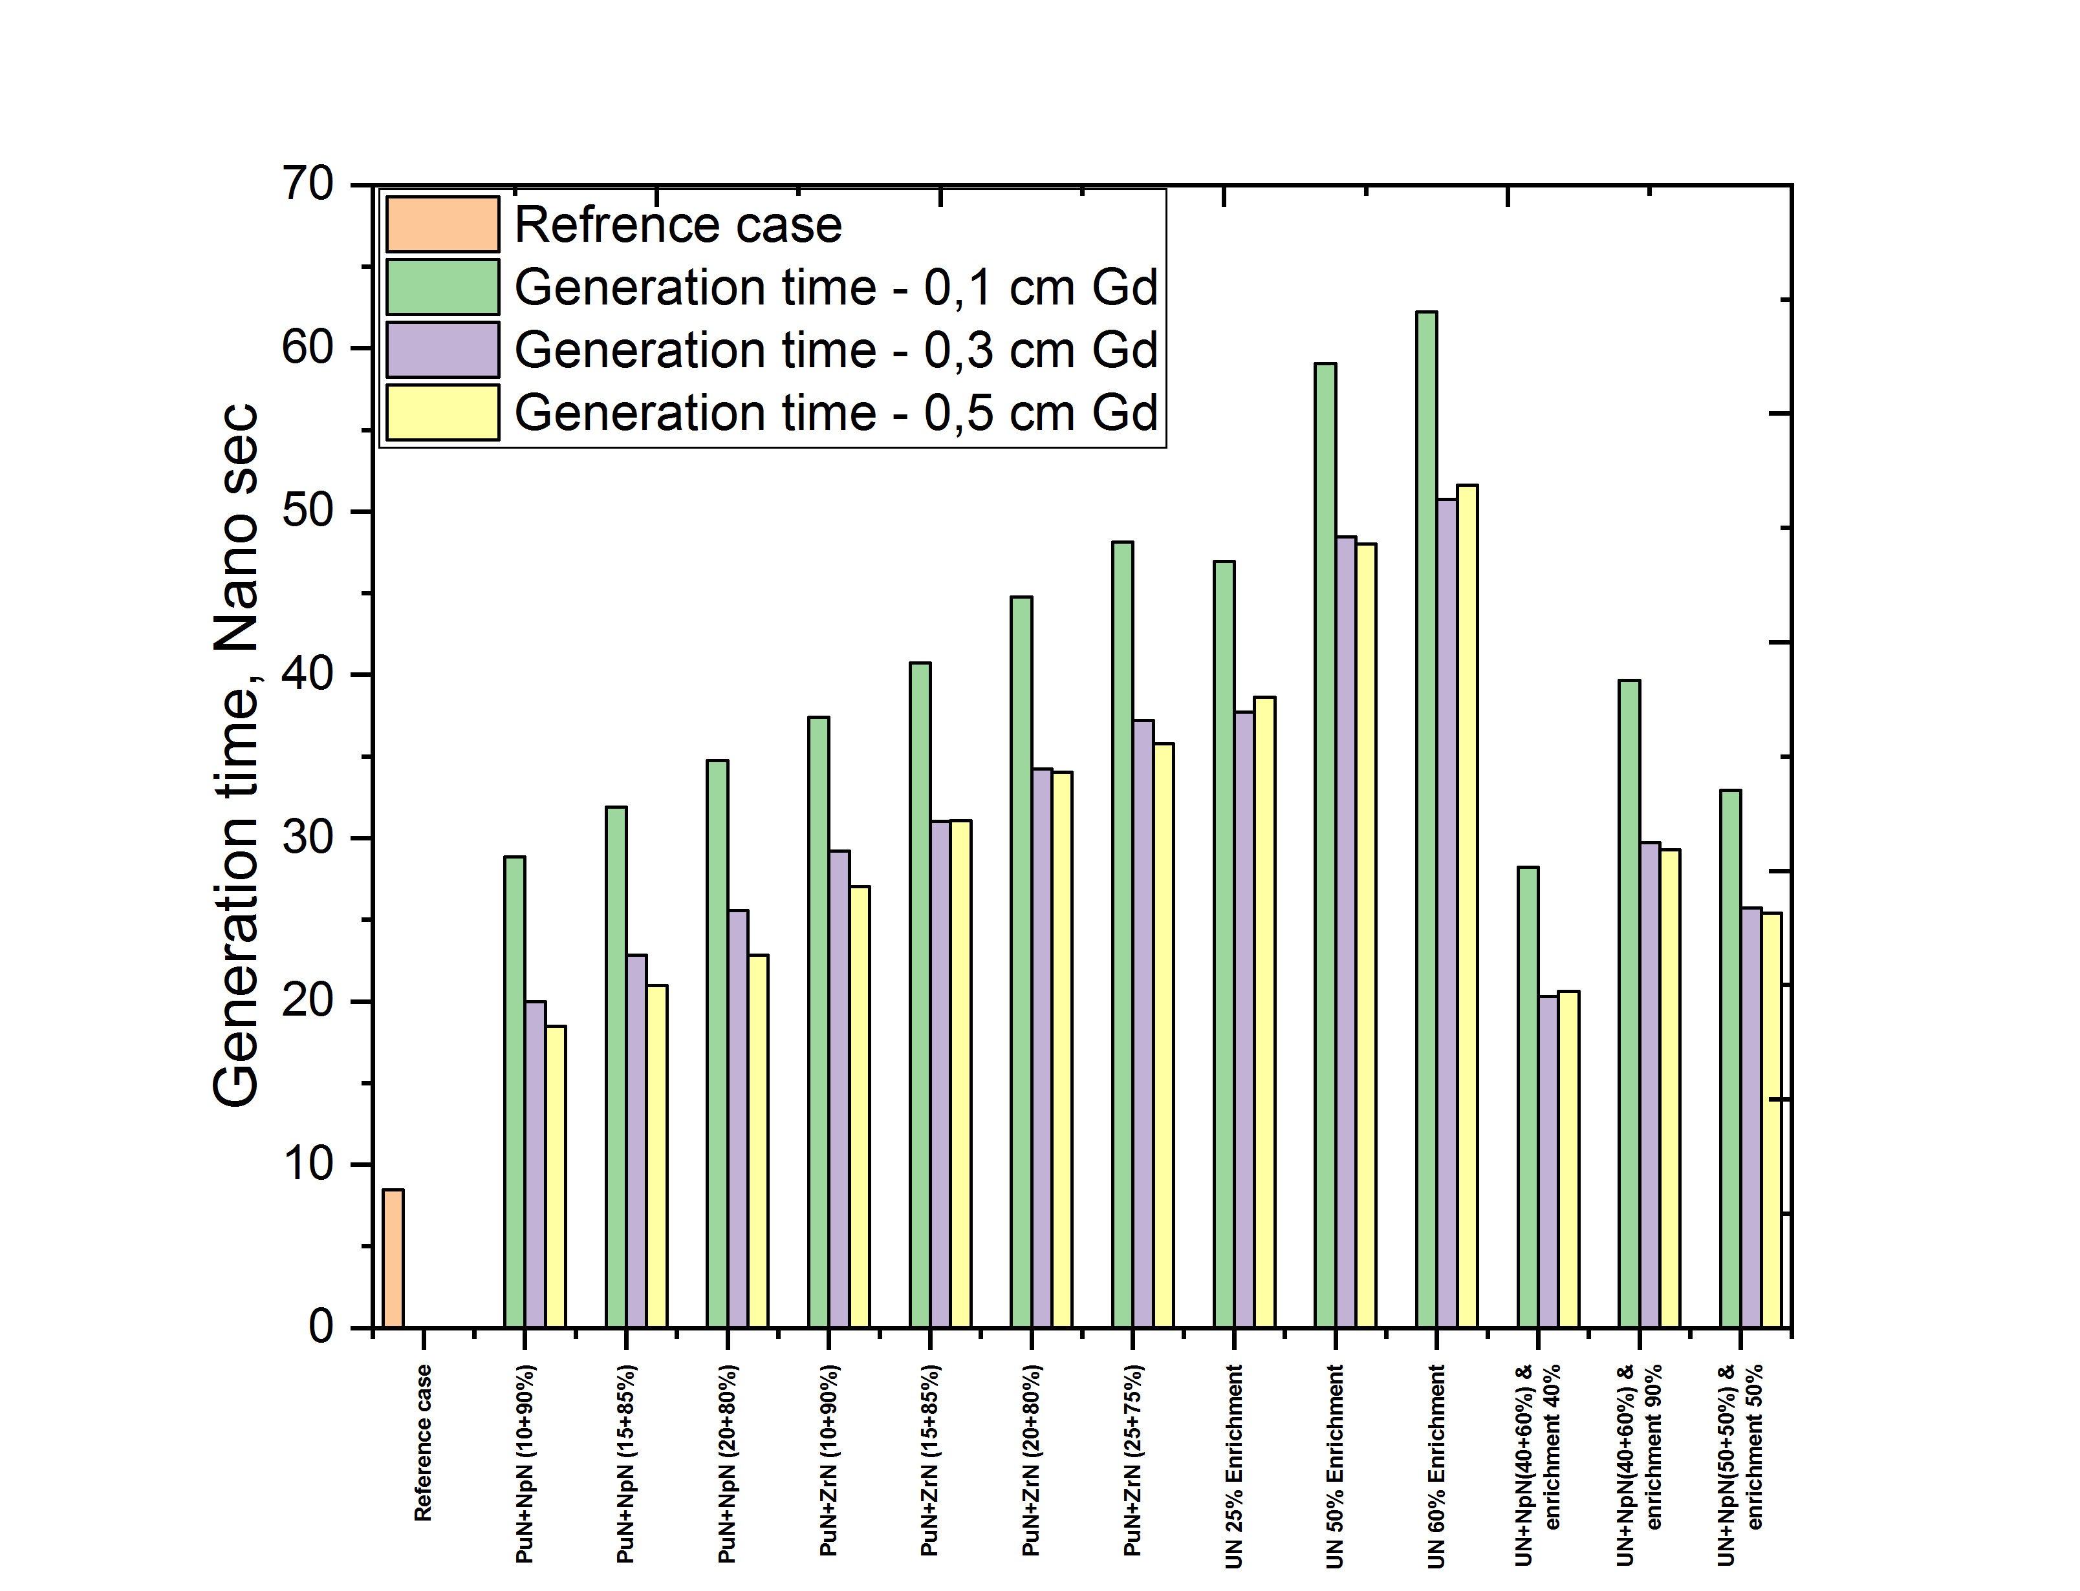
4 - RESULTS:
1- Время генерации нейтронов:

Slide 19
4,2 - Impulse delayed neutron fraction

Slide 20
4,3 – Change in reactivity

Slide 21
4,4– Pin Power distribution in reactor core:
In order to choose the most suitable variant, four factors will be considered:
The maximum pin power in the center.
The maximum pin power at the periphery.
The difference between the center and periphery.
The maximum pin power near to modular of reactivity.

Slide 22
Table; summary of pin power comparison, kWt /pin
 | Maximum pin power near to modular of reactivity, (kW) | Maximum pin power in the center, (kW) | Maximum pin power at the periphery, (kW) | The difference between the center and periphery, (kW)
15% PuN + 85% NpN | 31.3 | 35.218 | 23.9 | 11.318
20% PuN + 80% NpN | 30.696 | 34.598 | 26.9 | 7.698
40 % UN (40% enrichment) + 60% NpN | 32.59 | 36.6 | 19 | 17.6
50% UN (50% enrichment) + 50% NpN | 31.9 | 35.6 | 21.6 | 14

Slide 23
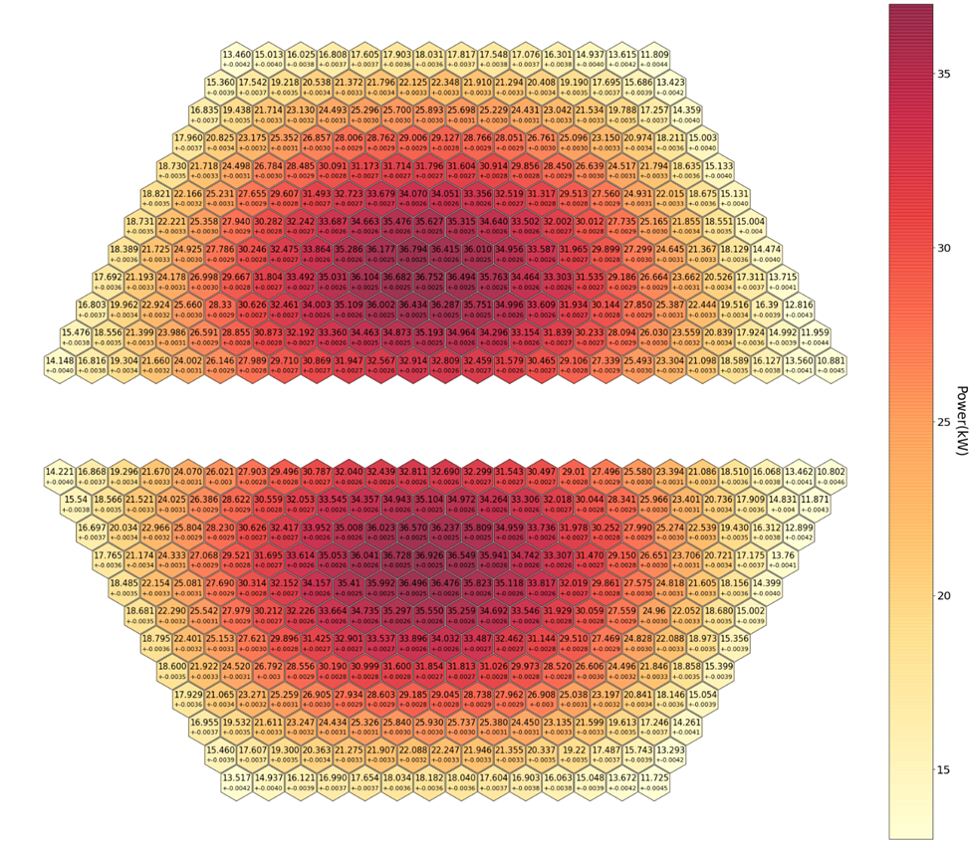
fig 7. Power distribution without any additions.

Slide 24
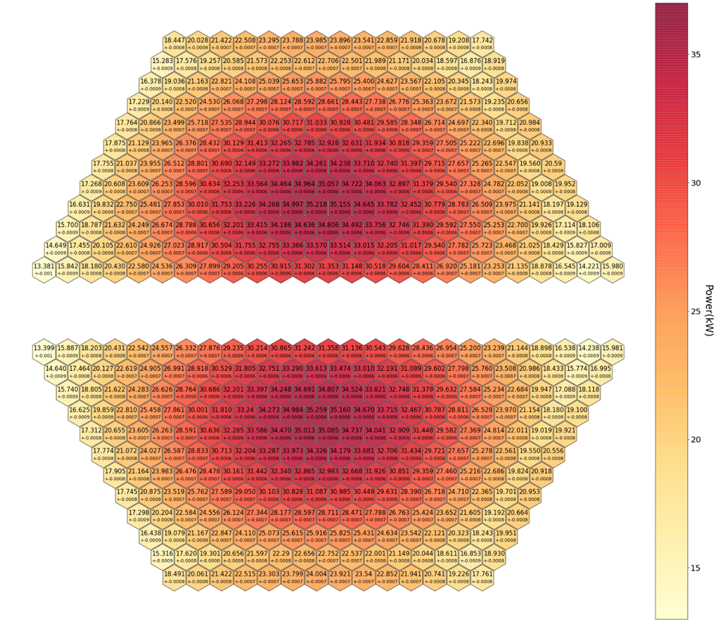
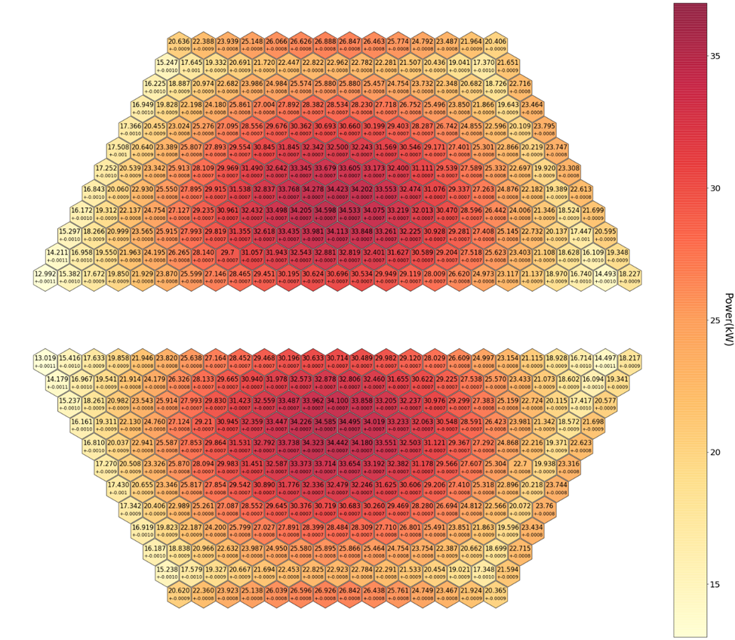
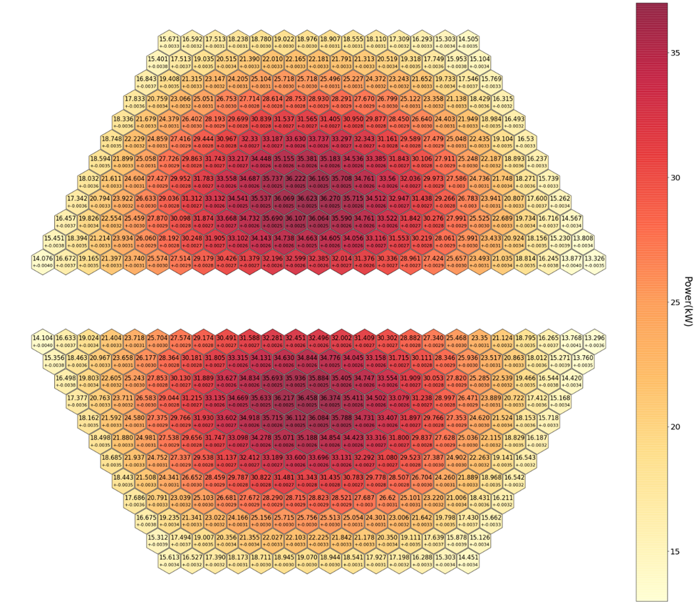
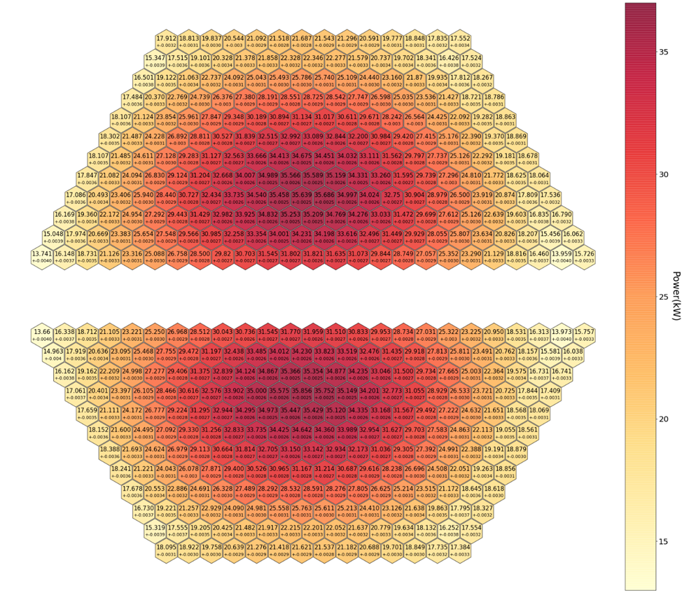
(a)
(b)
(c)
fig. 8. Power distribution for four choosed variants with Gd-filter 0,1 см: (a) (15% PuN + 85% NpN), (b) (20% PuN + 80% NpN), (c) (40 % UN (40% enrichment) + 60% NpN) and (d) (50% UN (50% enrichment) + 50% NpN).
(d)

Slide 25
5 – Conclusion.
A proposed method is presented to reduce the pulse power fluctuations and instability in the core of IBR-3 (NEPTUNE), Which can be summarized in the following:
in increasing the "beta - pulse" parameter by increasing the generation time of the prompt neutron.
This can be achieved by adding uranium or plutonium to the fuel elements bordering with moderators with the simultaneous introduction of a gadolinium filter.
Numerical computer simulations used to get the acceptable concentrations of fissile elements that realize the increase in the generation time of the prompt neutron to 30 n.sec and the "beta - pulse" value by a factor of 2.1.
Additions of uranium and plutonium simultaneously reduce the coefficient of non-uniformity of energy release and somewhat increase the neutron flux from the moderator.
Fuel elements doped with uranium are more convenient to operate in comparison with plutonium, without overloading.
The resulting beta impulse value is expected to be 8-9 10-5, which will be 60% of the similar value for the IBR-2.
In addition to calculations, work to reduce vibrations of fuel elements and other construction materials of the reactor will be continued by means of constructive measures.

Slide 26
Thank you for your patience.

