Slide 1
Reconstruction of energy and collision point of heavy ions with Forward Hadron Calorimeter at MPD setup
А. Strizhak
MIPT, Moscow
Institute for Nuclear Research RAS, Moscow

Slide 2
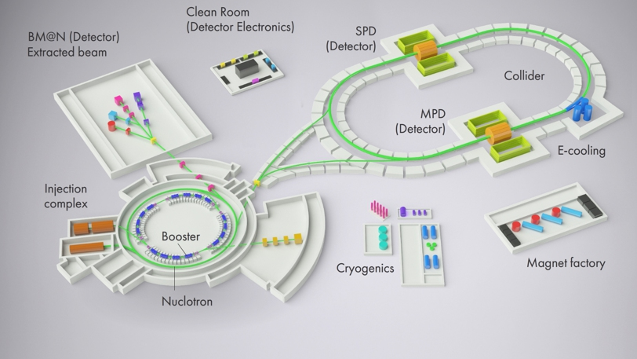
Goals of MPD/NICA project
- research of phase transition
- research of mixed phase
- search for a critical point
- help in deriving equation of state
Phase diagram of QCD
2/18

Slide 3
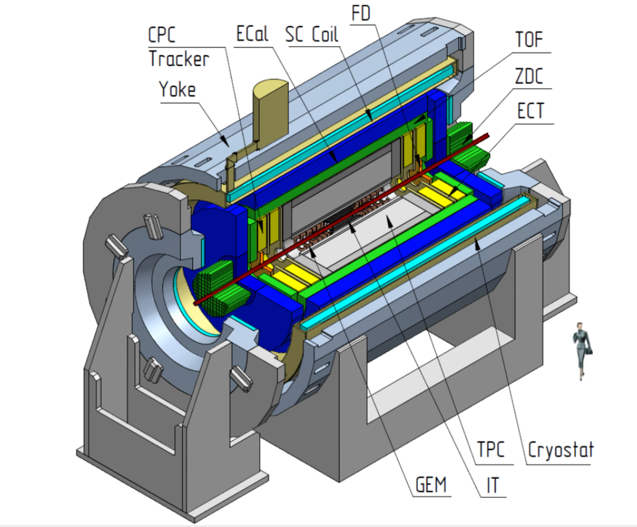
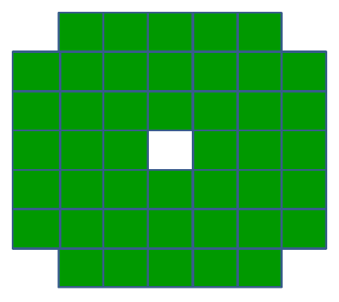
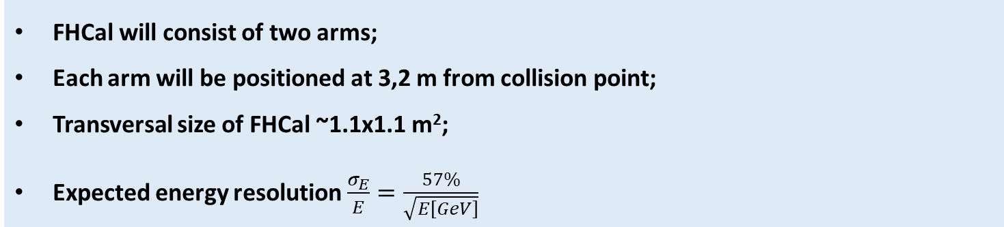
Position and design of FHCal
(FHCal)
FHCal
Left - FHCal in MPD(green), right – transversal cut of FHCal arm
FHCal will consist of two arms;
Each arm will be positioned at 3,2 m from collision point;
Transversal size of FHCal ~1.1x1.1 m²;
Expected energy resolution $\frac{σ_{E}}{E}=\frac{57\%}{\sqrt{E\left[GeV\right]}}$
3/18

Slide 4
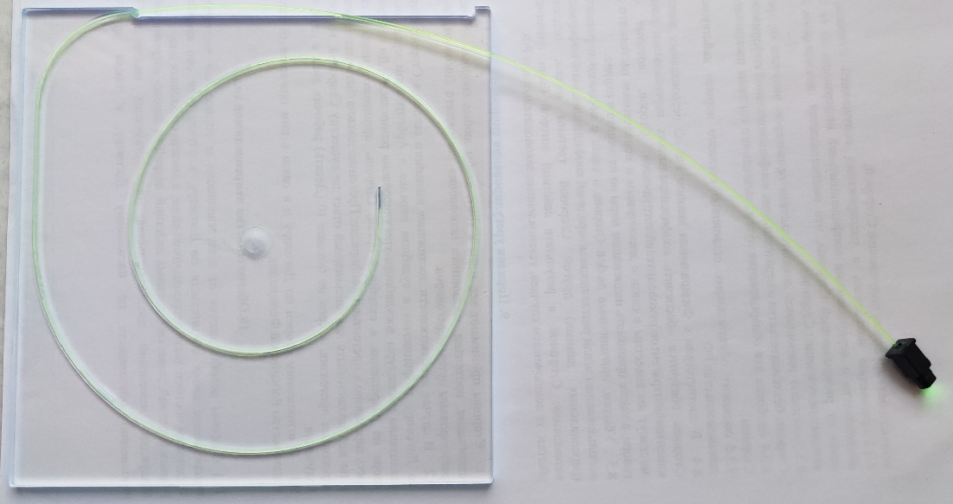
Design of FHCal module
FHCal module
A module will consist of 42 pairs of lead/scintillator plates (16mm/4mm) having total length of 84cm
Transversal size of FHCal module: 15x15cm² ;
Module length ~ 4 λ_{int};
Each module consists of 7 equal cells, connected(SiPM) ;
Scintillator plate
4/18

Slide 5
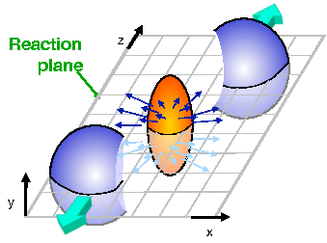
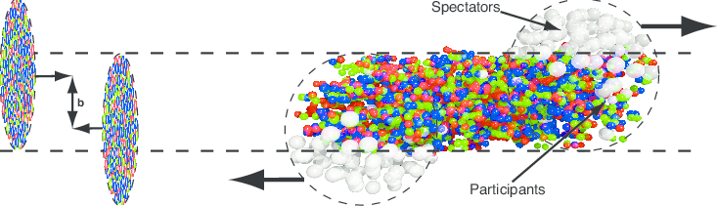
Main aim of FHCal
Impact parameter – distance named b in the left picture (experimental estimate – centrality, that is fraction of nuclear inelastic cross-section);
Reaction plane is determined by impact parameter vector and beam axis (experimental estimate – Event plane)
5/18

Slide 6
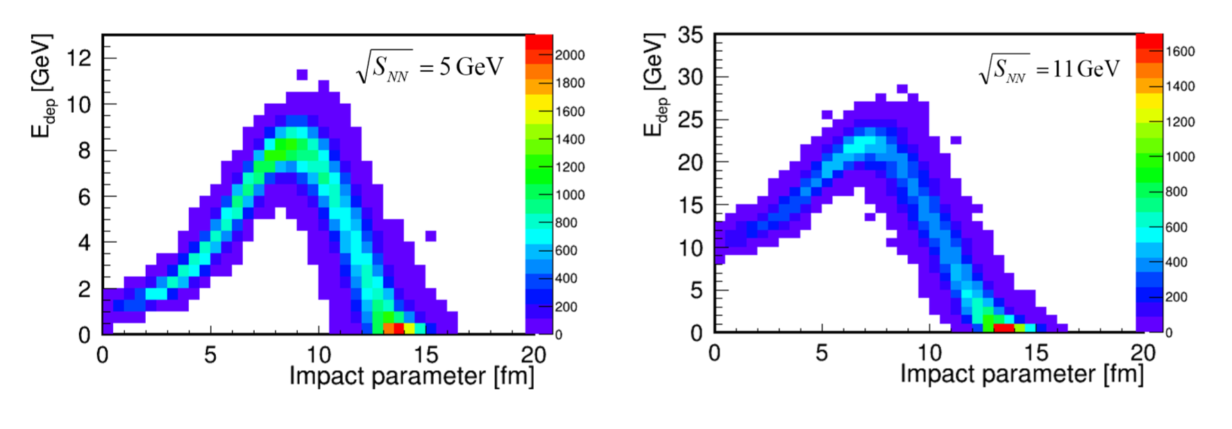
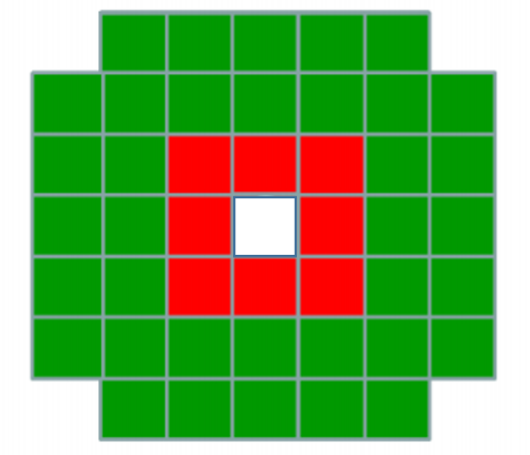
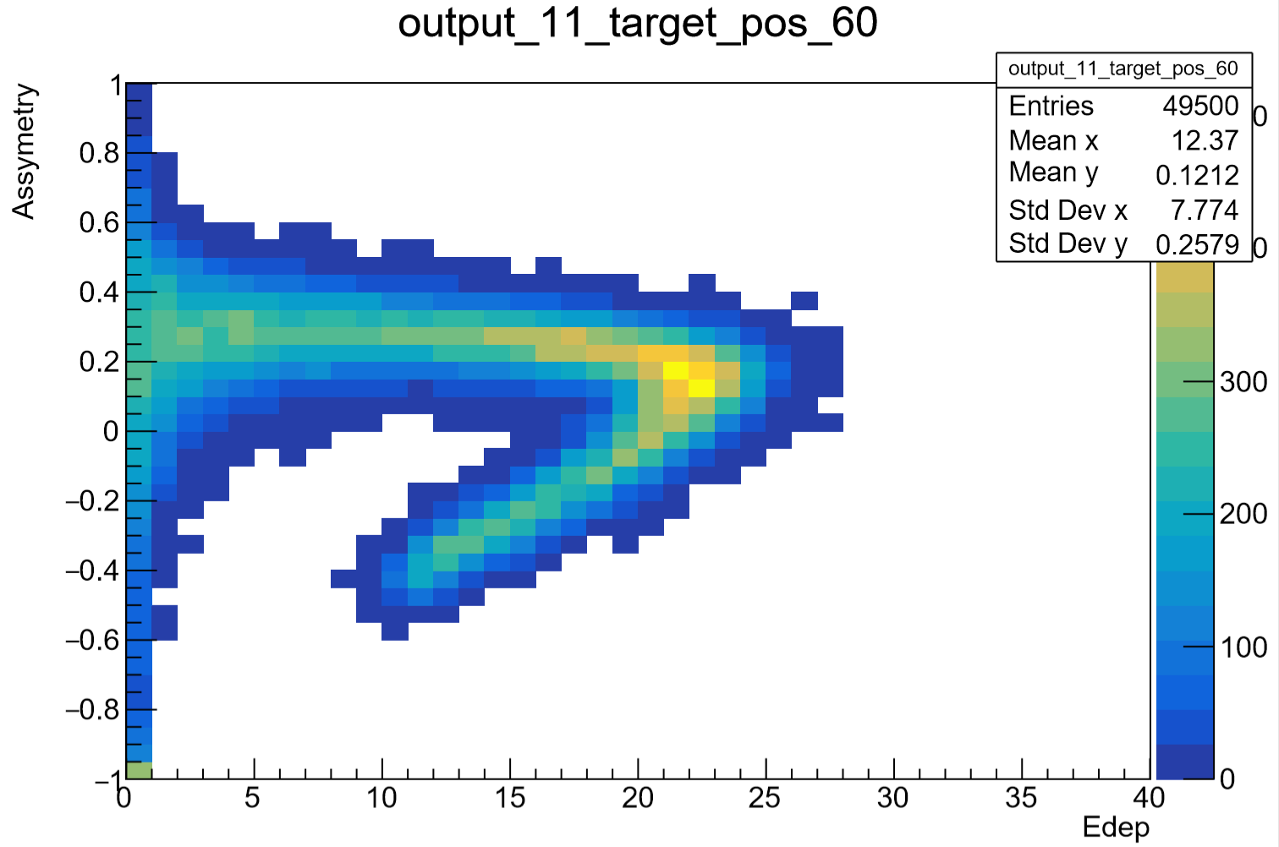
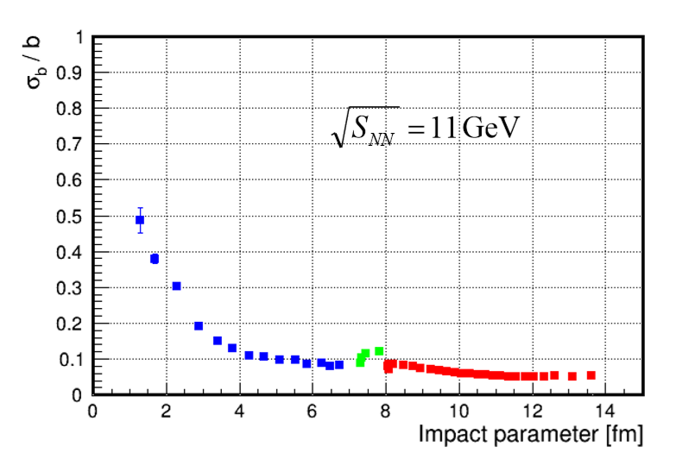


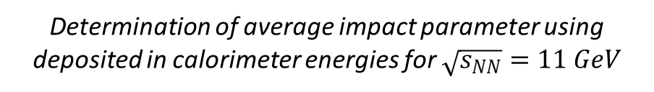

Determination of centrality
$$E_{in}$$
$$E_{out}$$
Determination of average impact parameter using deposited in calorimeter energies for $\sqrt{s_{NN}}=11 GeV$
$$\left(E_{in}−E_{out}\right)/\left(E_{in}+E_{out}\right)$$
peripheral
central
Asymmetry of deposited energies in inner and outer zones of calorimeter
6/18
Error in centrality determination for$\sqrt{s_{NN}}=5, 11 GeV$

Slide 7
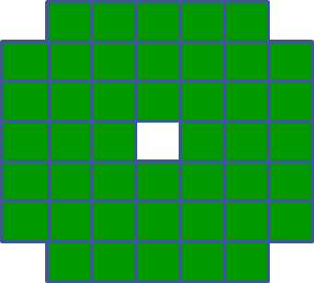
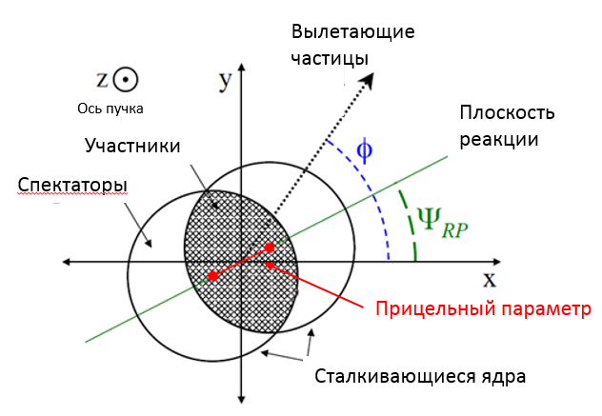
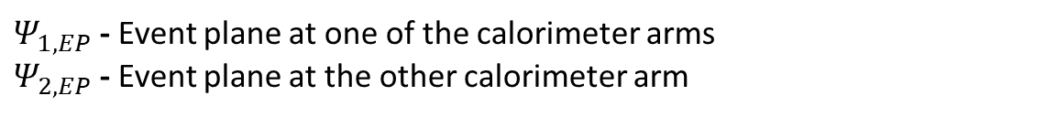
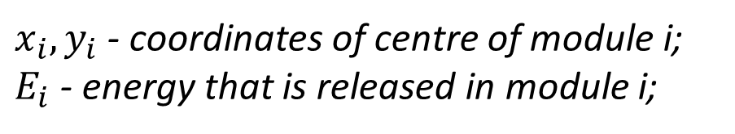

Event Plane determination
$x_{i},y_{i}$ - coordinates of centre of module i;
$E_{i}$ - energy that is released in module i;
i
$Ψ_{1,EP}$ - Event plane at one of the calorimeter arms
$Ψ_{2,EP}$ - Event plane at the other calorimeter arm
ejected particles
$$Ψ_{EP}=arctg\frac{\sum{E_{i}∙sin\left(φ_{i}\right)}}{\sum{E_{i}∙cos\left(φ_{i}\right)}}$$
Beam line
Reaction Plane
Participants
Spectators
Full event plane
Impact parameter
colliding nuclei
7/18

Slide 8
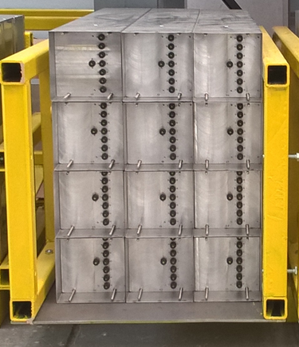
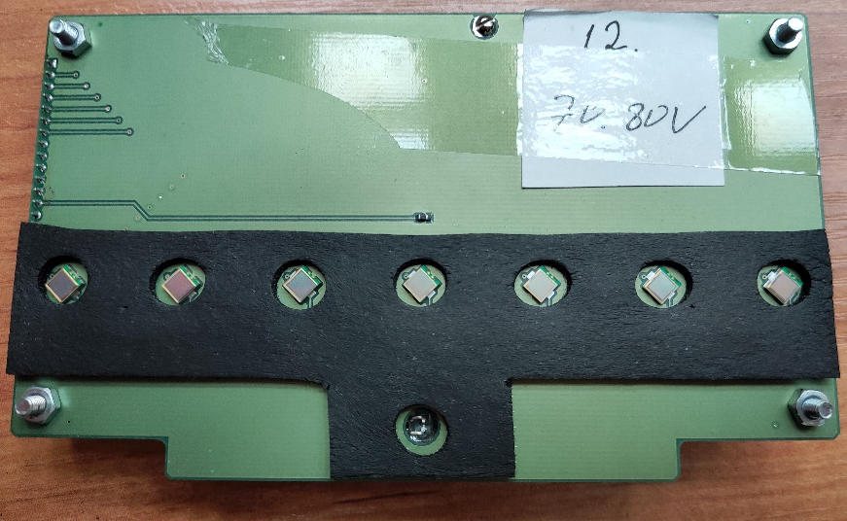
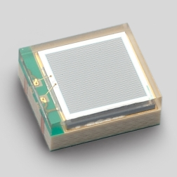
Test stand
LED
Photodetector (SiPM)
Hamamatsu MPPC S12572-010C/P
Front End Electronics (FEE)
Traits of Hamamatsu MPPC S12572-010C/P
+ high dynamic range
+ relatively low noise
+ low relaxation time
+ high count rate
- low photon detection efficiency
Test stand of 12 modules
8/18

Slide 9
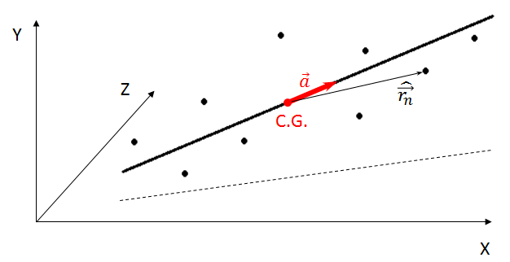
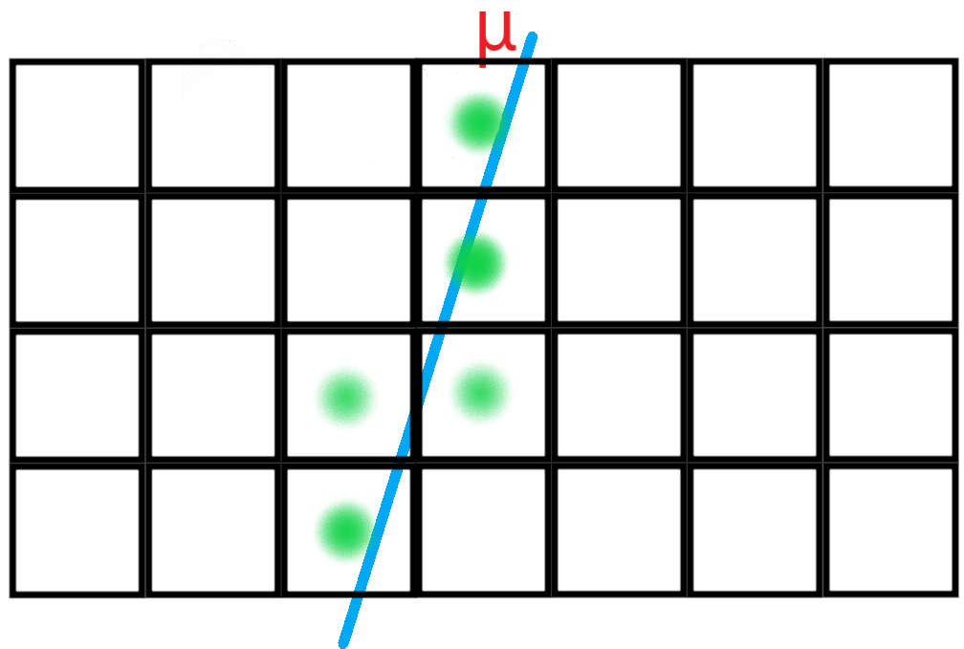
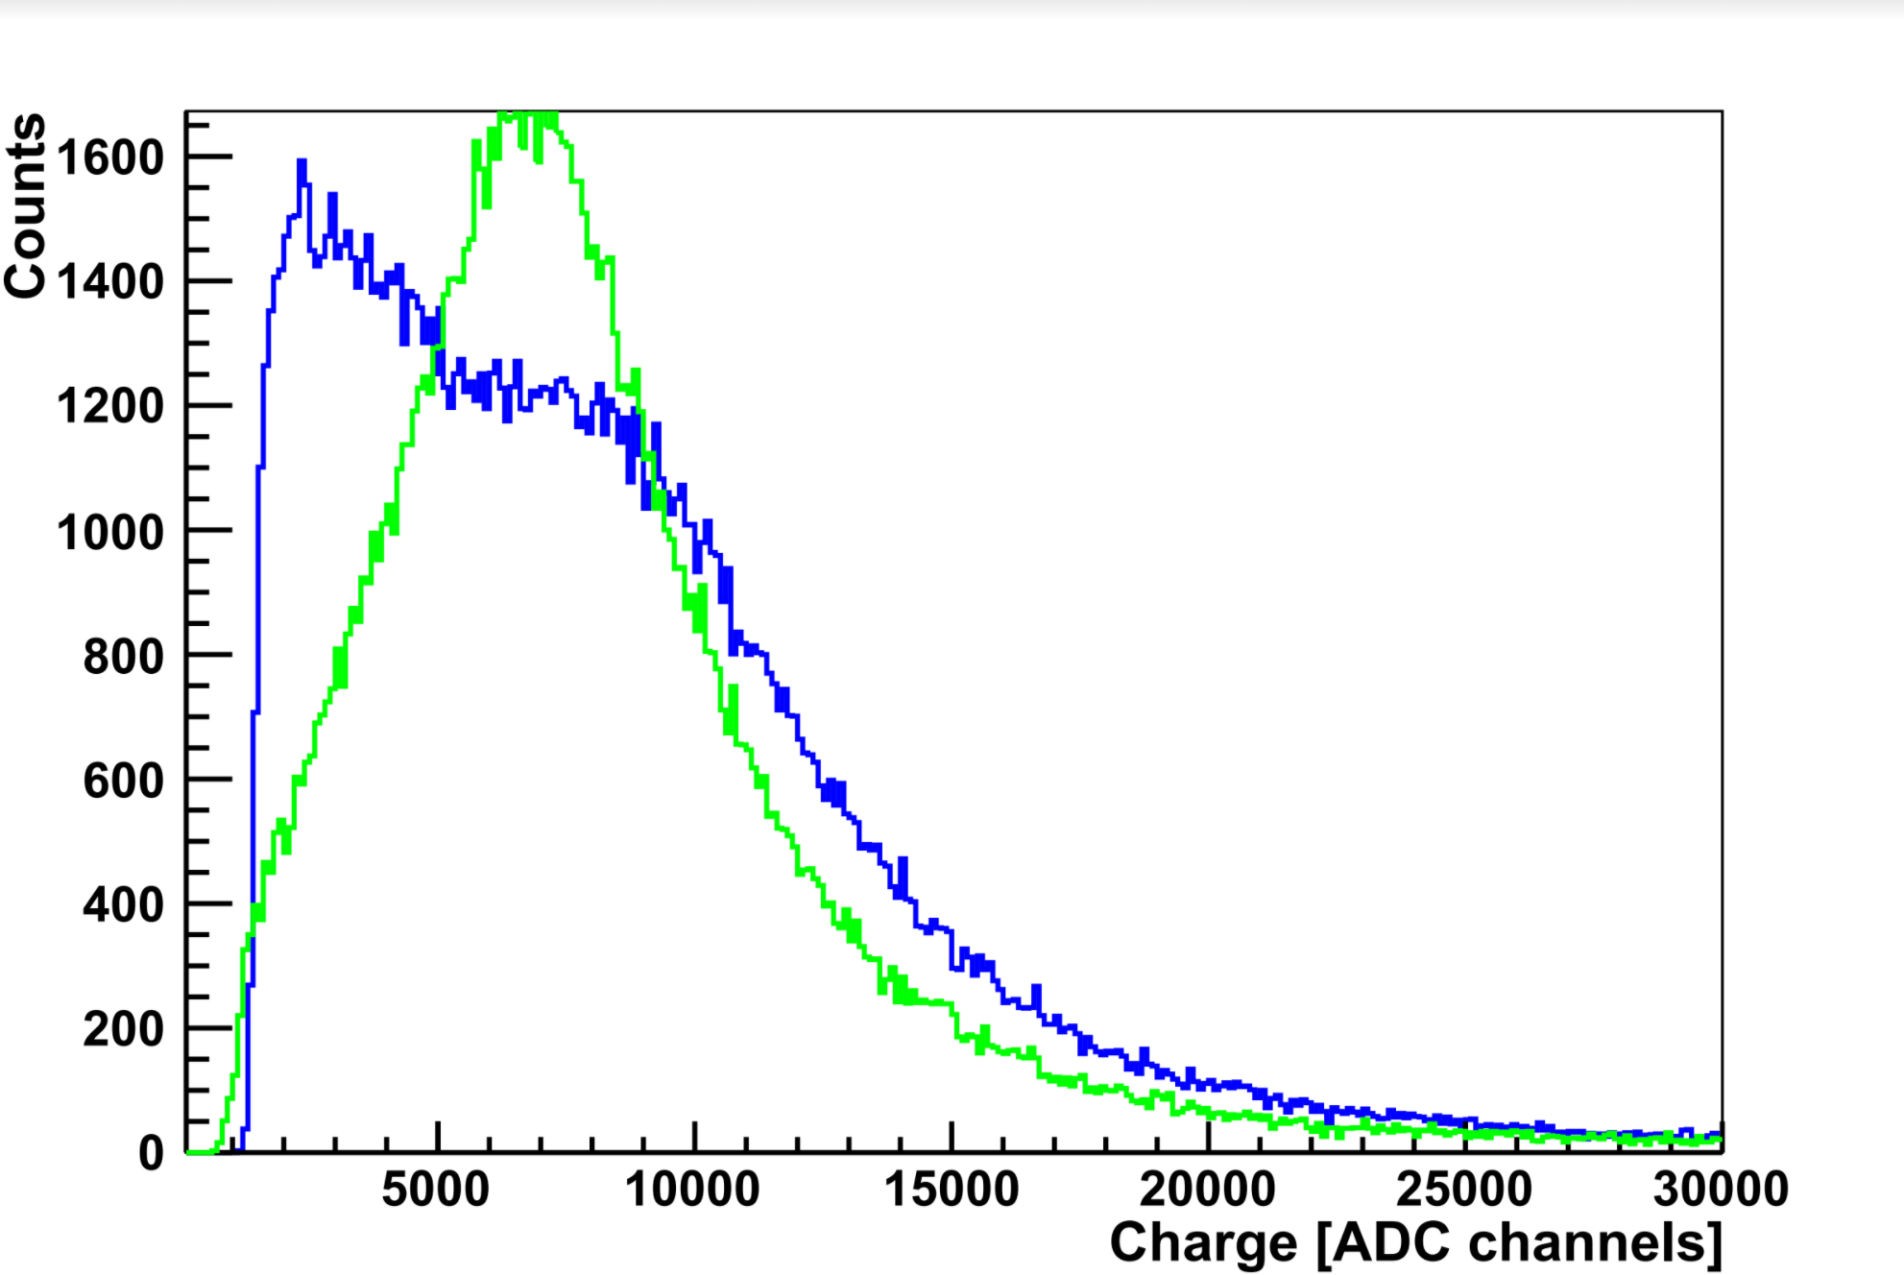
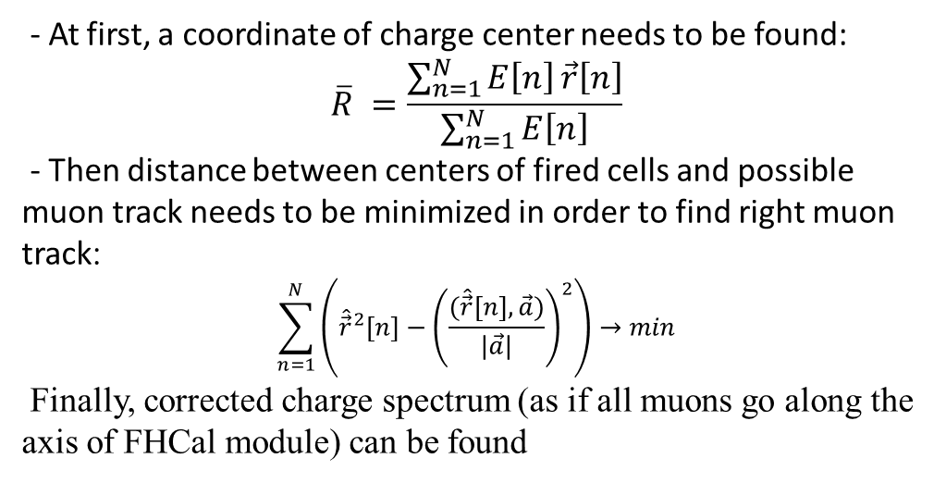
Energy calibration on cosmic muons from all directions
Experimental setup consisting of 4x3 modules (longitudinal cut)
- At first, a coordinate of charge center needs to be found:
$$\overline{R} =\frac{\sum_{n=1}^{N}{E\left[n\right]}\vec{r}\left[n\right]}{\sum_{n=1}^{N}{E\left[n\right]}}$$
- Then distance between centers of fired cells and possible muon track needs to be minimized in order to find right muon track:
$$\sum_{n=1}^{N}{\left({\hat{\vec{r}}}^{2}[n]−{\left(\frac{(\hat{\vec{r}}[n],\vec{a})}{|\vec{a}|}\right)}^{2}\right)→min}$$
Finally, corrected charge spectrum (as if all muons go along the axis of FHCal module) can be found
Position of peak corresponds to released energy of muon
Real charge spectrum of muon and corrected charge spectrum
9/18

Slide 10
Determination of ion interaction point.
Energy method.

Slide 11
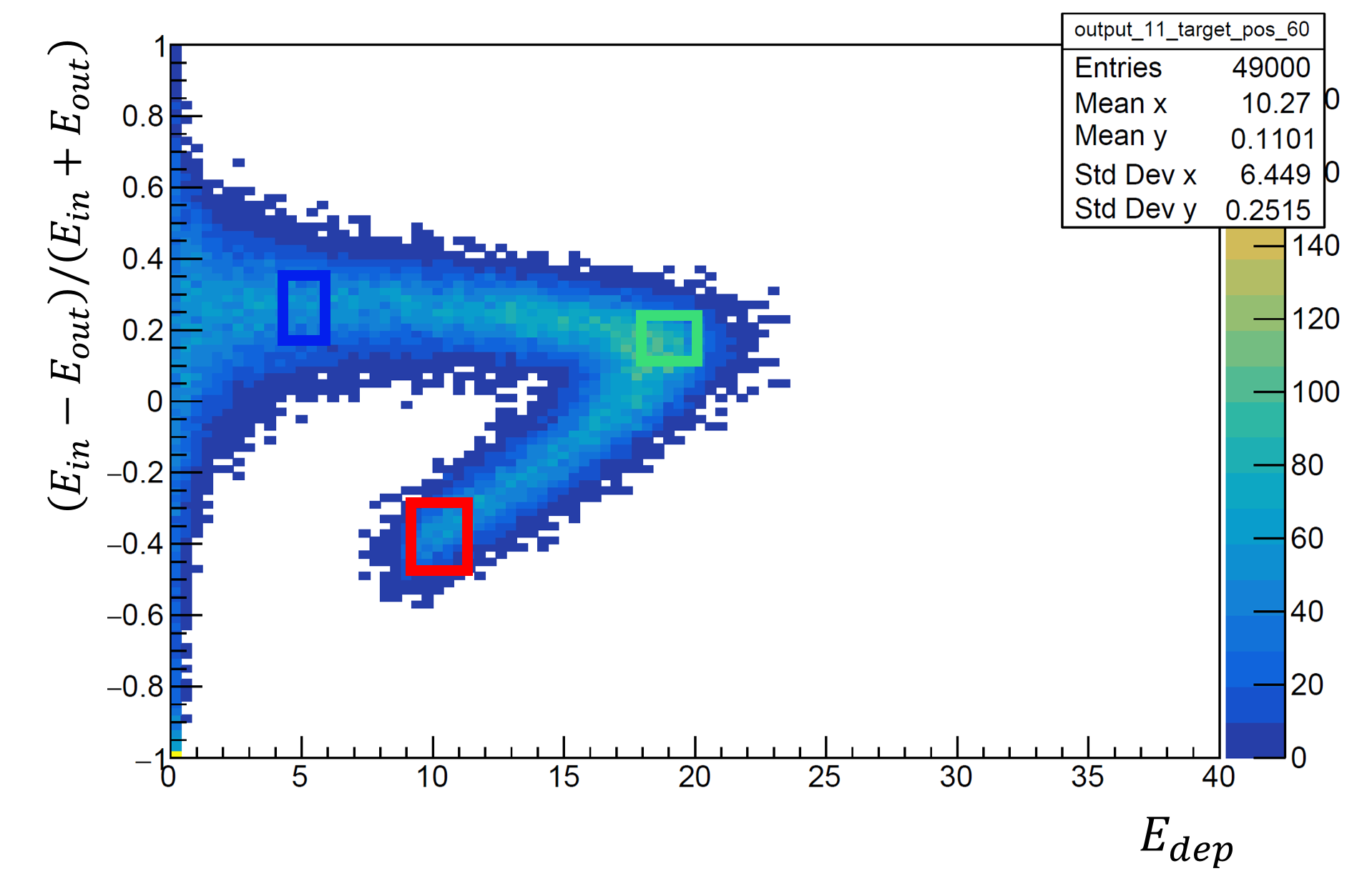
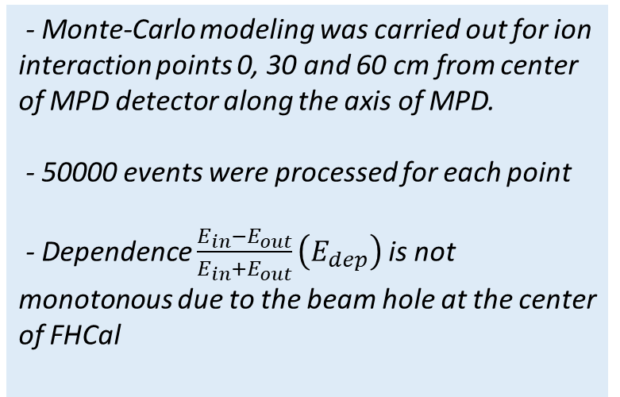


Determination of ion interaction point for different event classes
$$E_{in}$$
$$E_{out}$$
- Monte-Carlo modeling was carried out for ion interaction points 0, 30 and 60 cm from center of MPD detector along the axis of MPD.
- 50000 events were processed for each point
- Dependence $\frac{E_{in}−E_{out}}{E_{in}+E_{out}}\left(E_{dep}\right)$is not monotonous due to the beam hole at the center of FHCal
= deposited Energy
peripheral
central
semi-peripheral
Three different event classes can be distinguished: central, peripheral, semi-peripheral
10/18

Slide 12
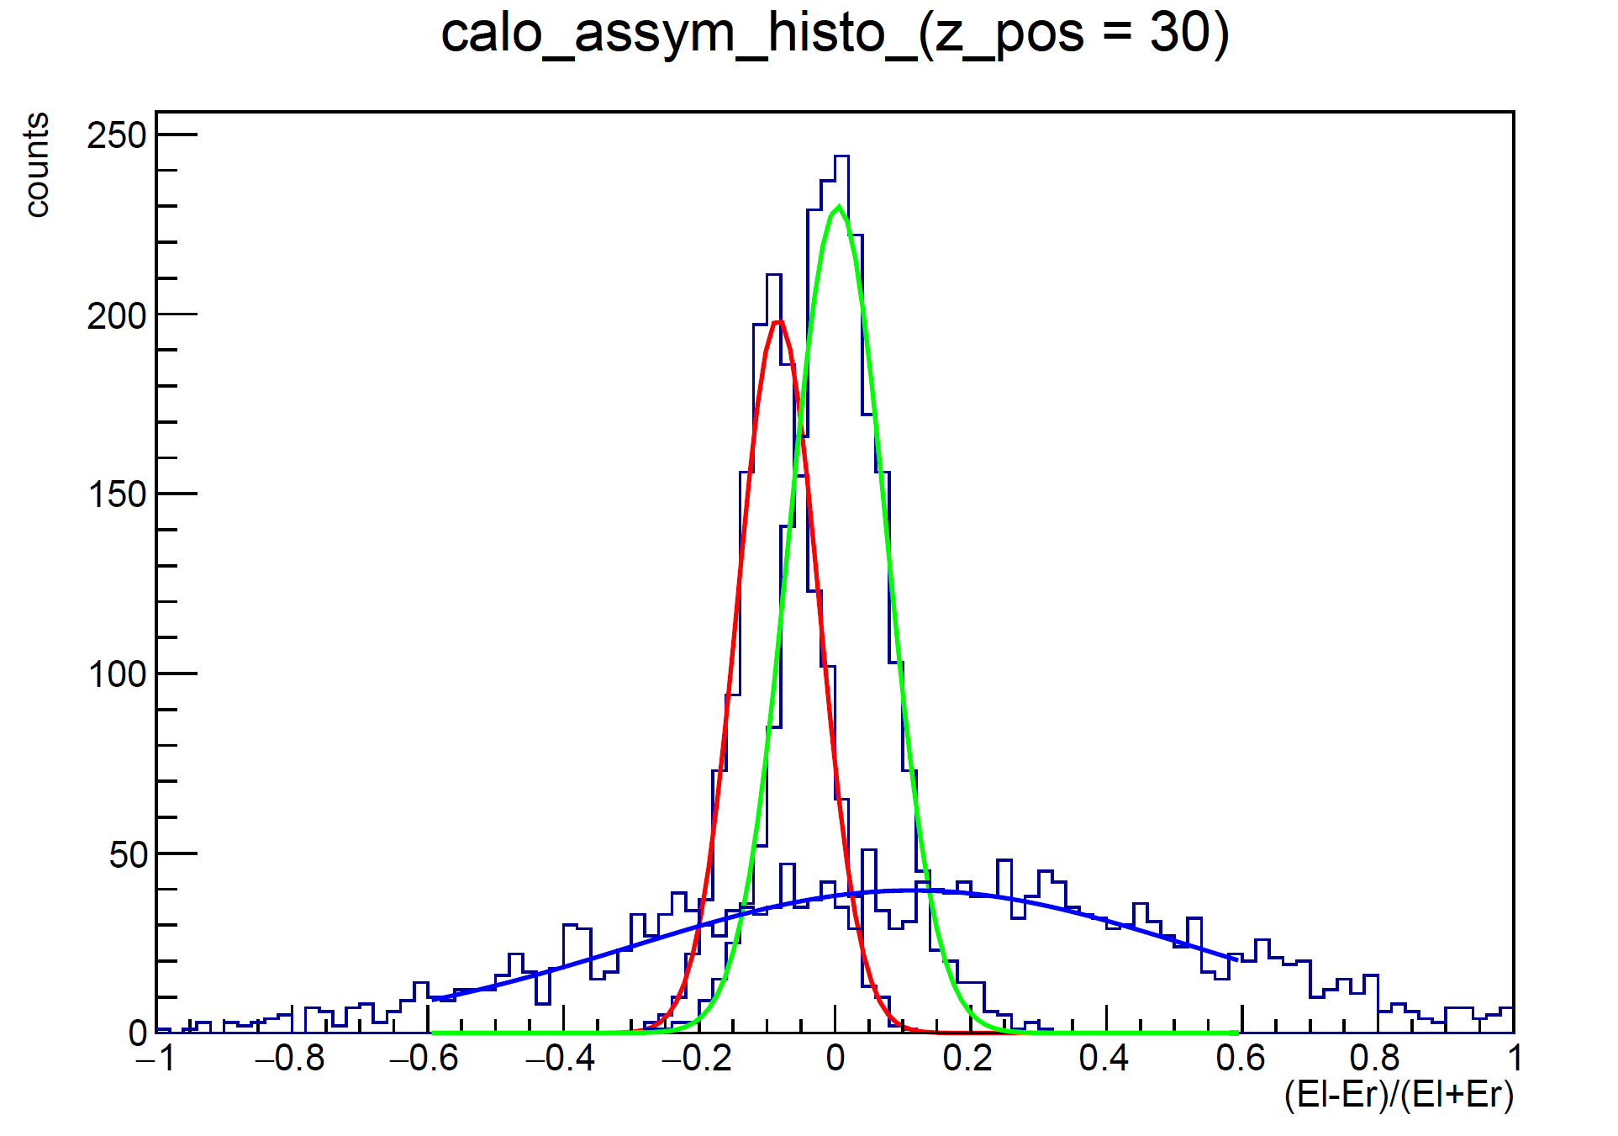
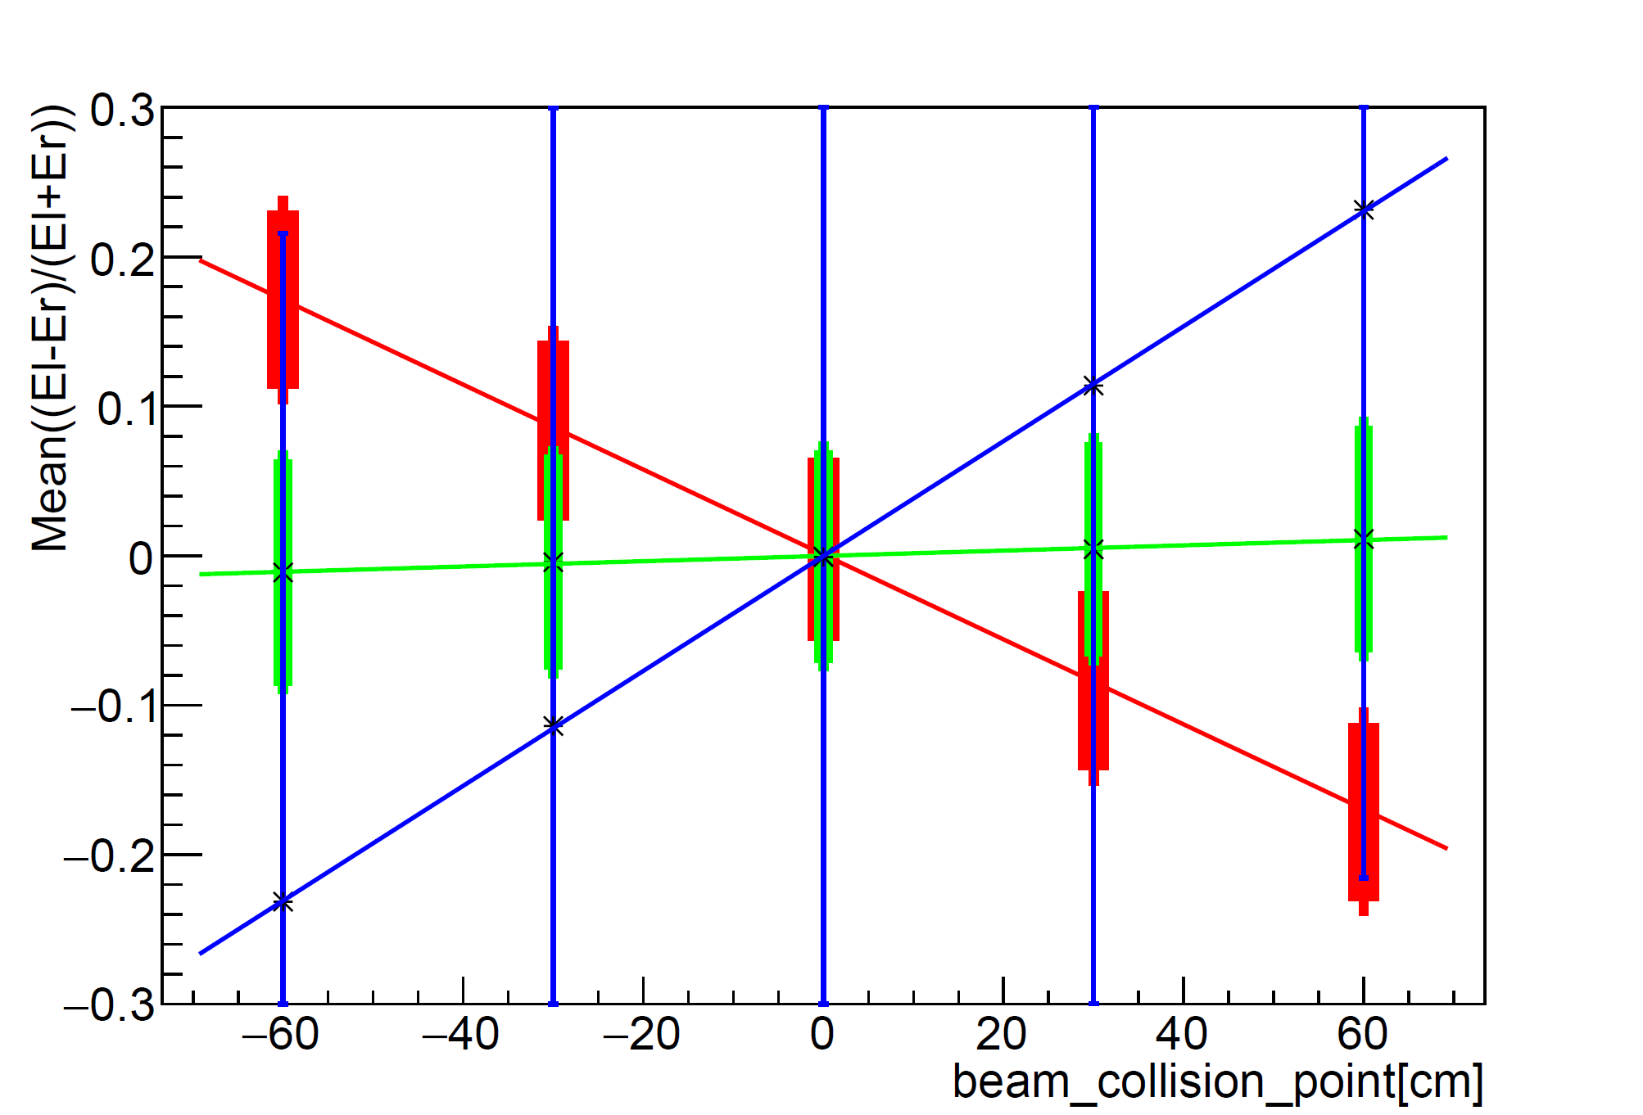
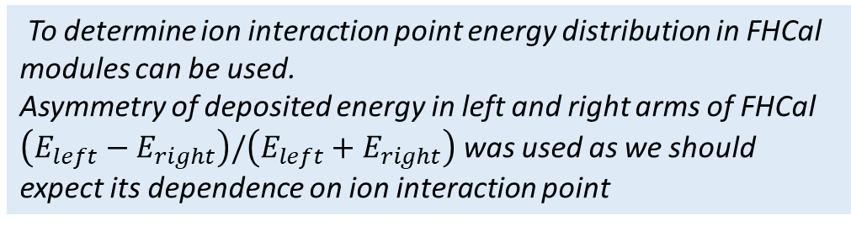



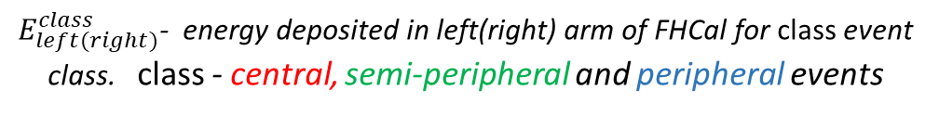
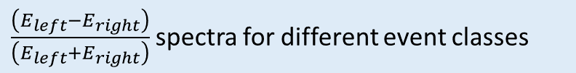
Determination of ion interaction point for different event classes
$$E_{left}$$
$$E_{right}$$
To determine ion interaction point energy distribution in FHCal modules can be used.
Asymmetry of deposited energy in left and right arms of FHCal $\left(E_{left}−E_{right}\right)/\left(E_{left}+E_{right}\right)$ was used as we should expect its dependence on ion interaction point
Left FHCal arm
Right FHCal arm
$E_{left(right)}^{class}$- energy deposited in left(right) arm of FHCal for class event class. class - central, semi-peripheral and peripheral events
$$Mean\left(E_{left}^{class}−E_{right}^{class}\right)/\left(E_{left}^{class}+E_{right}^{class}\right)$$
$\frac{\left(E_{left}−E_{right}\right)}{\left(E_{left}+E_{right}\right)}$spectra for different event classes
$Mean\left(E_{left}^{class}−E_{right}^{class}\right)/\left(E_{left}^{class}+E_{right}^{class}\right)\left(z\right)$ for different event classes
11/18

Slide 13
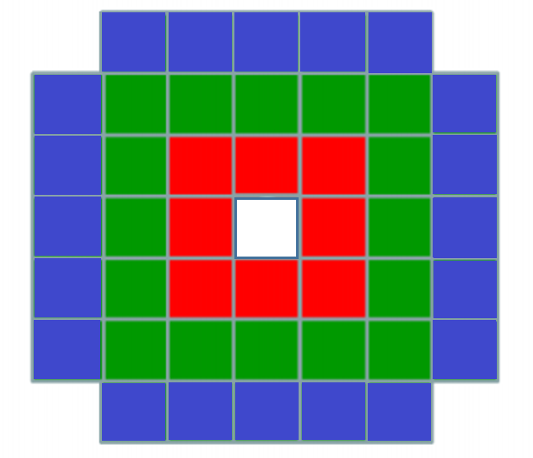
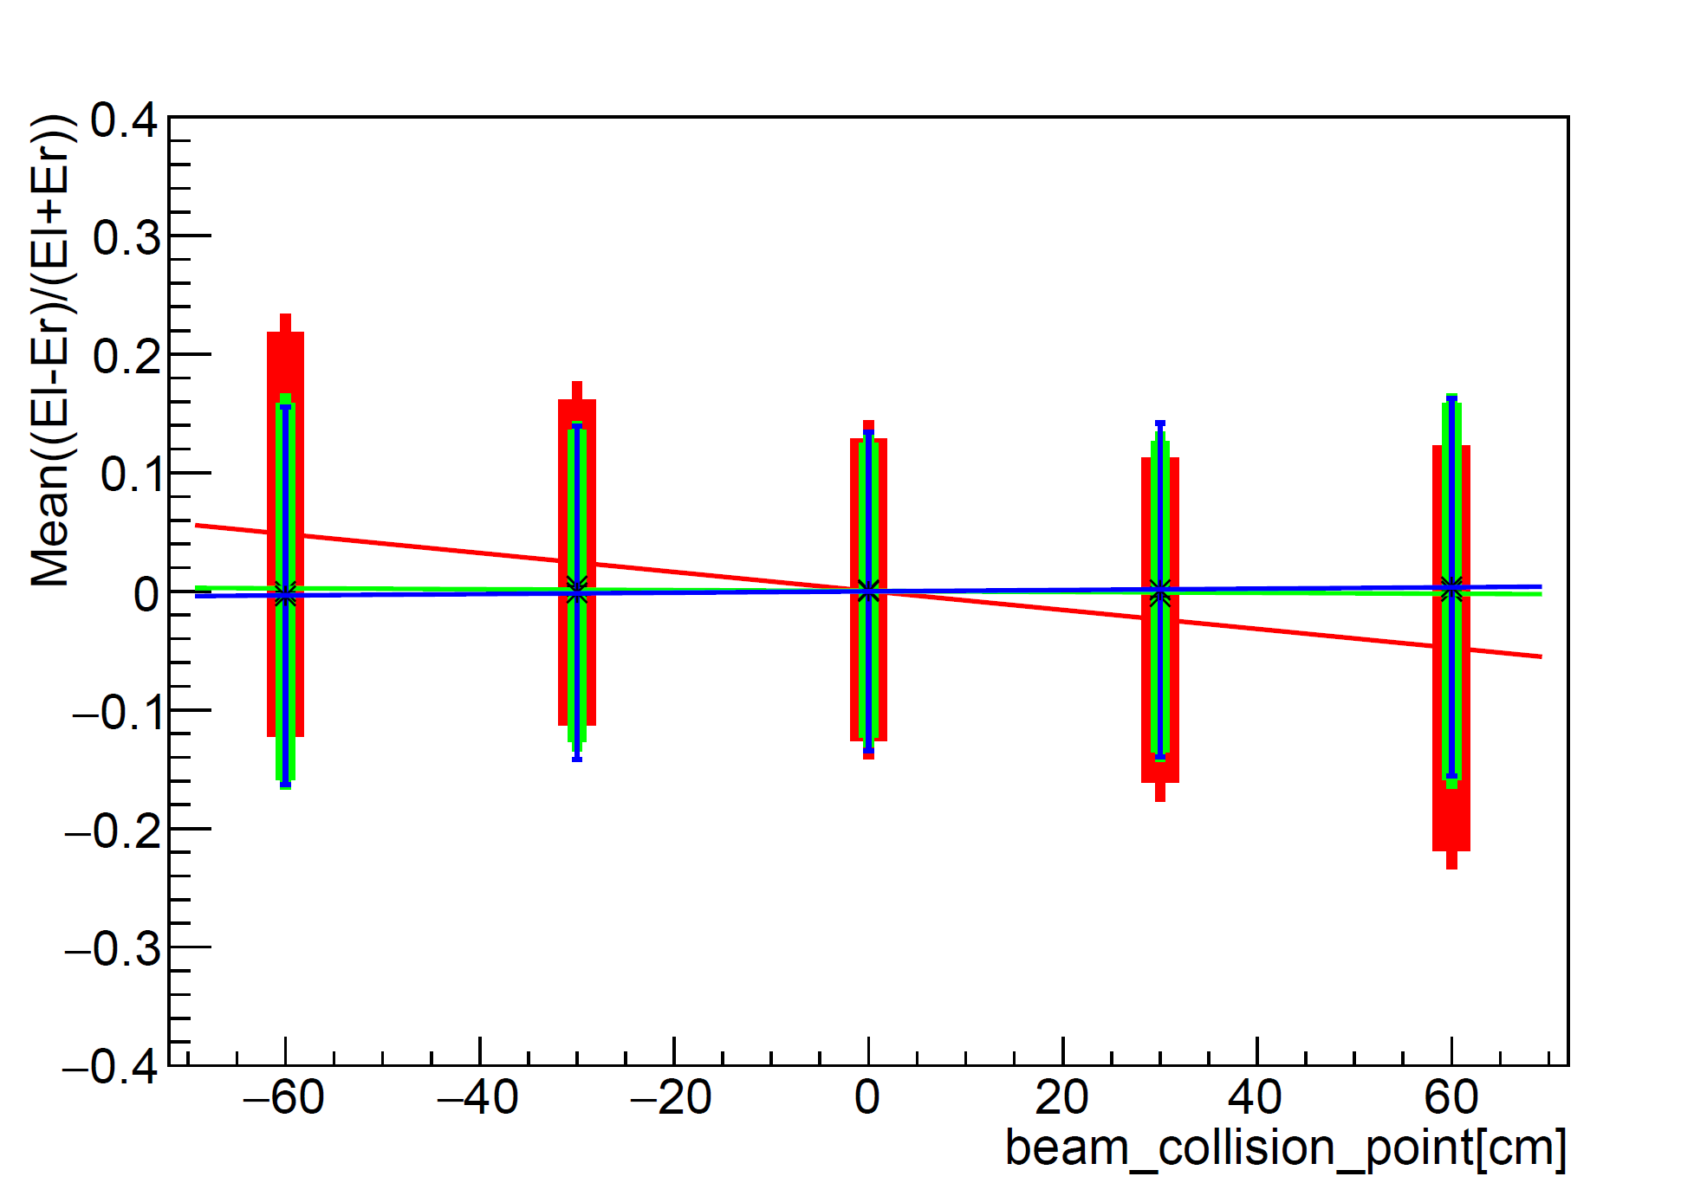

Determination of ion interaction point for different calorimeter zones
The same procedure as in the previous slide for different calorimeter zones (instead of event classes) was used
$$Mean\left({E_{x}}_{left}−{E_{x}}_{right}\right)/\left({E_{x}}_{left}+{E_{x}}_{right}\right)$$
External ring of modules
Middle ring of modules
Internal ring of modules
$\left({E_{x}}_{left}−{E_{x}}_{right}\right)/\left({E_{x}}_{left}+{E_{x}}_{right}\right)\left(z\right)$ for different rings
The picture shows that internal modules react more to change in collision point than others
12/18

Slide 14
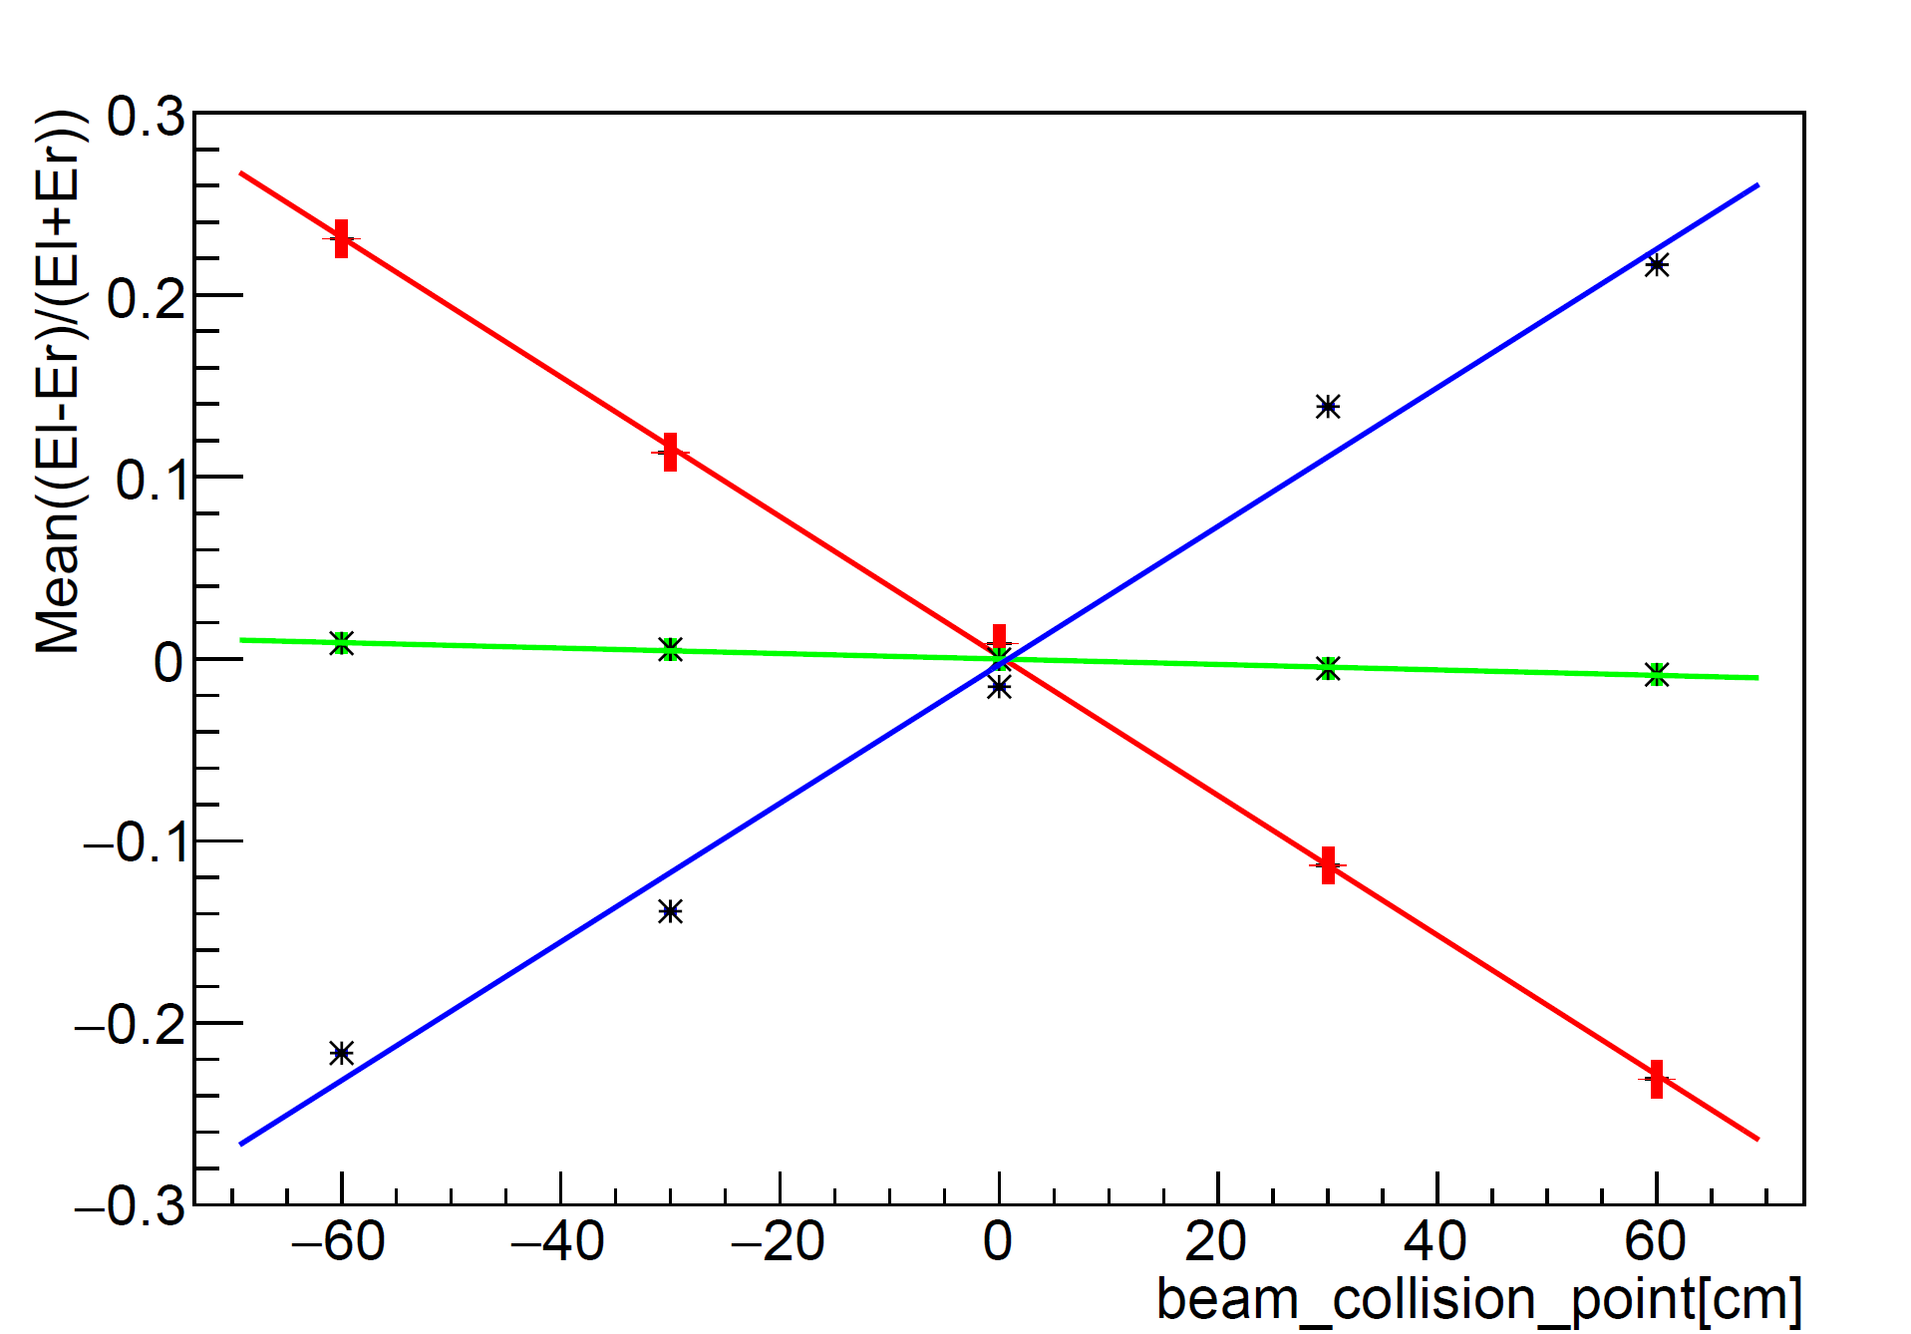
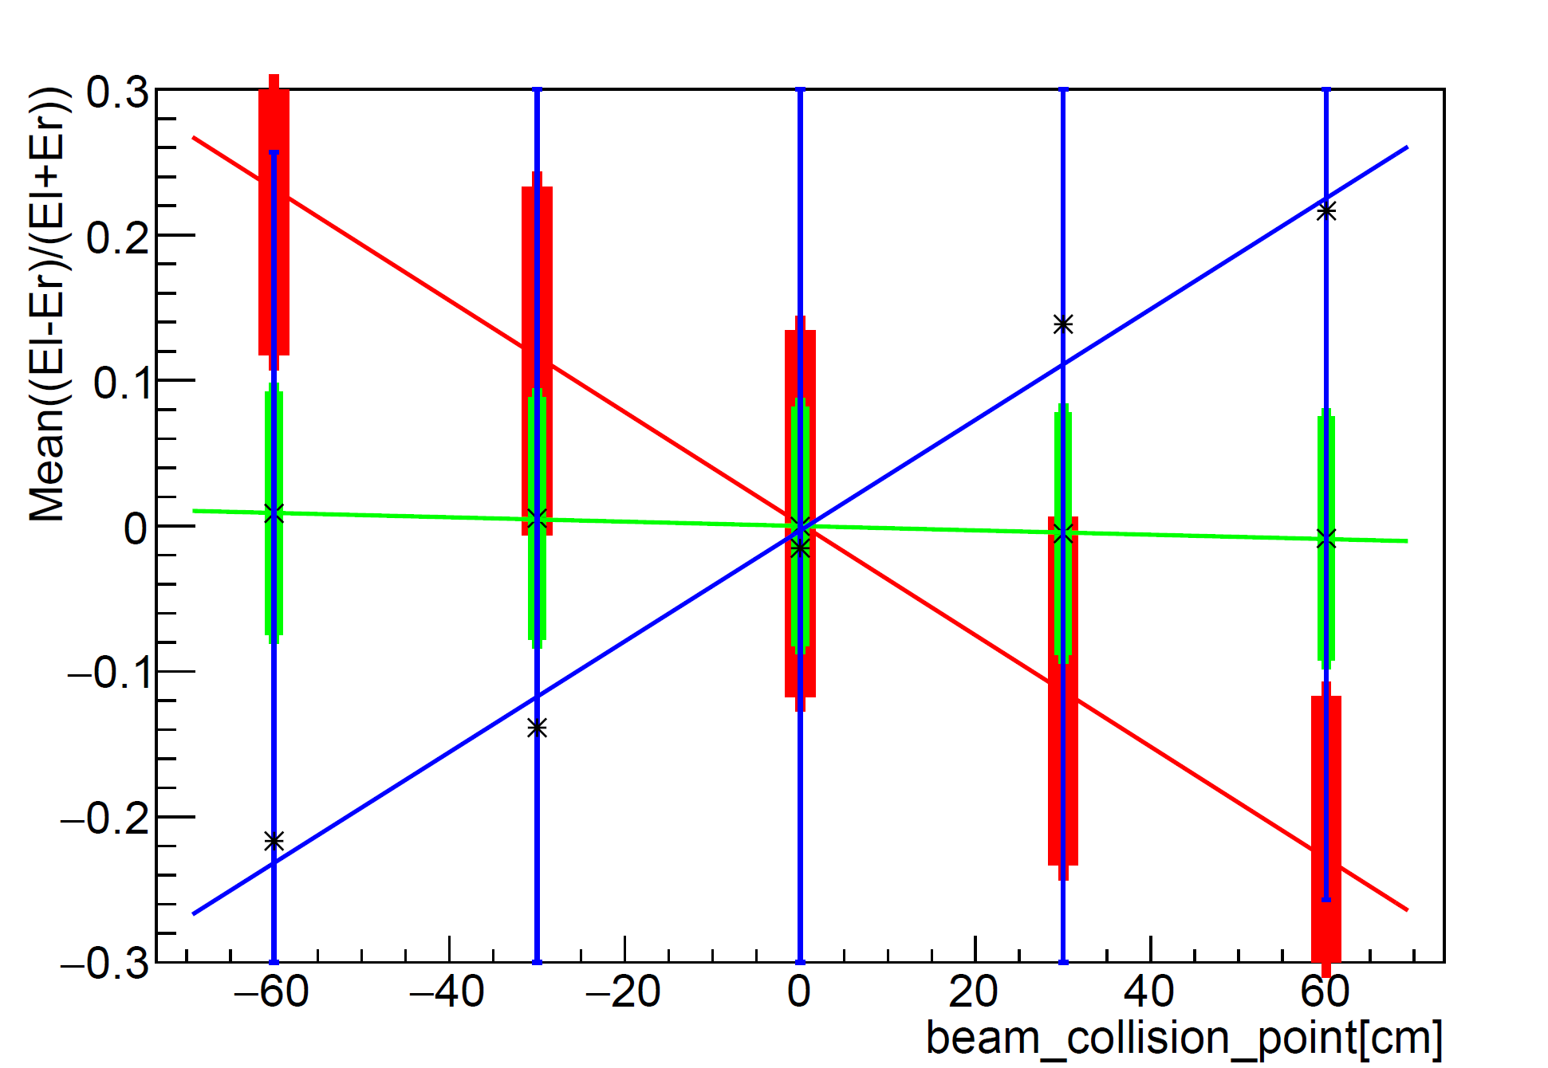


$$\left({E_{in}}_{left}−{E_{in}}_{right}\right)/\left({E_{in}}_{left}+{E_{in}}_{right}\right)\left(z\right)$$
Determination of ion interaction point. Combination of methods.
$$Mean\left({E_{x}}_{left}−{E_{x}}_{right}\right)/\left({E_{x}}_{left}+{E_{x}}_{right}\right)$$
$$Mean\left({E_{x}}_{left}−{E_{x}}_{right}\right)/\left({E_{x}}_{left}+{E_{x}}_{right}\right)$$
Without errors
With errors
In this slide lines $\left({E_{in}}_{left}−{E_{in}}_{right}\right)/\left({E_{in}}_{left}+{E_{in}}_{right}\right)\left(z\right)$ are shown for central, semi-peripheral and peripheral centrality classes only for internal ring of modules
13/18

Slide 15
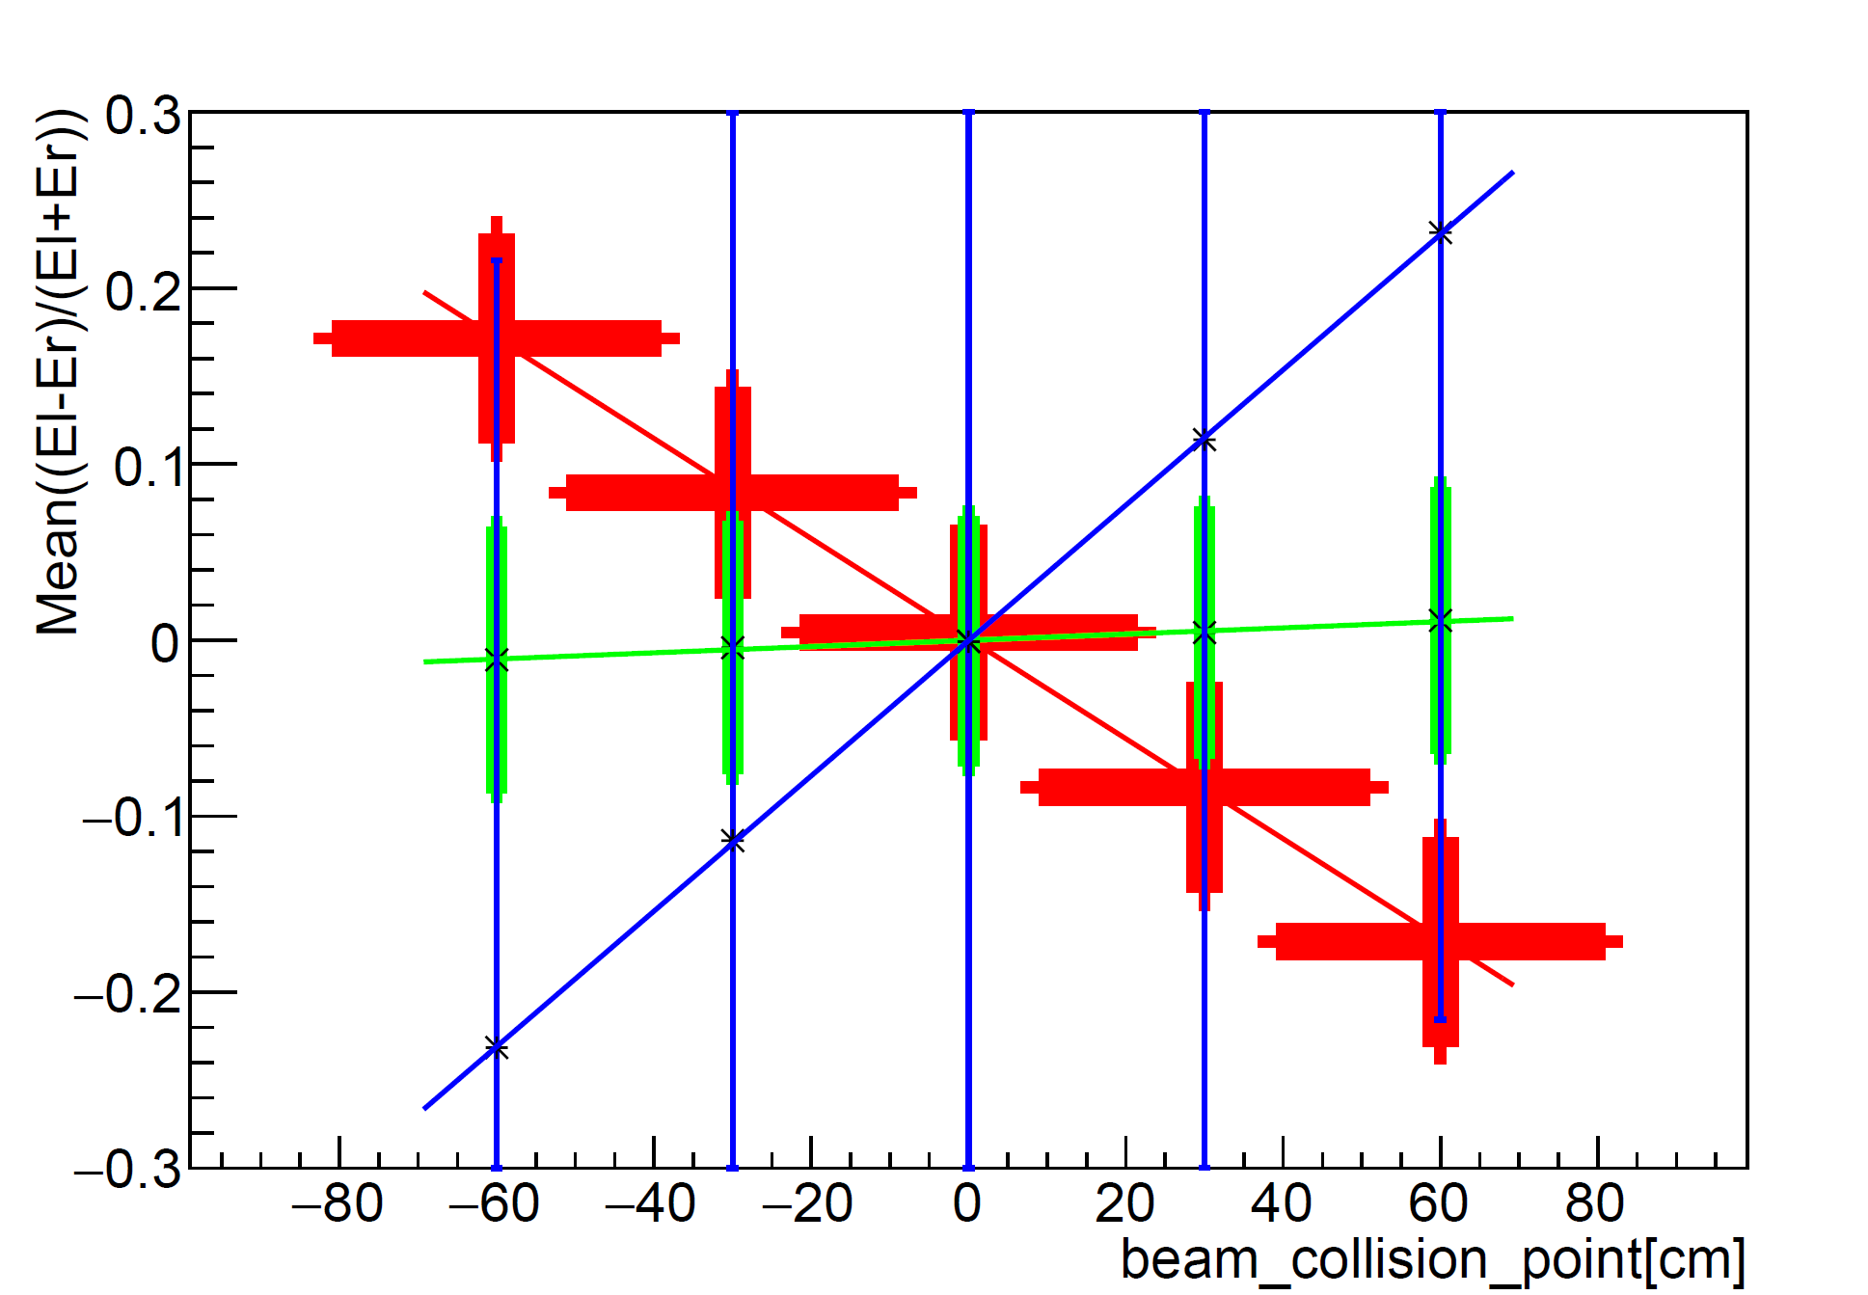

$$\left({E_{in}}_{left}−{E_{in}}_{right}\right)/\left({E_{in}}_{left}+{E_{in}}_{right}\right)\left(z\right)$$
Determination of ion interaction point. Accuracy.
$$Mean\left(E_{left}^{class}−E_{right}^{class}\right)/\left(E_{left}^{class}+E_{right}^{class}\right)$$
$Mean\left(E_{left}^{class}−E_{right}^{class}\right)/\left(E_{left}^{class}+E_{right}^{class}\right)\left(z\right)$ for different event classes
Spatial resolution obtained from the combination of methods is worse than the resolution obtained from the first method.
The accuracy of reconstruction of the collision point using the first method is 21-23 cm.
14/18

Slide 16
Determination of ion interaction point.
Time method.

Slide 17
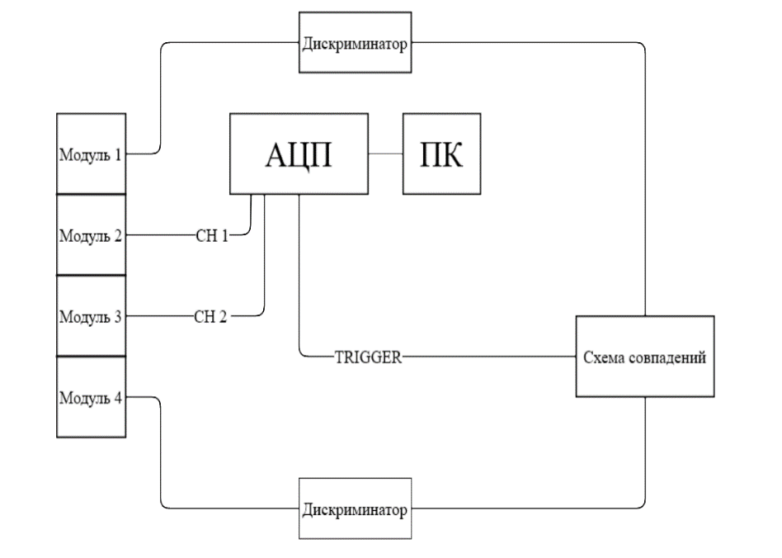




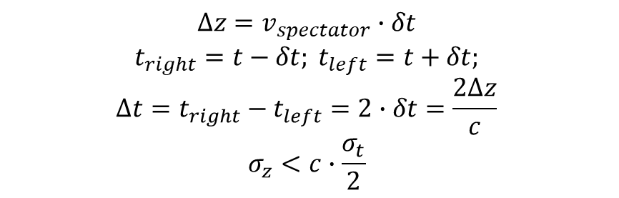

Time method of ion interaction point determination
In order to increase the accuracy of determination of ion interaction point time resolution should be determined
Time method of determination of ion interaction point
Discriminator
$$v_{spectator}∙t$$
$$v_{spectator}∙t$$
1
ADC
PC
Left FHCal arm
Right FHCal arm
2
Module №
3
Coincidence scheme
$$v_{spectator}∙(t+δt)$$
$$v_{spectator}∙\left(t−δt\right)$$
4
Left FHCal arm
Right FHCal arm
Discriminator
$$Δz$$
Experimental setup for determination of time resolution
Collision point
Muons that pass through modules 1 and 4 are selected and are used as input signals for coincidence scheme.
Coincidence scheme yields trigger signal.
Time and amplitude spectra from modules 2 and 3 are written.
$$Δz=v_{spectator}∙δt$$
$$t_{right}=t−δt; t_{left}=t+δt;$$
$$Δt=t_{right}−t_{left}=2∙δt=\frac{2Δz}{c}$$
$$σ_{z}<c∙\frac{σ_{t}}{2}$$
15/18

Slide 18
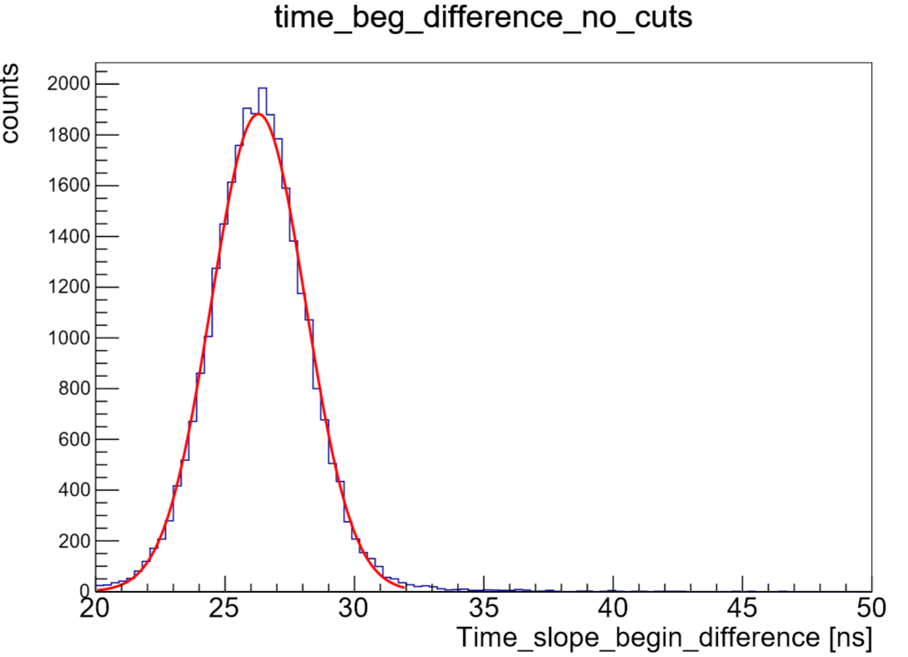
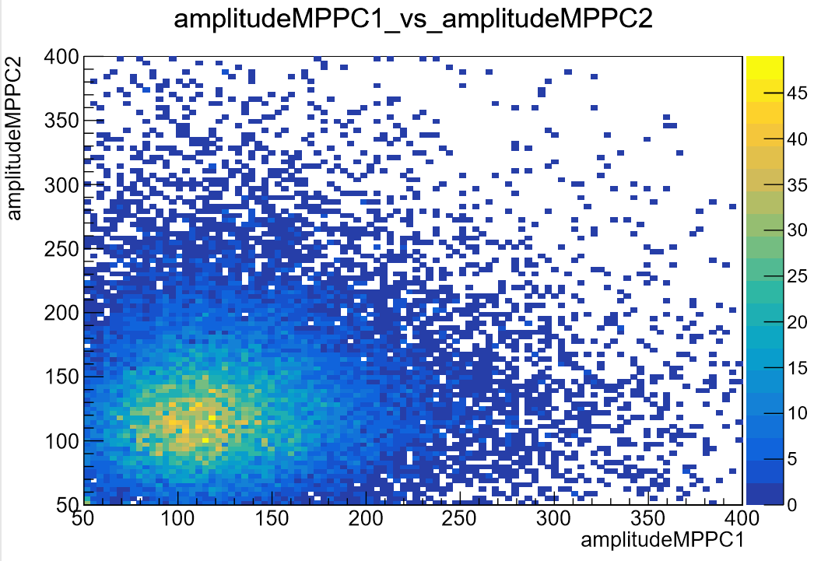
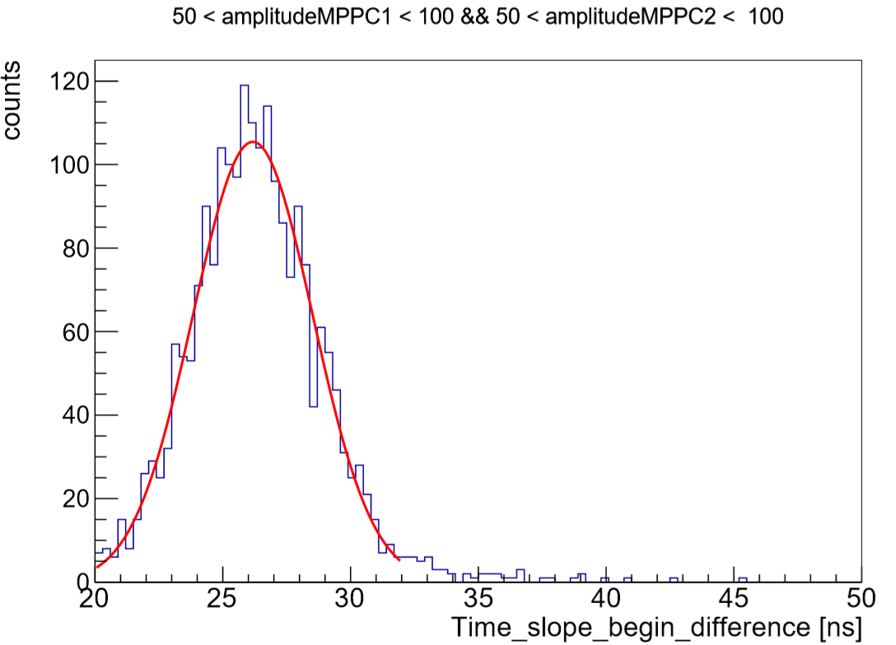
Time resolution of FHCal modules
In order to increase the accuracy of determination of ion interaction point time resolution was explored
Amplitude from module 3
cut
Spectrum of difference in time pulses of modules 2 and 3
Amplitude from module 2
Spectrum of difference in time pulses of modules 2 and 3 for mentioned range of amplitudes
Correlation between muon amplitude spectra of modules 2 and 3
All events were divided as shown above.
Time spectra for all event cuts were fitted with gauss distribution in order to get time resolutions of corresponding energy regions.
16/18

Slide 19
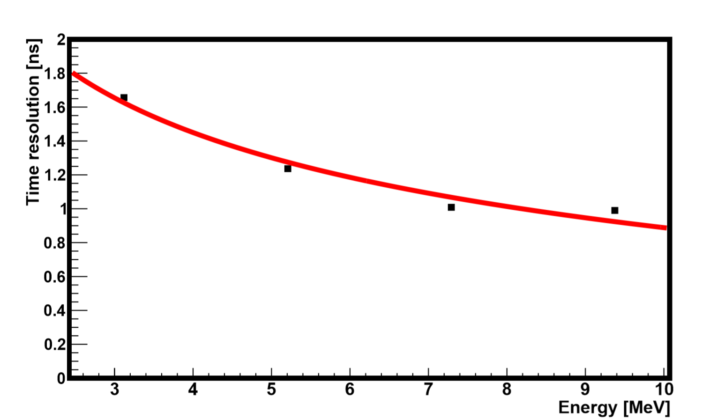


Accuracy of ion interaction point reconstruction by the time method
Time resolution can be obtained from time spectra, acquired from energy cuts (they are shown as green rectangles at the previous slide)
$$σ_{gauss}$$
$$σ_{t}\sim \frac{1}{\sqrt{E}}$$
In order to get energy in MeVs energy calibration results were used
Spectrum of difference in time pulses of modules 2 and 3 for mentioned range of amplitudes
Dependence of time resolution on energy
If released energy $E>10 MeV⇒σ_{t}<1 ns$
If time resolution $σ_{t}<1 ns⇒$ accuracy of reconstruction $σ_{z}<15 cm$
17/18

Slide 20
Thank you for your attention

Slide 21
Determination of ion interaction point
Energy method

Slide 22
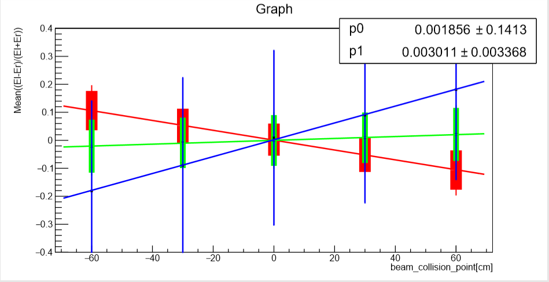



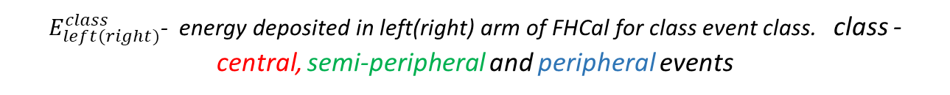
Determination of ion interaction point for different event classes
$$\left(E_{in}−E_{out}\right)/\left(E_{in}+E_{out}\right)$$
$$Mean\left(E_{left}^{class}−E_{right}^{class}\right)/\left(E_{left}^{class}+E_{right}^{class}\right)$$
peripheral
central
semi-peripheral
$$E_{in}$$
$Mean\left(E_{left}^{class}−E_{right}^{class}\right)/\left(E_{left}^{class}+E_{right}^{class}\right)\left(z\right)$ for different event classes
$$E_{out}$$
$E_{left(right)}^{class}$- energy deposited in left(right) arm of FHCal for class event class. class - central, semi-peripheral and peripheral events
8/28

Slide 23
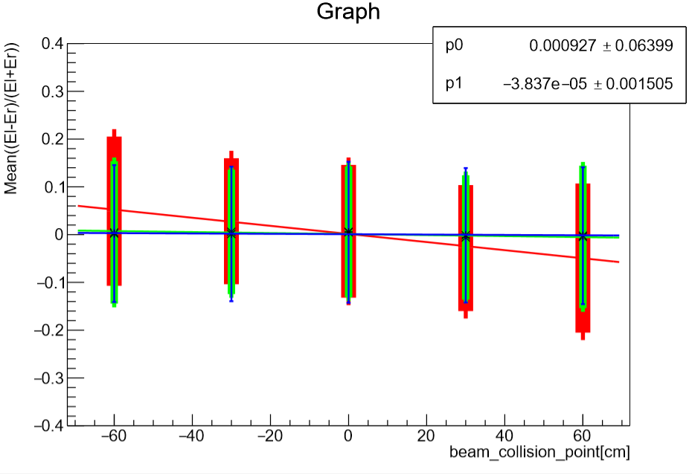

Determination of ion interaction point for different calorimeter zones
$$Mean\left({E_{x}}_{left}−{E_{x}}_{right}\right)/\left({E_{x}}_{left}+{E_{x}}_{right}\right)$$
Internal module ring
External module ring
Middle module ring
$\left({E_{x}}_{left}−{E_{x}}_{right}\right)/\left({E_{x}}_{left}+{E_{x}}_{right}\right)\left(z\right)$ for different rings
The picture shows that internal modules react more to change in collision point than others
9/28

Slide 24
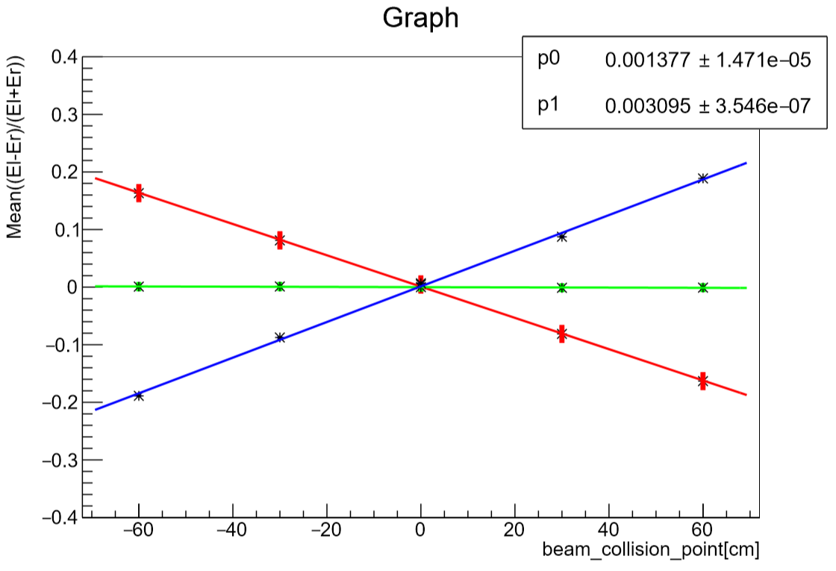
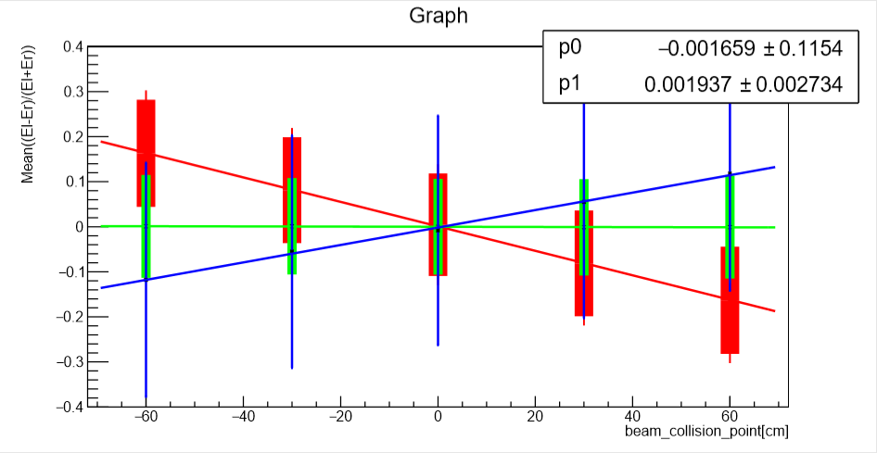


$$\left({E_{in}}_{left}−{E_{in}}_{right}\right)/\left({E_{in}}_{left}+{E_{in}}_{right}\right)\left(z\right)$$
Determination of ion interaction point. Combination of methods.
$$Mean\left({E_{x}}_{left}−{E_{x}}_{right}\right)/\left({E_{x}}_{left}+{E_{x}}_{right}\right)$$
$$Mean\left({E_{x}}_{left}−{E_{x}}_{right}\right)/\left({E_{x}}_{left}+{E_{x}}_{right}\right)$$
Without errors
With errors
In this slide lines $\left({E_{in}}_{left}−{E_{in}}_{right}\right)/\left({E_{in}}_{left}+{E_{in}}_{right}\right)\left(z\right)$ are shown for central, semi-peripheral and peripheral centrality classes only for internal ring of modules
10/28

Slide 25
Energy calibration of FHCal modules

Slide 26
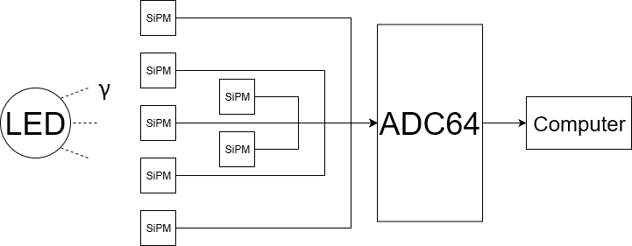
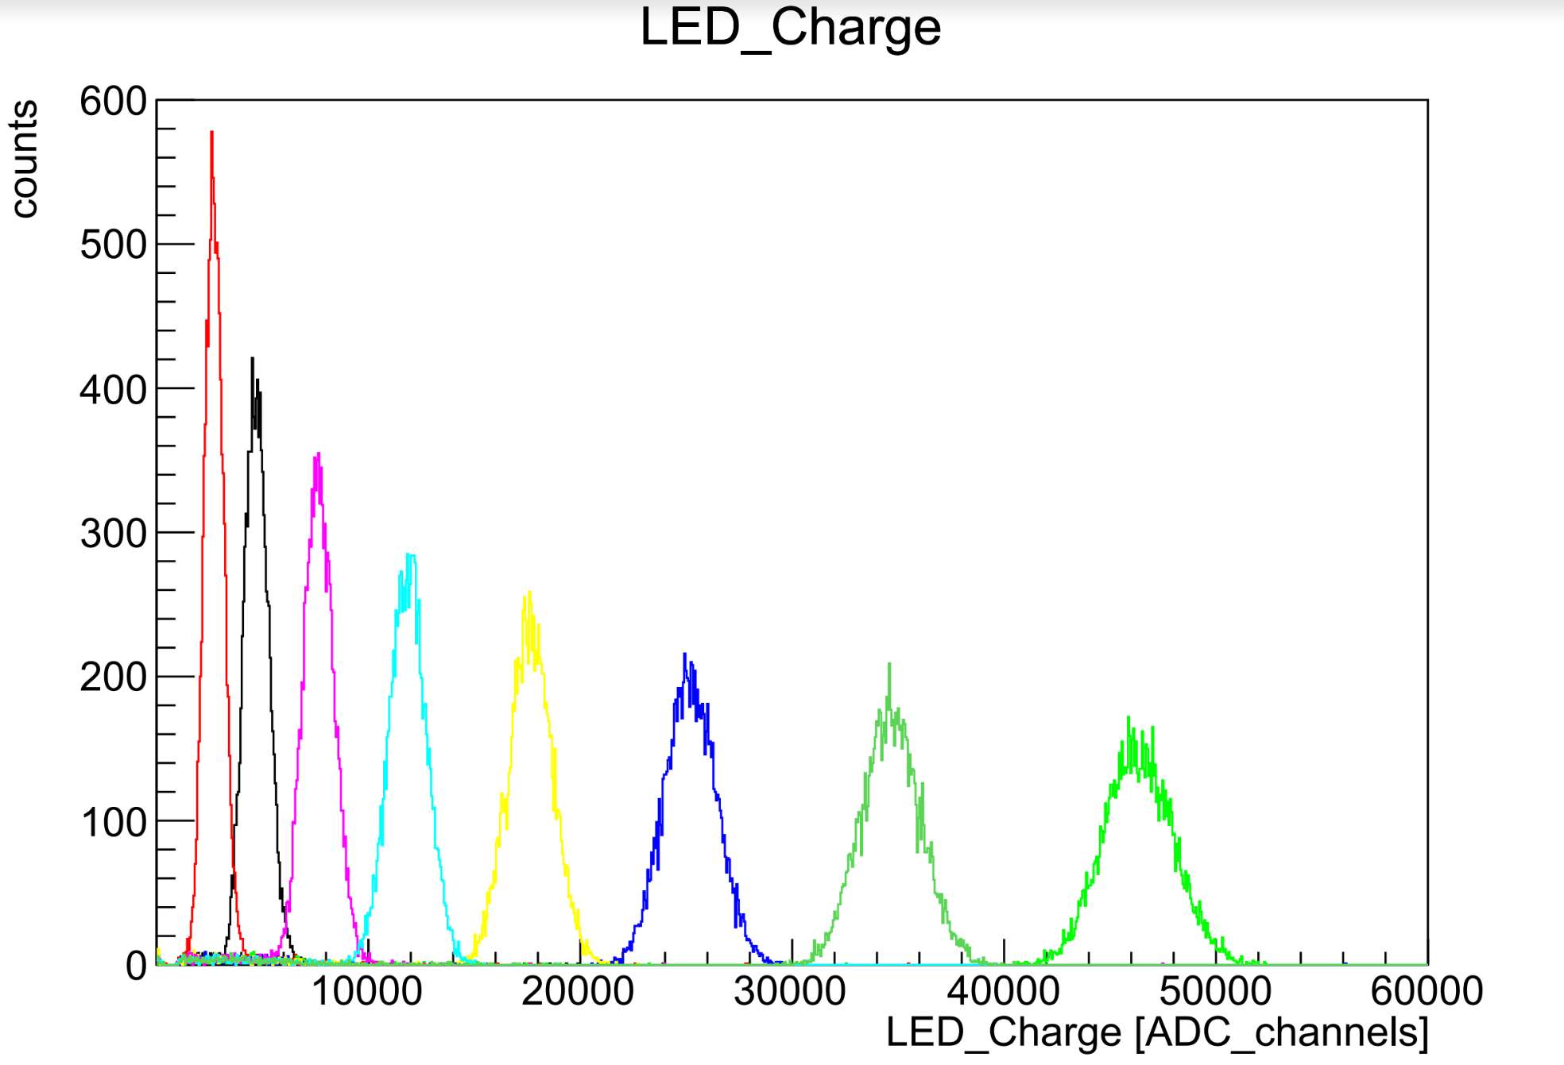
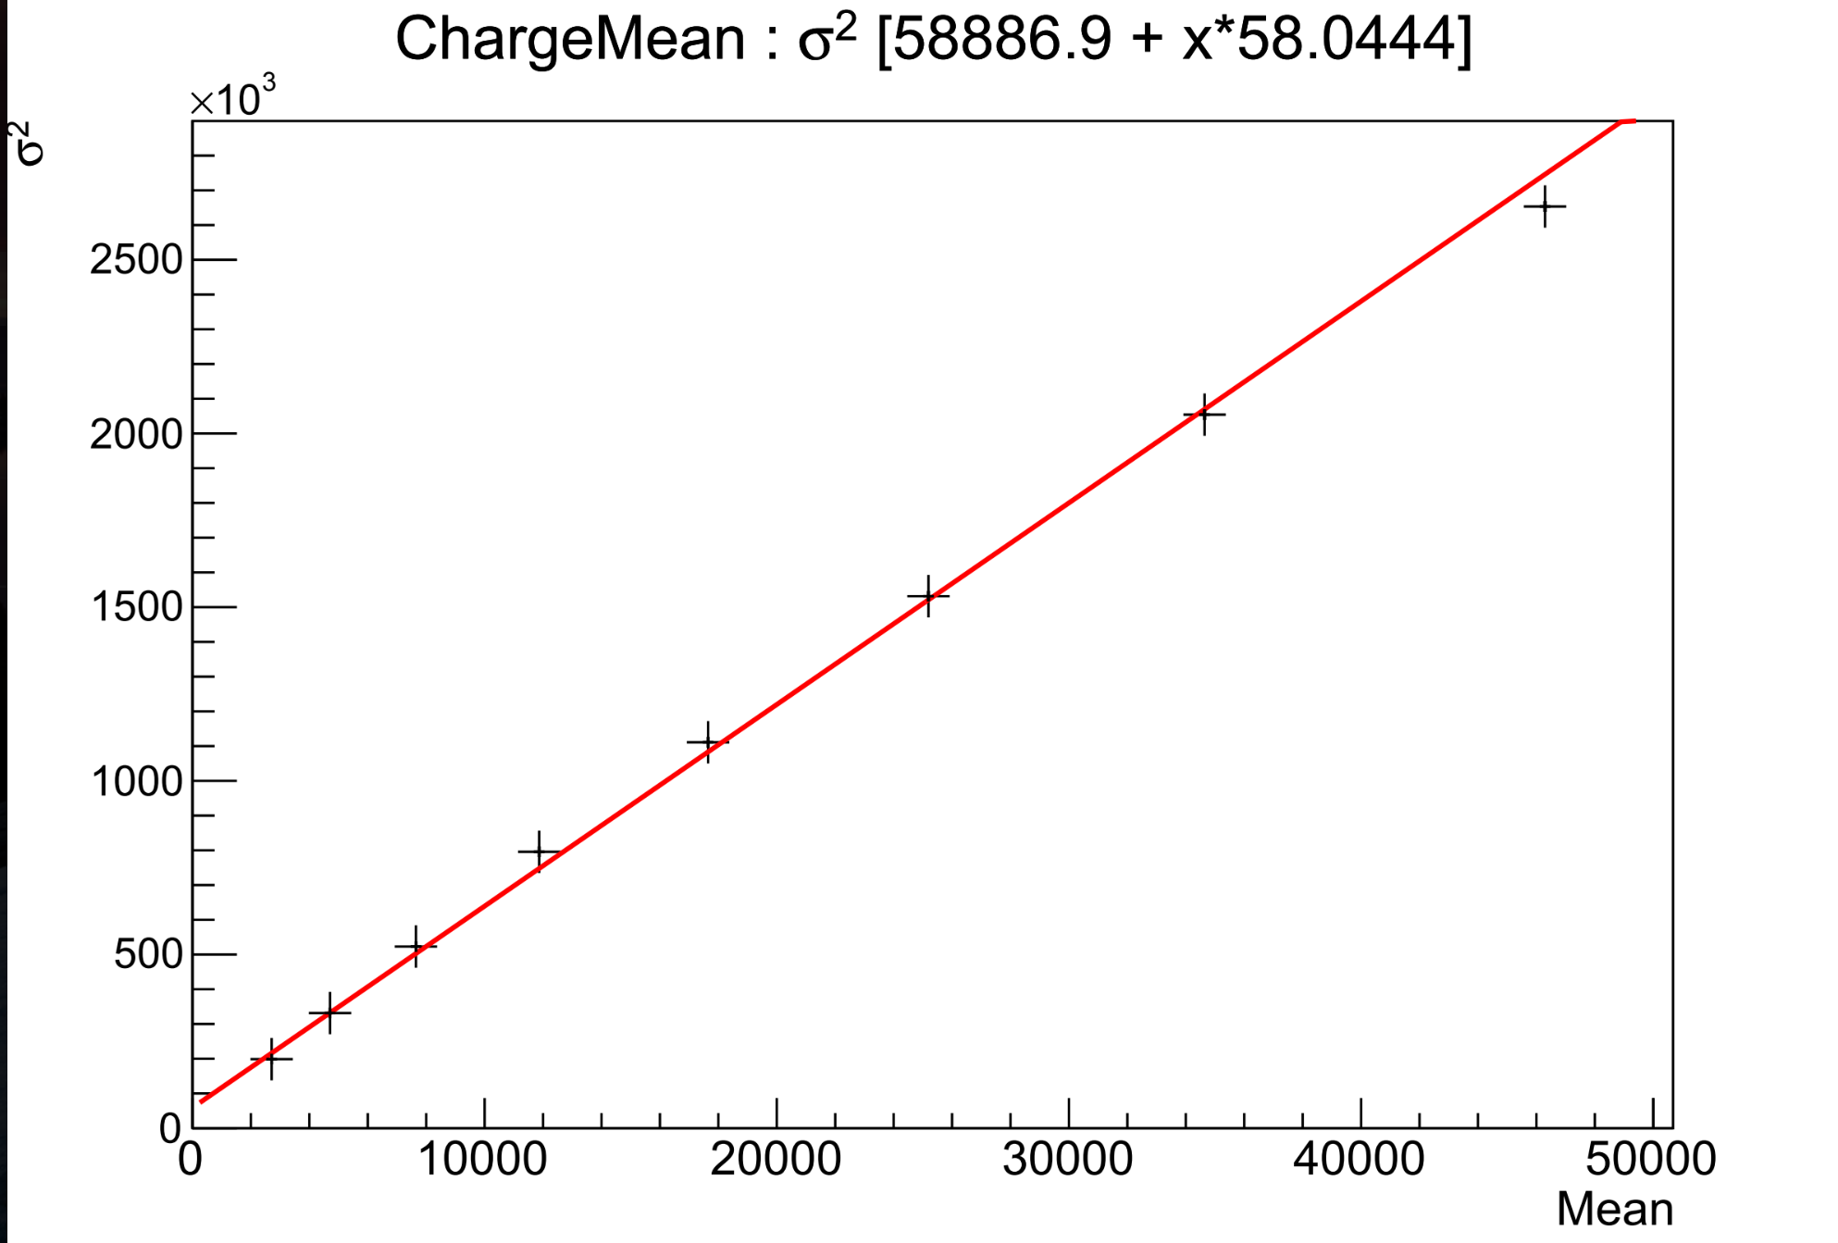


Absolute calibration
Experimental setup scheme
LEDs amplitude spectrum for a module
These spectra have Poisson distribution. Poisson distribution has following parameters: $σ[ф.э]=\sqrt{N}$, $Mean[ф.э]=N$
$$Mean\left[channels\right]=calibration_coefficient∙Mean\left[ph.e\right];$$
$$σ\left[channels\right]=calibration_coefficient∙σ\left[ph.e\right];$$
$N={\left(\frac{Mean}{σ}\right)}^{2}$=>$calibration_coefficient=\frac{σ^{2}}{Mean}\left[\frac{channel}{photoelectron}\right]$

Slide 27



Energy calibration on cosmic muons
FHCal module design
Cosmic muon amplitude spectra of all cells in one of FHCal modules
Different muon tracks that are taken into account:
- when two neighbor cells signals
- three neighbor cells signals
- all cells signals
are compared
Light yield of module cells that was received after fitting amplitude spectra of cosmic muons with langaus distribution

Slide 28

Калибровка на космических мюонах всех направлений
Калибровка на космических мюонах
Energy calibration on cosmic muons from all directions
Recently a method of simultaneous calibration of all modules was invented
When compared to previously used method the new one has following advantages:
- more statistics
- grater signal/noise ratio
- possibility of simultaneous calibration of all modules
Test stand scheme (longitudinal cut)
11/28

Slide 29




Energy calibration on cosmic muons from all directions
Using corrected amplitude spectrum it is possible to find light yield like it was done before
Average light yield of 9 modules (old SiPMs)
13/28
Average light yield of 9 modules (new SiPMs)

Slide 30
Determination of ion interaction point
Time method

