Slide 1

Study of the scintillation properties of pure and yttrium-doped BaF₂ crystals
Ilya Vasilyev, Yuri Davydov, Vladimir Baranov
Dzhelepov Laboratory of Nuclear Problems, JINR, Dubna
The XXIV International Scientific Conference of Young Scientists and Specialists
(AYSS-2020)
November 9-13, 2020

Slide 2

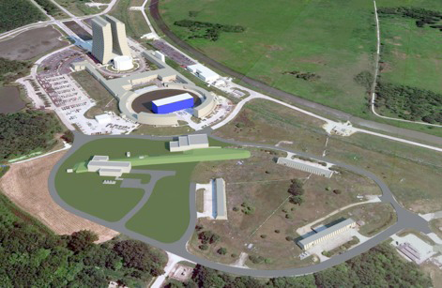
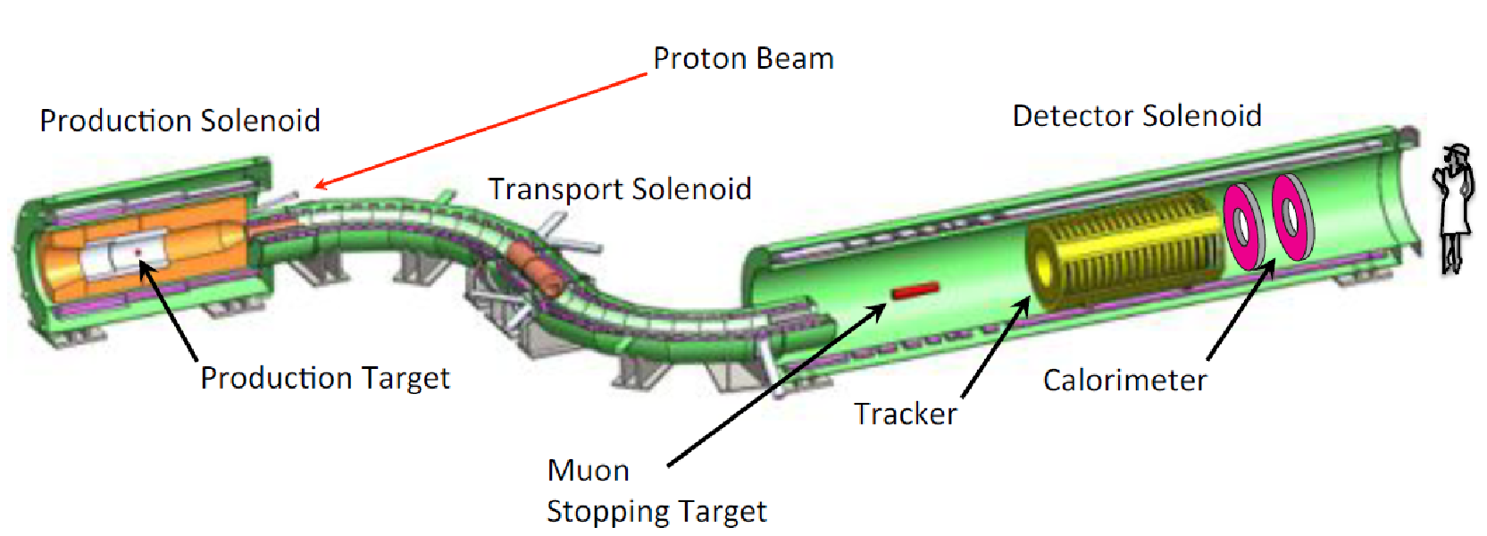
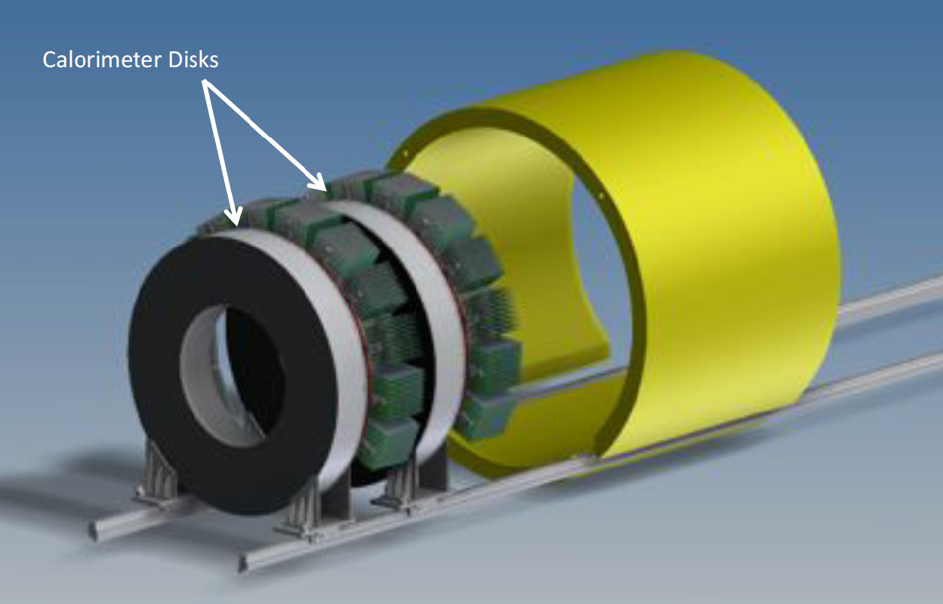
Introduction
What is Mu2e?
A search for neutrino less conversion of a muon into an electron in the field of a nucleus Charged-Lepton Flavor Violation via
Will use current Fermilab accelerator complex to reach a sensitivity 10 000 better than current world’s best
μ⁻ N → e⁻ N
Undoped CsI crystal used for the Mu2e calorimeter has a fast scintillation at 310 nm with 30 ns decay time and survives an ionization dose up to 100 krad.
BaF₂ crystal has an ultrafast scintillation at 220 nm with 0,5 ns decay time and a similar intensity as CsI, and may survive 100 Mrad. Its slow scintillation at 300 nm with 650 ns decay time, however, causes pileup in a high rate environment.
 | CsI | BaF₂
Density (g/cm³ ) | 4,51 | 4,89
Radiation length (cm) | 1,86 | 2,03
Z value | 54 | 51,6
dE/dX (MeV/cm) | 5,56 | 6,52
Emission peak (nm) | 310 | 300 (slow) 220 (fast)
Refractive index | 1,95 | 1,5
Decay time (ns) | 30(slow) 6(fast) | 650(slow) 0,5(fast)
The 0.5 ns scintillation in BaF₂ promises a ultrafast crystal calorimeter to face the challenge of high event rate expected by Mu2e-II
2

Slide 3
Approaches to solve the problem of the BaF₂ slow component
1) Develop a SiPM that is sensitive only to the fast component
D. Hitlin et al. An APD for the Detection of the Fast Scintillation Component of BaF₂, IEEE Trans.Nucl.Sci 63(2016) no. 2, p.513.
2) Use of a thin multilayer filter on the quartz glass substrate between the crystal and the photodetector to suppress luminescence in the range 250-400 nm
A.M. Artikov et al., Suppression of the slow component of BaF₂ crystal luminescence with a thin multilayer filter, J.Phys.Conf.Ser. 1162(2019) 1, 012028. DOI: 10.1088/1742-6596/1162/1/012028
3) Use of a solar-blind photomultiplier with an aluminum-gallium nitride (AlGaN) photocathode
N. Atanov et al., A Photomultiplier With an AlGaN Photocathode and Microchannel Plates for BaF₂ Scintillator Detectors in Particle Physics, IEEE Trans.Nucl.Sci 67(2020) no. 7, p.1760.
4) Suppress the BaF₂ slow component by Y doping
J. Chen et al., Slow Scintillation Suppression in Yttrium Doped BaF₂ Crystals, IEEE TNS 65(2018), no. 8, p. 2147.

Slide 4
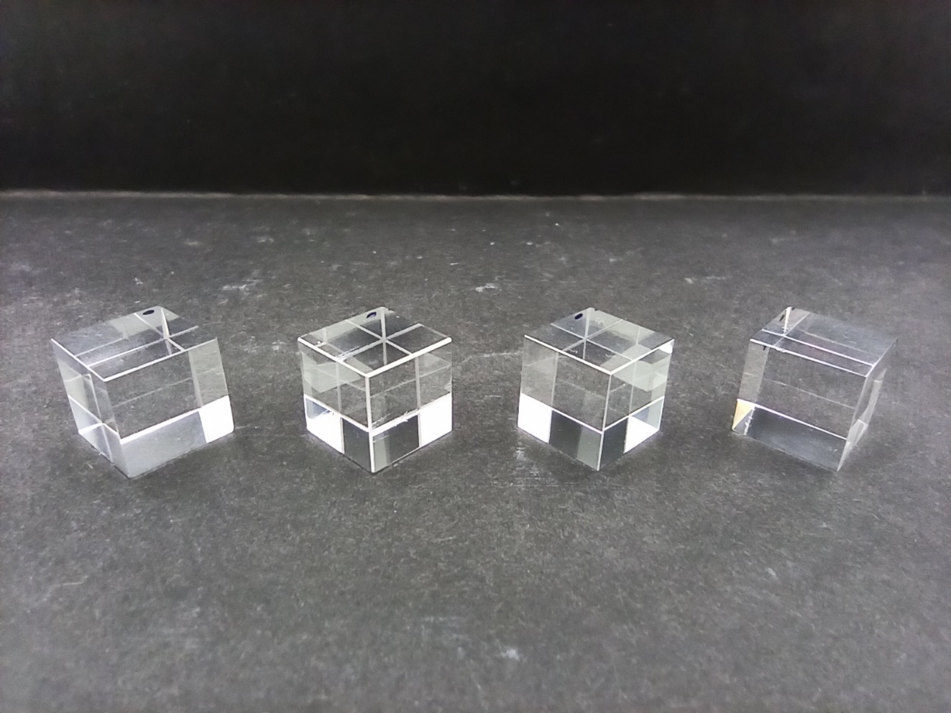
Crystal samples
We have samples from both SICCAS and BGRI (China):
BaF₂ pure crystal, 10x10x10 mm
BaF₂ crystal doped with Y (1at.%), 10x10x10 mm
BaF₂ crystal doped with Y (3at.%), 10x10x10 mm
BaF₂ crystal doped with Y (5at.%), 10x10x10 mm
and
BaF₂ pure crystal, 30x30x200 mm
BaF₂ crystal doped with Y (3at.%), 30x30x200 mm
We also expect to receive more samples from Incrom (Russia)
4

Slide 5
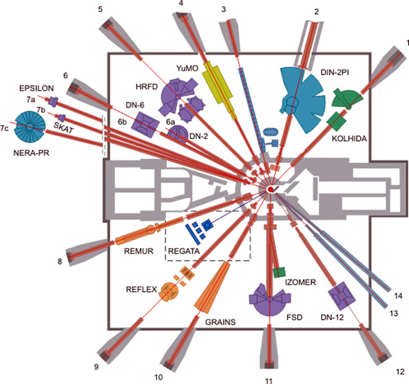
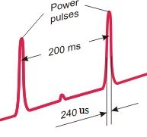
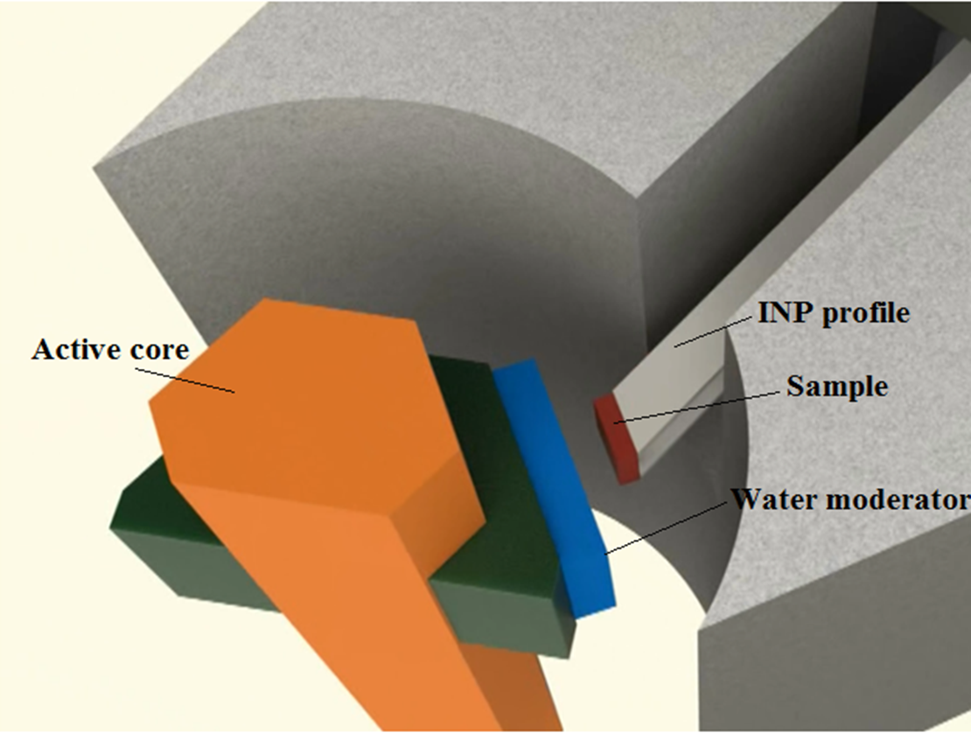
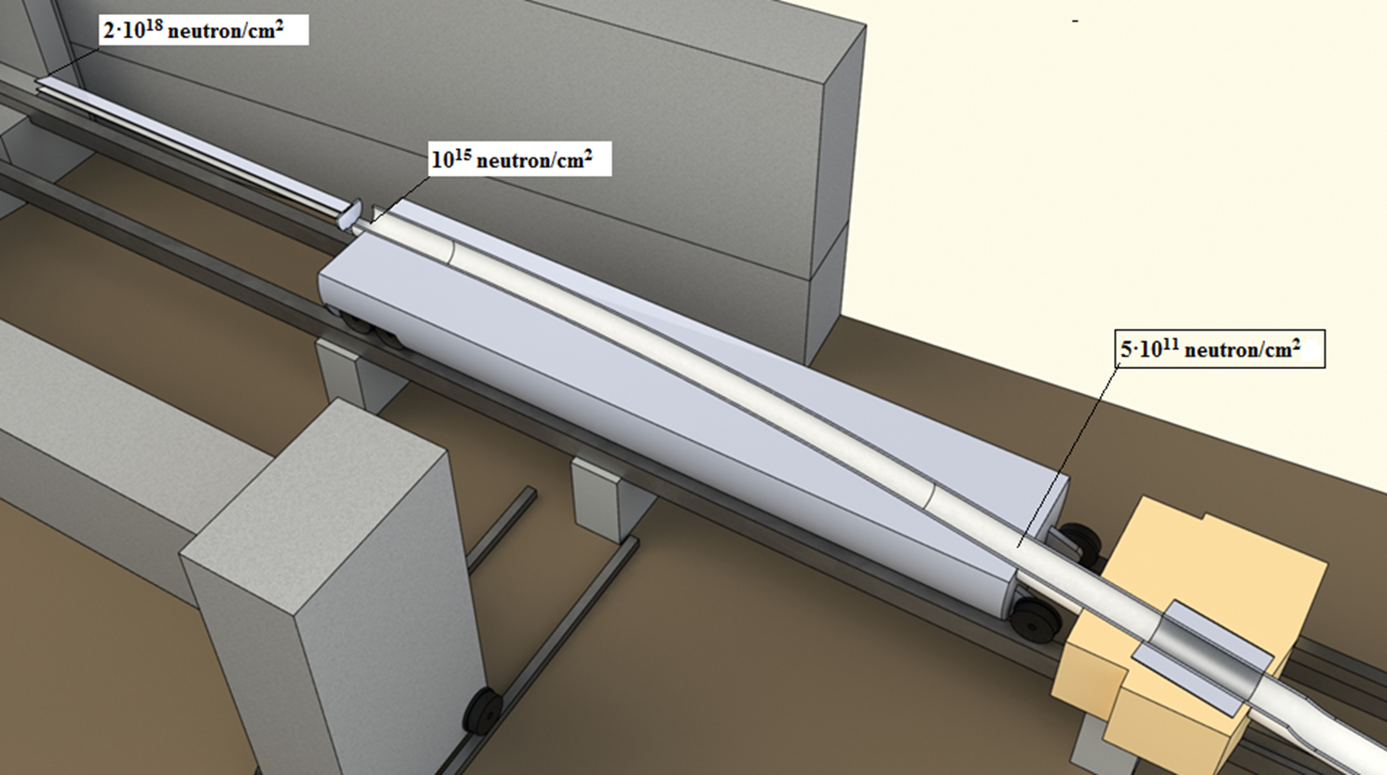
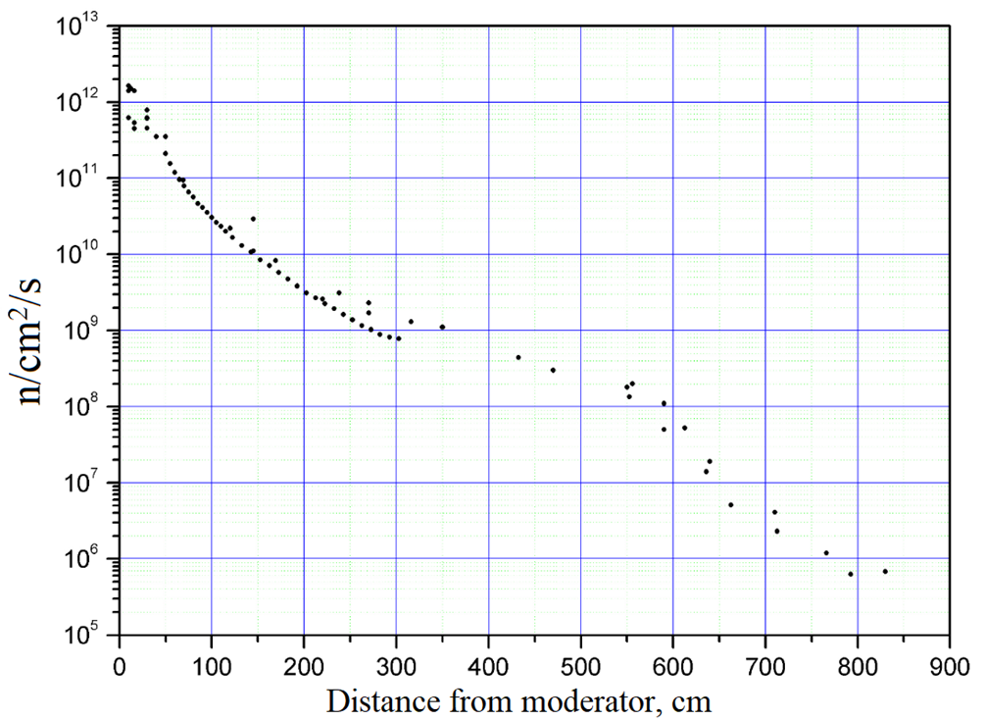
Irradiation facility at IBR-2M
Crystal samples were irradiated at the irradiation facility of the IBR-2M pulsed reactor at the Frank Laboratory of Neutron Physics, JINR (Dubna, Russia).
Typical reactor run continues 12-14 days. The reactor operates with a pulse frequency of 5 Hz with 200-300 microseconds pulse duration.
Thermal neutron flux density immediately after the water moderator is ~10¹⁶ n/cm²∙s per pulse or ~10¹³ n/cm²∙s on average over time. For 2 weeks of operation, it is possible to obtain a neutron fluence from ~10¹¹ n/cm² on the end of channel #3 up to ~10¹⁸ n/cm² next to the water moderator.
4 samples from SICCAS of 10x10x10mm were taken: pure BaF₂, BaF₂:Y(1 at.%), BaF₂:Y (3 at.%) and BaF₂:Y (5 at.%)
The samples were placed about 5 m from the water moderator. A nickel wire placed along with the samples was used to measure the fluence of the fast neutrons.
During the irradiation run, ~2.3×10¹⁴ n/cm² (E>1MeV) were passed through the samples
5

Slide 6
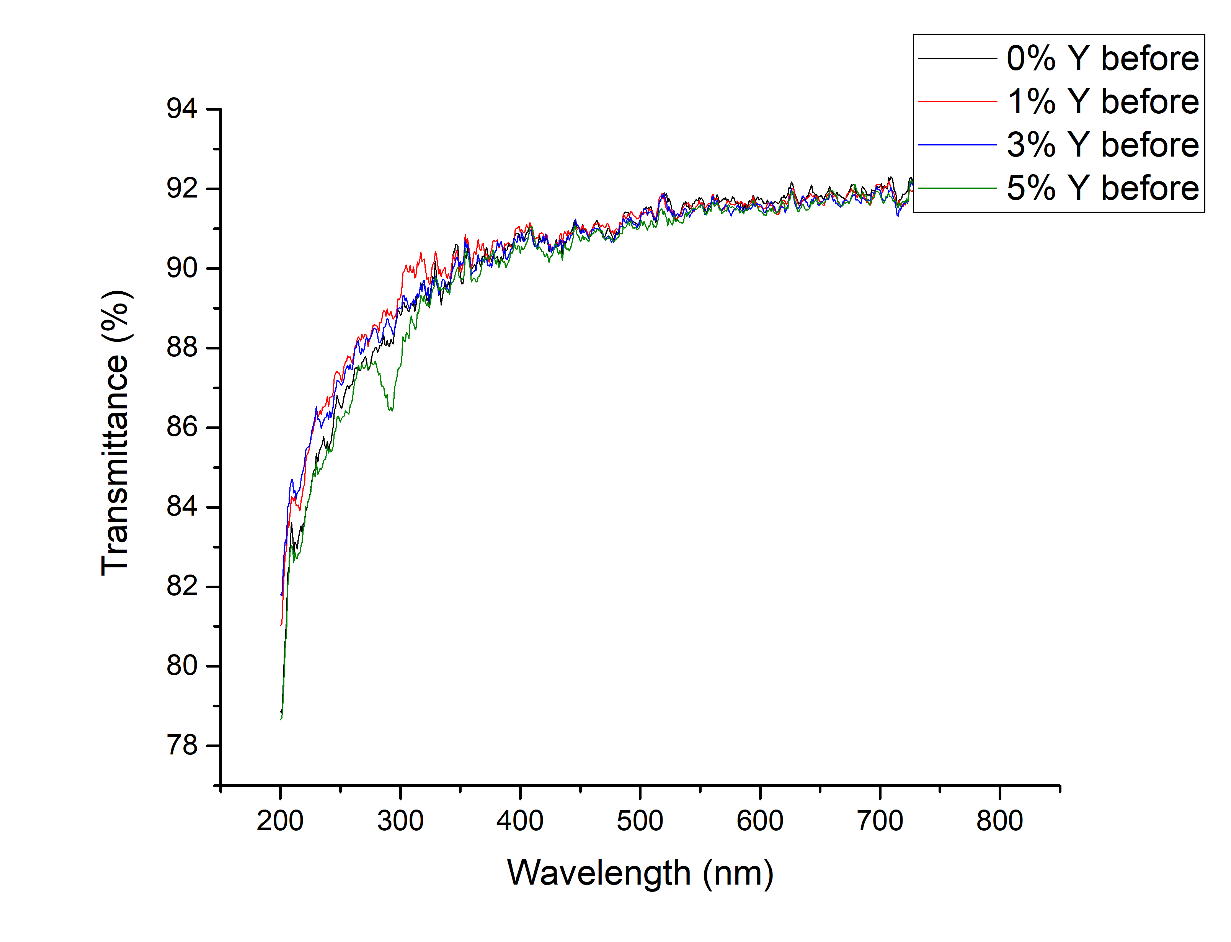
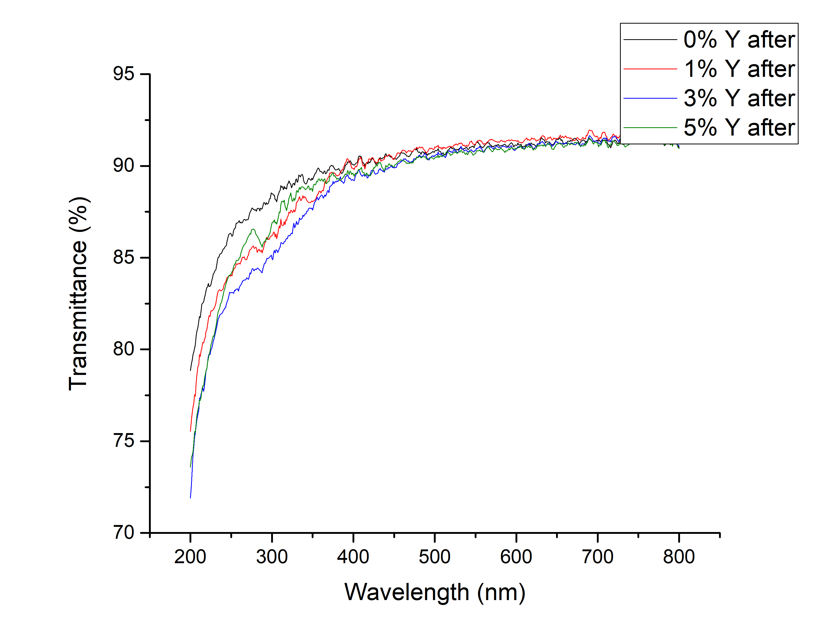
Transmittance measurements
The transmittance of the samples was measured before irradiation and 4 month later after irradiation using the SHIMADZU SolidSpec-3700 DUV spectrophotometer

Slide 7
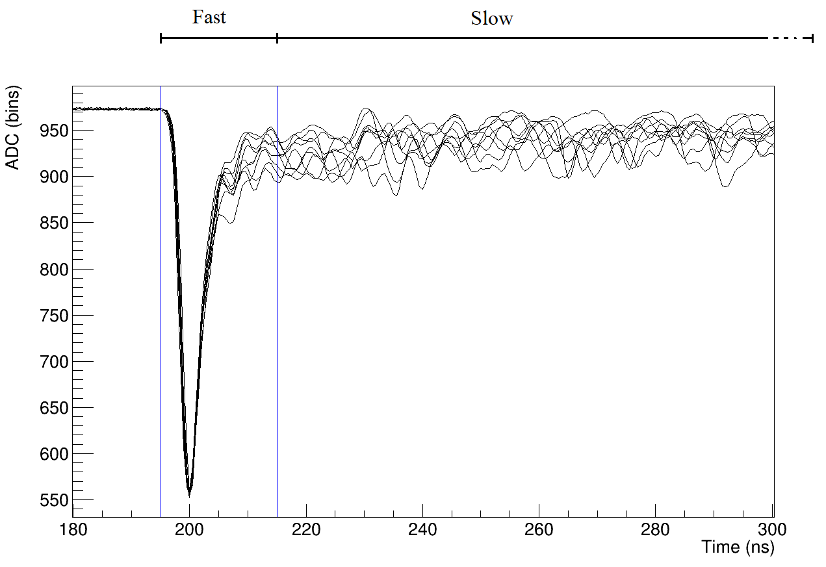
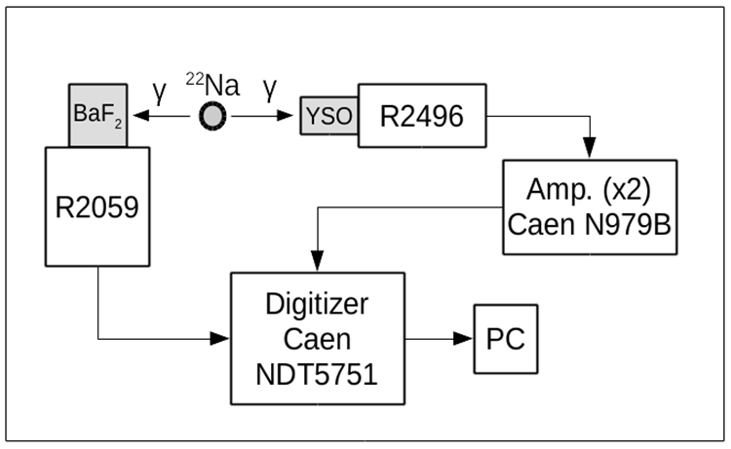
Light output measurements
Light outputs were measured by a Hamamatsu R2059 PMT with ²²Na gamma source with a coincidence trigger (E=511 keV)
Samples were wrapped with Teflon tape (2x100 micron)
No optical grease was used between samples and PMT
The total signal was integrated within 2 microseconds, while the fast component was taken within first 20 ns and the slow component – after 20 ns
The calibration was performed using a single-photoelectron peak from PMT
7

Slide 8
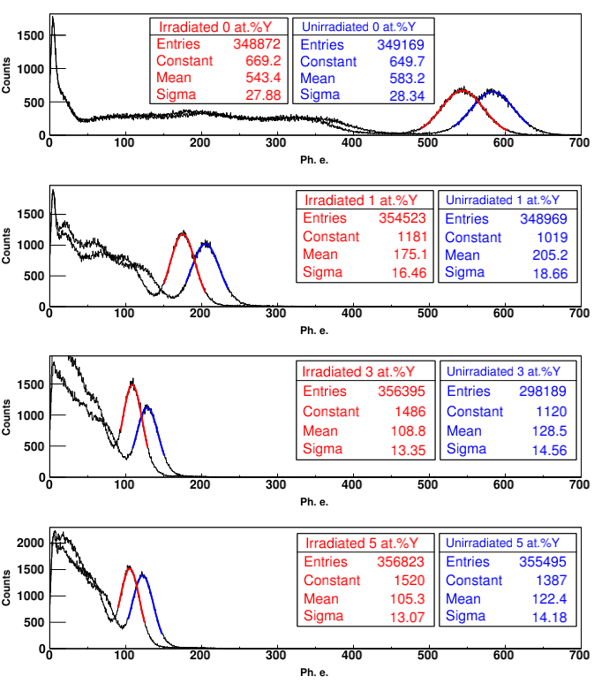
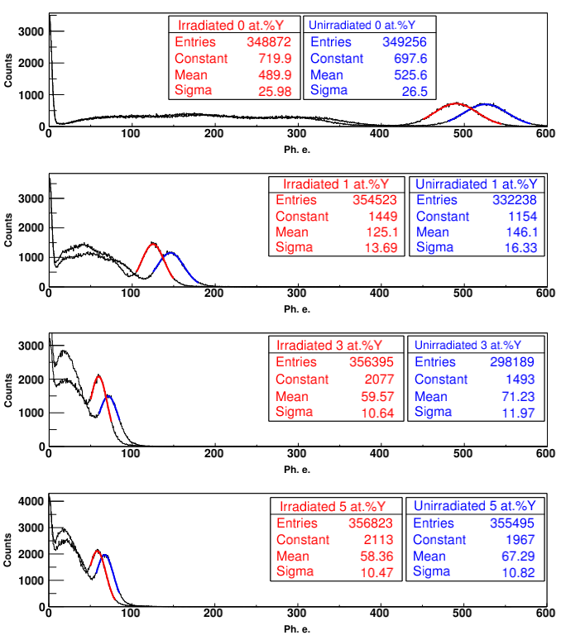
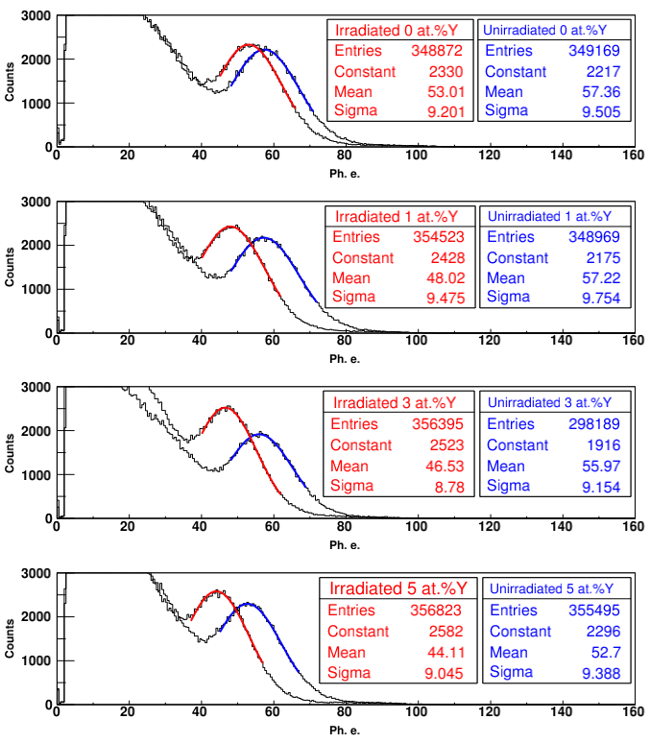
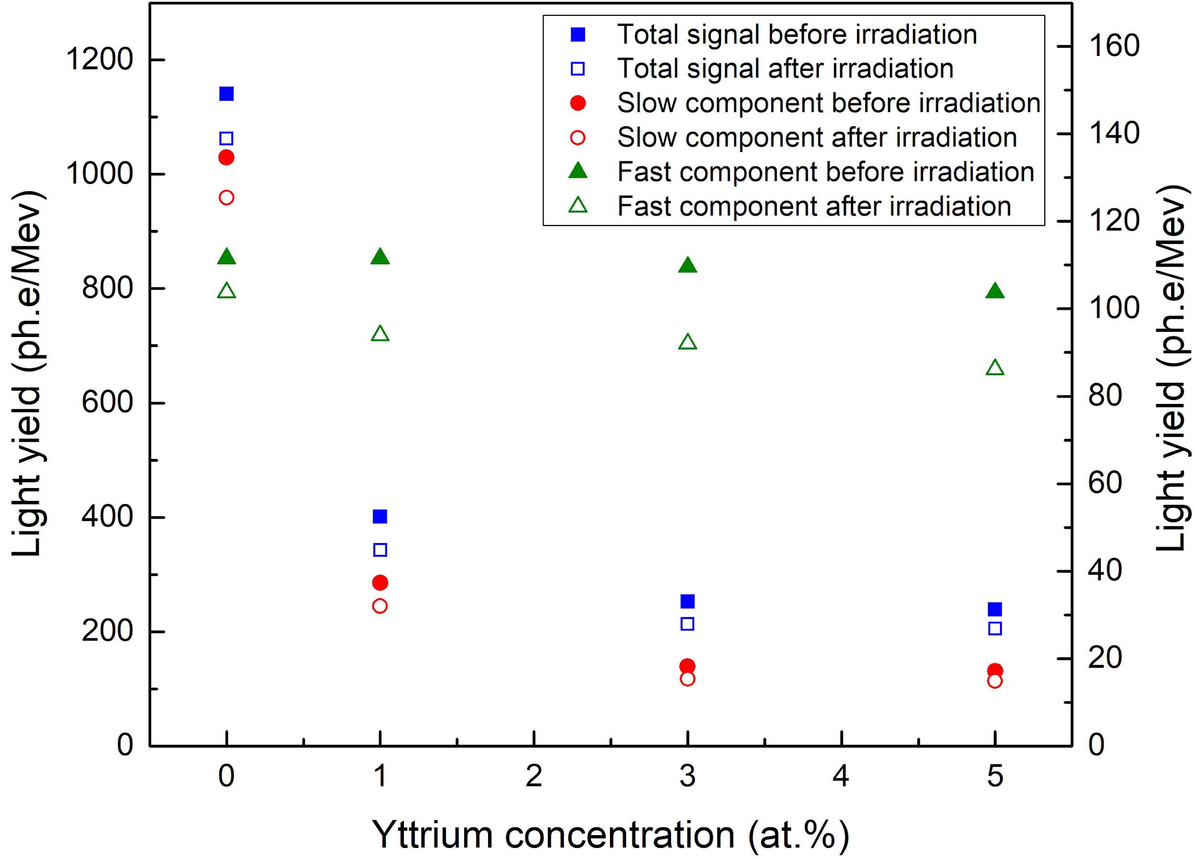
Results and discussion
Total spectra (0-2μs)
Slow component (20ns-2μs)
Fast component (0-20ns)
 | Y doping | 0% | 1at.% | 3at.% | 5at.%
Before irradiation | Total | 583±28 | 205±19 | 129±15 | 122±14
 | Slow | 526±27 | 146±16 | 71±12 | 67±11
 | Fast | 57±10 | 57±10 | 56±9 | 53±9
After irradiation | Total | 543±28 | 175±16 | 109±13 | 105±13
 | Slow | 490±26 | 125±14 | 60±11 | 58±10
 | Fast | 53±9 | 48±9 | 47±9 | 44±9
Light output (ph.e./MeV)
Light output (ph.e./MeV)

Slide 9
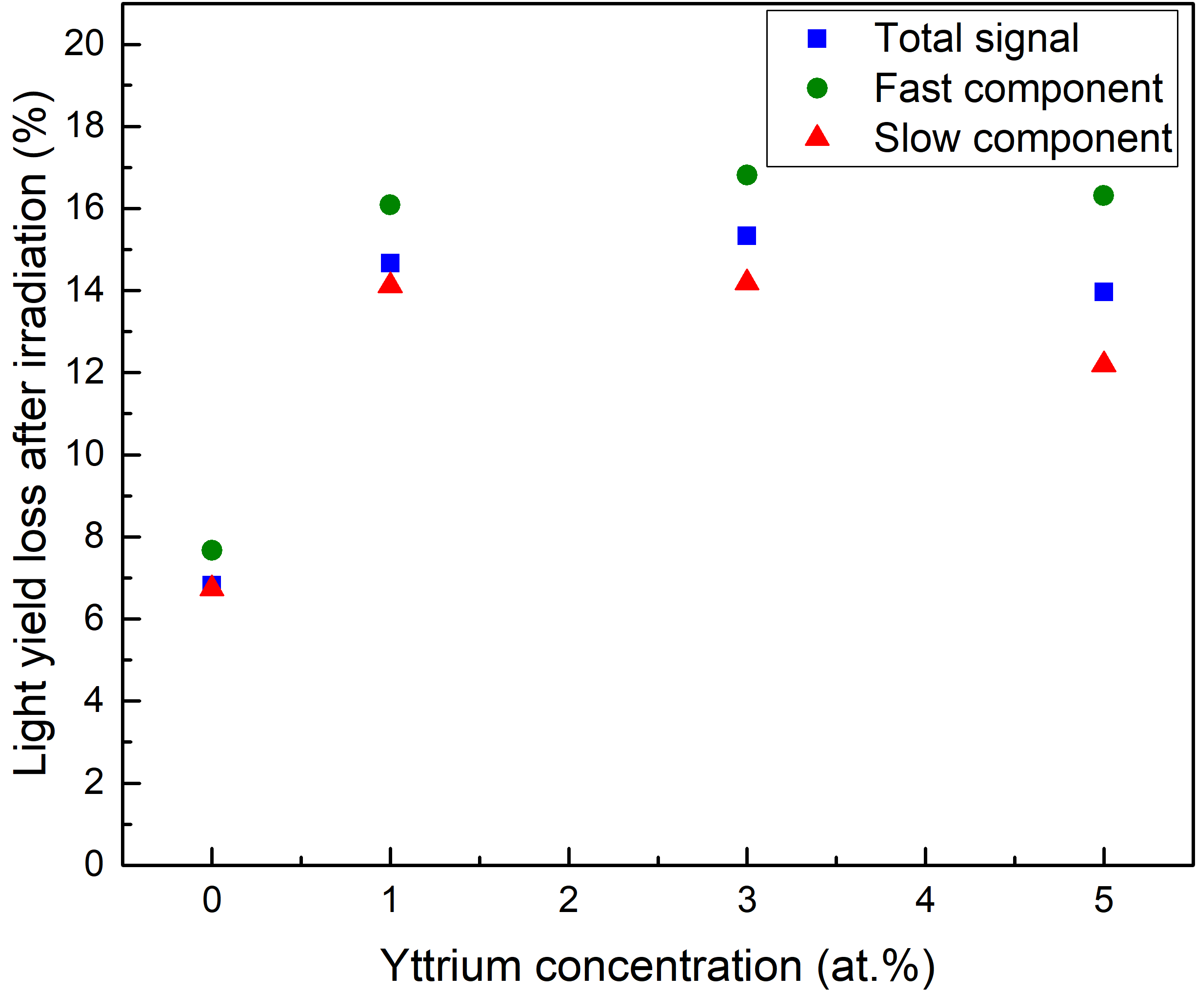
Results and discussion
The light output loss after neutron irradiation is more than twice as high for yttrium doped samples as compared to the pure BaF₂ sample
Light output loss after irradiation (%)
Y doping | 0% (pure) | 1at.% | 3at.% | 5at.%
Fast | 7.6% | 16.1% | 16.8% | 16.3%
Slow | 6.8% | 14.4% | 15.5% | 13.4%
Total | 6.9% | 14.7% | 15.3% | 14.0%
9

Slide 10
Conclusion
Light outputs of a pure BaF₂ crystal and three samples doped with yttrium in a proportion of 1at.%, 3at.% and 5at.% were measured before and after irradiation in a neutron beam.
The light output losses after neutron irradiation are almost two times higher for the yttrium doped samples compared to the losses in the pure BaF₂ sample
The light output loss of the fast component after neutron irradiation is higher compared with the slow component on all samples
Obviously, more study is required in a wider range of radiation doses.
10

Slide 11
Acknowledgments
The authors are grateful to the IBR-2M staff of the Frank Laboratory of Neutron Physics for their help in irradiating the samples
This work was partially supported by a grant from the Russian Foundation for Basic Research No. 18-52-05021
11

Slide 12
Thank you for your attention!

