Slide 1


Description of low-lying states of ⁹⁶Zr based on the collective Bohr Hamiltonian including the triaxial degree of freedom.
E. V. Mardyban,
E. A. Kolganova, T. M. Shneidman, R. V. Jolos

Slide 2
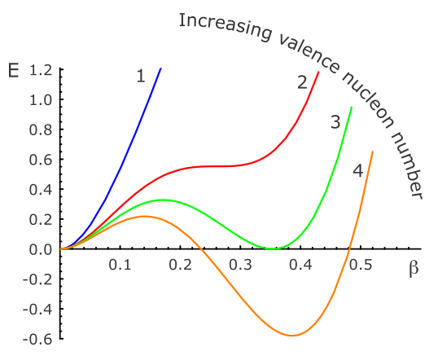
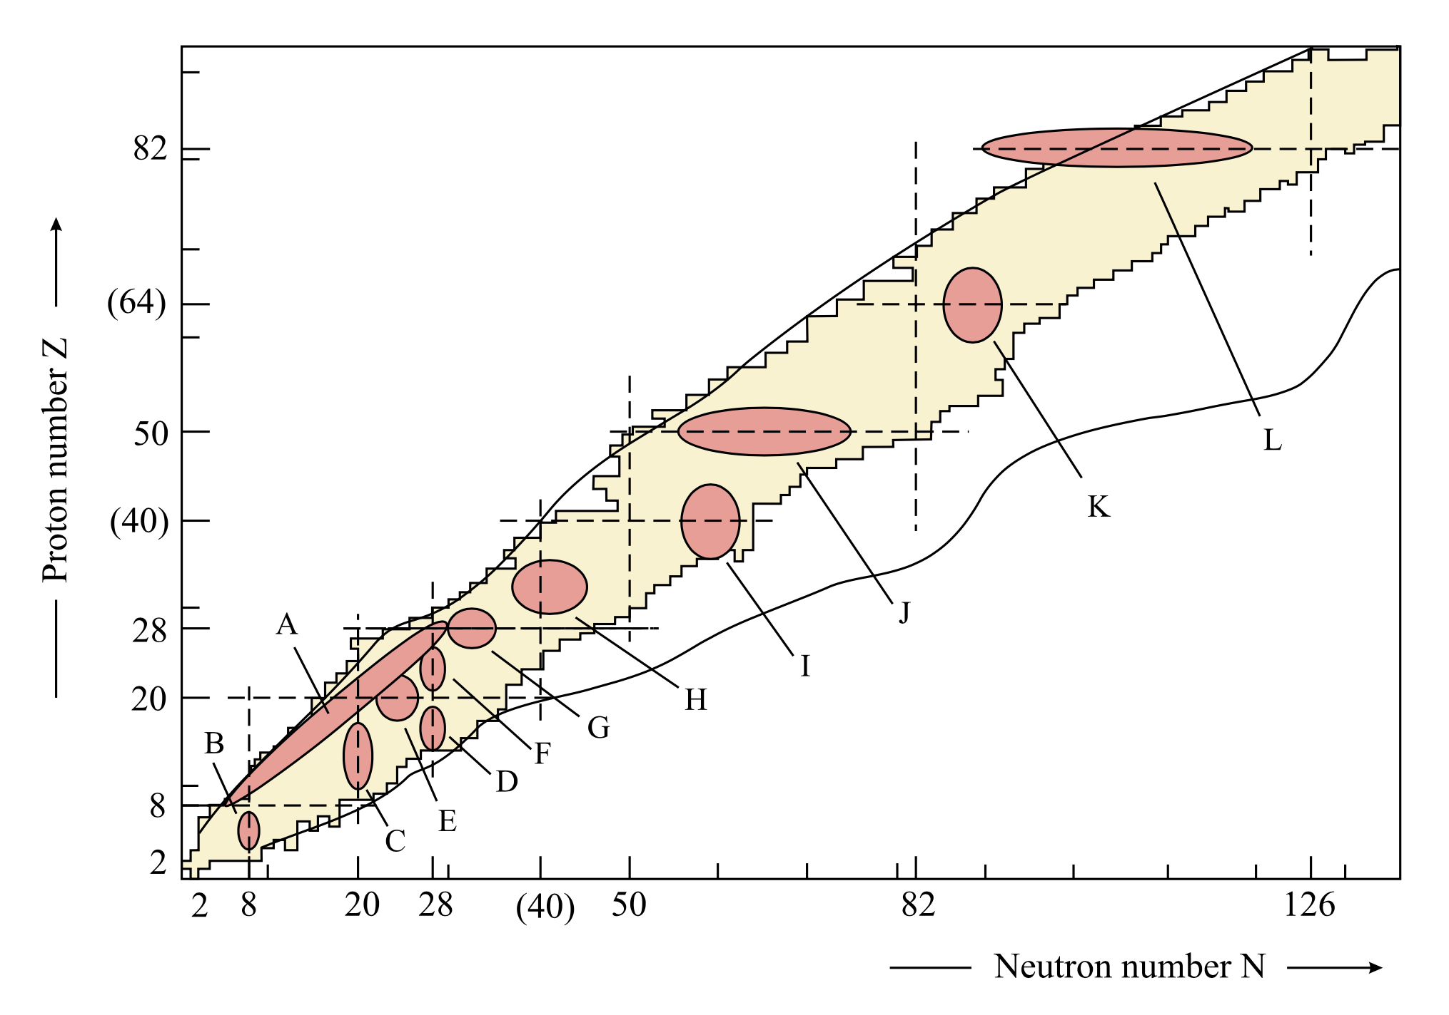
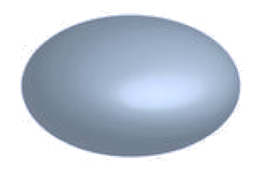
Introduction
The coexistence of forms in nuclei is an interesting phenomenon that can occur in many nuclei with increasing excitation energy, angular momentum, and number of nucleons.
A. Poves, J.Phys. G: Nucl. Part. Phys. 43, 024010 (2016).
K. Heyde, J.L. Wood, Rev.Mod.Phys. 83, 1467 (2011).
J.L. Wood, K. Heyde, W. Nazarewich, M. Huyse, and P.V. Duppen, Phys. Rep. 215, 101 (1992).
K. Heyde, P. Van Isacker, M. Waroquier, J.L. Wood, and R.A.Meyer, Phys. Rep., 102, 291 (1983).

Slide 3
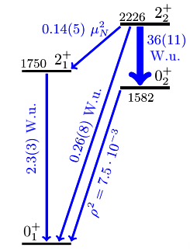
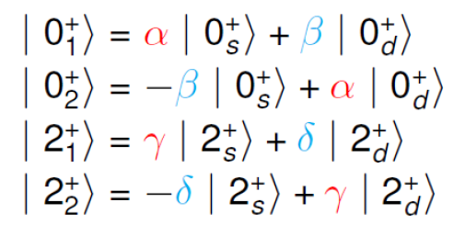
Introduction
The evolution of the shape can occur with a smooth or abrupt transition from a spherical to a deformed shape, and there can be a strong or weak mixing of configurations with different shapes. Such information is contained in the probabilities of electromagnetic transitions, and a high purity of coexisting forms was established in ⁹⁶Zr
C. Kremer et al. Phys. Rev. Lett. 117, 172503 (2016)

Slide 4
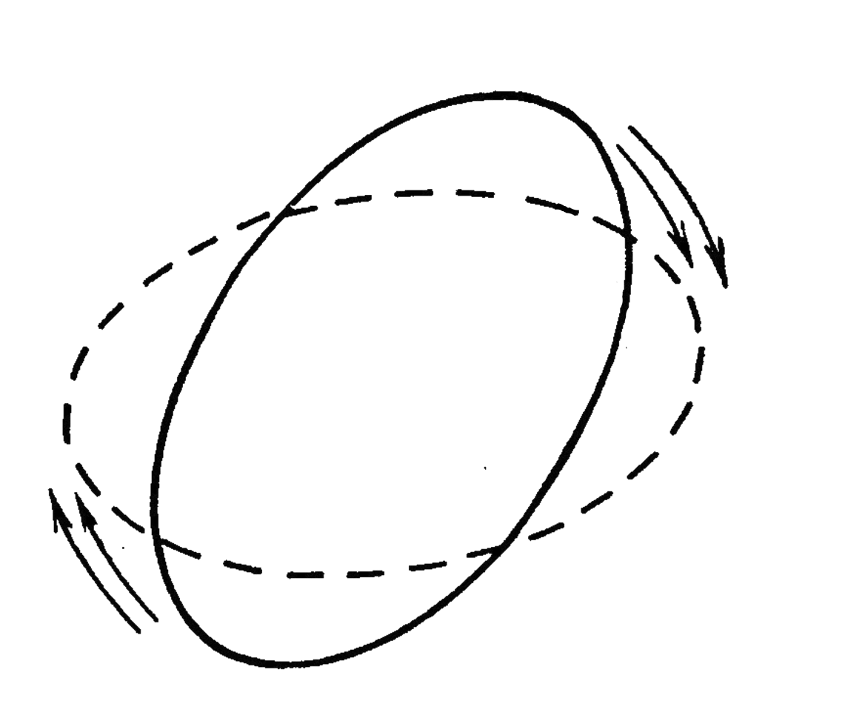
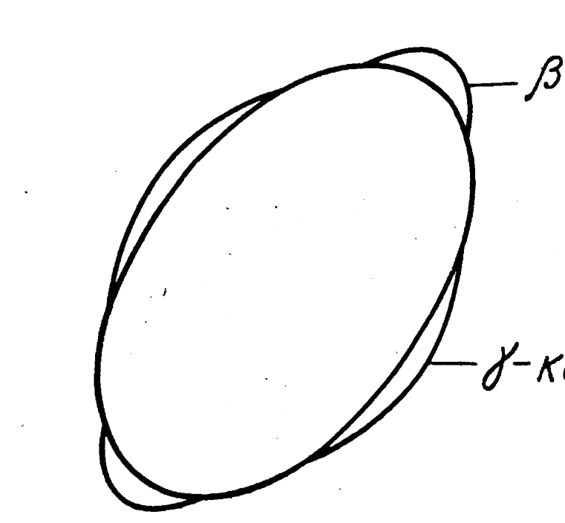
Model
Previously this problem was solved under the assumption that the γ degree of freedom can be separated from β in the potential and the value of γ is stabilized around γ=0.
The collective quadrupole Bohr Hamiltonian including axial degree of freedom can be written as :
It is assumed that the potential energy has two minima, spherical and deformed, separated by a barrier.
To find the eigenvalues of the Hamiltonian, we expand the eigenfunctions in terms of the complete set of basis functions that depend on the deformation variables β and γ and the Euler angles.
J.E. Garcia-Ramos and K. Heyde, Phys.Rev. C 43, 044315 (2019).
N. Gavrielov and A. Leviatan, Phys.Rev. C 99, 064324 (2019).
D.A. Sazonov, E.A. Kolganova, T.M. Shneidman, R.V. Jolos, N.Pietralla, and W. Witt, Phys.Rev. C 99, 031304(R) (2019).

Slide 5
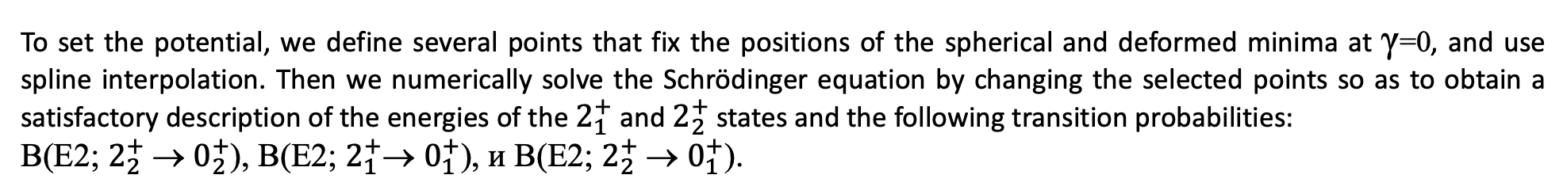
Model
Potential energy is chosen in the form
To set the potential, we define several points that fix the positions of the spherical and deformed minima at γ=0, and use spline interpolation. Then we numerically solve the Schrödinger equation by changing the selected points so as to obtain a satisfactory description of the energies of the $2_{1}^{+}$and $2_{2}^{+}$ states and the following transition probabilities:
B(E2; $2_{2}^{+}$→ $0_{2}^{+}$), B(E2; $2_{1}^{+}\text{→} 0_{1}^{+}$), и B(E2; $2_{2}^{+}$→ $0_{1}^{+}$).
Potential energy U(β) (при γ=0) (solid) in comparison with the potential energy without taking into account the
γ-degree of freedom (dashed)
Calculated potential energy V (β, γ)

Slide 6
Results
Distributions over β of squares of wave functions 0₁⁺ (solid line), 0₂⁺ (dashed line), and 0₃⁺ (dotted line) states
Wave function 0₁⁺ , 0₂⁺ and 0₃⁺ states.

Slide 7
Results
Components of the wave functions of 2₁⁺ and 2₂⁺ states with K = 0 and K = 2 times the volume element.
Distributions over β of squares of components of 2₁⁺ and 2₂⁺ states with K=0 (solid), K=2 (dashed)

Slide 8
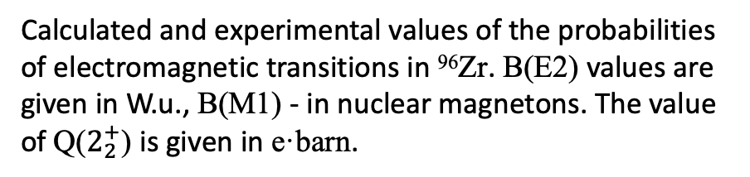
Results
Calculated and experimental values of the probabilities of electromagnetic transitions in ⁹⁶Zr. B(E2) values are given in W.u., B(M1) - in nuclear magnetons. The value of Q($2_{2}^{+}$) is given in e·barn.
Experimental data taken from
W. Witt, N. Pietralla, V. Werner, and T. Beck, Eur.Phys.J. A 55, 79 (2019)
https://www.nndc.bnl.gov/ensdf/

Slide 9
Results
Experimental (right) and calculated (left) schemes of low-lying states of positive parity ⁹⁶Zr. Experimental energies are given in keV, B(E2) transitions are given in W.u.

Slide 10
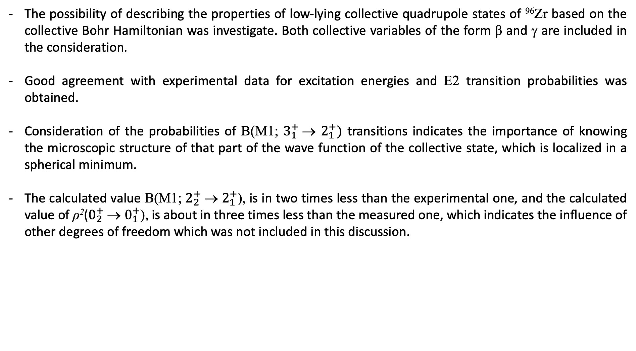
Conclusion
The possibility of describing the properties of low-lying collective quadrupole states of ⁹⁶Zr based on the collective Bohr Hamiltonian was investigate. Both collective variables of the form β and γ are included in the consideration.
Good agreement with experimental data for excitation energies and E2 transition probabilities was obtained.
Consideration of the probabilities of B(M1; $3_{1}^{+}$→ $2_{1}^{+})$ transitions indicates the importance of knowing the microscopic structure of that part of the wave function of the collective state, which is localized in a spherical minimum.
The calculated value B(M1; $2_{2}^{+}$→ $2_{1}^{+}$), is in two times less than the experimental one, and the calculated value of ρ²($0_{2}^{+}$→ $0_{1}^{+}$), is about in three times less than the measured one, which indicates the influence of other degrees of freedom which was not included in this discussion.
The main results of this work are included in
E. V. Mardyban, E. A. Kolganova, T. M. Shneidman, R. V. Jolos, and N. Pietralla
Phys. Rev. C 102, 034308 (2020)
Thank you for attention!

