Slide 1
Online Logbook System for the NICA experiments
A. Chebotov, K. Gertsenberger, I. Slepov A. Moshkin
Veksler and Baldin Laboratory of High Energy Physics, JINR

Slide 2
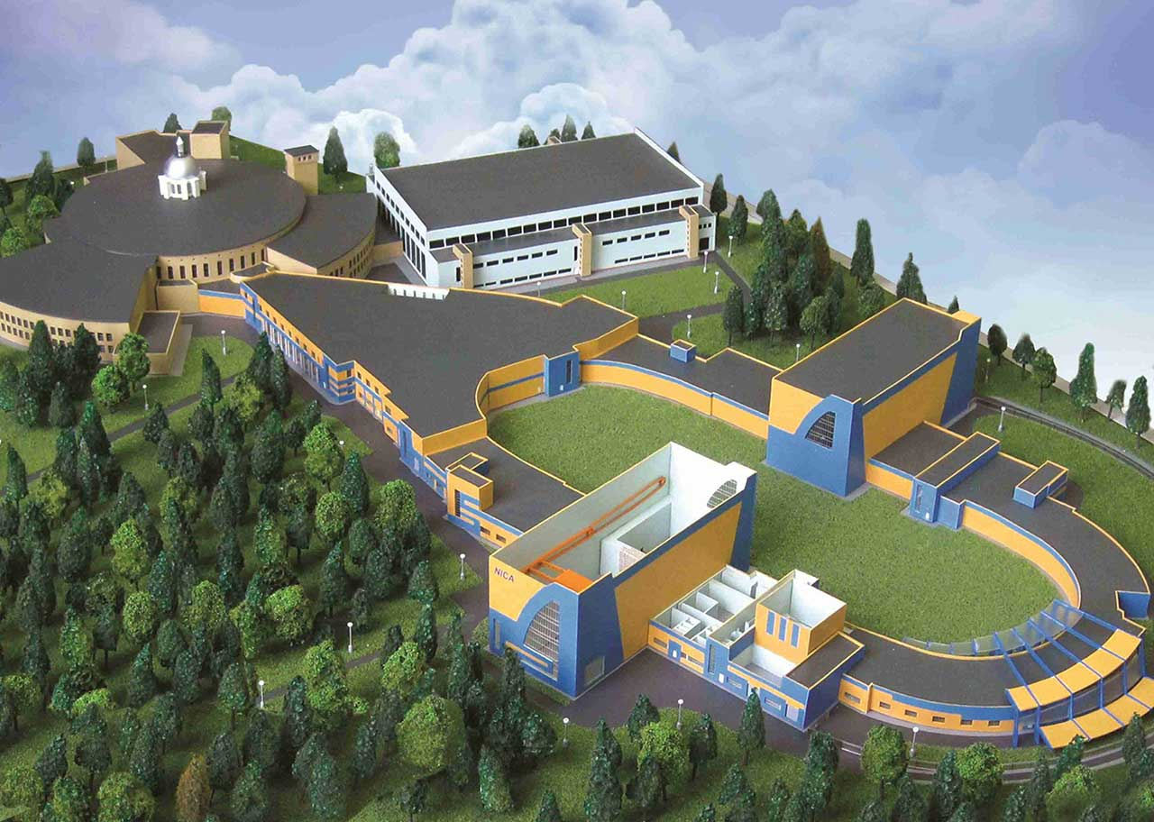
Nuclotron-based Ion Collider fAcility
BM@N
Nuclotron
SPD
MPD
Beams: from $d^{↑}, C$to${Au}^{79+}$
Fixed target experiment: BM@N (2018)
Official site: bmn.jinr.ru
Trigger rate: up to ${5∗10}^{5}$($2022−2023$)
Collision energy: $E_{lab}$ = 1 – 6 AGev
10 November 2020
2

Slide 3
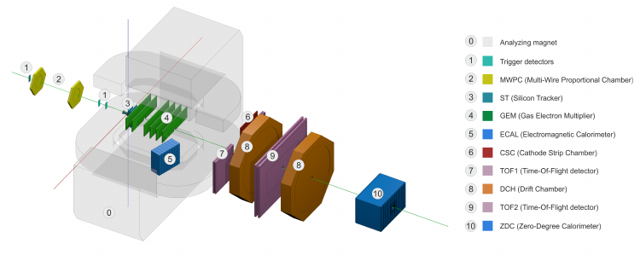
Baryonic Matter @ Nuclotron
BM@N Sessions (2015 – 2018)
Session №51 (d,C) Feb. 22 – Mar. 15, 2015
Session №52 (d) June 29 – June 30, 2016
Session №53 (d, $d^{↑}$) Dec. 9 – Dec. 23, 2016
Session №54 (C) Mar. 7 – Mar. 18, 2017
Session №55 (C,Ar,Kr) Mar. 3 – Apr. 05, 2018
10 November 2020
3

Slide 4
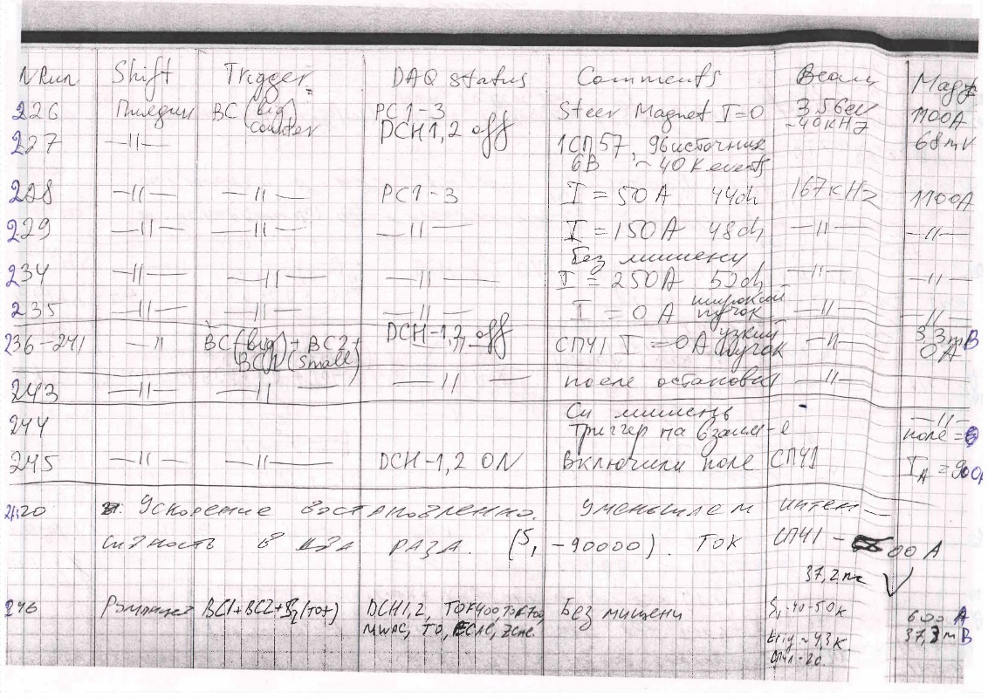
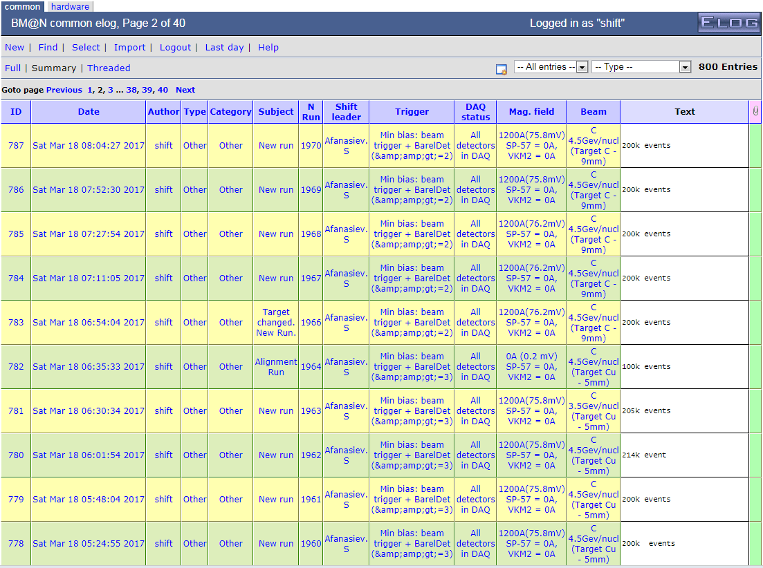
Old Versions of the Logbook
Old Versions of the Logbook
10 November 2020
4

Slide 5
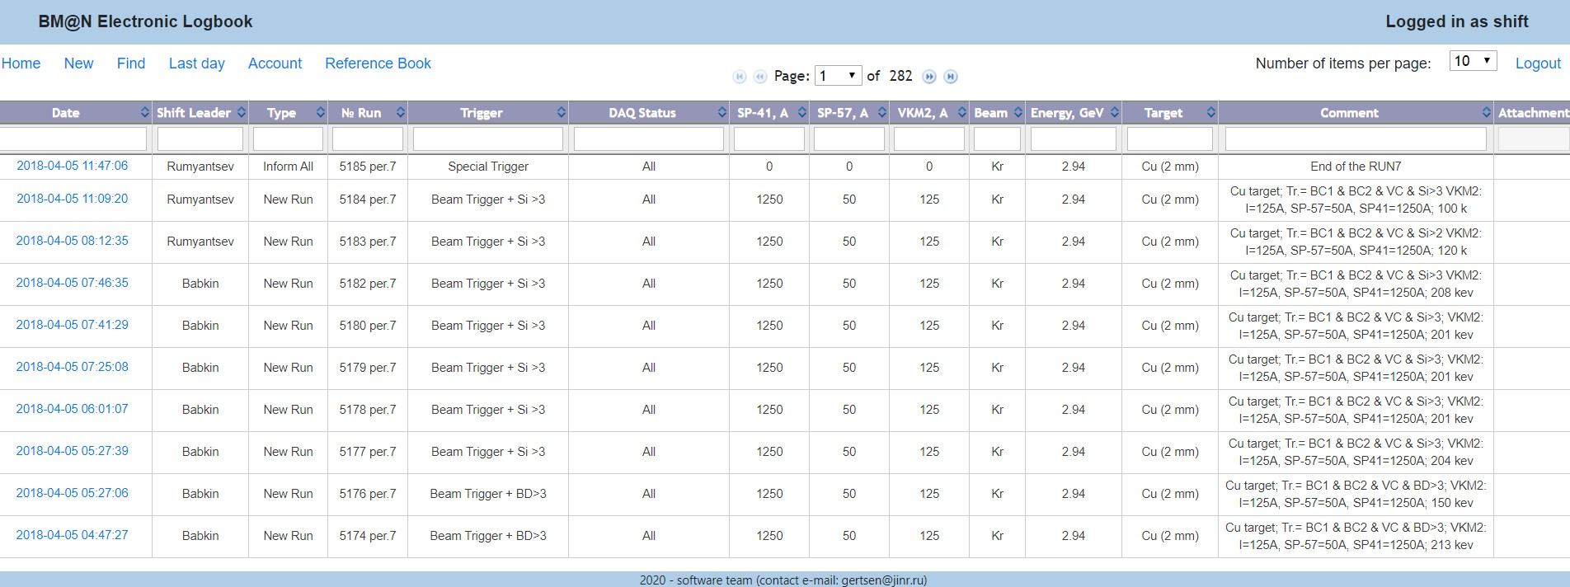
Current version of the logbook: e-Log platform
Create a
new run
Current
day records
Work with
dictionaries
Number of records per page
Username
Advanced find
User
Cabinet
Page number
Fast
search
10 November 2020
5

Slide 6
Electronic Logbook
What is an e-Log and why is it needed?
The online electronic logbook allows shift members to record information on current events, states of various systems, operation conditions of detectors., which are further used in processing and physics analysis of the particle collision events.
The system provides collaboration members with tools for convenient viewing, managing and searching for the required information in the logbook.
10 November 2020
6

Slide 7
e-Log platform
The e-Log platform uses a developed Logbook Database based on PostgreSQL.
The e-Log uses the Database to store the experiment logbook data, ensure correct multi-user access, data consistency, integrity and provide automatic regular data backup for cases of software errors or hardware failures.
Developed interfaces provides an unified access to required logbook data for various online and offline systems, such as: BmnRoot and Online Monitoring
A part of e-Log data is automatically transferred to the Unified Database of the experiment to use in offline event analysis.
10 November 2020
7

Slide 8
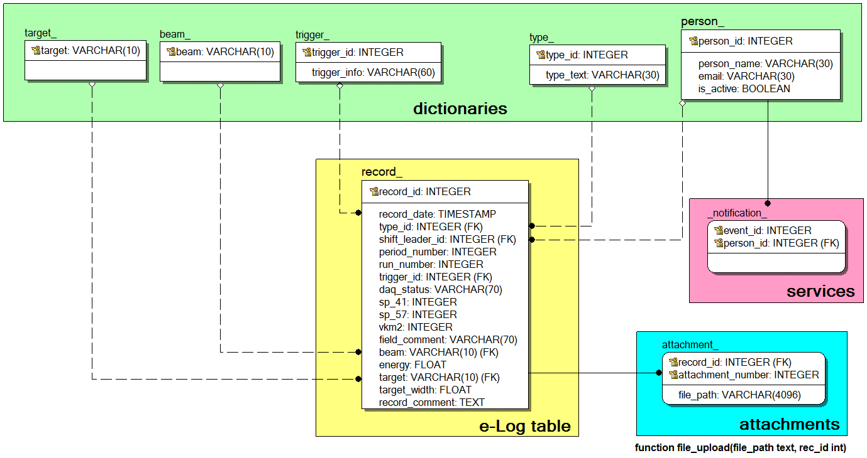
e-Log database scheme
The main table with all logbook records (record_ table located in the center of the figure) uses the following set of dictionaries:
a dictionary of all possible beam particles;
a dictionary of all possible targets;
a dictionary of all possible trigger types;
a dictionary of record types: ‘shift started’, ‘problem report’, ‘configuration’, ‘new run’, etc.
a list of the collaboration members.
10 November 2020
8

Slide 9
e-Log: Authentication/Authorization service
Three-step process
Identification
Authentication
Authorization
Identification happens when a user claims an identity.
That is the authentication process: verifying a claimed identity.
This stage provides access to functions the service (system) depending on access only do what you have permissions
Access control systems grants access to resources only to users whose identity has been proved and having the required permissions.
10 November 2020
9

Slide 10
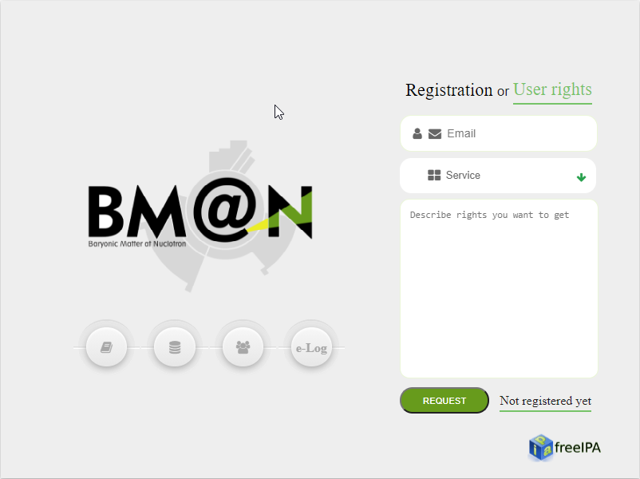
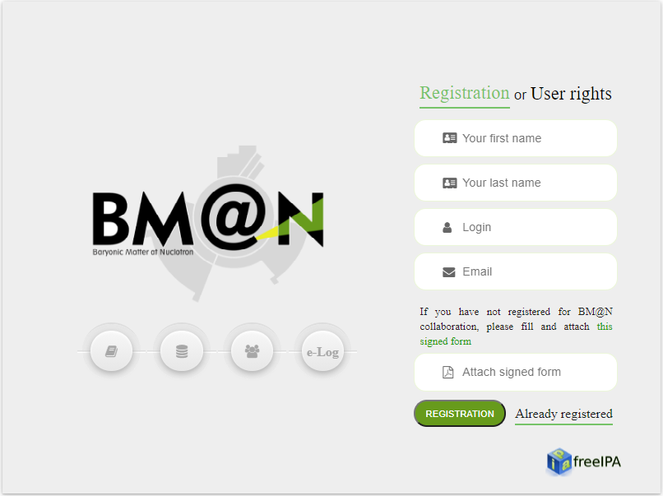
e-Log: Authentication/Authorization service
10 November 2020
10

Slide 11
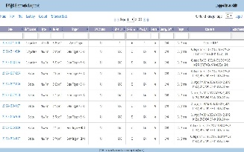
e-Log: Access scheme
admins
shift
operators
users
Web
interface
Database
10 November 2020
11

Slide 12
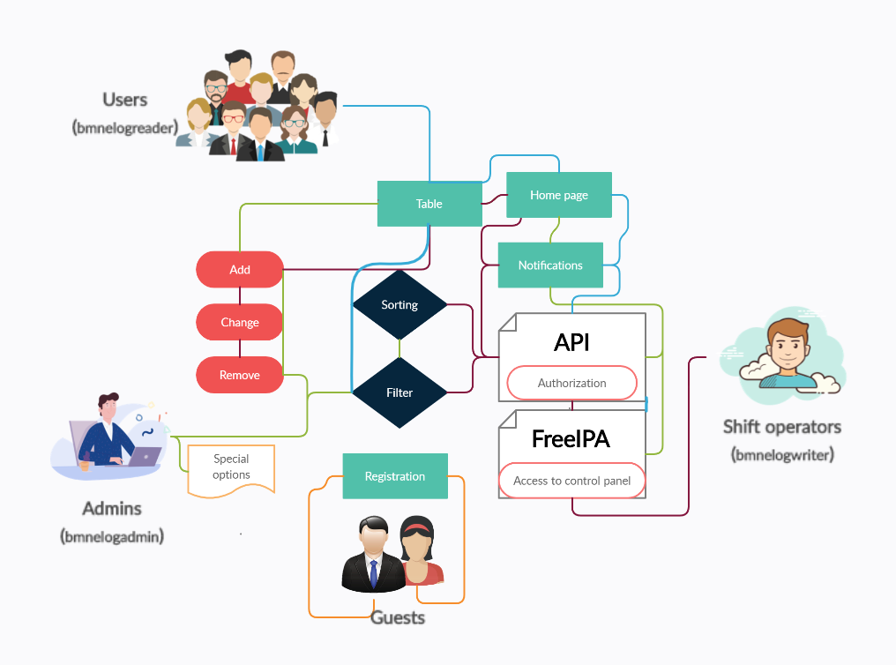
e-Log: Group users
10 November 2020
12

Slide 13
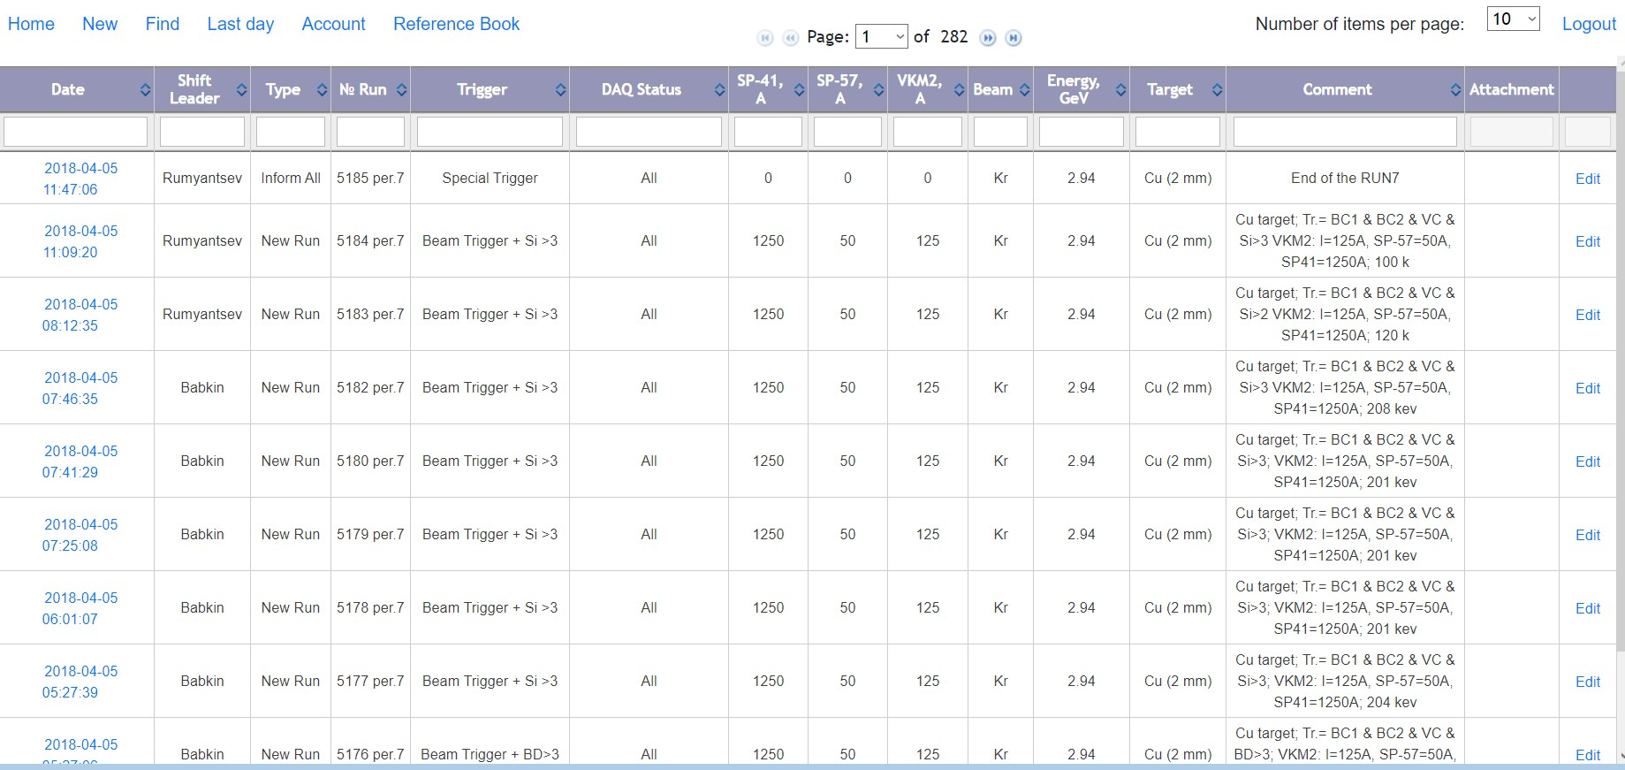
e-Log: Functions
Administrator access
10 November 2020
13

Slide 14
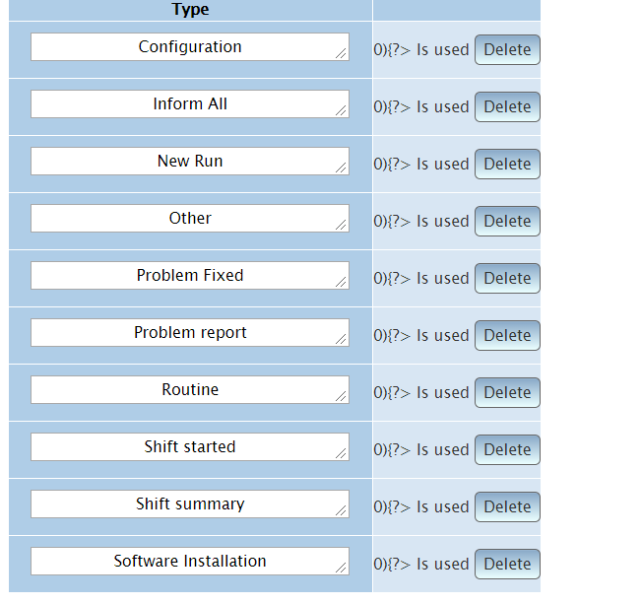
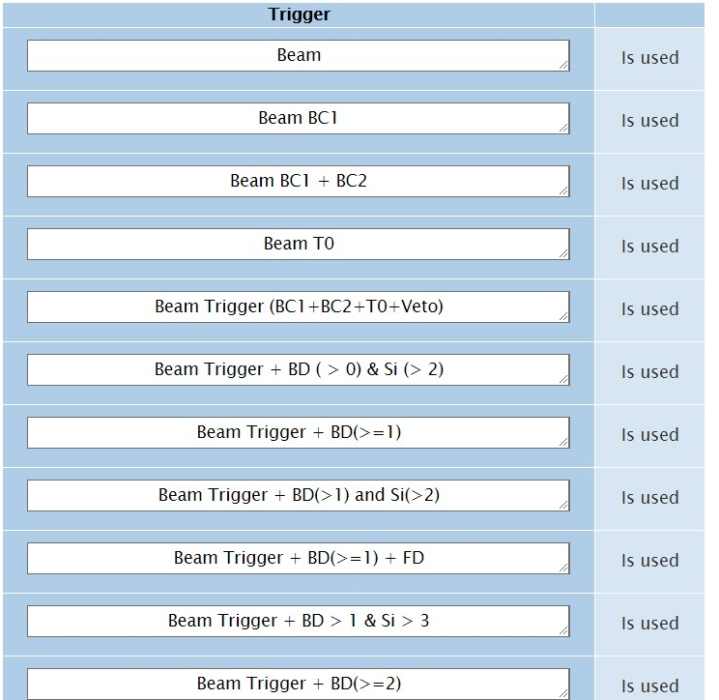
e-Log: Functions
Dictionary of record types
Dictionary of used triggers
Advanced administrator settings
10 November 2020
14

Slide 15
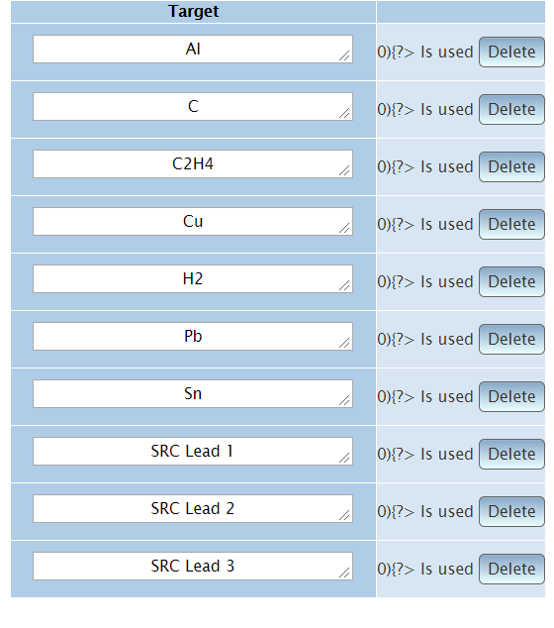
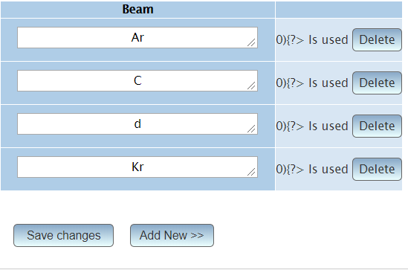
e-Log: Functions
Dictionary of targets
Dictionary of beam particles
Advanced administrator settings
10 November 2020
15

Slide 16
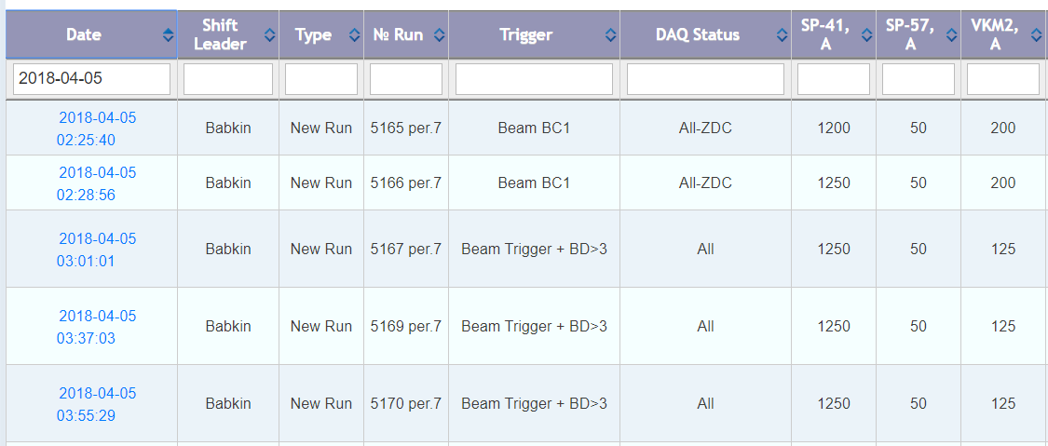
e-Log: Functions
Sort data by selected parameters and Fast data filtering
Before
After
10 November 2020
16

Slide 17
e-Log: Last day
is a useful feature during Runs
There is a table of current day events for shift operators.
10 November 2020
17

Slide 18
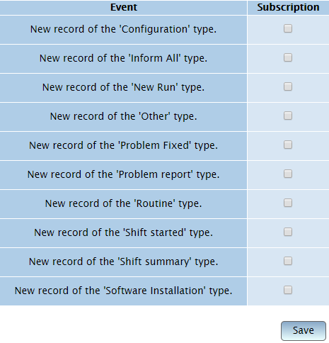
e-Log: Account
In your account you can subscribe to the email notifications for selected types of occurred events
10 November 2020
18

Slide 19
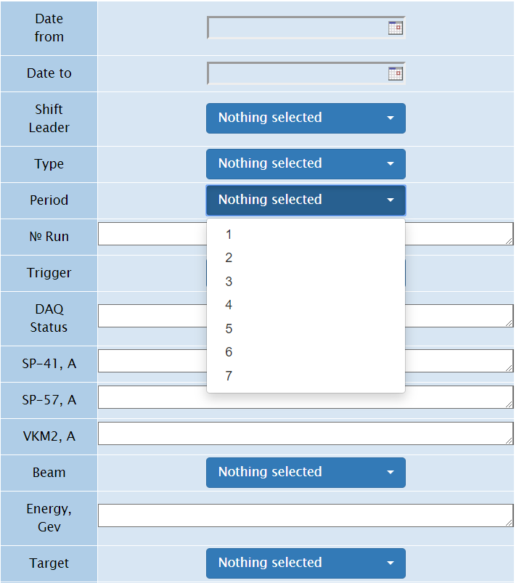
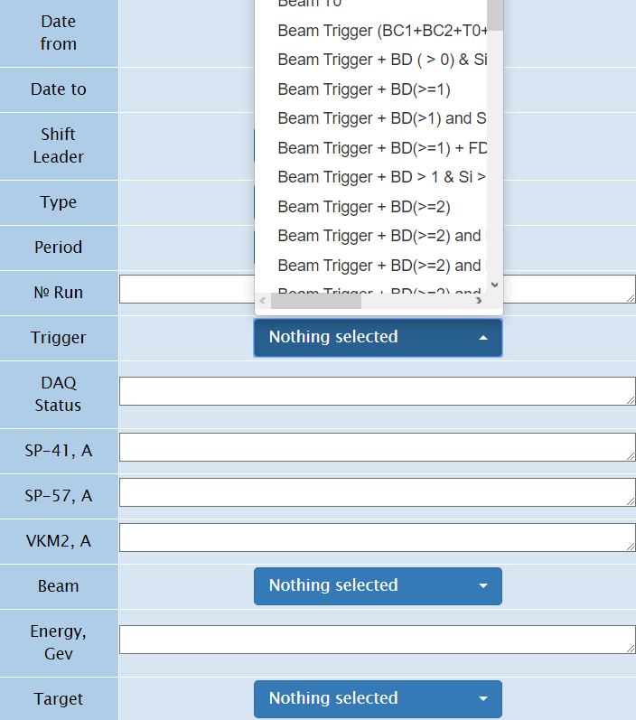
e-Log: Functions
Advanced filtering
10 November 2020
19

Slide 20
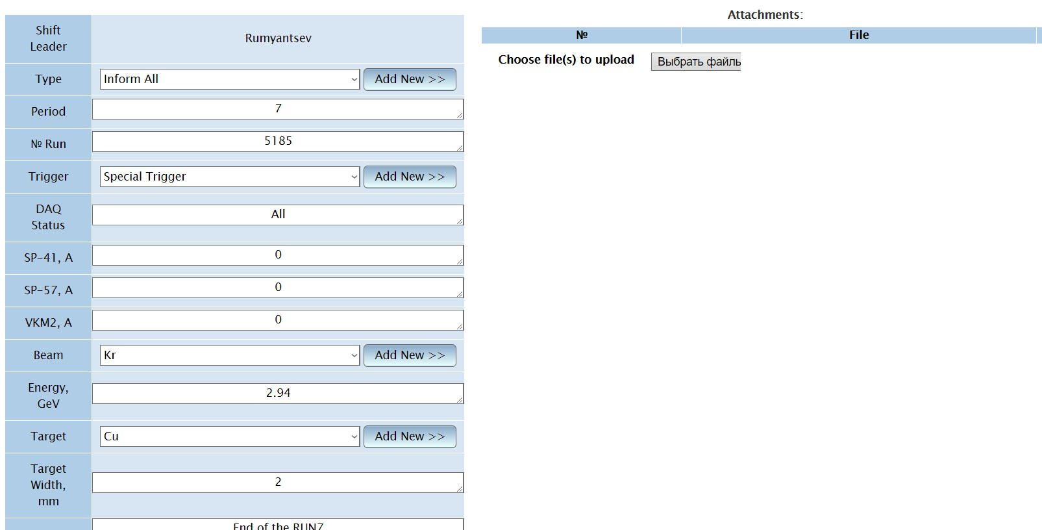
e-Log: Functions
Only users belonging to the administrator role or shift operators can create or change records.
10 November 2020
20

Slide 21
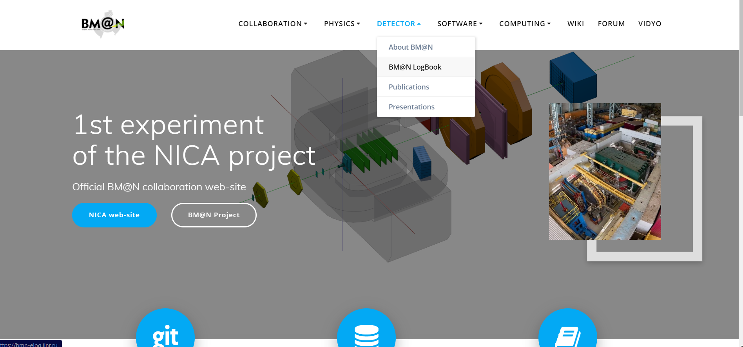
e-Log on the BM@N official Web site
https://bmn.jinr.ru/
10 November 2020
21

Slide 22
Summary
e-Log platform is an information system for viewing, modifying and visualizing the information on the BM@N experiment sessions for shift crews. The Electronic Logbook stores the information on events and problems occurred in the experiment during its operation.
The e-Log system uses the developed Logbook Database based on PostgreSQL which ensures data consistency, integrity and automatic backup of the stored data.
The platform integrates access control functions using the FreeIPA system.
RFBR support with the NICA three-year grant (№18-02-40125) enables to improve the online Electronic Logbook system, which is used in online and offline data processing.
10 November 2020
22

Slide 23
Thank you for your attention!
10 November 2020
23

