Slide 1
Gleb Olegovich Kosheev^{1,2} Ján Buša Jr.^{2,3}
¹Institute of System Analysis and Management, Dubna University, Russia
²Laboratory of Information Technologies, JINR, Dubna, Russia
³Institute of Experimental Physics, SAS, Košice, Slovakia
AYSS-2020, Dubna
11.11 .2020

Slide 2
Problem Formulation
We have program that calls some computationally intensive function many times for the same arguments
Propose the solution for saving and reusing intermediate results of this function
Implement proposed solution using C++
Compare time of proposed method to calculations without cashing

Slide 3
AVL Tree
Search: O(log N)
Insert: O(log N)

Slide 4
Function f₁(k)
Function f₂(k₁,k₂,k₃,….,k_{m-1},k_{m})
k – function argument
Implement AVL tree
Replace calculation in f₁ by search from AVL tree
k – array of arguments
m – amount of arguments of function
Our structure (AVL’s tree leaf) will contain several variables: data – stores argument
result – stores result of function
left, right – pointers to leaves

Slide 5
AVL Tree + Linked List = = Linked List of Trees (LLT)
AVL Tree
Linked List

Slide 6
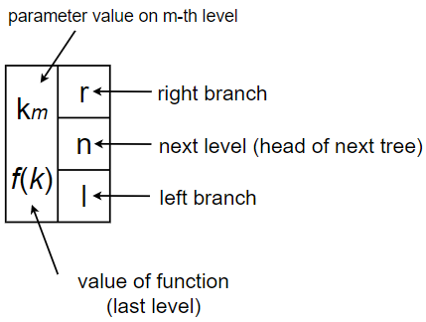
Detailed Example of LLT for Function of m=3 Parameters
Insert: O(m log N) Search: O(m log N)

Slide 7
Performance Comparison
Calculations: 56 minutes
LLT: 10.5 minutes (81.1% faster)
Calculations: GNU FORTRAN LLT: GNU FORTRAN and g++

Slide 8
Multithreaded Search with OpenMP
Time acceleration (compared to LLT)
LLT (amount of threads)
LLT (2) – 5.5%
LLT (3) – 7.7%
LLT (4) – 8.5%
LLT (6) – 7.3%

