Slide 1
Local strategy of particle tracking with TrackNETv2 on the BES-III CGEM inner detector
Anastasiya Nikolskaya, Egor Shchavelev, Pavel Goncharov, Gennady Ososkov, Yury Nefedov, Alexey Zhemchugov, Igor Denisenko, Olga Bakina Saint Petersburg State University, JINR
The reported study was funded by RFBR and NSFC according to the research project № 19-57-53002
Notes:
Good afternoon, everyone, my name is Anastasiya Nikolskaya, and i am 2 year master student at SPBU. My presentation is about a part of big research project of JINR, SPBU and Bejing high energy physics institute. As mentioned before, neural networks are very succesfull method for charged particle track reconstruction. One of the possible strategies is track-by-track or local strategy, wich i will introduce you in this presentation.

Slide 2
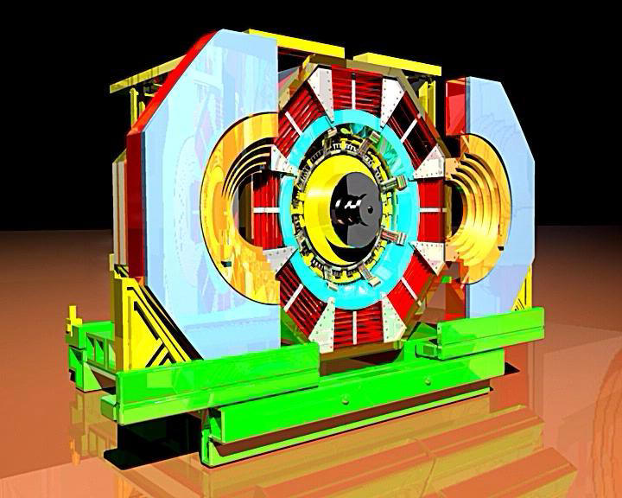
Contents
Tracking overview
BESIII and its inner tracker
Events in BESIII experiment
Previous work: TrackNETv2
Improved approach
Results for the GEM-detector
12.11.2020
AYSS-2020: A.Nikolskaya et al. Local tracking with TrackNETv2 on the BES-III
Notes:
I will tell you about experiment and its inner detector,our previous model tracknet_v2 and its generalisation for bes 3
After all, i will give you some results of evaluation

Slide 3
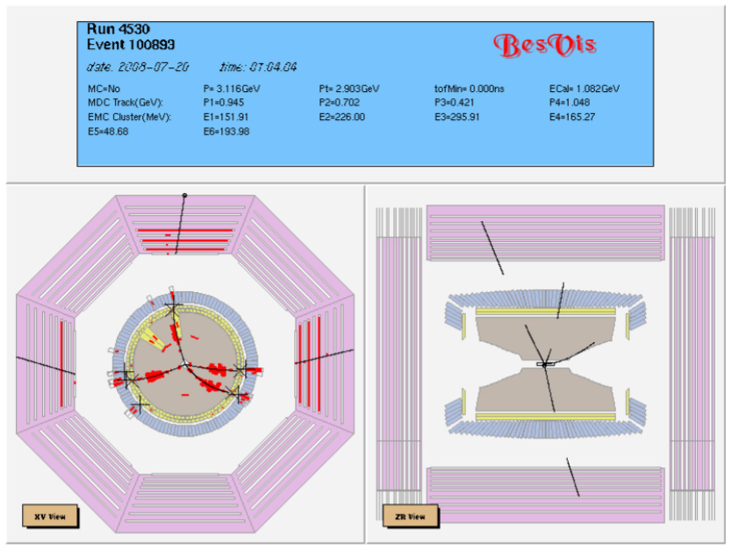
BESIII
Located in Beijing
Electron-positron collisions (e+,e-)
The average number of tracks varies from 2 to 10 depending on the energy and type of interaction
12.11.2020
AYSS-2020: A.Nikolskaya et al. Local tracking with TrackNETv2 on the BES-III
Notes:
BESIII~\cite{Ablikim:2009aa} is a particle physics experiment running on $e^+e^-$ collider BEPCII at Institute of High-Energy Physics in Beijing.
Each $e^+e^-$ collision produces up to 20 charged particles. The average number of tracks varies from 2 to 10 depending on the energy and type of interaction.

Slide 4
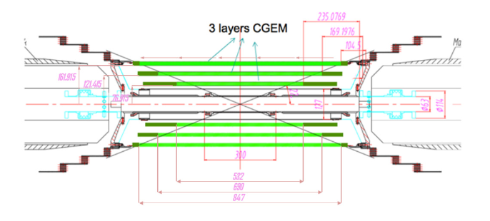
CGEM
Inner detector of experiment (Project)
Beams of electrons collide with each other inside the CGEM-IT
Practically all charged particles born in the interaction are detected
BESIII CGEM Monte-Carlo simulation followed by a clustering algorithm was used to reconstruct CGEM hits in our work
12.11.2020
AYSS-2020: A.Nikolskaya et al. Local tracking with TrackNETv2 on the BES-III
Notes:
CGEM - is the main detector of experiment and is still under construction, hence we need to use Monte-Carlo simulation for reconstruction.

Slide 5
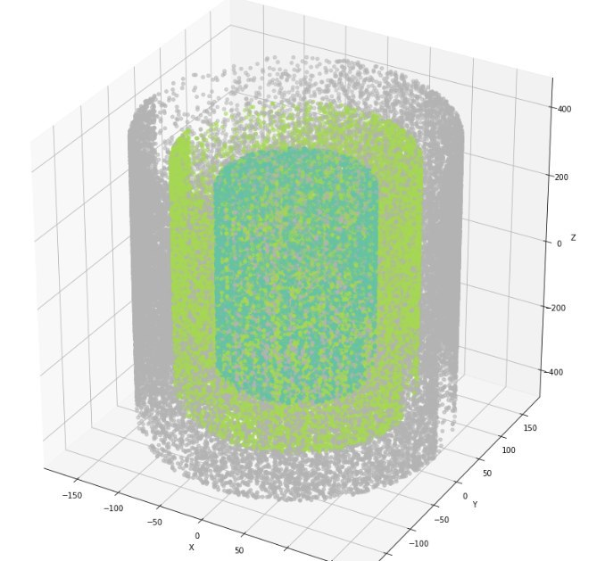
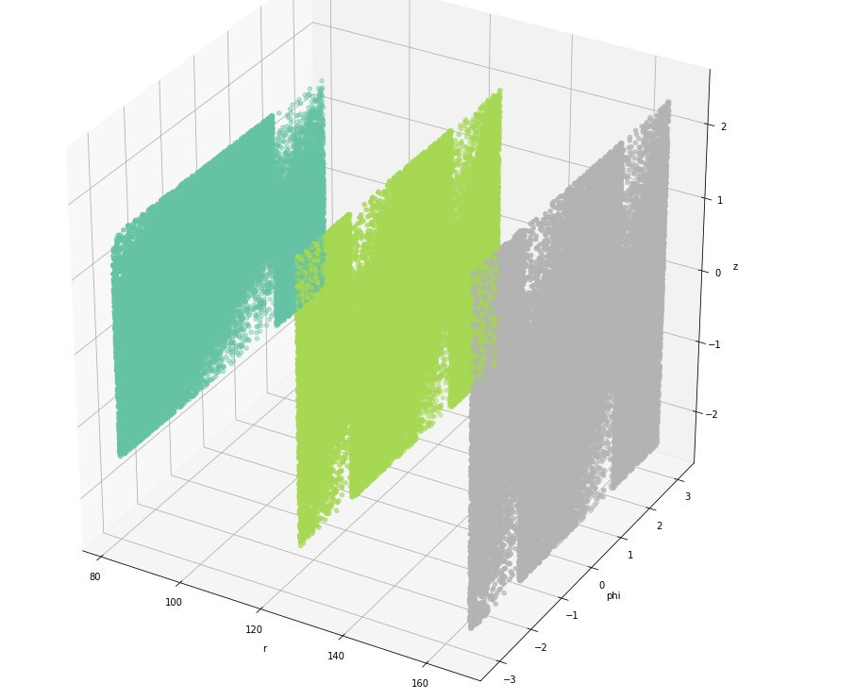
Conversion to cylindrical coordinates
12.11.2020
AYSS-2020: A.Nikolskaya et al. Local tracking with TrackNETv2 on the BES-III
Notes:
As you can see, it is cylinder-shaped detector, and in contrast to BM@N, stations are located not one-by-one on the same axis, but one around the other.
So we decided to convert coordinate plane into cylindrical one.

Slide 6
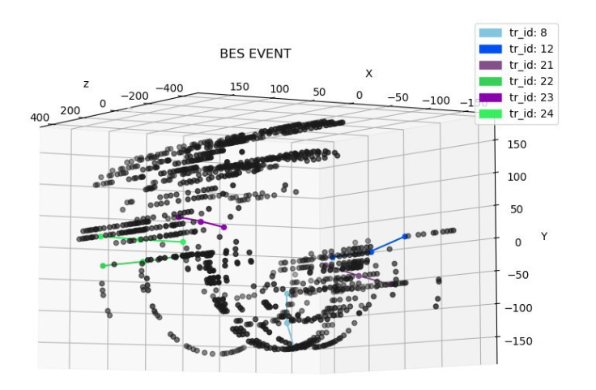
Problems with microstrip gaseous chambers
12.11.2020
AYSS-2020: A.Nikolskaya et al. Local tracking with TrackNETv2 on the BES-III
Notes:
CGEM is based on GASEOUS Main drift chamber, and the big disadvantage of this type of chambers is that evey collision produces enourmous number of fake detections, or fake hits. Because of that, it is a hard challenge to reconstruct tracks for classical methods such as Kalman filter.

Slide 7
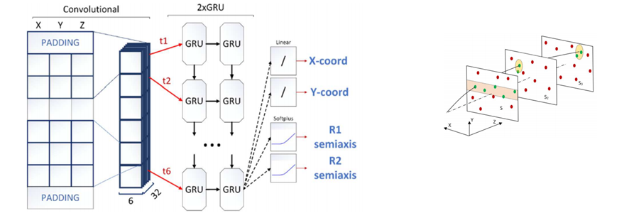
Previous work. TrackNETv2
https://aip.scitation.org/doi/10.1063/1.5130102
12.11.2020
AYSS-2020: A.Nikolskaya et al. Local tracking with TrackNETv2 on the BES-III
Notes:
our previous model, tracknet_v2 showed very good results for BM@N, so we decided to utilize it method for new experiment. Tracknet_v2 uses recurrent architechture to extract temporal features from data and convolutional to get additional features from coordinates of hit. The prediction is ellipse in whch we search for next candidate hit. So, one by one, we construct candidate tracks, and even if early ellipses contain wrong hits, consequential construction of ellipses leads to discarding of such candidates.
Complete information about this model and its parts can be found in the matherials of previous AYSS conference []

Slide 8
Training and validation setup
Training
Batch size: 120
Epoch count: 200
Validation
Number of events | 134997
Number of candidate tracks | 686246
Number of hits (fake and real) | 7137867
Fake hits ratio | 77%
Number of events | 57716
Number of candidate tracks | 293634
Number of hits (fake and real) | 3059086
Fake hits ratio | 77%
12.11.2020
AYSS-2020: A.Nikolskaya et al. Local tracking with TrackNETv2 on the BES-III
Notes:
So, we trained our model on more than 100 thousands of events and validated it on more than 50 thousands of events. Mean number of hits in one event was 50, but some of them contained up to 300 hits

Slide 9
What is wrong with TrackNETv2?
High Recall: passes near all true tracks
Low Precision: passes over a lot of fake tracks
Can not handle short tracks (3 stations) and filter true tracks properly and needs to be reworked
Metric | Test set result
Precision | 5%
Recall | 99%
Metrics definition
Recall - fraction of the found real tracks
Precision - fraction of the reconstructed tracks that are actually true tracks
12.11.2020
AYSS-2020: A.Nikolskaya et al. Local tracking with TrackNETv2 on the BES-III
Notes:
BUT, then we tested it on our new data, we realized, that is generalizaion potential is not enouth big to handle this challenge. To validate model, we construct syntetic track-candidates from cartesian product of first and second station hits respectively. All candidates are fed into model and if at least one hit on third station is in returned ellipse, we say, that model found ending and track is reconstructed.
As you can see, it shows very high recall: for each real track beginning it finds real hit as ending with probability of 99 percent. At the same time, it finds something for fake candidates too! And the percent of candidates with found ending which are real tracks is only 4 percent.
So tracknet isn’t able to filter short tracks right without updating track cone on next station
вставить мотивацию, уточнить про пресижн

Slide 10
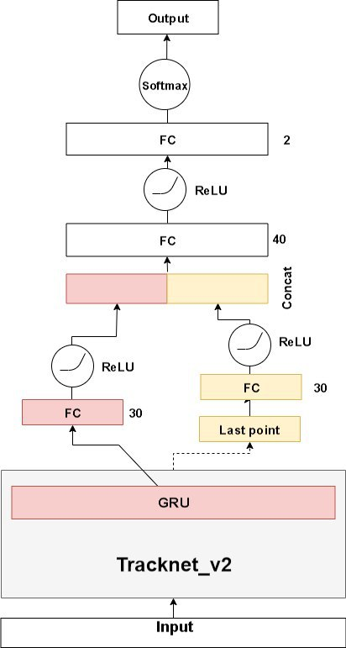
Classifier
We added a new part on top of the TrackNet_v2 to predict whether or not a set of input hits belongs to a true track or not
Given the pretrained TrackNet_v2, we can use its output and features to extract information about smoothness and primary vertex of the track candidate
FC - Fully connected layer
GRU - Gated Recurrent Unit
ReLU - activation function: max(x, 0).
SoftMax - function function that makes the sum of output data to be equal to 1
12.11.2020
AYSS-2020: A.Nikolskaya et al. Local tracking with TrackNETv2 on the BES-III
Notes:
So we developed new part on top of the tracknet to classify is reconstructed candidate real track or not. The aim of this part is to filter syntetic track-candidates. It has mostly classical dense structure and combines TrackNet_v2 inner features and predicted ending to classify track
добавить пояснения к обозначениям, не останавливаться на деталях

Slide 11
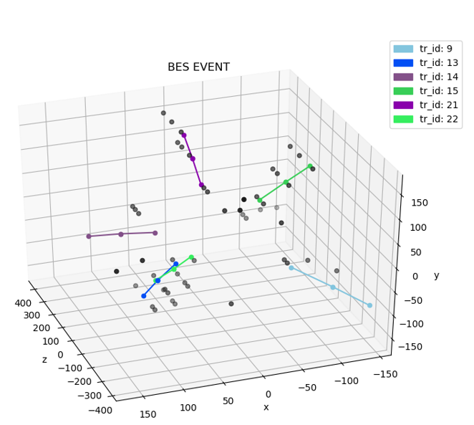
How to get training dataset for classifier?
Given validation subset for TrackNet_v2
For each event:
We get cartesian product of all hits on first two stations
All “synthetic” tracks are marked as fakes
If TrackNet_v2 the last hit of a real track incorrectly or prolongs a fake track, we mark its answer as False, else True
GRU-output and the found point are saved and fed into the Classifier during its training
12.11.2020
AYSS-2020: A.Nikolskaya et al. Local tracking with TrackNETv2 on the BES-III
Notes:
To train classifier we use pretrained model and its validation set. We construct it event-by-event and validate on other subset.

Slide 12
Results
To train classifier we use 2000 events from validation set of tracknet
We can observe that our approach produces promising results for collider environment with strip-based detectors experiments, which demonstrates overall generalization potential.
Metric | Test set result
Precision | 77%
Recall | 97%
12.11.2020
AYSS-2020: A.Nikolskaya et al. Local tracking with TrackNETv2 on the BES-III
Notes:
As a result we have precision of 77 % and recall of 94 percent. Recall is slightly lower than for TrackNet_v2 itself, but still enough.

Slide 13
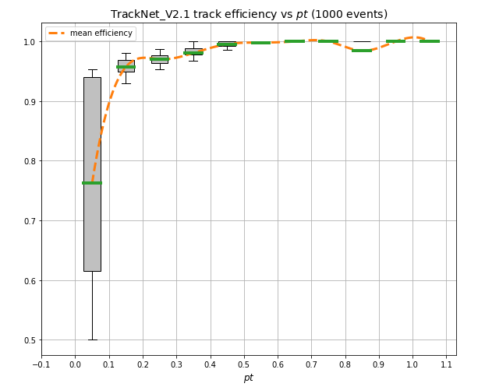
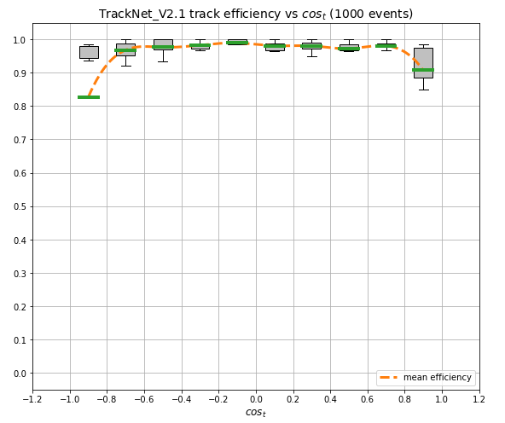
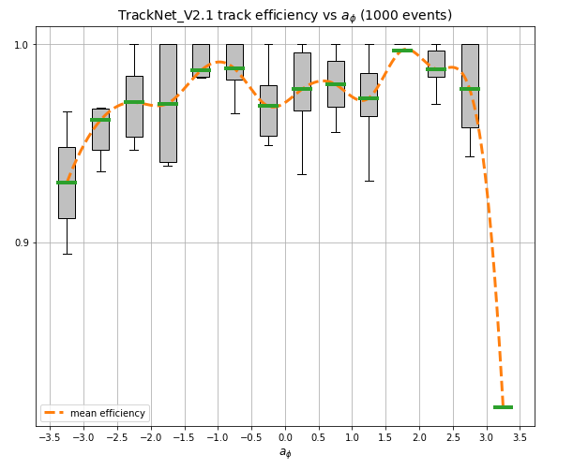
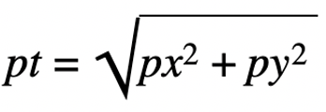
Results (track efficiency)
Transverse momentum
Track polar angle
Track azimuthal angle
Notes:
So, to analise results more wisely we use dependence of track efficiency (or fraction of percent of full tracks without gaps found by network out of all tracks in a single event) on moment of tracks. The most important metrics here are dependence on transverse momentum, which is characteristic of particle energy and on polar angle, wich is characteristic of track curvature. As you can see, our model shows good results for all theese dependencies

Slide 14
Conclusion
We have modified our model (TrackNetv2) adding new blocks which expanded its generalization capability.
Our new approach demonstrates promising results for a detector with 3 stations.
Recall increased by an order of magnitude comparing with the previous approach (5% -> 77%).
12.11.2020
AYSS-2020: A.Nikolskaya et al. Local tracking with TrackNETv2 on the BES-III
Notes:
добавить оутлук
вместо на 70 написать на порядок

Slide 15
Local strategy of particle tracking with TrackNETv2 on the BES-III CGEM inner detector
Anastasiya Nikolskaya, Egor Shchavelev, Pavel Goncharov, Gennady Ososkov, Yury Nefedov, Alexey Zhemchugov, Igor Denisenko, Olga Bakina Saint Petersburg State University, JINR
The reported study was funded by RFBR and NSFC according to the research project № 19-57-53002
Notes:
Good afternoon, everyone, my name is Anastasiya Nikolskaya, and i am 2 year master student at SPBU. My presentation is about a part of big research project of JINR, SPBU and Bejing high energy physics institute. As mentioned before, neural networks are very succesfull method for charged particle track reconstruction. One of the possible strategies is track-by-track or local strategy, wich i will introduce you in this presentation.

