Slide 1
Global strategy of tracking on the basis of Graph Neural Network for BES-III CGEM inner detector
The reported study was funded by RFBR and NSFC according to the research project № 19-57-53002
The reported study was funded by RFBR and NSFC according to the research project № 19-57-53002
Egor Shchavelev¹
Olga Bakina², Igor Denisenko², Pavel Goncharov², Yury Nefedov², Anastasia Nikolskaya¹, Gennady Ososkov², Aleksey Zhemchugov²
AYSS-2020
November 12, 2020
The reported study was funded by RFBR and NSFC according to the research project № 19-57-53002

Slide 2
Plan
What is tracking
Tracking for BES-III GEM
Event as a graph conception
Graph neural network
Results
Conclusion

Slide 3
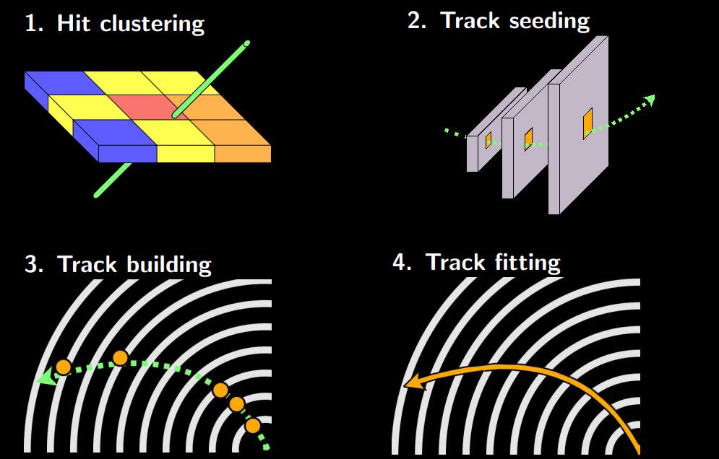
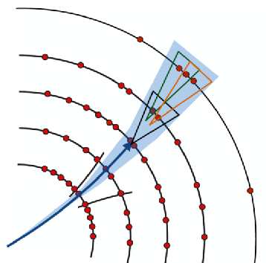
What is tracking?
Tracking or track finding is a process of reconstruction the particle’s trajectories in high-energy physics detector by connecting the points – hits – that each particle leaves passing through detector’s planes.
Tracking includes track seeding and track building phases.

Slide 4
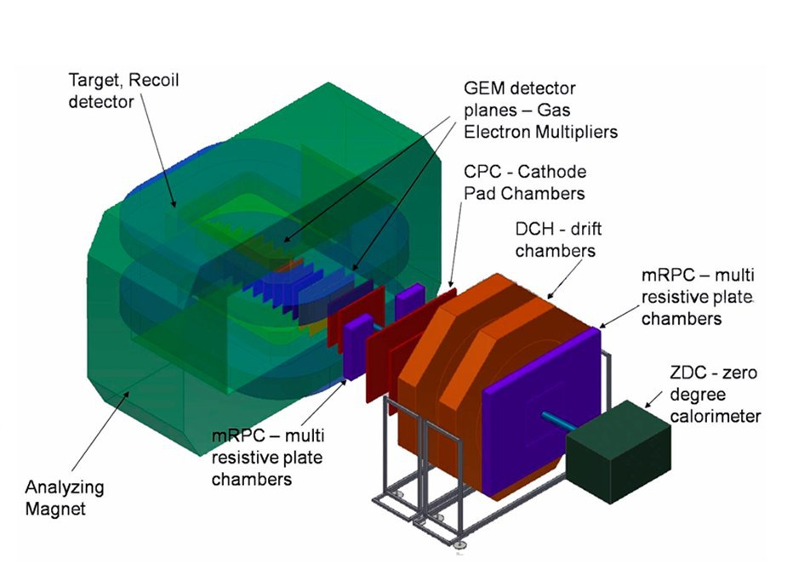
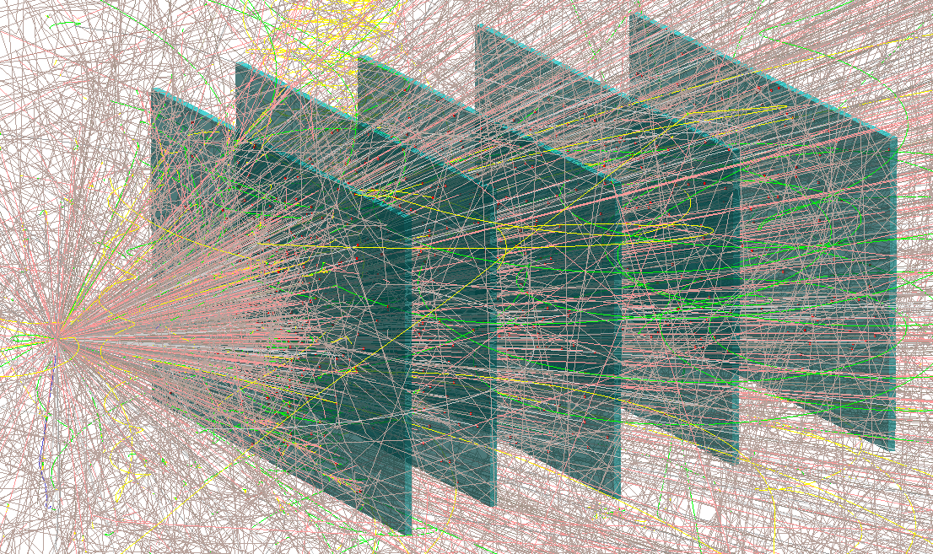
Tracking for BESIII CGEM
The purpose of this study was to summarize the algorithms and programs developed on the basis of deep learning methods for tracking events obtained in the fixed target BM@N JINR experiment for the track reconstruction with the data of the tracking detector of the BES-III collider experiment in Beijing IHEP.
BM@N configuration
Au+Au BM@N MC simulated event

Slide 5
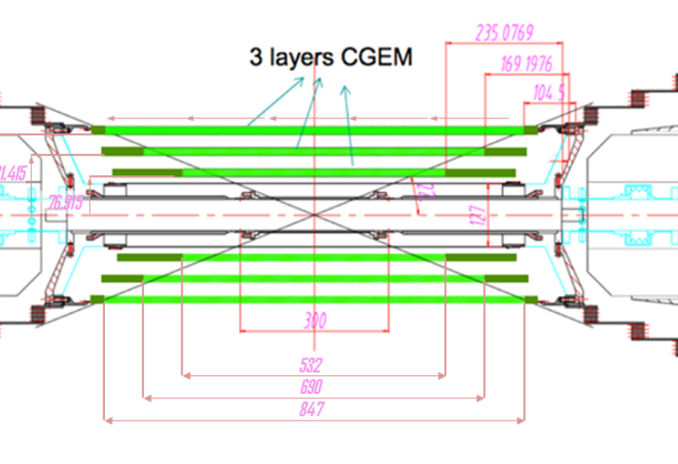
Tracking for BESIII CGEM
BESIII CGEM is used as a demonstrator for the novel tracking approach
BESIII CGEM Monte-Carlo simulation was used followed by a basic clustering algorithm to reconstruct CGEM hits

Slide 6
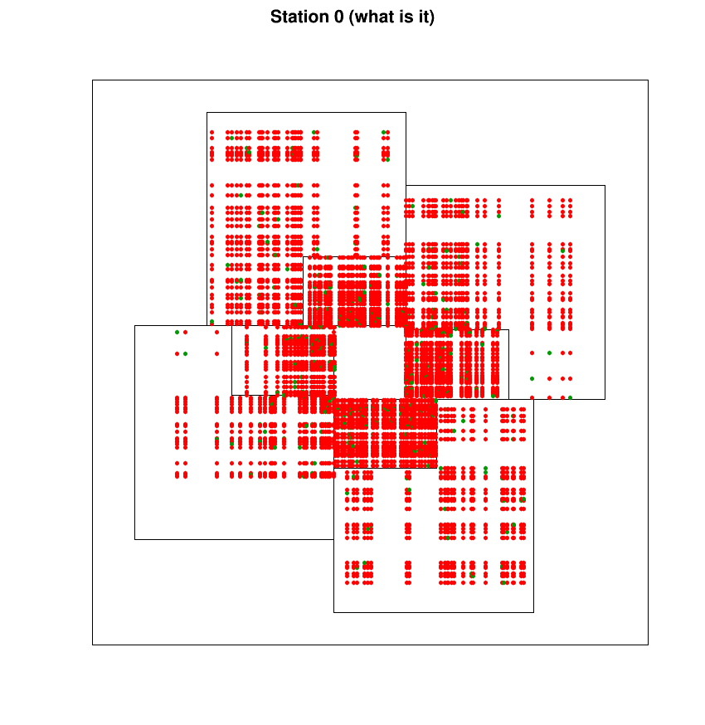
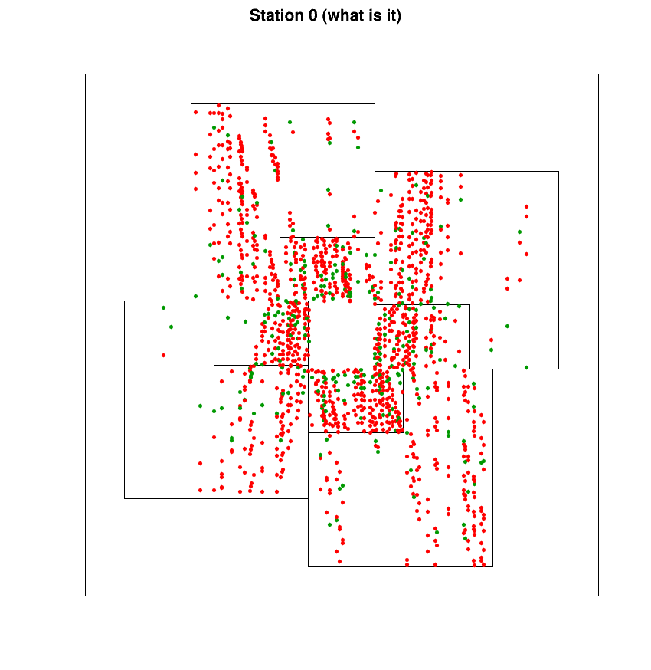
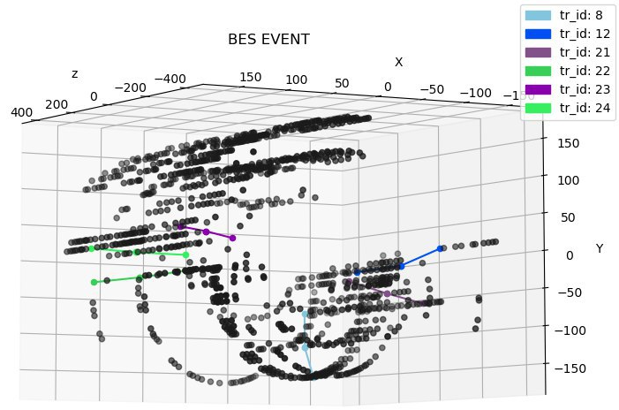
Problems with microstrip gaseous chambers
Problems of CGEM at BES-III and of GEM at BM@N are the same:
Real hit (electron avalanche center)
- Spurious crossing
One of ways to decrease the fake number is to rotate strips of one layer on a small angle (5-15 degrees) in respect to another layer
(BM@N)Angle between strips 90 degrees,
UrQMD event Au-Au, 4 A·GeV
- hit
- fake
(BM@N)Angle between strips 15 degrees, UrQMD event Au-Au, 4 A·GeV
Although small angle between layers removes a lot of fakes, pretty much of them are still left

Slide 7
Why neural networks?
Modern experiments produce vast amount of data in real time
Kalman filter (KF) based tracking approaches can not handle such giant data volumes in a reasonable time
KF algorithms are local, sequentially following tracks station-by- station, therefore they cannot assess the global picture of an event, to see the dependence between individual tracks or groups of tracks and have exponentially growing scalability with increasing the event multiplicity
Modern Neural Network (NN) based approaches are coming to rescue - they can be easily run in parallel on GPU achieving comparable results in terms of purity and efficiency
Moreover, there are Graph Neural Network that can realize namely global approach to tracking when the recognition of tracks among noises is performed immediately across the entire picture of the event

Slide 8
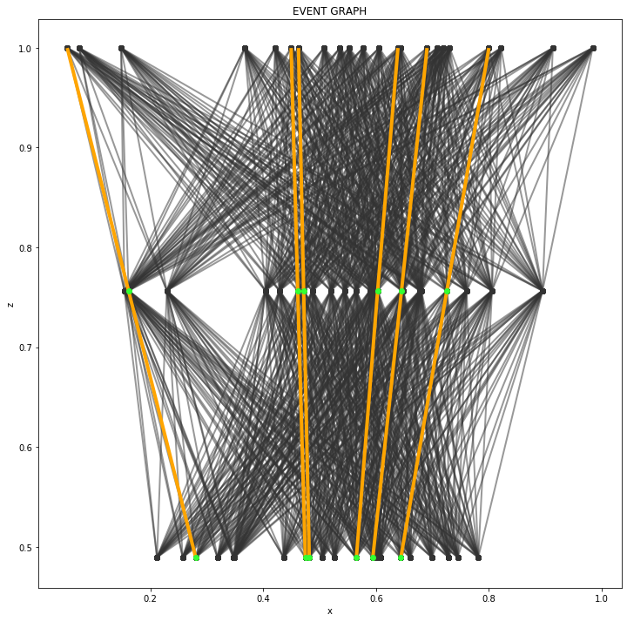
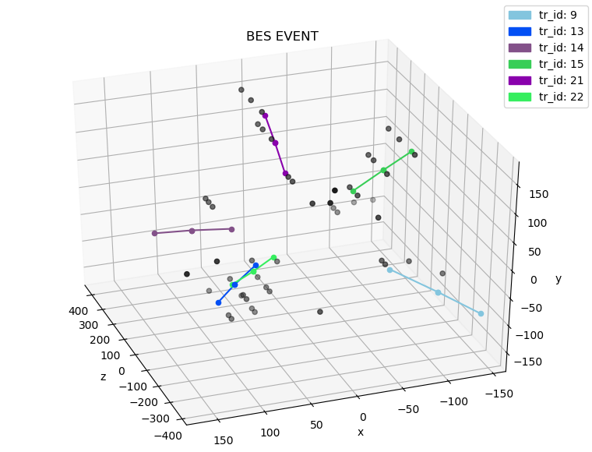
Event as a graph conception
Consider following BES-III event
Hits are represented as nodes of the graph;
Nodes are fully connected between adjacent layers;
Hits features (X, Y, Z) are being propagated inside the Graph Neural Network (GNN) through their connections to the other hits;

Slide 9
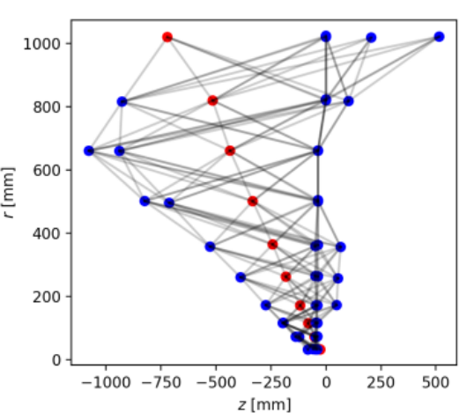
Graph Neural Network
Graph Neural Network approach for tracking was initially presented by HEP.TrkX project at LHC and based on Interaction Networks approach adapted for particle tracking;
We introduced derivative graph as a preprocessing step to deal up with noise hits (fakes) produced by strip-based detectors [Link, NEC-2019]
Note: LHC detectors do not produce any fake hits (they are pixel-based)

Slide 10
Graph Neural Network
The goal of the Graph Neural Network to recover the true segments of the graph G (marked orange)
That is, GNN is labelling every segment with the weight W in [0,1] interval
We consider a segment as a true segment if W > 0.5

Slide 11
Results (efficiency)
Model was trained on 180k MC events on the Nvidia Tesla V100 (~8 hours)
During test run on (20000 MC events) we calculated following metrics:
recall, precision, hit efficiency, track efficiency.
Comparing it with the results of the same approach for the BM@N MC data:
 | recall | precision | hit efficiency | track efficiency
BES-III (this study) | 96.23 | 90.64 | 92.61 | 89.17
BM@N (previous study) | 96. | 85. | 94. | 87.
We can observe that our approach produces comparable results both for the fixed target and collider environment with strip-based detectors experiments, which demonstrates overall generalization potential.
Metrics definition:
Recall (percent of the found real segments)
Precision (percent of the found true segments interpreted as true segments)
Hit efficiency (percent of true hits found by network out of all true hits in a single event)
Track efficiency (percent of full tracks without gaps found by network out of all tracks in a single event)

Slide 12
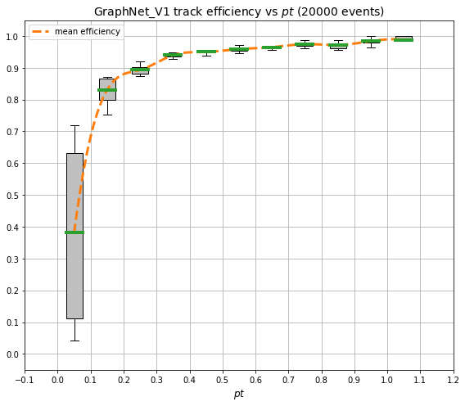
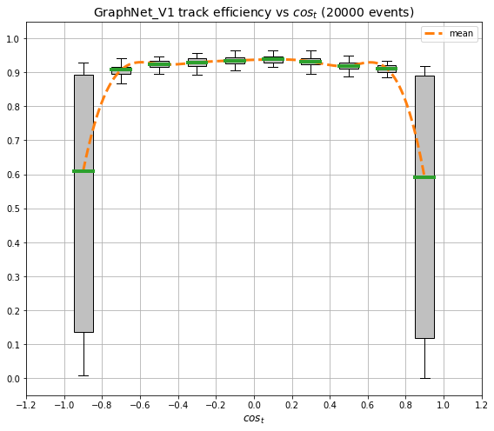
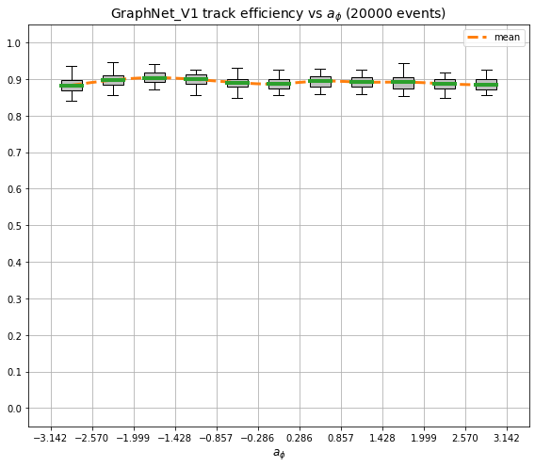
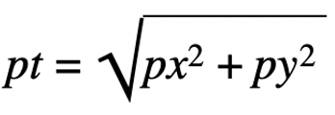
Results (track efficiency)
transverse momentum $pt$
track polar angle
track azimuthal angle $φ$

Slide 13
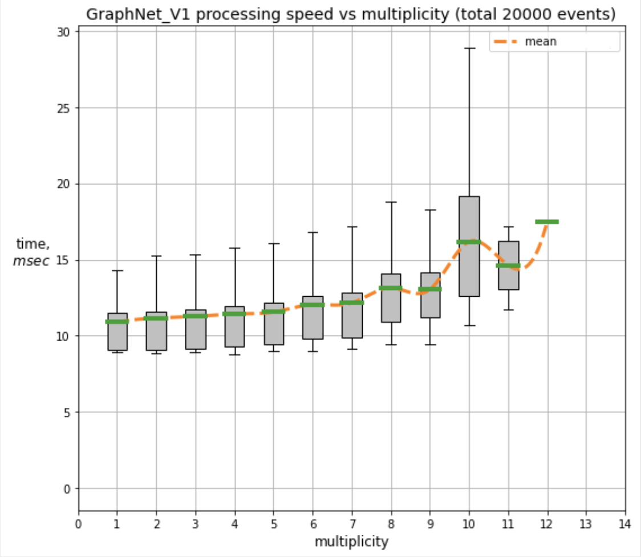
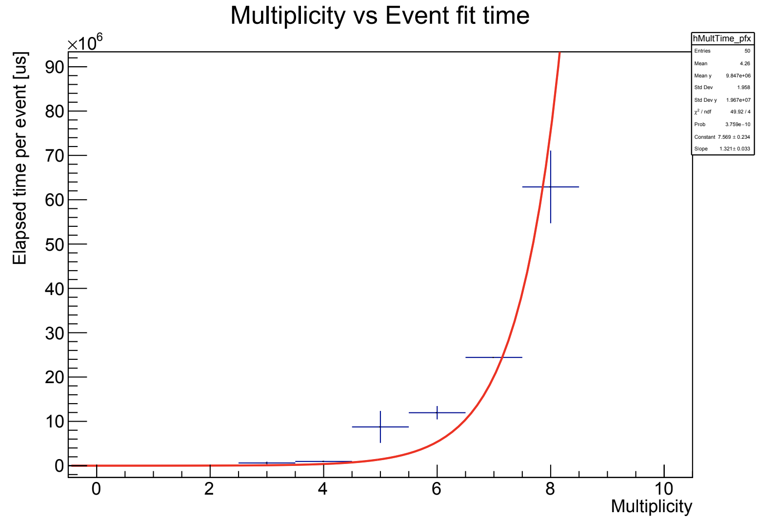
Results (speed), naive Kalman vs GraphNet
Left: full processing speed (preprocessing in python + GPU GNN inference), milliseconds
Right: naive Kalman filter implementation, microseconds * 10^6

Slide 14
Results (speed)
Construction a line digraph (preprocessing step):
~20 events per second (single threaded, CPU, raw python 3.7, Intel 7700K)
~570 events per second (multi threaded, CPU, C++, Intel Xeon E3-1230)
Inference of the GNN:
~900 events per second (GOVORUN, Nvidia Tesla V100)
A preprocessing step could be greatly faster if rewritten in C++ (x30 speed-up!)
GNN inference could be easily run in a multi-GPU environment

Slide 15
Conclusion
GNN approach demonstrated its generalization potential for the strip-based detectors.
Although our approach demonstrate promising results it is a bit overkill for a detector with 3 stations, it can make much more profit on the more complex detectors;
Our approach demonstrates potential in terms of speed: current implementation written in pure python has an obvious bottleneck in the preprocessing. C++ preprocessing speeds up the tracking process at least by 30 times now;
GNN model could be optimized for the BES-III detector in terms of GPU memory consumption and GPU speed as well.

Slide 16
Global strategy of tracking on the basis of Graph Neural Network for BES-III CGEM inner detector
The reported study was funded by RFBR and NSFC according to the research project № 19-57-53002
The reported study was funded by RFBR and NSFC according to the research project № 19-57-53002
Egor Shchavelev¹
Olga Bakina², Igor Denisenko², Pavel Goncharov², Yury Nefedov², Anastasia Nikolskaya¹, Gennady Ososkov², Aleksey Zhemchugov²
AYSS-2020
November 12, 2020
The reported study was funded by RFBR and NSFC according to the research project № 19-57-53002

