Slide 1
Effect of stroke on telomere length in the cells of the subventricular zone of lateral ventricles in mice
Author: Maria Shadrina
Co-Author: Nikolai Nemirovich-Danchenko
Tomsk, TSU, laboratory of neurobiology
The XXIV International Scientific Conference of Young Scientists and Specialists (AYSS-2020)
Dubna, 2020

Slide 2
Adult healthy mouse brain (green line marks subventrikular zone), CC-corpus callosum, LV-lateral ventricle)
cortex
LV
CC
LV
streatum
source:BrainMaps.org, photo by Shawn Mikula

Slide 3
Telomeres (red & green dots) at the ends of human chromosomes (blue)
Image by Jack Griffith & Titia de Lange, Published in Cell, 1999

Slide 4
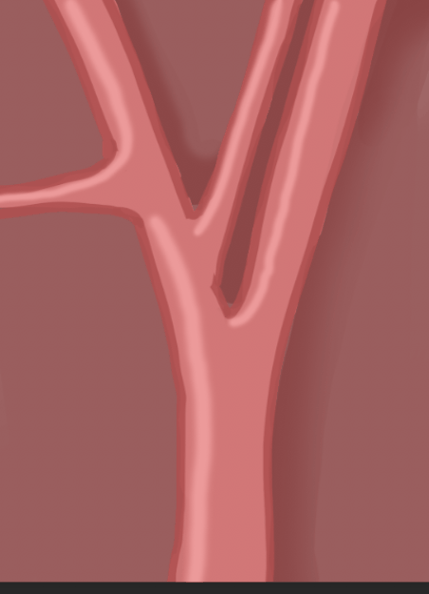
Our model object and scheme of the operation

Slide 5
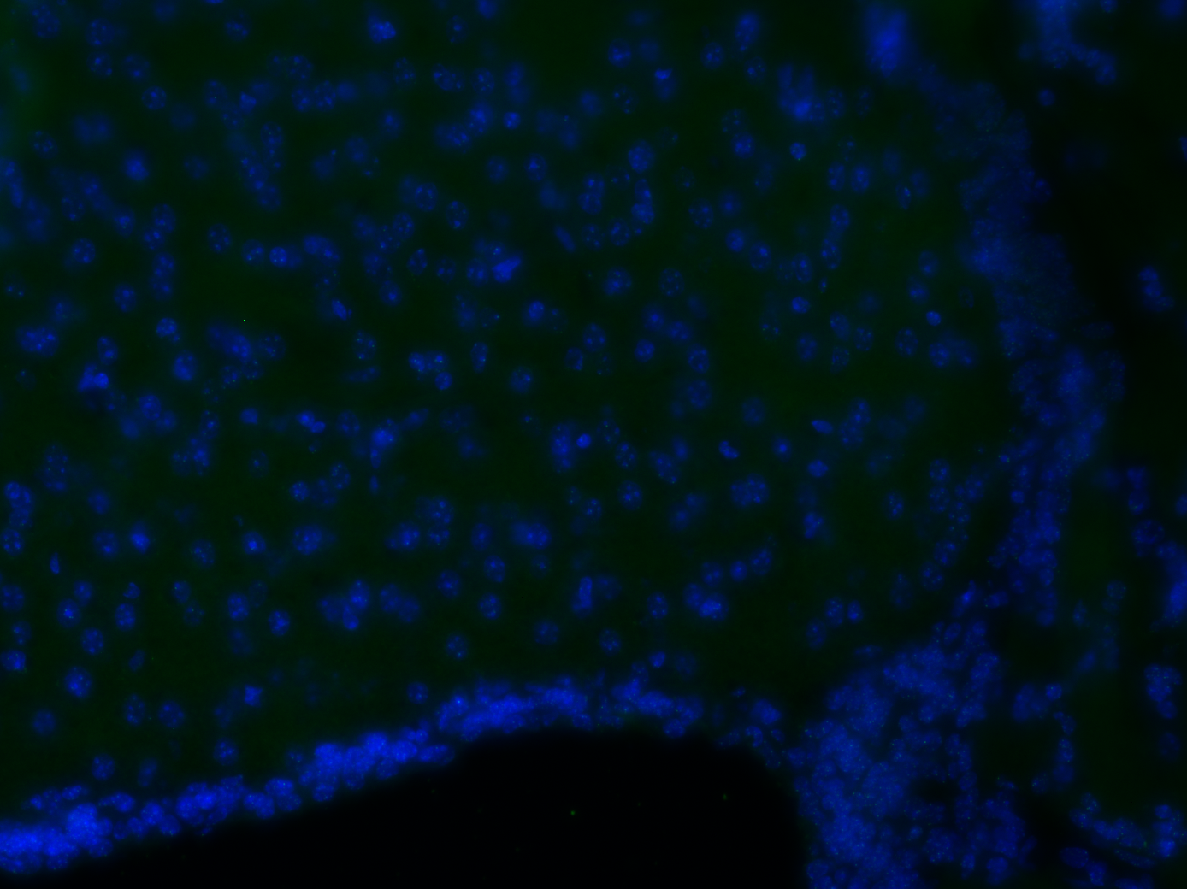
Examples of micro photos of the SVZ zone of the brain
х20
х40

Slide 6
The neurological score of animals in operated group
animal№ | 1st day | 10th day | difference
1-1 | 2 | 1 | 1
8-3 | 2 | 2 | 0
8-1 | 2 | 2 | 0
3-4 | 1 | 2 | -1
3-1 | 1 | 2 | -1
1-2 | 1 | 0 | 1
average | 1.5 | 1.5 | 0

Slide 7
***
***
The amount of telomeres luminiscence in operated and sham groups (normalized by chromatin luminescence)

Slide 8
A
B
PCC=0.81
PCC=0.75
The linear correlation bar represents information about the amount of telomeres luminescention and the difference in the neurological status A – х20; B-x40

Slide 9
Conclusions
Ischemic brain damage leads to a significant shortening of telomeres in the cells of the subventricular zone of the damaged hemisphere, at least 10 days after injury, and telomere shortening also positively correlates with the degree of restoration of neurological status.

Slide 10
Thank you for your attention

