Slide 1
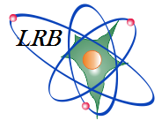

JINR
DNA double-strand breaks complexity in human fibroblasts under the action of low and high-LET radiation
Shamina Daria, Boreyko A., Zadneprianetc M., Kulikova E., Smirnova E.
The XXIV International Scientific Conference of Young Scientists and Specialists (AYSS-2020)

Slide 2
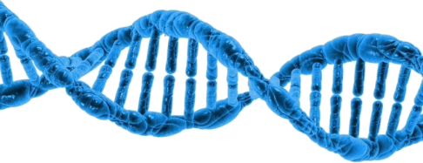
Types of DNA damage
Individual
Clustered DNA lesions
base excision repair
nucleotide excision repair
?
Base damage
Non-DSB cluster
(SSB + 2 base damage)
SSB repair
Single-strand break (SSB)
DSB cluster
(DSB + base damage)
homologous recombination
non-homologous end joining
single strand annealing
Double-strand break (DSB)

Slide 3
Investigation goal
Visualization and analysis of the structure of clustered DNA double-stranded breaks in the nuclei of normal human skin fibroblasts induced by the action of accelerated ¹⁵N ions, protons, and ⁶⁰Co γ-rays.

Slide 4
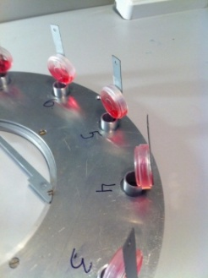
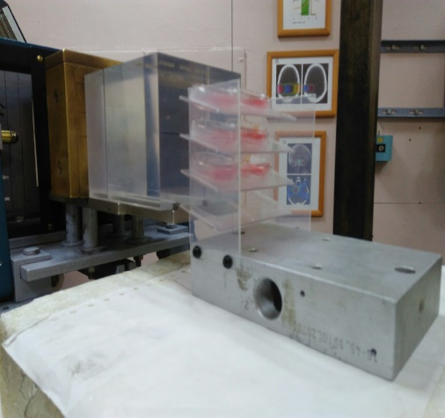
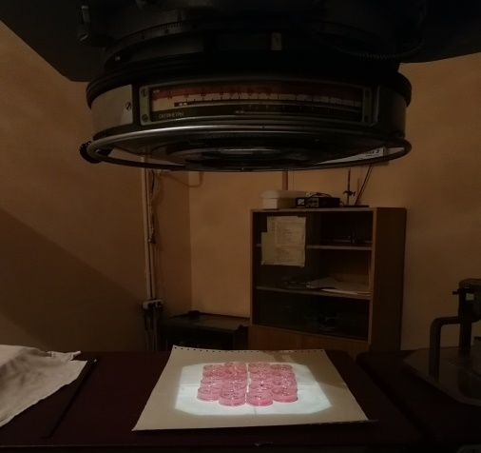
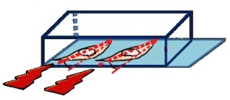
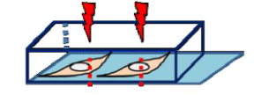
Parameters of irradiation
Type of irradiation | LET, keV/μm | Energy, MeV/n | Dose, Gy | Radiation source
¹⁵N ions | 181 | 13 | 1.25 | U-400M, FLNR JINR
protons | 2-25 | 0.01-47.5 | 1.25 | Phasotron, DLNP JINR
⁶⁰Co γ-rays | ̴ 0.3 | - | 1.25 | «Rocus-M», DLNP JINR
10⁰
90⁰
U400-M
Phasotron
«Rocus-M»
Notes:
Важно упомянуть, что протоны в расширенном пике Брэгга

Slide 5


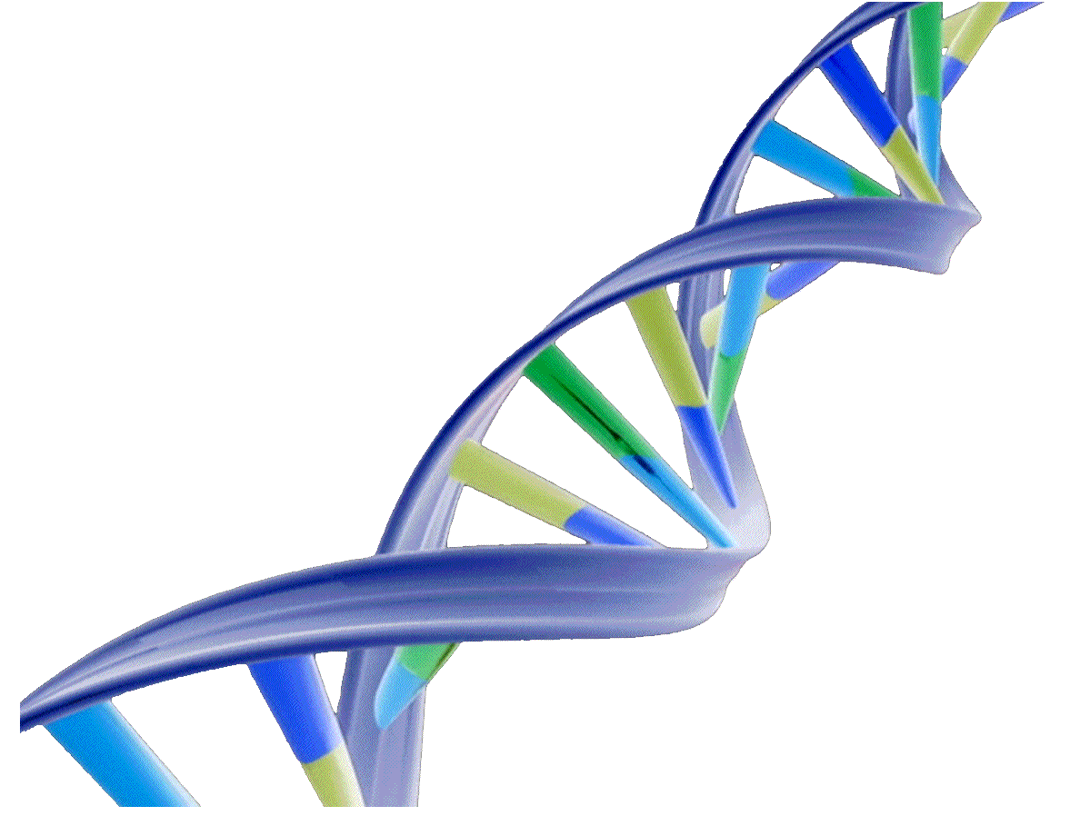

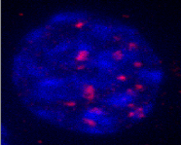
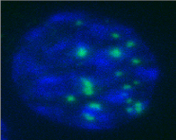
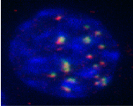
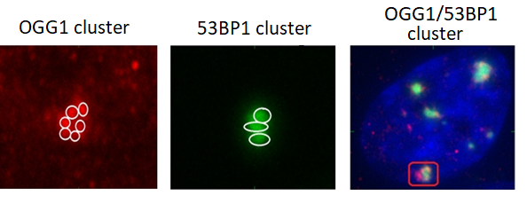
Materials and methods
Immunostaining procedure
Irradiation of human fibroblasts with ¹⁵Nions, protons and ⁶⁰Co γ-rays
Secondary antibody conjugated to fluorescent label
Primary antibody
Fixation of cells at different times post-irradiation
OGG1
53BP1
Base damage
DNA DSB
Visualization of induced DSBs and base damage:
-immunostaining procedure
- obtaining images of colored samples using microscope Carl Zeiss - AxioImager.M2
Clustered DNA DSBs
Analysis of the obtained results

Slide 6
Comparative analysis of the formation and elimination of OGG1 and 53BP1 foci in clusters under the action of radiation with different physical characteristics
Repair kinetics
Relative number of 53BP1/OGG1 clusters, %
Time post irradiation

Slide 7
Analysis of the structure of OGG1/53BP1 foci clusters under the action of radiation with different physical characteristics
15 min
ions ¹⁵N
protons
γ-rays ⁶⁰Co
Frequency, N/N _{cell}
4 h
Frequency, N/N _{cell}
Number of OGG1 to 53BP1 foci in clusters

Slide 8
Results
It was shown that the structure of formed clustered DNA damage becomes more complex with the growth of LET radiation. At the same time, the complex organization of damage persists for a long time under the action of high-LET radiation.
Quantitative analysis of OGG1/53BP1 foci showed that accelerated nitrogen ions induce more complex and difficult-to-repair clustered DNA damage compared to ⁶⁰Co gamma-rays and protons.
It was found that under the action of protons and accelerated nitrogen ions, a large number of cluster damage with a complex structure are formed in the fibroblast nuclei, where several base damage are formed on 1 DNA double-strand break. On the other hand the opposite cases are observed after exposure to gamma-rays.

Slide 9
Thank you for your attention!

