Slide 1
Study of the effect of anthropogenic load on the elemental composition and gene expression level of endemic sponges of Lake Baikal
DLNP JINR Molecular Genetics Group
Together with Limnological Institute
Siberian Branch of the Russian Academy of Sciences
Yakhnenko A.S., Zinicovscaia I.I., Yushin N.S., Nebesnykh I.A., Kravchenko E.V.
AYSS, 2020

Slide 2
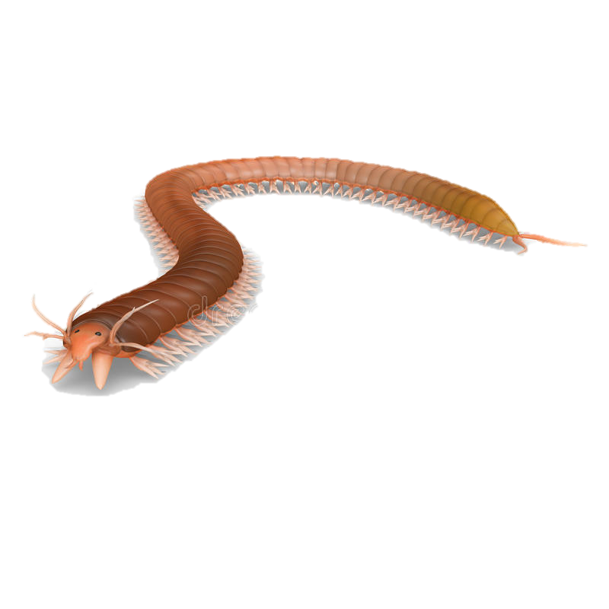
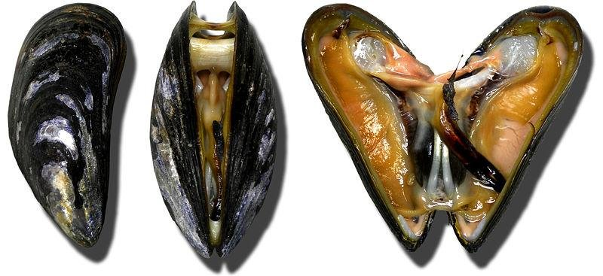
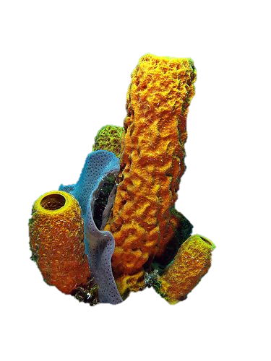
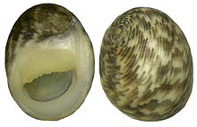
Aquatic invertebrates as biomonitors of pollution by inorganic contaminants in aquatic ecosystems
Pictures from:
Paiva, Filipa. (2014). "Ship transport of marine invasive species and its stress resistance".
https://en.wikipedia.org/wiki/Nerita
https://ru.dreamstime.com/%D0%B8%D0%BB%D0%BB%D1%8E%D1%81%D1%82%D1%80%D0%B0%D1%86%D0%B8%D1%8F-%D1%88%D1%82%D0%BE%D0%BA%D0%B0-%D0%BD%D0%B0%D1%81%D0%B5%D0%BA%D0%BE%D0%BC%D0%BE%D0%B5-nereis-image55455421
https://www.pinterest.com/pin/277323289524160864/
DLNP JINR Molecular Genetics Group
2
Notes:
Today in the world there is an acute problem of water pollution with heavy metals and other intoxicants. many aquatic invertebrates are widely used as bioindicators of the state of aquatic ecosystems. They spend most of their lives at the contaminated site. They can determine the concentration of existed heavy metal pollution. A variation in the efficiency of heavy metal accumulation was shown between different invertebrate groups. For example, you can see some of organisms used as bioindicators. Some of them are sponges.

Slide 3
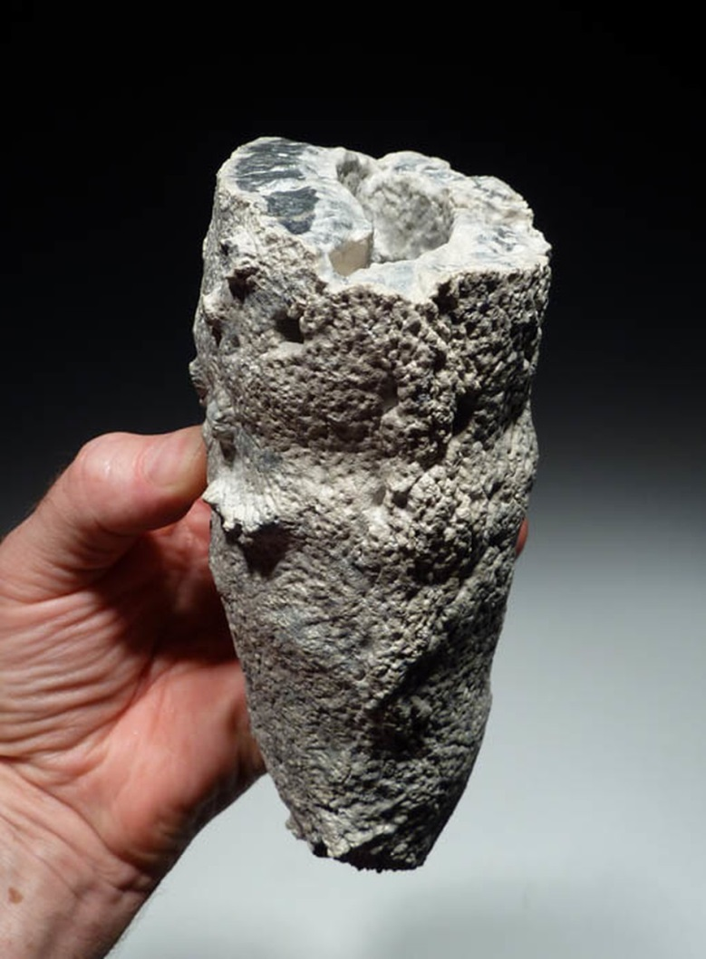
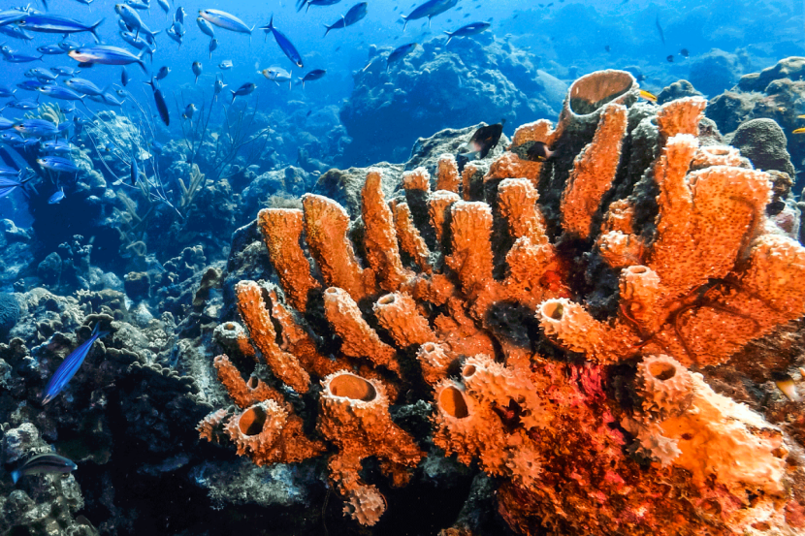
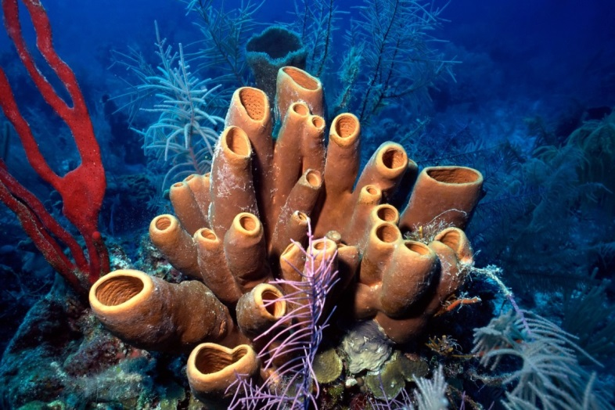
Sponges
Fossil sponge
The earliest sponge fossils are 680 Ma old.
Filter feeders, so they play an important role in aquatic ecosystems.
Bioindicators of the state of aquatic ecosystems, since pollutants accumulate in their bodies.
Events of mass diseases and mortality of sponges in different aquatic ecosystems were noted.
DLNP JINR Molecular Genetics Group
3
Notes:
Sponges are one of the oldest multicellular animals that have survived almost unchanged to this day. The earliest finds of sponge remains date back 680 Ma. At the moment, the planet is inhabited by both marine and freshwater sponges. By the type of nutrition, all sponges are filter feeders, so they play an important role in aquatic ecosystems.
Since sponges are strongly associated with marine environment, they are sensitive to environmental variations. So they can be used as a tool for environmental monitoring.
At a certain moment events of mass diseases and mortality of sponges were noted in different aquatic ecosystems.
Freshwater sponges are also can be good indicators for lakes and rivers sates

Slide 4
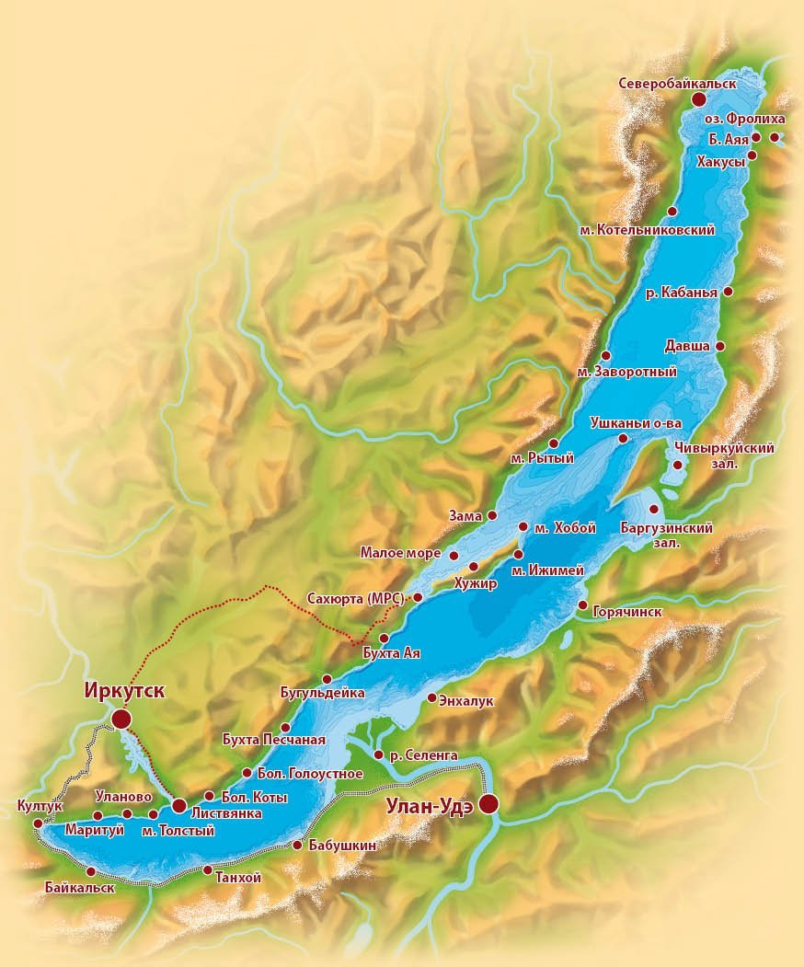
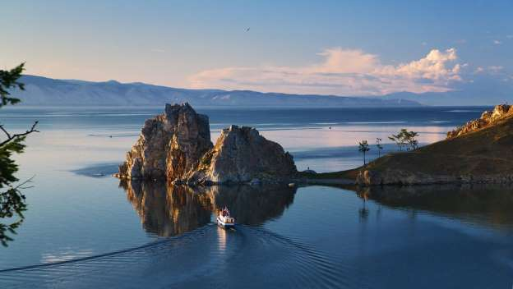
Lake Baikal
Ancient lake (was formed 25-30 Ma ago)
The maximum depth is 1642m.
Contains 20% of the world's fresh water reservoirs
UNESCO World Heritage Site.
DLNP JINR Molecular Genetics Group
4
Notes:
Lake Baikal is unique ancient ecosystem inhabited with hundreds of endemic species.
Lake Baikal inhabited with 15 species of endemic sponges

Slide 5
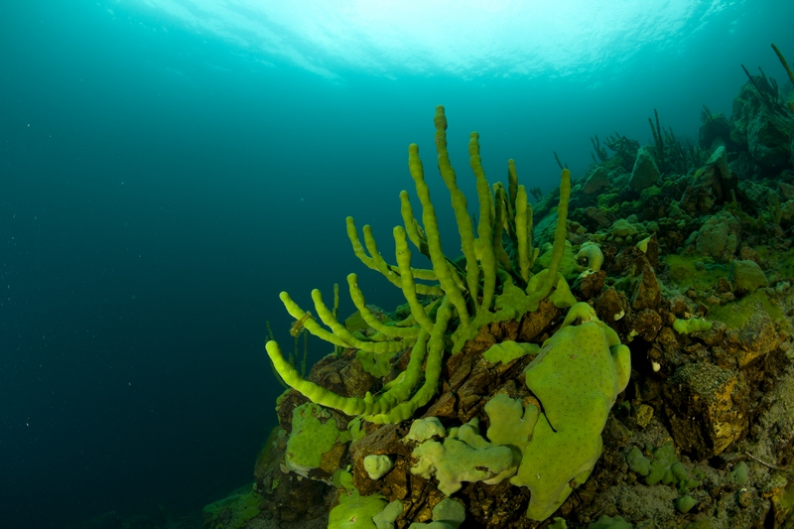
Endemic sponges from lake Baikal
Endemic
Lubomirskia baikalensis
Cosmopolitan
Ephydatia muelleri
Picture: Evgeniy Safonov
DLNP JINR Molecular Genetics Group
5
Notes:
Baikal sponges are not just one organism, but a whole community of sponge with symbionts - unicellular algae and bacteria. Due to the symbiosis, the sponges are green colored.

Slide 6
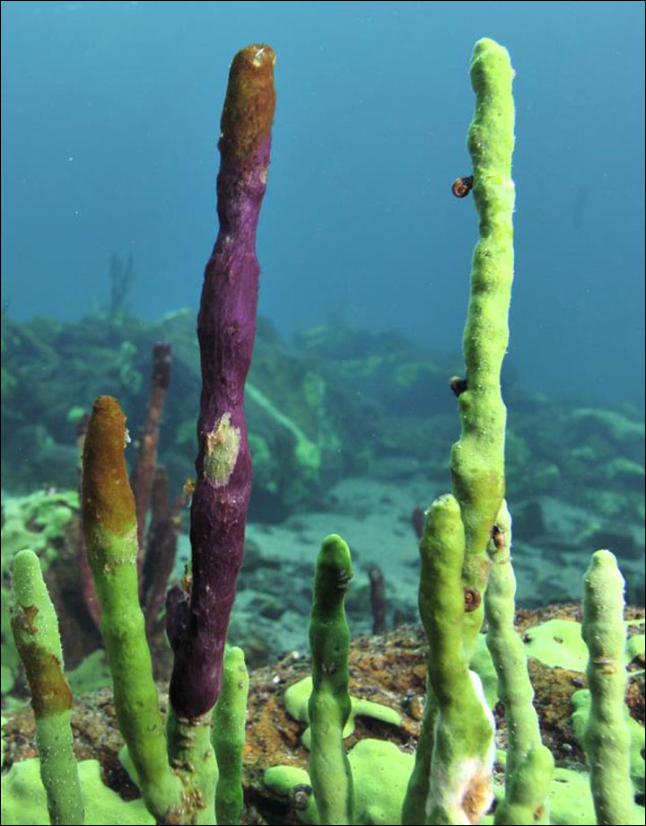
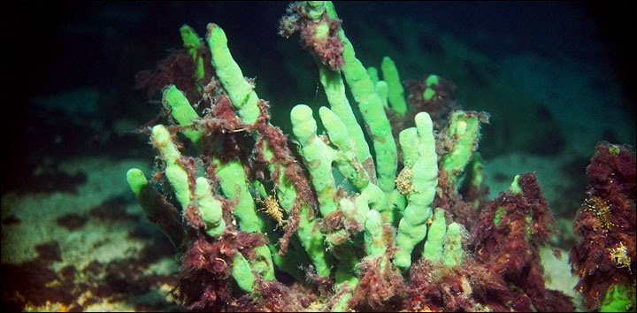
Disease and mortality of sponges
In the last decade, events of mass diseases and mortality of sponges have been observed on Lake Baikal, which indicates negative changes in the ecosystem of the lake.
DLNP JINR Molecular Genetics Group
6
Notes:
In the last decade, events of mass diseases and mortality of sponges have been observed on Lake Baikal, which indicates negative changes in the ecosystem of the lake. Endemic sponges are an important object to study, since they make up a bulk of benthos biomass and play a key role in the ecosystem of Lake Baikal, which contains 20% of the world's fresh water and is a UNESCO World Heritage Site. To reveal background of these events we perform analyses of elemental composition and gene expression of Baikal endemic sponge Lubomirskia baikalensis.

Slide 7
Why sponges get sick?
Unusual
bacterial communities
Water bloom
Increase in water temperature
Increased content of heavy metals
DLNP JINR Molecular Genetics Group
7
Notes:
The reasons for the mass diseases and mortality of sponges both in in water temperature, the development of bacterial communities unusual for a sponge on its surface, water bloom due to the spontaneous growth of spirogyra, or an increased content of heavy metals that enter the water due to human the ocean and in Lake Baikal are still not completely clear. There are several parameters that could affect the condition of the sponges. These include an increase activities. And sponges, due to the filter feeding type, are capable of accumulating heavy metals.
In this study, we check if sponges from places with different anthropogenic load have different levels of heavy metal concentrations in their bodies. Also we study, how it affects heavy metal transporting gene expression.

Slide 8
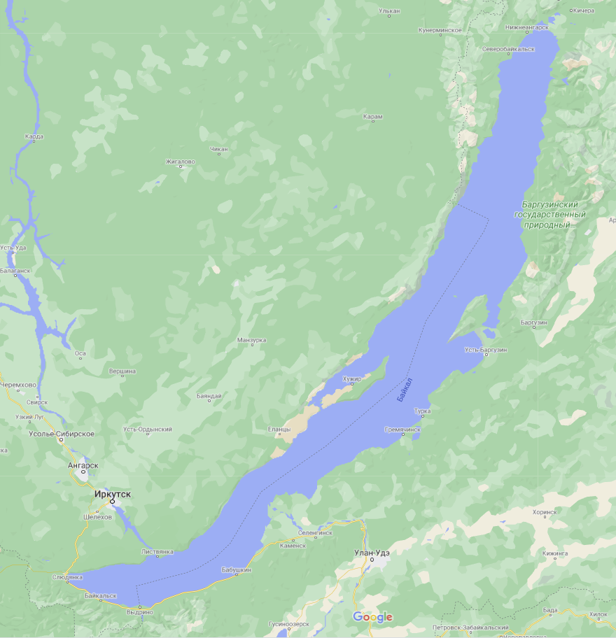
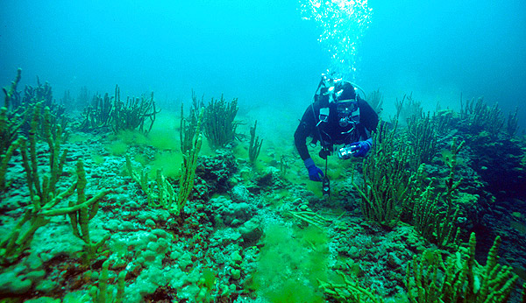
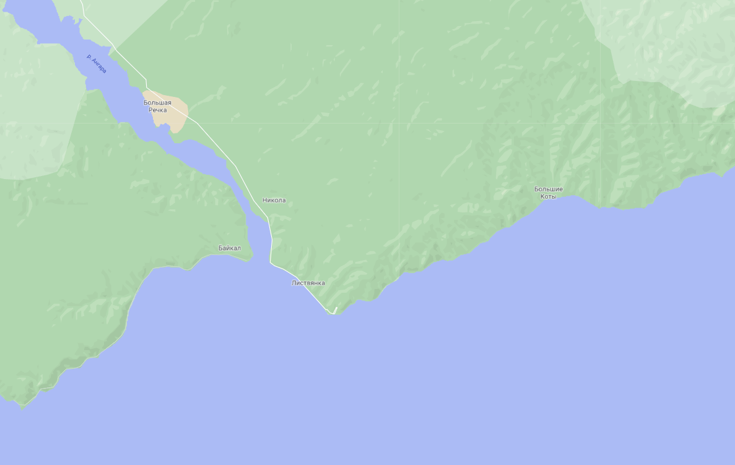
Sampling
Samples of endemic Baikal sponges Lubomirskia baikalensis were collected at two points - with high (Listvyanka Bay) and low (B. Koty Bay) anthropogenic load.
Samples of L.baikalensis were collected at August 2020 by SCUBA diving at Listvyanka Bay, n=10, and Bolshie Koty Bay, n=10
Bolshie Koty Bay
Listvyanka Bay
Pictures from
https://www.google.com/maps/@53.687435,107.5958147,7.46z?hl=ru
http://babr24.com/irk/?IDE=153099
DLNP JINR Molecular Genetics Group
8
Notes:
Two sampling points were chosen by monitoring data, showed places with the highest and the lowest rates of sponge disease. It was Listvyanka bay, which is considered to be the most anthropogenic impacted point and Bolshie Koty bay, which looks like almost intact. Samples of L.baikalensis were collected at August 2020 by SCUBA diving at Listvyanka Bay, n=10, and Bolshie Koty Bay, n=10. Immediately after collection, the samples were frozen at -20°C for Neutron Activation Analysis (NAA) and tissue parts were placed in IntactRNA solution for gene expression analyses.

Slide 9
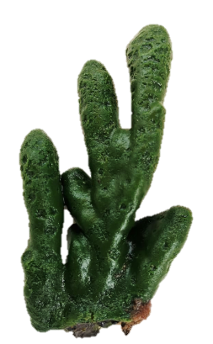
Neutron Activation Analysis
In the Sector of Neutron Activation Analysis and Applied Research, FLNP, JINR, the elemental composition of sponge samples and their substrates will be determined.
After collection samples were:
- Dried
- Separated from the stone substrate
- Divided into equal parts of 6 cm
Grinded into powder
6 cm is equal to 6 years due to growth rate of 1 cm per year
Substrate and each part of a sample will be analyzed separately.
The youngest part
6 cm
The oldest part
DLNP JINR Molecular Genetics Group
9
Notes:
For this, the sponges were dried to dry weight, and then separated from the stone substrate and divided into equal parts of 6 cm. The substrate and all these pieces will be analyzed separately. Since sponges of this species grow vertically upward at a rate of 1 cm per year, the uppermost part is the youngest.

Slide 10
Neutron Activation Analysis
Such sample preparation will help to:
Evaluate the difference in the concentrations of heavy metals in the sponges collected at different points
Assess the accumulation of heavy metals in the body of the sponge with age,
Assess the contribution of the substrate composition to the elemental composition of the sponge.
The youngest part
6 cm
The oldest part
DLNP JINR Molecular Genetics Group
10
Notes:
The analysis of each site separately will make it possible to evaluate not only the difference in the concentrations of heavy metals in the sponges collected at different points, but also to assess the accumulation of heavy metals in the body of the sponge with age, as well as the contribution of the substrate composition to the elemental composition of the sponge.

Slide 11
Study of gene expression
Candidate genes of heavy metal stress response :
Gene | Function
Glutathione-s-transferase mu class | Detoxification of xenobiotics and the oxidative stress response
Copper transporting ATPase 1 | Transport Cu(I) across cell membrane
Copper chaperone for superoxidedismutase | Metalloprotein that is responsible for the delivery of Cu to superoxide dismutase
Metal Regulatory Transcription Factor 1 | Zinc-dependent transcriptional regulator of cellular adaption to conditions of exposure to heavy metals
DLNP JINR Molecular Genetics Group
11
Notes:
Changing the level of gene expression is one of the main mechanisms of adaptation of a living organism to changes in the environment. Since the endemic Baikal sponges have lived in very stable conditions for the past several million years, even small changes in the environment should trigger a response at the level of gene expression. To study the mechanisms of sponge cells protection from the effects of heavy metals, an analysis of the gene expression, whose products are involved in the most important metabolic pathways of cell interaction with heavy metals, will be carried out.
To characterize expression patterns in L.baikalensis four candidate stress response genes were chosen for later qPCR analyses, based on previous assessments of upregulation in other aquatic invertebrate species [1,2] and studies of gene expression response to heavy metal exposure for different types of organisms. For glutathione-s-transferase mu class gene expression differences have been shown on Mollusca, collected in points with different anthropogenic load. Copper transporting ATPase 1 and copper chaperone for superoxidedismutase were also used in this study.[2] MTF1 gene is shown to be transcriptional regulator involved in cellular adaptation to exposure to heavy metals [3]

Slide 12
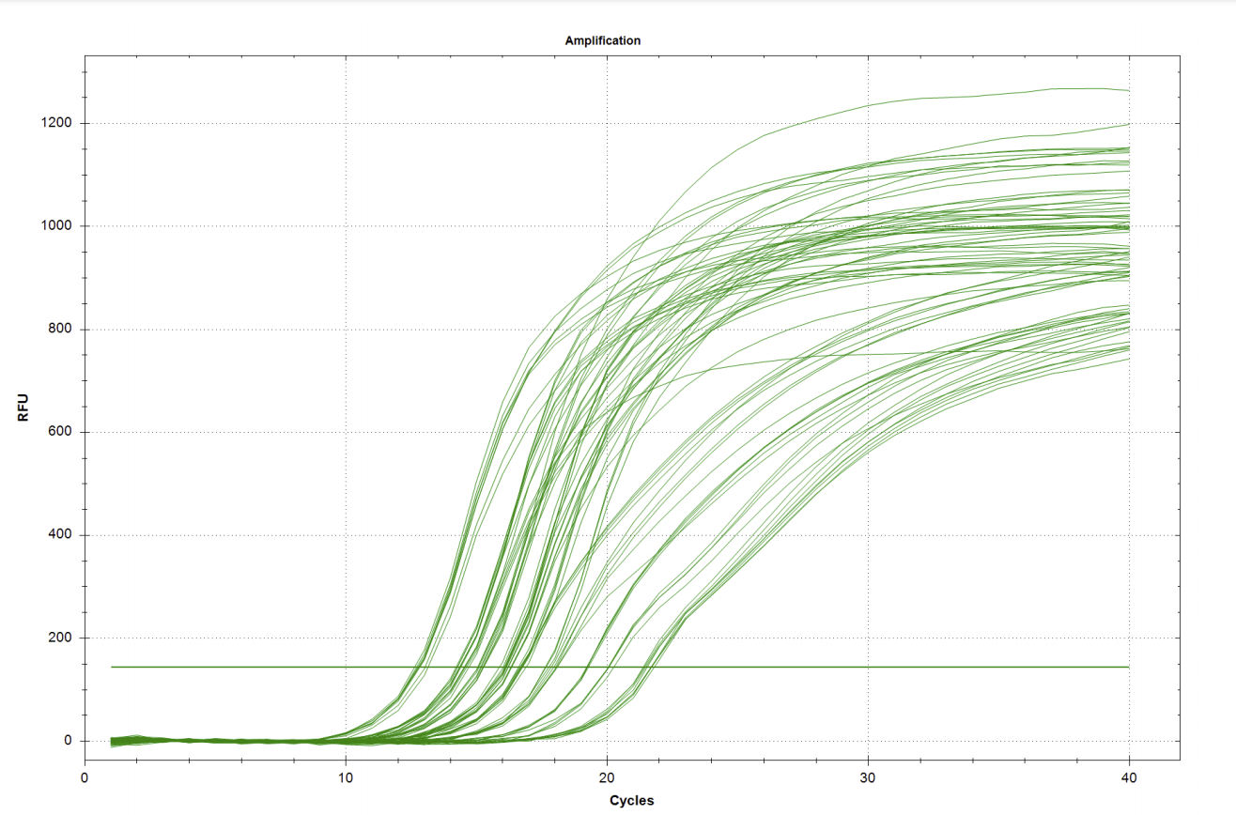
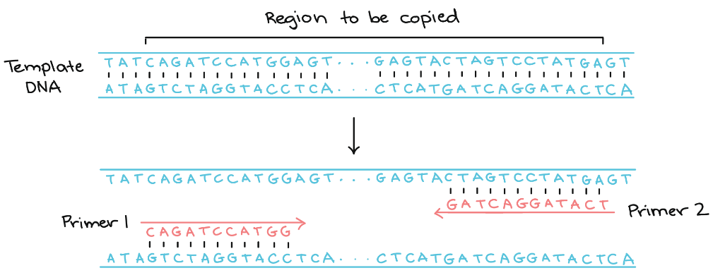
Study of gene expression
Specific primer pairs for each gene were selected from transcriptome data
Every primer pair was tested on our samples
Suitable reference genes were selected
Gene expression analyses will be carried out with RT qPCR
Primer design and further analyzes is carried out in Molecular Genetics Group DLNP, JINR.
Pictures from:
https://www.americanlaboratory.com/914-Application-Notes/180125-Getting-the-Most-Out-of-Limited-Samples-A-PCR-Workflow-for-Monitoring-Gene-Expression/
https://www.google.com/url?sa=i&url=https%3A%2F%2Fwww.khanacademy.org%2Fscience%2Fap-biology%2Fgene-expression-and-regulation%2Fbiotechnology%2Fa%2Fpolymerase-chain-reaction-pcr&psig=AOvVaw1zIOJBQFqOjul4Mn8KaQeE&ust=1605109093833000&source=images&cd=vfe&ved=0CA0QjhxqFwoTCNCOnL-n-OwCFQAAAAAdAAAAABAJ
DLNP JINR Molecular Genetics Group
12
Notes:
Specific primer pairs for these genes were selected based on previously published transcriptome data of L.baikalensis. [4] Changes in the expression level of these genes will be assessed using rt qPCR. For gene expression analyses samples were collected from the area of ​​the upper part of the sponge (the youngest, which was formed at the beginning of summer) and it was fixed in RNA intact for 5 samples from each point. Then, RNA was isolated from each sample. Primers were successfully tested. Primer design and further analyzes is carried out in Molecular Genetics Group DLNP, JINR.
As a result, a test system will be developed based on the expression levels of heavy metal defense genes to quickly assess the state of the ecosystem of Lake Baikal.

Slide 13
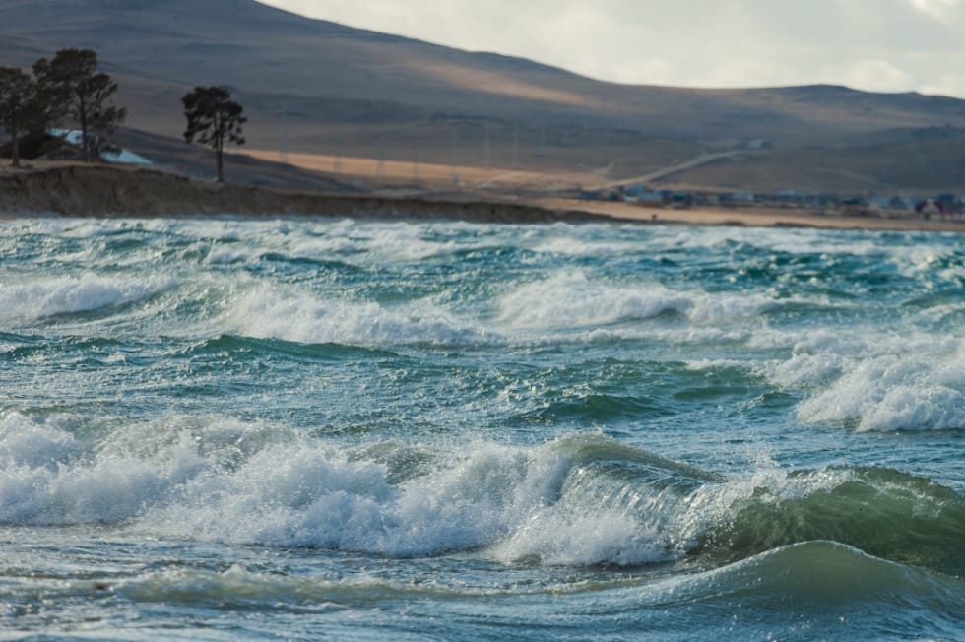
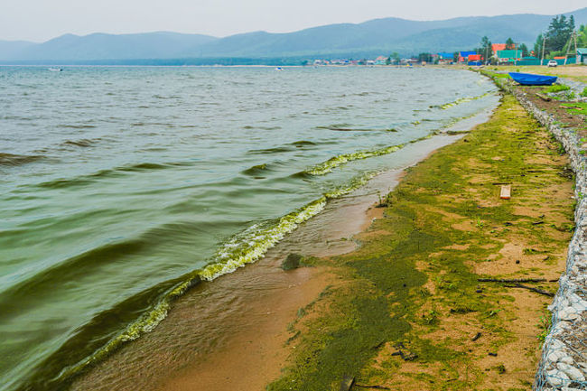
Further prospects
Thus, the analysis of the elemental composition and gene expression will shed light on the question of the causes of sponge diseases on Lake Baikal.
It will allow assessing the levels of accumulation of heavy metals in the sponge bodies of and the reaction of sponges to these substances at the level of transcription.
This, in turn, will make it possible to assess the anthropogenic load on the ecosystem of Lake Baikal.
DLNP JINR Molecular Genetics Group
13

Slide 14
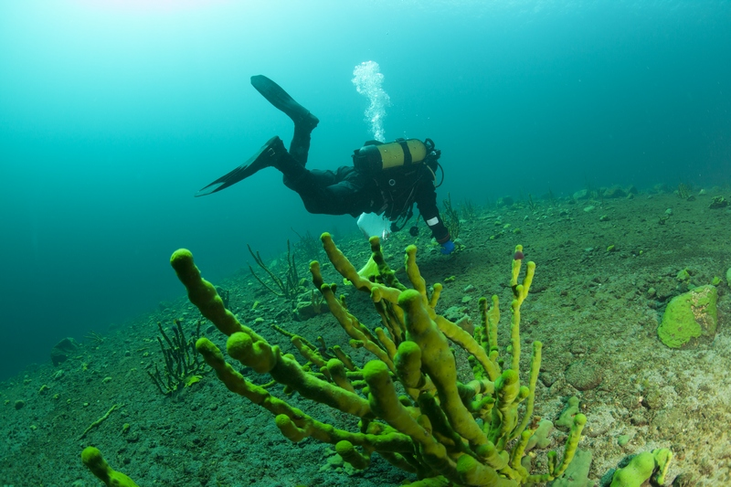
Thanks for your attention
DLNP JINR Molecular Genetics Group
14

