Slide 1
A STUDY OF RADIATION RESISTANCE FOR DISKS OF NEUTRON CHOPPERS IN ESS
Prepared by Belova M.O.
JINR, FLNP

Slide 2
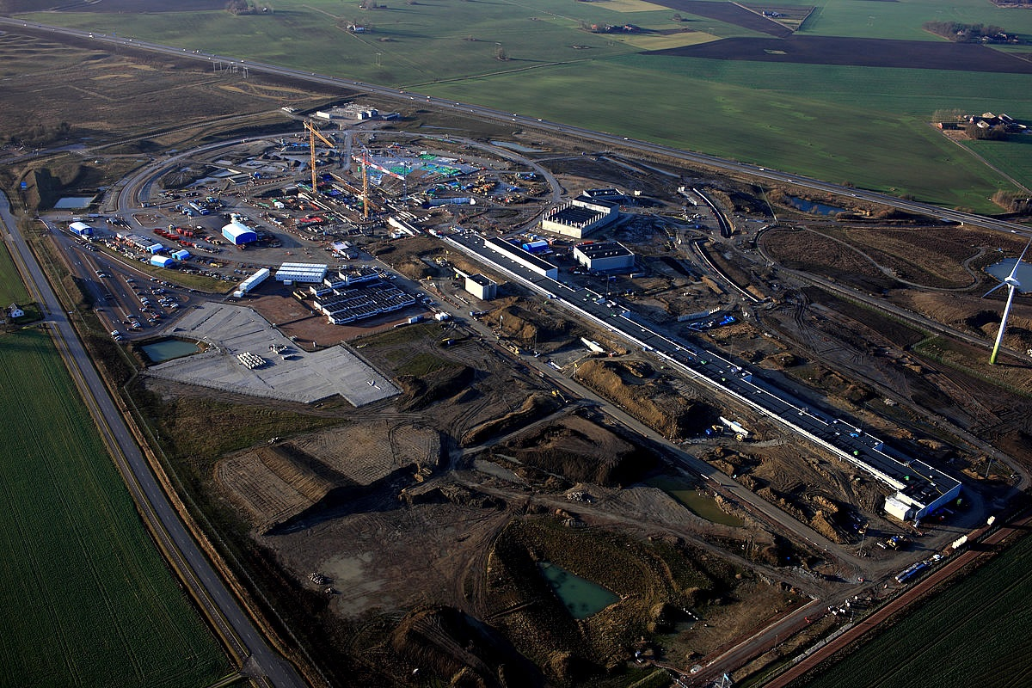

Slide 3
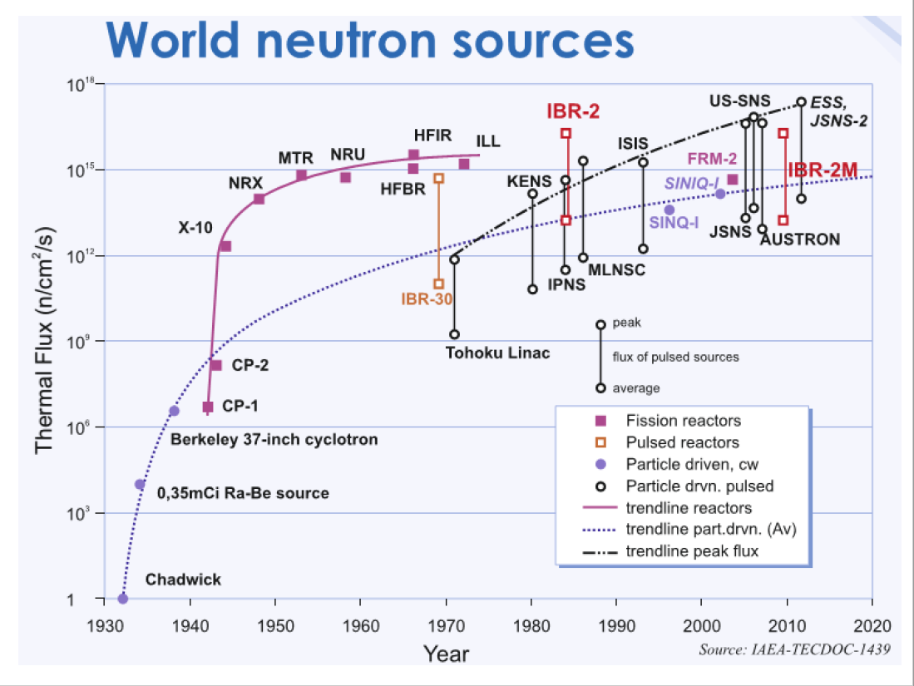

Slide 4
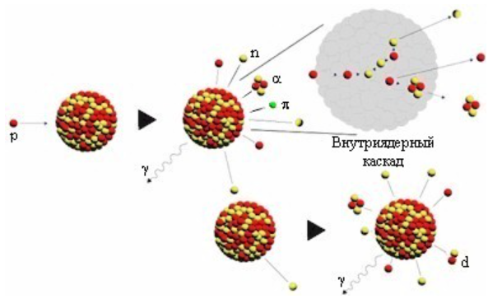

Slide 5
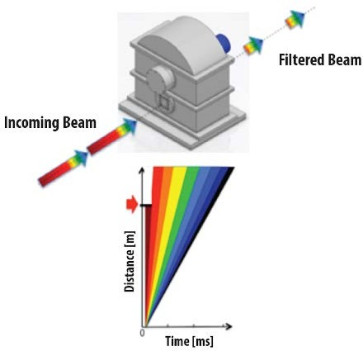
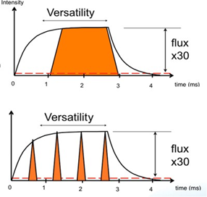

Slide 6
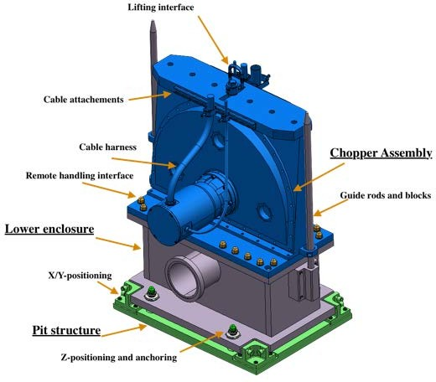

Slide 7
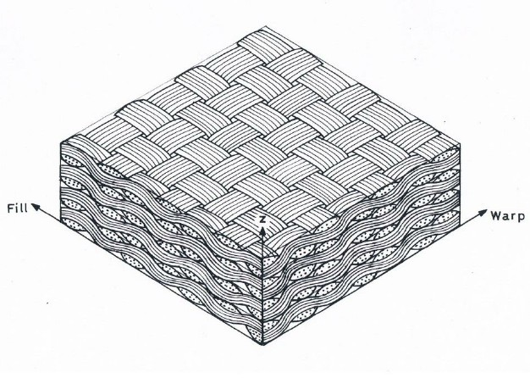
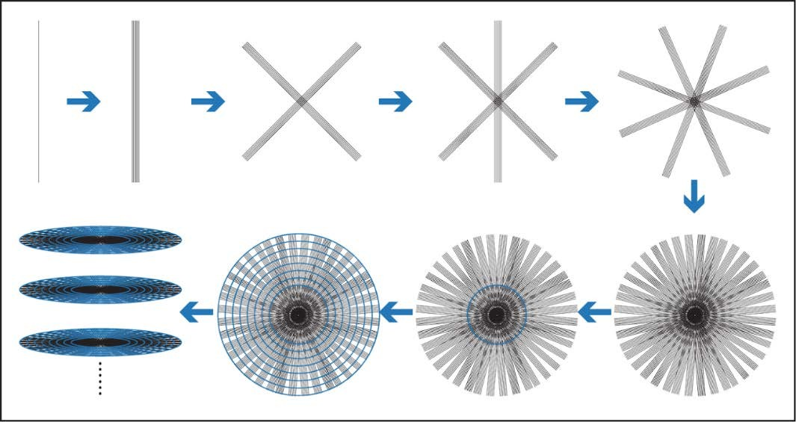

Slide 8
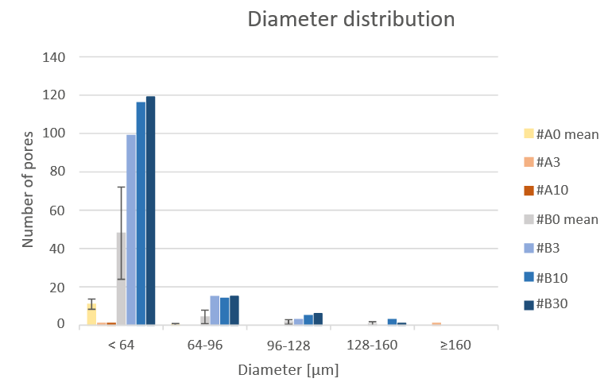

Slide 9
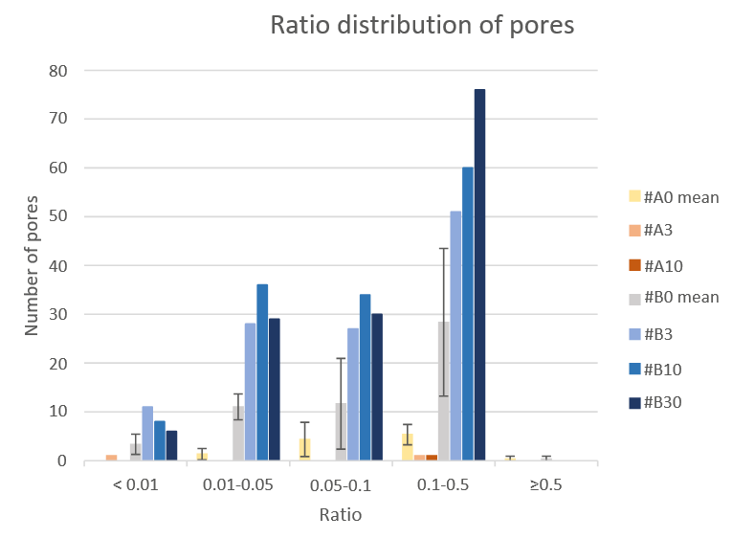

Slide 10
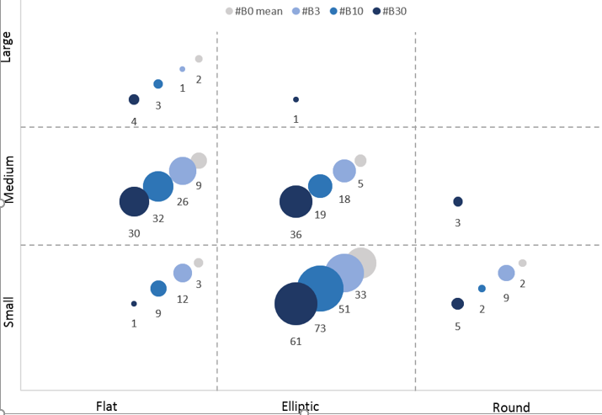

Slide 11
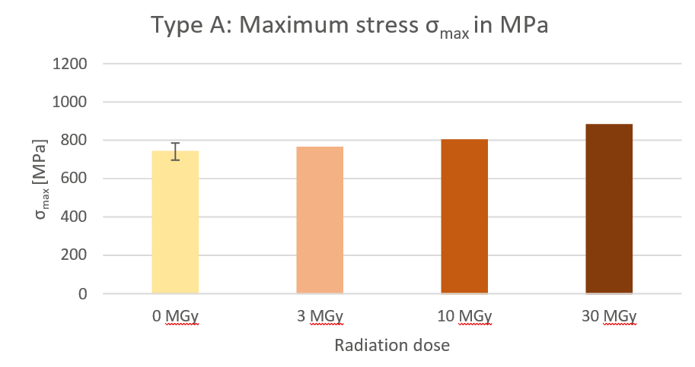

Slide 12
Conclusions:
Increase in the number of pores with increasing dose
No significant changes were found in the mechanical properties with increasing radiation dose.
SEMdid not show any obvious structural changes at different dose levels.

Slide 13
Thanks for your attentions!

