Slide 1

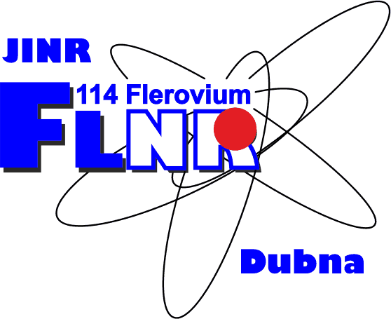
Ion beam irradiation of 12-tungstophosphoric acid – influence of energy of accelerated ions on structural and electrochemical properties
Željko Mravik, Danica Bajuk-Bogdanović, Andrzej Olejniczak, Ivan Trajić, Ljubiša Vukosavljević, Nemanja Gavrilov, Zoran Jovanović
AYSS - 2020
Notes:
Ion beam irradiation is a versatile tool for structural modification and engineering of new materials, where the energy of ions dictates the nature of interactions between accelerated ions and the target. In this study, 12-tungstophosphoric acid (WPA) films of different thickness were spin-coated on platinized silicon substrate and irradiated with: low energy light ions (H- and C+) with energies up to 20 keV and swift heavy ions (Bi, Xe and V) with energies up to 710 MeV. Raman spectroscopy was used as a main technique for investigation of structural properties of irradiated WPA. New wide vibrational bands in regions from 100 to 500 and 600 to 1000 cm-1 were observed in Raman spectra of all irradiated samples which are comparable to the ones recorded for WPA thermally treated at 600 °C. Ratio of these bands compared to the bands of Keggin anion varied with the energy of ions and the sample thickness where swift heavy vanadium ions showed the most prominent change inducing significant modification of 20 µm films and partial modification of 120 nm films. In an attempt to correlate structural changes with electrochemical performance, samples irradiated with low energy light ions where characterized by cyclic voltammetry. 120 nm films irradiated with carbon ions showed increase in lithiation capacity and activity for HER with irradiation, while 20 µm-thick H¬- irradiated samples showed more uniform lithiation with cyclic voltammograms similar to those of phosphate tungsten bronzes.

Slide 2
Outline
Polyoxometalates
  Heteropolyacids (HPAs)
Ion beam irradiation
Motivation
Goals
Results
  Structural characterization
  Electrochemical characterization
Conclusions
Acknowlegements

Slide 3
Polyoxometalates
In polyoxometalates (POMs) a building blocks of transition metal oxoanions (Mo⁶⁺, W⁶⁺, V⁵⁺ and to lesser extent Nb⁵⁺ and Ta⁵⁺) are linked together by shared oxygen atoms to form a wide variety of structures.
Charge of the structure as well as redox characteristics of the substance are strongly dependent of the type of polyhedron assemble.
Corella-Ochoa M.N. et al., Chemistry 18 (2012) 13743-54.
Gumerova, N.I., et al., Nature Reviews Chemistry 2 (2018) 0112.

Slide 4

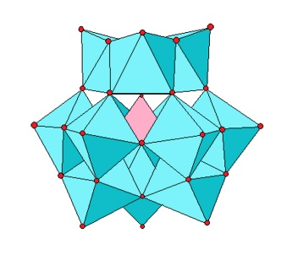
Heteropolyacids (HPAs)
Reversible, multielectron oxidoreduction reaction as well as the significant thermal stability of heteopolyacids make them desirable for various applications. A typical representative of this group is 12-tungstophosphoric acid (WPA)

Slide 5
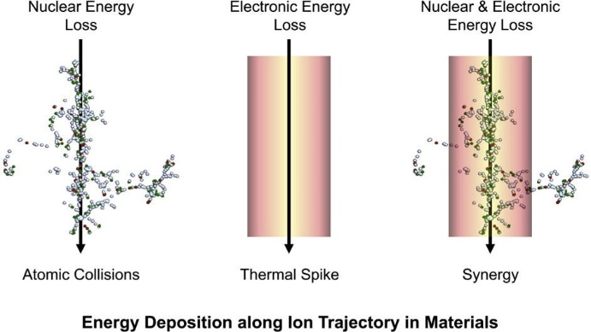
Ion beam irradiation
Ion beam irradiation is a versatile tool for structural modification and engineering of materials which can enable processes far from thermodynamic equilibrium.
Type of interaction between ion and target is highly dependent on the energy of ion beams.
Focused Ion Beam Systems: Basics and Applications, Cambridge University Press, Cambridge, 2007.
Weber W.J. et al.; Current Opinion in Solid State and Materials Science 19 (2015) 1-11.

Slide 6
Ion beam irradiation
Y. Zhang, H.J. Whitlow, Modification of Materials by MeV Ion Beams, Electrostatic Accelerators 2005, pp. 506-529.

Slide 7
Motivation

Slide 8
GO/WPA nanocomposite
In our previous work a nanocomposite of graphene oxide and WPA was synthesized and thermally treated.
Jovanović Z. et al., Electrochemistry Communications 83 (2017) 36-40.

Slide 9
Thermal treatment of GO/WPA nanocomposite
After thermal treatment structural changes were observed
500 ⁰C is critical temperature at which significant structural and chemical changes occur.
This was motivation to use other ion beam irradiation for inducing structural changes of WPA
Jovanović Z. et al., Electrochemistry Communications 83 (2017) 36-40.
We are not aware of literature reports related to ion beam irradiation of polyoxometalates

Slide 10
Goals
Investigation of the influence of energy of accelerated ions on structural and electrochemical properties of WPA.
WPA films of different thickness (120 nm and 20 µm) were spin-coated on platinized silicon substrate and irradiated with: low energy light ions (H and C) with energies up to 20 keV and swift heavy ions (Bi, Xe and V) with energies up to 710 MeV.
Investigation of structural properties of irradiated WPA with Raman spectroscopy.
To correlate structural changes with electrochemical performance, samples irradiated with low energy light ions where characterized by cyclic voltammetry.

Slide 11
Structural characterization

Slide 12
Raman spectra of pristine WPA
Raman spectra of spin-coated WPA showed characteristic bands of Keggin anion.
W=O_{d} bond: 1006 and 991 cm⁻¹
P-O_{a} bond: 982 cm⁻¹ (weak)
W-O_{b}-W bond: 900 cm⁻¹
W-O_{c}-W bond: 530 cm⁻¹
W-O_{a} bond: 216 cm⁻¹
2.5 x 10¹⁵
1.25 x 10¹⁵
5 x 10¹⁴
Unniradiated 120 nm
Unirradiated 20 µm
Raman bands of Keggin anion

Slide 13
Low energy light ions
WPA 120 nm, C 10 keV
C 10 keV
2.5 x 10¹⁵
10 keV carbon ions were used for structural modification of Keggin anion.
Raman spectra showed presence of new wide bands in the regions from 600 to 1000 cm⁻¹ and 200 to 500 cm⁻¹.
1.25 x 10¹⁵
5 x 10¹⁴
Unirradiated 120 nm
Unirradiated 20 µm
Raman spectra of 120 nm WPA irradiated with carbon ions

Slide 14
Low energy light ions
WPA 20 µm, H 10 keV
H 10 keV
To further investigate influence of energy and type of ions on strucutre of Keggin anion, 10 keV hydrogen ions were also used.
Raman spectra showed similar wide bands at in the regions from 600 to 1000 cm⁻¹ and 200 to 500 cm⁻¹ but with perseverance of Keggin anion bands.
1 x 10¹⁷
5 x 10¹⁶
Unirradiated
Raman spectra of 20 µm WPA irradiated with hydrogen ions

Slide 15
Swift heavy ions
WPA 120 nm, V 61 MeV
V 61 MeV
120 nm samples of WPA were also irradiated with swift heavy vanadium ions.
Irradiation with 61 MeV caused partial change in Raman spectra with appearence of wide bands.
Unirradiated
Raman spectra of 120 nm WPA irradiated with vanadium ions

Slide 16
Swift heavy ions
WPA 20 µm, V 61 MeV
Swift heavy ions were also used for modification of thicker samples of WPA.
Irradiation with 61 MeV caused complete change in Raman spectra with well defined wide bands.
V 61 MeV
Unirradiated
Raman spectra of 20 µm WPA irradiated with vanadium ions

Slide 17
Swift heavy ions
WPA 120 nm, Bi 710 MeV
Bi 710 MeV
120 nm samples of WPA were also irradiated with swift heavy bismuth ions.
Bismuth ions of 710 MeV caused almost no change in Raman spectra with perservence of Keggin anion bands.
Raman spectra of 120 nm WPA irradiated with bismuth ions

Slide 18
Swift heavy ions
WPA 20 µm, Bi 710 MeV
Bi 710 MeV
Swift heavy ions were also used for modification of thicker samples of WPA.
Bismuth ions of 710 MeV caused partial change in Raman spectra with perservence of Keggin anion bands.
Unirradiated
Raman spectra of 20 µm WPA irradiated with bismuth ions

Slide 19
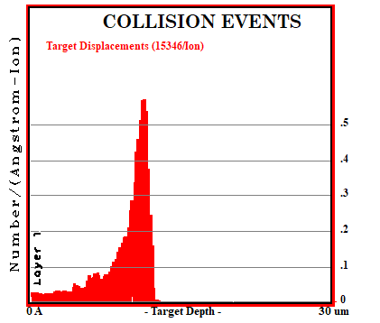
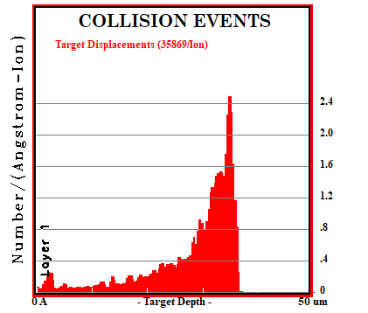
Swift heavy ions – Vanadium and bismuth ions
V 61 MeV
Bi 710 MeV
Target displacement for vanadium ions - SRIM
Target displacement for bismuth ions - SRIM
SRIM calculations show higher amount of target displacement for vanadium ions in the range of WPA thikness.

Slide 20
Type of structural modification
V 61 MeV
900 °C
600 °C
100 °C
Raman shift / cm⁻¹
Raman spectra of 20 µm WPA irradiated with vanadium ions
Raman spectra of bulk WPA thermally tretaed at different temperatures
Raman spectra od thermally treated WPA showed that structural modification induced with ion beams is similar to the thermal treatment at 600°C.

Slide 21
Electrochemical characterization

Slide 22
Cyclic voltammetry of carbon irradiated 120 nm WPA
Lithiathion/delithiation experiments in 0.1 M LiClO₄ in acetonitrile were carried out. After adding H₂SO₄ hydrogen evolution (HER) was observed.
Ion beam irradiation with lower fluence increased lithiathion capacity and activity for HER were observed.
Highest fluence had low lithiathion capacity and activity for HER.
2.5 x 10¹⁵
2.5 x 10¹⁵
1.25 x 10¹⁵
1.25 x 10¹⁵
5 x 10¹⁴
5 x 10¹⁴
Unirradiated
Unirradiated
Unirradiated
Si/Pt

Slide 23
Cyclic voltammetry of carbon irradiated 120 nm WPA
Structural characterisation showed that low fluence caused bond bracking which created active cites for HER and more chanels for lithiathion.
Highest fluence caused increased interconection in the structure with lower number of active cites and closed chanels.
2.5 x 10¹⁵
2.5 x 10¹⁵
1.25 x 10¹⁵
1.25 x 10¹⁵
5 x 10¹⁴
5 x 10¹⁴
Unirradiated
Unirradiated
Unirradiated
Si/Pt

Slide 24
Conclusions
Ion beam irradiation can be used as a tool for structural modification of polyoxometalates.
All ions caused similar changes in Raman spectra of WPA.
Depending on the type and energy of ions the ratio of modified sample can be adjusted. Vanadium ions showed the highest ability for modification both 120 nm and 20 µm samples.
Lower degree of structural modification induced with 10 keV carbon ions was proven beneficial for lithiathion delithiathion process and also increased activity for HER.

Slide 25

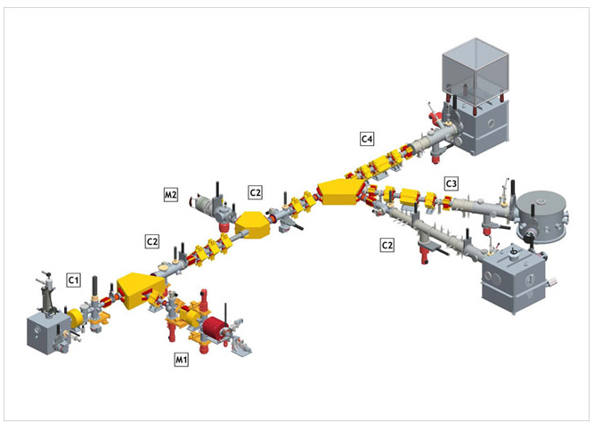
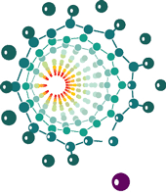
Acknowledgements
The research was supported by the Ministry of Education, Science and Technological Development of the Republic of Serbia
FAMA facility
Laboratory of Physics, Vinča Institute of Nuclear Sciences
Faculty of Physical Chemistry, University of Belgrade, Serbia
Cooperation between JINR and Republic of Serbia
Part of Central European Research Infrastructure Consortium – CERIC.
FAMA enables modification of materials with multiply charged heavy ion beams (M1) of energies of 10-20 keV per charge unit, and with light ion beams (M2) of energies of 15-30 keV.

Slide 26
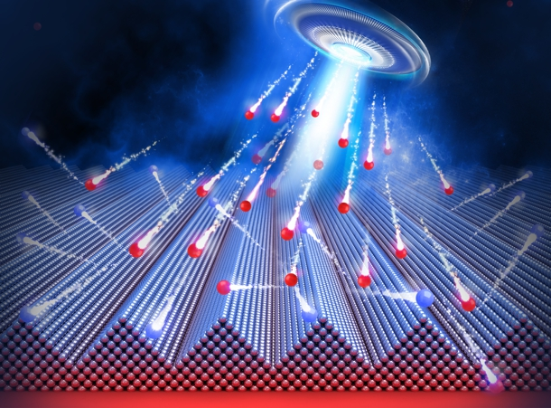
Thank you for attention

