Slide 1



Swift Heavy Ion Irradiation-Induced Changes in Mechanical Properties of Si3N4
The XXIV International Scientific Conference of Young Scientists and Specialists
A.D. Ibrayeva, E. Korneeva, J. Arno Vuuren, L.Kurpaska, M. Clozel, N.Kirilkin, V.A. Skuratov, J.Neethling, M.V. Zdorovets
2020

Slide 2
Si3N4 as a candidate material for inert matrices
The small absorption cross section for thermal neutrons
The resistance at irradiation with neutrons, α particles, and fission fragments.
Good thermal properties
Si3N4 is the ONLY nitride ceramic where latent tracks have been registered

Slide 3
There is almost no data about Si3N4 mechanical characteristics changes induced by swift heavy ion irradiation despite the actuality for its use inert matrix fuel hosts.
Change in microhardness of Si₃N₄ depending on the fluence of 0.5 MeV Si⁺ ions. Circles correspond to T = 450 K, triangles-T=100 K
[Bolse W., Peteves S.D. (1992). NIM B 68(1-4), 331-341]

Slide 4
The purpose of the work
is to study the radiation-induced changes in mechanical properties of Si3N4 under the irradiation with swift heavy ions

Slide 5
Experimental
Incident ion | Energy, MeV | Fluence, cm⁻²
Ar | 46 | 4×10¹³
Kr | 107 | 2×10¹³, 3×10¹³, 1×10¹⁴, 2×10¹⁴
Xe | 167 | 5×10¹², 1×10¹³, 5×10¹³, 5×10¹⁴
 | 220 | 6×10¹¹, 1×10¹³, 2×10¹⁴
Bi | 710 | 1×10¹², 5×10¹², 1×10¹³, 2×10¹³
All samples were irradiated at accelerators in FLNR JINR (Dubna, Russia) and Institute of Nuclear Physics (Nur-Sultan, Kazakhstan)
TEM research was conducted in HR TEM Center of Nelson Mandela University (Port-Elizabeth, South Africa)
Mechanical hardness was measured in National Center for Nuclear Research (Sverk, Poland) and Nazarbayev University (Nur-Sultan, Kazakhstan).

Slide 6
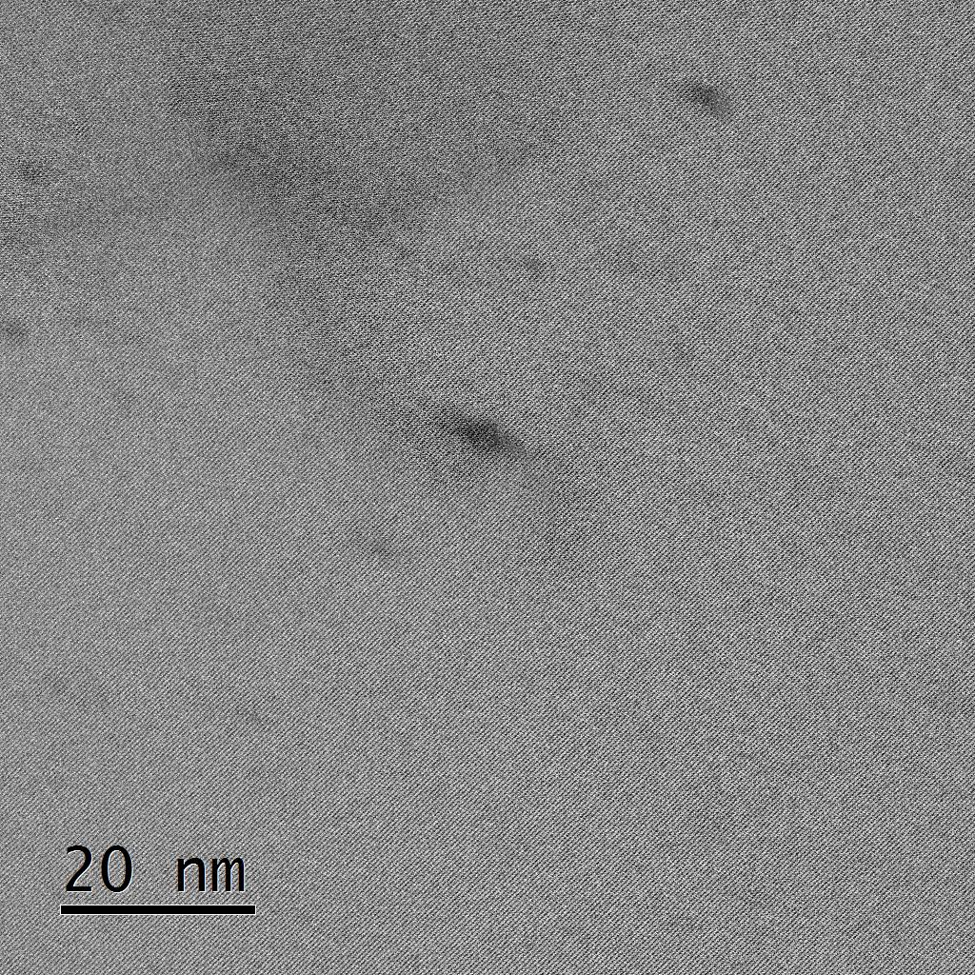
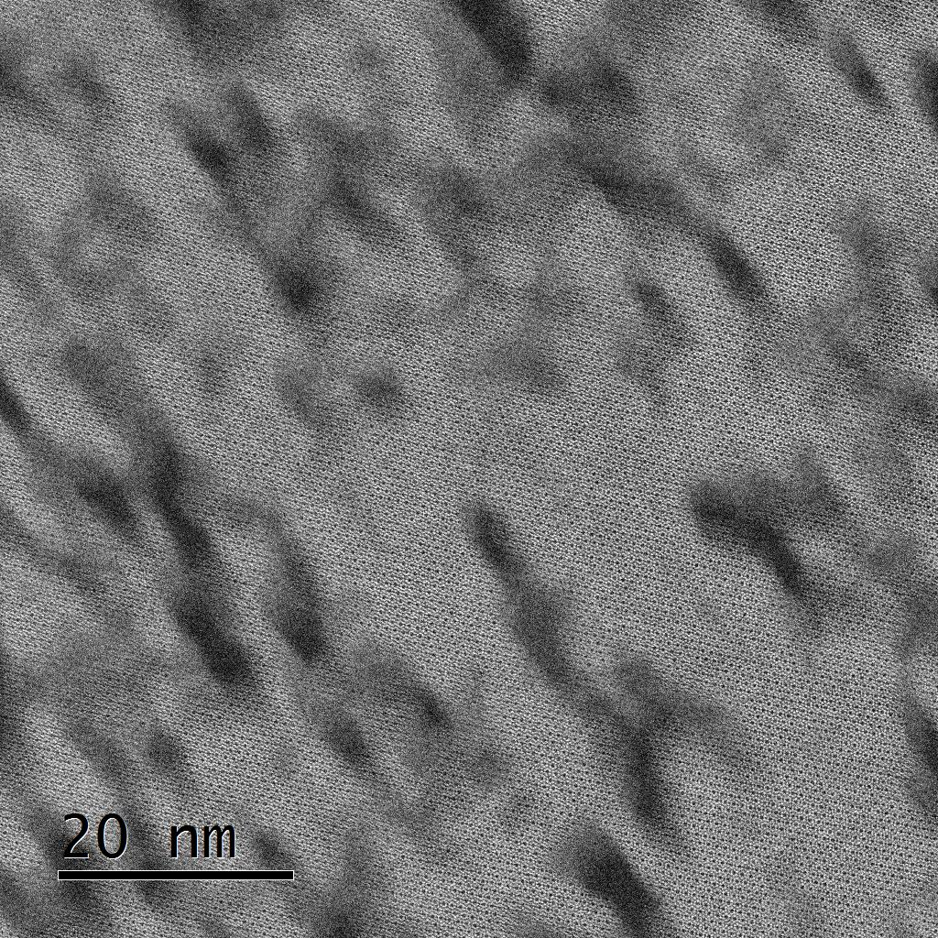
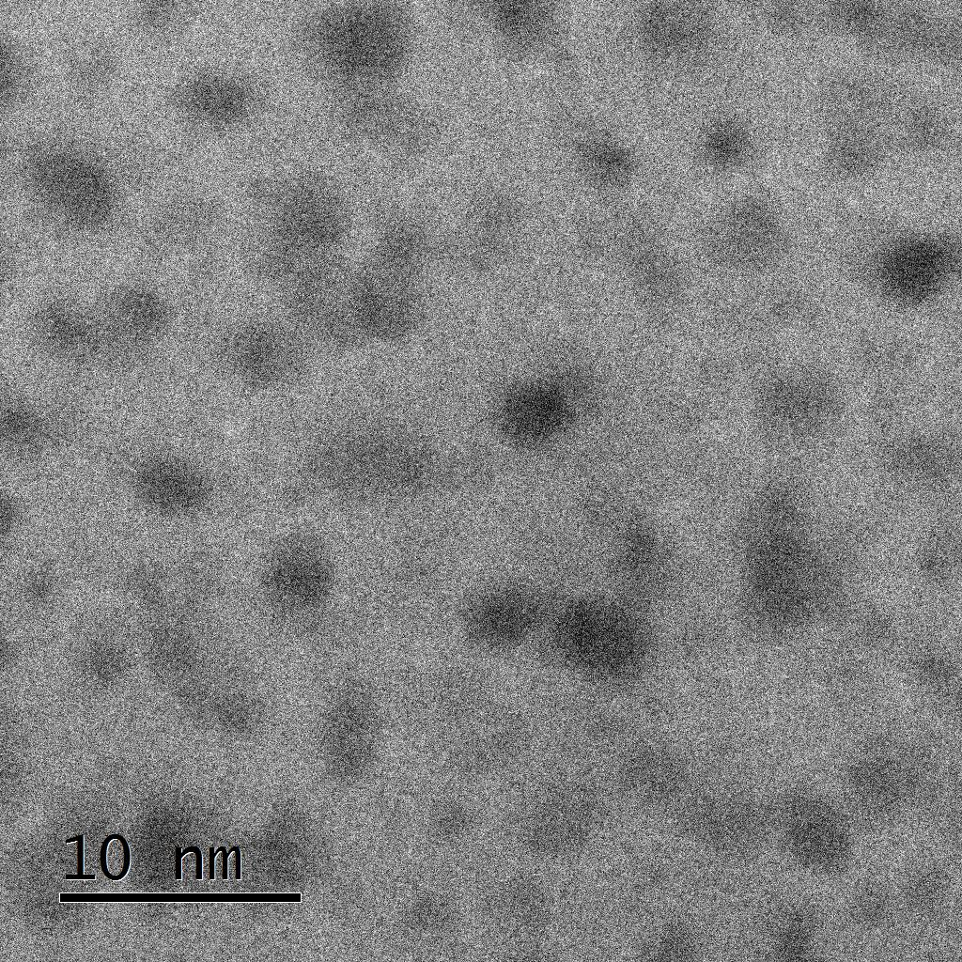
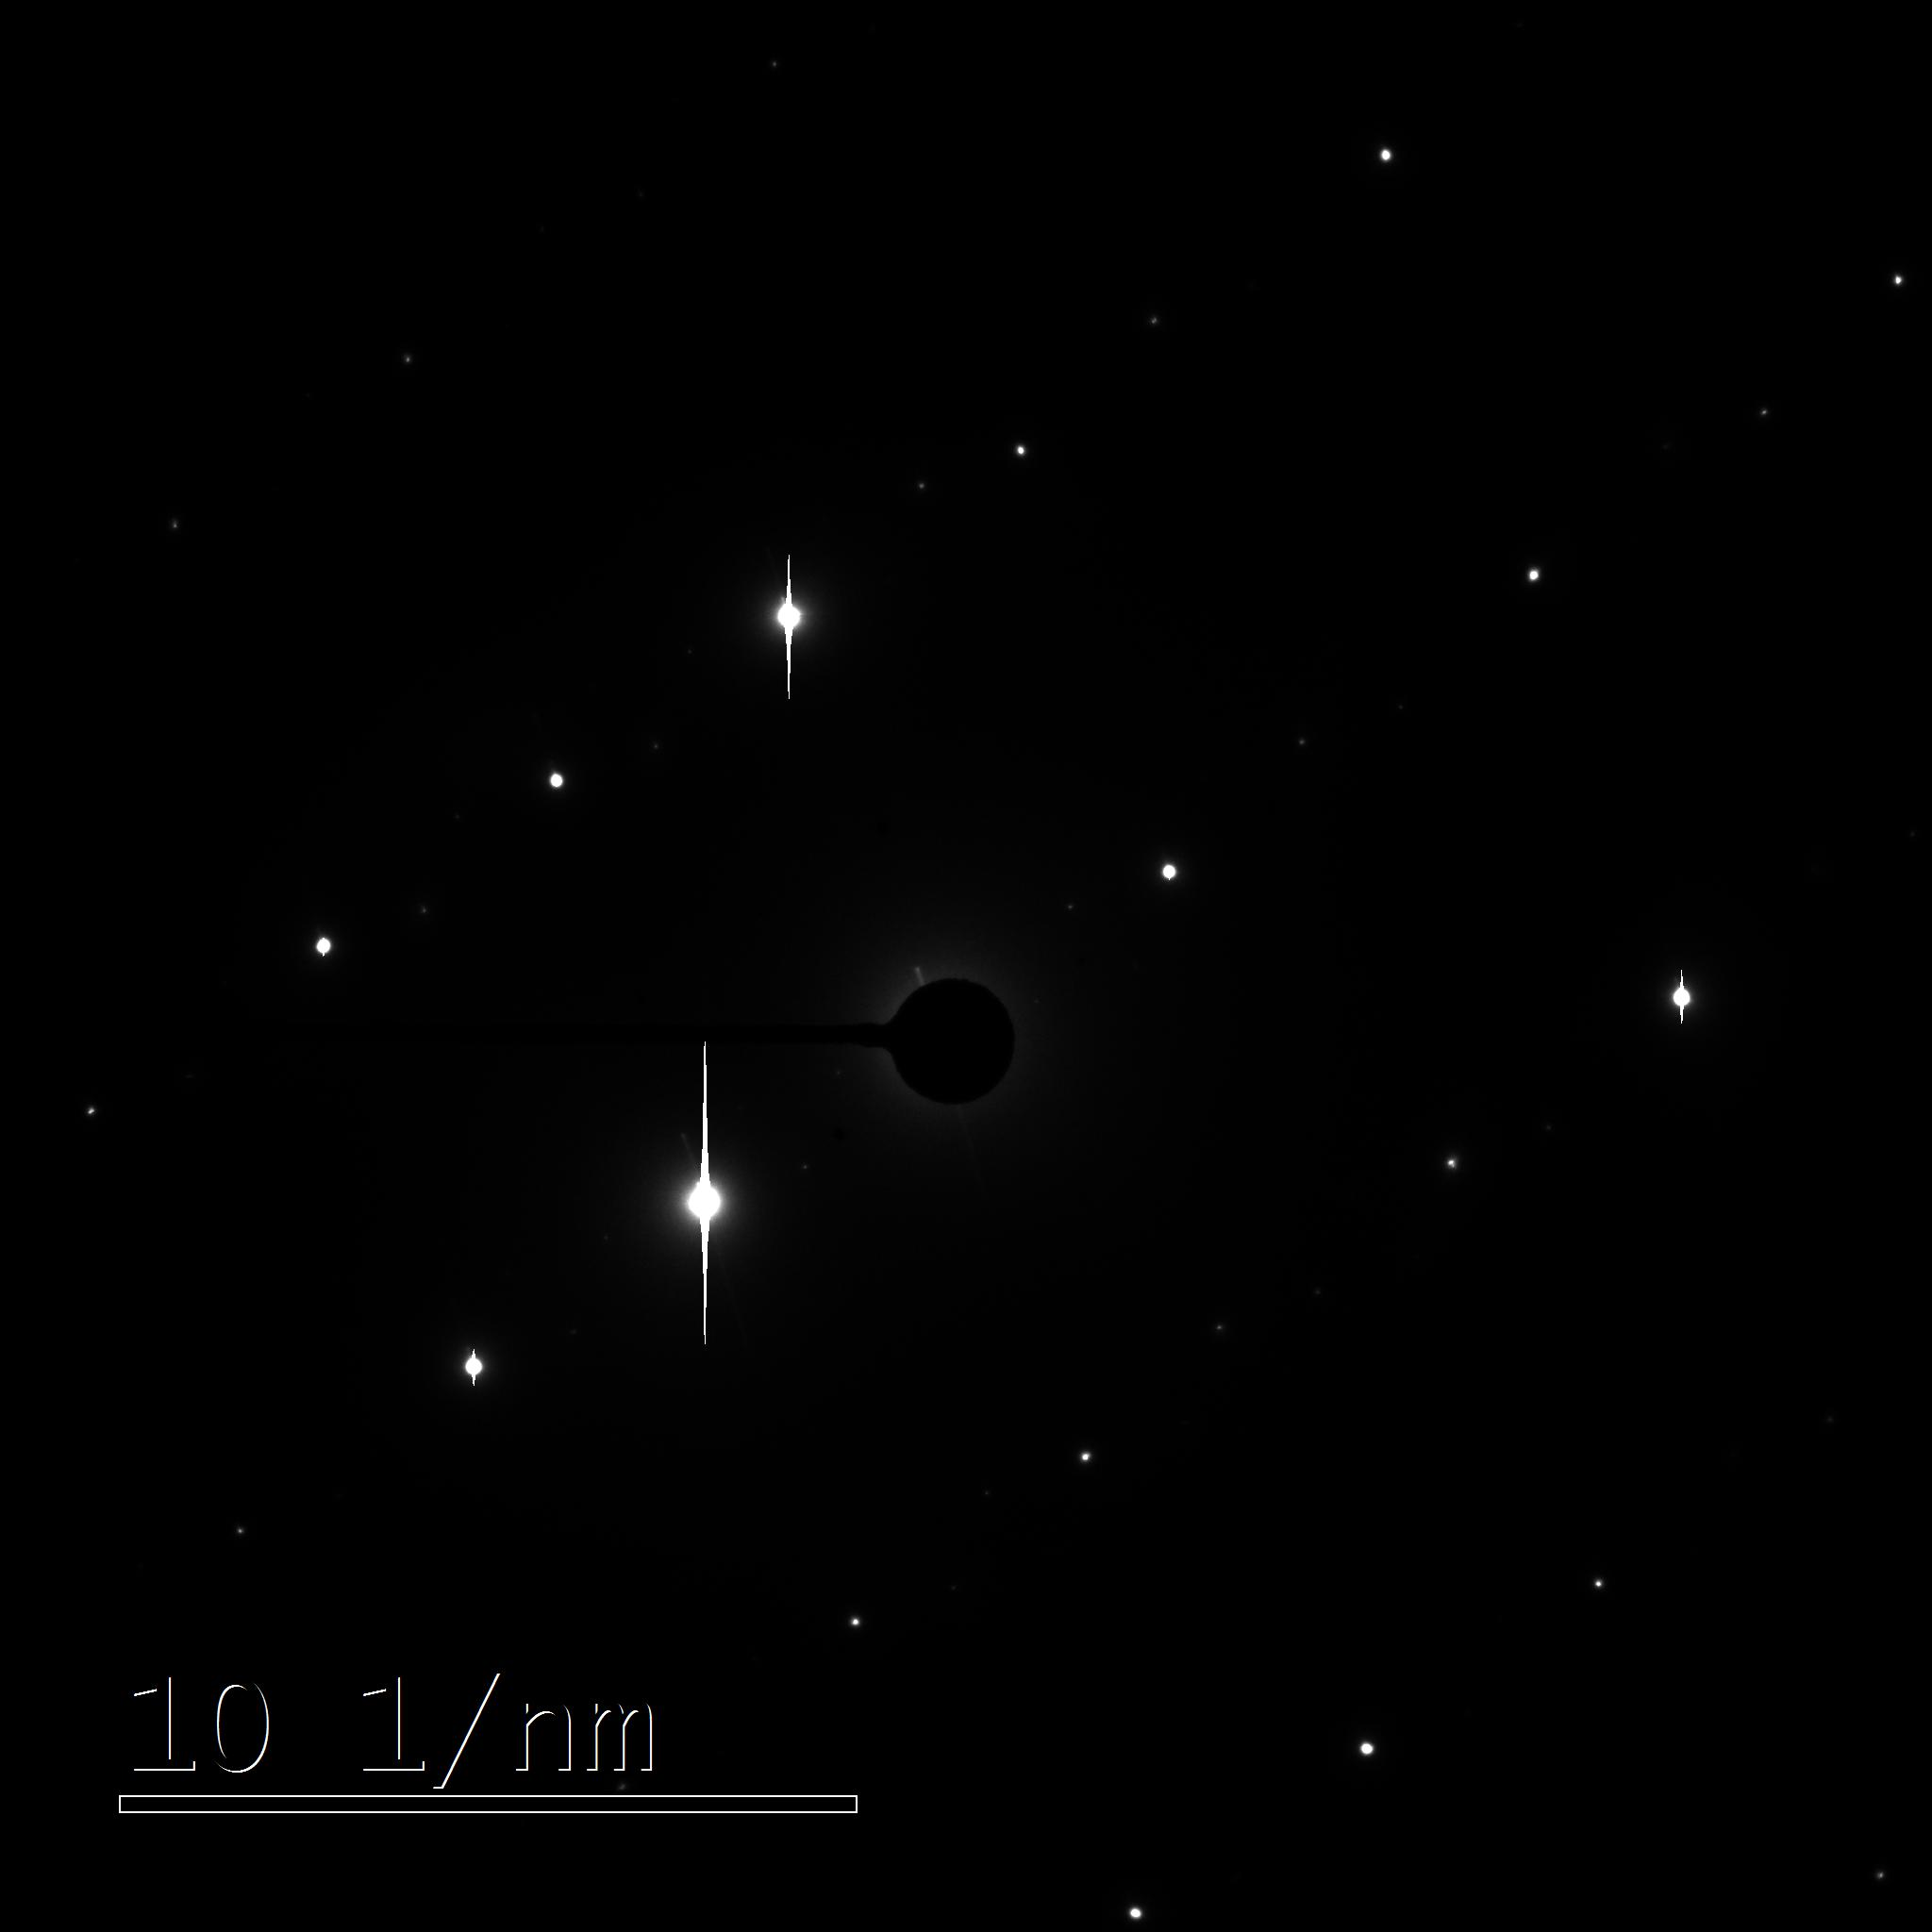
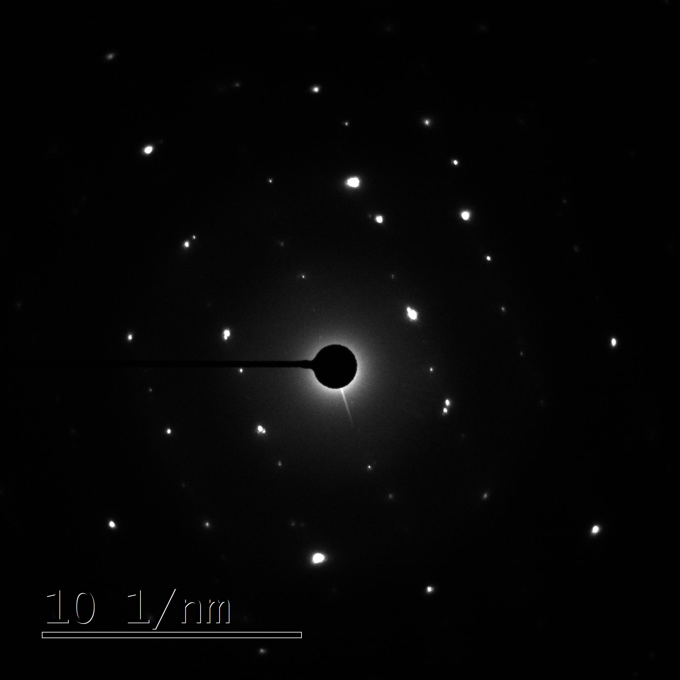
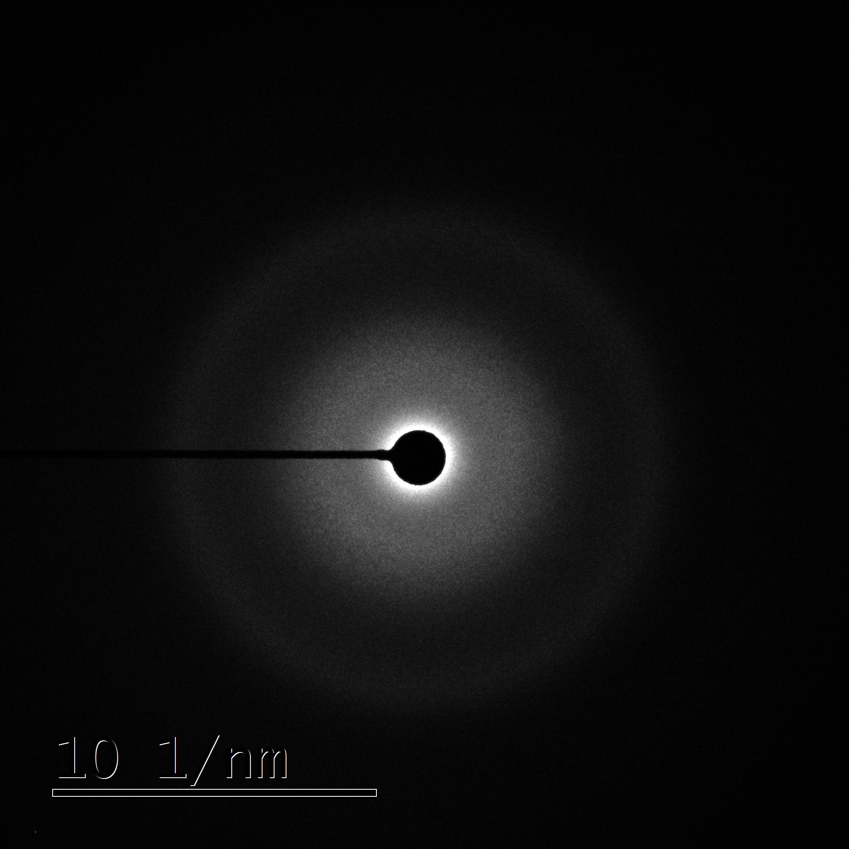
TEM images and SAD of
p-Si3N4+220 MeV Xe
5x10¹¹ cm⁻²
1x10¹³ cm⁻²
2x10¹⁴ cm⁻²

Slide 7
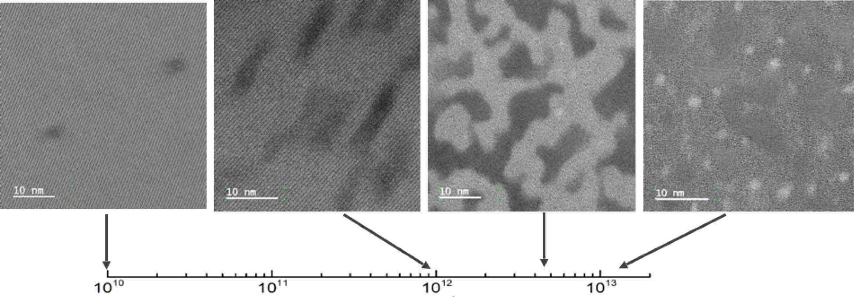
TEM images of
p-Si3N4+710 MeV Bi
Fluence, cm⁻²
Matrix amorphizied under irradiation
Crystalline matrix

Slide 8
Nanoindentation curves of p-Si3N4

Slide 9
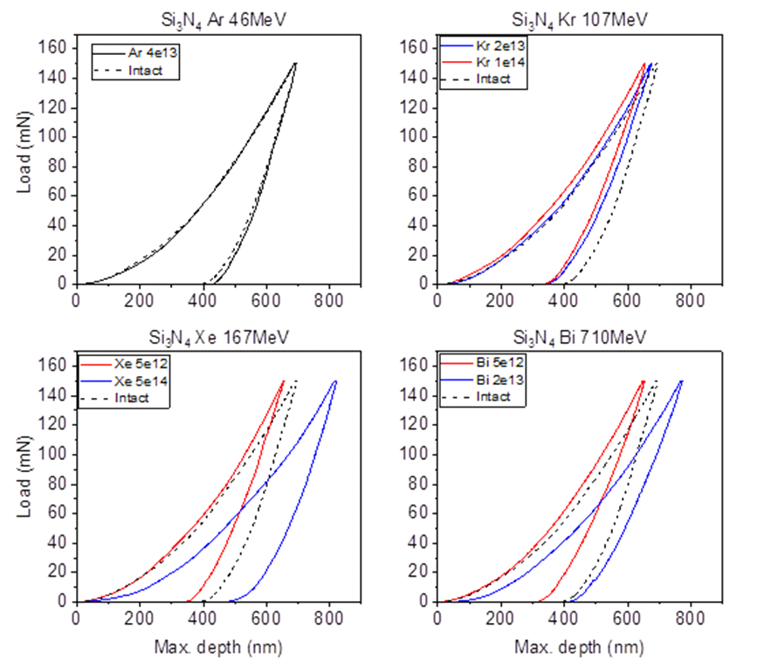
Nanoindentation curves of p-Si3N4

Slide 10
Dependence of relative nanohardness of ion-irradiated p-Si3N4 on fluence

Slide 11
Nanohardness of ion-irradiated p-Si3N4 vs fluence
The hardness of initial samples was 23±2.3 GPa, which corresponds to the literature data for a given load value. The hardness of the irradiated p-Si3N4 is close to the value of the hardness for the unirradiated ones, which is observed up to a fluence of 1 × 10¹⁴ cm⁻². For a sample irradiated with a fluence of 2×10¹⁴ cm⁻², the hardness decreases by 15% compared to the initial sample, and is equal to 17.1±3 GPa
Maximal studied fluencies of Xe and Bi lead to a decrease in the material hardness by ~23 % and ~15%, respectively. However, at slightly lower fluence values of 1×10¹³ cm⁻² for 167 MeV Xe and 5×10¹² cm⁻² for 710 MeV Bi, the sample hardness growth by ~23-25% is observed.

Slide 12
Conclusion
The dependence of the radiation-stimulated change in the mechanical properties of silicon nitride on the fluence of high-energy ions of krypton, xenon, and bismuth has been studied by the nanoindentation method. It was found that irradiation to fluences corresponding to radiation damage doses of ~3×10⁻³ dpa leads to a decrease in material hardness by ~20%.
Hardening was observed for all other SHI-irradiated samples up to a critical fluence which is related to the onset of complete amorphisation, which then results in a decrease in the hardness.
The obtained values of radiation-stimulated changes in material hardness and their non-monotonic character are consistent with the literature data (devoted to silicon nitride irradiated with Si ions with energies of 0.5–1 MeV). Based on both these results it could be suggested that amorphization of the material plays a significant role in changing the mechanical characteristics of nitride ceramics under the irradiation conditions

Slide 13

Thank you for your attention!

