Slide 1

POLARIZED NEUTRON REFLECTOMETRY WITH SECONDARY RADIATION REGISTRATION
Zhaketov Vladimir
Participants of work: V.D. Zhaketov, A.V. Petrenko, Yu.M. Gledenov, Yu.N. Kopach A.N. Gundorin, Yu.V. Nikitenko, V.L. Aksenov
Frank Laboratory of Neutron Physics
Joint Institute for Nuclear Research, Dubna, Russia
The XXIV International Scientific Conference of Young Scientists and Specialists (AYSS-2020), 9-13 November 2020

Slide 2
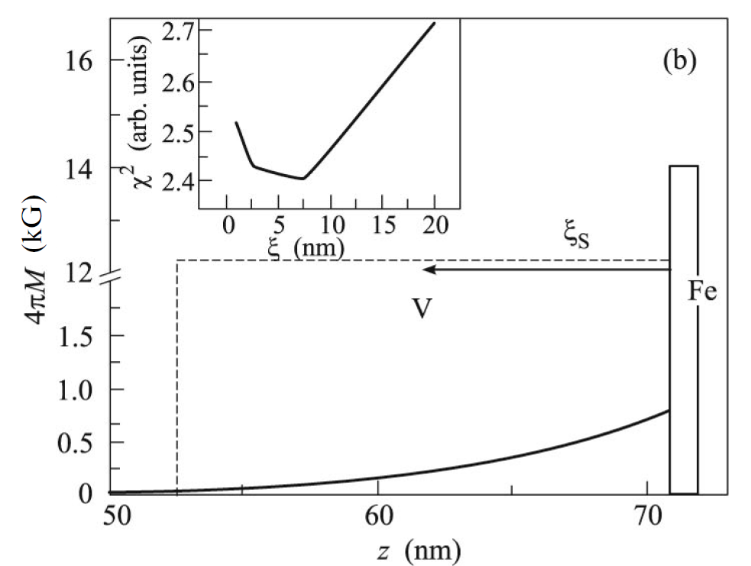
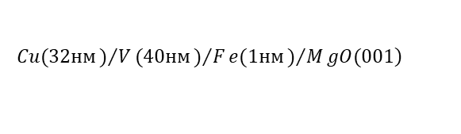


Motivation
Spin-triplet pairing
Proximity effects at the superconducting / ferromagnetic
heterostructures
Spin-triplet superconductivity,
including of a long-range proximity
2. Inverse proximity effect ⇔
magnetization of superconductor
3. Cryptoferromagnetic state in ferromagnet ⇔
antiferr. ordered domains with size 1-100 nm
4. Paramagnetic Meissner effect -
- Positive magnetic moment at cooling in magnetic field
5. Spontaneous vortex phase
at zero external field in superconducting ferromagnetic
$$S_{pair}=1$$
S/F system
Inverse proximity effect
$$d∼1÷{10}^{3} nm$$
$$Yu.Khaidukov, Yu.Nikitenko, V.Aksenov et al.$$
$$\left.Cu(32нм)/V(40нм)/Fe(1нм)/MgO(001\right)$$
1/16

Slide 3
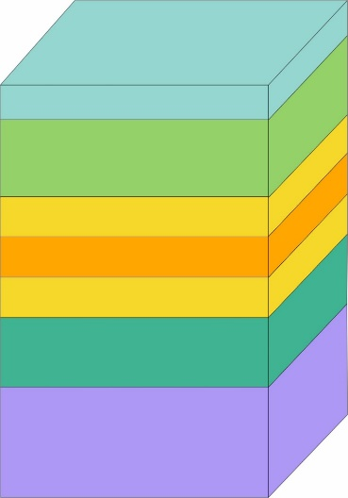
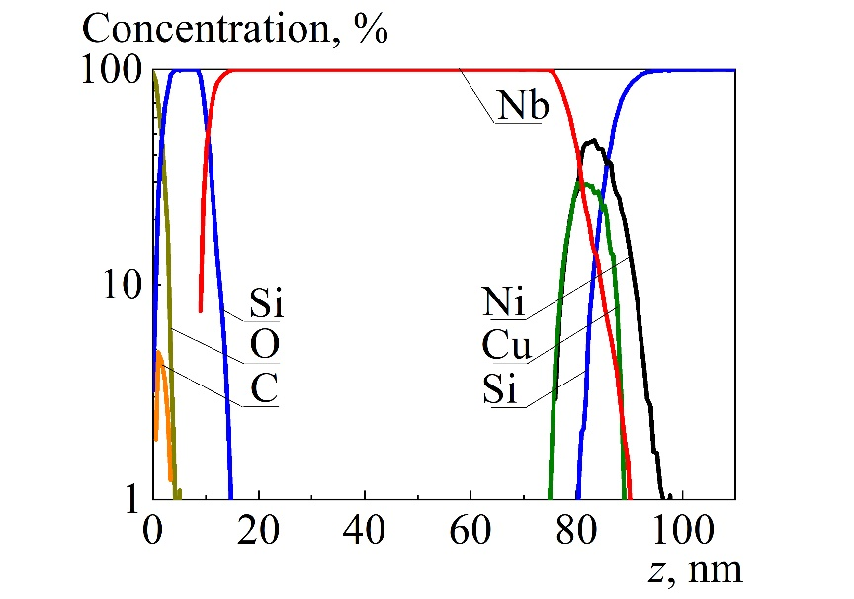
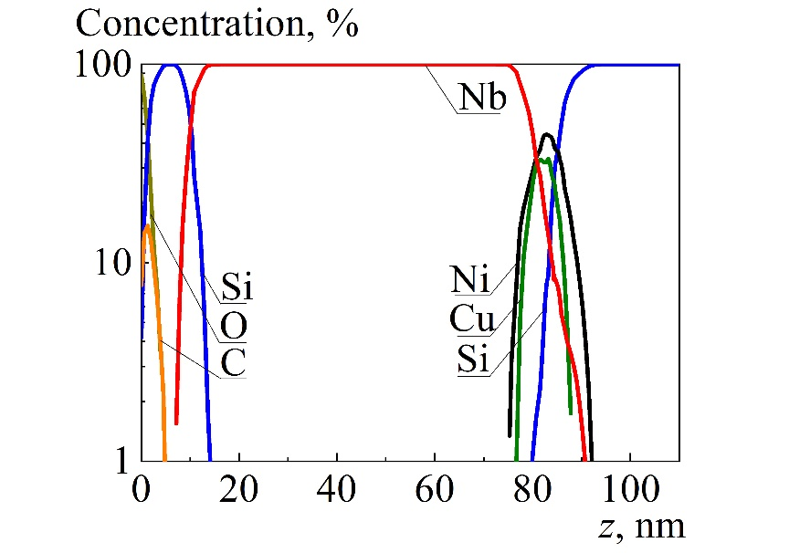
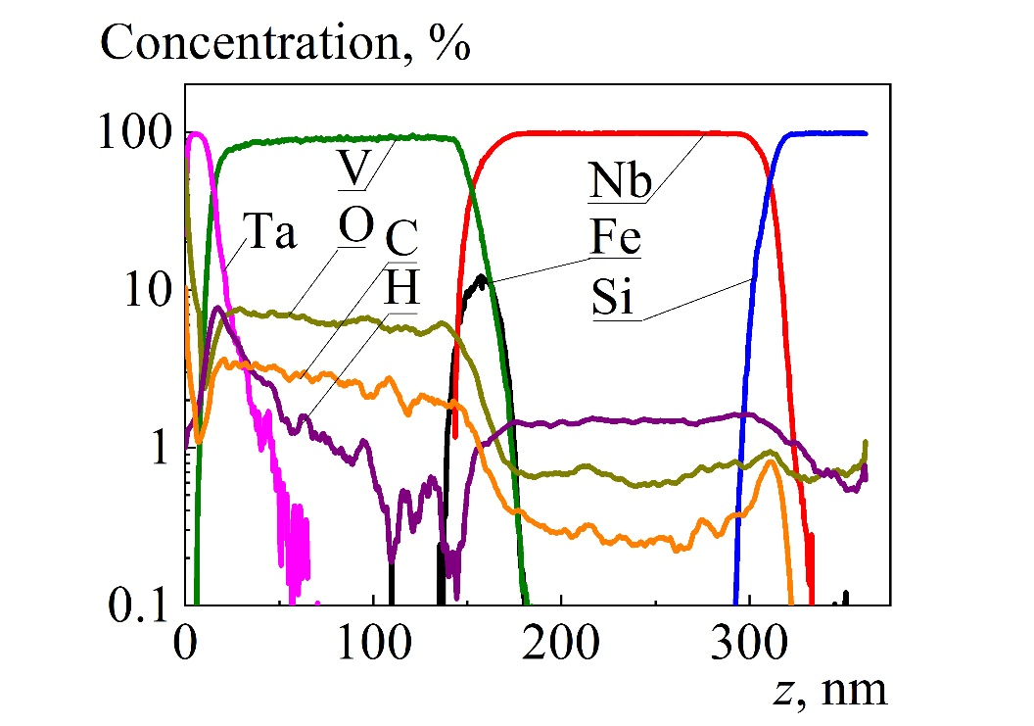




Motivation
Diffusion of elements at interface
Ta(20nm)
Nb(70nm)
$$d_{nominal}∼\text{4} nm$$
V(150nm)
$${d(FM)}_{nominal}∼1 nm$$
Fe_{0.7}V_{0.3}(1nm)
Ni(65%)Cu(35%)(4nm)
2 layers
$${d(FM)}_{real}∼6.5 nm →8.8 nm$$
V(1.2nm)
Fe_{0.7}V_{0.3}(1nm)
Substrate (Si, 1 mm)
Nb(150nm)
$${d(FM)}_{real}∼20 nm$$
Cu→Nb
Si(0.5mm)
9 month after manufacturing
15 month after manufacturing
2/16

Slide 4
Motivation
Tasks to the experimental method
Task 1
Definition at interface the spatial profiles of elements
To determine magnetic profile – only polarized neutron reflectometry (PNR)
Use different methods for spatial profile:
  poor fit and correspondence of experimental data
  samples change
  disadvantages of the other methods
Question: how improve PNR to get spatial profile of separate element or its isotope ?
Task 2
Correspondence of magnetic profile to element profile
3/16

Slide 5
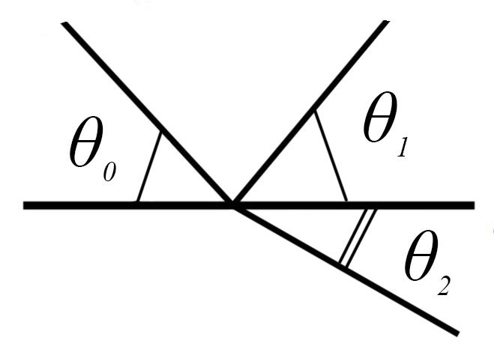

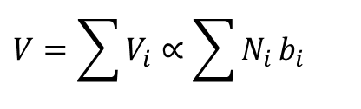

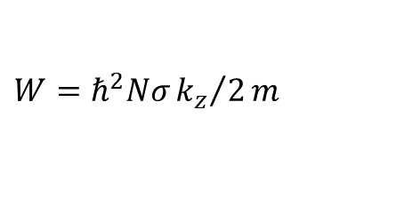


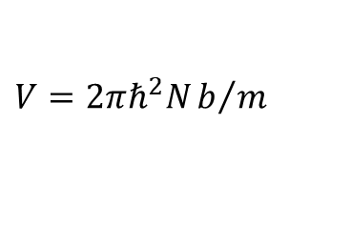

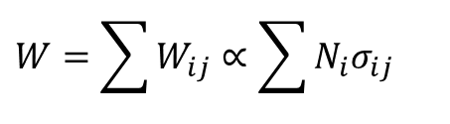




Conventional neutron reflectometry
$$λ=1÷15 Å$$
$$θ=2÷20 mrad$$
$$Q_{z}≈{10}^{−3}÷{10}^{−1} Å^{−1}$$
$$Δz=1÷1000 nm$$
$$δΔz=1 nm$$
$$J(magnetiz.)≈1 G÷20 kG$$
Initial beam
At interface of two and more isotopes:
$$V=\sum{V_{i}}∝\sum{N_{i}}b_{i}$$
$$W=\sum{W_{ij}}∝\sum{N_{i}σ_{ij}}$$
i – isotope
j – type of secondary radiation
$$U=V−iW$$
$$V=2πℏ^{2}Nb/m$$
$$W=ℏ^{2}Nσ{k_{z}}/2m$$
$$W={10}^{−5}÷{10}^{−3}\text{​ }V$$
Geometry of experiment
$$ΔU(z)⇔ΔN_{i}(z) ?$$
4/16

Slide 6
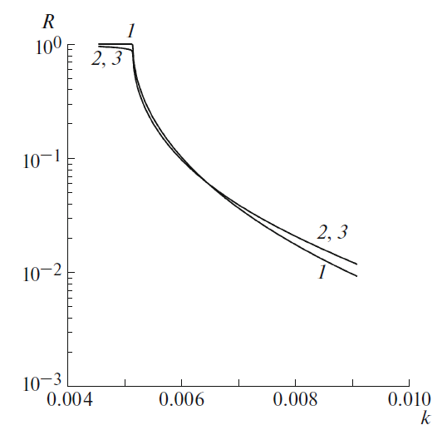
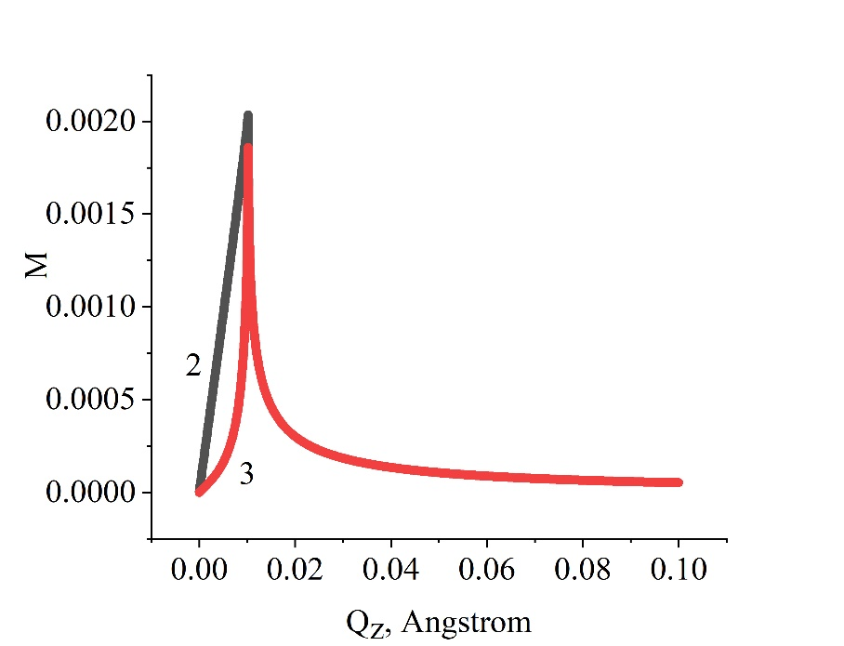


Neutron reflectometry disadvantages
Neutron reflectometry gives information only about integral distribution of the coherence length density for all elements and their isotopes.
In the case of low absorption in the system (several % or less), classical reflectometry does not allow determining the neutron absorption coefficient
$$U=\sum{U_{i}}$$
$$M=1−R$$
Absorption coefficient
for 2 and 3 cases
1 – interface vacuum/Al
2 – structure vacuum/(Al+¹⁰B)(1nm)//Al
3 – structure vacuum/Al(20nm)/(Al+¹⁰B)(1nm)//Al
Yu.V.Nikitenko et al. Isotope-Identifying Neutron Reflectometry
// Crystallography reports, 2017, vol.60, No.4, pp. 466-479
5/16

Slide 7
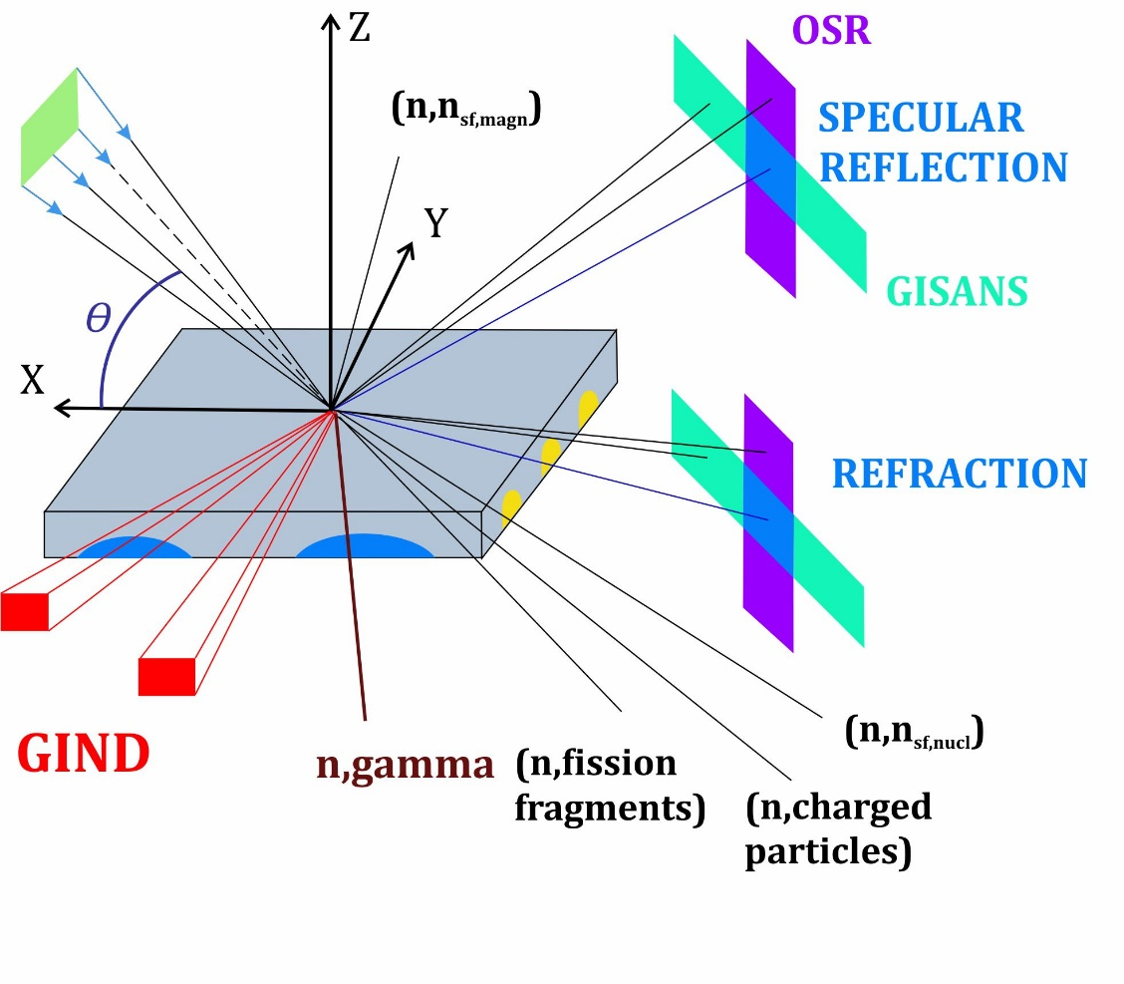

Secondary radiation
charged particles (n, α); (n, t); (n, p)
gamma quanta (n, γ)
fission fragments (n, f)
coherent spin-flip neutrons because of passage through magnetically non-collinear medium
incoherently scattered neutrons on atomic nuclei
inelastically scattered neutrons by atoms and the medium
diffusely scattered neutrons at interfaces and inhomogeneities in the structure layers
Initial beam
$$σ=σ_{abs}+σ_{nc}+σ_{diff}+σ_{inel}$$
6/16

Slide 8
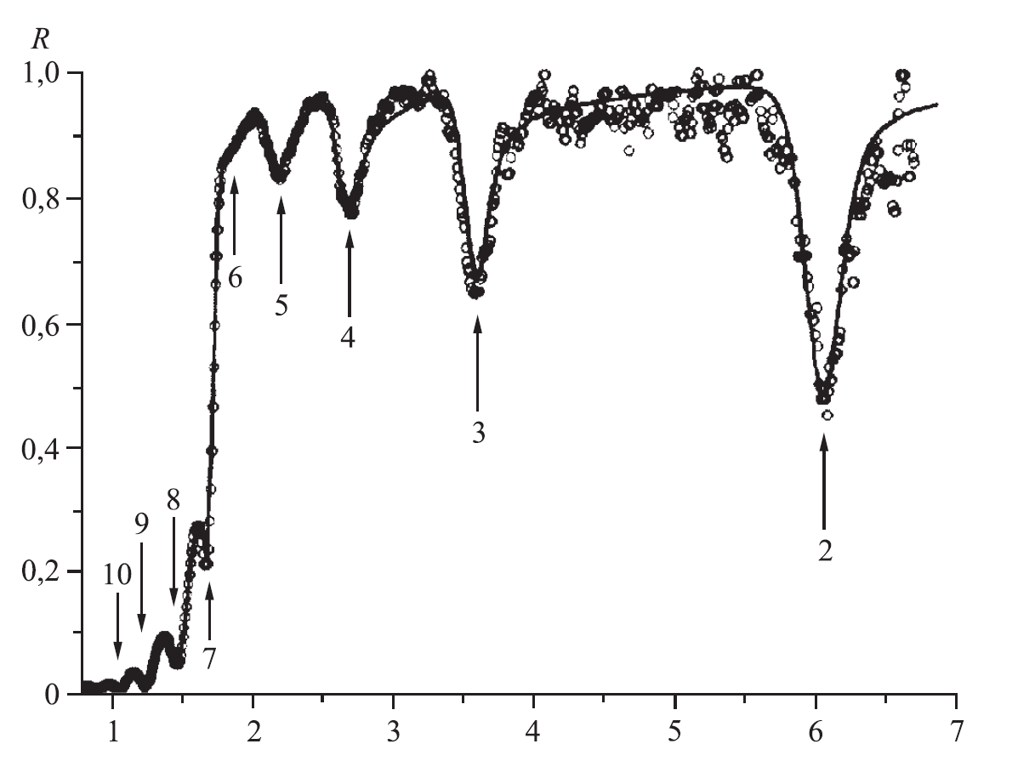
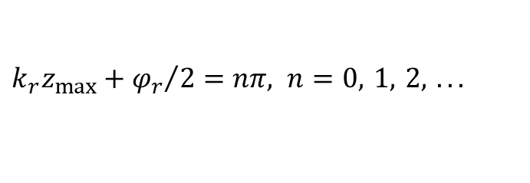



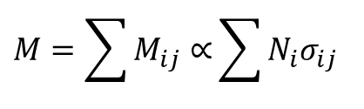










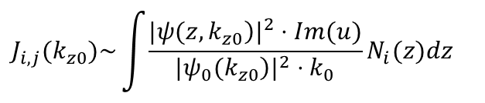
Standing wave mode
$$W={10}^{−5}÷{10}^{−3}\text{​ }V$$
Total reflection
$$V>0$$
$$k_{0z}<k_{v}$$
$$R+T+M=1$$
$$M=\sum{M_{ij}∝}\sum{N_{i}σ_{ij}}$$
$$T=0$$
i – isotope
j – type of secondary radiation
Standing waves
⁶$LiF(19nm)/Ti(200nm)/Cu(100nm)/glass$
$$η_{max}=4$$
$${\left|ψ(z,k)\right|}^{2}={\left|ψ_{d}(z,k)+ψ_{b}(z,k)\right|}^{2}$$
$$k_{r}z_{max}+{φ_{r}}/2=nπ, n=0, 1, 2, ...$$
Enhanced standing waves
$${\left|ψ\right|}^{2}$$
$$k_{Res_0}$$
$$η_{max}(nucl. density)≈{10}^{5}$$
$$η_{max}{(R}_{sf})≈{10}^{10}$$
$$k_{Res_1}$$
Secondary radiation
    $$J_{i,j}(k_{z0})\sim \int{\frac{{|\left.ψ(z,k_{z0}\right)|}^{2}⋅Im(u)}{{|\left.ψ_{0}(k_{z0}\right)|}^{2}⋅k_{0}}}N_{i}(z)dz$$
$$k_{Res_2}$$
$$z$$
7/16

Slide 9
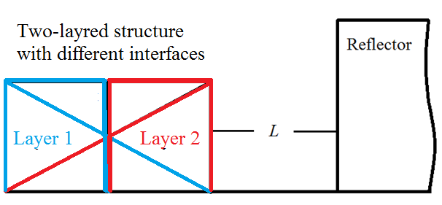
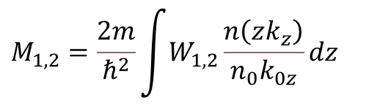
Interface profile through absorption through secondary radiation
Model calculations
$$M_{1,2}=\frac{2m}{ℏ^{2}}\int{W_{1,2}\frac{\left.n ( zk_{z}\right)}{n_{0}k_{0z}}}dz$$
8/16

Slide 10
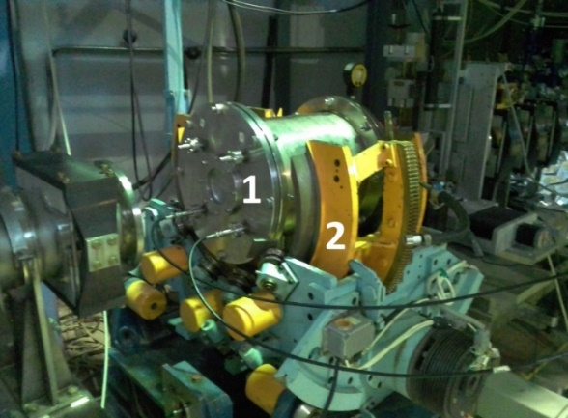
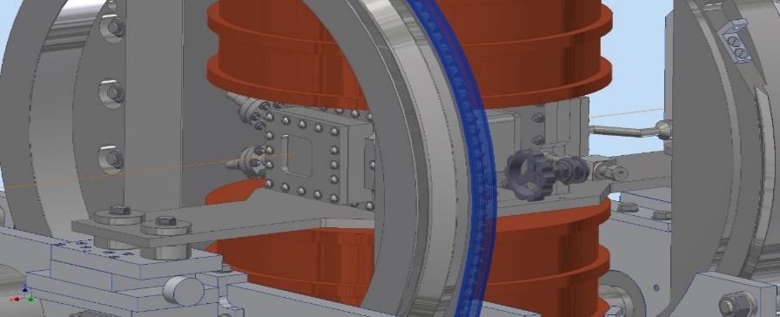
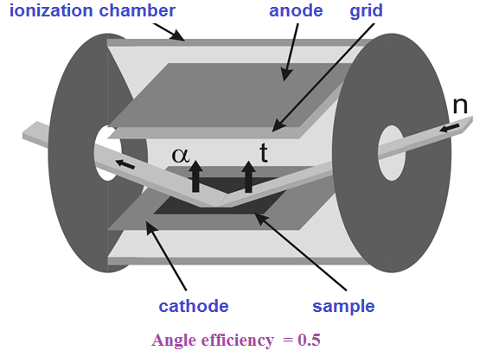
Charged particle detection channel at the REMUR
Measurements scheme
1 – ionization chamber
2 – goniometer
Perspective: possibility for detection of charged particles with simultaneous application of magnetic field
9/16

Slide 11
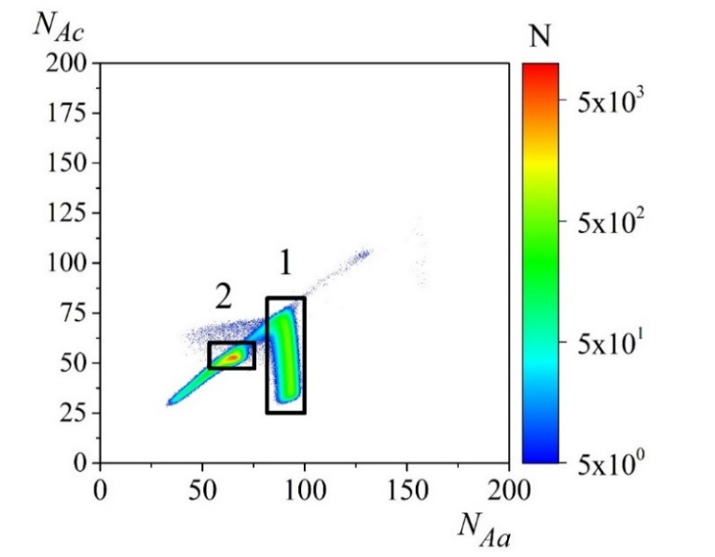
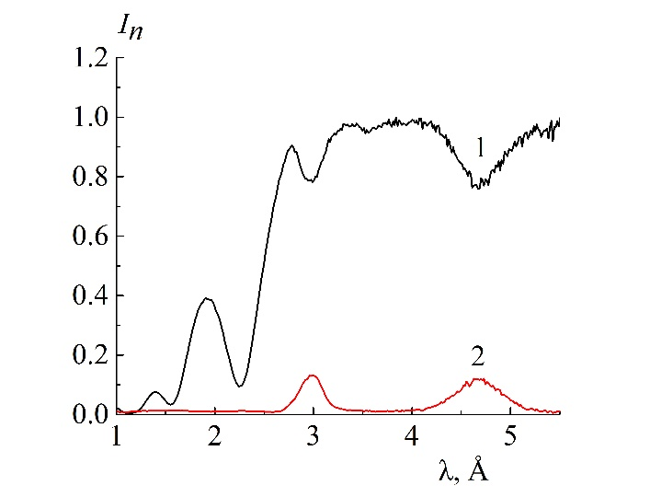
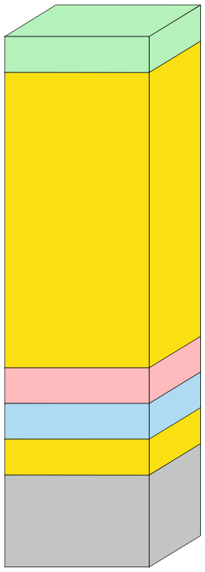
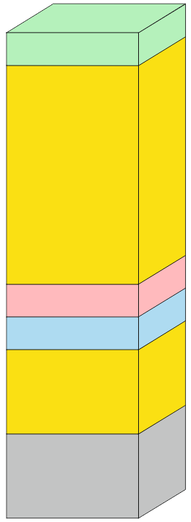
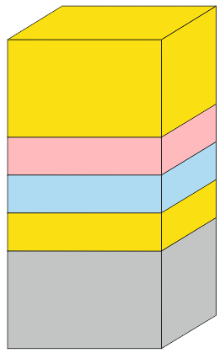
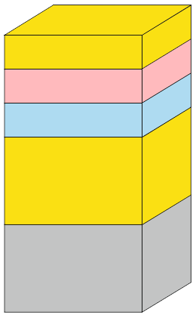
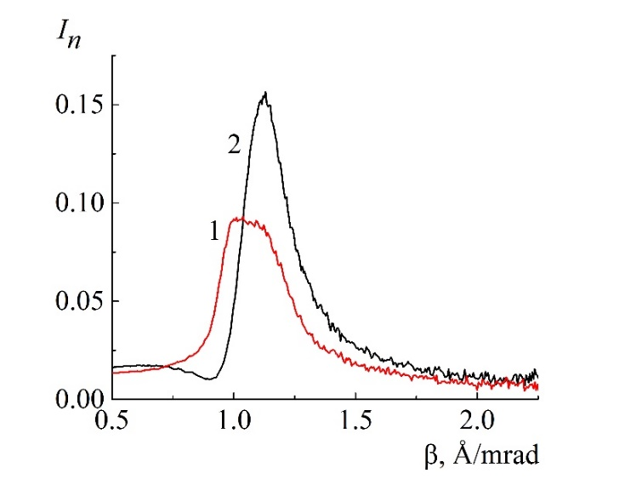
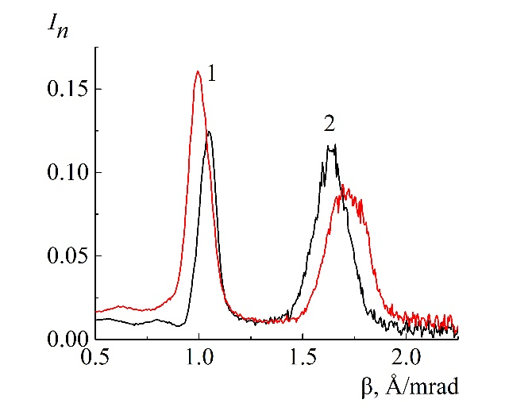


Charged particle detection channel at the REMUR
$$θ=3 mrad$$
$$n+{}_{ }^{6}Li→{}_{ }^{3}T+{}_{ }^{4}He$$
1 – tritons
2 – alpha-particles
Atmosphere of Ar + 3% CO₂ at pressure 1.5 bar – effective for triton registration with energy 2.73 MeV.
Sample №4
1 - neutron reflectivity
2 - secondary radiation
Cu (10nm)
Cu (10nm)
Charged particles 2d-map
Normed spectra
V (20nm)
V (10nm)
CoFe (5nm)
V (65nm)
V (55nm)
CoFe (5nm)
6LiF (5nm)
6LiF (5nm)
V (15nm)
CoFe (5nm)
V (5nm)
6LiF (5nm)
Substrate (Si)
Substrate (Si)
CoFe (5nm)
1 - sample №1
2 - sample №2
1 - sample №3
2 - sample №4
6LiF (5nm)
V (15nm)
V (5nm)
Sample №1
Sample №2
Substrate (Si)
Substrate (Si)
Sample №3
Sample №4
Secondary radiation coefficient
10/16

Slide 12
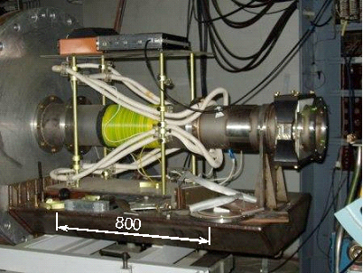
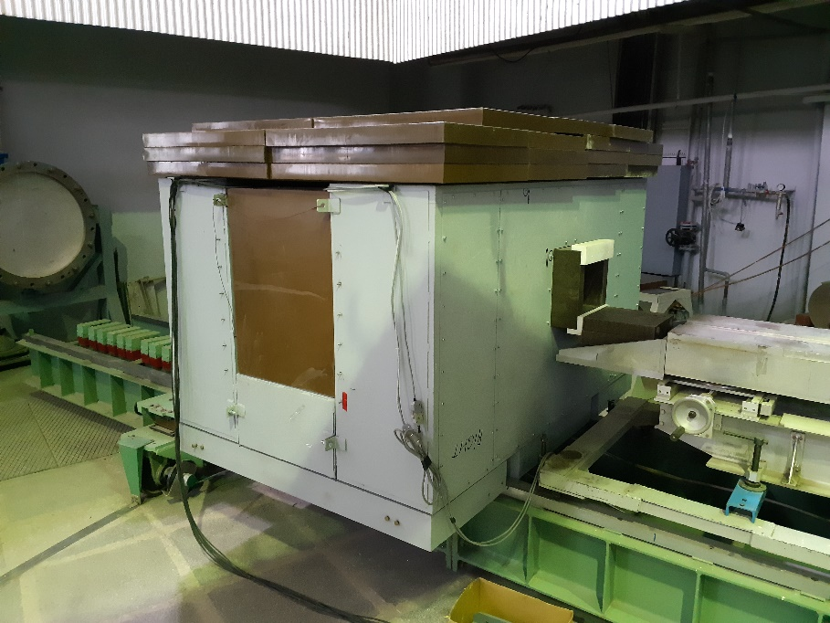
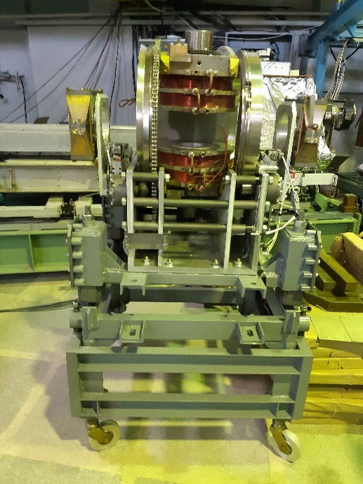
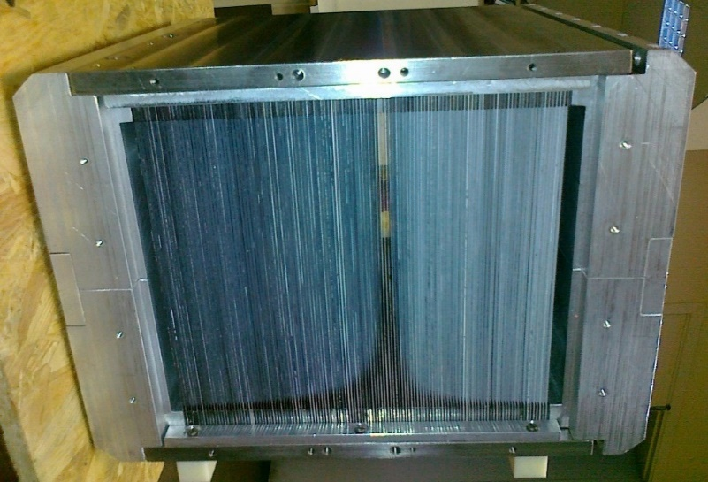





Polarized neutrons detection channel at the REMUR
$$m2−supermirror$$
Polarizer:
Spin-flippers: radio-frequent with steady gradient magnetic field
Polarization analyzer: focused multichannel with 125 m2-supermirrors and cross-section 20cm·20cm (5 m from sample position)
$S=10 cm⋅80 cm (4 m from sample position$)
$$Δθ=1 mrad$$
$$I_{sample}=2⋅{10}^{4} cm^{−2}s^{−1}$$
$$δλ=0.02 Å$$
$$f=75 kGz$$
Spin-flipper
Wide-aperture analyzer
polarization
Background protection for PSD-detector and polarization analyzer
Electromagnet
11/16

Slide 13
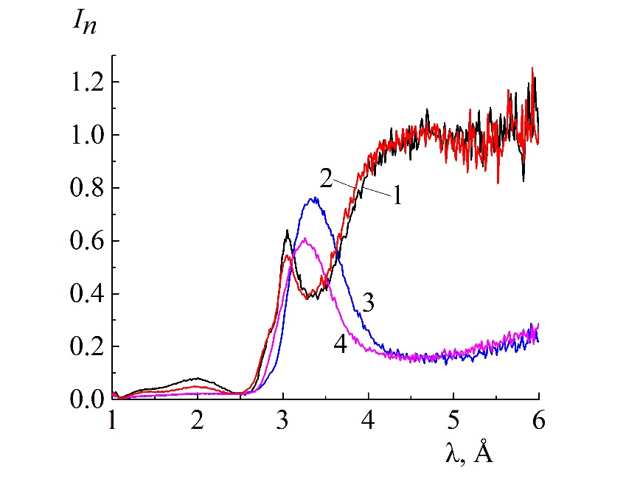
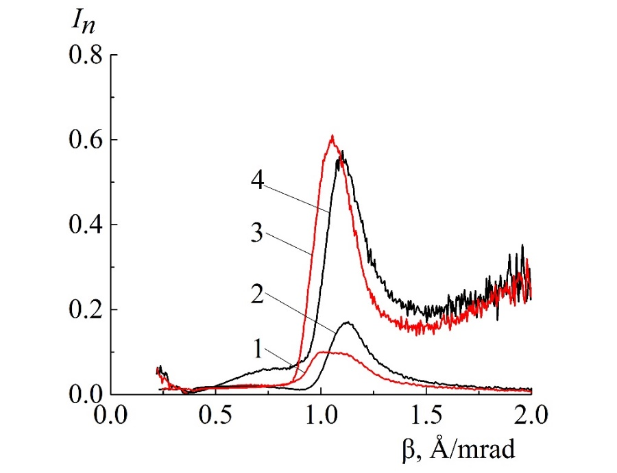





Polarized neutrons detection channel at the REMUR
V (10nm)
Sample 1
V (20nm)
CoFe (5nm)
CoFe (5nm)
6LiF (5nm)
6LiF (5nm)
V (15nm)
V (5nm)
Substrate (Si)
Substrate (Si)
Sample №1
Sample №2
$$1−I_{off,off}; 2−I_{on,on}; 3−I_{off,on}; 4−I_{on,off}$$
1, 2 – absorption
3, 4 – spin-flip
$$70°$$
$$H=295 Oe$$
$$70 degrees$$
$$3.11 mrad$$
$$\vec{H}$$
12/16

Slide 14
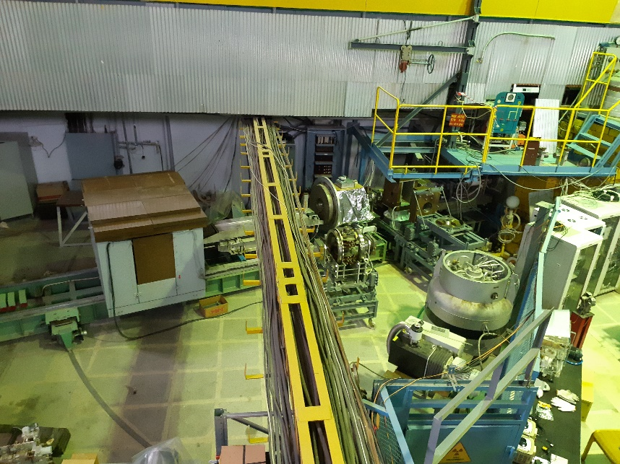
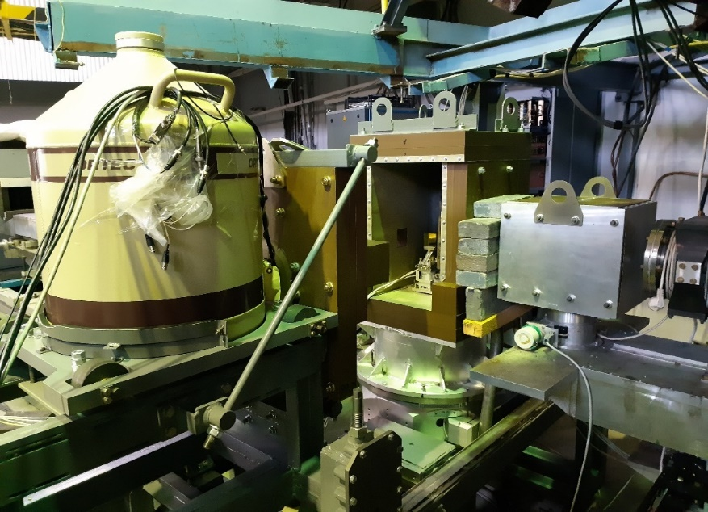
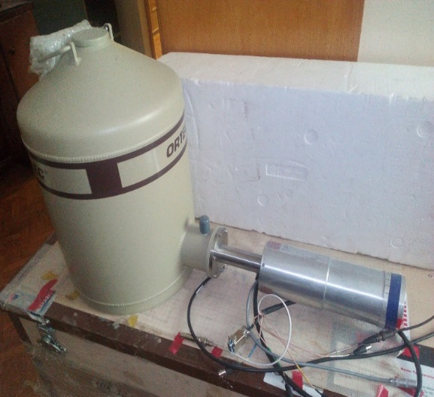
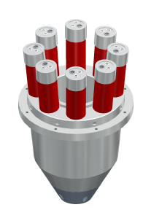
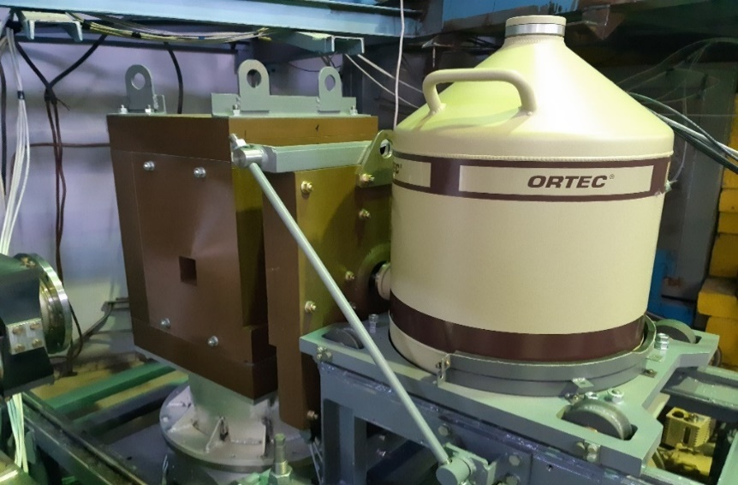
Gamma quanta registration channel at the REMUR
REMUR
Gamma detector and sample position
Gamma-detector
Anti-compton detector scattering
Gamma detector and sample position
13/16

Slide 15
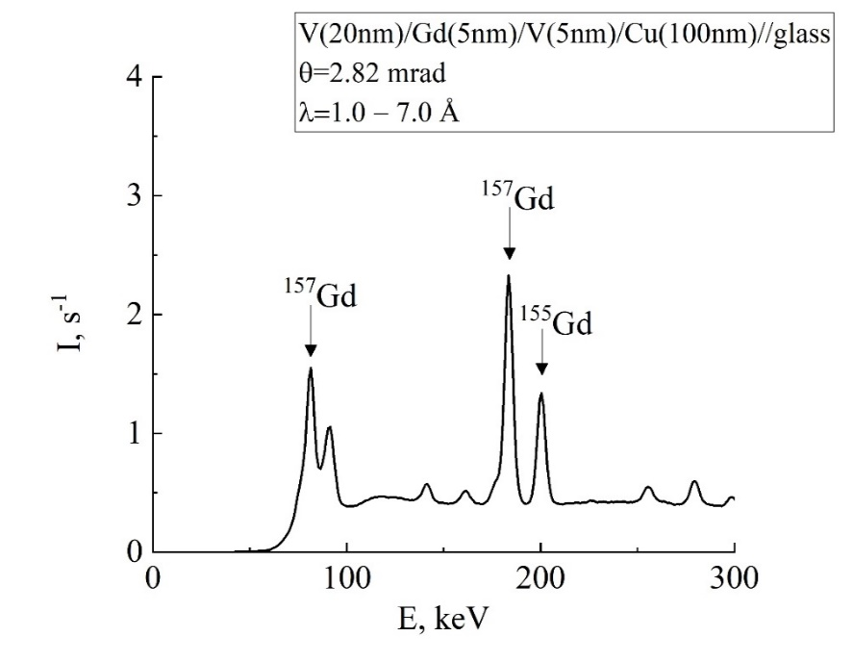
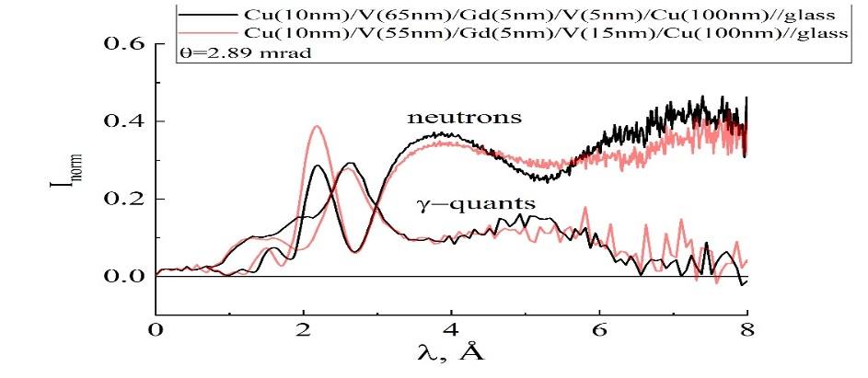
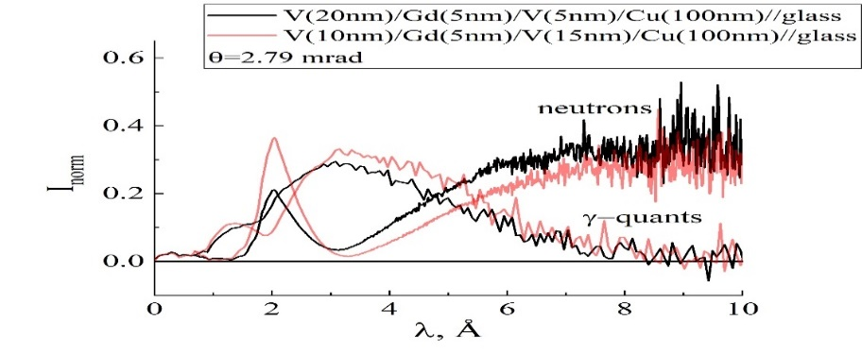
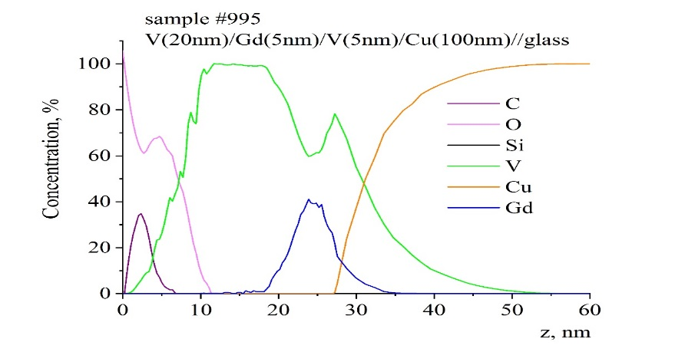
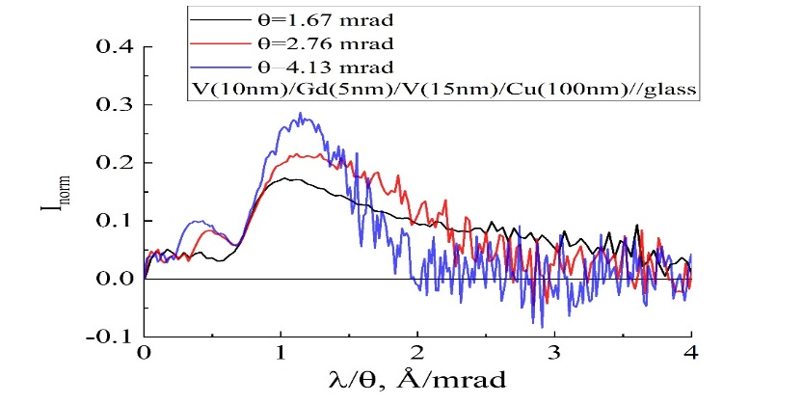
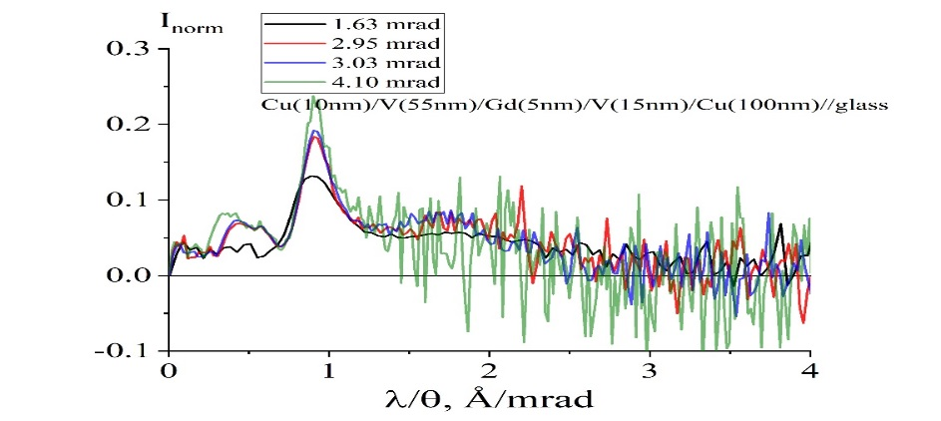
Gamma quanta registration channel at the REMUR
Gamma quanta spectra
Standing waves mode
Enhanced standing waves mode
SNMS data
14/16
Angle dependence

Slide 16
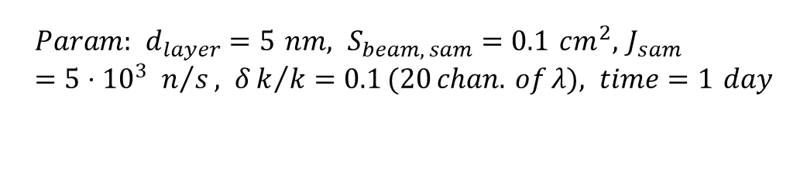

Estimation of element minimal cross-section from a measurement time
$$ΔN_{eff}=δN_{stat} ⇒ t=\frac{2J_{backgr}+J_{effect}(σ)}{J_{eff}^{2}}$$
$$Param: d_{layer}=5 nm, S_{beam, sam}=0.1 cm^{2}, J_{sam}=5⋅{10}^{3} n/s, δk/k=0.1 (20 chan. of λ), time=1 day$$
Red color – Superconductor elements, Green – Magnetic
Channel of charged particles: σ_{min} = 0.025 barn
σ > 0.025 barn (22 isotopes):
³He, ⁶Li, ⁷Be, ¹⁰B, ¹⁴N, ¹⁷O, ²¹Ne, ²²Na, ²⁶Al(1.18K), ³³S, ³⁵Cl, ³⁶Cl, ³⁷Ar, ⁴⁰K, ⁴¹Ca, ⁵⁹Ni, ⁶⁵Zn(0.85K), ⁷⁶Br, ⁸⁴Rb, ¹⁰⁹Cd(0.52K), ²⁰³Tl, ¹⁴³Nd, ¹⁴⁹Sm
Channel of gamma quanta: σ_{min} = 0.3 barn
σ > 0.3 barn ( > 100 isotopes ):
Cl, ³⁶Ar, ³⁹K, ⁴³Ca, ⁴⁵Sc, Ti, V(5.4K), Cr, ^{53,55}Mn, Fe, ⁵⁹Co, Ni, Cu, ⁶⁷Zn, ⁷⁵As, Se, Br, Kr, ⁸⁷Sr, Mo(0.915 K), ⁹⁹Tc(7.8 K), Ru, ¹⁰³Rh, La(4.9 ,6.0 K), Pd, Nb (9.25K), Ag, Cd(0.52K), Dy, Gd, Tb, Ho, Er, Tm, In(3.41K), Sn(3.72K), Re(1.7K), Ta(4.47K), Os,^{192,195}Pt, ¹⁹⁷Au, Hg, ²²⁶Ra,²²⁷Ac, ²²⁸⁻²³⁰Th(1.4K), ²³¹Pa(1.4K), W(1.5K), Re, Os(0.66K), ^{192,195}Pt, ¹⁹⁷Au, Hg(4.15, 3.95K), ^{203,204}Tl, ²⁰⁷Pb(7.2K), ²²⁶Ra, ²²⁷Ac, ²²⁸⁻²³⁰Th, ²³¹Pa, ²³¹⁻²³⁵U, ^{203,204}Tl(2.38K), ²³⁷Np, ²³⁸⁻²⁴²Pu, ²⁴¹⁻²⁴³Am, ^{243-245,247}Cm, ²⁴⁹⁻²⁵²Cf
Channel of polarized neutrons
For magnetic layer of 5 nm thickness minimal perpendicular component magnetization is of order 1 Gs
Fe, Co, Ni, Gd, Dy, Tb, Ho, Er, Tm, (9 elements )
15/16

Slide 17
Conclusion
Simultaneous registration of reflected (refracted) neutrons and secondary radiation allows to define the spatial profiles of isotopes
Further improvements are connected with possible decreasing of background (∼5÷10 times), increasing of neuron intensity (∼5÷10 times) and increasing of detector solid angle for gamma channel (4 times) ⇒ σ≈1 mbarn at 5 nm layer thickness or ∼ 1 Å layer thickness at σ=50 mbarn
With supermirror reflector in SW regime can be achieved spatial resolution 1 Å
Realization of modes: cryostat + gamma-detection, electromagnet + gamma-detection, electromagnet + charged particles
Further application of the method
16/16

Slide 18
Thank you for your attention !

