Slide 1

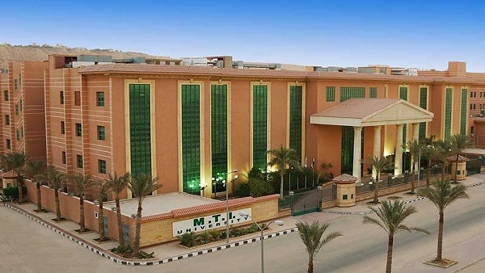



Spectroscopic Analysis of P₂O₅–ZnO–Na₂O Doped Glass
Shymaa Moslem
MTI – University
In collaboration with
Cairo University
Egypt
Research Group members
Prof. Hussam Hassan – Dr. Yehia El-bashar- Dr. Diaa Al-rayan
The XXIV International Scientific Conference of Young Scientists and Specialists
(AYSS-2020)

Slide 2
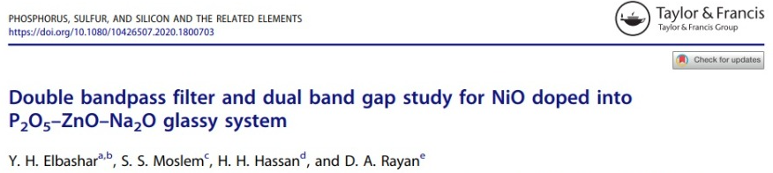
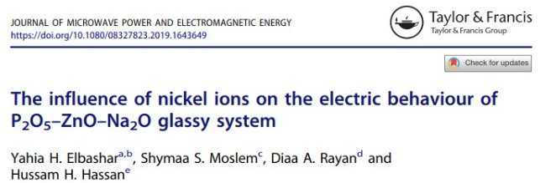
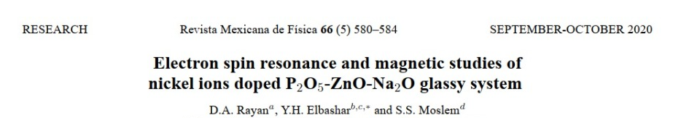
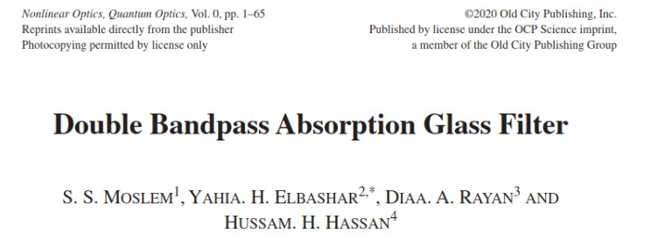
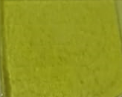



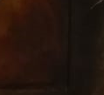
Contents
1
Introduction
2
Experimental Technique
3
Results and Discussions
4
Conclusion
NiO
Concentration

Slide 3
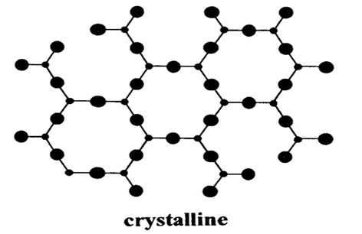
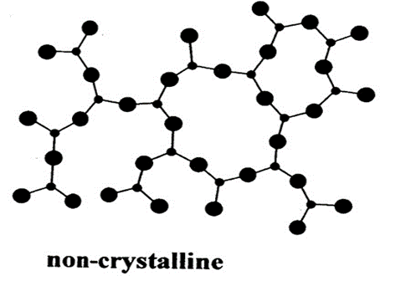
Physical States of Matter
Solids can be classified into two main groups according to their atomic arrangement:
Crystalline solids
Amorphous solids
The glassy state
Glass is an amorphous (non-crystalline) solid material. Usually produced when a suitably viscous molten material cools very rapidly thereby not giving enough time for regular crystal lattice to form.
The XXIV International Scientific Conference of Young Scientists and Specialists
(AYSS-2020)

Slide 4
Experimental Technique
The XXIV International Scientific Conference of Young Scientists and Specialists
(AYSS-2020)

Slide 5
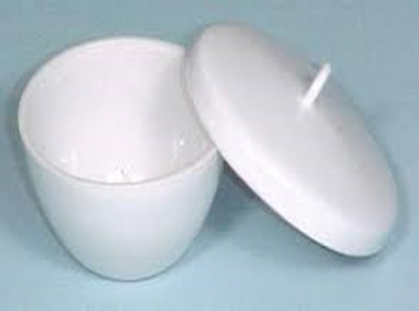
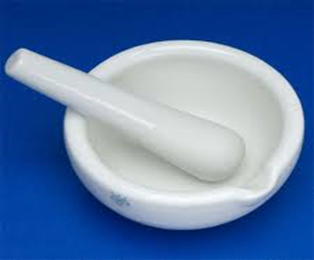
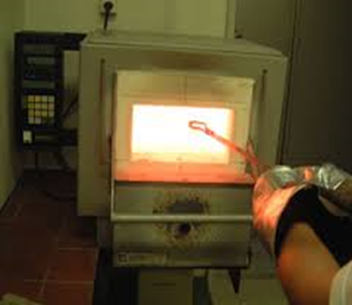
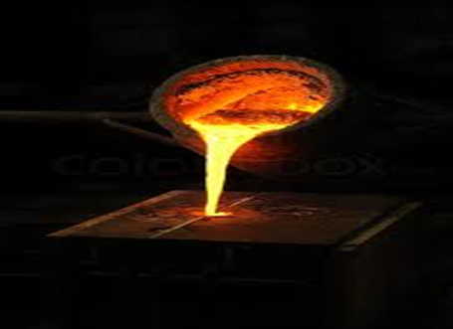
Preparation of the Samples
Each composition was taken in an open porcelain crucible and melted in an electric furnace.
Temp. rang 1000 °C for 1 hour.
The mixture of chemicals is well-grounded after carefully weighted the calculated ratios.
Finally, the melted samples are then quickly quenched by infuse them on a stainless-steel plate and cover them with another one plate. This casting happens in a heated furnace at 250 ºC.
melt-quenching technique
We let the samples inside it for 2 hours, then the furnace is turn off. The glass samples are allowed to cool down inside the furnace for 24 hours.
The XXIV International Scientific Conference of Young Scientists and Specialists
(AYSS-2020)

Slide 6

Glass System & prepared samples
The glass system under investigation has the general formula:
42P₂O₅– 40ZnO–(18-x) Na₂O–xNiO
with X=1, 2, 3, 4, 5 and 6 mol. %
P₂O₅ : Good Glass Former.
ZnO: Residual Stresses.
Transparence.
Na₂O : Melting Point.
NiO : optical filtering element.
NiO= 1 mol.%
NiO= 2 mol.%
NiO= 3 mol.%
NiO= 4 mol.%
NiO= 5 mol.%
NiO= 6 mol.%
The XXIV International Scientific Conference of Young Scientists and Specialists
(AYSS-2020)

Slide 7
Results
&
Discussions
The XXIV International Scientific Conference of Young Scientists and Specialists
(AYSS-2020)

Slide 8
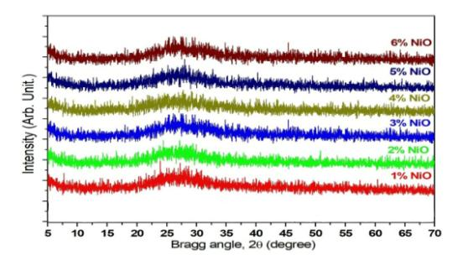
X-ray diffraction
XRD spectra doesn’t exhibit any sharp peak.
This pattern confirms the amorphous structure of prepared glass .
Phosphorus, Sulfur, and Silicon and the Related Elements, Y.H. Elbashar, S.S. Moslem, et. al.
DOI: https://doi.org/10.1080/10426507.2020.1800703
The XXIV International Scientific Conference of Young Scientists and Specialists
(AYSS-2020)

Slide 9
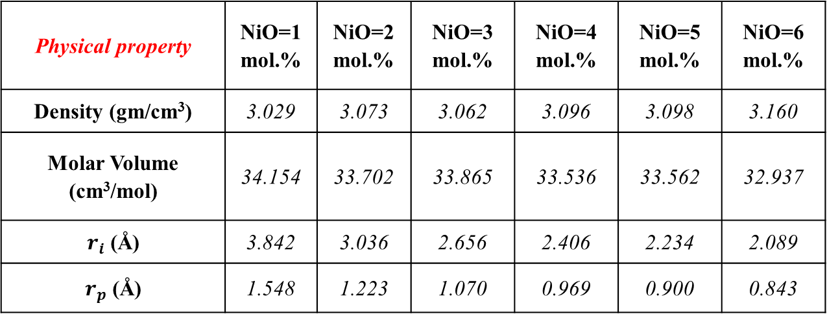
Physical Parameters of the Nickel Doped Zinc Sodium Phosphate Glasses
        The density increased due to substitution of light sodium ions by heavier nickel ions.
        The molar volume increased, expected that the glass structure become more compact.
Physical property | NiO=1 mol.% | NiO=2 mol.% | NiO=3 mol.% | NiO=4 mol.% | NiO=5 mol.% | NiO=6 mol.%
Density (gm/cm³) | 3.029 | 3.073 | 3.062 | 3.096 | 3.098 | 3.160
Molar Volume (cm³/mol) | 34.154 | 33.702 | 33.865 | 33.536 | 33.562 | 32.937
$r_{i}$ (Å) | 3.842 | 3.036 | 2.656 | 2.406 | 2.234 | 2.089
$r_{p}$ (Å) | 1.548 | 1.223 | 1.070 | 0.969 | 0.900 | 0.843
Inter-ionic distance (r_{i}), polaron radius (r_{p}) decreases, suggests that the reduction in free space inside glass network.
Phosphorus, Sulfur, and Silicon and the Related Elements, Y.H. Elbashar, S.S. Moslem, et. al.
DOI: https://doi.org/10.1080/10426507.2020.1800703
The XXIV International Scientific Conference of Young Scientists and Specialists
(AYSS-2020)

Slide 10
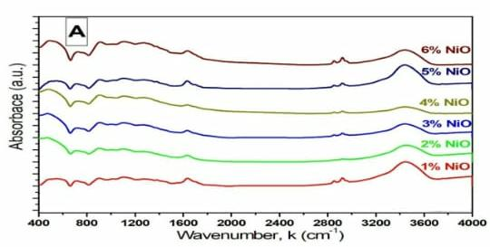
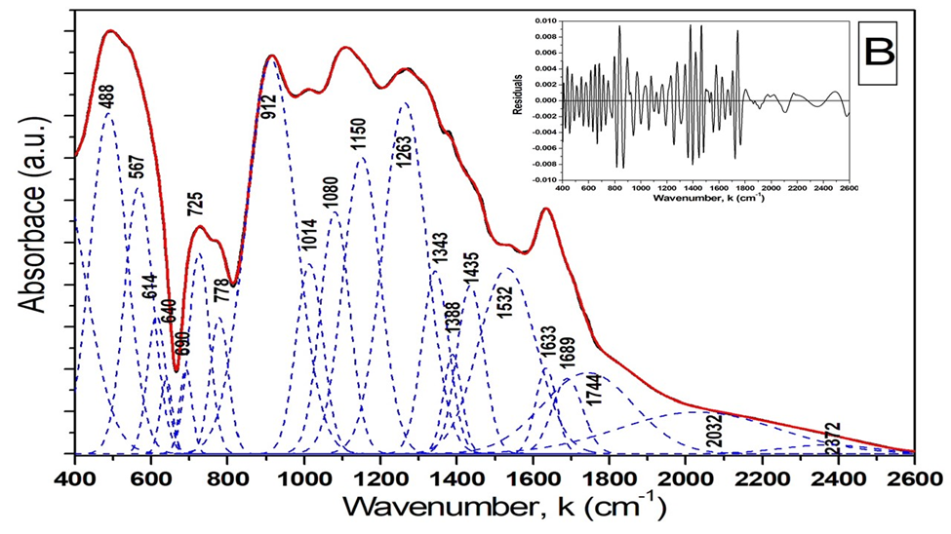
Fourier transform Infrared (FTIR)
        The deconvolution of the FTIR absorption spectrum of the sample containing 6 mol.% of NiO.
        FTIR absorbance spectra.
Phosphorus, Sulfur, and Silicon and the Related Elements, Y.H. Elbashar, S.S. Moslem, et. al.
DOI: https://doi.org/10.1080/10426507.2020.1800703
The XXIV International Scientific Conference of Young Scientists and Specialists
(AYSS-2020)

Slide 11
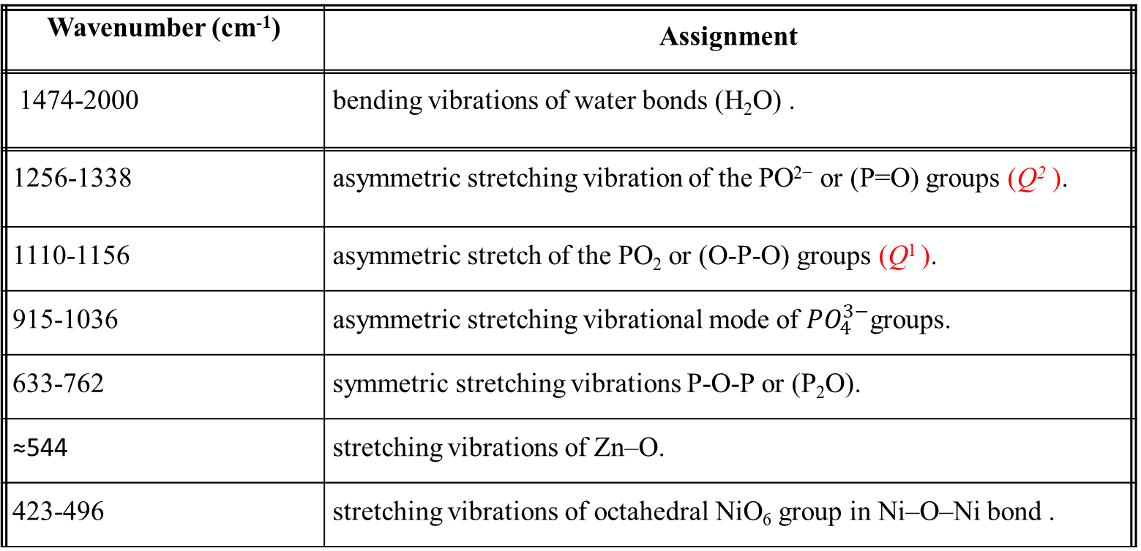
Summary of FTIR Spectral Band Positions of the Investigated Glasses.
Wavenumber (cm⁻¹) | Assignment
1474-2000 | bending vibrations of water bonds (H₂O) .
1256-1338 | asymmetric stretching vibration of the PO²⁻ or (P=O) groups (Q² ).
1110-1156 | asymmetric stretch of the PO₂ or (O-P-O) groups (Q¹ ).
915-1036 | asymmetric stretching vibrational mode of ${PO}_{4}^{3−}$groups.
633-762 | symmetric stretching vibrations P-O-P or (P₂O).
≈544 | stretching vibrations of Zn–O.
423-496 | stretching vibrations of octahedral NiO₆ group in Ni–O–Ni bond .
The XXIV International Scientific Conference of Young Scientists and Specialists
(AYSS-2020)

Slide 12
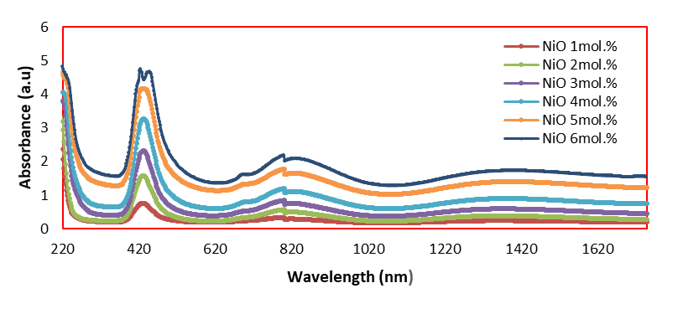
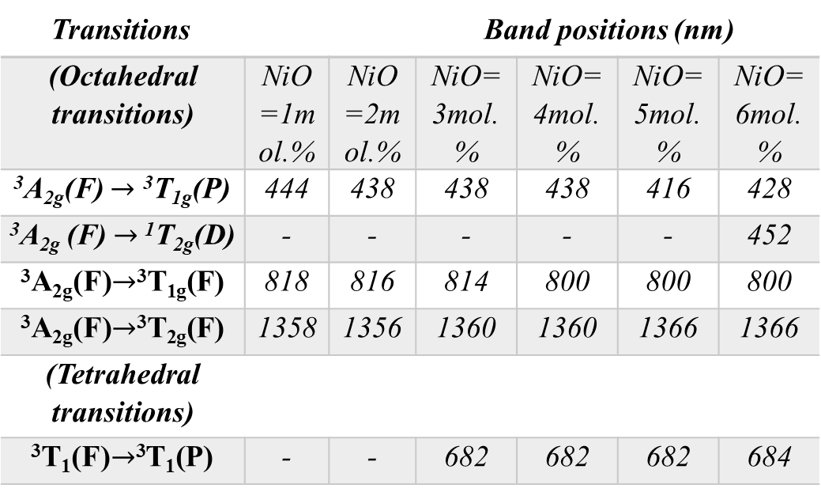
Optical Absorbance Spectra
Assignment of the observed optical absorption bands in the studied glasses.
Transitions Band positions (nm)
(Octahedral transitions) | NiO=1mol.% | NiO=2mol.% | NiO=3mol.% | NiO=4mol.% | NiO=5mol.% | NiO=6mol.%
³A_{2g}(F) $→$ ³T_{1g}(P) | 444 | 438 | 438 | 438 | 416 | 428
³A_{2g} (F)$→$ ¹T_{2g}(D) | - | - | - | - | - | 452
³A_{2g}(F)$→$³T_{1g}(F) | 818 | 816 | 814 | 800 | 800 | 800
³A_{2g}(F)$→$³T_{2g}(F) | 1358 | 1356 | 1360 | 1360 | 1366 | 1366
(Tetrahedral transitions)
³T₁(F)$→$³T₁(P) | - | - | 682 | 682 | 682 | 684
The XXIV International Scientific Conference of Young Scientists and Specialists
(AYSS-2020)

Slide 13
Energy Gap E_{g} and Urbach Energy ΔE of the Studied Samples.
NiO mol. % | E_{g} (eV) | ∆E (eV)
1 | 4.87 | 0.36
2 | 4.68 | 0.37
3 | 4.19 | 0.63
4 | 3.88 | 0.68
5 | 3.74 | 0.98
6 | 3.65 | 1.25
Phosphorus, Sulfur, and Silicon and the Related Elements, Y.H. Elbashar, S.S. Moslem, et. al.
DOI: https://doi.org/10.1080/10426507.2020.1800703
The XXIV International Scientific Conference of Young Scientists and Specialists
(AYSS-2020)

Slide 14
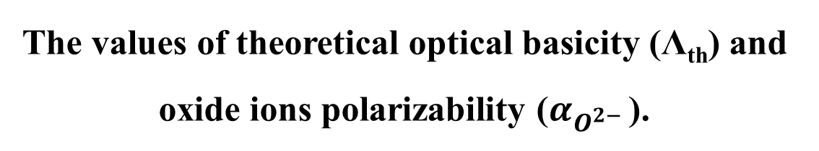
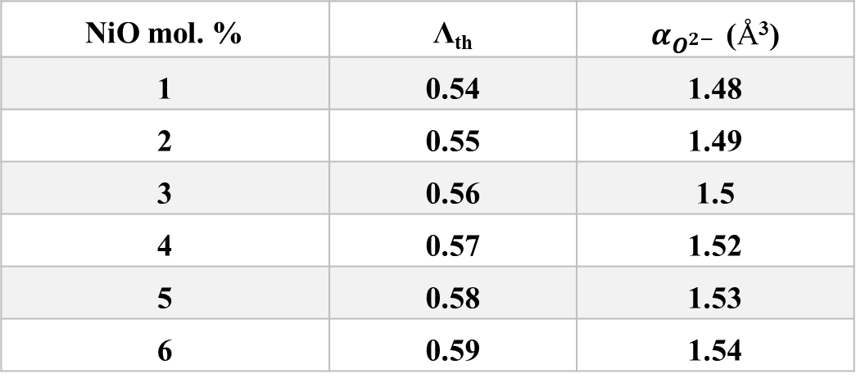
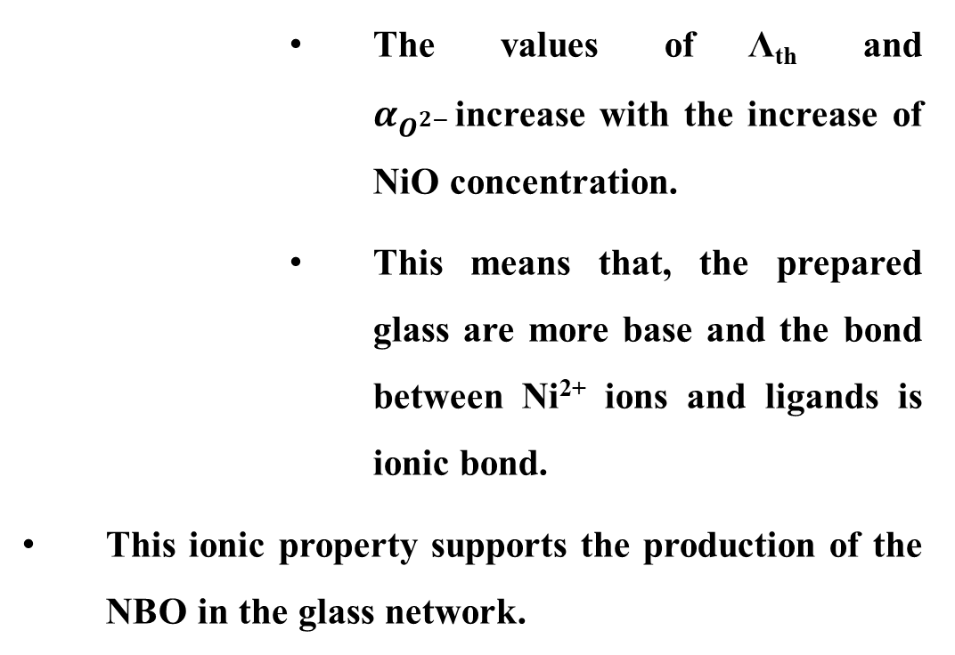
The values of theoretical optical basicity (Λ_{th}) and oxide ions polarizability ($α_{O^{2− }}$).
        The values of Λ_{th} and $α_{O^{2− }}$increase with the increase of NiO concentration.
        This means that, the prepared glass are more base and the bond between Ni²⁺ ions and ligands is ionic bond.
This ionic property supports the production of the NBO in the glass network.
NiO mol. % | Λ_{th} | $α_{O^{2− }}$ (Å³)
1 | 0.54 | 1.48
2 | 0.55 | 1.49
3 | 0.56 | 1.5
4 | 0.57 | 1.52
5 | 0.58 | 1.53
6 | 0.59 | 1.54
Phosphorus, Sulfur, and Silicon and the Related Elements, Y.H. Elbashar, S.S. Moslem, et. al.
DOI: https://doi.org/10.1080/10426507.2020.1800703
The XXIV International Scientific Conference of Young Scientists and Specialists
(AYSS-2020)

Slide 15
conclusion
It is observed that the density (ρ) increases and the molar volume (M.V) decreases with increasing NiO content. This result mean the glass network becomes more compact.
FTIR spectra shows that the network structure is based mainly on Q¹ and Q² units. This refers to the increase in the amount of NBO and disorder of glass network due to presence of nickel ions as a modifier.
The optical band gap energy (E_{g}) decreases with increasing of NiO content. This may be attributed to the formation of non-bridging oxygen (NBO).
The theoretical calculation of optical polarizability (α₀²⁻) and the optical basicity (Λ) enhancing the ionic bond forming between Ni²⁺ ions and ligands. This is in agreement with the experimental results.
The XXIV International Scientific Conference of Young Scientists and Specialists
(AYSS-2020)

Slide 16
References
Limkitjaroenporn, P.; Kaewkhao, J.; Limsuwan, P.; Chewpraditkul, W. Physical, Optical, Structural and Gamma-Ray Shielding Properties of Lead Sodium Borate Glasses. J. Phys. Chem. Solids. 2011, 72, 245-251.
Çelikbilek, M.; Ersundu, A.E.; Aydin, S. Preparation and Characterization of TeO₂–WO₃–Li₂O Glasses. J. Non-Cryst. Solids. 2013, 378, 247-253.
Gedam, R.S.; Ramteke, D.D. Electrical, Dielectric and Optical Properties of La2O3 Doped Lithium Borate Glasses. J. Phys. Chem. Solids. 2013, 74, 1039–1044.
Rao, P.V.; Satyanarayana, T.; Reddy, M.S.; Gandhi, Y.; Veeraiah, N. Nickel Ion as a Structure Probe in PbO-Bi₂O₃-B₂O₃ Glass System by Means of Spectroscopic and Dielectric Studies. Physica B, 2008, 403, 3751-3759.
Dimitrov, V.; Komatsu, T., An Interpretation of Optical Properties of Oxides and Oxide Glasses in Terms of The Electronic Ion Polarizability and Average Single Bond Strength. J. Univ. Chem. Technol. Metall. 2010, 45, 219-50.
Halimah, M.K.; Daud, W.M.; Sidek, H.A.A.; Zaidan, A.W.; Zainal, A.S. Optical Properties of Ternary Tellurite Glasses. Mater Sci-Poland. 2010, 28, 173-180.
The XXIV International Scientific Conference of Young Scientists and Specialists
(AYSS-2020)

Slide 17

The XXIV International Scientific Conference of Young Scientists and Specialists
(AYSS-2020)

