Slide 1

Study of unstable states of the lightest nuclei in the dissociation of relativistic nuclei.
Andrei Zaitsev
LHEP, JINR
The XXIV International Scientific Conference of Young Scientists and Specialists (AYSS-2020)
Dubna, 9-13 November 2020

Slide 2
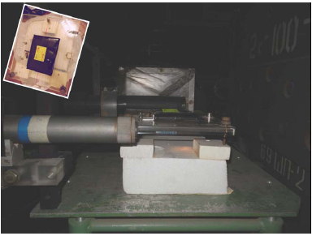
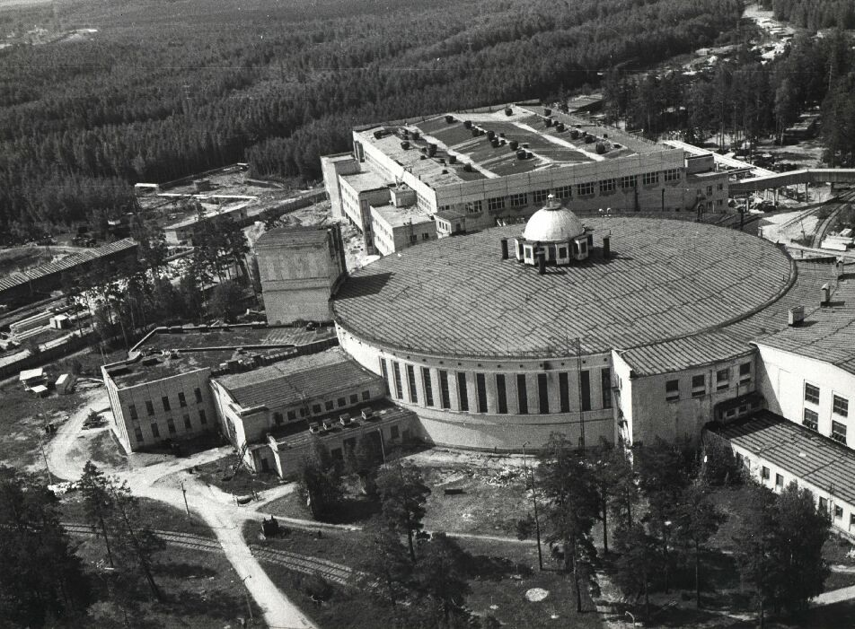
BECQUEREL Experiment at Nuclotron JINR
Within the framework of the project, a systematic study of the cluster structure of light nuclei is carried out. The project is based on the analysis of layers of nuclear emulsion longitudinally irradiated in primary and secondary nuclear beams with an energy of about 1 A GeV. The research is provided by the developing laboratory and the laboratory of viewing and measuring microscopes of the sector of thick-layer nuclear emulsion of the V. Veksler & A. M. Baldin Laboratory of High Energy Physics JINR.

Slide 3
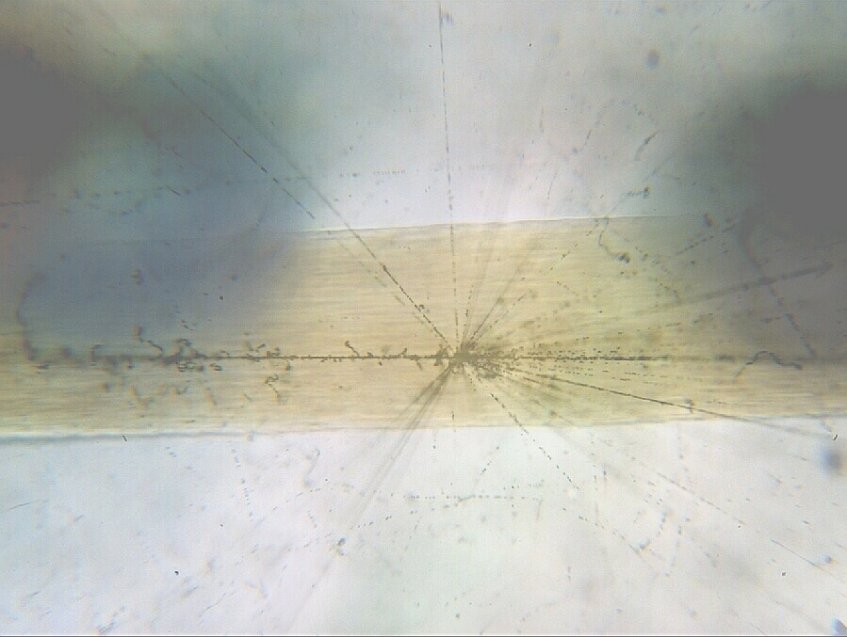
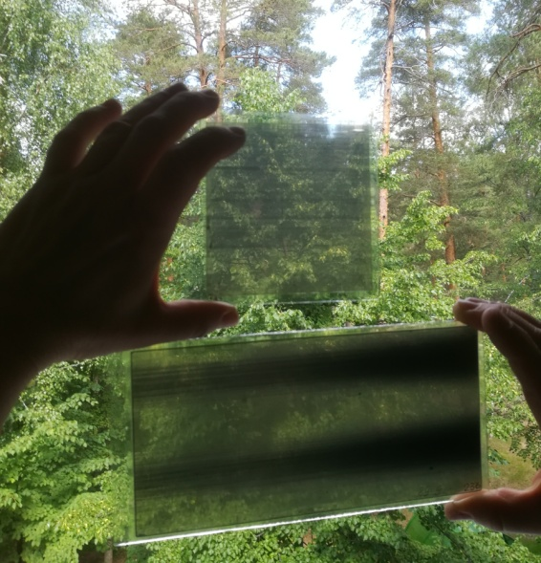
AgBr Crystal - 0.2 μm
Atom - 10⁻⁴ μm
Proton - 10⁻⁹ μm
Hair
60 μm
The project is based on the method of nuclear track emulsions (NTE) providing unrivaled spatial resolution (0.5 μm) and a sensitivity range for measuring tracks of charged particles, starting with highly ionizing short-range ions and up to singly-charged relativistic particles. The use of NTE in newly created beams of relativistic nuclei accelerators makes it possible to make analysis that can not to be reach by electronic detection methods. The accuracy and completeness of the measurement of the angles of emission of fragments generated in peripheral interactions of relativistic nuclei provides unique opportunities for studying the nucleon clustering of light nuclei.

Slide 4
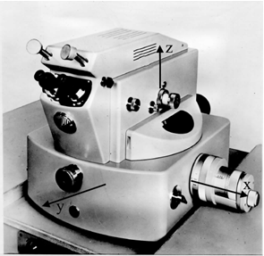
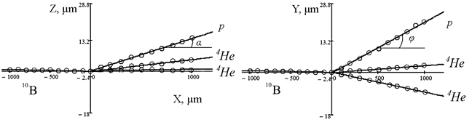
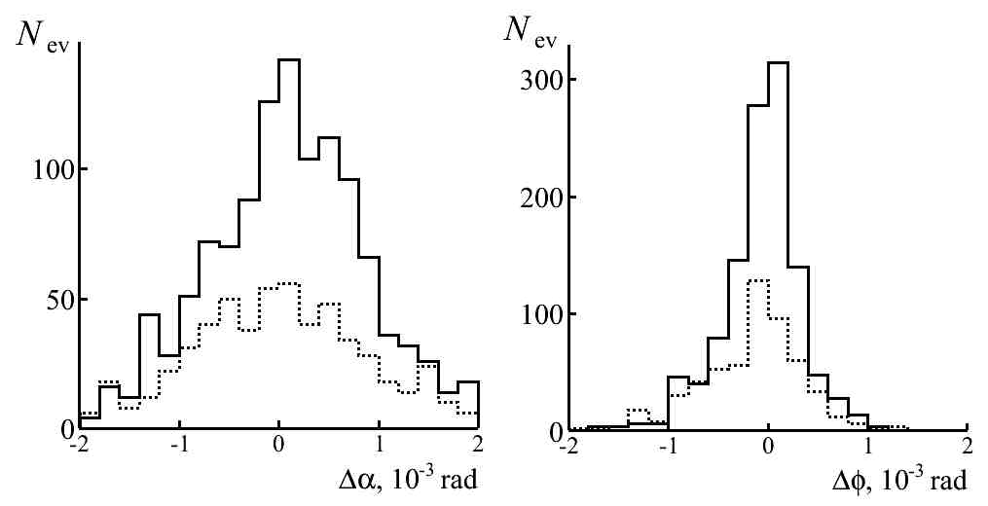
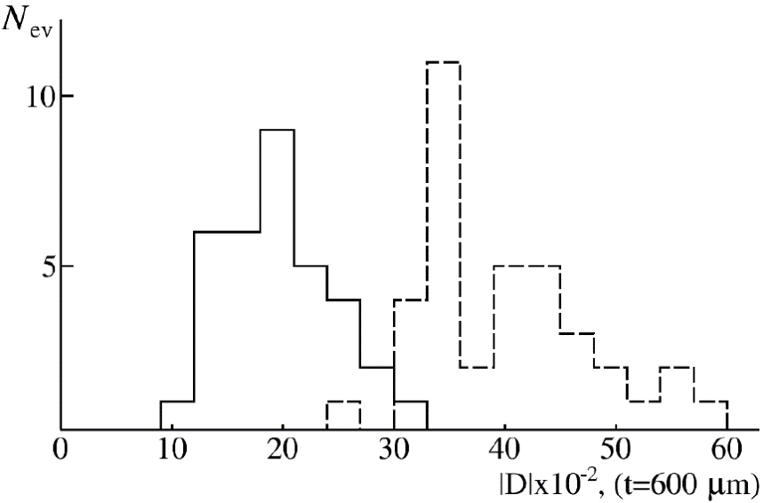
Reconstruction of emission angles of secondary fragments
Example of the restored directions of emission of fragments in the plane of XOZ and XOY in the event №10107 by channel of ¹⁰В → 2α + р.
Microscope KSM-1
⁴He
³He
Errors in reconstruction of deep (α) и plan (φ) angles for tracks of He (solid) and H (dotted) fragments in event ¹⁰B → 2He + H. 〈Δα〉 = 0.08 ± 0.02 (0.78) mrad and 〈Δφ〉 = 0.06 ± 0.01 (0.39) mrad.
A_{fr} = P_{fr}β_{fr}c/(P₀β₀c)

Slide 5
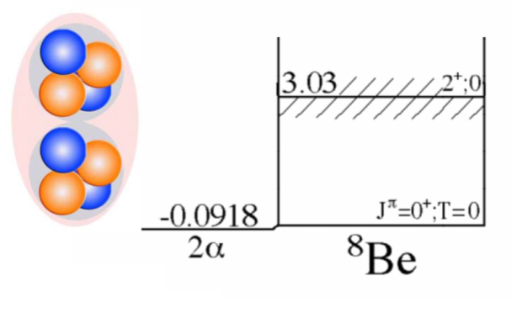
The ‘Ikeda diagram’, showing the development of cluster structure within α-conjugate nuclei as excitation energy is increased.
Example of calculating the density distribution of the ⁸Be nucleus (TSHR model; Bose-Einstein alpha condensate)

Slide 6
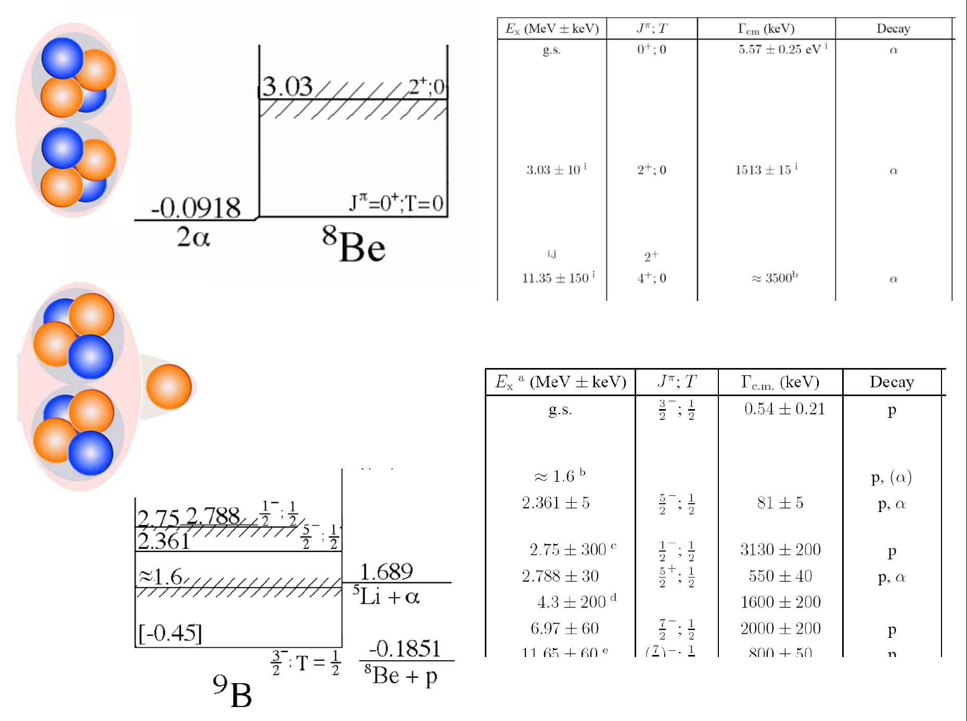

Slide 7
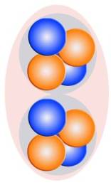

2 A GeV/c ⁹Be → 2α
⁹Be
2α
Q_{2α} = M∗ - M
M^{*2} = ∑(P_{i}·P_{k})
Distribution of number of 2α-pairs N_{2α} over invariant mass Q_{2α} in all 500 events of dissociation ⁹Bе → 2α (dotted line) at 1.2 A GeV and in 198 “white” stars out of them (solid); in the inset, the enlarged part of the distributions Q_{2α} < 1 MeV.
The distribution over Q_{2α} of 2α-pairs (N_{2α} = 500), including “white” 2α-stars (N_{ws} = 198), indicates the condition Q_{2α}(⁸Be) < 0.2 MeV. Then the fraction of decays ⁸Be 36 ± 3 and 41 ± 5%, respectively. Two “influxes” deserve to be noted around 0.6 and 3 MeV. The first of them corresponds to decay through the ⁹Be 2.43 MeV excitation, and the second corresponds to decay from the first excited state ⁸Be₂₊.

Slide 8
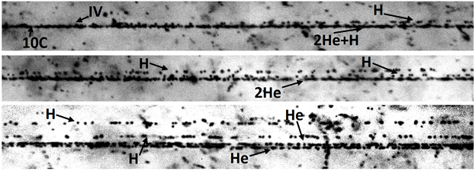
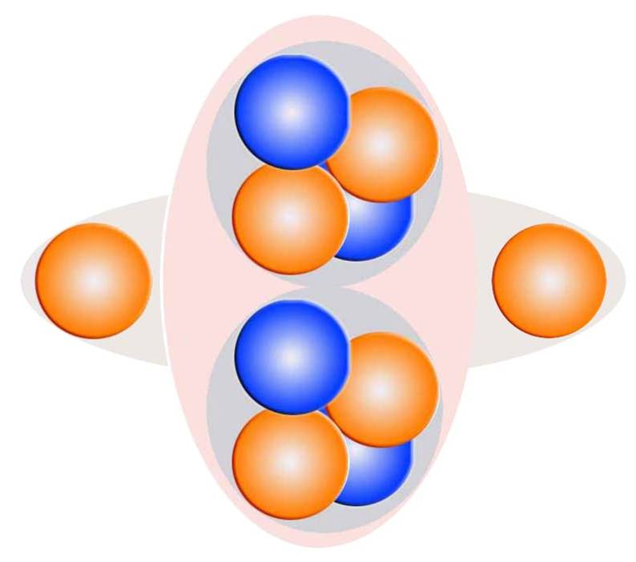
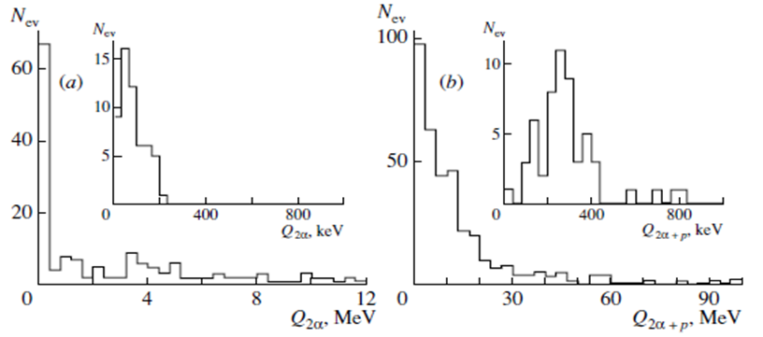
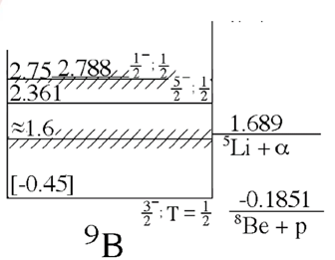
¹⁰C
Channel | Ratio
2He + 2H | 82%
He + 4H | 5%
6H | 4%
3He | 3%
Li + 3H | 3%
Be + He | 1%
⁸Be
⁹B
A clear correlation between Q_{2α} and Q_{2αp} points to the cascade process ¹⁰C → ⁹B → ⁸Be. The contribution of these decays allows concluding that the ⁹B nucleus manifests itself with a probability of (30 ± 4)% in the ¹⁰C structure.

Slide 9
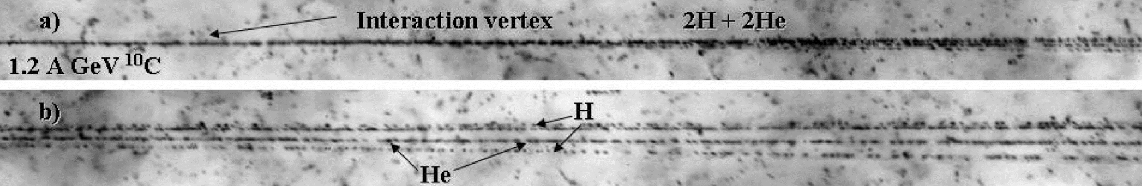
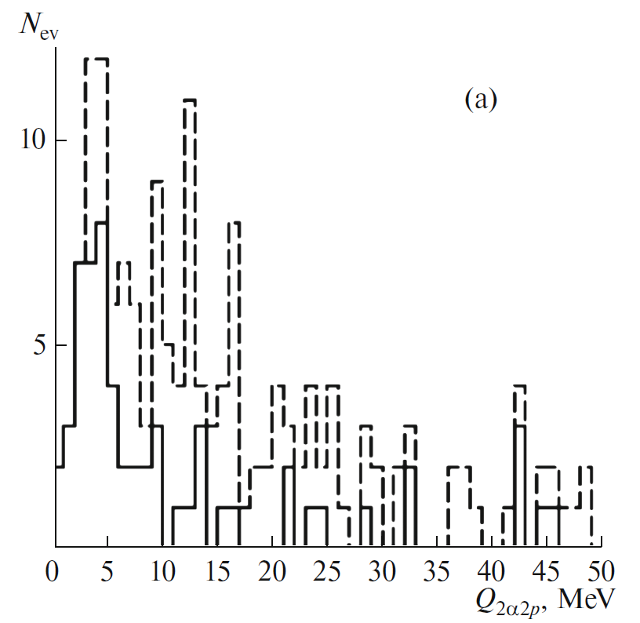
Emulsion exp:
¹⁰C → ⁹B + p - 17 ± 4%
E_{x}(¹⁰C) =4.2 MeV - ?
N. Curtis et al.,
Phys. Rev. C 77, 021301(R) (2008)

Slide 10
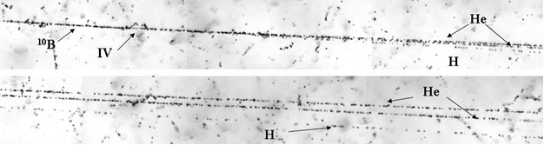
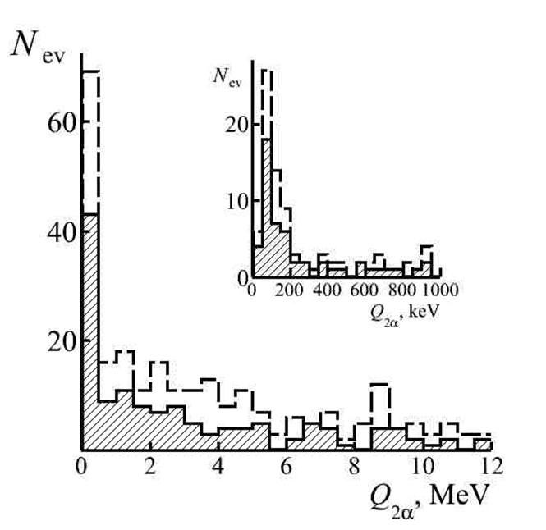
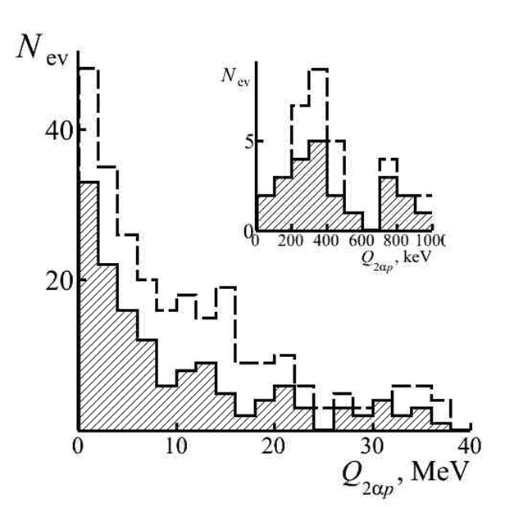
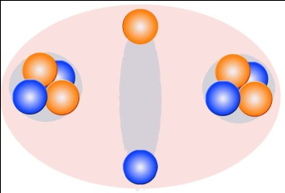
¹⁰B
¹⁰B→⁸Be..
¹⁰B→⁹B..
Channel | Ratio
2He + H | 77%
He + 3H | 13%
Li + He | 4%
Li + 2H | 4%
Be + H | 1%
5H | 1%
The ⁸Be_{g.s.} nucleus is manifested in the coherent dissociation ¹⁰B → 2He + H with a probability of 25% including 13% of ⁹B decays.

Slide 11
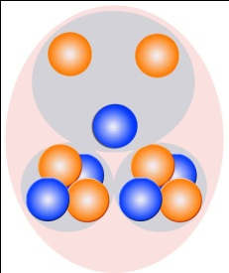
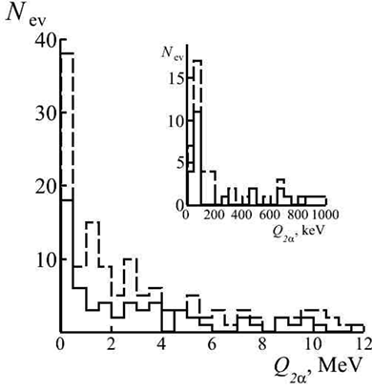
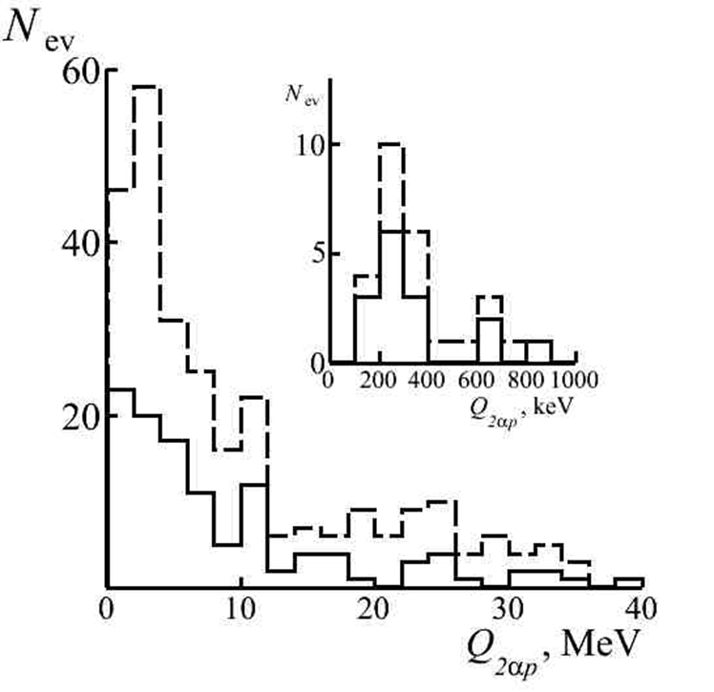
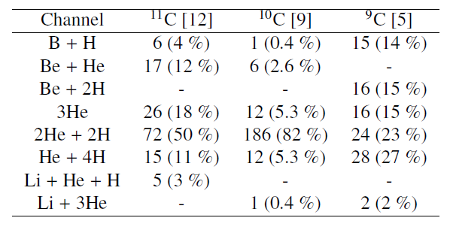
¹¹C
¹¹C→⁸Be..
¹¹C→⁹B..
The distributions of He fragments over the Q_{2He} show that ⁸Be_{g.s.} decays are presented in 20% and ⁹B with 13% in 2He + 2H .
Table. Distribution of white stars produced by carbon isotopes (of energy 1.2 GeV per nucleon) among charge channels of the dissociation of nuclei.

Slide 12
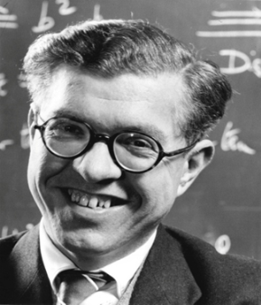
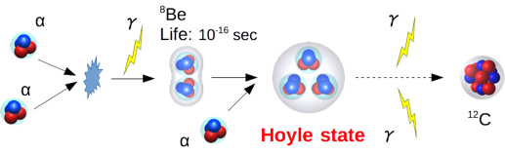
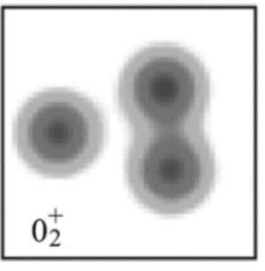
Hoyle
State
Scheme of ¹²C nucleus synthesis
Energy level of ¹²C
RADIUS - ?
STRUCTURE- ?
AMD density of HS
Occupation of the single-α orbitals of the Hoyle state of ¹²C compared with the ground state.

Slide 13
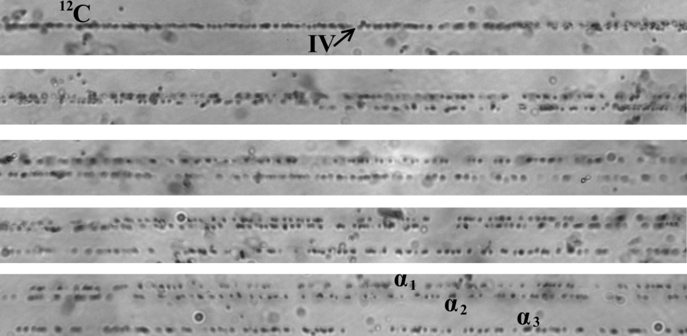
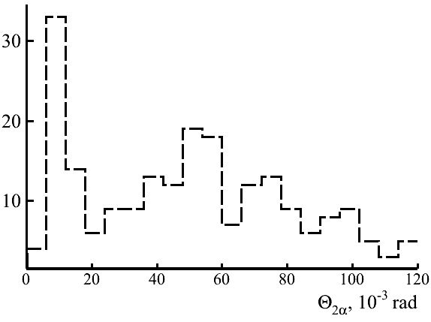
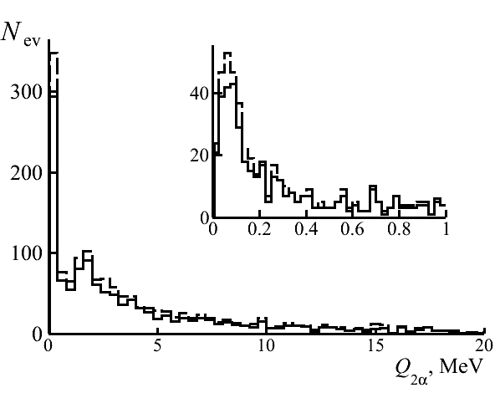
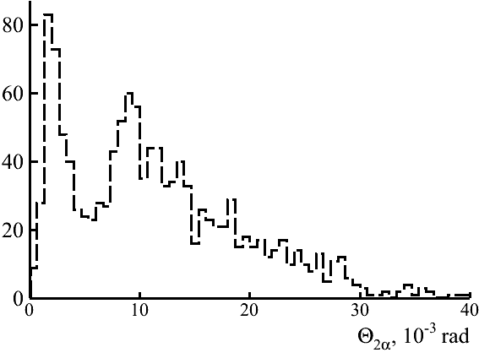
Observation of narrow α-pairs in dissociation of ¹²C nucleus
¹²C → 3α (1 А GeV/с)
Sequential microphoto of event ¹²C → 3α (P₀ 1 A GeV/с), IV – position of the interaction vertex. The main characteristics of the event : θ₁₂ = 8 mrad, θ₁₃ = 15 mrad, θ₂₃ = 8 mrad, Q₁₂ = 57 keV, Q₁₃ = 227 keV, Q₂₃ = 61 keV, Q_{3α} = 230 keV.
¹²C → 3α (4.5 А GeV/с)
¹²C → ⁸Be + α - (45 ± 4) %

Slide 14
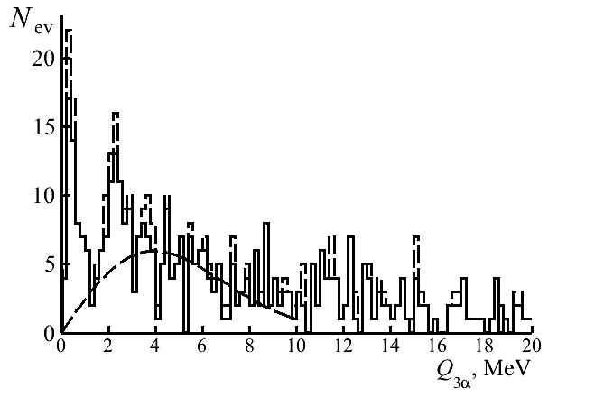
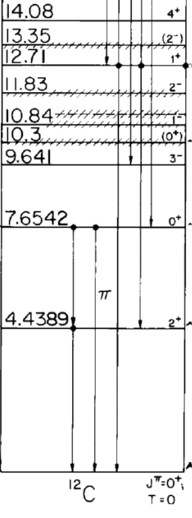
Identification in Hoyle state events
P₀, А GeV/с | 〈Q_{3α}〉, МэВ (Q_{3α} < 1МэВ) | Events Number(tot)
1 | 346 ± 28 | 9 (86)
4.5 | 397 ± 26 | 42 (424)
Σ | 415 ± 28 | 51 (510)
¹²C(HS) →⁸Be + α – (10 ± 2)%
7.275
3α
The distribution of the invariant mass of the α-triples Q_{3α} in the dissociation of ¹²C → 3α with 4.5 A GeV/c (hatched) and 1 A GeV/c (added); inset: region up to Q_{2α} < 2 MeV.

Slide 15
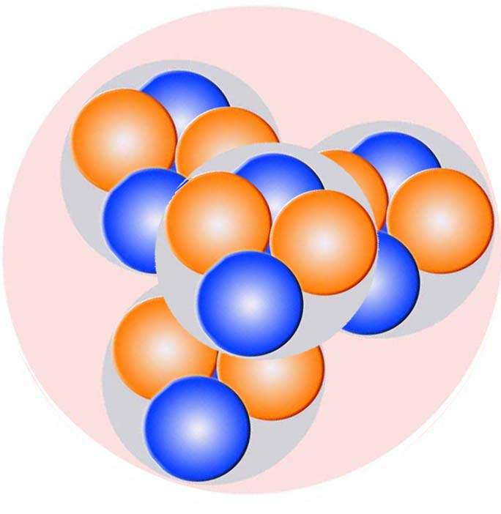
¹⁶O
Extensions to heavier nuclei
Energy level of oxygen-16

Slide 16
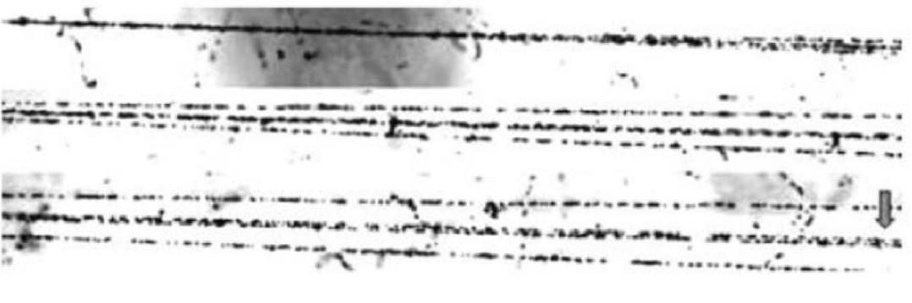
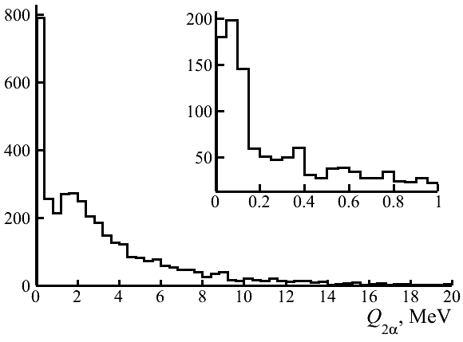
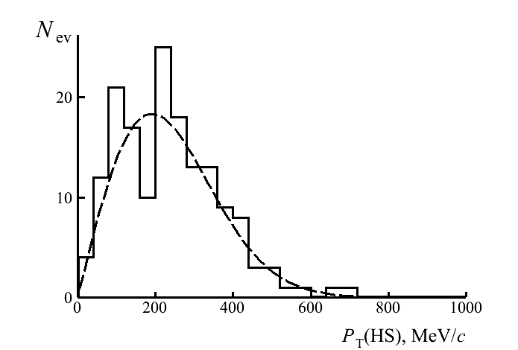
Coherent dissociation of ¹⁶O → 4α at 4.5 A GeV/c
¹⁶O → ⁸Be (62 ± 3)%
Fragmentation of a relativistic ¹⁶O nucleus at 4.5 A GeV/c in the peripheral interaction on heavy nucleus
¹⁶O → ¹²C*(HS) + α – (22 ± 2) %
σ_{PT(HS)} = (191 ± 8) МэВ/c

Slide 17
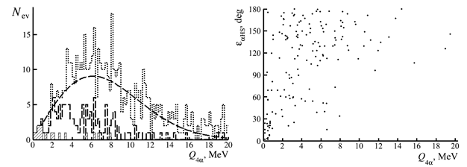
Coherent dissociation of ¹⁶O → 4α at 4.5 A GeV/c
¹⁶O(0⁺₆) → ¹²C*(→3α) + α – (7 ± 1) %
〈Q_{4α}〉= (624 ± 84) keV
Distribution over the invariant mass Q_{4α} in 641 “white” star ¹⁶O → 4α at 3.65 A GeV of all 4α-quartets (dotted line), αHS events (dashed line), and αHS events satisfying ε(αHS) < 45⁰ (hatched); the line is the Rayleigh distribution.

Slide 18
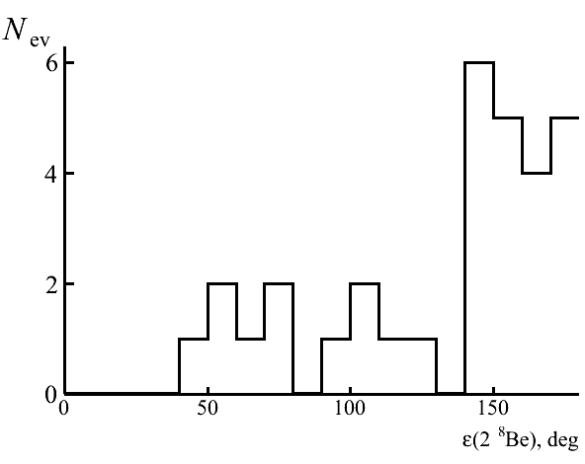
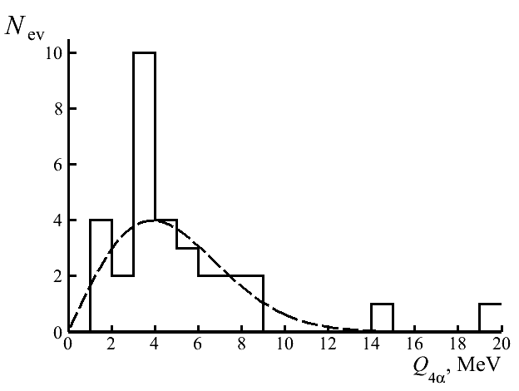
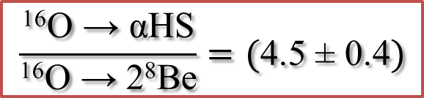
Search for ¹⁶O →2 ⁸Be events
¹⁶O → 2⁸Be – 5 ± 1%
Distribution of events ¹⁶O → 2⁸Be over azimuth angle ε(2⁸Be) between ⁸Be fragment.
Distribution of events ¹⁶O → 2⁸Be over invariant mass Q_{4α}; line - Rayleigh distribution
$$\frac{\text{16}\text{O}\text{ →} \text{αHS}}{\text{16}\text{O}\text{ →} \text{2}\text{8}\text{Be}}=(\text{4.5 ± 0.4})$$

Slide 19
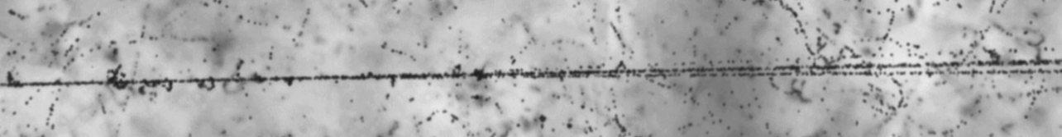
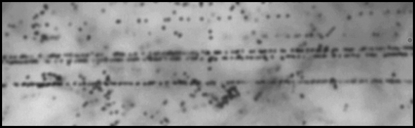
Preliminary results of research of the dissociation of ¹⁴N
¹⁴N→⁸Be..
¹⁴N→¹²C*(HS)..
Distribution over invariant mass Q_{2α} of all 2α-pairs in events ¹⁴N → 3α (solid), including 60 events ¹⁴N → 3αp (dashed line); the inset shows enlarged region of the smallest values of Q_{2α}.Contribution of ⁸Be_{gs} nuclei is 46 ± 8%.
Distribution in region of smallest values of invariant mass Q_{3α} for all 3α-triplets in events ¹⁴N → 3He (solid), including ¹⁴N → α⁸Be (dashed line).
¹⁴N → 3α + p
¹⁴N→⁹B..
Measurements are on progress now
⁹Bp, ⁹Bα and HSp - ?
Distribution over Q of a system of 2α-particles and a proton. Contribution of

Slide 20
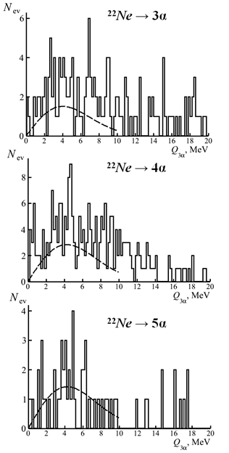
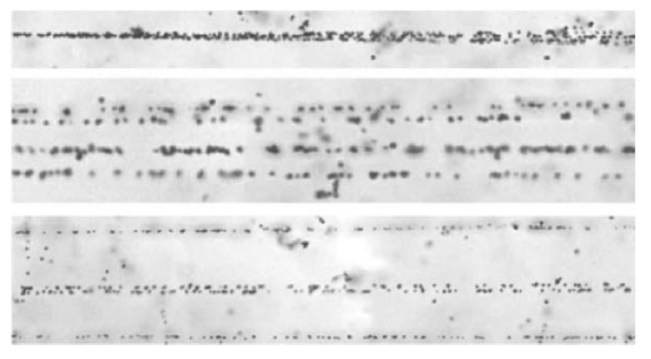
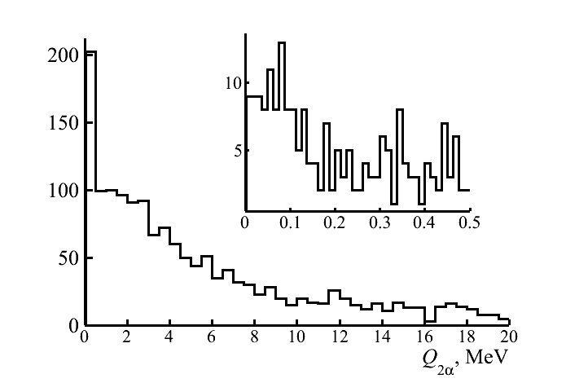
Fragmentation of relativistic ²²Ne nucleus
1.2%
15%
Fragmentation of the relativistic nucleus ²²Ne → 5α at 4.1 A GeV/c in the peripheral interaction
10%

Slide 21
Q_{2α}
Q_{2αp}
Q_{3α}
Q_{4α}
14.6 A GeV ²⁸Si:
52 events Q_{2α} < 0.2 MeV; 15 events Q_{2αp} < 0.5 MeV (⁹B); 9 events Q_{3α} < 0.7 MeV (HS).

Slide 22
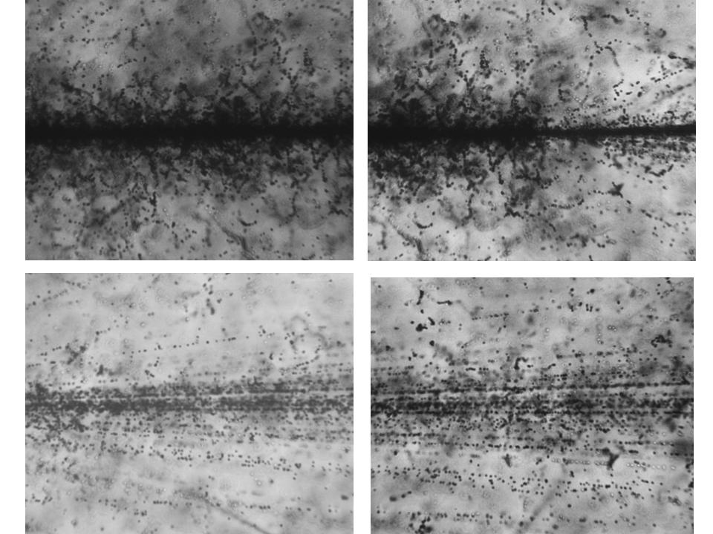
Au 10.7 A GeV

Slide 23
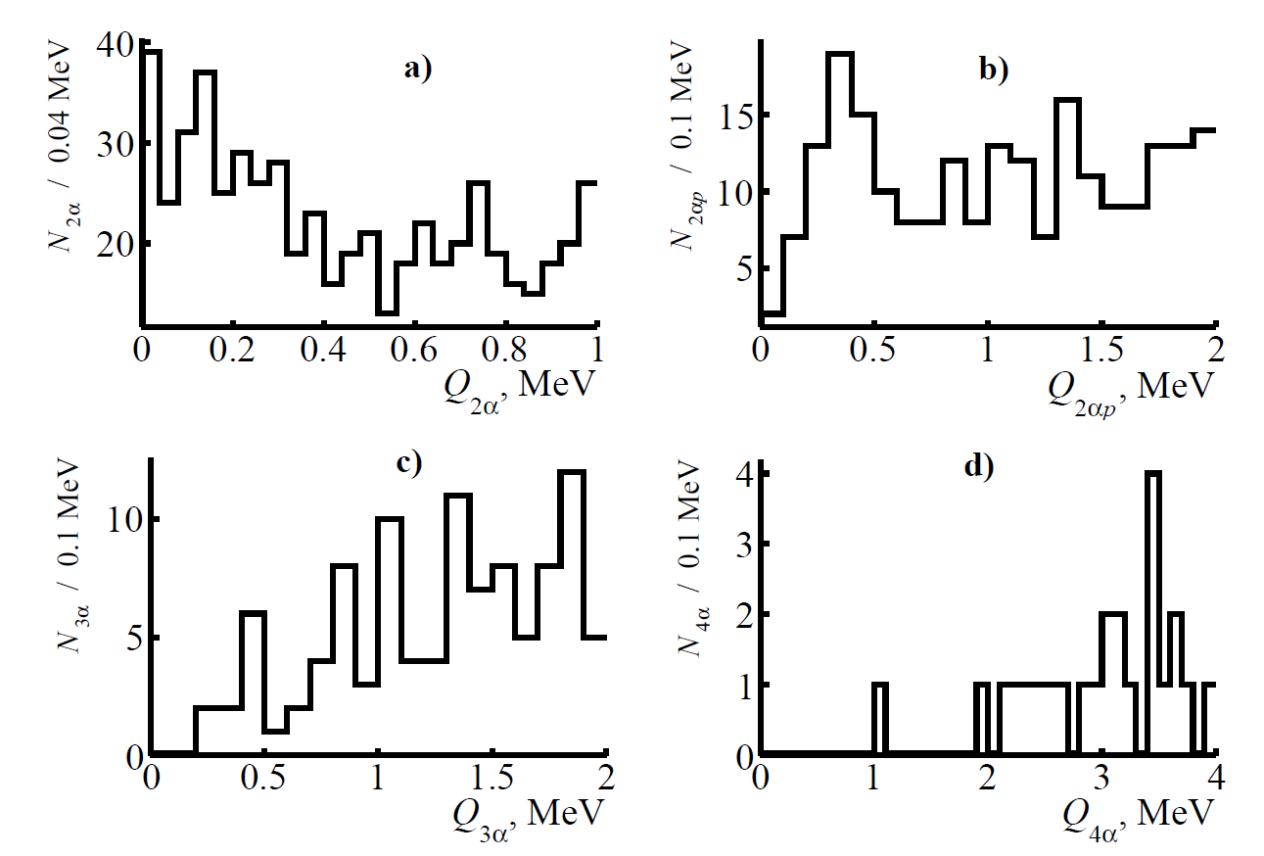
Q_{2α}
Q_{2αp}
Q_{3α}
Q_{4α}
1316 interactions of 10.7 A GeV Au; 160 α-pairs Q_{2α} < 0.2 MeV; 40 events with 2αp-triples Q_{2αp} < 0.5 MeV (⁹B); 12 events with α-triples Q_{3α} < 0.7 MeV (Hoyle state); 1 event with α-quartet Q_{4α} = 1 MeV.

Slide 24
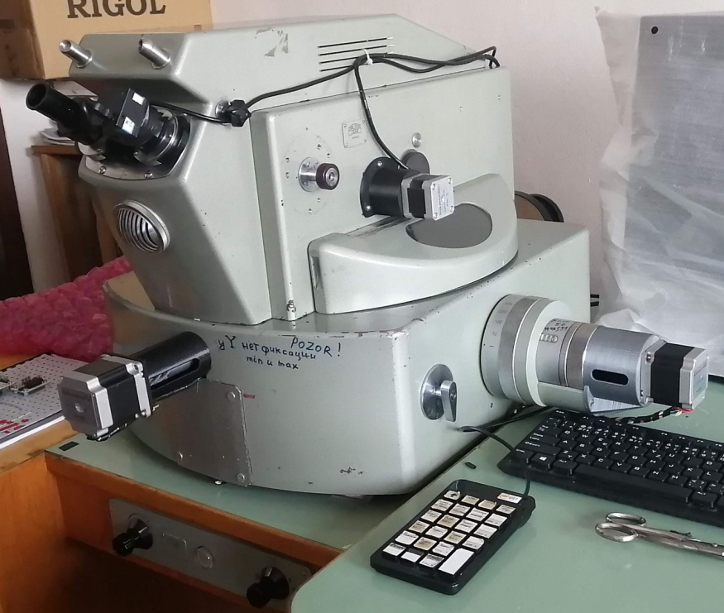

New is well forgotten old
⁺¹⁹⁷Au →

Slide 25
Conclusions
Preserved and recently obtained data on interactions of light relativistic nuclei in a nuclear track emulsion allowed to establish the contribution in their dissociation of unstable nuclei ⁸Be and ⁹B and the Hoyle state as well as to assess the prospects of such research in relation to medium and heavy nuclei. These three states are uniformly identified by the invariant masses calculated from the measured angles of emission of He and H fragments under the assumption of conservation of the primary momentum per nucleon.
The ⁸Be selection in dissociation of the isotopes ⁹Be, ¹⁰B, ¹⁰C, and ¹¹C is determined by the restriction from above of the invariant mass of 2α-pairs up to 0.2 MeV, and the ⁹B 2αp-triple mass up to 0.5 MeV. The certainty in the ⁸Be and ⁹B identification of became the basis for the search for decays from the Hoyle state in the dissociation ¹²C → 3α. In the latter case, the 3α triple invariant mass is set to be limited to 0.7 MeV. The choice of these three conditions as “cut-offs from above” is sufficient because the decay energy values of these three states are noticeably lower than the nearest excitations with the same nucleon compositions, and the reflections of more complex excitations is small for these nuclei.
Being tested in the studies of the light nuclei, a similar selection is applicable to the dissociation of heavier nuclei to search for more complex states. In turn, the products of α-particle or proton decay of these states could be the Hoyle state or ⁹B, and then ⁸Be. A possible decay variant is the occurrence of more than one state from this triple. In any case, the initial stage of searches should be the selection of events containing relativistic ⁸Be decays.
Dozens of ⁸Be and ⁹B decays are identified in the relativistic fragmentation cone of Si and Au nuclei. At the same time, the small number of 3α triples attributable to the decay of the Hoyle state which requires increasing statistics to the current ⁸Be equivalent. Then, the search for the excited state ¹⁶O(0⁺₆) will become feasible. There are no fundamental problems along this path since there are a sufficient number of earlier exposed NTE layers, with transverse scanning of which the required α ensemble statistics is achievable. This whole complex of problems, united by questions of identification of unstable states, is in the focus of the application in the BECQUEREL experiment in the present time.
It is hoped that the rapid progress in image analysis will give a whole new dimension to the use of the NTE method in the study of nuclear structure in the relativistic approach. The solution of the tasks set requires investment in modern automated microscopes and the reconstruction of NTE technology at a modern level. At the same time, such a development will be based on the classical NTE method, the foundations of which were laid seven decades ago in cosmic ray physics.

