Slide 1
Determination of the gamma-ray yields generated during the interaction of 14.1 MeV neutrons with Na, K and Cl nuclei by the tagged neutron method
Ruslan Marzhokhov
Joint Institute for Nuclear Research
For the TANGRA Collaboration
R.B. Marzhokhov, N.A. Fedorov, I.D. Dashkov, D.N. Grozdanov, Yu.N. Kopatch,
I.N. Ruskov, V.R. Skoy, T.Yu. Tretyakova, F.A. Aliev,
S. Dabylova, N.A. Gundorin, C. Hramco
R. Marzhokhov, AYSS-2020, 9-13 November 2020, Dubna, Russia

Slide 2
Objective and relevance:
Obtain the relative yields for Na, K, Cl nuclei.
The experimental data obtained by means of a HPGe detector were processed and analysed with CERN-ROOT modular scientific software toolkit. The data obtained can be used for scientific, applied and methodological purposes.
Study of the elemental composition of various substances.
Each element has an individual gamma lines. This will help initialize any elemental composition.
2

Slide 3
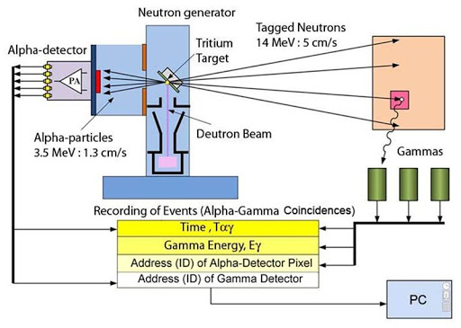
Tagged Neutron Method
6

Slide 4
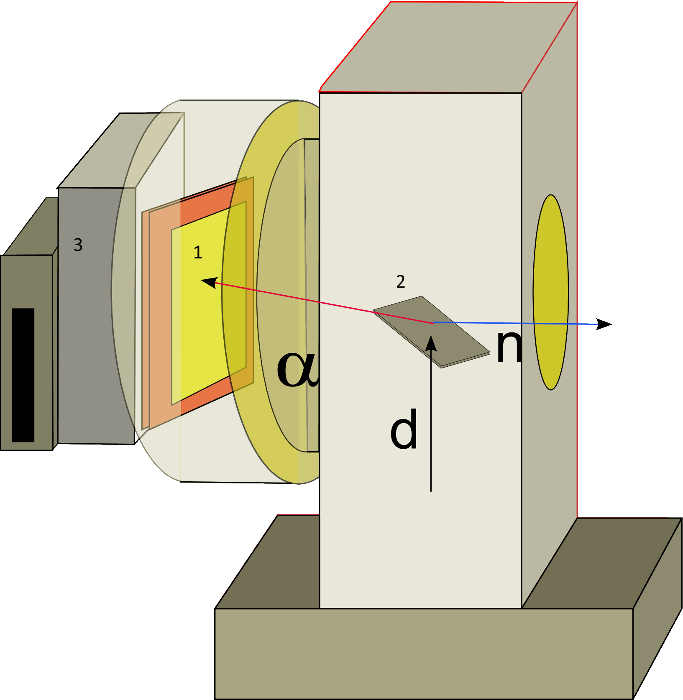
Neutron generator ING-27:
1) Alpha detector (Position-Sensitive Detector)
2)Tritium target
3)Amplifier
Max intensity | 5 х10 ⁷ с ⁻¹
Neutron Energy | 14,1 MeV
Neutron radiation mode | constant
Electricity supply | ± 5 V
Maximum power consumption | 40 W
Neutron generator size | 130х279х227 mm
Total weight | 8 kg
Lifetime | ~ 800 h
5

Slide 5
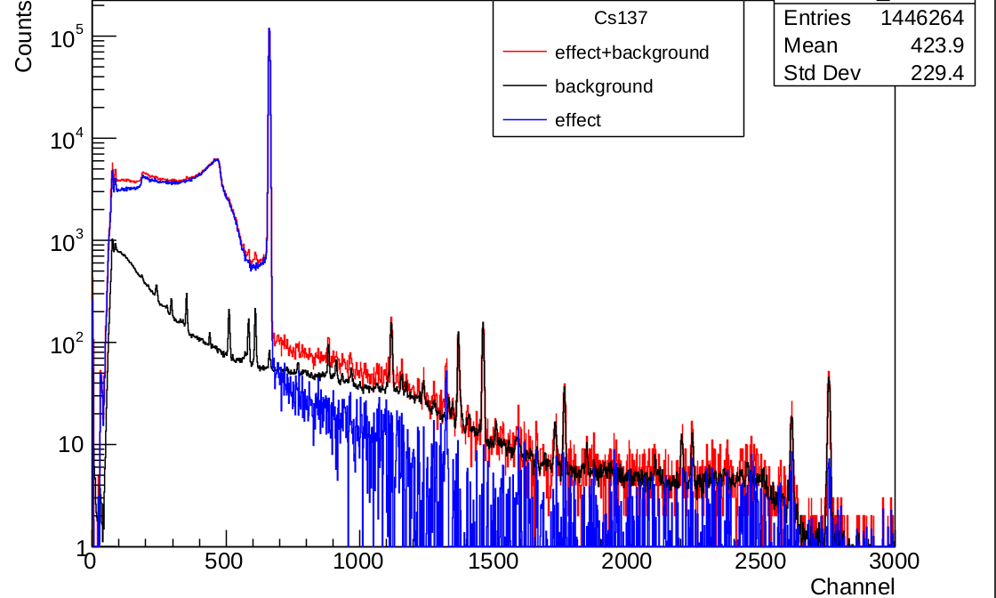
Obtaining a spectrum of calibration sources
8

Slide 6
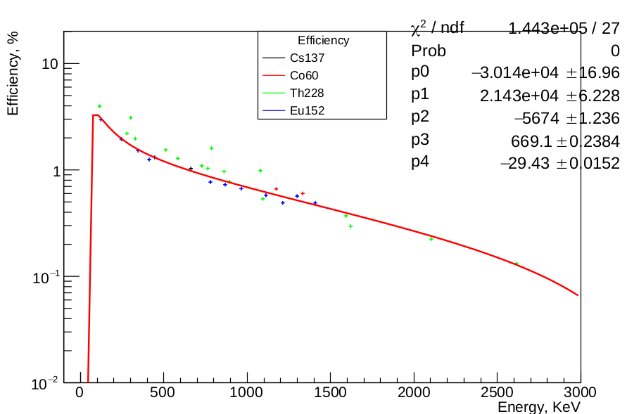
Determining the detector efficiency using calibration gamma-ray sources (¹³⁷Cs, ¹⁵²Eu, ⁶⁰Co, ²²⁸Th)
9

Slide 7
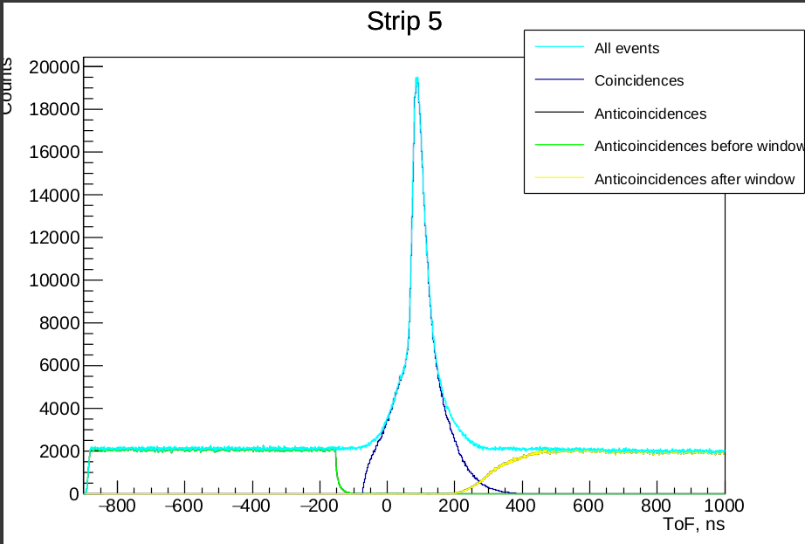
Time of Flight spectrum
11

Slide 8
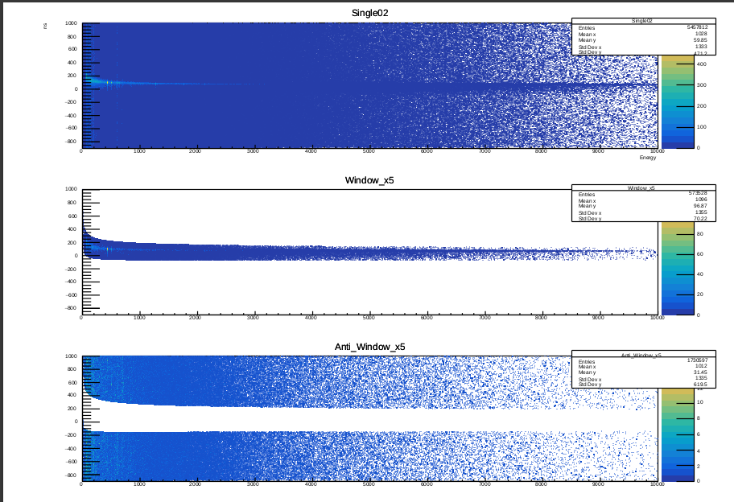
Coincidence and Anticoincidence windows 2D spectrum
12

Slide 9
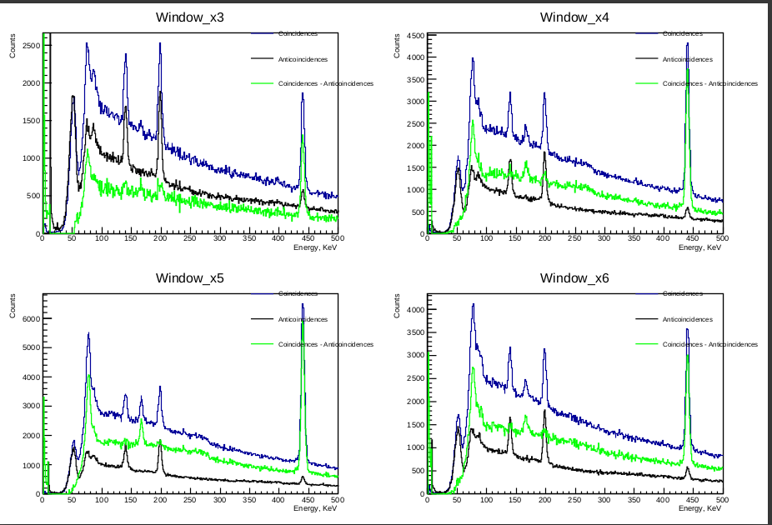
Subtraction of the background spectrum
13

Slide 10
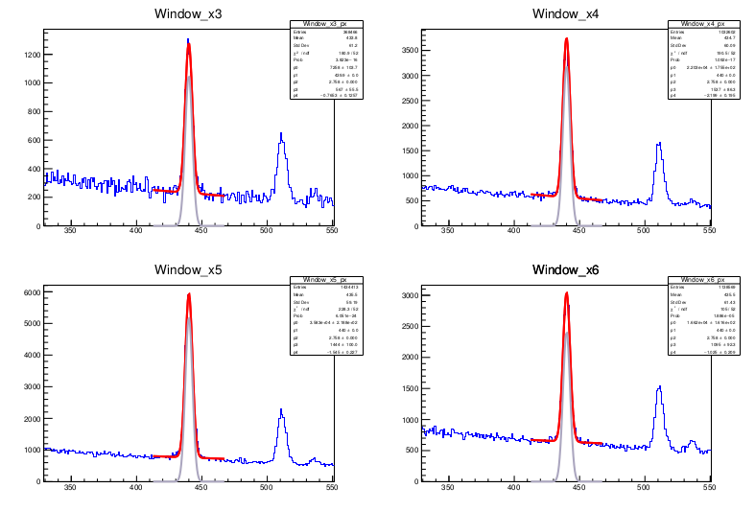
Fit sodium peak
14

Slide 11
Results:
Element | Reaction | Energy (KeV) | Sigma | Relative Area (%)
 |  |  |  | This work | [1]
Na | 23Na(n,a)20F | 166.721±0.090 | 2.136 | 9.61867±0.00317 | -
Na | 23Na(n,n')23Na | 440.044±0.019 | 2.739 | 100±0.00886 | 100±0.11842
Na | 23Na(n,n')23Na | 627.223±0.174 | 3.043 | 7.40912±0.00271 | 4.34±0.00822
Na | 23Na(n,a)20F | 656.407±0.128 | 3.085 | 8.85722±0.00297 | 7.56579±0.00986
Na | 23Na(n,d)22Ne | 1274.15±0.073 | 3.839 | 13.1884±0.00239 | 31.9079±0.02302
Na | 23Na(n,n')23Na | 1636.12±0.180 | 4.194 | 9.55062±0.00262 | 24.5066±0.01809
[1] S. P. Simakov , A. Pavlik , H. Vonach , S. Hlavac // Status of experimental and
evaluated discrete Y-ray production at En = 14,5 MeV . International Atomic Energy
Agency, 1998.
16

Slide 12
Chlorine
Element | Reaction | Energy (KeV) | Sigma | Relative Area (%)
 |  |  |  | This work | [1]
Cl | 37Cl(n,n')37Cl | 788.376±0.186 | 3.269 | 36.1989±0.01774 | 6.05422±0.00662
Cl | 37Cl(n,2n)36Cl | 821.358±0.536 | 3.314 | 10.2041±0.01393 | -
Cl | 37Cl(n,n')37Cl | 1763.55±0.196 | 4.309 | 40.5432±0.01601 | 47.5904±0.12951
Cl | 35Cl(n,n')35Cl | 1990.5±0.270 | 4.506 | 24.0454±0.01361 | -
Cl | 35Cl(n,p)35S | 2127.93±0.098 | 4.618 | 100±0.02467 | 100±0.23795
Cl | 35Cl(n,d)34S | 2645.87±0.372 | 5.015 | 16.8463±0.009720 | -
Cl | 35Cl(n,n')35Cl | 3102.6±0.355 | 5.334 | 12.8729±0.007660 | -
Cl | 37Cl(n,n')37Cl | 3162.8±0.286 | 5.374 | 14.8416±0.00763 | 21.988±0.04518
17

Slide 13
Potassium
Element | Reaction | Energy (KeV) | Sigma | Relative Area (%)
 |  |  |  | This work | [1]
K | 39K(n,n')39K | 347.324±0.248 | 3.86453 | 38.4279±0.02504 | -
K | 39K(n,d)38Ar | 670.264±0.353 | 4.15578 | 25.8502±0.01993 | -
K | 39K(n,p)39Ar | 1266.99±0.275 | 4.54554 | 33.1994±0.02053 | 10±0.01139
K | 39K(n,d)38Ar | 1642.54±0.244 | 4.74377 | 45.2676±0.02047
K | 39K(n,d)38Ar | 2167.7±0.091 | 4.98572 | 100±0.02607 | 100±0.07254
K | 39K(n,n')39K | 2814.32±0.184 | 5.24602 | 29.1079±0.01135 | 38.342±0.02590
K | 39K(n,n')39K | 3596.91±0.619 | 5.52442 | 6.32301±0.00594 | 11.917±0.01554
18

Slide 14
Thank you for attention!
19

