Slide 1



Production of metal ion beams from DECRIS-3 ion source
А.E. Bondarchenko¹, S.L. Bogomolov¹, V.N. Loginov¹, A.N. Lebedev¹, V.E. Mironov¹, D.K. Pugachev¹, М.V. Zdorovets², I.А. Ivanov² ,Е.К. Sambayev², M. V. Koloberdin²,А.Е. Kurakhmedov², D.A. Mustafin², M.B. Abdigaliyev²
¹ Joint Institute for Nuclear Research, FLNR, Dubna, Russia
² Astana branch of Institute of Nuclear Physics, Nur-Sultan, Kazakhstan

Slide 2
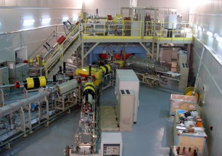
The accelerator complex DC-60 of Astana branch of the INP (Nur Sultan, Kazakhstan Republic)
The main parameters of the beams
Type of ions | Li - Xe
Mass to charge ratio (A/Z) | 6 - 12
Accelerated ion energy | 0,35 – 1,7 MeV/nucleon
MAIN OBJECTIVES :
Scientific research
Education
Production of track membranes with special properties-
Creation of micro and nano structures
Surface modification of standard materials, creation of new materials with required properties
The cyclotron is equipped with the Electron Cyclotron Resonance (ECR) ion source DECRIS-3

Slide 3
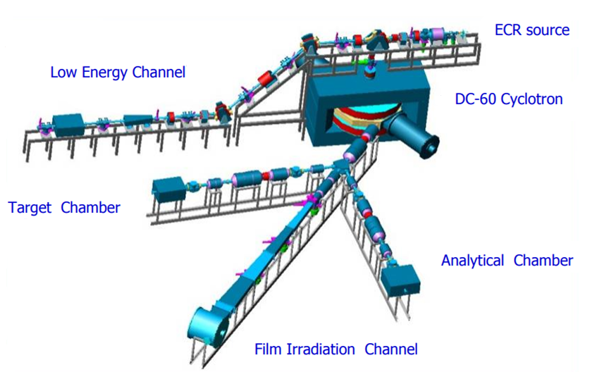
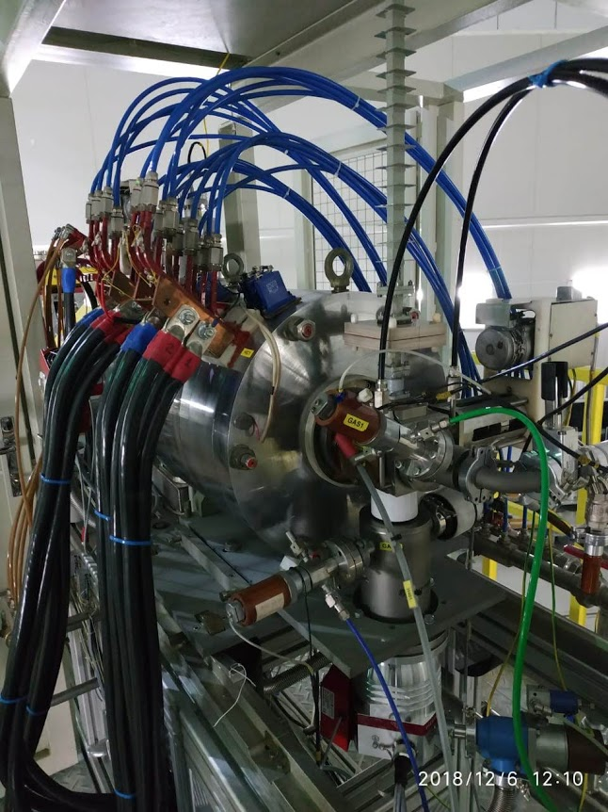
CYCLOTRON DC-60
DECRIS-3 ion source
The experience and knowledge on the production of metal ion beams from ECR ion sources in FLNR by the MIVOC method has been successfully transferred to the DC-60 cyclotron.

Slide 4
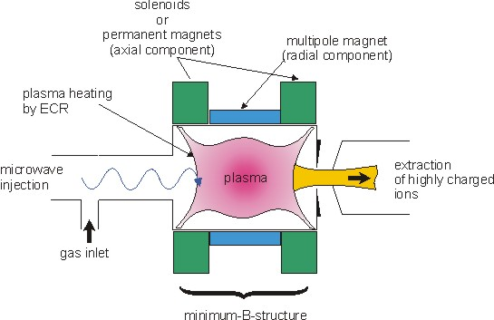
The ECR ion source

Slide 5
Production of ions of solids
Many of the elements required for acceleration at the cyclotrons are available in the solid state form only.

Slide 6
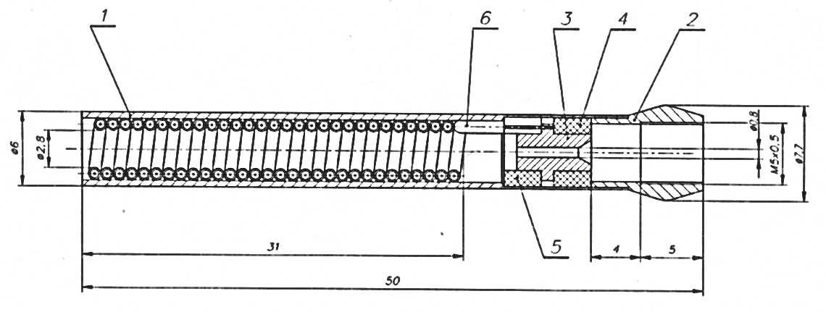
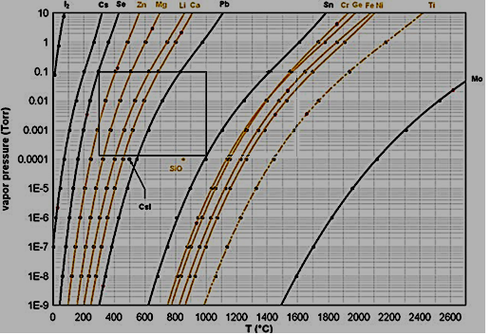
Production of ions of solids
Vapor of metals
(oven method)
or
Volatile compounds
(MIVOC method)
FLNR microoven
Metals vapor pressure vs temperature
Oven method

Slide 7
Metal ion beams produced at DC—60 cyclotron using oven method
Parameters of accelerated ions: ⁴⁰Ca⁷⁺, ²⁴Mg⁴⁺, ³¹P⁵⁺, ⁷Li⁺
Ion | Energy, MeV/nucleon | Ion beam current in injection, µA | The extracted ion beam current, µA | Transmission ratio, %
⁴⁰Ca⁷⁺ | 1,75 | 50 | 1,35 | 2,75
³¹P⁵⁺ | 1,75 | 20 | 0,58 | 3,00
²⁴Mg⁴⁺ | 1,75 | 46 | 1,14 | 2,48
⁷Li⁺ | 1,32 | 100 | 1,5 | 1,5

Slide 8
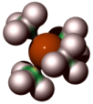
MIVOC-method (Metal Ions from VOlatile Compounds)
Requirements:
1) Chemical compound containing required element has to be found
2) The saturated vapour pressure (at room temperature) of the compound has to be high enough (≥ 10⁻³ mbar)
- minimum usable vapour pressure of the compound is determined by the material consumption rate of the ion source and by the conductance between the MIVOC chamber and the ion source
C₂B₁₀H₁₂ - carboran
(C₅H₅)₂Me – metallocene molecule (Fe, Ni,Cr..)
(CH₃)₄Me – tetrameethyl molecule (Sn, Ge)
(CO)₆Me – hexacarbonyl molecule (Cr, W)
Fe(C₅H₅)₂
W(CO)₆

Slide 9
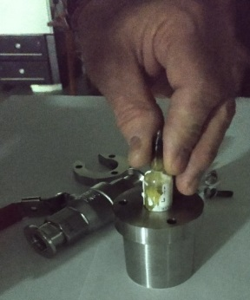
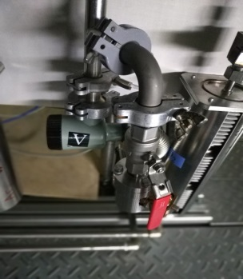
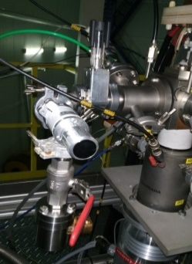
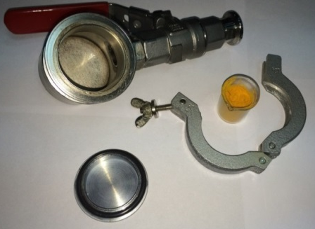
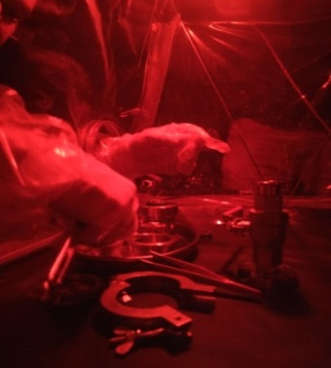
The preparation of the titanium compound.
Titanium ions beams were produced from the compound (CH₃)₅C₅Ti(CH₃)₃.
Preparation of the titanium compound (CH₃)₅C₅Ti(CH₃)₃ for operation. Left - an ampoule with a substance is placed in a container; in the center - the container with the substance is pumped to the forevacuum; on the right - the container with the working substance is connected to the ECR ion source through a mechanical regulating valve.
The preparation compounds ferrocene, cobalt, chrome, nickel, germanium, silicium and hafnium.
The organometallic compound Fe(C₅H₅)₂ hasn’t a chemical activity with oxygen and isn’t sensitive to visible light. Therefore, the preparation of the MIVOC chamber with the compound Fe(C₅H₅)₂ was carried without an argon box.
The compounds Cr(C₅H₅)₂, Co(C₅H₅)₂, Ge(CH₃)₄, Si(CH₃)₄ and (C­₅H₅)₂Hf(CH₃)₂ has a chemical activity with oxygen. So, the preparation of the MIVOC chamber was carried out an argon box.
The compound Ni(C₅H₅)₂ has a high chemical activity with oxygen and is highly sensitive to visible light. Therefore, the preparation of the MIVOC chamber with the compound Ni(C₅H₅)₂ was carried out in an argon box under red light.
After preparation all containers with compounds are pumped to the forevacuum, and connected to the ECR ion source through a mechanical regulating valve.

Slide 10
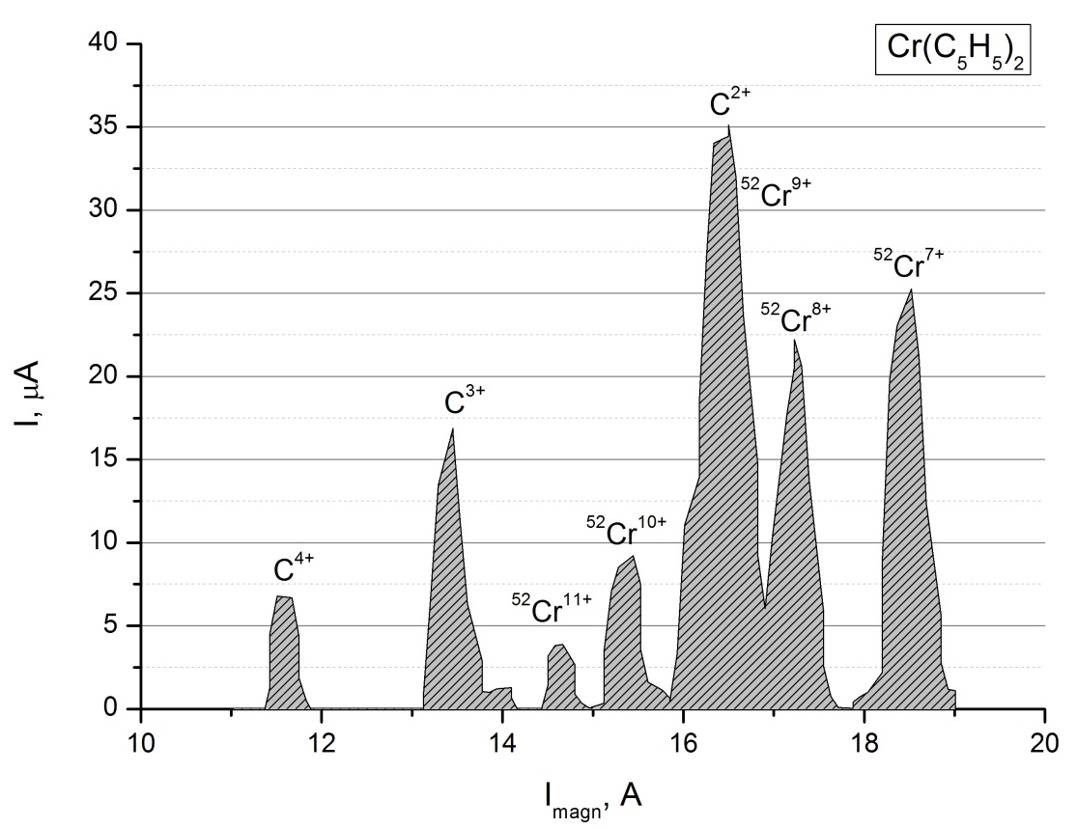
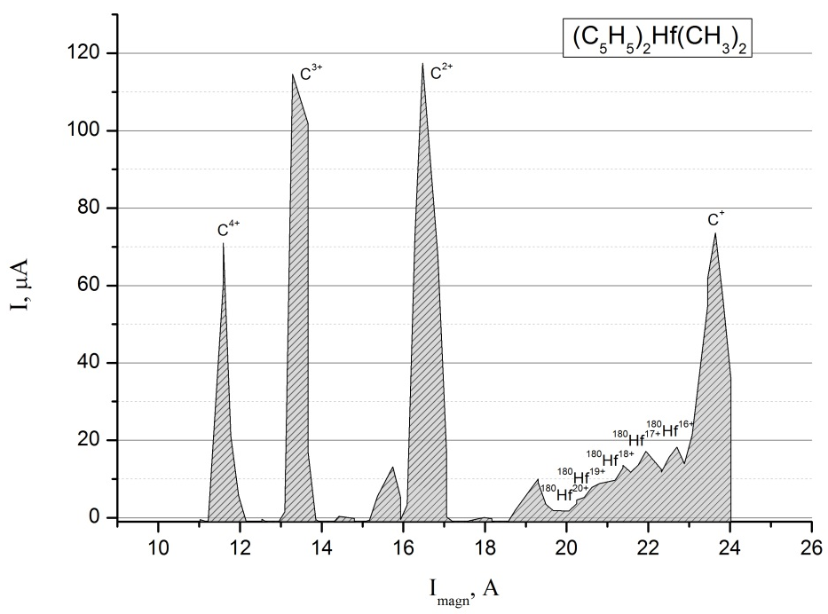
The spectrum of Cr ions, the source settings are optimized for ⁵²Cr¹⁰⁺ - 18 μA . UHF power – 72 W.
The spectrum of Hf ions, the source settings are optimized for ¹⁸⁰Hf¹⁷⁺ - 19 μA. UHF power – 230 W.

Slide 11
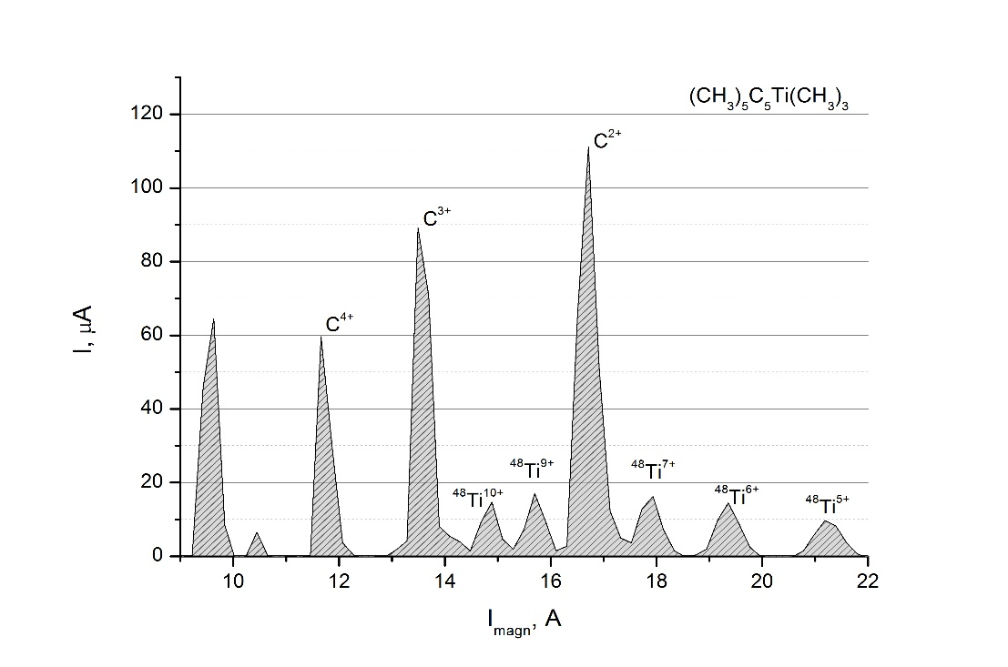
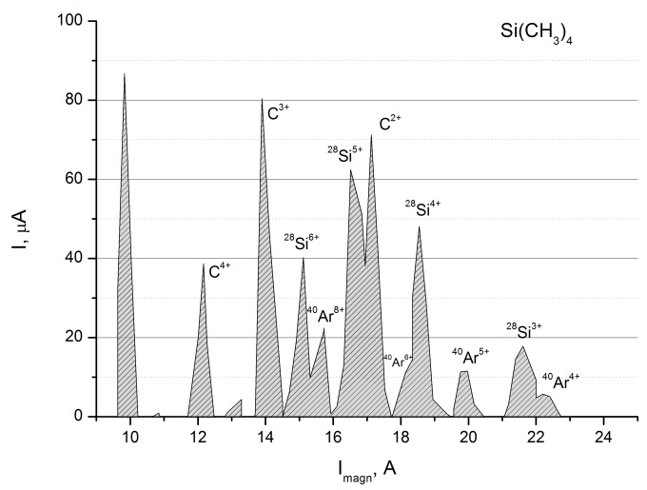
The spectrum of Ti ions, the source settings are optimized for ⁴⁸Ti⁹⁺ - 18 μA.
UHF power – 156 W.
The spectrum of Si ions, the source settings are optimized for ²⁸Si⁵⁺ - 62 μA. UHF power – 50 W.

Slide 12
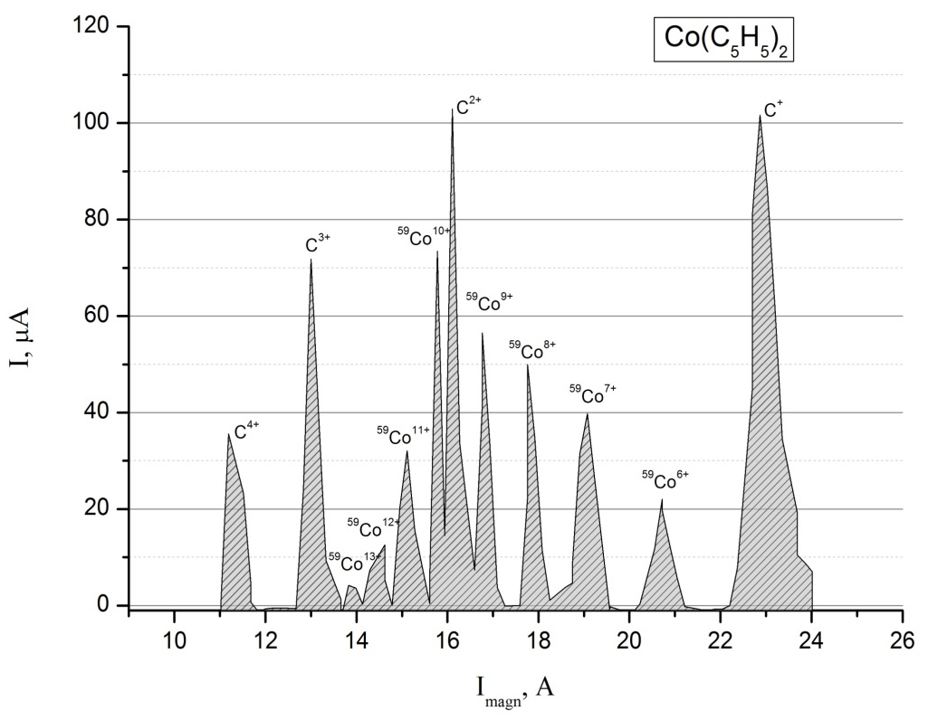
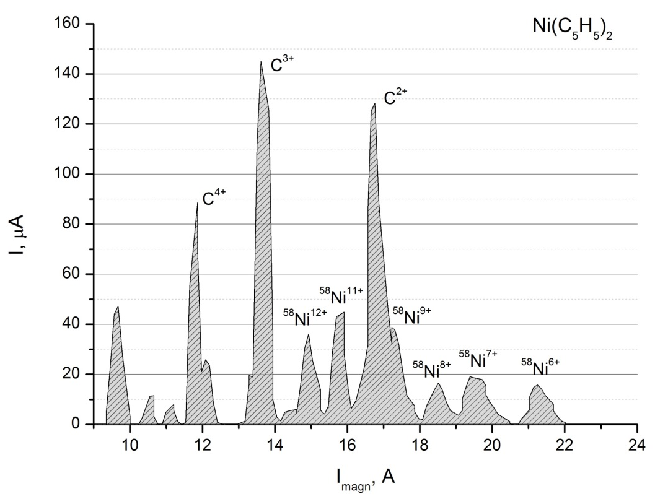
The spectrum of Co ions, the source settings are optimized for ⁵⁹Co¹²⁺ - 12 μA .
UHF power – 207 W.
The spectrum of Ni ions, the source settings are optimized for ⁵⁸Ni¹¹⁺ - 43 μA. UHF power – 260 W.

Slide 13
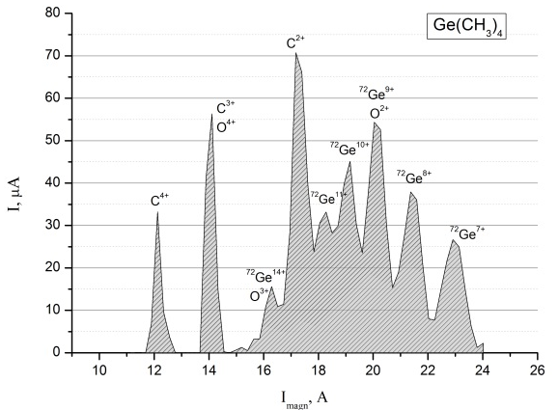
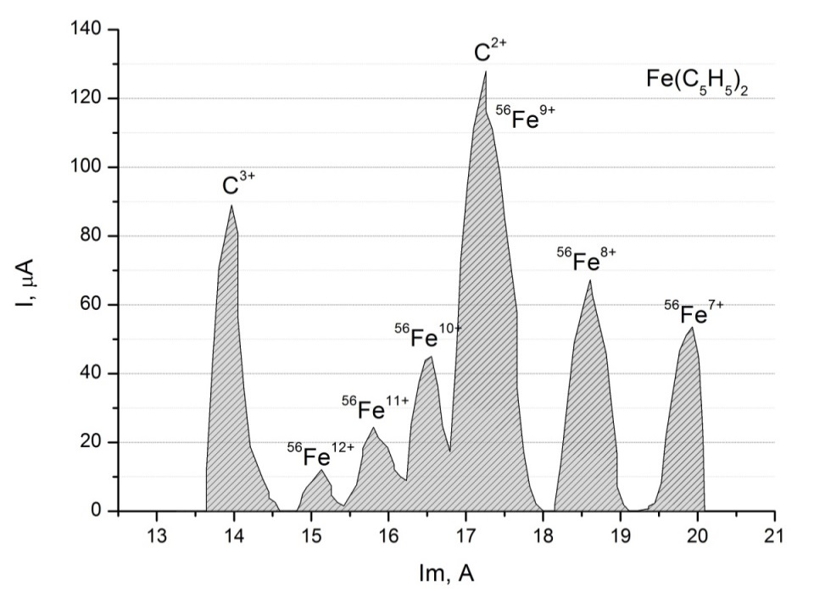
The spectrum of Ge ions, the source settings are optimized for ⁷²Ge¹⁰⁺ - 46 μA. UHF power – 270 W.
The spectrum of Fe ions, the source settings are optimized for ⁵⁶Fe¹⁰⁺ – 44 µA. UHF power – 120 W.

Slide 14
Table. The intensity (μA) of metal ion beams produced from the DECRIS-3 ECR ion source of the DC-60 cyclotron using the MIVOC method
Z | 5+ | 6+ | 8+ | 9+ | 10+ | 11+ | 12+ | 14+ | 15+ | 17+ | 18+ | 20+
²⁸Si | 62* | 40
⁴⁸Ti |  |  |  | 18* | 16
⁵⁸Ni |  |  |  | 39 |  | 43* | 37
⁵⁹Co |  |  |  | 57 | 73 | 36 | 12*
⁵²Cr |  |  | 22 |  | 9*
⁷²Ge |  |  | 38 |  | 46* | 34
⁵⁶Fe |  |  | 68 |  | 44* | 25 | 12
¹⁸⁰Hf |  |  |  |  |  |  |  |  |  | 19 | 15 | 5
* –metal ion beams accelerated at the DC-60 cyclotron

Slide 15
CONCLUSION
The main goal of this work was to employ the MIVOC method for production of ions of solid and extend the spectrum of accelerated ions at the DC-60 cyclotron.
With the expansion of the spectrum of accelerated elements, it becomes possible to set up new experiments in the field of experimental nuclear physics, radiation solid state physics, and various applied problems, which makes the research objective particularly relevant. As a result of the work done, for the first time at the DC-60 cyclotron, the ion beams of ⁴⁸Ti⁹⁺, ⁷²Ge¹⁰⁺, ⁵⁶Fe¹⁰⁺, ¹⁸⁰Hf¹⁷⁺, ⁵⁸Ni¹¹⁺, ²⁸Si⁵⁺, ⁵⁹Co¹²⁺ and ⁵²Cr¹⁰⁺ were produced.

Slide 16
Thanks for attention

