Slide 1
The software development for data processing from the heavy ion beam loss diagnostics system for the DC-280 accelerator
AYSS – 2020
K. Timoshenko

Slide 2
Outline
Introduction
Motivation
Advantages and disadvantages of diagnostic methods
location of the diagnostic system
Used equipment
Software in the LabVIEW development environment
Conclusion

Slide 3
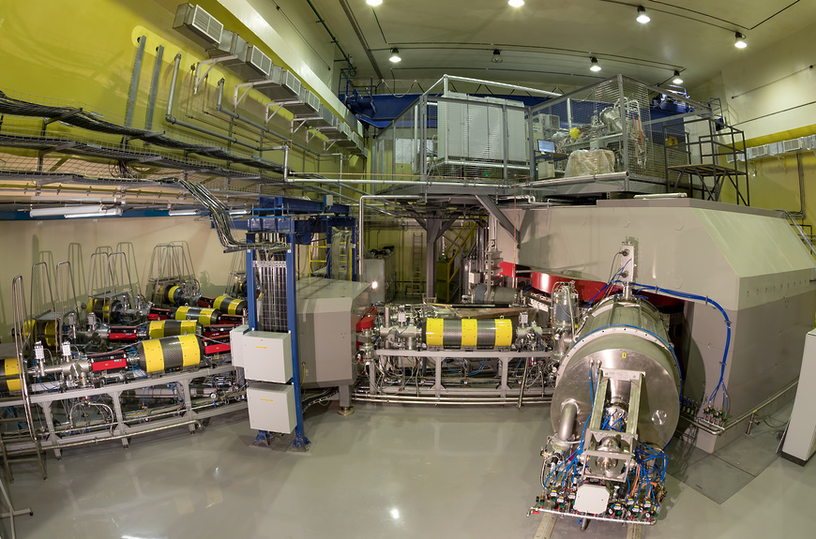
Accelerator complex DC280
Ion energy 4÷8 MeV/n
Ion masses 4÷238
Intensities (A~50) – 10 ρμA
K factor – 280
Efficiency of beam transfer >50%

Slide 4
The ion beam diagnostics methods:
Contact methods;
Non-destructive methods.

Slide 5
Contact sensors
Secondary emission grid,
secondary emission monitor, SEM
Faraday Cup
Luminescent screen,
phosphor screen

Slide 6
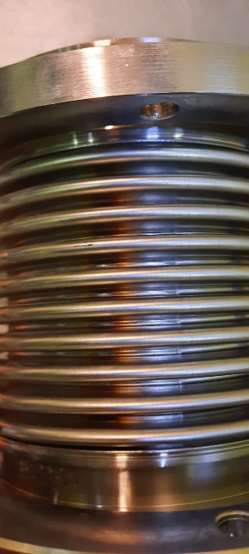
Disadvantages of contact methods
destructive effect on the beam;
Overheating and destruction of equipment.
A high-intensity ion beam hit the bellows

Slide 7
The ion beam loss diagnostic system of an ion beam
– Ion beam
– secondary radiation
Ion beam channel
Ion beam channel

Slide 8
The ion beam loss diagnostic system of an ion beam
3 m
– Ion beam
– secondary radiation

Slide 9
Registration of fast neutrons using a moderator

Slide 10
Requirements for BLDS
Sensitivity
Response time
Excessive radiation response (saturation effects)
Physical size

Slide 11
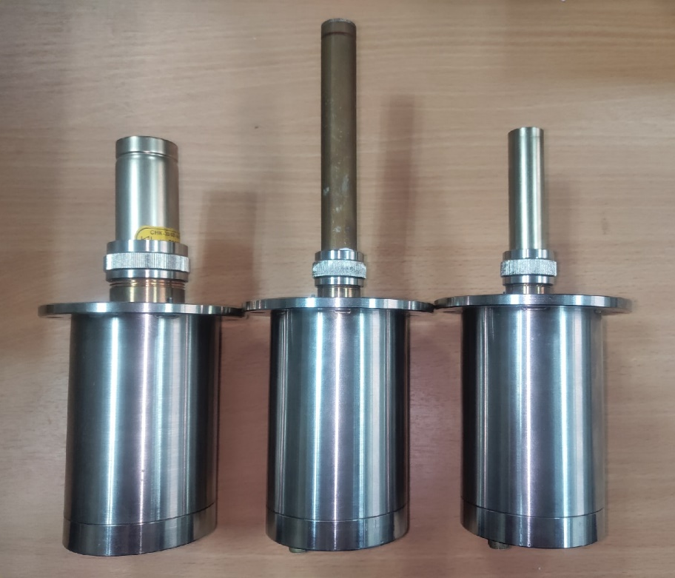
Thermal neutrons counters
SNM-16 (Corona Counters)
Rated operating voltage range, V | 2000-2800
Effective working length, mm | 105
Thermal neutron detection efficiency,% | 80
Helium-18/80-3,0/L (proportional counter)
Rated operating voltage range, V | 1150-1450
Effective working length, mm | 55
Thermal neutron detection efficiency,% | 80
SNK-30/60-4,6/L (Corona Counters)
Rated operating voltage range, V | 1900-2000
Effective working length, mm | 25
Thermal neutron detection efficiency,% | 70

Slide 12
Equipment used for processing and collecting data
Chassis PXIe-1092
Controller NI PXIe-8880
Terminal Block NI TB-2706
Multifunctional I/O module PXIe-6396
Analog Input channels | 8
Analog Ouput channels | 2
Digital I/O channels | 24

Slide 13
The block diagram of the beam loss diagnostics system

Slide 14
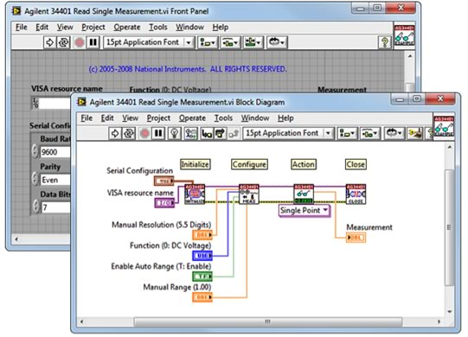
LabVIEW Hardware Drivers
You can quickly see the signal and identify the problem using the test capabilities of the NI-DAQmx drivers
The NI-DAQmx driver also allows you to quickly display and verify the current data from the device using the test panel.
LabVIEW hardware drivers use a single software architecture

Slide 15
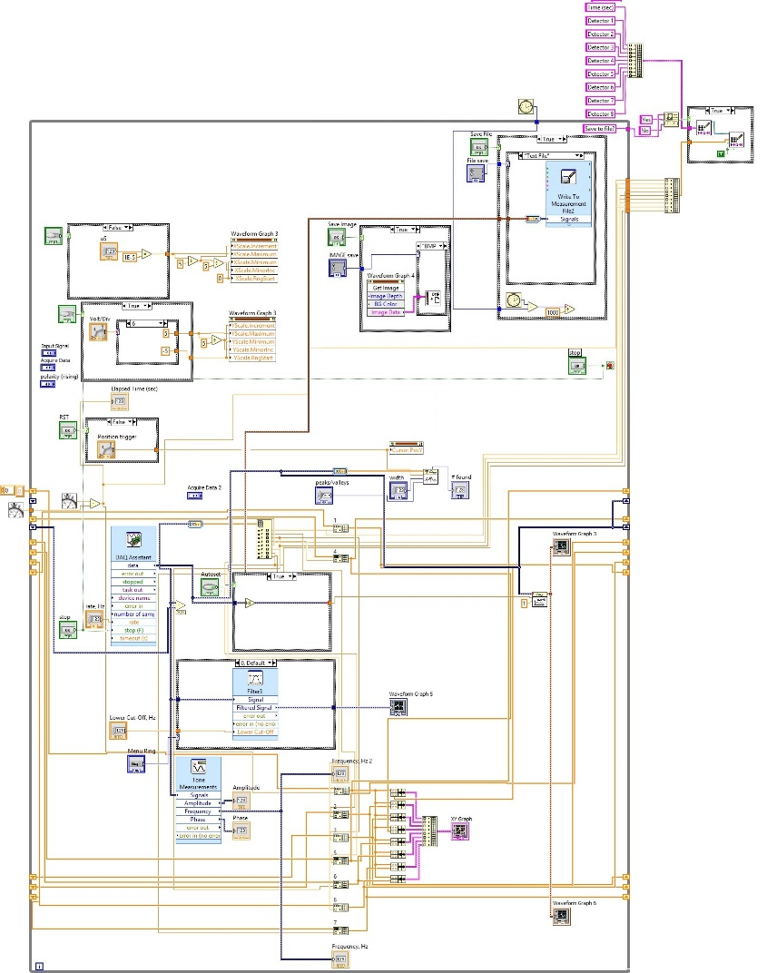
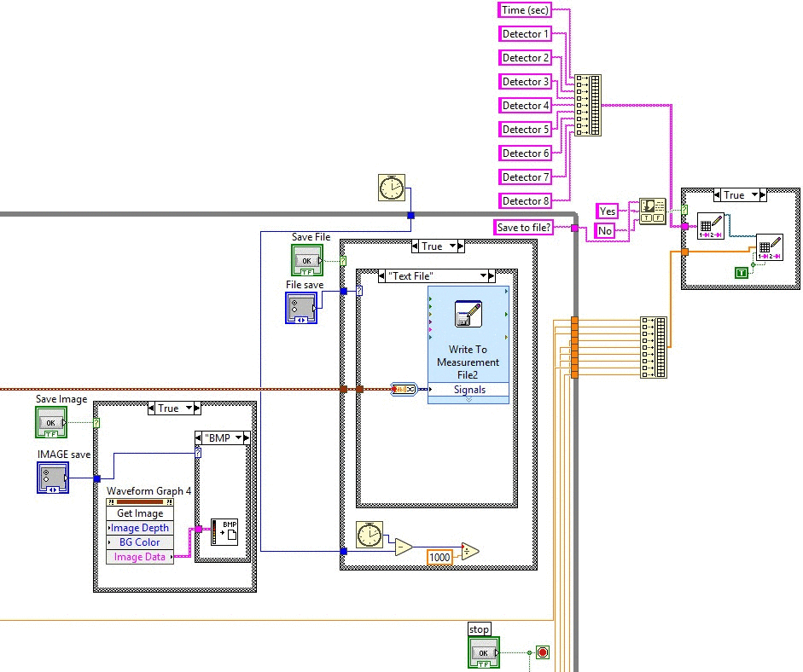
Software block diagram in LabVIEW 2017 Development Environment
1
4
1
3
4
1 – Loop body
2 – iteration counter
3 – termination condition terminal
4 – output terminals
3
2

Slide 16
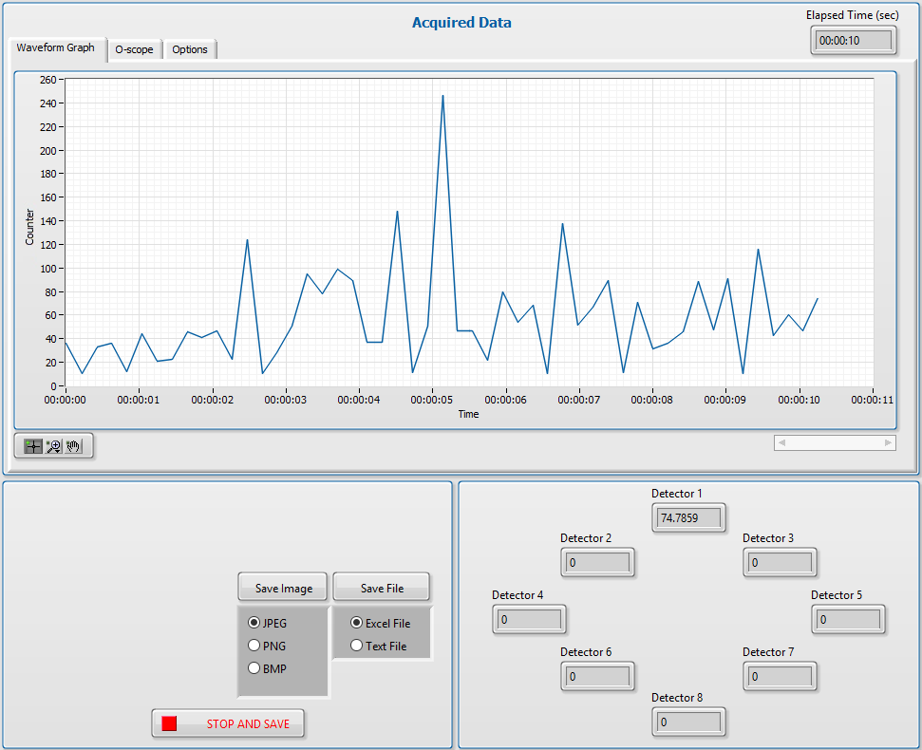
The main interface of the program

Slide 17
Conclusion
Software tests were performed with 1 thermal neutron counter. Adding counters may change software functions written in the LabVIEW development environment. The National Instruments products were used for the implementation of the software.
At this stage, the diagnostic system on the assembled stand is working properly. There are noise issues that we fix as it arise.
In the future it is planned to install and conduct a series of experiments such systems at cyclotron U-400 and further at all basic facilities of FLNR in JINR

Slide 18
The software development for data processing from the heavy ion beam loss diagnostics system for the DC-280 accelerator
AYSS – 2020
K. Timoshenko
Email: timoshenkokd@jinr.ru

