Slide 1
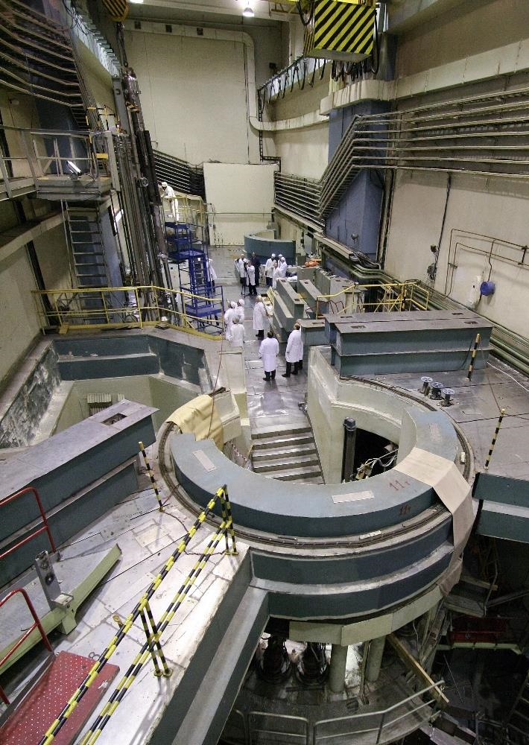
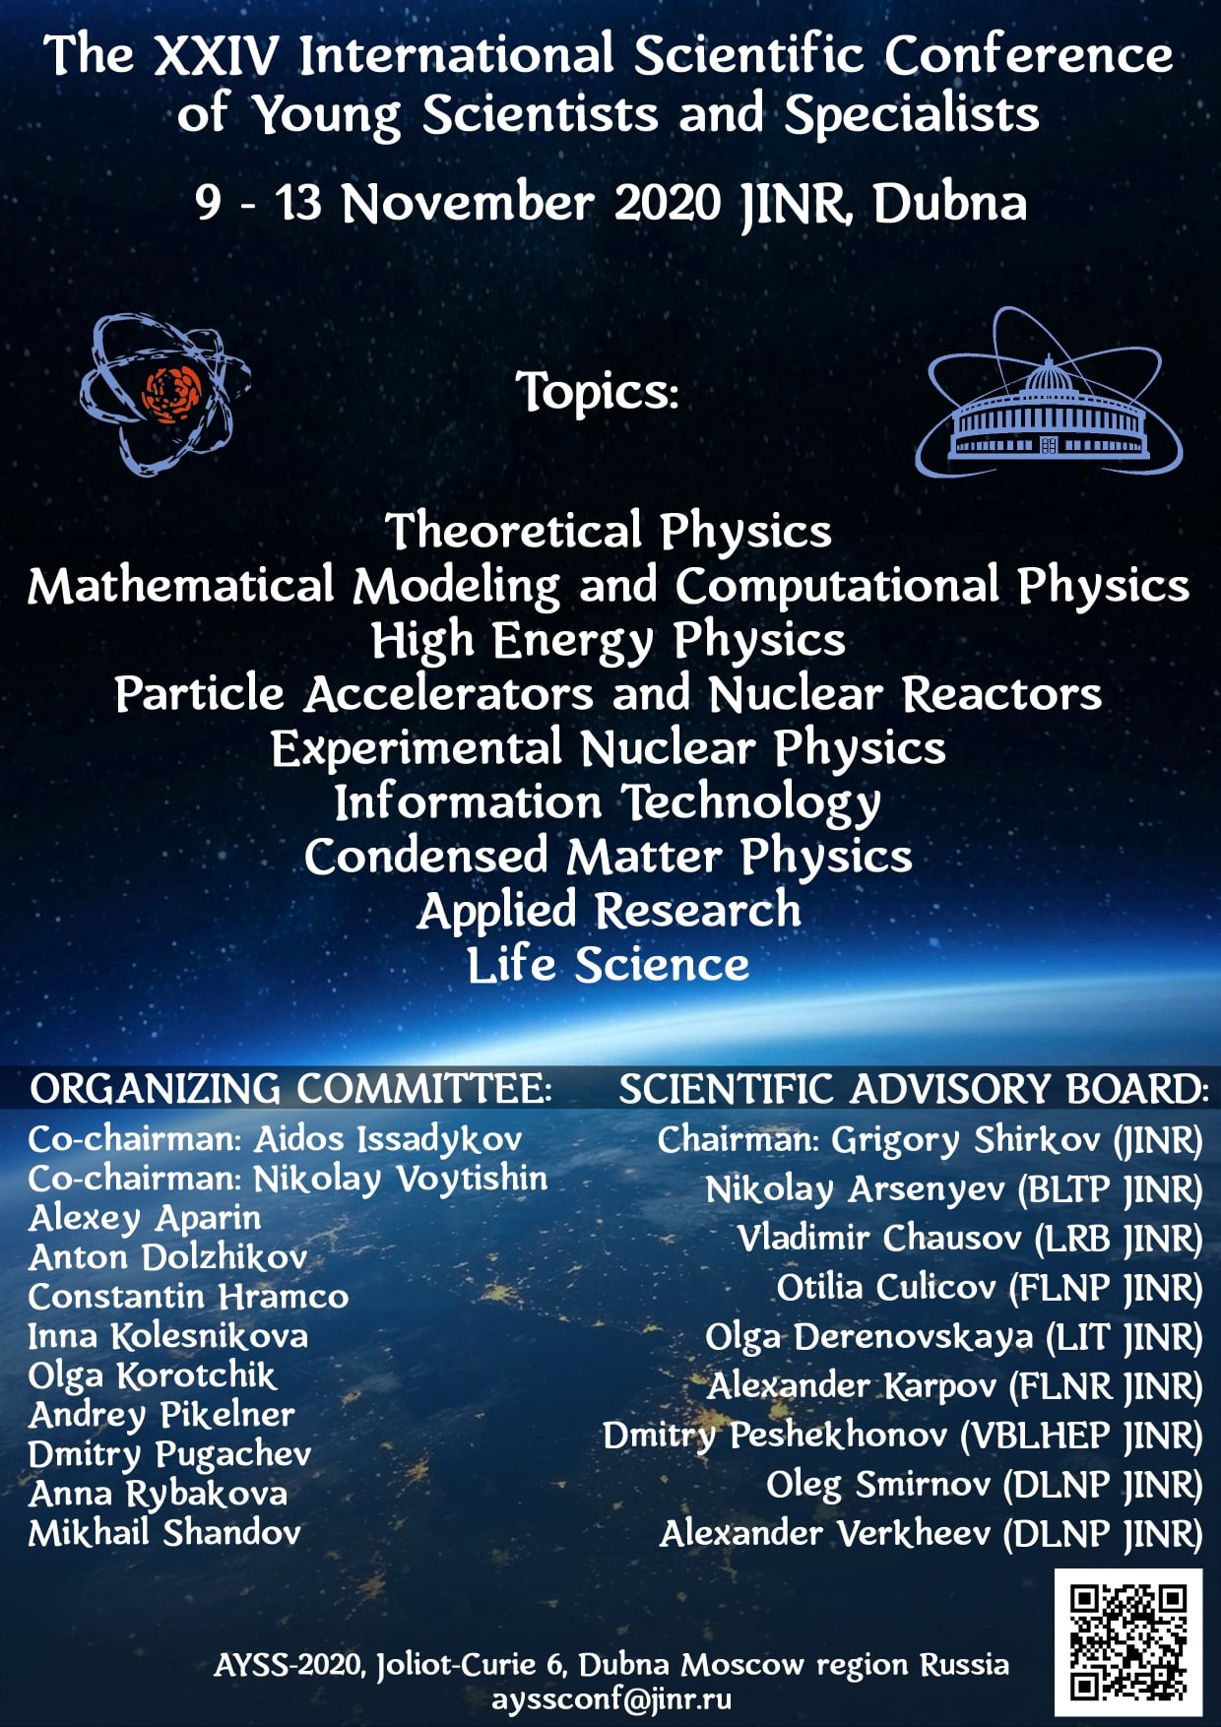
Neutron Physics at JINR: current highlights and future perspectives
V.Shvetsov

Slide 2
STATISTICS

Slide 3
Frank Laboratory of Neutron Physics
582 staff personnel, 106 from JINR member-countries , average age 47 years;
168 scientists 71 from JINR member-countries;
31.684 M$ - 2019 annual budget, 51% - for the research;
Two scientific directions:
  Neutron nuclear physics;
  Condensed matter physics;
Methodic;
Basic facilities:
  IBR-2M;
  IREN;
About 250 papers published annually;

Slide 4
INTRODUCTION

Slide 5
Neutrons comes into action at t=1 μs after Big Bang when temperature goes down to 10⁸ K and formed nucleons can survive and interact with each other. Neutron lifetime – one of the key parameters of the Primordial Nucleosynthesis!
Since 10⁹ years neutrons are governing the stellar nucleosynthesis through r and s processes!
Neutron lifetime and beta-decay parameters – low energy approach to the Standard Model
Neutrons are driving force in nuclear power plants
SO NEUTRONS ARE EVERYWHERE

Slide 6
Atom
10⁻⁸ cm
10⁻¹² cm

Slide 7
Neutron – wave and particle
cold
resonance
UCN
thermal
fast

Slide 8
Scattering Experiment
Scattering cross section
Differential scattering
cross section
Double differential scattering
cross section
The task: from the properties of the scattered radiation one have to determine the coordinate and time generalized function of some parameter m, where m – atomic mass or electric polarization or magnetic momenta…

Slide 9
Slow Neutrons Scattering
Scattering triangle
Scattering vector
Elastic scattering
Slow Neutrons(E = 10-100 meV)
b – scattering length
H: b = -0.374*10⁻¹² cm; D: b = 0.667*10⁻¹² cm;
O: b = 0.580*10⁻¹² cm; N: b = 0.580*10⁻¹² cm; …
composition
structure

Slide 10
Scattering Experiment

Slide 11
Neutron interaction with condensed matter and nuclei
^{nat}Gd (n, γ)
¹⁵²Gd - 0.20%
¹⁵⁴Gd - 2.18%
¹⁵⁵Gd - 14.80%
¹⁵⁶Gd - 20.47%
¹⁵⁷Gd - 15.65%
¹⁵⁸Gd - 24.84%
¹⁶⁰Gd - 21.86%
Sample:
m_{g} = 172.8 g
size: 11.2 x 14.5 cm²
ρ: 1.064039 g/cm²
d: 1.35mm
IREN, Dubna
f = 25 Hz
I_{e} = 2A; t_{e}=100ns
L = 58.6m

Slide 12
Measuring Neutron Energy by Time of Flight
Source
Sample
Flight path L, m
dt
Detector
Collimator
≈50 ns at 1 keV; 500 ns at 10 eV

Slide 13
Development of the pulsed neutron sources at JINR

Slide 14
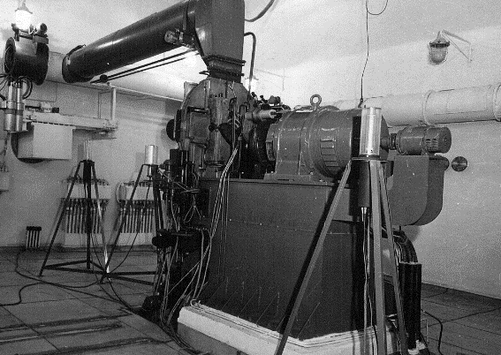
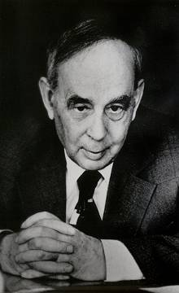

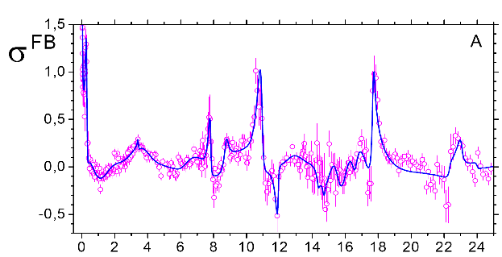
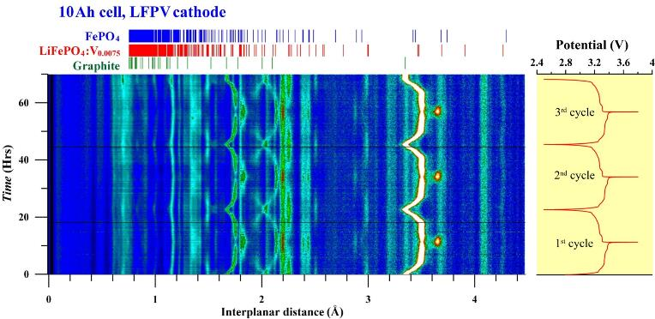
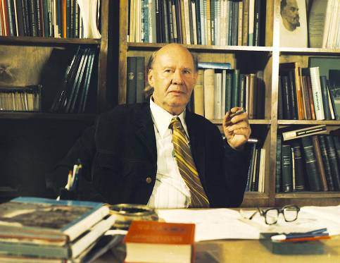
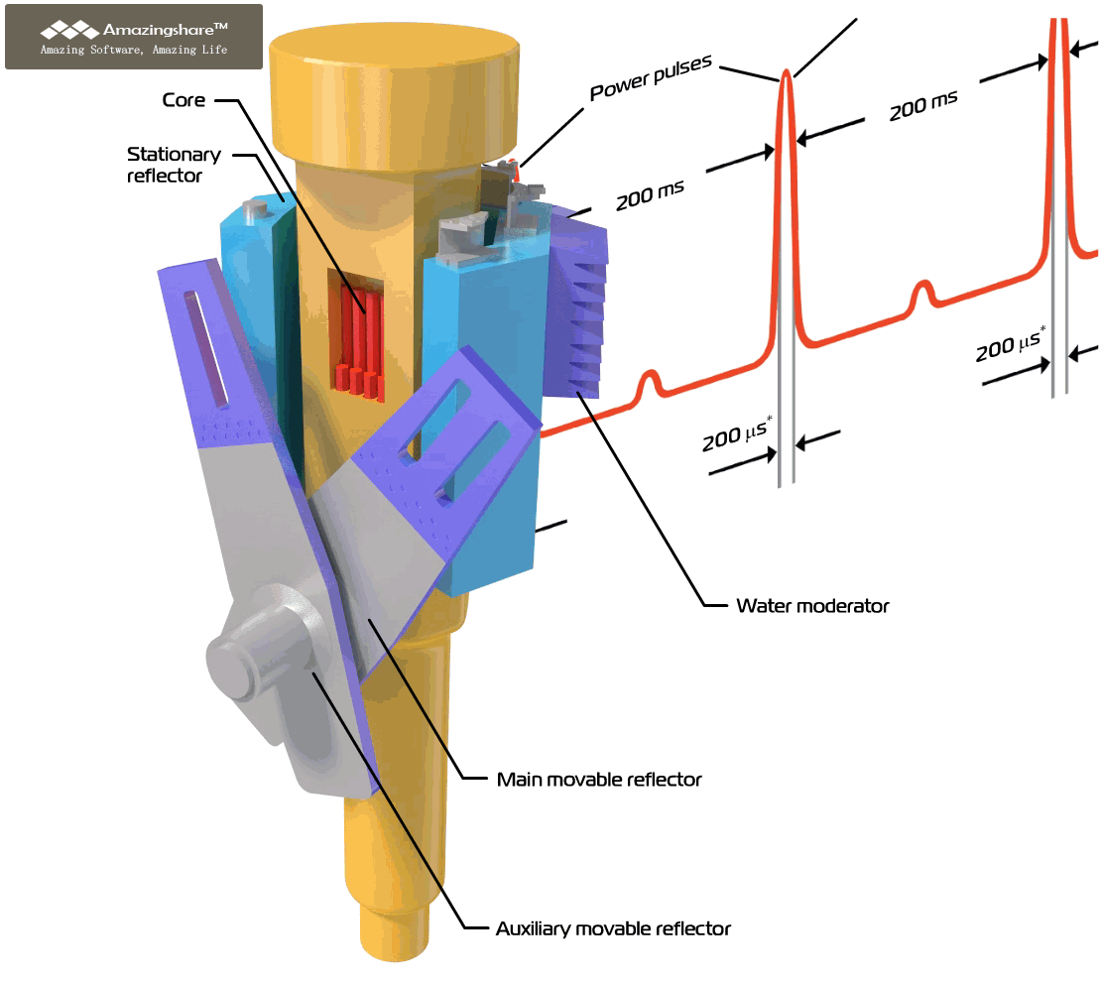
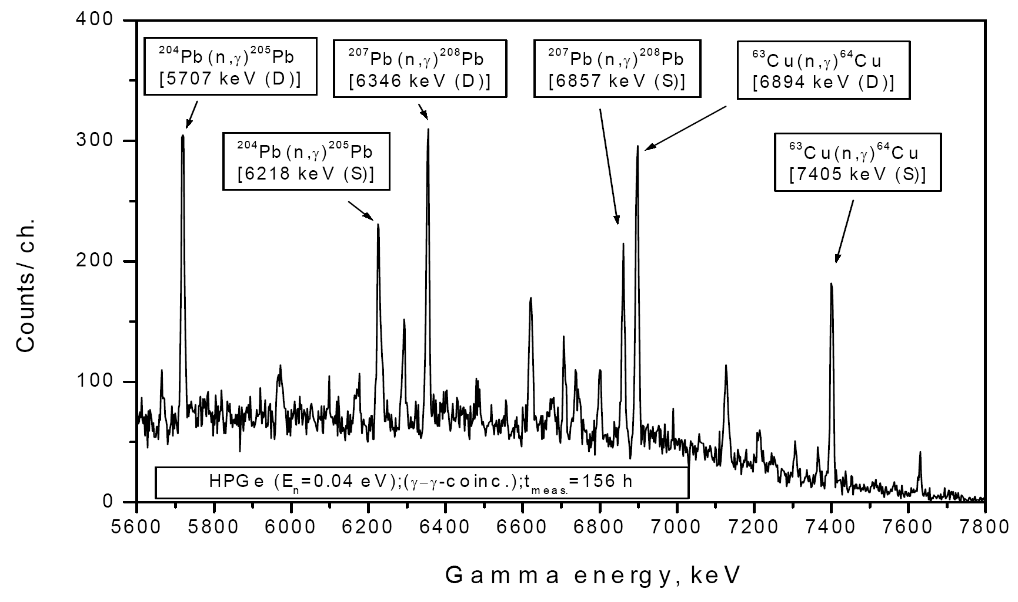
Ilya Frank
Fyodor Shapiro
Dmitry Blokhintsev

Slide 15
IBR, IBR-30, IBR-2
IBR reactor – one of the worlds first dedicated for experiments on extracted beams;
Condensed matter physics – one of the three scientific “pillars” of the Joint Institute;
First experiments on CMP at the Laboratory of Neutron Physics of JINR started in early 60-th by initiative of F.Shapiro, J.Janik and B.Buras;
Effective development of the neutron instrumentation in parallel with construction of the new neutron sources;

Slide 16
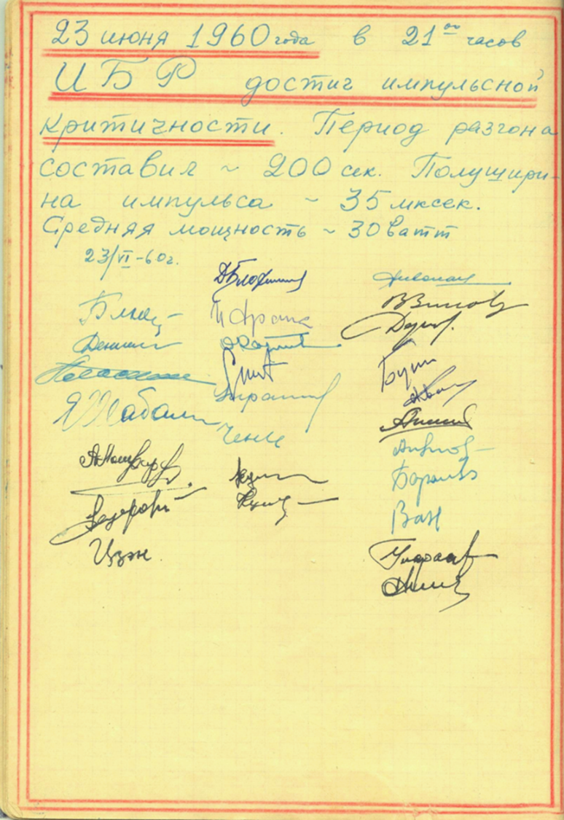
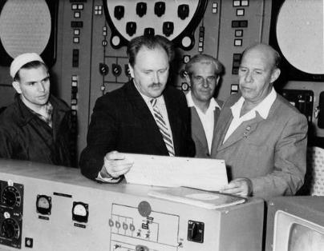
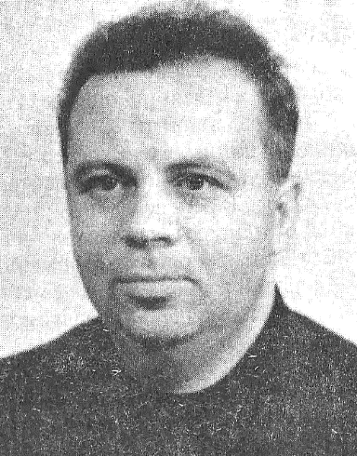
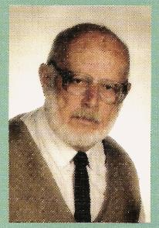
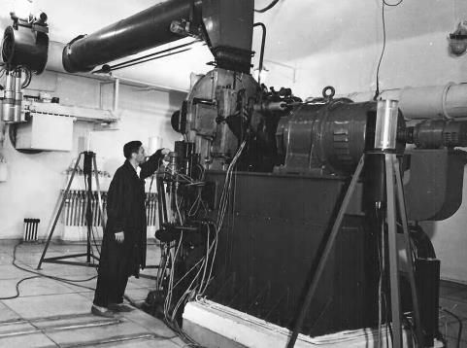
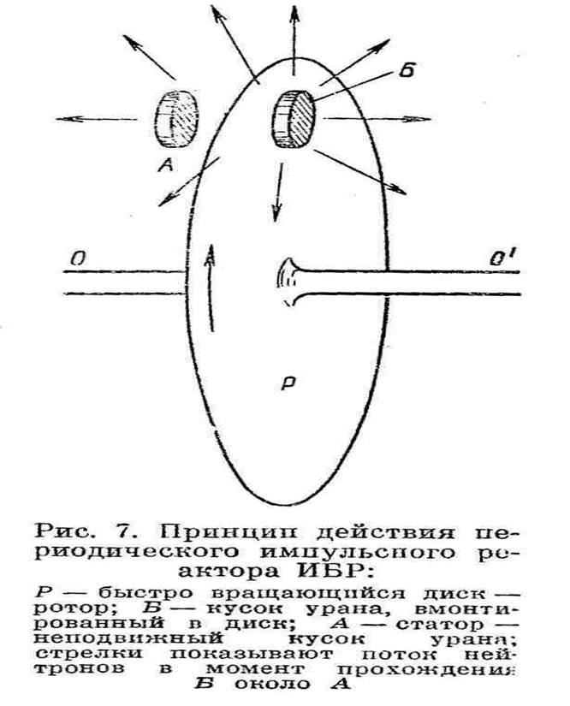
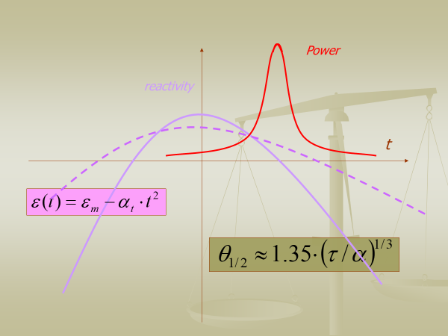
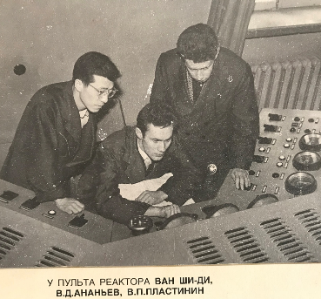
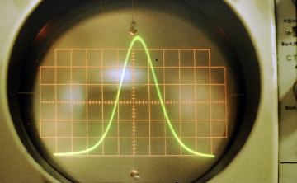
The very first IBR
An idea!
1956
June 23 1960
1955
The theory!!
First criticality!!!

Slide 17
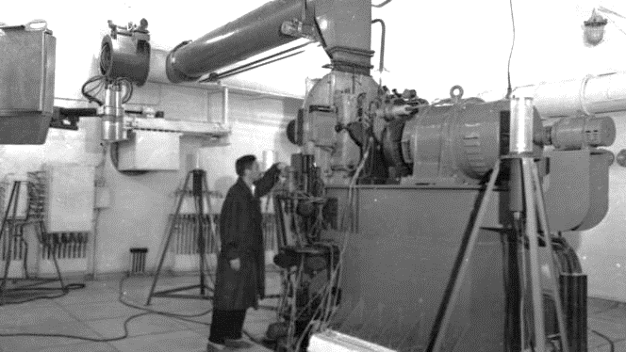
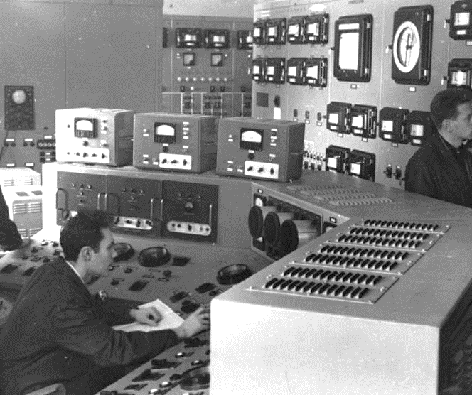
Brief History of IBR reactors
The first IBR was created chiefly by physicists from IPPE (Obninsk) with the participation of specialists from FLNP JINR under the direction of I.M.Frank.
To simplify the design of a unique reactor constructed for the first time in the world, the IBR average power was chosen to be rather small 1 kW (but instantaneous power in pulse reached 5 MW). Later on the possibility to raise the reactor average power up to 6 kW with an increase in the consumption of cooling air was substantiated, and since 1964 the reactor worked at a power from 2 to 6 kW.
In general, rather long pulse of the reactor (50 µs) was more adequate to the tasks of condensed matter physics. To reduce pulse duration, at the suggestion of F.L.Shapiro since 1965 the first IBR started to be used in a neutron pulse multiplication mode of a neutron-producing target of the electron accelerator-microtron. With the start-up of the pulsed booster) the neutron pulse length reduced to 3 μs.

Slide 18
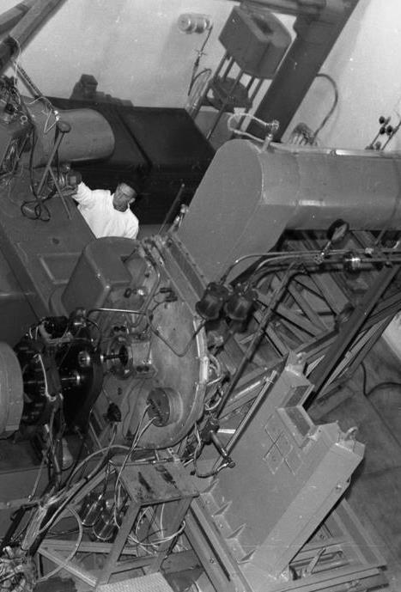
Brief History of IBR reactors cont.
The first IBR stopped its operation in August 1968. It is particularly remarkable that the last experiment on this reactor was a well-known experiment on the first observation of ultracold neutrons carried out in a rare pulse mode. On June 10, 1969 an advanced analogue of the first IBR – IBR-30 was put into operation. An increase in power was achieved by changing the design of plutonium fuel elements and by introducing two uranium inserts (modulators of reactivity) instead of one in the steel disk.
The operation in a booster mode (IBR-30 was used in the reactor and booster modes alternately up to 1986, when its operation in the reactor mode was stopped) was carried out with the resonant linear accelerator LUE-40 as an injector with an energy of accelerated electrons of 44 MeV and a pulse current of 0.2 A. An average power in the booster mode was 10 kW at a fast neutron pulse halfwidth of 4 μs. High luminosity of the spectrometer at IBR-30 made it possible to open up a number of entirely new areas in nuclear research and condensed matter physics.

Slide 19
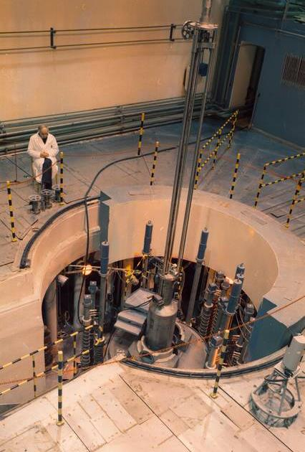
Brief History of IBR reactors cont.
In 1963 preliminary design works were started to substantiate the possibility to create a much more powerful IBR, which in its neutron characteristics for investigations by slow neutron scattering methods would compare well with 50-100 megawatt stationary reactors (HFR in ILL, Grenoble, SM-2 in RIAR, Dmitrovgrad, PIK in PNPI RAS, Gatchina). In JINR a new reactor with a design power of 4 MW under the name IBR-2 was constructed by 1977 with the participation of NIKIET (A.N.Dollezhal Research and Development Institute of Power Engineering), SSDI (State Specialized Design Institute), VNIINM (A.A.Bochvar All-Russian Research Institute of Inorganic Materials) and other institutes and organizations of the USSR and JINR Member States.
The physical start-up was in 1978 and the official operation began in April 1984. Later on it was decided to restrict the average power to 2 megawatts to ensure the maximum possible nuclear safety and reliability of the facility, and the pulse duration turned out to be 216 μs instead of design value of 90 μs. But even with these parameters IBR-2 was and still remains to be one of the most effective pulsed sources of slow neutrons for condensed matter investigations. The requirement to obtain high neutron fluxes at short pulse duration also led to the necessity to create a compact zone with high specific heat release and short neutron lifetime. The reactor core of plutonium oxide with sodium cooling was chosen. The sodium cooling system has been functioning successfully and uninterruptedly since its startup in 1981 to the present day both during the reactor cycles and in shutdown periods.

Slide 20
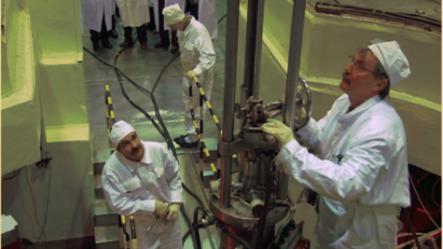
IBR-2 Modernization 2007-2010
Any reactor has a limited lifetime because of the development of radiation fatigue of structural materials. In the middle 90s the program of modernization of the IBR-2 was initiated to replace the most part of its units. In 2007, the reactor reached the service life limit on fuel burn up and fluence on the reactor vessel and was shut down for modernization and replacement of the primary reactor equipment. The main objectives of the modernization were to increase safety, reliability and experimental possibilities of the reactor for the next 25 years of operation. By 2010 the installation of new equipment was completed and followed by a successful power startup. Now we have reactor lifetime extended to mid of 2030th.

Slide 21
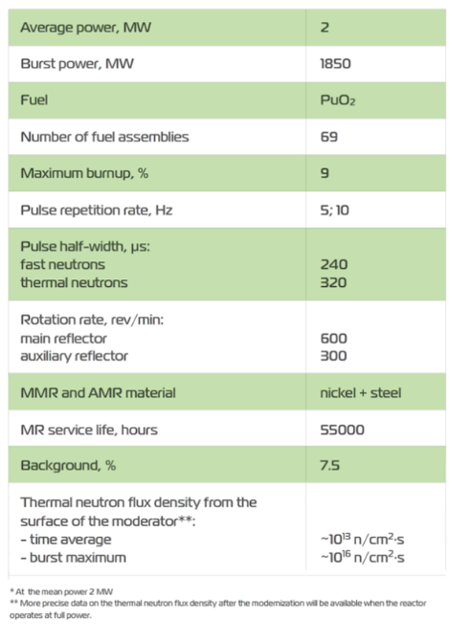
Notes:
IBR-2 is a pulsed fast reactor of periodic operation. Its main difference from other reactors consists in mechanical reactivity modulation by a movable reflector. The movable reflector is a complex mechanical system providing reliable operation of two parts, which determine the reactivity modulation: the main movable reflector and the auxiliary movable reflector. The rotors of the main and auxiliary movable reflectors rotate in opposite directions with different velocities. The IBR-2 reactor with its unique technical approach produces one of the most intense neutron fluxes at the moderator surface among the world's reactors: ~10^16 n/cm2/s, with a peak power of 1850 MW. Nevertheless, the reactor is "ecologically friendly": it consumes very little electrical energy as compared to other research reactors, uses a very little amount of fuel (less than 20 l) which is changed once in 15-20 years. The reactor operates continuously for a 12 day cycle followed by a week shutdown to prepare for the next experiments. In addition, there is a longer shutdown to carry out necessary maintenance work during the summer time. Normally there are about 9 cycles a year.

Slide 22
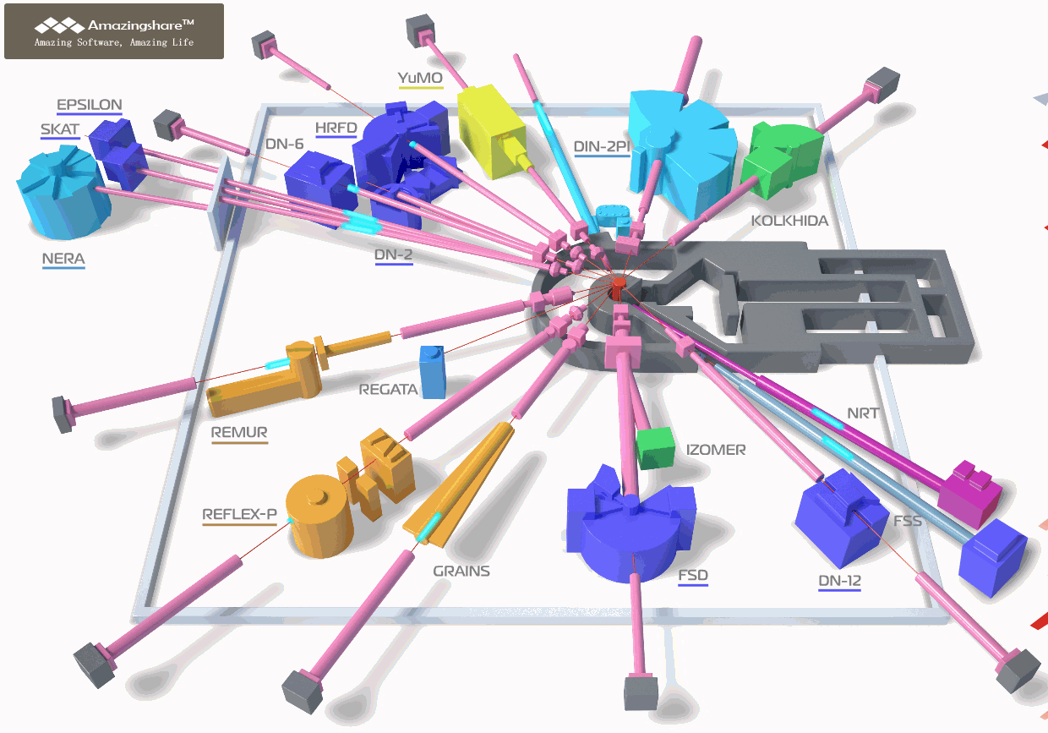
Diffractometers:
HRFD, DN-6, RTD, DN-12, FSD, SKAT/Epsilon, FSS;
Reflectometers:
REMUR, REFLEX, GRAINS;
Small Angle Scattering Spectrometer:
YuMO;
Inelastic Neutron Scattering Spectrometers:
NERA, DIN-2PI
Radiography and Tomography:
NRT;
New Instruments:
DN-6, GRAINS, NRT, FSS;
Reconstruction:
REFLEX – SESANS;

Slide 23
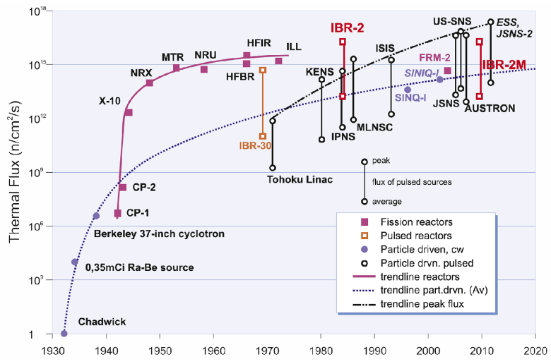

Slide 24
Research in the field of condensed matter physics at JINR

Slide 25
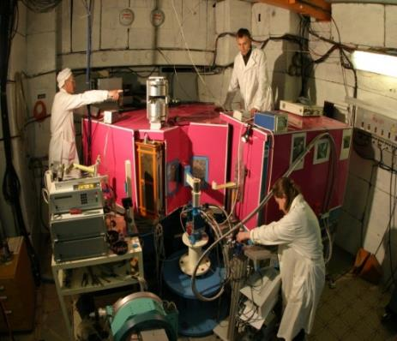
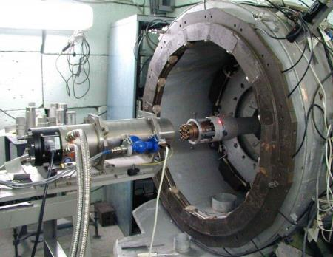
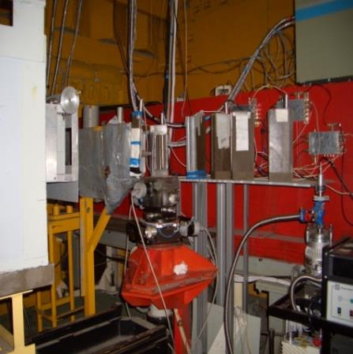
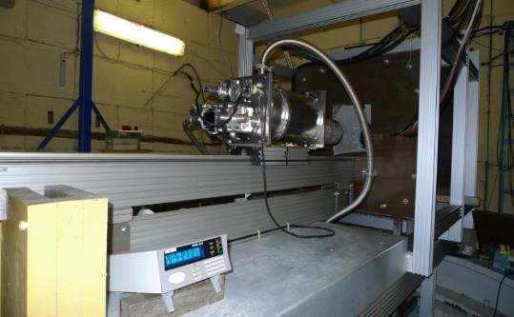
HRFD
DN-12
RTD
Real Time Diffractometer (RTD)
Studies of structure and dynamics of condensed matter under extreme conditions (P ~ 7 GPa)
Precise structural studies of crystalline materials using reverse TOF method, Δd/d ~ 0.001
DN-6
In operation since 2012
DIFFRACTION
Structural studies at ultrahigh pressures (up to 30-50 GPa)
Real time studies

Slide 26
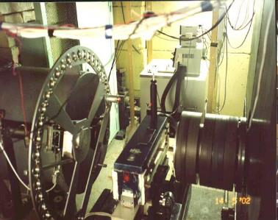
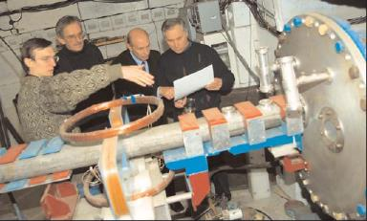
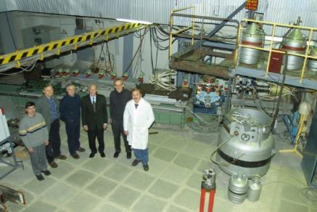
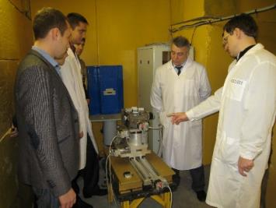
YuMO - SANS
REFLEX
Reflectometer with polarized neutrons
SMALL ANGLE NEUTRON SCATTERING AND REFLECTOMETRY
A study of structural characteristics of nanostructured materials, biological objects, polymers
A study of structural properties of thin films and layered nanostructures
Reconstruction into Spin Echo Small Angle Neutron Scattering Spectrometer
REMUR
Reflectometer with polarized neutrons
GRAINS
Multifunctional reflectometer
A study of magnetization profile, magnetic and structural properties of layered nanostructures
A study of structural properties of liquid and soft matter interfaces

Slide 27
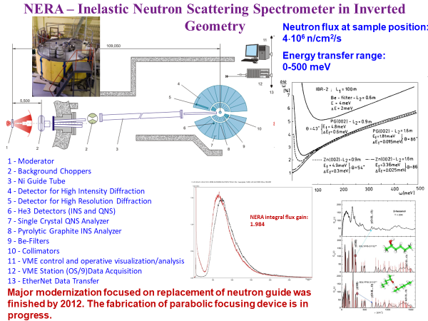
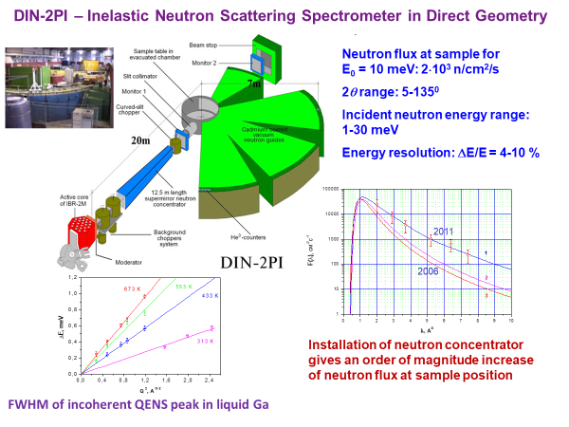
INELASTIC NEUTRON SCATTERING

Slide 28
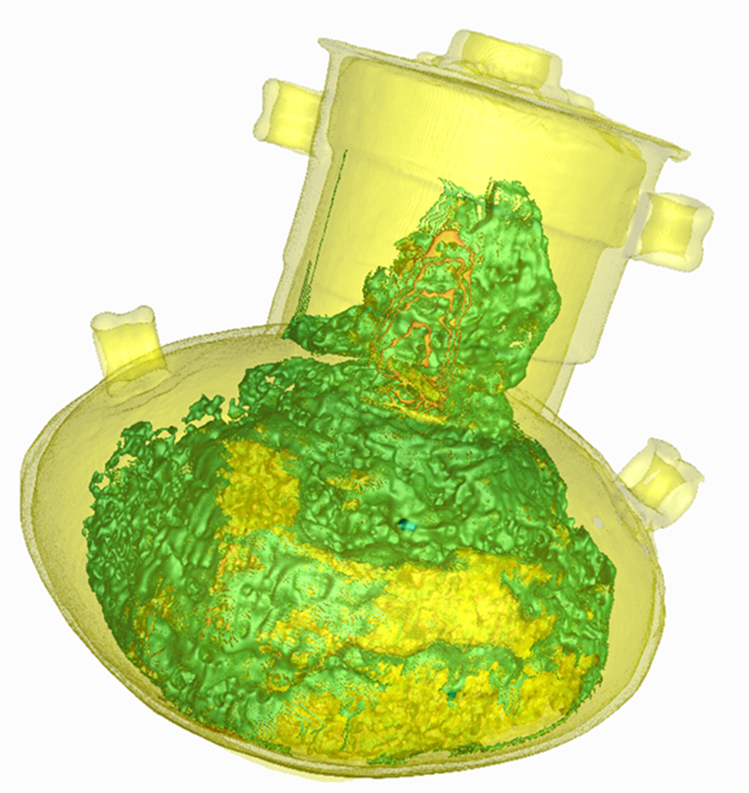
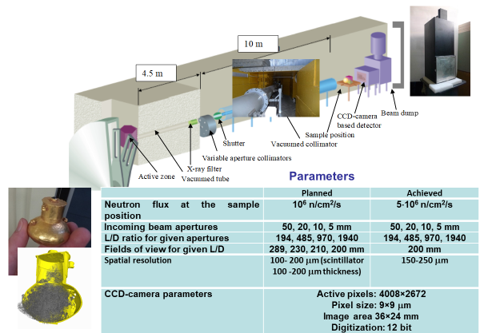
NEUTRON TOMOGRAPHY

Slide 29
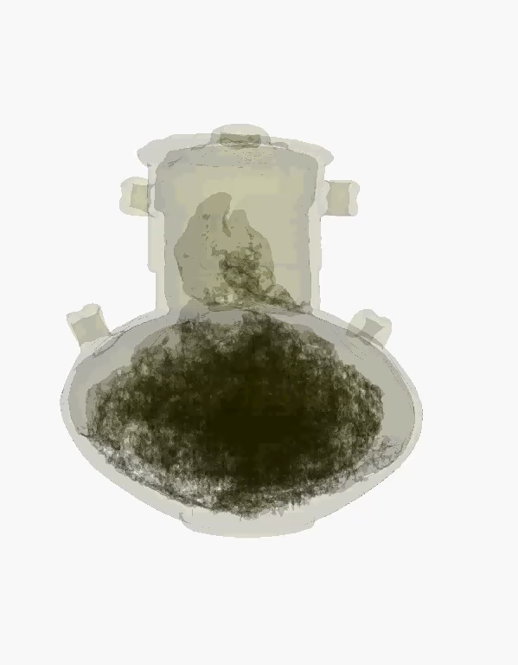
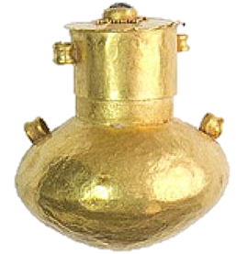
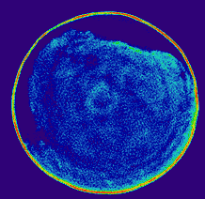

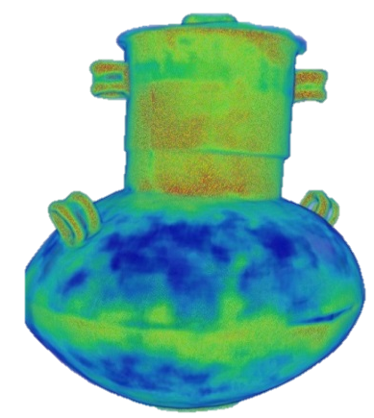
Neutron radiography and tomography facility: mystery of the incense vial

Slide 30
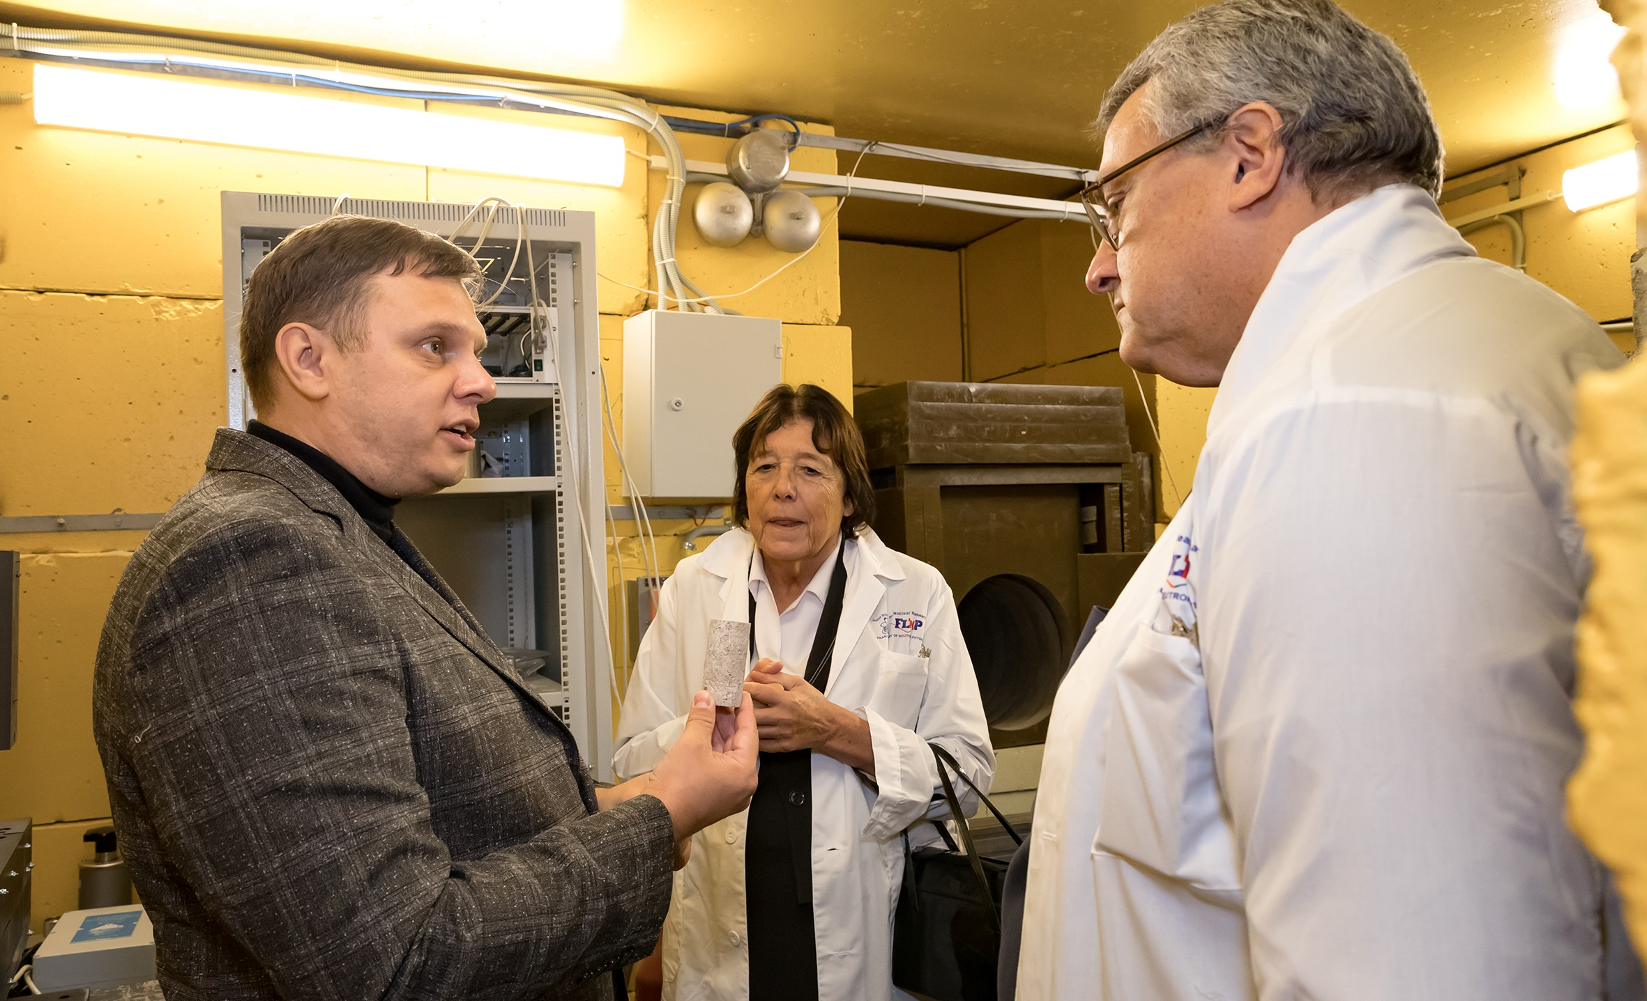
November 9 2019. Visit of the secrétaire perpétuel honoraire of the French Academy od Science Catherine Brechignac to FLNP

Slide 31
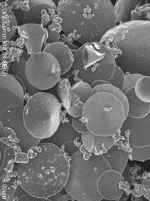
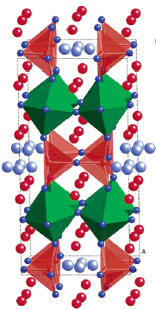
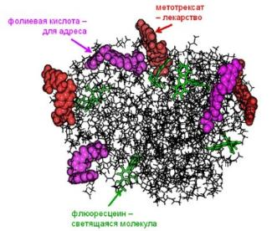
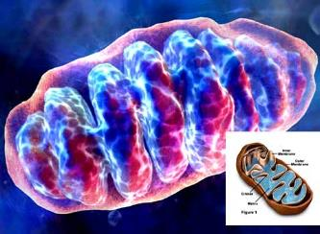
Nanoscale physics
Physics and Chemistry of Functional Materials
Physics and Chemistry of
Complex Liquids and Polymers
Physics of Soft Condensed Matter

Slide 32
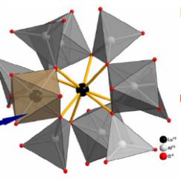
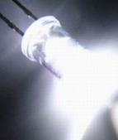
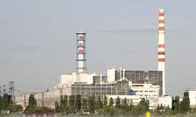




Structural characterization of functional
materials used in different (nano)technologies
Non-destructive control of residual
stresses and internal organization of bulk
materials and products
Texture analysis of geomaterials
and constructional materials
Stainless steel
Zr based alloy

Slide 33





Novel type of the charge ordering state in iron oxide Fe₄O₅ involving competing dimer and trimer formation
Iron oxides:
important role in the formation of magnetic and other physical properties of the Earth,
find a wide range of technological applications
Previously known: Fe₃O₄, Fe₂O₃, FeO
Formation mechanism of the dimeric and trimeric states
a)
b)
a new iron oxide, Fe₄O₅, was synthesized under the combined effect of high pressures and temperatures;
new type of charge-ordering state was revealed.
c)
d)
Crystal structure of Fe₄O₅ (a), neutron diffraction patterns, measured at different temperatures and processed by the Rietveld method (b), magnetic structures at Т = 150 К (c), and Т = 10 К (d).
S.V. Ovsyannikov,.., D.P. Kozlenko, et al., Nature Chemistry (2016)
Notes:
Here is an example of scientific research performed with the new DN-6 spectrometer.
Iron oxides play an important role in the formation of magnetic and other physical properties of the Earth.
Recently, a new iron oxide, Fe₄O₅, which can presumably exist in the layers of the Earth's upper mantle, has been synthesized under the combined effect of high pressures and temperatures.
A comprehensive study of its physical properties, as well as atomic and magnetic structure using neutron diffraction techniques at the IBR-2 reactor, has revealed a new type of the charge-ordering state with the formation of dimeric and trimeric electronic states in this compound. The phase transition into this state is accompanied by a sharp increase in the electrical resistance and a subsequent change in the symmetry of the magnetic order, namely from a collinear antiferromagnetic (AFM) order to a canting AFM order with a ferromagnetic (FM) component, as well as by a change in the nature of the modulation of the atomic structure
Оксиды железа играют важную роль в формировании магнитных и других физических свойств Земли, и находят широкий спектр технологических применений. Недавно в условиях комбинированного воздействия высоких давлений и температур был синтезирован новый оксид железа – Fe₄O₅, который предположительно может существовать в слоях верхней мантии Земли. В результате комплексного исследования физических свойств, а также атомной и магнитной структуры с применением методов нейтронной дифракции на реакторе ИБР-2, в этом соединении был обнаружен новый тип зарядово-упорядоченного состояния с формированием димерных и тримерных электронных состояний. Фазовый переход в это состояние сопровождается резким скачком электрического сопротивления и последующим изменением симметрии магнитного упорядочения с коллинеарного антиферромагнитного (АФМ) на скошенное АФМ с ферромагнитной (ФМ) компонентой, а также изменением характера модуляции атомной структуры.

Slide 34

G.D.Bokuchava et al., Comptes rendus de l'Académie bulgare des sciences (2014).

Slide 35




Helical structure of fibril-type amyloidal aggregates
Alzheimer
disease
Motivation
Model of amyloid
filament structure from XRD
Formation of amyloidal aggregates are associated with many aged-related illnesses (e.g. Alzheimer diseases)
11.5 nm, 24 β-strands
Structure analysis of model lysozyme (hen egg) amyloidal solutions
Cylindric
symmetry
~q⁻¹
SANS
AFM
Helical
symmetry
M.V.Avdeev, et al, J. Appl. Cryst. (2013)

Slide 36





Diffraction Studies of Li-Based Accumulators
Real-time monitoring of transition processes during charge-discharge cycles revealed 10% increase of LiC₆ phase in anode when cathode was doped with vanadium oxide, which correlates with better electrochemical properties.
I.A.Bobrikov et al., J. Power Sources (2014)
Notes:
Investigation of the structural behavior of new electrode materials based on the modified LiFePO4 directly during the charging and discharging of the battery, as well as in stationary conditions, was carried out on the High Resolution Furrier Diffractometer at the IBR-2 reactor. As a result of the experiments, the phase transitions occurring in the electrodes directly during the charge-discharge cycles were studied in detail and the structural reasons for improving their characteristics were identified.
The biggest challenge in this project was to build a universal model that can equally well describe bilayer features seen by x-rays and neutrons. Each of the component groups has to have nearly the same functional form for all of the different contrast conditions. We found that the adequate model has at least three structural components describing the lipid head group region, and three additional groups describing the hydrocarbon chain region.
Although our universal SDP model is designed to obtain structure from x-ray and neutron scattering data, the primary description is neither in terms of ED or NSLD. Instead, it is described by volume probability distributions, which satisfy a spatial conservation principle whereby volume is conserved.
The newly devised SDP model was fit with only one set of parameters simultaneously to the three sets of experimental data, consisting of x-ray scattering curve and the two neutron scattering curves taken at the two different contrasts. The area we obtained for one of the most studied lipid, DOPC, is almost 10% smaller than previously reported value obtained in a stand alone x-ray experiment. However it is quite close to the simulated value that was previously not taken seriously because of the discrepancy with the x-ray areas. When I presented this result recently at the biophysical society meeting, it started to attract the attention of several major players in a field of MD simulations immediately. Further, I got very positive feedback from many other labs that were getting smaller lipid areas than those “officially accepted”.

Slide 37





GRAINS time-of-flight reflectometer with horizontal geometry
Initial beam size | 10×1 см²
Neutron wavelength | 0.5 – 10 Å
Incident angle | 3 – 25 mrad
q-range | 0.005 – 0.5 Å⁻¹
Angle resolution | 3 - 10 %
Maximal sample size | 50×80 mm²
Total neutron flux at sample | 1×10⁶ cm⁻² s⁻¹
Deflector | Supermirror, m = 2, L = 1 m
Detector | 2D PSD, ³He, 20×20 cm², resolution 2 × 2 mm²

Slide 38









Project: A system for neutron operando monitoring and diagnostics of materials and interfaces for electrochemical energy storage devices at the IBR-2 reactor (2018-2020)
Electrochemical cells for studies of processes at the interface metal electrode/liquid electrolyte by neutron reflectometry
Experimental NR curves and fitting results
Working electrode (WE)
Counter electrode (CE)
Reference electrode (RE)
Polarization analysis development
Installation of analyzer
Polarizer unit upgrade

Slide 39
User policy at IBR-2 facilities
18 experimental facilities around the reactor;
15 instruments for condensed matter studies are now presented for users;
Simple, convenient web-application;
Two calls/year;
No charge for beam time except of commercial use;
Since 2020 Radioanalytical Laboratory with NAA will be introduced as user facility;

Slide 40
Visitors 2018
Russia | 30 | Poland | 3
Germany | 10 | Ukraine | 3
Slovakia | 2 | Romania | 1
Estonia | 1 | Egypt | 1
Bulgaria | 1

Slide 41

Comparison of the effectiveness of the IBR-2 instruments with the instruments at European sources
We have about 160 neutron instruments at 13 European neutron sources, generating almost 30000 instrument ⋅ days, resulting 1900 scientific papers each year;
16 instrument ⋅ days/paper at European instrument
17 instrument ⋅ days/paper at IBR-2 instrument
At IBR-2 we have 15 instruments, operating about 2500 hours per year, that generates about 1563 instrument ⋅ days, resulting about 90 scientific papers each year;

Slide 42
Neutron Nuclear Physics

Slide 43
Main scopes of research:
Investigations of violations of fundamental symmetries in neutron-nuclear interactions and related data
Investigation of fundamental properties of the neutron, UCN physics
Applied and methodological research
Main directions of research:
Investigation of P- T-symmetry breaking in reactions with neutrons;
Nuclear data measurements for neutron energy up to 1GeV;
Research with very cold and ultracold neutrons;
Nuclear analytical methods and research for different fields of science;
Methodical research;
Development of the Intense REsonance Neutron Source (IREN)
Project TANGRA (TAgged Neutrons & Gamma RAys)

Slide 44





IREN
Neutron Resonance Capture Analysis of the archeological samples
Scheme of a new configuration of the accelerator
Spectra of neutron flux density from IREN obtained during the development of the facility
TOF spectrum, obtained from measurement with ancient coins from the Phanagoria's treasure
122nd session of SC
Notes:
In collaboration with Institute of Archaeology Russian Academy of Sciences the works on investigation of elemental/isotopic composition of archeological samples have been started with the use of Neutron Resonance Capture Analysis (NRCA). An identification of elements (isotopes) is performed by neutron resonance energies at radiative capture, while their content in sample is determined by an yield of gamma-quanta in resonances. This method is nondestructive and it may have an perspective for application in such kind of investigations.
Optional
By the end of 2016 the second accelerating section was putted in to operation instead of drift gap at the LUE-200 accelerator. First measurements of neutron flux has shown an increase of the neutron yield by more than 3 times. In first half of 2017 the training of the accelerating systems with the gradual achievement of nominal power of 50 Hz was carried out.

Slide 45


Part of the TOF spectra from multi crystal gamma detector at IREN

Slide 46





Developing of IREN during 2018
Working with two accelerating section was started at 2017
REGATA-2 pneumatic transportation system at stand
Dry cooling tower
During 2018
Deep modernization of the cooling system to work independent of IBR-2 (will finished to the end of year)
New ventilation for target hall was mounted
The REGATA-2 equipment was assembled and test at the stand
To work with ANA at IREN the renovations of rooms (sanitary inspection room, chemical laboratory, etc.) are going
Preparatory works was done for designing overhauls of experimental halls
Manufacturing of new waveguide
Manufacturing of new klystrons (120 Hz) will be finished at the first month of 2019
One of two Chillers
Four heat exchange
modules
Plans for 2019:
Start to operate with new cooling system routinely
REGATA-2 mounting at its place
Designing overhauls of experimental halls

Slide 47




Traditional annual ISINN conference coorganized by the FLNP JINR and Chinese partners took place at Xi’an, China

Slide 48






The series of experiments are performed at the FRM-II reactor
In Garching (Germany)

Slide 49
Reactions with fast neutrons and charged particles at exit channels (Yu. Gledenov and his team )
Measurements at EG-5 of FLNP and EG-4.5 HII PU
¹⁴⁴Sm(n,α)¹⁴¹Nd and ⁶⁶Zn(n,α)⁶³Ni at E_{n}= 4.0, 5.0 и 6.0 MeV
^{56,54}Fe(n,α)^{53,51}Cr at 5.0-11.0 MeV
²⁵Mg(n,α)²²Ne at 4.0 - 6.0 MeV
¹⁰B(n,t2α) and ¹⁰B(n,α)⁷Li
at E_{n}=4.0, 4.5 и 5.0 MeV

Slide 50
Cross section for ²⁵Mg(n,α)²²Ne reaction in comparison with the existing experimental data, libraries and calculations by TALYS-1.8.
Cross section for ²⁵Mg(n,α₀)²²Ne reaction in comparison with the existing experimental data, libraries and calculations by TALYS-1.8.
According to the principle of detailed balance, the data provide information about the reaction ²²Ne(α,n)²⁵Mg that is one of the main sources of neutrons in the nucleosynthesis process

Slide 51


Slide 52


Slide 53


Set-up for the study of PFN in fission induced by resonance neutrons
A double ionization chamber was designed to measure the kinetic energies, masses, and orientation of fission axe in the 3D space for the correlated fission fragments. The accuracy of direction cosines definition is better than 0.05.
32 PFN detectors were placed close to the axis of the ionization chamber to guarantee the maximum PFN detection efficiency ~0.8π.
The slides on the left demonstrate measurements of PFN distributions measured at FLNP for ²³⁵U(n,f) reaction in comparison with the old data from KI measured in 1964. With improved data on PFN distribution we managed to achieve better mass resolution of FF in ²³⁵U(n,f) reaction. This fact, along with the new PFN investigation facility, raises interest in the investigation of mass&TKE variations in resonance neutron induced fission of ²³⁵U and ²³⁹Pu at IREN source.
[1] Sh. Zeynalov, P. Sedyshev, O. Sidorova, V. Shvetsov. International Journal of Modern Physics: Conference Series, Vol. 48 (2018) 1860123.
Segmented Anode Position Sensitive Detector. UCANS-VII, March 11-15,2017, Bariloche, Argentina
[2] Sh. Zeynalov, P. Sedyshev, O. Sidorova, V. Shvetsov. Prompt fission neutron investigation in 235U(nth,f) reaction. EPJ Web of Conferences 146, 04022 (2017), ND2016
[3] Sh. Zeynalov, P. Sedyshev, O. Sidorova, V. Shvetsov. WONDER 2018 (to be published in EPJ Web of Conferences)
[4] Zeynalov Sh.C., Sedyshev P. P., Sidorova O.V., Shvetsov V.N. ISINN-26, International Seminar on Interaction of Neutrons with Nuclei, Xi‘an, China, 28 May-2 June, 2018

Slide 54


Search of the UCN heating on surface acoustic waves (SAW)
The measurement is performed at the HF reactor
In Grenoble (France)
1
2
Sample with US wave
IDT
Detector
Cupper foil
UCN out
Λ
UCN in
surface acoustic wave
Monitor
Vacuum chamber
Chamber for UCN spectra cleaning
@PF2EDM
Amplitude of SAW ~2 nm
The heating effect was determined as -0.035 ± 0.047 c/s at the first measurement while a theoretical estimate is 0.1 c/s. The effect is not visible. Analysis of the results is under the way. The experiment will be repeated with the better statistics.

Slide 55


Experiments with tagged neutrons

Slide 56




Experiments with tagged neutrons
a=1.58±0.04
b=1.22 ±0.05
TANGRA Collaboration

Slide 57





TANGRA Project
A new configuration of the set-up consisting of 18 BGO detectors has been created.
Gamma-spectra and angular distributions of gamma ray have been measured in inelastic neutron scattering reactions for 20 nuclei.
Examples of measured angular distributions for 847 keV gamma transition in iron and 6.13 MeV transitions in oxygen.

Slide 58





Development of the Intense REsonance Neutron Source (IREN)
During 2017 the IREN worked on the experiment at a frequency of cycles of 20–25 Hz for 1049 hours with two accelerating sections of linac.
In 2018 it was stopped for deep modernization of the cooling system.
REGATA-2 tube transportation system at stand
During 2018
Deep modernization of the cooling system to operate independently of IBR-2 (was started and finished in 2019)
New ventilation for target hall was mounted
The REGATA-2 equipment was assembled and tested at the stand
To work with ANA at IREN the renovation of rooms (a sanitary inspection room, a chemical laboratory, etc.) was started (it was finished in 2019)
Preparatory works were carried out for designing the overhauls of experimental halls
Manufacturing of a new waveguide
Manufacturing of new klystrons (120 Hz) will be finished in the first month of 2019
Dry cooling tower
One of two Chillers
Four heat exchange
modules
During 2019:
Designing overhauls of experimental halls is started
Start to operate with a new cooling system routinely
REGATA-2 mounting at its place

Slide 59





Slide 60



A three-electrode high-voltage electron gun for the accelerator LUE-200 of the IREN installation has been constructed and tasted.
A feature of this injector is the ability to control the pulse duration of the electron beam in the range from 40 up to 400 ns
Oscillograms of the electron gun start-up pulses and the pulses of beam current: СН3 is the trigger pulse of the electron gun grid; CH1 is the pulse of the current beam.

Slide 61






Measurement of the palladium content in the engine elements (nozzles) of the “Proton” launch vehicle using neutron resonance analysis at the IREN facility
Spectrum from parts containing palladium
Spectrum from a sample of pure palladium
Spectrum from palladium-free parts
The mass of detected palladium is 99 ± 7 mg in a sample with a mass of 60 g. The sensitivity of the method is about 2 mg / g.

Slide 62





UNECE
Collaboration with Laboratory of Information Technologies of JINR
United Nations Economic Commission for Europe
DATA MANAGEMENT SYSTEM OF THE UNECE ICP VEGETATION MONITORING NETWORK
created at the cloud platform of JINR
Prof. Gednnadiy Ososkov and Dr. Aleksandr Uzinskiy
International Cooperative Programme on Effects of Air Pollution on Natural Vegetation and Crops
http://moss.jinr.ru
About 2000 samples were measured by NAA technique and about 1000 samples - by AAS only during 2018.
~ 6000 sampling sites

Slide 63



Study of metal biosorption and bioaccumulation from complex solutions using different types of biological sorbents
Reduction of metal content to the maximum admissible level
Effect of pH on Cr, Fe and Ni removal
SEM Image of biosorbent

Slide 64










QUALITATIVE AND QUANTITATIVE ANALYSIS OF ARSENIC AND MERCURY IN HUMAN REMAINS OF THE XVI-XVII CENTURIES FROM THE MOSCOW KREMLIN NECROPOLISES BY NEUTRON ACTIVATION ANALYSIS AT THE IREN FACILITY AND THE IBR-2 REACTOR OF FLNP JINR.
T.D. Panova, A.Yu. Dmitriev, S.B. Borzakov, C. Hramco
Measurements at
IREN and IBR-2
Unknown author.
Prince M. V. Skopin-Shuisky.
The remains of Ivan the Terrible in the grave.
The remains of Tsarevich Ivan. The opening in 1963.
Mass fraction of arsenic and mercury in the samples
Sample number | Arsenic (As) |  | Mercury (Hg)
 | Mass fraction, mg/kg | Relative uncertainty, % | Mass fraction, mg/kg | Relative uncertainty, %
1 | 0.19 | 30 | 0.36 | 19.1
2 | 0.23 | 30 | 0.2 | 29.5
3 | 1.18 | 18.3 | 46.6 | 2.5
For modern people
Sample type | Mass fraction, mg/kg
 | Arsenic (As) | Mercury (Hg)
Hair | <= 0.05 | 0.145 ± 0.009
Rib bones | < 0.1 | <= 0.008

Slide 65
A series of methodological and applied research on the interaction of slow neutrons with nanoparticles continues (development of reflectors of slow neutrons)
2009-2015 search of the technology for purification of nano-diamond from hydrogen. Fluoridation gave the first positive results.
2016
Using for very cold neutron extraction
Simulation of the reflection probability
2018
Increasing of quasi-mirror reflection probability for cold neutrons after fluoridation
V.V.Nesvizhevsky, M.Dubois, Ph.Gutfreund, E.V.Lychagin, A.Yu.Nezvanov, and K. N. Zhernenkov
“Effect of nanodiamond fluorination on the efficiency of quasispecular reflection of cold neutrons” // PHYSICAL REVIEW A 97, 023629 (2018)

Slide 66
METHODIC

Slide 67
NEUTRON SPECTROMETERS;
DETECTORS;
SAMPLE ENVIRONMENT;
HARDWARE & SOFTWARE;
CRYOGENICS;
NETWORK AND COMPUTING;

Slide 68

Cryogenic Moderator
The third stage
Moderator for beams #1,4-6, 9
The first stage
Moderator for beams #7,8,10,11
The second stage
Moderator for beams #2, 3
Main moveable reflector,
Auxiliary moveable reflector,
Fuel assembly,
Stationary reflector,
5. Cold moderators,
6. Emergency system,
Water moderators,
Control rods;

Slide 69






Solid mesitylene as a material for cold moderators
mesitylene
m-xylene
T_{m} = 227 K
T_{m} = 225 K
Solid balls of the frozen mixture
of mesitylene and m-xylene

Slide 70




Water pre-moderator
Grooved water moderators
CM
The cold moderator
(membrane only visible)
Flat water moderator

Slide 71


New 2D PSD detectors has been created and put into operation on the spectrometers: REMUR, RTD and REFLEX

Slide 72



International School for Young Scientist and Students «Instruments and Methods of Experimental Nuclear Physics»

Slide 73
APPLIED RESEARCH
NEUTRON ACTIVATION ANALYSIS

Slide 74



Experimental facility REGATA at IBR-2 reactor
Transport capsules for irradiation
      Ch1-Ch4 –irradiation channels, S- intermediate storage, DCV- directional control valves, L- loading unit, RCB- radiochemical glove-cell, U- unloading unit, SU- separate unit, SM- storage magazine, R- repacking unit, D- detector, CB- control board, R1-R3- the rooms where the system is located.

Slide 75
Neutron energy spectra and irradiation channels
    Neutron energy spectra
    in irradiation channels CH1() and CH2 (curve)
The main characteristics of the irradiation channels at 1.5 MW
Notes:
75
Pay attention to the low temperature in irradiation channels! Very convenient for studying biological objects!

Slide 76


Slide 77








Slide 78
NAA + AAS
NAA ~ 55 elements
~ 55 elements

Slide 79
  Air pollution studies
  based on moss analysis

Slide 80


1993: Biomonitoring…
M.V. Frontasyeva, V.M. Nazarov and E. Steinnes. Mosses as monitors of heavy metal deposition: Comparison of different multi-element analytical techniques. In R.J. Allan and J.O. Nriagu, eds., Heavy Metals in the Environment, Vol.2, pp. 17-20. CEP Consultants, Edinburgh 1993.
Hylocomium splendens
1
2
3
4
5

Slide 81


Slide 82



UNECE
CONVENTION ON
LONG-RANGE TRANSBOUNDARY
AIR POLLUTION
adopted in 1979
entered into force 1983
United Nations Economic Commission for Europe
International Cooperative Programme on Effects of Air Pollution on Natural Vegetation and Crops
Working Group on Effects - 1981

Slide 83





Cadmium
Lead
Mosses provide a complementary method to assess spatial patterns and temporal trends of atmospheric heavy metal deposition:
Carpet forming mosses receive
trace elements and nutrients mainly
from the atmosphere.
In recent years, the lowest
concentrations of heavy metals in
mosses were found generally in
northern Europe and the highest
concentrations in Belgium and
eastern Europe .
Europe-wide the concentration in
mosses of arsenic, cadmium,
lead and vanadium has declined
the most between 1990 and 2010,
with hardly any reduction being
observed for chromium and
mercury.
Temporal trends were country-
specific.
Spatial patterns and temporal trends
for cadmium and lead agree quite
well with those modelled by the
European Monitoring and
Evaluation Programme (EMEP).
-72%
-12%
-2%
1990
1990
-20%
Cadmium
Lead
-20%
-62%
2005
2005
-45%
-29%
-52%
-72%
ICP Vegetation Programme Coordination Centre
Notes:
83

Slide 84
LGNS
Luna-26
2020
Evolution Tree of RSRI instruments
for Nuclear Planetology
since 1989 till
2021
ADRON_LG
Luna-27
2021
MGNS
BeppiColombo
2018
ADRON_ML
Lander/ExoMars
2020
BTN-2
ISS
2018
ADRON_LG
Luna-25
2019
NS-HEND
Phobos-Grunt
2011
BTN-M1
ISS
2007 - now
DAN
Curiosity
2011 - now
Future
ADRON-MR
Rover/ExoMars
2020
GRS/HEND
Mars Odyssey
2001-now
LEND
LRO
2009 - now
PGS
Mars-96
1996
FREND
TGO/ExoMars
2016
VGS/GS-14
Phobos-2
1988-89
Present
Past

Slide 85



Cooperation of two JINR Labs with Russian Space Research Institute since 1997;
FLNP and LRB responsibility are: conceptual design, physical and numerical modeling, physical calibrations;

Slide 86


Lunar Exploration Neutron Detector (LEND) at LRO
Suppressed Neutron
Region at Cabeus
impact crater
Map of emission of epithermal neutrons is presented for the segment of southern polar region with impact crater Cabeus (left) according the data from Lunar Exploration Neutron Detector (LEND, right). Lower counting rate (blue) represents the enhancement of Hydrogen content within 1 meter top layer of the surface. Gray shadowing corresponds to the surface relief in accordance to LOLA measurements. White contours represent Permanently Shadowed Regions (PSR), as derived from the altimetry data of Japanese Kaguya mission.
According to the preliminary analysis of LEND data, PSRs are not consistent with detected Suppressed Neutron Regions (SNRs) on the Moon with high content of Hydrogen. However, some PSRs are positioned inside SNRs, like one at the Cabeus crater, which is found to have one of the strongest signature of subsurface Hydrogen at the South pole.
Instrument LEND was developed in the Institute for Space Research (Moscow), as the contribution of Federal Space Agency of Russia to the NASA’s Lunar Reconnaissance Orbiter mission.

Slide 87

Dynamic Albedo of Neutrons (DAN) Russian detector onboard of the Curiosity Rover
Pulsed neutron Logging: idea belongs to G.N.Flerov. Fast neutrons from generator penetrates into the soil and moderated. Time profile of the slow neutron counter located above the soil drastically depends on the hydrogen content in the soil.
FLNP and LRB of JINR are collaborating with Russian Space Research Institute since 1997. DAN device was proposed in 2003 as one of the scientific instruments onboard of the Mars Science Laboratory and in the beginning of 2004 after non-advocating review was accepted by NASA.

Slide 88



DAN flight unit onboard the NASA Mars rover Curiosity

Slide 89

Tagged Neutrons Technique First Testing

Slide 90
New JINR neutron source –
DNS-IV

Slide 91


Dubna Neutron Source of the Fourth Generation two options
PuO₂ based superbooster
Progress outline:
A superbooster (multiplying target of proton linear accelerator with periodic reactivity modulation) is being considered for the new neutron source
Feasibility study of 2 concepts (neptunium and plutonium based) has been started
Time schedule road map has been developed that establishes 6 major stages and proposes the finalization in 2035 – replacing the present source IBR-2M smoothly
N. Kučerka & E.V. Lychagin: Development of the scientific case for a new source of neutrons at JINR
E. Shabalin & Yu.N. Pepelyshev: Concepts of JINR’s high-flux pulsed neutron source
V.N. Shvetsov & V.L. Aksenov: Milestones and time schedule proposal to the strategy plan of JINR
Notes:
In accordance to the 7-year plan and long-term strategic planning of JINR, the Frank Laboratory of Neutron Physics has initiated project for the realization of new JINR source of neutrons. In addition to developing the case for scientific justification, discussions are carried out regarding the type of this new source. A superbooster (multiplying target of proton linear accelerator with periodic reactivity modulation) has been concluded to be able to provide record parameters desired by physicists. Recently, the feasibility study of 2 most appealing concepts has been ordered at NIKIET, and time schedule road map has been developed that will allow a timely and smooth replacement of the present source IBR-2M.

Slide 92
В проекте ПЛУТОН важнейшим фактором, определяющим его реализуемость и безопасность, является использование горизонтально ориентированной активной зоны и связанные с этим технологические проблемы. Именно этой особенностью определяется существенная часть необходимых НИОКР с неопределённым результатом: разработка и полномасштабное обоснование твэл и ТВС, в том числе в переходных и динамических режимах с учётом отсутствия исследовательских реакторов, имеющих необходимые объёмы для реакторных ресурсных испытаний, отработка транспортной технологии, исследование кризиса теплообмена –
ожидаемый объём временных и финансовых ресурсов будет выше, чем у НЕПТУНа.
Кроме того, не следует упускать из виду находящийся за пределами рассмотрения настоящего отчёта вопрос протонного ускорителя для установки ПЛУТОН, его надёжность, стабильность и влияние на устойчивость работы установки в целом.

Slide 93
Basic parameters of the reactor
Parameter | Value
1 Average thermal power, MW | 15
2 Operational mode | pulsed
3 Repetition rate, Hz | 10
4 Fuel | NpN
5 Coolant | Na
6 Inlet temperature of the coolant, ⁰С | 290
7 Outlet temperature of the coolant, ⁰С | 391
8 Coolant flow through ½ of the core, kg/s | 58
9 Pressure drop across the core, Pa | 0,33·10⁵
10 Fast neutrons flux density on the reactor vessel, 10¹⁴ n/cm²·s¹ | 5,7
11 Fluence on the reactor vessel for 20 000 hours, n/cm² | 4,1·10²²

Slide 94
PROJECT ROADMAP (preliminary)
Stage | 18 | 19 | 20 | 21 | 22 | 23 | 24 | 25 | 26 | 27 | 28 | 29 | 30 | 31 | 32 | 33 | 34 | 35 | 36 | 37
Concept development
Conceptual design
Investment justification
R&D
Technical design
Construction
Commissioning

Slide 95
Beams – Moderators
Moderator | Amount of beams (first stage) | Temperature, K | Size, mm | Possible material
bi-spectral | 2 | Cold 80-90 K + warm 300 K (one above the other) | 100x100 + 100x100 | (Liquid methane/ethane/ pelletized mesitylene)+water
cold | 4 | 80-90K | 200 x 200 | Liquid methane/ethane/ pelletized mesitylene
very cold | 3 | <30K | 200 x 200 | Pelletized solid methane/parahydrogen/pelletized mesitylene
very cold | 6 | <30K | 100 x 100 | Pelletized solid methane/parahydrogen/pelletized mesitylene

Slide 96


4 – small/ cold (80K)
8 – large cold (80K)
8 – large/ very cold (<30K)
Core
2- small/tangential/cold (80K)
2- small/ tangential/ very cold (<30K)
32 beamports with
10° separation:
For instruments:
4 – bi spectral
8 – large cold
8 – large very cold
8 – small cold
4- small tangential cold
Water pre-moderators
4– small /cold
(80K)
4 – bi spectral
(300+80K)
Be reflector

Slide 97
CONCLUSION

Slide 98


Slide 99

THANK YOU FOR YOUR ATTENTION

