Slide 1
B*_{c} meson radiative decay width
Issadykov Aidos
AYSS-2020,
Dubna 10.11.2020

Slide 2
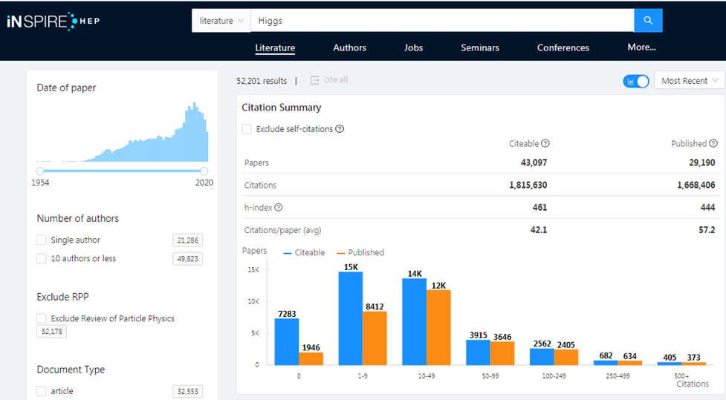
Why B physics?
* inspirehep.net

Slide 3
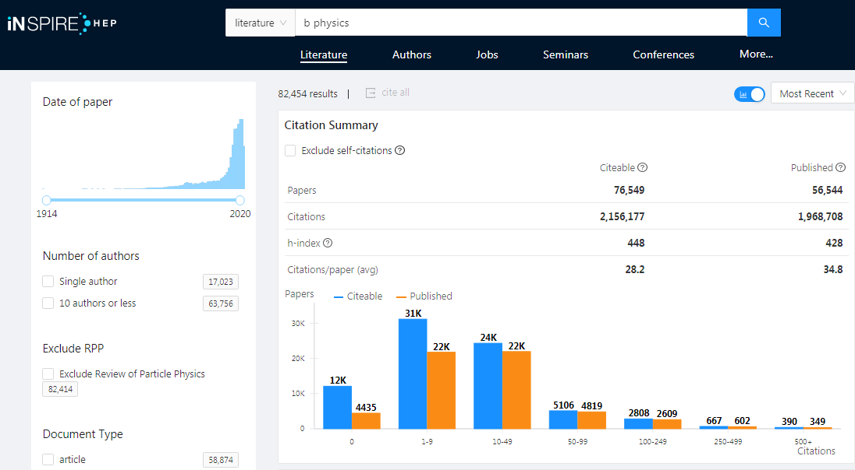
Why B physics?
* inspirehep.net

Slide 4
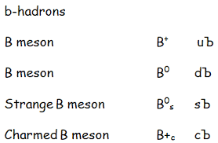
The “B” family
B*→Bγ
* particlezoo.net
B_{s}*→B_{s}γ

Slide 5
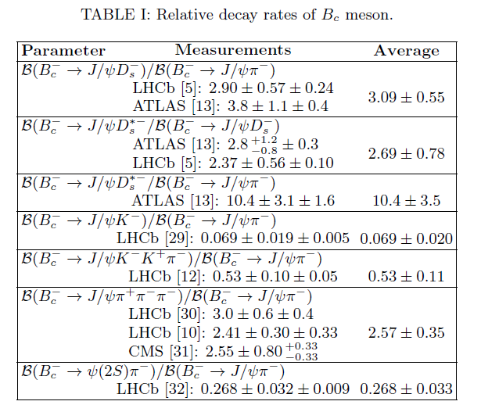
What we know about B_{c} meson ?

Slide 6
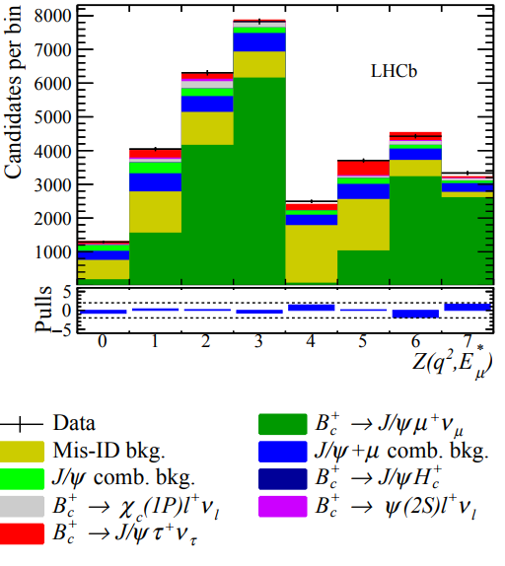
October 2017
*R. Aaij et al. Phys.Rev.Lett. 120 (2018) 121801

Slide 7
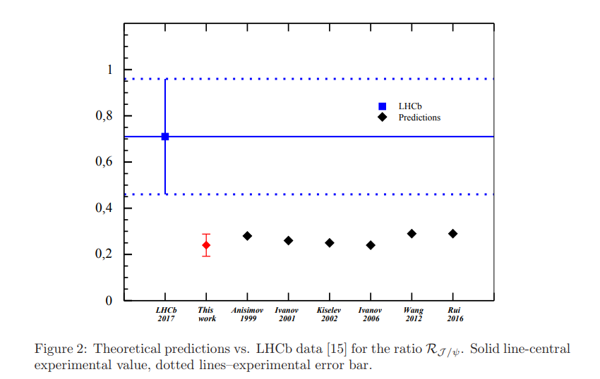
Branching ratios of semileptonic $B_{c}$ decays
*A. Issadykov, Mikhail A. Ivanov, Phys.Lett. B783 (2018) 178-182

Slide 8
Nonleptonic decays of B_{c} meson
LHCb collaboration(nonleptonic):
*R. Aaij et al. [LHCb Collaboration], JHEP 1309 (2013) 075
*R. Aaij et al. [LHCb Collaboration], JHEP 1609 (2016) 153

Slide 9
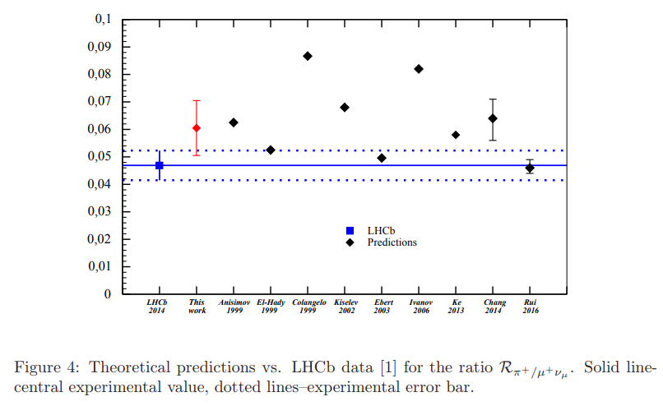
Ratios of branching fractions
*A. Issadykov, Mikhail A. Ivanov, Phys.Lett. B783 (2018) 178-182

Slide 10
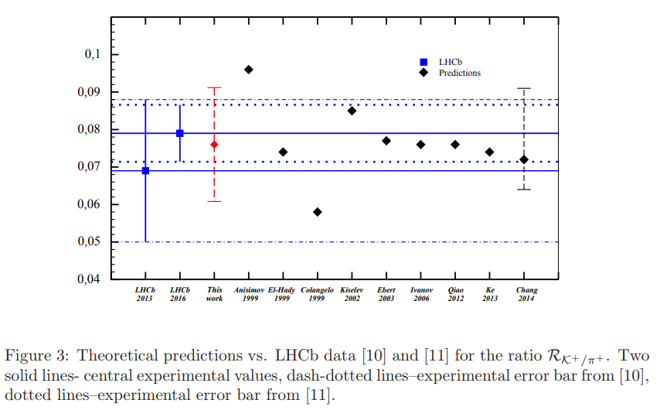
Ratios of branching fractions
*A. Issadykov, Mikhail A. Ivanov, Phys.Lett. B783 (2018) 178-182

Slide 11
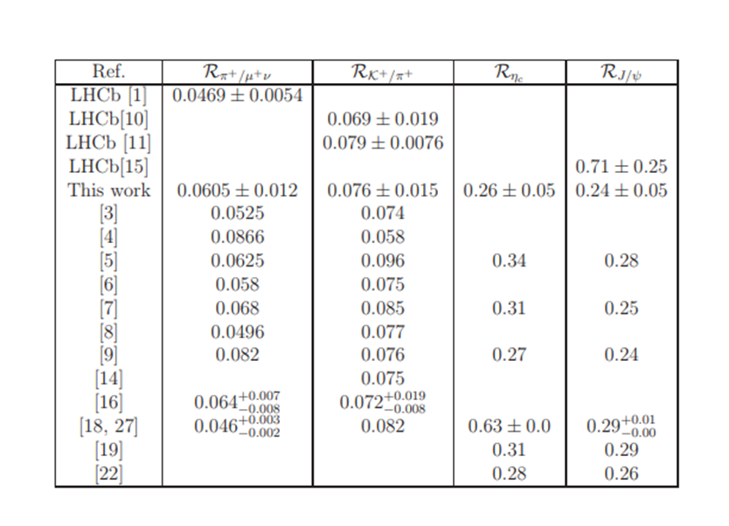
New physics in B_{c} meson decays?
*A. Issadykov, Mikhail A. Ivanov, Phys.Lett. B783 (2018) 178-182

Slide 12
Ratios of branching fractions

Slide 13
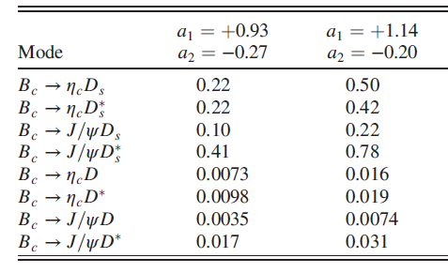
Nonleptonic decays of B_{c} meson
* Dubnicka, Dubnickova, Issadykov, Ivanov, Liptaj, Phys.Rev. D96 (2017) no.7, 076017

Slide 14
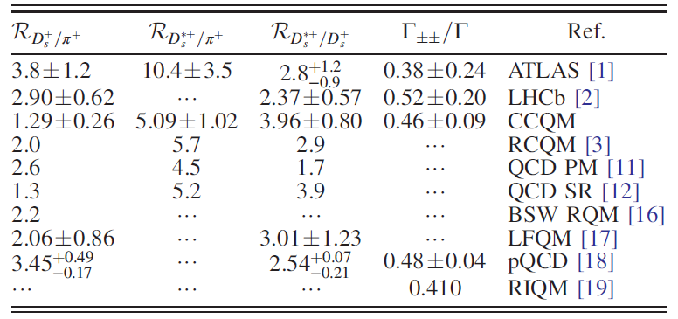
Ratios of branching fractions
* Dubnicka, Dubnickova, Issadykov, Ivanov, Liptaj, Phys.Rev. D96 (2017) no.7, 076017

Slide 15
Covariant quark model
* G.V. Efimov and M.A. Ivanov, Int. J. Mod. Phys. A 4 (1989) 2031.

Slide 16
Compositeness condition in covariant quark model
* S. Weinberg, Phys. Rev. 130 (1963) 776.
* A. Salam, Nuovo Cim. 25 (1962) 224.

Slide 17
Model parameters
The fitted values of the size parameter Λ in GeV
*P.A. Zyla et al. (Particle Data Group), Prog. Theor. Exp. Phys. 2020, 083C01 (2020).

Slide 18
Leptonic decay constants
* Dubnicka, Dubnickova, Issadykov, Ivanov, Liptaj, Phys.Rev. D96 (2017) no.7, 076017

Slide 19
Parameters
*S. Descotes-Genon, T. Hurth, J. Matias, and J. Virto, J. High Energy Phys. 05 (2013) 137.
*P.A. Zyla et al. (Particle Data Group), Prog. Theor. Exp. Phys. 2020, 083C01 (2020).

Slide 20
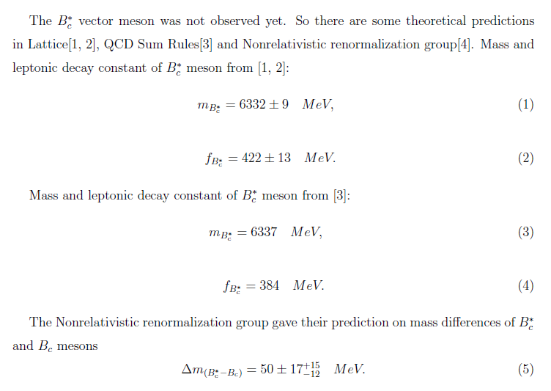
Literature review

Slide 21
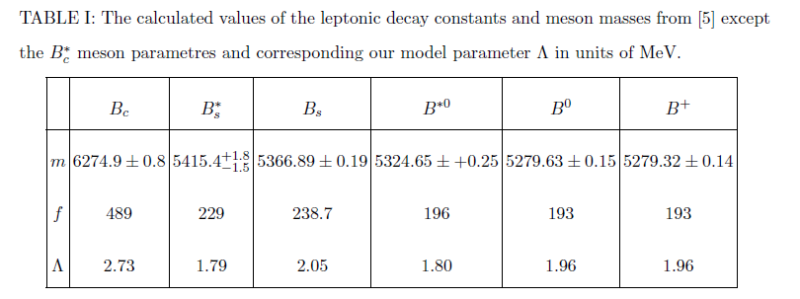
Parameters from PDG and CCQM Λ

Slide 22
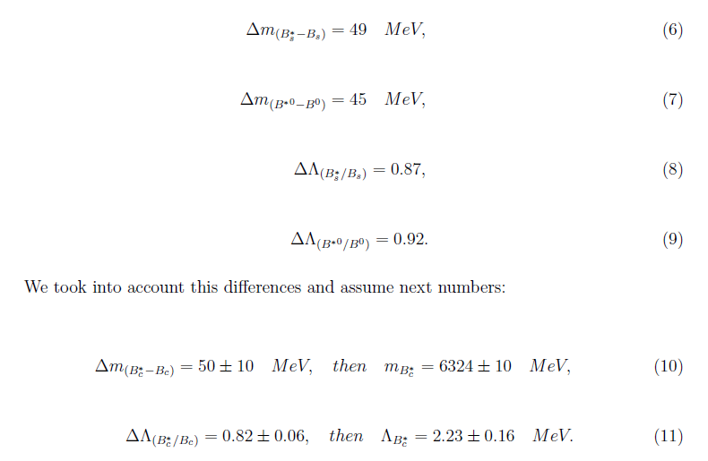
Simple predictions for B*c

Slide 23
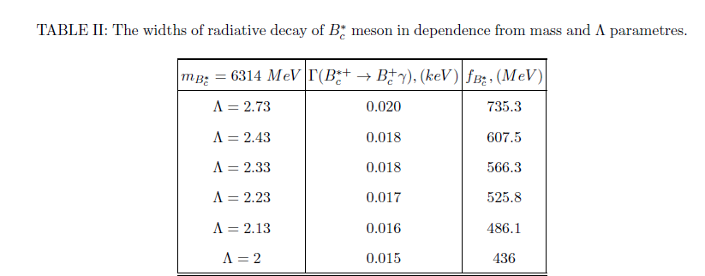
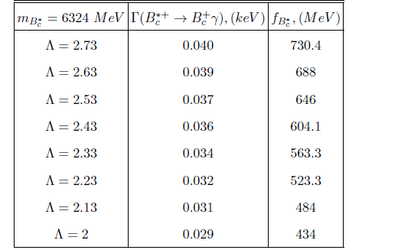
The width of radiative decay width in dependence of mass and Λ

Slide 24
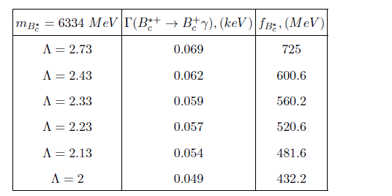
The width of radiative decay width in dependence of mass and Λ

Slide 25
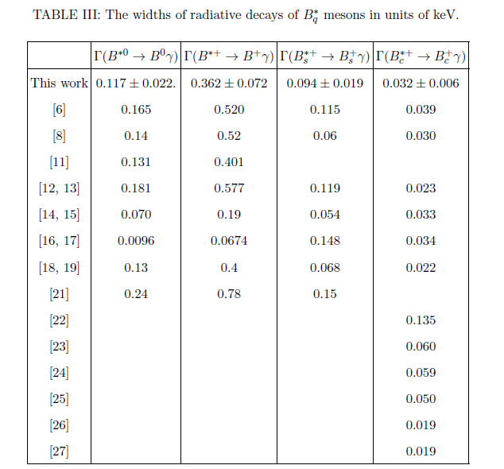
Preliminary results

Slide 26
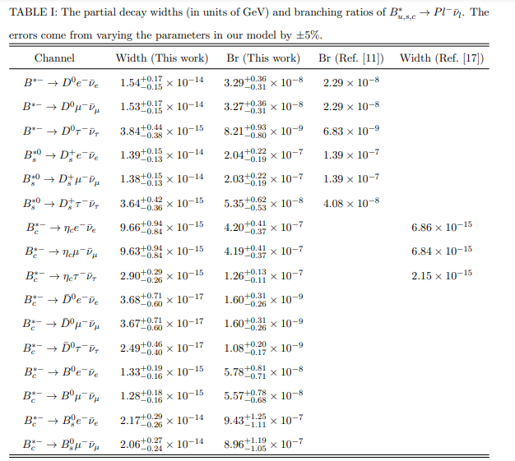
Future plans
*J.Phys.G 45 (2018) 11, 115001 • e-Print: 1804.06545

Slide 27
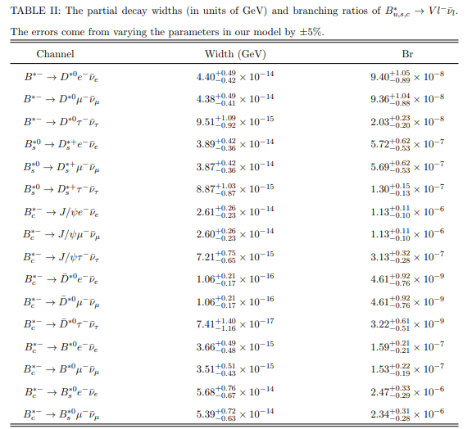
Future plans
*J.Phys.G 45 (2018) 11, 115001 • e-Print: 1804.06545

Slide 28
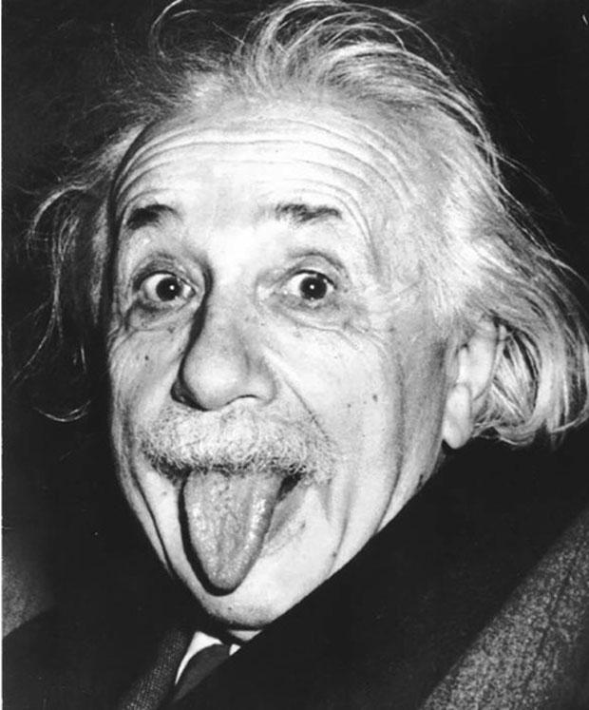
Thank you!
*A. Einstein

Slide 29
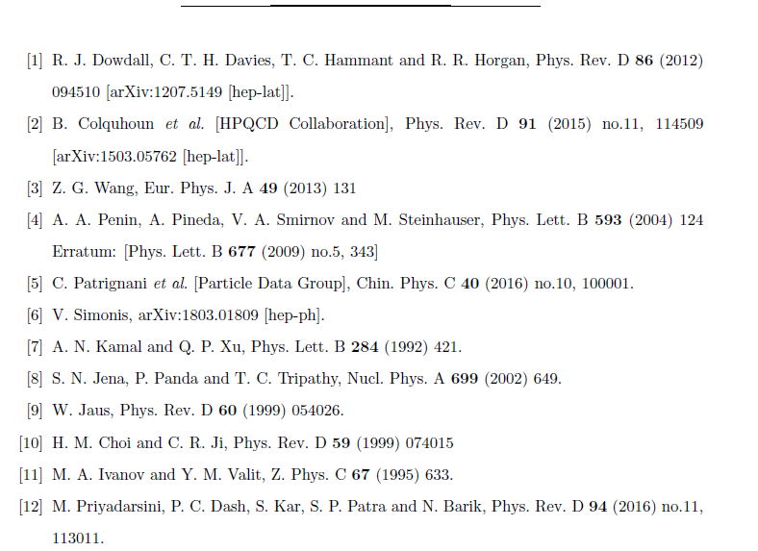
References

Slide 30
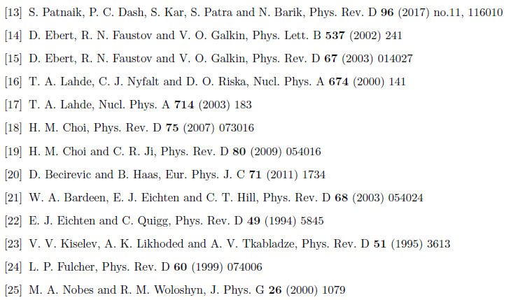
References

