Slide 1
The XXIV International Scientific Conference of Young Scientists and Specialists AYSS-2020
Association of Young Scientists and Specialists of
Joint Institute for Nuclear Research
9-13 November, 2020
JINR, Dubna

Slide 2
Conference overview
138 participants from 11 countries;
5 lectures;
117 oral presentations scheduled (15 minutes each);
9 parallel sessions:
HEP;
Theoretical Physics;
IT;
Life Science;
Applied research;
Mathematical modeling and computational physics;
Particle accelerators and nuclear reactors;
Condensed Matter Physics;
Nuclear Physics.

Slide 3
Invited speakers
9.11 Academician of RAS Trubnikov G.V., from JINR “JINR's strategic plan for long-term development”
10.11 Prof. Popov S.B., from Sternberg Astronomical Institute, MSU
“Life of neutron stars with evolving magnetic field”
11.11 Dr. Ospanov R.K., from CERN-LHC-ATLAS “Higgs boson discovery and other selected results from LHC”
12.11 Dr. Volkova P. Yu., from Russian Institute of Radiology and Agroecology “Omic technologies in radiation biology”
13.11 Dr.Shvetsov V.N., from JINR “Neutron physics at JINR”

Slide 4
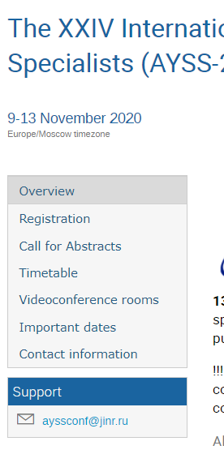
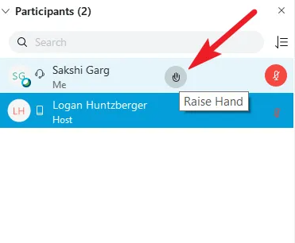
ayss-2020.jinr.ru
Current schedule
Make sure that your talk is scheduled.
Upload your slides to the indico page to avoid possible problems.
Up-to-date links to each session
Videoconference rules:
The right to share slides will be given to the presenter right before his talk;
participants(except the presenter) are muted while a presentation is given;
If you want to ask a question or make a comment after the presentation – raise your hand.

