Slide 1
The XXIV International Scientific Conference of Young Scientists and Specialists AYSS-2020
Association of Young Scientists and Specialists of
Joint Institute for Nuclear Research
9-13 November, 2020
JINR, Dubna

Slide 2
Conference overview
138 participants from 11 countries;
5 lectures: recorded lectures are uploaded on conf. website and will be available on JINR YouTube channel:
https://www.youtube.com/user/jinrtv
115 oral presentations scheduled (15 minutes each);
9 parallel sessions:
HEP;
Theoretical Physics;
IT;
Life Science;
Applied research;
Mathematical modeling and computational physics;
Particle accelerators and nuclear reactors;
Condensed Matter Physics;
Nuclear Physics.
Thank all of you

Slide 3
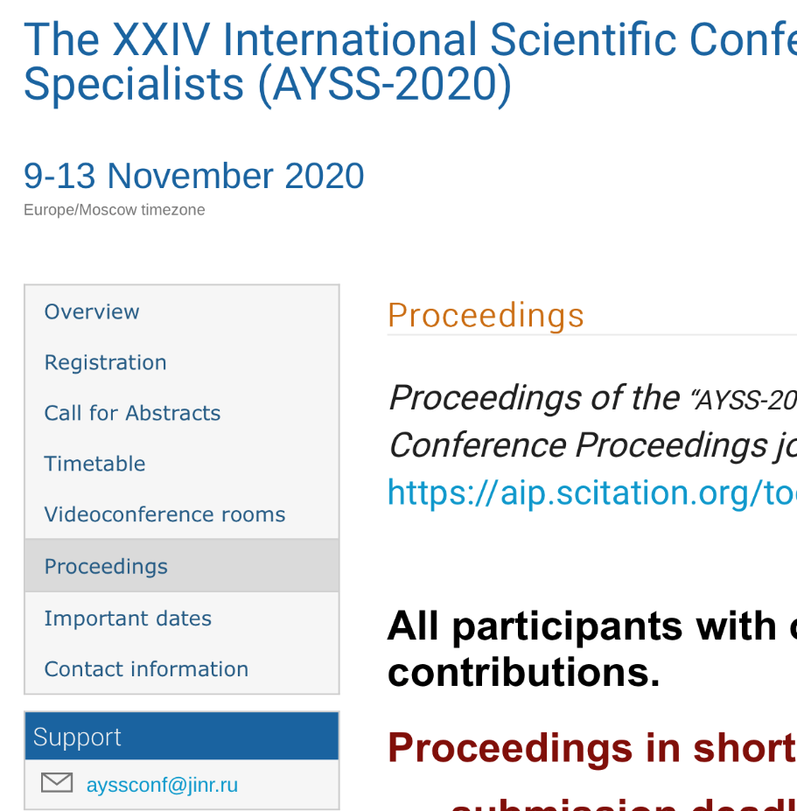
AYSS-2020 Proceedings
All participants with oral talks are invited to publish contributions. Proceedings in short:
submission deadline - 13th December 2020
5 pages, page sizes - 8.5 × 11-inch single-column, pdf file
to be published in AIP Conference Proceedings
AIP is indexed in leading databases — Web of Science, Scopus, and Inspec
More details at http://ayss-2020.jinr.ru/
all manuscripts will be reviewed before being sent to the AIP editorial office

Slide 4
Diploma for the best presentation
HEP sessions:
Denisenko Igor
Shalaev Vladislav
Galavanov Andrei
Vinh Luong
Stadnichuk Egor IT sessions:
Tokareva Victoria
Priakhina Daria
Goncharov Pavel
Theoretical ph. sessions:
Ievlev Evgenii
Pikelner Andrei Life science session:
Kozhina Regina
Particle accelerators session:
Ponkin Dmitriy
Nuclear Physics session:
Vladimirova Elena
Condensed MP session:
Mravik Željko Applied research session:
Nazarova Assel
MathModeling session:
Baranov Dmitry
Congratulations !!!

Slide 5
AYSS-2020
SCIENTIFIC ADVISORY BOARD:
Chairman: Grigory Shirkov
Nikolay Arsenyev
Vladimir Chausov
Otilia Culicov
Olga Derenovskaya
Alexander Karpov
Dmitry Peshekhonov
Oleg Smirnov
Alexander Verkheev
JURY ON SECTIONS:
Alexander Bednyakov
Ivan Bobrikov
Vratislav Chudoba
Konstantin Gertsenberger
Anna Maksymchuk
Sergei Merts
Danila Oleynik
Sergei Shmatov
Vasiliy Semin
Timur Tropin
Semen Turchikhin
Inga Zinicovscaia

